Slide 1

We will begin the call at five minutes past the hour.
Microsoft 365 Champion Community Call
October 2025
Microsoft 365 Champion Community
Learn more. Do more. Achieve more, together.

Slide 2



Microsoft 365 Champion
community call
October 2025

Slide 3
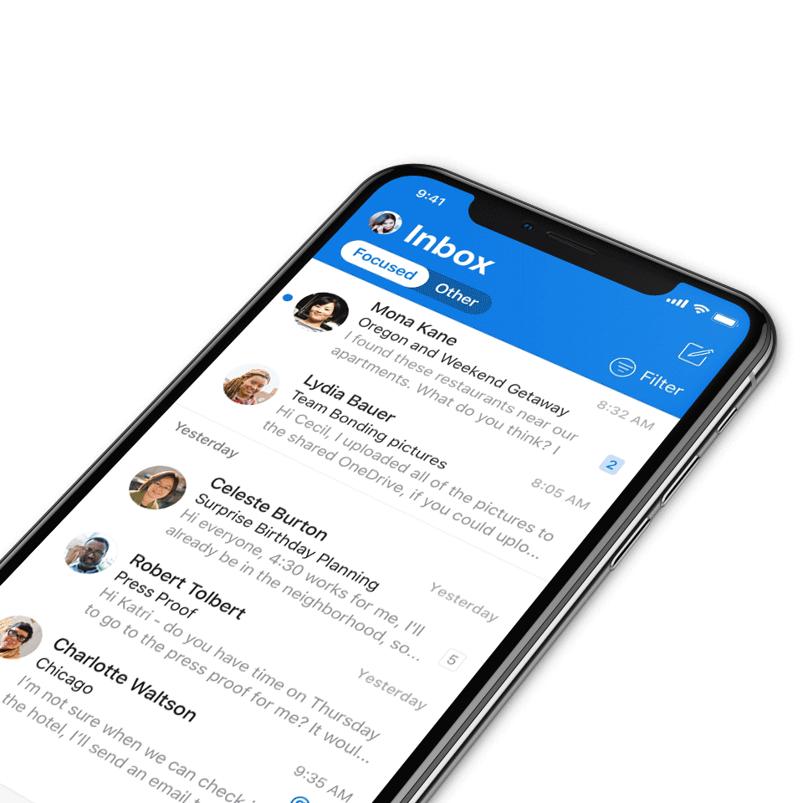
Digital Event Code of Conduct
Microsoft’s mission is to empower every person and every organization on the planet to achieve more. This includes all Microsoft events and gatherings, including on digital platforms, where we seek to create a respectful, friendly, fun and inclusive experience for all participants.​
We expect all digital event participants to uphold the principles of this Code of Conduct, which covers the main digital event and all related activities. We do not tolerate disruptive or disrespectful behavior, messages, images, or interactions by any party participant, in any form, at any aspect of the program including business and social activities, regardless of location.​
Microsoft will not tolerate harassment or discrimination based on age, ancestry, color, gender identity or expression, national origin, physical or mental disability, religion, sexual orientation, or any other characteristic protected by applicable local laws, regulations, and ordinances.​
We encourage everyone to assist in creating a welcoming and safe environment.
For more info, visit aka.ms/CodeofConduct.

Slide 4

Agenda
Announcements
Top Microsoft 365 updates
Topic: Collaborate within your Teams channel using Loop Pages
Open discussion forum
Become a Champion today!
https://aka.ms/BecomeaChampion

Slide 5
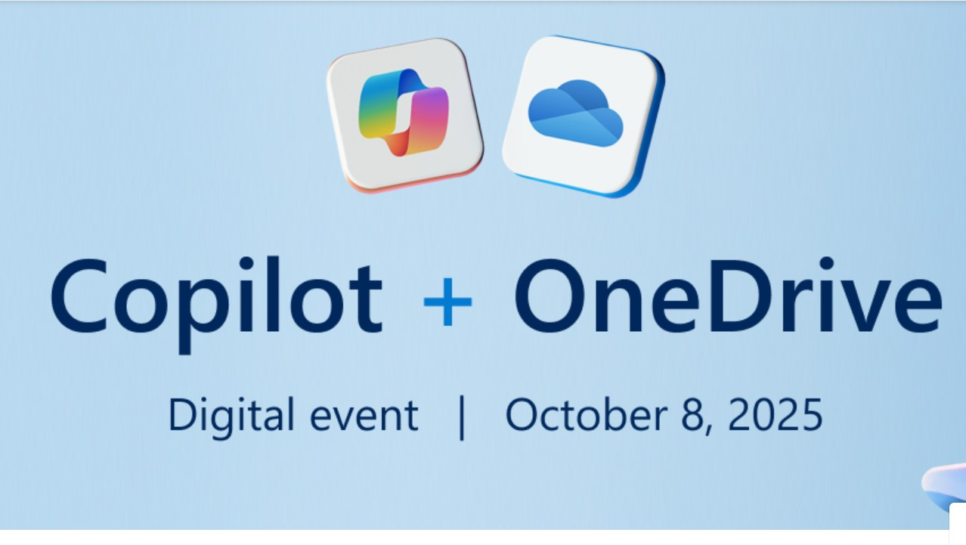
Announcements
Community
Copilot + OneDrive Digital Event
Relive the magic of OneDrive’s 3rd annual digital showcase, packed with AI innovations for every part of your day. From secure storage to smart productivity tools, OneDrive delivers intelligence in every click, and inspiration in every memory. Visit https://aka.ms/OneDriveEvent to learn more!

Slide 6
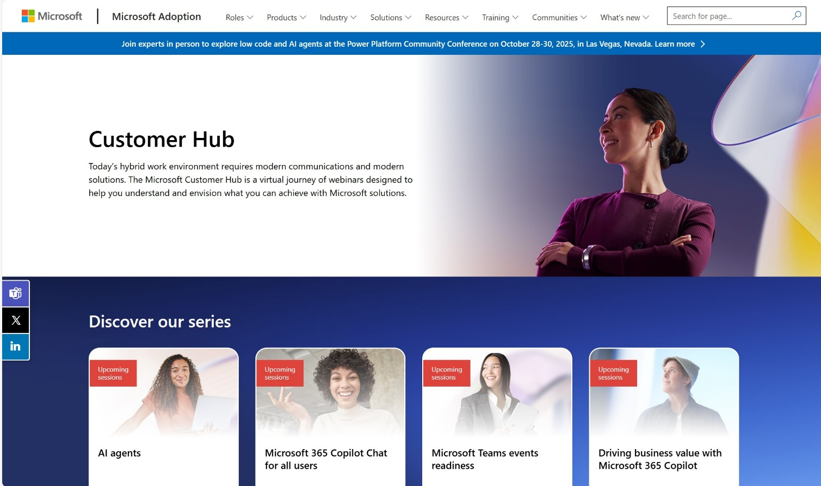
Announcements
Customer Hub
Upcoming Microsoft 365 Copilot webinars
Have you attended our Customer Hub webinar sessions? In today's hybrid work environment, modern communication and solutions are essential. Our goal is to help you explore what you can achieve with Microsoft solutions.
Join us for one or more of our upcoming sessions, including the launch of several new Copilot series. We also have all past session recordings so you can watch any that you missed and download the presentation materials.
Visit aka.ms/CustomerHubSessions to sign up today.

Slide 7
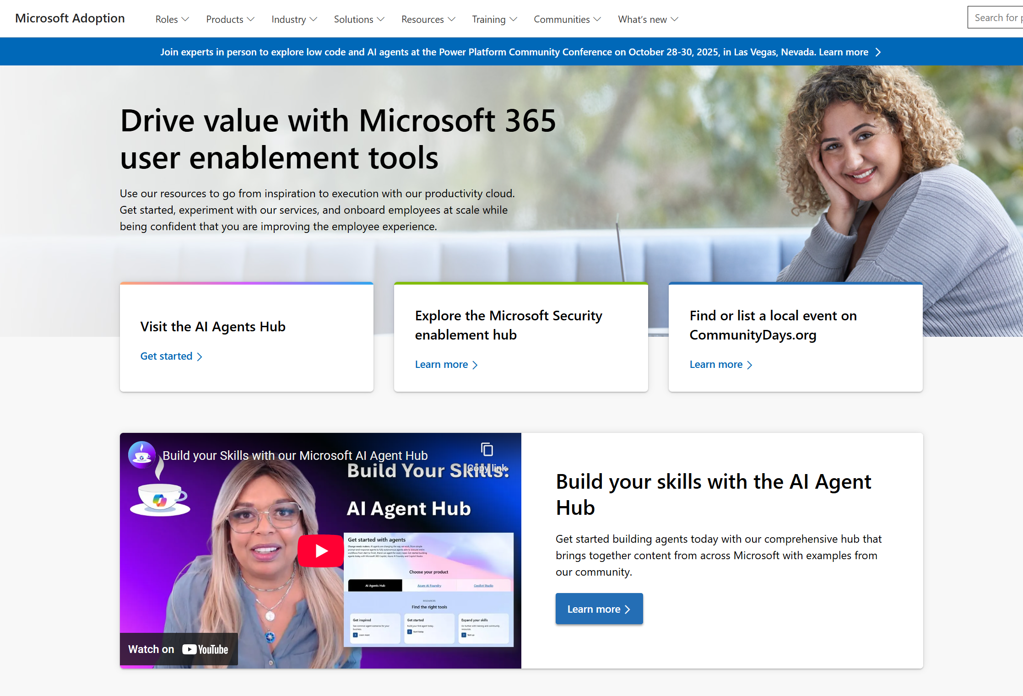
adoption.microsoft.com
Update highlights
New resources page for the Microsoft AI Tour
New Getting started guide for the Frontier Program
New pages for Dragon Medical One learning series and Microsoft Edge for Business
New resources for all roles and information about the Azure AI Agent Open Hack event added to the Azure AI Foundry page
Multiple on-demand sessions for Microsoft 365 Copilot, Copilot Chat, Teams added to the Customer Hub
Read or subscribe to our Release notes for more updates.

Slide 8

Top Microsoft 365 updates
Microsoft Lists
Microsoft Lists mobile apps retirement in November 2025
Microsoft is officially announcing the retirement of the Microsoft Lists mobile apps for both Android and iOS. This decision is part of our ongoing commitment to deliver the best possible experience through our web-based solutions, ensuring users have access to the latest features and improvements.
September 2025: New users will no longer be able to install the Microsoft Lists mobile apps from the Apple App Store or Google Play.
November 2025: The mobile apps will be removed from both app stores. Existing users will see an error message when attempting to open the app, and the apps will no longer be usable.
Click here to learn more.
Notes:
How to Prepare
Switch to the Mobile Browser Experience:
For work and school accounts, access your lists at office.com/launch/Lists.
For Microsoft personal accounts, use lists.microsoft.com.
Review Feature Differences:
Some features, such as QR code scanning and image-based editing, are not supported in the mobile browser version. Plan accordingly if you depend on these capabilities.
Stay Informed:
For the latest updates and support resources, regularly check the official documentation at https://support.microsoft.com/en-us/office/microsoft-lists-mobile-apps-retirement-f8645669-d5d1-401f-afc5-295e529ddaaf.
Next Steps
Current Users: Begin transitioning to the browser-based experience as soon as possible to familiarize yourself with any differences and ensure uninterrupted access to your lists.
IT Administrators: Communicate these changes to your teams and update any internal documentation or training materials to reflect the retirement timeline and new access methods.
All Users: Bookmark the relevant URLs and explore the enhanced features available in the web version of Microsoft Lists.

Slide 9
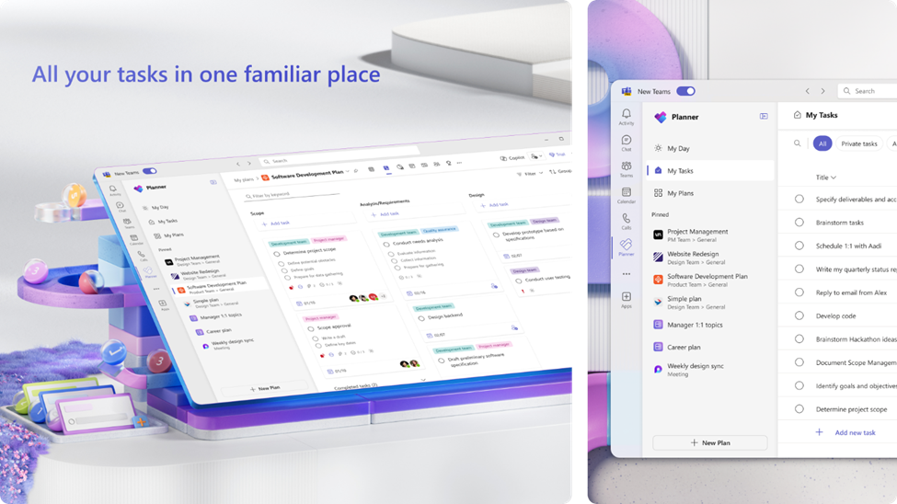
Top Microsoft 365 updates
Microsoft Planner
The new Planner in Microsoft Teams is now available to customers in GCC High
We’re excited to announce that the new Planner app in Microsoft Teams (web and desktop) is now available to customers in the Government Community Cloud (GCC) High environment!
There’s no migration required—your existing tasks, basic plans, and premium plans are already in the new Planner. In August, we introduced the modern Planner experience on the web for GCC High. Now, that same experience comes to Microsoft Teams—the hub for teamwork in Microsoft 365—so your teams can plan, track, and collaborate on work right alongside their chats, meetings, and files.
Click here to learn more.
Notes:
Open Planner in Teams. You can also find the Planner app in the Apps browser. Start by selecting the View more apps “…” menu in the navigation bar. Then, select the Planner icon.
Once you’ve added Planner, you can pin the app (select Pin) to the left side of Teams for easy access.

Slide 10
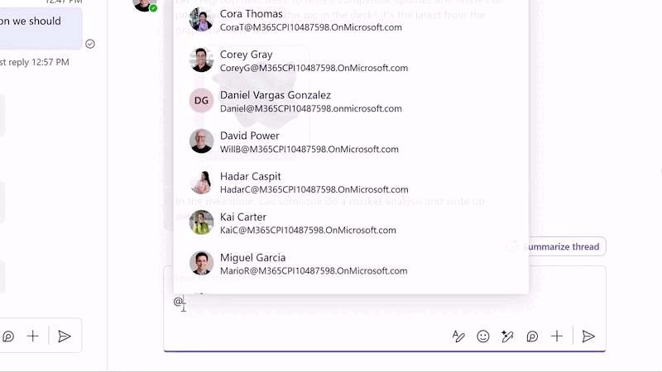
Top Microsoft 365 updates
Copilot in Teams
Agents in channels [Public Preview]
Microsoft Teams channels provide an organized space for teams to manage workstreams and communicate with stakeholders. Now, each channel can have a Channel Agent that draws on its conversations and meetings to act as a domain expert for the team. These agents adopt the channel’s name and help with common tasks – for example, flagging important deadlines that are buried in conversations, summarizing progress with succinct status reports, assigning tasks and due dates, and answering questions asked in natural language like “What’s the latest on our budget?” You can even invite these agents into meetings when you need expert insights in the discussion. Channel Agent is now in Public Preview* for users with a Microsoft 365 Copilot license.
Click here to learn more.
Notes:
Channel Agent brings many AI-powered skills to your projects, streamlining communication and automating routine tasks. Key benefits include:
AI-generated status reports: Automatically drafts and shares status reports, allowing for team review, collaboration, and report customization.
Meeting integration: Uses meeting transcripts as knowledge sources, and schedules meetings with suggested titles, agendas, invite lists, and times based on project needs.
Task management: Helps create tasks and provides reminders to the team.
Question & answer: Answers questions in the channel, group chats, and meetings that the agent is invited to. The agent responds using channel messages, meeting transcripts, and web search (if allowed by your organization’s IT admin).
Streamline communication: Draft and send emails using Channel Agent, saving you time and energy from switching between Teams and Outlook.

Slide 11
Collaborate within Teams channels using Pages!

Slide 12
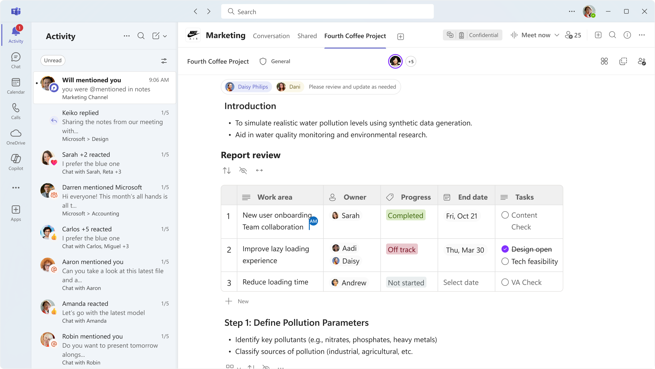
Pages in Channels
Introducing Pages in Channels!
What are Pages in Channels? ​
A Channel Page is a collaborative canvas - powered by Loop! It is designed for seamless collaboration directly in Teams.
Pages in Channels in Teams is a new feature!
Although Loop pages already exist, integrating pages directly into channels in Teams is new!

Slide 13
Pages in Channels
Why use pages in channels?
Discover content most relevant to your channel
Collaborate with your team in the context of your most relevant conversations
Seamlessly integrate with the rest of your Teams experience
Notes:
Writing formulas in Excel could be time-consuming and difficult - even for experienced users. Selecting the right function, referencing the correct cells, and ensuring the syntax is accurate can slow down your workflow and lead to mistakes.
Many users spend extra time searching for explanations and examples, troubleshooting errors, or trying to remember the exact formula structure.
When you type “=” in a cell, Excel analyzes the context of your workbook and suggests a formula completion suggestion, using the context of your worksheet - headers, nearby cells, formulas and tables. Alongside the suggestion you will see a preview of the result, as well as a short description in natural language of the formula’s intent:

Slide 14
Pages in Channels
Why use pages in channels?
Discover content most relevant to your channel
Collaborate with your team in the context of your most relevant conversations
Seamlessly integrate with the rest of your Teams experience
Notes:
Writing formulas in Excel could be time-consuming and difficult - even for experienced users. Selecting the right function, referencing the correct cells, and ensuring the syntax is accurate can slow down your workflow and lead to mistakes.
Many users spend extra time searching for explanations and examples, troubleshooting errors, or trying to remember the exact formula structure.
When you type “=” in a cell, Excel analyzes the context of your workbook and suggests a formula completion suggestion, using the context of your worksheet - headers, nearby cells, formulas and tables. Alongside the suggestion you will see a preview of the result, as well as a short description in natural language of the formula’s intent:

Slide 15
Pages in Channels
Why use pages in channels?
Discover content most relevant to your channel
Collaborate with your team in the context of your most relevant conversations
Seamlessly integrate with the rest of your Teams experience
Notes:
Writing formulas in Excel could be time-consuming and difficult - even for experienced users. Selecting the right function, referencing the correct cells, and ensuring the syntax is accurate can slow down your workflow and lead to mistakes.
Many users spend extra time searching for explanations and examples, troubleshooting errors, or trying to remember the exact formula structure.
When you type “=” in a cell, Excel analyzes the context of your workbook and suggests a formula completion suggestion, using the context of your worksheet - headers, nearby cells, formulas and tables. Alongside the suggestion you will see a preview of the result, as well as a short description in natural language of the formula’s intent:

Slide 16
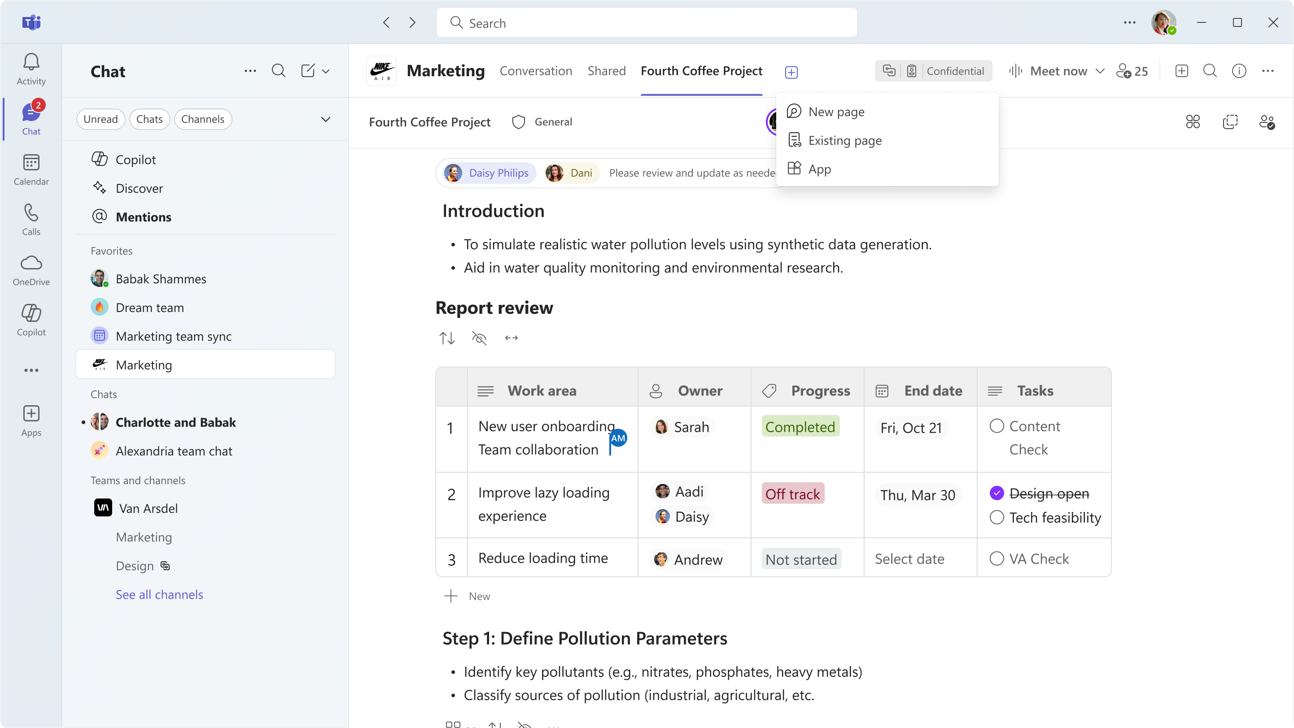
Pages in Channels
Add a new page
Notes:
Writing formulas in Excel could be time-consuming and difficult - even for experienced users. Selecting the right function, referencing the correct cells, and ensuring the syntax is accurate can slow down your workflow and lead to mistakes.
Many users spend extra time searching for explanations and examples, troubleshooting errors, or trying to remember the exact formula structure.
When you type “=” in a cell, Excel analyzes the context of your workbook and suggests a formula completion suggestion, using the context of your worksheet - headers, nearby cells, formulas and tables. Alongside the suggestion you will see a preview of the result, as well as a short description in natural language of the formula’s intent:

Slide 17
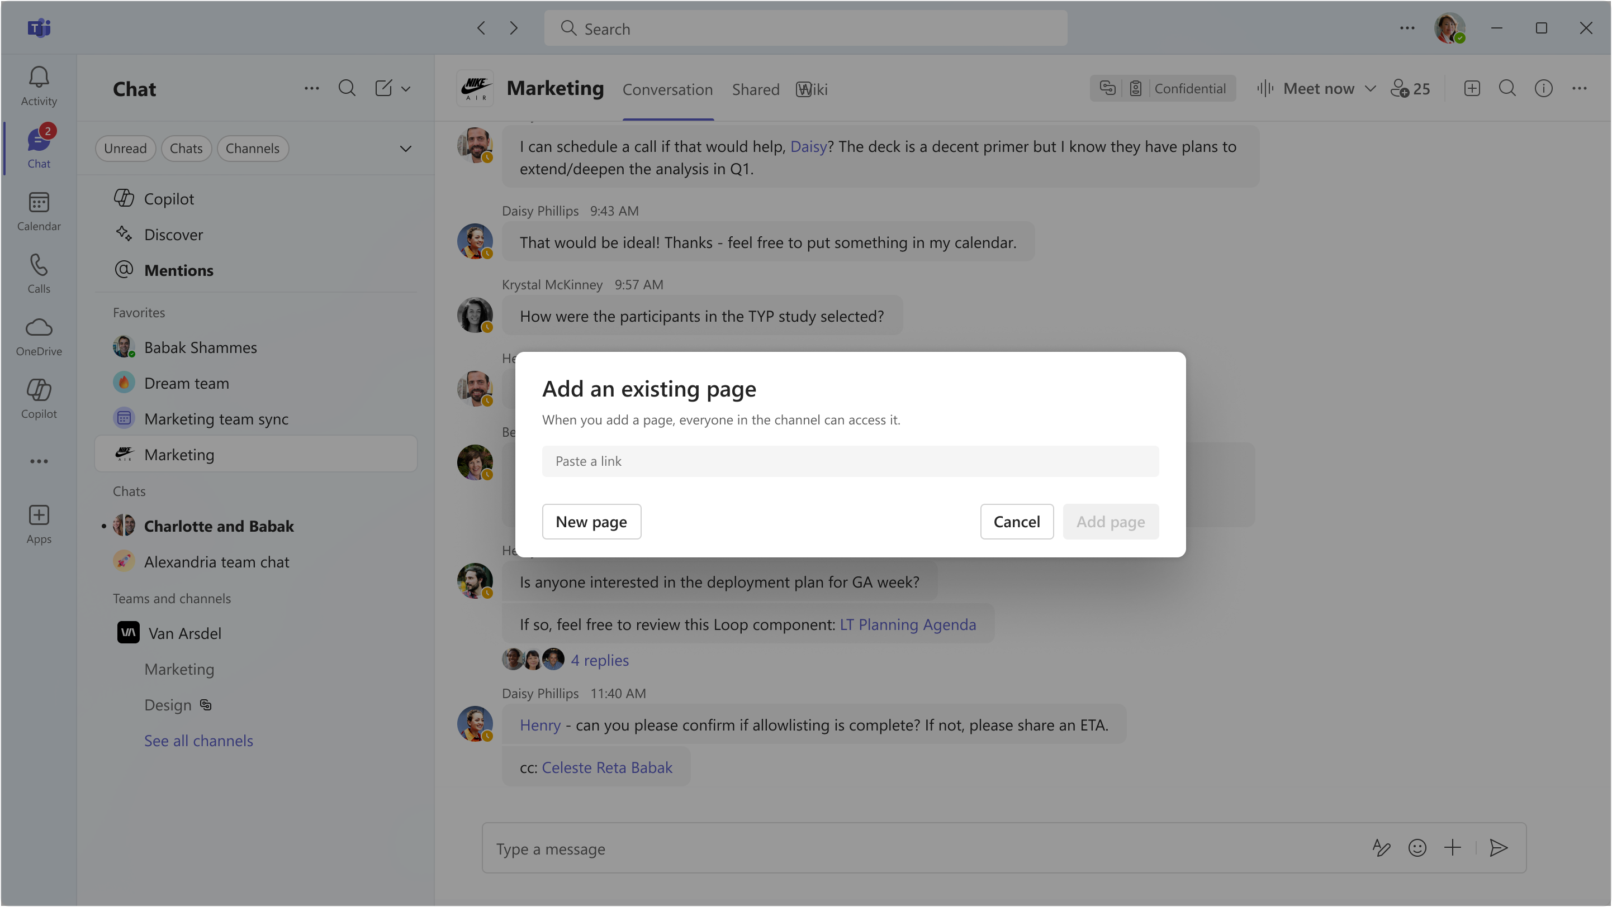
Pages in Channels
Add an existing page
Notes:
Writing formulas in Excel could be time-consuming and difficult - even for experienced users. Selecting the right function, referencing the correct cells, and ensuring the syntax is accurate can slow down your workflow and lead to mistakes.
Many users spend extra time searching for explanations and examples, troubleshooting errors, or trying to remember the exact formula structure.
When you type “=” in a cell, Excel analyzes the context of your workbook and suggests a formula completion suggestion, using the context of your worksheet - headers, nearby cells, formulas and tables. Alongside the suggestion you will see a preview of the result, as well as a short description in natural language of the formula’s intent:

Slide 18
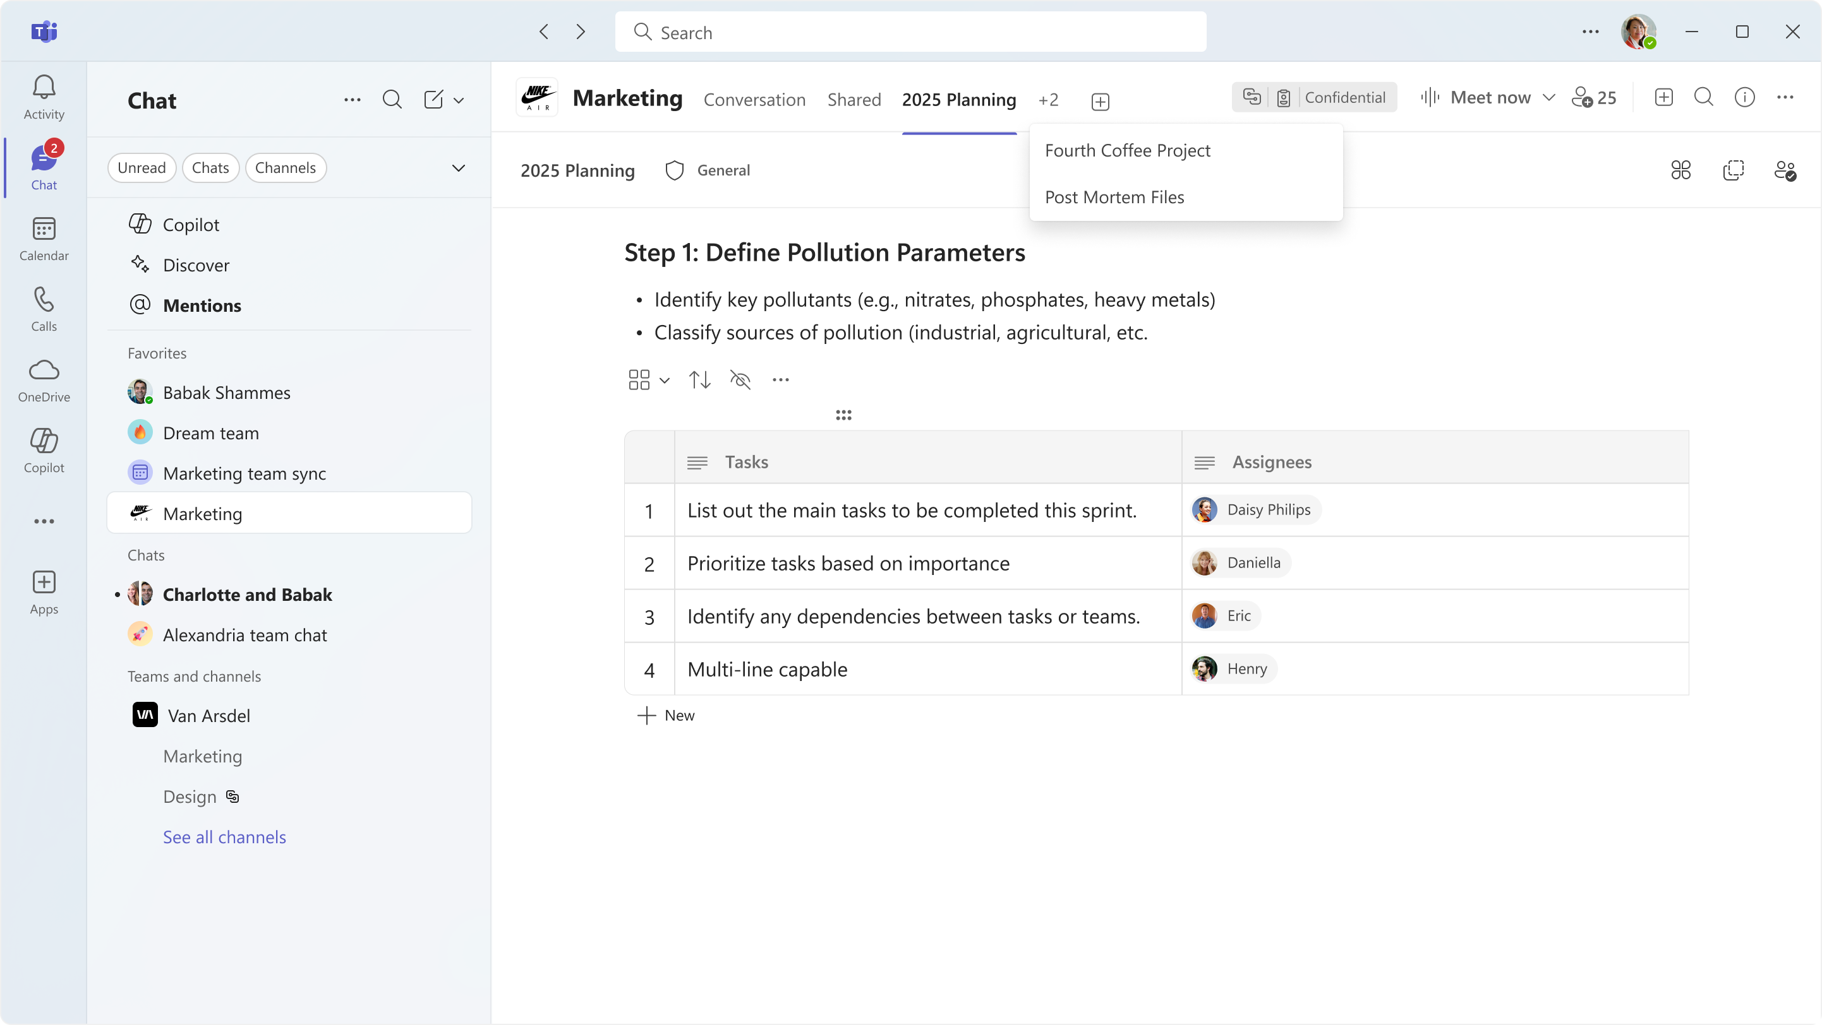
Pages in Channels
Browse channel pages
Notes:
Writing formulas in Excel could be time-consuming and difficult - even for experienced users. Selecting the right function, referencing the correct cells, and ensuring the syntax is accurate can slow down your workflow and lead to mistakes.
Many users spend extra time searching for explanations and examples, troubleshooting errors, or trying to remember the exact formula structure.
When you type “=” in a cell, Excel analyzes the context of your workbook and suggests a formula completion suggestion, using the context of your worksheet - headers, nearby cells, formulas and tables. Alongside the suggestion you will see a preview of the result, as well as a short description in natural language of the formula’s intent:

Slide 19
Pages in Channels
Notifications for page @ mentions
Notes:
Writing formulas in Excel could be time-consuming and difficult - even for experienced users. Selecting the right function, referencing the correct cells, and ensuring the syntax is accurate can slow down your workflow and lead to mistakes.
Many users spend extra time searching for explanations and examples, troubleshooting errors, or trying to remember the exact formula structure.
When you type “=” in a cell, Excel analyzes the context of your workbook and suggests a formula completion suggestion, using the context of your worksheet - headers, nearby cells, formulas and tables. Alongside the suggestion you will see a preview of the result, as well as a short description in natural language of the formula’s intent:

Slide 20
Pages in Channels
Demo

Slide 21
Upcoming community events
Power Platform Community Conference | Oct 28-30 | Las Vegas, NV
Microsoft Ignite 2025 | Nov 17-21 | San Francisco, CA
European SharePoint Conference | Dec 1-4 | Dublin, Ireland
Explore other Microsoft events here and a full list of community-led events can be found at CommunityDays.org

Slide 22

Open discussion
If viewing on-demand, drop your questions in the Microsoft Tech Community – Driving Adoption event page to engage with us!
Share your feedback for this call by visiting https://aka.ms/Microsoft365ChampionCallFeedback

Slide 23



What’s next
Share your feedback
https://aka.ms/Microsoft365ChampionCallFeedback
Next call:
Microsoft Ignite Recap
Join the Driving Adoption community
https://aka.ms/DrivingAdoption
Invite colleagues to become a Champion
https://aka.ms/M365Champions

