Slide 1

We will begin the call at five minutes past the hour.
Microsoft 365 Champion Community Call
May 2025
Microsoft 365 Champion Community
Learn more. Do more. Achieve more, together.

Slide 2



Microsoft 365 Champion
community call
May 2025

Slide 3
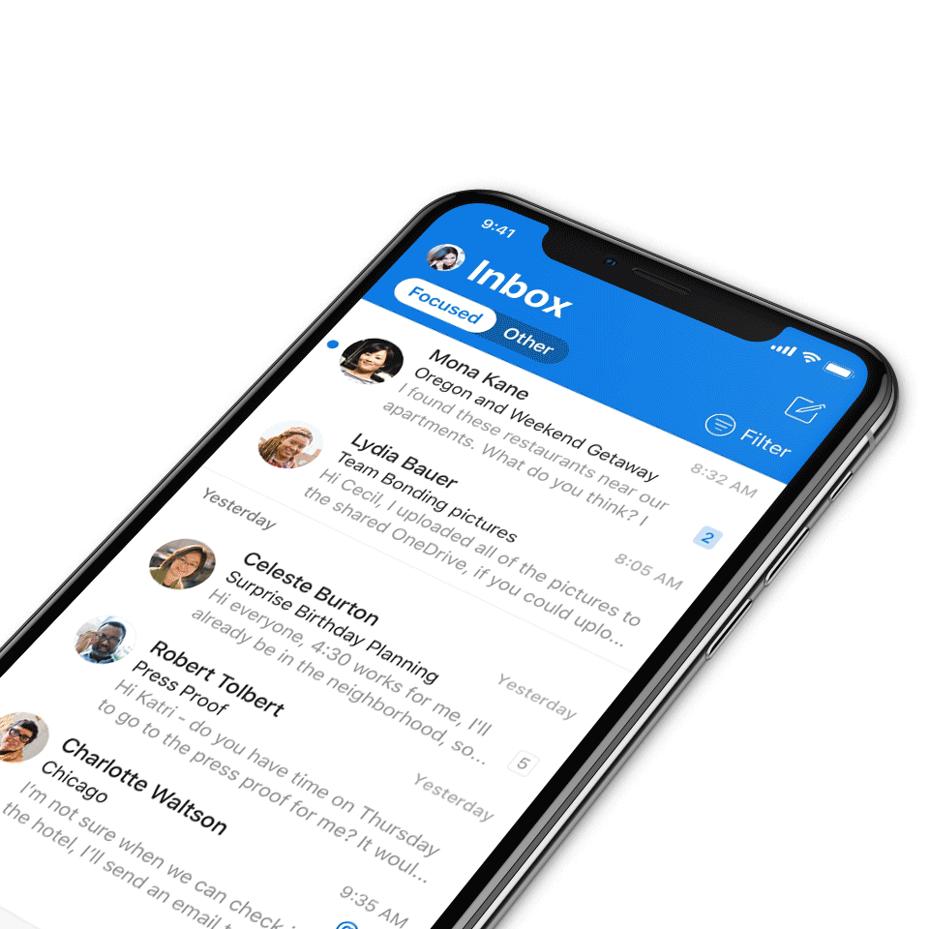
Digital Event Code of Conduct
Microsoft’s mission is to empower every person and every organization on the planet to achieve more. This includes all Microsoft events and gatherings, including on digital platforms, where we seek to create a respectful, friendly, fun and inclusive experience for all participants.​
We expect all digital event participants to uphold the principles of this Code of Conduct, which covers the main digital event and all related activities. We do not tolerate disruptive or disrespectful behavior, messages, images, or interactions by any party participant, in any form, at any aspect of the program including business and social activities, regardless of location.​
Microsoft will not tolerate harassment or discrimination based on age, ancestry, color, gender identity or expression, national origin, physical or mental disability, religion, sexual orientation, or any other characteristic protected by applicable local laws, regulations, and ordinances.​
We encourage everyone to assist in creating a welcoming and safe environment.
For more info, visit aka.ms/CodeofConduct.

Slide 4

Agenda
Announcements
Top Microsoft 365 updates
Topic: New updates on adoption.microsoft.com
Open discussion forum
Become a Champion today!
https://aka.ms/BecomeaChampion

Slide 5
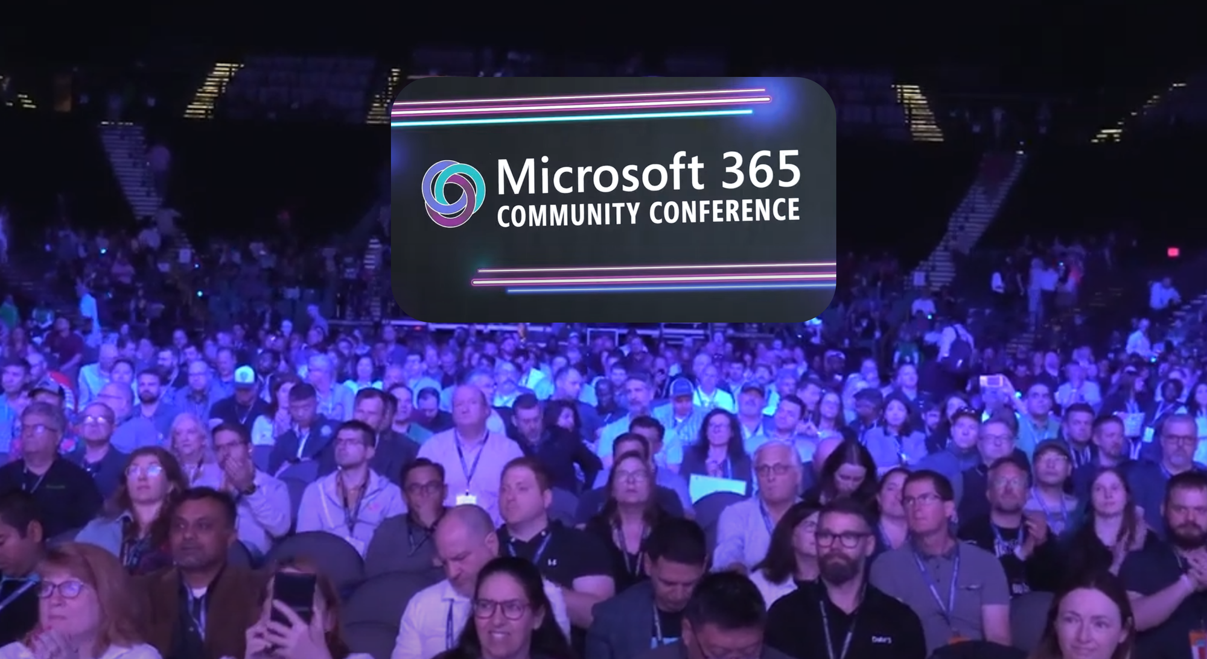
Announcements
Community
Sharing the vision: Microsoft 365 Community Conference Keynotes Now Available
The energy is still lingering in the air after another remarkable Microsoft 365 Community Conference, where our community of technologists and enthusiasts from around the world gathered to share, learn, and innovate together. This year’s keynotes set the stage for inspiration and transformation, and today, we are excited to announce that the highly anticipated keynote sessions from Jeff Teper, Vasu Jakkal, Jared Spataro, and Brenna Robinson are now available for all to experience. Check out the keynotes at https://aka.ms/Community/Learning
Click here to learn more!

Slide 6

Announcements
Microsoft Build 2025
Build Book of News 2025
The Microsoft Build 2025 Book of News is your guide to key news items that we announced at Microsoft Build. Within this edition, you’ll learn about more than 50 announcements designed to make it easier for developers to work faster, think bigger and build at scale.
Click here to access!

Slide 7
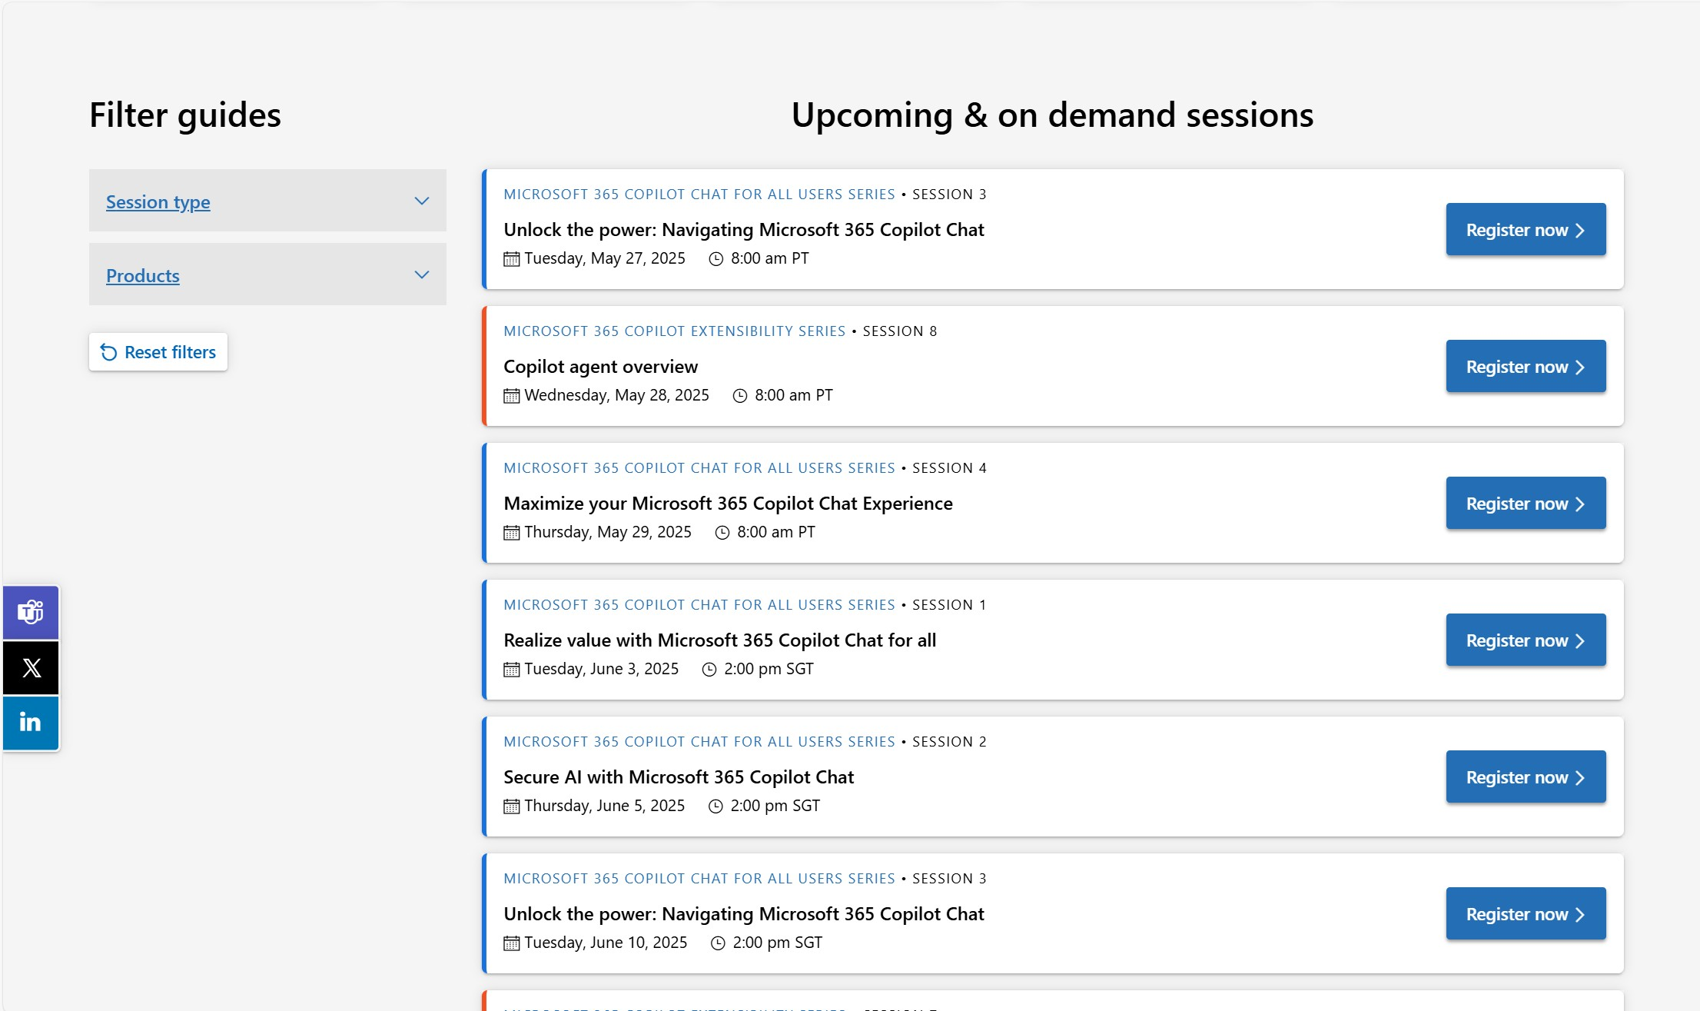
Announcements
Customer Hub
Upcoming Microsoft 365 Copilot webinars
Have you attended our Customer Hub webinar sessions? In today's hybrid work environment, modern communication and solutions are essential. Our goal is to help you explore what you can achieve with Microsoft solutions.
Join us for one or more of our upcoming sessions, including the launch of several new Copilot series. We also have all past session recordings so you can watch any that you missed and download the presentation materials.
Visit aka.ms/CustomerHubSessions to sign up today.

Slide 8
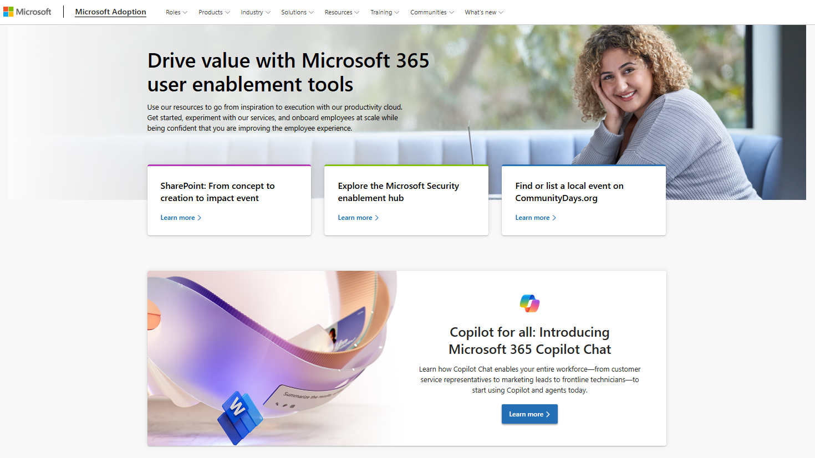
adoption.microsoft.com
Update highlights
Redesigned the Microsoft 365 Copilot enablement hub to include separate resources for Microsoft 365 Copilot Chat
New cross-organizational AI Agents Hub, with resources from Microsoft 365 Copilot, Copilot Studio, and Azure AI Foundry
Redesigned Microsoft Scenario Library
New Copilot Chat and agent resources for Microsoft 365 Copilot SMB
Multiple upcoming sessions and new on-demand sessions added across the Customer Hub
New gen AI playbook for CIOs on the Leading in the era of AI page
New Get Stuff Done video campaign launch
New Microsoft 365 Community Conference resources page
Read or subscribe to our Release notes for more updates.

Slide 9
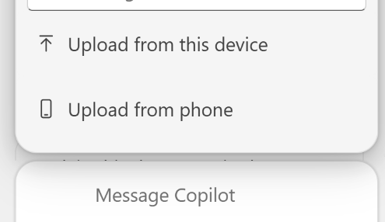
Top Microsoft 365 updates
Microsoft 365 Copilot
Upload phone images with Copilot
Microsoft 365 Copilot now makes it effortless for users to bring their phone’s photos directly into your Word, Excel, or PowerPoint workspace, so they can transform visual data into actionable insights without the hassle of emailing or downloading files.
Click here to learn more.

Slide 10
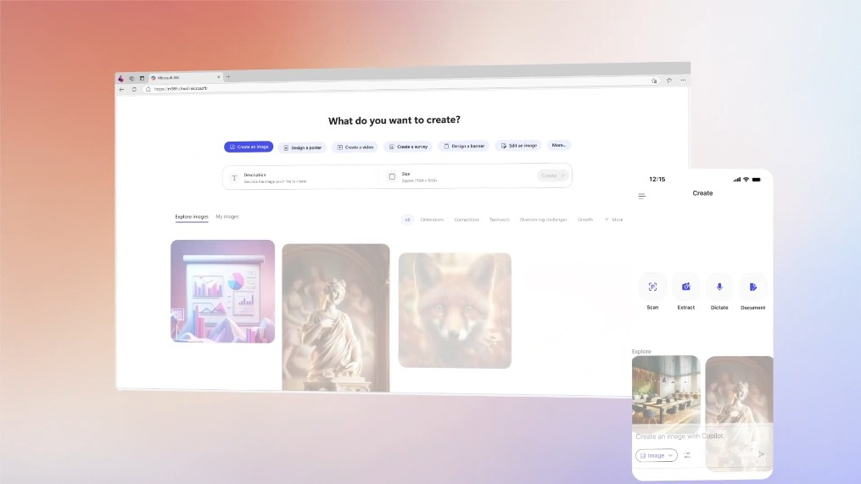
Top Microsoft 365 updates
Microsoft 365 Copilot
New in May: Create in the Microsoft 365 Copilot app
Last week we began rolling out an updated Create experience in the Microsoft 365 Copilot app to Microsoft 365 commercial customers, empowering them to unlock AI’s full potential in the creative process. Create will become generally available to commercial customers worldwide over the coming weeks.
Create reduces the cognitive load of deciding where and how to start your creative work. Users can quickly generate and edit a wide variety of content including visual artifacts, videos, and text artifacts.
Click here to learn more.

Slide 11
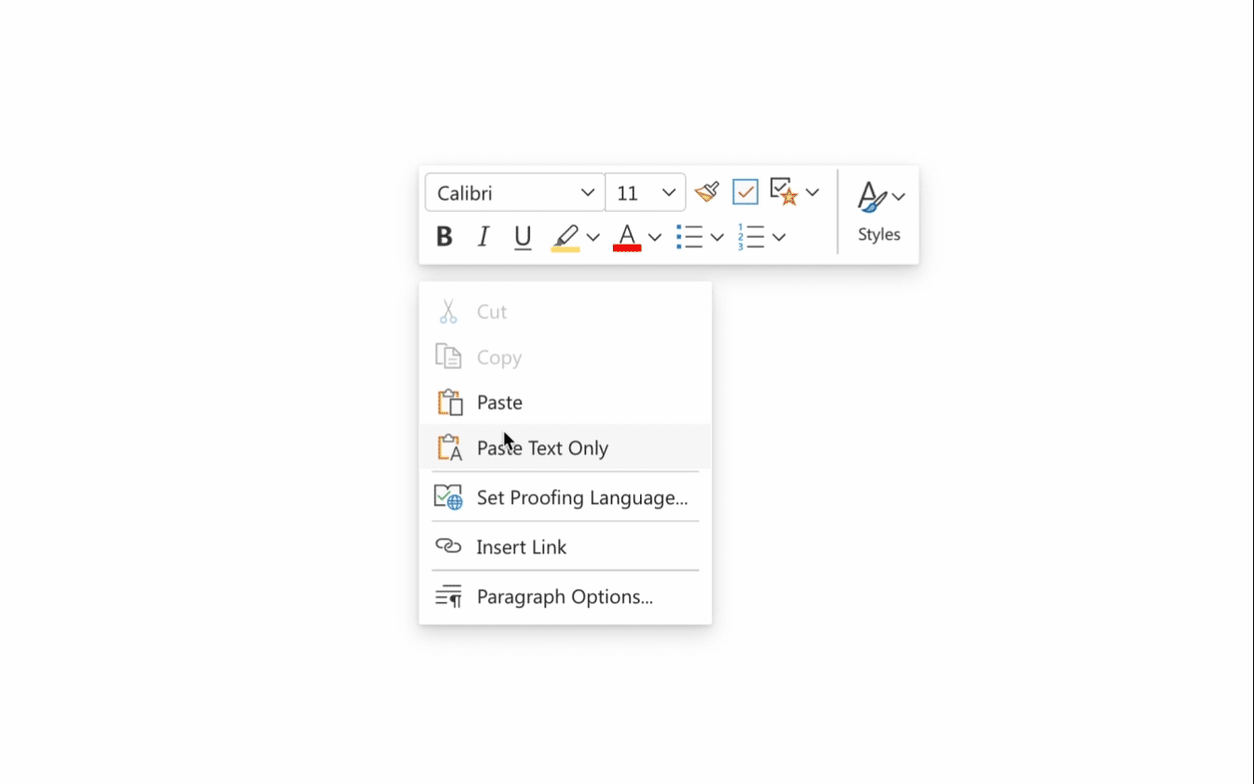
Top Microsoft 365 updates
Microsoft OneNote
Enhancements in OneNote for the web
We are happy to share a series of enhancements made over the past few months in OneNote for the web, designed to elevate your note-taking experience and boost your productivity. Updates include copy-paste enhancements:
Triple-click select
Introduction of the paste floatie
Keep source formatting during paste
Improved table operations
Proofing enhancements and more!
Click here to learn more.

Slide 12
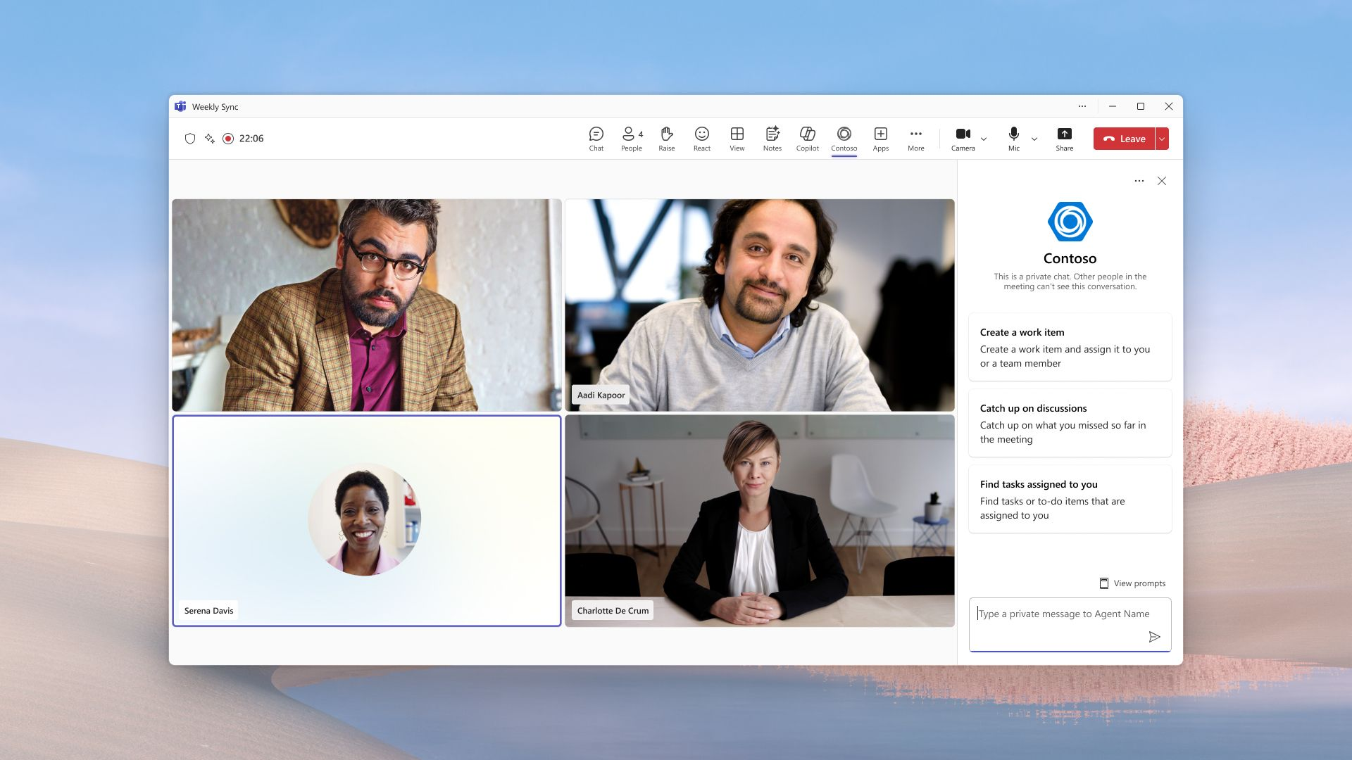
Top Microsoft 365 updates
Microsoft Teams
Interactive agents for Teams meetings and calls: Available in public preview
Now you can seamlessly invite AI-powered agents—like those built in Copilot Studio or available from the Teams Store—into your Teams meetings and calls. These agents can:
Join group or private conversations during meetings.
Offer real-time assistance without needing a prompt (zero-state prompts)
Suggest helpful prompts
Support a wide range of tasks
Click here to learn more.

Slide 13
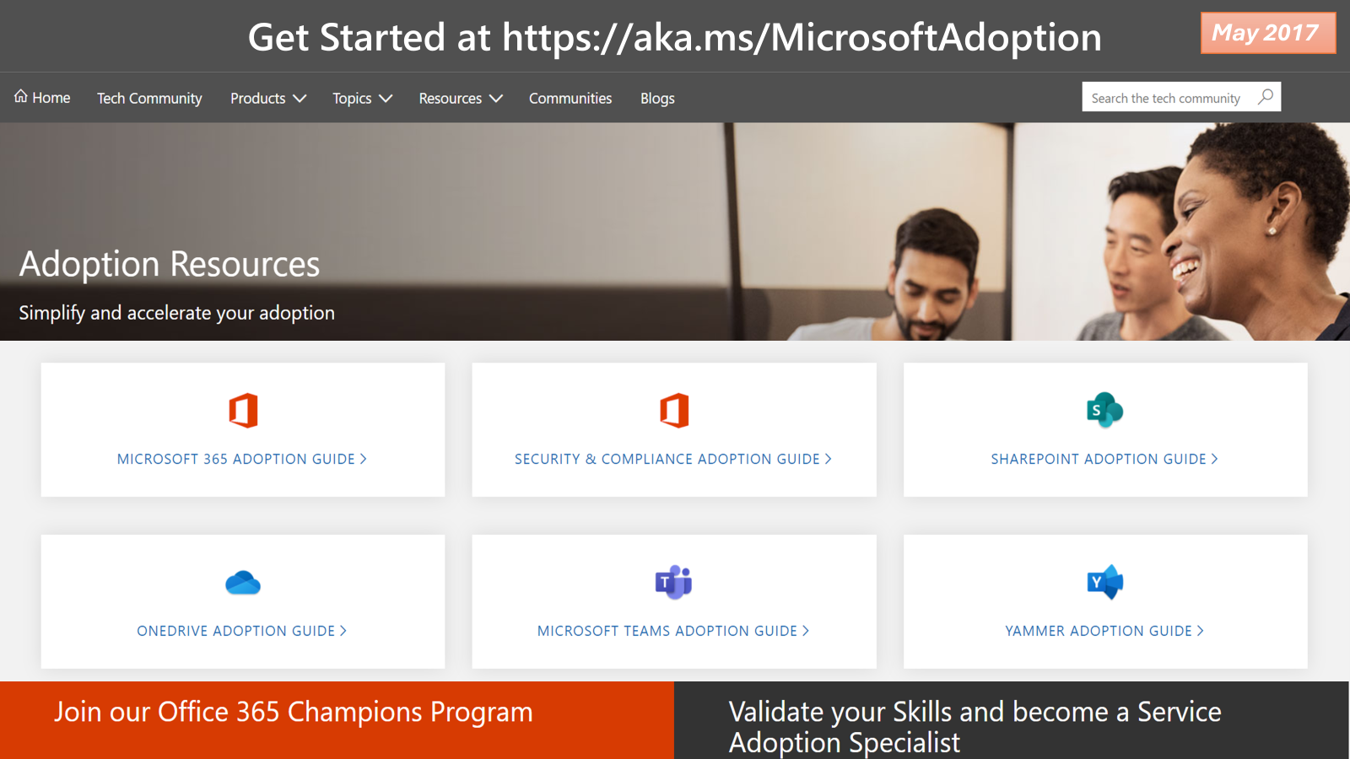
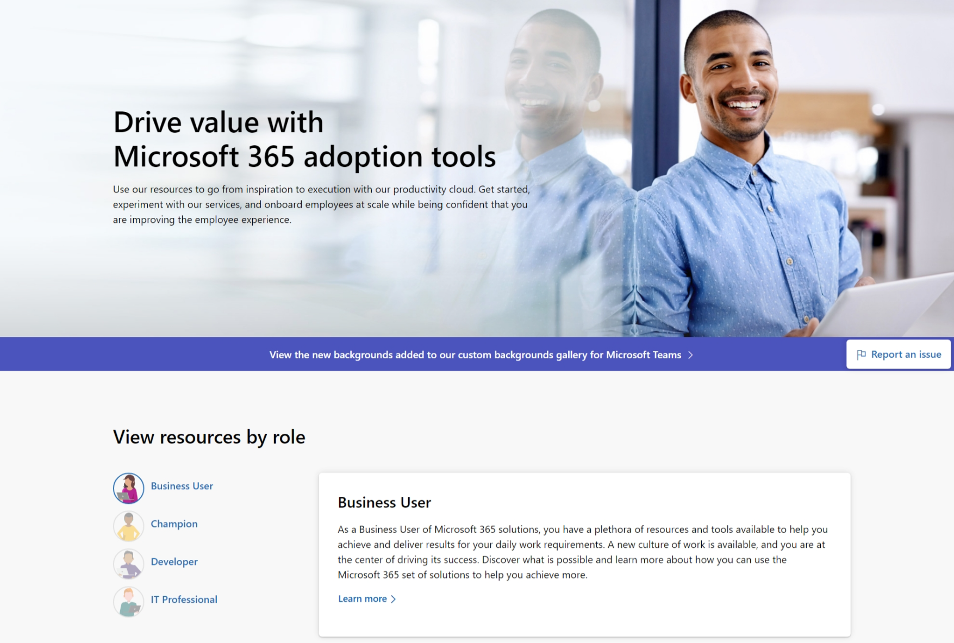
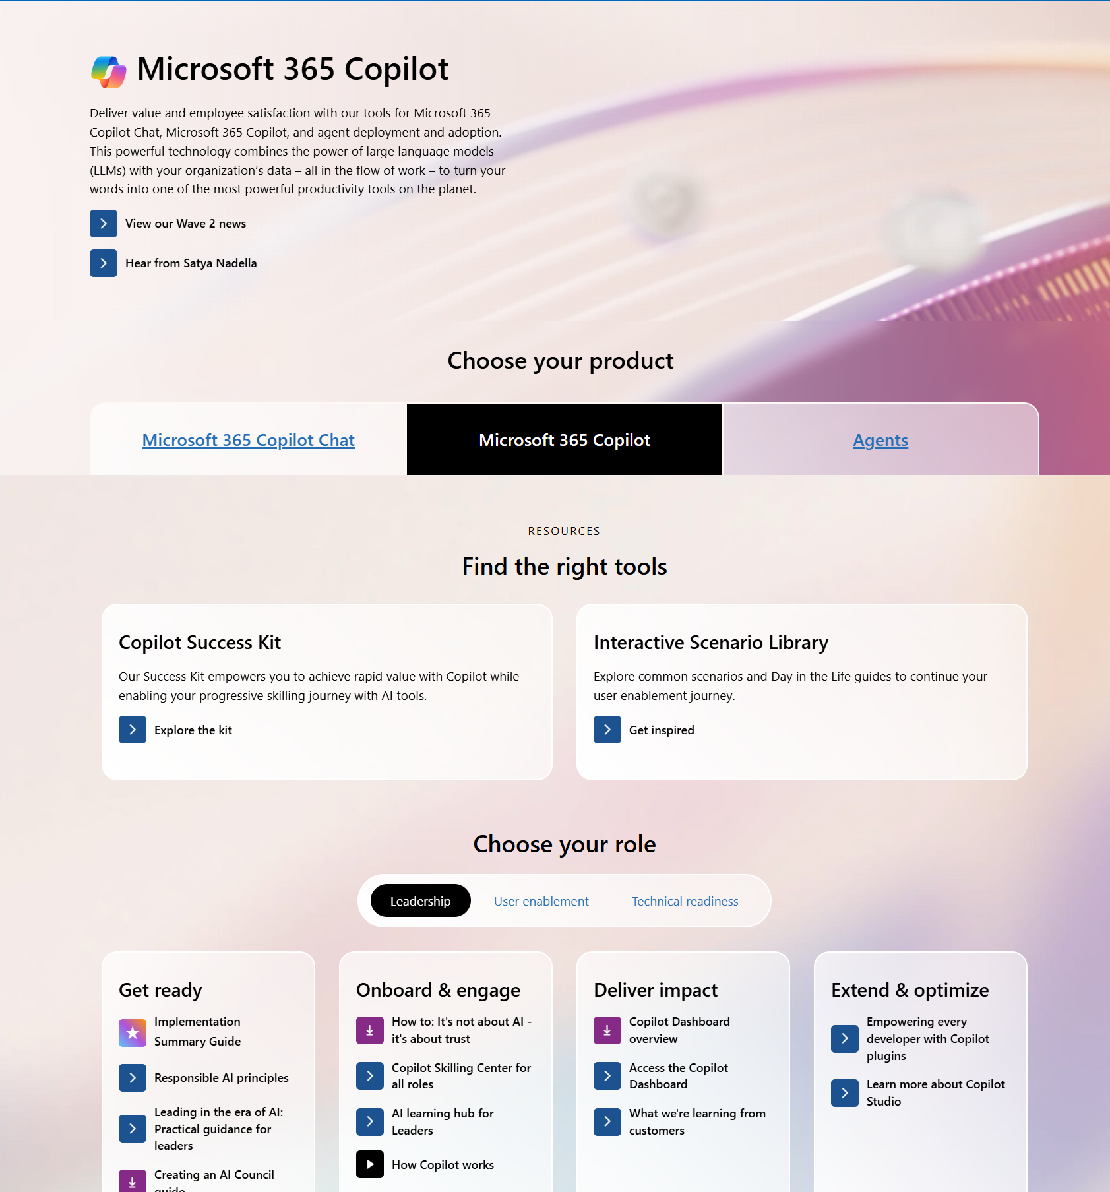
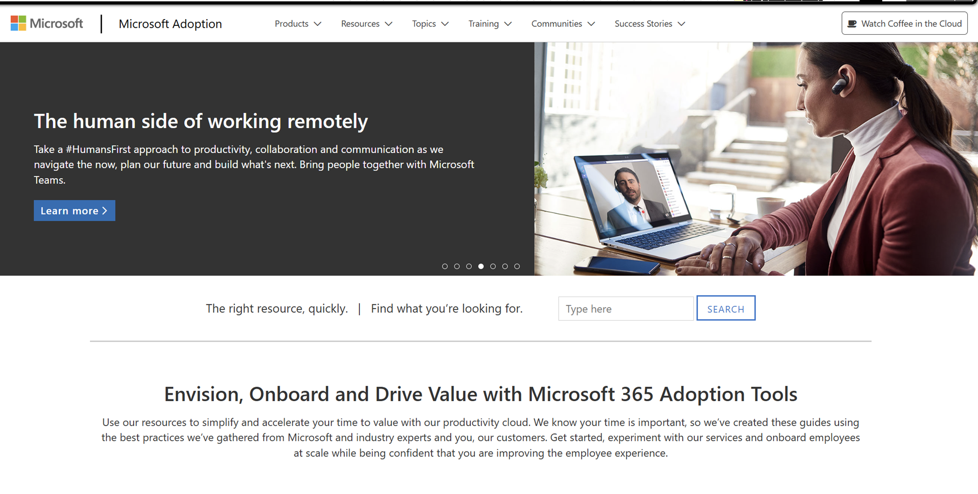
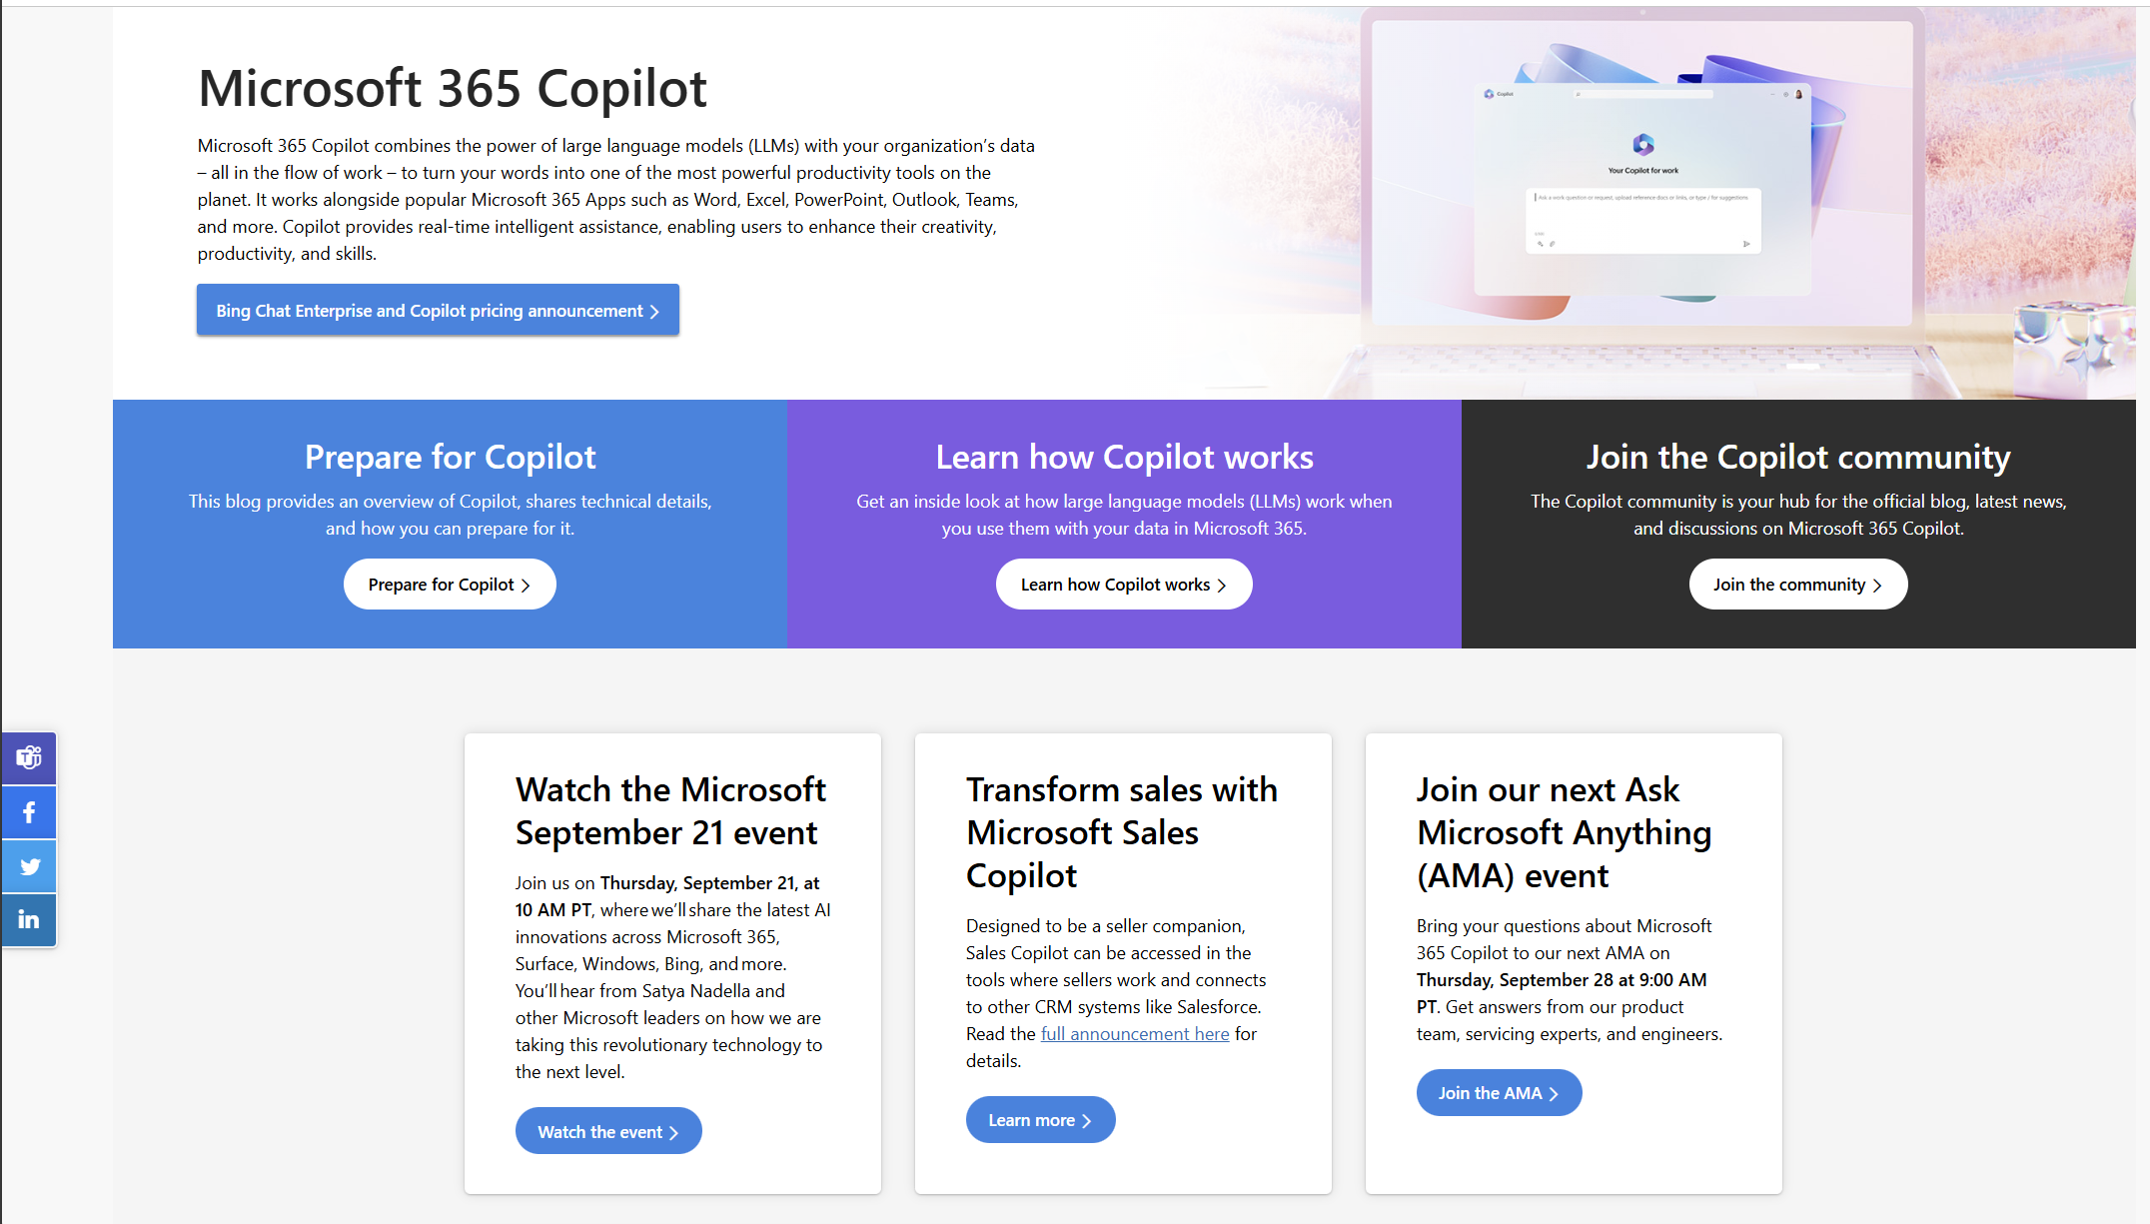
AMC history
2017
2022
May 2025
2020
September 2023

Slide 14
New microsite model
adoption.microsoft.com/Copilot
Simplified and streamlined UI
New “Choose your product” filter, where applicable, helps you find relevant content faster
Resources are dynamically filtered to only show what’s relevant to the tab selected
News, community, and events have been consolidated into one section
Notes:
The new microsite model launched at the Copilot Wave 2: Spring announcements moment on April 23, 2025.

Slide 15
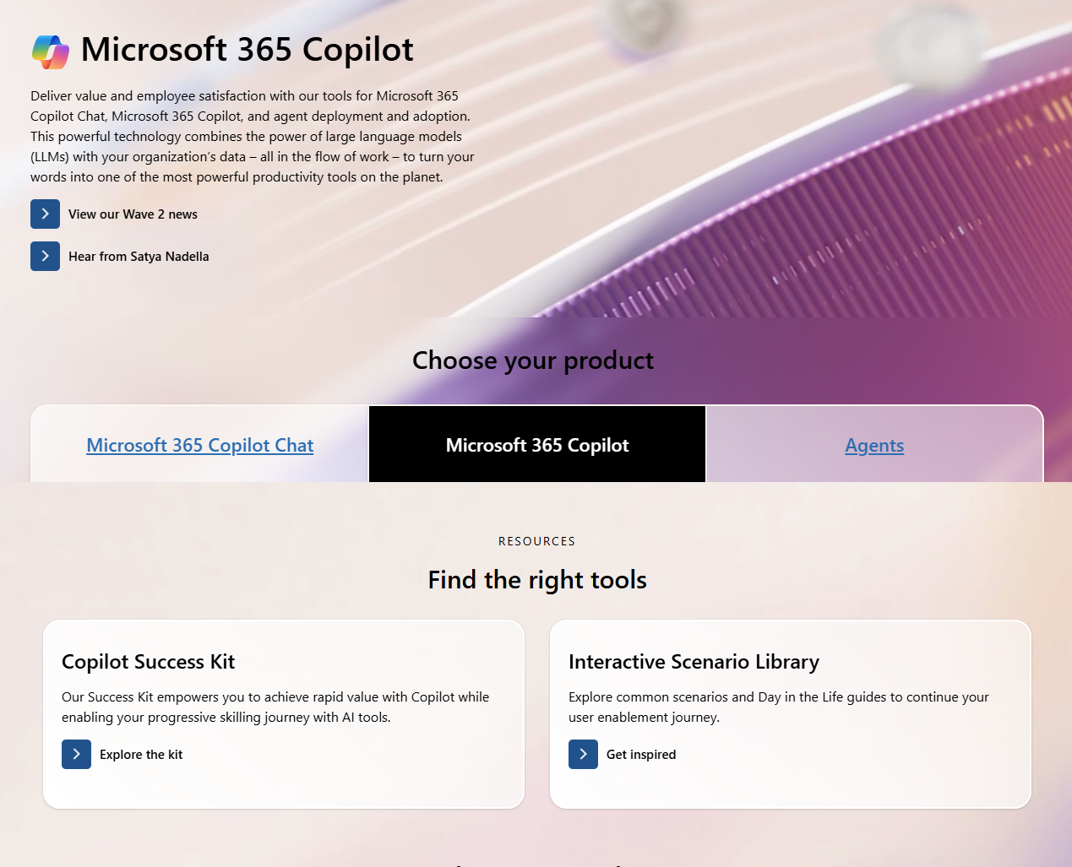
New microsite tour – pt 1
Top news
New product selector based on feedback
Curated primary assets and actions based on click data analysis

Slide 16
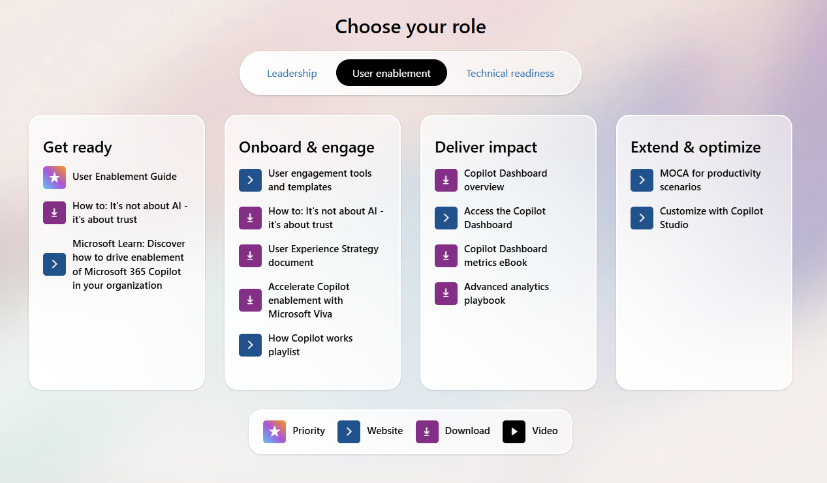
New microsite tour – pt 2
Simplified role selector
Role curated content organized by implementation phase

Slide 17
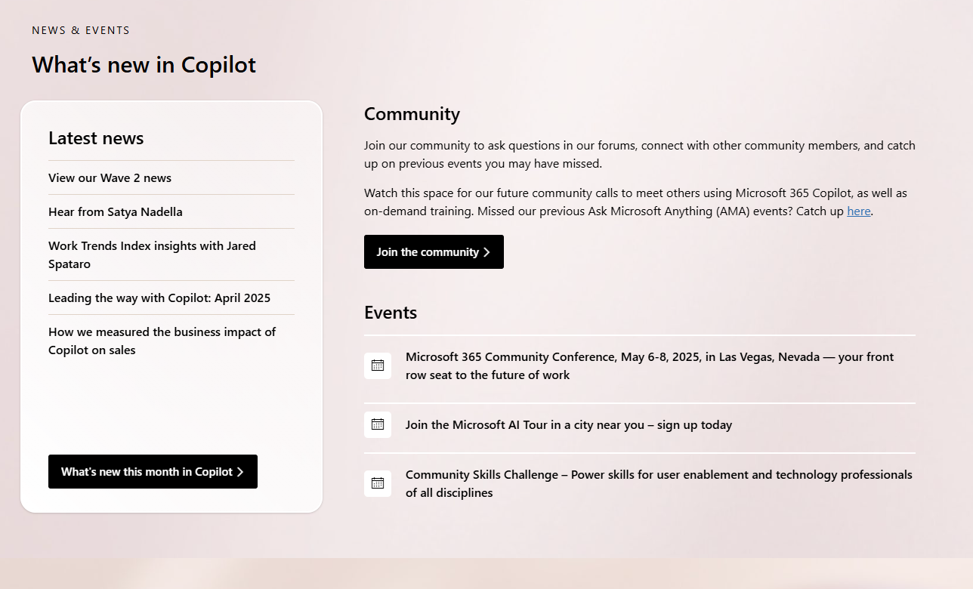
New microsite tour – pt 3
Consolidated news, community, and events section
News section will soon pull dynamically from the Microsoft 365 Copilot blog
Persistent “What’s new this month” blog

Slide 18
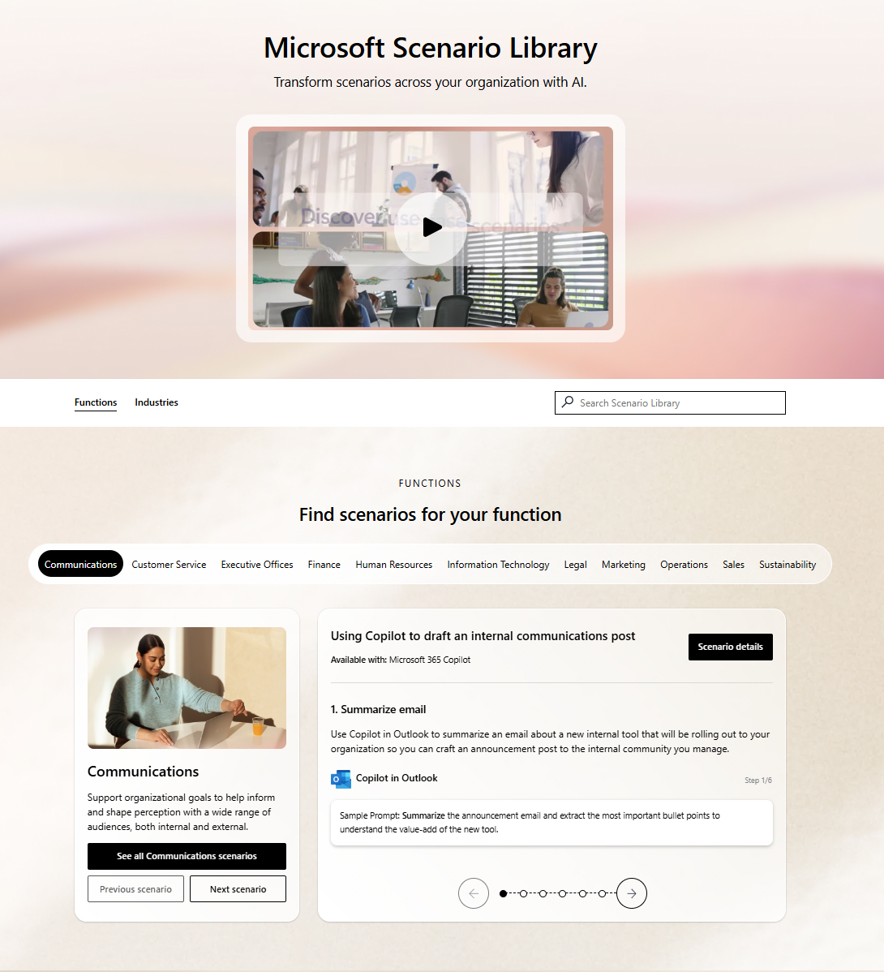
Newly redesigned Scenario Library
Simplified navigation
Filter by functional department or industry vertical
Resources are dynamically filtered to only show what’s relevant to what’s selected
Easily click through the scenarios to see the steps
Easily navigate to the next or previous scenario, or click through to see all
Notes:
The redesign launched at the Copilot Wave 2: Spring announcements moment on April 23, 2025, and matches the new microsite model in look and feel.

Slide 19
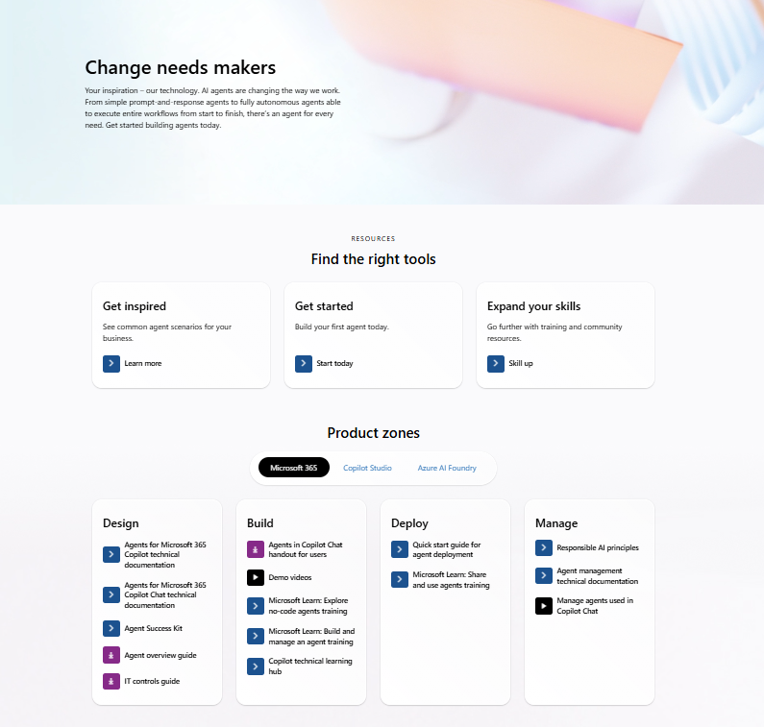
New AI Agents Hub
https://aka.ms/AIAgentsHub
Cross-organizational landing page for AI agents.
This new hub brings resources from learn.microsoft.com, developer.microsoft.com, setup.microsoft.com, and more, into one location.
Notes:
The new AI Agents Hub launched at Build 2025.

Slide 20
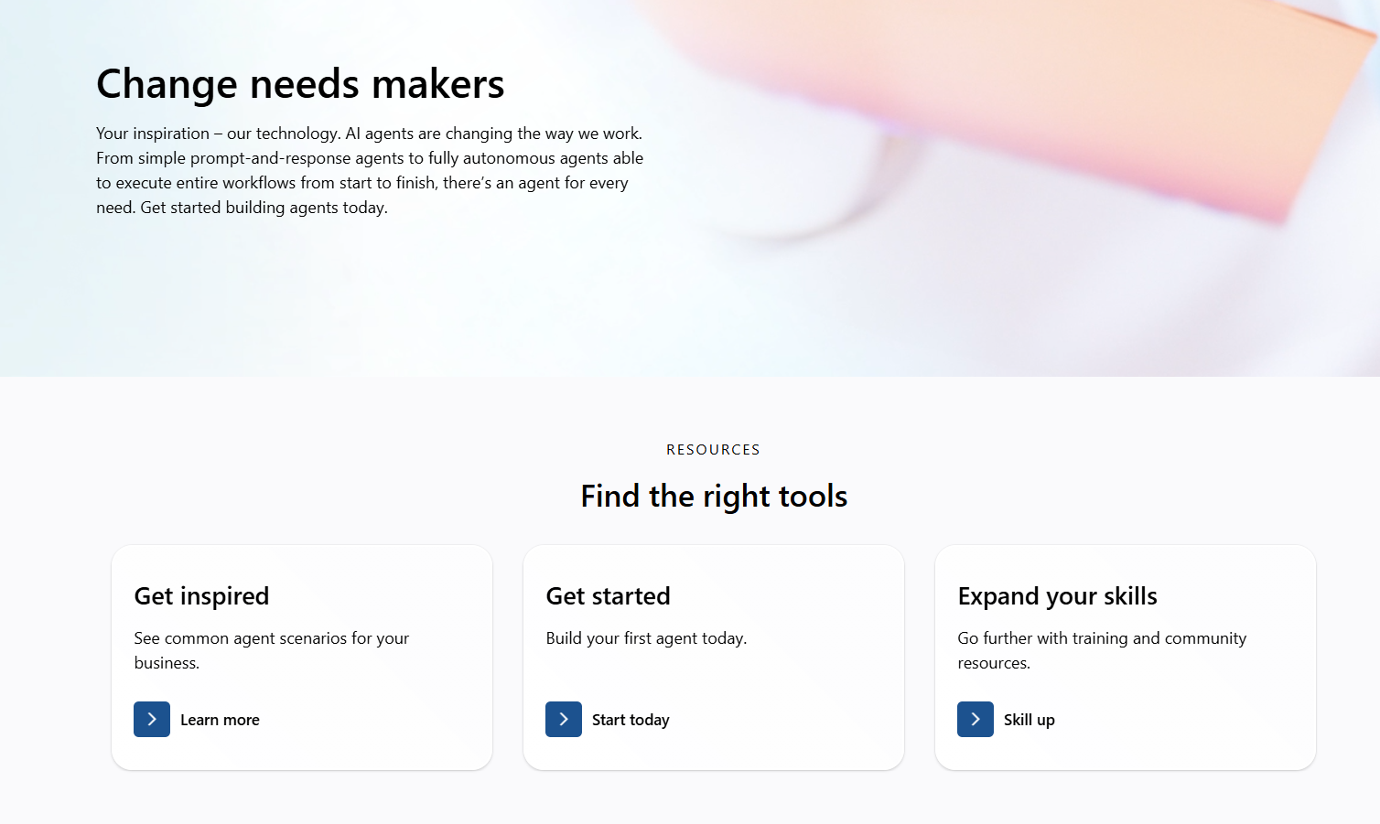
New AI Agents Hub tour – pt 1
Curated primary resources and go-do’s

Slide 21
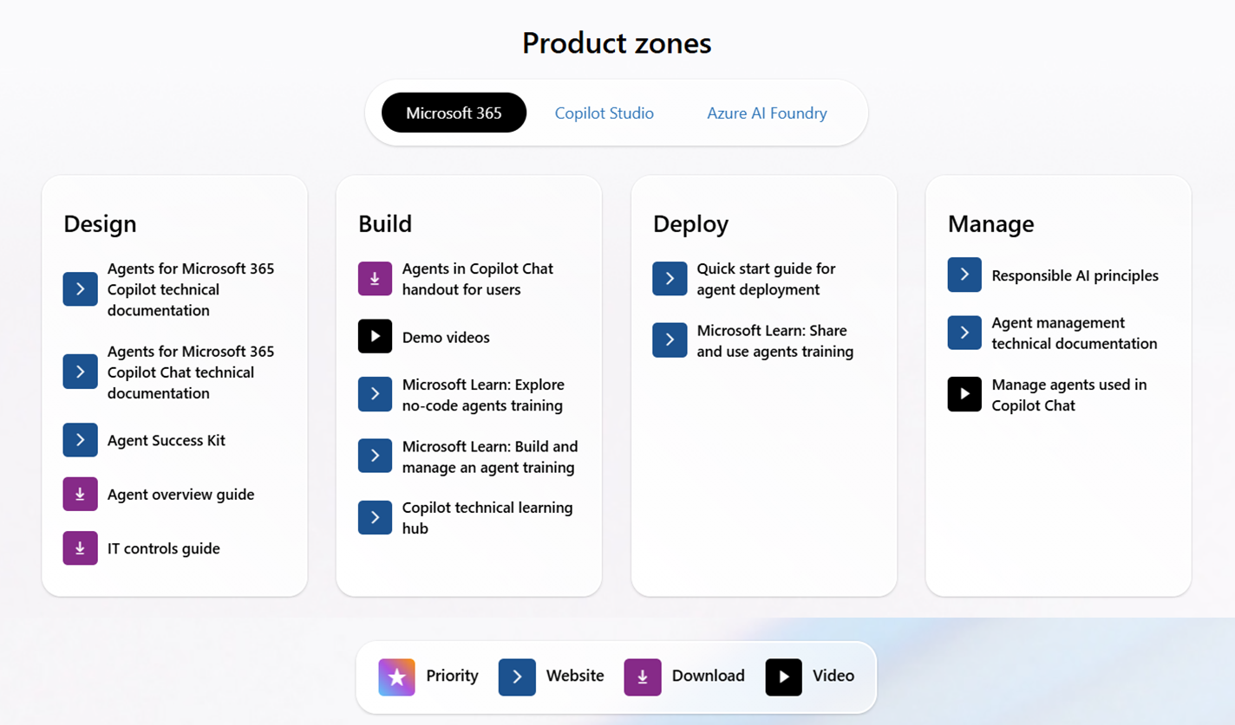
New AI Agents Hub tour – pt 2
Product selector
Dynamic resources organized by phase
Icon legend

Slide 22
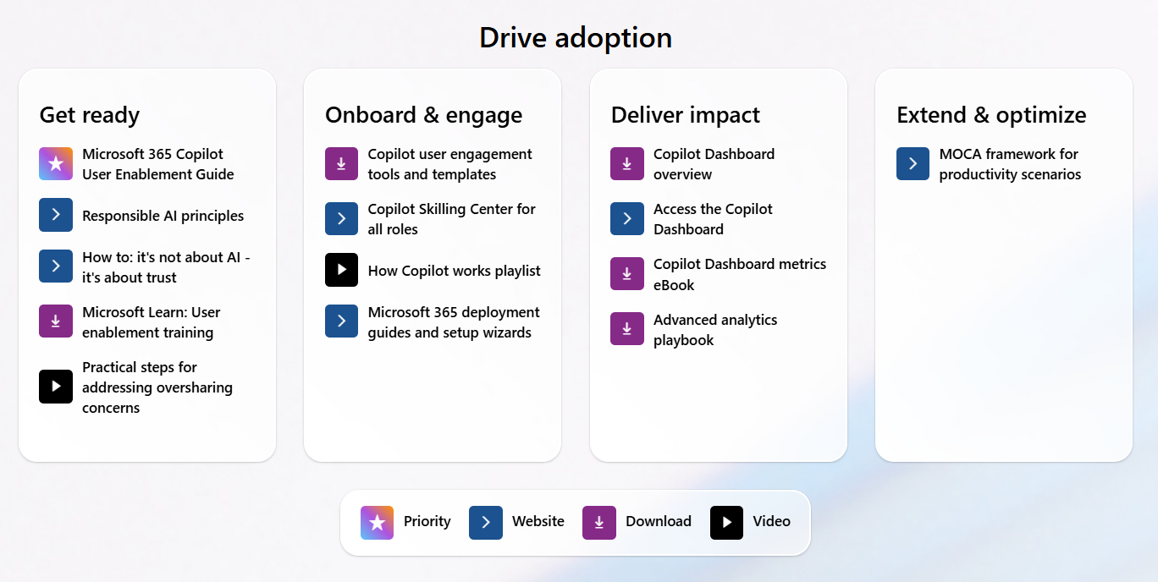
New AI Agents Hub tour – pt 3
Adoption resources organized by phase
Consistent legend

Slide 23
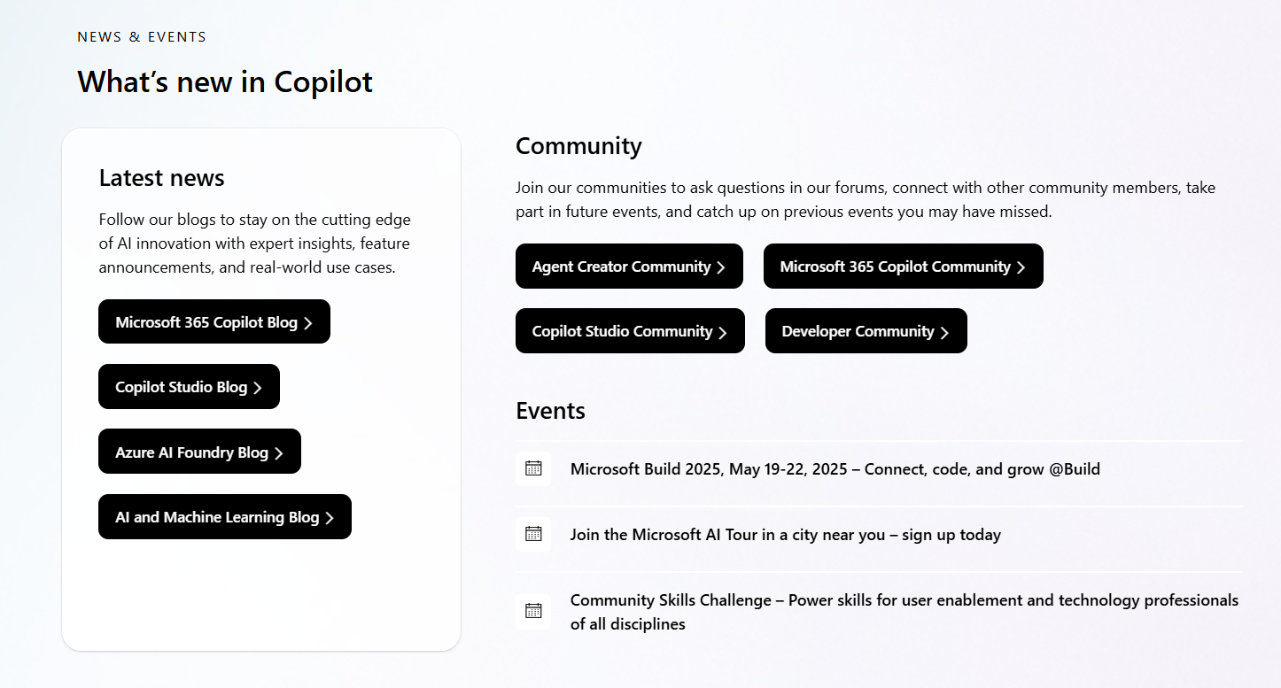
New AI Agents Hub tour – pt 4
News, events, community condensed into one simplified section

Slide 24
Upcoming community events
European Collaboration Summit 2025 | May 25-28 | Düsseldorf, Germany
Community Days Aguascalientes | May 27 | Aguascalientes, Mexico
Community Days Madrid | May 28-29 | Madrid, Spain
European Power Platform Conference | June 16-19 | Vienna, Austria
TechCon 365 Seattle 2025 | June 23-27 | Seattle, Washington
Explore other Microsoft events here and a full list of community-led events can be found at CommunityDays.org

Slide 25

Open discussion
If viewing on-demand, drop your questions in the Microsoft Tech Community – Driving Adoption event page to engage with us!
Share your feedback for this call by visiting https://aka.ms/Microsoft365ChampionCallFeedback

Slide 26



What’s next
Share your feedback
https://aka.ms/Microsoft365ChampionCallFeedback
Next call:
June 24
Topic:
SharePoint agents, agent governance and the Get Stuff Done campaign with Karuana Gatimu
Join the Driving Adoption community
https://aka.ms/DrivingAdoption
Invite colleagues to become a Champion
https://aka.ms/M365Champions

