Slide 1



Microsoft 365 Champion
community call
March 2025

Slide 2
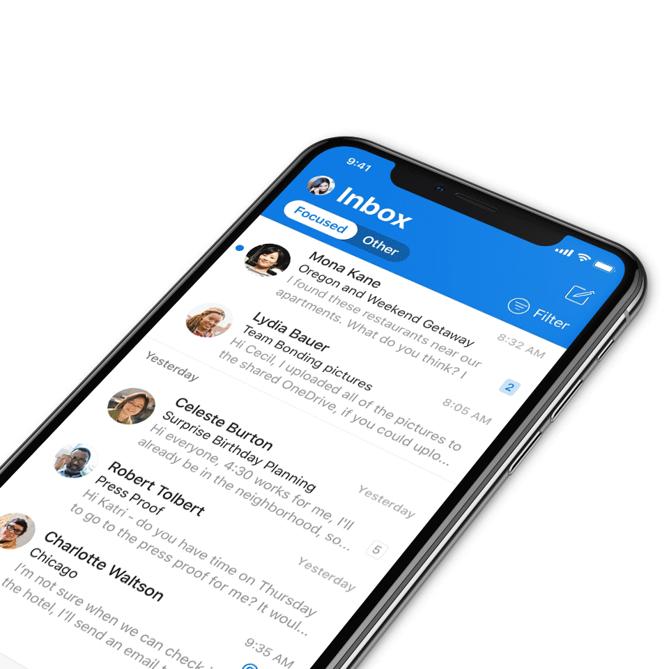
Digital Event Code of Conduct
Microsoft’s mission is to empower every person and every organization on the planet to achieve more. This includes all Microsoft events and gatherings, including on digital platforms, where we seek to create a respectful, friendly, fun and inclusive experience for all participants.​
We expect all digital event participants to uphold the principles of this Code of Conduct, which covers the main digital event and all related activities. We do not tolerate disruptive or disrespectful behavior, messages, images, or interactions by any party participant, in any form, at any aspect of the program including business and social activities, regardless of location.​
Microsoft will not tolerate harassment or discrimination based on age, ancestry, color, gender identity or expression, national origin, physical or mental disability, religion, sexual orientation, or any other characteristic protected by applicable local laws, regulations, and ordinances.​
We encourage everyone to assist in creating a welcoming and safe environment.
For more info, visit aka.ms/CodeofConduct.

Slide 3

Agenda
Announcements
Top Microsoft 365 updates
Main topic: SharePoint flexible sections
Open discussion forum
Become a Champion today!
https://aka.ms/BecomeaChampion

Slide 4
New call format
We’re listening to your feedback! The Champion community calls has returned to Microsoft Teams and will still be available on-demand on the Microsoft Tech Community.
How to watch:
Beginning in February 2025, the Microsoft 365 Champion community calls has moved to Teams webinars and be available on-demand on the Microsoft Tech Community (MTC) and the Microsoft Community Learning YouTube channel within 48 hours after the call. The join links remain the same and clicking through will take you to the webinar registration page. You must register to join the live call. Our community call times also remain the same: 4th Tuesday of every month at 8:05 AM and 5:05 PM Pacific Time.
https://aka.ms/M365ChampionCallAM
https://aka.ms/M365ChampionCallPM
REMINDER:
All presentations remain available to Microsoft 365 Champion program members, link in the monthly newsletters. Not a member? Join in the link below for access to calendar invites, presentations, and all previous calls.
Microsoft 365 Champions
https://aka.ms/M365Champions

Slide 5

Announcements
Microsoft 365 Community Conference
Your front-row seat to the future of work
Join us in Las Vegas, Nevada, May 6-8! At the Microsoft 365 Community Conference, you’ll join hundreds of engineers, experts, executives, and MVPs—and thousands of professionals and tech superfans—from around the world. From learning about the latest advancements in AI-driven tools, to talking to the people who build Microsoft products, to developing the practical skills that will serve you and your organization, you’ll dive deep into big innovations and come home with tangible solutions.
Claim your spot now: aka.ms/M365Con25

Slide 6

Microsoft 365 Community Conference 2025 – Featured speakers
Register today | aka.ms/M365Con25

Slide 7
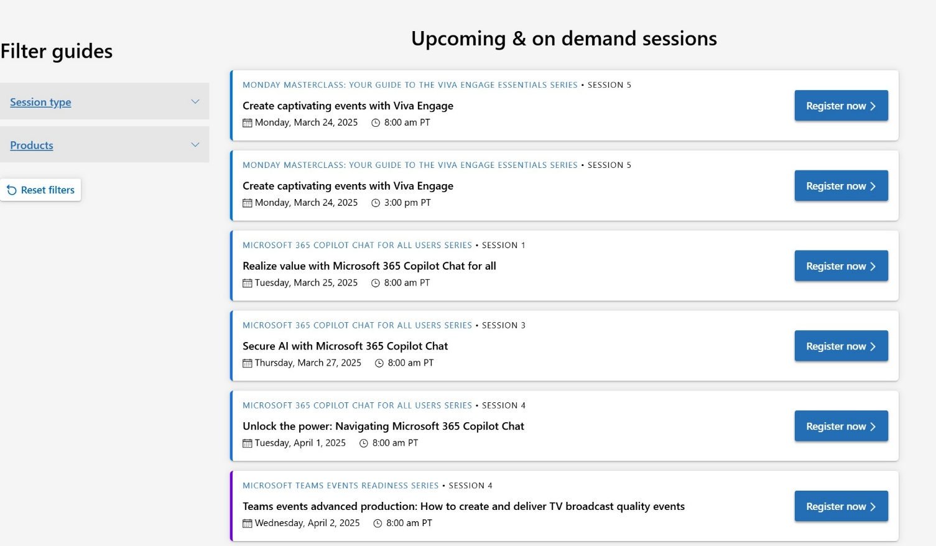
Announcements
Customer Hub
Upcoming Microsoft 365 Copilot webinars
Have you attended our Customer Hub webinar sessions? In today's hybrid work environment, modern communication and solutions are essential. Our goal is to help you explore what you can achieve with Microsoft solutions.
Join us for one or more of our upcoming sessions, including the launch of several new Copilot series. We also have all past session recordings so you can watch any that you missed and download the presentation materials.
Visit aka.ms/CustomerHubSessions to sign up today.

Slide 8
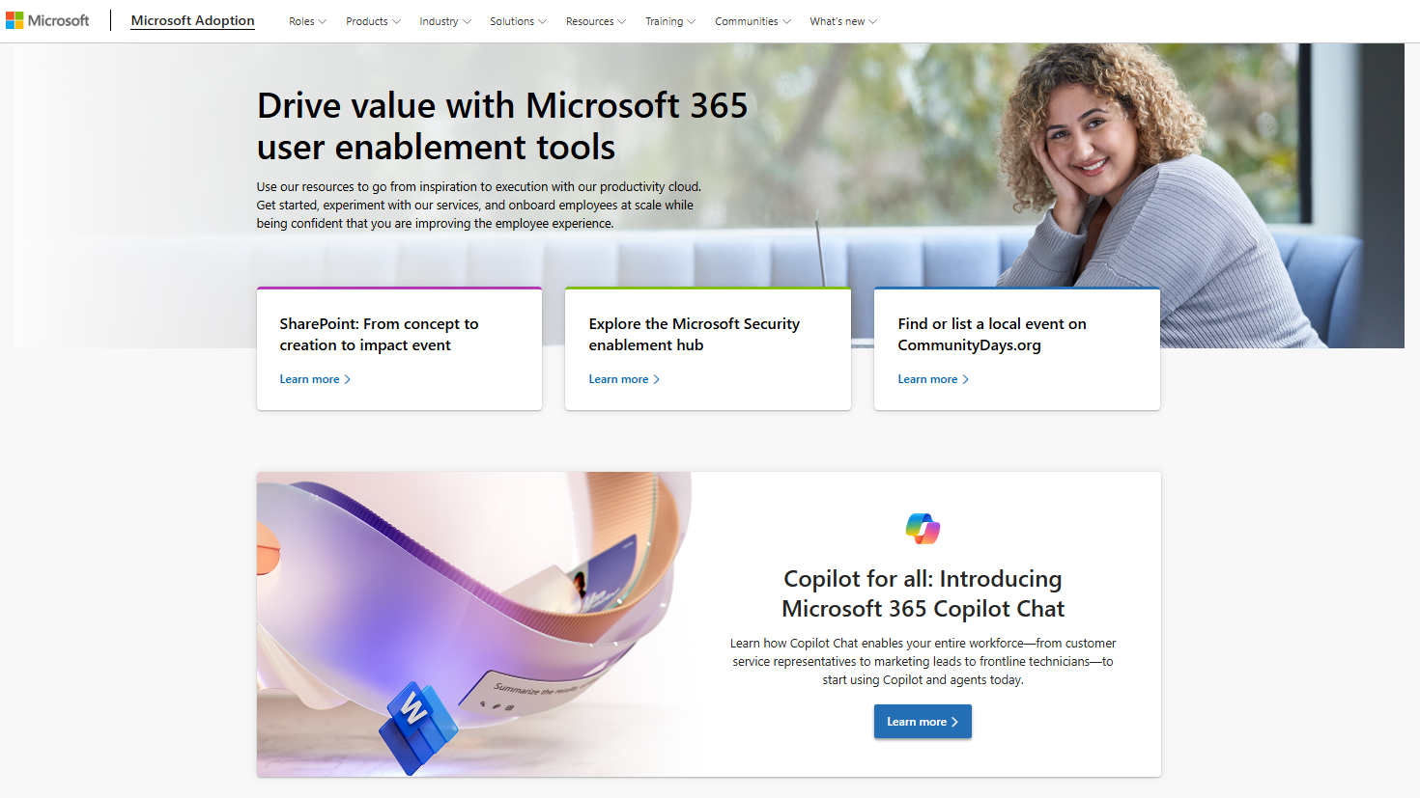
adoption.microsoft.com
Update highlights
New Microsoft Security Copilot video hub, with spotlight interviews, deep dives, and more
New Modern employee communications page with best practices, migration resources, common communication scenarios, and training
New Microsoft 365 Copilot resources: advanced analytics eBook, risks and compliance discussion guide, and new sessions in the Customer Hub
New Microsoft customer zero story with Microsoft Legal and SharePoint agents
Read or subscribe to our Release notes for more updates.

Slide 9
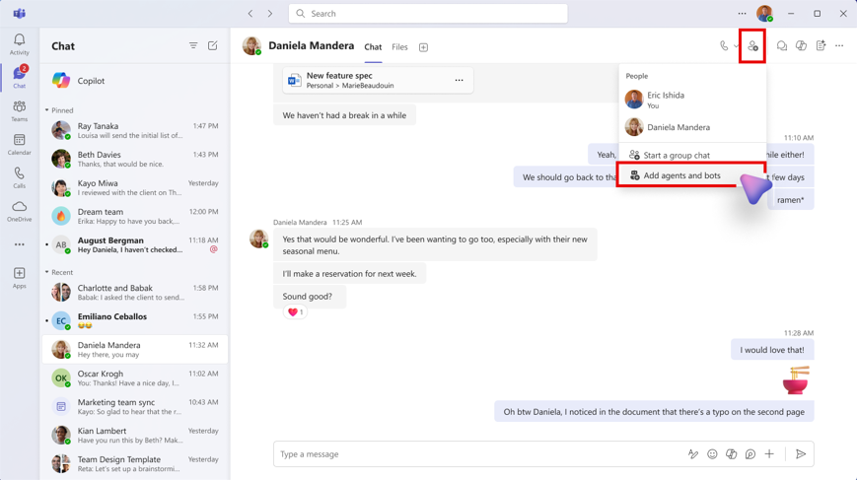
Top Microsoft 365 updates
Microsoft Teams
Add agents or bots in Teams chat
Whether answering questions or taking care of mundane tasks, agents and bots in Teams save you and others time so you can focus on what's most important. You can now add an agent or bot in your 1:1 or group chat and access it directly from that chat. To add, click on ‘Add people, agents and bots’ -> ‘Add agents and bots’ and search for the agent or bot you want to add. Once added, everyone in the chat can interact with the agent. Users can '@mention' the agent along with a relevant prompt, and everyone in the chat will see the agent’s response. This update is available for Teams on Windows desktop, Mac desktop, and the web.
Click here to learn more.

Slide 10
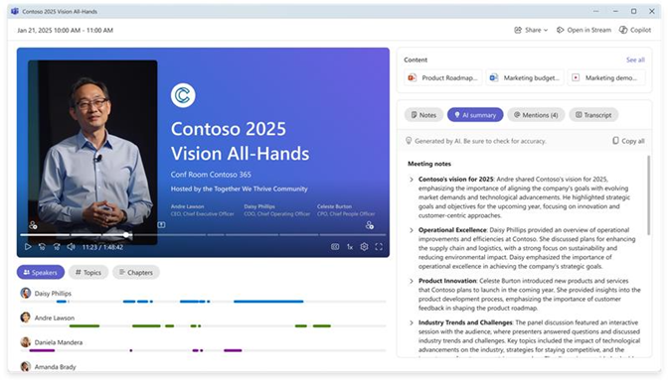
Top Microsoft 365 updates
Microsoft Teams
Intelligent Meeting Recap for events (Premium)
Intelligent recap is now available for town hall and webinar event instances, just like the intelligent recap experience you are used to in meetings. Event organizer, co-organizers, and presenters can now easily explore the meeting recording by speakers and topics, and access AI-generated meeting notes, AI-generated tasks, and name mentions. In addition to availability with a Teams Premium license, intelligent event recap features are available with a Microsoft 365 Copilot license.
Click here to learn more.
Notes:
Outlook features coming to Teams include delegate access, print support, expanded calendar settings, filtering, support for multiple time zones, time suggestions in scheduling, support for attachments, and more.
Expanded calendar views
The new calendar offers several new views and navigation options:
Month View: View your calendar by month, a highly requested feature, especially useful for users with sparse calendars.
Split View: When more than one calendar is selected, you can now split the calendar into two independent views.
Time Scale: Specify time scales or intervals for the calendar surface
Saved Views: Save your current view for easy access later
Weather Display: See the weather for your current location directly in the calendar
Calendar settings and customization
Customize your calendar settings, including start and end times for events, location settings, and more. You can also share your calendar with others in your organization and print your entire calendar. Lastly, the new calendar can be popped out as a separate window, allowing you to multitask more effectively.
Save time with easy scheduling
Creating meetings is now more intuitive. You can quickly create a meeting from the quick view by clicking on a timeslot in your calendar or by opening the new scheduling form. The new scheduling form includes refreshed meeting options and templates for different meeting types

Slide 11
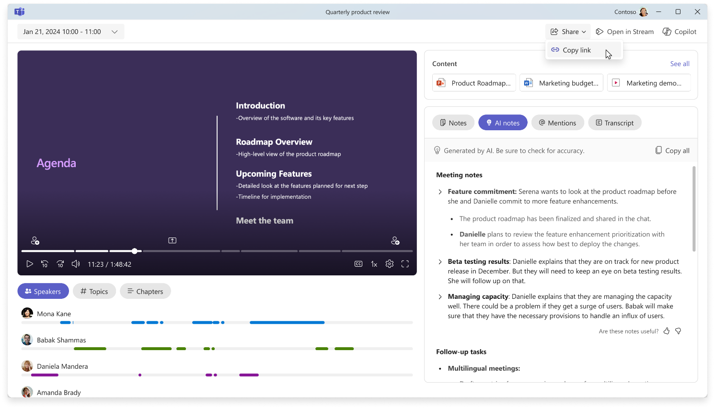
Top Microsoft 365 updates
Microsoft 365 Copilot
GCC availability and meeting recap options for Copilot in Teams
Copilot in Teams meetings is now available for GCC. Users can now run more effective meetings, get up to speed on conversations, organize key discussion points, and summarize key actions so participants know what they need to do next. Users can type questions or use predetermined prompts during or after the meeting, and their interactions with Copilot are only visible to them. Copilot in Teams meetings for GCC rolled out in February.
Click here to learn more.

Slide 12

Top Microsoft 365 updates
Microsoft Public Sector
New Microsoft Public Sector Blogs
Check out the Microsoft Public Sector monthly roadmap newsletters for the latest updates across Microsoft 365 for public sector.
January 2025 - Microsoft 365 US Public Sector Roadmap Newsletter
February 2025 - Microsoft 365 US Public Sector Roadmap Newsletter
March 2025 - Microsoft 365 US Public Sector Roadmap Newsletter

Slide 13
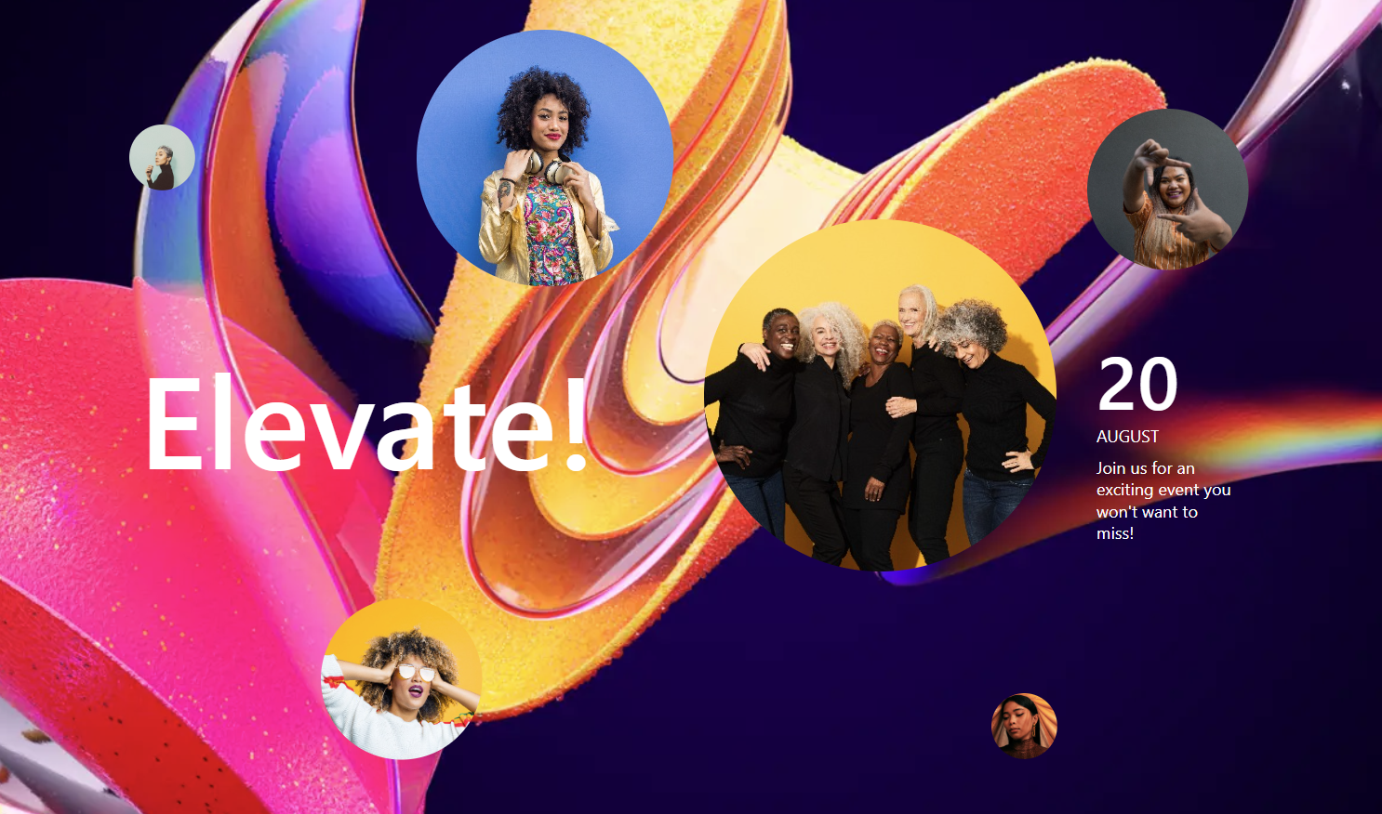
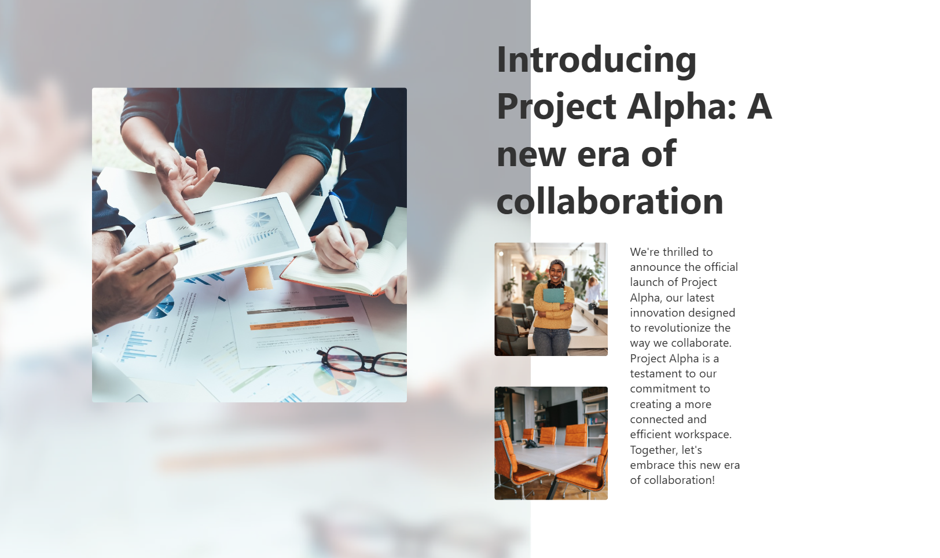
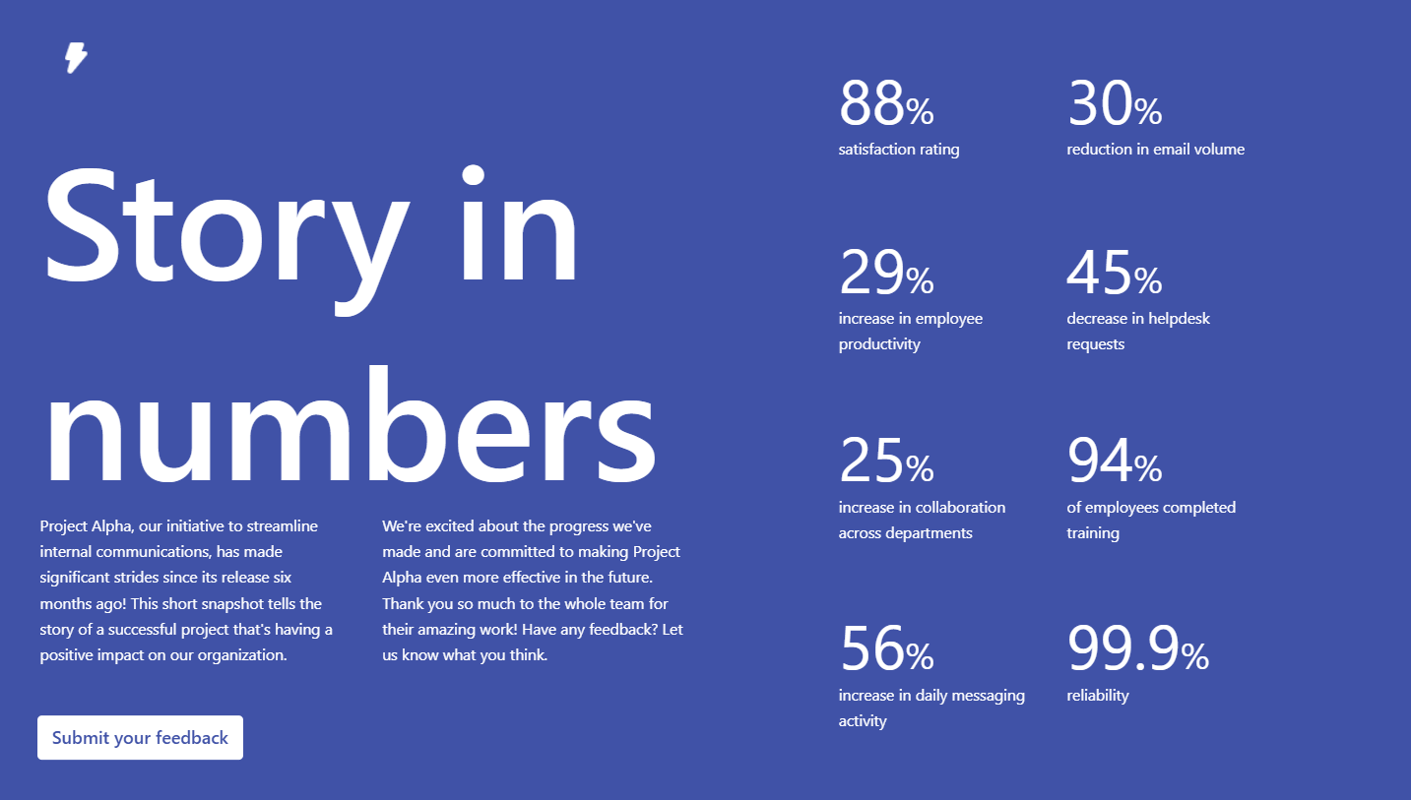
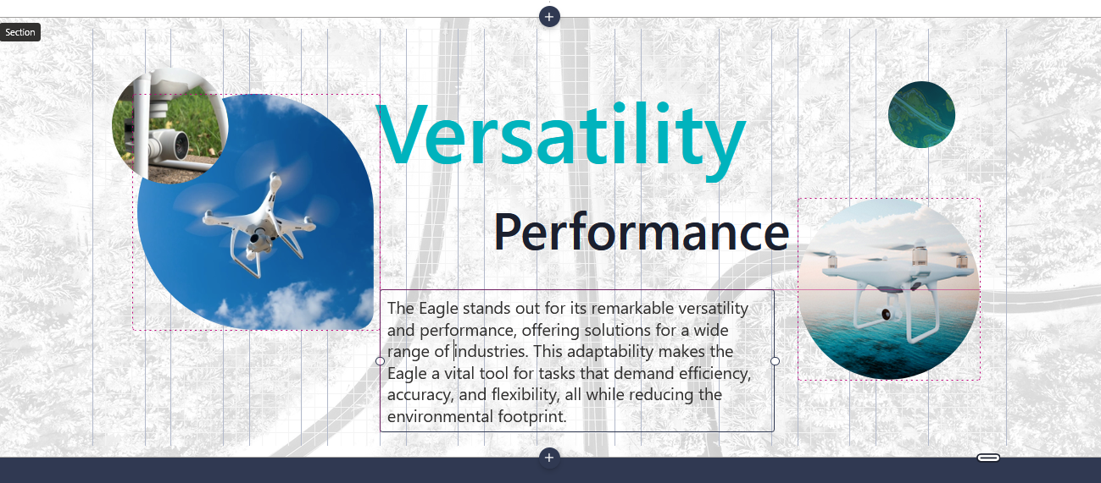
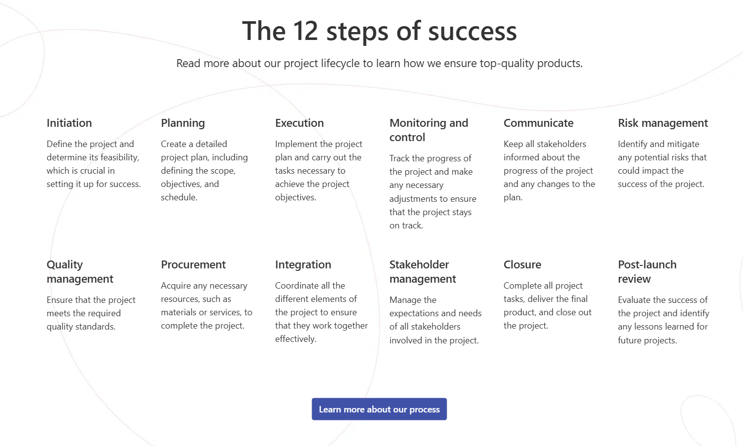
Flexible sections
New section type
3-dimensional web part placement
Overlap web parts
Multi-select and group web parts
Resize section

Slide 14
Upcoming community events
Boston Code Camp 38 | March 29 | Burlington, Massachusetts
Microsoft Fabric Community Conference | March 31-April 2 | Las Vegas, Nevada
aMP Boston – Healthtech Leadership Summit | April 3 | Burlington, Massachusetts
Microsoft 365 Community Conference | May 4-9 | Las Vegas, Nevada
European Power Platform Conference | June 16-19 | Vienna, Austria
TechCon365 – Seattle 2025 | June 23-27 | Seattle, Washington
Explore other Microsoft events here and a full list of community-led events can be found at CommunityDays.org

Slide 15

Open discussion
If viewing on-demand, drop your questions in the Microsoft Tech Community – Driving Adoption event page to engage with us!
Share your feedback for this call by visiting https://aka.ms/Microsoft365ChampionCallFeedback

Slide 16



What’s next
Share your feedback
https://aka.ms/Microsoft365ChampionCallFeedback
Next call:
April 22
Topic:
Accessibility in Teams & Microsoft 365 Copilot Business Case Builder
Join the Driving Adoption community
https://aka.ms/DrivingAdoption
Invite colleagues to become a Champion
https://aka.ms/M365Champions

