Slide 1

We will begin the call at five minutes past the hour.
Microsoft 365 Champion Community Call
July 2025
Microsoft 365 Champion Community
Learn more. Do more. Achieve more, together.

Slide 2



Microsoft 365 Champion
community call
July 2025

Slide 3
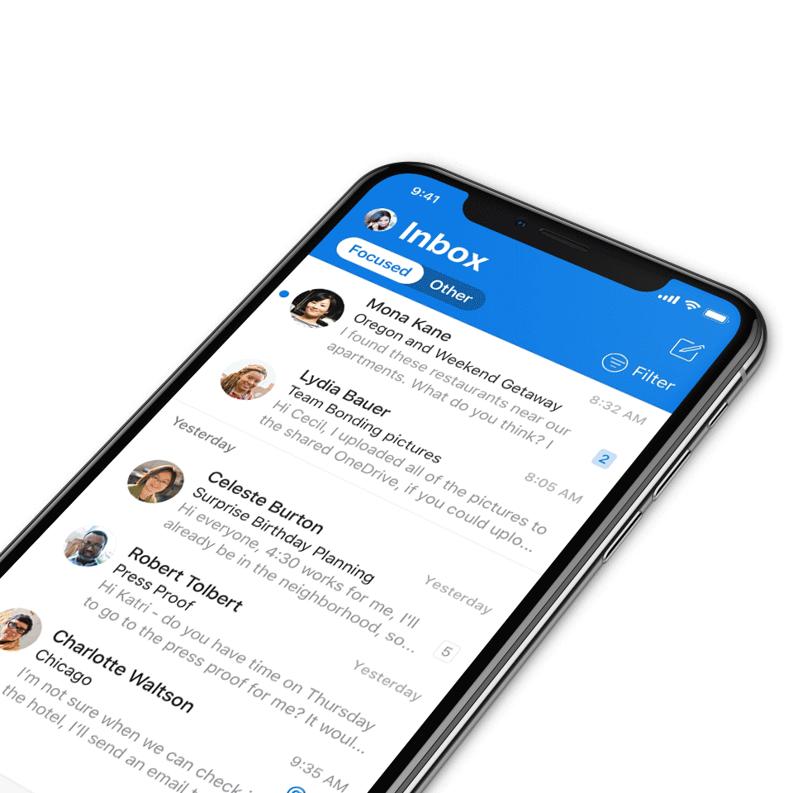
Digital Event Code of Conduct
Microsoft’s mission is to empower every person and every organization on the planet to achieve more. This includes all Microsoft events and gatherings, including on digital platforms, where we seek to create a respectful, friendly, fun and inclusive experience for all participants.​
We expect all digital event participants to uphold the principles of this Code of Conduct, which covers the main digital event and all related activities. We do not tolerate disruptive or disrespectful behavior, messages, images, or interactions by any party participant, in any form, at any aspect of the program including business and social activities, regardless of location.​
Microsoft will not tolerate harassment or discrimination based on age, ancestry, color, gender identity or expression, national origin, physical or mental disability, religion, sexual orientation, or any other characteristic protected by applicable local laws, regulations, and ordinances.​
We encourage everyone to assist in creating a welcoming and safe environment.
For more info, visit aka.ms/CodeofConduct.

Slide 4

Agenda
Announcements
Top Microsoft 365 updates
Topic 1: IT management controls and measurement for Copilot and agents – Samer Baroudi, Senior Product Marketing Manager
Topic 2: People Skills and Skills agent – Anirudh Bajaj, Senior Product Manager
Open discussion forum
Become a Champion today!
https://aka.ms/BecomeaChampion

Slide 5
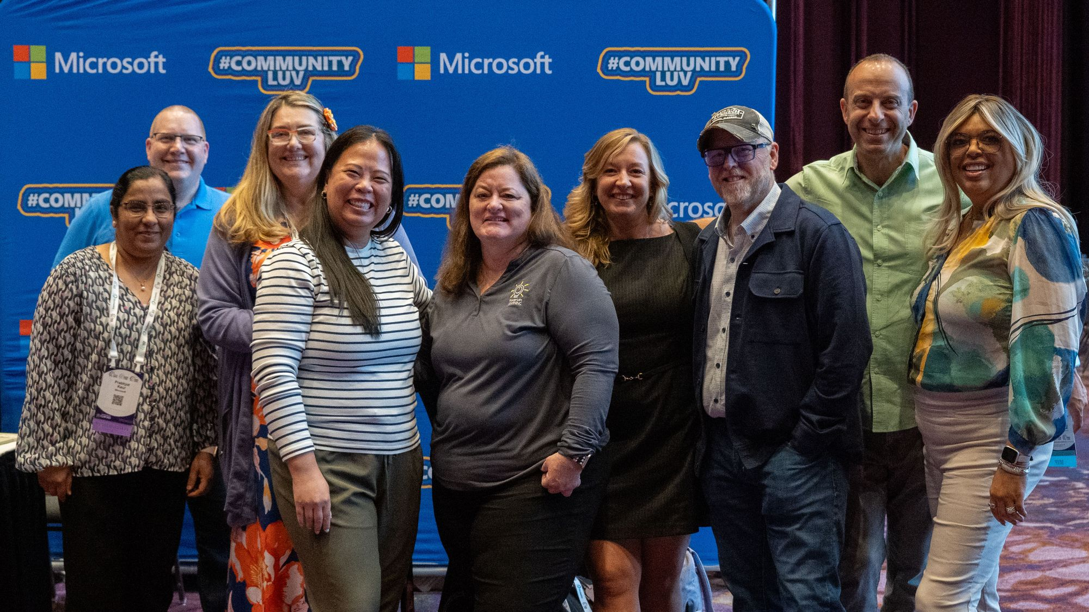
Announcements
Community
Check out the latest MCGI July Newsletter
If you’re an event organizer and want to do more in your local community or would like to discover events in your area- learn more about MGCI.
In addition, there is a monthly newsletter from MGCI with highlights on events, session topics like how-to produce an event and more!
Click here to learn more!

Slide 6
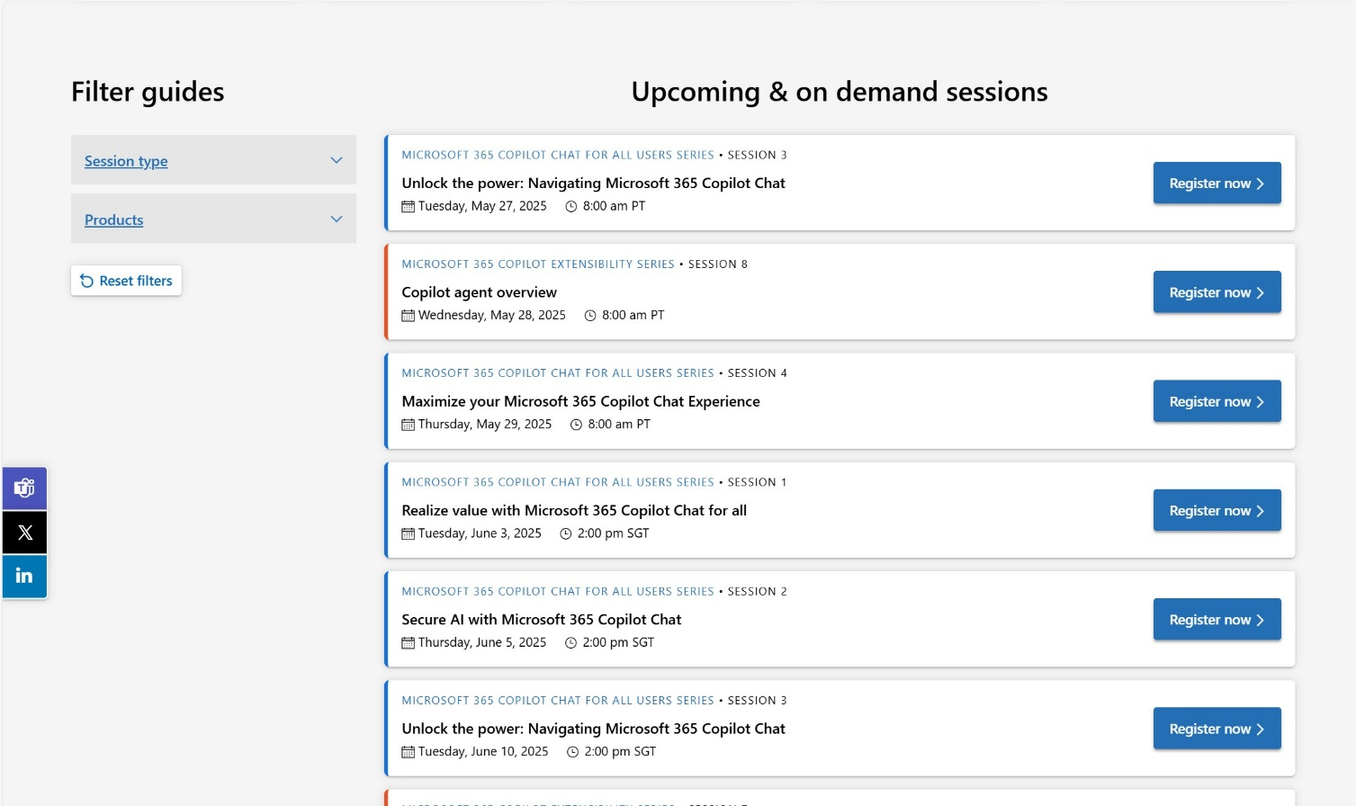
Announcements
Customer Hub
Upcoming Microsoft 365 Copilot webinars
Have you attended our Customer Hub webinar sessions? In today's hybrid work environment, modern communication and solutions are essential. Our goal is to help you explore what you can achieve with Microsoft solutions.
Join us for one or more of our upcoming sessions, including the launch of several new Copilot series. We also have all past session recordings so you can watch any that you missed and download the presentation materials.
Visit aka.ms/CustomerHubSessions to sign up today.

Slide 7
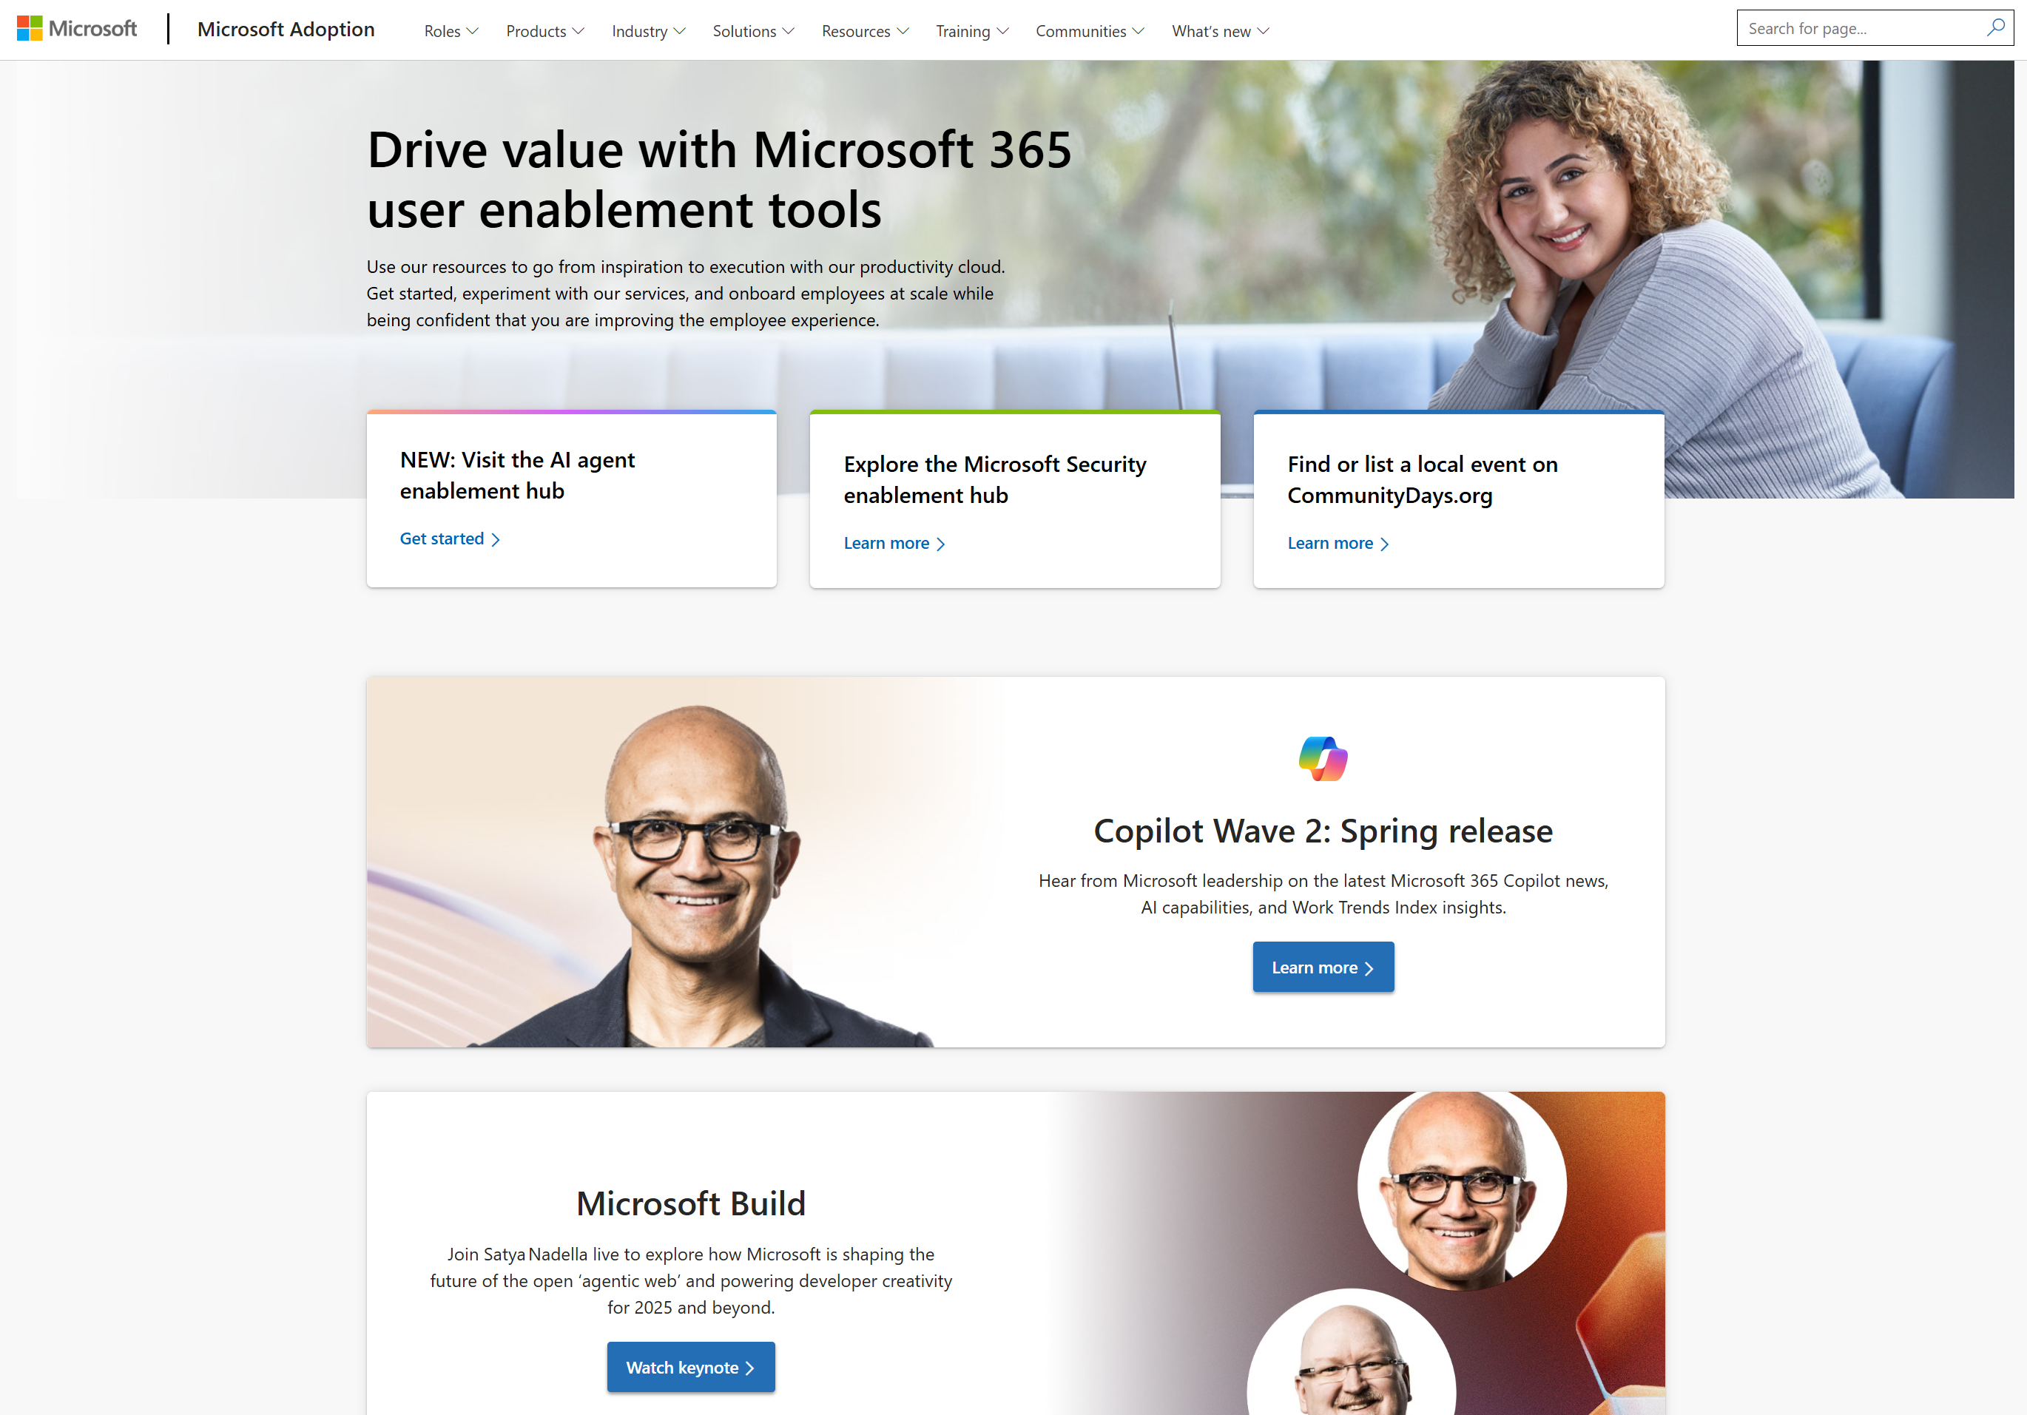
adoption.microsoft.com
Update highlights
Lots of new on-demand recordings: OneDrive Customer Office Hours, Viva Glint Ask the Experts, Building Psychological Safety, Copilot Control System digital deep dive, Frontline Fridays
New IT Pro resources for Microsoft Security
Updates to the Live Events Assistance Program (LEAP) services
Updates to the events on the AI Agents Hub
New Windows Role Optimization Packets for Windows 11
New agents video to the Microsoft Security Copilot video hub
Translated versions of the license allocation guide in the Copilot Success Kit
Read or subscribe to our Release notes for more updates.

Slide 8
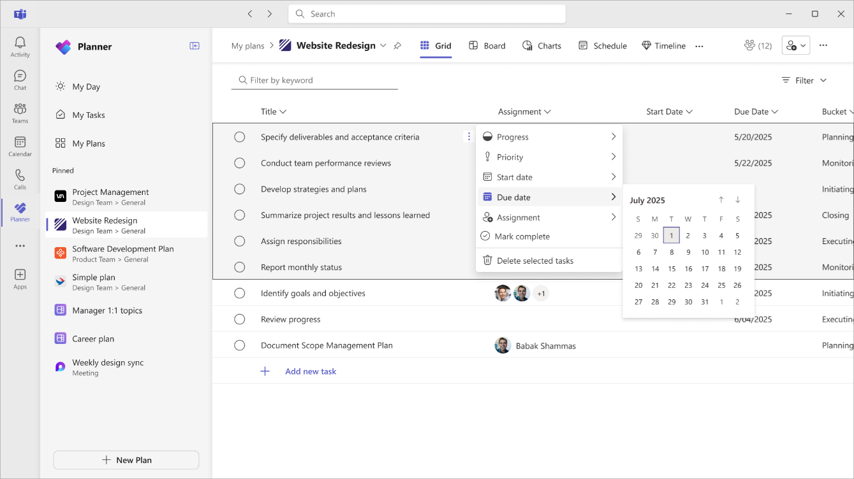
Top Microsoft 365 updates
Microsoft Planner
Boost efficiency with Planner's bulk editing feature
Planner’s new bulk editing feature is here to simplify task management. In the Grid view of any basic plan, you can now update multiple tasks simultaneously—assign tasks, adjust priorities, update progress, and modify start and due dates—all in one go.
Click here to learn more.

Slide 9
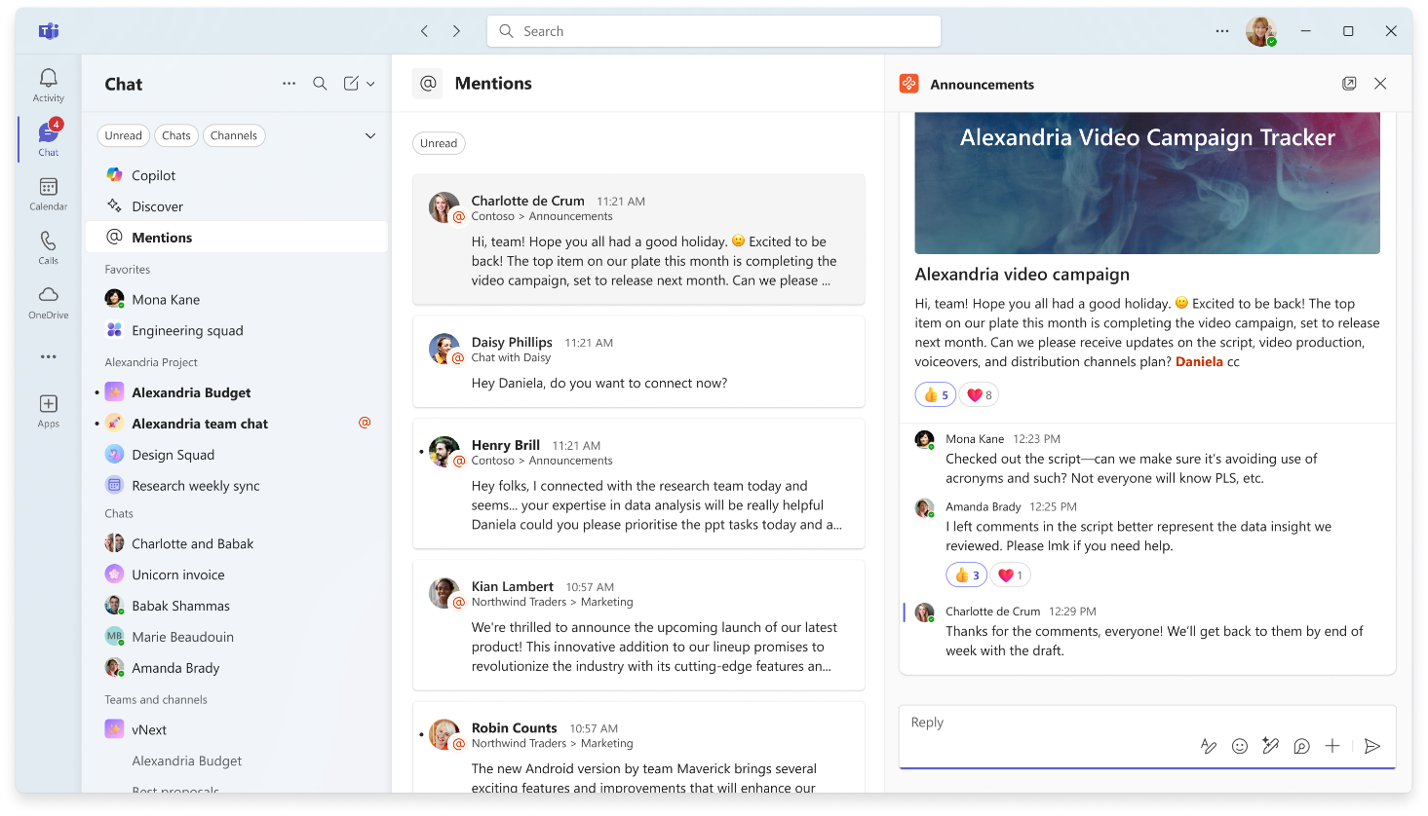
Top Microsoft 365 updates
Microsoft Teams
New Teams chat and channels experience and meeting notes now avaliable in GCC
We’re excited to share that the new chat and channels experience is now available for GCC users.
In addition, meeting notes powered by Loop now available for Microsoft 365 GCC High and DoD
Click here to learn more.

Slide 10
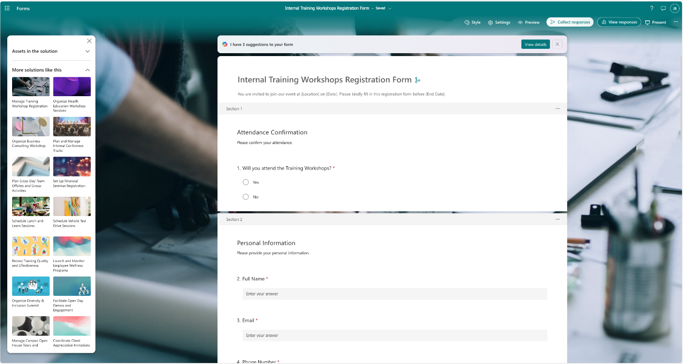
Top Microsoft 365 updates
Microsoft Forms
More solution-based templates are now available
Whether it’s gathering feedback, managing internal processes, or streamlining event planning, these ready-to-use templates help you get started faster and work smarter.
Templates can be found in the Forms portal. Browse the gallery for registration, research, and quiz templates. Please note that this experience is currently only available in the en-US region.
Click here to learn more.
Notes:
What’s in the Registration Template?
The template comes with a them that fits the topic and covers all the essential questions needed to organize a successful event, including:
Attendance confirmation
Contact information (name, email, and phone number)
Event or session preferences
Special requirements (e.g., dietary restrictions, accessibility needs)
Open-ended questions for additional comments

Slide 11
Copilot Control System (CCS)
Management and measurement in Microsoft 365 admin center

Slide 12
Admin role with scoped permissions for AI management
CCS – AI admin role
Scoped Permissions for AI Management
- Manage Copilot settings without Global Admin rights
- Administer Copilot agents and extensibility features
- Approve and publish agents and connectors
Improved Governance and Delegation
- Delegate AI-related responsibilities to specific individuals or teams
- Reduce risk and improve operational clarity
Access to Usage and Adoption Insights
- View usage reports and adoption insights in Microsoft 365 admin center
- Access the Copilot Dashboard in Viva Insights
Operational Efficiency and Security
- Create and manage support tickets
- Read and configure service health dashboards
Support for Pay-As-You-Go Billing
- Manage billing for Copilot Chat directly in the Microsoft 365 admin center
- Set up and edit billing, view cost reports
Global admin
  AI admin
or
Global reader
Help desk admin
Integrated apps admin
User admin
Generally Available
Product images subject to change

Slide 13
Microsoft 365 Copilot

Slide 14
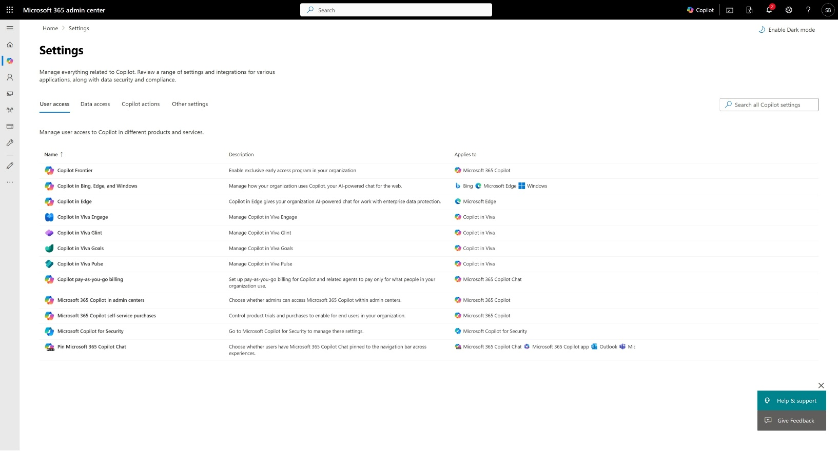
Configure and manage Microsoft 365 Copilot
CCS – Settings
Manage everything related to ‎Microsoft 365 Copilot from one place‎.
Review and apply a range of settings and integrations for various applications.
Directly configure and manage tenant-level settings for Microsoft 365 Copilot and navigate to relevant and more specialized control surfaces such as data security and compliance.
Generally available
Product images subject to change

Slide 15
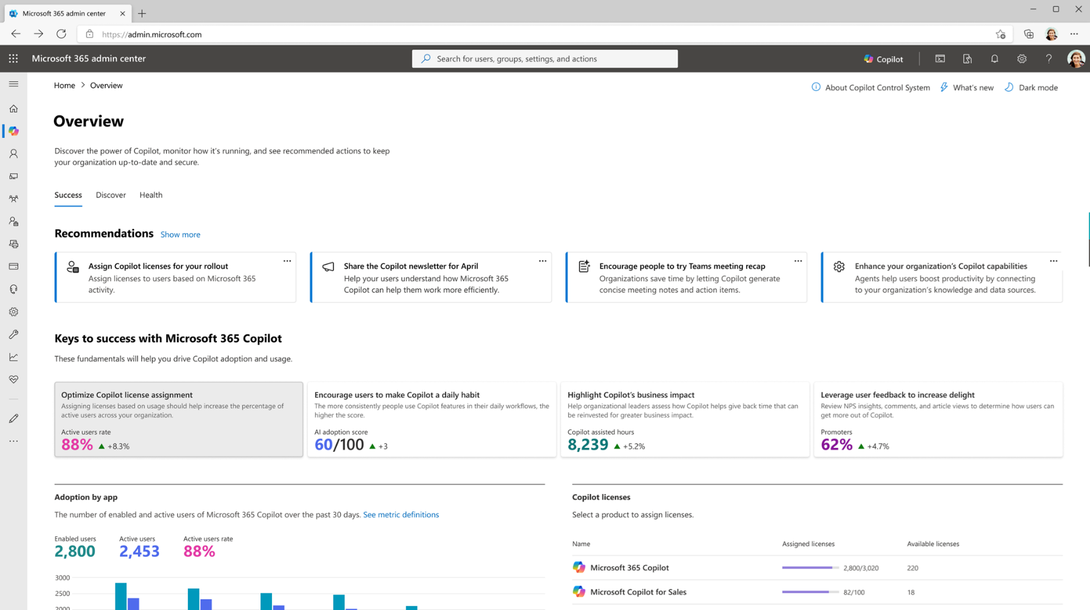
Success metrics and recommended actions
CCS – Overview
Track keys to success – usage, adoption, impact and user satisfaction.
Navigational guide to key measurement surfaces.
Dynamic recommended actions to streamline administration and maximize adoption.
Generally available
Product images subject to change

Slide 16
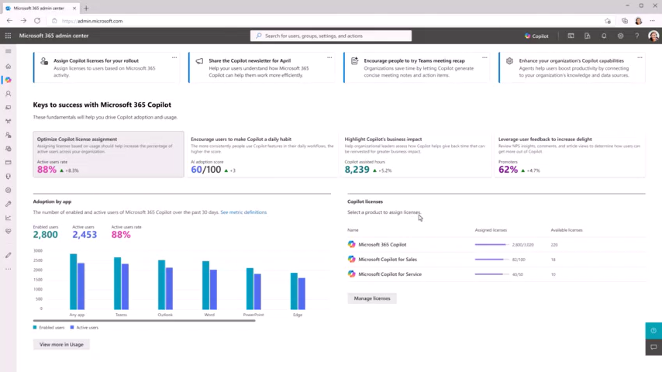
Success metrics
CCS – Overview
Product images subject to change

Slide 17
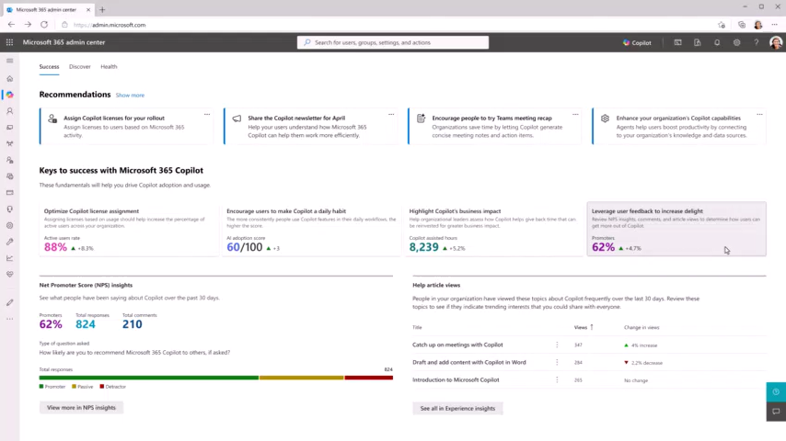
Action cards
CCS – Overview
Product images subject to change

Slide 18
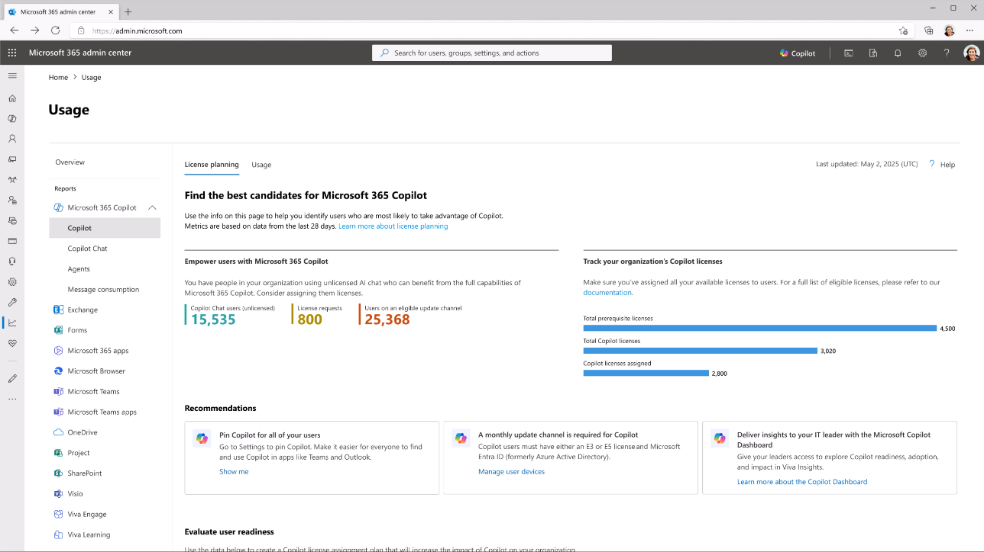
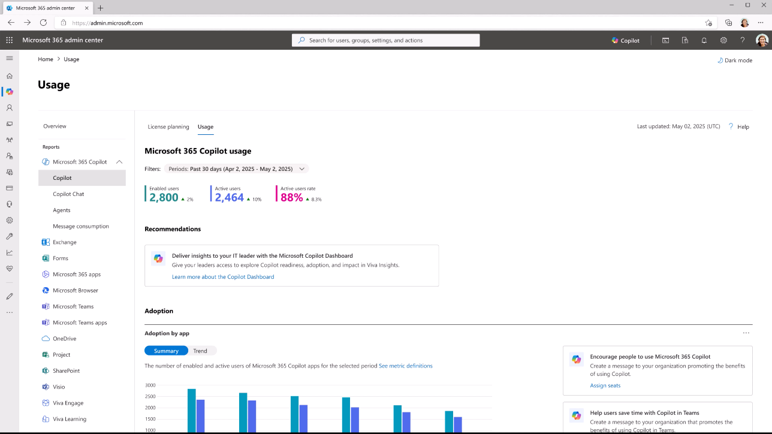
Review license planning and usage insights
CCS – Microsoft 365 Copilot usage report
Review license planning and usage insights to right-size your license strategy and maximize adoption.
Technical eligibility information, assigned and available licenses, suggested candidates for Microsoft 365 Copilot licenses based on Microsoft 365 app usage.
Usage insights including total enabled and active users, in aggregate and per app with user-level last activity dates.
Generally available
Product images subject to change

Slide 19
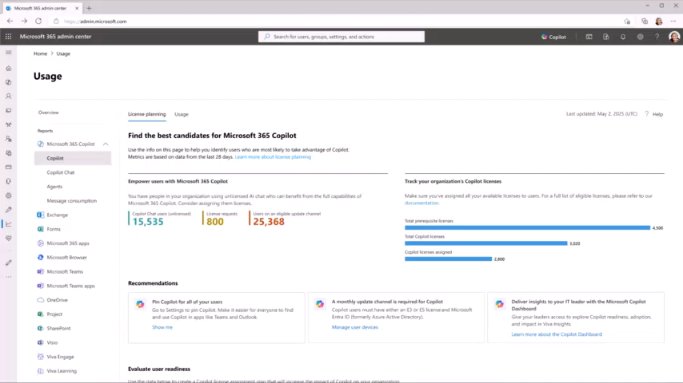
License planning
CCS – Microsoft 365 Copilot usage report
Product images subject to change

Slide 20

Usage
CCS – Microsoft 365 Copilot usage report
Product images subject to change

Slide 21
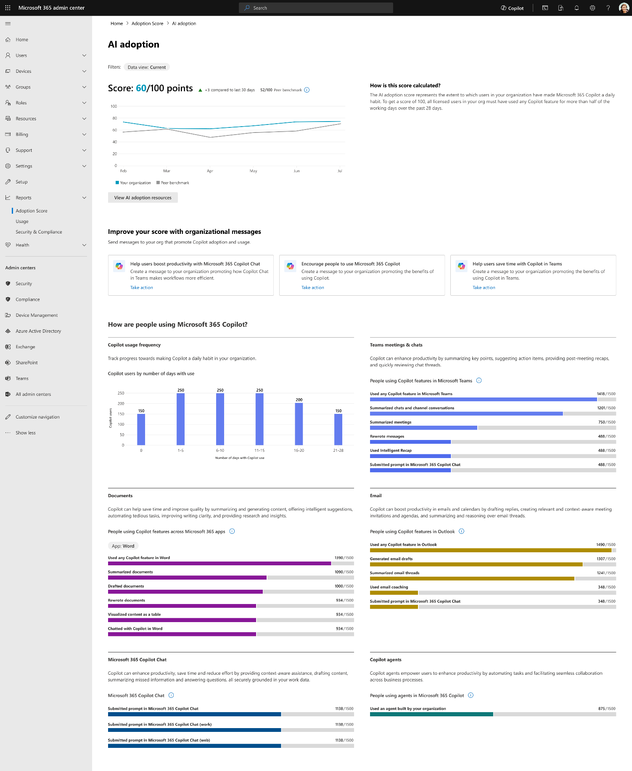
Measure and accelerate Microsoft 365 Copilot adoption
CCS – AI adoption score report
Track meaningful, habit-forming usage—not just one-time activity—with a behavior-based research-backed scoring model.
Compare AI adoption to similar companies by industry, region, and size with peer benchmarking. Identify areas for improvement with feature-level usage metrics and visualize progress with 180-day usage trends.
Drive re-engagement and support onboarding at scale with actionable organizational messaging—send in-product messages to users who haven’t used Copilot recently, directly from the AI adoption score report.
Generally available
Product images subject to change
Notes:
Tracking 3 days per week. That’s when you become regular user

Slide 22
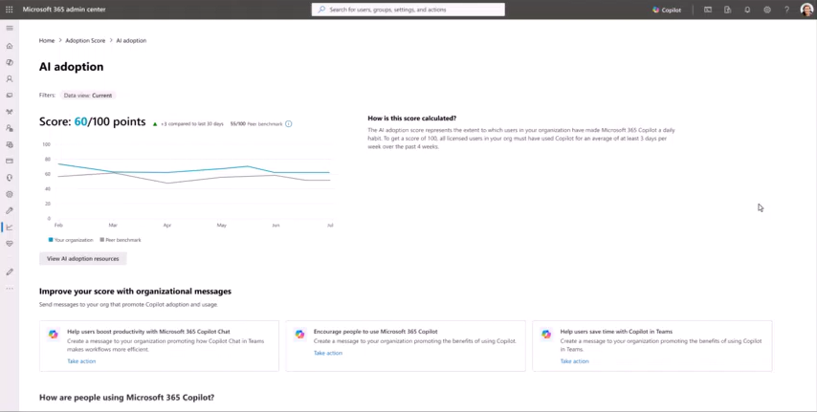
AI adoption score report
CCS – Microsoft 365 Copilot usage report
Product images subject to change

Slide 23
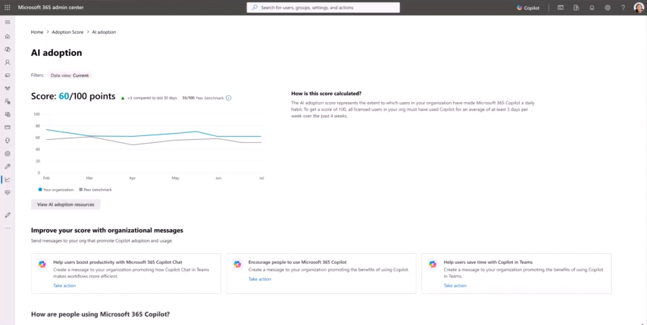
Organizational messages
CCS – Microsoft 365 Copilot usage report
Product images subject to change

Slide 24
Copilot Chat

Slide 25
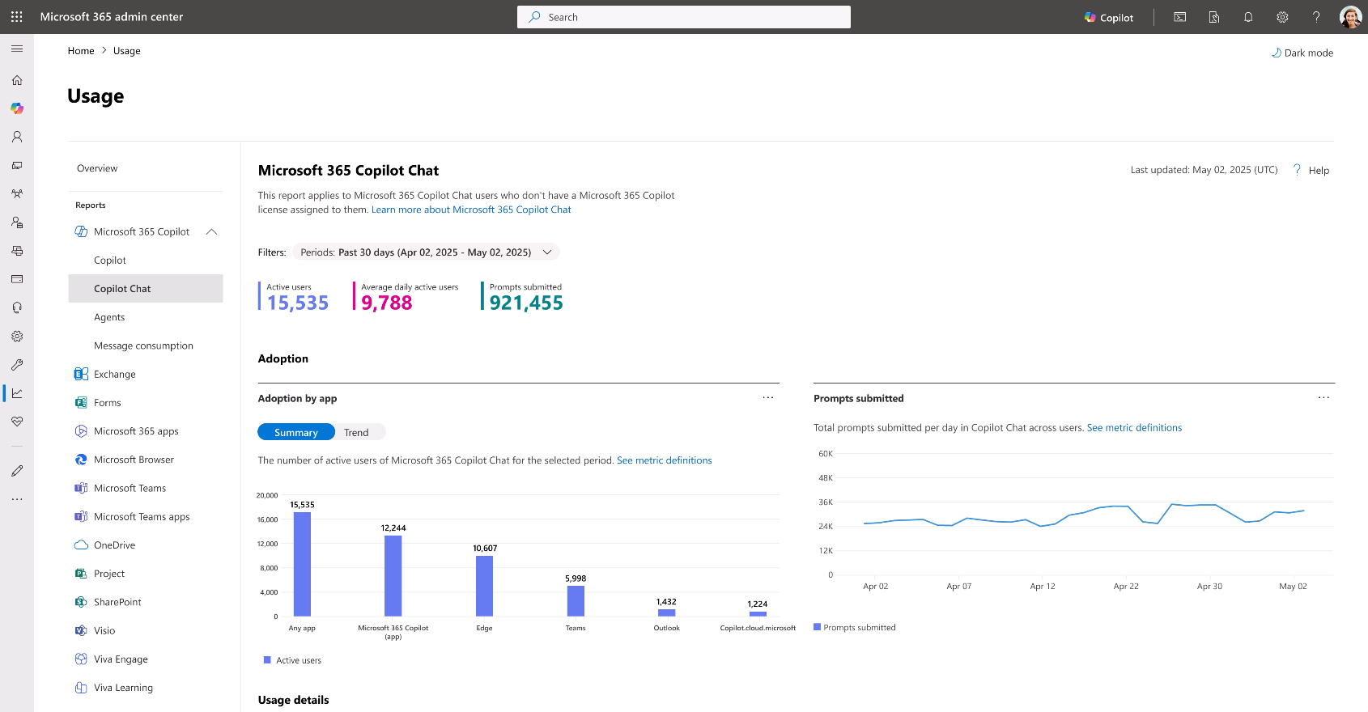
Track usage of Copilot Chat
CCS – Copilot Chat usage report
Understand Copilot Chat adoption patterns and support Microsoft 365 Copilot licensing decisions with detailed usage metrics in totals and at the user level.
Review total active users, average daily active users, prompts submitted and usage by app entry-point, e.g., Microsoft 365 Copilot app, Microsoft Teams, Outlook, copilot.cloud.microsoft.
Generally Available
Product images subject to change

Slide 26
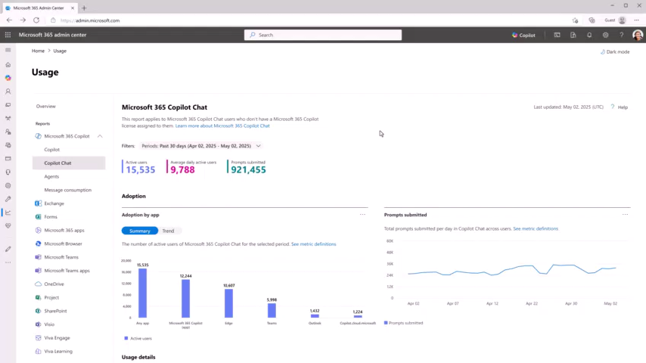
CCS – Copilot Chat usage report
Product images subject to change

Slide 27
Agents in Microsoft 365 Copilot Chat

Slide 28
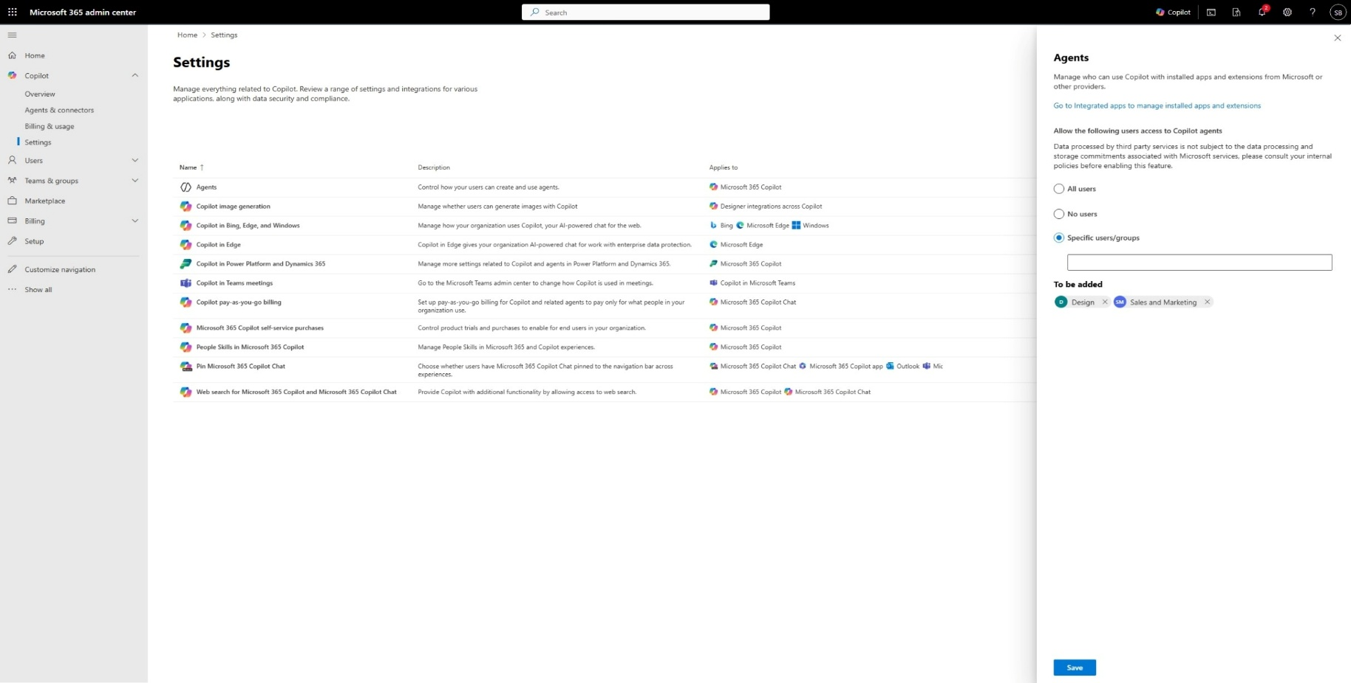
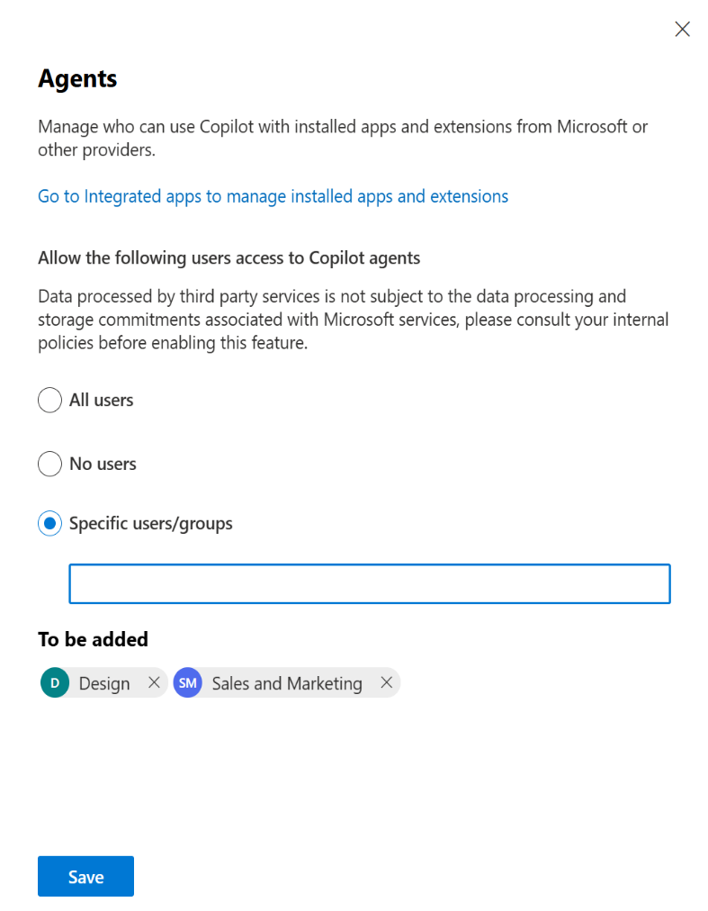
Manage who can create and use agents
CCS – Agent enablement
AI admins can manage who can create and use agents in Microsoft 365 Copilot Chat.
Options to enable agents for all users, no users, or specific users and groups.
Enables staged rollout of agents by security groups.
Generally Available
Product images subject to change

Slide 29
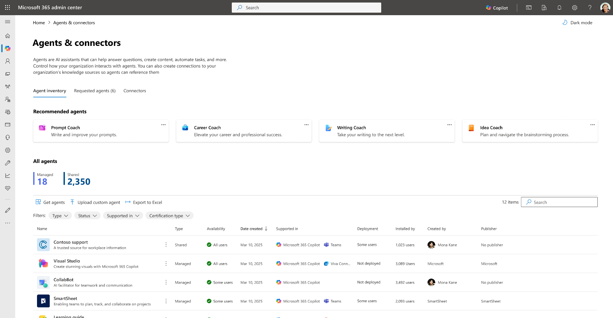
Central management of agents in Microsoft 365
CCS – Agent management
Agent inventory - rich agent metadata, capabilities, data sources, custom actions, certification details and more.
Deploy and block agents, review and approve requested agents.
Agent-level user access controls.
GA: Q2 CY2025
Product images subject to change

Slide 30
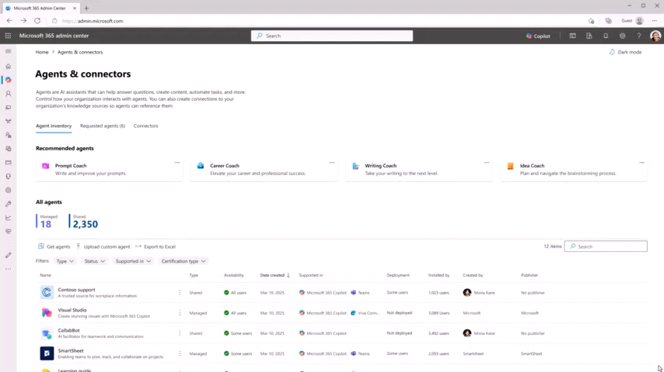
Deploying a recommended agent to all users
CCS – Agent management
Product images subject to change

Slide 31
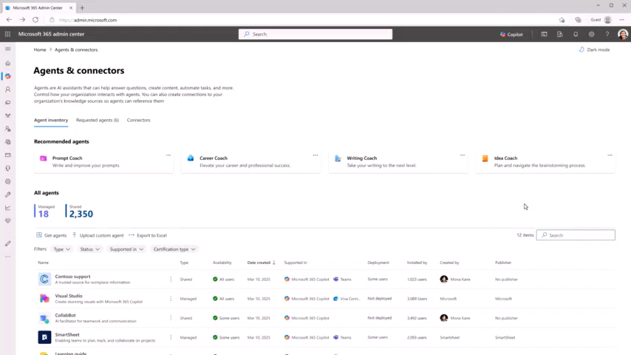
Deploying an agent to a group of users
CCS – Agent management
Product images subject to change

Slide 32
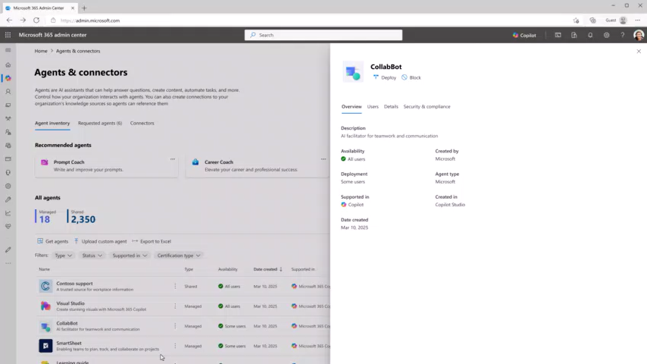
Remove user access to an agent
CCS – Agent management
Product images subject to change

Slide 33
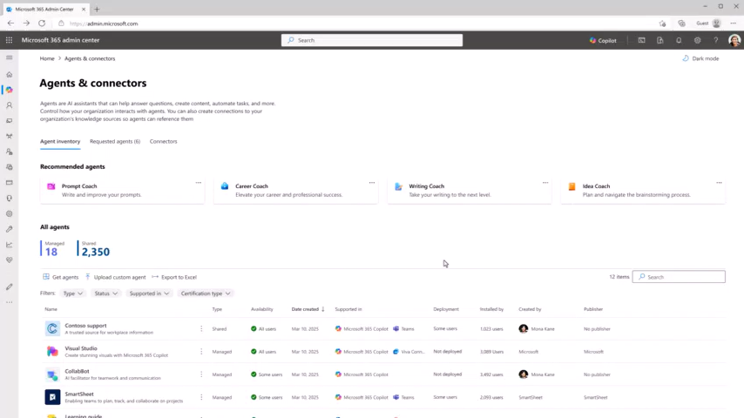
Block an agent
CCS - Agent management
Product images subject to change

Slide 34
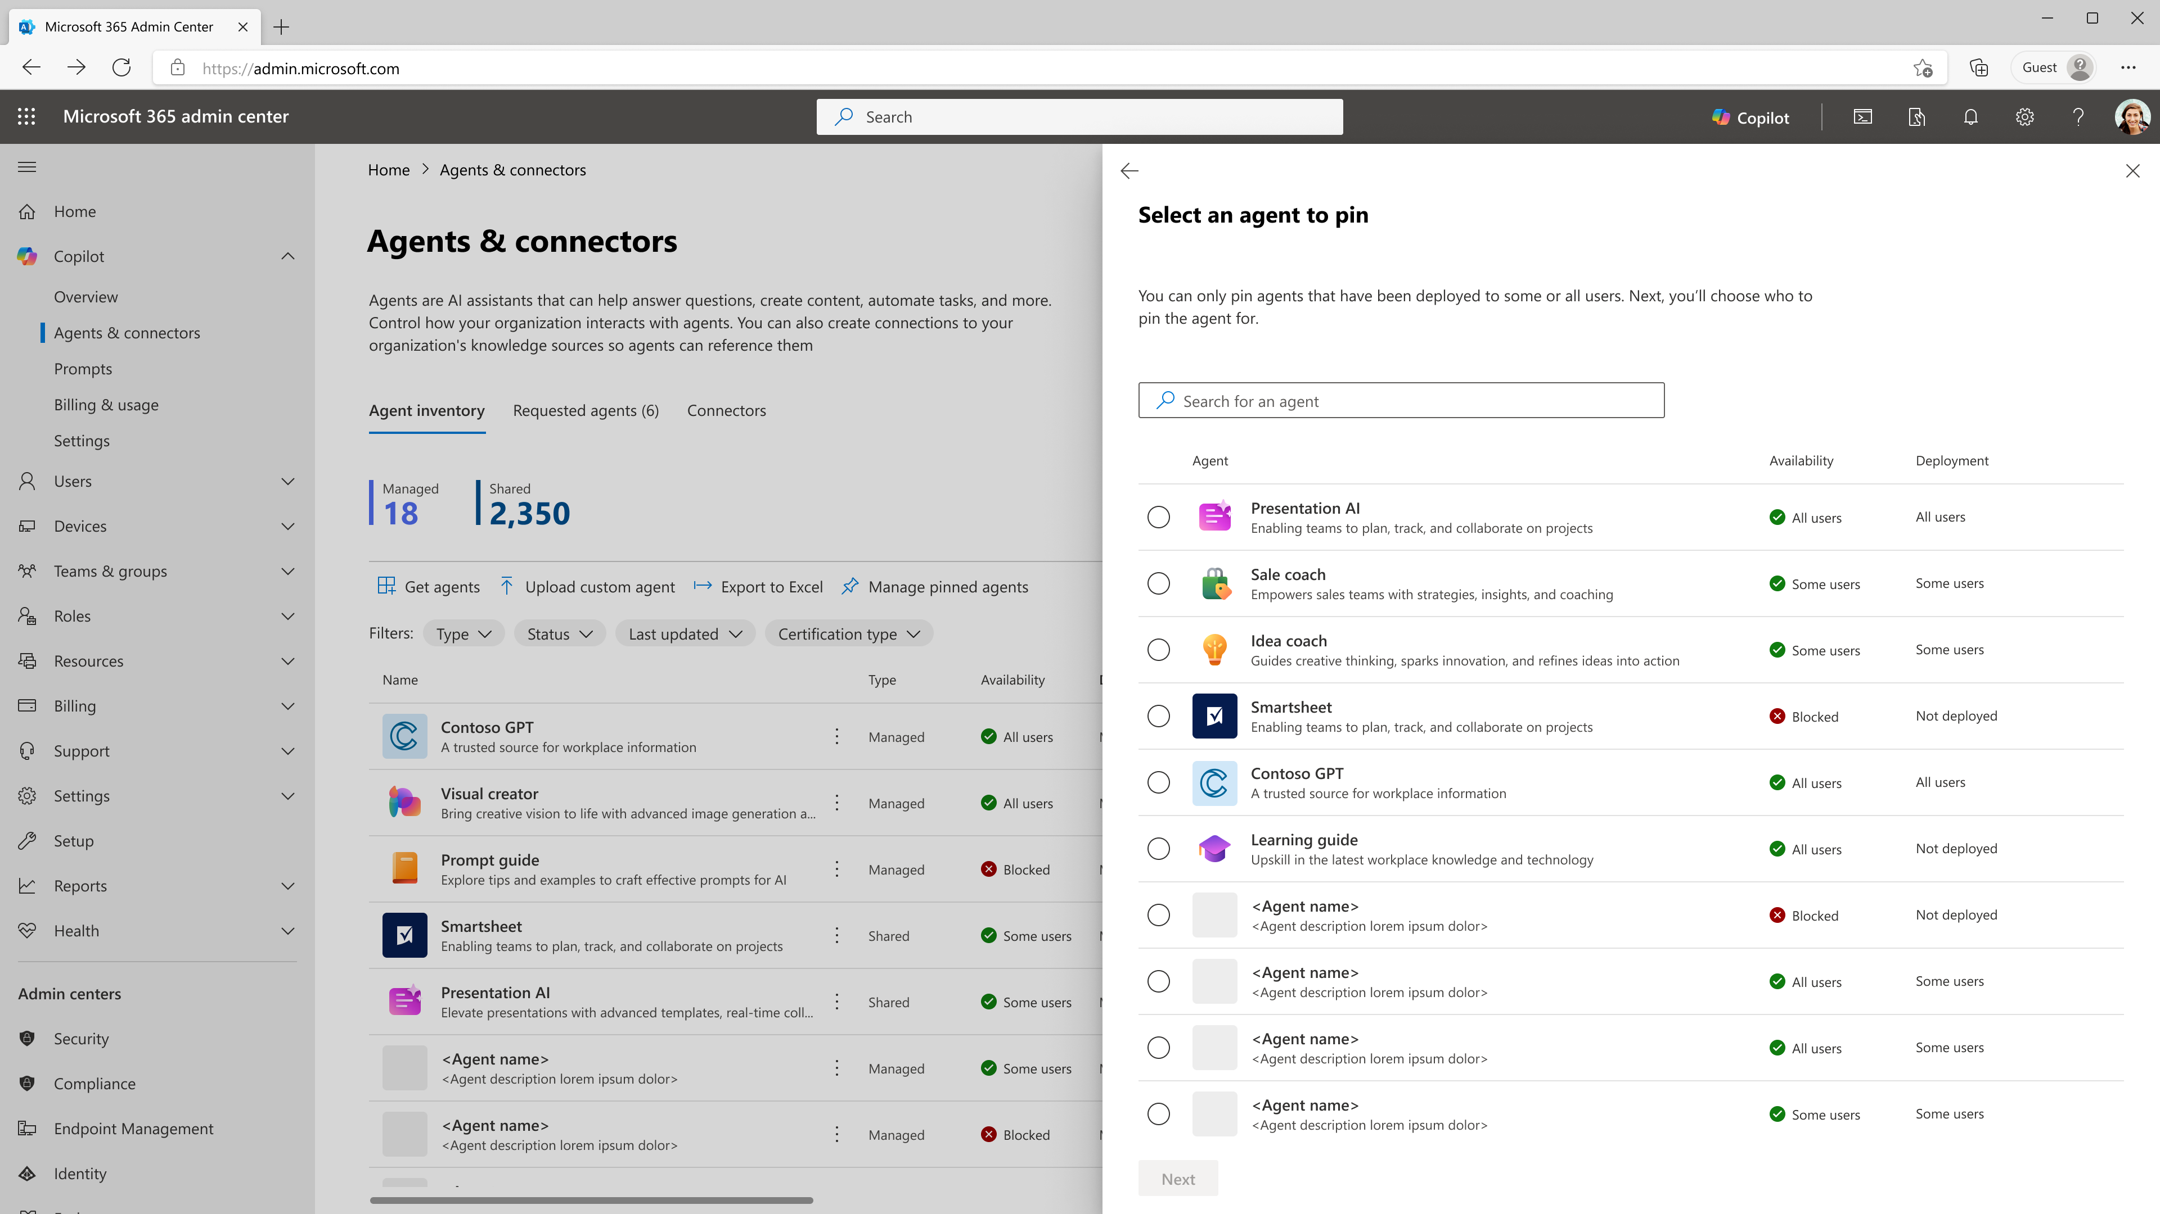
Agent pinning
CCS - Agent management
Curate high-value agents for all users in the organization.
Pin function-specific agents for users and groups.
GA: Q3CY2025
Product images subject to change

Slide 35
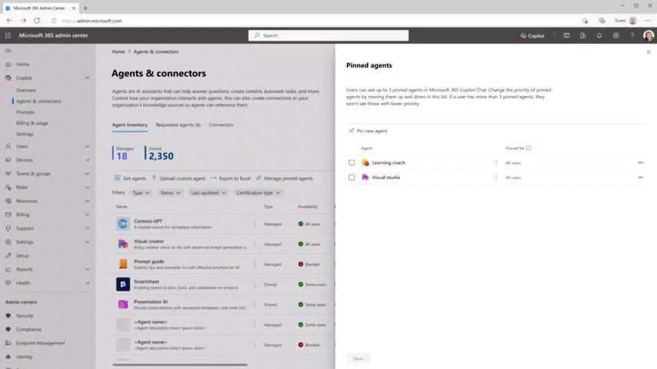
Pin an agent
CCS - Agent management
Product images subject to change

Slide 36
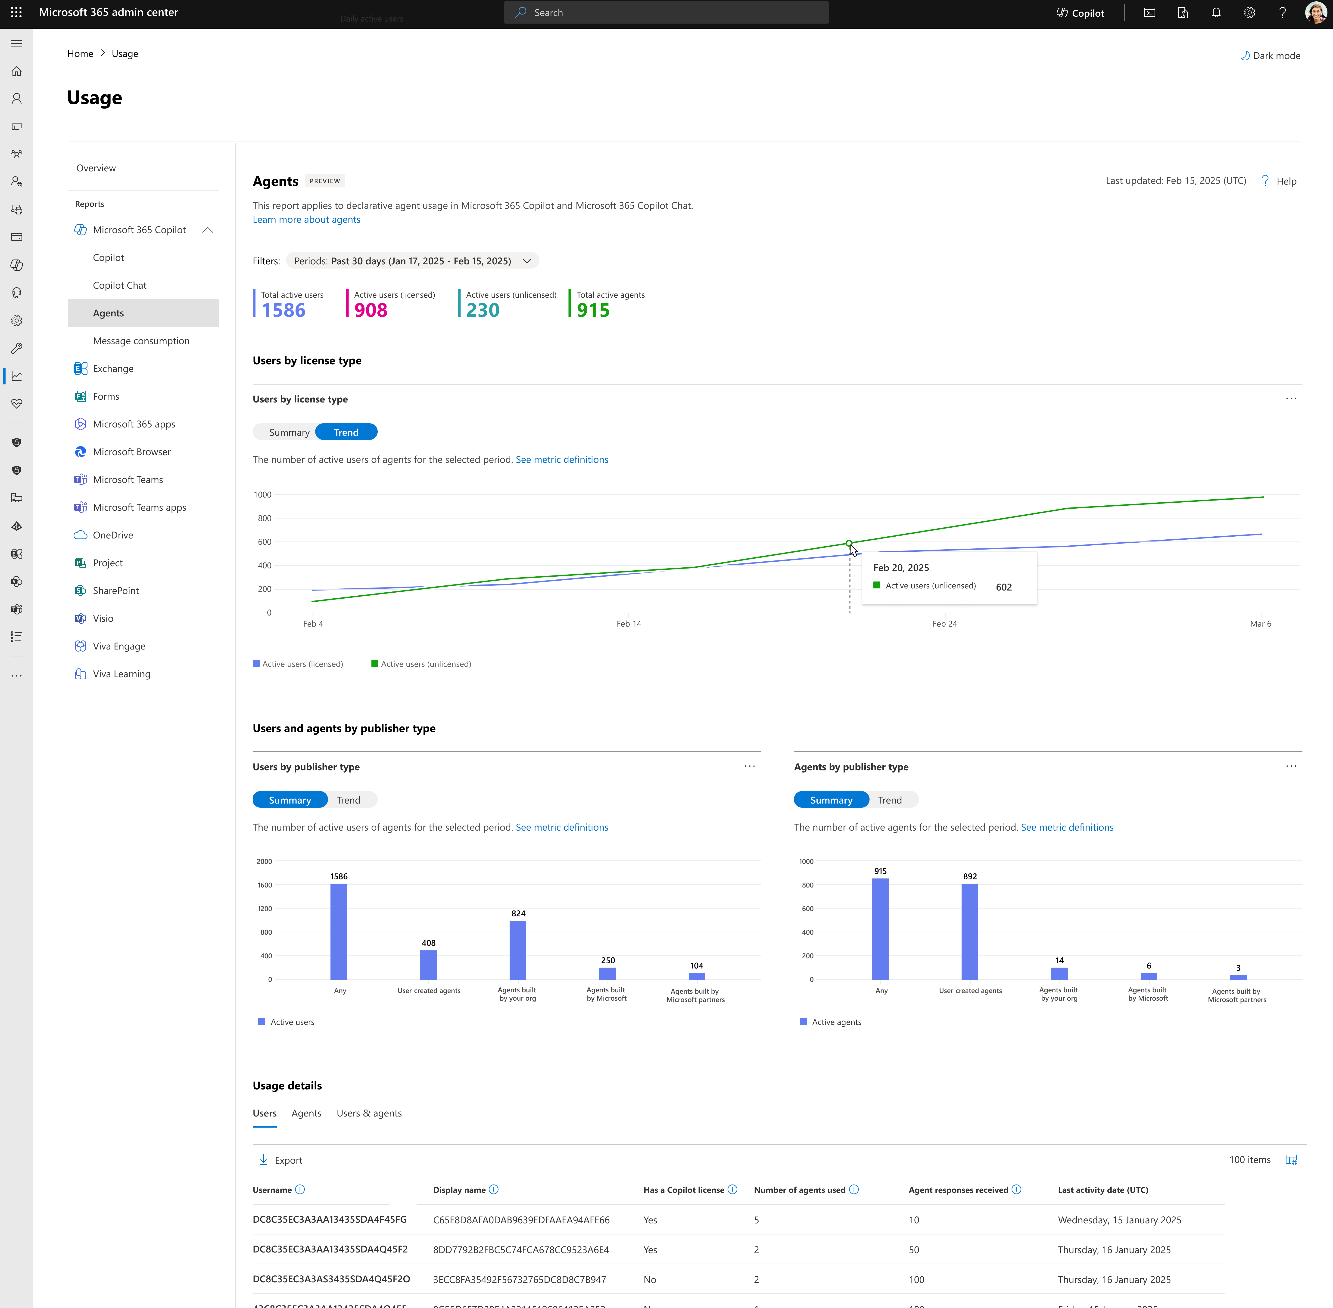
Assess agent usage
CCS – Usage reporting
Inform agent management and adoption strategy decisions with insight into agent usage.
Total active users with segmentation by Microsoft 365 Copilot licensed and unlicensed users.
Total active agents.
Active users and active agents by publisher type, e.g., user-created, built by your organization, built by Microsoft, built by Microsoft partners.
Line-level details per user, agent, and user-agent pair.
Public preview: Q3CY2025
Product images subject to change

Slide 37
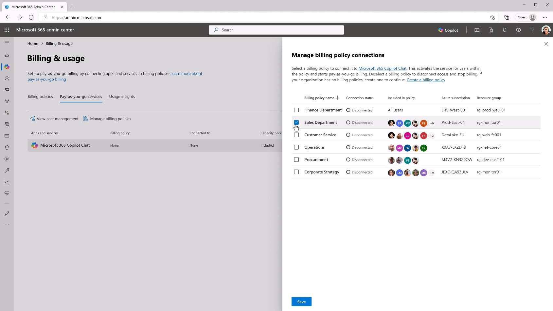
Granular billing aligned to usage by group
CCS – Billing policies
Set billing policies scoped to defined users and groups and associated Azure subscription.
Enables departmental billing and cross charges.
Supports agent management decisions with group-level usage and cost insight.
GA: Q2CY2025
Product images subject to change

Slide 38
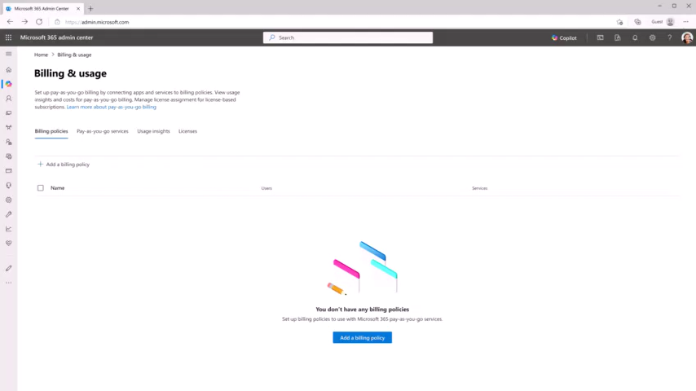
Create a billing policy and view usage and cost
CCS – Billing policies
Product images subject to change

Slide 39
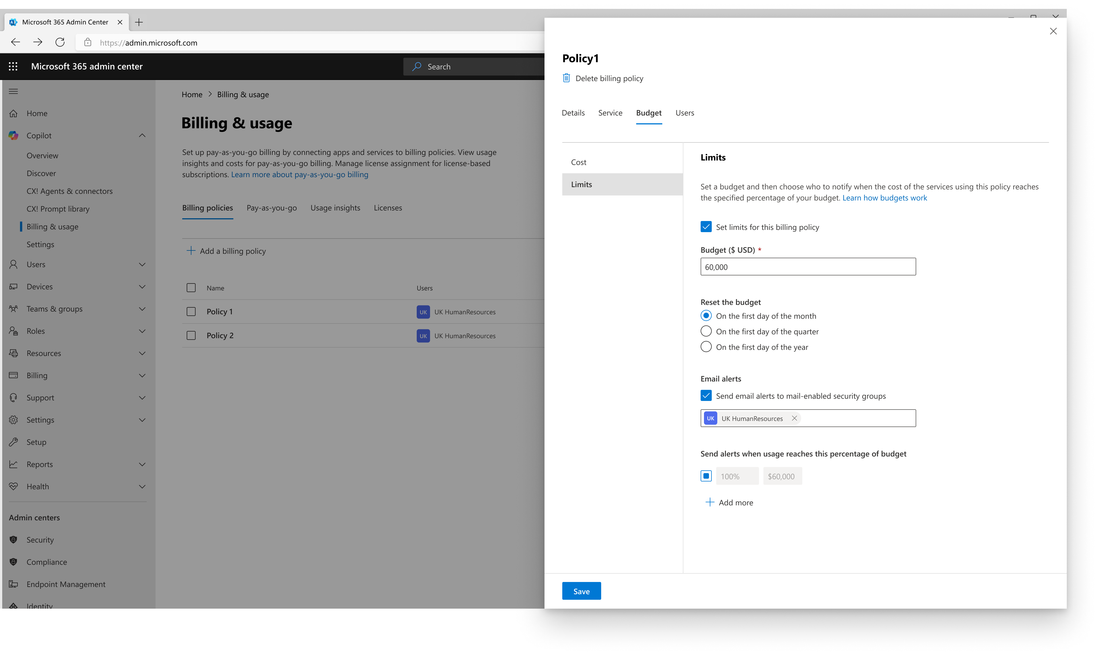
Budget and spending limits
CCS – Billing policies
Define budget and spending limits at the billing policy level.
Options to reset the budget on a monthly, quarterly or annual basis.
Email alerts at defined thresholds, e.g., 70%, 90% of budget.
GA: July 2025
Product images subject to change

Slide 40
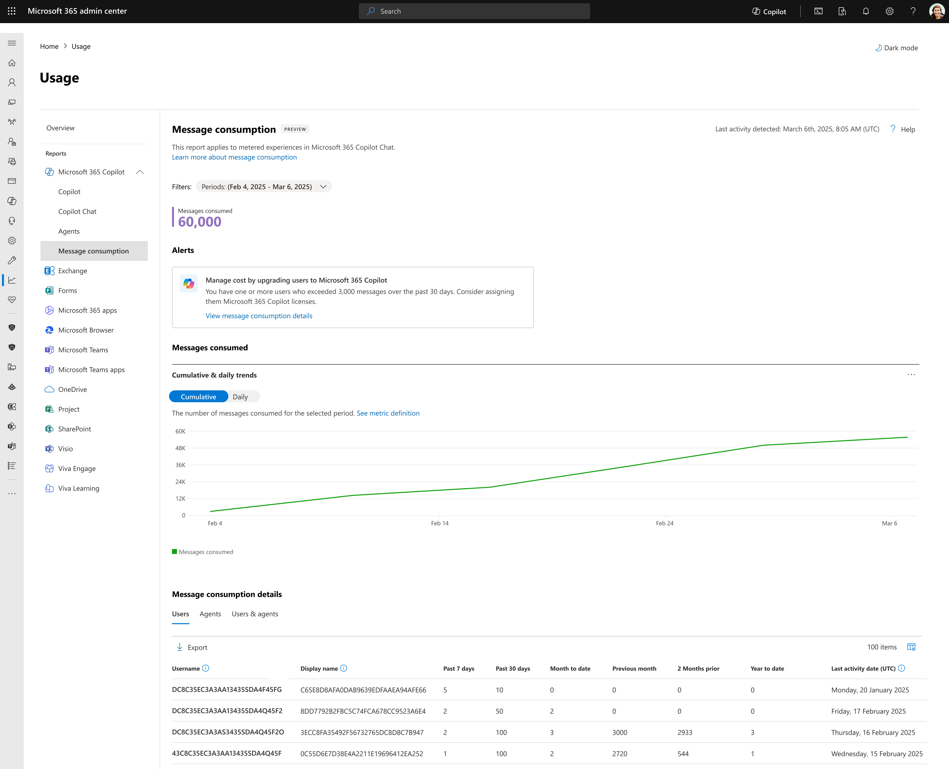
Track message consumption
CCS – Usage reporting
Near real-time visibility into metered message consumption.
Total messages consumed for the selected period with cumulative and daily trends.
Line-level consumption details per user, agent, billing policy*, and user-agent pair.
High-consumption alerts to prevent over-spending.
Public preview: Q2CY2025
*Consumption per billing policy planned for Q3CY2025

Slide 41
Copilot Search

Slide 42
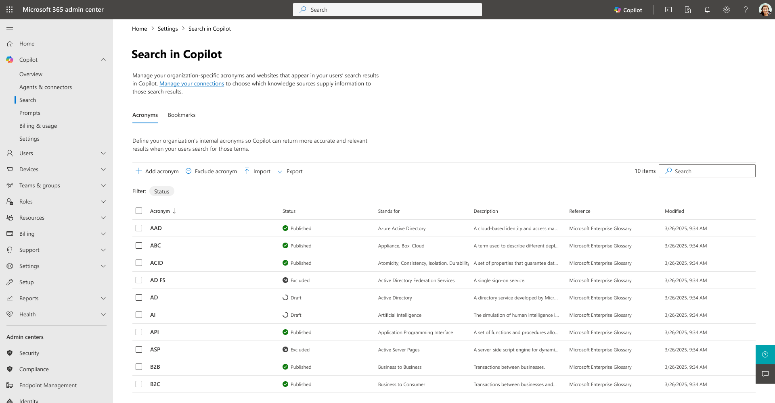
Tailor the Copilot Search experience
CCS – Copilot Search
Configure and customize Copilot Search using curated bookmarks, acronyms, and search settings to align with your organization.
GA July 2025
Notes:
Copilot Search in Microsoft 365 Copilot delivers a unified, AI-powered search experience that helps users find, understand, and act on information across Microsoft 365 and connected third-party systems. By leveraging Microsoft Graph, organizational context, and natural language understanding, it transforms traditional search into a personalized, task-oriented assistant—bridging the gap between discovery and execution. Rollout out this month is a new management experience in the Microsoft 365 admin center under Copilot > Search, providing AI admins with centralized tools to configure and customize the Copilot Search experience using curated bookmarks and acronyms, maximizing the value of Microsoft 365 Copilot Search for both users and the organization.

Slide 43
People Skills in Microsoft 365 Copilot + Skills agent
July 2025

Slide 44
Enabling the frontier firm
The next era is powered by AI and guided by people. The future belongs to companies that seamlessly integrate the scalability of AI with the ingenuity of people.
AI skills
AI skills are the distinct competencies of a generative AI model, encompassing its ability to process, analyze, generate, or interact with information in ways that provide value to users.
People skills
People skills are the unique combination of an individual’s technical expertise, interpersonal abilities, and behavioral competencies that drive their productivity, collaboration, and personal growth within an organization.

Slide 45
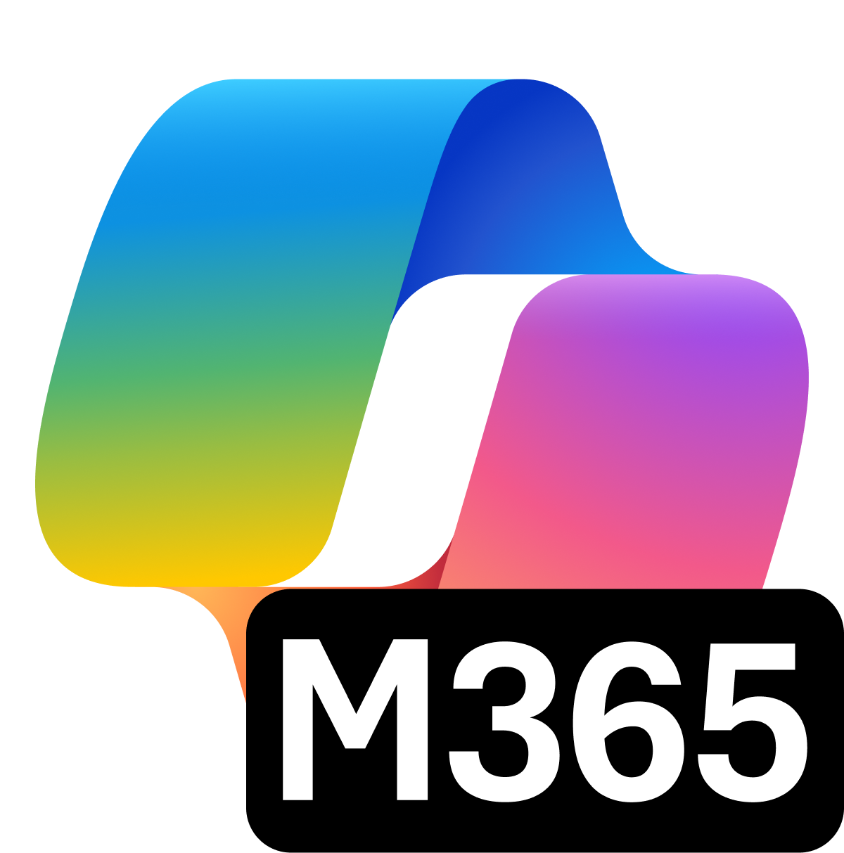
Microsoft 365 Copilot
Business context
Deep understanding of your business powered by the Microsoft 365 Graph
NEW
Your AI assistant for work
People context
Deep understanding of your people powered by People Skills
Notes:
Microsoft 365 Copilot as the platform that already deeply understands your enterprise data, now deeply understands your people.
Microsoft 365 Copilot, on the other hand, is your complete AI assistant for work.
It provides far more capabilities and far more value. In addition to all the capabilities of Copilot Chat, it includes
Chat grounded in your tenant work data.
Included ability to access and use agents without having to pay based on consumption.
And, it has all of the personal assistant capabilities of Copilot, like Copilot in Outlook, Copilot in Teams, and Copilot in all the Microsoft 365 apps.
In addition, the $30 per user product comes with Advanced Management capabilities like SharePoint Advanced Management and Copilot Analytics, including the Copilot Dashboard and Viva Insights.

Slide 46




Introducing: People Skills
AI that understands your business and your people
AI with people context
A Copilot that understands your people and your business
Advanced skill inferencing
Combine productivity signals with advanced AI reasoning to accurately infer user skills
In the flow of work
Bring skills to the tools and platforms where users already spend their time

Slide 47



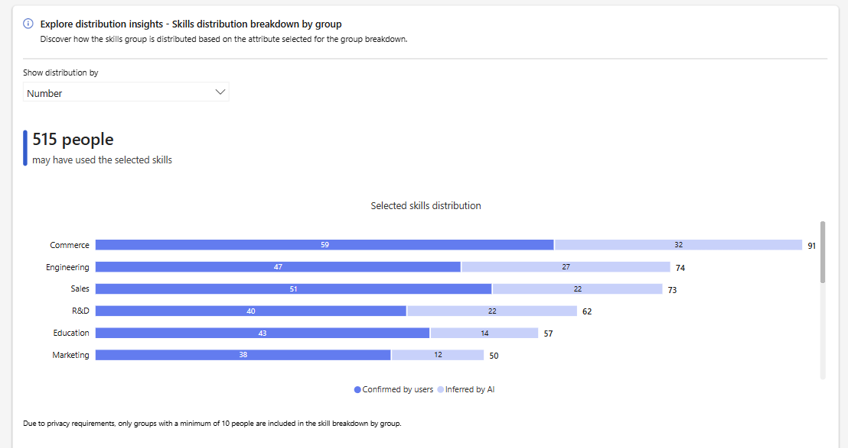
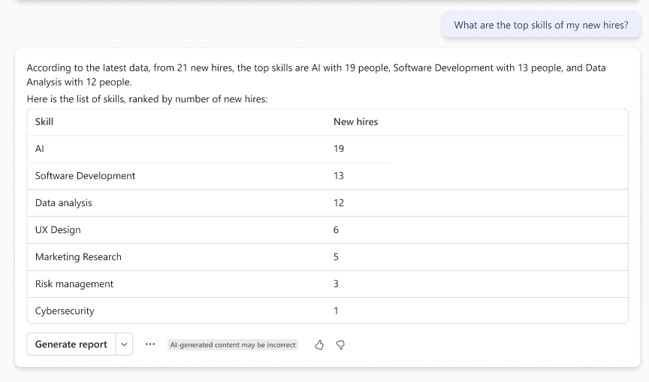
People Skills inference model
Out of box skills taxonomy
Custom skills library (tenant)
Downstream applications
Job title
Substrate AI
Skill
semantic description
Microsoft 365 people surfaces
Microsoft 365 Profile Card
People Companion
Org. Explorer
SharePoint Search
Rank skills based on clustering
User activity from Graph
(documents & meetings)
Microsoft 365 Copilot
Skill extraction (Multi-agent LLM model)
Re-rank for skill
diversity
AI-inferred
user skills
Skills agent
Viva Learning
Skill candidates for user
Re-rank for skill
specificity
User skills from
3P systems
Copilot Analytics
Analyst workbench
Aggregated org skills data
Leader Insights in Microsoft 365 Copilot Chat

Slide 48
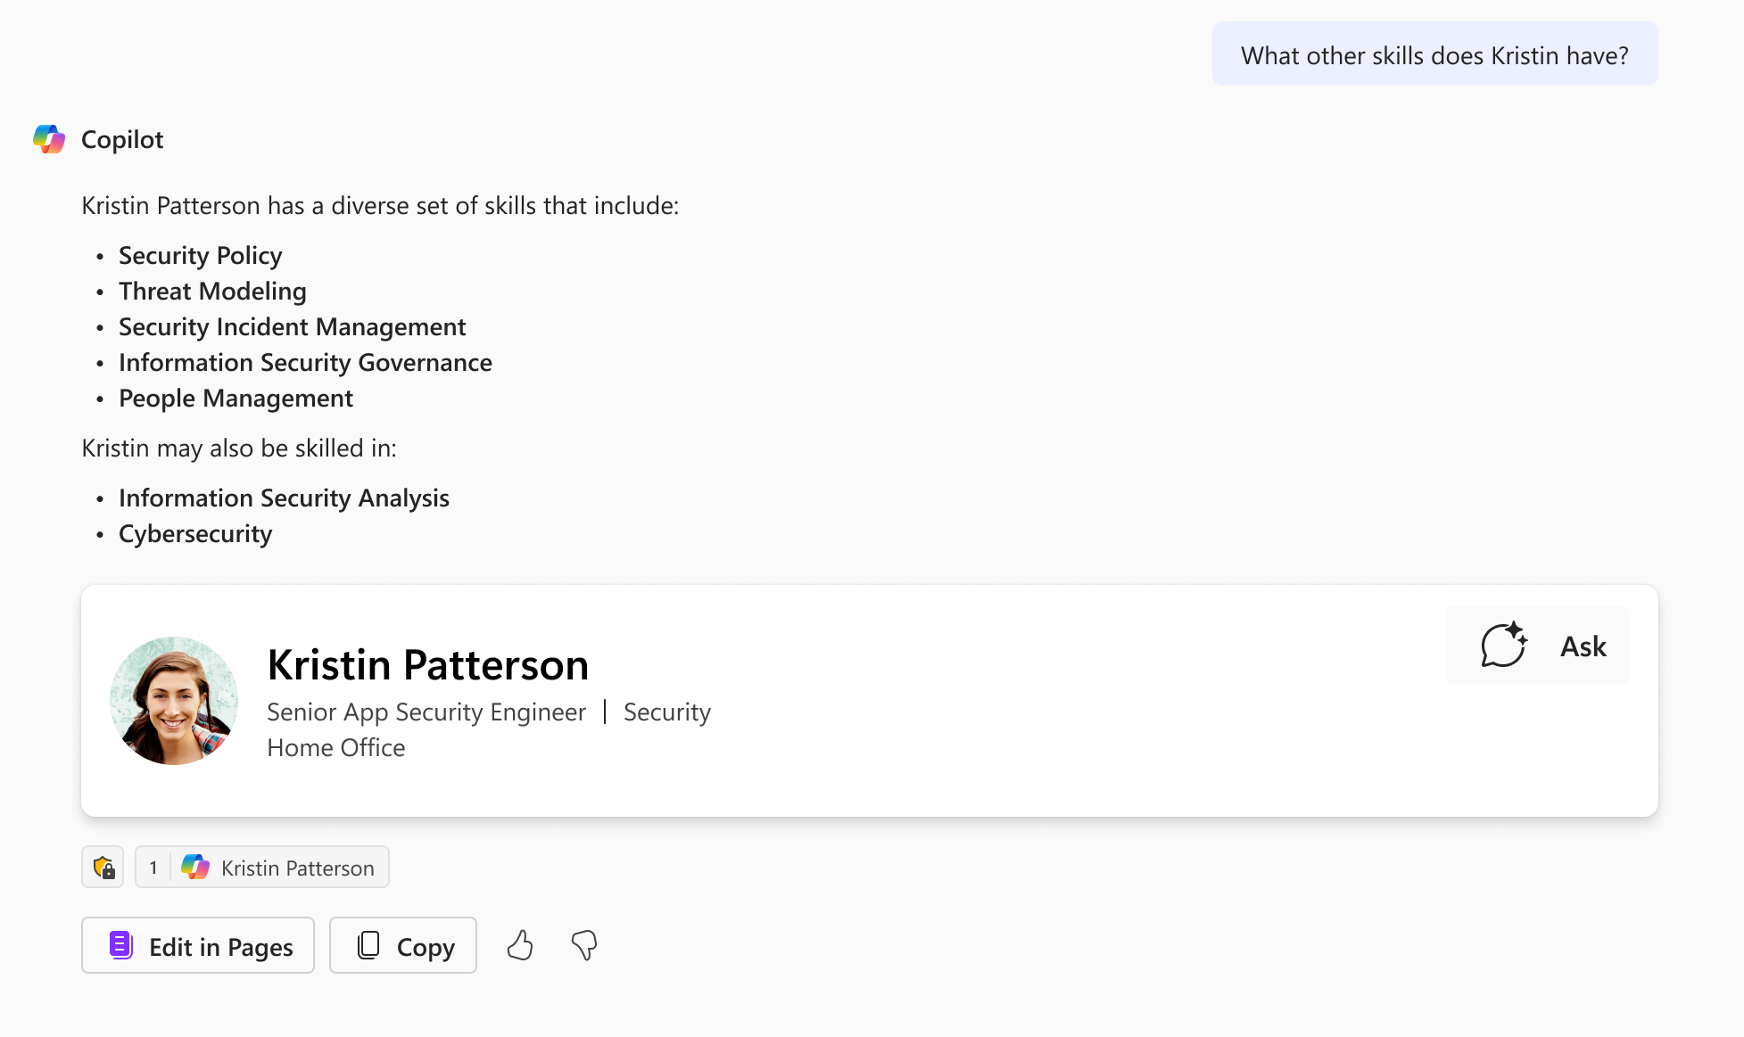
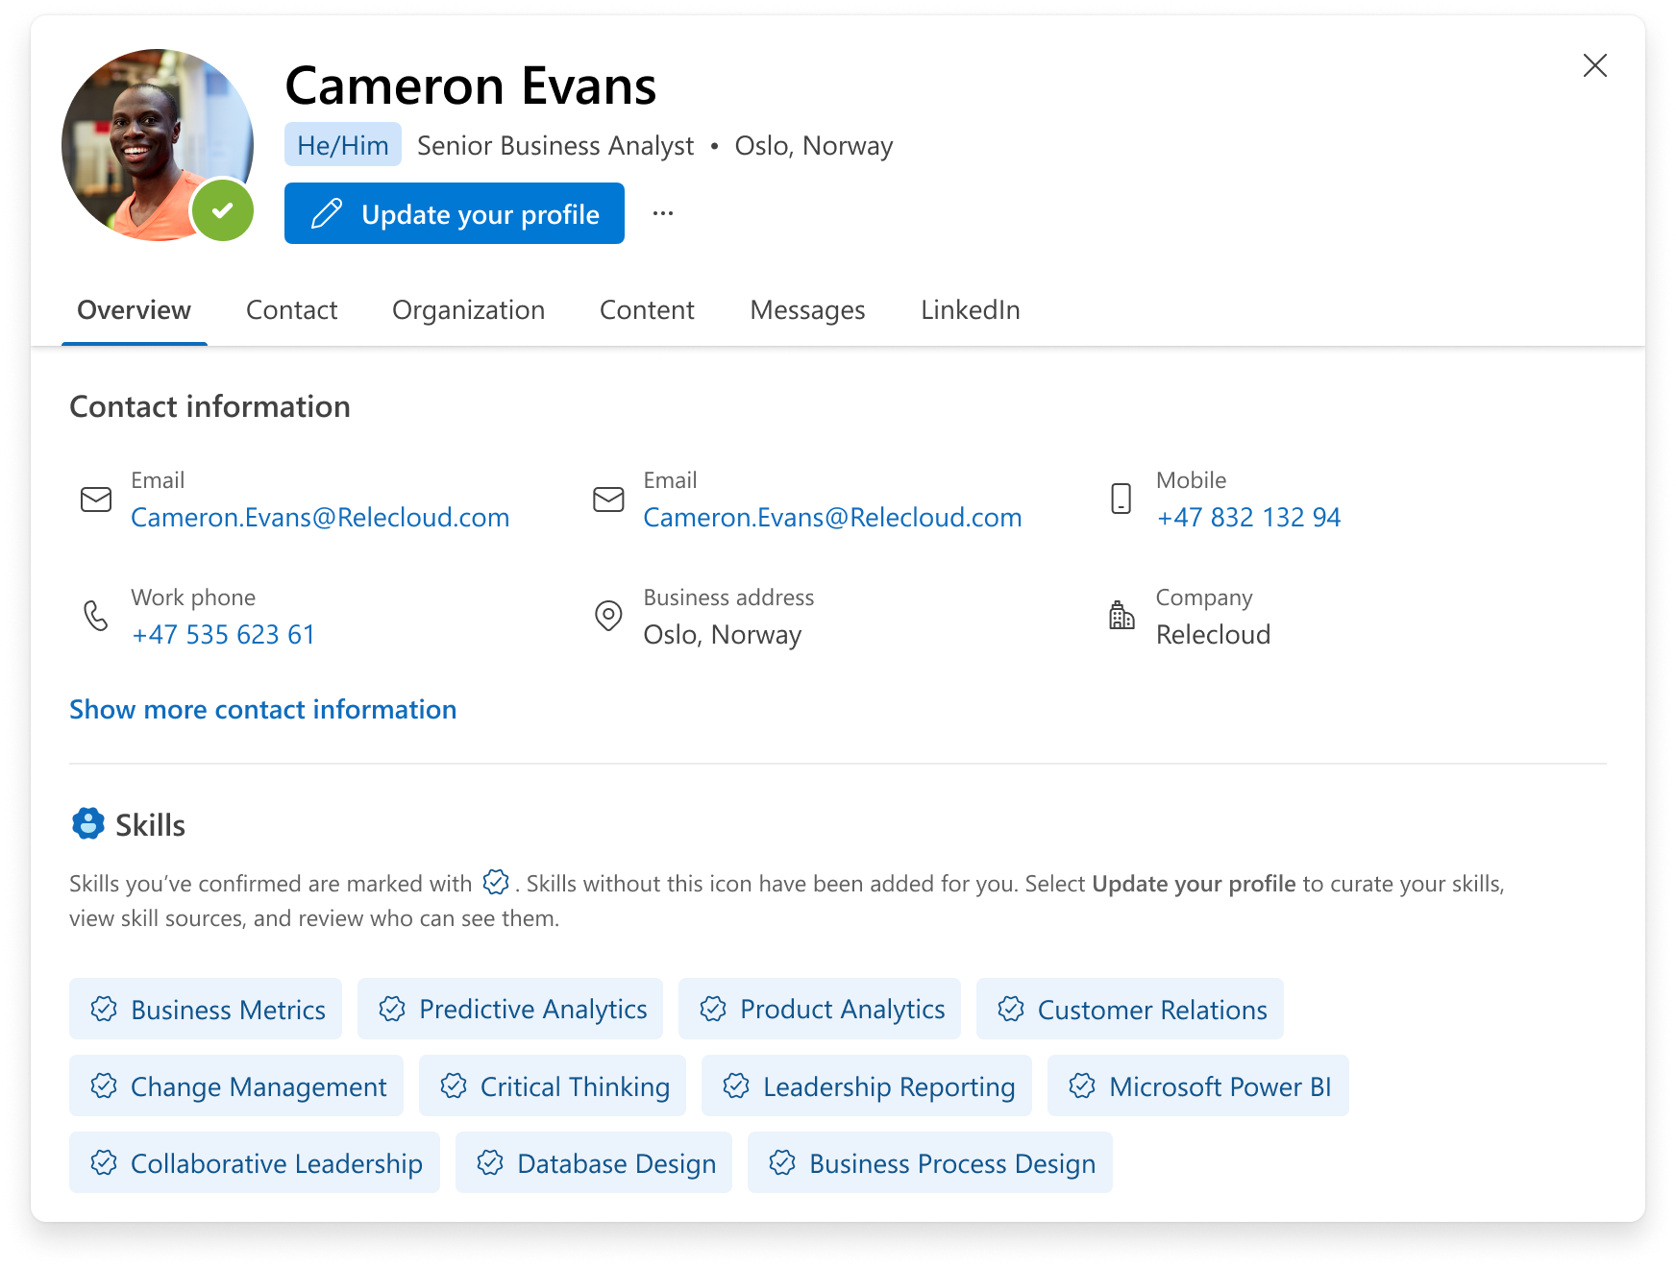
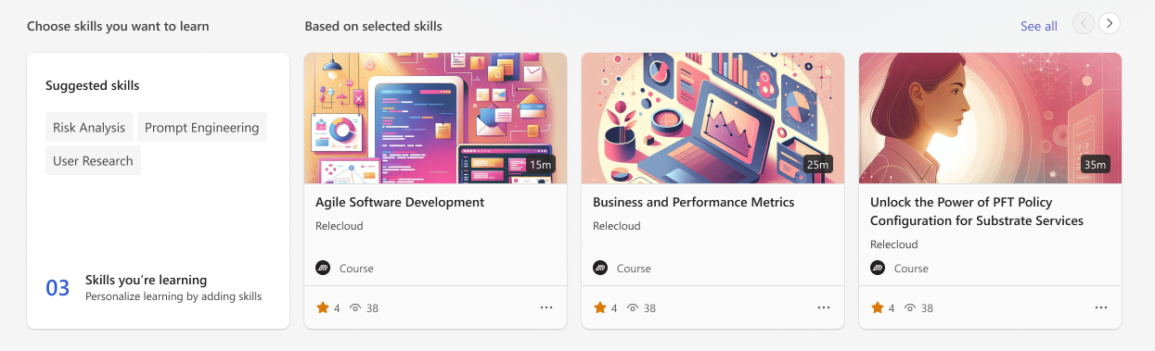
People Skills for employees
People Skills for Employees
Empower employees to discover, connect, and learn about others:
Find the right expert to get help from
Get to know someone with a more complete view
Prepare for meetings and tailor communication
Skills based learning journeys

Slide 49
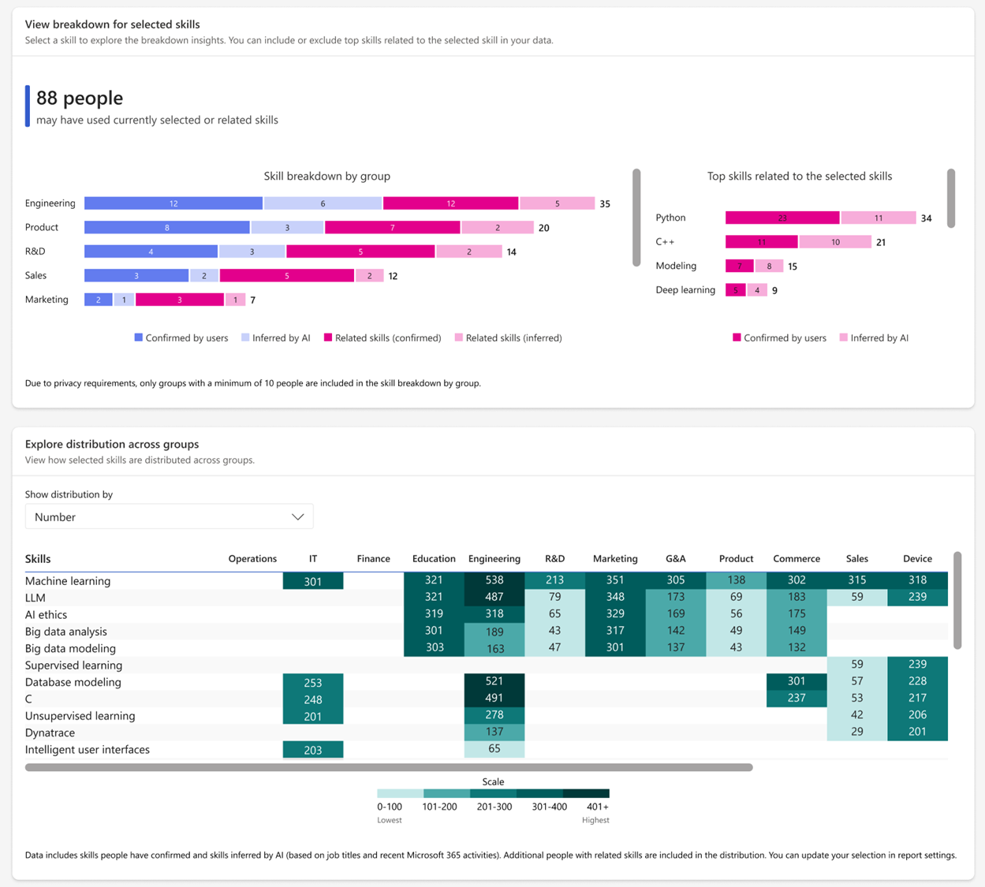
People Skills for organizations
People Skills for organizations
Provides organizations with scalable, up-to-date talent landscape reports to enable:
Skills gaps or surpluses analysis
Strategic upskilling planning
Strategic workforce planning (hiring, reorganizations)
Tracking skills over time

Slide 50
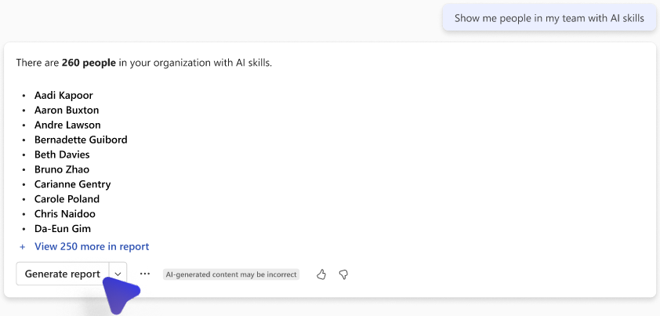
People Skills for leaders
People Skills for leaders
Provides leaders with a friction-free solution to understand skills distribution within their team to:
Strategically load balance teams
Facilitate project assignments
Identifying experts
Identify upskilling opportunities/career planning

Slide 51
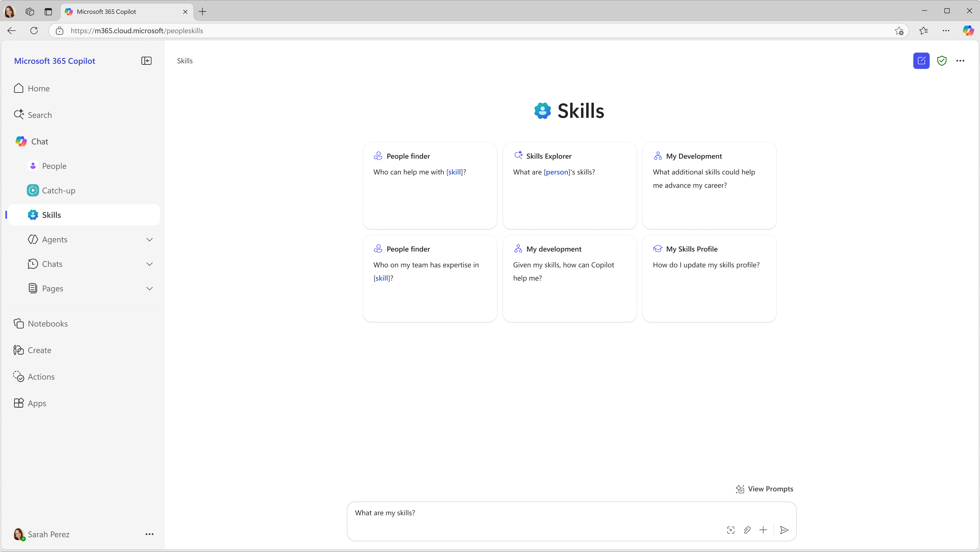
Skills agent
AGENTS
The Skills agent improves upon Microsoft 365 Copilot performance with more accurate, complete, and reliable responses on skills- based queries.
For Employees – find colleagues with specific skills for collaboration and knowledge sharing; identify their skill gaps and growth areas to develop their expertise
For Leaders – quickly identify experts in your team to make informed decisions about project assignments, balancing workloads, targeted talent management or career initiatives
AVAILABILITY: GA in Aug 2025

Slide 52
Privacy controls offered
PEOPLE SKILLS
Admins can configure default privacy settings for skills using Feature Access Management by creating access policies that apply across the tenant or target specific users, groups, or regions. For detailed steps on setting up an access policy, refer to the People Skills settings documentation.
Skills AI inferencing controls
Skills visibility controls
Will users receive AI-based skill suggestions?
Will user’s skills be shared with others in Microsoft 365?
Admins will have the option to:
Visibility controls are offered at 3 levels
Admins will have the option to:
Enable
Disable AI inferencing
Turn off inferencing
Users can opt-out
Users can opt-in
No user controls
Enable
Disable sharing
Turn off sharing*
Users can opt-out sharing
Users can opt-in to sharing
No user controls*
Skills profile (Parent)
Includes all skills in user profile, including confirmed, AI-inferred and imported skills
(Default behavior)
(Default behavior)
AI inferred skills only (Child)
Includes all skills in user profile, including confirmed, AI-inferred and imported skills
Imported skills only (Child)
Sharing is disabled if Skills profile (parent) is opted-out/disabled
*Turning off sharing completely (no user controls) is only available for the 2 child controls (AI-inferred and Imported skills) and not available for Skills profile

Slide 53


People Skills timeline
People Skills timeline
People Skills now generally available!
Skills agent generally available in Aug 2025

Slide 54
People Skills functionality access by license
User License | People Skills access
Microsoft 365 Copilot licensed users | Get access to all of the Skills functionality and the Skills agent, including AI inferencing and all related experiences.
Viva licensed users | Get access to AI inferencing and suggestions*
Commercial Microsoft 365 licensed users (e.g., Microsoft 365 E3 or E5, except EDU) | Can manually manage their skills in their profile, but will not have access to AI inferencing
*Available for users licensed for the Viva Suite, Viva Insights, or Viva Learning

Slide 55
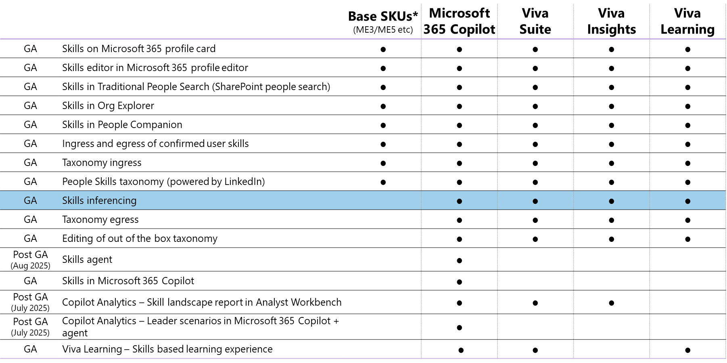
People Skills licensing table
*People Skills will be available in Microsoft 365 commercial public cloud, excluding EDU

Slide 56
Next steps
Learn more about how you can get started with People Skills today: https://aka.ms/PeopleSkillsAdoption
If you have further questions, please reach out to your account team
Stay tuned for upcoming announcements on availability of the Skills agent

Slide 57
Upcoming community events
M365 Community Days NYC | Jul 25 | New York, NY
TechCon 365 Atlanta 2025 | Aug 11-15 | Atlanta, GA
European Microsoft Fabric Community Conference 2025 | Sep 15-18 | Vienna, Austria
Microsoft Ignite 2025 | Nov 17-21 | San Francisco, CA
European SharePoint Conference | Dec 1-4 | Dublin, Ireland
Explore other Microsoft events here and a full list of community-led events can be found at CommunityDays.org

Slide 58

Open discussion
If viewing on-demand, drop your questions in the Microsoft Tech Community – Driving Adoption event page to engage with us!
Share your feedback for this call by visiting https://aka.ms/Microsoft365ChampionCallFeedback

Slide 59



What’s next
Share your feedback
https://aka.ms/Microsoft365ChampionCallFeedback
Next call:
No call next month, community break. Have a great summer! ☺
Join the Driving Adoption community
https://aka.ms/DrivingAdoption
Invite colleagues to become a Champion
https://aka.ms/M365Champions

