Slide 1
Microsoft 365 Champions
community call
January 2025

Slide 2
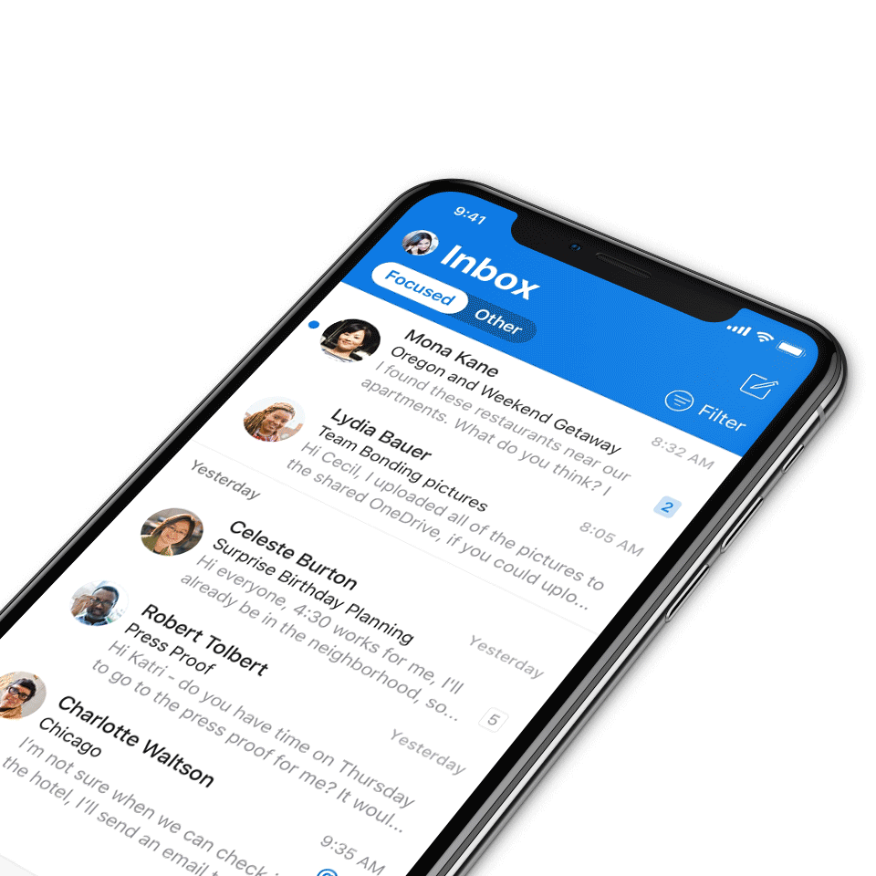
Digital Event Code of Conduct
Microsoft’s mission is to empower every person and every organization on the planet to achieve more. This includes all Microsoft events and gatherings, including on digital platforms, where we seek to create a respectful, friendly, fun and inclusive experience for all participants.​
We expect all digital event participants to uphold the principles of this Code of Conduct, which covers the main digital event and all related activities. We do not tolerate disruptive or disrespectful behavior, messages, images, or interactions by any party participant, in any form, at any aspect of the program including business and social activities, regardless of location.​
Microsoft will not tolerate harassment or discrimination based on age, ancestry, color, gender identity or expression, national origin, physical or mental disability, religion, sexual orientation, or any other characteristic protected by applicable local laws, regulations, and ordinances.​
We encourage everyone to assist in creating a welcoming and safe environment.
For more info, visit aka.ms/CodeofConduct.

Slide 3
Agenda
Announcements
Top Microsoft 365 updates
Main topic: Microsoft Teams: New chat and channels experience
Open discussion forum
Become a Champion today!
https://aka.ms/BecomeaChampion

Slide 4
New call format starting February 2025
We’re listening to your feedback! The Champion community calls will return to Microsoft Teams and will still be available on-demand on the Microsoft Tech Community.
How to watch:
Beginning in February 2025, this Microsoft 365 Champion community calls will move to Teams webinars and be available on-demand on the Microsoft Tech Community (MTC) and the Microsoft Community Learning YouTube channel within 48 hours after the call. The join links remain the same and clicking through will take you to the MTC event page. Our community call times also remain the same: 4th Tuesday of every month at 8:05 AM and 5:05 PM Pacific Time.
https://aka.ms/M365ChampionCallAM
https://aka.ms/M365ChampionCallPM
REMINDER:
All presentations remain available to Microsoft 365 Champion Program members, link in the monthly newsletters. Not a member? Join in the link below for access to calendar invites, presentations, and all previous calls.
Microsoft 365 Champions
https://aka.ms/M365Champions

Slide 5
Announcements
SharePoint event, January 29
SharePoint: From concept to creation to impact + Live AMA
Uplevel your SharePoint IQ! Join us Wednesday, January 29, from 9:00-10:00 AM PST, as the SharePoint team shines a light on the latest capabilities and share glimpses of what some of our customers are doing with it. Get clarity on what's available, tips and tricks, and the boundaries you can now push with the latest.
Register today: https://aka.ms/SharePointEvent

Slide 6
Announcements
Microsoft 365 Community Conference
Your front-row seat to the future of work
Join us for the Microsoft 365 Community Conference in Las Vegas, Nevada, May 6-8!
At the Microsoft 365 Community Conference, you’ll join hundreds of engineers, experts, executives, and MVPs—and thousands of professionals and tech superfans—from around the world. From learning about the latest advancements in AI-driven tools, to talking to the people who build Microsoft products, to developing the practical skills that will serve you and your organization, you’ll dive deep into big innovations and come home with tangible solutions.
The 2025 Microsoft 365 Community Conference is your front-row seat to the future of work.
Claim your spot now: aka.ms/M365Conf/registration

Slide 7
Announcements
Microsoft Community
New MGCI community calls
Are you a seasoned event organizer looking to promote your event? Or you want to discover ways to get involved in community locally? If so, join the MGCI to get exclusive access to best practices, training, opportunities to network with other event organizers, and more.
Find us at:
Visit aka.ms/MGCI to join MGCI today!
Subscribe to youtube.com/@MicrosoftCommunityLearning
Become a member at techcommunity.microsoft.com

Slide 8
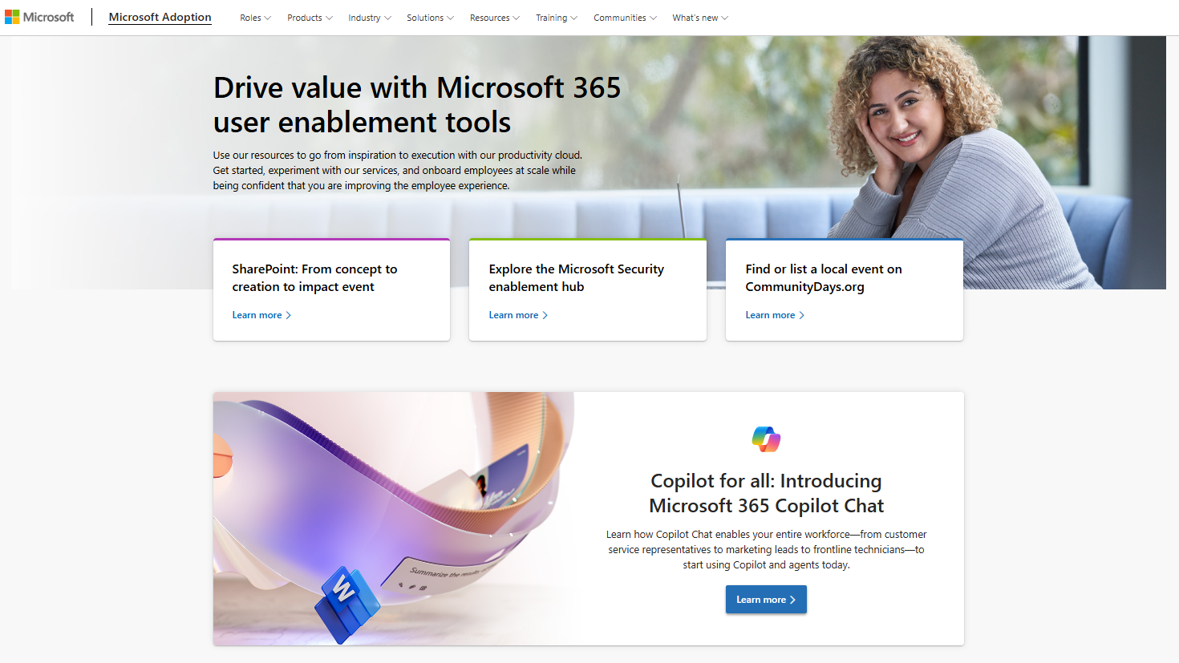
Adoption.microsoft.com
Update highlights
Multiple updates to the Customer Hub sessions
Multiple updates to the Copilot Success Kit: new change log, updates to guides, new Copilot Chat and agent starter kit, updates to the user engagement templates and tools
Multiple updates to the Copilot user engagement templates and tools: new Copilot prompt-a-thon, updates to existing templates, new templates and tools added
New releases:
Microsoft Clipchamp and agents in Microsoft 365 pages
Day in the Life guides for accessibility
Copilot chat and agent scenarios in the Copilot Scenario Library
Read or subscribe to our Release notes for more updates.
Notes:
Multiple updates to the Customer Hub sessions: new on-demand videos, new series, new search filters
Note: the Trainer Kit with user-facing handouts and get started guides have moved from the Copilot Success Kit to the user engagement templates and tools page

Slide 9
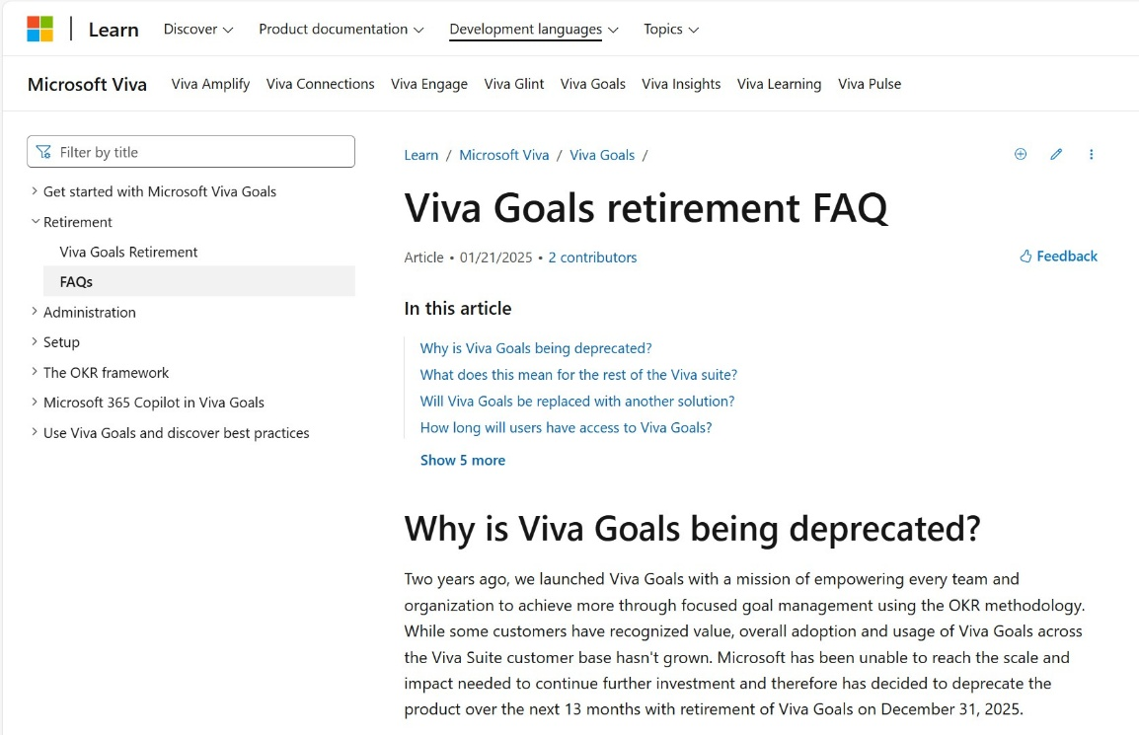
Top Microsoft 365 updates
Microsoft Viva Goals
Viva Goals Retirement
Viva Goals will be retired on December 31, 2025, with no new feature developments after December 5, 2024. Microsoft remains fully committed to the Viva suite, continuing to innovate and deliver tools to help our customers drive meaningful business impact.
Click aka.ms/VivaGoals/RetirementAnnouncement to learn more.
Click aka.ms/VivaGoals/RetirementFAQ for the FAQ article.

Slide 10
Top Microsoft 365 updates
Microsoft Teams
What’s next for accessibility in Teams
In the coming months, Teams will develop new features designed to enable effective collaboration for all. These include improvements to the Teams meetings experience:
The ability to customize the meeting stage to better fit your daily use.
Enhancing captions for those that prefer to read the meeting content in real time.
Allowing those who use sign language to be better recognized as the active speaker and improving the overall sign language experience.
Click aka.ms/Teams/WhatsNewAccessibility to learn more.

Slide 11
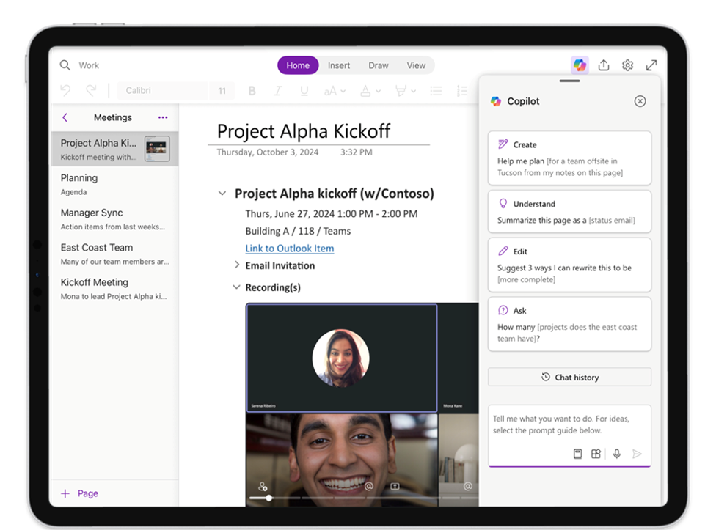
Top Microsoft 365 updates
Microsoft OneNote
Copilot for OneNote
Copilot for OneNote on Mac and iPad is an intelligent assistant that helps transform the way users interact with their notes. With simple natural language commands, users can use Copilot to help them understand, summarize, and rewrite notes for enhanced clarity and purpose. It is designed to work seamlessly on the Mac, offering a contextual chat experience that empowers users to accomplish tasks faster. Whether preparing for a meeting or organizing thoughts, Copilot for OneNote on Mac is the perfect partner for boosting productivity. Copilot for OneNote for Mac and iPad rolled out in December.
Click aka.ms/Copilot/WhatsNew to learn more.

Slide 12
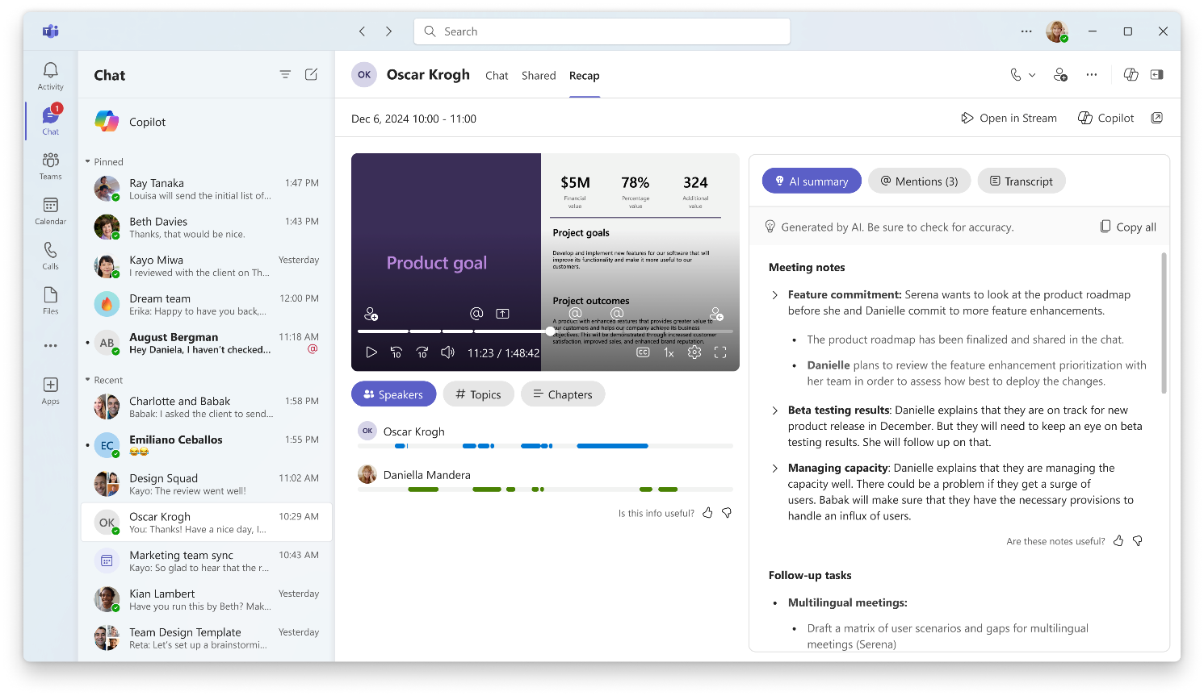
Top Microsoft 365 updates
Microsoft Teams
Intelligent recap in Teams for calls from chat and ‘Meet now’ meetings
Soon, you will be able to enjoy AI-generated summaries for more types of meetings, even when they are not scheduled in advance. Intelligent meeting recap will be available for impromptu calls and meetings, like those started from ‘Meet now’ and calls started from chat. You can easily browse the recording by speakers and topics, as well as access AI-generated notes, AI-generated tasks, and name mentions after the ad-hoc meeting ends. This feature has begun rolling out and will be available in January.
Click aka.ms/Copilot/WhatsNew to learn more.

Slide 13
The new chat and channels experience
Jan 2025 Champions Community Call
Microsoft Teams Collaboration Framework

Slide 14
Vision & goals
Speaker: Diana Hsu

Slide 15
Asynchronous collaboration key pain points
Stay on top of what matters
Collaborate efficiently in channels
Stay focused (too much noise)
Notes:
The pandemic has completely changed how we work. While people want the flexibility of remote work they also want the ease of in-person collaboration. This comes across in conversations we have had with customers. They tell us that their people are simultaneously feeling both overwhelmed and missing out.
There is just so much going on that even if people try hard to focus they tend to miss out on important things they need to know. Despite being always on, they are still playing catch-up.
For today, we will be exploring some concepts around how Teams can help users stay on top and catch up better, and collaborate more efficiently with their workgroups.

Slide 16
Principles
Simple by default, powerful on demand
Adaptable, it’s my Teams
More collaboration in fewer places
Notes:
Before we dive into solutions, I want to call out a set of key principles we adhere to as we were thinking through how to solve for the key pain points.
First: We want to offer a simple product by default, that can be powerful when users ask for it based on their needs
Second: We want to let users customize their experience to suit the way they work. We serve a very large user base across industries, and a one size does not fit all for the diversity of users we support.
We want to be adaptable to the ways that entire organizations work. Enterprise collaboration solution needs to blend in with how enterprises are structured and how they work, including in collaborating within and across organizational boundaries.
Third: We want to help users and their workgroups coalesce collaboration into fewer places, by elevating channels to be easier to find and re-use, and fulfill the need for durable collaboration.

Slide 17
Who are we designing for?
Daniela
Light / New
10 active chats
2 active channels
15 activities a day
Colin
Medium
30 active chats
15 active channels
50 activities a day
Kat
Heavy
100 active chats
100’s active channels
100’s activities a day
Notes:
We put our users at the center. And Teams is used by 100s of millions of users with a variety of industry segments, for a variety needs and use cases. Based on data and telemetry, research and some intuition, we defined different cohorts of users, different jobs to be done and how the product can help achieve these user goals.
So the key takeaway for this slide is here is that we prioritize the users in the decisions we made and based on this.

Slide 18
Role of chats and channels
Chats and Channels are collaboration spaces
Chats are meant for transient, lightweight conversations with smaller groups of people.
Channels are meant for durable collaboration for groups around projects and topics.
Channels are discoverable and manageable, with lifecycle and membership governance
Chats are peer-to-peer collaboration spaces where everyone is equal.
Chats work off resources anchored to user; channels have shared resources.
Channels have centralized ownership, governance, lifecycle & management capabilities.
Channels are discoverable via teams.
Notes:
Let’s talk about chats and channels – the two fundamental units of collaboration in Microsoft Teams.
Both are collaboration spaces.
Chats are meant for quick, directed messages between individuals or smaller groups. For 1:1 discussions or similar, if they continue, they change topics over time. But this can also siloed information between whoever was included, or fragmented information when conversations are covered across many group chats.
Channels are durable, managed collaboration workspaces for your hybrid workplace. Shared resources, common topics or projects, even when membership changes.

Slide 19
Achieve two user outcomes
"It's easy for me to catch up and stay on top of what's important"
"I can collaborate more effectively with my workgroups"

Slide 20
Recap: Reduce noise and clutter
Generally available or rolling out

Slide 21
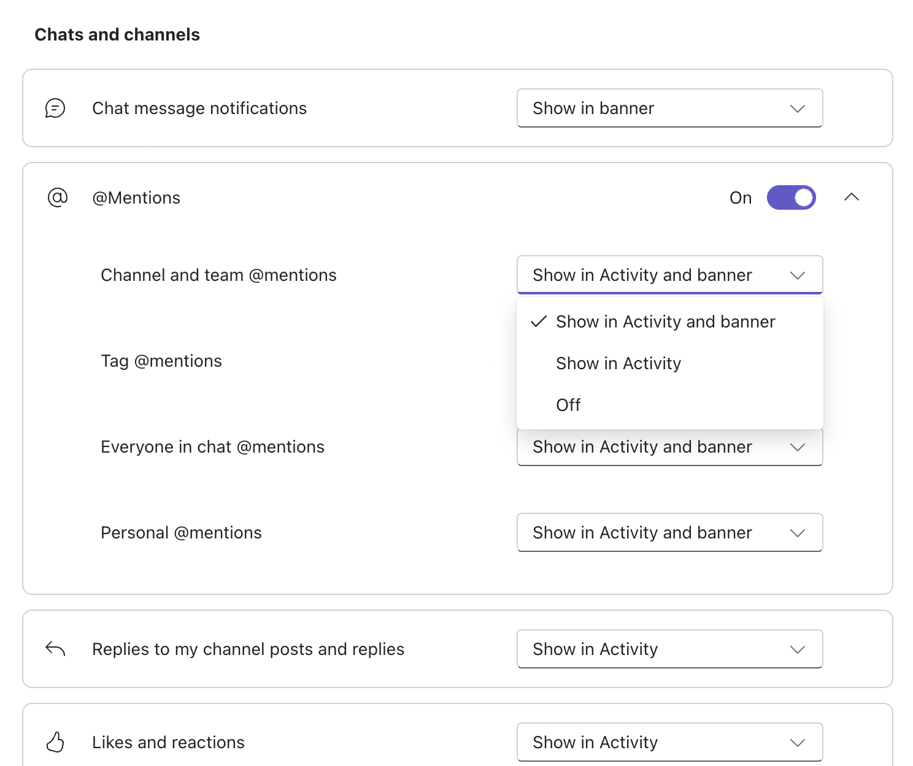
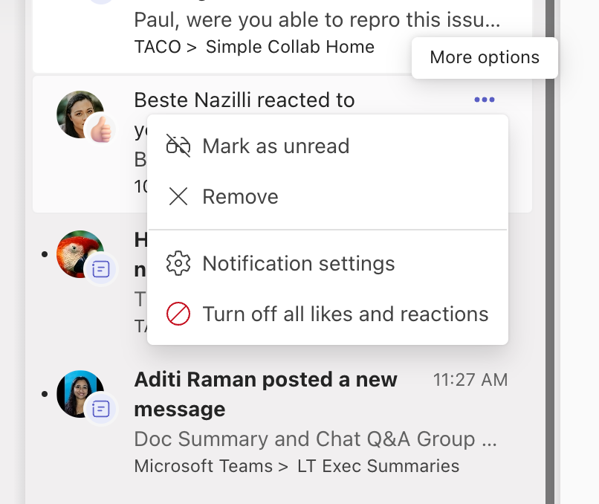
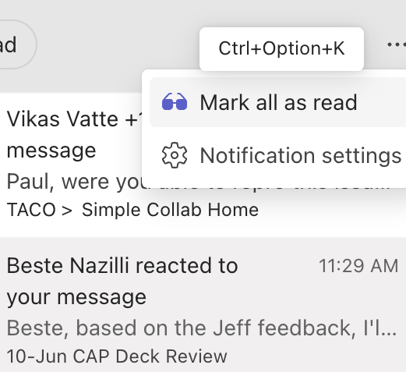
Notifications
Generally available
Simplified notifications
Contextual controls
Mark as all read

Slide 22
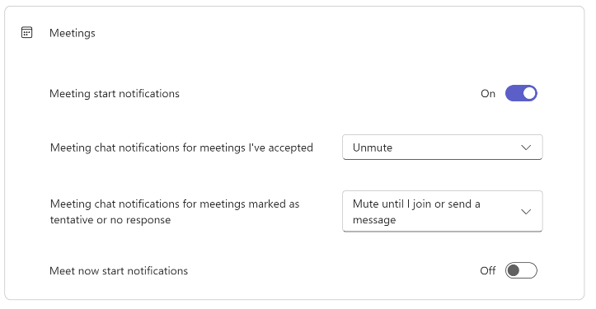
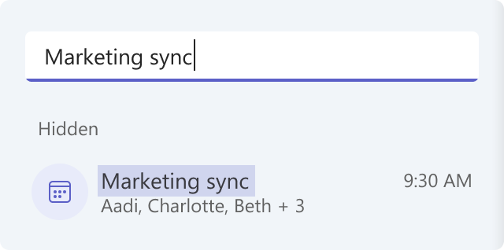
Chats and channels
Generally available
Generally available
CY25H2
Hide general channel
Archive channels
Hide declined meeting chat

Slide 23
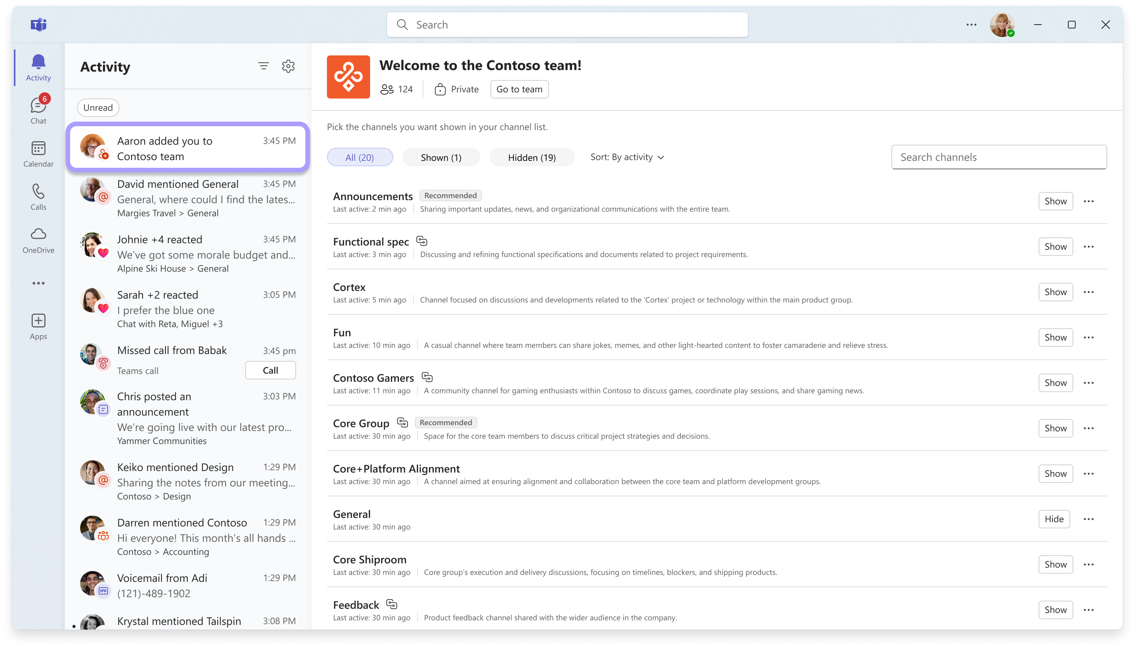
Adding to new team doesn’t assume interest in all channels
Generally available
Notes:
https://techcommunity.microsoft.com/t5/microsoft-teams-blog/what-s-new-in-microsoft-teams-september-2024/ba-p/4255348

Slide 24
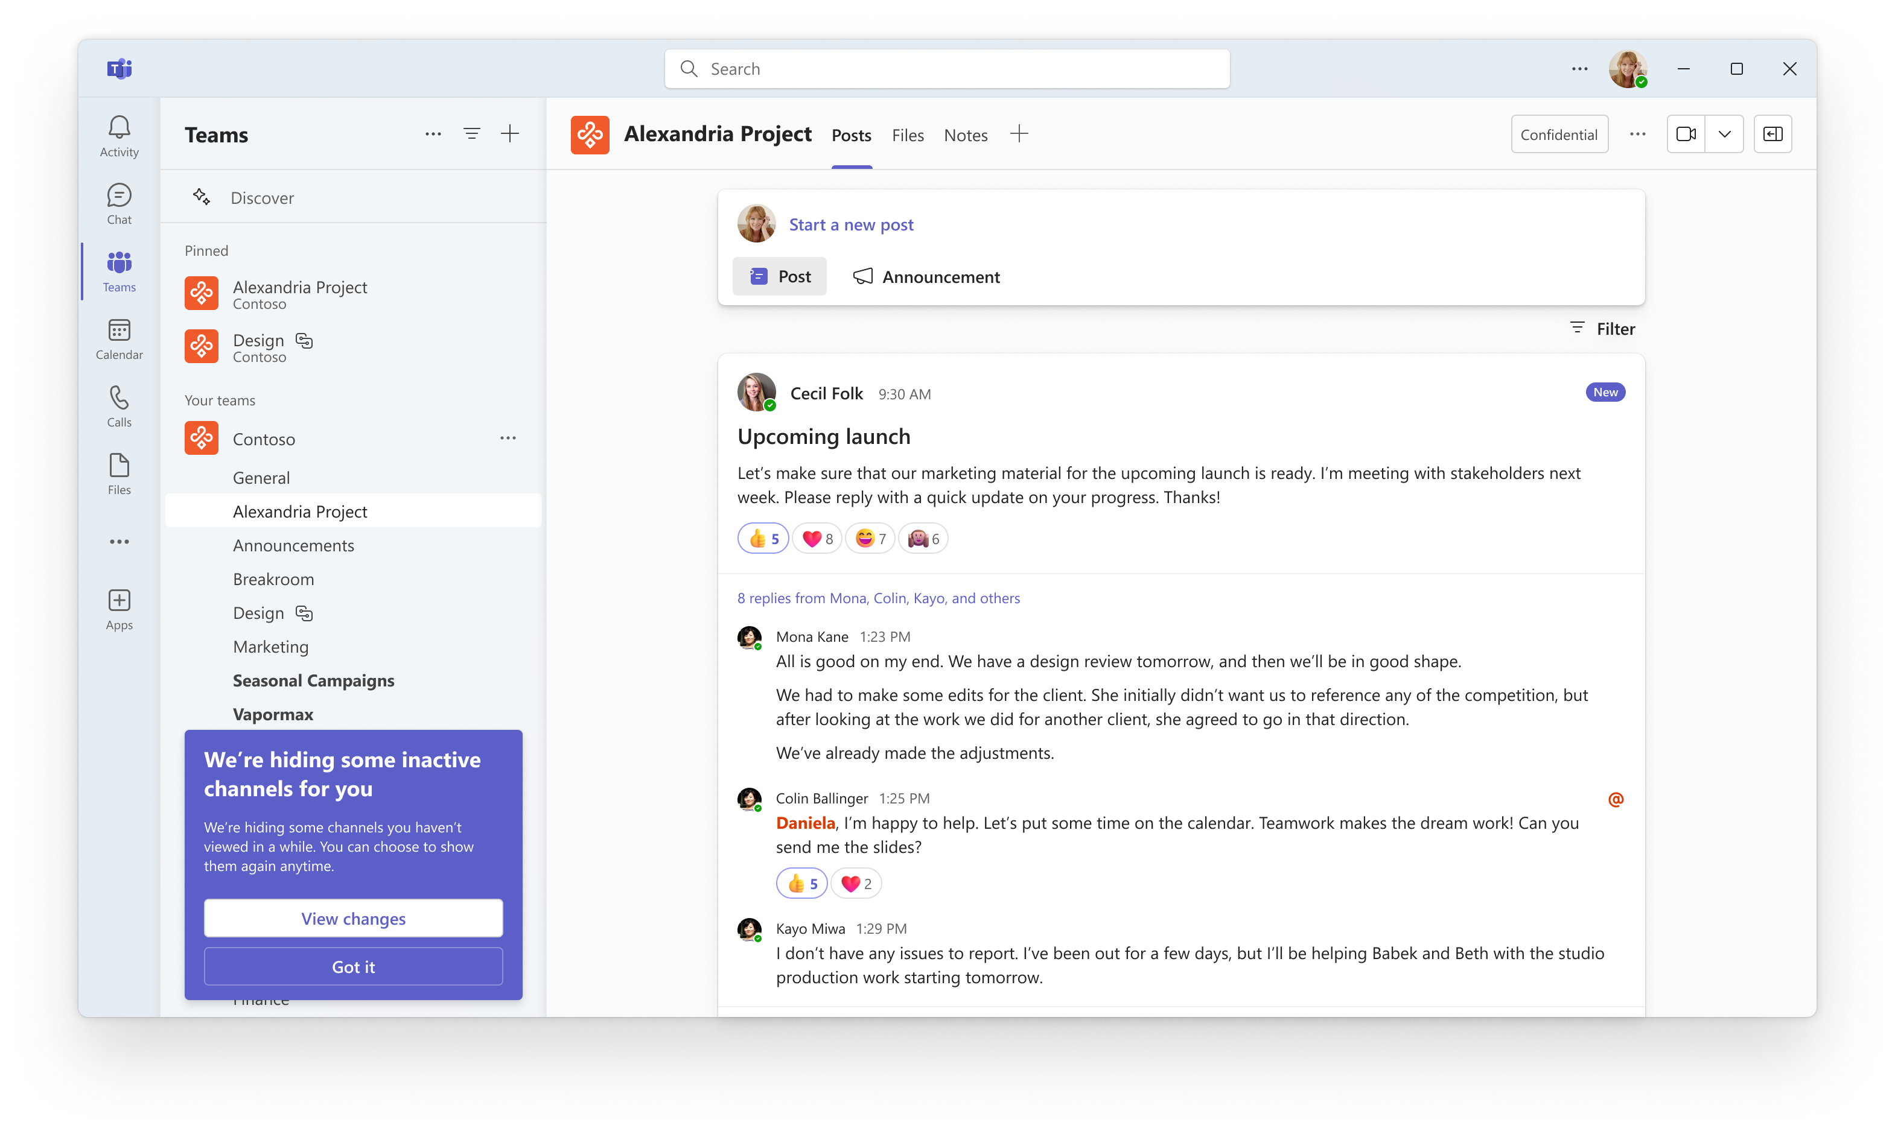
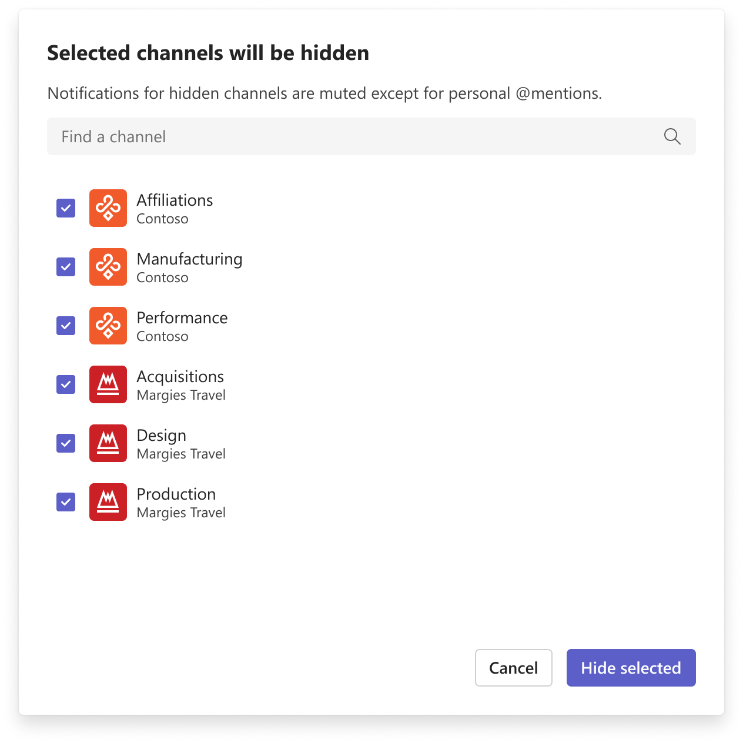
Auto or manual cleanup of channels of low interest
CY25H2

Slide 25
New chats and channels experience
Public Preview at Microsoft Ignite (November 2024), Generally available late March 2025

Slide 26
Live demo
Stay on top of chat and channels in one place
Chat, teams, and channels in one place.
Adaptability: separate chats and channels.
Display channels grouped by teams or as a single list.
Sort by the most recent activity or by unread messages.
Compact chat and channel list.
Adjust your view in settings to show message previews or timestamps.
Start chat or channel from a ‘new message’.
Organize chat and channels your way
Three default sections: Chats, channels, and favorites.
Pinned chats and channels are now both in the favorites section.
Custom sections.
Sort:
Reorder your sections by dragging
Sort each section by unread, recency, or customize
Easily navigate and triage messages
Filters: ‘Unread’, chat, channels, meetings and muted.
@mention view.
New keyboard shortcut Ctrl+G.

Slide 27
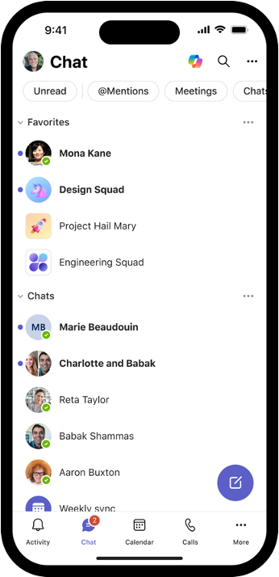
Optimized for every device
The new and channels experience is coming to Teams iPhone, iPad, and Android apps
Optimized to different screen sizes
Customize your experience with mobile-specific settings, such as choosing between viewing messages organized by sections or recency

Slide 28
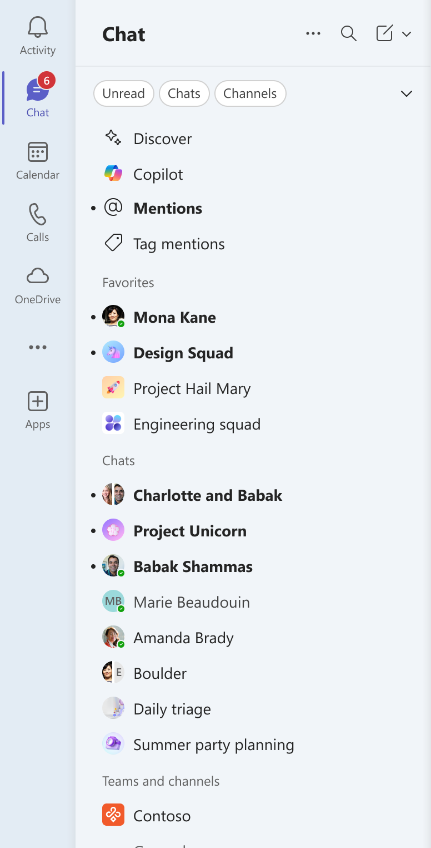
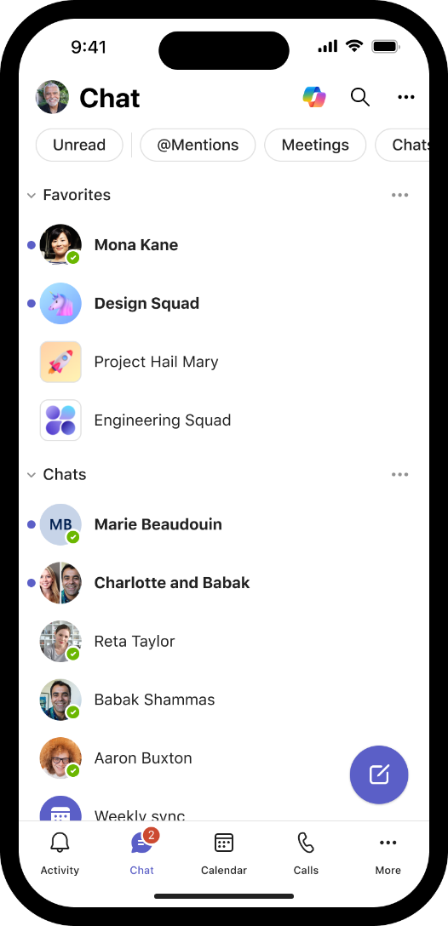
Chats and channels together in one place
Find and message a chat or channel easily
Filter to what matters now
Get to what matters quickly – Copilot, at-mentions
Pinned chats and channels in Favorites in user order
Create custom sections to organize
All your chats
Teams and channels hierarchy like before

Slide 29
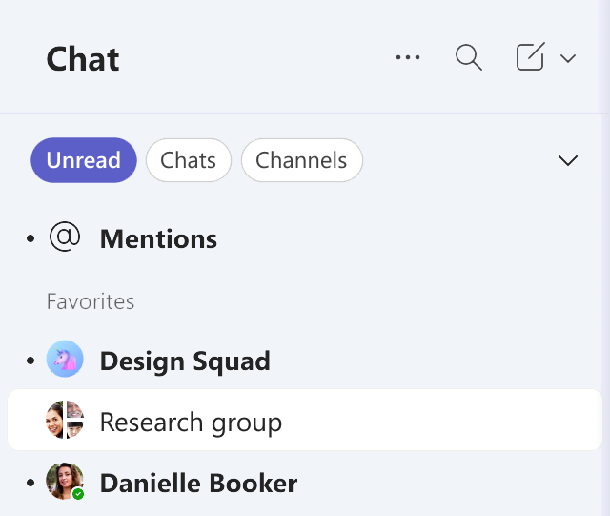
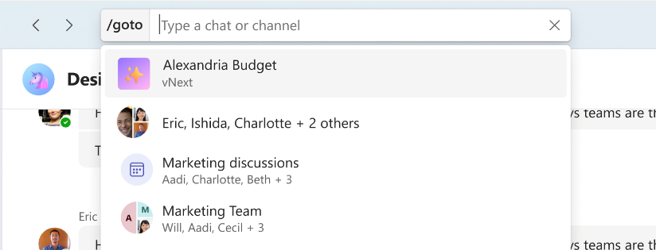
Optimized for triage and navigation
Filter via search to chats or channels
Triage personal and tag mentions
Fast nav with Ctrl/Cmd+G (goto)
Unread items clear on read

Slide 30
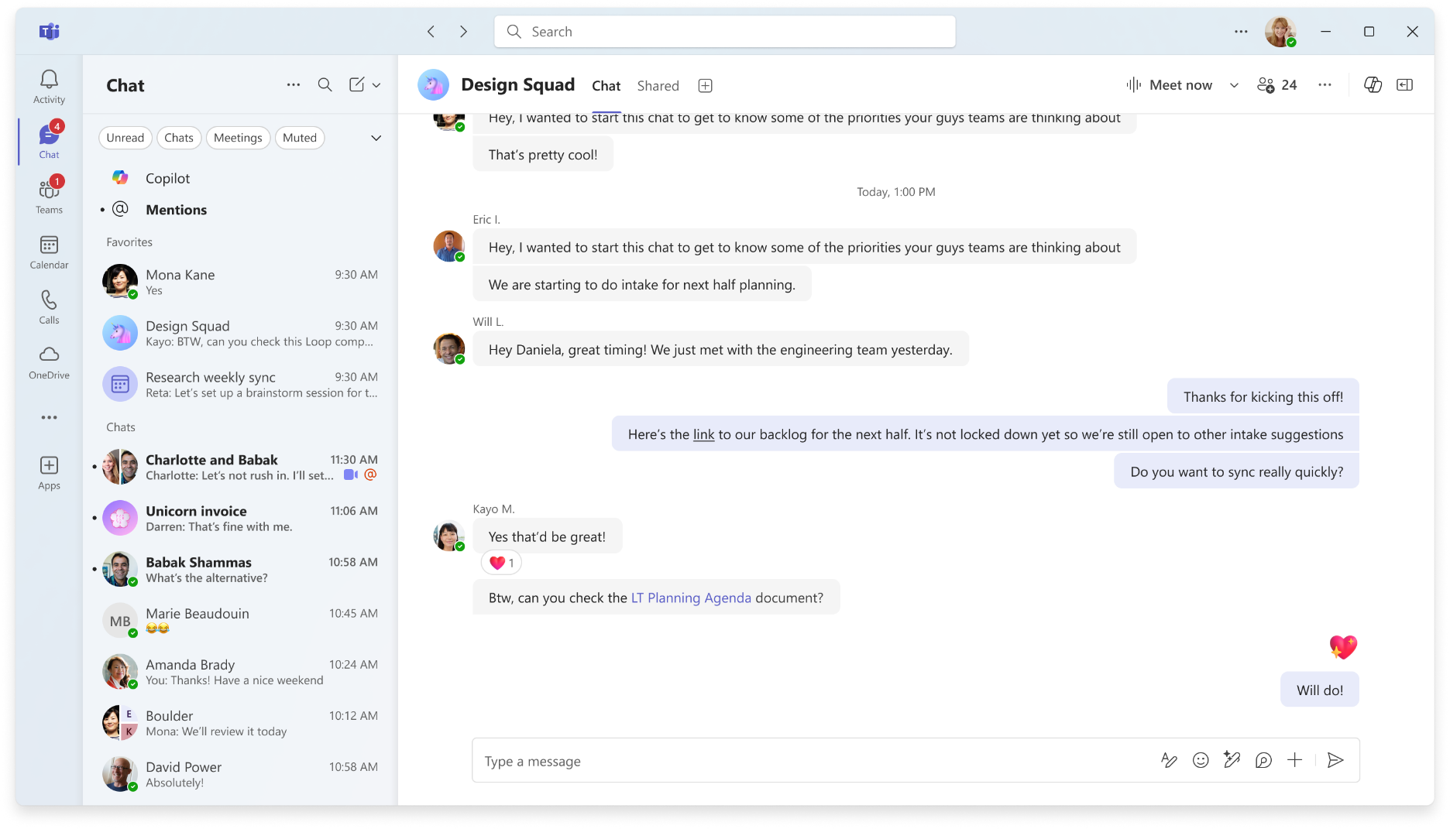
Quickly switch to separate chats and channels, like before

Slide 31
Change management

Slide 32
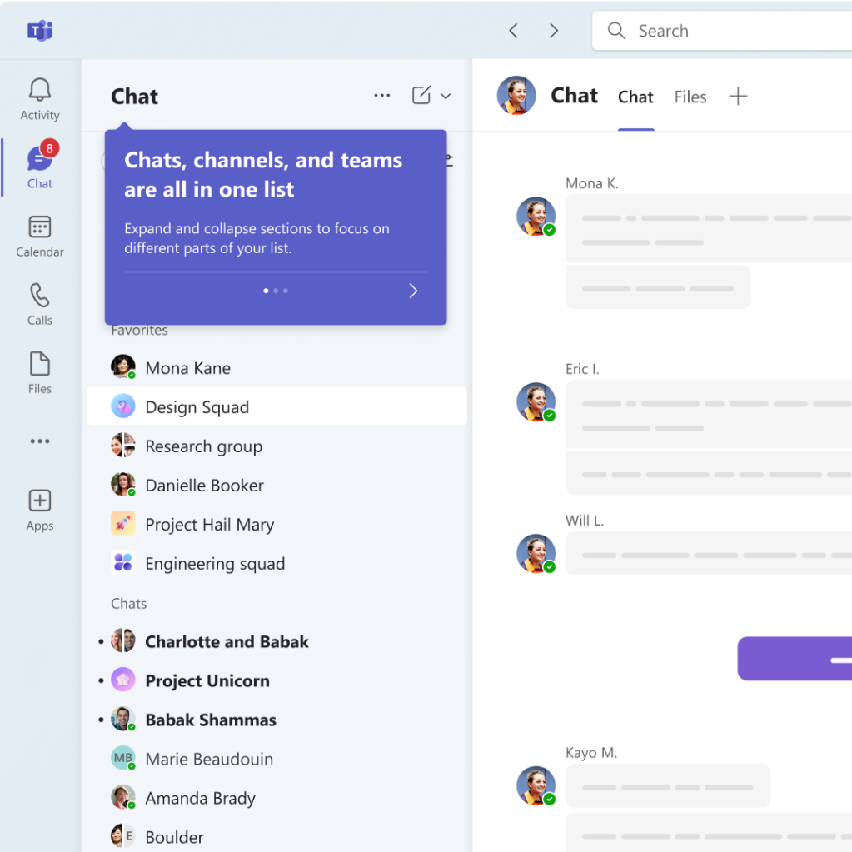
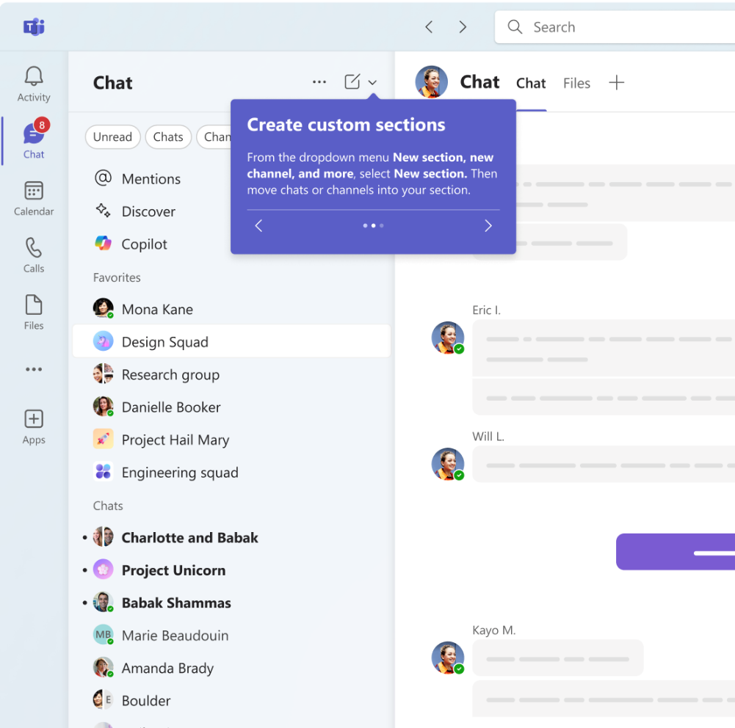
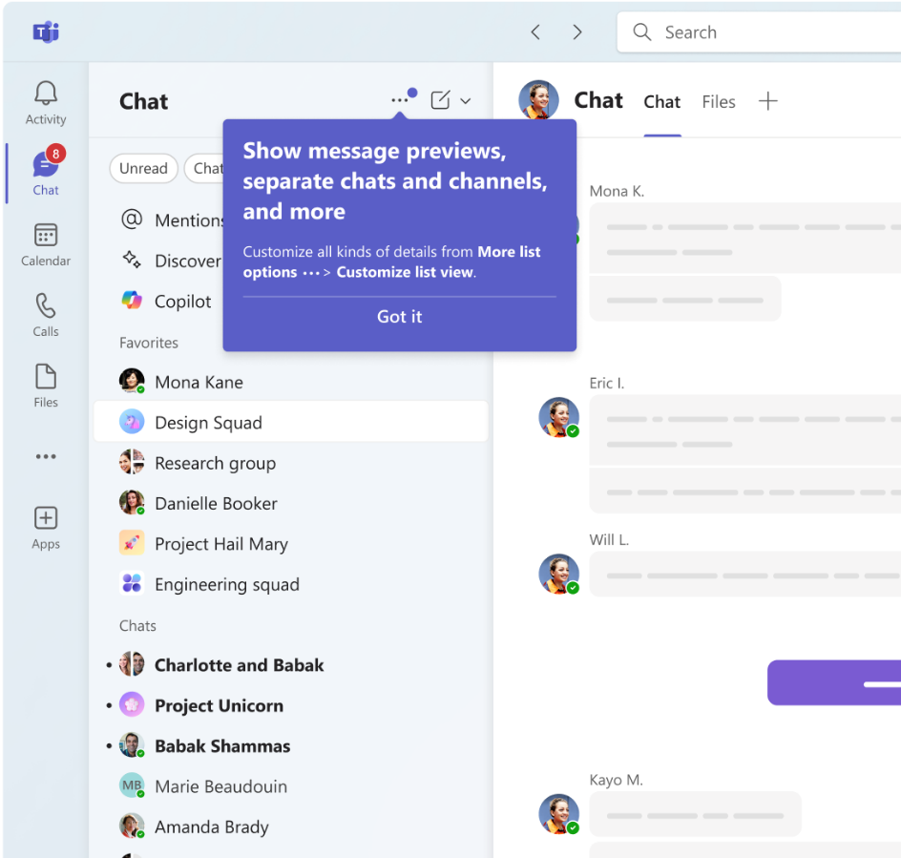
In-app onboarding experience

Slide 33
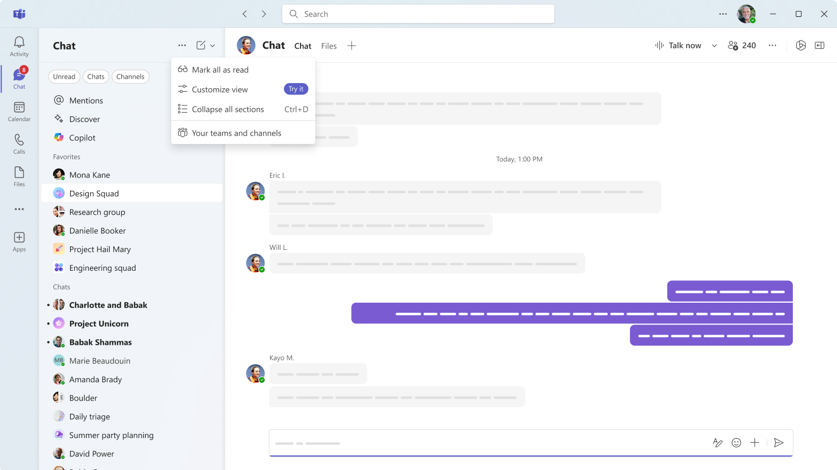
Adaptability - Discovery

Slide 34
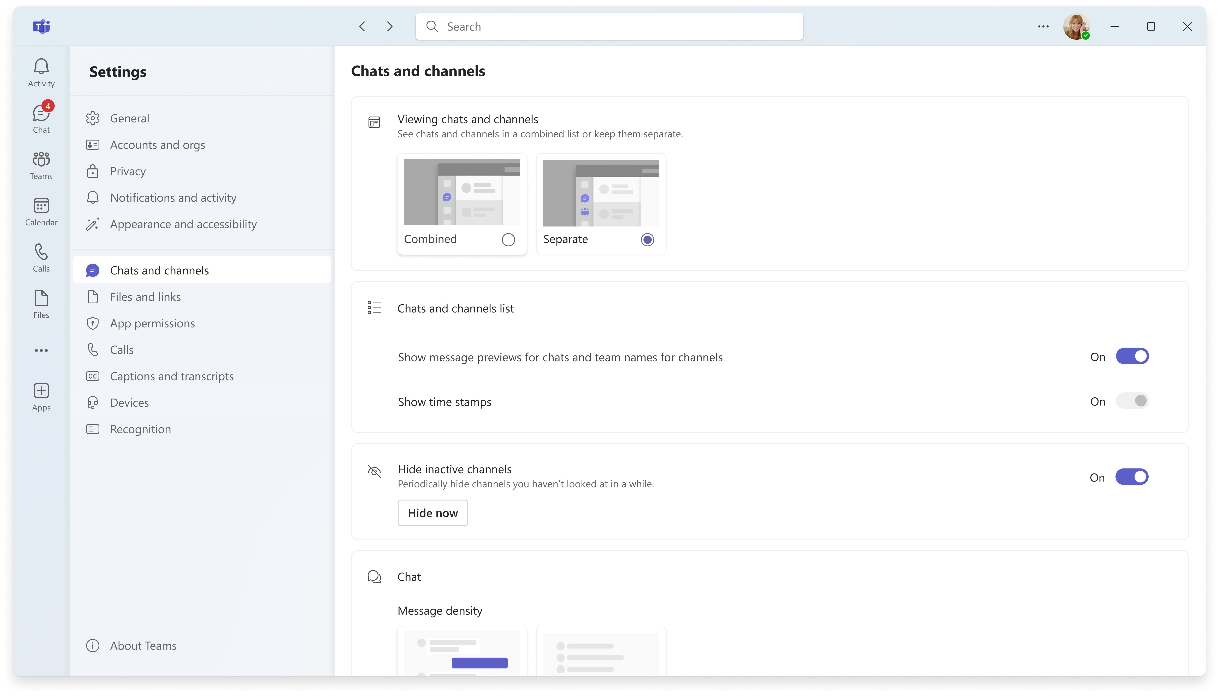
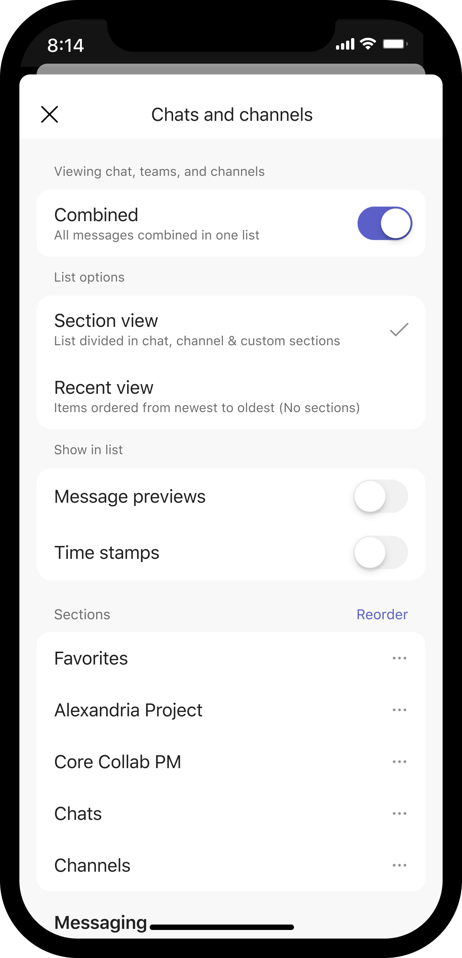
Adaptable. It’s your Teams.

Slide 35
User and admin enablement
User and admin adoption
Learning series
✅
Dedicated adoption.microsoft.com site
Admin adoption guide
User guide
Downloadable content
Meet the Makers episode with product leaders
✅
✅
Ask Microsoft Anything video Q&A (November)
Make the most of the new chats and channels experience tips (March)
✅
Teams Admin Center updates and links
✅
In-app onboarding at your pace
Accessibility and inclusive design for the new chat and channels experience
✅
Email for organizations (opt-in)
✅ Now available!
Notes:
Our focus is to make sure customers are ready to go on day one. A user experience update or optimization means admins and managers want clarity and end-users want simplicity and control. For organizations we’ll have a dedicated adoption site with documentation including how to get teams ready, and for end users our focus is to make it easy to get started or to customize to how you work.

Slide 36
Resources Microsoft 365 blog https://aka.ms/Teams/NewCCAnnouncement and Tech Community blog Microsoft Adoption https://aka.ms/Teams/NewChatChannels Champions, IT Pro, Admin guide, User guide, and community events.
Notes:
There are several resources to help end users, champions, IT Pros and admins transition and make the most of the new chat and channels experience.
Follow these links to learn more and access these resources.

Slide 37
Thank you!

Slide 38
Upcoming community events
February 6-7
February 19-20
February 19
February 21
May 6-8
M365 Community Days Miami
Get-CsLatam
M365 Community Day West Michigan
M365 Community Days DC
Microsoft 365 Community Conference
Miami, Florida
Mexico City, Mexico
Grand Rapids, Michigan
Arlington, Virginia
Las Vegas, Nevada
Explore other Microsoft events here and a full list of community-led events can be found at CommunityDays.org

Slide 39
Open discussion
Drop your questions in the Microsoft Tech Community – Driving Adoption event page or visit https://aka.ms/M365ChampionCall/ask to join the live on-air queue to get your questions answered!
Share your feedback for this call by visiting https://aka.ms/Microsoft365ChampionCallFeedback

Slide 40
What’s next
Share your feedback
https://aka.ms/Microsoft365ChampionCallFeedback
Next call:
February 25
Topic:
Deep dive into SharePoint sites and pages
Join the Driving Adoption community
https://aka.ms/DrivingAdoption
Invite colleagues to become a Champion
https://aka.ms/M365Champions

