Slide 1
Microsoft 365 Champion
community call
February 2025

Slide 2
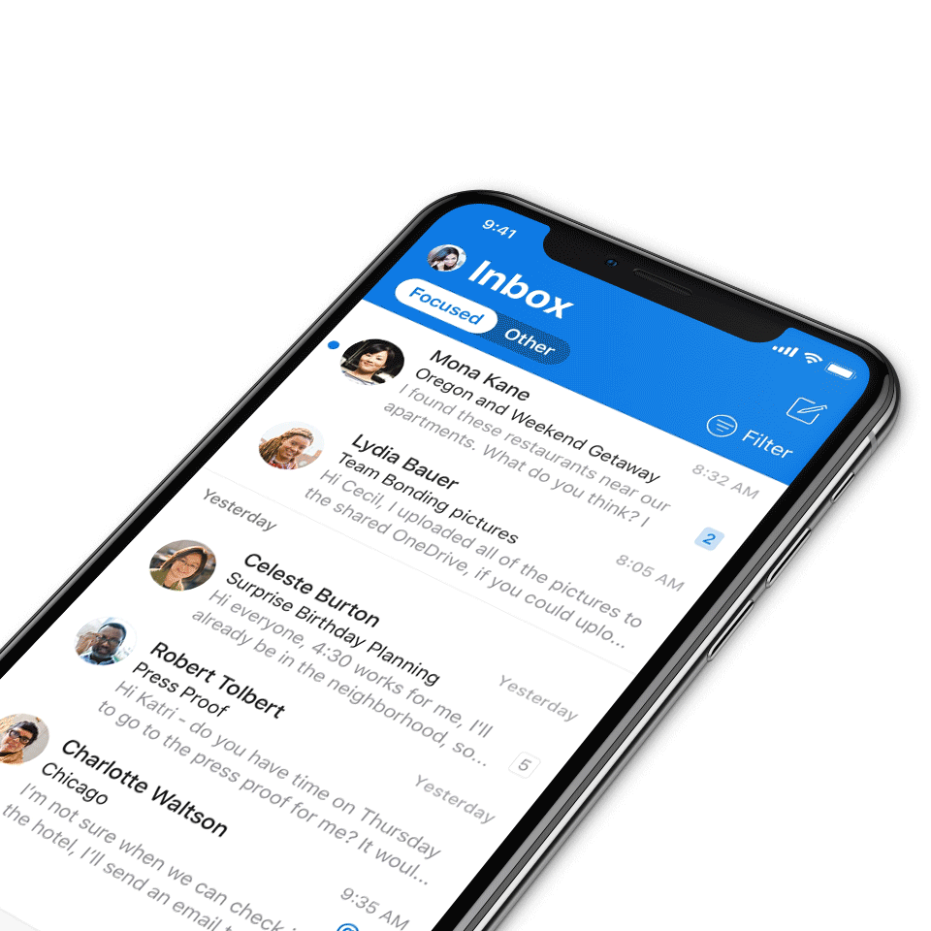
Digital Event Code of Conduct
Microsoft’s mission is to empower every person and every organization on the planet to achieve more. This includes all Microsoft events and gatherings, including on digital platforms, where we seek to create a respectful, friendly, fun and inclusive experience for all participants.​
We expect all digital event participants to uphold the principles of this Code of Conduct, which covers the main digital event and all related activities. We do not tolerate disruptive or disrespectful behavior, messages, images, or interactions by any party participant, in any form, at any aspect of the program including business and social activities, regardless of location.​
Microsoft will not tolerate harassment or discrimination based on age, ancestry, color, gender identity or expression, national origin, physical or mental disability, religion, sexual orientation, or any other characteristic protected by applicable local laws, regulations, and ordinances.​
We encourage everyone to assist in creating a welcoming and safe environment.
For more info, visit aka.ms/CodeofConduct.

Slide 3
Agenda
Announcements
Top Microsoft 365 updates
Main topic: SharePoint – Mark Kashman
Open discussion forum
Become a Champion today!
https://aka.ms/BecomeaChampion

Slide 4
New call format starting February 2025
We’re listening to your feedback! The Champion community calls will return to Microsoft Teams and will still be available on-demand on the Microsoft Tech Community.
How to watch:
Beginning in February 2025, the Microsoft 365 Champion community calls will move to Teams webinars and be available on-demand on the Microsoft Tech Community (MTC) and the Microsoft Community Learning YouTube channel within 48 hours after the call. The join links remain the same and clicking through will take you to the webinar registration page. You must register to join the live call. Our community call times also remain the same: 4th Tuesday of every month at 8:05 AM and 5:05 PM Pacific Time.
https://aka.ms/M365ChampionCallAM
https://aka.ms/M365ChampionCallPM
REMINDER:
All presentations remain available to Microsoft 365 Champion program members, link in the monthly newsletters. Not a member? Join in the link below for access to calendar invites, presentations, and all previous calls.
Microsoft 365 Champions
https://aka.ms/M365Champions

Slide 5
Announcements
SharePoint event, January 29
SharePoint: From concept, to creation, to impact + Live AMA
Uplevel your SharePoint IQ! The SharePoint team highlighted the latest AI capabilities and what some of our customers are doing with it. Get clarity on what's available, tips and tricks, and the boundaries you can now push with the latest.
Now on demand: https://aka.ms/SharePointEvent
+ Jeff Teper’s related blog
+ 5-part SharePoint learning series
+ 3 new customer case studies

Slide 6
Announcements
Microsoft 365 Community Conference
Your front-row seat to the future of work
Join us in Las Vegas, Nevada, May 6-8! At the Microsoft 365 Community Conference, you’ll join hundreds of engineers, experts, executives, and MVPs—and thousands of professionals and tech superfans—from around the world. From learning about the latest advancements in AI-driven tools, to talking to the people who build Microsoft products, to developing the practical skills that will serve you and your organization, you’ll dive deep into big innovations and come home with tangible solutions.
Claim your spot now: aka.ms/M365Con25

Slide 7
Microsoft 365 Community Conference 2025 – Featured speakers
Register today | aka.ms/M365Con25

Slide 8
Announcements
Microsoft Community
Microsoft Global Community Initiative community calls
Are you a seasoned event organizer looking to promote your event? Or you want to discover ways to get involved in community locally? If so, join the MGCI to get exclusive access to best practices, training, opportunities to network with other event organizers, and more.
Find us at:
Visit aka.ms/MGCI to join MGCI today!
Subscribe to youtube.com/@MicrosoftCommunityLearning
Become a member at techcommunity.microsoft.com

Slide 9
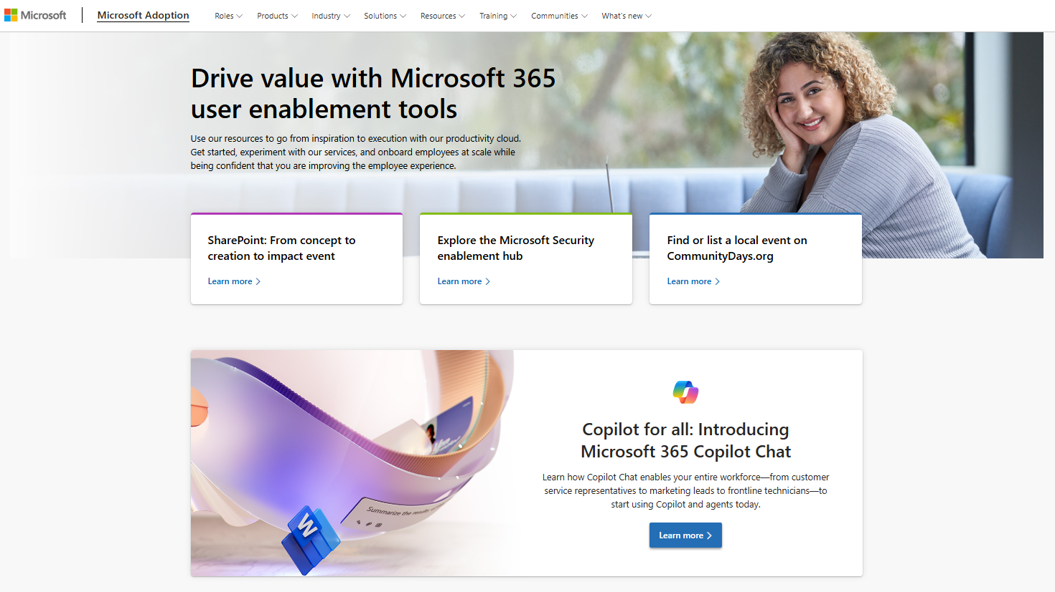
adoption.microsoft.com
Update highlights
Launch of the SharePoint Event and SharePoint Hackathon pages
Location updates to the MGCI Advisors page to make it easier to find Regional Leaders
Updated the translated versions of the Copilot Success Kit
New guided tour demo for Copilot Sales (Technical Readiness > Extend & optimize)
New non-native English speaker Day in the Life guide
Added Copilot Chat user engagement resources to the Copilot Chat and agent starter kit page
New leader-focused deployment resource page under the Training top drop-down menu
Read or subscribe to our Release notes for more updates.

Slide 10
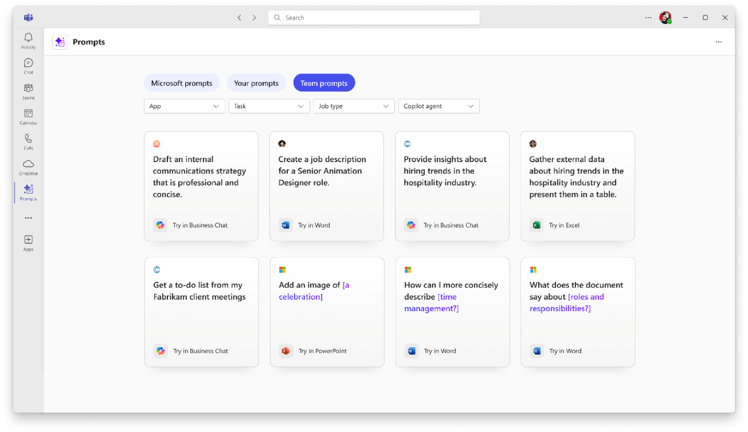
Top Microsoft 365 updates
Copilot Prompt Gallery app
New app helps users discover, save, and share their favorite prompts
The new Copilot Prompt Gallery app provides a central place for users to find and use relevant prompts across Microsoft 365 Copilot, Copilot Chat, and agents, complementing the existing in-app experiences. Users can also save and revisit their favorite prompts, share them with colleagues, and discover prompts for specific tasks or workflows shared within a Microsoft Teams team.
This app is rolling out in February and will be available for all Microsoft 365 Copilot users to add in www.microsoft365.com, Teams desktop, and Outlook. Copilot Chat users without a Microsoft 365 Copilot license will gain access to the app this spring.
Click here to learn more.

Slide 11
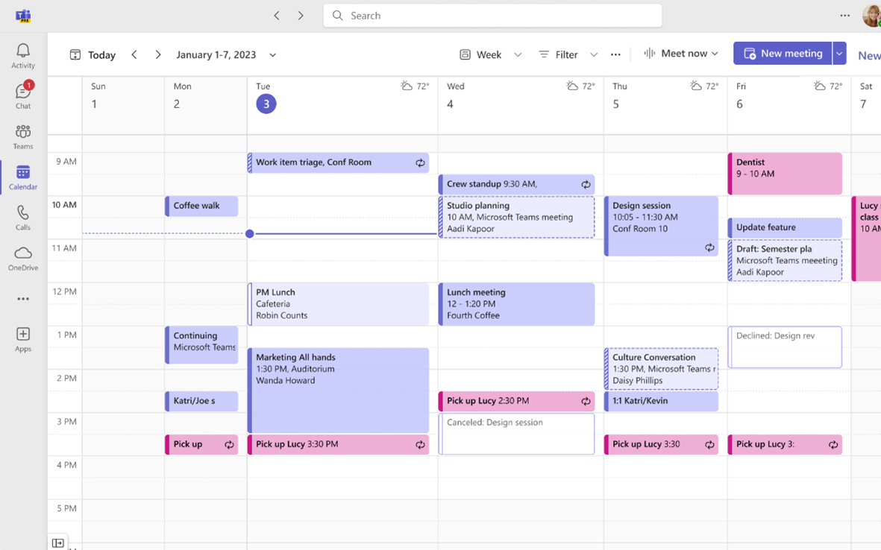
Top Microsoft 365 updates
Microsoft Teams
The new calendar in Teams now generally available
We are excited to announce that the new calendar in Teams is now generally available for commercial customers. The new calendar is designed for familiarity and reliability, while incorporating the latest innovations in Microsoft 365 Copilot and Places to elevate your scheduling and time management experience.
Updates include:
Unified calendar experience between Outlook and Teams
Expanded calendar views
Calendar settings and customization
Click here to learn more.
Notes:
Outlook features coming to Teams include delegate access, print support, expanded calendar settings, filtering, support for multiple time zones, time suggestions in scheduling, support for attachments, and more.
Expanded calendar views
The new calendar offers several new views and navigation options:
Month View: View your calendar by month, a highly requested feature, especially useful for users with sparse calendars.
Split View: When more than one calendar is selected, you can now split the calendar into two independent views.
Time Scale: Specify time scales or intervals for the calendar surface
Saved Views: Save your current view for easy access later
Weather Display: See the weather for your current location directly in the calendar
Calendar settings and customization
Customize your calendar settings, including start and end times for events, location settings, and more. You can also share your calendar with others in your organization and print your entire calendar. Lastly, the new calendar can be popped out as a separate window, allowing you to multitask more effectively.
Save time with easy scheduling
Creating meetings is now more intuitive. You can quickly create a meeting from the quick view by clicking on a timeslot in your calendar or by opening the new scheduling form. The new scheduling form includes refreshed meeting options and templates for different meeting types

Slide 12
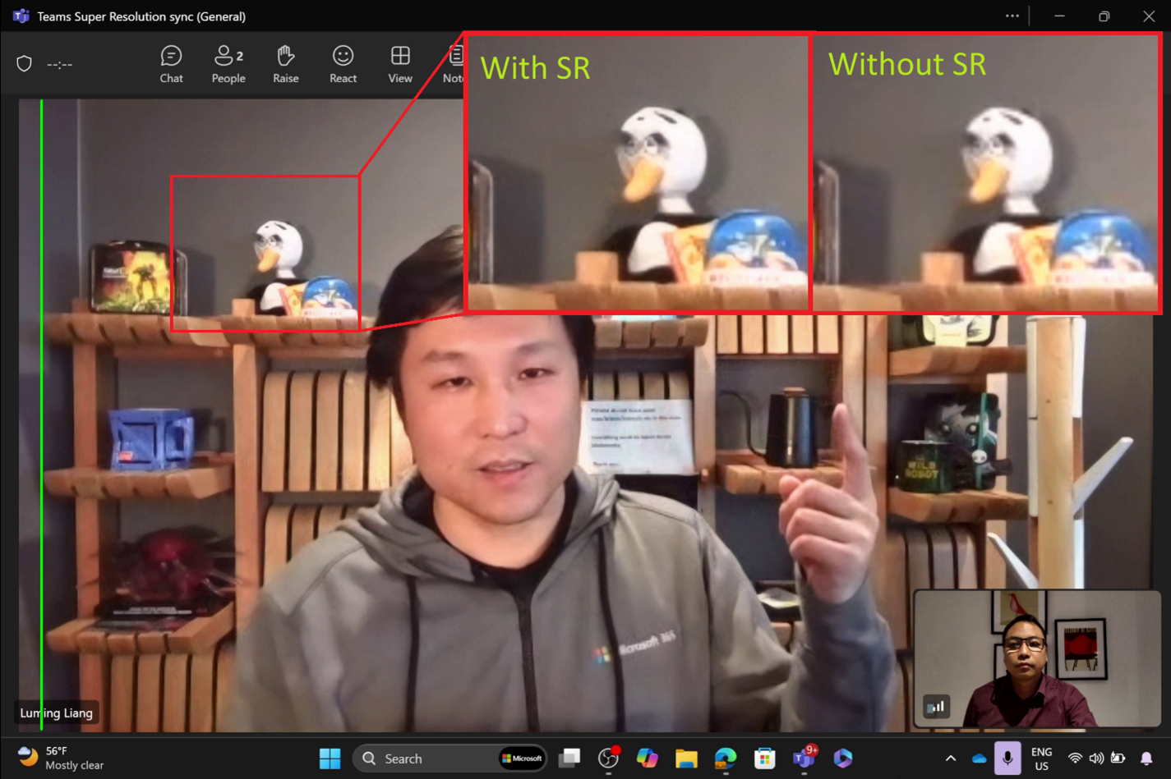
Top Microsoft 365 updates
Microsoft Teams
Enhancing Teams video quality with Super Resolution
First at Microsoft Ignite 2024, Super Resolution (SR) is now available in public preview and will be general available in March. This feature enhances video quality, especially under poor network conditions.
SR for Teams leverages the power of Copilot+ PC AI to restore video resolution. Instead of relying on conventional upscaling methods, which fall short in delivering clearer images, Teams uses AI to enhance video resolution, producing notably improved video.
Click here to learn more.

Slide 13
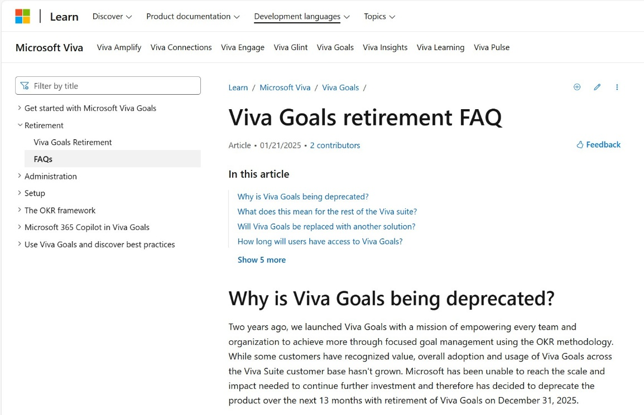
Top Microsoft 365 updates
Microsoft Viva Goals
Viva Goals retirement
Viva Goals will be retired on December 31, 2025, with no new feature developments after December 5, 2024. Microsoft remains fully committed to the Viva suite, continuing to innovate and deliver tools to help our customers drive meaningful business impact.
Click aka.ms/VivaGoals/RetirementAnnouncement to learn more.
Click aka.ms/VivaGoals/RetirementFAQ for the FAQ article.

Slide 14
SharePoint is the content service for Microsoft 365.
Notes:
The SharePoint “Ferris Wheel” graphic – Depicts the value of SharePoint as a content service and platform for Microsoft 365 apps. [Image version]

Slide 15
SharePoint
Notes:
The SharePoint “Ferris Wheel” graphic – Depicts the value of SharePoint as a content service and platform for Microsoft 365 apps. [Video version]

Slide 16
SharePoint works with Copilot and agent tech
Notes:
We are driven to make sure SharePoint platform is BOTH the best platform for managing content for AI and the best application for using AI to help every person and organization.
And we’re doing that through Microsoft 365 Copilot and Agents. Microsoft 365 Copilot is your personal assistant that is grounded from the content you have access to in SharePoint-making Copilot helpful and secure across Microsoft 365.

Slide 17
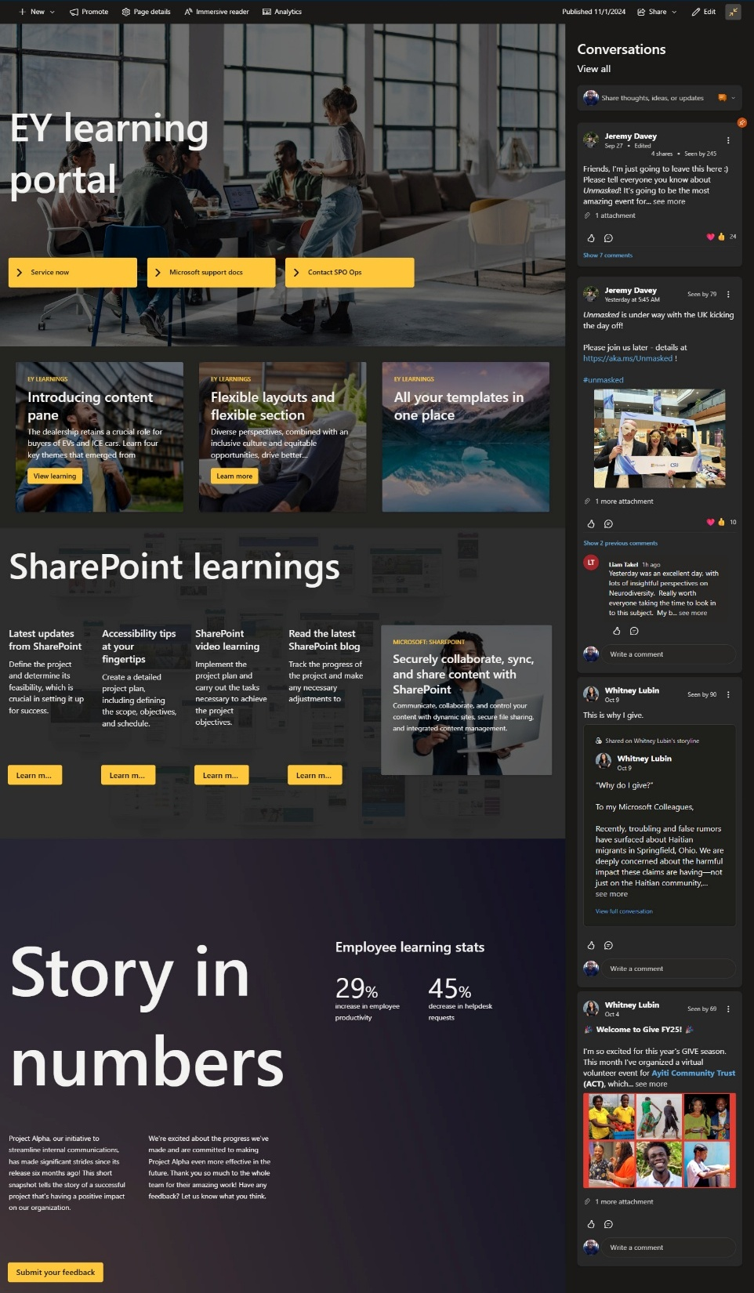
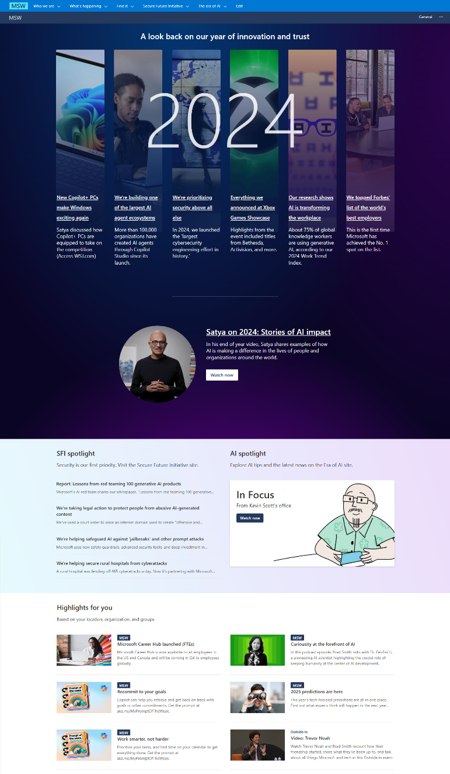
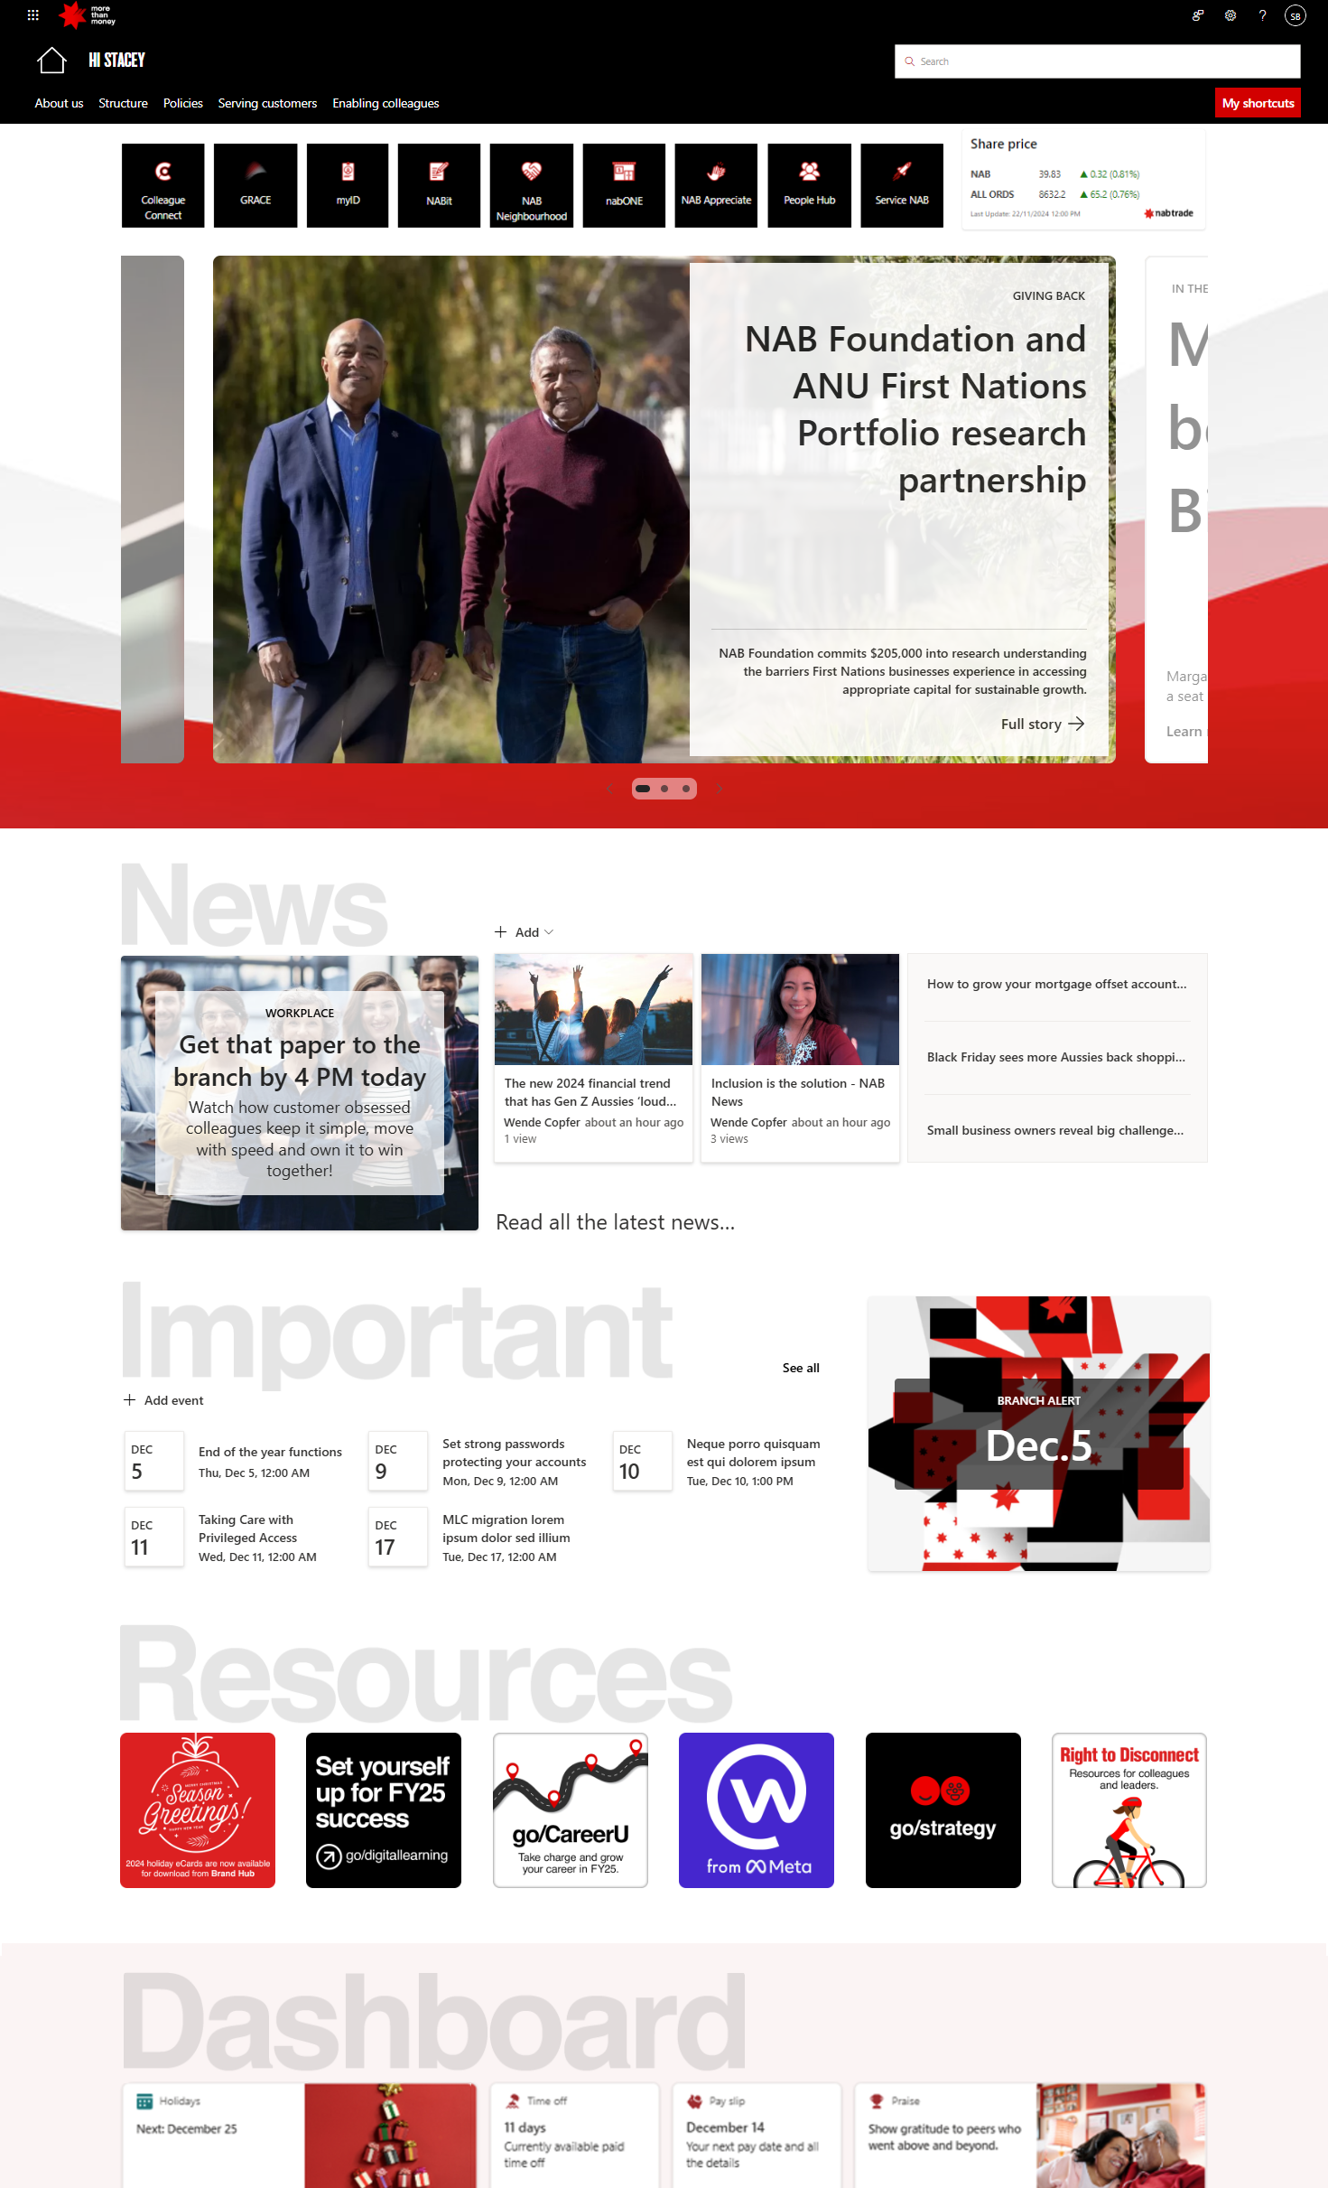
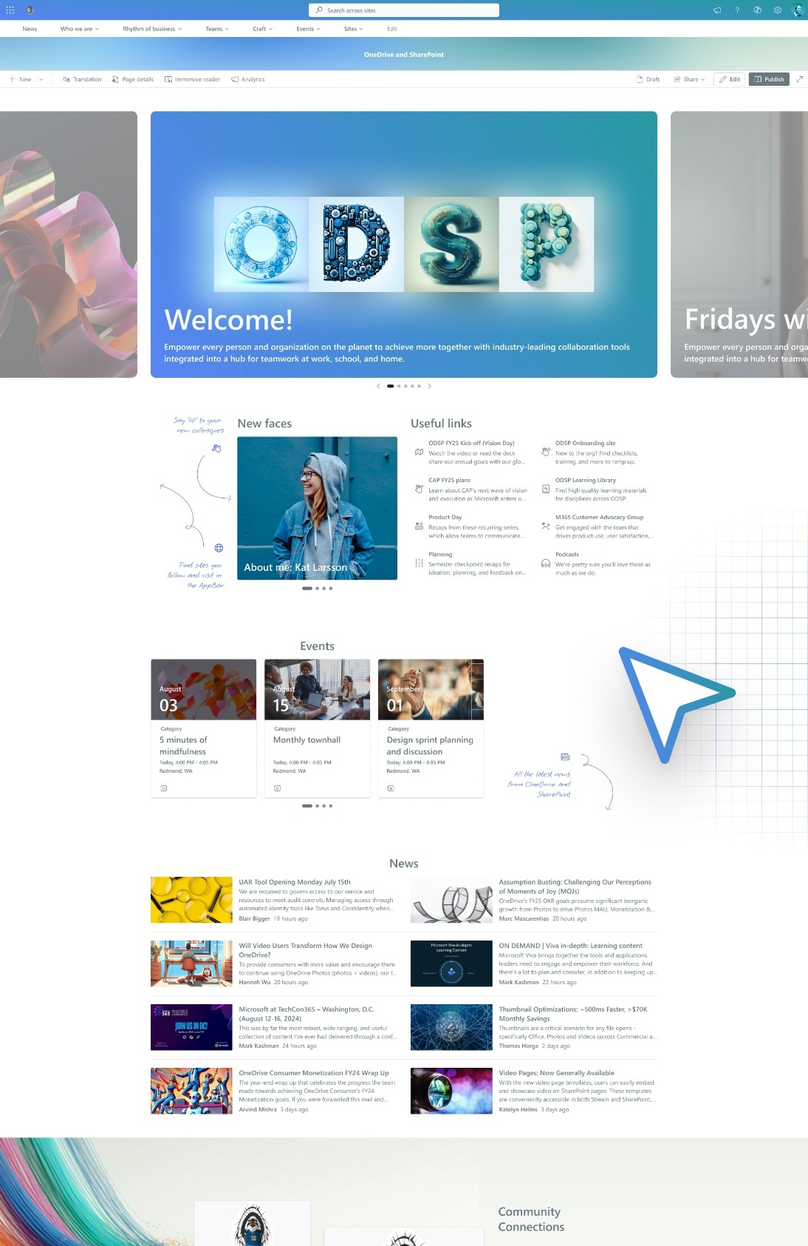
Example SharePoint sites
Notes:
As we have always said – SharePoint is a platform and an application – and I’m incredibly excited about the next step for the SharePoint app – powered by AI. Here you can see all the value of design and functionality that comes through an endless possibility of the ways you can design and create beautiful, content-rich sites for your organization’s intranet.

Slide 18
SharePoint agents
Generally available
Notes:
SharePoint agents have reach general availability (GA).

Slide 19
DEMO TIME
SharePoint agents
Notes:
Placeholder slide to demonstrate SharePoint agents.

Slide 20
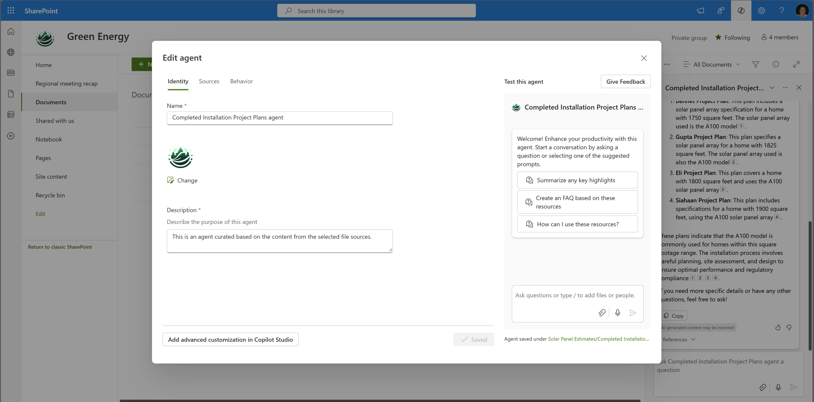
Edit agent – Generate sales proposal
Notes:
Work gets better when agents learn from these past projects to draft a proposal using new requirements. Let’s edit this SharePoint agent to do that.

Slide 21
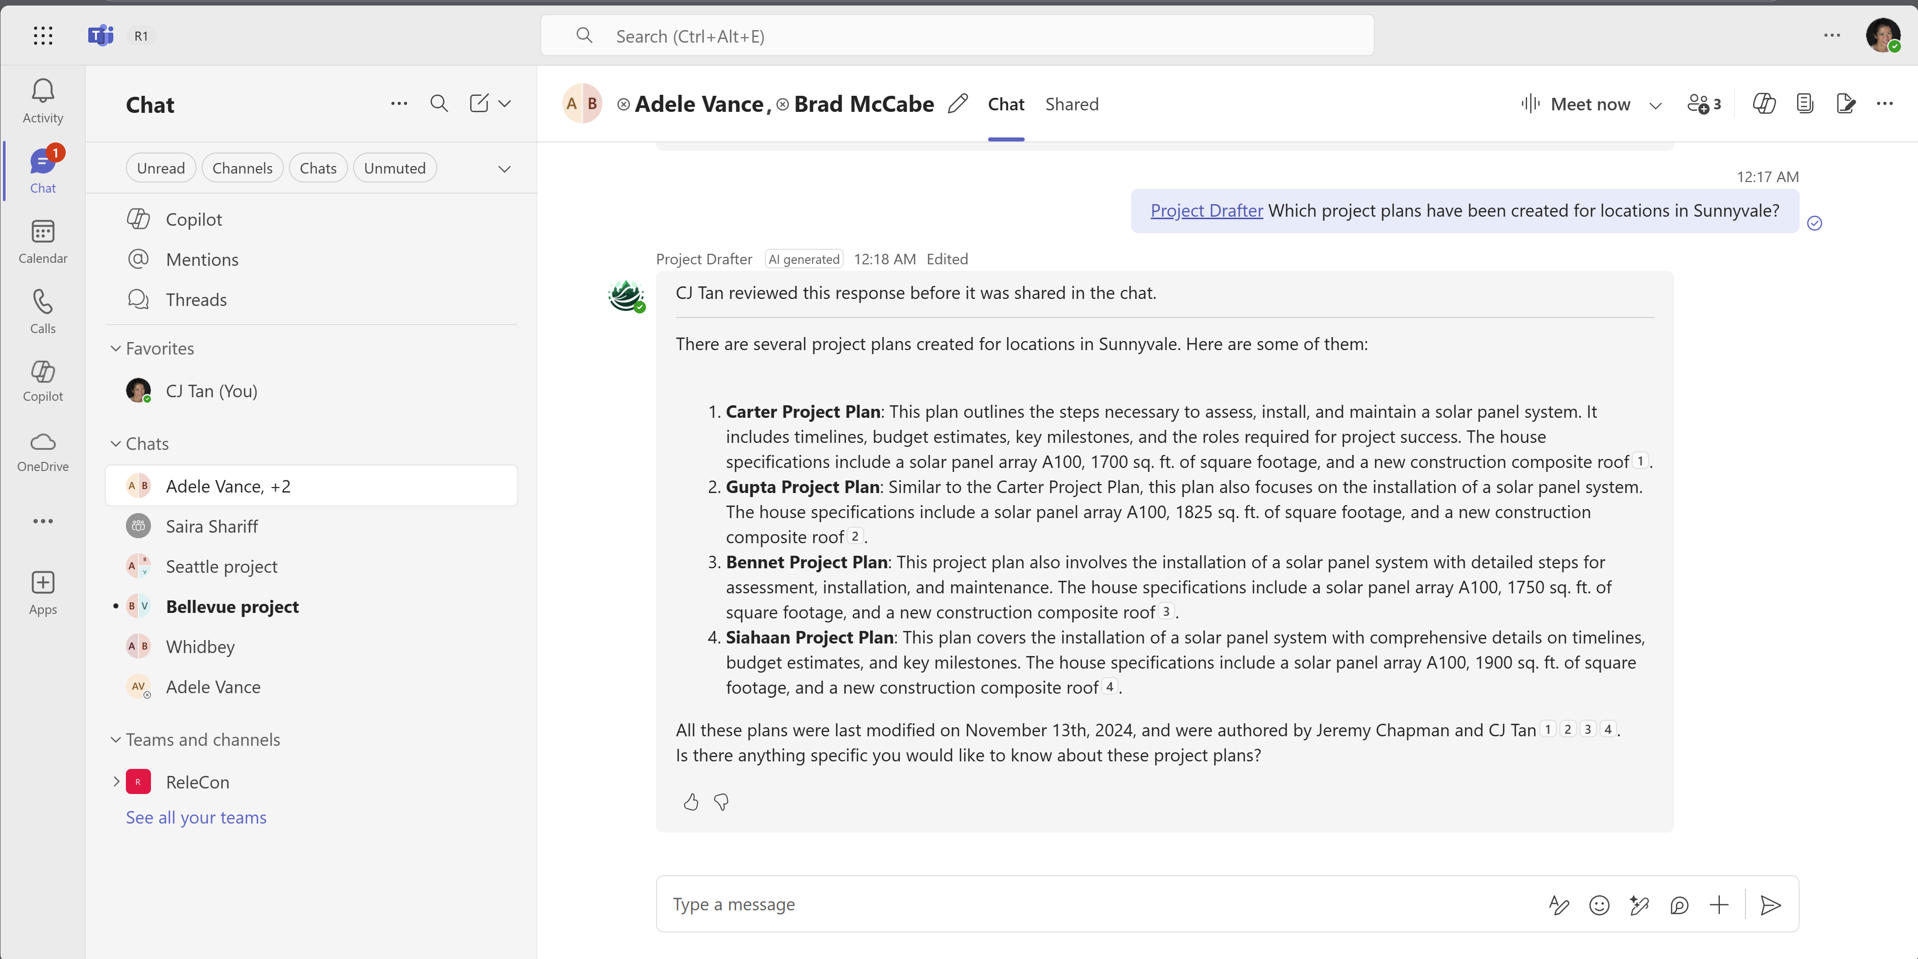
Collaborate
Notes:
When I choose to send the response, the access permissions of the underlying files do not change. The recipients in the chat see the response with a message indicating that I reviewed and shared it.
Interacting with the agent continues to protect from oversharing and doesn’t create any new processes for how the source content is shared.

Slide 22
Common business scenarios for agents
Accelerate how teams take action and make business impact
 | Customer Service | Sales | Finance | Marketing | HR | Legal | IT
KPI Example | Lower average resolution time (ART) | Increase sales conversion rate | Lower analysis cycle time | Decrease time to market | Reduce onboarding time | Decrease IP documentation review time | Increase user satisfaction score
How Agents can assist | Generate answers based on specific deployments and processes | Collate relevant materials for customized proposals | Get cost savings recommendations by analyzing years of financial reports | Provide a 24/7 go-to for product updates and questions | Streamline learning and information consumption with role specific onboarding agents | Accelerate researching, summarizing, analyzing documentation | Analyze customer feedback for trends and opportunities to inform product roadmap
Notes:
Onboarding and learniaccessiblet experiences are just two business scenarios where agents can improve how you work.
But, any scenario where an agent grounded in SharePoint content can be used to fact-check, research, summarize, analyze or generate recommendations can have a positive impact on business outcomes
Combined with how easy it is to create, share and secure SharePoint agents means that this collaborative AI is accessible to everyone.

Slide 23
The value of SharePoint sites and portals
Simple authoring
Beautiful content
Deeper engagement
Notes:
Breaking down the value of SharePoint sites and portals: Simple authoring, crafting beautiful content, and deeper engagement with your internal audiences.

Slide 24
DEMO TIME
SharePoint: Flexible sections
Notes:
Placeholder slide to demonstrate flexible sections within a SharePoint page.

Slide 25
Dozens of authoring improvements
Notes:
It’s a huge responsibility to empower so many creators – which is why about 18 months ago we embarked on an overhaul of the SharePoint site user experience, yet again.
We are on a mission to simplify the authoring experience, enable the creation of compelling content with the best looks on the web in your site, and help you generate engagement to all this content.
Let me show you.

Slide 26
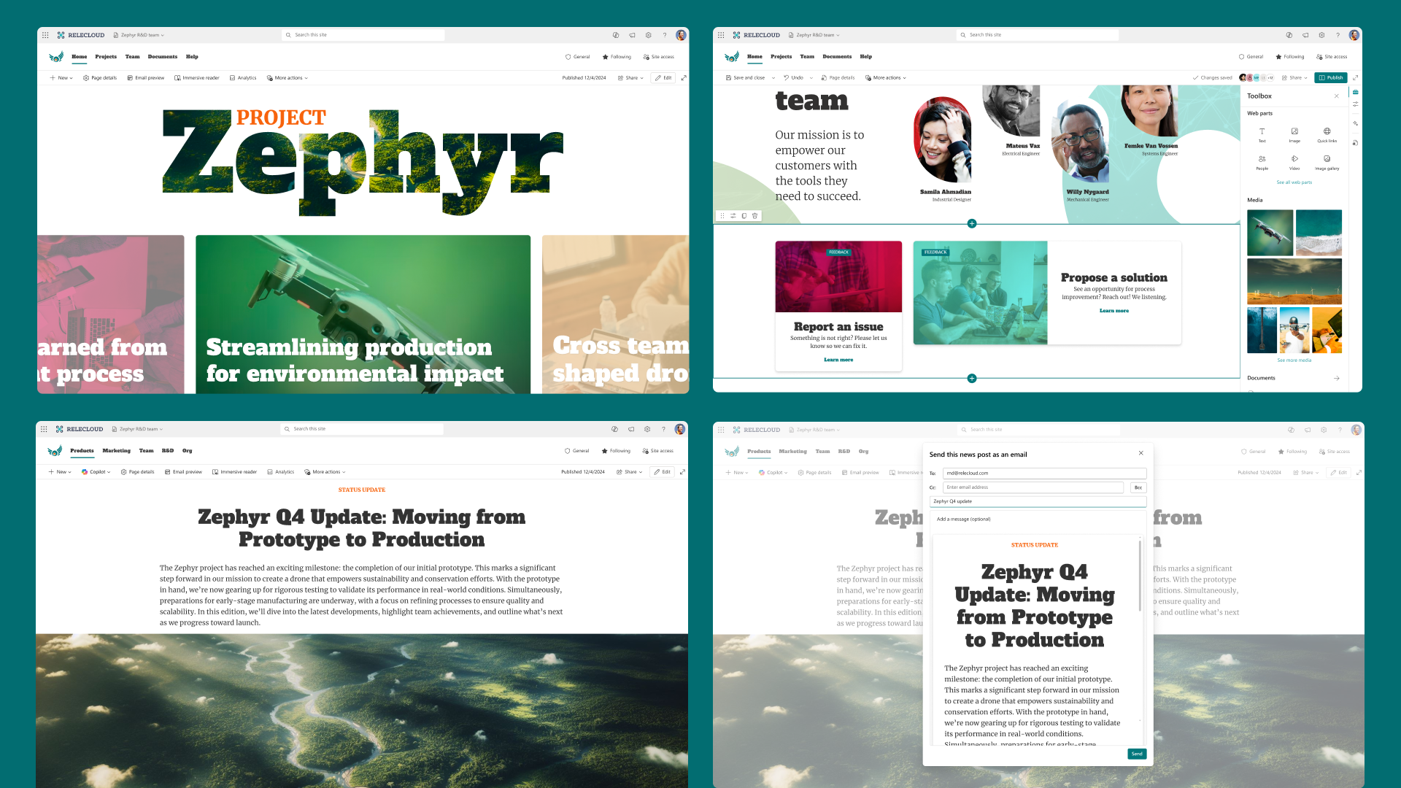
Beautiful content
Notes:
Here is another view of working with section in SharePoint pages to make them more appealing to your intended audience.

Slide 27
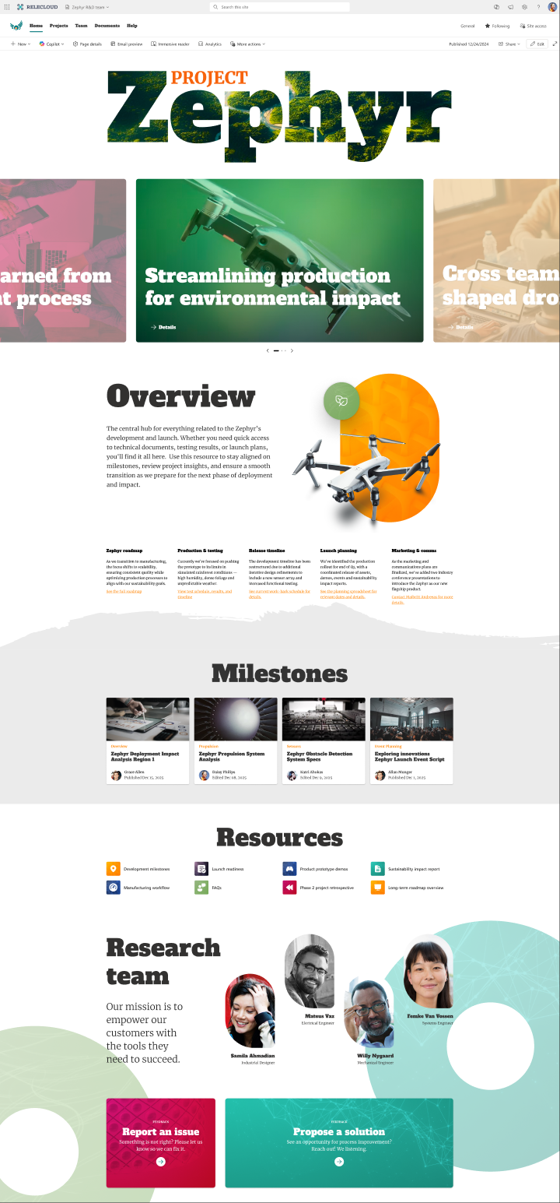
SharePoint hackathon
Microsoft SharePoint
March 3 – 17, 2025
More details:
https://aka.ms/SharePoint/Hackathon
Notes:
SharePoint Hackathon | Design, create, share! We are excited to invite you to a hackathon dedicated to crafting exceptional employee experiences using AI and the latest SharePoint features!
Submission deadline: Monday, March 17, 2025, at 11:59 PM PST.
Visit the event main site to learn more: https://aka.ms/SharePoint/Hackathon.

Slide 28
Hackathon webinars📽️
Monday | March 3rd - 9:00 AM
Kickoff to Innovation: SharePoint Hackathon Launch
Wednesday | March 5th - 9:00 AM
Building Beautiful SharePoint Portals: Latest Features in Action
Thursday | March 6th - 9:00 AM
Unlocking Efficiency: SharePoint Agents in Action
Monday | March 10th - 9:00 AM
Transforming Employee Experiences with Stunning Dashboards in Viva Connections
Wednesday | March 12th - 9:00 AM
Using SharePoint Framework (SPFx) to elevate SharePoint portal UX
Wednesday | March 26th - 9:00 AM
Celebrating Creativity: SharePoint Hackathon Awards Ceremony
Join in: https://aka.ms/SharePoint/Hackathon
Notes:
Six SharePoint Hackathon webinars - hosted on the Microsoft Community Learning YouTube channel: https://www.youtube.com/playlist?list=PLR9nK3mnD-OVxVg6MvSFvbljiZtaJJmwX
1) "Kickoff to innovation: SharePoint Hackathon launch" | March 3, 2025, at 9:00 AM PT. Event kickoff with hackathon rules, inspiration for what's possible, and how to submit.
2) "Building beautiful SharePoint portals: Latest features in action" | March 5, 2025, at 9:00 AM PT. See sample designs for portals and explanations on how they were built with a live AMA.
3) "Unlocking efficiency: SharePoint agents in action" | March 6, 2025, at 9:00 AM PT. Introduction to the SharePoint agents and their capabilities with a live AMA.
4) "Transforming employee experiences with stunning dashboards in Viva Connections" | March 10, 2025, at 9:00 AM PT. See the art of the possible with the Viva Connections dashboard and extensibility options.
5) "Using SharePoint Framework (SPFx) to elevate SharePoint portal UX" | March 12, 2025 at 9:00AM PT. Explore extensibility options for SharePoint portals and Viva Connections dashboards with a live AMA.
6) "Celebrating creativity: SharePoint Hackathon awards ceremony" | March 26, 2025, at 9:00 AM PT. Showcasing the people behind the creative designs and hackathon submissions.

Slide 29
Upcoming community events
Knoxville Microsoft 365 Community Day | February 27-28 | Knoxville, Tennessee
aMP Yaounde | March 13 | Yaoundé, Cameroon
2025 North America MCT Summit | March 21-23 | Redmond, Washington
Boston Code Camp 38 | March 29 | Burlington, Massachusetts
Microsoft Fabric Community Conference | March 31 – April 2 | Las Vegas, Nevada
aMP Boston – Healthtech Leadership Summit | April 3 | Burlington, Massachusetts
Microsoft 365 Community Conference | May 4-9 | Las Vegas, Nevada
European Power Platform Conference | June 16-19 | Vienna, Austria
TechCon365 – Seattle 2025 | June 23-27 | Seattle, Washington
Explore other Microsoft events here and a full list of community-led events can be found at CommunityDays.org

Slide 30
Open discussion
If viewing on-demand, drop your questions in the Microsoft Tech Community – Driving Adoption event page to engage with us!
Share your feedback for this call by visiting https://aka.ms/Microsoft365ChampionCallFeedback

Slide 31
What’s next
Share your feedback
https://aka.ms/Microsoft365ChampionCallFeedback
Next call:
March 25
Topic:
Accessibility in Teams
Join the Driving Adoption community
https://aka.ms/DrivingAdoption
Invite colleagues to become a Champion
https://aka.ms/M365Champions

