Slide 1

We will begin the call at five minutes past the hour.
Microsoft 365 Champion Community Call
April 2025
Microsoft 365 Champion Community
Learn more. Do more. Achieve more, together.

Slide 2



Microsoft 365 Champion
community call
April 2025

Slide 3
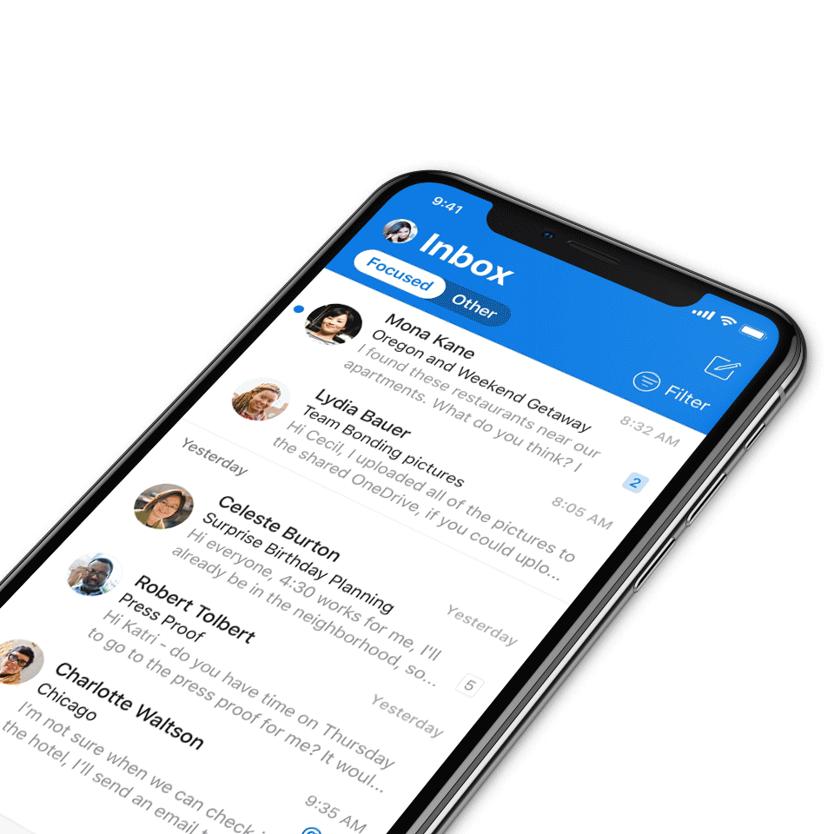
Digital Event Code of Conduct
Microsoft’s mission is to empower every person and every organization on the planet to achieve more. This includes all Microsoft events and gatherings, including on digital platforms, where we seek to create a respectful, friendly, fun and inclusive experience for all participants.​
We expect all digital event participants to uphold the principles of this Code of Conduct, which covers the main digital event and all related activities. We do not tolerate disruptive or disrespectful behavior, messages, images, or interactions by any party participant, in any form, at any aspect of the program including business and social activities, regardless of location.​
Microsoft will not tolerate harassment or discrimination based on age, ancestry, color, gender identity or expression, national origin, physical or mental disability, religion, sexual orientation, or any other characteristic protected by applicable local laws, regulations, and ordinances.​
We encourage everyone to assist in creating a welcoming and safe environment.
For more info, visit aka.ms/CodeofConduct.

Slide 4

Agenda
Announcements
Top Microsoft 365 updates
Topic 1: Microsoft Teams Accessibility Update
Topic 2: Copilot Business Case Builder Demo
Open discussion forum
Become a Champion today!
https://aka.ms/BecomeaChampion

Slide 5

Announcements
Microsoft 365 Community Conference
Your front-row seat to the future of work
Snag our biggest #M365Con savings yet! With 200+ expert-led sessions, you’ll discover game-changing insights to accelerate your productivity and AI transformation. Plus, meet Microsoft experts face-to-face, get hands on with the latest AI products and innovations, and build relationships with our global community.
🎉Limited time offer! Bring your team and save BIG together using code LASTCHANCE.
Discounted pricing:
1 ticket: $1,548 ($402 off)
2 tickets: $1,498 each ($452 off)
3–4 tickets: $1,398 each ($552 off)
5+ tickets: $1,298 each ($652 off)

Slide 6

Announcements
Microsoft 365 Community Conference
Champions meetup at the Microsoft 365 Community Conference
Come meet Karuana Gatimu, Tiffany Lee, and Jessie Hwang in person at the Microsoft 365 Community Conference in Las Vegas, Nevada, on May 7, 12-12:30 PM PT in the Community Lounge. This will be a casual meet and greet, where you can chat with us and network with your fellow Champions.
Bring your questions or suggestions – looking forward to seeing you there!

Slide 7

Microsoft 365 Community Conference 2025 – Featured speakers
Register today | aka.ms/M365Con25

Slide 8
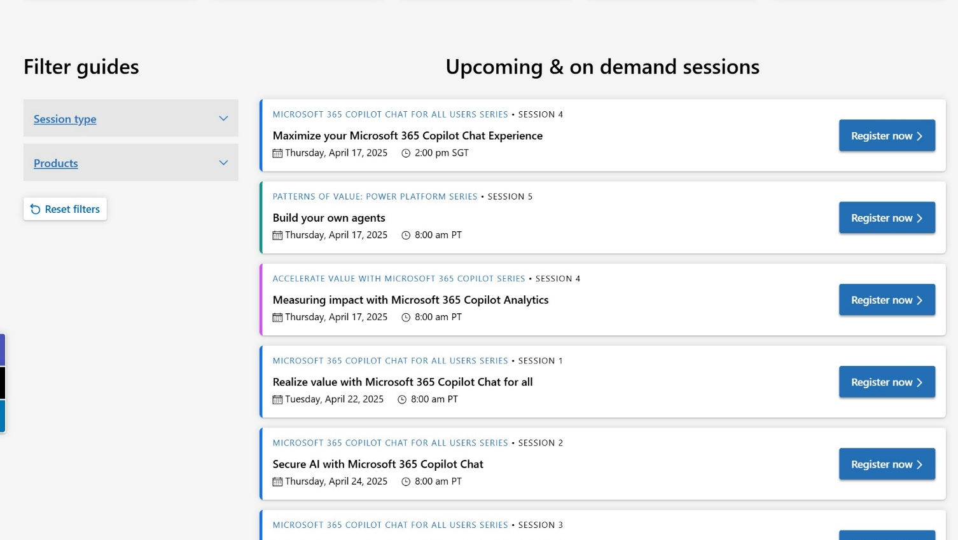
Announcements
Customer Hub
Upcoming Microsoft 365 Copilot webinars
Have you attended our Customer Hub webinar sessions? In today's hybrid work environment, modern communication and solutions are essential. Our goal is to help you explore what you can achieve with Microsoft solutions.
Join us for one or more of our upcoming sessions, including the launch of several new Copilot series. We also have all past session recordings so you can watch any that you missed and download the presentation materials.
Visit aka.ms/CustomerHubSessions to sign up today.

Slide 9
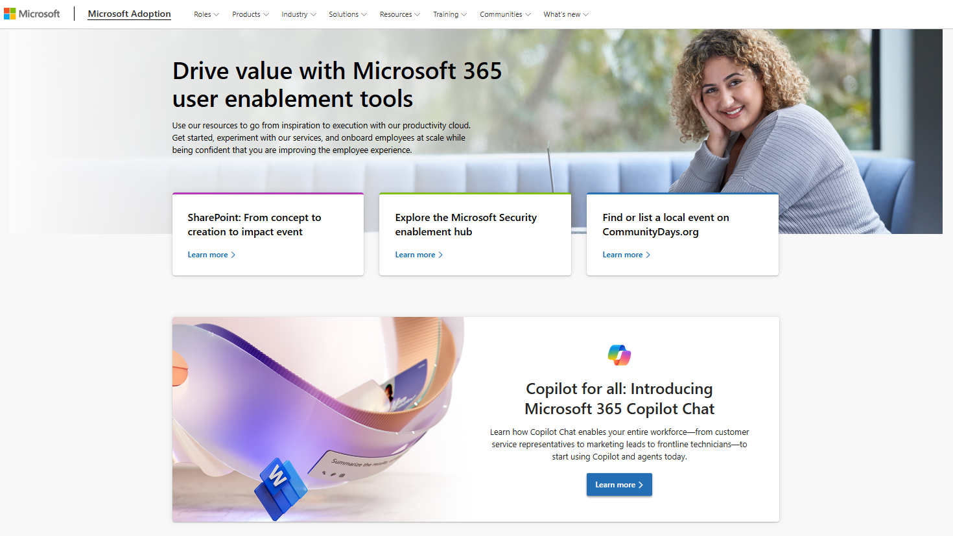
adoption.microsoft.com
Update highlights
New releases: Windows 11, Building Psychological Safety webinar series, OneDrive Customer Office Hours, Microsoft Clipchamp day in the life guides, loss of hearing and neurodivergence (ADHD) day in the life guides, the Copilot Skilling Event Framework kit, and new media and entertainment Copilot scenarios
Multiple updates to the Viva Engage Monday Masterclass, Patterns of value: Power Platform, Microsoft 365 Copilot Chat for all users and extensibility series on the Customer Hub
Updated adoption guide for Microsoft Security
New videos for Microsoft Security Copilot video hub
New security whitepaper for new Outlook for Windows
Read or subscribe to our Release notes for more updates.

Slide 10
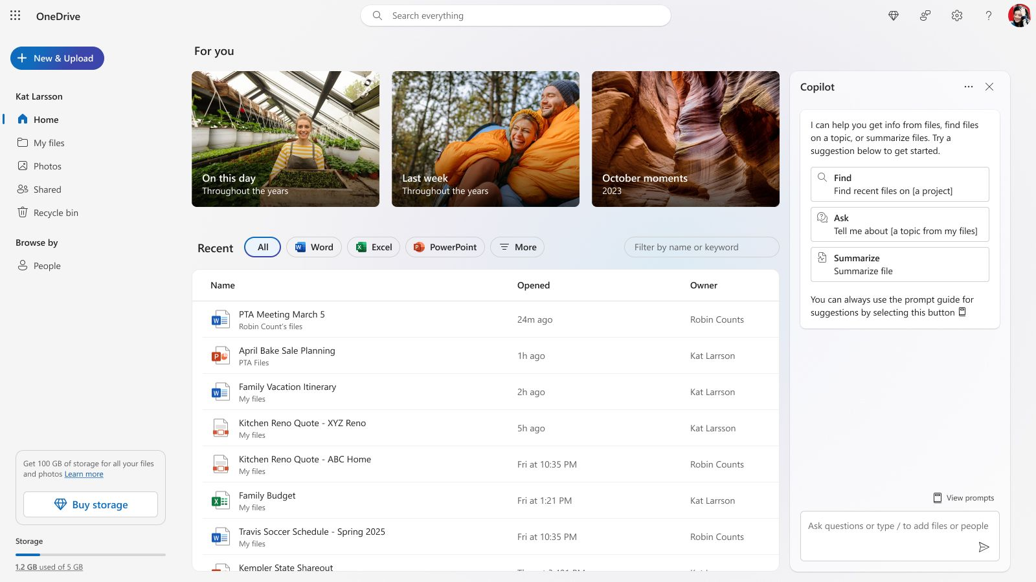
Top Microsoft 365 updates
Microsoft OneDrive
Microsoft 365 subscribers can now experience Copilot in OneDrive
We are excited to announce our rollout of new Copilot features available to subscribers on the web version of OneDrive. Consumers can now get more out of their OneDrive files utilizing the power of AI. Now you’re able to ask Copilot to summarize your files, compare files and ask questions about certain files.
Click here to learn more.

Slide 11
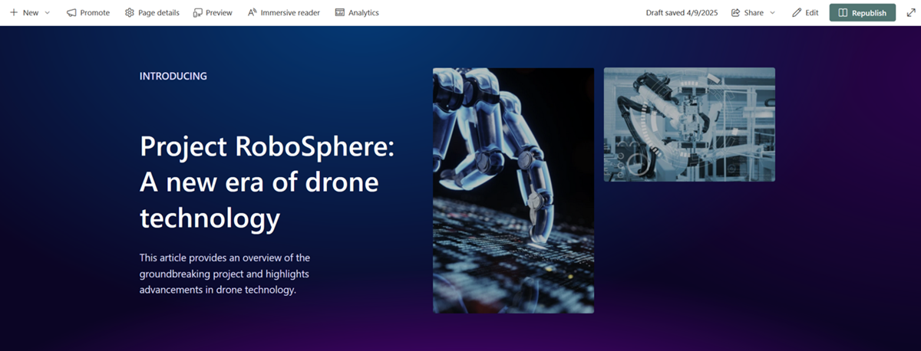
Top Microsoft 365 updates
Microsoft SharePoint
Introducing Preview mode in SharePoint pages and news
We are excited to share that we are releasing Preview mode in SharePoint pages and news. Preview mode can be used to understand how a page will look across different device types when it is viewed by an audience. Explore how you can utilize preview mode in page and news, mobile view, and add animation effects to web parts!
Note: This feature has started rolling out to Targeted Release customers and will continue to roll out to all enterprise customers through the end of April.
Click here to learn more.
Notes:
In Preview mode for Pages, authors can switch between Desktop and Mobile views of the page. In Preview mode for News, authors also have the option to look at the Email view of the news post if their news post can be sent as an email. To adjust the mobile view of flexible sections, authors can change the order in which the web parts reflow within a section by using the control in the section properties pane. We are also introducing animation effects for various web parts: People, Quick Links, and Editorial Cards. When these web parts enter the viewport, you will notice that they slide into view. By default, the animation will be turned on. To disable animation, use the web part properties pane. Animation can be seen in Preview mode.

Slide 12
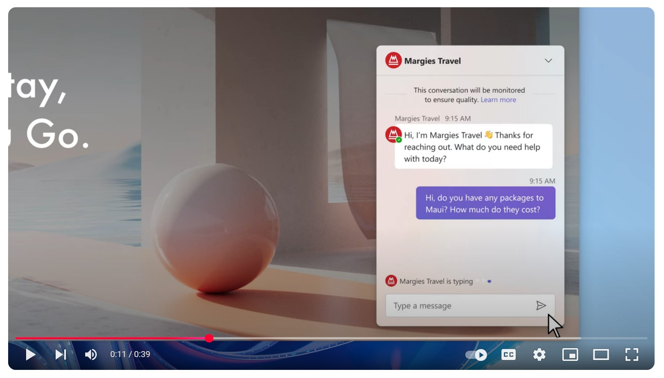
Top Microsoft 365 updates
Microsoft Teams
Live chat in Microsoft Teams
Live chat in Microsoft Teams enables small businesses to provide quick and helpful customer service by allowing website visitors to chat directly with their team in Teams. This feature includes notifications for incoming chat requests, a dashboard for managing conversations, and the ability to view previous customer interactions. You can get started using this today by adding the live chat widget on your website.
Click here to learn more.

Slide 13
Microsoft Teams accessibility updates
Making Teams better for all
Rolling out to general users
More visually responsive for low vision users enabling better flexibility for all
Keyboarding efficiency improvements
Pop-out captions
Coming soon
More flexible keyboarding through customization of shortcuts
Real-time Text (RTT) support

Slide 14
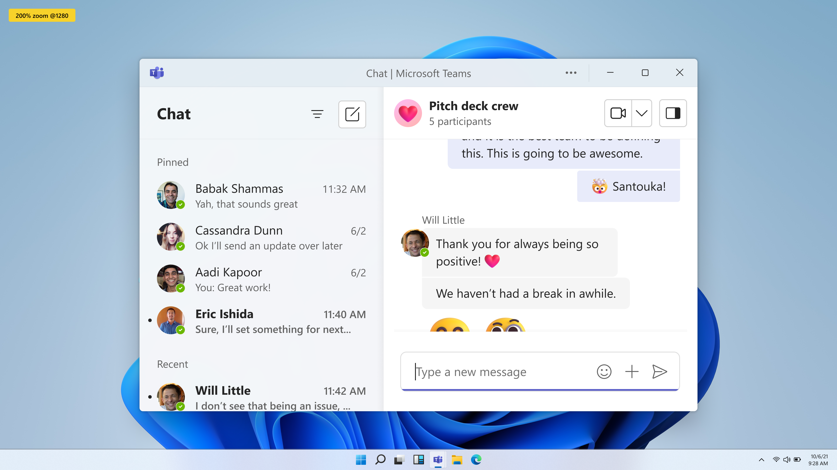
Responsive by design
The Teams desktop and web clients now dynamically adapt to different screen sizes and zoom levels without loss of content or functionality. This supports users who magnify content, use small screens, or need flexible layouts—making the Teams client more responsive and usable for everyone. General Availability – May 2025

Slide 15
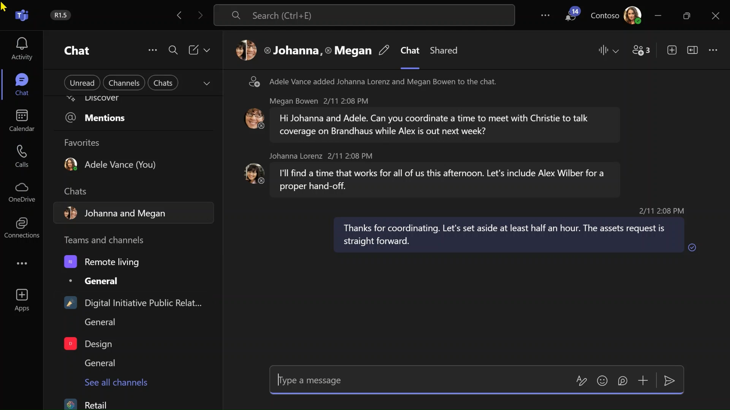
Video demo 1

Slide 16
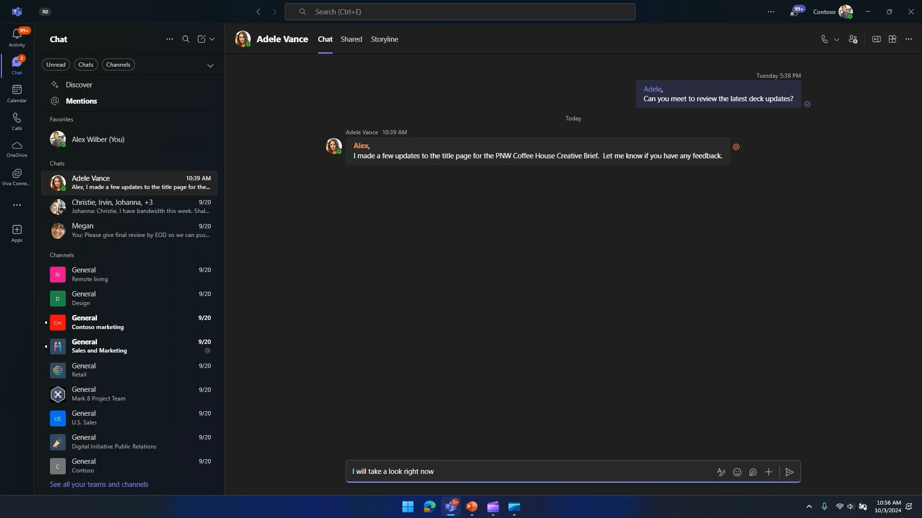
Video demo 2

Slide 17
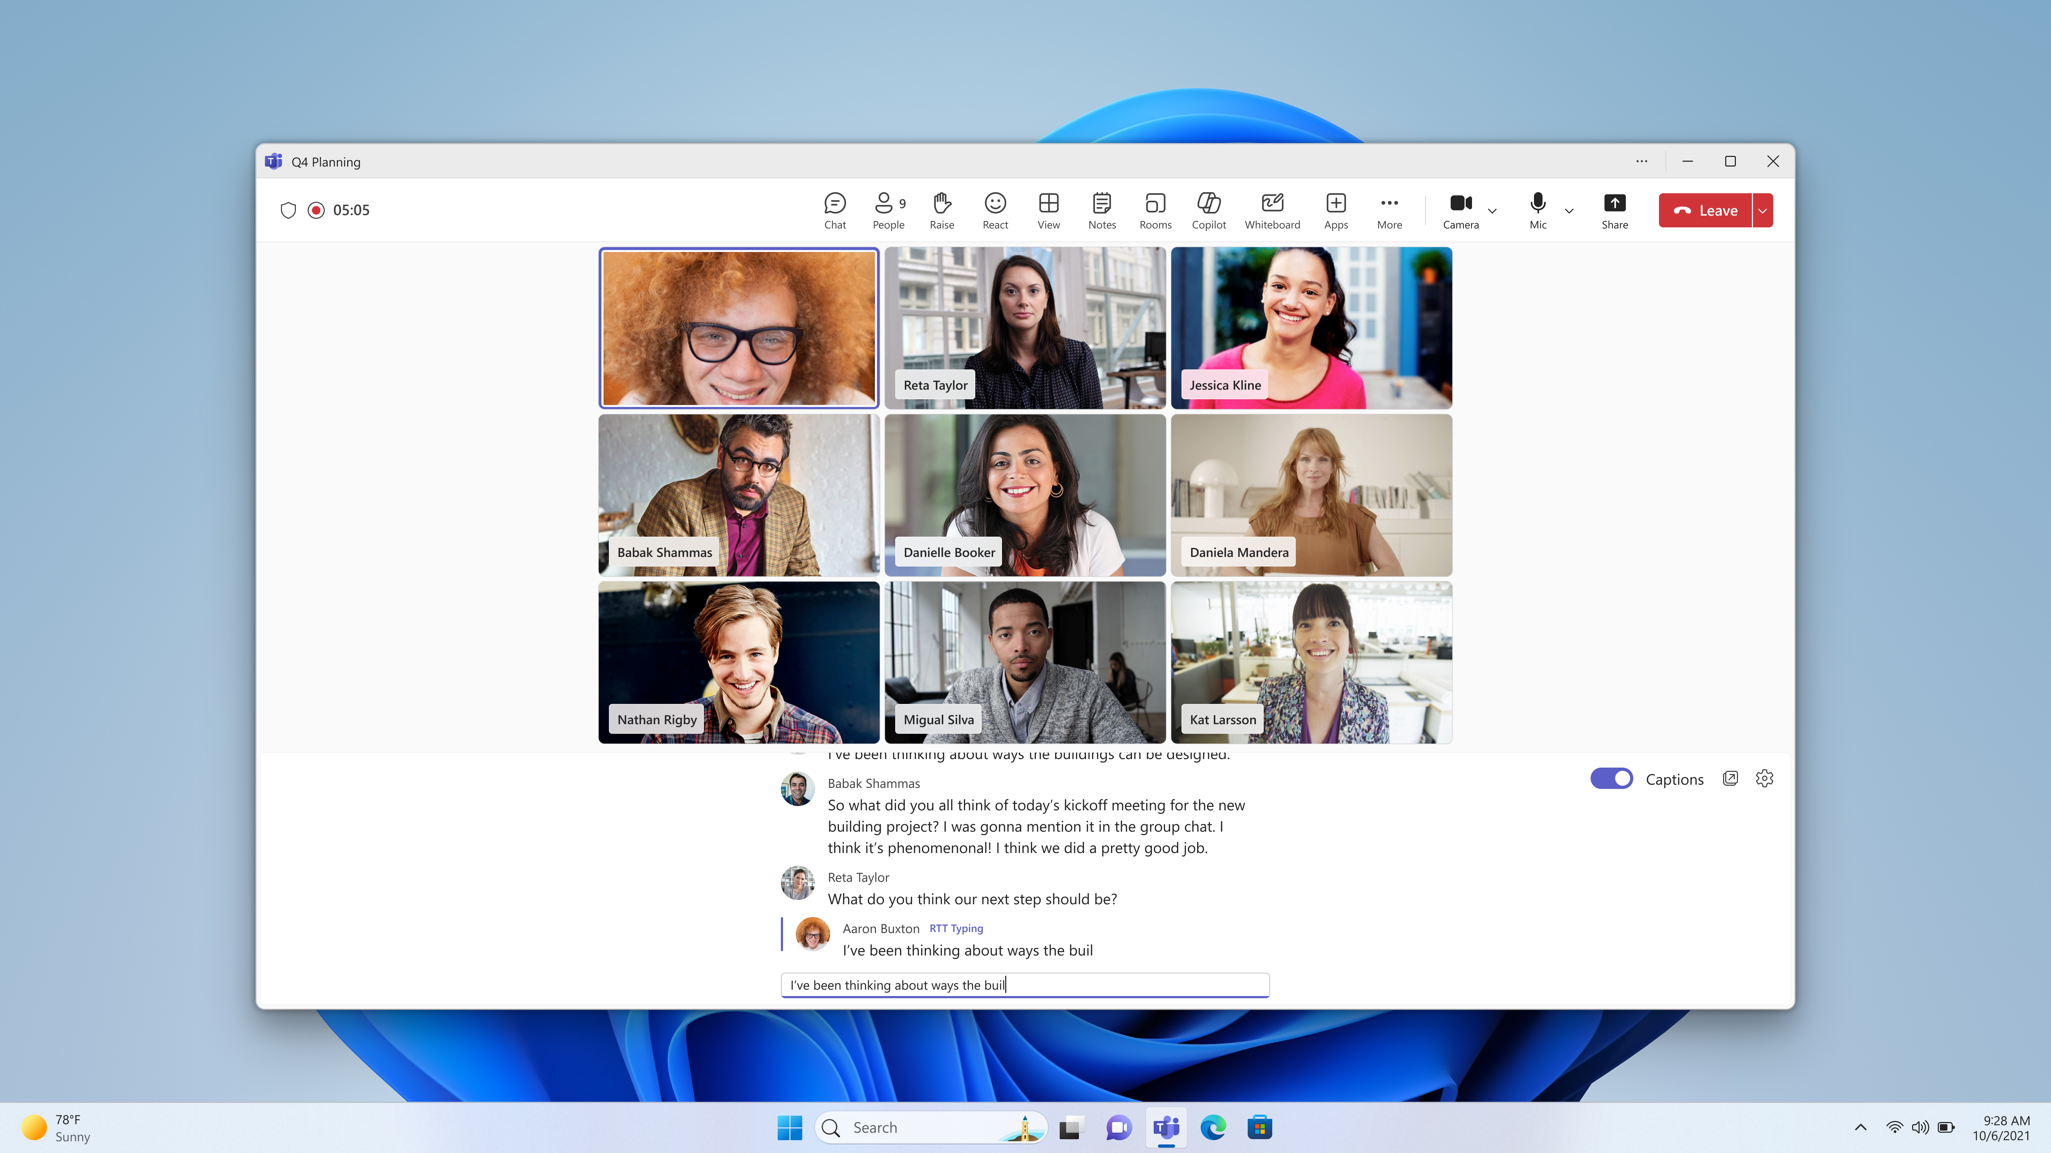
Introducing Real-time text (RTT)
Real-time text (RTT) is a fast, accessible, and immediate communication method that transmits text character by character as it is typed. It is particularly valuable in various calling and meeting scenarios where it enables deaf and hard-of-hearing individuals, neurodiverse users, and those with speech-related disabilities to engage in real-time conversations through text. General Availability – May 2025

Slide 18
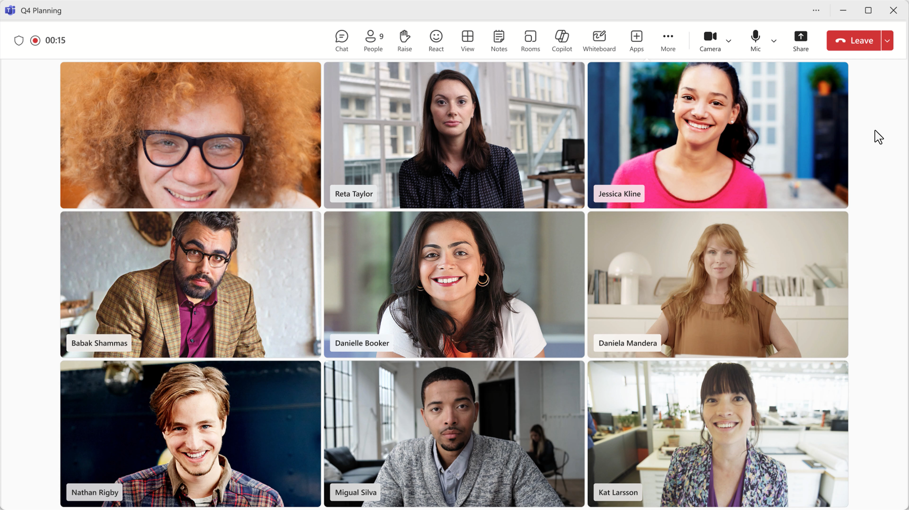
Video demo 3

Slide 19
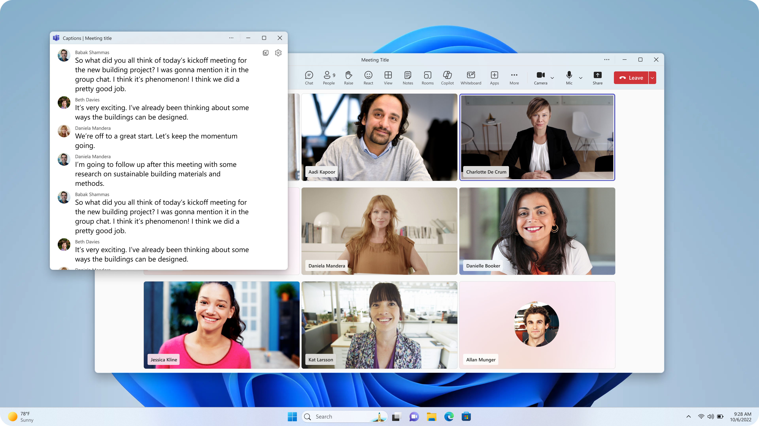
Pop-out captions
Teams now provides an even more flexible, customizable experience by allowing users to pop-out, move and resize captions independently from the main meeting window. This empowers users to place captions where they’re most useful, improving access and focus for participants who rely on them during meetings and calls.
General Availability – May 2025

Slide 20
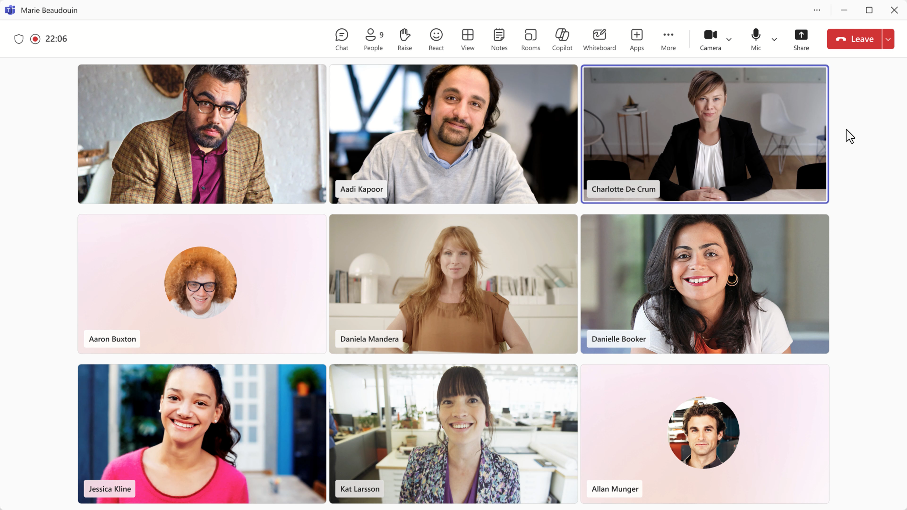
Video demo 4

Slide 21
SMBs using Microsoft 365 Copilot are already seeing transformative results
353%
projected ROI over a three-year period
132% low-end ROI
Statistics sources: “New Technology: The Projected Total Economic Impact™: Of Microsoft 365 Copilot for SMB,” a commissioned study conducted by Forrester Consulting on behalf of Microsoft. October 2024.
Notes:
SMBs who have been using Microsoft 365 Copilot are already seeing transformative results, with a projected ROI of 353% over a 3-year period. This impressive ROI highlights the significant benefits that come with integrating Copilot into your flow of work.
By streamlining internal processes and enhancing productivity, businesses like yours can leverage these returns to thrive in today's fast-paced business environment and stay ahead of the competition.

Slide 22
Copilot transforms your business to enhance personal productivity and business processes
New Technology: The Projected Total Economic Impact™: Of Microsoft 365 Copilot for SMB
6%
20%
18%
increase in
net revenue
reduction in operating costs
increase in employee satisfaction
Statistics sources: “New Technology: The Projected Total Economic Impact™: Of Microsoft 365 Copilot for SMB,” a commissioned study conducted by Forrester Consulting on behalf of Microsoft. October 2024.

Slide 23
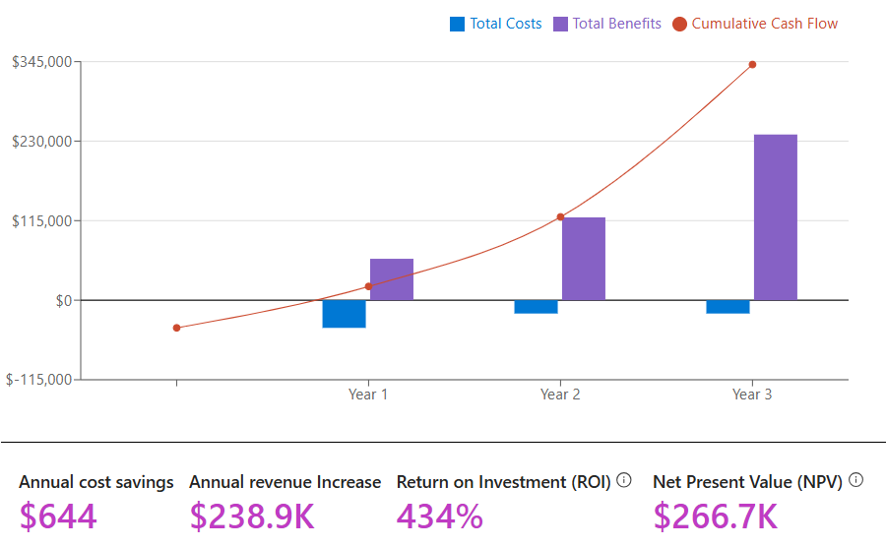
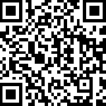
Estimate your ROI
Companies have seen:
Customer Service increase in customer retention
3%
Sales increase in sales win rate
2.5%
Marketing More opportunities created
2.7%
aka.ms/SMBValue
1. Microsoft 365 Copilot drove up to 353% ROI - new study

Slide 24
Upcoming community events
M365 Community Day Saint Louis | May 2 | Saint Louis, Missouri
Microsoft 365 Community Conference | May 4-9 | Las Vegas, Nevada
DynamicsCon 2025 | May 13-16 | Chicago, Illinois
CollabDays Poland 2025 | May 16-17 | Warsaw, Poland
European Power Platform Conference | June 16-19 | Vienna, Austria
TechCon365 – Seattle 2025 | June 23-27 | Seattle, Washington
Explore other Microsoft events here and a full list of community-led events can be found at CommunityDays.org

Slide 25

Open discussion
If viewing on-demand, drop your questions in the Microsoft Tech Community – Driving Adoption event page to engage with us!
Share your feedback for this call by visiting https://aka.ms/Microsoft365ChampionCallFeedback

Slide 26



What’s next
Share your feedback
https://aka.ms/Microsoft365ChampionCallFeedback
Next call:
May 27
Topic:
Microsoft Adoption updates
Join the Driving Adoption community
https://aka.ms/DrivingAdoption
Invite colleagues to become a Champion
https://aka.ms/M365Champions

