Slide 1
Microsoft 365 Champions
community call
October 2024

Slide 2
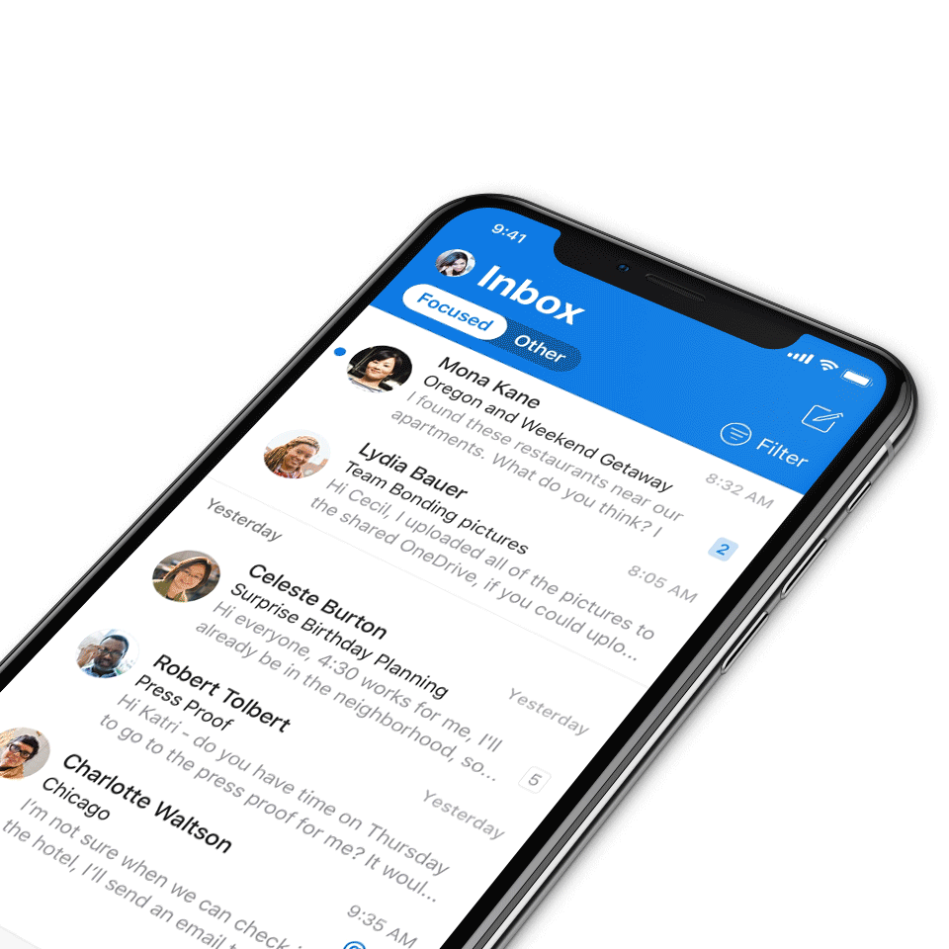
Digital Event Code of Conduct
Microsoft’s mission is to empower every person and every organization on the planet to achieve more. This includes all Microsoft events and gatherings, including on digital platforms, where we seek to create a respectful, friendly, fun and inclusive experience for all participants.​
We expect all digital event participants to uphold the principles of this Code of Conduct, which covers the main digital event and all related activities. We do not tolerate disruptive or disrespectful behavior, messages, images, or interactions by any party participant, in any form, at any aspect of the program including business and social activities, regardless of location.​
Microsoft will not tolerate harassment or discrimination based on age, ancestry, color, gender identity or expression, national origin, physical or mental disability, religion, sexual orientation, or any other characteristic protected by applicable local laws, regulations, and ordinances.​
We encourage everyone to assist in creating a welcoming and safe environment.
For more info, click here.

Slide 3
Agenda
Announcements
Top Microsoft 365 updates
Main topic: Microsoft Lists
Open discussion forum
Become a Champion today!
https://aka.ms/BecomeaChampion

Slide 4
Our updated call format
We’re enabling new call formats to embrace new community interactions and reach.
How to watch:
The show will now stream live to the Microsoft Tech Community (MTC) and the Microsoft Community Learning YouTube channel. The join links remain the same and clicking through will take you to the MTC event page. Our community call times are still the same: 4th Tuesday of every month at 8:05 AM and 5:05 PM Pacific Time.
https://aka.ms/M365ChampionCallAM
https://aka.ms/M365ChampionCallPM
How to join the open discussion at the end of the call:
If you're watching on the Tech Community, ask your questions by leaving comments on the Tech Community page.
Reason for the new format:
Our community calls will be more accessible to worldwide audiences. All calls will be immediately available on demand once the call ends.
REMINDER:
All presentations remain available to Microsoft 365 Champion Program members, link in the monthly newsletters. Not a member? Join in the link below for access to calendar invites, presentations, and all previous calls.
Microsoft 365 Champions
https://aka.ms/M365Champions

Slide 5
Announcements
Mondays at Microsoft
Mondays at Microsoft with Karuana and Heather
Join Karuana Gatimu and Heather Cook every other Monday morning to stay informed and in-the-know on Microsoft’s biggest topics, including the latest in AI and what’s happening in the Microsoft community.
Visit https://aka.ms/MondaysAtMicrosoft to see when the next episode airs and to catch up on previous episodes.

Slide 6
Announcements
Microsoft Community
New MGCI community calls
Are you a seasoned event organizer looking to promote your event? Or you want to discover ways to get involved in community locally? If so, join the MGCI to get exclusive access to best practices, training, opportunities to network with other event organizers, and more.
Find us at:
Visit aka.ms/MGCI to join MGCI today!
Subscribe to youtube.com/@MicrosoftCommunityLearning
Become a member at techcommunity.microsoft.com

Slide 7
Build your community skills
The Community Skills Challenge
Build your skills – get the badge! Are you new to the Microsoft world or never learned the basics? Do you want to build your professional skills? Then this challenge is for you! You will learn:
Fundamental power skills
Introductory Microsoft 365 content
User enablement training
Get started here: https://aka.ms/communityskills

Slide 8
Adoption.microsoft.com
Update highlights
New Microsoft AI Tour resources page, including a behind-the-scenes video from the kick-off event in Mexico City
Addition of Business Chat to the Copilot Scenario Library
Multiple updates to the Microsoft Lists page, including a new overview video, new blog posts, and images
Updated the free trial extension for SharePoint Premium through June 2025
New Microsoft 365 Copilot GCC page
New on demand sessions for Copilot extensibility on the Modern Work Customer Hub
Read or subscribe to our Release notes for more updates.

Slide 9
Top Microsoft 365 updates
Microsoft 365 Copilot
Join the Unlocking ROI: Forrester TEI Study Insights on Microsoft 365 Copilot for SMBs webinar
We are excited to announce an upcoming webinar that will delve into the findings of the Forrester Total Economic Impact™ (TEI) study on Microsoft 365 Copilot for Small and Medium-sized Businesses (SMBs). This event promises to be a valuable opportunity for SMBs to learn about the significant business value and return on investment (ROI) that can be achieved by implementing Microsoft 365 Copilot.
Click here to register.

Slide 10
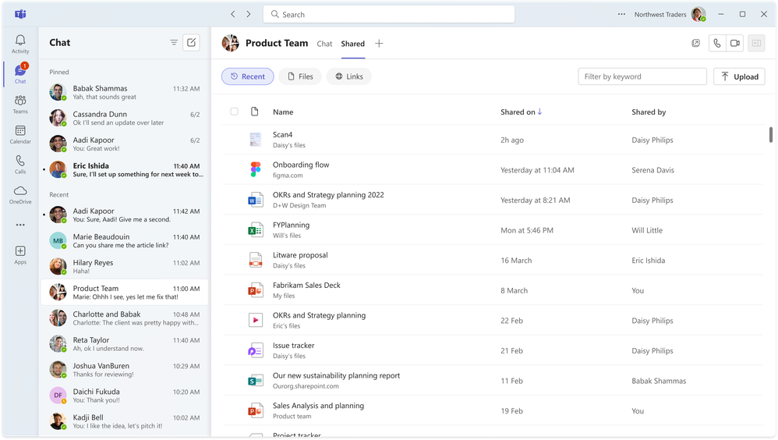
Top Microsoft 365 updates
Microsoft Teams
‘Shared’ tab in chat
To streamline finding a previously shared document or link and to simplify content management, we are introducing the ‘Shared’ tab in 1:1 and group chat conversations. The ‘Shared’ tab replaces the ‘Files’ tab and consolidates files and links that were sent in the chat, making it easier to find them all in one place. In addition, the ‘filter by keyword’ option will help you quickly locate content you need that was shared in the chat. This enhancement simplifies file management and boosts productivity. No action is required to receive this update, and channels are not affected by this change.
Click here to learn more.

Slide 11
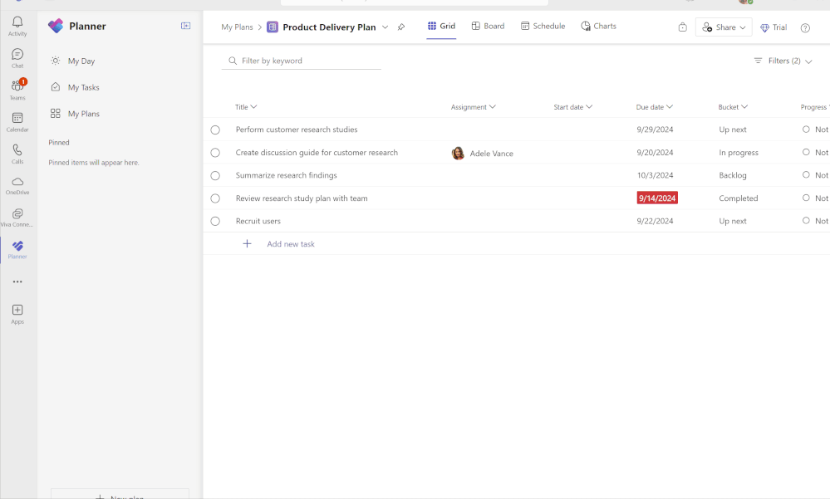
Top Microsoft 365 updates
Microsoft Planner
Labels column now in Grid view
Organize and categorize your tasks more efficiently using the labels column in your basic plans’ Grid view. We’ve commonly heard this feature request from customers and hope this feature makes it easier for you to track progress and manage your projects. Try it out by navigating to Grid view for any basic plan and selecting “Add label” for any task in the Labels column. You can edit the name of the label by selecting the label on the task, and filter by label to get a more granular view of your plan.
Click here to learn more.

Slide 12
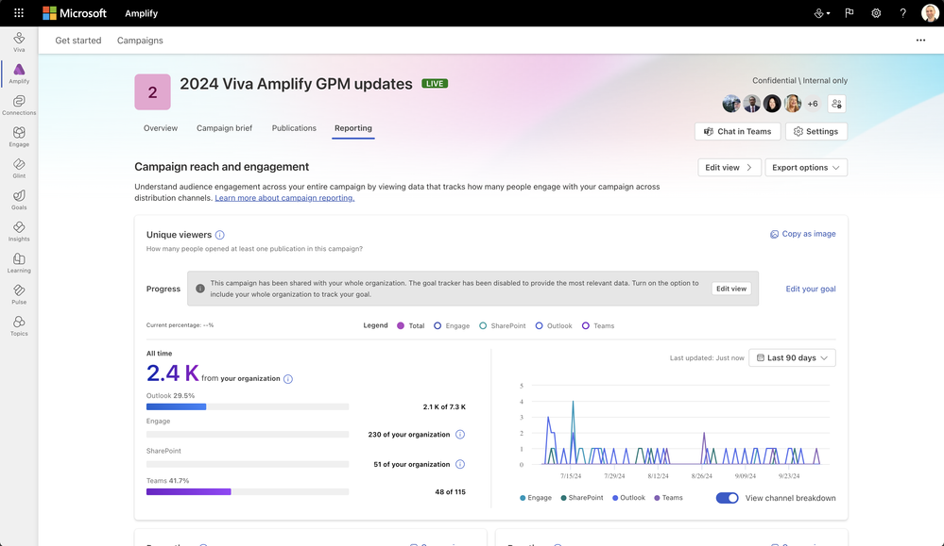
Top Microsoft 365 updates
Microsoft Viva Amplify
Enhancements to Viva Amplify analytics
We are excited to announce the availability of new analytics capabilities in Viva Amplify.
Updates include:
Reports displaying audience count and percentage
User signals in data graphs
Reactions, and more
Click here to learn more.

Slide 13
Open discussion
Drop your questions in the Microsoft Tech Community – Driving Adoption event page or visit https://aka.ms/M365ChampionCall/ask to join the live on-air queue to get your questions answered!
Share your feedback for this call by visiting https://aka.ms/Microsoft365ChampionCallFeedback

Slide 14
Primary Topic | Microsoft Lists
Mark Kashman
Senior Product Manager
Microsoft
Nate Tennant
Senior Product Manager
Microsoft

Slide 15
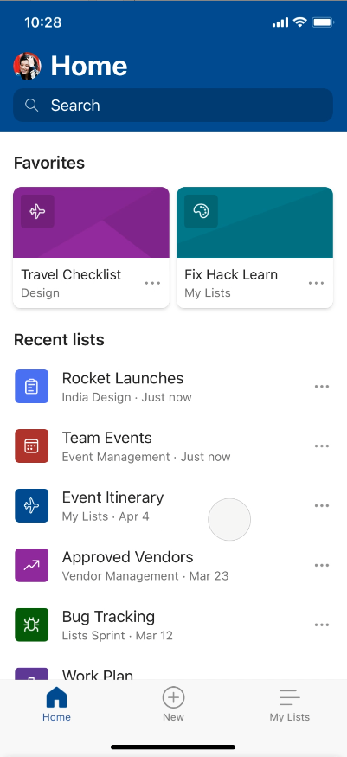
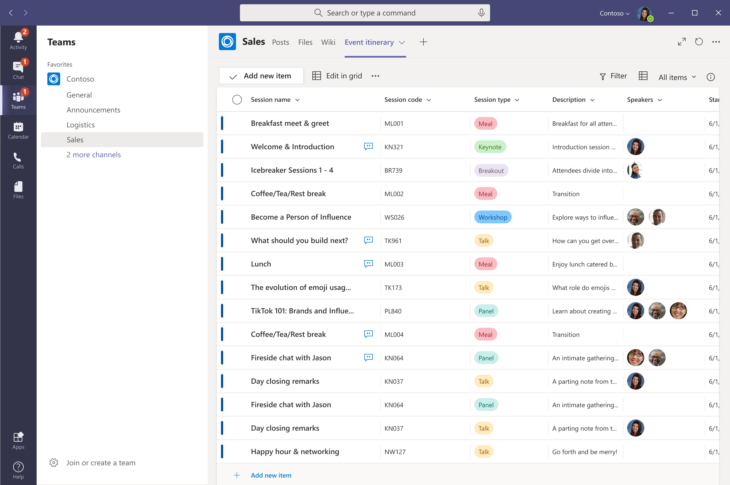
Microsoft Lists
Your smart information tracking app in Microsoft 365

Slide 16
Microsoft Lists – Simple, Smart, and Flexible
Simple
Easily create, share and track lists with anyone, on any device
Smart
Keep everyone in sync with smart alerts and collaboration features
Flexible
Customize your lists for whatever your business needs
Notes:
Microsoft Lists | A simple and powerful app to share and track information. Make a list and let it flow. Track and organize your work.
We’ve made lists a fundamental element throughout Microsoft 365, to help users track and prioritize content calendars, contact lists, issue tracking, inventory, contract renewals, event itinerary, ticket submission, status reporting, employee on boarding, business trip approvals, deal milestones, roadmap, FAQs, spend, KPIs, patient rounding in healthcare and more.
Create | Empower lightweight work management with beautiful, flexible views, rules and flows [world-class UX]
Share | Collect, unite and distribute structured information across day-to-day business [collaborative and social]
Track | Manage information for individuals, teams and the organization [including Microsoft Graph, Search & SP-level security/compliance]
We are making significant investments in lists this year, applying craftsmanship and customer empathy to turn an awesome technical asset into a product/service that people love, on the web and on mobile.
How will people use “lists”? Submit travel requests; drive important team processes; track important customer engagements and more.
FYI | What to use when – how we differentiate with other M365 apps:
Microsoft Lists [Work management, work tracking] | Create, share and track structured information with the ability to create, collect, view, filter, sort, collaborate, share, etc. across status, life cycle, ownership, etc.
Lists can further integrate with the Power Platform to design and build productivity apps alongside Power Apps and Power Automate; lists are the underlying database for IW-led productivity apps.
Microsoft To Do [Task management] | For individuals - a complete view of all their tasks, including tasks assigned to them. It is their view on their tasks. When completed, tasks disappear.
Microsoft Planner [Task management] | For the team; task management for the team; tasks assigned to individuals on the team. When completed, tasks disappear.
Microsoft Tasks [Task management] | an app within Teams to help users manage and prioritize their work generated, aggregated from Microsoft’s portfolio of productivity and collaboration tools: Office docs, Planner plans, emails, chats, and more.
Microsoft Excel [Analysis tool] | Create spreadsheets using built-in tools to help turn data into insights and to visualize via charts and graphs – to help calculate, analyze and predict.
In Excel, the individual cell is the focus; related information sits next to each other
With Lists, an entire row is the collective focus; related information with each other
Note: You can import data from Excel, manage with the list and one-way export up-to-date info back in Excel or Power BI.
Power Platform – Common Data Service (CDS): [App platform] | Rich base for custom solutions that combine external connectors and require support for more complex data modeling.

Slide 17
demo time with Mark
Notes:
Where to get it/how to access: Start from the Figma Community page, then Open in Figma: https://aka.ms/SPWebUIkit
How to use:
Getting Started - explain how you can start with a template or start from scratch, call out change logs Change the look - explain how you can see different layouts/configurations here, maybe the copy me element Templates - show how to customize with both copy and paste or drag and drop, demonstrate how to edit a text heading Web part - pick a web part and demonstrate the different settings; show how to edit the components directly and how that flows through to the kit; green dots means added most recently

Slide 18
Microsoft Lists | Add Approvals to any list or library
Nate Tennant
Senior Product Manager
Microsoft

Slide 19
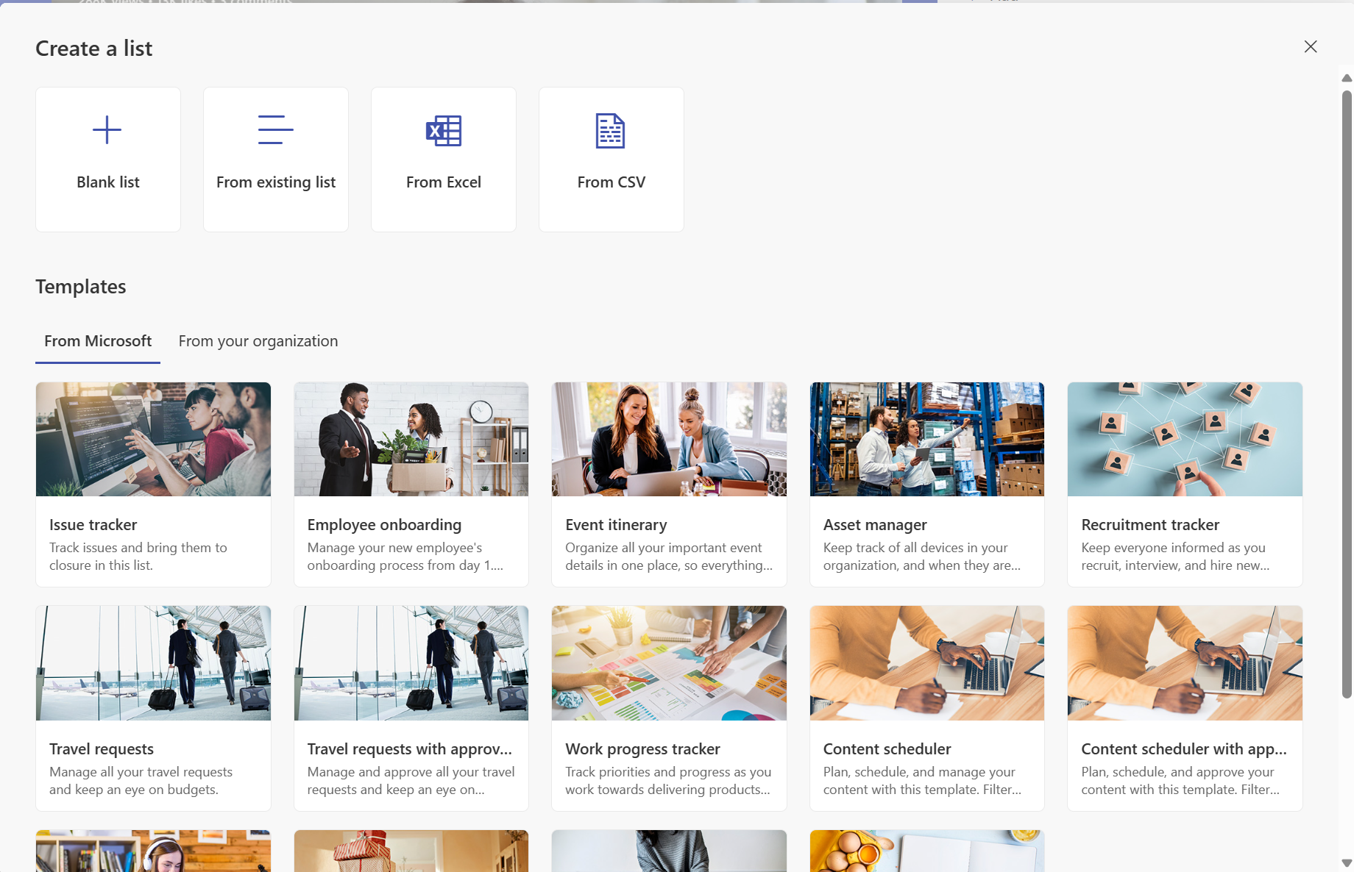
Lightweight approvals in Lists | Built in
Connected to Teams Approvals | Available in two list templates

Slide 20
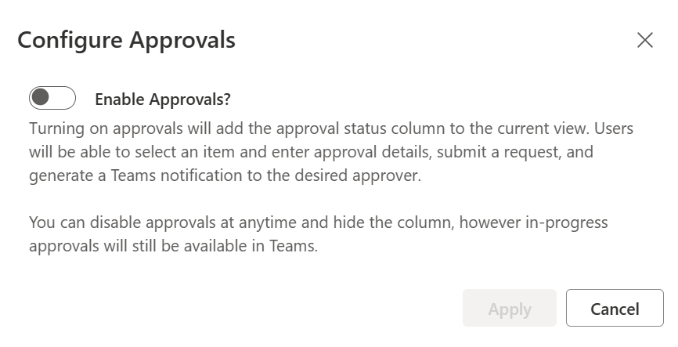
Lightweight approvals in Lists | Add to any list
Enable with the flick of a simple toggle…
… to bring the same experience to any of your lists – in Lists, SharePoint, and Teams.

Slide 21
demo time with Nate
Notes:
Where to get it/how to access: Start from the Figma Community page, then Open in Figma: https://aka.ms/SPWebUIkit
How to use:
Getting Started - explain how you can start with a template or start from scratch, call out change logs Change the look - explain how you can see different layouts/configurations here, maybe the copy me element Templates - show how to customize with both copy and paste or drag and drop, demonstrate how to edit a text heading Web part - pick a web part and demonstrate the different settings; show how to edit the components directly and how that flows through to the kit; green dots means added most recently

Slide 22
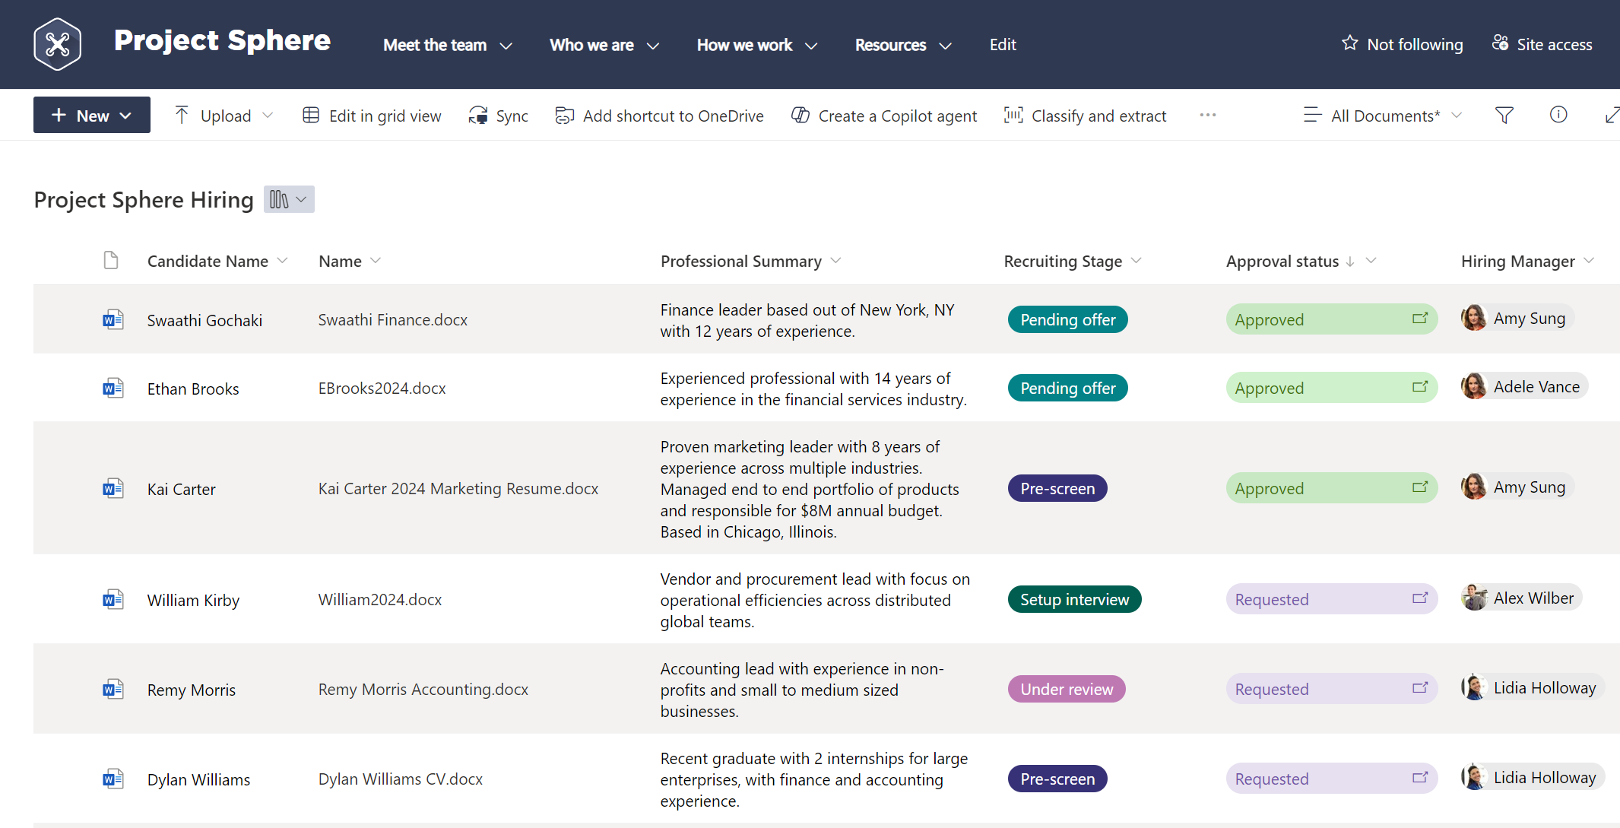
And one more related item…
With that same flick of a toggle…
… you, too, will be able to add the same approvals experience to any document library!

Slide 23
Learn more | Microsoft Lists
aka.ms/MSLists

Slide 24
Upcoming community events
Oct 23
Oct 26
Oct 31
Nov 1
Nov 11-15
Nov 18-22
Dec 2-5
D365UG Sverige
Community Days Montreal
Community Days Mexico City
AI Community Conference
TechCon365 Dallas
Microsoft Ignite 2024
European SharePoint Conference
Stockholm, Sweden
Montréal, Canada
Mexico City, Mexico
Houston, TX
Dallas, TX
Chicago, IL / Hybrid
Stockholm, Sweden
Explore other Microsoft events here and a full list of community-led events can be found at CommunityDays.org

Slide 25
Open discussion
Drop your questions in the Microsoft Tech Community – Driving Adoption event page or visit https://aka.ms/M365ChampionCall/ask to join the live on-air queue to get your questions answered!
Share your feedback for this call by visiting https://aka.ms/Microsoft365ChampionCallFeedback

Slide 26
What’s next
Share your feedback
https://aka.ms/Microsoft365ChampionCallFeedback
Next call:
November 26
Topic:
Microsoft Ignite recap
Join the Driving Adoption community
https://aka.ms/DrivingAdoption
Invite colleagues to become a Champion
https://aka.ms/M365Champions

