Slide 1
Microsoft 365 Champions
community call
November 2024

Slide 2
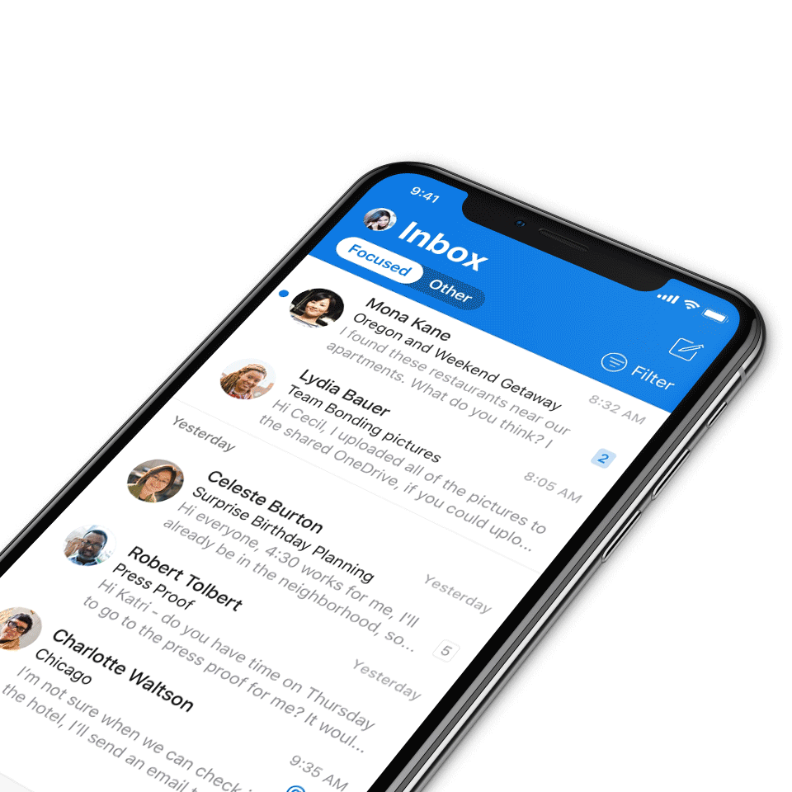
Digital Event Code of Conduct
Microsoft’s mission is to empower every person and every organization on the planet to achieve more. This includes all Microsoft events and gatherings, including on digital platforms, where we seek to create a respectful, friendly, fun and inclusive experience for all participants.​
We expect all digital event participants to uphold the principles of this Code of Conduct, which covers the main digital event and all related activities. We do not tolerate disruptive or disrespectful behavior, messages, images, or interactions by any party participant, in any form, at any aspect of the program including business and social activities, regardless of location.​
Microsoft will not tolerate harassment or discrimination based on age, ancestry, color, gender identity or expression, national origin, physical or mental disability, religion, sexual orientation, or any other characteristic protected by applicable local laws, regulations, and ordinances.​
We encourage everyone to assist in creating a welcoming and safe environment.
For more info, click here.

Slide 3
Agenda
Announcements
Main topic: Ignite recap
Open discussion forum
Become a Champion today!
https://aka.ms/BecomeaChampion

Slide 4
Our updated call format
We’re enabling new call formats to embrace new community interactions and reach.
How to watch:
The show will now stream live to the Microsoft Tech Community (MTC) and the Microsoft Community Learning YouTube channel. The join links remain the same and clicking through will take you to the MTC event page. Our community call times are still the same: 4th Tuesday of every month at 8:05 AM and 5:05 PM Pacific Time.
https://aka.ms/M365ChampionCallAM
https://aka.ms/M365ChampionCallPM
How to join the open discussion at the end of the call:
If you're watching on the Tech Community, ask your questions by leaving comments on the Tech Community page.
Reason for the new format:
Our community calls will be more accessible to worldwide audiences. All calls will be immediately available on demand once the call ends.
REMINDER:
All presentations remain available to Microsoft 365 Champion Program members, link in the monthly newsletters. Not a member? Join in the link below for access to calendar invites, presentations, and all previous calls.
Microsoft 365 Champions
https://aka.ms/M365Champions

Slide 5
Announcements
Mondays at Microsoft
Mondays at Microsoft with Karuana and Heather
Join Karuana Gatimu and Heather Cook every other Monday morning to stay informed and in-the-know on Microsoft’s biggest topics, including the latest in AI and what’s happening in the Microsoft community.
Visit https://aka.ms/MondaysAtMicrosoft to see when the next episode airs and to catch up on previous episodes.

Slide 6
Announcements
Microsoft Community
New MGCI community calls
Are you a seasoned event organizer looking to promote your event? Or you want to discover ways to get involved in community locally? If so, join the MGCI to get exclusive access to best practices, training, opportunities to network with other event organizers, and more.
Find us at:
Visit aka.ms/MGCI to join MGCI today!
Subscribe to youtube.com/@MicrosoftCommunityLearning
Become a member at techcommunity.microsoft.com

Slide 7
Build your community skills
The Community Skills Challenge
Build your skills – get the badge! Are you new to the Microsoft world or never learned the basics? Do you want to build your professional skills? Then this challenge is for you! You will learn:
Fundamental power skills
Introductory Microsoft 365 content
User enablement training
Get started here: https://aka.ms/communityskills

Slide 8
Adoption.microsoft.com
Update highlights
Addition of a Microsoft Ignite highlight on the Microsoft 365 Copilot page
Release of Get started with Copilot in PowerPoint, Word, and Teams guides in the Copilot Success Kit
Addition of the new chat and channels experience link on the classic and new Microsoft Teams pages
Updates to the Microsoft 365 Copilot for Small and Medium Business page, including aligning with the Microsoft 365 implementation framework and resources
Addition of a customer adoption guide on the agents in SharePoint page
Read or subscribe to our Release notes for more updates.

Slide 9
Ignite 2024 Recap
Introduction
Microsoft Ignite & Ignite 2024 Book of News
Microsoft Ignite(Nov 18-22, 2024), our annual event that spotlights the updates and creations that enable customers, partners and developers to unleash the full potential of Microsoft’s technology and change the way people and organizations approach work.
200,000 total registered participants with more than 14,000 attendees at our in-person events in Chicago. Attendees chose from more than 800 sessions, demos and expert-led labs from Microsoft and our partners.
Missed it? Visit ignite.microsoft.com to view on demand or catch up via the Ignite Book of News

Slide 10
Ignite 2024 Recap
AI at Work
Agents, agents, agents
“Think about [agents] these like your teammates. They are scoped to specific roles with specific permissions”- Satya Nadella, Ignite 2024
Facilitator agent - acts like someone you add to a Teams meeting, keeping the meeting focused, chats, follow-up and action items
Project manager agent - in Planner helps automate the key steps in a project management workflow, create a new plan from scratch, task assignment, content creation
Self service agent - using Microsoft 365 Copilot Business Chat (BizChat) answers for common workplace policy-related questions and takes actions on key HR and IT related-tasks.
Notes:
Self service agent- using Microsoft 365 Copilot Business Chat (BizChat) answers for common workplace policy-related questions and takes actions on key HR and IT related-tasks. Users can retrieve benefits and payroll information, start a leave of absence, request a new laptop with IT and even get assistance for Microsoft 365 products and services, all in one place

Slide 11
Ignite 2024 Recap
AI at Work
Agents, agents, agents
Interpreter agent(early preview next year)- a real-time translation tool in Teams with up to nine languages, with the opportunity to have the agent simulate the user’s voice for any meeting participant
SharePoint agent - every SharePoint site will have this agent that will provide instant access from real time information grounded on specific SharePoint content, users can create their own agents on specific SharePoint files, folders or sites that support common business processes, these agents personalized name and certain behaviors

Slide 12
Ignite 2024 Recap
AI at Work
Copilot Actions and Analytics
Copilot Actions, now in private preview, enable anyone to automate everyday tasks with simple, fill-in-the-blank prompts, whether it’s getting a daily summary of meeting actions in Microsoft Teams, compiling weekly reports or getting an email upon return from vacation that summarizes missed meetings, chats and emails.
Anyone can easily set up Actions right in their Microsoft 365 app, allowing users to focus on more impactful work, save time and boost productivity.
Users will be able to maximize their meetings with Microsoft 365 Copilot in Teams’ new ability to analyze content presented in Teams for valuable insights.
Notes:
Copilot already analyzes spoken words and chat messages, and the addition of onscreen content will enhance the user experience with a 360-degree view of meetings. Users will be able to ask Copilot to summarize screenshared content, (i.e., “Which products had the highest sales?”), consolidate insights across both the conversation and presentation (i.e., “What was the feedback per slide?”) and draft new content based on the entire meeting (i.e., “Rewrite the spreadsheet as a table with only the rows that are On Track”). This capability will be in preview in early 2025.

Slide 13
Ignite 2024 Recap
AI at Work
Copilot File Summaries
With new file summaries in 1:1 and group chats in Teams, Copilot in Teams will be able to quickly summarize the content so the user can understand the main points without opening the file.
Copilot file summaries will be available in preview in early 2025 with Microsoft 365 Copilot in Teams for both mobile and desktop clients.
Notes:
When a file is shared in a chat, you don’t always have the time to open it, read through, and grasp the key ideas. With new file summaries in 1:1 and group chats in Teams, Microsoft 365 Copilot can quickly summarize content from Microsoft Word documents, PowerPoint presentations, and PDFs, so you can understand the main points without opening the file. This feature is also available on mobile, making it easier to grasp key ideas without reading an entire document on a small screen while on the move. It respects the file's security policies, ensuring that only users with access to the file receive a summary, which will carry the same sensitivity label as the original file.

Slide 14
Ignite 2024 Recap
AI at Work
Copilot Control system
Copilot Control System—designed for IT to confidently adopt and accelerate the business value of Copilot and agents.
Including:
Data protection : SharePoint Advanced Management will be included at no additional charge
Management controls: Copilot in Microsoft 365 admin centers will be avaliable to all Copilot customers
Measurement and reporting: Viva insights will be included at no additional charge as part of new Copilot Analytics
*Generally avaliable in early 2025*
Notes:
Data protection enables intelligent grounding on enterprise data while respecting your organization’s controls. To give IT even more control, we’re announcing that SharePoint Advanced Management will be included at no additional charge for Copilot customers to accelerate adoption and address oversharing with built-in content governance reports and controls. Generally available in early 2025.
Management controls allow IT to govern access and usage of Copilot and agents—including controls over which users can use Copilot and agents—along with visibility into agent status and lifecycle. And we’re announcing that Copilot in Microsoft 365 admin centers will be available to all Copilot customers to automate time-consuming IT tasks, provide personalized insights to improve tenant management, and answer admin questions. In private preview; generally available early 2025.
Measurement and reporting allow IT and business leaders to track adoption patterns and return on investment from the use of Copilot and agents. We’re announcing that Microsoft Viva Insights will be included in Copilot at no additional charge as part of the new Copilot Analytics. Copilot Analytics provides out-of-the-box experiences to measure Copilot adoption and business impact, customizable reporting for deeper analysis, and the new Copilot Business Impact Report for analyzing Copilot usage against business key performance indicators across sales, finance, marketing, and more. The Copilot Business Impact Report is in public preview; Copilot Analytics generally available in early 2025.

Slide 15
Ignite 2024 Recap
AI at Work
Microsoft Places
Microsoft Places, now generally available, brings AI-powered location understanding to Teams and Outlook with Microsoft 365 Copilot to help employees optimize in-office days to drive more in-person connections.
Notable features include:
Recommended in-office day with Copilot
Managed booking with Copilot
Workplace presence
Places finder
Space analytics
Notes:
Recommended in-office day with Copilot: Copilot provides a recommendation of when to go into the office based on scheduled in-person meetings, team guidance and collaborators’ planned attendance from the unified calendar’s Places card.
Managed booking with Copilot: Copilot will manage room booking for a single or recurring meeting through any changes, updates and conflicts, making sure meetings will always have the right space booked for the meeting and attendees.
Workplace presence: This feature allows employees to update their location to “office” or to a specific office location when in office to help coordinate in-person meetings and connections. With users’ permission, employees can see where coworkers are working and see who is nearby to maximize in-person connections.
Places finder: This updated room and individual desk booking experience has the additional value of images of the space, building floorplans and information about the technology available to filter based on need.
Space analytics: This allows admins to analyze intended versus actual occupancy and utilization data across their workplace to make more effective space decisions.

Slide 16
Ignite 2024 Recap
AI at Work: Admins
Windows Resiliency Initiative
We’re introducing the Windows Resiliency Initiative, which includes Quick Machine Recovery—a new solution to help customers recover from unexpected disruptions, giving admins the ability to execute targeted fixes from Windows Update on PCs even if they’re unable to boot. Coming to Windows Insider Program in early 2025.

Slide 17
Ignite Recap
Windows 365 Link
Windows 365 Link- Now in Preview
Windows 365 Link, the simple, secure, purpose-built device for Windows 365, will enable users to work securely in a familiar Windows desktop in the Microsoft Cloud with responsive, high-fidelity experiences. Windows 365 Link is in preview and will become generally available for purchase in select markets in April 2025 at an MSRP of $349.
Cloud powered performance
Secure by design
Simplified IT management
Aligned with sustainability goals
.
Notes:
Compact, fanless and lightweight
Windows 365 Link will take seconds to boot, instantly wake from sleep and offer local processing for high-fidelity experiences, such as Microsoft Teams meetings and Webex by Cisco.
-Link won’t need to be managed like a dedicated PC for IT admins, and can easily be added to Microsoft Intune with little configuration.
Cloud Powered performance: Maximize productivity with Cloud PC devices that connect in seconds to Windows 365 and offer responsive, high-fidelity experiences.
Secure by design: Reduce your attack surface with Cloud PC devices that have no local data, adminless users, and passwordless authentication using Microsoft Entra ID.
Simplified IT Management: Efficiently configure Windows 365 Link within minutes and manage it alongside other PCs using Microsoft Intune.
Aligned with sustainability goals: Windows 365 Link contains a minimum of 50% recycled content¹, has 100% paper-based packaging, is an ENERGY STAR-certified device, and is designed to be long-lasting and repairable.

Slide 18
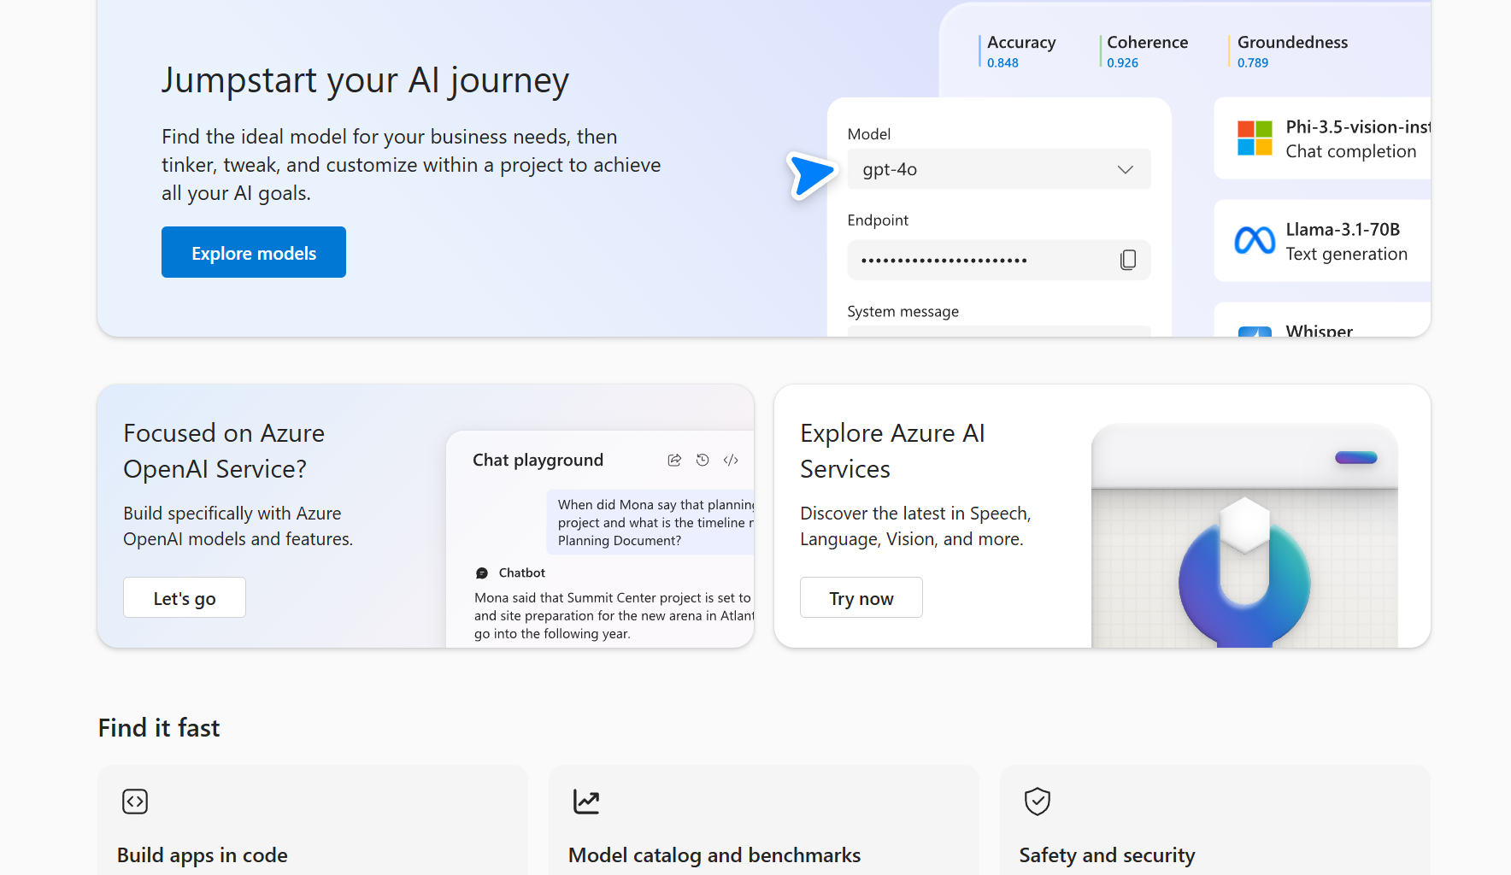
Ignite Recap
Azure
Azure AI Foundry
Azure AI Foundry helps organizations design, customize and management AI applications
Azure AI Foundry brings together existing Azure AI models, tooling and safety and monitoring solutions with new capabilities to help organizations design, customize and manage their AI solutions. It is integrated with popular developer tools like GitHub, Visual Studio and Copilot Studio.
Notes:
Azure AI Foundry is a unified platform designed to streamline the development, customization and management of AI applications. It integrates various Azure AI services and tools, providing developers with a comprehensive environment to build and deploy AI solutions efficiently. The platform includes a new software development kit that facilitates integration with familiar development environments like GitHub and Visual Studio, promoting seamless collaboration and innovation.

Slide 19
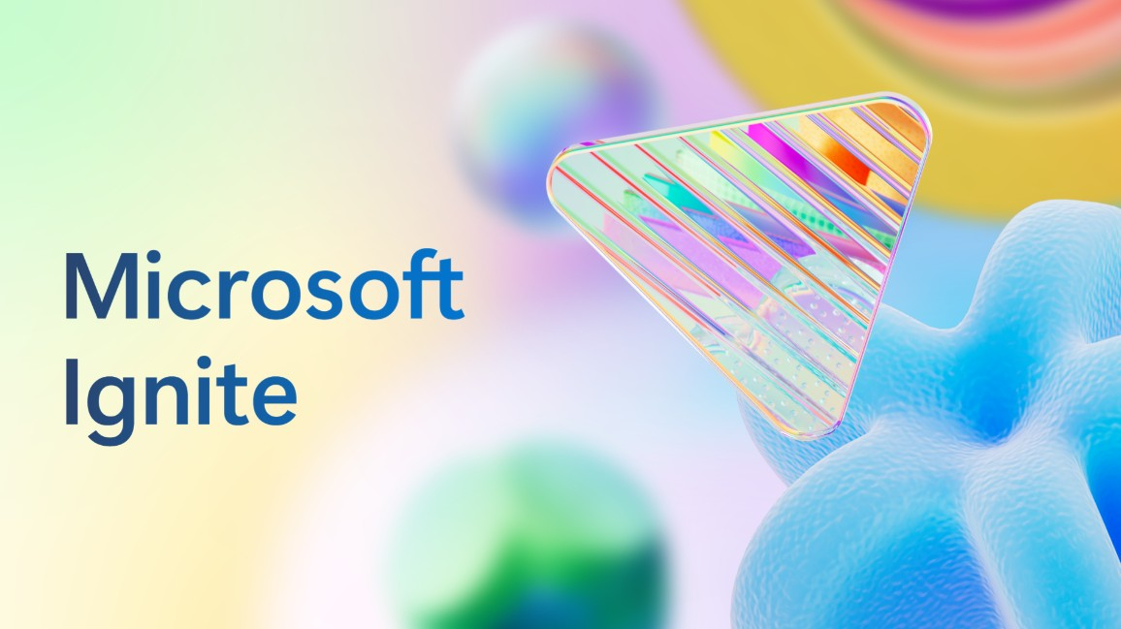
Ignite Recap
Azure
Azure AI Agent Service
Azure AI Agent Service, coming next month in preview, will enable professional developers to orchestrate, deploy and scale enterprise-ready agents to automate business processes. With features like bring your own storage (BYOS) and private networking, it will ensure data privacy and compliance to help organizations protect their sensitive data.
Notes:
is a capability of Azure AI Foundry for developers to create, deploy and scale intelligent AI agents that can automate complex business processes. The service enables developers to build secure, stateful autonomous agents by integrating models and technologies from Microsoft, OpenAI and partners like Meta, Mistral and Cohere. These agents can leverage knowledge from diverse sources, including Bing, SharePoint, Fabric, Azure AI Search, Azure Blob and licensed data repositories, providing unprecedented flexibility in agent development.

Slide 20
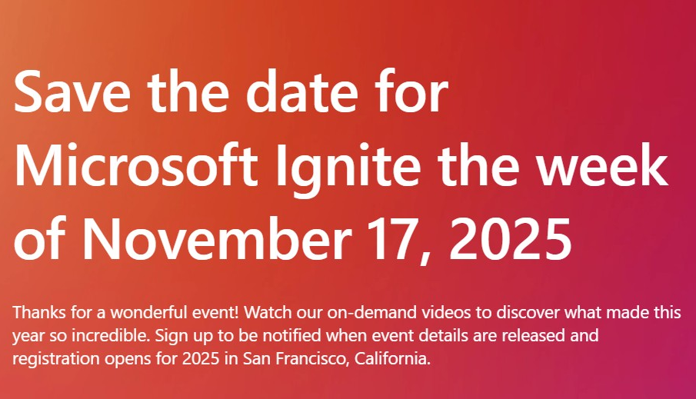
Ignite 2025
Save the date!
Ignite 2025- San Francisco, California- week of Nov 17th, 2025
Sign up to get notified when event details are released & registration opens at ignite.microsoft.com
Review the top announcements from Ignite 2024 at ignite.microsoft.com to view on demand or catch up via the Ignite Book of News

Slide 21
Open discussion
Drop your questions in the Microsoft Tech Community – Driving Adoption event page or visit https://aka.ms/M365ChampionCall/ask to join the live on-air queue to get your questions answered!
Share your feedback for this call by visiting https://aka.ms/Microsoft365ChampionCallFeedback

Slide 22
Upcoming community events
Nov 27-28
Dec 2-5
Dec 6-7
Jan 17
Collabdays Hungary
European SharePoint Conference
M365 Saturday Bangalore 2024
M365 Community Days Phoenix
Budapest, Hungary
Stockholm, Sweden
Bangalore, India
Phoenix, Arizona
Explore other Microsoft events here and a full list of community-led events can be found at CommunityDays.org

Slide 23
Open discussion
Drop your questions in the Microsoft Tech Community – Driving Adoption event page or visit https://aka.ms/M365ChampionCall/ask to join the live on-air queue to get your questions answered!
Share your feedback for this call by visiting https://aka.ms/Microsoft365ChampionCallFeedback

Slide 24
What’s next
Share your feedback
https://aka.ms/Microsoft365ChampionCallFeedback
Next call:
No call in December- Happy Holidays!
Join the Driving Adoption community
https://aka.ms/DrivingAdoption
Invite colleagues to become a Champion
https://aka.ms/M365Champions

