Slide 1

We will begin the call at five minutes past the hour.
Microsoft 365 Champion Community Call
April 2024
Microsoft 365 Champion Community
Learn more. Do more. Achieve more, together.

Slide 2
Microsoft 365 Champion Community
April 2024 Monthly Call
Microsoft Teams Customer Advocacy Group
Karuana Gatimu, Tiffany Lee, Jessie Hwang

Slide 3
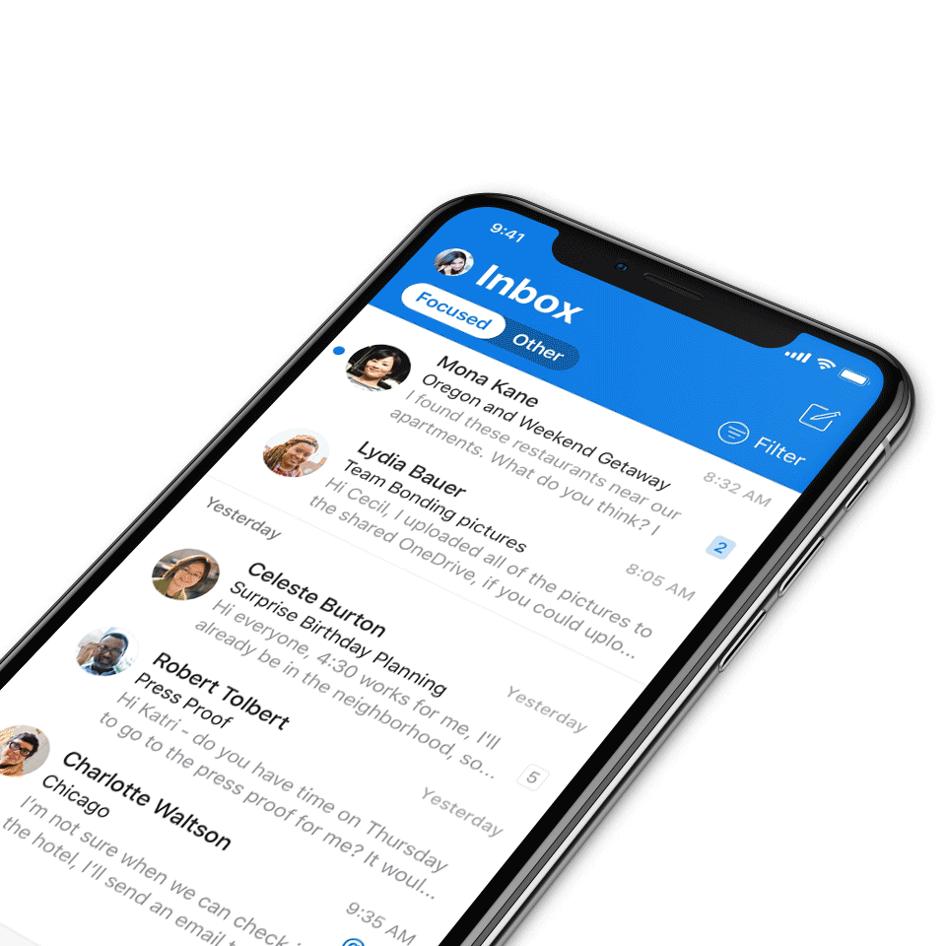
Digital Event Code of Conduct
Microsoft’s mission is to empower every person and every organization on the planet to achieve more. This includes all Microsoft events and gatherings, including on digital platforms, where we seek to create a respectful, friendly, fun and inclusive experience for all participants.​
We expect all digital event participants to uphold the principles of this Code of Conduct, which covers the main digital event and all related activities. We do not tolerate disruptive or disrespectful behavior, messages, images, or interactions by any party participant, in any form, at any aspect of the program including business and social activities, regardless of location.​
Microsoft will not tolerate harassment or discrimination based on age, ancestry, color, gender identity or expression, national origin, physical or mental disability, religion, sexual orientation, or any other characteristic protected by applicable local laws, regulations, and ordinances.​
We encourage everyone to assist in creating a welcoming and safe environment.
For more info, click here.

Slide 4

Agenda
Announcements
Top Microsoft 365 updates
Teams Communities
Community events & updates
Open discussion forum
Find resources from previous calls here:
https://aka.ms/M365ChampionResources

Slide 5



Microsoft 365 COMMUNITY CONFERENCE
A Community-produced technology conference
Event dates: April 30 – May 2, 2024
Workshops: April 28, 29, and May 3, 2024
Why attend?
Microsoft delivered content on AI, Microsoft 365, Microsoft Viva, Windows, and more.
Learn from experts how to leverage Microsoft Copilot to boost productivity, creativity, and collaboration
Network with thousands of Microsoft experts, industry leaders, and peers who all share a passion for Microsoft 365 and AI
Build skills and knowledge through hands-on demos and workshops
Location: Walt Disney World Swan & Dolphin Resort
Orlando, FL
Special offer! Buy one, get one free with code: BOGO
Note: offer can not be applied to previously purchased passes, and workshops are not
included in this deal. If a workshop is added, the user will get prompted for card information to
purchase the workshop desired.
Event website
#M365Con

Slide 6
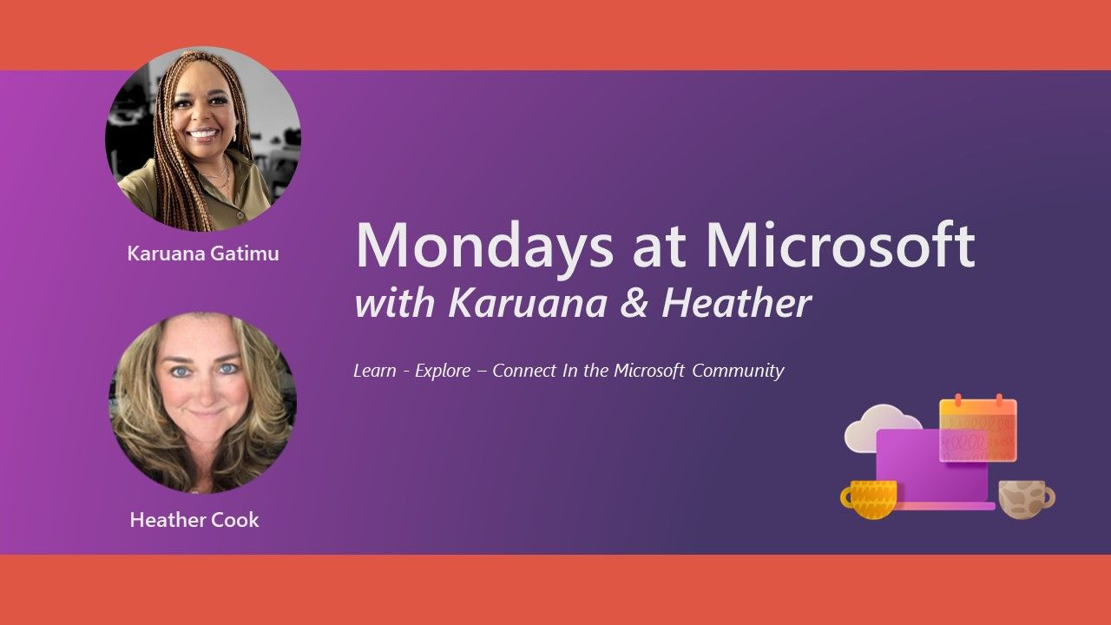
Mondays at Microsoft with Karuana and Heather
Microsoft
Community
Hosted in the Microsoft Community on LinkedIn, Mondays at Microsoft is a bi-weekly show that aggregates new product announcements and upcoming community events to drive technical skilling and engagement.
Missed it? Click here for all the Mondays at Microsoft recordings.
Click here to join the Microsoft Community on LinkedIn so you can get ready for our next call.
Find us on
https://aka.ms/MSCommunityLinkedIn

Slide 7
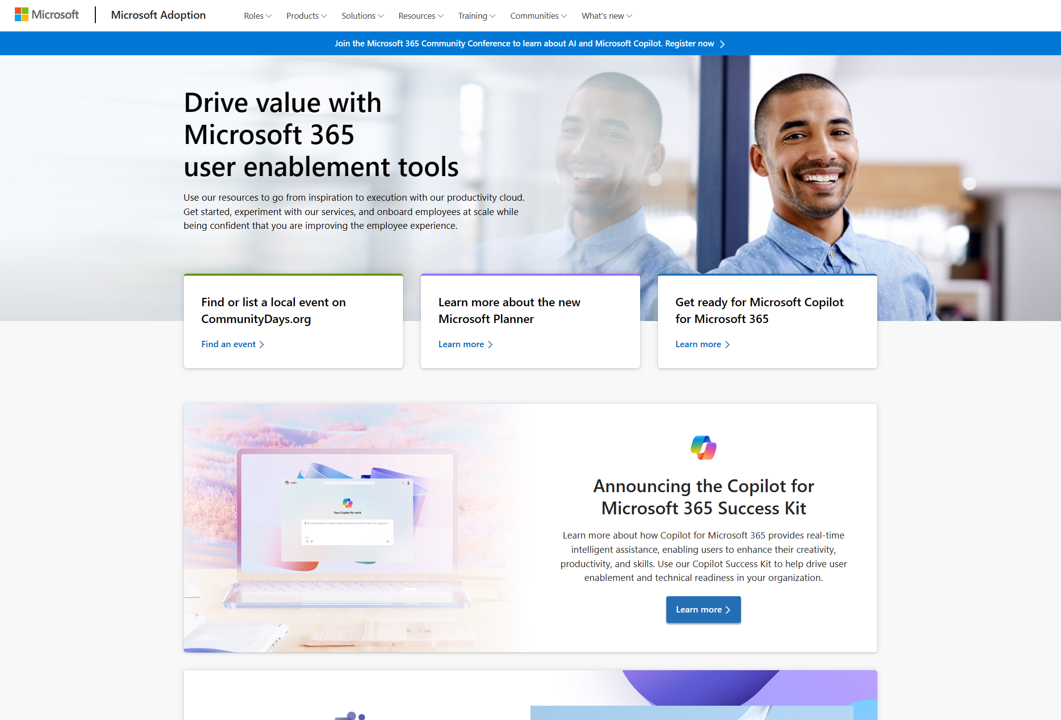
Update highlights on adoption.microsoft.com
Microsoft
Adoption
Launch of the Leading in the era of AI page, providing leadership guidance around the adoption of AI capabilities.
Launch of the new Microsoft Planner microsite, timed with the GA rollout of the new Planner.
Updates to the Microsoft Teams App Templates and Teams Emergency Operations Center to highlight version 3 updates.
Release of the Town halls in Microsoft Teams page.
Release of Microsoft Copilot resources for education page.
Update of the Frontline Success Kit on the Microsoft Teams for Frontline Workers page.
Addition of Earth Day 2024 backgrounds to the Custom Background Gallery for Teams page.
Addition of a new “Copilot skilling experiences” slide to the Implementation Summary Guide, User Enablement Guide, Technical Readiness Guide, and Training Content Map in the Copilot for Microsoft 365 Success Kit.
Read or subscribe to our Release notes for more updates.

Slide 8
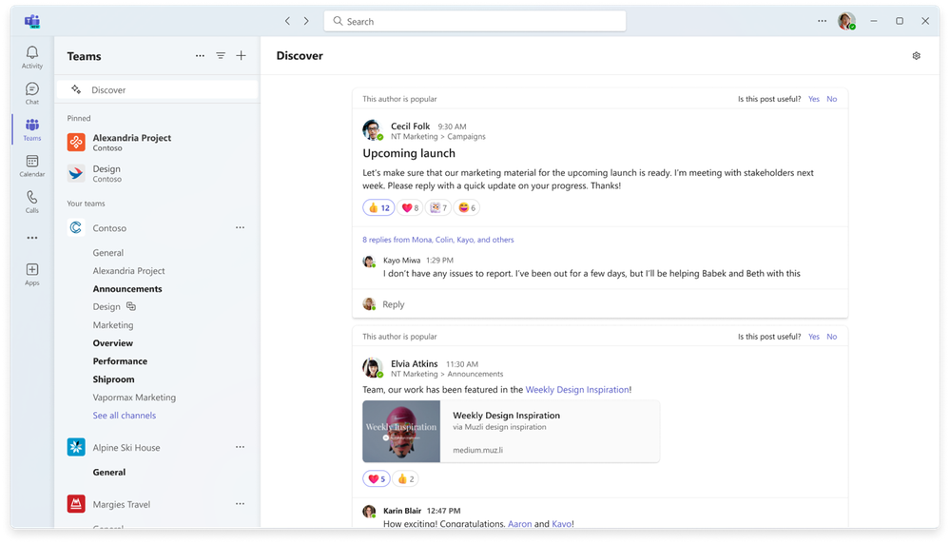
Discover feed in channels
Microsoft
Teams
With so much communication happening every day, it can be hard to keep track of the most important information. The new discover feed is a personalized feed that surfaces the most relevant content in channels, based on the people you work with or the topics you might be interested in. The discover feed surfaces channel posts that you may not be aware of, because you are not directly mentioned, replied to, or tagged. Scroll through your feed, easily catch up on news, and like, comment or share a post from the discover feed, just like any other channel post. This feature is available now.
Read our blog to learn more.
Click here for business user help & training.

Slide 9
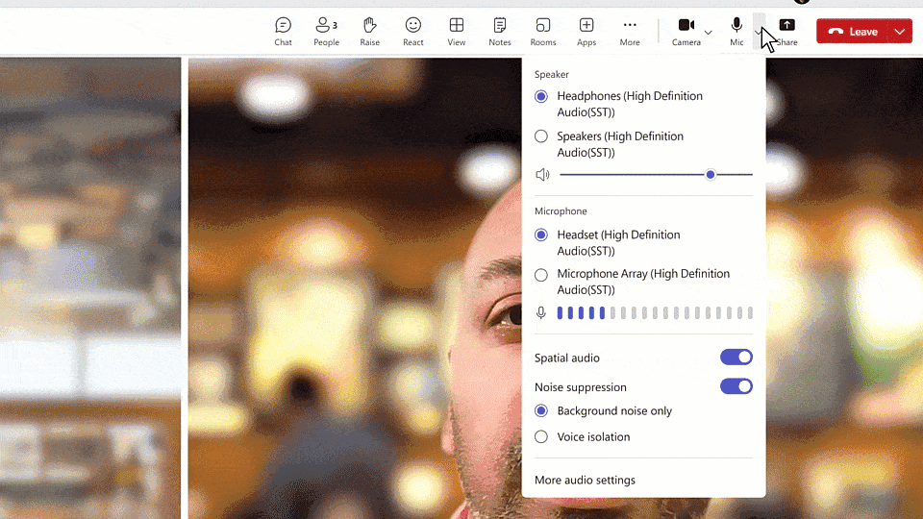
Voice isolation
Microsoft
Teams
Whether you’re at your desk or at a coffee shop, nearby conversations can interfere with your Teams calls and meetings. Voice isolation is an AI based advanced noise suppression feature that eliminates unwanted background noise including other human voices. The technology recognizes your voice profile and ensures only your voice is transmitted. Voice isolation can be enabled for calls and meetings and will be available starting in April.
Read our blog to learn more.

Slide 10
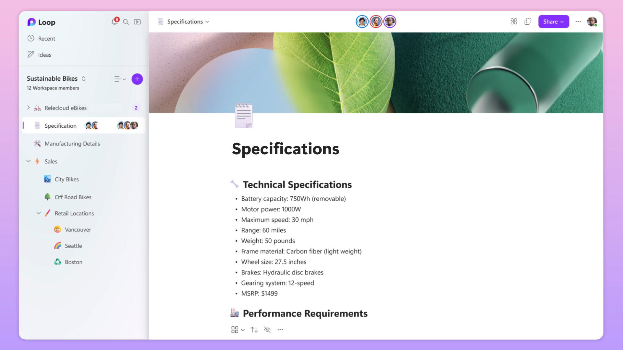
Copilot in Loop
Microsoft
Copilot
Now, Copilot in Loop is better at parsing information on a page in context, which gives you more relevant output when you’re asking questions about a file. For example, now you can prompt Copilot about specific parts of a page, such as "Summarize the content of the first section" or "List out the deadlines in this table.” This helps you get up to speed with what’s in files quickly, so you can move on to other tasks.
Learn more about Copilot in Loop here.

Slide 11
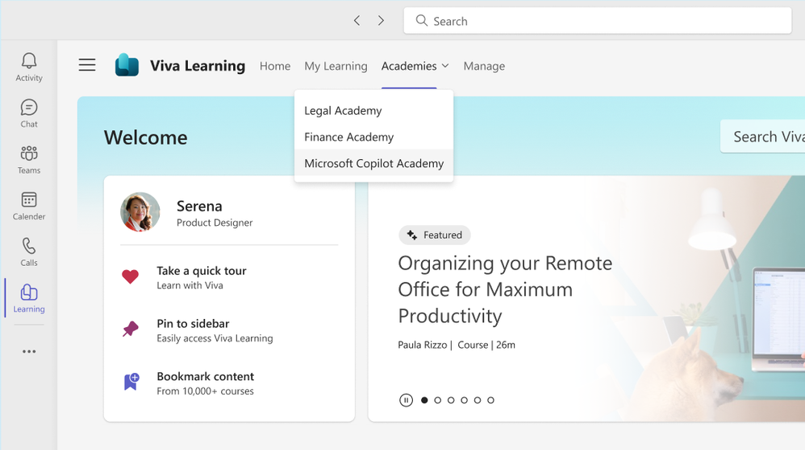
Microsoft Copilot Academy now generally available
Microsoft
Copilot
Recognizing the need to develop a new skillset around AI tools, we are excited to introduce Microsoft Copilot Academy, a new addition to our Viva Learning platform designed to help customers effectively utilize Copilot experiences through guided upskilling. Copilot Academy is generally available now in your Viva Learning Teams app or webapp.
To utilize the academy today, customer tenants must have access to Copilot for Microsoft 365, and individual users must be assigned a paid license of either Viva Learning or Viva Suite. Starting in CY2024 Q3, Copilot Academy will be available to all Copilot for Microsoft 365 customers at no additional cost and will not require a Viva license.
Read our blog to learn more.

Slide 12
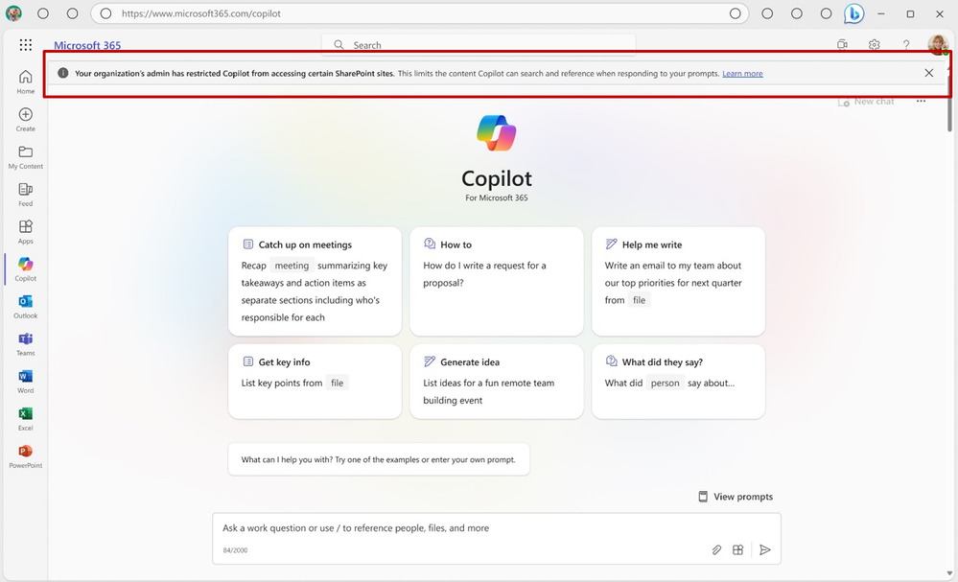
Introducing Restricted SharePoint Search
Microsoft
Copilot
As previously disclosed, Restricted SharePoint Search will start rolling out next month for customers with Copilot for Microsoft 365 licenses. Designed for organizations particularly concerned about unintentional oversharing of content, Restricted SharePoint Search allows you to disable organization-wide search and limit Copilot to selected SharePoint sites. This feature is intended as a temporary solution to give you time to review and audit site permissions while implementing robust data security with Microsoft Purview and manage content lifecycle with SharePoint Advanced Management. If you are interested in this feature, you can follow the status of the rollout on the public roadmap.
Read our blog to learn more.

Slide 13
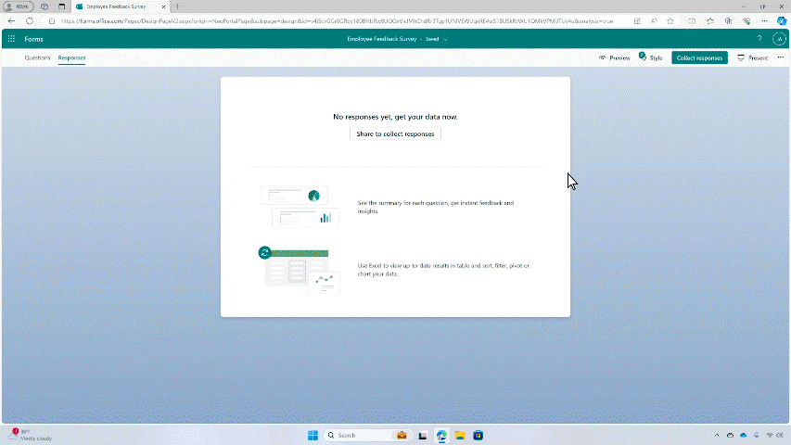
Forms data sync to Excel
Microsoft
Forms
New responses will be synced to your Excel workbook in real-time, allowing you to keep working on your existing spreadsheet without missing a beat. With just one click, you can easily access all your form responses in Excel for the web and take advantage of Excel’s rich functions to analyze and visualize your data.
Read our blog to learn more.

Slide 14
Teams Communities
Mark Rubinstein

Slide 15
What is Teams for personal use?

Slide 16


Whether for work or personal, it’s all just Microsoft Teams
Teams for work | Teams for SMB | Teams for education | Teams for home
AAD | AAD | AAD | MSA
User experience depends on:
- Sign in with AAD or MSA
- License / subscription
Today on Windows 11:
Microsoft Teams (work or school)
Microsoft Teams
In June on Windows 11:
Microsoft Teams

Slide 17
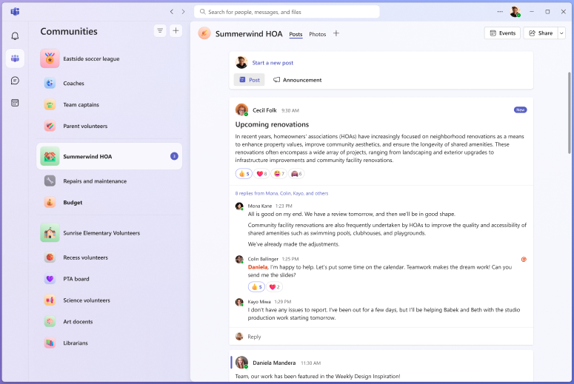
Teams for personal use on Windows 11

Slide 18
Communities in Teams
Connect your community

Slide 19
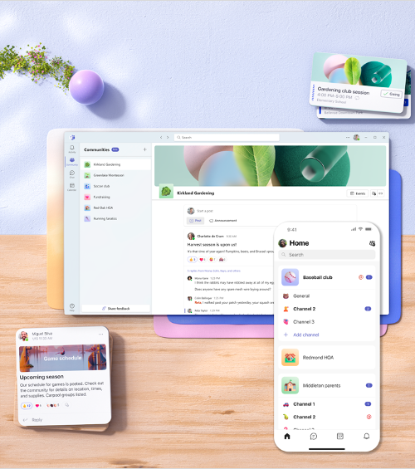
Why Communities in Teams?
There’s an inherent need to collaborate within groups outside work or school.
There’s also a growing need for a platform to engage with your audience.

Slide 20
Communities in Teams are optimized for personal use
Like in Teams for work, you can use channels to keep related conversations together.
In threaded conversations, you can share photos, files, use MS Designer for announcement banners or create polls.
Many communities build on community calendar.
Community events are Teams meetings for easy meeting joins.
You have tools to manage your community and access to it.
Community owners can delete content, remove community members and control access to the community.
Notes:
Titles on slides need to be unique to pass accessibility checker

Slide 21
Demo time
Communities in Teams

Slide 22
Meeting inter-operability
Even for meetings,
it will be just Microsoft Teams
Notes:
Delete subtitle line if not used.

Slide 23
Yay, no more joining a Teams meeting in browser as a guest!
You can choose which account to choose for the Teams meeting.
You can still join as a guest, too.
Join a Teams for work or school meeting with your personal Microsoft account.
Or the other way around.
Addresses a huge pain point as heard from Teams customers.
Teams meetings will just work.

Slide 24
Demo time
Join Teams for work meeting with your personal Microsoft account

Slide 25
Q & A

Slide 26

Upcoming community events
April 23-24
April 30-May 2
June 3-7
August 12-16
Comms vNext
Microsoft 365 Community Conference
TechCon365 & PWRCON Seattle 2024
TechCon365 DC
Denver, CO
Orlando, FL
Seattle, WA
Washington, DC
Explore other Microsoft events and a full list of community-led events can be found at CommunityDays.org

Slide 27
Upcoming community-produced events
Professionally produced community events draw from 1k-5k attendees (in-person). Attendance fees are charged, and pre/post event workshops delivered by Microsoft MVPs are often part of the event. Event organizers ask for our help in driving attendance and providing MSFT corporate speakers.
Event name | Start date | End date | City | State/Province | Country | Products
mDevCamp | 4/23/2024 | 4/23/2024 | Prague |  | Czech Republic | .NET; Developer tools + DevOps
Comms vNext | 4/23/2024 | 4/24/2024 | Denver | Colorado | United States | Microsoft 365
Dynaway CONNECT | 4/23/2024 | 4/24/2023 | Greenville | South Carolina | United States | Dynamics 365
Microsoft 365 Community Conference | 4/28/2024 | 5/2/2024 | Orlando | Florida | United States | Employee Experience; Microsoft 365
Visual Studio Live | 4/29/2024 | 5/3/2024 | Chicago | Illinois | United States | .NET; Developer tools + DevOps; Azure / Cloud; AI / ML
Tehcorama | 5/6/2024 | 5/8/2024 | Antwerp |  | Belgium | .NET; Azure / Cloud; Containers / Kubernetes; Data; Developer tools + DevOps; Microsoft 365
DynamicsCon LIVE | 5/13/2024 | 5/16/2024 | Denver | Colorado | United States | Dynamics 365; Power Platform
European Collaboration Summit 2024 | 5/14/2024 | 5/16/2024 | Wiesbaden |  | Germany | Microsoft 365; Power Platform
IM Tech Summit Europe 2024 | 5/15/2024 | 5/15/2024 | Brighton |  | United Kingdom | AI/ML
Get-CsLatam Conference and Expo 2024 | 5/16/2024 | 5/17/2024 | Mexico City |  | Mexico
DevSum | 5/15/2024 | 5/17/2024 | Stockholm |  | Sweden | .NET; Azure / Cloud; Career / D&I (Diversity and Inclusion); AI / ML; Containers / Kubernetes; Data; Developer tools + DevOps
DynamicsMinds 2024 | 5/26/2024 | 5/29/202 | Portoroz |  | Slovenia | Dynamics 365; Power Platform
Thrive Conference | 5/28/2024 | 5/29/2024 | Podcetrtek |  | Slovenia | Azure / Cloud; Microsoft 365; Power Platform
TechCon365 and PWRCON - A Microsoft 365 and Power Platform Conference | 6/3/2024 | 6/7/2024 | Seattle | Washington | United States | Microsoft 365; Power Platform
European Power Platform Conference | 6/11/2024 | 6/13/2024 | Brussels |  | Belgium | Microsoft 365; Power Platform

Slide 28
Upcoming community-led events
These events often serve underrepresented or emerging markets. They are organized by volunteers and are free to attendees. Newly branded “Community Days” events may cover any part of the Microsoft technical stack and/or cater to roles or industries. These are vibrant opportunities for recruiting, career development, and technical skilling. A full list of community-led events can be found at CommunityDays.org.
Event name | Start date | End date | City | State/Province | Country
Microsoft Fabric and Open AI day - London Ont - Free Event | 4/24/2024 | 4/24/2024 | London | Ontario | Canada
aMS Papeete | 4/25/2024 | 4/25/2024 | PIRAE Cedex Papeete | Tahiti | French Polynesia
BizApps-Palooza 2024 | 4/26/2024 | 4/26/2024 | Toronto | Ontario | Canada
Dynamics 365 Summit 2024 | 4/26/2024 | 4/27/2024 | Lisbon |  | Portugal
aMS Noumea | 4/30/2024 | 4/30/2024 | Noumea |  | New Caledonia
M365 Philly 2024 | 5/18/2024 | 5/18/2024 | Malvern | Pennsylvania | United States
Americas - SharePoint Intranet Festival | 5/22/2024 | 5/22/2024 | Virtual
EMEA - SharePoint Intranet Festival | 5/22/2024 | 5/22/2024 | Virtual
APAC - SharePoint Intranet Festival | 5/22/2024 | 5/22/2024 | Virtual
Power Platform Developer Summit 2024 | 5/25/2024 | 5/25/2024 | London |  | United Kingdom
DynUG Spring Conference | 5/28/2024 | 5/29/2024 | Oslo |  | Norway
BeConnected day 12 - CollabDays Italy 2024 | 5/30/2024 | 5/30/2024 | Milan |  | Italy
Explore other Microsoft events and a full list of community-led events can be found at CommunityDays.org

Slide 29
Microsoft 365 Champion Community news
Next call:
May 28
Topic:
Copilot Success Kit ft. Karuana Gatimu
Top asks:
Complete our monthly call survey: https://aka.ms/Microsoft365ChampionCallFeedback
Participate in the Driving Adoption Community:
https://aka.ms/DrivingAdoption
Invite colleagues to join the Champion Program: https://aka.ms/M365Champions

Slide 30
Thanks for attending! We’d love your feedback on today’s call and hear ways we can make future calls even better! https://aka.ms/Microsoft365ChampionCallFeedback
Microsoft 365 Champion Community
Learn more. Do more. Achieve more, together.
Now, let’s meet! Stay on to join our open discussion and feel free to come on video and off mute.

