Slide 1

We will begin the call at five minutes past the hour.
Microsoft 365 Champion Community Call
September 2023
Microsoft 365 Champion Community
Learn more. Do more. Achieve more, together.

Slide 2
Microsoft 365 Champion Community
September 2023 Monthly Call
Microsoft Teams Customer Advocacy Group
Karuana Gatimu, Tiffany Lee, Jessie Hwang

Slide 3
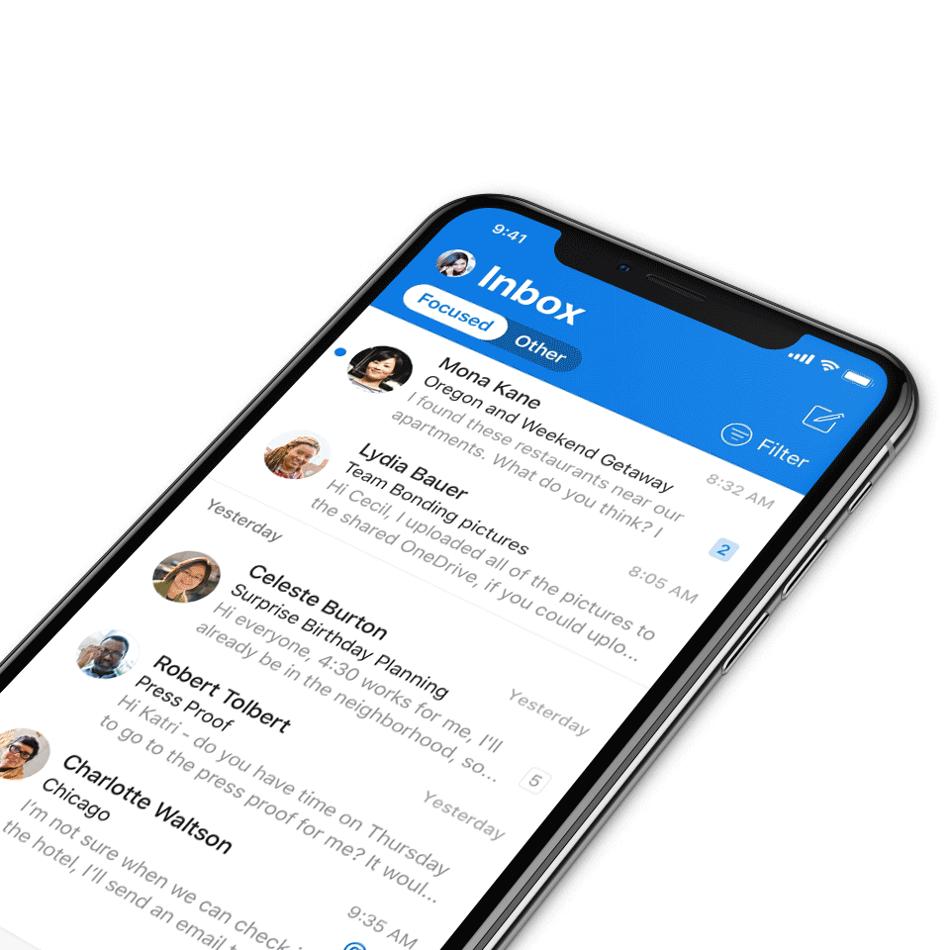
Digital Event Code of Conduct
Microsoft’s mission is to empower every person and every organization on the planet to achieve more. This includes all Microsoft events and gatherings, including on digital platforms, where we seek to create a respectful, friendly, fun and inclusive experience for all participants.​
We expect all digital event participants to uphold the principles of this Code of Conduct, which covers the main digital event and all related activities. We do not tolerate disruptive or disrespectful behavior, messages, images, or interactions by any party participant, in any form, at any aspect of the program including business and social activities, regardless of location.​
Microsoft will not tolerate harassment or discrimination based on age, ancestry, color, gender identity or expression, national origin, physical or mental disability, religion, sexual orientation, or any other characteristic protected by applicable local laws, regulations, and ordinances.​
We encourage everyone to assist in creating a welcoming and safe environment.
For more info, click here.

Slide 4

Agenda
FastTrack for Microsoft 365 | Edwin Der
Microsoft 365 updates | Top new features releases across Microsoft 365
Community events & updates
Open discussion forum
Find resources from previous calls here:
https://aka.ms/M365ChampionResources

Slide 5
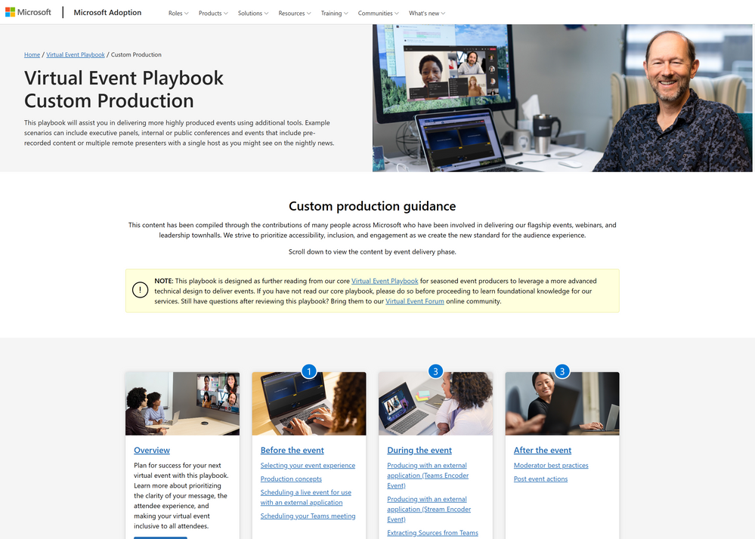
Now available: interactive Custom Production Virtual Event Playbook
Microsoft
Adoption
We're excited to announce the launch of the interactive version of our Custom Production Virtual Event Playbook. This playbook builds on the foundational knowledge in our core Virtual Event Playbook and provides guidance for seasoned event producers to deliver more highly produced events using additional tools. Example scenarios can include executive panels, internal or public conferences and events that include pre-recorded content or multiple remote presenters with a single host as you might see on the nightly news.
Explore the playbook now!

Slide 6
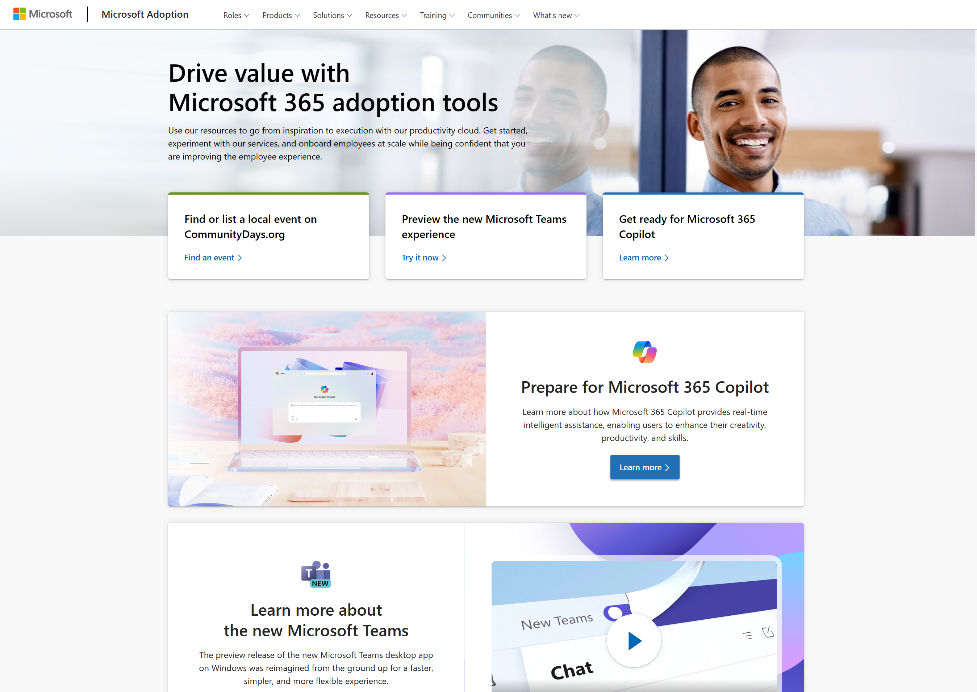
Additional updates on adoption.microsoft.com
Microsoft
Adoption
In addition to the newly interactive Custom Production Virtual Event Playbook, here are more update highlights:
New resources for our Modern Collaboration Architecture (MOCA) framework, including a “lite” version ideal for small and medium organizations
A new license calculator for Microsoft Syntex
New “featured samples” on the Sample Solution Gallery
Browse the Release notes for more details.

Slide 7
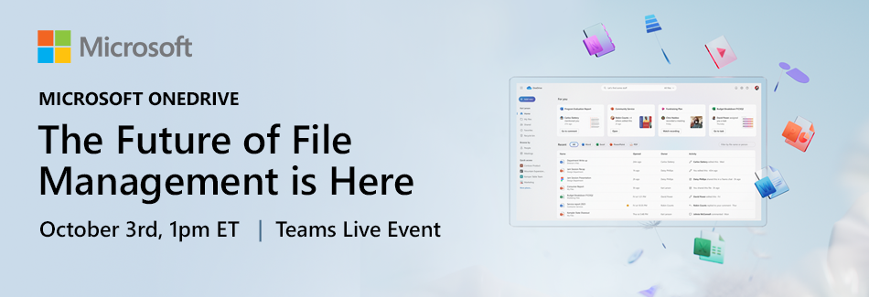
Future of File Management event
Microsoft
Events
Calling IT Admins, partners and Microsoft 365 enthusiasts! Mark your calendars for a special online event where you’ll get a first-hand look at the future of OneDrive. Join us on October 3 for Microsoft OneDrive: The Future of File Management in Here.
Join Jeff Teper and the OneDrive product team as they showcase the next generation of file management across Microsoft 365. See the new enhancements to OneDrive and discover the benefits of faster file access, better organization, simpler collaboration, and improved file security across Microsoft 365. Plus, we’ll give a sneak peek at our AI plans which include new search, sharing, and information queries across all your files in OneDrive.
When: October 3, 2023, 10AM PT/1PM ET
Where: https://aka.ms/OneDriveEvent
Download a calendar invite.

Slide 8
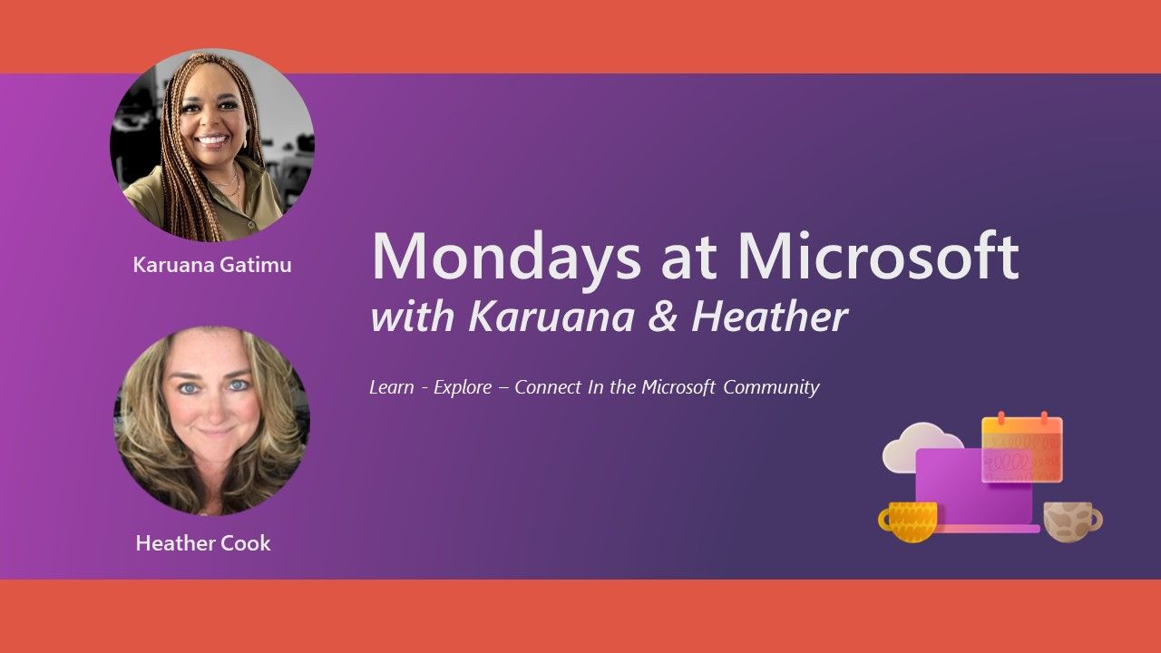
Mondays at Microsoft with Karuana and Heather
Microsoft
Community
Our Mondays at Microsoft show premiered on May 15! Karuana and Heather announced the new Microsoft Community on LinkedIn, and this bi-weekly show will aggregate new product announcements and upcoming community events to drive technical skilling and engagement!
Missed it? Click here for all the Mondays at Microsoft recordings.
Click here to join the new Microsoft Community on LinkedIn so you can get ready for our next call.
Find us on
https://aka.ms/MSCommunityLinkedIn

Slide 9

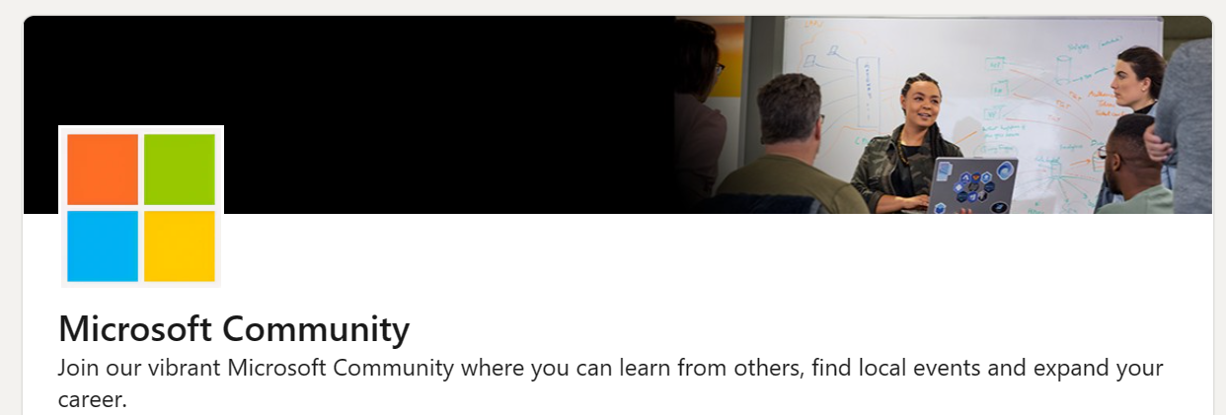
Microsoft Community on LinkedIn
Learn about community skilling events in one place, where you already are!
Watch Mondays at Microsoft with Karuana Gatimu and Heather Cook, highlighting product news and events
Connect with other community members in your local area and within your own company
https://aka.ms/MSCommunityLinkedIn
#ProTip: Share with your colleagues and groups

Slide 10

5 days of learning at each event
Top experts offer 25 Workshops and 120 Sessions in each city
Public Sector
Collaboration & Power Platform
Employee Experience

Slide 11
FastTrack
Edwin Der – Senior Program Manager

Slide 12
What is FastTrack?
FastTrack provides remote guidance to help organizations learn, prepare, and deploy Microsoft 365 services quickly and efficiently.
FastTrack utilizes step-by-step self-service deployment guides to simplify the deployment process and help organizations adopt Microsoft 365 services as quickly as possible.
FastTrack assistance can be requested through the Microsoft 365 Admin Center. Planned deployment date is highly recommended.

Slide 13
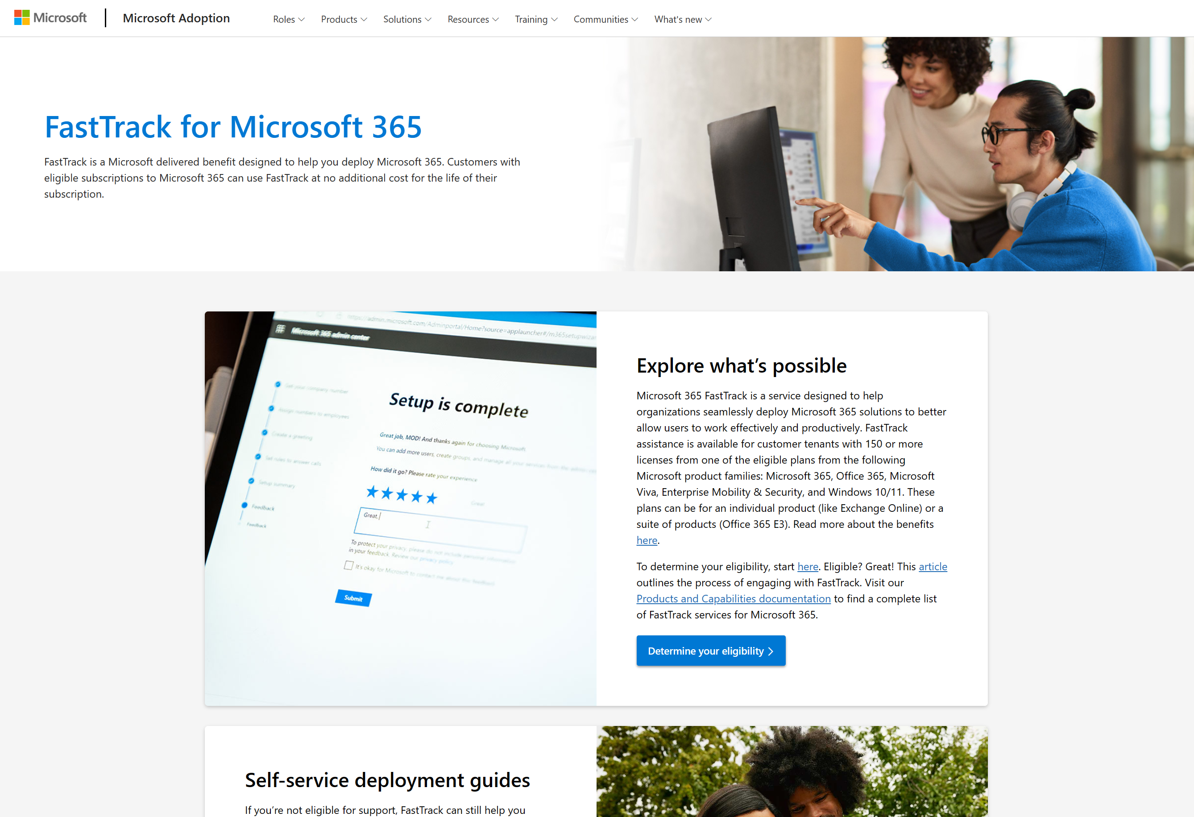
Now live on adoption.microsoft.com
FastTrack has a new home on adoption.microsoft.com, your one-stop shop for relevant articles and documentation to help leverage this free benefit for eligible subscriptions.
Check it out now: https://adoption.microsoft.com/fasttrack.
In addition, we’ve added direct FastTrack links to many other pages across the Microsoft Adoption Hub, such as the individual Microsoft Viva apps, Microsoft Teams Phone, and Microsoft Security.
Notes:
Demo the new site on adoption.microsoft.com/fasttrack.

Slide 14
Microsoft 365 updates
Top new feature releases across Microsoft 365

Slide 15
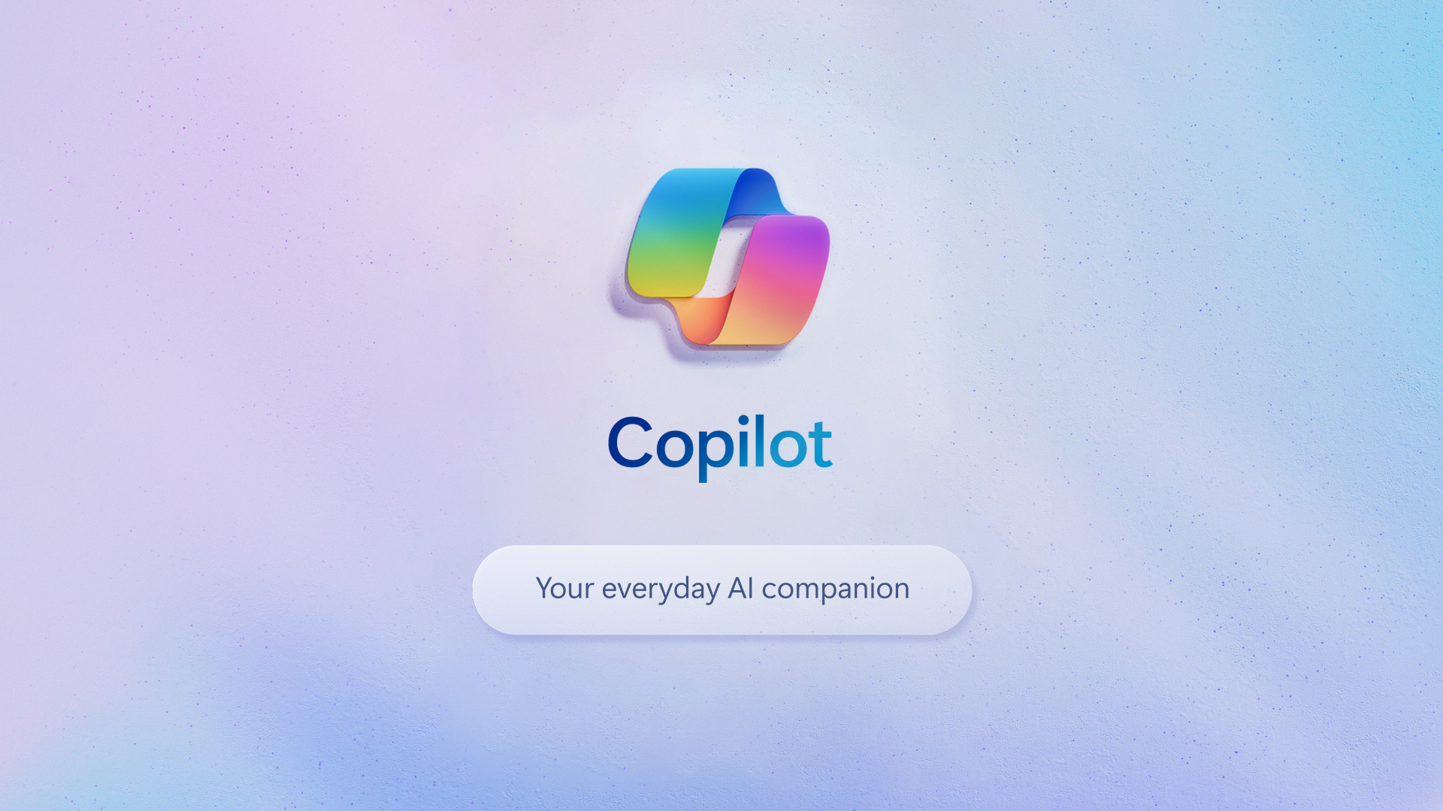
Announcing Microsoft Copilot, your everyday AI companion
Microsoft
Copilot
Microsoft Copilot will begin to roll out in its early form as part of our free update to Windows 11, starting September 26 — and across Bing, Edge, and Microsoft 365 Copilot this fall.
With over 150 new features, the next Windows 11 update is one of our most ambitious yet, bringing the power of Copilot and new AI powered experiences to apps like Paint, Photos, Clipchamp and more right to your Windows PC.
Microsoft 365 Copilot will be generally available for enterprise customers on November 1, 2023, along with Microsoft 365 Chat, a new AI assistant that will completely transform the way you work.
Click here to learn more.

Slide 16
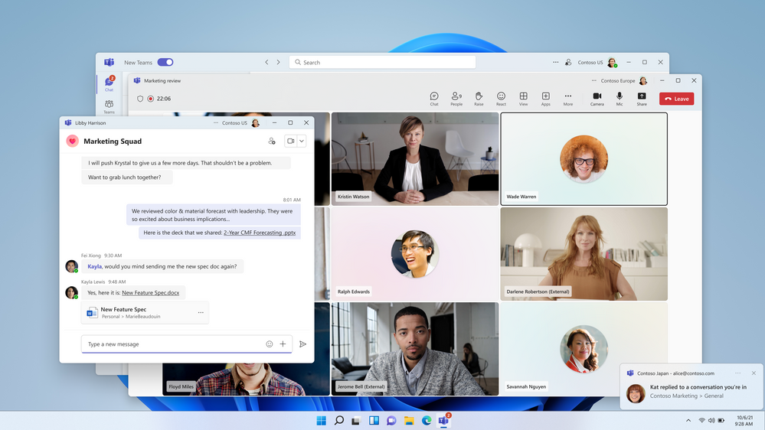
Side-by-side multitasking and cross-tenant notifications
Microsoft
Teams
With the new Teams client, users can now work across multiple tenants and accounts in side-by-side windows. They can join a meeting or collaborate in a channel hosted in another tenant, and simultaneously compose chat messages in their own tenant. Users can receive cross-tenant notifications for all accounts and tenants added to the Teams client, no matter which one is currently in focus.
Learn more here.

Slide 17
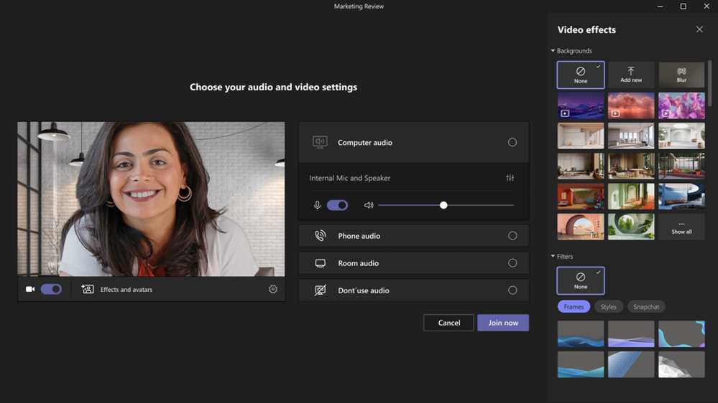
Animated backgrounds
Microsoft
Teams
The dynamic background feature in Teams meetings allows you to replace your existing background with a dynamic animation for a more immersive virtual environment. It offers various options to enhance meeting experience with creativity and personalization according to their preferences.
Before a meeting starts, select Effects and Avatars > Video effects in the pre-join screen and select a new animated background, identified by the small video icon in the bottom-left corner of the preview picture. During a meeting, you can select an animated background by clicking More > Effects and Avatars > Select a background.
Click here to learn more.

Slide 18
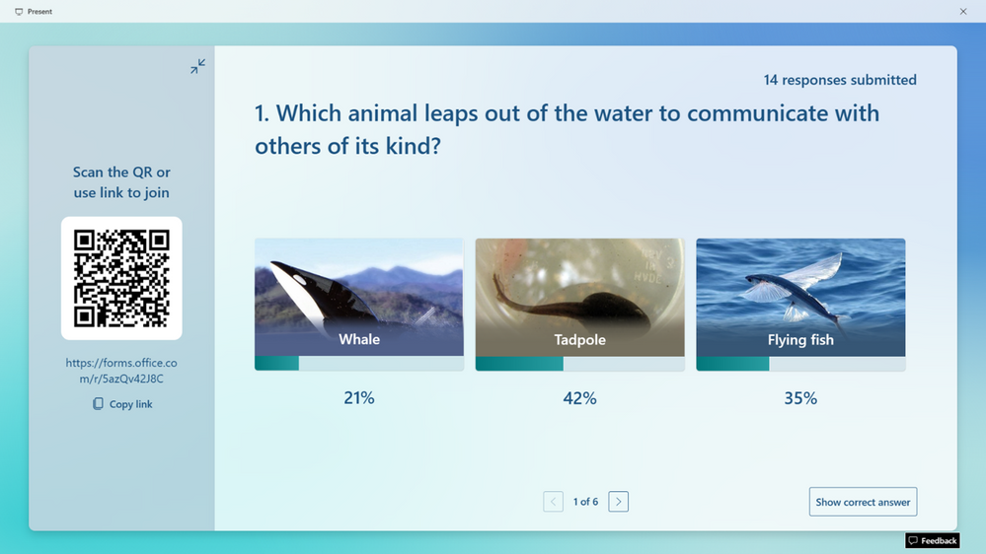
Improved experience for real-time form & quiz responses
Microsoft
Forms
The Forms live presentation feature is a crowd favorite, receiving an abundance of positive feedback since its initial release. It effectively bridges the gap between form owners and their audience, significantly elevating engagement levels. We've recently updated the live presentation experience to be even more immersive and seamless when you present your forms or quizzes. Let's delve into these exciting changes! You can also try out these improvements from this amazing template.
Click here to learn more.

Slide 19

Upcoming community events
Oct 3-5, 2023
Oct 13-14, 2023
Oct 30-Nov 3, 2023
Nov 27-30, 2023
Nov 15-16, 2023
Microsoft Power Platform Conference
South Coast Summit
365 EduCon Chicago
European SharePoint Conference (ESPC)
Microsoft Ignite
Las Vegas, NV
Farnborough, UK
Chicago, IL
Amsterdam, Netherlands
Hybrid/Seattle, WA
Explore other Microsoft events and a full list of community-led events can be found at CommunityDays.org

Slide 20
Upcoming community-led events
These events often serve underrepresented or emerging markets. They are organized by volunteers and are free to attendees. Newly branded “Community Days” events may cover any part of the Microsoft technical stack and/or cater to roles or industries. These are vibrant opportunities for recruiting, career development, and technical skilling. A full list of community-led events can be found at CommunityDays.org.
Event name | Start date | End date | City | State/Province | Country
CollabDays - National Museum of Computing - Bletchley Park | 9/27/2023 | 9/27/2023 | Bletchley |  | United Kingdom
aMS Montpellier 2023 | 9/28/2023 | 9/28/2023 | Montpellier |  | France
Microsoft 365 Ottawa | 9/29/2023 | 9/29/2023 | Ottawa | Ontario | Canada
aMS Sao Paulo | 9/29/2023 | 9/29/2023 | Sao Paulo |  | Brazil
Baltic Summit 2023 | 9/30/2023 | 9/30/2023 | Gdynia |  | Poland
Teamsdagen Hybrid 2023 | 10/4/2023 | 10/4/2023 | Stockholm |  | Sweden
aMS Seoul | 10/5/2023 | 10/5/2023 | Seoul |  | South Korea
Knoxville M365 Community Day | 10/13/2023 | 10/13/2023 | Knoxville | Tennessee | United States
MN M365 11th Bi-Annual Fall Workshop Day | 10/13/2023 | 10/13/2023 | Edina | Minnesota | United States
Collaboration Hero | 10/17/2023 | 10/19/2023 | Virtual
aMS Kuala Lumpur | 10/19/2023 | 10/19/2023 | Kuala Lumpur |  | Malaysia
aMS Singapore 23 | 10/21/2023 | 10/221/2023 | Singapore |  | Singapore
CollabDays Belgium | 10/21/2023 | 10/21/2023 | Brussels |  | Belgium
CollabDays New England | 10/21/2023 | 10/21/2023 | Burlington | Massachusetts | United States
aMS Manila | 10/24/2023 | 10/24/2023 | Manila |  | Philippines
Community Days Mexico City 2023 | 11/2/2023 | 11/2/2023 | Mexico City |  | Mexico
Explore other Microsoft events and a full list of community-led events can be found at CommunityDays.org

Slide 21
Upcoming community-led events (Continued)
Event name | Start date | End date | City | State/Province | Country
M365 Twin Cities | 11/11/2023 | 11/11/2023 | Brooklyn Park | Minnesota | United States
aMS Aachen | 11/16/2023 | 11/16/2023 | Aachen |  | Denmark
YYC Microsoft Community Day | 11/18/2023 | 11/18/2023 | Calgary | Alberta | Canada
M365 Community Days Lagos 2023 | 12/9/2023 | 12/9/2023 | Lagos |  | Nigeria
Explore other Microsoft events and a full list of community-led events can be found at CommunityDays.org

Slide 22
Microsoft 365 Champion Community news
See you at our next community call on October 24!
Top asks:
Complete our monthly call survey: https://aka.ms/Microsoft365ChampionCallFeedback
Participate in the Driving Adoption Community:
https://aka.ms/DrivingAdoption
Invite colleagues to join the Champion Program: https://aka.ms/M365Champions

Slide 23
Thanks for attending! We’d love your feedback on today’s call and hear ways we can make future calls even better! https://aka.ms/Microsoft365ChampionCallFeedback
Microsoft 365 Champion Community
Learn more. Do more. Achieve more, together.
Now, let’s meet! Stay on to join our open discussion and feel free to come on video and off mute.

