Slide 1

We will begin the call at five minutes past the hour.
Microsoft 365 Champion Community Call
October 2023
Microsoft 365 Champion Community
Learn more. Do more. Achieve more, together.

Slide 2
Microsoft 365 Champion Community
October 2023 Monthly Call
Microsoft Teams Customer Advocacy Group
Karuana Gatimu, Tiffany Lee, Jessie Hwang

Slide 3
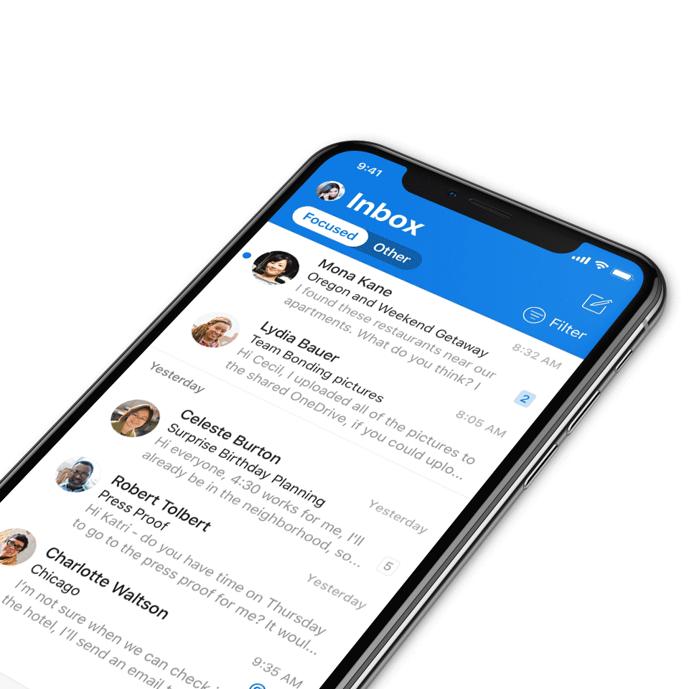
Digital Event Code of Conduct
Microsoft’s mission is to empower every person and every organization on the planet to achieve more. This includes all Microsoft events and gatherings, including on digital platforms, where we seek to create a respectful, friendly, fun and inclusive experience for all participants.​
We expect all digital event participants to uphold the principles of this Code of Conduct, which covers the main digital event and all related activities. We do not tolerate disruptive or disrespectful behavior, messages, images, or interactions by any party participant, in any form, at any aspect of the program including business and social activities, regardless of location.​
Microsoft will not tolerate harassment or discrimination based on age, ancestry, color, gender identity or expression, national origin, physical or mental disability, religion, sexual orientation, or any other characteristic protected by applicable local laws, regulations, and ordinances.​
We encourage everyone to assist in creating a welcoming and safe environment.
For more info, click here.

Slide 4

Agenda
Power Pages | Priya Vaidyanathan, Sandeep Dhanrajani and Tamay Bhagwat
Microsoft 365 updates | Top new features releases across Microsoft 365
Community events & updates
Open discussion forum
Find resources from previous calls here:
https://aka.ms/M365ChampionResources

Slide 5


Open call For Microsoft Community Regional Leads
Apply to be a Microsoft Global Community Regional Lead and part of the Microsoft Community Advisory Board.
A MGCI Regional Lead is a working volunteer position that helps to create and support Community Days (communitydays.org) events, spread the word about the Microsoft Community, and ensure global access to community resources.
Apply now at
aka.ms/MGCIRegionalLead

Slide 6
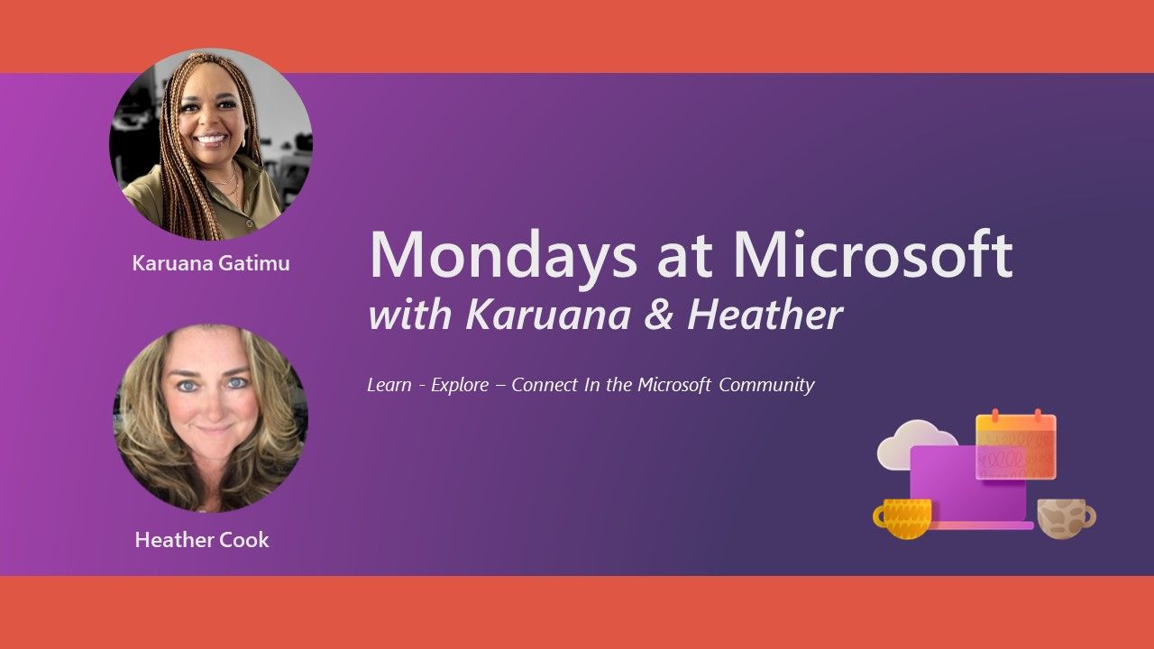
Mondays at Microsoft with Karuana and Heather
Microsoft
Community
Our Mondays at Microsoft show premiered on May 15! Karuana and Heather announced the new Microsoft Community on LinkedIn, and this bi-weekly show will aggregate new product announcements and upcoming community events to drive technical skilling and engagement!
Missed it? Click here for all the Mondays at Microsoft recordings.
Click here to join the new Microsoft Community on LinkedIn so you can get ready for our next call.
Find us on
https://aka.ms/MSCommunityLinkedIn

Slide 7

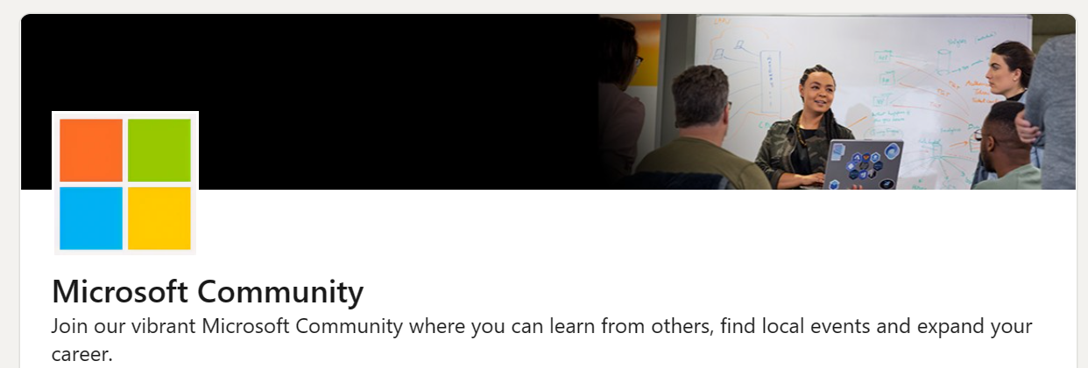
Microsoft Community on LinkedIn
Learn about community skilling events in one place, where you already are!
Watch Mondays at Microsoft with Karuana Gatimu and Heather Cook, highlighting product news and events
Connect with other community members in your local area and within your own company
https://aka.ms/MSCommunityLinkedIn
#ProTip: Share with your colleagues and groups

Slide 8

5 days of learning at each event
Top experts offer 25 Workshops and 120 Sessions in each city
Public Sector
Collaboration & Power Platform
Employee Experience

Slide 9
Power Pages
Priya Vaidyanathan
Sandeep Dhanrajani
Tanmay Bhagwat

Slide 10
Today’s agenda
1 | Power Pages overview
2 | Maker CoPilot Priya Vaidyanathan
3 | Pro dev CoPilot Sandeep Dhanrajani
4 | Site user CoPilot Tanmay Bhagwat
5 | Q & A

Slide 11






Microsoft Power Platform
No code, low code, and code first—all are welcome
Power BI
Business analytics
Power Apps
Application Development
Power Pages
Website Development
Power Automate
Workflow automation
Power Virtual Agents
Intelligent virtual agents

Slide 12
Types of websites
200M+ MAU
Citizen services
Application processing
Customer self-service
FAQ Sites
Partner Operations

Slide 13
Support a range of external workflows for your business
Government (Federal + SLG)
Financial services
Industrials & manufacturing
Automotive & transport
Self-service permitting
Claims submission
Supplier onboarding
Customer portal for B2B partners
Licensing
ID verification
Tracking
Grant/Visa applications
Support inquiries
Inquiry management
Baggage claim
Incident reporting
Partner engagement
Vendor support
Membership portal
Citizen services
Loan registrations
Partner engagement
Support inquiries

Slide 14
Business workflows for B2C and B2B scenarios supported by Power Pages
B2C
B2B
Customer self-service
Resident & Community Services
FAQ sites
Trading partner operations
Registration
Self-service permitting
Products
Supplier onboarding
Returns
Licensing
Services
Tracking
Support inquiries
Incident reporting
Special events
Inquiry management
Appointments
Grant/Visa applications
Policies
Vendor support
Bookings
Procedures
Trading partner analytics
Forums
Situational Dashboard
Partner stats

Slide 15





Power Pages Capabilities
AI ASSISTED DEVELOPMENT
AI CHATBOT FOR EVERY SITE
DATA CONNECTIVITY
SECURITY &
GOVERNANCE

Slide 16
Next gen AI is reshaping how developers can bring their intent and imagination to life with Power Pages Copilots
AI

Slide 17
Maker Copilot Demo
Site creation
Theme creation, Page creation
Text refinement
Multistep form

Slide 18
Pro-Dev Copilot Demo
Form Validation
Advanced customization

Slide 19
Site user Copilot Demo
Chatbot setup
Anonymous Q&A
Authenticated Q&A

Slide 20



Power Pages
Generative AI Experiences
LOW-CODE COPILOT
PRO-DEV COPILOT
Site user COPILOT (PVA)
Create Sites
Create and Edit Pages
Create Themes
Create Forms
Create and Rewrite Text
Generate code for Form Validations
Generate code for Page customizations using WebAPIs
1-click Chatbot to answer questions from website content
Personalized responses based on users permissions
Responses include data from tables

Slide 21
The next generation of applications will be built by everyone

Slide 22
The best possible programming language
is natural language

Slide 23

Next Steps

Slide 24

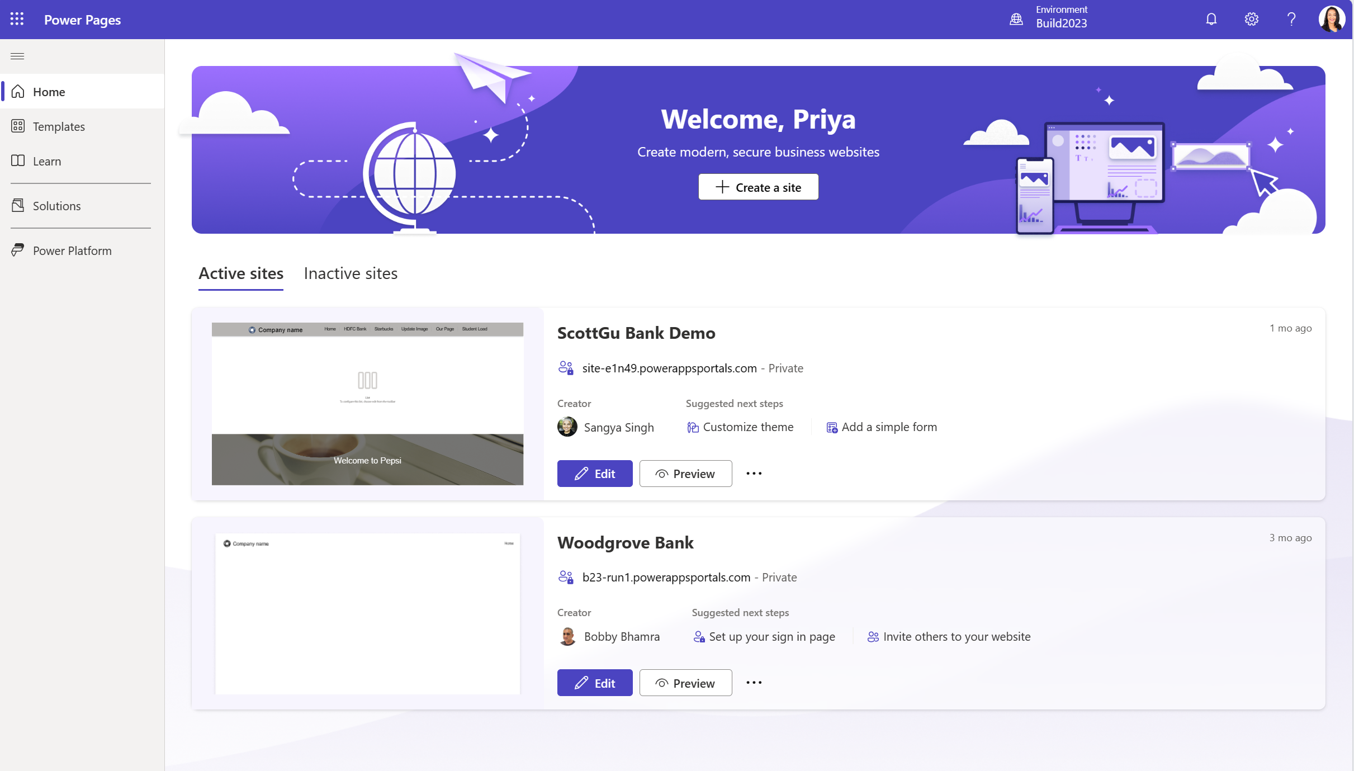
Get Started with Power Pages
Get Started today:
http://aka.ms/makePowerPages
Available now in Public Preview (Environments in US region):
Maker Copilot: Site creation, Page Creation, Form Creation, Text refinement, Stock Images
End user Copilot for sites (Private and Public)
Pro-Developer copilot in VSCode: Javascript and WebAPI code generation

Slide 25
Example Prompts to create a site
Government
Financial services
Industrials & manufacturing
Automotive & transport
“Create a site showcasing <Institution name’s> business banking solutions, including corporate accounts, trade finance, and treasury services.”
“Create a site for locating <Company name’s> authorized service centers, scheduling maintenance appointments, and accessing service packages.”
“Create a site detailing housing policies, available community services, and resources for vulnerable populations in <City name>”
“Create a site detailing <Company Name’s> supplier partnerships, and supplier application process”

Slide 26
Thank you

Slide 27
Microsoft 365 updates
Top new feature releases across Microsoft 365

Slide 28
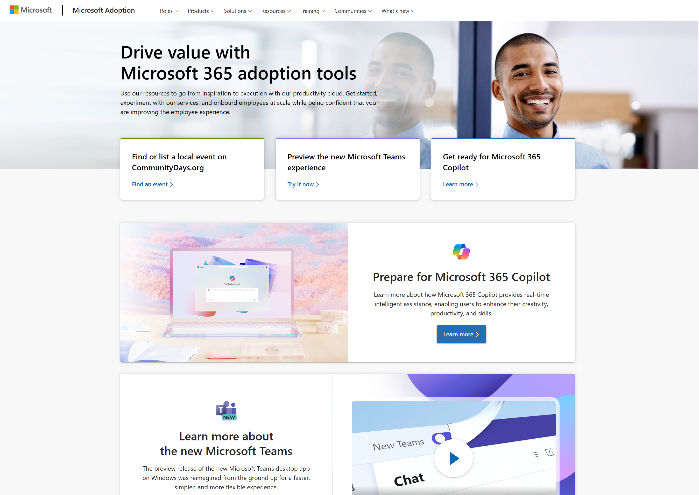
Update highlights on adoption.microsoft.com
Microsoft
Adoption
Updated the new Microsoft Teams microsite to align with its GA, including a new video on Coffee in the Cloud: Making the Switch to the New Teams Now Generally Available
Multiple updates to the Microsoft Copilot microsite, including an article on How to get the best out of generative AI
Additional resources added to Viva Engage and Viva Goals
New blog detailing the September 2023 content updates for Microsoft 365 Learning Pathways
Browse the Release notes for more details.

Slide 29
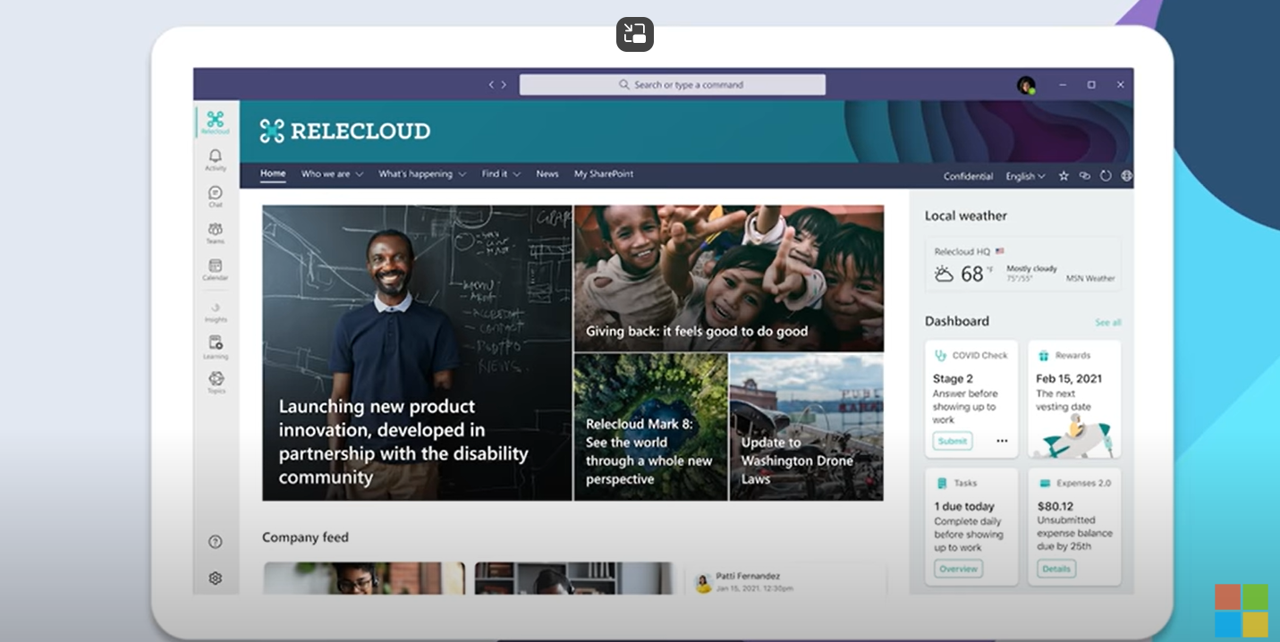
Microsoft Viva Amplify now generally available
Microsoft
Viva
Viva Amplify empowers organizational communication teams and leaders to elevate their message and energize their people. The app centralizes communication processes and offers writing guidance to help messages from every part of the organization reach all employees. Communicators can publish to multiple channels simultaneously, manage their campaigns from a central hub, and study resulting metrics to better plan future communications.
Learn more about Viva Amplify here.
Watch the Viva Amplify product overview video here.

Slide 30
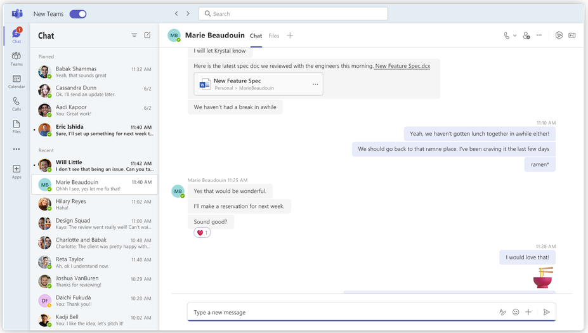
New Teams now generally available for Windows and Mac
Microsoft
Teams
On October 5, the general availability of the new Microsoft Teams app for Windows and Mac, including education customers, was announced.
We’re also beginning to roll out new Teams to public preview for our VDI and government cloud customers (GCC, GCC-H, DoD).
New Teams now has full feature parity for almost all features. Additionally, many new features and enhancements will be available exclusively in the new Teams experience, such as support for multi-tenant organizations (MTO) and multi-tenant, multi-account (MTMA).
Make the switch and upgrade today – it’s easy! Learn more here.

Slide 31
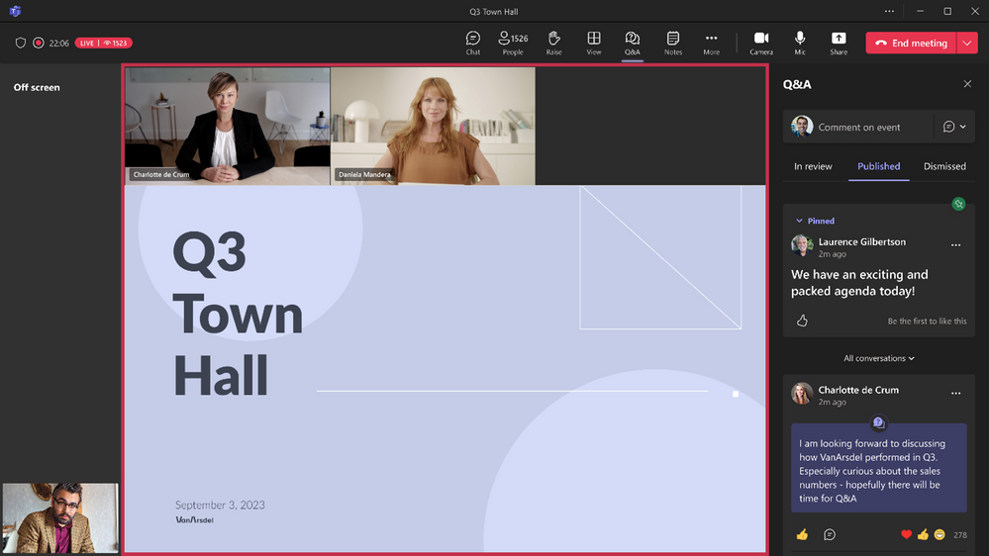
Introducing Town halls in Microsoft Teams
Microsoft
Teams
We are excited to announce Town halls in Teams, a new experience to host and deliver large-scale, internal events to create connections across an organization. Town halls will provide a one-to-many format with advanced production capabilities and a structured approach for attendee engagement. With town halls, customers can host various types of internal as well as external events including company-wide town halls, all hands, global team meetings, internal broadcasts, fireside chats, and more.
Learn more here.

Slide 32
Retiring Teams Live Events
Microsoft
Teams
With the introduction of Town halls and its integration of live event capabilities, Teams Live Events (TLE) will be retired for commercial customers on September 30, 2024. Customers can continue to use TLE between now and then with no change to their existing experience, but after September 30, 2024, TLE will no longer be supported, and access will be discontinued. Existing recordings will be available to access until December 31, 2024, but customers should download and save them to a different location before then.
For government customers, including GCC, GCC-H, and DoD, the retirement date of TLE will be announced in the coming months.
Learn more here.

Slide 33

Upcoming community events
Oct 30-Nov 3, 2023
Nov 27-30, 2023
Nov 15-16, 2023
365 EduCon Chicago
European SharePoint Conference (ESPC)
Microsoft Ignite
Chicago, IL
Amsterdam, Netherlands
Hybrid/Seattle, WA
Explore other Microsoft events and a full list of community-led events can be found at CommunityDays.org

Slide 34
Upcoming community-produced events
Professionally produced community events draw from 1k-5k attendees (in-person). Attendance fees are charged and pre/post event workshops delivered by Microsoft MVPs are often part of the event. Event organizers ask for our help in driving attendance and providing MSFT corporate speakers.
Event name | Start date | End date | City | State/Province | Country | Products
REFACTR.TECH | 10/27/2023 | 10/27/2023 | Atlanta | Georgia | United States | Career / D&I (Diversity and Inclusion), AI / ML, Data, Developer tools + DevOps.JavaScript, IoT, Open Source
365 EDUCon Chicago (M365 + Power Platform) | 10/30/2023 | 11/3/2023 | Chicago | Illinois | United States | Azure / Cloud
ODSC West | 10/31/2023 | 11/3/2023 | San Francisco | California | United States | AI / ML
KubeCon North America 2023 | 11/6/2023 | 11/9/2023 | Chicago | Illinois | United States | Containers / Kubernetes; Open Source
Visual Studio Live | 11/12/2023 | 11/17/2023 | Orlando | Florida | United States | .NET; AI / ML; Containers / Kubernetes; Data; Developer tools + DevOps
Agile Testing Days EU | 11/13/2023 | 11/16/2023 | Potsdam |  | Germany | Developer tools + DevOps
Build Stuff 2023 | 11/15/2023 | 11/17/2023 | Vilnius |  | Lithuania | Open Source; Security / Compliance; JavaScript; Developer tools + DevOps; Azure / Cloud; AI / ML
DDD Adelaide​ | 11/18/2023​ | 11/18/2023​ | Adelaide​ | ​ | Australia​ | .NET; Developer tools + DevOps; Open Source; Python; JavaScript; Mixed Reality; Java; Azure / Cloud; AI / ML​
AutomationSTAR 2023​ | 11/20/2023​ | 11/21/2023​ | Berlin​ | ​ | Germany​ | Developer tools + DevOps​
Level Up Your Data​ | 11/20/2023​ | 11/21/2023​ | Brisbane​ | ​ | Australia​ | Data; Azure / Cloud; AI / ML; Security / Compliance​
Update Conference​ | 11/23/2023​ | 11/24/2023​ | Prague​ | ​ | Czech Republic​ | .NET; Azure / Cloud; Developer tools + DevOps​
NZ Business Applications Summit 2023​ | 11/24/2023​ | 11/24/2023​ | Wellington​ | ​ | New Zealand​ | Power Platform, Dynamics 365​

Slide 35
Upcoming community-produced events (continued)
Professionally produced community events draw from 1k-5k attendees (in-person). Attendance fees are charged and pre/post event workshops delivered by Microsoft MVPs are often part of the event. Event organizers ask for our help in driving attendance and providing MSFT corporate speakers.
Event Name​ | Start​ | End​ | City​ | State/Province​ | Country​ | Products​
European SharePoint, Office & Azure Confernce (ESPC23)​ | 11/27/2023​ | 11/30/2023​ | Amsterdam​ | ​ | Netherlands​ | Azure / Cloud; Microsoft 365​
Sinergija 23​ | 11/28/2023​ | 11/30/2023​ | Belgrade​ | ​ | Serbia​ | Azure / Cloud.AI / ML,Industry events​
Prague Power Conference 2023​ | 12/1/2023​ | 12/1/2023​ | Prague​ | ​ | Czech Republic​ | Power Platform​
DevIntersection​ | 12/5/2023​ | 12/7/2023​ | Orlando​ | Florida​ | United States​ | .NET; AI / ML; Azure / Cloud; Containers / Kubernetes; Data; Developer tools + DevOps; Microsoft 365; Open Source; Power Platform​
Test JS Summit​ | 12/7/2023​ | 12/11/2023​ | Berlin​ | ​ | Germany​ | Developer tools + DevOps; JavaScript; Open Source​

Slide 36
Upcoming community-led events
These events often serve underrepresented or emerging markets. They are organized by volunteers and are free to attendees. Newly branded “Community Days” events may cover any part of the Microsoft technical stack and/or cater to roles or industries. These are vibrant opportunities for recruiting, career development, and technical skilling. A full list of community-led events can be found at CommunityDays.org.
Event name​ | Start date​ | End date​ | City​ | State/Province​ | Country​
aMS Manila​ | 10/24/2023​ | 10/24/2023​ | Manila​ | ​ | Philippines​
M365 Saturday Pune 2023​ | 10/28/2023​ | 10/28/2023​ | Pune​ | ​ | India​
Community Days Mexico City 2023​ | 11/2/2023​ | 11/2/2023​ | Mexico City​ | ​ | Mexico​
Dynamics User Group Southeast Regional Meetup​ | 11/7/2023​ | 11/8/2023​ | Atlanta​ | Georgia​ | United States​
M365 Twin Cities​ | 11/11/2023​ | 11/11/2023​ | Brooklyn Park​ | Minnesota​ | United States​
aMS Aachen​ | 11/16/2023​ | 11/16/2023​ | Aachen​ | ​ | Denmark​
Power of the Cloud​ | 11/17/2023​ | 11/17/2023​ | Toronto​ | Ontario​ | Canada​
YYC Microsoft Community Day​ | 11/18/2023​ | 11/18/2023​ | Calgary​ | Alberta​ | Canada​
M365 Community Days Lagos 2023​ | 12/9/2023​ | 12/9/2023​ | Lagos​ | ​ | Nigeria​
M365 Community Day – Phoenix​ | 1/13/2024​ | 1/13/2024​ | Tempe​ | Arizona​ | United States​
Explore other Microsoft events and a full list of community-led events can be found at CommunityDays.org

Slide 37
Microsoft 365 Champion Community news
See you at our next community call on November 28!
November topic: Microsoft Ignite 2023 recap with Karah Burgess and Josh Leporati
Top asks:
Complete our monthly call survey: https://aka.ms/Microsoft365ChampionCallFeedback
Participate in the Driving Adoption Community:
https://aka.ms/DrivingAdoption
Invite colleagues to join the Champion Program: https://aka.ms/M365Champions

Slide 38
Thanks for attending! We’d love your feedback on today’s call and hear ways we can make future calls even better! https://aka.ms/Microsoft365ChampionCallFeedback
Microsoft 365 Champion Community
Learn more. Do more. Achieve more, together.
Now, let’s meet! Stay on to join our open discussion and feel free to come on video and off mute.

