Slide 1

We will begin the call at five minutes past the hour.
Microsoft 365 Champion Community Call
November 2023
Microsoft 365 Champion Community
Learn more. Do more. Achieve more, together.

Slide 2
Microsoft 365 Champion Community
November 2023 Monthly Call
Microsoft Teams Customer Advocacy Group
Karuana Gatimu, Josh Leporati, Karah Burgess

Slide 3
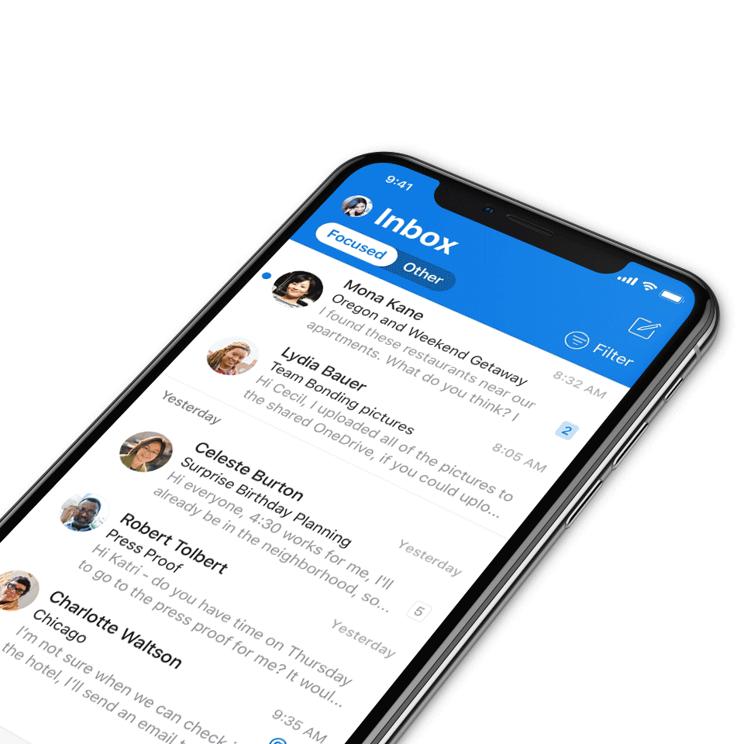
Digital Event Code of Conduct
Microsoft’s mission is to empower every person and every organization on the planet to achieve more. This includes all Microsoft events and gatherings, including on digital platforms, where we seek to create a respectful, friendly, fun and inclusive experience for all participants.​
We expect all digital event participants to uphold the principles of this Code of Conduct, which covers the main digital event and all related activities. We do not tolerate disruptive or disrespectful behavior, messages, images, or interactions by any party participant, in any form, at any aspect of the program including business and social activities, regardless of location.​
Microsoft will not tolerate harassment or discrimination based on age, ancestry, color, gender identity or expression, national origin, physical or mental disability, religion, sexual orientation, or any other characteristic protected by applicable local laws, regulations, and ordinances.​
We encourage everyone to assist in creating a welcoming and safe environment.
For more info, click here.

Slide 4

Agenda
Announcements
Ignite Recap
Community events & updates
Open discussion forum
Find resources from previous calls here:
https://aka.ms/M365ChampionResources

Slide 5


Open call For Microsoft Community Regional Leads
Apply to be a Microsoft Global Community Regional Lead and part of the Microsoft Community Advisory Board.
A MGCI Regional Lead is a working volunteer position that helps to create and support Community Days (communitydays.org) events, spread the word about the Microsoft Community, and ensure global access to community resources.
Apply now at
aka.ms/MGCIRegionalLead

Slide 6

Microsoft Global Community Initiative
Microsoft
Community
Develop new skills and connect with like-minded peers and product experts. The Microsoft Global Community Initiative features forums, training, blogs, user groups, resources, and more.
Visit https://aka.ms/MicrosoftCommunity to access the Microsoft Community Hub.
How to get involved: join the initiative here and sign up here to organize a Community Day event.

Slide 7
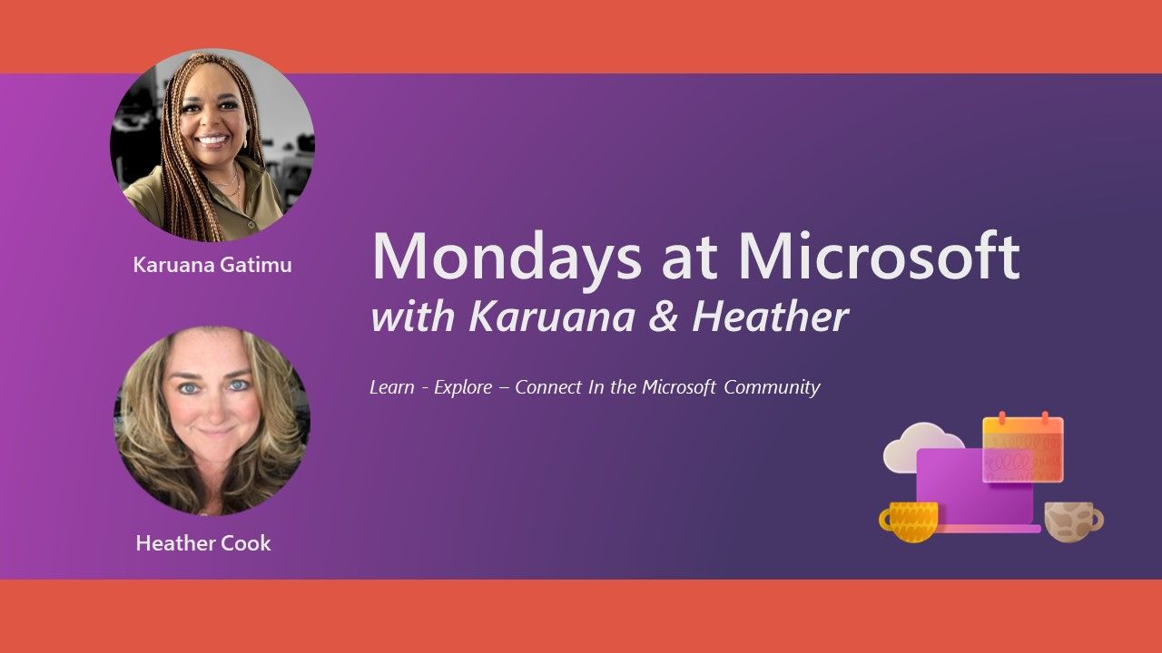
Mondays at Microsoft with Karuana and Heather
Microsoft
Community
Our Mondays at Microsoft show premiered on May 15! Karuana and Heather announced the new Microsoft Community on LinkedIn, and this bi-weekly show will aggregate new product announcements and upcoming community events to drive technical skilling and engagement!
Missed it? Click here for all the Mondays at Microsoft recordings.
Click here to join the new Microsoft Community on LinkedIn so you can get ready for our next call.
Find us on
https://aka.ms/MSCommunityLinkedIn

Slide 8
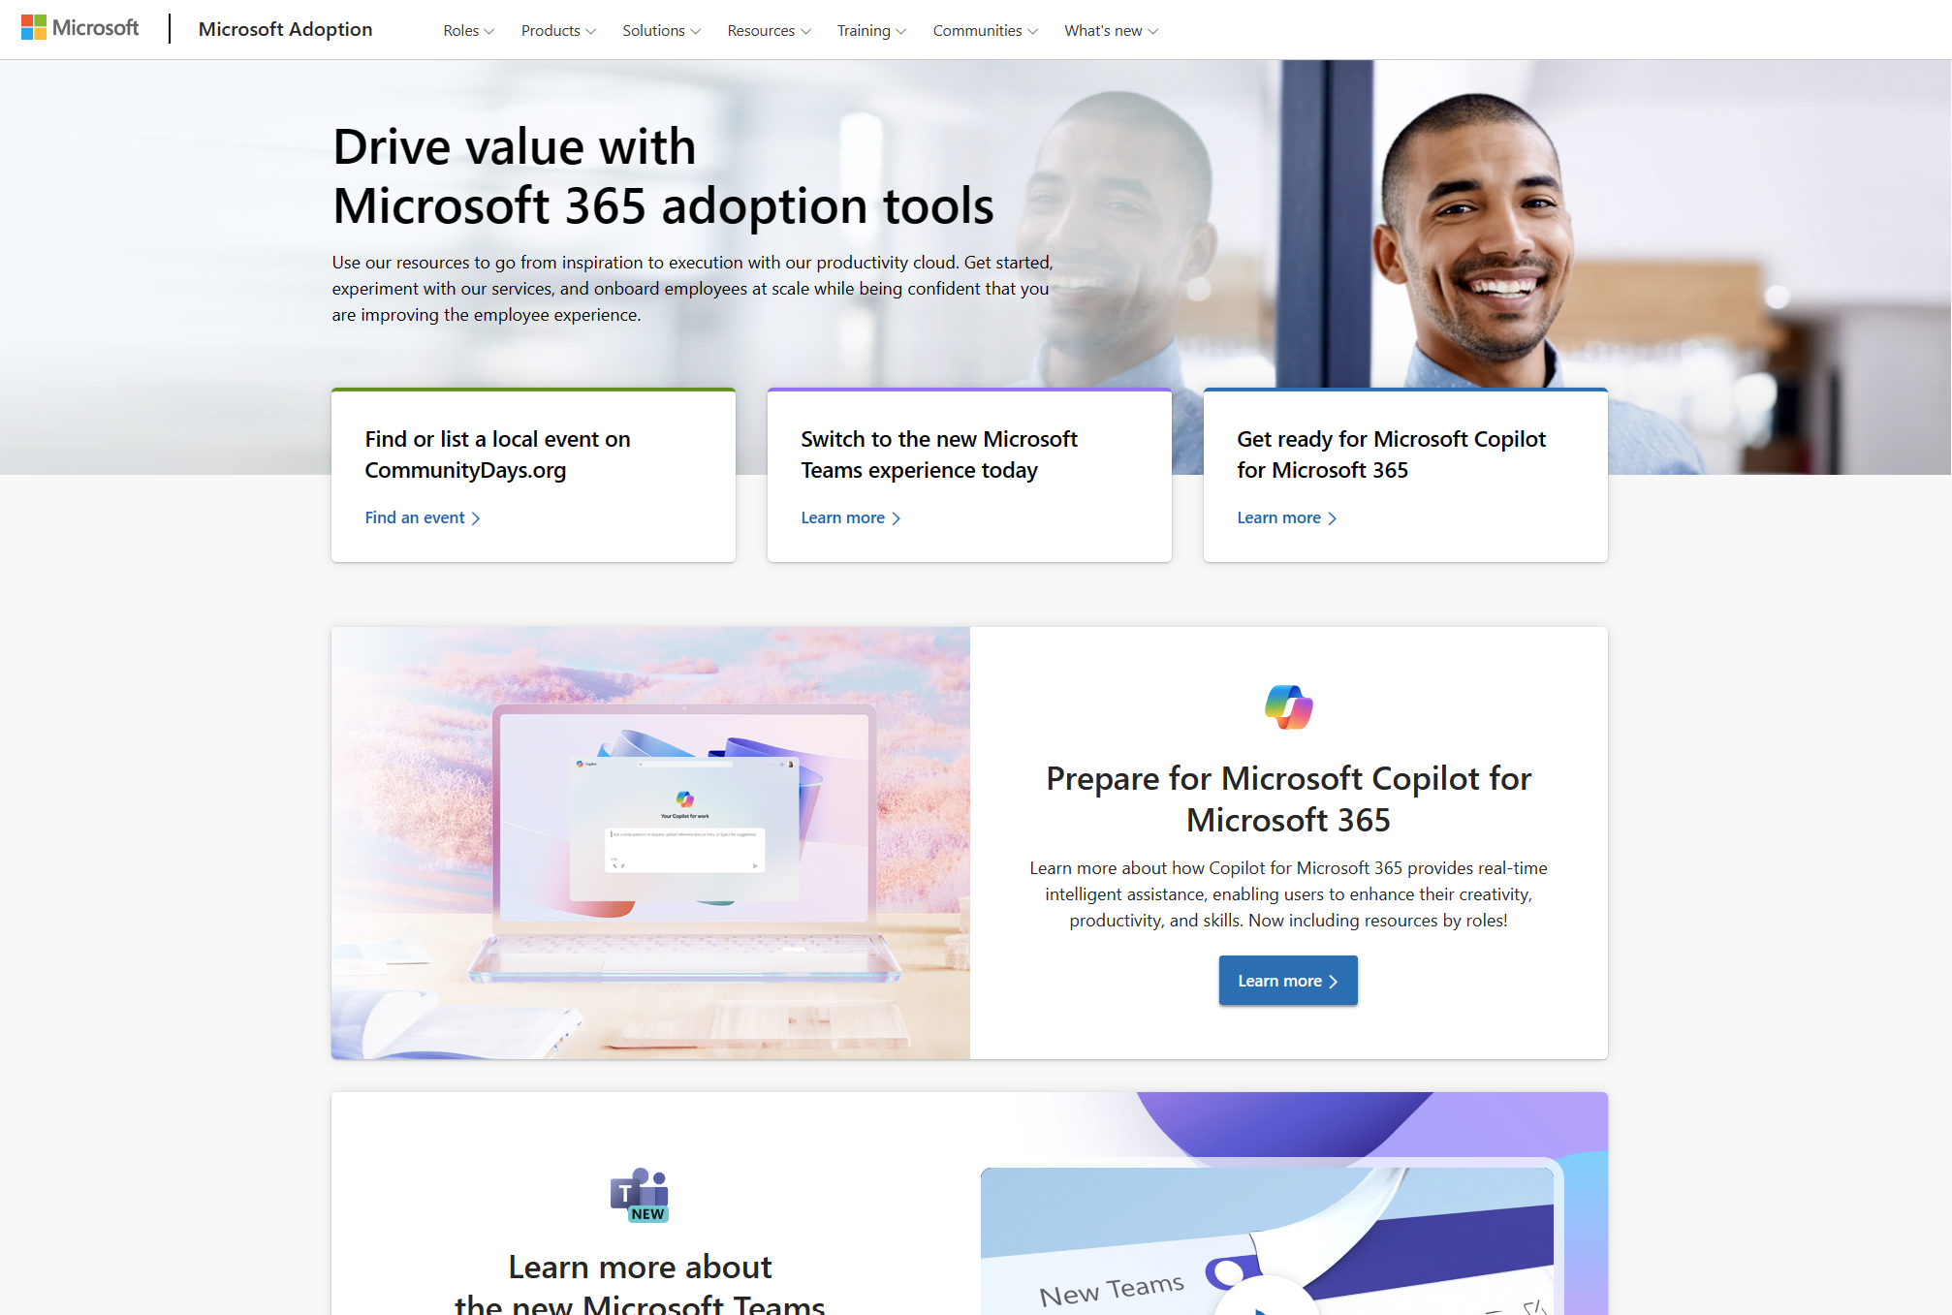
Update highlights on adoption.microsoft.com
Microsoft
Adoption
New adoption content for the Microsoft 365 Copilot Hub, including an adoption workbook, an adoption planning checklist, and tailored content for roles – read our blog to learn more
New pages:
  Bing Chat Enterprise is now Microsoft Copilot
  SharePoint Premium
  Microsoft 365 Backup
  Microsoft 365 Archive
  SharePoint eSignature
  Microsoft Loop, including new Day in the Life guides
Browse the Release notes for more details.

Slide 9

Rethinking cloud infrastructure
Microsoft
Ignite
At Ignite, we announced new innovations across our datacenter fleet, including the latest AI optimized silicon from our industry partners and two new Microsoft-designed chips.
Microsoft Azure Maia, an AI Accelerator chip designed to run cloud-based training and inferencing for AI workloads such as OpenAI models, Bing, GitHub Copilot and ChatGPT.
Microsoft Azure Cobalt, a cloud-native chip based on Arm architecture optimized for performance, power efficiency and cost-effectiveness for general purpose workloads.
Additionally, we are announcing the general availability of Azure Boost, a system that makes storage and networking faster by moving those processes off the host servers onto purpose-built hardware and software.
Notes:
Microsoft has led with groundbreaking advances like partnerships with OpenAI and the integration of ChatGPT capabilities into tools used to search, collaborate, work and learn. As we accelerate further into AI, Microsoft is rethinking cloud infrastructure to ensure optimization across every layer of the hardware and software stack.

Slide 10
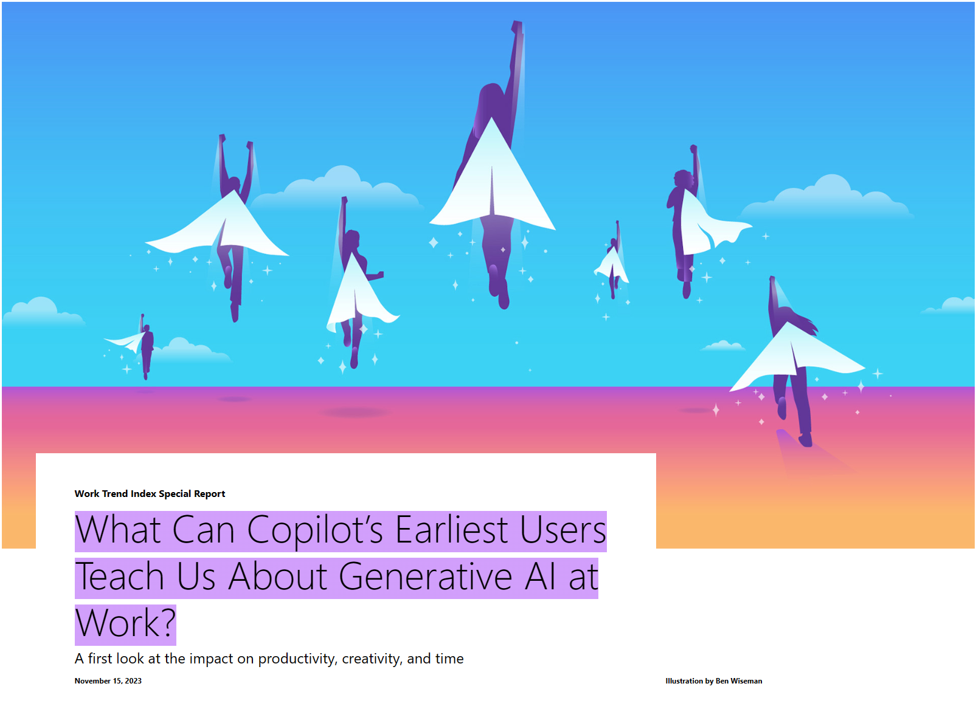
Signals of AI’s potential to transform work
Microsoft
Ignite
Take our latest Work Trend Index.
70% of Copilot users said they were more productive and 68% said it improved the quality of their work; 68% say it helped jumpstart the creative process.
Overall, users were 29% faster at specific tasks (searching, writing and summarizing).
Users caught up on a missed meeting nearly 4x faster.
64% of users said Copilot helps them spend less time processing email.
87% of users said Copilot makes it easier to get started on a first draft.
75% of users said Copilot “saves me time by finding whatever I need in my files.”
77% of users said once they use Copilot, they don’t want to give it up.
Notes:
Eight months ago, we introduced Copilot for Microsoft 365 to reduce digital debt and increase productivity so people can focus on the work that is uniquely human. What everyone wants to know now is: Will Copilot really change work, and how? Our research, using a combination of surveys and experiments, shows the productivity gains are real:

Slide 11
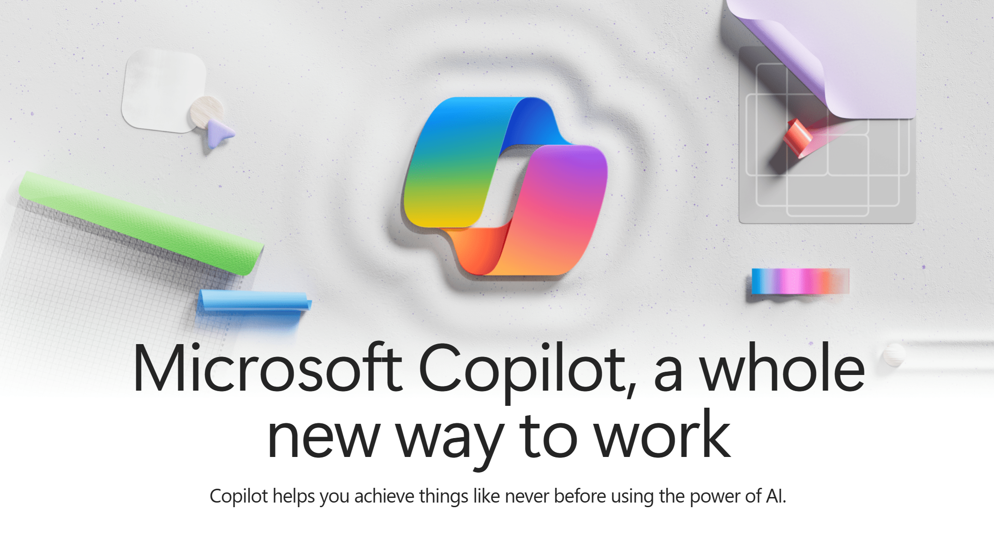
Extending the Copilot Experience
Microsoft
Ignite
Some of our Copilot-related announcements and updates include:
Bing Chat and Bing Chat Enterprise are now simply Microsoft Copilot: The efforts to simplify the user experience and make Copilot more accessible to everyone starts with Bing, Microsoft’s leading experience for the web.
Microsoft Copilot for Microsoft 365: Now generally available for enterprise, we continue to bring new value, based on learnings from our Early Access Program and other research channels. The new Microsoft Copilot Dashboard shows customers how Copilot is impacting their organization – with insights like those found in our Work Trend Index.
Microsoft Copilot Studio: AI transformation begins by tapping into an organization’s unique data and workflows. Microsoft Copilot Studio is a low-code tool designed to customize Microsoft Copilot for Microsoft 365 by integrating business-critical data and build custom copilots for internal or external use.
Notes:
Some of our high-level Copilot experiences that were announced/updated

Slide 12
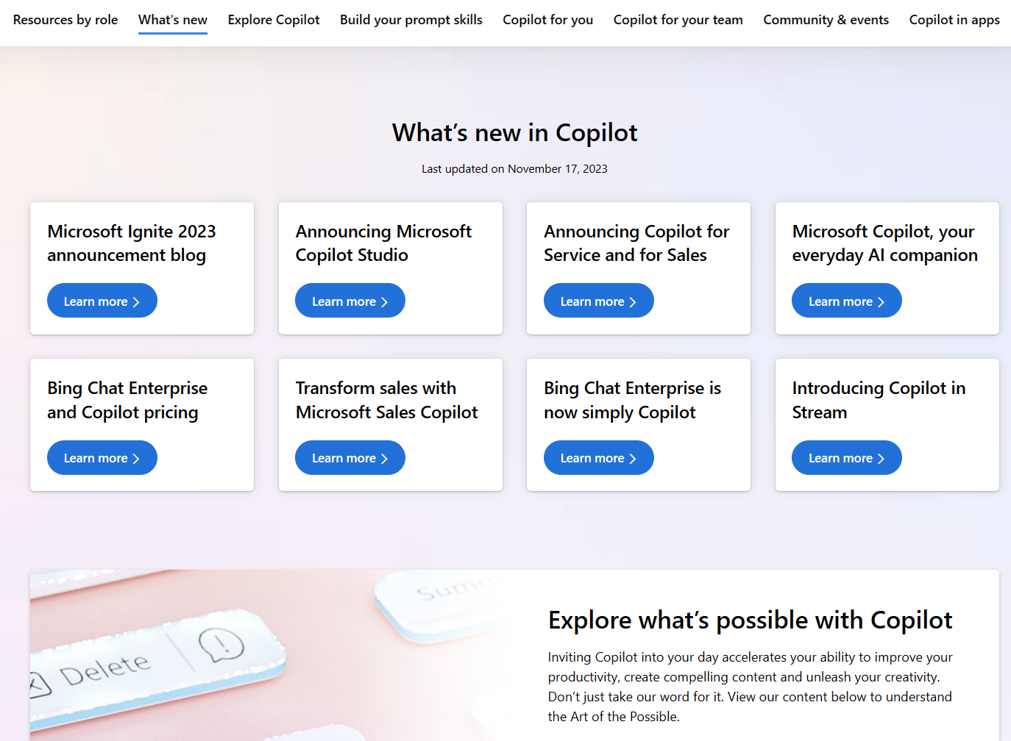
Extending the Copilot Experience (continued)
Microsoft
Ignite
Microsoft Copilot for Service: The newest copilot to provide role-based support helps businesses accelerate their AI transformation of customer service. Copilot for Service includes Microsoft Copilot for Microsoft 365 and helps extend existing contact centers with generative AI.
Copilot in Microsoft Dynamics 365 Guides: Combining the power of generative AI and mixed reality, this copilot helps frontline workers complete complex tasks and resolve issues faster without disrupting workflow.
Microsoft Copilot for Azure: Copilot for Azure helps IT teams gain new insights into their workloads, unlock untapped Azure functionality and orchestrate tasks across both cloud and edge.
Notes:
Additional areas that Copilot experiences have been introduced into

Slide 13
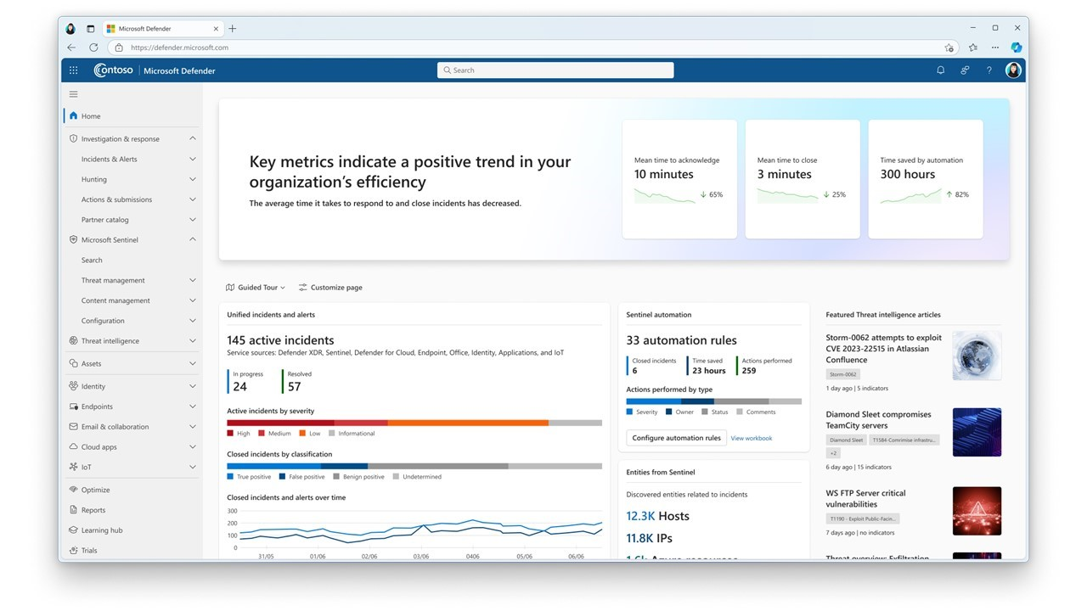
Strengthening defenses in the era of AI
Microsoft
Ignite
The threat landscape has evolved dramatically in recent years, and at Microsoft Ignite we are introducing new technologies across Microsoft’s suite of security solutions to help defenders make the world a safer place.
Microsoft Sentinel and Microsoft Defender XDR (previously Microsoft 365 Defender) will be combined to create the industry’s first Unified Security Operations Platform, with embedded Security Copilot experiences. With built-in generative AI, it’s a single, powerful experience focused on protecting threats at machine speed and aiding defenders by simplifying the complexity of their environment.
Notes:
Additionally, the expansion of Security Copilot embedded within Intune, Purview and Entra will help IT administrators, compliance units and identity teams simplify complex scenarios. In Entra, identity administrators can quickly troubleshoot identity access. In Purview, data security alerts deliver rich context to help resolve problems faster. In Intune, IT administrators can use “what if” analysis to keep business running while improving governance and compliance.

Slide 14

Microsoft Fabric
Microsoft
Ignite
Microsoft Fabric reshapes how teams work with data by bringing everyone together on a single, AI-powered platform that unifies all those data estates on an enterprise-grade data foundation.
Copilot in Microsoft Fabric also integrates with Microsoft Office and Teams to foster a data culture to scale the power of data value creation throughout the organization. We’ve made more than 100 feature updates since Build and expanded our ecosystem with industry leading partners, and have over 25,000 customers, including Milliman, Zeiss, London Stock Exchange, and EY, using it today.
Notes:
Microsoft Fabric is now GA and can reshape how your teams work with data by bringing everyone together on a single, AI-powered platform built for the era of AI. Fabric is a complete analytics platform
Fabric combines the best of Microsoft Power BI, Azure Synapse Analytics, and Azure Data Factory

Slide 15

New Teams meeting features
Microsoft
Ignite
Voice isolation in Teams meetings and calls: This AI-driven feature is an advanced noise suppression capability that leverages user’s voice profiles and suppresses other people’s voices in the background during a Teams meeting or call. AI in Teams will recognize an individual’s voice and filter only their voice in Teams meetings and calls. This feature rollout has begun and will be generally available in early 2024.
Decorate your background: Meeting participants will be able to use generative background effects in Teams to show up at their best – even when the space they’re working from isn’t at its best. With Decorate your background, meeting participants can use the power of AI to generate a background that decorates and enhances their real-world room, by cleaning up clutter or adding plants to a wall. This feature will be available early next year in Teams Premium.

Slide 16
Immersive spaces in Teams
Microsoft
Ignite
Immersive spaces in Microsoft Teams, currently in preview, will be generally available in January 2024. Immersive spaces in Teams will bring the power of Mesh into the place where people work every day – Microsoft Teams. From the View menu in a Teams meeting, users can easily transform a 2D meeting into an immersive 3D experience.
Key capabilities in immersive spaces in Teams will include:
Avatars
3D environments
Seat assignments
Spatial audio and audio zones
Interactive activities
Live reactions

Slide 17
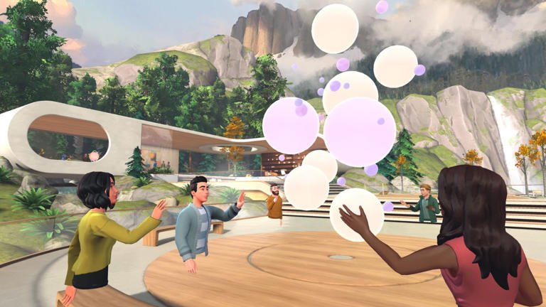
Microsoft Mesh
Microsoft
Ignite
Microsoft Mesh, currently in preview, will be generally available in January 2024. With Mesh, users will be able to create custom immersive spaces tailored to specific business needs, such as employee events, trainings, guided tours and internal product showcases.
At GA:
Event organizers will be able to facilitate a Q&A session by enabling attendees to raise hands
Organizers will see the list of hands raised, in order, and will be able to call on participants, engaging them directly. When called on, attendees will be effectively seen and heard by everyone in the event.

Slide 18

Updates to Viva Engage and Viva Amplify
Microsoft
Ignite
Viva Engage and Viva Amplify are tools to allow organizations to connect everyone through employee communities and conversations to build meaningful relationships and give company messages needed volume. Updates to both platforms include:
Multi-tenant organization (MTO) communication: Viva Engage supports MTO cross-tenant communication to make it easier for leaders to communicate and engage at scale to build community across the organization.
Publish from Viva Amplify to Viva Engage: integration will allow for publishing from Viva Amplify to Viva Engage communities and storylines. It will also incorporate content shared to Engage within reports in Viva Amplify (private preview early 2024).

Slide 19
Updates to Viva Engage and Viva Amplify (continued)
Microsoft
Ignite
Viva Goals and Viva Engage integration: The integration will bring mission, alignment and results into communities and conversation by helping customers build communities around goals, view goal progress from Viva Goals directly in Viva Engage and create divisional communities within Viva Engage (GA 2024).
Seeded and AI-connected knowledge in Answers: This update will allow users to use AI to generate questions and answers from existing files and import them into Answers. Also, AI will automatically route open questions to people who might have the answer (end of 2023).
Viva Amplify updates: Viva Amplify will include publication templates for campaigns, adds localization in more than 50 languages and will include better reporting from system data to incorporate custom data from HR tools into filtering and reports.

Slide 20
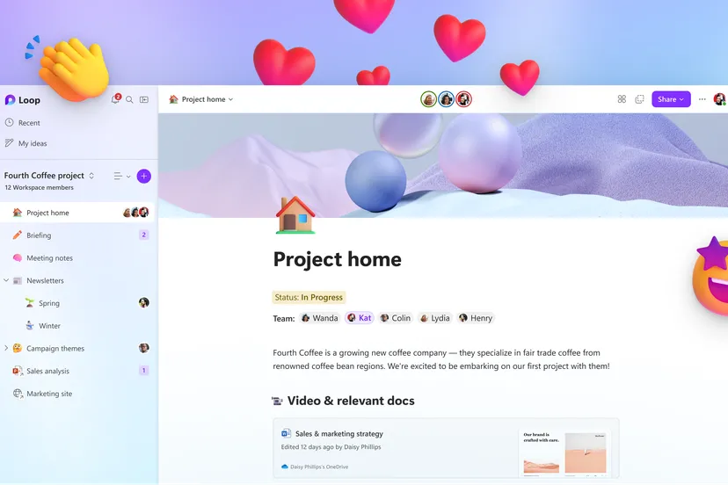
Microsoft Loop now GA in web and mobile
Microsoft
Ignite
The Microsoft Loop app is now generally available for the web and mobile (iOS and Android) for commercial customers. The Loop mobile app (iOS and Android) is generally available for consumer customers as well. Full functionality is available to business customers as part of their Microsoft 365 E3, E5, Business Standard and Business Premium Licenses.
Updates and new capabilities include:
Workspace status
Workspace descriptions
Power Automate
Start a workspace from Teams

Slide 21
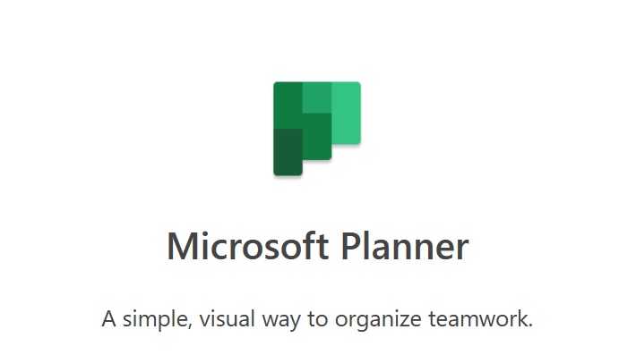
The new Microsoft Planner
Microsoft
Ignite
Microsoft is bringing together Microsoft To Do, Planner, and Project for the web into a single, unified experience called Microsoft Planner. This experience will first be available in the Planner app in Microsoft Teams in spring 2024, followed by web experiences later in 2024.
Benefits will include:
The ability to easily find tasks, so users can focus on the tasks they need to get done today.
Helping users work the way they want. Whether for individual tasks or team initiatives, Planner will enable them to choose the approach that’s best for their needs.
Creating project plans with powerful scheduling and resourcing tools. As plans evolve, Planner will offer a menu of capabilities to meet unique business needs.
Copilot in Planner will help users get started with a plan faster with simple prompts and as the plan evolves, it will add goals and intelligently suggest new tasks to help keep users informed on progress.

Slide 22

Ignite Book of News
Microsoft
Ignite
This year’s edition of the Book of News. It’s an action-packed version that features more than 100 announcements in a wide range of topics, including infrastructure, Microsoft Copilot, the relationship between data and AI, new tools for developers and security.
The Book of News is designed to be your guide to all our announcements, making it easy for you to navigate the latest information and provide key details on the topics in which you are most interested in at Microsoft.
Microsoft Ignite 2023 Book of News

Slide 23

Upcoming community events
Nov 27-30, 2023
Apr 28-May 3, 2024
European SharePoint Conference (ESPC)
Microsoft 365 Conference
Amsterdam, Netherlands
Orlando, Florida
Explore other Microsoft events and a full list of community-led events can be found at CommunityDays.org

Slide 24
Upcoming community-produced events
Professionally produced community events draw from 1k-5k attendees (in-person). Attendance fees are charged and pre/post event workshops delivered by Microsoft MVPs are often part of the event. Event organizers ask for our help in driving attendance and providing MSFT corporate speakers.
Event Name​ | Start​ | End​ | City​ | State/Province​ | Country​ | Products​
Prague Power Conference 2023​ | 12/1/2023​ | 12/1/2023​ | Prague​ | ​ | Czech Republic​ | Power Platform​
DevIntersection​ | 12/5/2023​ | 12/7/2023​ | Orlando​ | Florida​ | United States​ | .NET; AI / ML; Azure / Cloud; Containers / Kubernetes; Data; Developer tools + DevOps; Microsoft 365; Open Source; Power Platform​
Test JS Summit​ | 12/7/2023​ | 12/11/2023​ | Berlin​ | ​ | Germany​ | Developer tools + DevOps; JavaScript; Open Source​

Slide 25
Upcoming community-led events
These events often serve underrepresented or emerging markets. They are organized by volunteers and are free to attendees. Newly branded “Community Days” events may cover any part of the Microsoft technical stack and/or cater to roles or industries. These are vibrant opportunities for recruiting, career development, and technical skilling. A full list of community-led events can be found at CommunityDays.org.
Event name​ | Start date​ | End date​ | City​ | State/Province​ | Country​
M365 Community Days Lagos 2023​ | 12/9/2023​ | 12/9/2023​ | Lagos​ | ​ | Nigeria​
M365 Community Day – Phoenix​ | 1/13/2024​ | 1/13/2024​ | Tempe​ | Arizona​ | United States​
Explore other Microsoft events and a full list of community-led events can be found at CommunityDays.org

Slide 26
Microsoft 365 Champion Community news
Reminder: we’ll have a community break in December (no call) and will reconvene in January 2024.
Happy holidays! :)
Top asks:
Complete our monthly call survey: https://aka.ms/Microsoft365ChampionCallFeedback
Participate in the Driving Adoption Community:
https://aka.ms/DrivingAdoption
Invite colleagues to join the Champion Program: https://aka.ms/M365Champions

Slide 27
Thanks for attending! We’d love your feedback on today’s call and hear ways we can make future calls even better! https://aka.ms/Microsoft365ChampionCallFeedback
Microsoft 365 Champion Community
Learn more. Do more. Achieve more, together.
Now, let’s meet! Stay on to join our open discussion and feel free to come on video and off mute.

