Slide 1

We will begin the call at five minutes past the hour
Microsoft 365 Champion Community Call
May 2023
Microsoft 365 Champion Community
Learn more. Do more. Achieve more, together.

Slide 2
Microsoft 365 Champion Community
May 2023 Monthly Call
Microsoft Teams Customer Advocacy Group
Karuana Gatimu, Tiffany Lee, Jessie Hwang

Slide 3
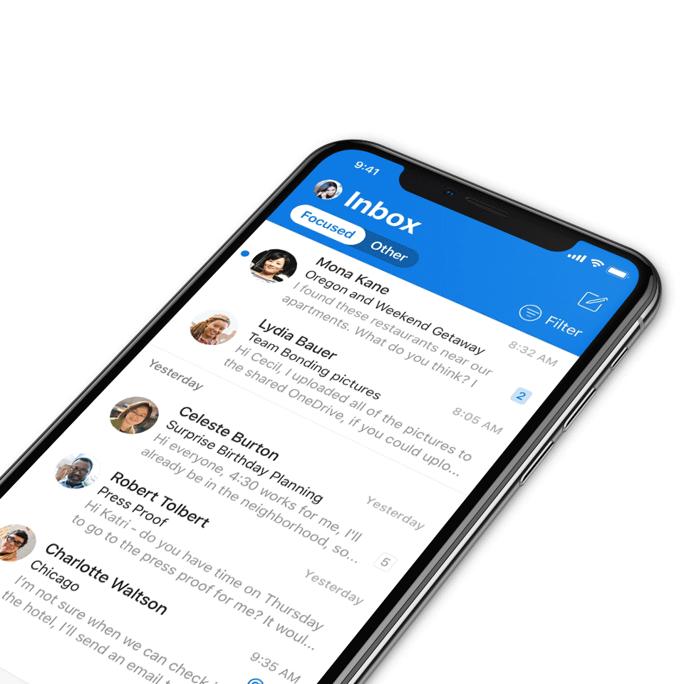
Digital Event Code of Conduct
Microsoft’s mission is to empower every person and every organization on the planet to achieve more. This includes all Microsoft events and gatherings, including on digital platforms, where we seek to create a respectful, friendly, fun and inclusive experience for all participants.​
We expect all digital event participants to uphold the principles of this Code of Conduct, which covers the main digital event and all related activities. We do not tolerate disruptive or disrespectful behavior, messages, images, or interactions by any party participant, in any form, at any aspect of the program including business and social activities, regardless of location.​
Microsoft will not tolerate harassment or discrimination based on age, ancestry, color, gender identity or expression, national origin, physical or mental disability, religion, sexual orientation, or any other characteristic protected by applicable local laws, regulations, and ordinances.​
We encourage everyone to assist in creating a welcoming and safe environment.
For more info, click here.

Slide 4

Agenda
Microsoft 365 updates | Top new features releases across Microsoft 365
Adoption Score: Group Level Aggregates | Mohammad Akram
Community Spotlight | Kathy Pepe, Program Manager at Dell
Community events & updates
Open discussion forum
Find resources from previous calls here:
https://aka.ms/M365ChampionResources

Slide 5
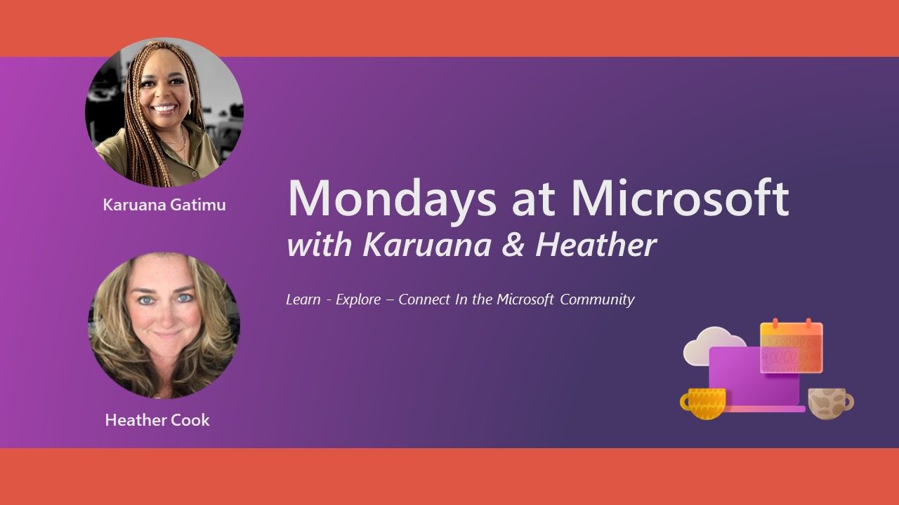
Microsoft
Community
Mondays at Microsoft: with Karuana and Heather
Our Mondays at Microsoft show premiered on May 15! Karuana and Heather announced the new Microsoft Community on LinkedIn and This bi-weekly show will aggregate new product announcements and upcoming community events to drive technical skilling and engagement!
Missed the call? Click here for Mondays at Microsoft show notes
Click here to join the new Microsoft Community on LinkedIn so you can get ready for our next call on June 5, which will include highlights from Microsoft Build.

Slide 6
Microsoft 365 updates
Top new feature releases across Microsoft 365

Slide 7
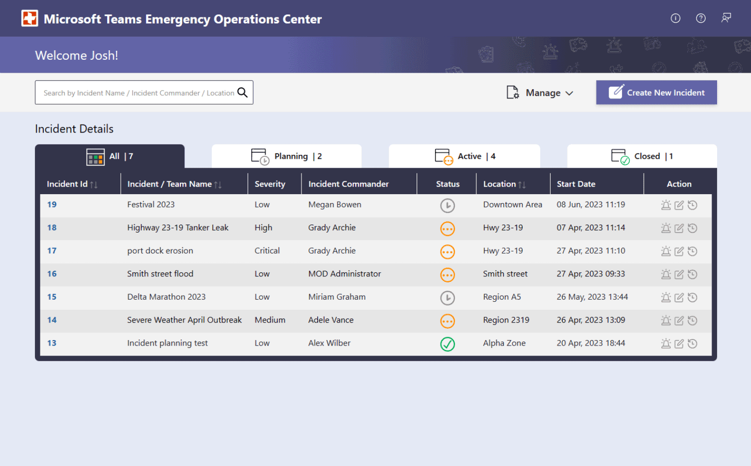
Microsoft
Teams
Teams Emergency Operations Center v2 release
This solution template leverages the power of the Microsoft 365 platform to centralize incident response, information sharing, and field communications using powerful services like Microsoft Lists, SharePoint, and more. Our latest updated includes the following features and enhancements to the solution
TEOC v2 updates include:
Microsoft 365 Government cloud support
Active dashboard fore each incident
Expanded assets during deployment
Dashboard role-based access
Lead assignment for roles
Core component updates
Interested in using TEOC for your organization? Sign up here to schedule an overview and demo at https://aka.ms/TEOCGetStarted.

Slide 8
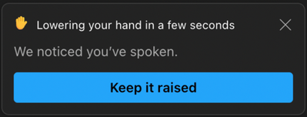
Microsoft
Teams
Automatic lowering of a user’s raised hand after speaking
If you raised your hand and then spoke in a meeting, this feature will alert you that your hand will be lowered after you have spoken. This feature allows meeting organizers the opportunity to focus on unanswered questions.
You will be able to choose to keep your hand raised if you wish by clicking the “Keep it raised” button. If you do not act on the notification, your hand will automatically be lowered. This should ensure smoother meeting facilitation for organizers and presenters. This release is rolling out only to Teams desktop users.

Slide 9
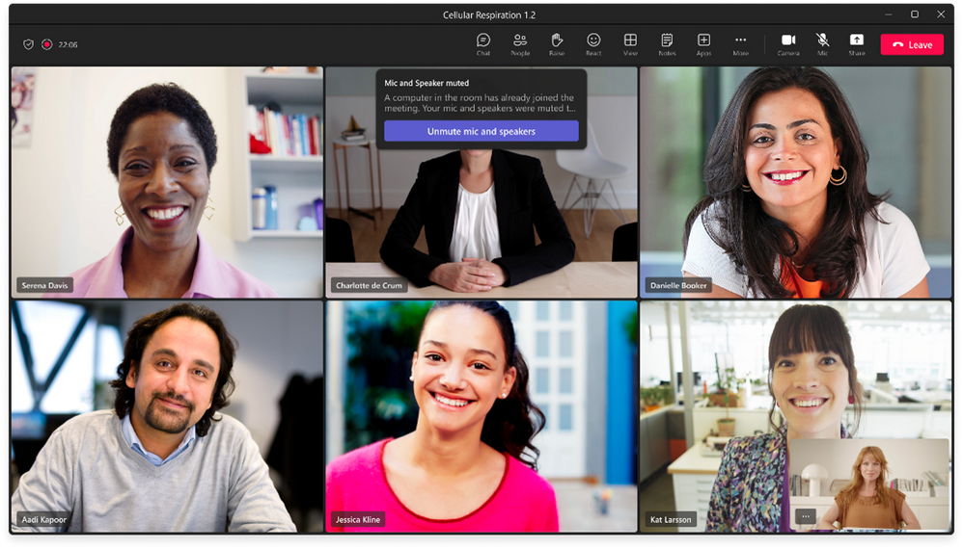
Microsoft
Teams
Ultrasound howling detection
When multiple users are in a Teams meeting in the same room using audio, a feedback loop is created, causing an echo. With this update, Teams can detect if another Teams device is nearby and already included with audio in the same meeting and notifies the users that want to join. Teams then automatically mutes the microphone and speakers of these users. You can turn the switch back on at any time if they wish.
Click here to learn more.

Slide 10
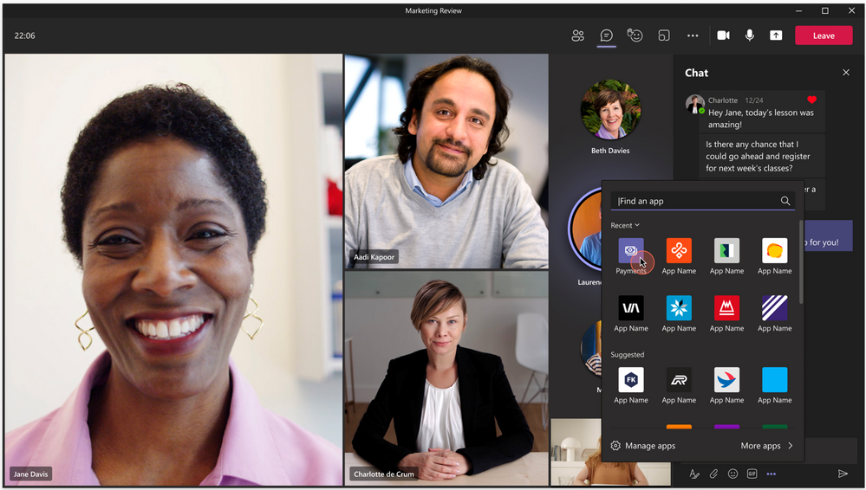
Microsoft
Teams
Microsoft launches the Teams Payments app for small businesses
Getting paid for appointments, classes, and webinars—essentially any meeting you host in Teams—has just become easier. The new Payments app, currently in public preview in the Teams Store, allows small businesses in the United States and Canada to easily manage and collect payments from within Teams on your desktop or mobile device during a meeting. Click here to learn more.
Come meet Microsoft small and medium business (SMB) Product Managers and other small and medium businesses like yours!
Join us at the SMB Champions Community at aka.ms/SMBCommunitySignup.

Slide 11
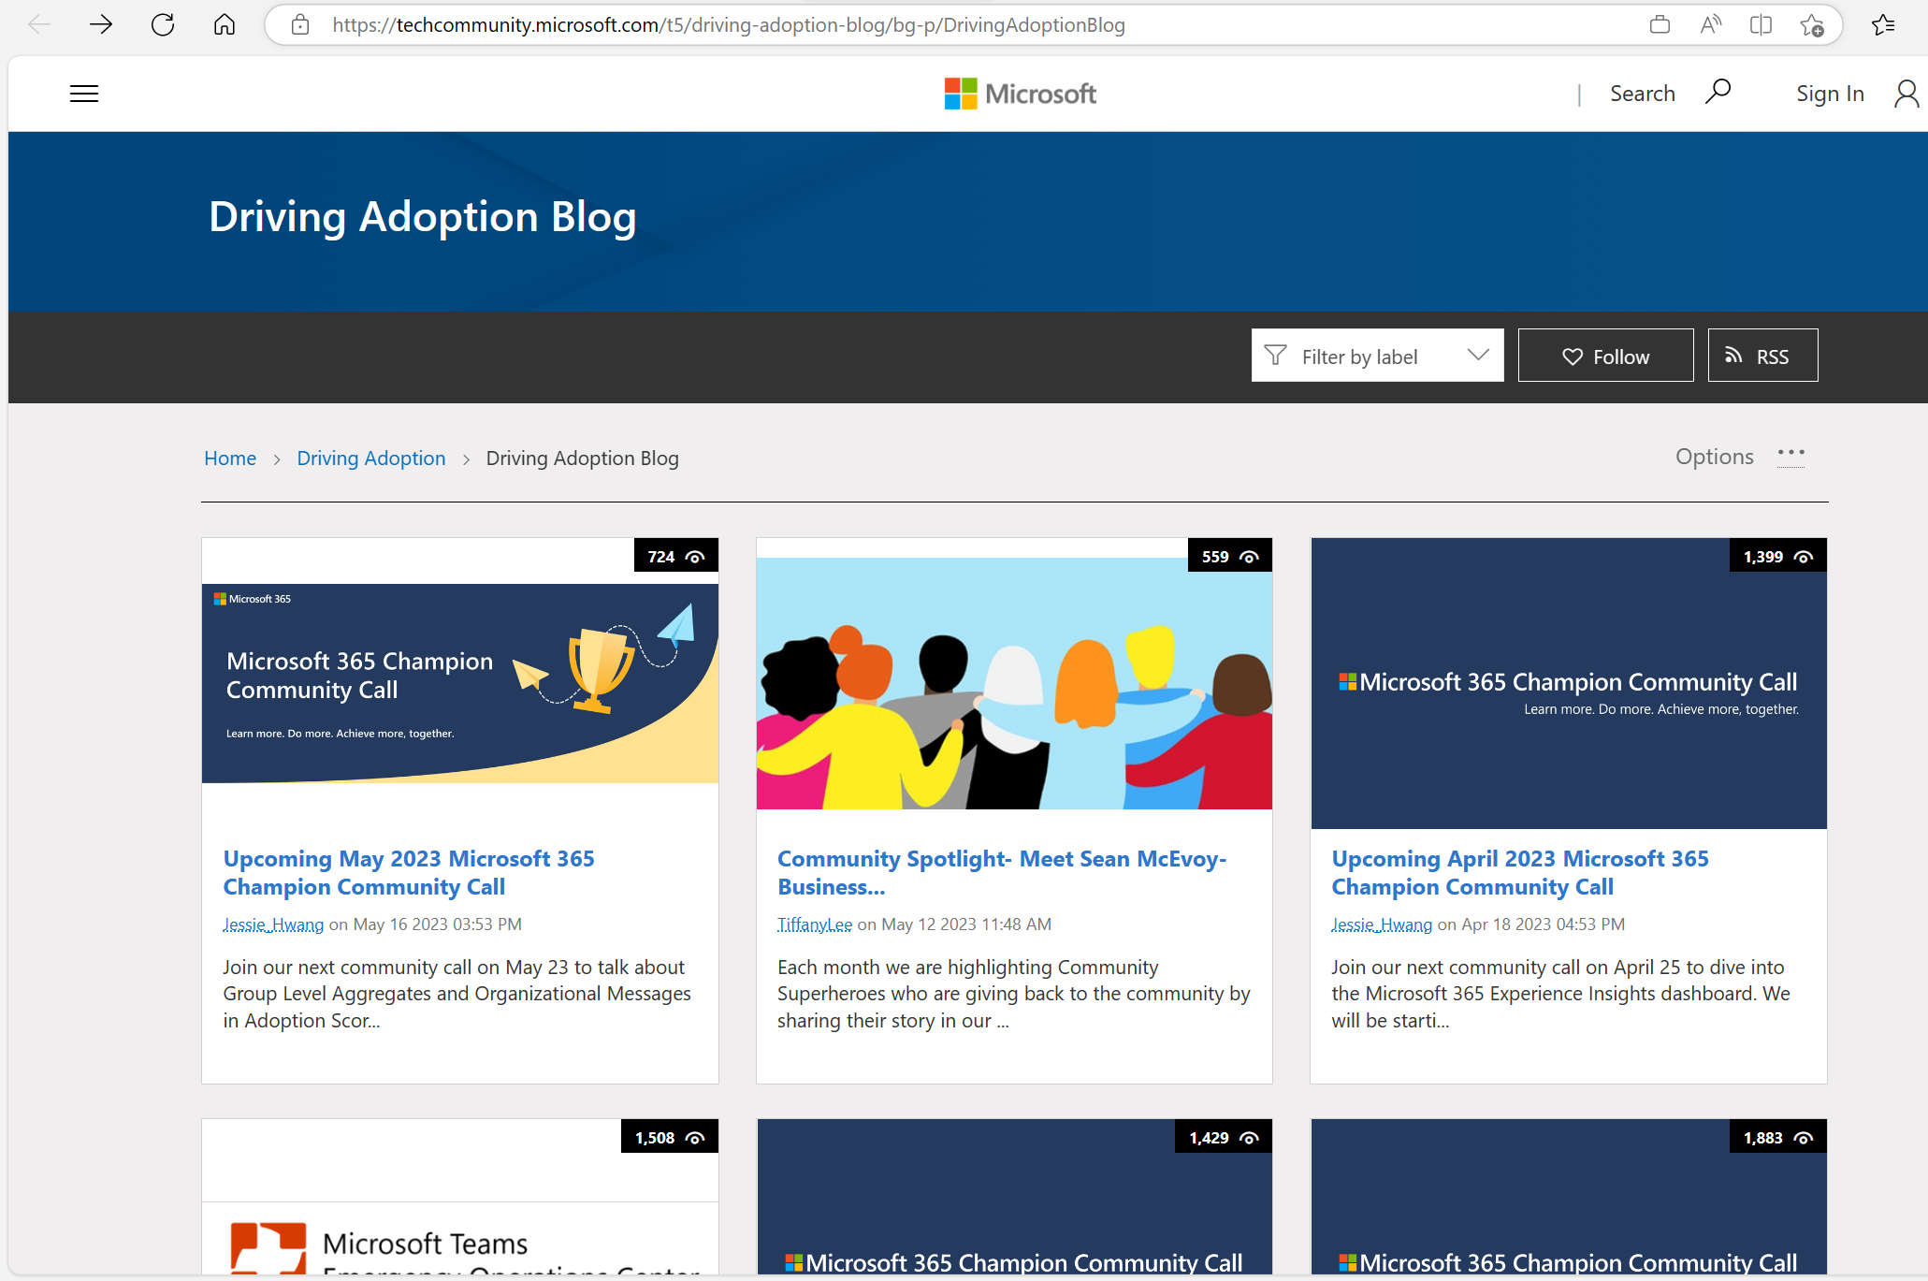
Microsoft
Teams
New Community Spotlight blog post: Sean McEvoy
We are now highlighting our Community Spotlight series with an in-depth blog post on the Driving Adoption Blog. Click here to read the blog with a summary of Sean’s inspirational journey as a true citizen developer without a background in IT – now working as a Business Applications specialist at Aleron Group.
Don’t miss Sean’s bonus tips + resources at the end!

Slide 12
Group Level Aggregates in Adoption Score
Mohammad Akram

Slide 13



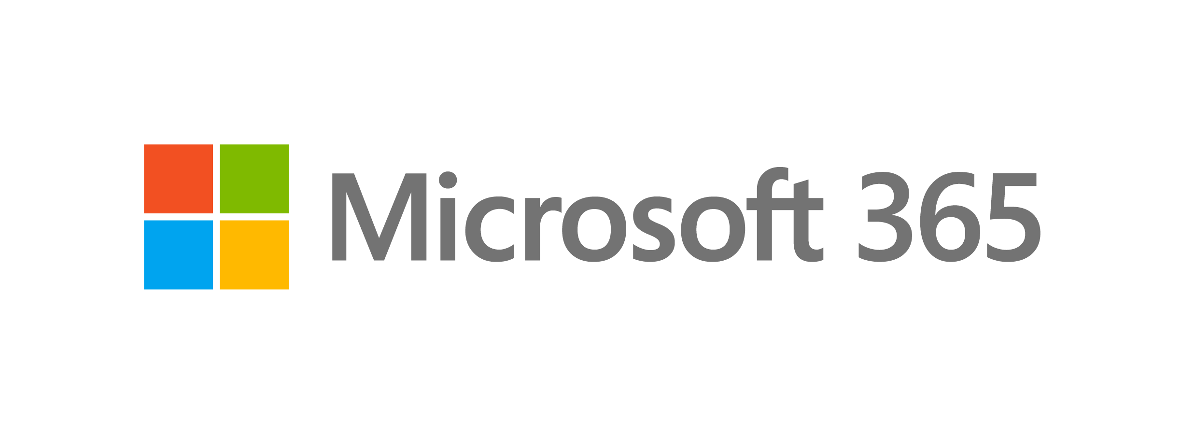
Adoption Score: maximize your investment in Microsoft 365
Visibility
Understand how
your organization works
Improve the everyday experiences of the workforce and
get the most out of your investment in Microsoft 365
Actions
Adopt recommended practices and
improve usage
Insights
Identify where you
can enable improved experiences
Notes:
The role of IT is evolving– and shifting focus to get the most out existing investments to understand how technology is being used in the organization to drive business outcomes. The traditional roles and responsibilities of IT remain, but now more than ever, IT leaders need to reduce cost and complexity while empowering a digitally connected and distributed workforce.
Microsoft 365 brings together a complete, intelligent solution that empowers everyone to be creative and work together, securely.
Adoption Score supports IT admins and Adoption Specialists in three ways. Firstly, Adoption Score provides visibility to understand how your organization works with Microsoft 365. Second, we provide insights on this data to identify where you can enable improved experiences for the workforce so they can reach their goals quicker and easier than before. Lastly, we want to help you take actions on items that matter to your organization, so the workforce can adopt recommended practices and work smarter when using Microsoft 365.

Slide 14








How it works
Actionable insights
People experiences
Technology experiences
Communication
Meetings
Content Collaboration
Teamwork
Mobility
Endpoint Analytics
Network Connectivity
Microsoft 365 Apps Health
Adoption Score is backed by Microsoft’s continued
commitment to user-level privacy
Notes:
To aid interpretation of Adoption Score insights, a score is given for each Microsoft 365 tenant across eight categories, with a maximum score of 800.
The score is comprised of two main sub-scores: People Experiences, which has five categories, and Technology Experiences, which has three categories. Each category has a key insight that earns a maximum of 100 points.
People experiences in Adoption Score helps you, the IT admin or adoption specialist, understand how the workforce leverages the rich capabilities included in Microsoft 365 and provides guidance on how to get the most out of your Microsoft 365 subscription. By providing insights about how your organization adopts Microsoft 365, users can be reminded about a recommended approach to use one or more products or features, backed by research that save time or effort. We qualify this in a measurable score across five people experience categories – Communication, Meetings, Content Collaboration, Teamwork and Mobility.
The Technology Experiences section allows IT admins to gain further insights into technology areas that can influence your people experiences. Factors such as endpoint boot times , network throughput and latency, and app currency all contribute to varying degrees to people’s technology experiences and the responsiveness of the apps the user works in. Technology experiences are qualified in a measurable score across three categories – Endpoint Analytics, Network Connectivity and Microsoft 365 Apps Health. Ensuring users have optimized endpoints, great connectivity and healthy applications all help to complete the Microsoft 365 experience and lead to improved outcomes for the workforce.
These insights are backed by our strengthened commitment to user level privacy. At Microsoft, we believe that data-driven insights are crucial to empowering people and organizations to achieve more. We are also deeply committed to the privacy of every person who uses our products. As part of that commitment, no one in the organization will be able to use Adoption Score to access data about how an individual user is using apps and services in Microsoft 365. Administrators control access to who can see the insights through role-based access controls and empower adoption specialists to drive digital transformation without visibility into administrative functions.

Slide 15
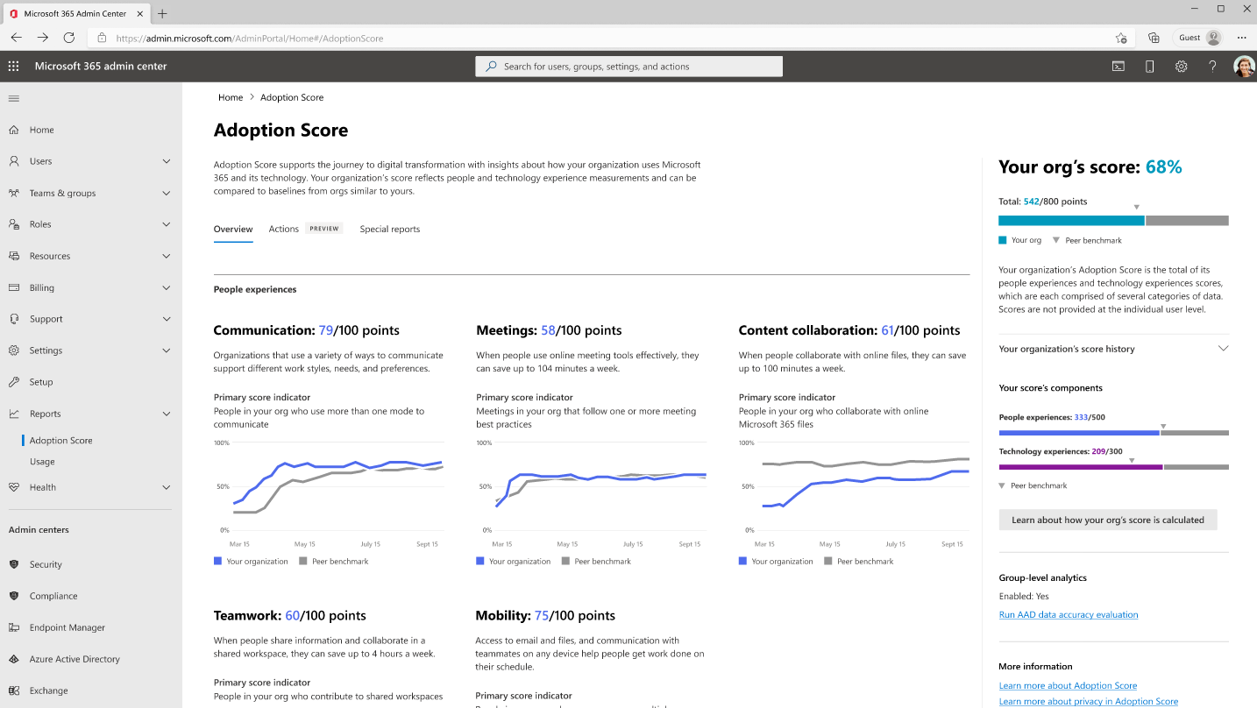
Adoption Score: Interface
Notes:
Instead of video embedded into the slide, alternatively add screenshots

Slide 16
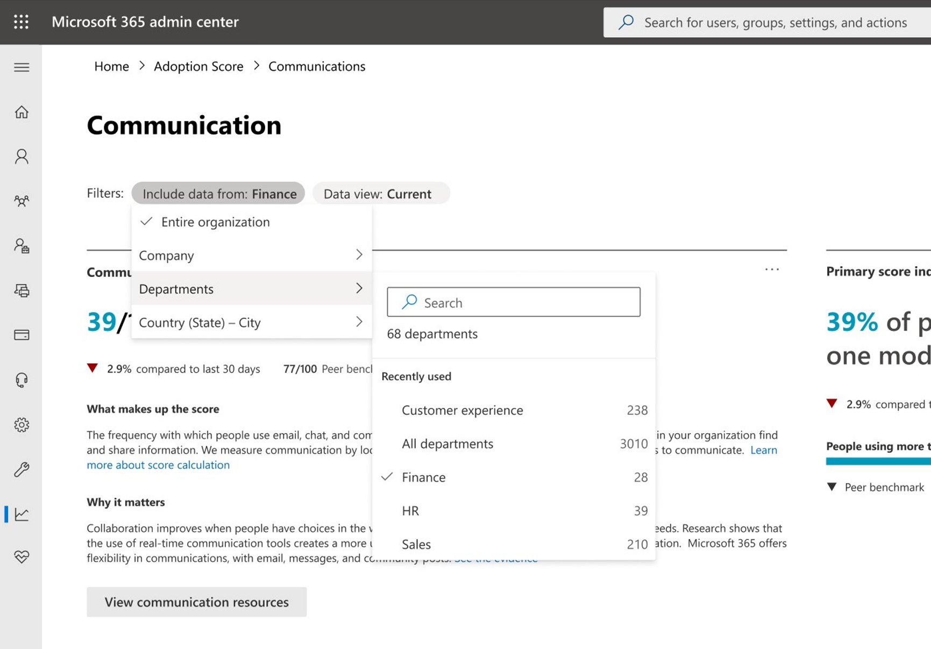
Group Level Aggregates
Group Level Aggregates enable IT admins and adoption specialists to filter by five Azure Active Directory attributes:
Company
Department
Country
State
City
Group Level Aggregates help improve transparency for which areas of an organization are adopting recommended practices with Microsoft 365
Notes:
We understand that different parts of your organization have different needs and workstyles, group level aggregates help you to filter organizational data whilst respecting user-level privacy. To allow you to see nuances in each of your business groups in Adoption Score, we are adding group level aggregates to Communication, Content collaboration, and Mobility, with support for Meetings and Teamwork to follow. This functionality is separate from the messaging capability of Microsoft Viva Amplify, which supports leaders, corporate communications, and HR to effectively communicate at scale.
For group level aggregate information to be displayed, the capability must be enabled by a Global Administrator and a minimum of 10 users must be included in a group to help ensure that individual user data is not revealed, part of our ongoing commitment to user level privacy.
funtionality
Fix customer data issues….check what has not been working

Slide 17
Community Spotlight

Slide 18

Microsoft 365 Champion community stories
We want to highlight your story in future community calls! This is your opportunity to share with other Champions in this community. Format can be live in the call or a pre-recorded video.
We’d love to hear:
How you/your organization implemented Microsoft technologies
How you lead adoption and change management in your organization
How a Microsoft product improved your life or work culture
Or more!
Sign up at aka.ms/CommunitySpotlight to share your experience!

Slide 19
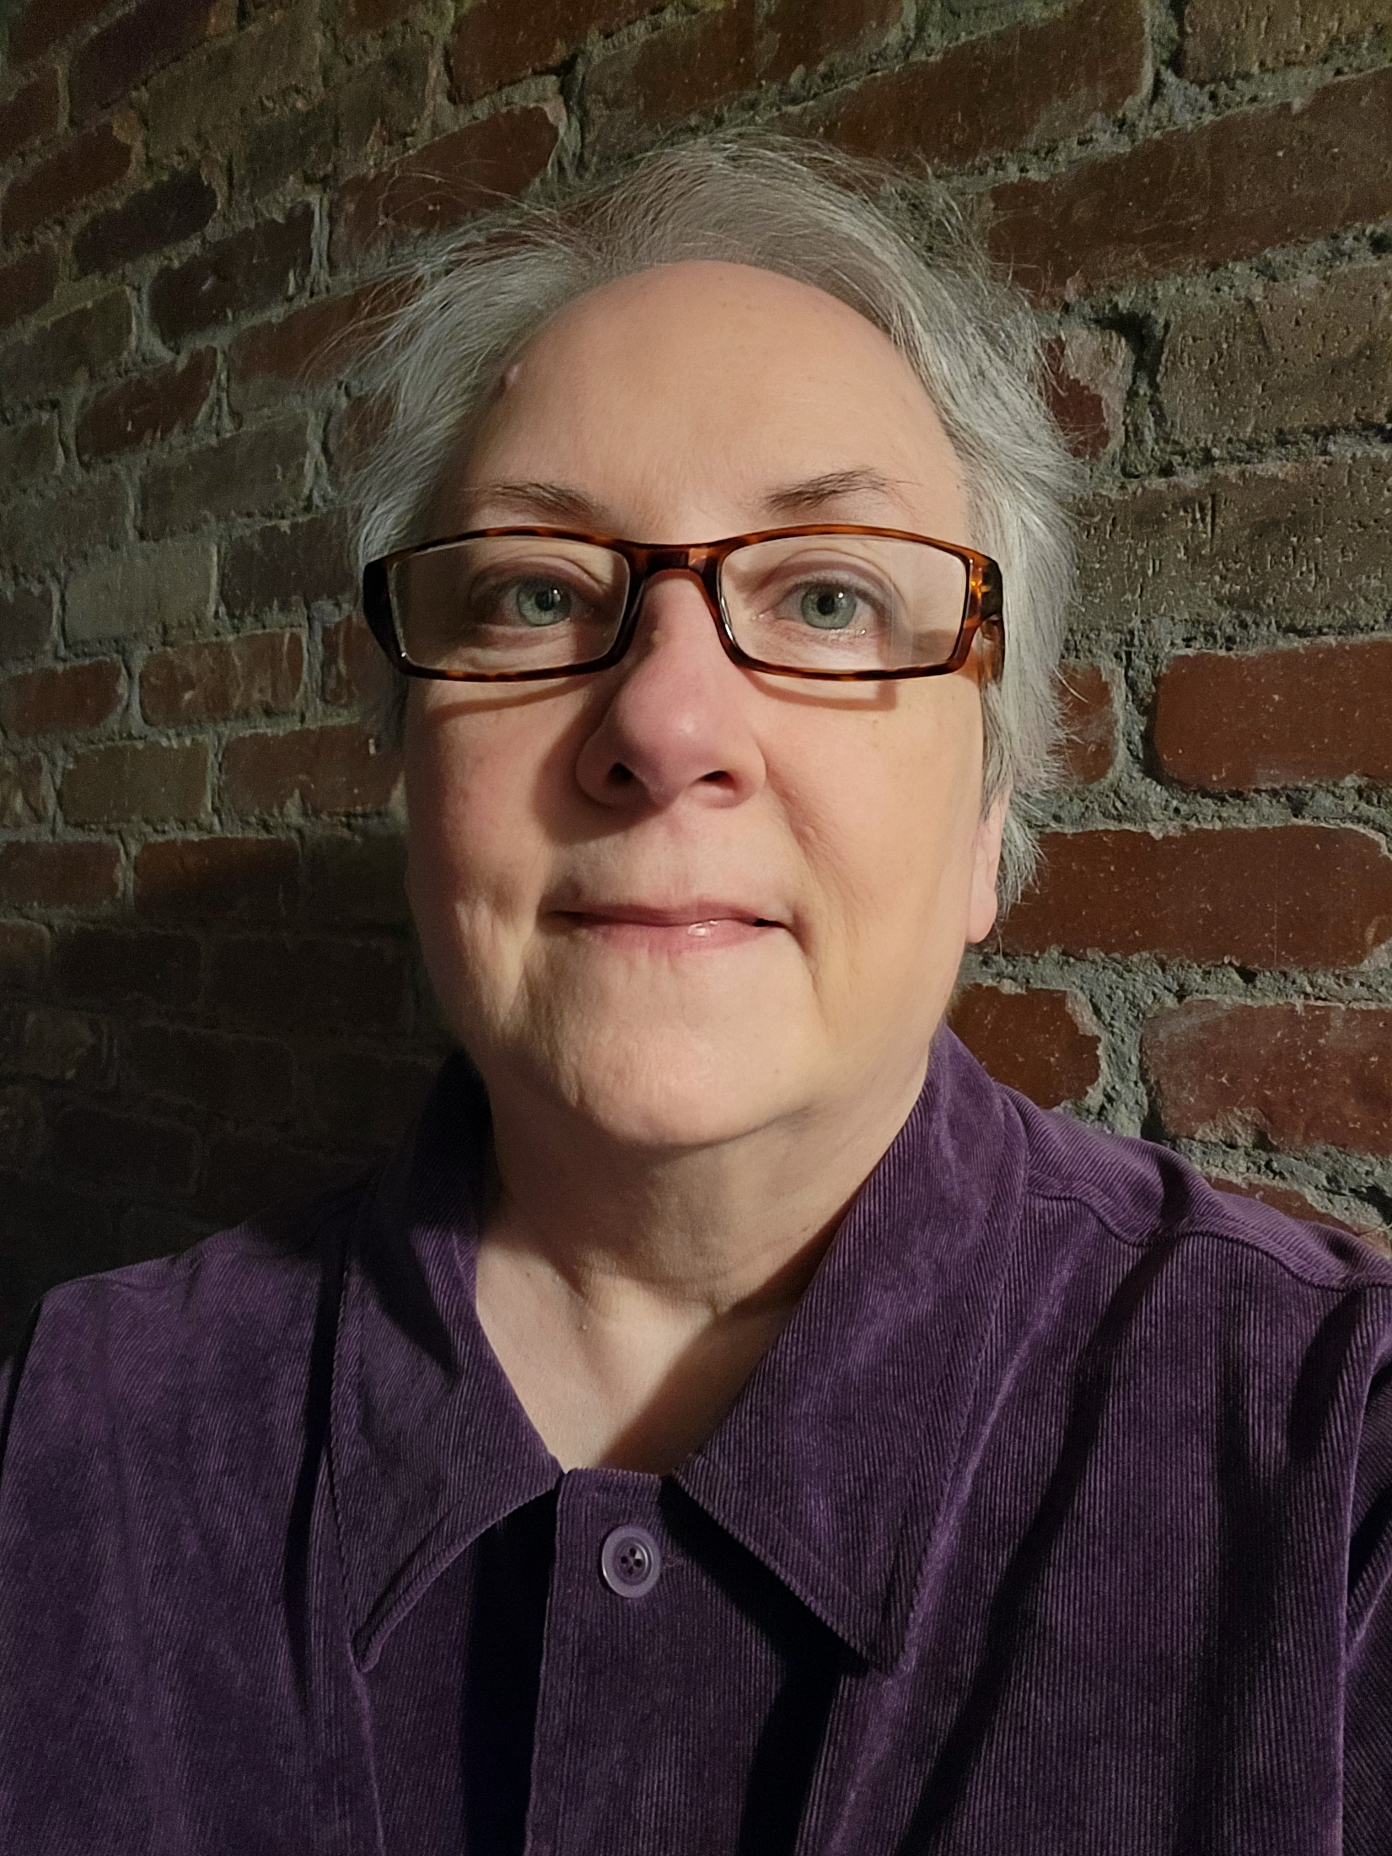
Community Spotlight:
Kathy Pepe
Role: Program Manager
Company: Dell Technologies Services, 133K employees
Fun fact: As a native Texan, I rode horses before I could walk!

Slide 20



Digital Fluency: Automation Learning Path
Creation of tiered learning paths to increase capability awareness and support Citizen Developers
Recommended distribution % for Org
1%
Expert
Industry certification
(~4-200 hours)
Learning Paths Adopted by IT
10%
Practical
Getting started with specific tools
(~2-6 hours)
Foundational
Includes video to promote
100%
Overview of tools, capabilities with demos
(~90 mins)
Target 95% course completion for Org
Notes:
96.6% of GPEFS FTEs are <=I9 and M9

Slide 21





Digital Literacy: Virtual Power Platform Community
Enabling self-automation for Citizen Developers
50+
Dell-Wide
Organizational
Participation
Identify
Improve
Recognition
Personal Achievements and Inspire our team members
770+
Active and Peripheral Teams Members
Practice
Body of knowledge, methods, stories, solve problems & develop tools
Community
Relationships built through
discussion,
activities & learning
Domain
Areas of shared interest, common purpose & key issues
140+
Contributors &
mentors
Management
540%
Increase in citizen
developed automation
MS Power Platform

Slide 22


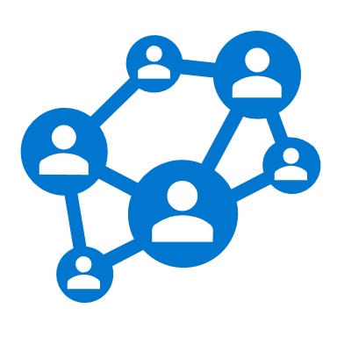



MS Power Platform - Virtual Community of Practice
Enabling transformational knowledge and skills for Digital Literacy
Domain
Areas of shared interest, common purpose & key issues
770+
Active and Peripheral Teams Members
50+
Dell-Wide
Organizational
Participation
540%
Increase in citizen
developed automation
Community
  Relationships build through discussion, activities & learning
Practice
  Body of knowledge, methods, stories,
  solve problems &
  develop tools
140+
Contributors and
mentors
Notes:
Introduce Kathy Pepe – Facilitator of Dell wide MS PowerPlatform vCoP. The Strategic planning and gold IP team in EUC (Greg Bomsta’s team), Teams champion, and all around great lady.
Kathy Key Topics
Domain – what is the purpose of the community
Community – who participates
Practice – Benefits to the person and organization

Slide 23




Getting Started – Best Practices & Resources
Enabling transformational knowledge and skills for Digital Literacy
Leadership Support
Align with any related Corporate initiatives
Enlist leadership announce your initiative
Provide Infrastructure
Video playlist for demos
Automated distribution list
Gather Mentors
Organize subject matter experts to present
Schedule consistent presentations
Align with IT & Microsoft
Develop a network with the related IT administrators; it will benefit both organizations
Invite Microsoft to present as topics dictate
Internal mentor collaboration site
Gather curated training materials
Appreciate & reward mentors
Utilize Microsoft Power User Forum
Notes:
Introduce Kathy Pepe – Facilitator of Dell wide MS PowerPlatform vCoP. The Strategic planning and gold IP team in EUC (Greg Bomsta’s team), Teams champion, and all around great lady.
Kathy Key Topics
Domain – what is the purpose of the community
Community – who participates
Practice – Benefits to the person and organization

Slide 24

Upcoming community events
May 22-24, 2023
May 30-31, 2023
June 12-16, 2023
June 20-22, 2023
June 21-23, 2023
October 3-5, 2023
October 13-14, 2023
November 4, 2023
European Collaboration Summit
Thrive Conference
365EDU Con
European Power Platform Conference
Commsverse
Microsoft Power Platform Conference
South Coast Summit
M365 Community Days
Dusseldorf, Germany
Lipica, Slovenia
Washington, D.C.
Dublin, Ireland
Mercedes-Benz World, UK
Las Vegas, NV
Farnborough, UK
Hybrid/Phoenix, AZ
Explore other Microsoft events and a full list of community-led events can be found at CommunityDays.org

Slide 25
Microsoft 365 Champion Community news
See you at our next community call!
Date: June 27, 2023
Top asks:
Complete our monthly call survey: https://aka.ms/Microsoft365ChampionCallFeedback
Participate in the Driving Adoption Community:
https://aka.ms/DrivingAdoption
Invite colleagues to join the Champion Program: https://aka.ms/M365Champions

Slide 26
Thanks for attending! We’d love your feedback on today’s call and hear ways we can make future calls even better! https://aka.ms/Microsoft365ChampionCallFeedback
Microsoft 365 Champion Community
Learn more. Do more. Achieve more, together.
Now, let’s meet! Stay on to join our open discussion and feel free to come on video and off mute.

