Slide 1

We will begin the call at five minutes past the hour
Microsoft 365 Champion Community Call
March 2023
Microsoft 365 Champion Community
Learn more. Do more. Achieve more, together.

Slide 2
Microsoft 365 Champion Community
March 2023 Monthly Call
Microsoft Teams Customer Advocacy Group
Karuana Gatimu, Tiffany Lee, Jessie Hwang

Slide 3
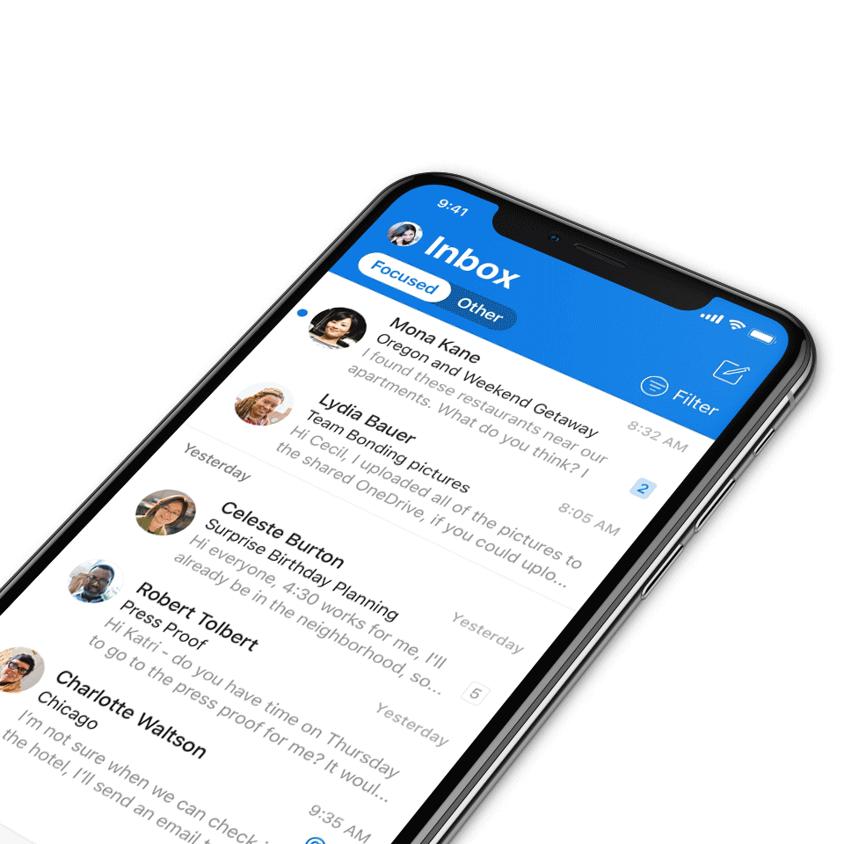
Digital Event Code of Conduct
Microsoft’s mission is to empower every person and every organization on the planet to achieve more. This includes all Microsoft events and gatherings, including on digital platforms, where we seek to create a respectful, friendly, fun and inclusive experience for all participants.​
We expect all digital event participants to uphold the principles of this Code of Conduct, which covers the main digital event and all related activities. We do not tolerate disruptive or disrespectful behavior, messages, images, or interactions by any party participant, in any form, at any aspect of the program including business and social activities, regardless of location.​
Microsoft will not tolerate harassment or discrimination based on age, ancestry, color, gender identity or expression, national origin, physical or mental disability, religion, sexual orientation, or any other characteristic protected by applicable local laws, regulations, and ordinances.​
We encourage everyone to assist in creating a welcoming and safe environment.
For more info, click here.

Slide 4

Agenda
Microsoft 365 updates | Top new features releases across Microsoft 365
The new Microsoft Teams | Karuana Gatimu
Community spotlight | Alana Kelsey, Microsoft 365 Champion
Community events & updates
Open discussion forum
Find resources from previous calls here:
https://aka.ms/M365ChampionResources

Slide 5
Announcements
New meeting start time
Meeting time will start 5 minutes after the hour
8:05am and 5:05pm PT to follow best practices
Visit our Champion Resources page to make sure you have the updated invite series through July 2023
NOTE: the recording will now include the Q+A segment. Your name may be shown in the published recording, as well as your name, face, and voice if you come on video and off mute.

Slide 6
Service retirements
Classic Stream
  Update on Stream (Classic) retirement: Last day of service set for Feb 15, 2024
Wiki page in Microsoft Teams – Community content
  Microsoft Teams News: Wiki Page Retiring in April 2023 & There Are Things You Must Do

Slide 7


Core Conference: May 2-4
Workshops: April 30, May 1, May 5
$150 discount for customers with code: MSCUST150
Why attend?
Microsoft delivered content on hot topics –
3 Executive Keynotes, 60 sessions
Double click into recent announcements with a full AI content track
Additional tracks focused on Power Platform, Teams, Viva, ODSP and D&I
Poolside attendee networking party hosted by Jeff Teper
aka.ms/m365conf23 | #M365Conf

Slide 8
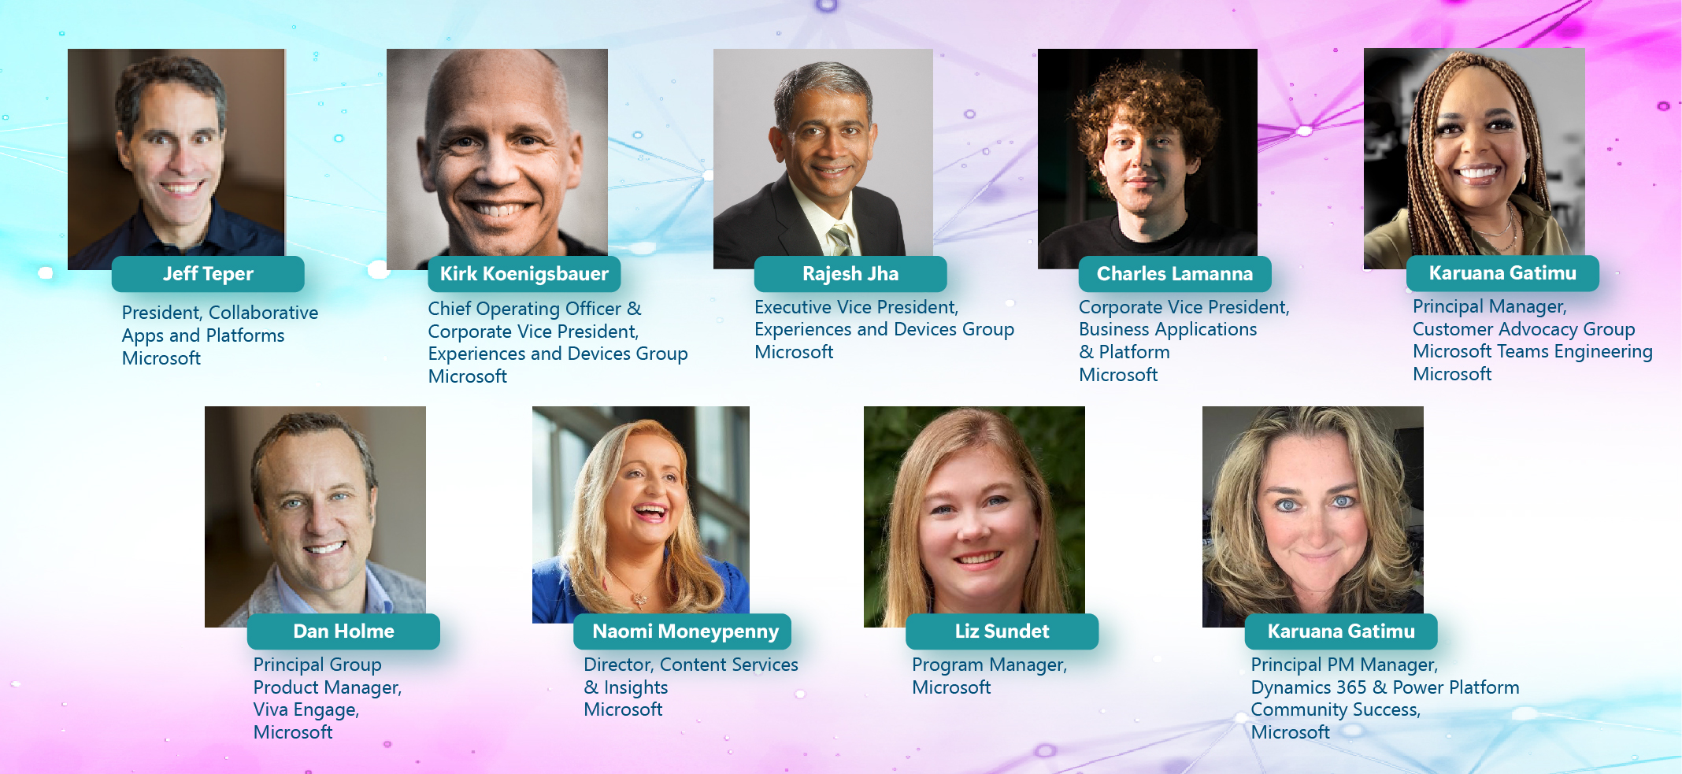
Heather Newman
Thousands of
Attendees
150
Sessions
50
Exhibitors
18
Workshops

Slide 9
Microsoft 365 updates
Top new feature releases across Microsoft 365

Slide 10
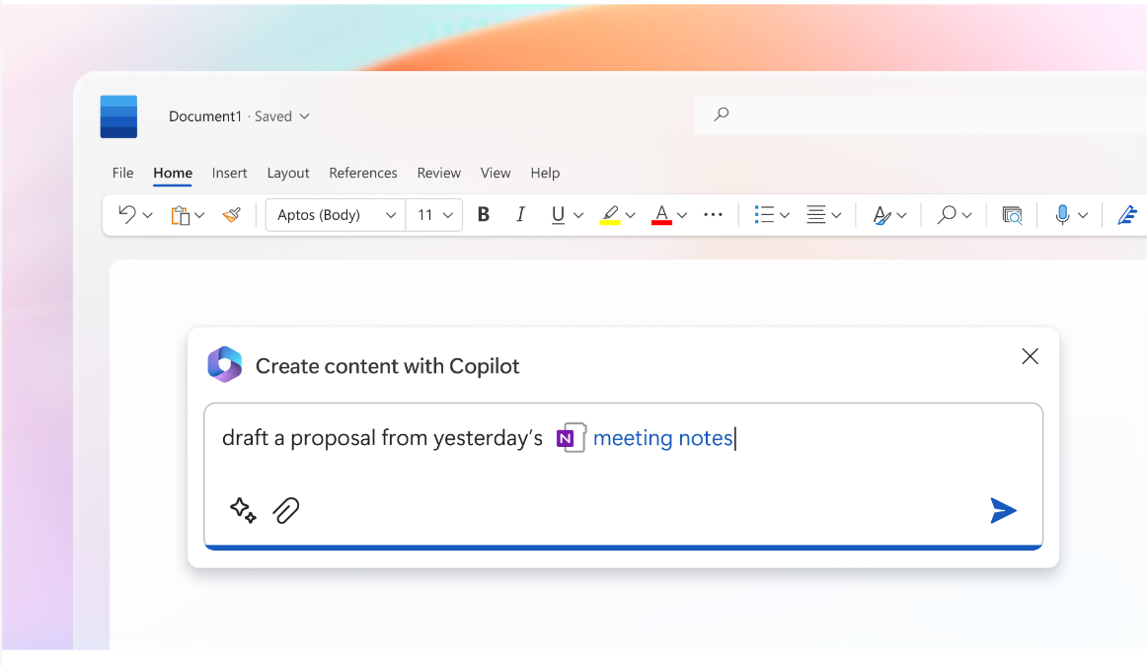
Microsoft
CoPilot
Copilot announcement
On March 16, we introduced Microsoft 365 Copilot — your copilot for work. It combines the power of large language models (LLMs) with your data in the Microsoft Graph and the Microsoft 365 apps to turn your words into the most powerful productivity tool on the planet.
Learn more here.

Slide 11
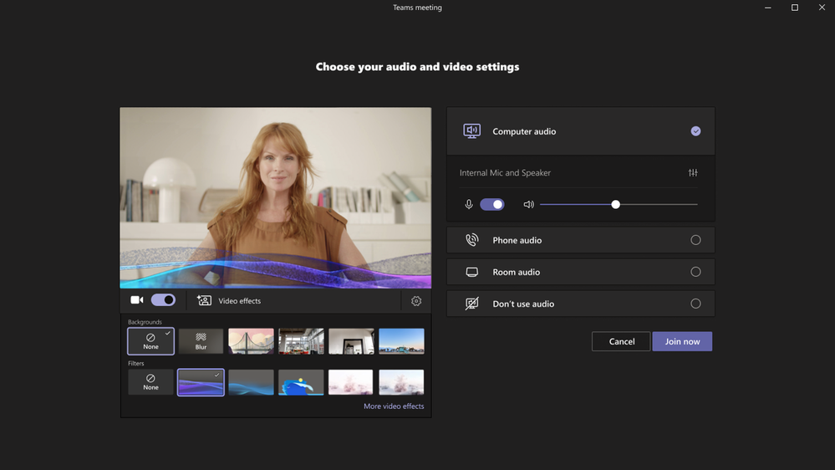
Microsoft
Teams
Introducing Video Filters in Microsoft Teams Meetings
Microsoft Teams empowers users to feel their best with AI powered capabilities that let you soften the appearance of the video feed and add backgrounds. Now, we’re taking it one step further with video filters – allowing you to remove unwanted distractions and better express yourself by bringing your personality to each meeting. The filters enable participants in Teams Meetings to augment their video stream with visual effects ranging from animated frames to styles changing the video’s hue. You can apply these filters even before you join a meeting from the lobby.
In March, we’ll begin rolling out Video Filters to general availability after first announcing Public Preview in January.

Slide 12
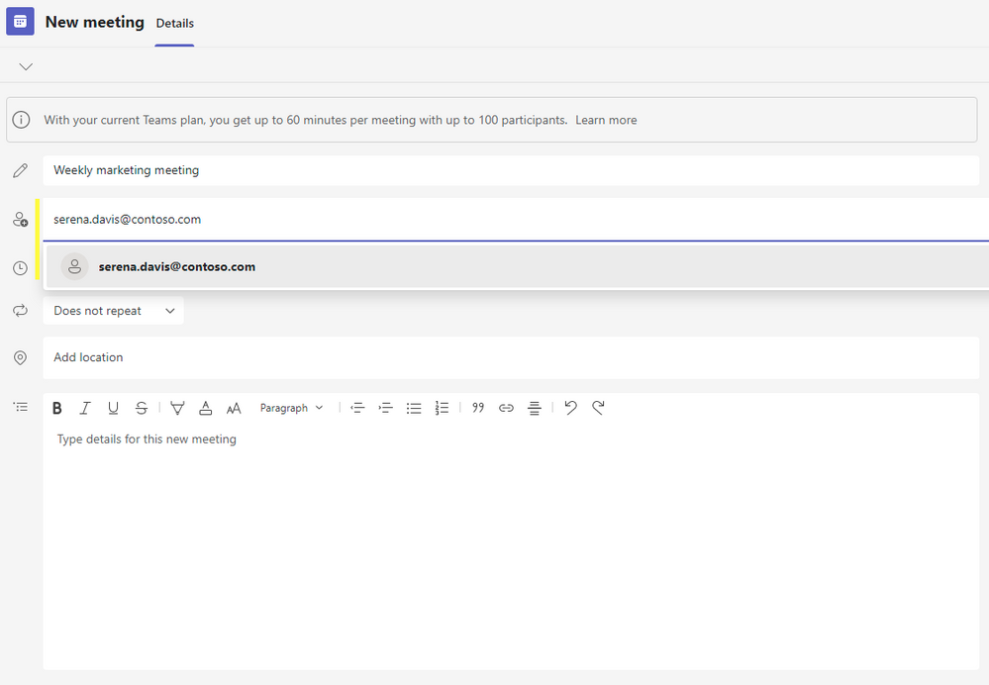
Microsoft
Teams
Easier to invite Microsoft Teams for work or school users to Microsoft Teams (free) meetings
You can now include Microsoft Teams for work or school account users to meetings you create on desktop in Microsoft Teams (free). Just type the recipient’s email address the normal way in the recipient field when creating a new meeting and the invited recipient can then accept the invite to have it in their Teams calendar, allowing easier meeting joins. Learn more about how to create a meeting in Microsoft Teams (free).

Slide 13
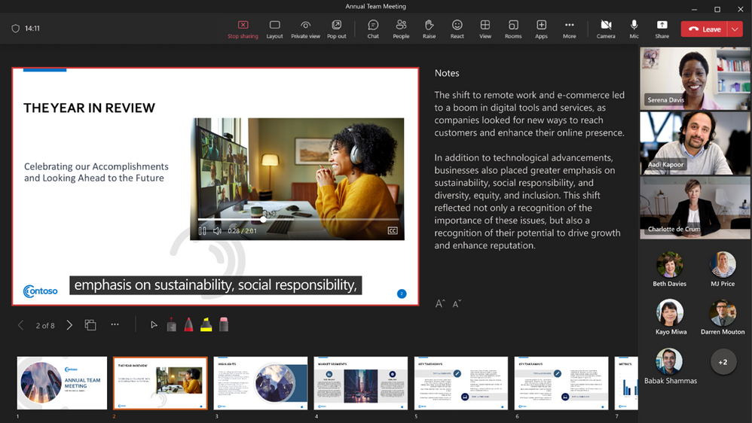
Microsoft
Teams
Introducing Closed Captions in PowerPoint Live for Microsoft Teams Meetings
Today we are pleased to announce Closed Captions in PowerPoint Live, a new feature in Microsoft Teams meetings that aims to help those who are Deaf or hard of hearing, have difficulty processing auditory information, have a language barrier, or who are simply joining the meeting from a loud environment, to better understand the auditory content being shared. Meeting attendees will now have the option to turn on closed captions for any video that includes a closed captions file.
Learn more here.

Slide 14
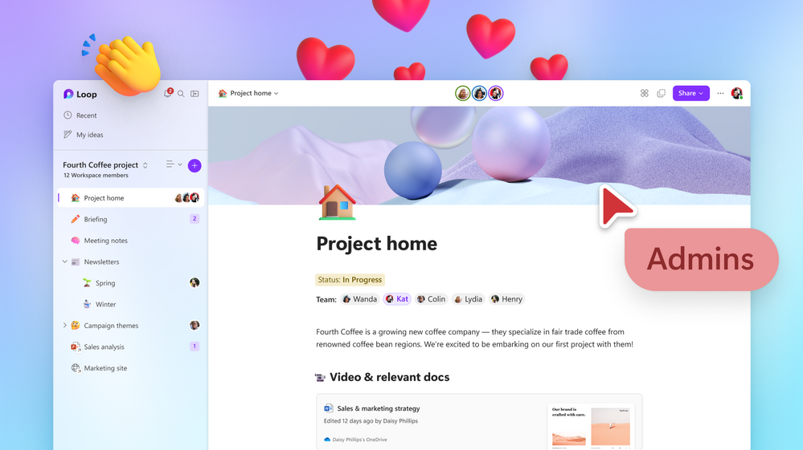
Microsoft
Loop
Microsoft Loop is now in Public Preview
Microsoft Loop is the perfect solution for your teams to think, plan, and create together, like never before, even when they’re not in the same place. It’s a transformative co-creation experience that brings together teams, content and tasks across your tools and devices.
The Loop app is opt-in during our Public Preview, so as an IT Admin, you need to follow the steps here in the Loop admin settings documentation for your users to experience it, otherwise it is disabled. Once enabled, you and the people in your organization can try it today at https://loop.microsoft.com.

Slide 15



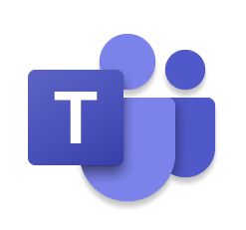
#NewTeams
The new Microsoft Teams

Slide 16




Continuously improving Microsoft Teams thanks to customer feedback
During the past year, we’ve
delivered incremental performance improvements to classic Teams.
But we aren’t stopping there: we’ve been researching modern technologies and building prototypes to reimagine Teams from the ground up for a faster, simpler, and more flexible experience that addresses our customer’s most-pressing performance feedback.
The result: the new Microsoft Teams.
Over the past several years, we’ve collected feedback from customers regarding Microsoft Teams performance. That feedback has been loud and clear: customers want continued innovation around performance in Teams.
Top customer feedback
App responsiveness
Memory consumption
Meeting experience

Slide 17









The new era of Microsoft Teams is here
Try the new Teams
Try the new Teams
Why
When
How
To address customer challenges around performance, ease-of-use, and reliability
Releasing in Public Preview on March 27, with general availability coming later this year¹
Admins can opt-in and encourage end users to switch using the simple toggle²
Try the new Teams
Try the new Teams
Reimagined from the ground up for a faster, simpler, and more flexible experience
¹Public preview in March will be for Windows users only. Check Microsoft Adoption for availability details across other platforms..
²Get guidance for switching to the new Teams app..

Slide 18
Better performance, externally verified
In March 2023, an independent benchmarking firm, GigaOm, verified the performance improvements of the new Teams on Windows. These are some of their findings.
2X
50%
up to
faster
fewer resources used
Installation
3X faster
App launch
2X faster
Join meetings
2X faster
Chats and channels
1.7X faster switching
Memory
50% less used
Disk space
70% less used

Slide 19
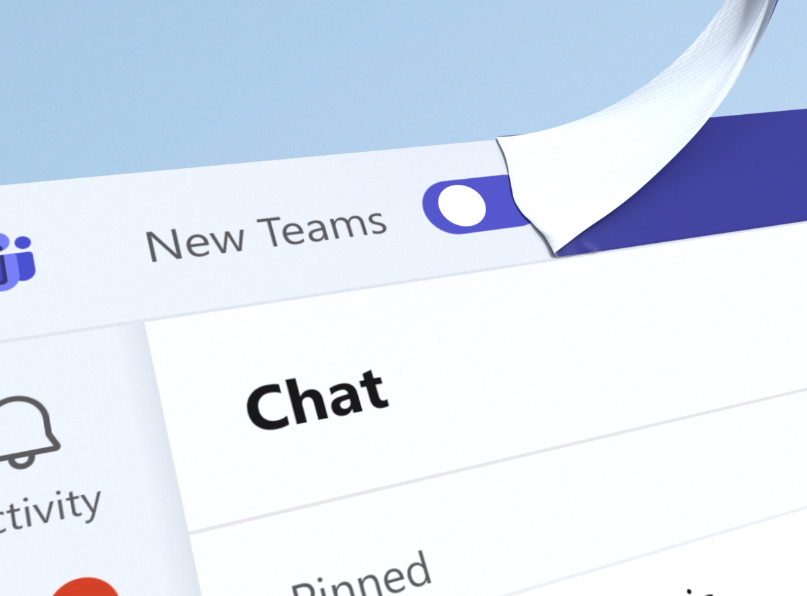
Try the new Teams toggle for admins
Encourage users to switch using the toggle — they can always switch back
The new Teams is a big deal, but switching isn’t. Users can easily try it by flipping the toggle in the upper-left corner of the app. They can always switch back using the same toggle before the app is enabled by default.
Steps for admins
Determine the new Teams release type for your org:
Public Preview: the toggle is available now
Targeted release: the toggle will be available in April 2023
General availability: opt into the new Teams using the Teams update management policy and select which users should see the toggle
Promote and educate users about the new Teams and toggle
Learn more
Technical documentation with installation instructions
Microsoft Teams in Public Preview documentation
End user instructions

Slide 20
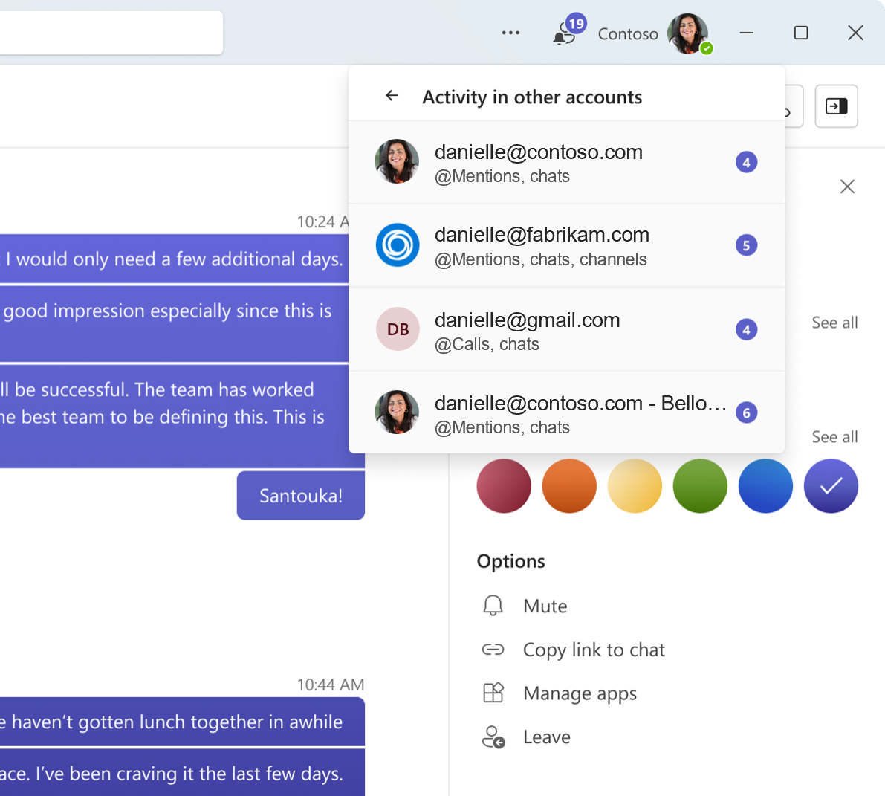
Multi-Tenant Multi-Account for admins
Enable users to access multiple work or school accounts simultaneously
With Multi-Tenant Multi-Account (MTMA) support in
the new Teams, users can sign into multiple work or school accounts (or as a Guest in other organizations) without signing in on multiple web browsers.
Steps for admins
Review your tenant policies:
  Guest access
  External access
Check out the feature comparison table for quick reference
Remind users of these sharing features to ensure secure collaboration
Learn more
Technical documentation

Slide 21

The new Teams for Help Desk

Slide 22
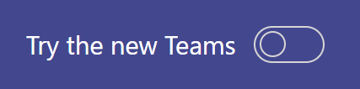
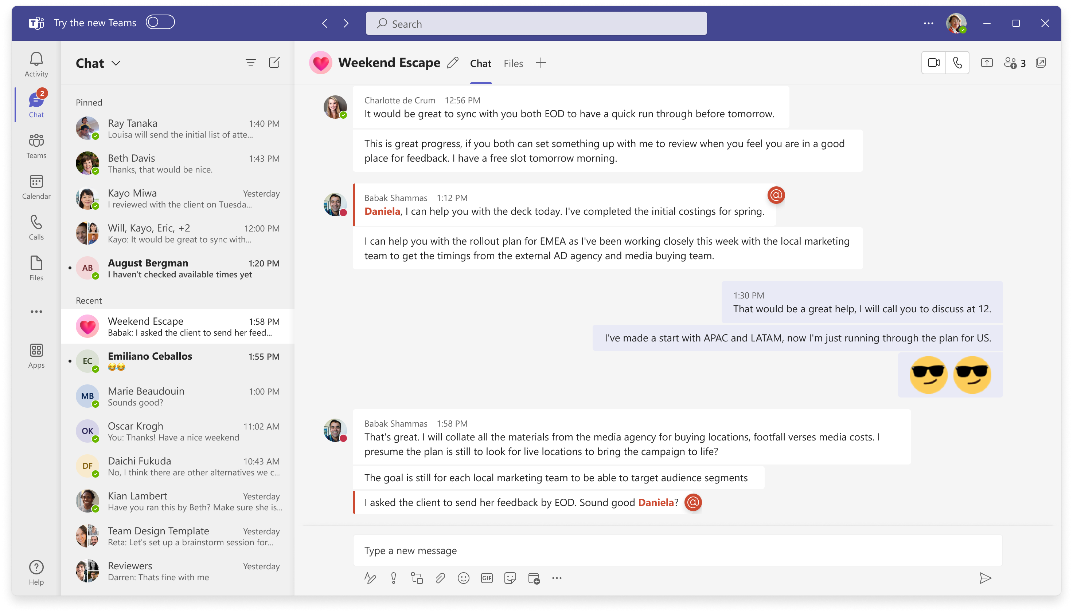
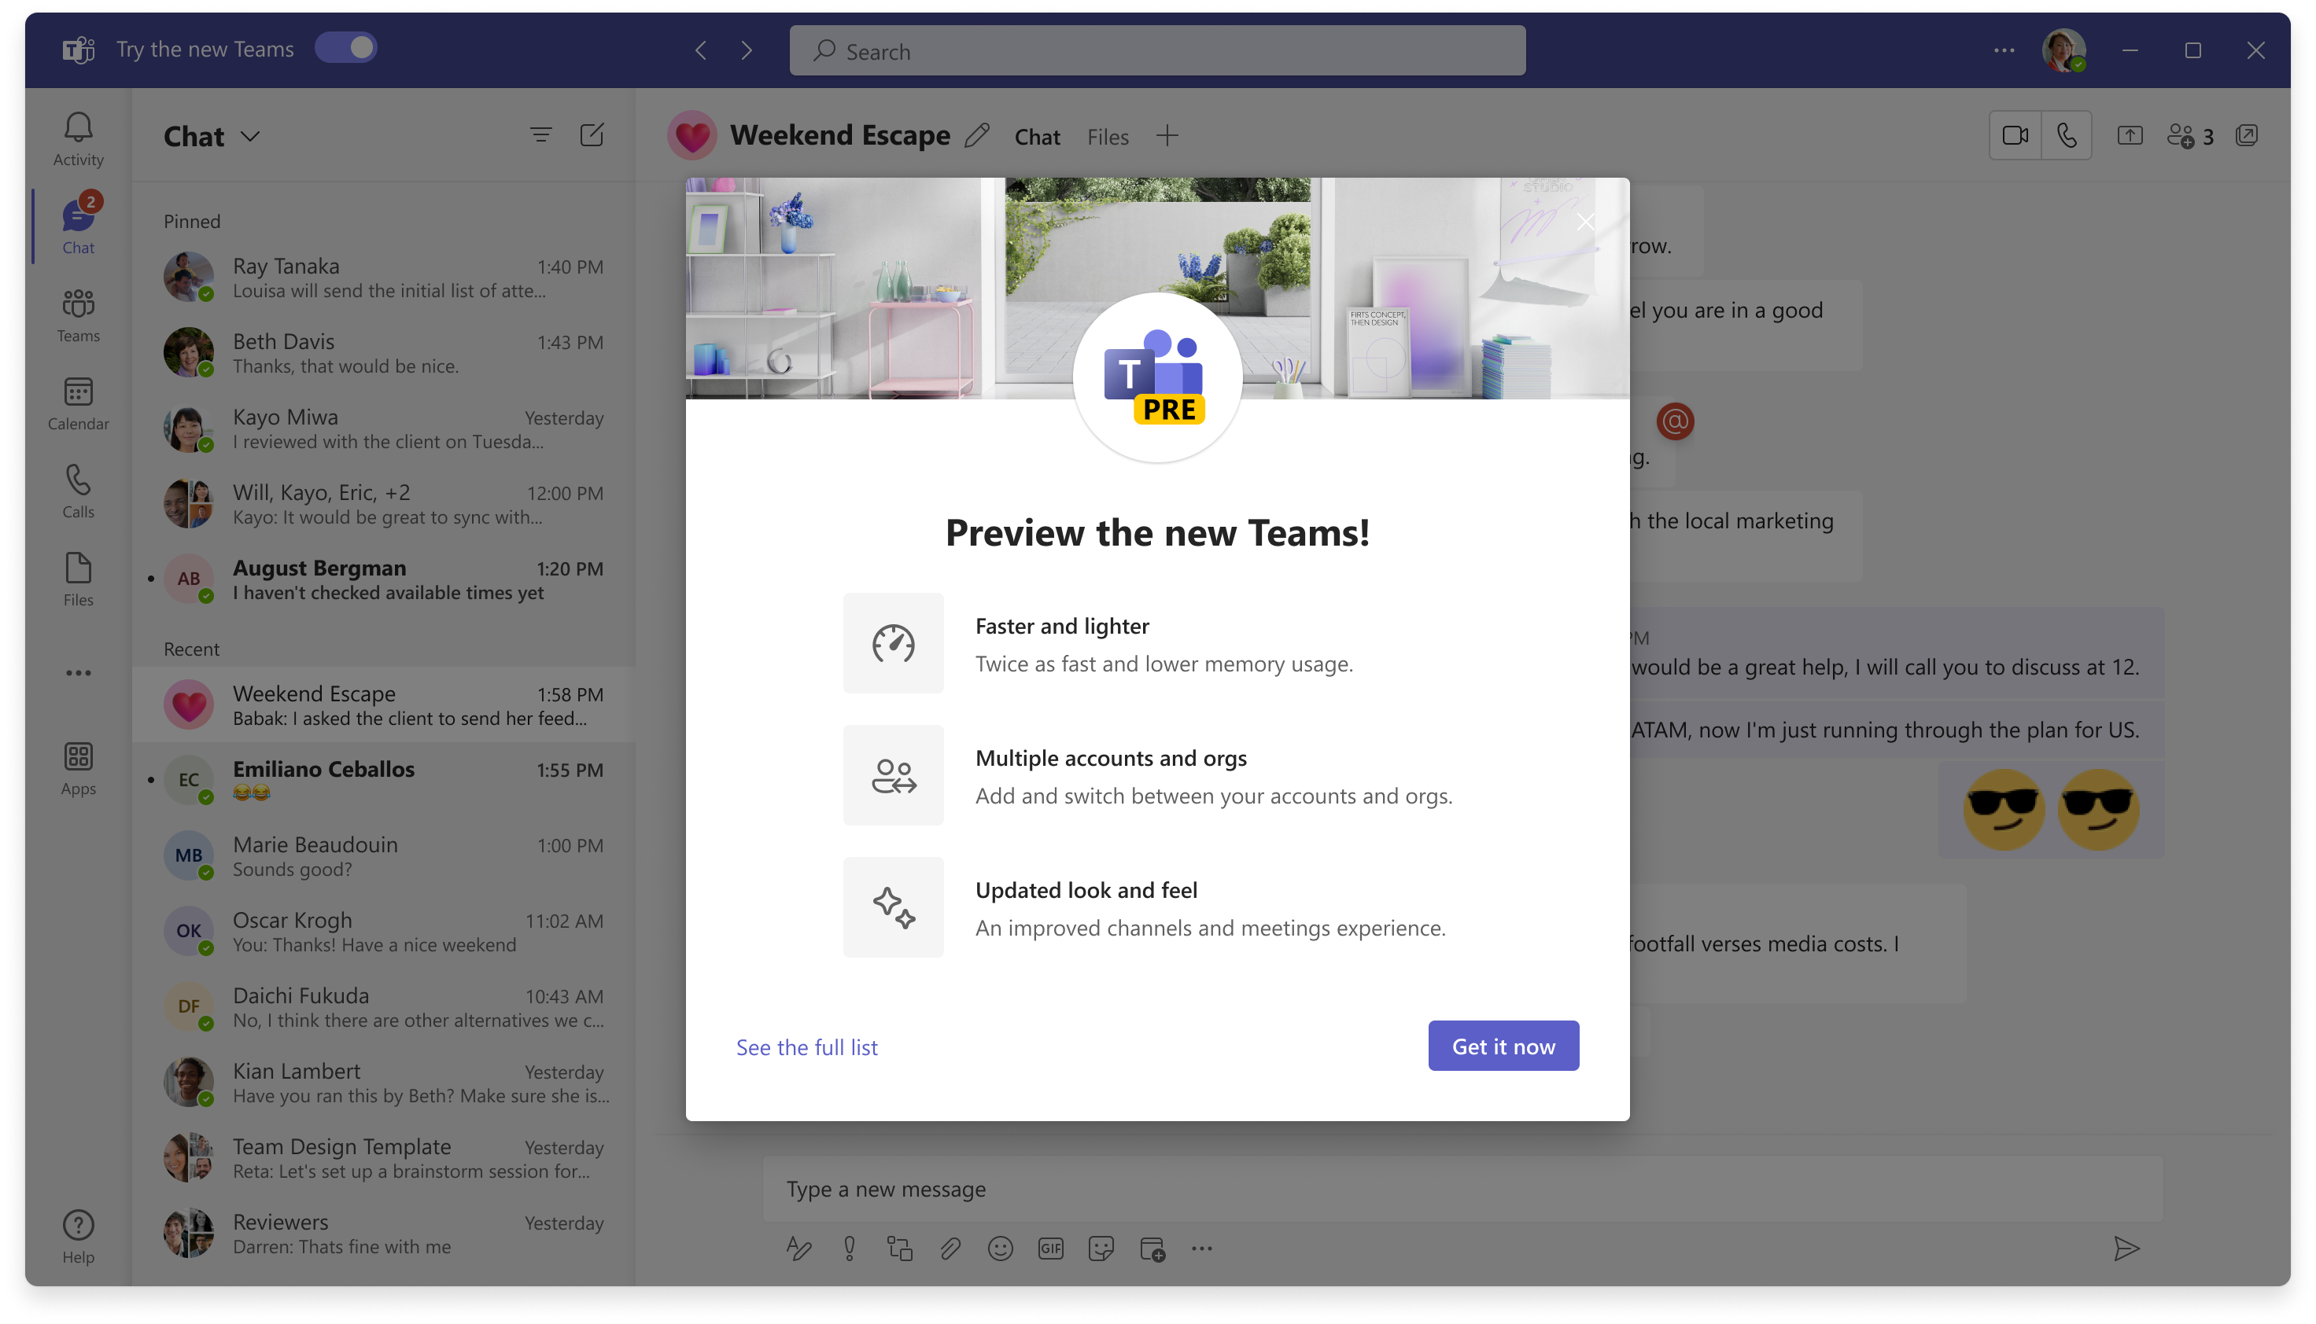



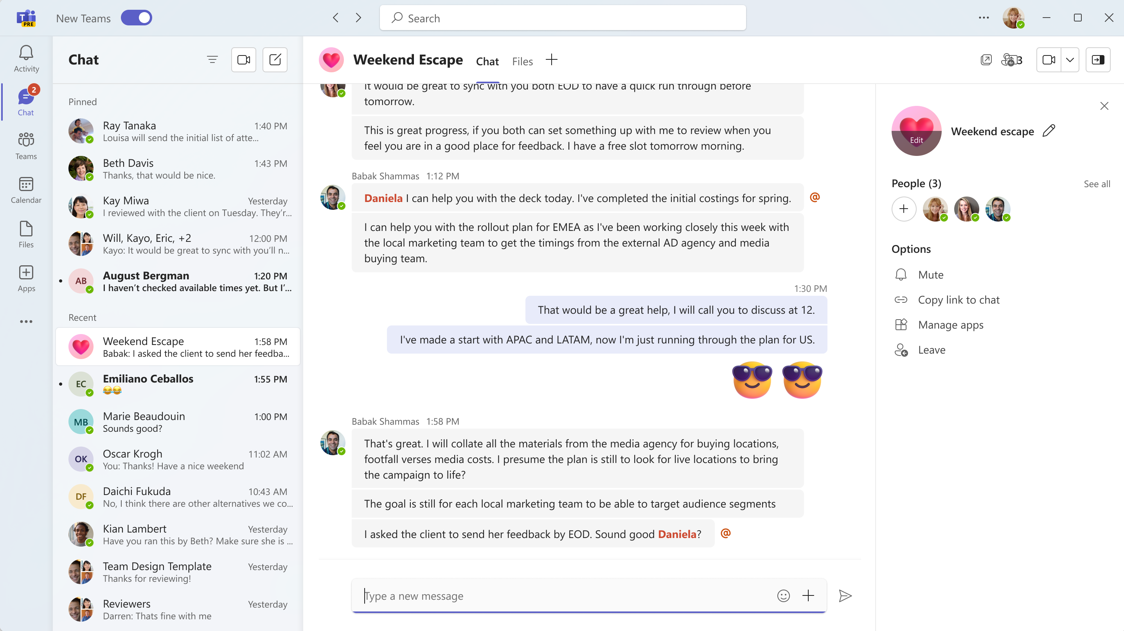
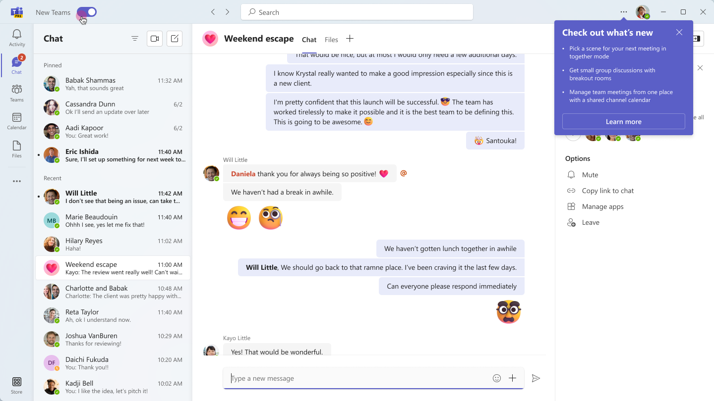


Try the new Teams toggle for Help Desk
Encourage users to switch using the toggle — they can always switch back
1
2
Flip the toggle in the upper-left corner to switch from classic to new Teams. Users can always switch back using the same toggle in the new experience.
Personalize each account and organization with a color theme to quickly recognize which workspace you’re in.
Note: Help has moved! Select Settings and more next to your profile picture at the top right of the new Teams, then select
Help > Suggest a feature or Report a problem to send feedback about how to improve the new Teams experience.
3
4
Pro Tip: You can always keep classic Teams running in a web browser window for quick
and easy access if you find yourself switching frequently.

Slide 23
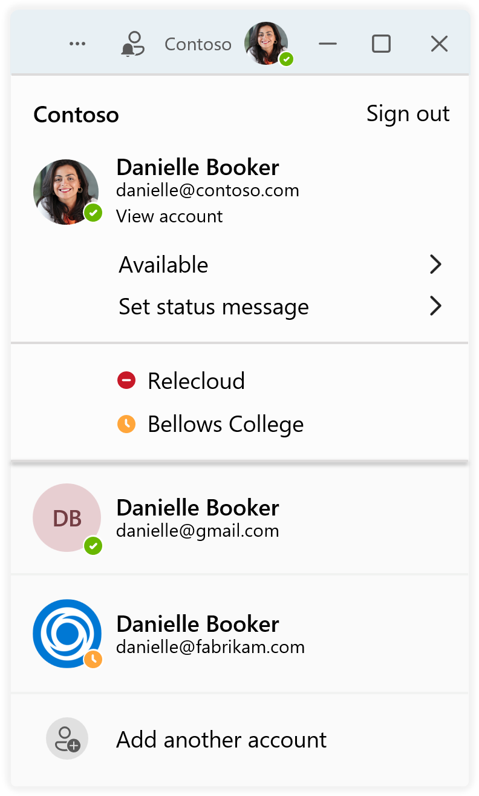
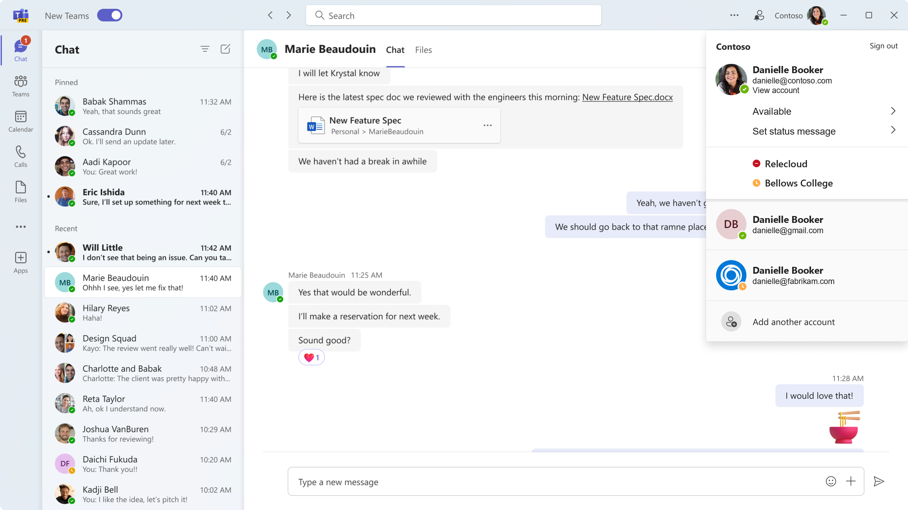
Multi-Tenant Multi-Account for Help Desk
Users can use their work or school accounts simultaneously, without having to sign out or open a separate browser
Select your profile picture in the upper right to
switch or add accounts and organizations
Set your status for each account and organization individually
Easily switch between multiple accounts and organizations without dropping from a call or meeting
To add another account, select your profile picture
at the top right of the new Teams, then select Add another account

Slide 24
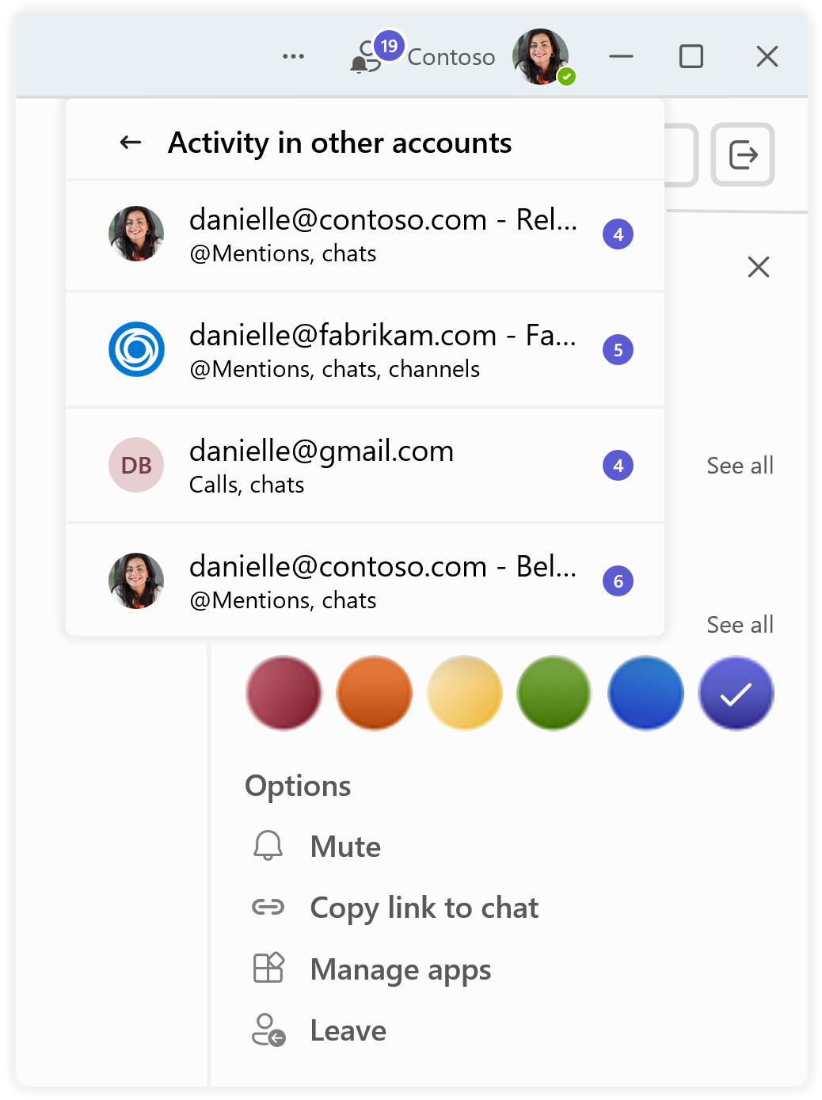
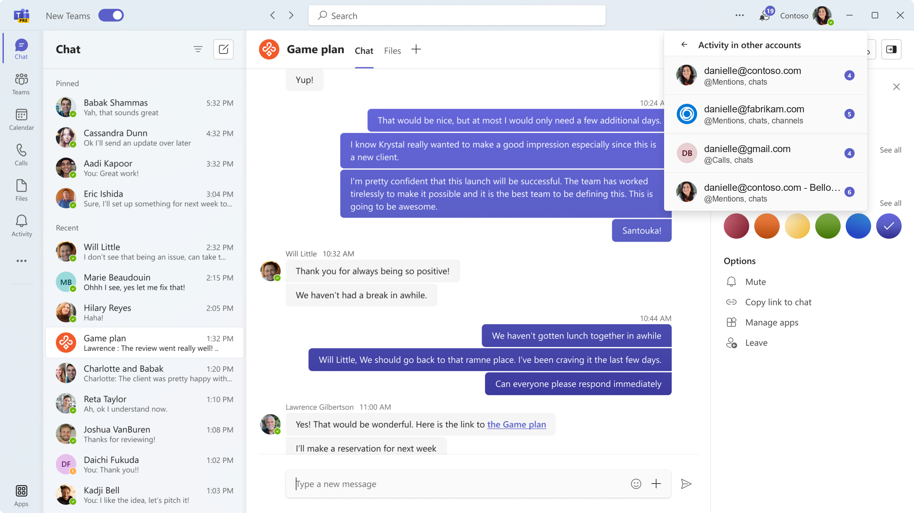
Multi-Tenant Multi-Account for Help Desk
Enable users to easily communicate and collaborate with who they need to
See activity and receive real-time notifications from all your accounts and associated organizations in
one place
Personalize each account and organization with a color theme to quickly recognize which workspace you’re in
Easily mute notifications, copy links from a chat, manage your apps, or leave an account or organization from a simple options list

Slide 25
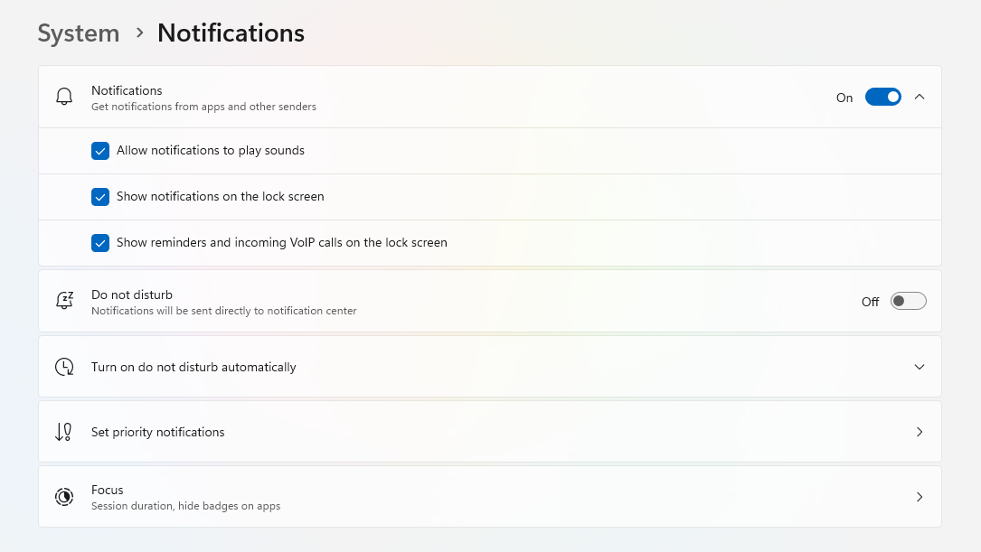
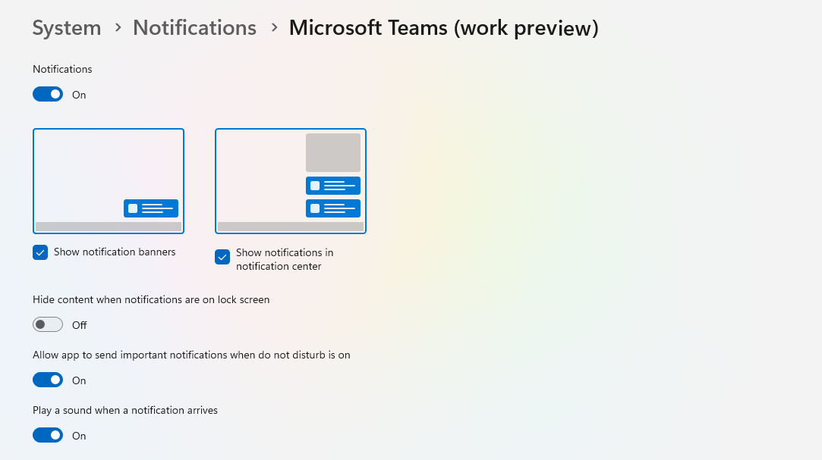


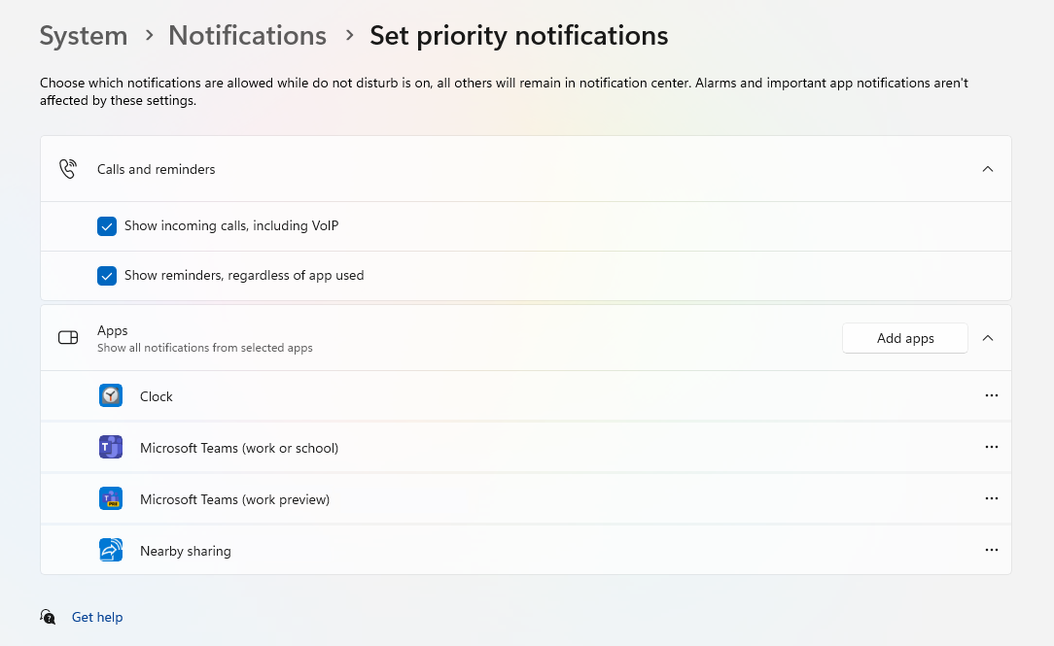
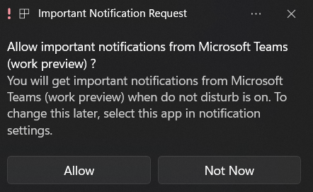
Notifications for Help Desk
Notifications in Windows must be turned on for users to receive any notifications and calls
1
2
Turn on Windows system notifications from the Settings app:
Select Start , then select Settings
Go to System > Notifications
Turn notifications on by flipping the toggle. To see all options, expand the notifications area.
3
4
Scroll down to the Microsoft Teams (work preview) app and configure where you want notifications to be displayed.
Set priority notifications allows you to choose which notifications are allowed
while do not disturb is on. Select the Add apps button and add Microsoft Teams
(work preview) to your app list.
When the Important Notification Request prompt shows (first run only), select Allow.

Slide 26
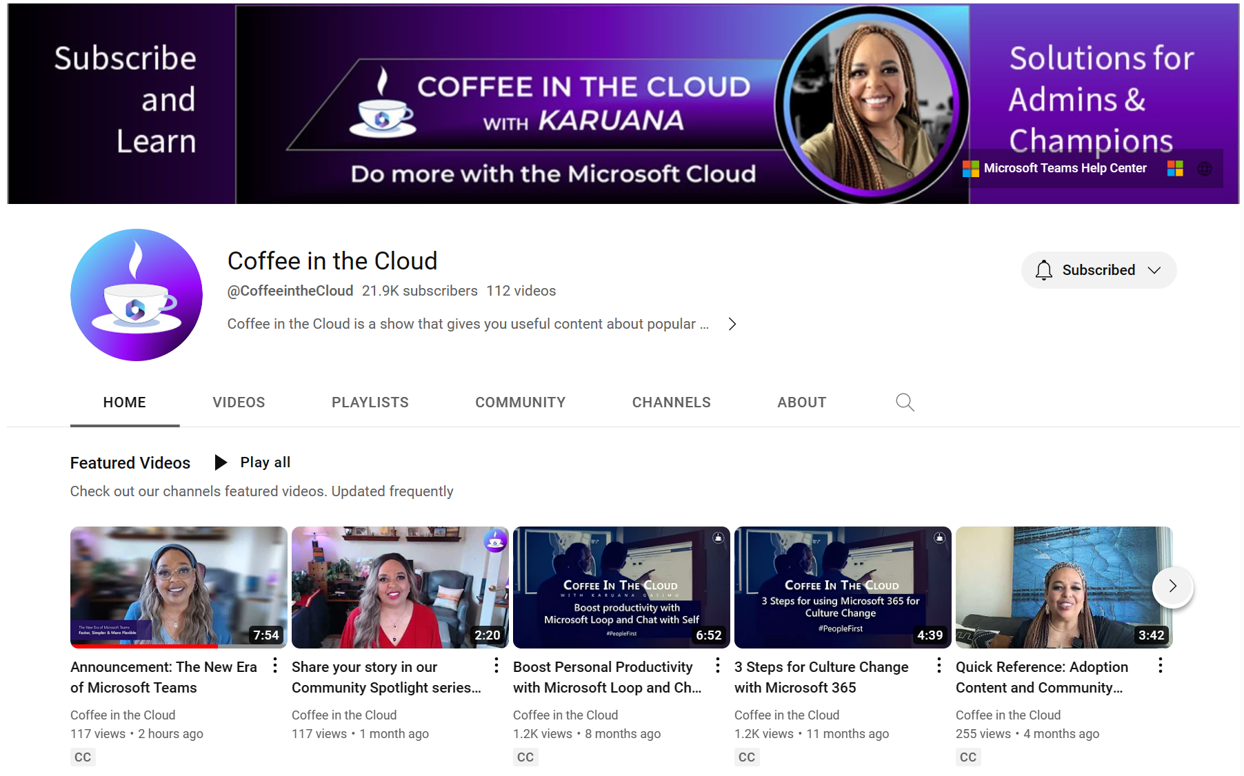
The new era of
Microsoft Teams
Check out the new Teams site at https://aka.ms/NewTeams and share with your colleagues and/or customers. This one-stop shop page has links to all our blog announcements and documentation, as well as an eBook for Champions, IT admins, and Help Desk, and will continue to be updated as we march toward feature parity later this calendar year.
Check out Karuana’s new video about the new era of Teams on Coffee in the Cloud for more information, where she focuses on what you need to know and on end user changes.

Slide 27

Resources to get started
Stay tuned for our online AMA on the new Teams
April 13, 2023 @ 9 AM PT
Aka.ms/TeamsTechCommunity
Microsoft Adoption: get started and find resources for your org, including a list of available and upcoming features (updated weekly)
Microsoft Teams technical documentation: includes step-by-step instructions on how to roll out the new Teams and known issues
End-user instructions: guidance on how to opt-in and start using the new Teams
Microsoft 365 Blog and Microsoft Teams Tech Community Blog:
read the new Teams announcements
Microsoft Tech Community Forum: share your experience with other customers and the Tech Community
Microsoft Teams Feedback portal: send suggestions to improve the new Teams experience

Slide 28
Community spotlight

Slide 29

Microsoft 365 Champion community stories
We want to highlight your story in future community calls! This is your opportunity to share with other Champions in this community. Format can be live in the call or a pre-recorded video.
We’d love to hear:
How you/your organization implemented Microsoft technologies
How you lead adoption and change management in your organization
How a Microsoft product improved your life or work culture
Or more!
Sign up at aka.ms/CommunitySpotlight to share your experience!

Slide 30

Community spotlight:
Alana Kelsey – Teams Ambassador Network
Role: Senior Manager Change Delivery – ScotiaBank
Company: ScotiaBank has +90K employees
Fun fact: Baby #Grogu is an absolute favourite and shares my Hybrid workspace (and my most used GIF in Teams)
Download Alana’s best practices presentation here.

Slide 31
Community events and updates
Upcoming events and community specific updates

Slide 32

Upcoming community events
Modern Workplace Conference | March 27-28, 2023 | Paris, France
QCon London | March 27-29, 2023 | London, UK
NAB Show Centennial 2023 | April 15-19, 2023 | Las Vegas, Nevada
WebExpo 2023 | April 19-21, 2023 | Prague, Czech Republic
Commsvnext | April 25-26, 2023 | Denver, Colorado
Microsoft 365 Conference | May 2-4, 2023 | Las Vegas, Nevada
M365 Community Days | May 13, 2023 | Hybrid/Phoenix, Arizona
CollabDays Poland 2023 | May 13, 2023 | Warsaw, Poland
European Collaboration Summit | May 22-24, 2023 | Dusseldorf, Germany
Thrive Conference | May 30-31, 2023 | Lipica, Slovenia
365EDU Con | June 12-16, 2023 | Washington, DC
European Power Platform Conference | June 20-22, 2023 | Dublin, Ireland
Commsverse | June 21-23, 2023 | Mercedes-Benz World, UK
Explore other Microsoft events and a full list of community led events can be found at CommunityDays.org

Slide 33
Microsoft 365 Champion Community news
Next community call:
Experience Insights
April 25, 2023
Top asks:
Complete our monthly call survey: https://aka.ms/Microsoft365ChampionCallFeedback
Participate in the Driving Adoption Community:
https://aka.ms/DrivingAdoption
Invite colleagues to join the Champion Program: https://aka.ms/M365Champions

Slide 34
Thanks for attending! We’d love your feedback on todays call and hear ways we can make future calls even better! https://aka.ms/Microsoft365ChampionCallFeedback
Microsoft 365 Champion Community
Learn more. Do more. Achieve more, together.
Now, let’s meet! Stay on to join our open discussion and feel free to come on video and off mute.

Slide 35
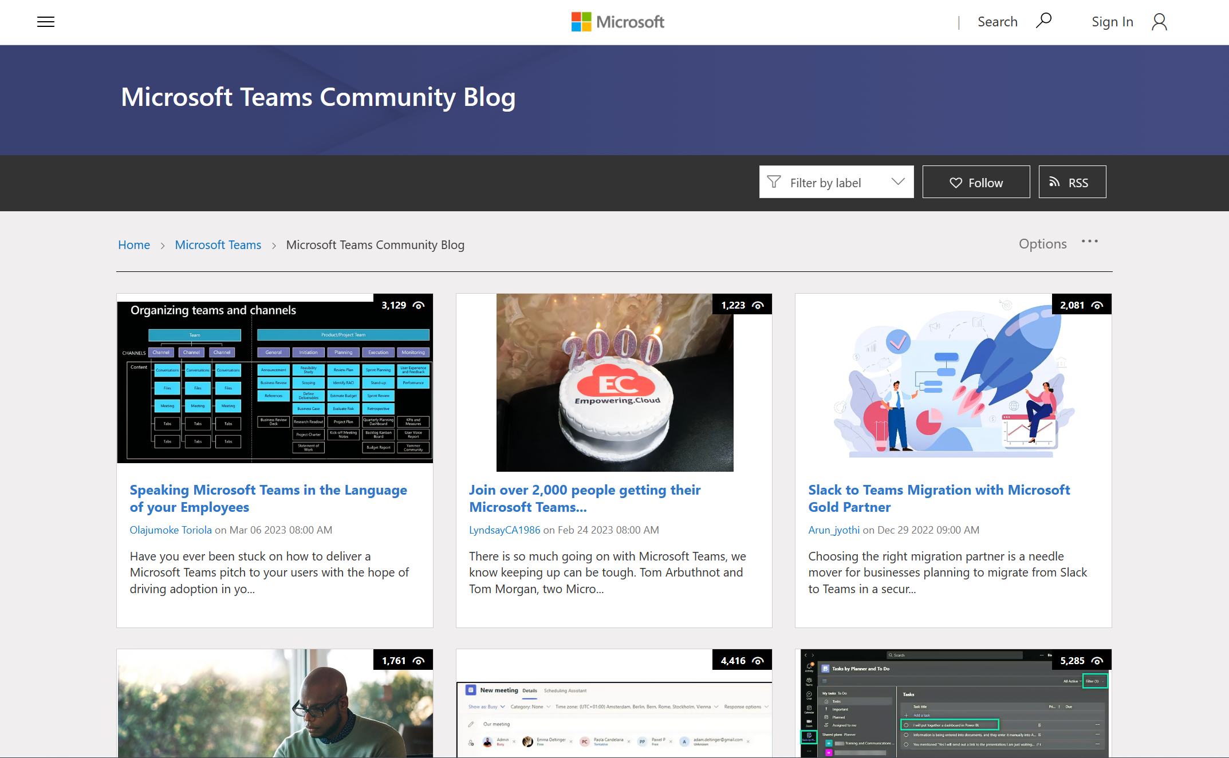
Microsoft
Teams
Microsoft Teams Community blog
Real world guidance curated from our customers and MVP influencers.
Check out the newest additions on the
Microsoft Teams Community blog.

