Slide 1

We will begin the call at five minutes past the hour.
Microsoft 365 Champion Community Call
June 2023
Microsoft 365 Champion Community
Learn more. Do more. Achieve more, together.

Slide 2
Microsoft 365 Champion Community
June 2023 Monthly Call
Microsoft Teams Customer Advocacy Group
Karuana Gatimu, Tiffany Lee, Jessie Hwang

Slide 3
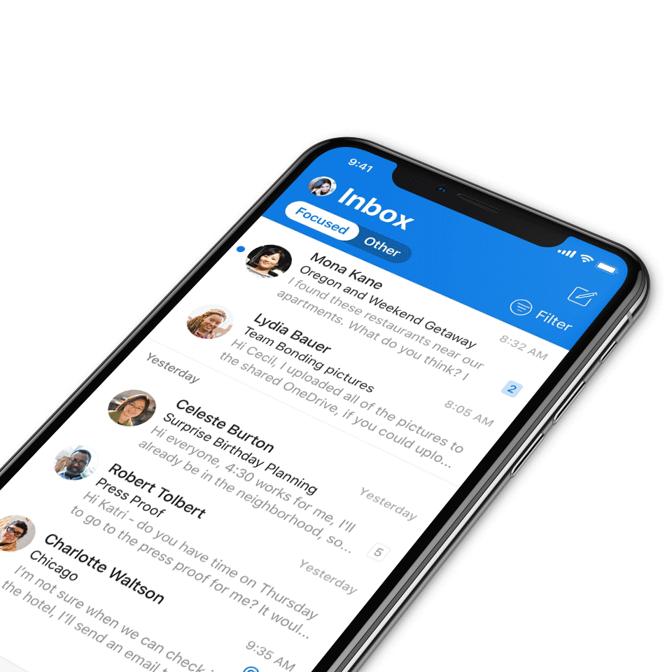
Digital Event Code of Conduct
Microsoft’s mission is to empower every person and every organization on the planet to achieve more. This includes all Microsoft events and gatherings, including on digital platforms, where we seek to create a respectful, friendly, fun and inclusive experience for all participants.​
We expect all digital event participants to uphold the principles of this Code of Conduct, which covers the main digital event and all related activities. We do not tolerate disruptive or disrespectful behavior, messages, images, or interactions by any party participant, in any form, at any aspect of the program including business and social activities, regardless of location.​
Microsoft will not tolerate harassment or discrimination based on age, ancestry, color, gender identity or expression, national origin, physical or mental disability, religion, sexual orientation, or any other characteristic protected by applicable local laws, regulations, and ordinances.​
We encourage everyone to assist in creating a welcoming and safe environment.
For more info, click here.

Slide 4

Agenda
Microsoft 365 updates | Top new features releases across Microsoft 365
Teams Emergency Operations Center v2 | Josh Leporati
Community Spotlight | Tanya Caruana, BMO Harris Bank
Community events & updates
Open discussion forum
Find resources from previous calls here:
https://aka.ms/M365ChampionResources

Slide 5
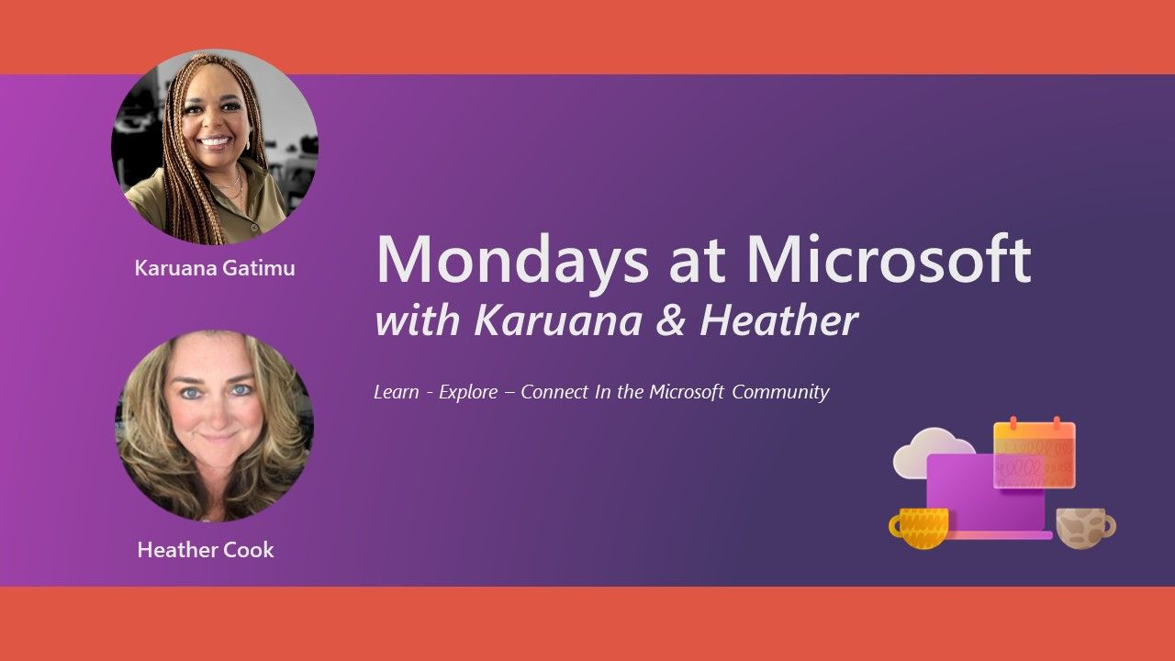
Microsoft
Community
Mondays at Microsoft with Karuana and Heather
Our Mondays at Microsoft show premiered on May 15! Karuana and Heather announced the new Microsoft Community on LinkedIn, and this bi-weekly show will aggregate new product announcements and upcoming community events to drive technical skilling and engagement!
Missed the call? Click here for Mondays at Microsoft show notes.
Click here to join the new Microsoft Community on LinkedIn so you can get ready for our next call.

Slide 6
Microsoft 365 updates
Top new feature releases across Microsoft 365

Slide 7
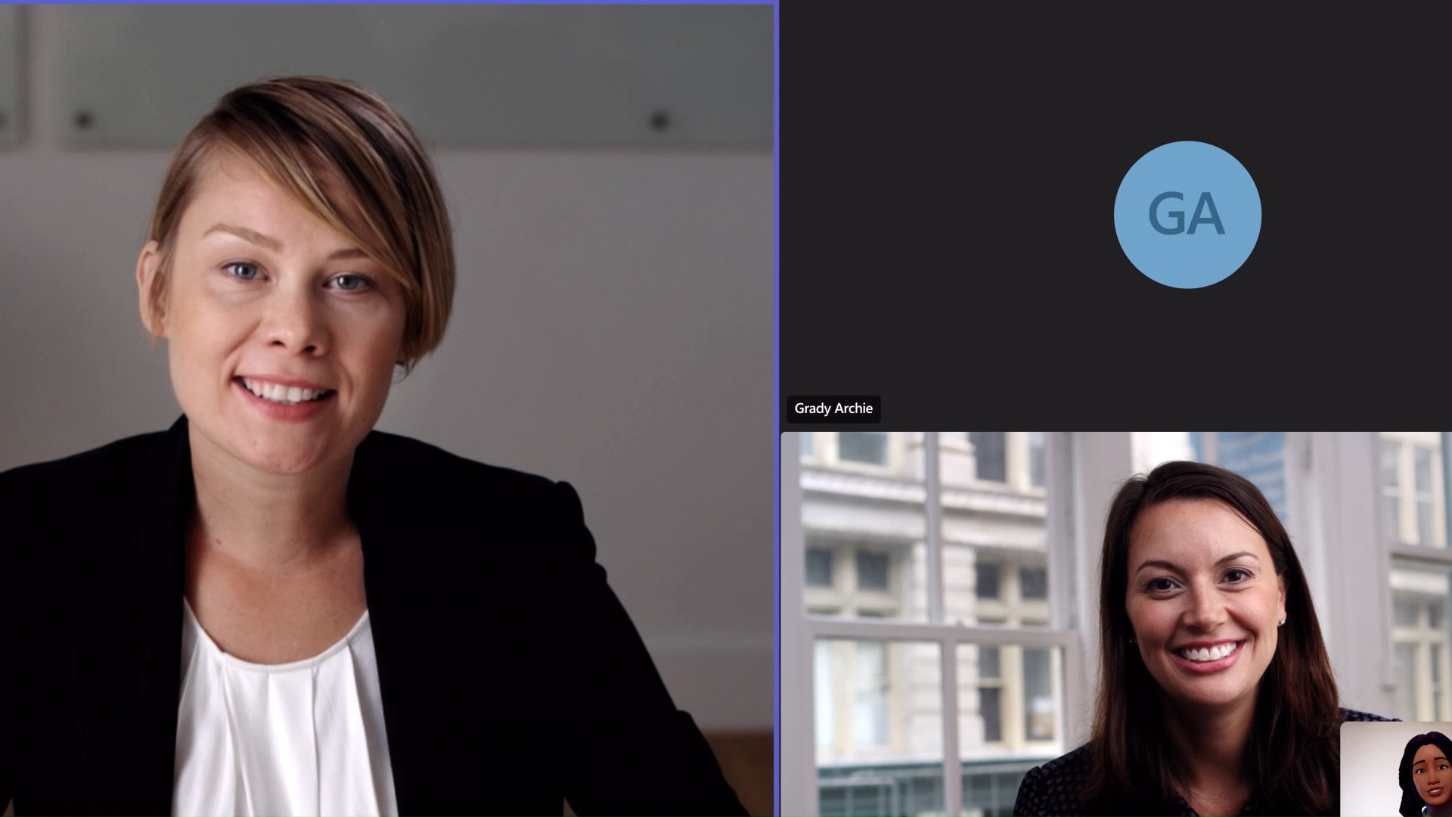
Microsoft
Teams
Avatars for Microsoft Teams
Avatars for Microsoft Teams gives you that much-needed camera break, while still allowing you to collaborate effectively. You can add a new layer of choice to your meetings and represent yourself the way you want with customizable avatars and reactions.
Teams customers can access this feature if they have one of the following licenses:
Microsoft 365 Enterprise E3
Microsoft 365 Enterprise E5
Microsoft 365 Business Standard
Microsoft 365 Business Premium License
Click here to set up Avatars for Teams.

Slide 8
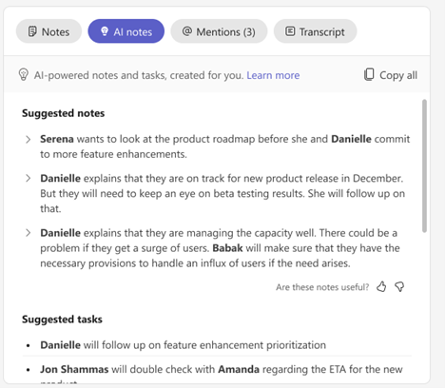
Microsoft
Teams
Intelligent meeting recap in Teams Premium, now available
Intelligent recap leverages AI to automatically provide a comprehensive overview of your meeting, helping users save time catching up and coordinating next steps. Found on the new ‘Recap’ tab in Teams calendar and chat, users will see AI-powered insights like automatic generated meeting notes, recommended tasks, and personalized highlights to help users quickly find the most important information, even if you miss the meeting.
Featuring:
AI-generated notes allow users to see key points and takeaways after the meeting, automatically created and powered by GPT. And follow-up is easy with AI-generated tasks and action items automatically suggested for you.

Slide 9
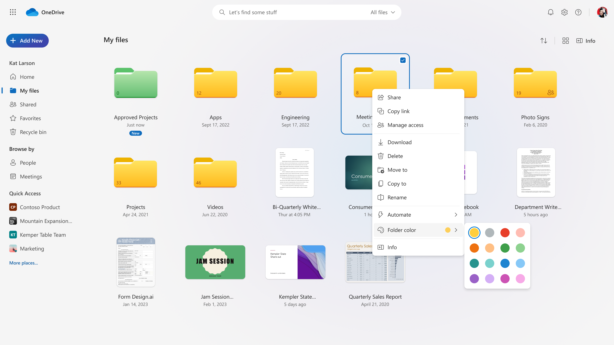
Microsoft
OneDrive
Experience the new OneDrive: Fast, organized, and personalized
We are excited to announce a new OneDrive experience for work and school that starts with the OneDrive home page and spans file experiences across Microsoft 365. It’s both a visual and functional upgrade designed to help you get to files quickly and keep your content organized in multiple ways, without you having to do any organizing. The new features and upgraded design make it faster to get to all your personal, shared, and team files in OneDrive so you can be more productive.
This new home experience in now available in OneDrive for work and school, with AI file recommendations coming soon!

Slide 10
Teams Emergency Operations Center v2
Josh Leporati

Slide 11
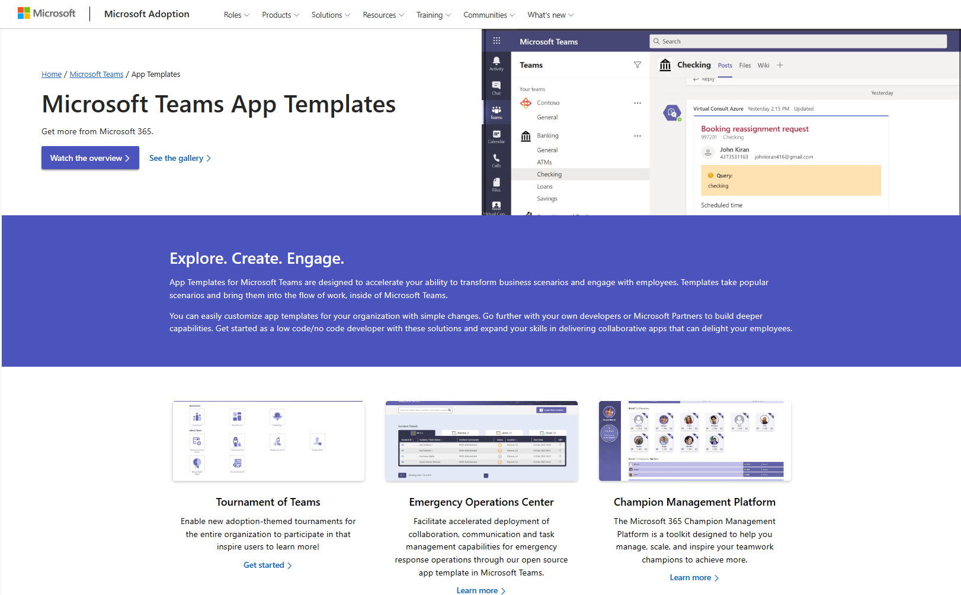
Inspire and Achieve More
Microsoft Teams App Templates
Pre-built Teams apps for common line-of-business scenarios. Templates take popular scenarios and bring them into the flow of work, inside of Microsoft Teams.
Tenant-wide: Give access to few, many or everyone.
Production ready: Download and use, today. Easily customize app templates for your organization with simple changes.
Open sourced: You can own, brand, configure and extend to your needs. Go further with your own developers or Microsoft Partners to build deeper capabilities
https://aka.ms/TeamsAppTemplates
Explore. Create. Engage.

Slide 12



Announcing new updates
and Government Cloud support!
Microsoft Teams Emergency Operations Center: Version 2 of our solution template is now available! Increased customization options, new incident active dashboard, US Government Cloud support (GCC & GCCH) and more!
Company Communicator: Newly updated and now supported in our Government Community Cloud High (GCCH) and Azure Government environments.
https://aka.ms/TeamsAppTemplates

Slide 13






Microsoft Teams Emergency Operations Center
Version 2 Now Available
May 2023
V2 Major Features & Updates
Microsoft 365 Government Support
Active Dashboard (for each incident)
Now available and supported within the Government Community Cloud (GCC), Government Community Cloud High (GCC High), and Azure Government deployment environments.
Central point for viewing and identifying role assignments and sending announcements to the team. Also provides the ability to start and stop Teams meetings (meet now) for bridge calls, as well as the ability to centrally manage, assign and act on tasks for an incident.
Expanded assets during deployment
Dashboard role-based access
During incident creation you can now add guest users to the incident, customize and save defaults for channel names, as well as provide a link to designate a cloud storage location for centralized documentation needs
Ability to control access to the TEOC dashboard based on admin or view only roles. When enabled control the ability to manage and create incidents by assigning admins through the designated list, while all non-named users will receive view only access
Lead assignment for Roles
Core Component Updates
Assign and designate leads for different role groups so team members can identify lead role contributors
Updates to core components and packages to latest stable and verified versions

Slide 14
Community Spotlight

Slide 15

Microsoft 365 Champion community stories
We want to highlight your story in future community calls! This is your opportunity to share with other Champions in this community. Format can be live in the call or a pre-recorded video.
We’d love to hear:
How you/your organization implemented Microsoft technologies
How you lead adoption and change management in your organization
How a Microsoft product improved your life or work culture
Or more!
Sign up at aka.ms/CommunitySpotlight to share your experience!

Slide 16
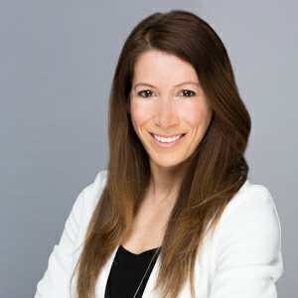
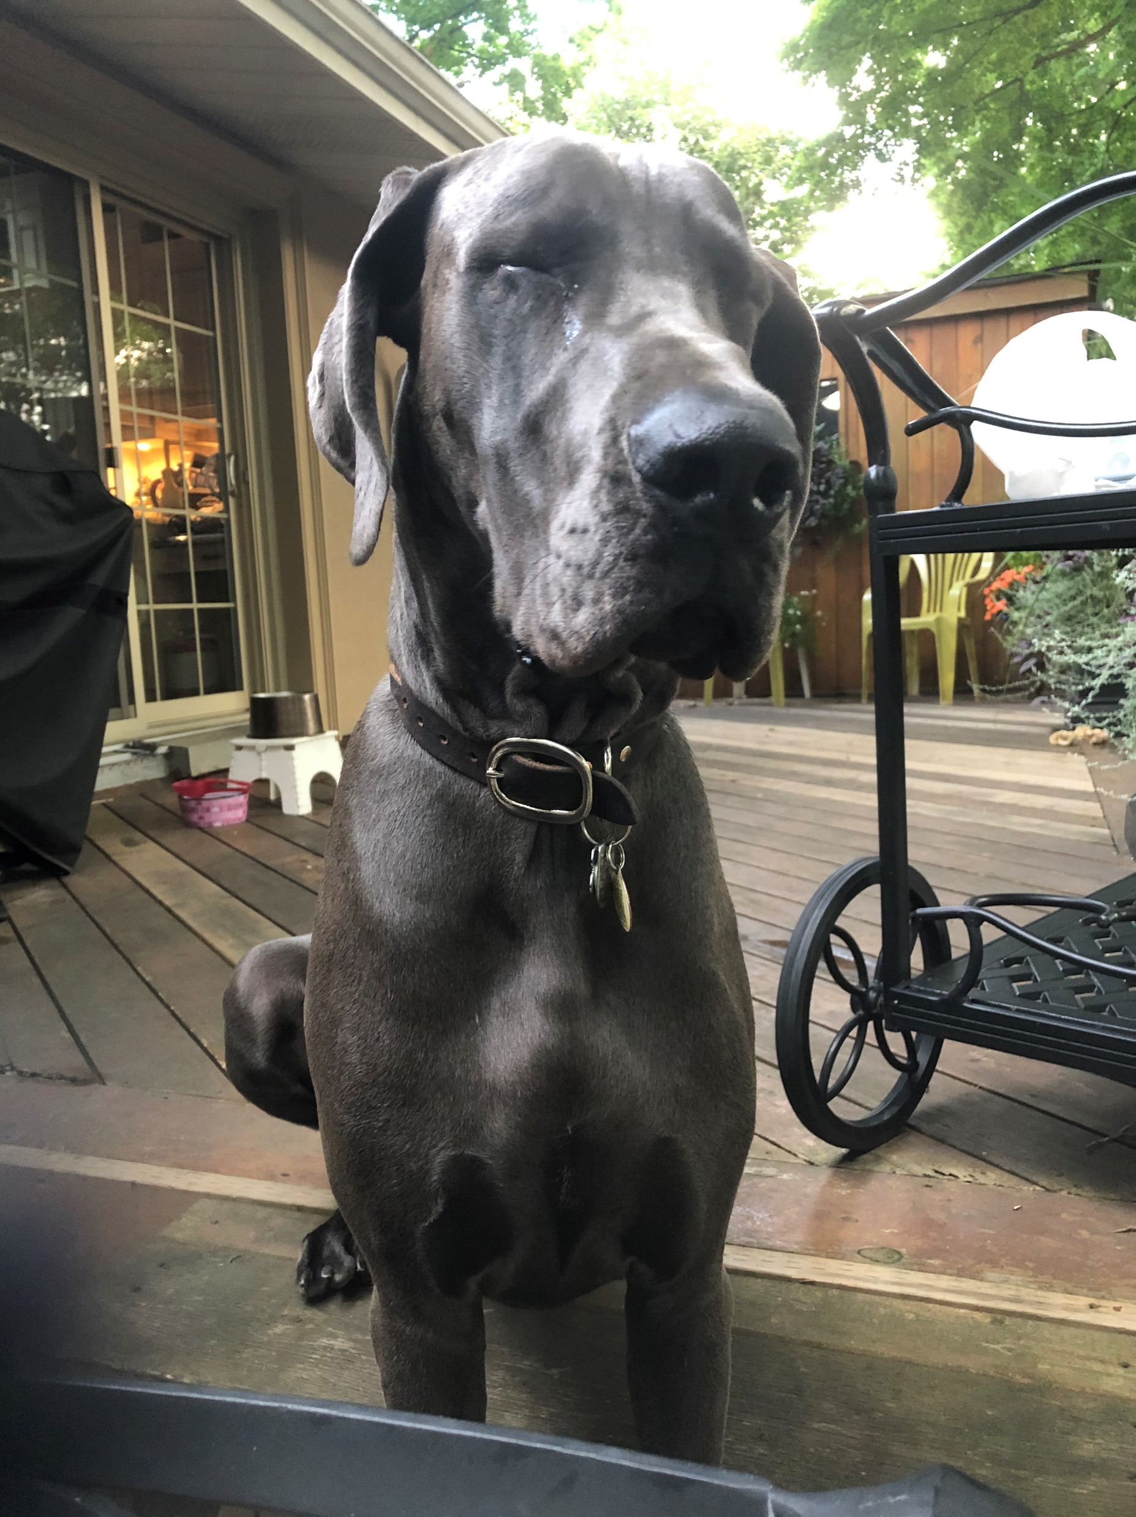
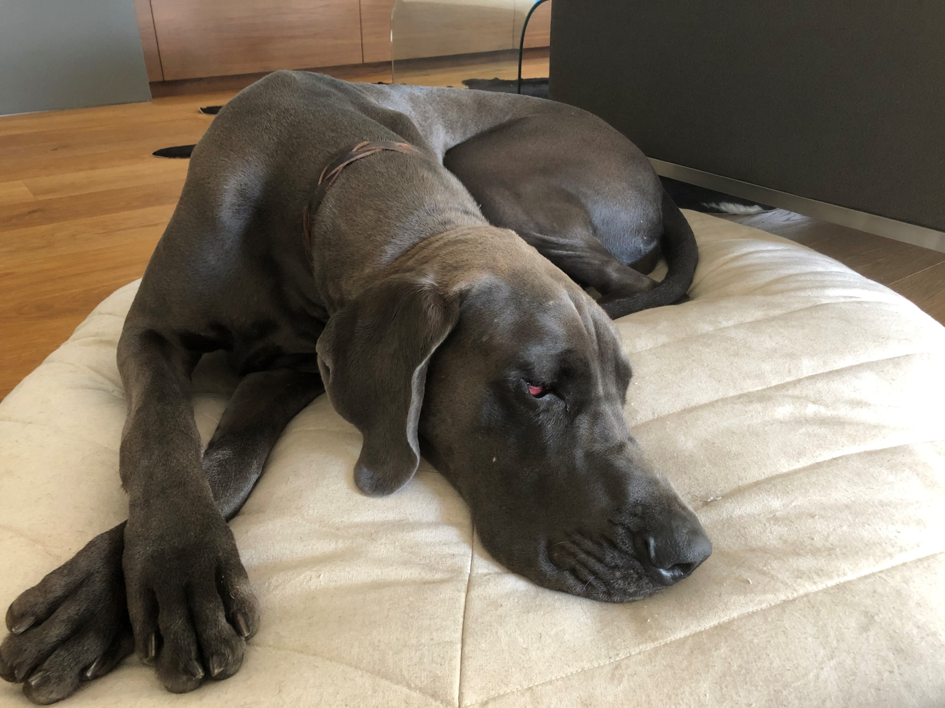
Community Spotlight
Tanya Caruana
Role: Director & Sr. Employee Digital Experience Specialist
Company: BMO Harris Bank with 50K employees
Fun fact: I own a Great Dane named Roxy!

Slide 17
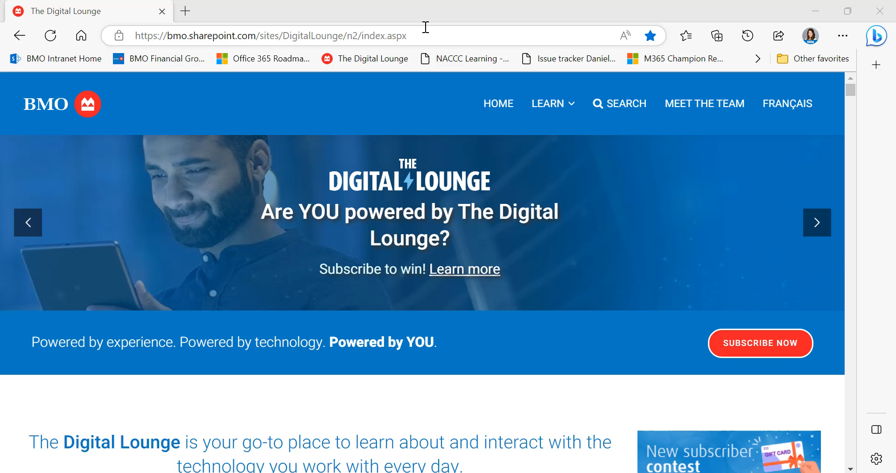
Champions
Community Spotlight
Digital Lounge at BMO Harris
Curious on how another Champion organized and set up their own self serve digital lounge for their community members at BMO Harris?
Watch this cool video demo of their Digital Lounge!

Slide 18

Upcoming community events
Jun 20-22, 2023
Jun 21-23, 2023
Aug 21-25, 2023
Oct 3-5, 2023
Oct 13-14, 2023
Oct 30-Nov 3, 2023
Nov 4, 2023
European Power Platform Conference
Commsverse
365 EDUcon Seattle
Microsoft Power Platform Conference
South Coast Summit
365 EDUcon Chicago
M365 Community Days
Dublin, Ireland
Mercedes-Benz World, UK
Seattle, WA
Las Vegas, NV
Farnborough, UK
Chicago, Illinois
Hybrid/Phoenix, AZ
Explore other Microsoft events and a full list of community-led events can be found at CommunityDays.org

Slide 19
CommunityDays.org: June to September 2023 events
Event name | Start date | End date | City | State | Country
Viva Round The World 2023 | 6/2/2023 | 6/2/2023 | Global
Brisbane Data, Power BI and AI Bootcamp | 6/10/2023 | 6/10/2023 | Brisbane | Queensland | Australia
CollabDays Netherlands 2023 | 6/10/2023 | 6/10/2023 | Utrecht |  | Netherlands
Viva Explorers Belgium | 6/12/2023 | 6/13/2023 | Zaventem |  | Belgium
aMS Berlin 2023 | 6/14/2023 | 6/15/2023 | Berlin |  | Germany
Collab Days Central Europe | 6/17/2023 | 6/17/2023 | Zurich |  | Switzerland
Iowa Code Camp 2023 | 6/17/2023 | 6/17/2023 | Ankeny | Iowa | United States
Dynamics 365 Bootcamp CX Summit | 6/23/2023 | 6/24/2023 | Brussels |  | Belgium
Collab Days Zagreb 23 | 7/1/2023 | 7/2/2023 | Zagreb |  | Croatia
Microsoft Community Days Boston - Healthcare Edition | 7/7/2023 | 7/7/2023 | Burlington | Massachusetts | United States
Nashville Microsoft 365 Community Day | 7/14/2023 | 7/14/2023 | Nashville | Tennessee | United States
Community Days NYC 2023 | 7/29/2023 | 7/29/2023 | New York | New York | United States
M365 Community Days So Cal | 8/12/2023 | 8/12/2023 | Playa Vista | California | United States
SEF 2023 (Share & Evolve in M365 Forum) | 9/11/2023 | 9/12/2023 | Stockholm |  | Sweden
CollabCon | 9/15/2023 | 9/15/2023 | Orlando | Florida | United States
Microsoft 365 Ottawa | 9/29/2023 | 9/29/2023 | Ottawa | Ontario | Canada
Explore other Microsoft events and a full list of community-led events can be found at CommunityDays.org

Slide 20
Microsoft 365 Champion Community news
See you at our next community call!
Date: July 25, 2023
Top asks:
Complete our monthly call survey: https://aka.ms/Microsoft365ChampionCallFeedback
Participate in the Driving Adoption Community:
https://aka.ms/DrivingAdoption
Invite colleagues to join the Champion Program: https://aka.ms/M365Champions

Slide 21
Thanks for attending! We’d love your feedback on today’s call and hear ways we can make future calls even better! https://aka.ms/Microsoft365ChampionCallFeedback
Microsoft 365 Champion Community
Learn more. Do more. Achieve more, together.
Now, let’s meet! Stay on to join our open discussion and feel free to come on video and off mute.

