Slide 1

We will get started shortly!
Microsoft 365 Champion Community Call
February 2023
Microsoft 365 Champion Community
Learn more. Do more. Achieve more, together.

Slide 2
Microsoft 365 Champion Community
February 2023 Monthly Call
Microsoft Teams Customer Advocacy Group
Karuana Gatimu, Tiffany Lee, Jessie Hwang

Slide 3
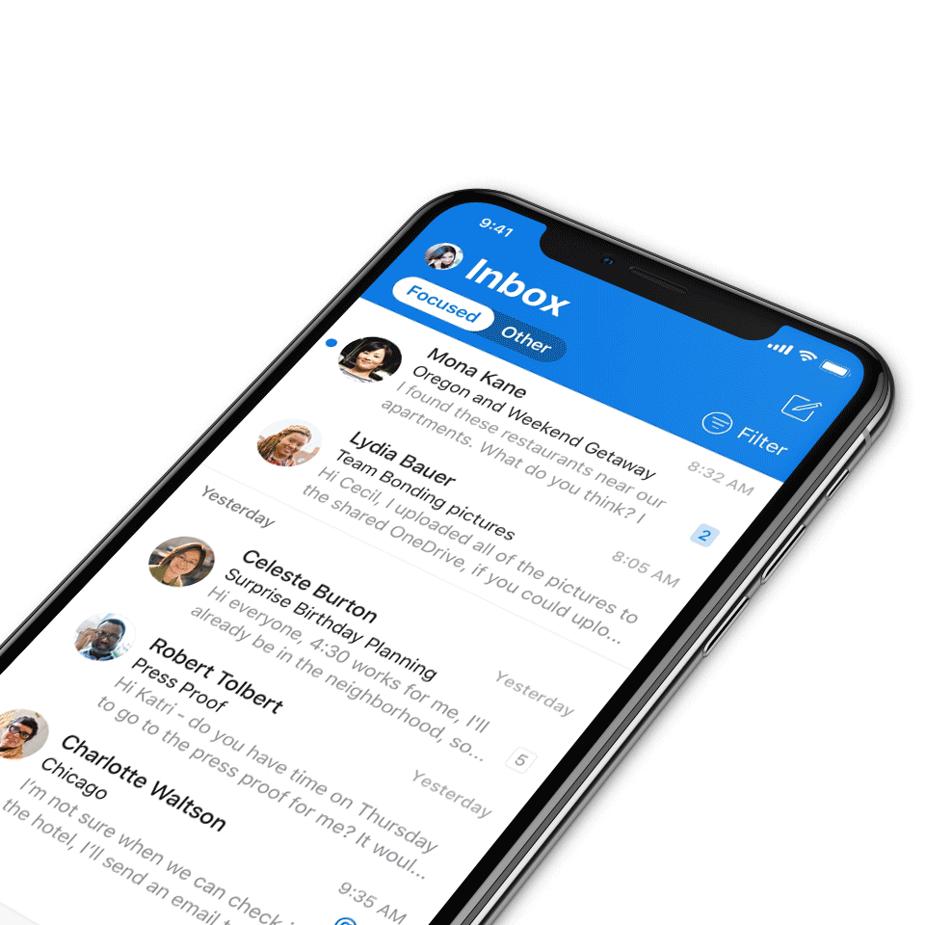
Digital Event Code of Conduct
Microsoft’s mission is to empower every person and every organization on the planet to achieve more. This includes all Microsoft events and gatherings, including on digital platforms, where we seek to create a respectful, friendly, fun and inclusive experience for all participants.​
We expect all digital event participants to uphold the principles of this Code of Conduct, which covers the main digital event and all related activities. We do not tolerate disruptive or disrespectful behavior, messages, images, or interactions by any party participant, in any form, at any aspect of the program including business and social activities, regardless of location.​
Microsoft will not tolerate harassment or discrimination based on age, ancestry, color, gender identity or expression, national origin, physical or mental disability, religion, sexual orientation, or any other characteristic protected by applicable local laws, regulations, and ordinances.​
We encourage everyone to assist in creating a welcoming and safe environment.
For more info, click here.

Slide 4

Agenda
Microsoft 365 updates | Top new features releases across Microsoft 365
Adoption Score | Samer Baroudi & Mohammad Akram
Community spotlight | Sean McEvoy, Champion
Community events & updates
Open discussion forum
Find resources from previous calls here:
https://aka.ms/M365ChampionResources

Slide 5
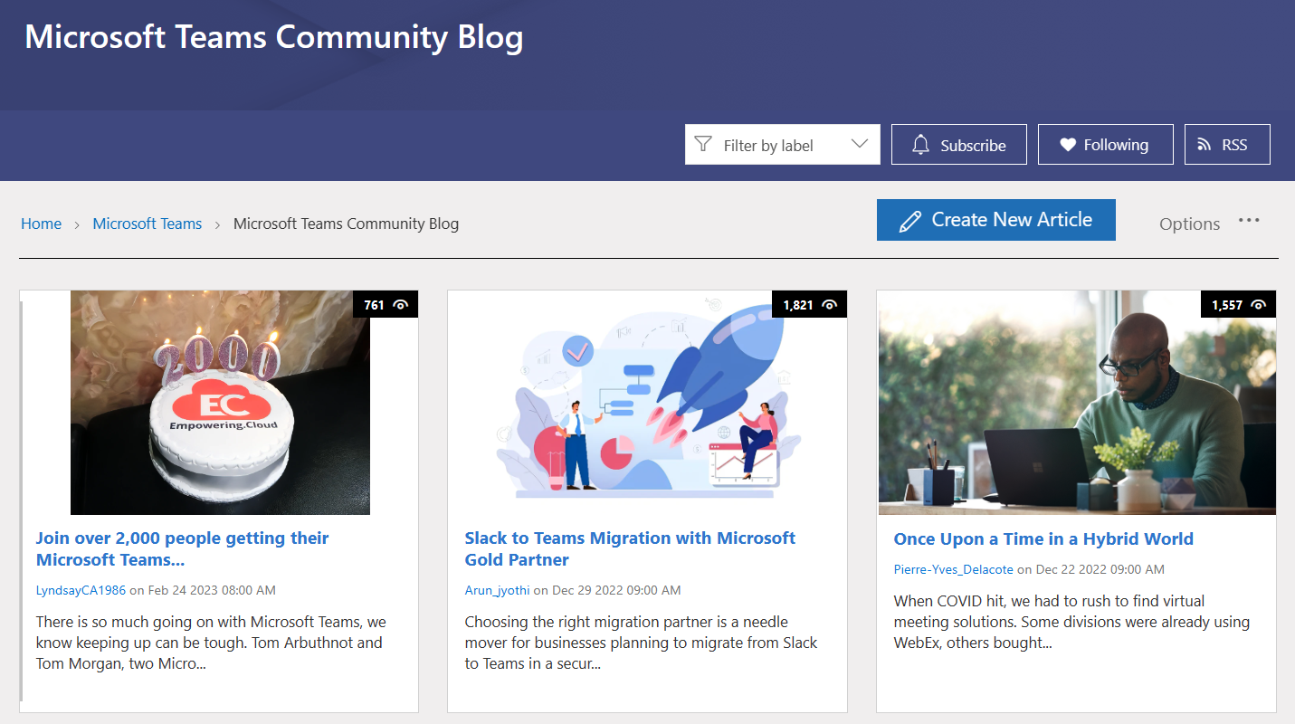
Microsoft
Teams
Microsoft Teams Community blog
Real world guidance curated from our customers and MVP influencers.
Check out the newest additions on the
Microsoft Teams Community blog.

Slide 6
Microsoft 365 updates
Top new feature releases across Microsoft 365

Slide 7
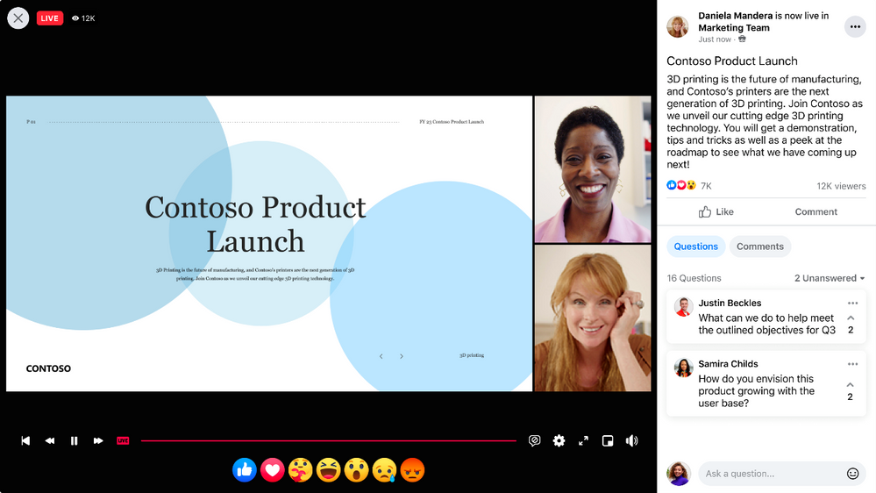
Microsoft
Teams
Live stream Teams meetings and webinars to Meta Workplace Live
Live stream your Teams meetings or webinars directly to Meta Workplace Live using the new Workplace Live app integration. This allows attendees to watch live meetings and webinars within their Workplace groups or catch up later by watching a recording on Workplace. Simply add the Workplace Live app to your Teams meeting or webinar, sign in using your Workplace account, and select the Workplace Event you'd like to live stream.

Slide 8
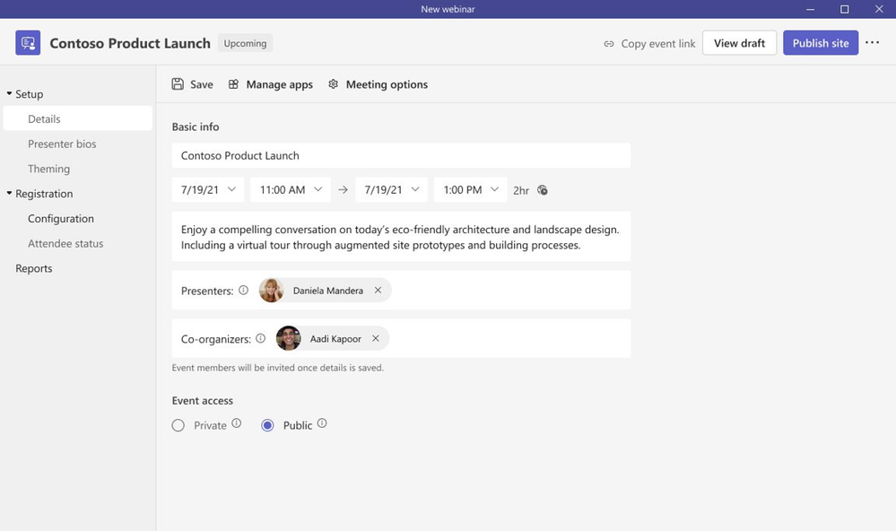
Microsoft
Teams
Teams Premium: new Advanced Webinar capabilities
We’ve revamped the setup and management of registration with a new structure and expanded options to customize registration details and event settings.
Designating co-organizers and adding the relevant event details
Enhancing presenter bios to showcase their expertise and social credentials
Showcasing your brand to align to the theme of your event; managing registration capacity limits for up to 1,000 attendees
Specifying custom questions to gather pertinent information about your prospective attendees and enabling consent for event terms and conditions upon registration
Viewing attendee status for registrations and cancellations, along with attendee reporting all in one central location
To learn more, click here.

Slide 9
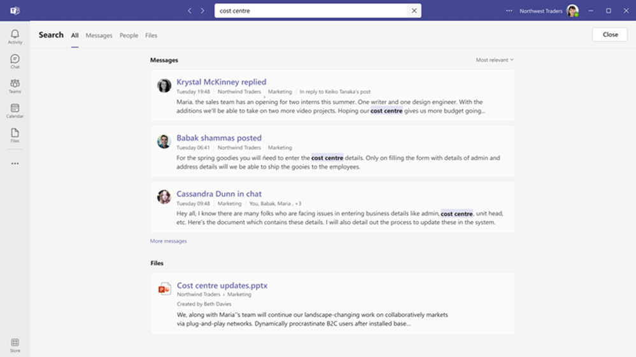
Microsoft
Teams
View the full chat conversation thread after clicking on search message results
When users search for a chat message in Teams and click on a message result, their search will now display the full context of the conversations related to the result, regardless of the age of the messages.
To learn more, click here.

Slide 10
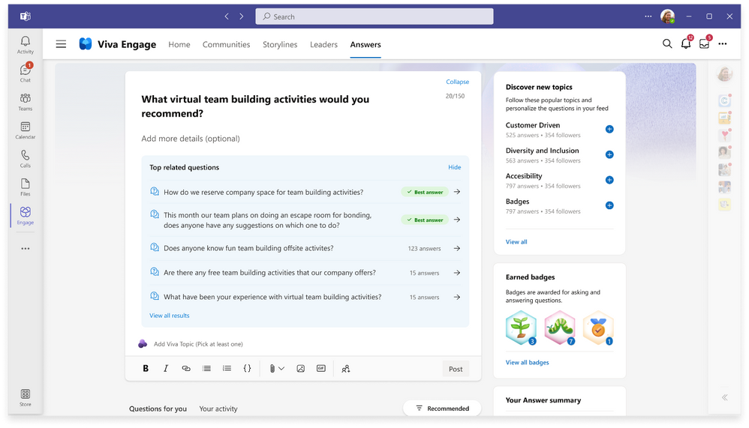
Microsoft
Viva
Answers in Viva
Answers in Viva is a new space in Viva Engage that helps people ask questions, find solutions, share what they know, and save everyone time. Powered by Viva Topics, Answers uses AI to help match questions and answers and rewards experts who contribute to its knowledge base, saving time that would otherwise be spent searching for answers or duplicating information. In other words, Answers in Viva puts collective knowledge to work for everyone.
To learn more, click here.

Slide 11
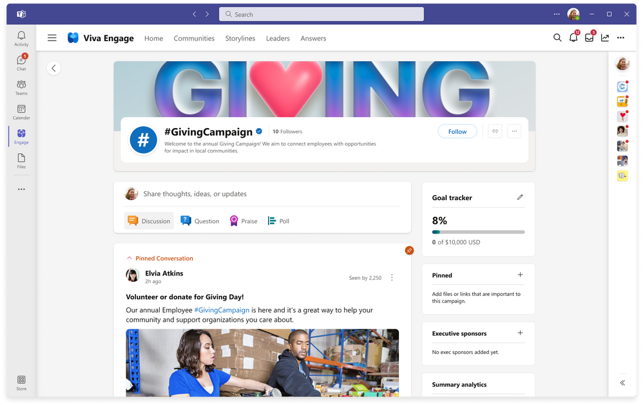
Microsoft
Yammer
Yammer will become Viva Engage
Over the next year, Yammer experiences will be rebranded to Viva Engage to better align with Microsoft Viva and become a key pillar of the Microsoft Employee Experience Platform. We are excited that this change will unify Viva Engage across web, mobile, Teams, Outlook and other experiences. This change is a direct result of the feedback we’ve heard from you, our customers, and it will help us deliver an integrated experience and a single Viva Engage platform across apps and endpoints—wherever you choose to engage.
To learn more, click here.

Slide 12
Adoption Score
Samer Baroudi | Mohammad Akram

Slide 13

To realize value, IT is being asked to do more
Traditional IT responsibilities
User and permissions management
Service configuration, deployment, and management
Security and compliance
Service health and billing
Documentation and support
Maintenance, monitoring, backup, and recovery
New IT responsibilities
Understand usage data across products
Understand workforce feedback/ sentiment to identify opportunities
Training employees to use technology more efficiently
Create adoption strategies to maximize value
Understand impact and prepare for technology changes on workforce
Identify unmet user needs and evaluate new technology options
Notes:
Recently, we have heard from customers there is a shift in what IT professionals are being asked to do – the traditional roles and responsibilities remain however, IT is being asked to realize more value from their investments for a distributed workforce.
The role of IT in an organization has evolved over the years and depending on the size and complexity of an organization, companies are approaching this problem by giving IT admins more responsibility, or asking other roles, such as success or adoption specialists, to take on these tasks. `

Slide 14



The Microsoft 365 admin center is evolving to support
Act on
intelligent recommendations
Gauge user satisfaction & success
Track license allocation & renewal
Adoption Score
Experience Insights
Usage Reports
Get the most out of your subscription using the easy-to understand insights and intelligent recommendations in the Microsoft 365 admin center.
Notes:
In order to help address this gap, the Microsoft 365 admin center is evolving and changing to support these needs. Typically used to manage applications, services, data, devices, and users across your Microsoft 365 subscription from a central dashboard, the admin center now helps you to maximize investments in Microsoft 365. With Adoption Score and Experience Insights, the admin center recommends ways to improve your experience based on how people in your company are actually using Microsoft 365, and with Usage reporting, you can track license allocation and renewal.

Slide 15



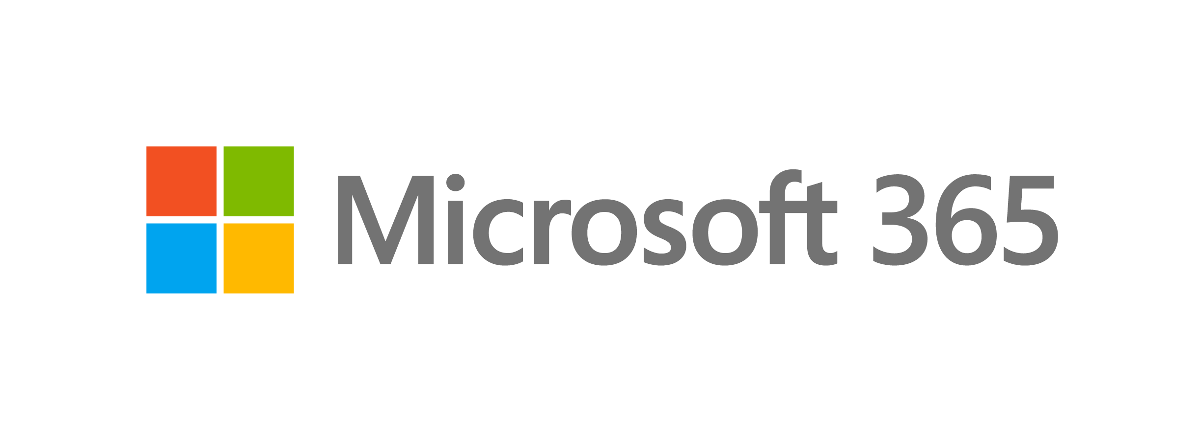
Adoption Score
Maximize your investment in Microsoft 365
Visibility
Understand how
your organization works
Actions
Adopt recommended practices and
improve usage
Insights
Identify where you can enable improved experiences
Improve the everyday experiences of the workforce and
get the most out of your investment in Microsoft 365
Notes:
Adoption Score supports IT admins and Adoption Specialists in three ways. Firstly, Adoption Score provides visibility to understand how your organization works with Microsoft 365. Second, we provide insights on this data to identify where you can enable improved experiences for the workforce so they can reach their goals quicker and easier than before. Lastly, we want to help you take actions on items that matter to your organization, so the workforce can adopt recommended practices and work smarter when using Microsoft 365.

Slide 16








How it works
Actionable insights
People experiences
Technology experiences
Communication
Meetings
Content Collaboration
Teamwork
Mobility
Endpoint Analytics
Network Connectivity
Microsoft 365 Apps Health
Adoption Score is backed by Microsoft’s continued
commitment to user-level privacy
Notes:
To aid interpretation of Adoption Score insights, a score is given for each Microsoft 365 tenant across eight categories, with a maximum score of 800.
The score is comprised of two main sub-scores: People Experiences, which has five categories, and Technology Experiences, which has three categories. Each category has a key insight that earns a maximum of 100 points.
People experiences in Adoption Score helps you, the IT admin or adoption specialist, understand how the workforce leverages the rich capabilities included in Microsoft 365 and provides guidance on how to get the most out of your Microsoft 365 subscription. By providing insights about how your organization adopts Microsoft 365, users can be reminded about a recommended approach to use one or more products or features, backed by research that save time or effort. We qualify this in a measurable score across five people experience categories – Communication, Meetings, Content Collaboration, Teamwork and Mobility.
The Technology Experiences section allows IT admins to gain further insights into technology areas that can influence your people experiences. Factors such as endpoint boot times , network throughput and latency, and app currency all contribute to varying degrees to people’s technology experiences and the responsiveness of the apps the user works in. Technology experiences are qualified in a measurable score across three categories – Endpoint Analytics, Network Connectivity and Microsoft 365 Apps Health. Ensuring users have optimized endpoints, great connectivity and healthy applications all help to complete the Microsoft 365 experience and lead to improved outcomes for the workforce.
These insights are backed by our strengthened commitment to user level privacy. At Microsoft, we believe that data-driven insights are crucial to empowering people and organizations to achieve more. We are also deeply committed to the privacy of every person who uses our products. As part of that commitment, no one in the organization will be able to use Adoption Score to access data about how an individual user is using apps and services in Microsoft 365.

Slide 17
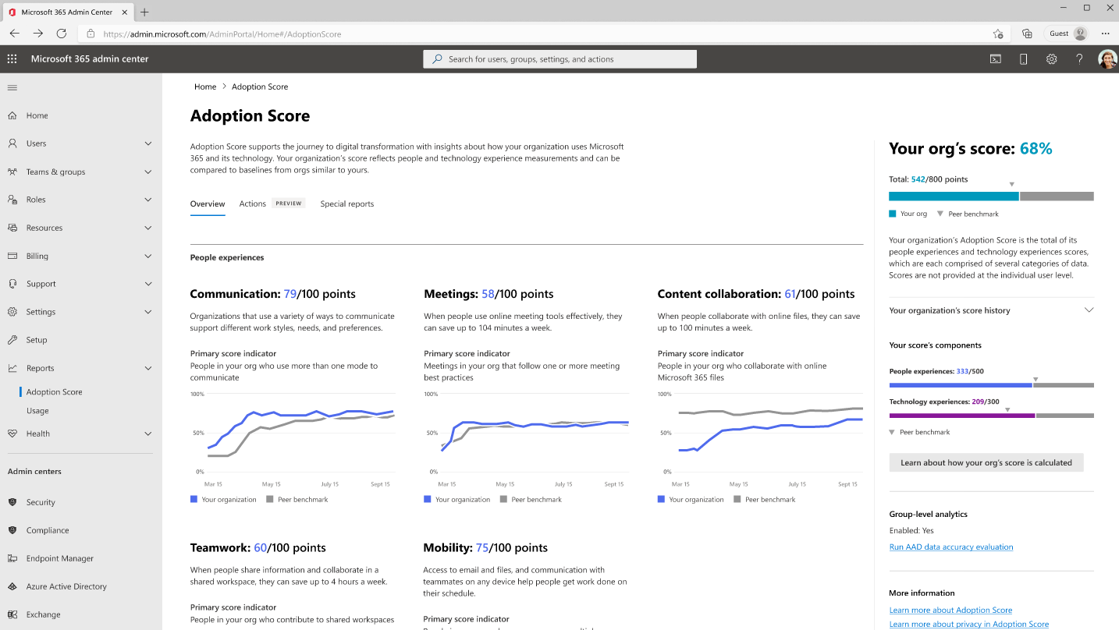
Adoption Score
Insights into technology areas that can influence Microsoft 365 users
Track adoption of Microsoft 365 recommended practice
Organizational level insights
Measure progress with
six months of history
Benchmark against others
organizations
Adoption Score helps IT admins and adoption specialists maximize their investment in Microsoft 365
Notes:
There are two areas that your score is built from: people experiences and technology experiences. The people experiences shows you how your organization is using Microsoft 365 to transform how work gets done. The technology experiences shows you how well key technologies in your environment are enabling great people experiences and helping you achieve your digital transformation goals. Right under the two areas you can see how your score has changed. You will be able to see up to six months of historical scores that will help you track your progress.
You also might have noticed that there are benchmarks for the scores. These help you compare how you are doing to other organizations like you.

Slide 18
Visibility
Improved transparency and recommendations and recommendations
Notes:
Understand how your organization works

Slide 19
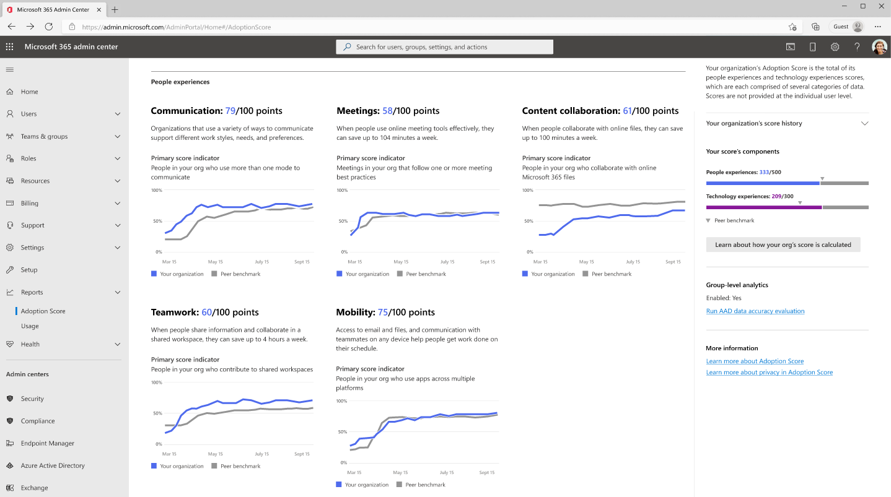
People experiences
Understand how your organization leverages recommended practices included in Microsoft 365
Drives focus on what to change
Assigns equal points across the categories
Time Trends extends data from 28 to 180 days
Quantifies how the organization
works
Notes:
Under people experiences we measure this across five people experience categories – Communication, Meetings, Content Collaboration, Teamwork and Mobility. We are looking to help you quantify how the organization is using Microsoft 365. Transform how users work across in a few different areas like content collaboration, mobility, communication, meetings, teamwork, and Time Trends.
People experiences in Adoption Score helps you, the IT admin or adoption specialist, understand how your organization leverages recommended practices included in Microsoft 365 and provides guidance on how to get the most out of your Microsoft 365 subscription. By providing insights about how your organization adopts Microsoft 365, users can be reminded about a recommended approach to use one or more products or features, backed by research that saves time and effort.
We realize that not everyone in your organization is going to do all the actions. For example, if you are looking at how the organization is collaborating on content and you have a lot of frontline workers on a factory floor, you might expect them to not be collaborating on content as that may not be part of their day-to-day work. Ultimately, we want to help you drive focus for what you want to change.
Each category will also contribute the same number of points to your score. We do this because we are not in a position to judge what categories are most important for your organization. We are trying to take a neutral position by making the points equal across all areas.
The time trends feature helps IT admins understand historical information about people experiences in their environment, extending organizational trend data from 28 days up to 180 days across Content collaboration, Meetings, Teamwork, Mobility, and Communication insight categories within people experiences.

Slide 20
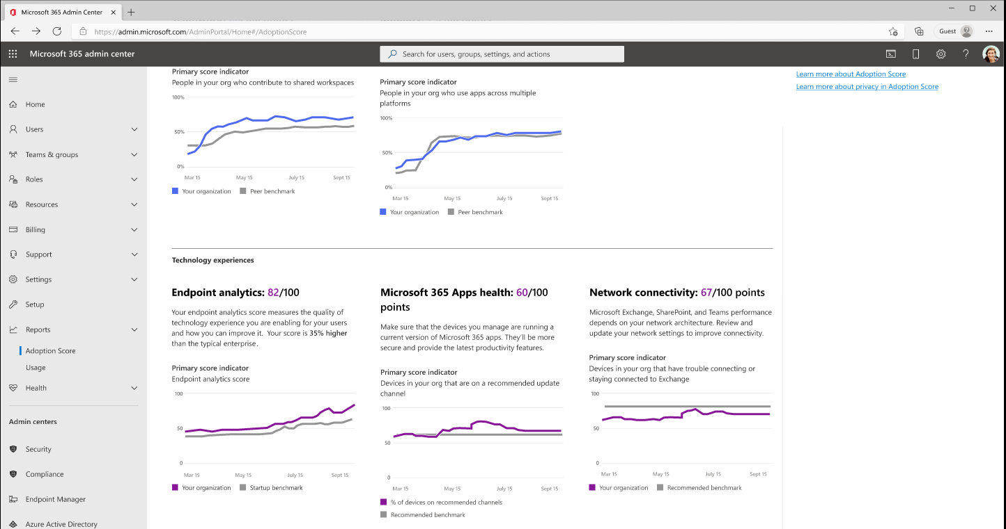
Technology experiences
Visibility into how user experience and digital transformation are impacted by underlying technology performance factors
Points assigned to each category individually, all of which contribute to total score
Up to 6 months of history
Quantifies how the technology in your environment is supporting your digital transformation
Notes:
Technology experiences focuses on providing insights and recommended actions around how well key technologies in your environment are enabling great people experiences and helping you achieve your digital transformation goals.
Factors are currently divided across three categories: Endpoint Analytics, Microsoft 365 Apps Health, and Network Connectivity. Factors such as network throughput and latency, PC boot times and app currency all contribute significantly but to varying degrees to people’s technology experience and the responsiveness of the apps the user works in. For example, we’ve all experienced how a PC that takes several minutes to boot up or poor network connectivity can affect our experience. From poor response to keyboard and mouse inputs to slow copy and paste operations, overtaxed system resources or a “slow” network can significantly affect customer satisfaction and the perception of IT.
Technology experiences factors are currently divided across three categories:
Endpoint Analytics
Network Connectivity
Microsoft 365 Apps Health
On the lower center part of the screen is where we show these categories, as well as a summary graphic of each category score over time.
Points are assigned across technology areas to produce three different scores, all of which contribute (along with people experiences score) to the total score (up to 6 months of history).
You can drill into each of the 3 cards for more detail. There, you’ll find insights and recommended actions that help you focus on areas for improvement. Technology experiences quantifies how the technology in your environment is supporting your digital transformation and enabling what’s measured in people experiences by helping you understand the impacts of underlying technology performance factors. It then uses these insights to suggest recommended actions you can take to make improvements and is invaluable for tracking progress on these improvement initiatives. Finally, and perhaps most importantly, the insights and actions surfaced within technology experiences can result in lower support costs, as costly help desk calls can often be avoided by addressing underlying issues.

Slide 21
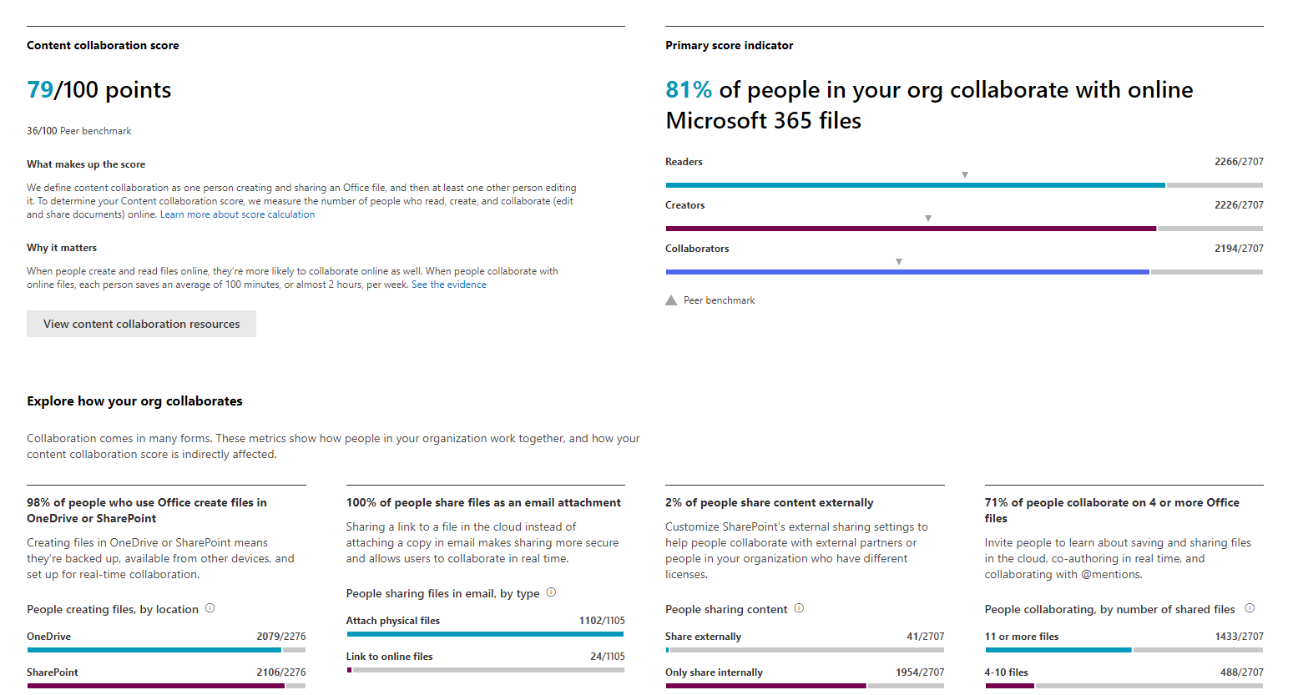
Peer benchmarking
Compare how you are doing compared to other organizations like you (size, region, tenure, industry)
Intended to be used as a broad indicator of progress
Does not show which Microsoft 365 workloads are enabled for other organizations
Research shows that when people share information and collaborate in a shared workspace, they can save up to four hours a week.
Notes:
You might have noticed that there are benchmarks for the scores, these help you compare how you are doing to other organizations like you. Having access to this information will help you set your own targets. We understand that it may take time to drive change in your score. Setting set interim targets to help you stay motivated to get the right score is a great idea.
Note: We include metrics from customers that don't have all workloads enabled (e.g. customers that use drobox instead of OneDrive), companies have different ways of working, and different workforce personas which also affects the score.

Slide 22
Insights
Create focus to drive workplace experiences
Notes:
[Identify where you can enable improved experiences] While it great that we give you visibility into where you are today and how you have progressed, we also understand that you are going to want advice on what you could do next and that is where the insights come in.

Slide 23
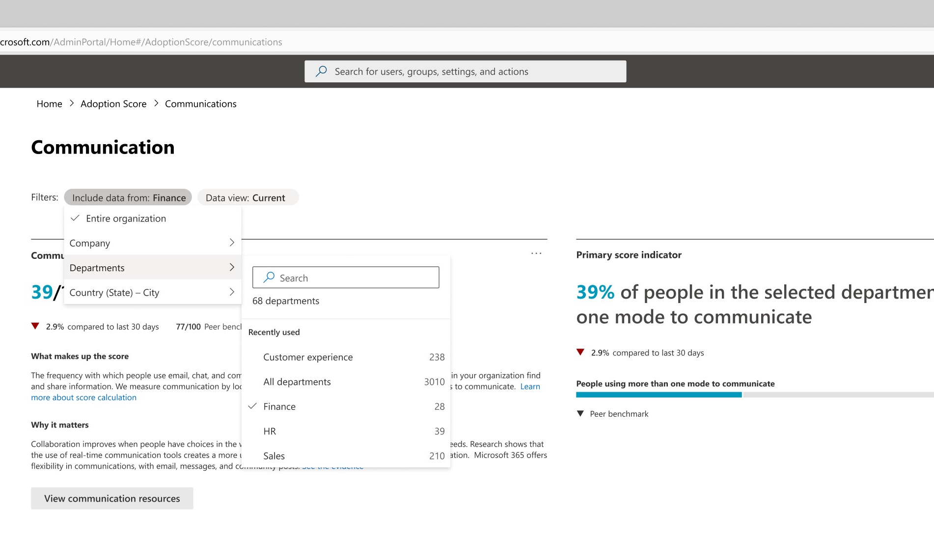
Group-level aggregates
Group-level aggregates enable IT admins and adoption specialists to filter by five Azure Active Directory attributes:
Company
Department
Country
State
City
Group level aggregates helps improve transparency on which areas of an organization are adopting recommended practices with Microsoft 365
Notes:
We understand that different parts of your organization have different needs and workstyles, group level aggregates help you to filter organizational data whilst respecting user-level privacy. To allow you to see nuances in each of your business groups in Adoption Score, we are adding group level aggregates to Communication, Content collaboration, and Mobility, with support for Meetings and Teamwork to follow. This functionality is separate from the messaging capability of Microsoft Viva Amplify, which supports leaders, corporate communications, and HR to effectively communicate at scale.
For group level aggregate information to be displayed, the capability must be enabled by a Global Administrator and a minimum of 10 users must be included in a group to help ensure that individual user data is not revealed, part of our ongoing commitment to user level privacy.

Slide 24
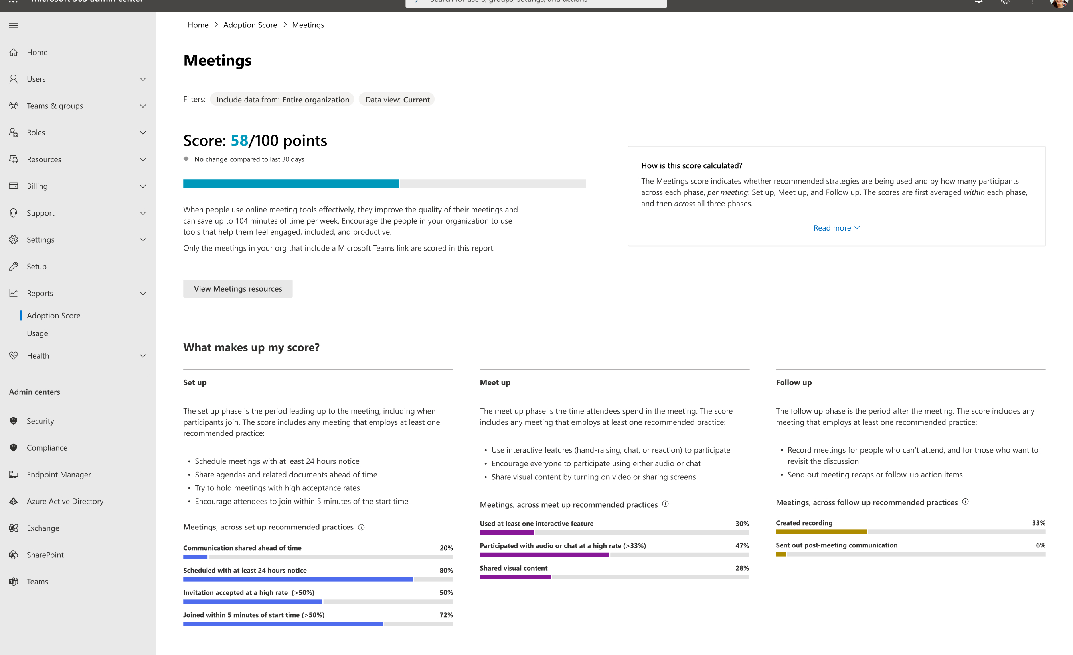
Improved meetings insights
Helps IT admins and adoption specialists understand what is working (and what isn’t)
Clearer visibility into recommended practices across the meeting experience
Recommendations on how to improve your meeting score, with insights to go deeper
Understand more about how your organization meets with improved meeting insights
Notes:
Meetings play a huge role in the hybrid world and can reflect user productivity. The number of meetings per week has increased by 153% globally for the average Microsoft Teams user since the start of the pandemic, and there is still no indication that this trend has reversed, suggesting this peak could become the new baseline.
To help IT admins and adoption specialists understand what is working (and what isn’t), we are releasing an updated Meetings page under People Experiences. The updated page shows insights into recommended practices across the meeting experience, from set-up to the meeting itself, to the critical post-meeting follow up. This is our first step to improving each people experience category in Adoption Score.

Slide 25
Actions
Improve outcomes while respecting user-level privacy
Notes:
[Adopt recommended practices and improve usage] Now that you understand what your organization could be doing to change how people work, what actions do you need to take to start that process?

Slide 26
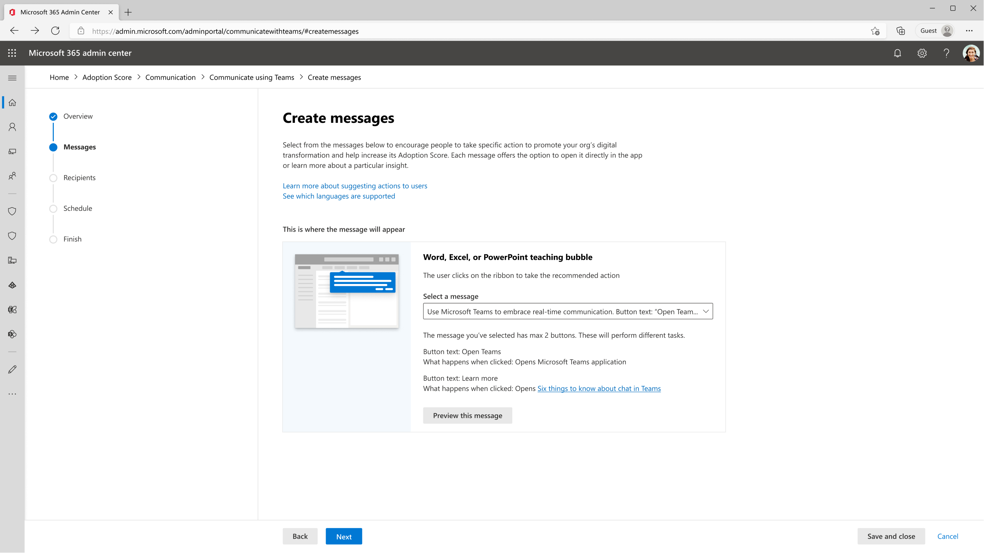
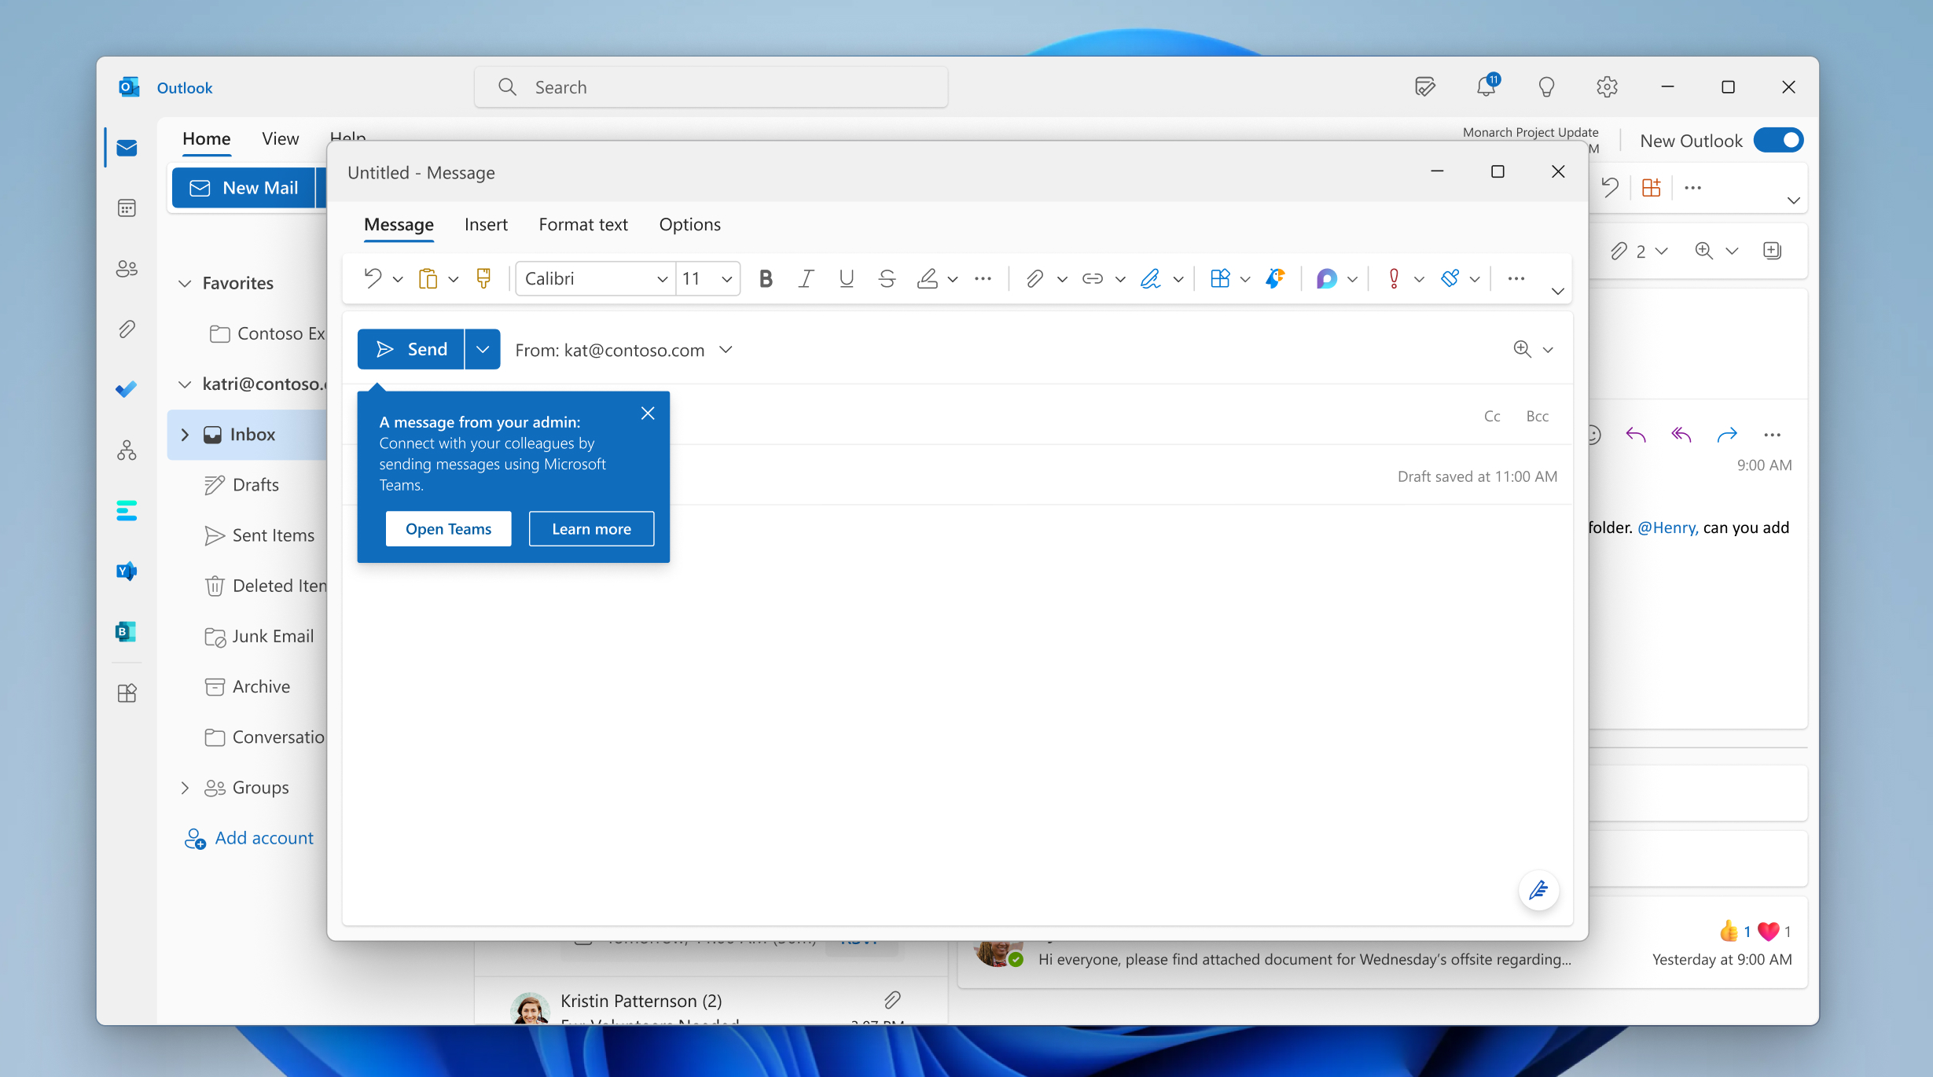
Organizational messages
Use data driven insights to encourage users to take action:
Create files in SharePoint or OneDrive
Email files with cloud attachments
Communicate using Teams
Use @mentions in Outlook
Use Outlook mobile
Use Teams mobile
Use templatized messages to promote usage and recommended practices in Microsoft 365
Notes:
To help IT admins and adoption specialists take action on both group and organizational insights, we are announcing organizational messages for Adoption Score. Organizational messages enable IT admins to deliver clear, actionable messages in product and in a targeted way, while maintaining user-level privacy. This functionality is separate from the messaging capability of Microsoft Viva Amplify, which supports leaders, corporate communications, and HR to effectively communicate at scale.
Organizational messages in Adoption Score use targeted in-product notifications to advise on Microsoft 365 recommended practices based on Adoption Score insights. Users can be reminded to use products that have recently been deployed, encouraged to try a product on a different surface, or recommend new ways of working such as using @mentions to improve response rates in communications. Templatized messages are delivered to users in their flow of work through surfaces including Outlook, Excel, PowerPoint and Word. Authorized professionals can use the organizational messages wizard in Adoption Score to choose from up to three templatized message types, define when and how often a message can be displayed, and exclude groups or priority accounts from receiving the message.
Organizations will now be able to act faster and smarter on these insights by delivering in-product communications through Organizational Messages, which help users adopt Microsoft 365 recommended practices and proactively address issues before they arise.

Slide 27
Demo

Slide 28

Adoption Score resources
Microsoft Adoption Score (https://aka.ms/adoptionscore)
Adoption Score Blog (https://aka.ms/AdoptionScore/Blog)
Microsoft 365 Adoption Homepage (https://adoption.microsoft.com/)
Adoption Score Overview Video (https://aka.ms/AdoptionScore/Overview)
Microsoft 365 Admin Center (https://admin.microsoft.com/)
Microsoft Experience insights (http://aka.ms/ExperienceInsights)
Notes:
This list of resources can help you take the next step on your journey to discover and use these new capabilities. Remember to check the Microsoft 365 public roadmap and message center in the Microsoft 365 admin center to confirm when new and planned capabilities will be released to your tenant. Thanks for taking the time to join us today to walk through these investments in the Microsoft 365 admin center, we’re excited for the role these capabilities will play in helping organizations get the most out of their investment in Microsoft 365 and we look forward to your feedback.

Slide 29
Community spotlight

Slide 30

Microsoft 365 Champion community stories
We want to highlight your story in future community calls! This is your opportunity to share with other Champions in this community. Format can be live in the call or a pre-recorded video.
We’d love to hear:
How you/your organization implemented Microsoft technologies
How you lead adoption and change management in your organization
How a Microsoft product improved your life or work culture
Or more!
Sign up at aka.ms/ChampionStory to share your experience!

Slide 31

Community spotlight:
Sean McEvoy – adopting Power Platform
Role: Dynamics 365 Admin/Business Application Specialist
Company: Aleron Inc – company size 7,500-10,000 employees
Fun fact: I am expecting my first born in May, a little boy named Oliver 🙂

Slide 32
Community events and updates
Upcoming events and community specific updates

Slide 33

Upcoming community events
M365 Community Days Women in Tech | March 3, 2023 | Virtual
Women in Cybersecurity (WICYS) | March 16-18, 2023 | Denver, Colorado
QCon London | March 27-29, 2023 | London, UK
NAB Show Centennial 2023 | April 15-19, 2023 | Las Vegas, Nevada
WebExpo 2023 | April 19-21, 2023 | Prague, Czech Republic
Commsvnext | April 25-26, 2023 | Denver, Colorado
Microsoft 365 Conference | May 2-4, 2023 | Las Vegas, Nevada
M365 Community Days | May 13, 2023 | Hybrid/ Phoenix, Arizona
CollabDays Poland 2023 | May 13, 2023 | Warsaw, Poland
European Collaboration Summit | May 22-24, 2023 | Dusseldorf, Germany
Thrive Conference | May 30-31, 2023| Lipica, Slovenia
365EDU Con | June 12-16, 2023 | Washington, DC
European Power Platform Conference | June 20-22, 2023 | Dublin, Ireland
Commsverse | June 21-23, 2023 | Mercedes-Benz World, UK
Explore other Microsoft events and a full list of community led events can be found at CommunityDays.org

Slide 34
Microsoft 365 Champion Community news
Next community call –
March 28, 2023
Top asks:
Complete our monthly call survey: https://aka.ms/Microsoft365ChampionCallFeedback
Participate in the Driving Adoption Community:
https://aka.ms/DrivingAdoption
Invite colleagues to join the Champion Program: https://aka.ms/M365Champions

Slide 35
Thanks for attending! We’d love your feedback on todays call and hear ways we can make future calls even better! https://aka.ms/Microsoft365ChampionCallFeedback
Microsoft 365 Champion Community
Learn more. Do more. Achieve more, together.
Now, let’s meet! Stay on to join our open discussion and feel free to come on video and off mute.

