Slide 1

We will begin the call at five minutes past the hour
Microsoft 365 Champion Community Call
April 2023
Microsoft 365 Champion Community
Learn more. Do more. Achieve more, together.

Slide 2
Microsoft 365 Champion Community
April 2023 Monthly Call
Microsoft Teams Customer Advocacy Group
Karuana Gatimu, Tiffany Lee, Jessie Hwang

Slide 3
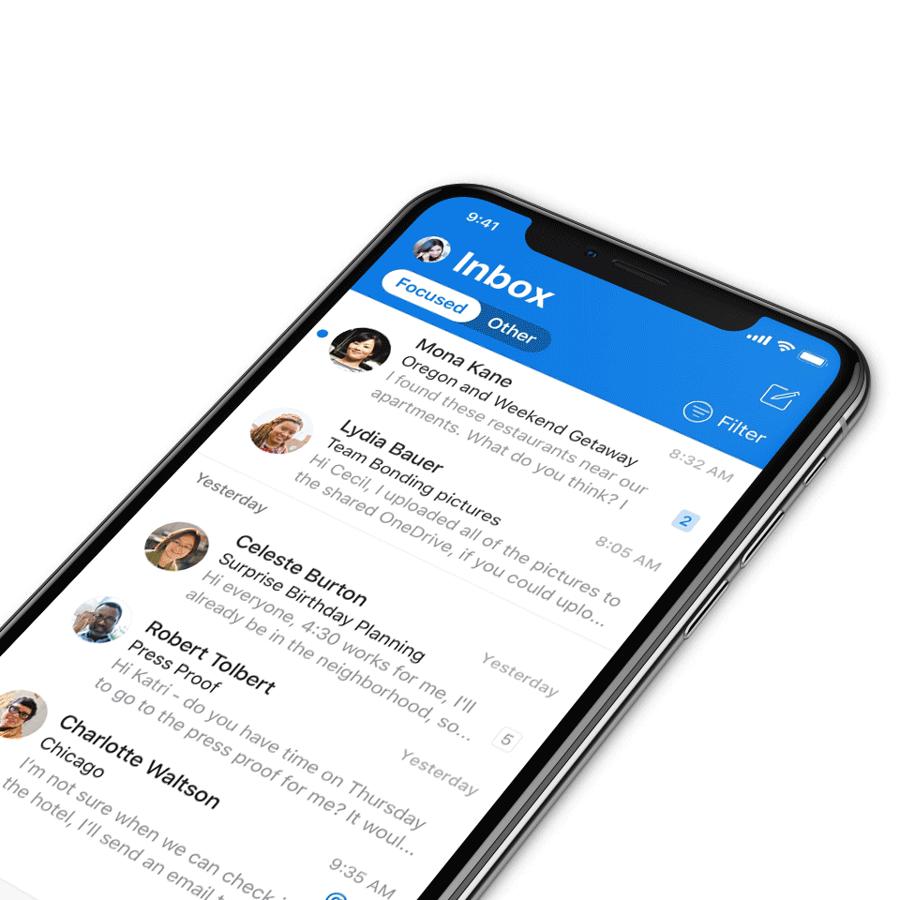
Digital Event Code of Conduct
Microsoft’s mission is to empower every person and every organization on the planet to achieve more. This includes all Microsoft events and gatherings, including on digital platforms, where we seek to create a respectful, friendly, fun and inclusive experience for all participants.​
We expect all digital event participants to uphold the principles of this Code of Conduct, which covers the main digital event and all related activities. We do not tolerate disruptive or disrespectful behavior, messages, images, or interactions by any party participant, in any form, at any aspect of the program including business and social activities, regardless of location.​
Microsoft will not tolerate harassment or discrimination based on age, ancestry, color, gender identity or expression, national origin, physical or mental disability, religion, sexual orientation, or any other characteristic protected by applicable local laws, regulations, and ordinances.​
We encourage everyone to assist in creating a welcoming and safe environment.
For more info, click here.

Slide 4

Agenda
Microsoft 365 updates | Top new features releases across Microsoft 365
Experience Insights | Amisha Bhatia
Community events & updates
Open discussion forum
Find resources from previous calls here:
https://aka.ms/M365ChampionResources

Slide 5


Core Conference: May 2-4
Workshops: April 30, May 1, May 5
$150 discount for customers with code: MSCUST150
Why attend?
Microsoft delivered content on hot topics –
3 Executive Keynotes, 60 sessions
Double click into recent announcements with a full AI content track
Additional tracks focused on Power Platform, Teams, Viva, ODSP and D&I
Poolside attendee networking party hosted by Jeff Teper
aka.ms/m365conf23 | #M365Conf

Slide 6
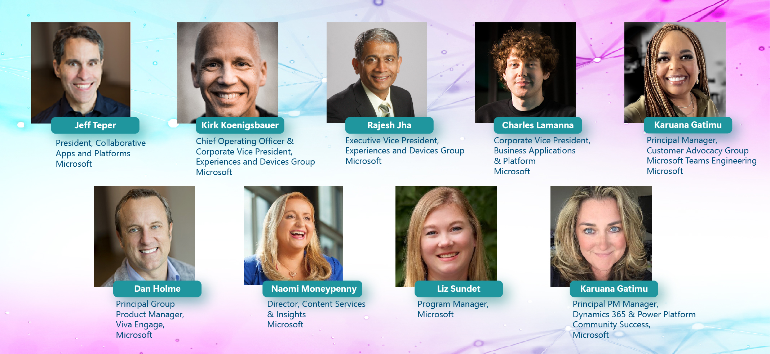
Heather Newman
Thousands of
Attendees
150
Sessions
50
Exhibitors
18
Workshops

Slide 7

Microsoft
Events
Register for Microsoft Build
Calling all developers! Connect with product experts, industry disruptors, and cutting-edge partners to share ideas to build the future.
This will be a hybrid event:
Held digitally on May 23-24
In person in Seattle, WA, on May 23-25
Register now for #MSBuild—made by and for developers at https://msft.it/60105Ijg6.

Slide 8
Microsoft 365 updates
Top new feature releases across Microsoft 365

Slide 9
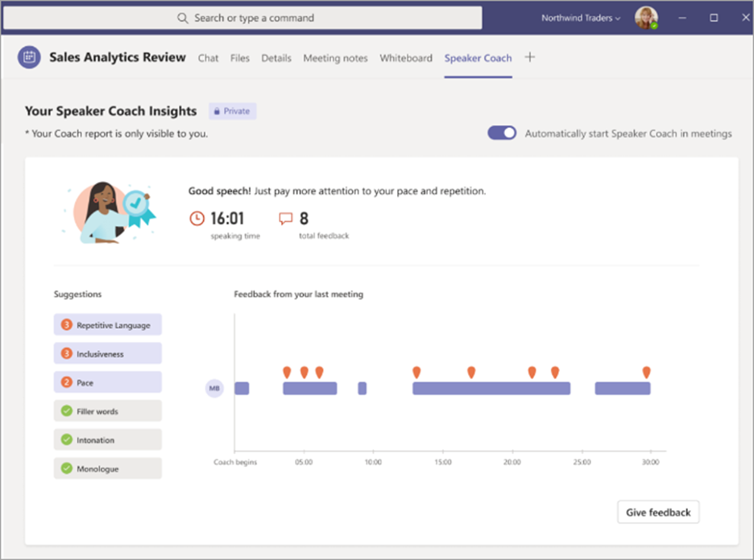
Microsoft
Teams
Speaker coach in Microsoft Teams meetings
Speaker Coach provides private, personalized feedback on your speaking and presentation skills in both real-time as well as post-meeting in a summary. Now available in preview. Live insights are only seen by you and are not saved in recorded meeting transcripts. Read more here.

Slide 10
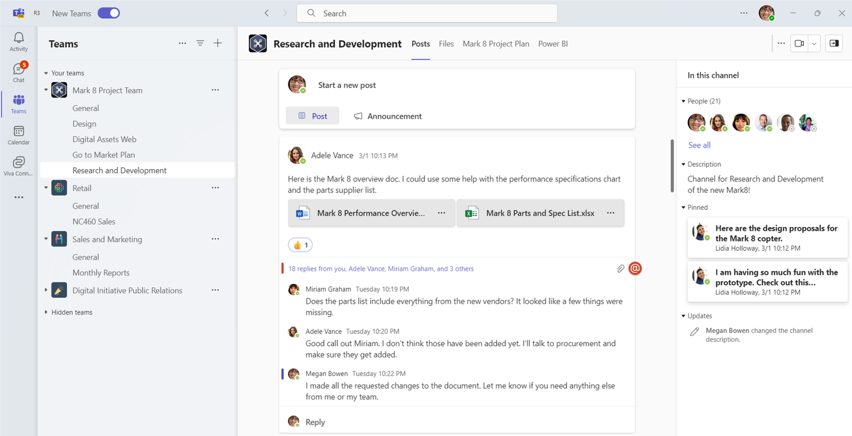
Microsoft
Teams
A new channel experience
The new Teams channel experience will be generally available in June and includes the following features:
The compose box and recent posts will appear at the top of the page. So now, it’s much easier to start a new post, keep up with the latest conversations and participate - giving you the confidence that they’ve not missed anything.
Every post is now a true conversation you can focus on. You can navigate to a conversation view that makes the discussion more engaging and synchronous, just like a chat. You can also pop out the post, keep an eye on the discussion, while continuing to work on other topics.
Click here to learn more of the upcoming features such as hashtags referring Viva Topics, streamlined information pane, pinned posts, and simplified badging.

Slide 11
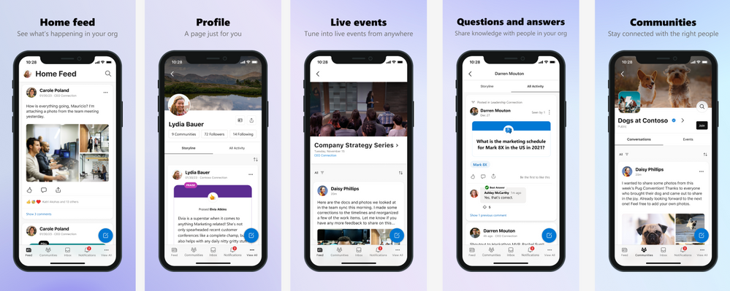
Microsoft
Viva
Introducing Viva Engage, now on iOS and Android!
We are excited to announce that the Yammer mobile app has now been rebranded as the Viva Engage mobile app! Following the Yammer Communities app in Teams and Outlook rebranding, our mobile app will now reflect the same to align Yammer more closely with our Viva suite of employee experiences
With Viva Engage on iOS and Android, you can:
Receive important messages and announcements
Discover communities and conversations happening across your network
Upload pictures and videos, directly from your photo album
React to messages and preview media right from the notifications
View Live Events while using other apps
Drag and drop across apps to easily compose messages
Click here to learn more!

Slide 12
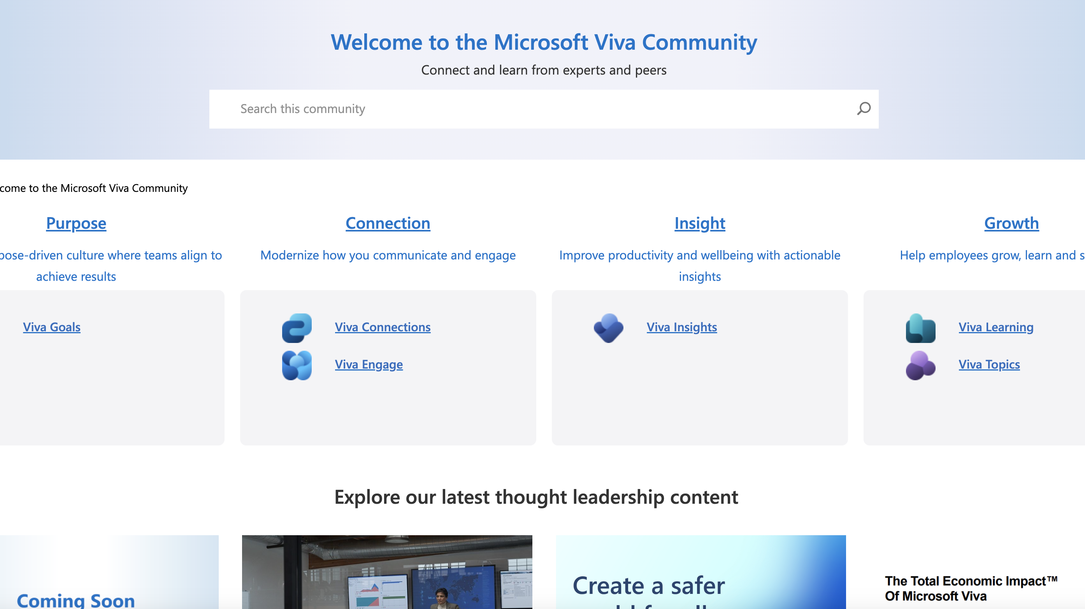
Viva Community launch
Part of the Microsoft Tech Community
A single destination for best practice guidance, conversation, content, support, and feedback around the strategy you're building and the problems your facing, as well as our products
The place for you to go when you're looking for the latest Viva events to attend so you can learn from experts
A space for peer-to-peer learning and getting questions answered from people in your same discipline area
The Viva Community launched on April 20, 2023, at the Viva Summit
#ProTip: Make a profile on the Tech Community so people can get to know you and your interests

Slide 13
Experience Insights
Amisha Bhatia

Slide 14

Agenda
Overview on Technology Decision influencers
Experience insights demo
Addressing new product evaluations
Q&A
Notes:
We’ll talk about a new category of roles that we’re targeting called Technology decision influencers, We’ll go through a demo of Experience insights which is the first experience targeted towards this new audience, and what we’re doing to help with new product evaluations, and leave plenty of time for Q&A

Slide 15



Technology Decision Influencers (TDIs)
A category of Business Strategy roles in IT who work on setting and/or influencing parts of the tech strategy for their organization. Often, there are many roles who need to work together.
In large enterprises, there’s often specialization into each role, but in smaller enterprises, a single person may fulfill several of these roles.
Tech Decision Influencers
Set the tech strategy to support business needs
Responsible for ensuring business value of tech investments
End users and BDMs
Utilize solutions to improve productivity
IT Admin
Deploy and configure solutions for safe and secure usage
Ensures smooth integration into existing stack
Provide feedback and request new software
Address needs through training and new IT solutions
Collaborate on feature rollout
TDIs may not be the power users of admin center and in many cases don't have access.
Notes:
With IT being tasked to do more, we see a new category of roles called Technology Decision Influencers or TDIs for short. These roles play a more business-strategy role in IT. While IT admins are doing the deployment and configurations for the Microsoft 365 service, TDIs are setting the tech strategy to support the business needs of the end users in their org.
They act as liaisons between the end users and IT where they are listening to user needs, finding solutions, and working with IT admins to implement those solutions for end users in their org. They are also responsible for measuring and driving success of the solutions they put in place.

Slide 16
TDI roles and responsibilities
 | TDI responsibilities
User experience | Understanding Microsoft 365 experience data to find opportunities, value
IT training | Training employees to use technology more efficiently
Adoption strategy | Setting the adoption strategy and rollout plan
Identifying business needs | Identifying product gaps or unmet needs
Staying current on tech | Keeping up to date on newly available and relevant tech
Starting trails/pilots | Evaluating new tech options and starting trials/pilots
Driving stakeholder signoff | Coordinating input/signoff across multiple stakeholders
New product evaluations | Assessing, trialing, and rolling out new tech to your org
Budgeting | Budgeting, cost optimization, license utilization
Small Ent.
2K-10K seats
Med. Ent.
10K-50K seats
Large Ent.
50k+ seats
Success Specialist
Product Owners / Managers
Product Owner / Manager
Product Owner / Manager
Success Specialist
First area of focus
Comms Specialist
Project Manager
IT Directors
POs/PMs are responsible for a subset of tools in the org
(e.g., communication tools, collab tools, security tools, etc.)
Notes:
We talked to a lot of customers to come with this core set of responsibilities for TDIs. They are on the hook for things like – understanding the user experience, IT training to make sure users are using tools efficiently, Setting the adoption strategy, identifying unmet business needs, staying abreast of new tech that could be leveraged for their org, evaluating new products/features through trials/pilots, working to drive stakeholder signoff on new initiatives, proposing a purchase decision and coordinating roll-out of features, and budgeting & cost optimization for IT tools
When we look at what kind of TDI roles complete these tasks, we see more stratification and specialization of roles as we move to larger enterprises.
In small enterprises, we see the product manager or product owner owning all of these tasks, as we go to medium enterprises, we start seeing a Success specialist form that manages the user experiences and IT Training, and as we go into the largest enterprises, we see multiple roles come about like comms/training specialists, Project Managers, and IT directors.
Additionally, there are typically multiple product owners in an org that are responsible for a specific area of the business-like communication tools or security tools. The tools that they support may straddle beyond Microsoft 365 as well.
Based on customer feedback, our first area of focus is on User experience and IT training as that is where we saw the biggest need to address urgently.

Slide 17
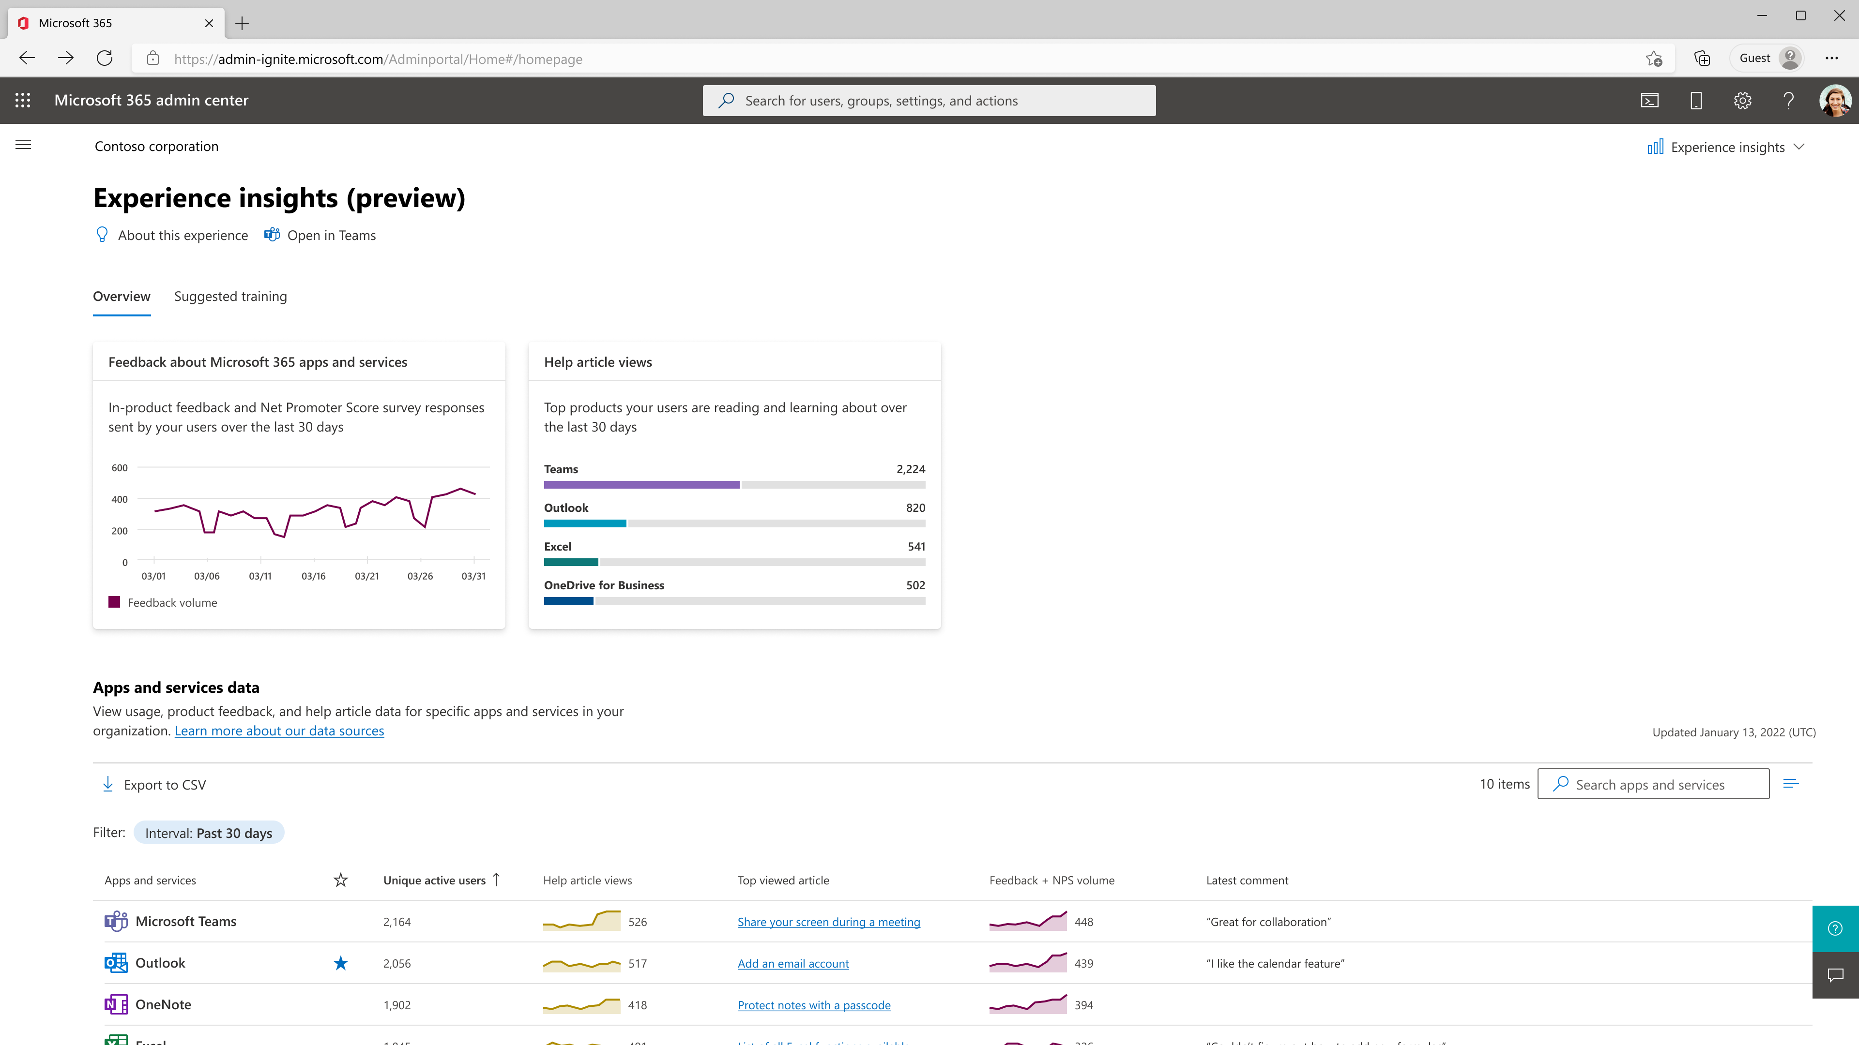
Introducing Experience insights (preview)
Dedicated experience
Built specifically for those responsible for driving a positive digital experience
Diverse data signals
Coalesces the relevant data signals and information into one at-a-glance view with the ability to deep dive
Custom training suggestions
Helps to identify areas in your org where more training may be needed
Maintains Microsoft’s privacy commitment to protecting user-level data
Notes:
To start to chip away at those first to areas of improving the user experience an IT training, we’ve built Experience insights in the Microsoft 365 Admin Center.
It’s a dedicated experience built specifically for those who are responsible for driving a positive digital experience in their org which we will build upon as we address more of the responsibilities you saw before.
It brings together diverse data signals across usage, feedback, NPS, and help article views for your org so that you can get an at-a glance view of user users’s experience with Microsoft 365 with the ability to deep dive into each of the metrics.
Since training is such a critical part of the strategy in driving a positive user experience, it also provides you with customized training suggestions for your org.
And very importantly, It upholds Microsoft’s privacy commitment in protecting user-level data and so all the data is aggregated at an org level.

Slide 18
Experience insights
Demo
Notes:
Let’s take a look at the experience!
Use Figma with slides as backup

Slide 19
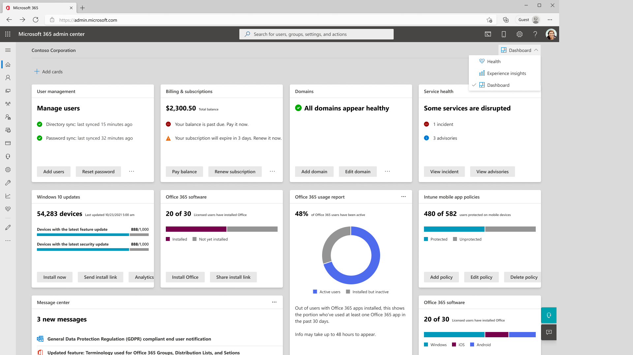
Availability
Option to opt in
Global admins
Global readers
Opted in by default
Reports readers
User experience success manager
You always have the option to toggle between views
In preview for organizations with >2,000 licenses
Notes:
As you saw in the demo, if you are a Global Admin or Global reader, you can use the dashboard switcher in the top right of the admin center to toggle into Experience insights. If you are Reports reader or a user experience success manager, you will be defaulted into the view.
No matter what, you can always switch between the different views whenever you choose.
The experience is currently in preview for customers with at least 2,000 licenses

Slide 20
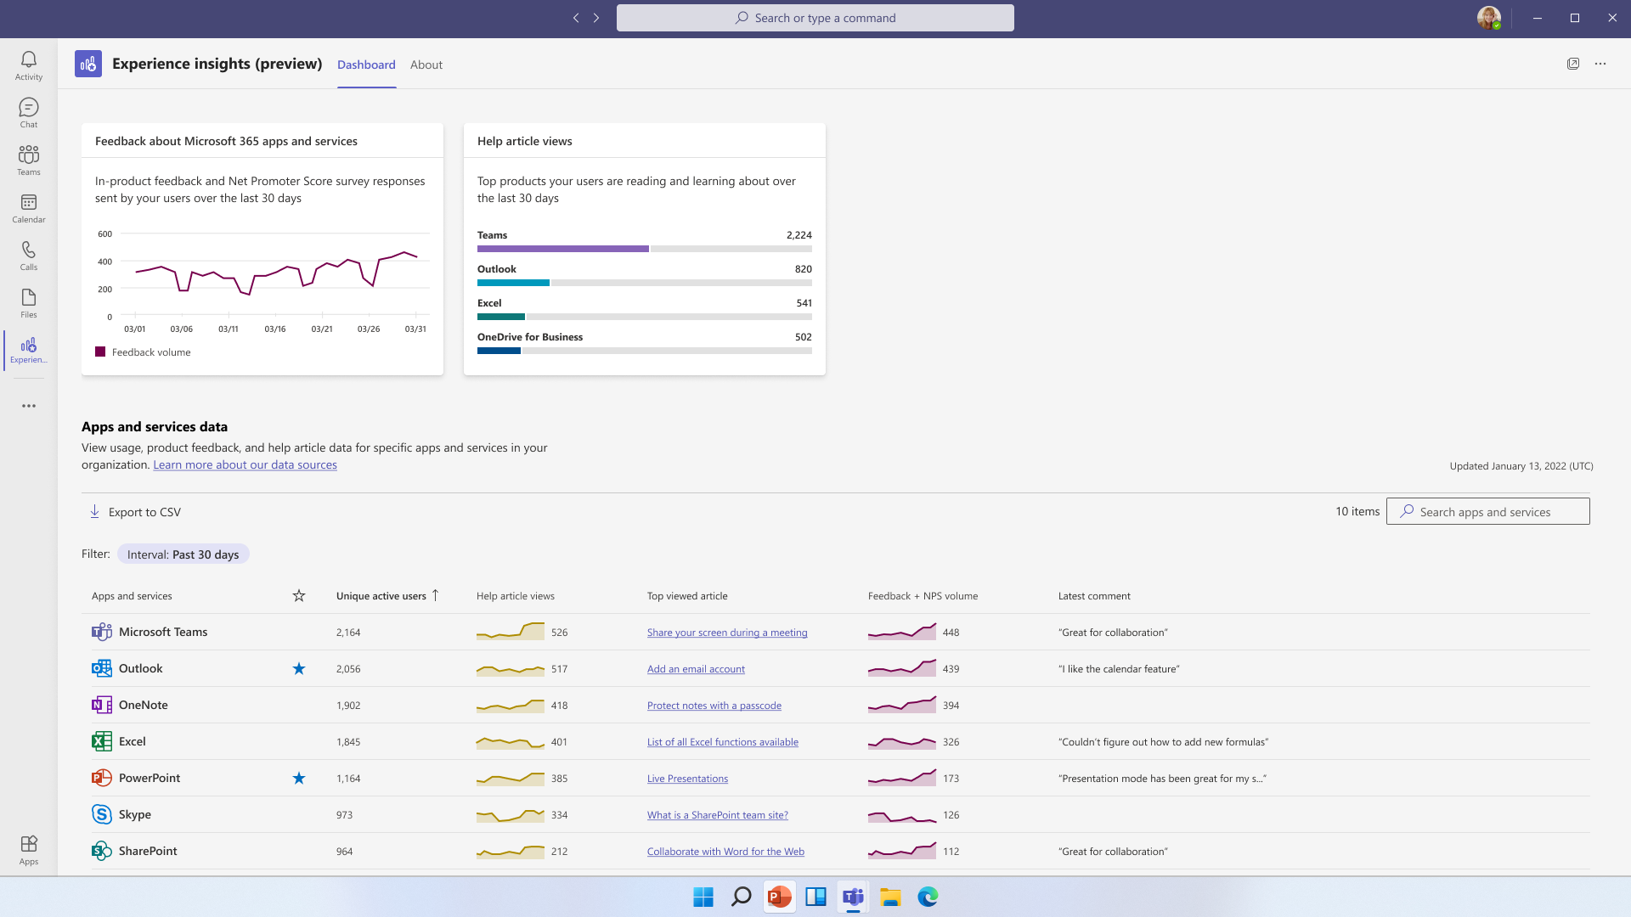
Unlocking access
New Azure AD role
New “User experience success manager” role provides access to relevant signal
Provides org-level data
Microsoft Teams app
Additional place to access the experience
More accessible for those not currently performing traditional IT admin tasks
Notes:
We know many people with these responsibilities don’t have access to the Microsoft 365 admin center. To combat this problem, we’ve done 2 things:
First, we’ve created a new Azure AD role called user experience success manager to provides access to Experience insights and relevant resources only like message Center, service Health, And Adoption score, among other resources. The data again is only at an org level across all resources to maintain user privacy.
Additionally, as you saw in the demo, we created a Teams app as another place to access the experience. Specifically for those who are not used coming to the admin center, this brings the data more in the flow of their work making it more easily accessible.

Slide 21
Q&A
Notes:
Before we get into the next topic, I wanted to quickly pause and see if there are any questions or feedback on the experience.
Questions to seed if no response: Are there specific actions you want to be able to take? Are there other data points that you’d like to see included? How would your org use this data? Do the set of roles/responsibilities that we went through resonate with your org or anything you would add or change?

Slide 22
Discover new technologies for your organization

Slide 23
Coming back to TDI core responsibilities
 | TDI responsibilities
User experience | Understanding Microsoft 365 experience data to find opportunities, value
IT training | Training employees to use technology more efficiently
Adoption strategy | Setting the adoption strategy and rollout plan
Identifying business needs | Identifying product gaps or unmet needs
Staying current on tech | Keeping up to date on newly available and relevant tech
Starting trails/pilots | Evaluating new tech options and starting trials/pilots
Driving stakeholder signoff | Coordinating input/signoff across multiple stakeholders
New product evaluations | Assessing, trialing, and rolling out new tech to your org
Budgeting | Budgeting, cost optimization, license utilization
Small Ent.
2K-10K seats
Med. Ent.
10K-50K seats
Large Ent.
50k+ seats
Success Specialist
Product Owners / Managers
Product Owner / Manager
Product Owner / Manager
Success Specialist
Comms Specialist
Project Manager
IT Directors
Notes:
Coming back to the TDI responsibilities, the next set we are focusing on are those related to identifying new business needs, staying current on relevant tech, driving trials and pilots along with stakeholder signoff and new product evaluations.

Slide 24
New product/feature evaluation process
New product/feature investigations often start one of two ways: users in the business come to IT with a request or IT finds an unmet business need or way to optimize the experience
New product
investigation
Try it within
my own team
Try it with
“friendlies” in IT
Try with “friendlies” in relevant business units
Final decision
is made
Evaluation criteria
Data governance, security, privacy, compliance
Cost
Competing product analysis
Product value
Support/training documentation
Setup/management complexity
Decision criteria
Does it work well?
Do we think it solves the problem?
Is it going to be easy to use, setup, manage support, manage?
Is it compatible with the rest of the environment?
Decision criteria
Does it work well?
Do we think it solves the problem?
Are there any ‘gotchas’?
Decision criteria
Does the product solve the business need?
Do they like it?
Final decision criteria
Feedback – did it solve the need well?
Usage – what features were used the most?
Cost – how much does it cost and how does it compare to other similar products (for new products only)?
ROI
Notes:
When a new product or feature is being evaluated, they often come about in 1 of 2 ways: Either users in the business groups come to IT with a new request or IT finds an unmet business need and way to optimize the experience for users. More often than not we’ve heard that users come to the IT groups as a starting point.
The process to evaluate a new product or feature then looks like this. Some steps may be skipped or fasttracked depending on the type of product or feature it is.
First, The product is looked at from a data governance, security, privacy, and compliance standpoint as well as cost and often times if it doesn’t meet the requirements the evaluation doesn’t proceed forward. Then they look at aspects like competing products, product value, what kind of support and training documentation is available, and what the setup and management complexity is going to be.
From there, its tried with a small set of folks in their own IT team and they look for things like if it is working well, is it going to solve the problem, is it going to be easy to set up and manage, and is it compatible with the rest of the vinvoment.
Then, it goes to broader set of folks within IT to see if it is going to solve the problem and if there are any other gotchas.
Then it is tried with friendlies within the relevant business units where the main criteria is does it solve the need and do users like using it.
Once those steps are completed a final decision is made where Feedback from the business units holds a lot of weight. Also looking at metrics like what features were used the most and cost are then put together to come up with the final decision.
Next we’re going to talk about the very firs tsteps we are taking to optimize parts of this process.

Slide 25



We’ve heard from customers that…
It’s important to stay up
to date on the latest technologies
They need help understanding when there are new or emerging business needs
They would like more visibility into new Microsoft 365 products users are using
Notes:
What we’ve heard so far is that it’s super important to stay abreast of what latest technologies are available that are relevant for your org, it’s really hard garner where there are new or emerging business needs for your org, and that you’d like more visibility into the new Microsoft 365 products that are being used within your org so that you can stay ahead of the curve.

Slide 26
Step 1: Discovery of new technology
Our first steps in optimizing this process for IT teams
Notes:
The first step we started with is first making sure that TDIs are aware of new Microsoft 365 technology available to them. The first product we’re starting out with is Microsoft Project. Let’s take a look

Slide 27
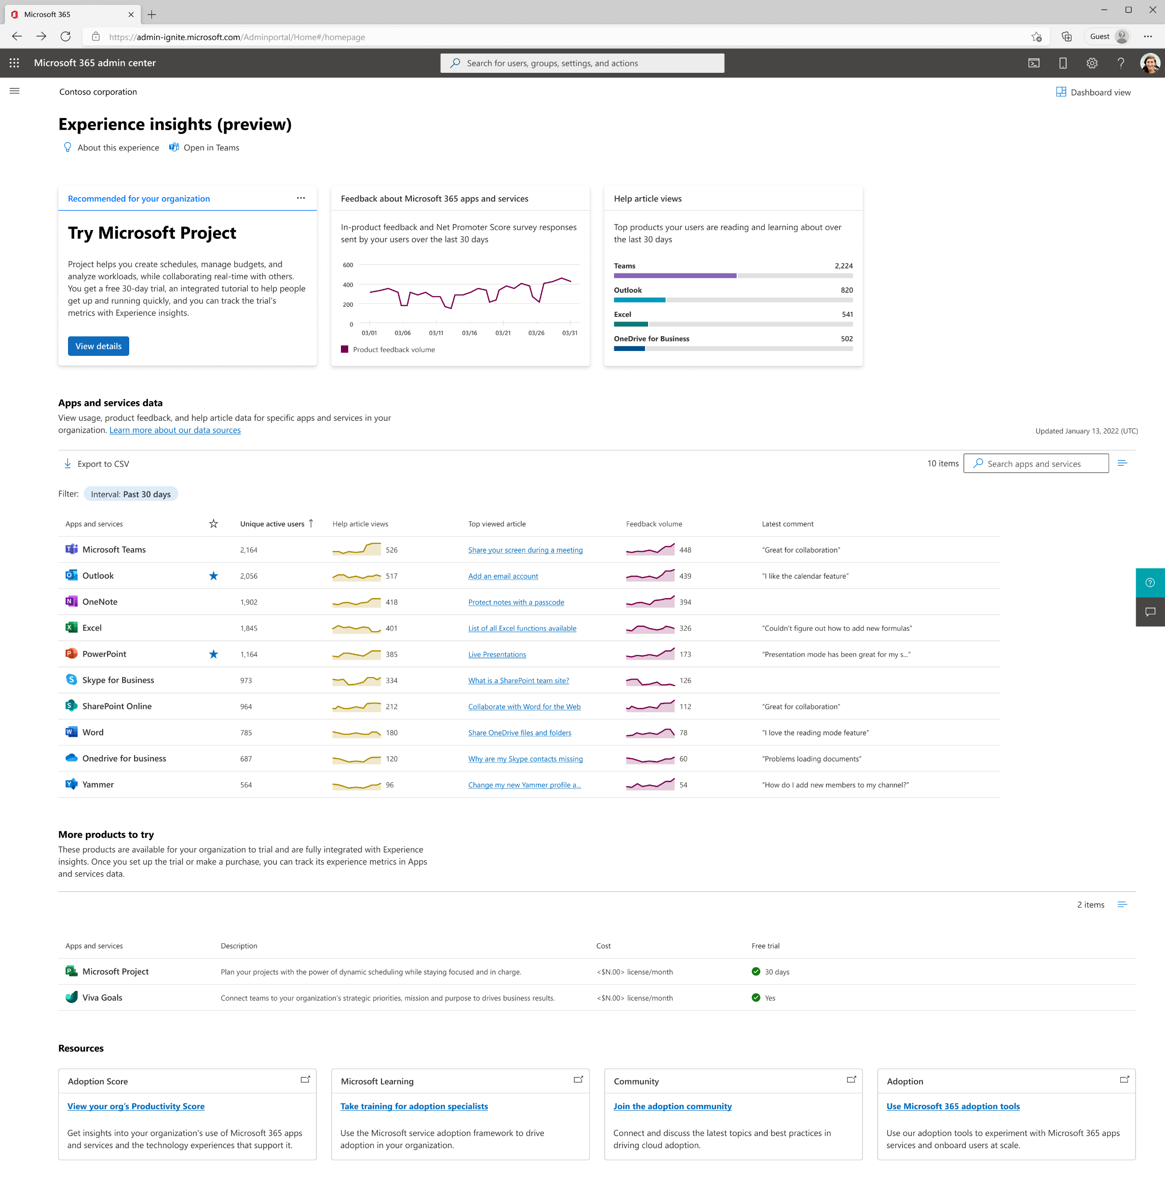

Easier discovery of new technologies in the Microsoft 365 admin center for TDIs
Recommended for your organization
Try Microsoft Project
Project helps you create schedules, manage budgets, and analyze workloads, while collaborating real-time with others. You get a free 30-day trial, an integrated tutorial to help people get up and running quickly, and you can track the trial’s metrics with Experience insights.
Brings front and center when a new product has been added to the list
View details
Highlights a separate list of additional products you can try
More products to try
These products are available for your organization to trial and are fully integrated with Experience insights. Once you set up the trial or make a purchase, you can track its experience metrics in Apps and services data.
Notes:
In Experience insights, you can see that we’ve added front and center when Project is available for your organization to try out. We’ve also added a More products to try sections so that you can keep a pulse on some of the new products that Microsoft is coming out with.
If you click on the product, we provide you with product details that allow you to assess the product and learn more. You can also download the contents of this pane so that you can share them with other stakeholders in your org who may not have access to the Microsoft 365 Admin Center.

Slide 28
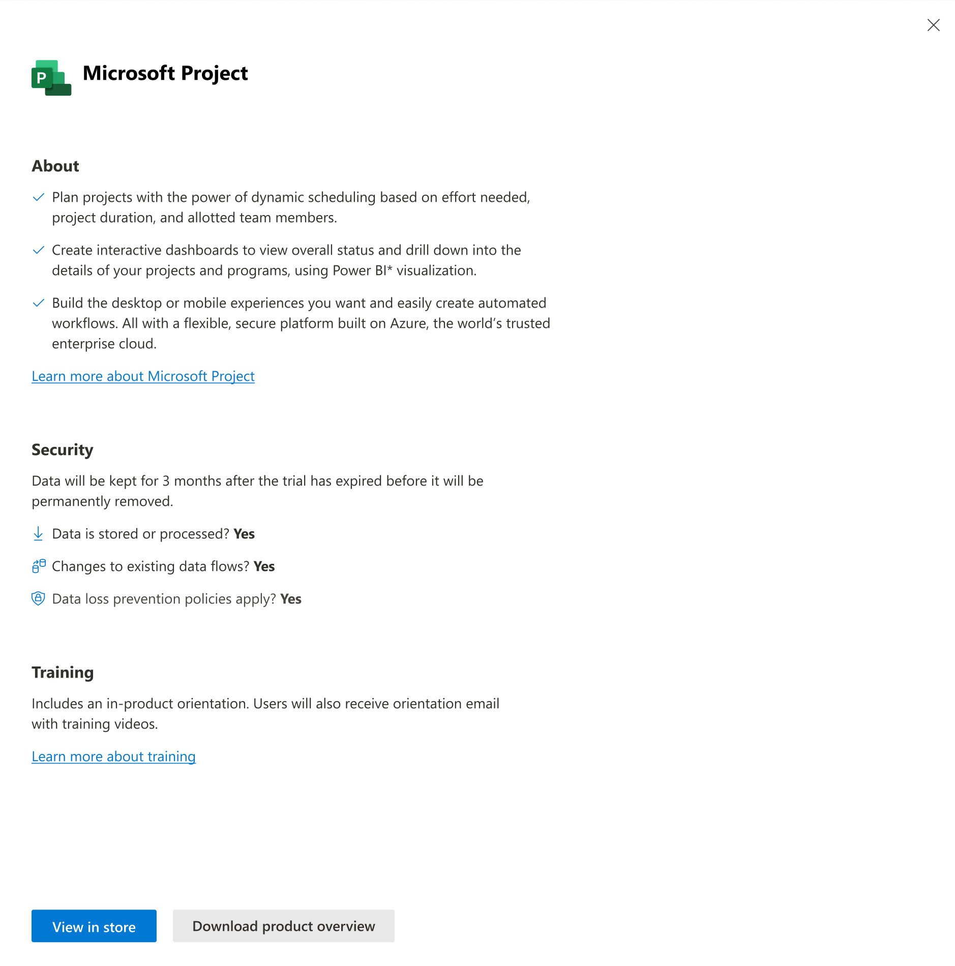

Experience insights (preview) dashboard with Microsoft Project product pane

Slide 29
Step 2: Trial initiation & Discovery of new business needs
Our first steps in optimizing this process for IT teams
Notes:
Next, we’re making it easier for IT to stay on top of new technologies that end users are trying out.

Slide 30
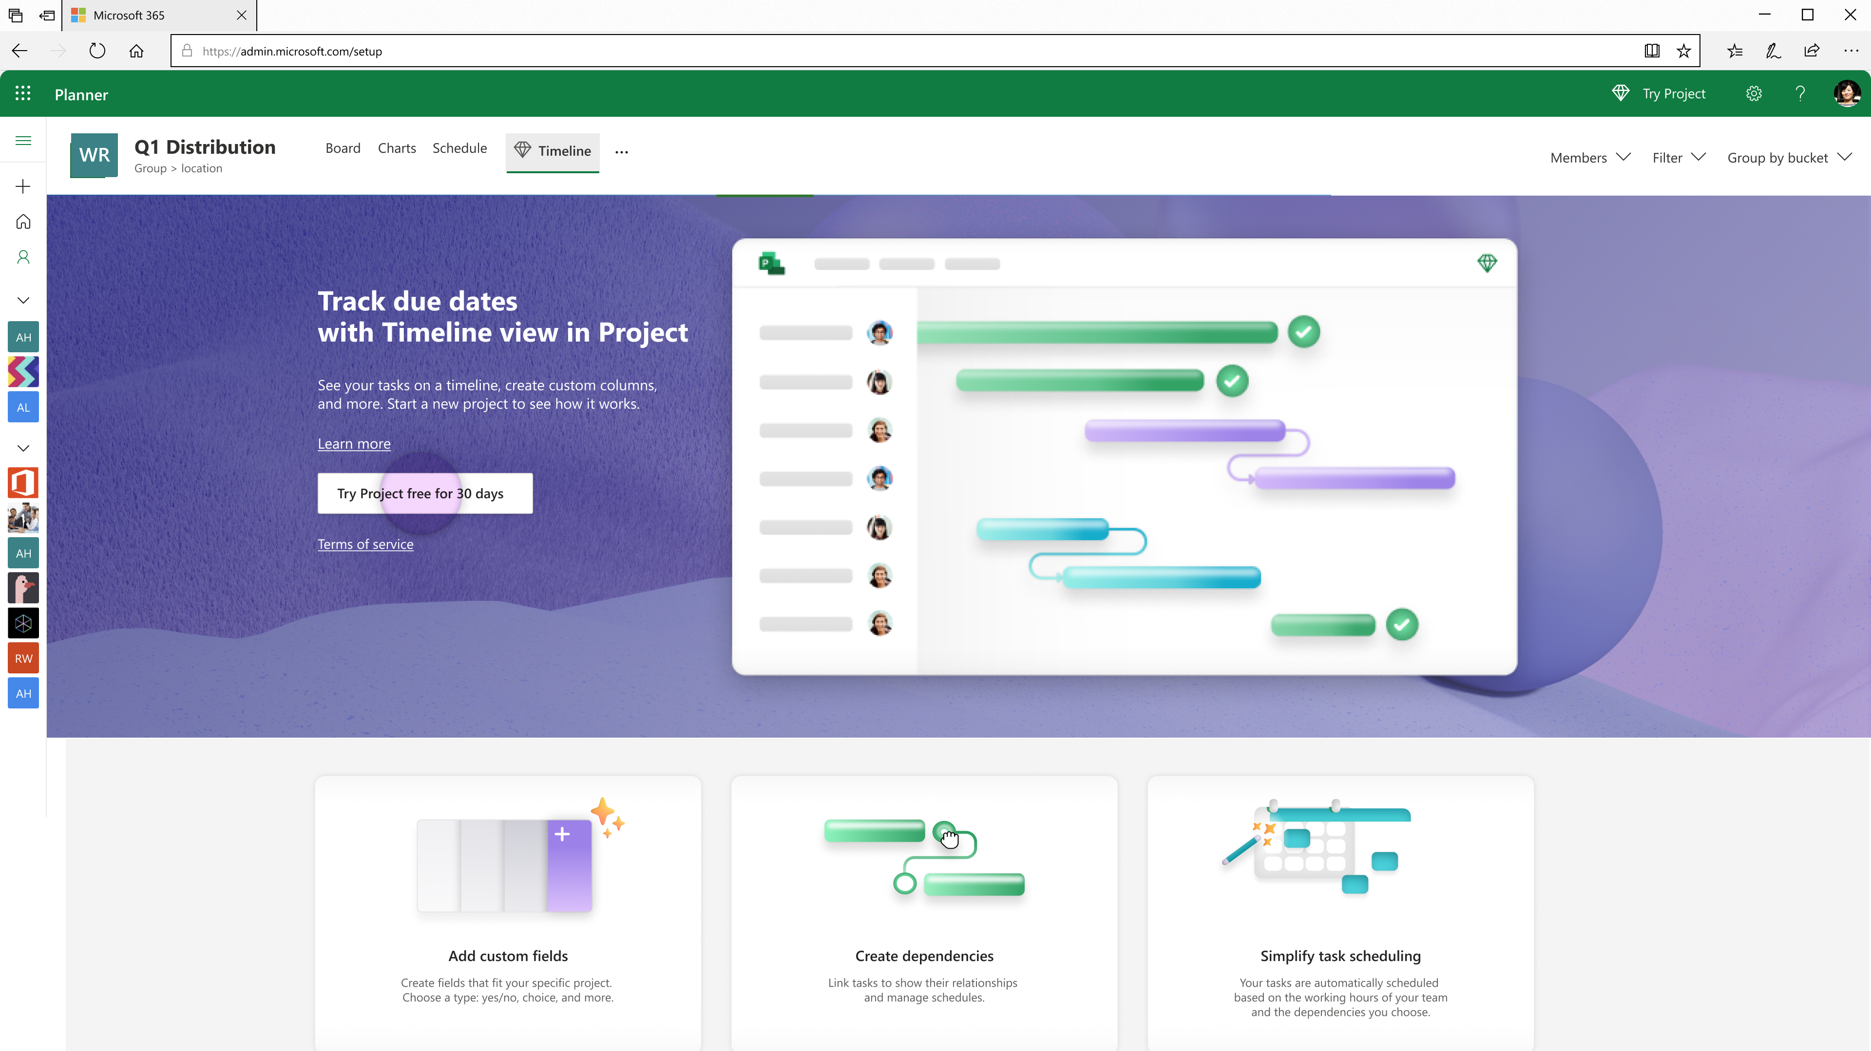
Users can start a self-service trial (if enabled)
From within Project, users can start a trial for Project if self-service trials are enabled for your organization
Try Project free for 30 days
Notes:
In the case of Project, users can start a trial of project within the product itself if the ability fo end users trials is turned on for your organization.

Slide 31
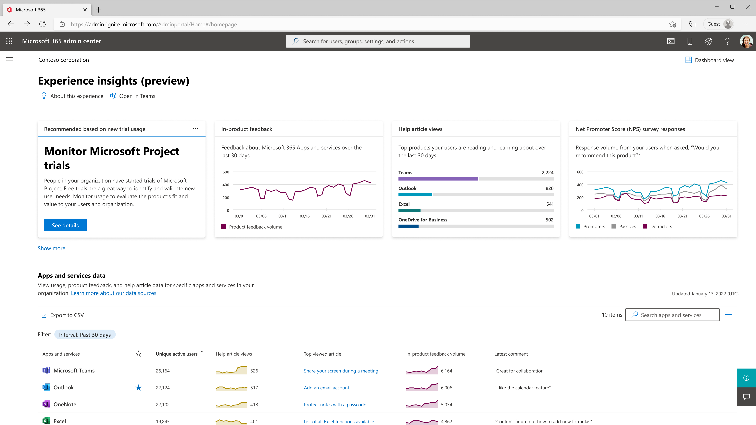
IT is notified if a new trial is started by users in the org
IT Admins & TDIs are notified if a new Project trial is started to so that they can identify new business needs and keep an eye on new technology needs
Recommended based on new trial usage
Monitor Microsoft Project trials
People in your organization have started trials of Microsoft Project. Free trials are a great way to identify and validate new user needs. Monitor usage to evaluate the product’s fit and value to your users and organization.
See details
Notes:
And if users go through that channel, IT is then notified that there is new usage of Project in their organization. This can help IT stay on top of new or emerging business needs and new technology that may need to be evaluated.

Slide 32
Step 3: Signals to evaluate the trial
Our first steps in optimizing this process for IT teams
Notes:
Finally, we’re starting to help you understand how the trial is performing.

Slide 33
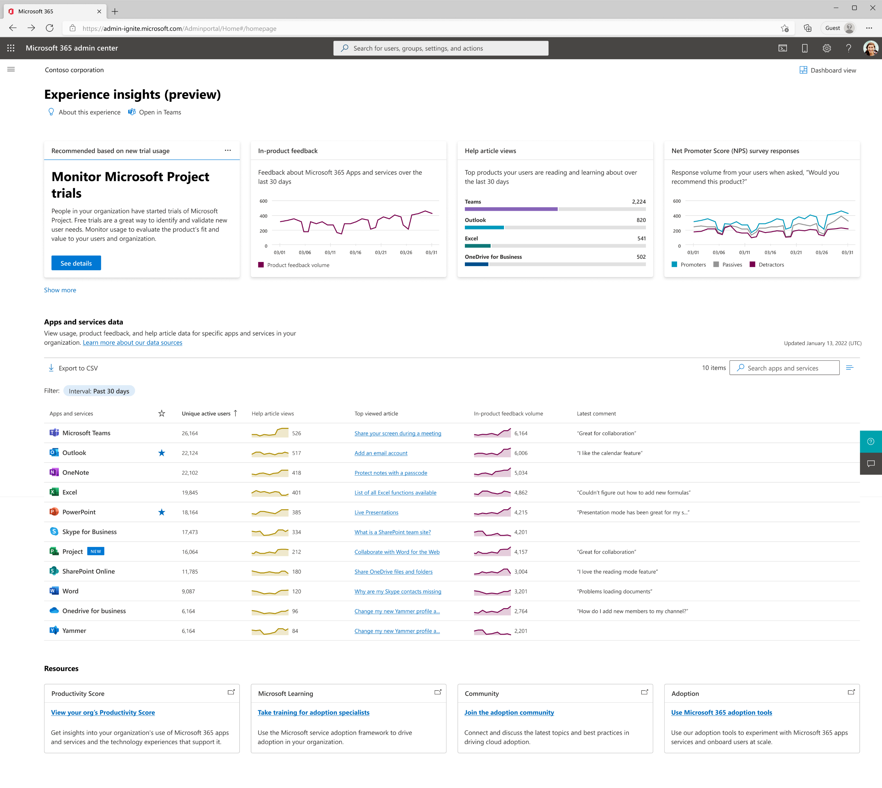
Monitor Experience insights data to evaluate how the trial is going
Notes:
For this new Product, you can see all of the Experience insights data around usage, feedback, NPS, and help articles to see how the trial is doing, how many people are using it, what users are saying about it, and where they may need help.

Slide 34
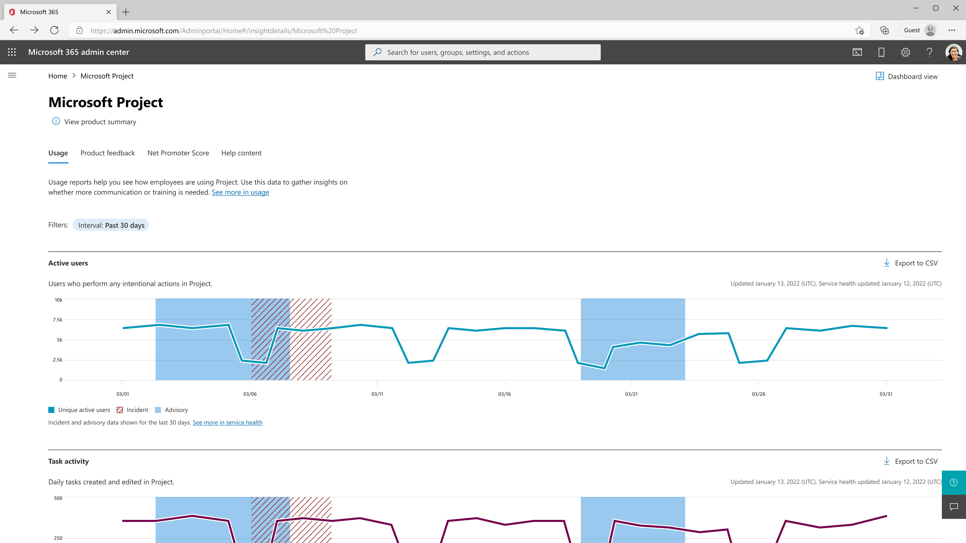
Microsoft Project usage reports
Notes:
Again you can deep dive into each of the signals to get a deeper view into the usage, sentiment, and help article data.

Slide 35
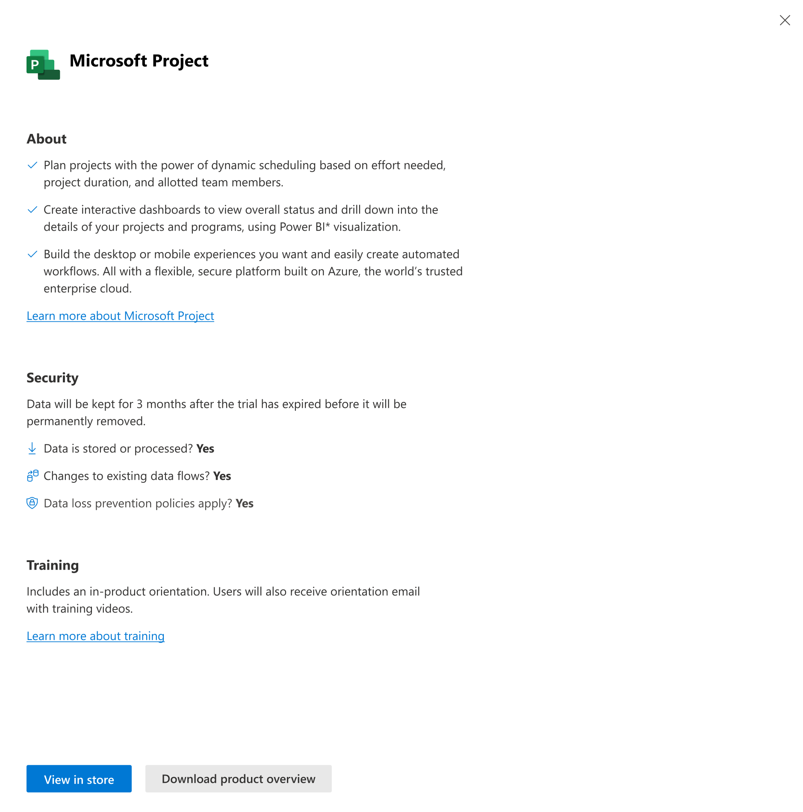
Microsoft Project: About, Security, and Training

Slide 36
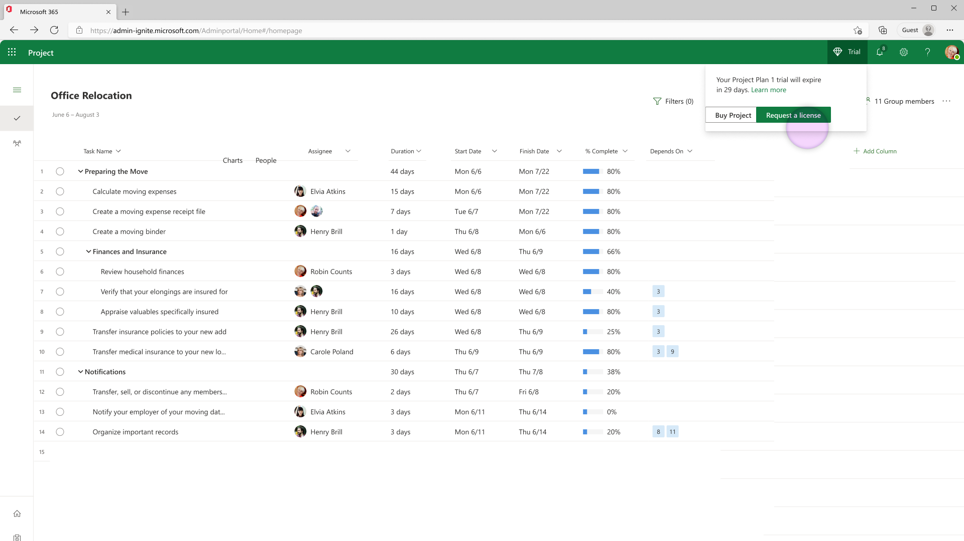
Users can request a license if things went well
From within the product during the trial, users can request a full license if the product is meeting their needs
Request a license
Notes:
If users are liking the trial, they can request a full license to project from within the product.

Slide 37
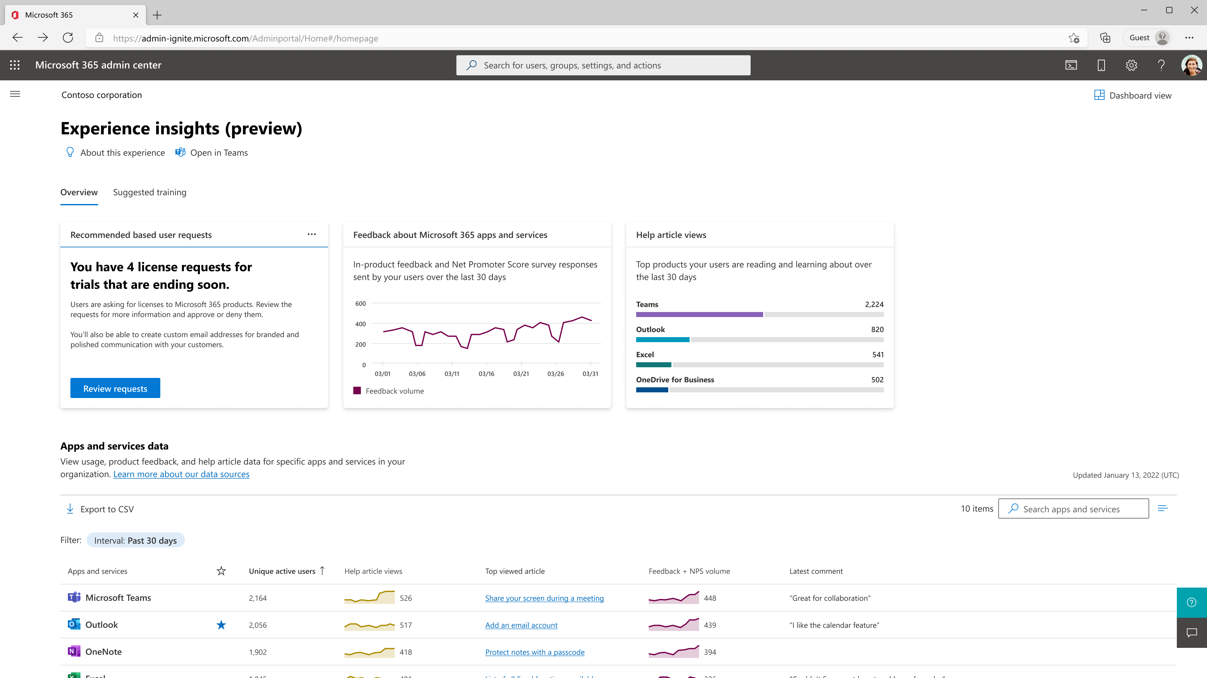
IT is notified of new license requests
IT Admins & TDIs are notified if there are new license requests which provides IT with a strong signal on product success
Recommended based on user requests
You have 4 license requests for trials that are ending soon.
Users are asking for licenses to Microsoft 365 products. Review the requests for more information and approve or deny them.
You’ll also be able to create custom email addresses for branded and polished communication with your customers.
Review requests
Notes:
Doing so, again notifies IT in Experience insights that there are new license requests for the org. This can give a strong signal if users liked the trial or not as you prepare your final decision on the product.

Slide 38
Summary and key takeaways
The Microsoft 365 admin center is expanding to support Technology Decision Influencers (TDIs)
Experience insights is the first dashboard designed for TDIs
Available for orgs with >2K licenses in the M365 admin center
Try it out and give us feedback!
We’re making the process to understand, evaluate, and discover new technology easier for TDIs
Notes:
So in summary, The Microsoft 365 Admin Center is expanding to support TDIs and their core responsibilities.
Checkout Experience insights which is the first dashboard designed for TDIs. Again itss available for orgs with over 2000 licenses. Don’t forget to give us feedback so we know what you like what you want to see improved!
And lastly, we’re invested in making the process to discover, try, and evaluate new technologies easier for TDIs and you’ll see that come through in Experience insights as well
With that, I’ll open it up for more Q&A

Slide 39

Upcoming community events
CommsvNext | April 25-26, 2023 | Denver, Colorado
Get-CsLATAM Conference | April 27-28, 2023 | Mexico City, Mexico
Microsoft 365 Conference | May 2-4, 2023 | Las Vegas, Nevada
CollabDays Poland 2023 | May 13, 2023 | Warsaw, Poland
European Collaboration Summit | May 22-24, 2023 | Dusseldorf, Germany
Thrive Conference | May 30-31, 2023 | Lipica, Slovenia
365EDU Con | June 12-16, 2023 | Washington, D.C.
European Power Platform Conference | June 20-22, 2023 | Dublin, Ireland
Commsverse | June 21-23, 2023 | Mercedes-Benz World, UK
South Coast Summit | October 13-14, 2023 | Farnborough, UK
M365 Community Days | November 4, 2023 | Hybrid/Phoenix, Arizona
Explore other Microsoft events and a full list of community led events can be found at CommunityDays.org

Slide 40
Microsoft 365 Champion Community news
See you at our next community call!
Date: May 23, 2023
Topic: Group Level Aggregates and Organizational Messages in Adoption Score and Community Spotlight
Top asks:
Complete our monthly call survey: https://aka.ms/Microsoft365ChampionCallFeedback
Participate in the Driving Adoption Community:
https://aka.ms/DrivingAdoption
Invite colleagues to join the Champion Program: https://aka.ms/M365Champions

Slide 41
Thanks for attending! We’d love your feedback on today’s call and hear ways we can make future calls even better! https://aka.ms/Microsoft365ChampionCallFeedback
Microsoft 365 Champion Community
Learn more. Do more. Achieve more, together.
Now, let’s meet! Stay on to join our open discussion and feel free to come on video and off mute.

