Slide 1

We will get started shortly!
Microsoft 365 Champion Community Call
July 26, 2022
Microsoft 365 Champion Community
Learn more. Do more. Achieve more, together.

Slide 2
Microsoft 365 Champion Community
July 2022 Monthly Call
Microsoft Teams Customer Advocacy Group
Karuana Gatimu, Josh Leporati, Jessie Hwang, Tiffany Lee

Slide 3
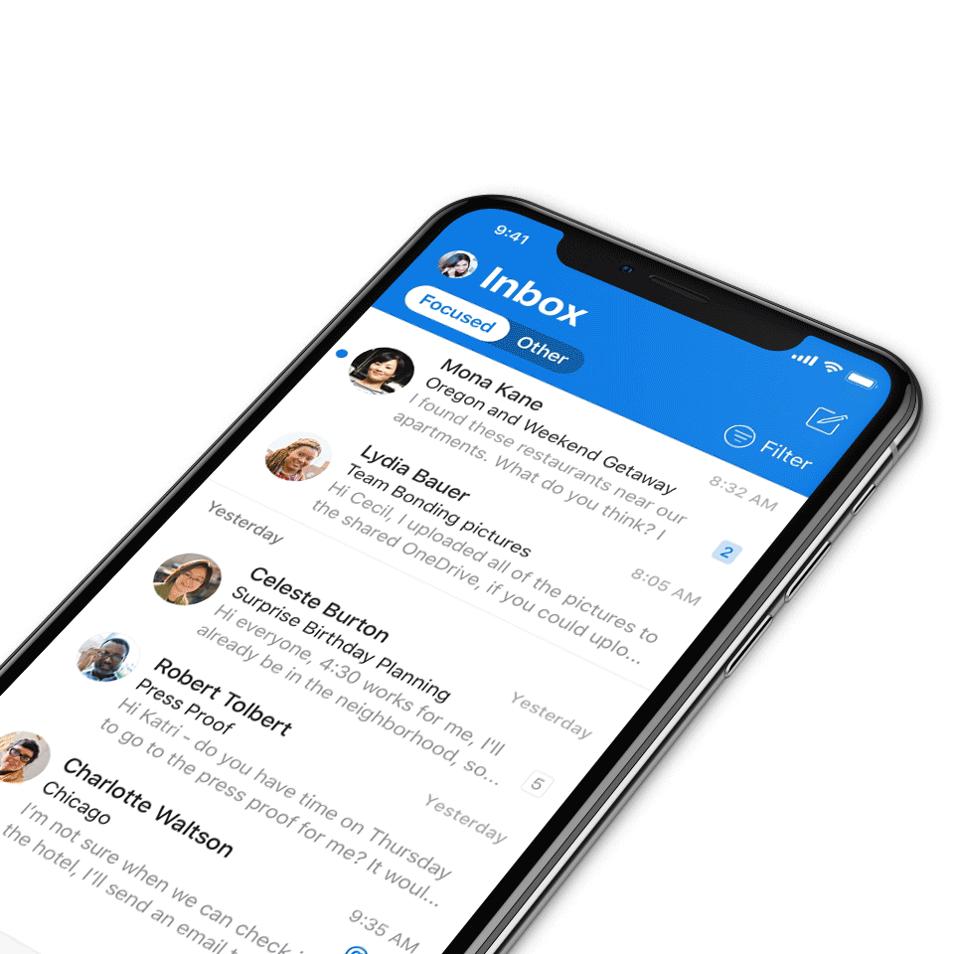
Digital Event Code of Conduct
Microsoft’s mission is to empower every person and every organization on the planet to achieve more. This includes all Microsoft events and gatherings, including on digital platforms, where we seek to create a respectful, friendly, fun and inclusive experience for all participants.​
We expect all digital event participants to uphold the principles of this Code of Conduct, which covers the main digital event and all related activities. We do not tolerate disruptive or disrespectful behavior, messages, images, or interactions by any party participant, in any form, at any aspect of the program including business and social activities, regardless of location.​
Microsoft will not tolerate harassment or discrimination based on age, ancestry, color, gender identity or expression, national origin, physical or mental disability, religion, sexual orientation, or any other characteristic protected by applicable local laws, regulations, and ordinances.​
We encourage everyone to assist in creating a welcoming and safe environment.

Slide 4

Agenda
01 Microsoft Adoption | v2 launch!
02 Microsoft 365 CARES | July update
03 The Office Insider Program | Overview
04 Microsoft 365 Updates | Top new features releases across Microsoft 365
05 Community Events & Updates | Upcoming events and community specific updates
06 Open forum | Time for open discussions
Find resources from previous calls here:
https://aka.ms/M365ChampionResources

Slide 5
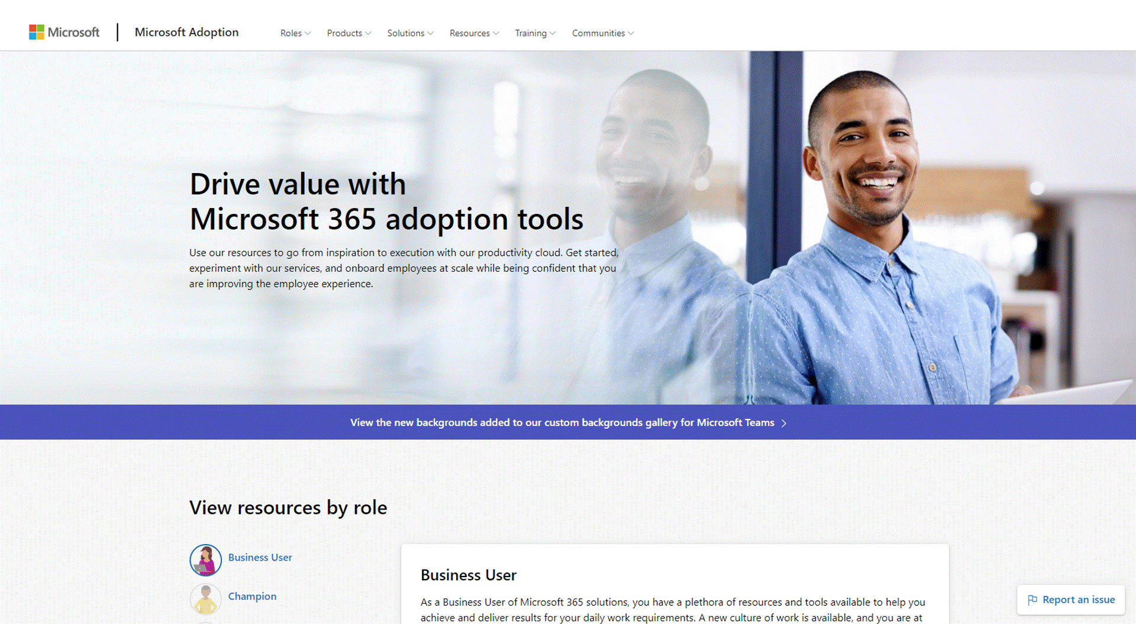
Microsoft Adoption v2
We are excited to announce the launch of Microsoft Adoption v2!
Performance improvements due to backend migration to GitHub & Azure
AI translation to 10 major languages
Enhanced gallery filtering
Day in the Life guides PDF to web page conversions
Microsoft Tech Community Resource Center migration to Microsoft Adoption
Partnership with Microsoft Dynamics 365
Updated colors and user interface elements
Notes:
The 10 major languages:
Dutch
English
Spanish
French
Italian
Portuguese
Russian
Chinese [simplified]
Chinese [traditional]
Japanese

Slide 6
Microsoft 365 CARES
July Update

Slide 7

Microsoft 365 CARES Program
Champions Active Research & Engagement Sessions
Connecting our community to research and engagement opportunities with internal Microsoft groups.
This is an opportunity for us to collect feedback about design concepts AND to learn about how you are using Teams at your organization. These are 90-minute, topic-based group discussions between 3-5 people from your organization and the researchers, PMs, engineers, and designers who work on Microsoft Teams.
Signup for future sessions: https://aka.ms/M365CARESSignup
Notes:
As a reminder, the CARES program stands for Champions Active Research & Engagement Series and is a partnership between the Teams Design Research group with their CAFÉ/LATTE series and our community. These sessions are engagement activities designed to connect you with Teams Engineering that focuses on better understanding the end user experience, as well as an opportunity for us to collect feedback about design alternatives and concepts.

Slide 8

Upcoming topic: Breakout rooms
Think of organizing or attending a meeting in which attendees are broken out into smaller sub-rooms for an activity.
Previous topics include:
Using apps in meetings
Discussing how you are using apps (1st party and 3rd party) in Teams meetings and in other contexts.
Teams + channels
Discussing how you are using Teams + channels on your desktops and mobile devices.
Share Content
Discussing how you work together and share content (inside and outside of meetings).
Standalone chat
Discussing how you use chat and some new concepts around chatting in Teams.
Signup for future sessions: https://aka.ms/M365CARESSignup

Slide 9
The Office Insider Program
Susan Cockrell & Dan Brown

Slide 10
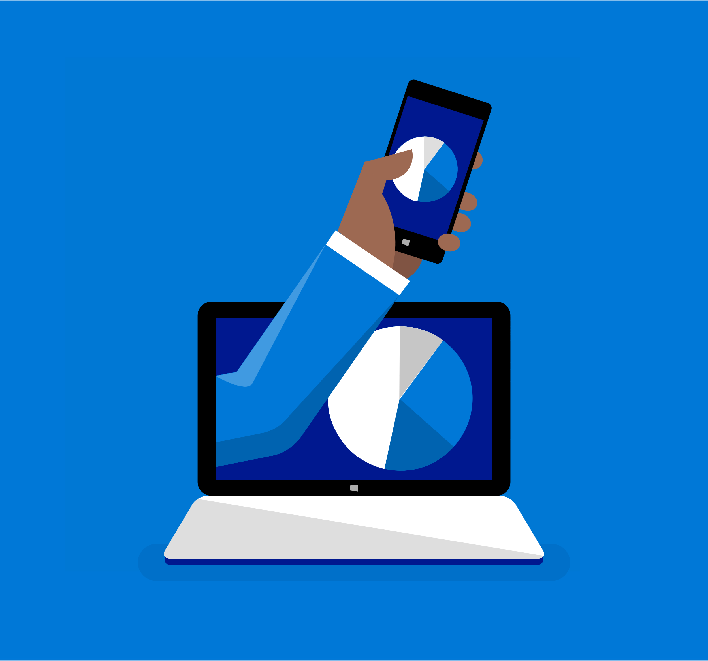


Office Insider Program
New features
Try new features first across platforms
Support
Support Microsoft 365 adoption in your org
Feedback
Give us feedback—we’re listening!
Notes:
The Office Insider program is Microsoft’s preview program for Office 365, and it gives you early access to new features, so you get to try new experiences in the Office suite of apps before the general public.
You are probably familiar with the members of our Office Insider community. You might be involved in the IT departments of your organization, and you are constantly looking for ways to improve the adoption of Microsoft 365 in your company. The Office Insider program can give you a leg up in testing and validation or change management. It helps you know what’s coming and helps get your org prepared.
By being in the program, you get to send us feedback that is very closely paid attention to by our product teams, because it’s the first signal we get from customers (and avid fans, like you all, at that!) so we really take your thoughts (and telemetry) into careful consideration.

Slide 11
What the Office Insider Program is not about
Notes:
We’ve heard this more than once: “C’mon, we’re just your guinea pigs, right? You just need someone to test everything for you, huh?” but that’s not how we think of our Office Insider community at all!

Slide 12
Notes:
The reality is that Office 365 has millions of paid subscribers and Office Insiders are the crucial few who are outside of Microsoft walls who play a key role and shaping Microsoft 365.

Slide 13
Office Insiders play a key role
Feature influence
Scenario validation
Bugs
Telemetry
Notes:
So, WHY would you want to be an Office Insider or have anyone in your org on an Office Insider channel? The first way that Office Insiders know that they are helping to shape Office is by using the new features that we ship in the preview builds. This gives you early access to check out what’s new, but it also gives us TELEMETRY from a wide range of users so that we know that what we’re shipping to the masses is high quality.
Next, we DO find great feedback from the thousands of internal Microsoft employees using new features—but we’re not the same as our customers. Whether it’s coverage across more geographies, different ways of using Office, or how Office works with line-of-business apps—our Insiders help us find issues and BUGS that we would miss if we only looked within the walls of Microsoft.
Similarly with scenario validation—your organizations have different ways of working, different add-ins, macros, and more that we don’t have inside of Microsoft. You can help get your organization get ready by having a few key users on Insider builds and checking that they make sense for your existing workflows.
The last reason you’d want to be an Insider is for your influence. Who doesn’t want to be an influencer!? Like I mentioned before, you get to help us shape the future of Office. Your feedback and the feedback from your organization, comes through to us marked specifically as “Insider” feedback and we know that it’s from our most passionate fans and we pay very close attention to this.

Slide 14
The foundation of the
Office Insider Program:
Your feedback!
Notes:
What makes the foundation of the Office Insider program? It really revolves around your feedback.

Slide 15
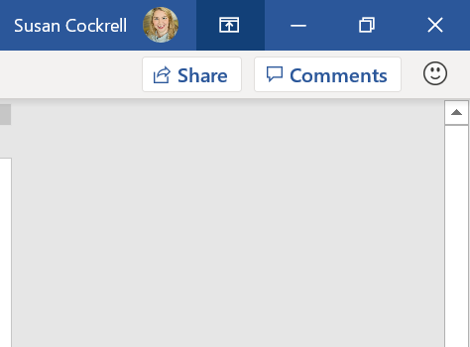
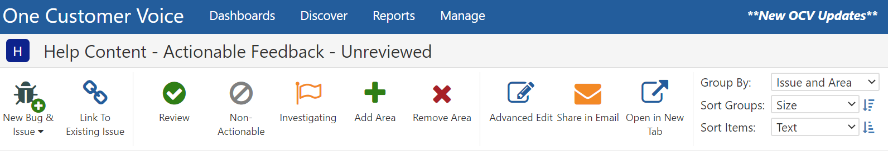
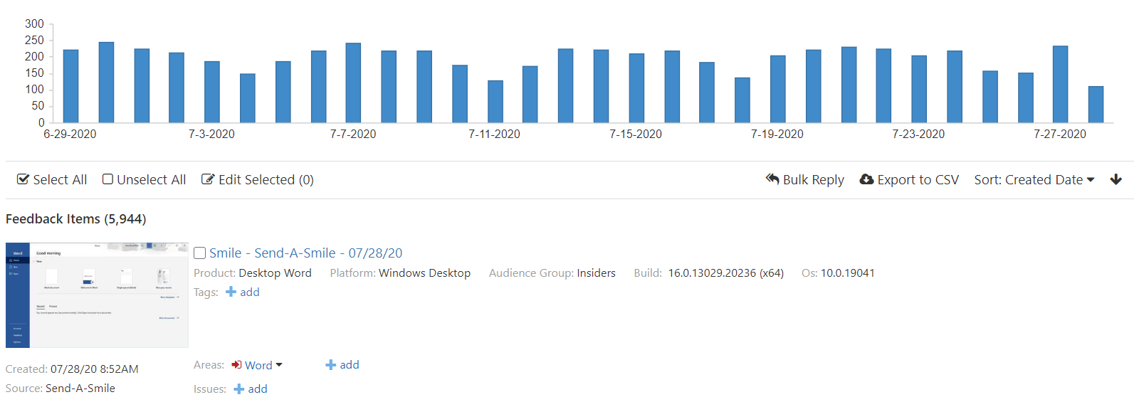
Your feedback goes to our inbox
Notes:
When you click on “Feedback” in one of your apps, you might wonder where it goes?
Well, our key internal tool for us is called “One Customer Voice”, or OCV. It collects feedback across dozens of different sources…everything from app store reviews, to send-a-smile/send-a-frown to customer support and many more.
Our product teams sets up queries for their features and look at them sometimes on an hourly basis after they launch their features, because they are so keen to get the immediate feedback from Insiders so that they can make changes to features if needed before they go out to production.

Slide 16
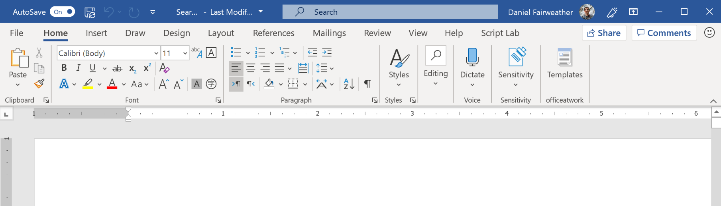
Fine-tuning Microsoft Search
This is taking real estate away from the status bar where I usually grab the window from moving around on the desktop.
“
The new search bar in the title bar
on the window looks terrible. It looks unfinished and cluttered. Make an option to hide it or move it.
“
Notes:
An example where Insider feedback led directly to product changes:
A few years ago, based on customer feedback, we made a major new investment in what we call Microsoft Search. We gave it a prominent new home at the top of the window. Our customers saw value in Search but they gave us feedback that it’s taking real estate away from the status bar and it looks cluttered and terrible. NOT what we wanted to hear or what we hoped the experience would be for our customers.

Slide 17
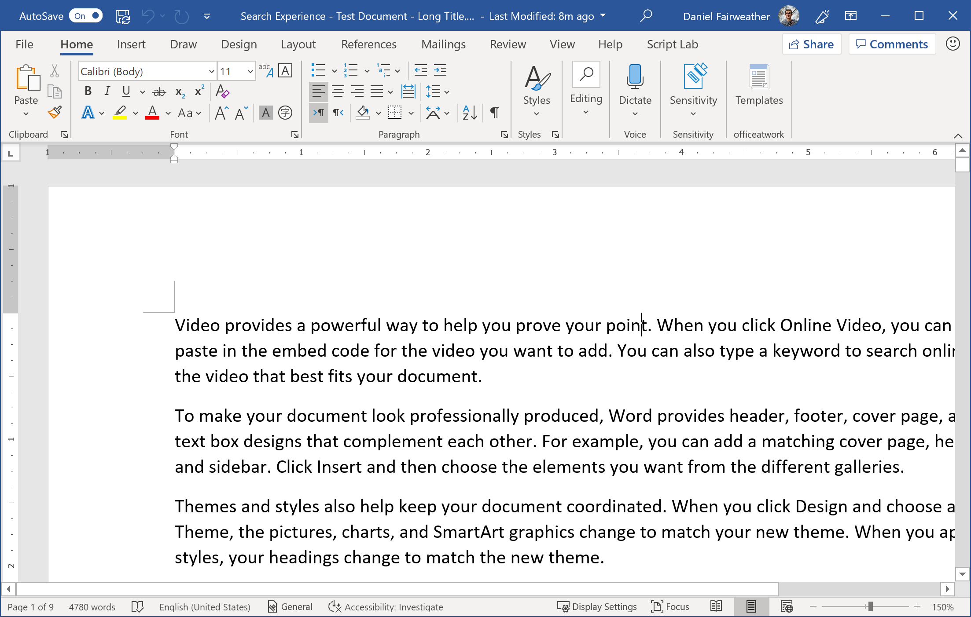
Microsoft Search: product changes
Notes:
But – feedback is a gift! As a result, we made a number of quick changes:
-We didn’t allow Search to truncate the document title and quick access toolbar
-We collapsed it to an icon when space was limited
-And we added a setting to always show the search box as an icon for those who prefer it that way
And so thanks to Insider feedback, we took the first draft of this experience, and got it ready for prime time and the production release.

Slide 18
Rolling out features & experiences in Office
Microsoft internal builds
Production builds
Current Channel,
Monthly Enterprise Channel, Semi-Annual Enterprise Channel
Beta Channel
Current Channel (Preview)
IT Admins
Champions
Unsupported
Weekly
Change Management
Training/Help Desk
Supported
Monthly
Notes:
And now that you have a solid example of how Insider feedback leads directly to change, I also want to make sure that you understand how we are releasing features and where Insiders fit in. We first roll out features to Microsoft internal users so that we can ensure that we’re giving everything a chance to be vetted before it goes out to the public.
But then our Insiders in Beta Channel (or what used to be called “Fast”) get to see features next. These builds go out weekly and they’re best for people who want to be the first to explore features and use the earliest builds to provide feedback. You also have to be the kind of person who doesn’t mind a bit of risk because it *IS* an unsupported build. (But just so you know, it’s very easy to go back and forth between Fast, Slow and production builds, should you find an issue and need to get back to your productive work day!) We find very often that IT Admins are the best candidates to be running Insider Fast builds within their orgs.
The next option for being an Insider is the “Slow” channel (or what we call “Current Channel (Preview)” if you’re an Office Insider on Windows. This one comes out monthly and IS a supported build and it’s perfect for those of you in change management or the help desk who are getting your orgs ready for what’s coming out in the Monthly Channel. If you are in one of these roles and on ProPlus at your company, ask your IT Admin about putting you on the Insider Slow build so that you can see features earlier.
Finally we roll out to our Production channels, where we move into either Current Channel, Monthly Enterprise or Semi-Annual and those are fully baked and supported builds.

Slide 19
We support multiple platforms
iOS
Android
Windows
Mac
Notes:
Another one of the things that is most exciting about the Office Insider program is that it runs across multiple platforms. We are very invested in bringing the best features and experiences not only to Windows and Mac but especially to your mobile devices and we need Insider feedback to tell us what Office features you want to see on mobile and what’s working for you.

Slide 20
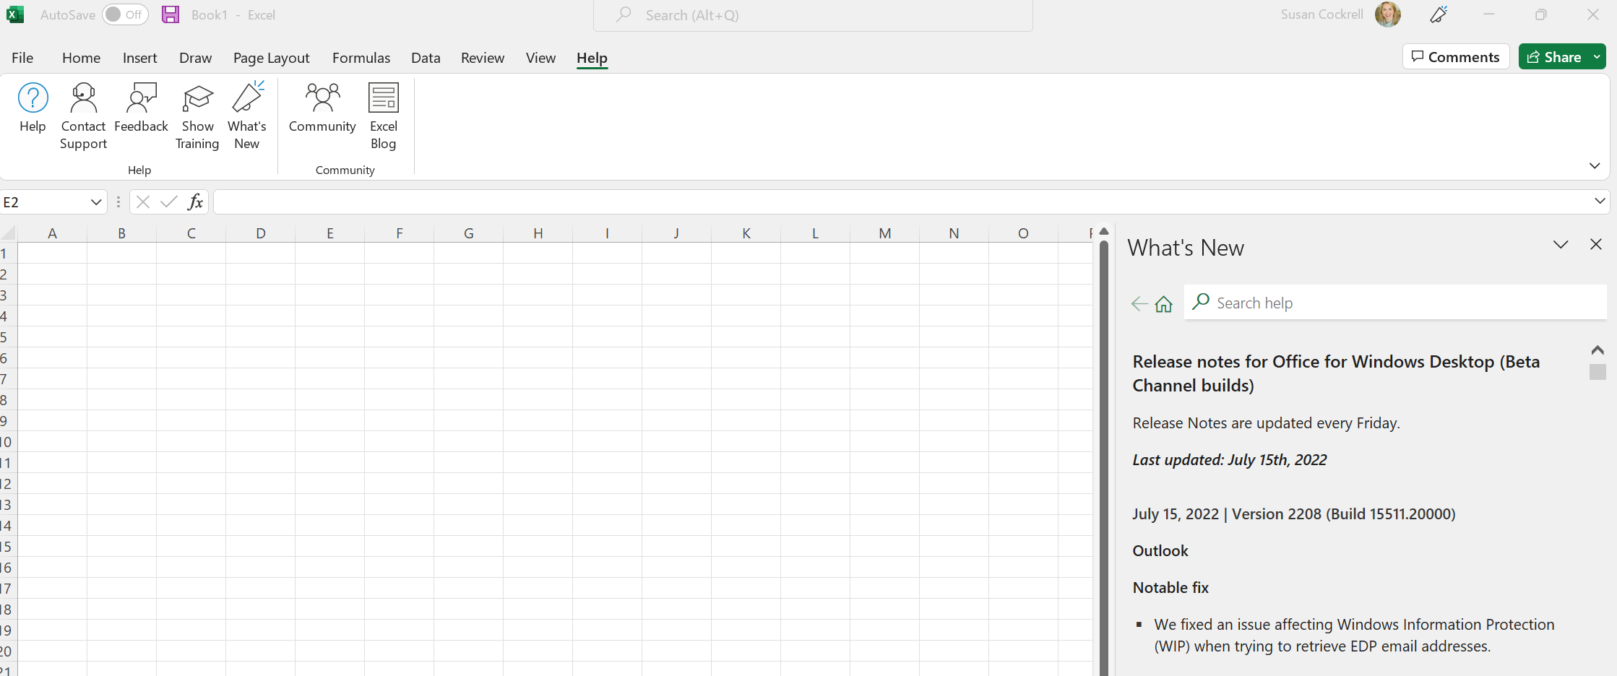
You can easily find Beta Channel release notes in-app
Notes:
We also like to keep you where you’re productive, so you can find your release notes in-app if you’re in the Beta Channel.

Slide 21
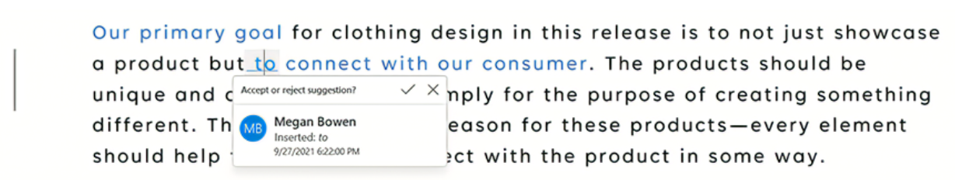
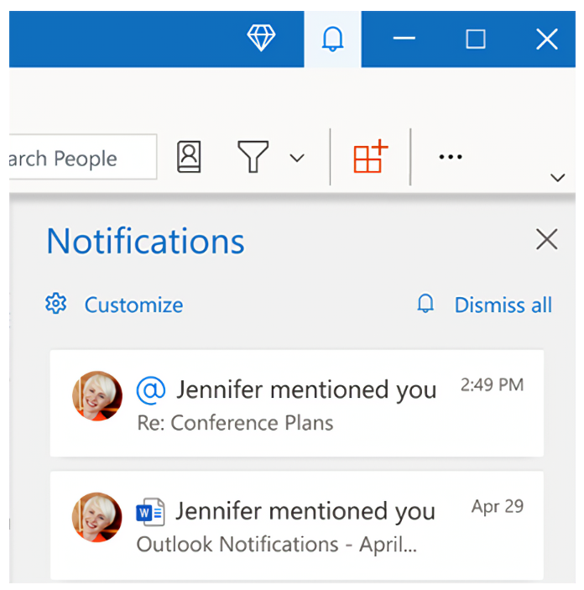
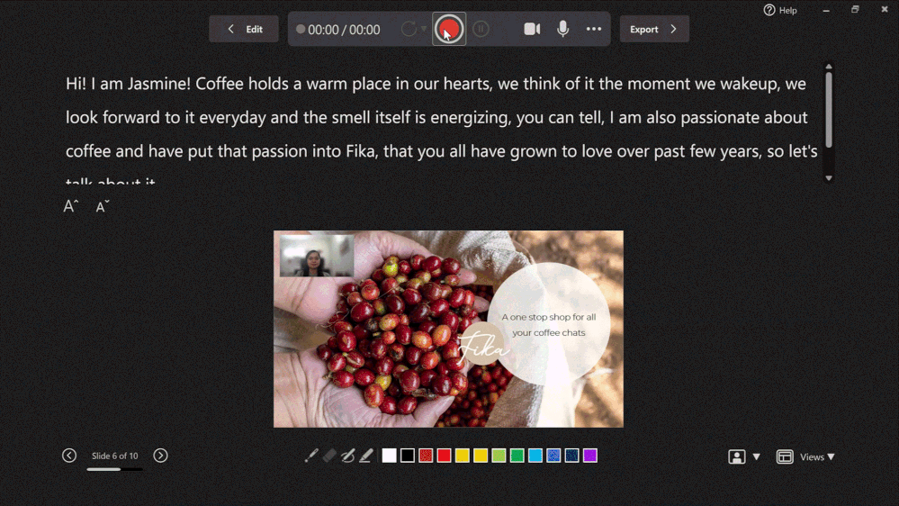
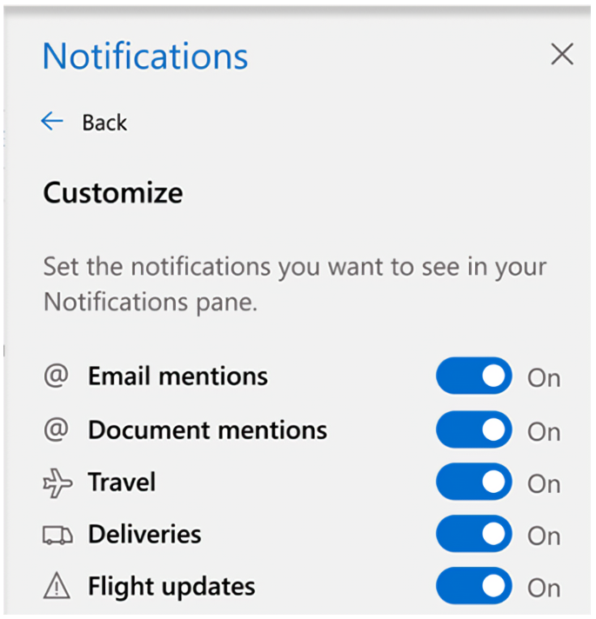
Hot 🔥 new Office Insider features in Beta Channel
The new Notifications pane in Outlook that helps you stay on task
Review tracked changes with new cards in Word
Personalize your PowerPoint video story with a live camera feed
Notes:
And to give you an idea of what Office Insiders have gotten in the way of features in the past few weeks, here are a few:

Slide 22
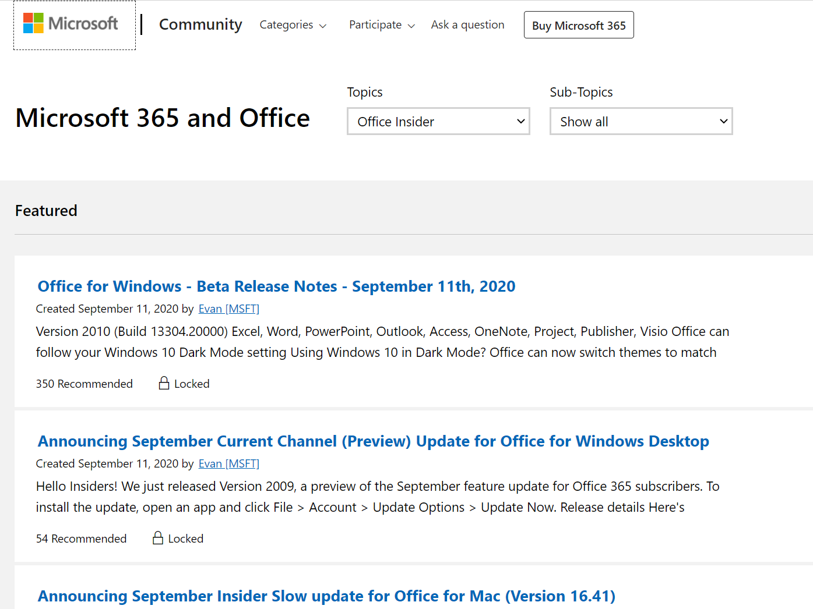
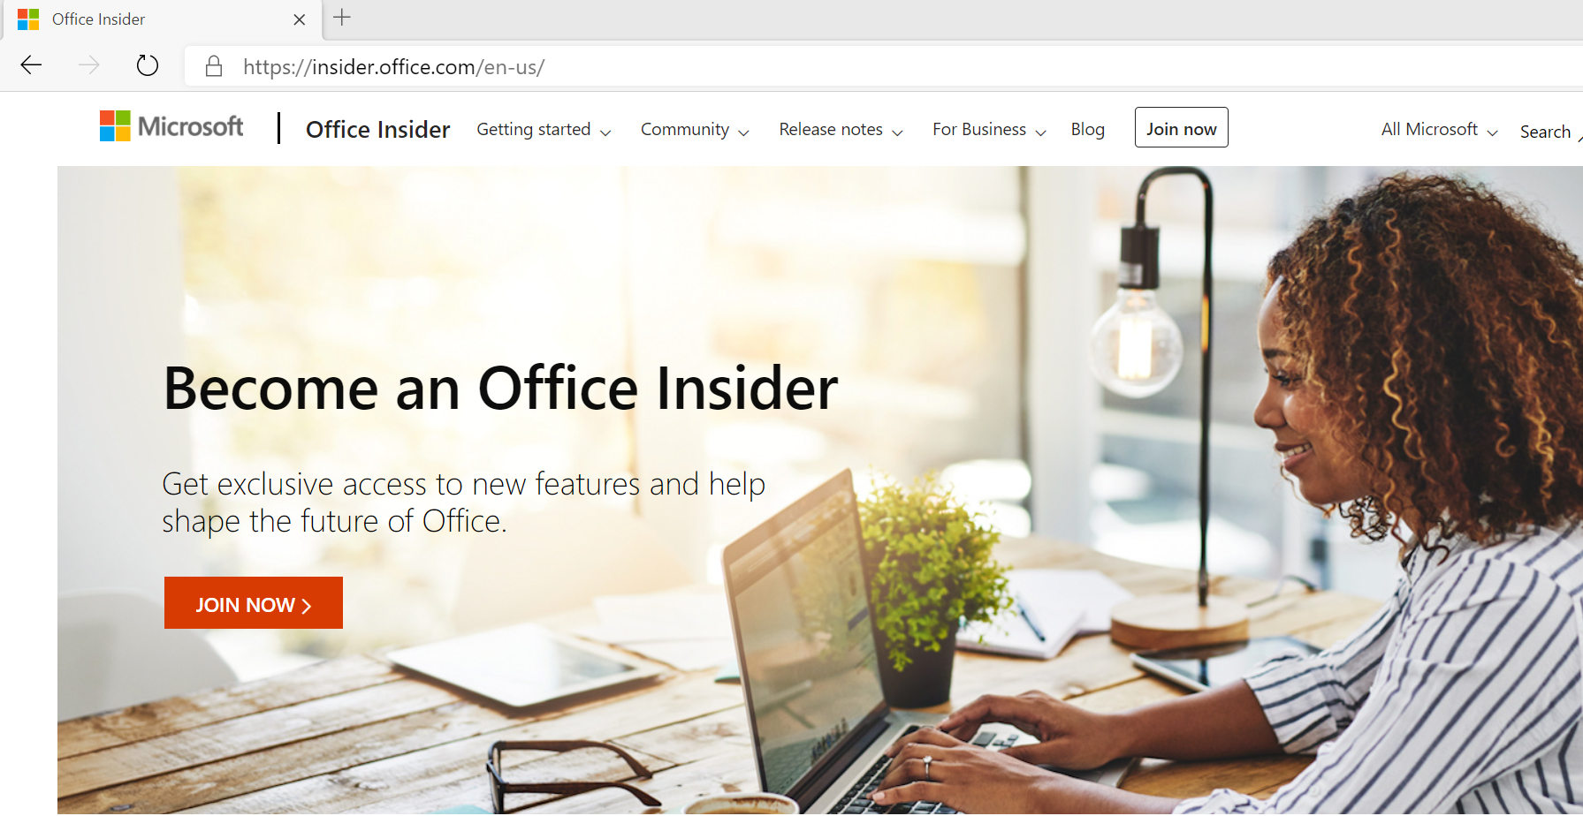
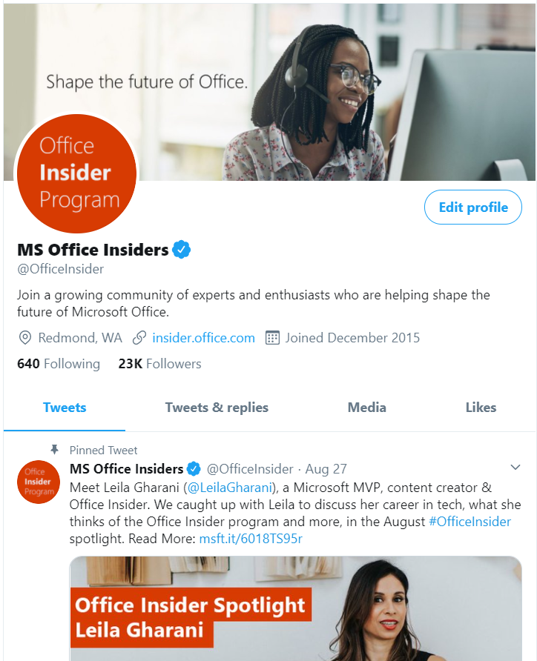
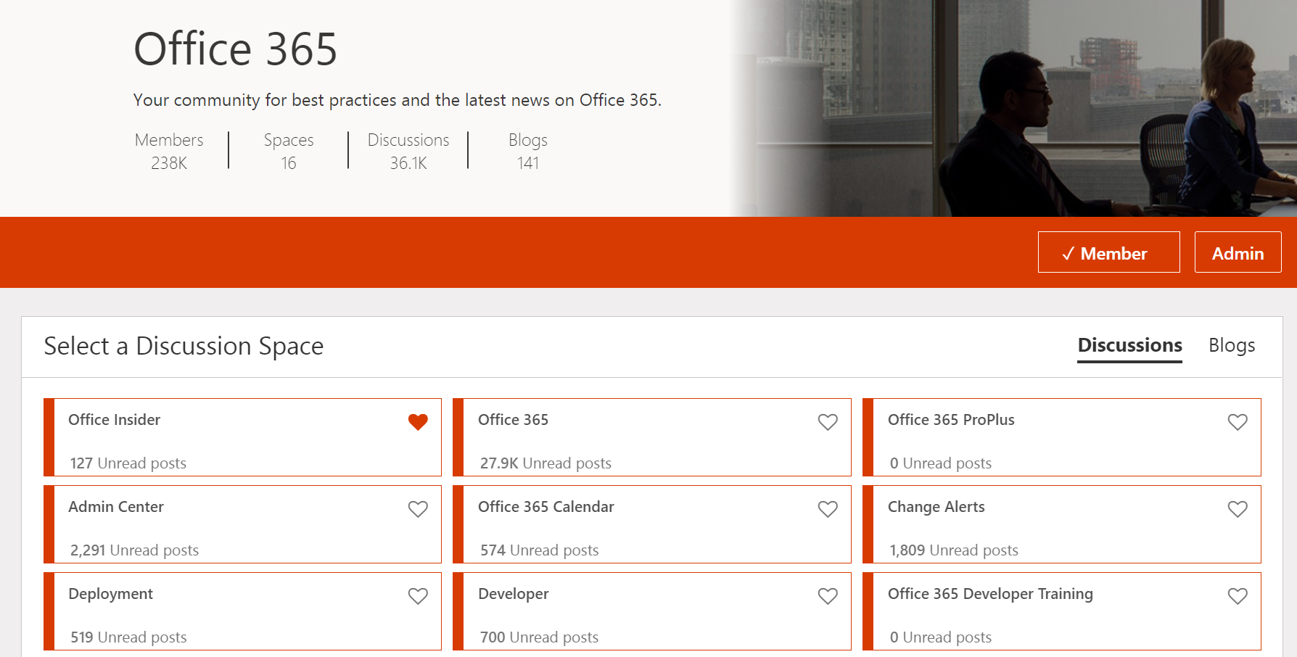
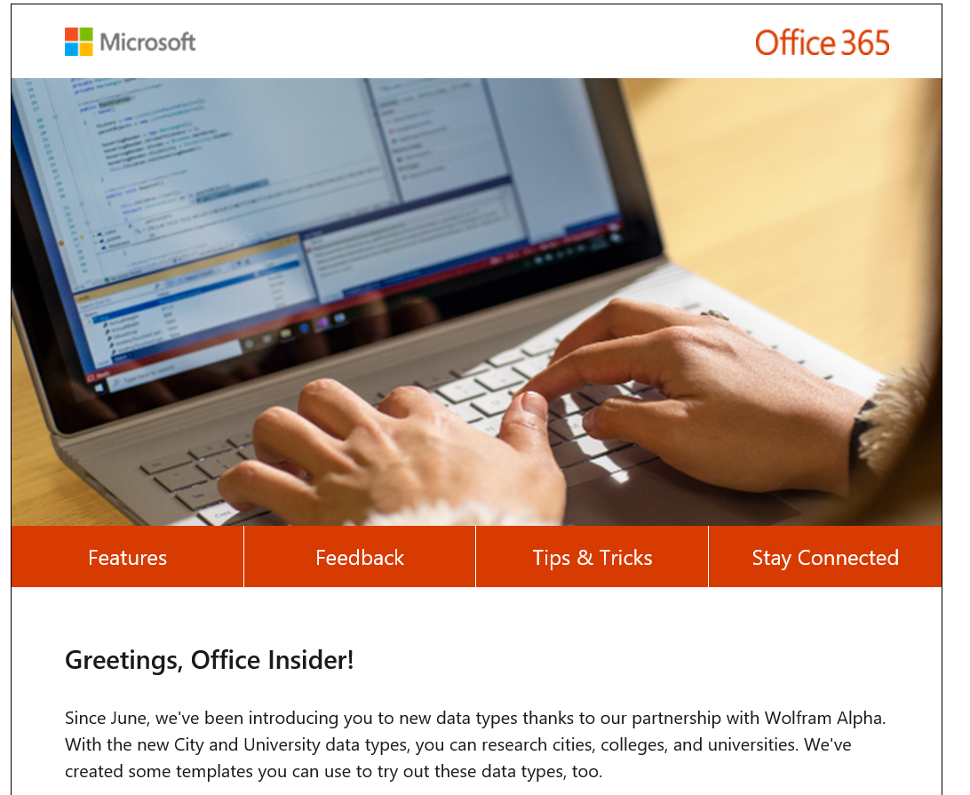
You can find us online everywhere
insider.office.com
Answers
Twitter
Microsoft Tech Community
Newsletter

Slide 23
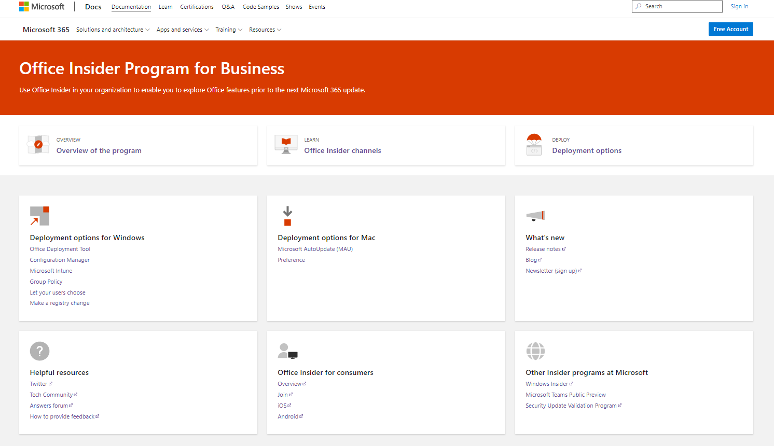
And now also on Docs.microsoft.com
https://aka.ms/officeinsiderbusiness

Slide 24
Dan Brown
Welcome
Notes:
And now I’d like to turn it over to Dan Brown, one of our senior technical writers, who is going to walk you through how to deploy the Office Insider Program within your organization via three different tools: The Office Deployment Tool, Group Policy, and Microsoft Intune. Dan….take it away.

Slide 25

Options for deploying Office Insider
Windows
  Mac
  Microsoft AutoUpdate (MAU)
  Preference
  For more information, see https://aka.ms/officeinsiderbusiness
Tool | New installs | Existing installs
Office Deployment Tool (ODT)
Microsoft Endpoint Configuration Manager
Microsoft Intune
Group Policy
Registry change

Slide 26
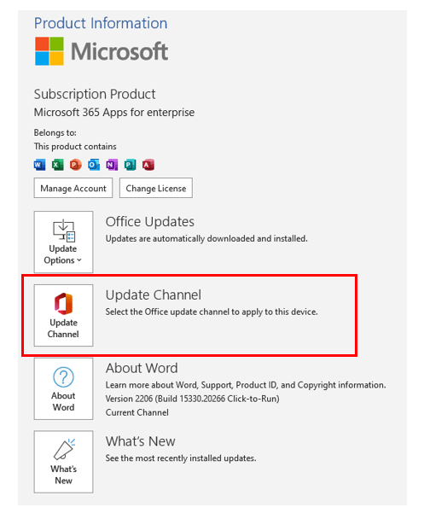
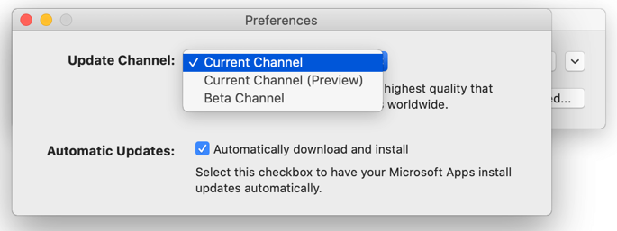
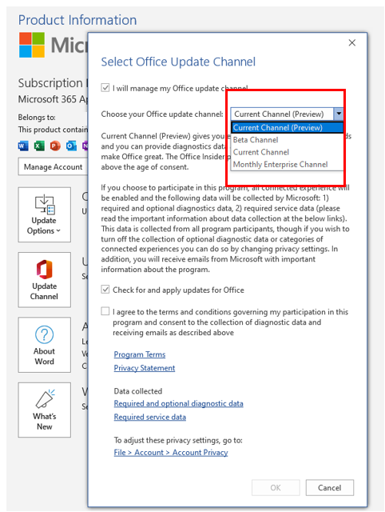
Let users choose Office Insider
  Windows
  Mac

Slide 27
Reminders about using Office Insider
  Office Insider choice is specific to the device, not to all the user’s devices.
  If Office, Project, and Visio are installed on the device, they all will be configured to use the same Office Insider channel.
  Need to be an admin on the device to change to Office Insider.
  Best practice: configure Office to get updates directly from the Office Content Delivery Network (CDN) on the internet.
  Beta Channel is not supported, so it’s best used in test environments.
Notes:
User can have a device with Current Channel (Preview) and a different device with Monthly Enterprise Channel
Because Beta Channel isn’t a supported channel, you’ll need to do some extra steps if deploying with the Office Deployment Tool, Configuration Manager, or Intune.

Slide 28
Demo
Office Deployment Tool | Group Policy | Microsoft Intune

Slide 29
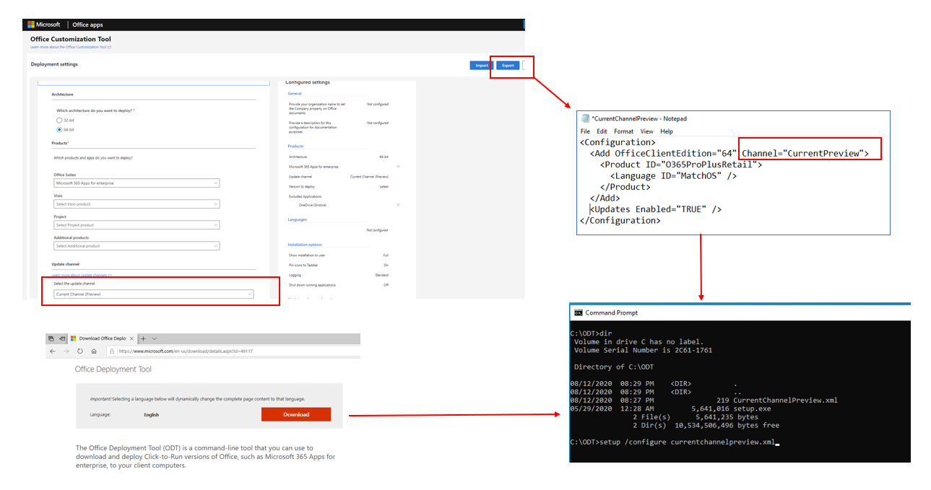
Office Deployment Tool
Notes:
Beta Channel isn’t available from the drop-down list in the Office Customization Tool. So you’ll have to hand edit your xml file.

Slide 30
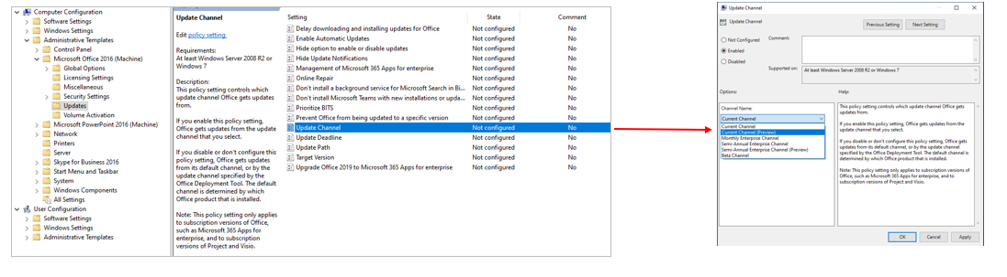
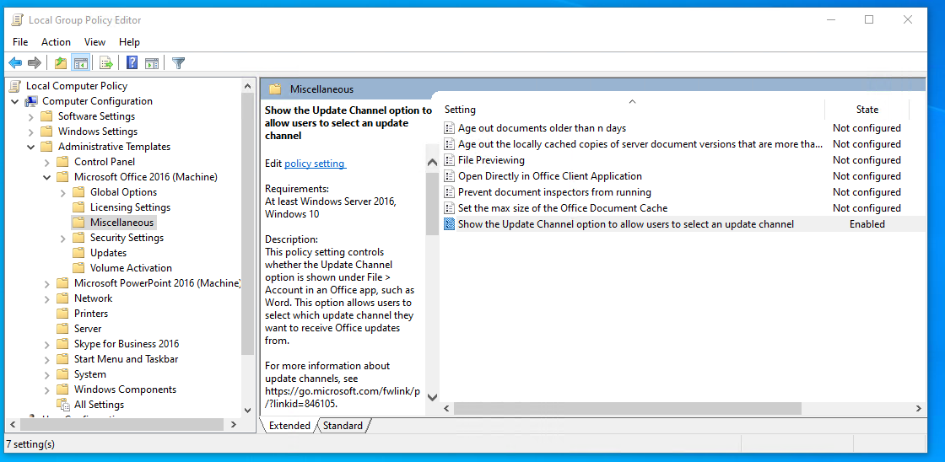
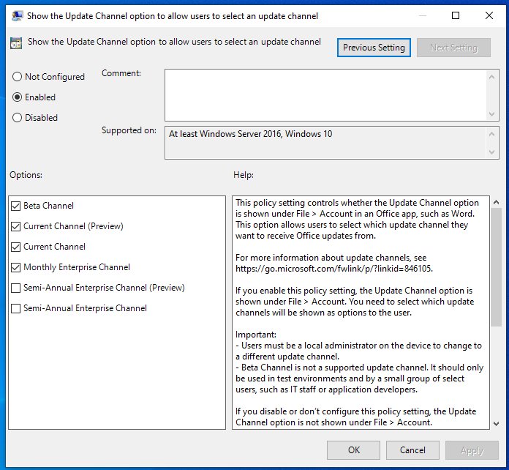
Group Policy
  Update Channel
  Show the Update Channel option to allow users to select an update channel
Notes:
Group Policy is the only deployment method where Beta Channel is shown as an option in the UI.

Slide 31
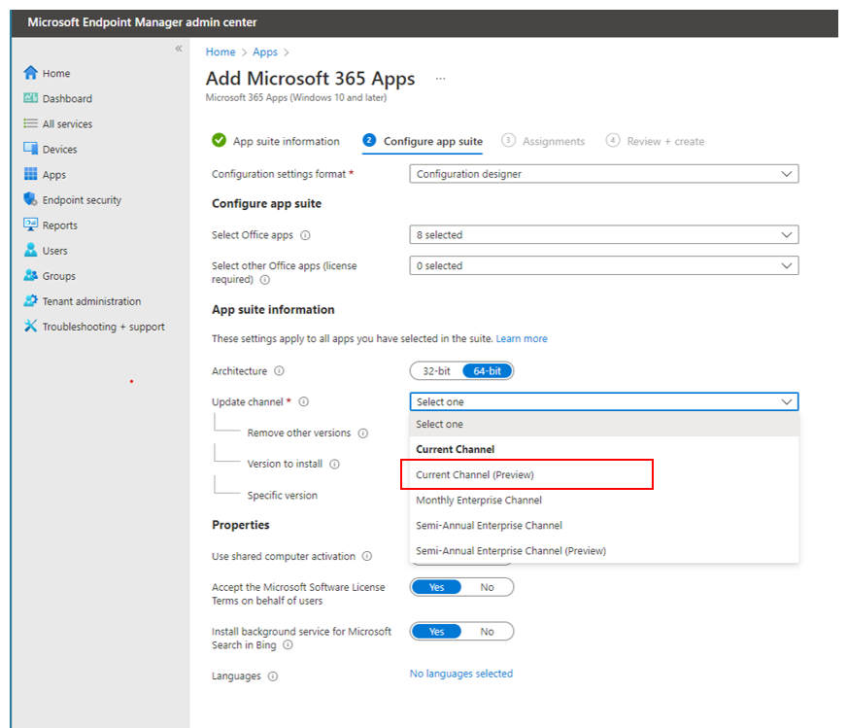
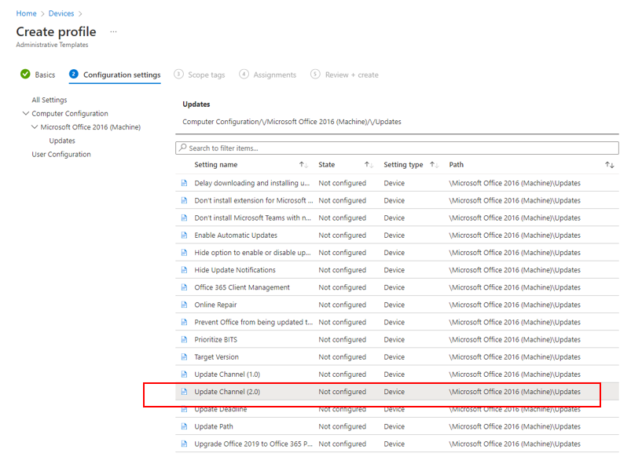
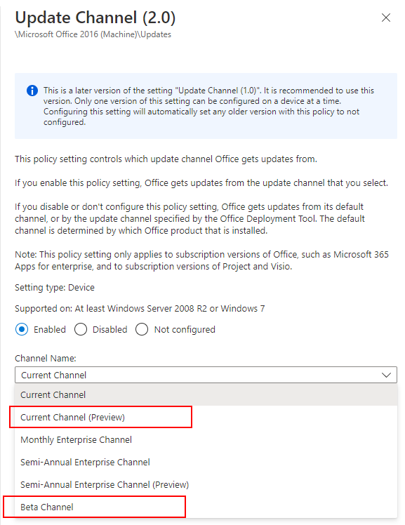
Microsoft Intune
  New install
  Existing install (Configuration profile)
Notes:
Beta Channel isn’t available from the drop-down list in Microsoft Intune when creating the app. As a workaround, in the “Configuration settings format” drop-down list, select “Enter XML data” and paste in the appropriate XML.
But if you’re using a device configuration profile, Beta Channel is a choice (since it’s the same as Group Policy)

Slide 32
Learn more:
aka.ms/officeinsiderbusiness
or
insider.office.com

Slide 33
Microsoft 365 Updates
Top new feature releases across Microsoft 365

Slide 34
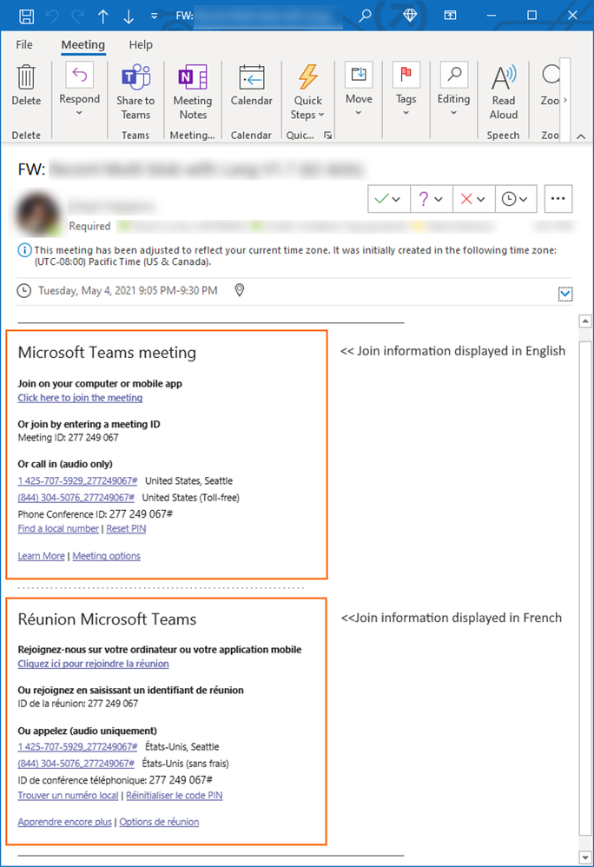
Microsoft
Teams
Multi-language meeting invite control
Multi-language Teams meeting invite control enables administrators to display the join information in meeting invitations in up to two languages across all email platforms. With this feature, you can customize meeting invites to include the languages with which your users are most familiar and comfortable. Administrators can apply a new policy in their admin portal by enabling the MeetingInviteLanguages parameter in the CsTeamsMeetingPolicy at the user or group level, or for the entire organization.

Slide 35
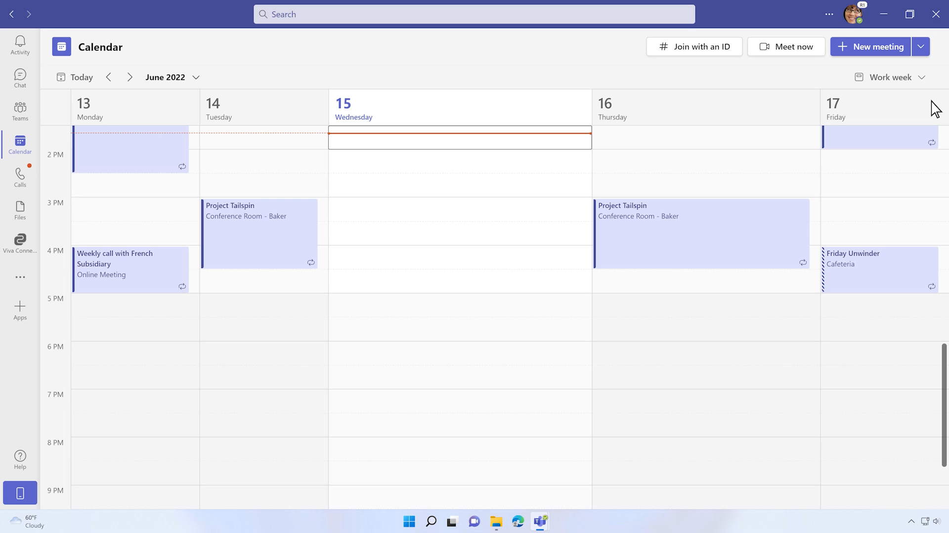
Microsoft
Teams
Enhanced webinar experience
Last May we introduced webinars in Microsoft Teams to drive more interactive and immersive experiences and nurture relationships. We’ve revamped our webinar experience starting with a new structure and expanded options to customize registration details and settings specific to each event as every event is unique. Updates include: presenter bios, theming, capacity limits, custom questions
These capabilities will be available in public preview next month.
Learn more about these webinar updates in our blog here.

Slide 36
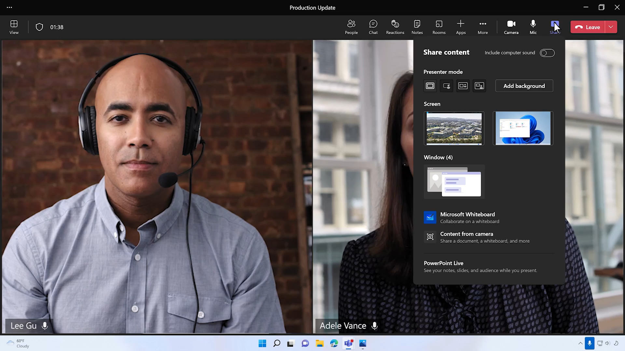
Microsoft
Teams
Collaborative Annotations
Collaborative Annotations lets all meeting participants draw, type, or react on top of the content being shared in the meeting using a rich toolset powered by Microsoft Whiteboard. During desktop screen sharing, and with Annotation mode enabled, meeting attendees will see the Annotations toolbar and can start adding annotations to get input and drive discussion. Collaborative Annotations is now generally available. Learn more here.

Slide 37
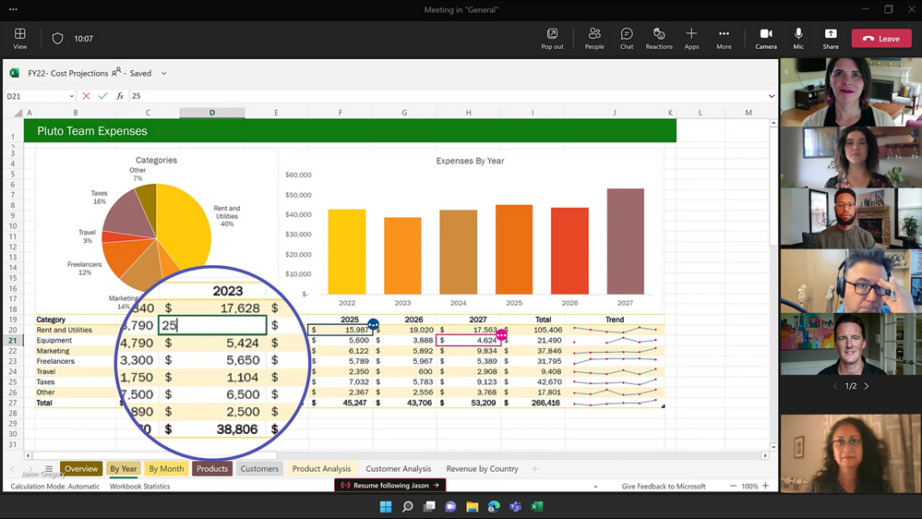
Microsoft
Teams
Excel Live in Teams
Excel Live revolutionizes the way you can collaborate in Microsoft Teams meetings – with a click, everyone has access to edit the workbook in real time – right within the meeting itself. Excel Live also supports Sheet Views, which means everyone co-editing the workbook can sort or filter however they need, without disrupting others. Excel Live will be available for public preview in August. Learn more here.

Slide 38
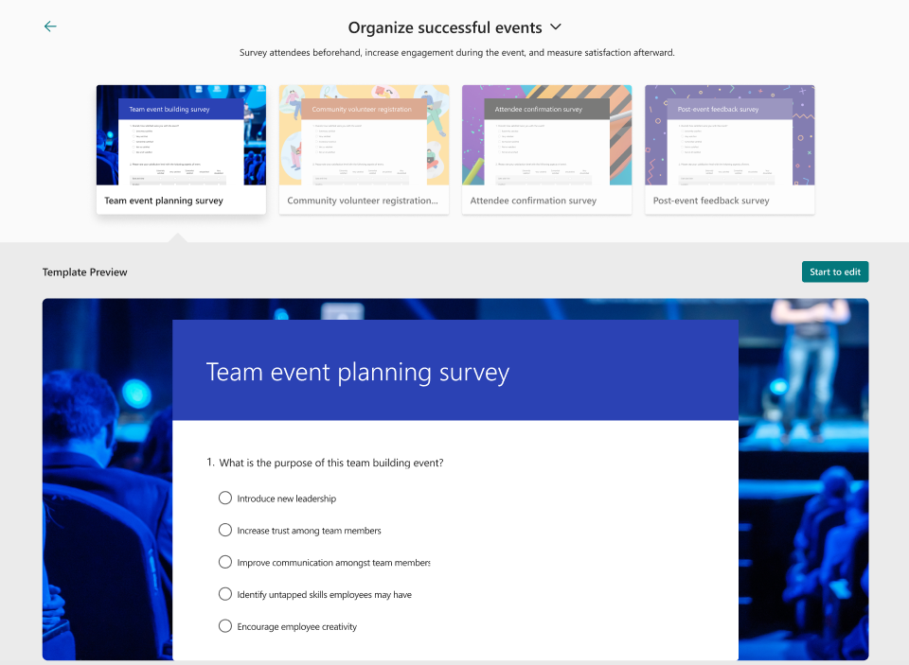
Microsoft
Forms
Getting started easily with Microsoft Forms’ new portal experiences
To help Forms customers easily create forms or quizzes from beginning to end, we have leveled up our portal page experience for brand new Forms customers and light up scenario-based templates tailored for commercial and educators separately.
If new users come to Forms for the first time, they can quickly get started either from scratch or from prepopulated templates. These new features are gradually rolling out and only available in https://forms.office.com but will expand to office.com start page in future. Commercial and EDU customers will be presented with different template categories for quick browsing.

Slide 39
Community Events and Updates
Upcoming events and community specific updates

Slide 40

Upcoming community events
365 EduCon August 8-12, 2022 | Dallas, TX
CommsvNext August 16-17, 2022 | Denver, CO
365 EduCon September 26-30, 2022 | Chicago, IL
North American Collaboration Summit October 12-14, 2022 | Branson, MO + Virtual
South Coast Summit October 15-16, 2022 | Southampton, UK
MVP-Dagan (MVP Day) October 19, 2022 | Oslo, Norway
European Sharepoint Conference November 28-December 1, 2022 | Copenhagen, Denmark
Microsoft 365 Conference December 6-8, 2022 | Las Vegas, NV
Microsoft events:
Microsoft Ignite Fall, 2022 | Virtual
Explore other Microsoft events and other Community events

Slide 41
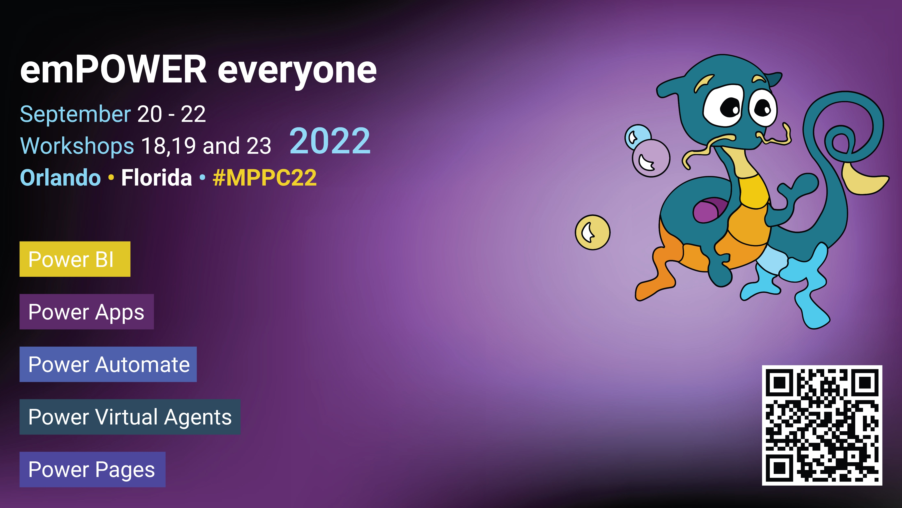
Join us and register today!

Slide 42
Microsoft 365 Champion Community news
Next community call – September 27th
^{No call in August!}
Top asks:
Complete our monthly call survey: https://aka.ms/Microsoft365ChampionCallFeedback
Participate in the Driving Adoption Community:
https://aka.ms/DrivingAdoption
Invite colleagues to join the Champion Program: https://aka.ms/M365Champions

Slide 43
Thanks for attending! We’d love your feedback on today’s call and hear ways we can make future calls even better! https://aka.ms/Microsoft365ChampionCallFeedback
Microsoft 365 Champion Community
Learn more. Do more. Achieve more, together.
Now, lets meet! Stay on to join our open discussion and feel free to come on video and off mute.

