Slide 1

We will get started shortly!
Microsoft 365 Champion Community Call
September 28th, 2021
Microsoft 365 Champion Community
Learn more. Do more. Achieve more, together.

Slide 2

Microsoft 365 Champion Community
September 2021 Monthly Call

Slide 3
Agenda
September 2021
Mindful minute | Managing your attention
M365 CARES Program | Updates & topics
Microsoft 365 learning pathways | Journey so far
Teams updates | Top new features releases
Other updates | Need to know
Community events & news
Open forum | Open meeting for discussion
Find resources from previous calls here:
https://aka.ms/M365ChampionResources

Slide 4

“Our attention is the most valuable resource any of us have. Guard and honor this precious resource for maximum benefit – to your relationships, your work and yourself.”
-Karuana
Create
Create focus
Outlook focus time
Team agreements
Reduce
Reduce distraction
Focus Assist
Do not disturb status
Recover
Recover focus
Desktop switch
Outlook rules
Chat to Tasks
Flagging emails
Communicate boundaries
No Meeting times
Windows Virtual Desktops
Hydrate
Move & stretch
Physical space
Headphones
Technical
Non-Technical

Slide 5
M365 CARES Program | Update & topics

Slide 6

Program updates
Sign up here https://aka.ms/M365CARESSignup
Over 50 sign-ups since last month
Sessions this week
October open topic…

Slide 7
Upcoming: Sept & Oct
September
LATTE Sessions – Teams usage, pain points & delights.
  Grupo CMA on 9/23
  Beckman Coulter on 9/29
October
CAFE Sessions – IT Pro/Business Decision Maker/Device Management.
  Securian Financial on 10/26
  LDS on 10/27
Latte Sessions – Teams usage, pain points & delights.
  AES – Applied Energy Services on 10/26
Signup here: https://aka.ms/M365CARESSignup
Notes:
General description of LATTE format new

Slide 8
Upcoming: Oct & Nov
October
CAFE Session – Meeting artifacts for people who attend meetings and/or people that missed meetings and want to catch-up.
  Recruit ask: 2 or 3 orgs to participate
November
CAFE Sessions – Presence & status in a hybrid world.
  Recruit ask: 2 or 3 orgs
LATTE Sessions
  Recruit ask: 2 orgs
Signup here: https://aka.ms/M365CARESSignup
Notes:
General description of LATTE format new

Slide 9

Taking December off
Notes:
General description of LATTE format new

Slide 10
Microsoft 365 learning pathways | Journey so far

Slide 11
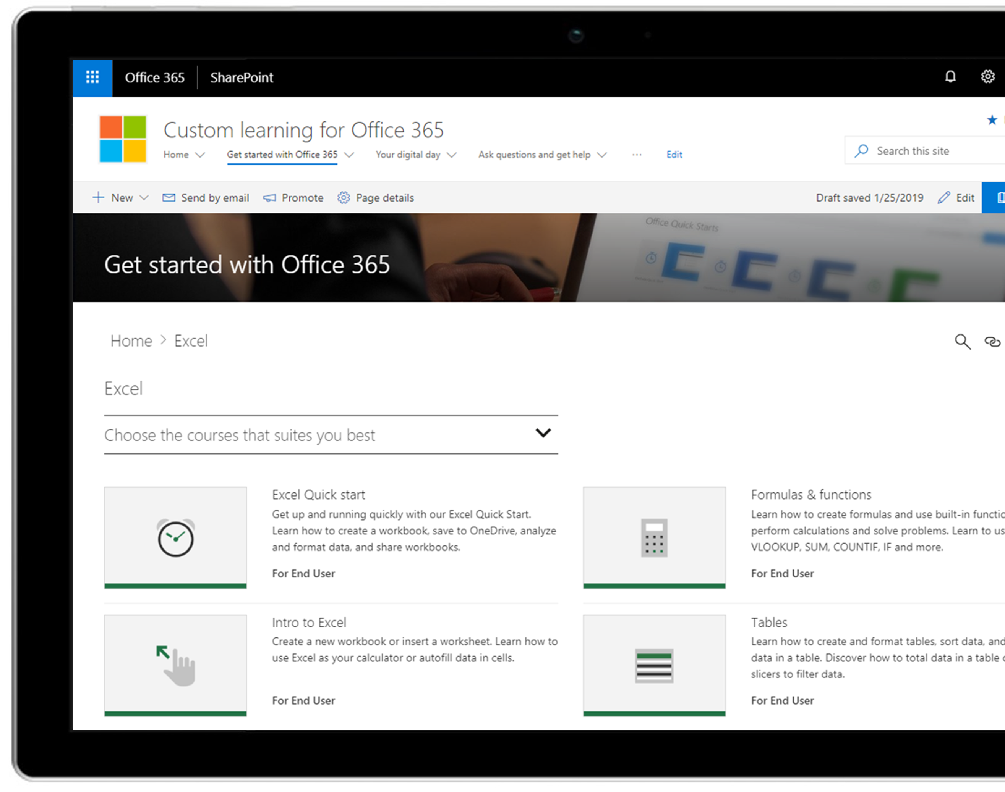
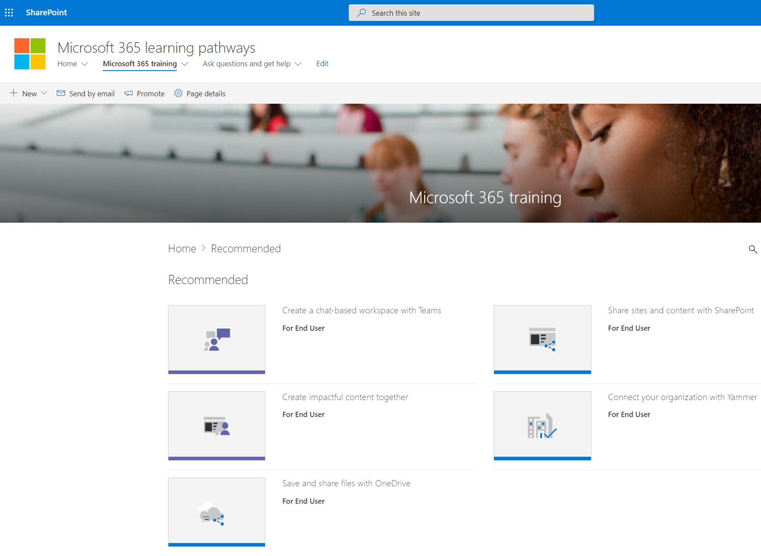
Microsoft 365 learning pathways
Accelerating end user training
Modern SharePoint Online communication site template
Connected to online catalog of Microsoft curated end-user training content
Customizable content experience
Easily installed via SharePoint Provisioning Service
Simple integration into Microsoft Teams
Steppingstone to Viva Learning
Learn more at https://aka.ms/M365LP

Slide 12



Microsoft Learning Platforms
Microsoft
Viva Learning
Microsoft 365
Learning Pathways
Help your organization learn at any stage via any platform

Slide 13
Teams updates | Top new feature releases

Slide 14

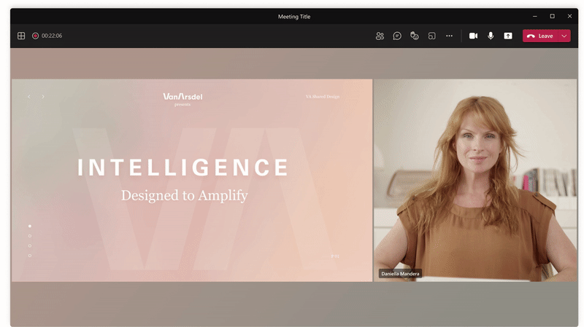
Make meetings better
Meetings & webinars
Reporter and Side-by-Side options in Presenter Mode for desktop and window sharing
In addition to the previously offered Standout option, two new presenter modes are available when sharing your desktop and window in the Teams desktop app:
Reporter mode places content as a visual aid above your shoulder like a news story.
Side-by-side mode displays your video feed next to your content.
You can now select a mode that fits your needs and promotes a more engaging presentation and experience. Learn more.

Slide 15
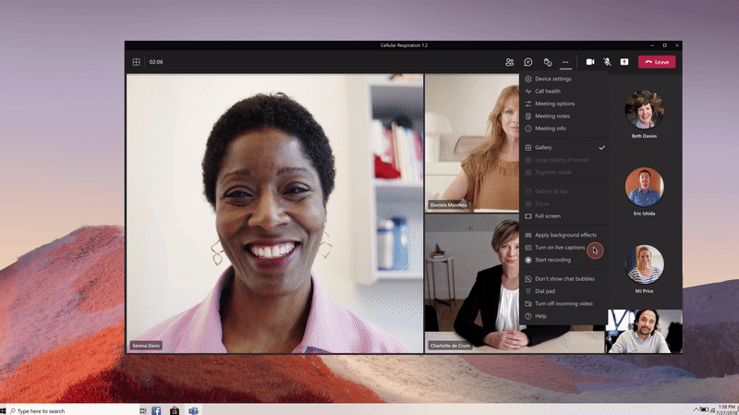
Make meetings better
Meetings & webinars
Live Captions and Live Transcript in additional spoken languages for Teams Meetings
Meetings held in one of the supported languages are now also supported by real-time captioning and transcription. We have expanded to 27 new spoken languages including German, Portuguese (Brazil), Japanese, and Hindi to name a few.
This provides flexibility and additional clarity for your participants to engage in the meeting. Learn more about Live Captions and Live Transcription.

Slide 16
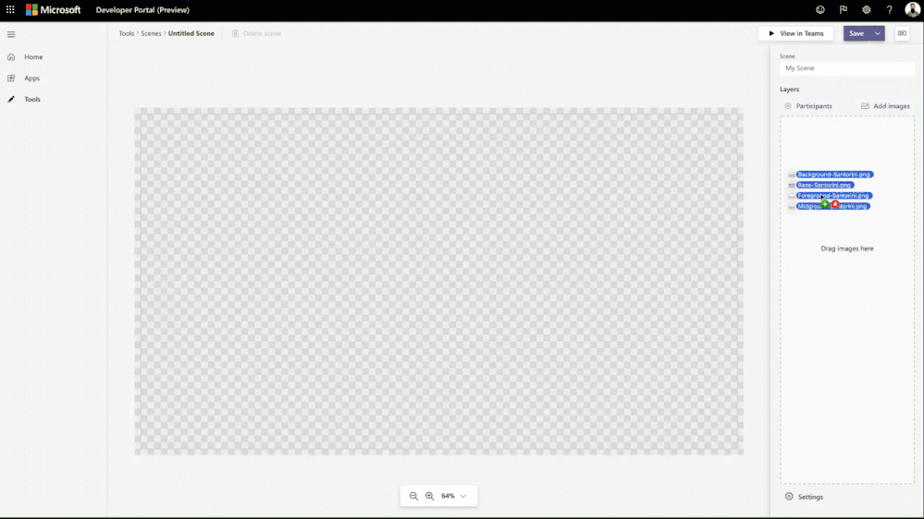
Make meetings better
Power Platform and custom development
Together Mode Extensibility
Developers can build custom scenes that elevate the meeting experience. We believe that by making Together Mode extensible, creators can create immersive scenes and users can go beyond simple video conferencing.
Learn more on how you can get started building your scenes.

Slide 17
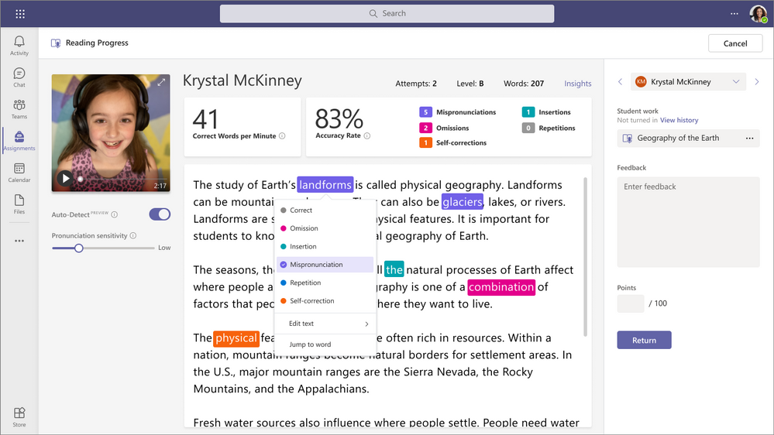
Teams for
Education
Reading Progress
Reading Progress enables readers to practice their skills in a safe, student-centric environment. Educators pick a reading passage and can choose to assign it to the entire class, a specific reading group, or an individual student. After the student reads the passage aloud, educators review the recording and either manually identify and code errors or use the Auto-detect feature to identify and code potential errors.
The recordings grant students and educators more flexibility to practice remotely or in the classroom. This helps bring the right support at the right time to each learner and makes it easier to plan regular reading fluency checks. Learn more about Reading Progress here.

Slide 18
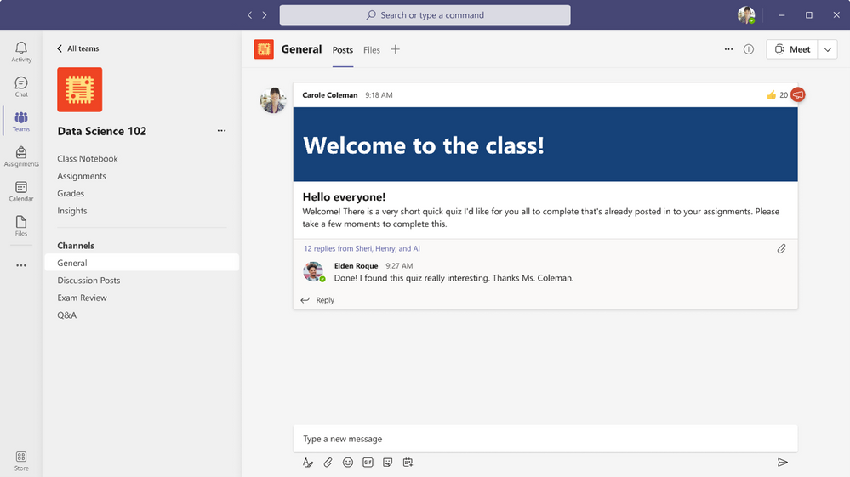
Teams for
Education
Simplified navigation in class teams
Now educators can easily access Assignments, Grades, Class Notebook, and Insights from any channel within a class team. Just open up your class team and you’ll see the updated-and-improved navigation. You’ll still be able to add tabs to the General channel and other channels you create.
This new view is available for all educators and students using our grid view layout for Teams, and IT Admins will have the option to remove any of the pre-pinned navigation. (Students will only see Class Notebook, Assignments, and Grades, not Insights.)

Slide 19
Other updates | Need to know

Slide 20

Upcoming community events
Thrive Conference in Slovenia – October 2021
European Collaboration Summit – November 2021
M365 Collaboration Conference in Las Vegas, NV – December 2021
TeamsFest / SharePointFest in Washington, D.C. – December 2021
Explore other Microsoft Events
Microsoft Ignite – November 2-4, 2021
Our next Champion Community call:
October 26th @ 8 AM & 5 PM PT

Slide 21
Microsoft 365 Champion Community news
Top asks:
Complete our monthly call survey: https://aka.ms/Microsoft365ChampionCallFeedback
Participate in the Driving Adoption Community:
https://aka.ms/DrivingAdoption
Invite colleagues to join the Champion Program: https://aka.ms/M365Champions
Next community call – Oct 26th

Slide 22

Let’s meet!
Turn on your cameras if you are comfortable doing so
Switch to Together Mode or Large Gallery
Tell us about yourself, favorite adoption moment, funny story, etc.

Slide 23
Thanks for attending! We’d love your feedback on todays call and hear ways we can make future calls even better!
https://aka.ms/Microsoft365ChampionCallFeedback
Microsoft 365 Champion Community
Learn more. Do more. Achieve more, together.

