Slide 1

Microsoft 365 Champion Community
June 2021 Monthly Call

Slide 2
Agenda
June 2021
Inspiration | Inspire & innovate – The collective power of us
Focusing on what matters | Your success, your stories – Day in our week
Collaborative Work | Tips on leveraging Lists and other tools to stay productive and informed
New & upcoming assets | Need to know
Monthly Meeting series format adjustments
Small group feedback opportunities
News for the community
Find resources from previous calls here:
https://aka.ms/M365ChampionResources

Slide 3


The collective power of us
Every action creates a ripple effect and results can be even greater when we work together. Learn from individuals in the LGBTQI+ communities about the power of tapping into intersectionality and how coming together across communities can make a difference for everyone.
Microsoft Pride

Slide 4
Focusing on what matters | Your success, your stories – Day in our week

Slide 5


Day in our week
Josh Leporati
Teams Customer Advocacy Group
Ryan McKinney
Customer Success Leader

Slide 6
















Microsoft Teams Engineering
Day in the week – Josh Leporati
Meet Josh, a Sr. Program Manager in Microsoft Teams Engineering.
5:00 AM
On mornings where I’ve kept my own commitments to myself I start out with a bike ride! I’ve also started alternating this time with morning walks either listening to podcasts or just walking with my thoughts
6:45 AM
I just bought a new espresso maker, so I like to wake up the whole house with griding fresh beans and steaming some milk. It is amazing, the family may disagree due to the amount of noise during summer mornings that are meant for sleeping later!
7:00 AM
I get into the office to check what is happening in the day. Prioritizing my calendar meetings for the day and ensuring I’ve got material ready.
I also use some of this morning time to catch up on random blogs / news / “the internet” :)
8:30 AM
All about connecting back into the Teams I’m a member of inside of Microsoft. Looking through internal feedback and program news that I’m a part of. Lots of information absorption and processing.
Probably have some classical or cinematic scores playing in background
~12:00 PM
FOOD! Something, out to eat with friends (most of mine are virtual now) or spending some time with the family (Lego’s at noon!)
Decompress time, refocus time. I try NOT to focus on anything technology centric for at least a hour, sometimes I succeed
1:00 PM
Back inside our Microsoft 365 productivity apps. Creating assets for new programs, helping with adoption focused global material, ideating on new solutions for the communities. Exploring & Testing!
4:30 PM
Start to wind down my day. Check for any last actions that I could take that would move things along overnight and review my calendar for tomorrow + a few days out. I also try to get my browser tab count back to zero for a fresh start!
~5:00 PM
Ensure that feedback I’ve collected throughout the day is entered into our systems – either external feedback from communities like this or internal testing feedback where we are trying out new solutions and functions. Capture my insights and wrap up the day with a virtual commute and mindful disconnect from the workday. (the shed makes for a short commute!)
6:00 PM
After dinner, I stay disconnected for the most part. It’s taken a lot of mental
discipline and change for me to get to this point and I work towards being better
at it DAILY. Set DND times in Teams for weekdays after this time and on weekends.
Reflect and enjoy time with family and other interactions. It’s typically
these “out of office” interactions that inspires my mind for new ideas
and solutions that we could enable for the world!

Slide 7

















Microsoft 365
Day in the week - Ryan
Ryan McKinney – Customer Success Manager who leverages M365 throughout the day to stay productive engaging with teammates, customers, and partners all while working remote
6:15 AM
Start the day with exercise, either a swim or a run. I will track my exercise in Strava and give kudos to friends for their latest posts.
7:00 AM
Cool down walk in the neighborhood with my dog Henry.
I often listen to podcasts from NPR, WSJ, or local sports radio, The Ticket. I may catch up on a Stream recording of a Town Hall or other meeting I missed.
8:00 AM
Check Teams calendar first for my meeting schedule for the day. I will focus next Chats and Activity Feed for latest updates.
Check Viva Connections to see latest corporate news and events
9:00 AM
Join internal Team meeting with broad account team for my Strategic customer. Having previously updated CRM, I will share my key activities and the team will coordinate actions for the week. I take notes in OneNote leveraging shared Notebooks connected in Teams.
12:00 PM
I join the US Customer Success Community Meeting to learn about new programs, product updates, and peer success stories. I will review and comment in the Yammer Community.
I often will combine this meeting lunch if I am not presenting, but rather listening.
1:00 PM
Focus Time to co-author PowerPoint slides for customer quarterly business review meeting next week. Deck is hosted in Teams for all to collaborate
3:00 PM
Teams meeting with Microsoft Stores training lead and Strategic customer to coordinate a series of training sessions for their Latin America regional sales, marketing, and HR teams. Use PowerApp to submit Training Program Request form.
4:30 PM
Join Strategic Customer Teams tenant as a Guest to respond to questions asked today and to post announcements about upcoming Ignite event and latest Teams blog.
5:30 PM
Launch Viva Insights for my virtual commute. I review today’s tasks, capture new tasks, review agenda for tomorrow, book some focus time, and close out with breathing exercise or guided meditation.
And maybe a few games on XBOX before helping with dinner ☺

Slide 8
Collaborative work | Microsoft 365 solutions to help you stay productive and informed

Slide 9







Collaborative work management with Microsoft 365
Secure
Connected
Content easily and safely shared
Tasks are managed across apps
Access & work on files from anywhere
Track team, personal tasks together
Track with activity & notifications
Assign tasks using @mentions
Information helps your workflow
Communications are in one place
Organize data into simple, powerful lists
Coordinate over chat, audio, video
Track with rules & conditional formatting
Quickly schedule and attend meetings

Slide 10


Microsoft Lists
Tasks by Planner & Microsoft To-Do
Helps you track information and organize work
Enhances with flexible views and easy to format visuals to bring information to life
Works with smart rules and alerts to automate processing
Manage your to do list across any platform – Teams, Outlook, Web, or app
Share to-do lists with anyone to help you keep structured tasks and assignments
Break tasks down into steps and apply due dates or reminders to keep on track
Track information. Organize work. Customize for your team.
Focus, from work to play, with the best to-do list app.
Microsoft Lists | Microsoft 365
To Do List and Task Management App | Microsoft To Do

Slide 11
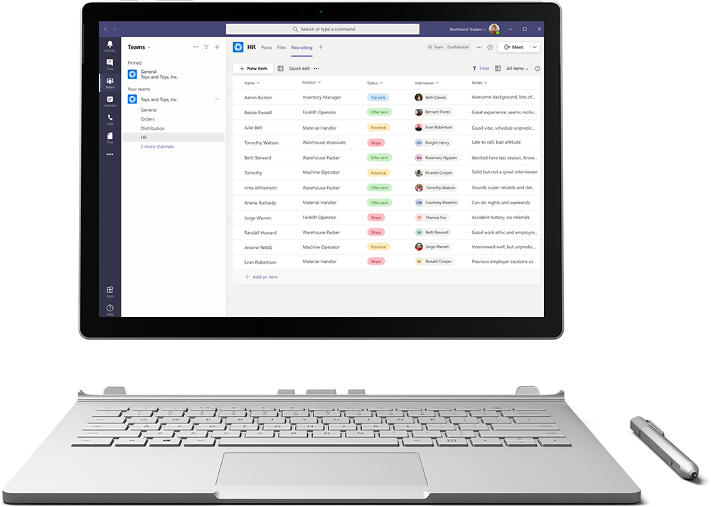
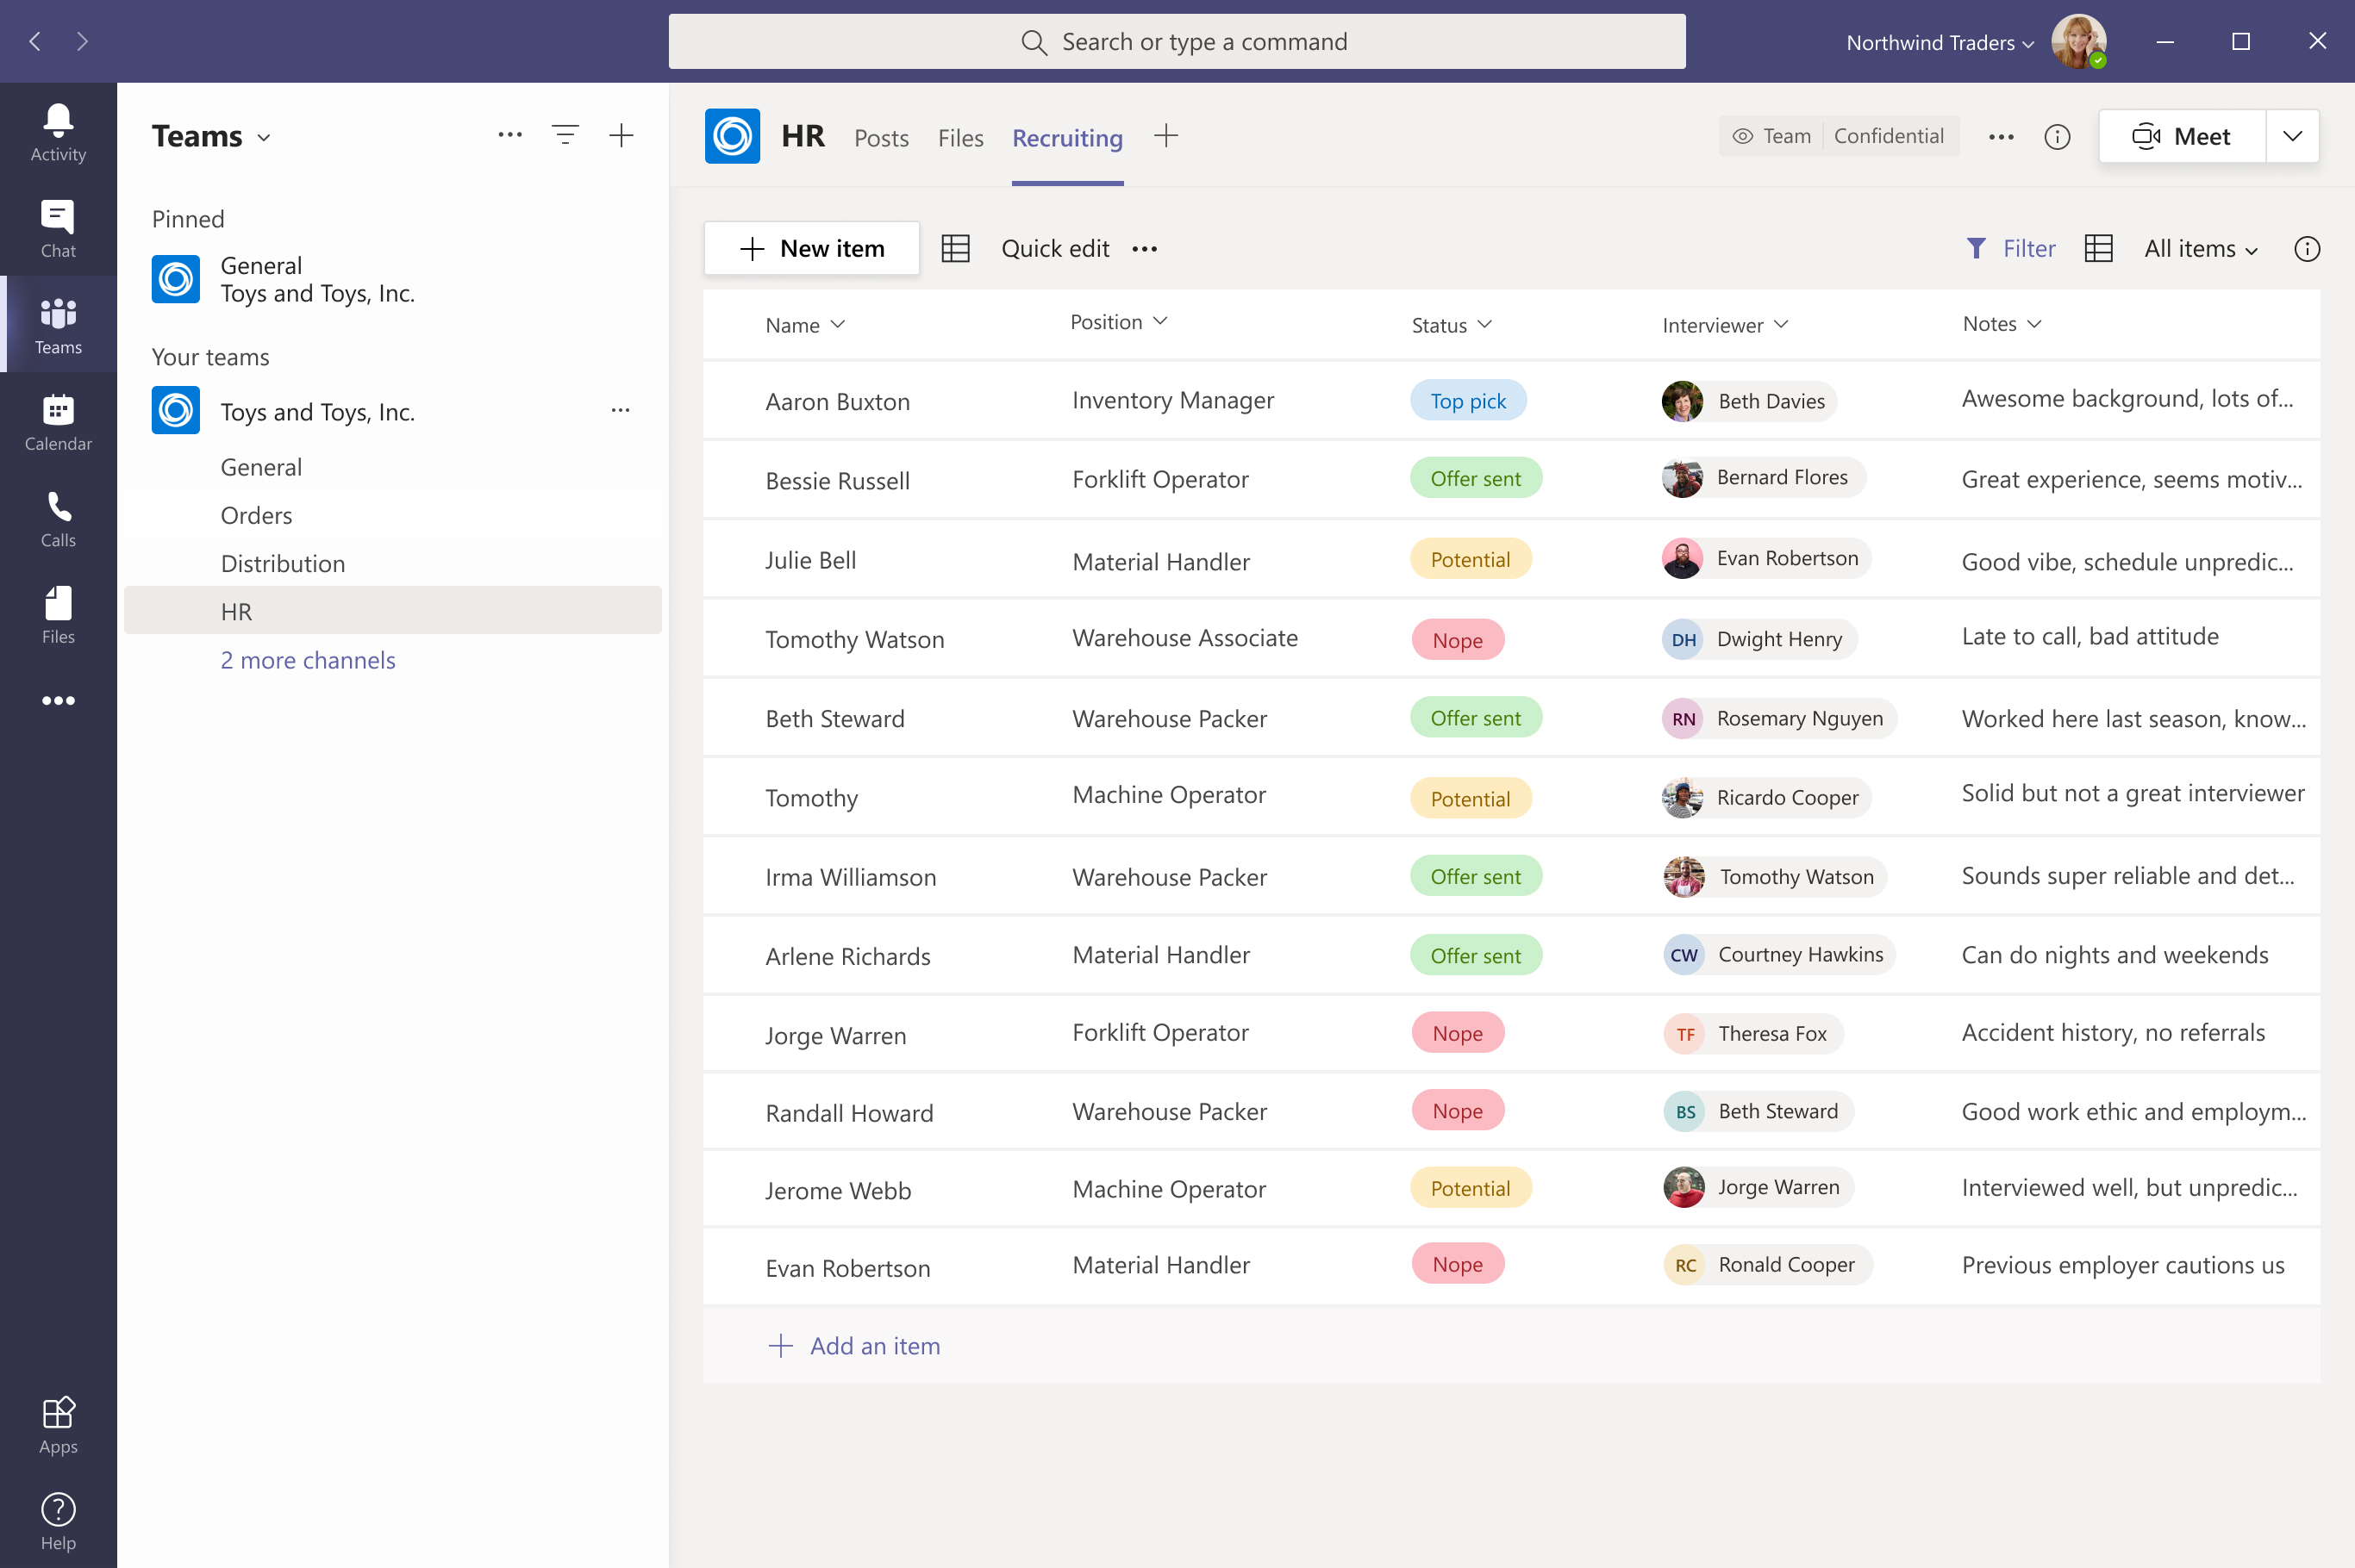

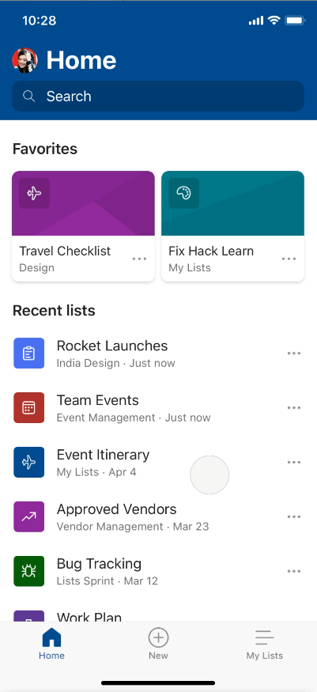
Track what matters most with Microsoft Lists
Simple
Easily create, share, and track lists with anyone, on any device
Smart
Keep everyone in sync with rules and quick edits
Flexible
Customize your lists for whatever your business needs
Notes:
This app is designed to help you track information and organize work. If you’re one of the millions of people already using SharePoint lists to track and organize work, the Lists app makes it easier than ever before to get back to the lists you rely on. If you are new to the world of Lists, I hope this presentation convinces you to go out and give them a try.
Think of Lists as lightweight databases that anybody can create and customize. At the heart of every list is a flexible table of data, where you can define the schema of the items you want to track. Using this power, anybody can start a list to track anything and everything that matters, including issues, assets, routines, contacts, inventory and more. If you’re not into defining your own schema, that’s OK, we’ve got you covered with our library of out of the box list templates – I’ll show you some of them in a bit.
The power of Lists as lightweight databases becomes evident when you start layering custom formatting, views, and automations on top of your data to help your team stay productive and focused on what needs to get done. In this session, we show you how to do this, and more, in the browser, in Teams, and on your mobile device. And the best part is, because Lists are a part of Microsoft 365, you can rely on enterprise-ready security and compliance for everything see here.

Slide 12
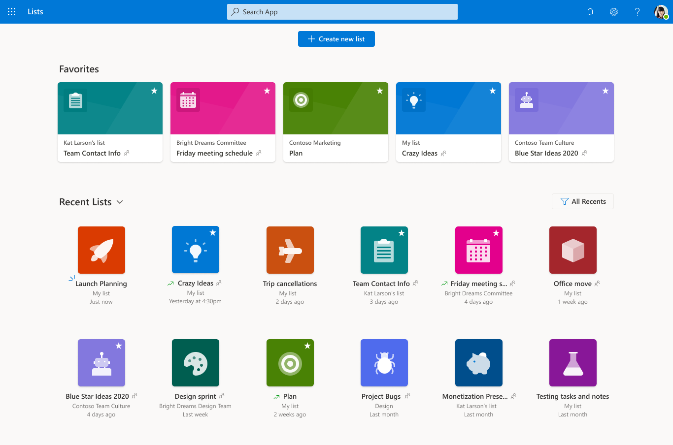
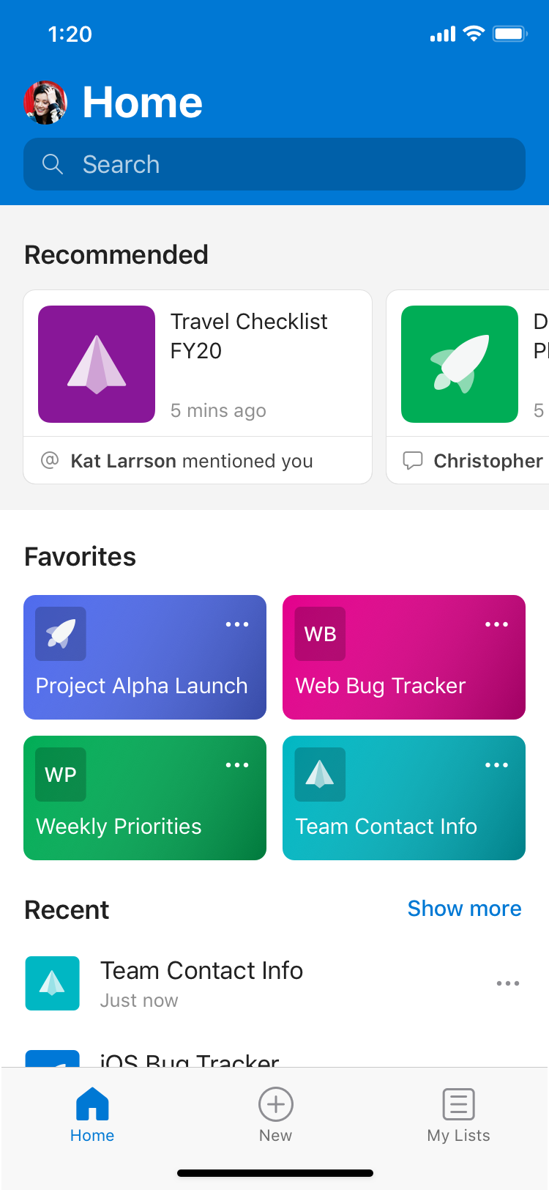
Microsoft Lists – web home and mobile
What’s new
Lists app, available in Microsoft 365 suite navigation on the web
View Favorites and Recent Lists across all your sites
Create new lists
Search across all your lists
Notes:
We're excited to announce that we're bringing the power of lists to all Microsoft 365 users, even those who aren’t currently acquainted with SP and regularly use team sites.
At Build 2020, we will launch a new Lists home that you will be able to access from Microsoft 365 suite navigation on the web. We, too, will bring this same functionality to a new “Lists” app for mobile. This app brings your lists “in your pocket” - you can see all your lists, view and edit items inside those lists with full fidelity and create and customize new lists.

Slide 13
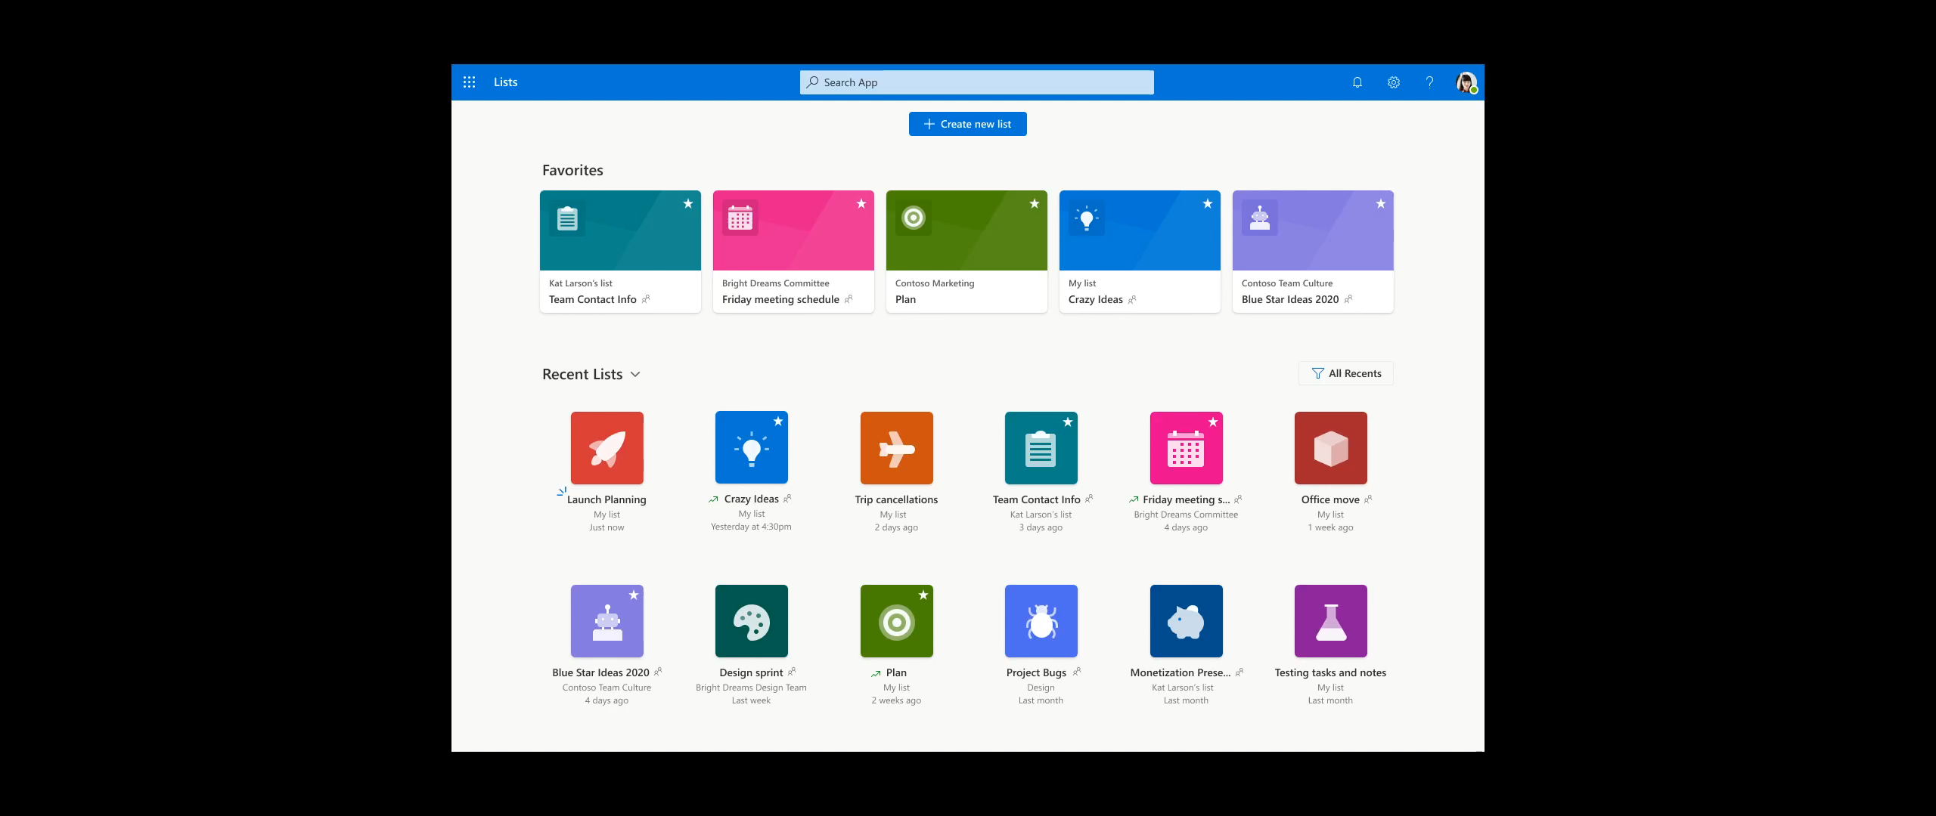
DEMO | Lists’ home & create new

Slide 14
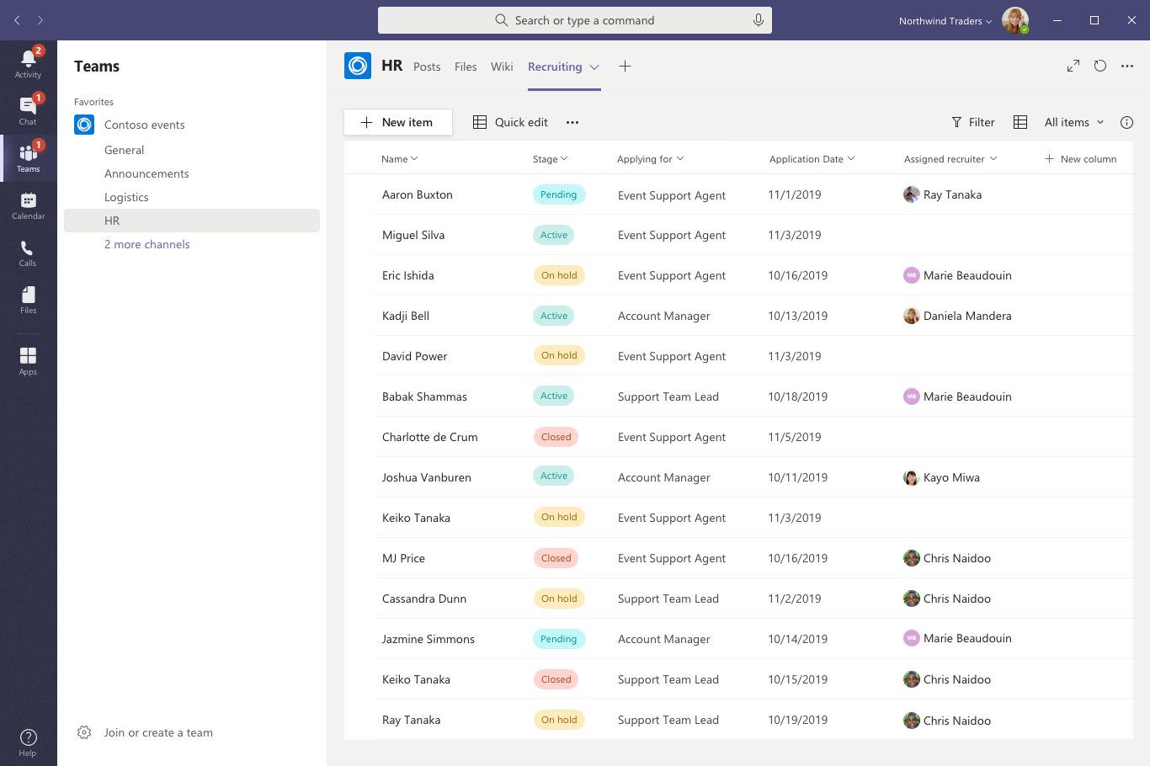
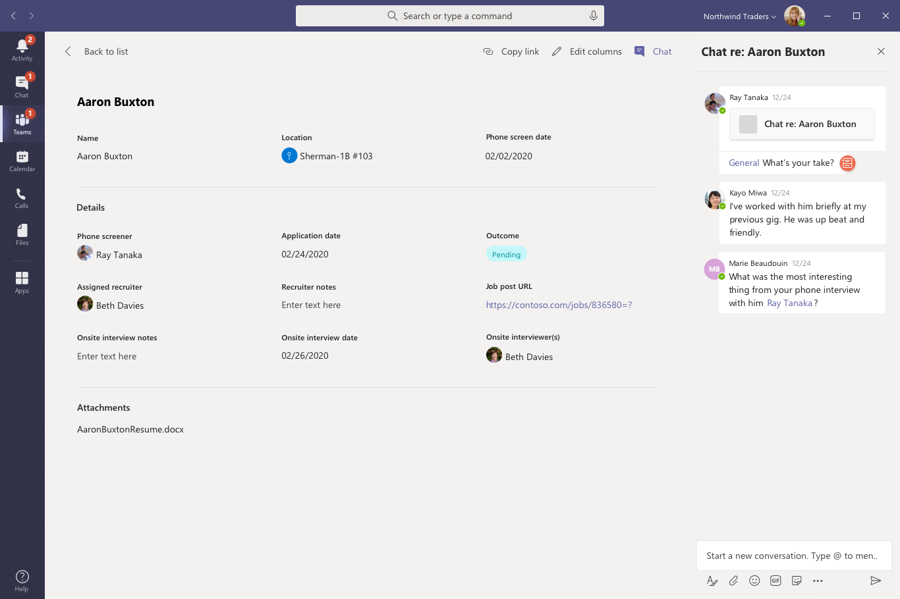
Lists + Teams
Work with Lists in the apps you use every day!
Embed a list as a tab
  Create New – same list of templates
  Embed existing list
Teams-tailored list experience with full feature parity
Conversations on list items, specific to each channel
Notes:
Work with lists in the apps you use every day to collaborate – like Microsoft Teams. Lists will be full-featured and look great embedded as Teams tabs.
At Build 2020, we will launch the Lists and Teams integration which will showcase a Patient rounding and care coordination template, built on modern list templates. This is just the start of list-powered, turnkey, vertical solutions provided by Microsoft.

Slide 15
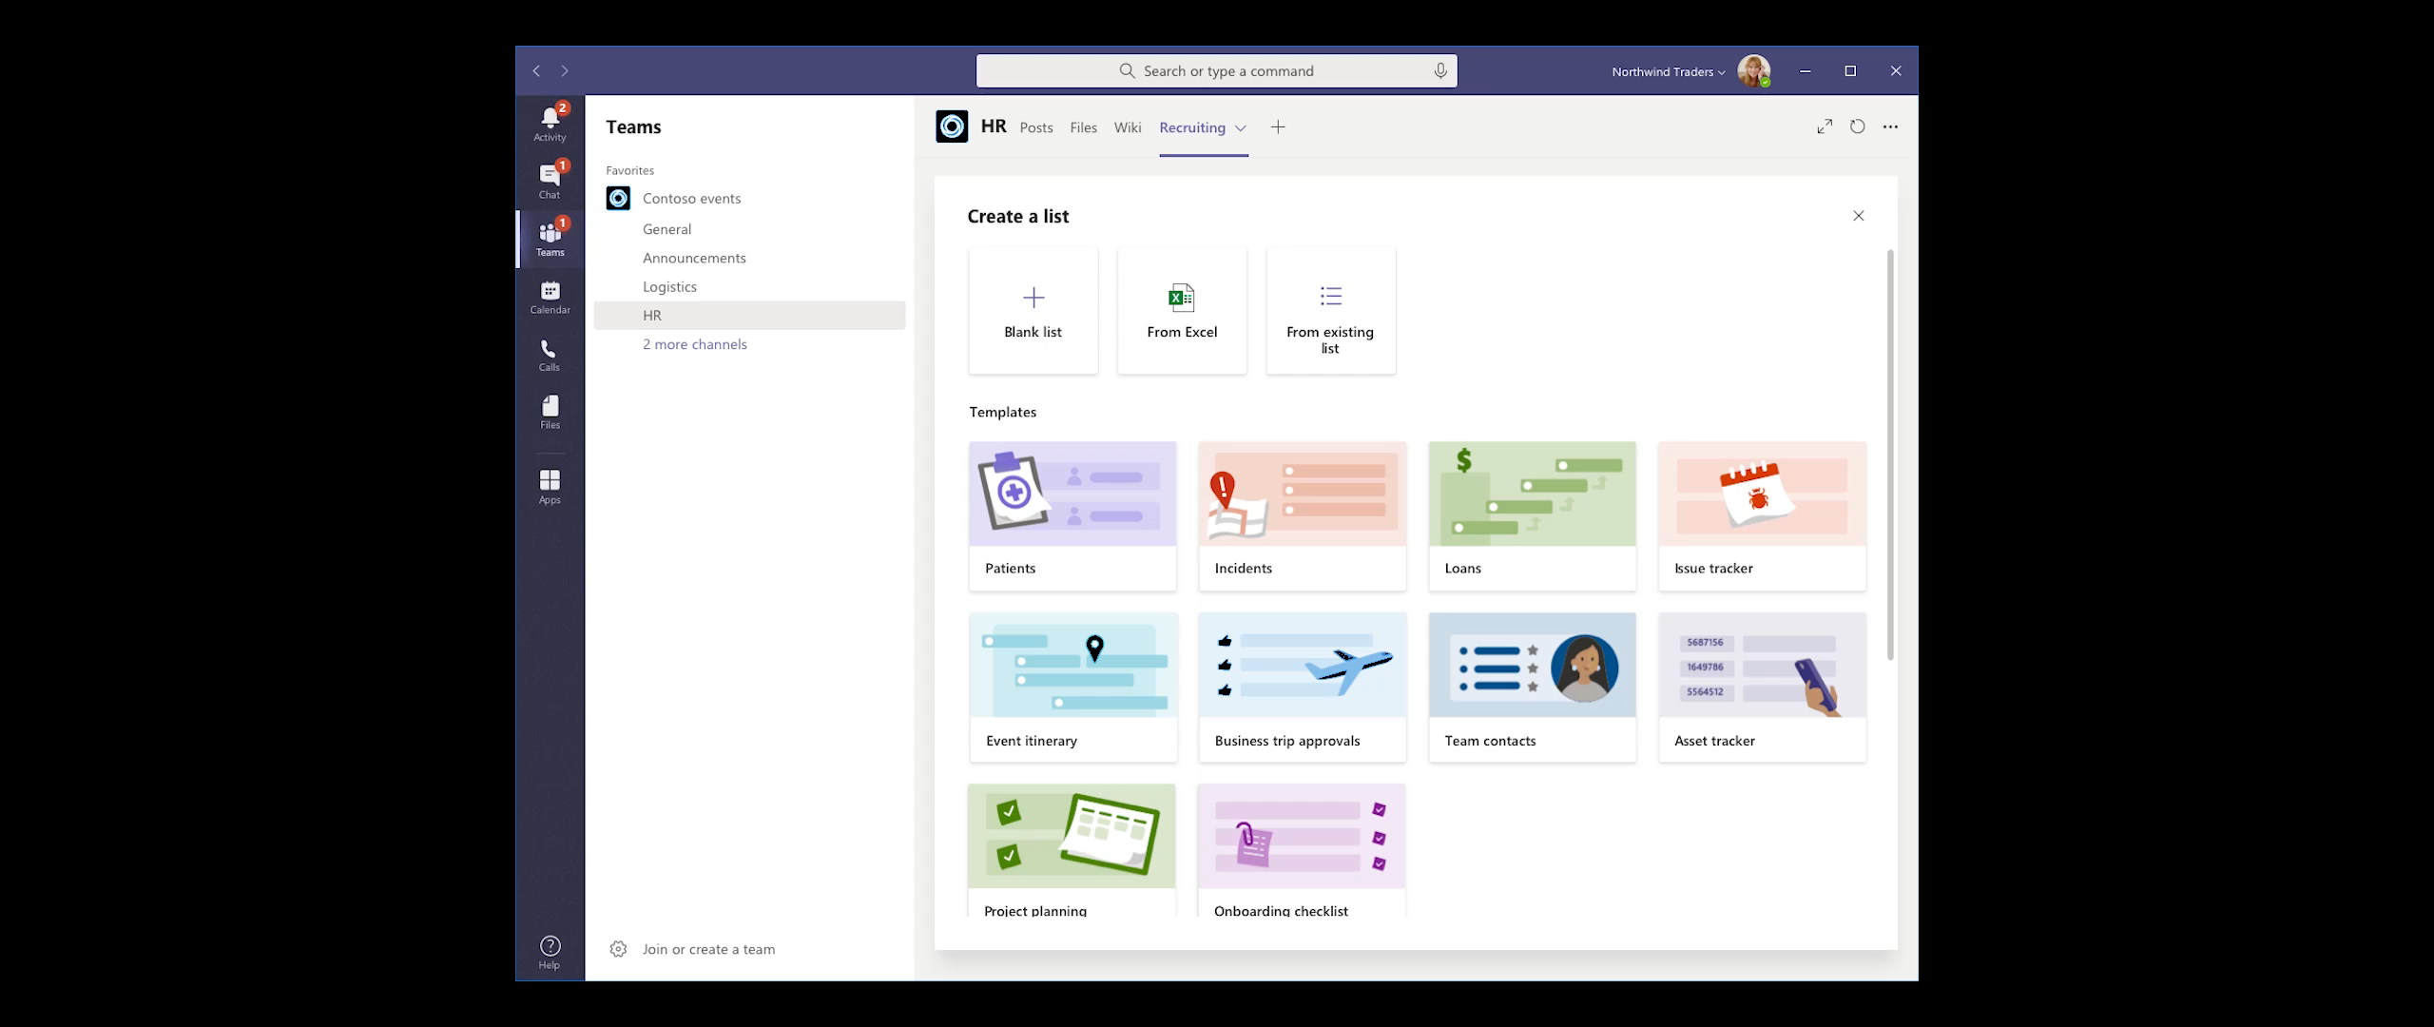
DEMO | Lists in Microsoft Teams

Slide 16
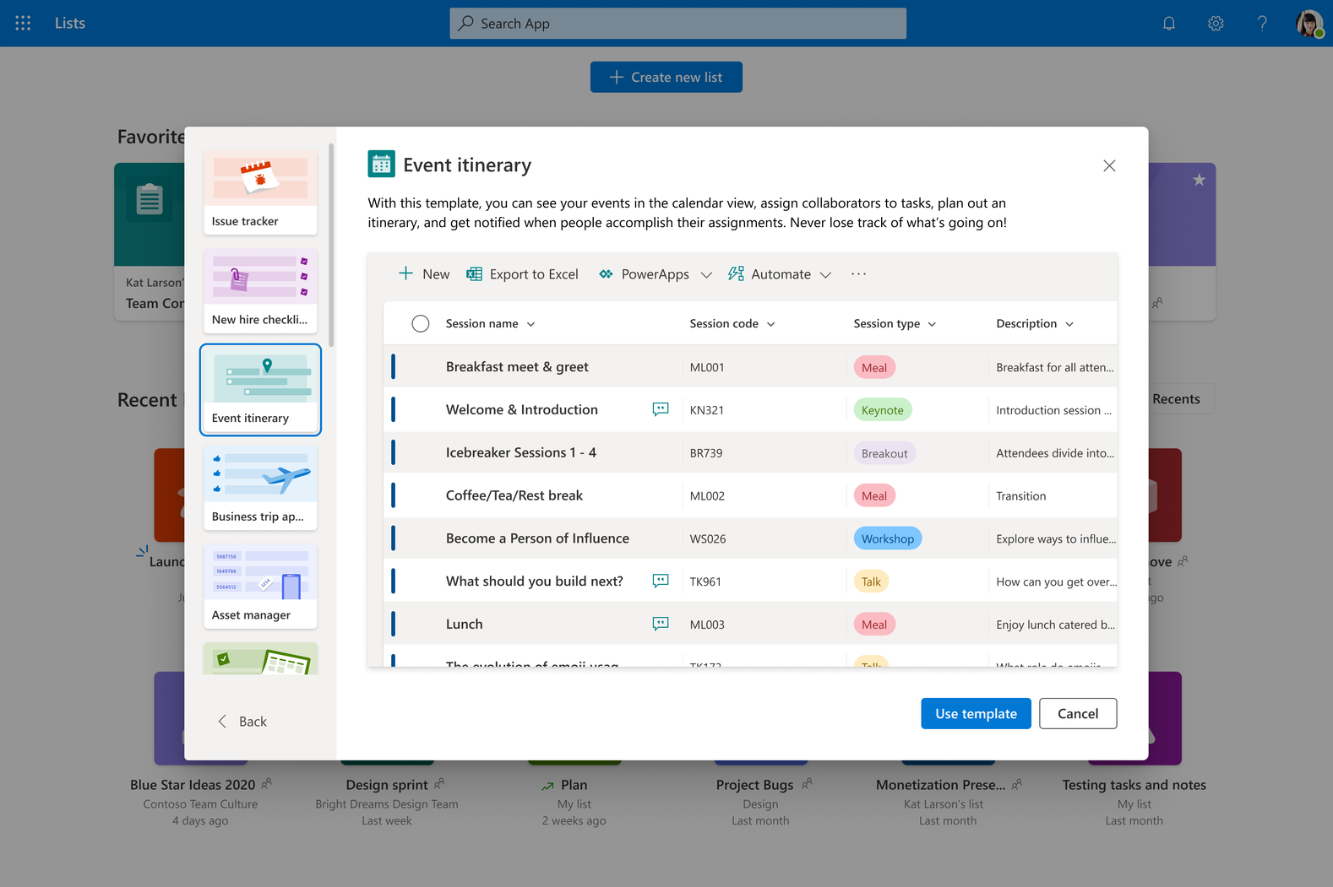
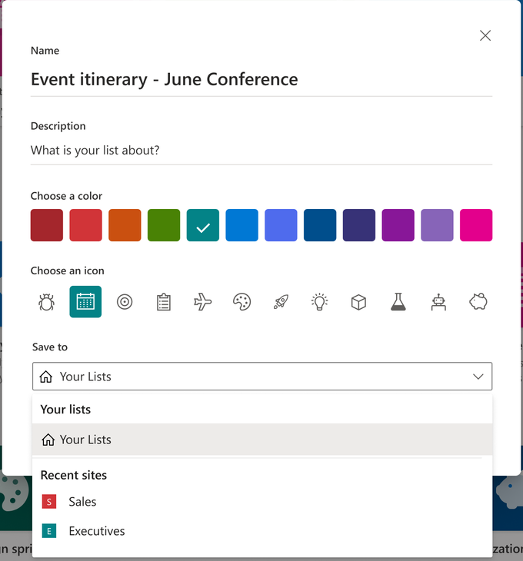
List creation
What’s new
Create from Excel
Create from template
  8-10 out of the box templates
Create personal lists or shared lists in team sites
Lists get a color & icon
Notes:
Millions of users a month use apps built on SharePoint lists to gather, manage, track, and share structured data.
All these users will notice sweeping improvements to core list experiences this year. Viewing and editing data, schema, and views will be fast and fluid with an industry-leading experience on web and mobile.
We're excited to announce that we're bringing the power of lists to all Microsoft 365 users, even those who aren’t currently acquainted with SP and regularly use team sites.
At Build 2020, we will launch a new Lists home that you will be able to access from Microsoft 365 suite navigation on the web. We, too, will bring this same functionality to a new “Lists” app for mobile. This app brings your lists “in your pocket” - you can see all your lists, view and edit items inside those lists with full fidelity and create and customize new lists.

Slide 17
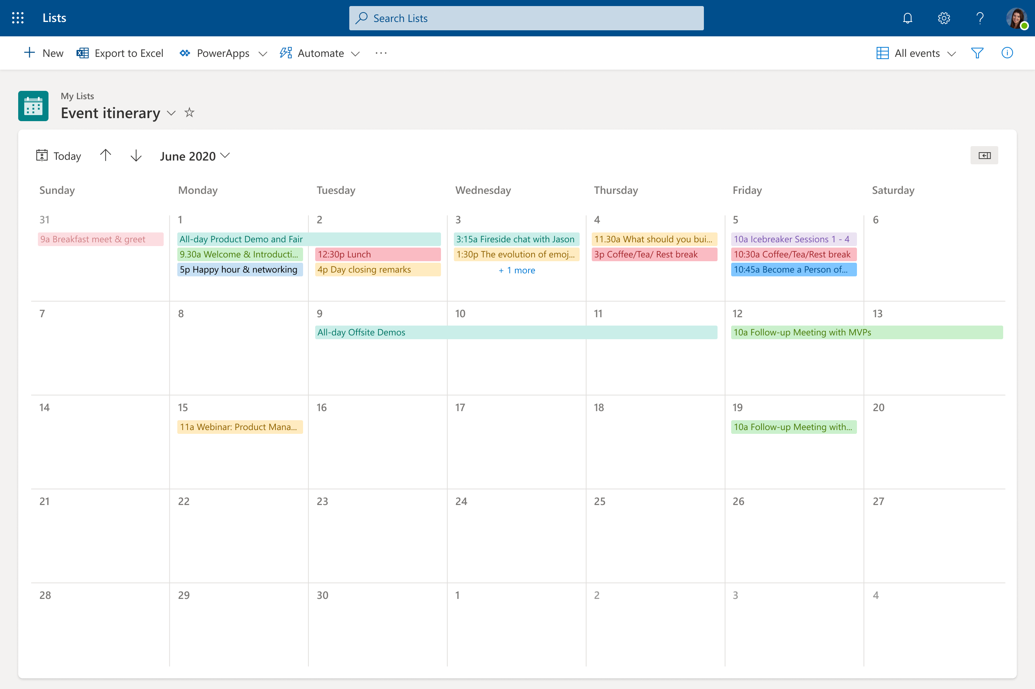
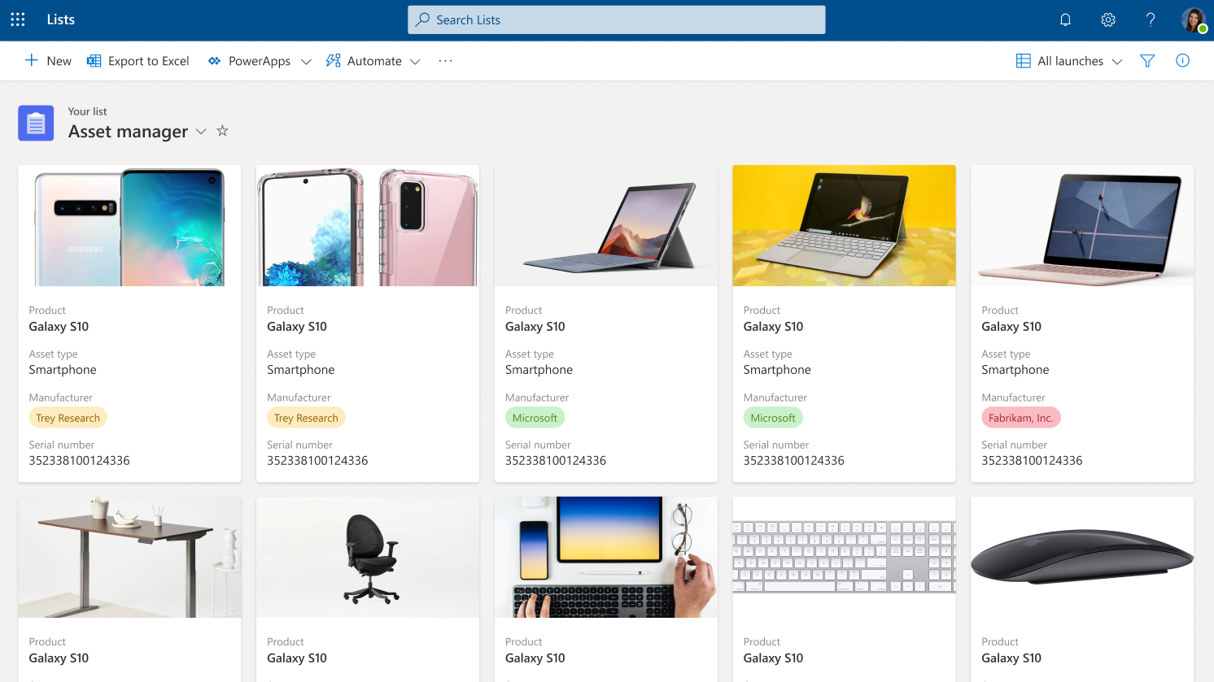
Views and formatting
What’s new
New View creation UI
Calendar View with Month Layout
Gallery View with Card Designer
Notes:
We're making it easier than ever before to get started building list apps by introducing a new modern template ecosystem. Users can choose from a set of Microsoft first-party templates when creating a new list. We’ll then work to enable third-party templates later in the year.
Lists can be created in the user's personal space and later shared or created in a team site to be shared from the get-go.
Lists from templates are lightweight turnkey apps. And their true power is in inspiring the “art of the possible.” Start from a template and easily tweak formats to shine a light on important data; configure forms to keep your team productive; configure reminders to keep you and your team up to date on what’s happening.
Calendar views are one of our top feature requests. Customers historically have loved using SharePoint to maintain a shared list of team events. For Build 2020, we’re enabling any list to be visualized inside a calendar view. This makes lists the ideal system for apps that use date as a tracking mechanism: vacation calendars, task lists, event planners, and more.

Slide 18
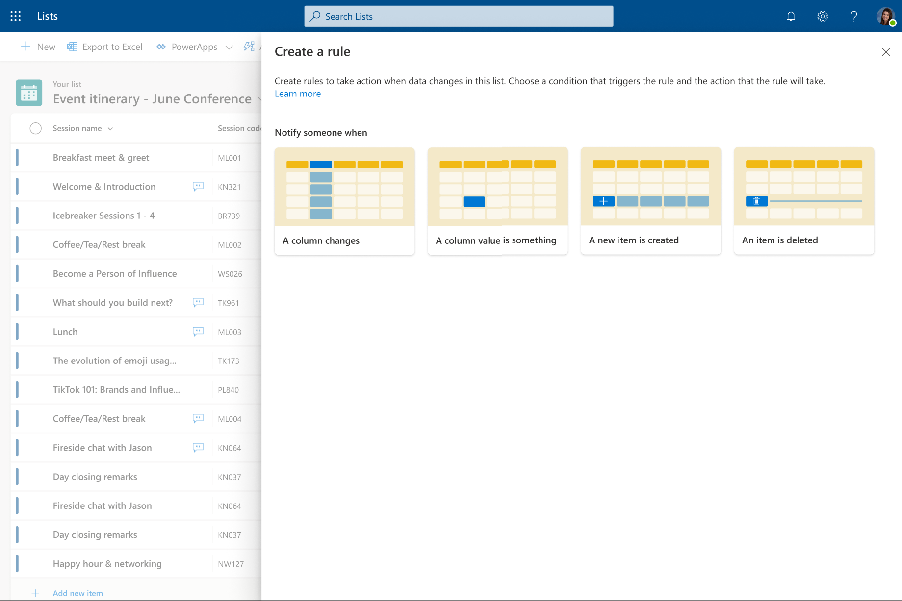
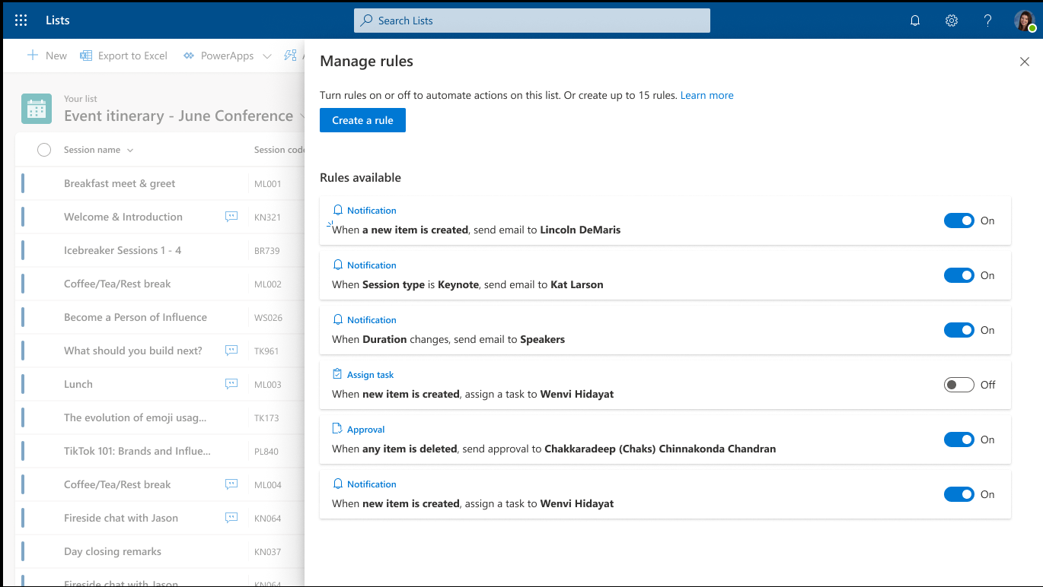
Rules and notifications
What’s new
Rules can be created for five conditions:
  Item is created, modified, or deleted
  A column value changes
  A column value = <something>
Rules will send notifications to specified recipients
Rules built into list templates
Notes:
People can easily set reminders to keep themselves and their teammates up to date. Microsoft Lists uses an if/then approach to optimize the management of the list and list items. People can build rules to trigger actions on status, conditions and value changes. This includes the ability to send notifications to specified recipients.

Slide 19
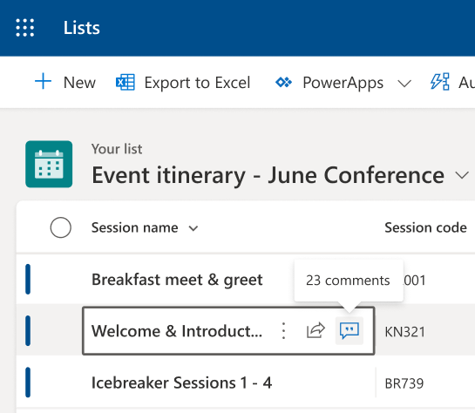
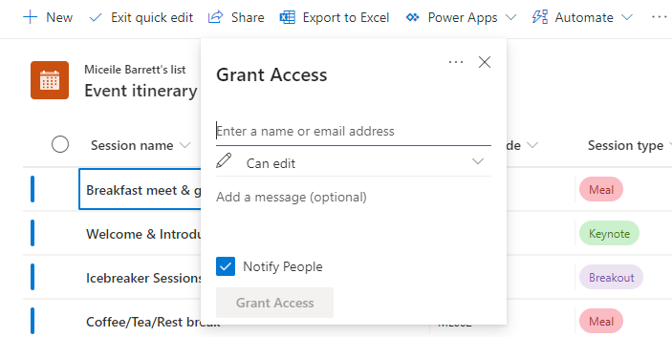
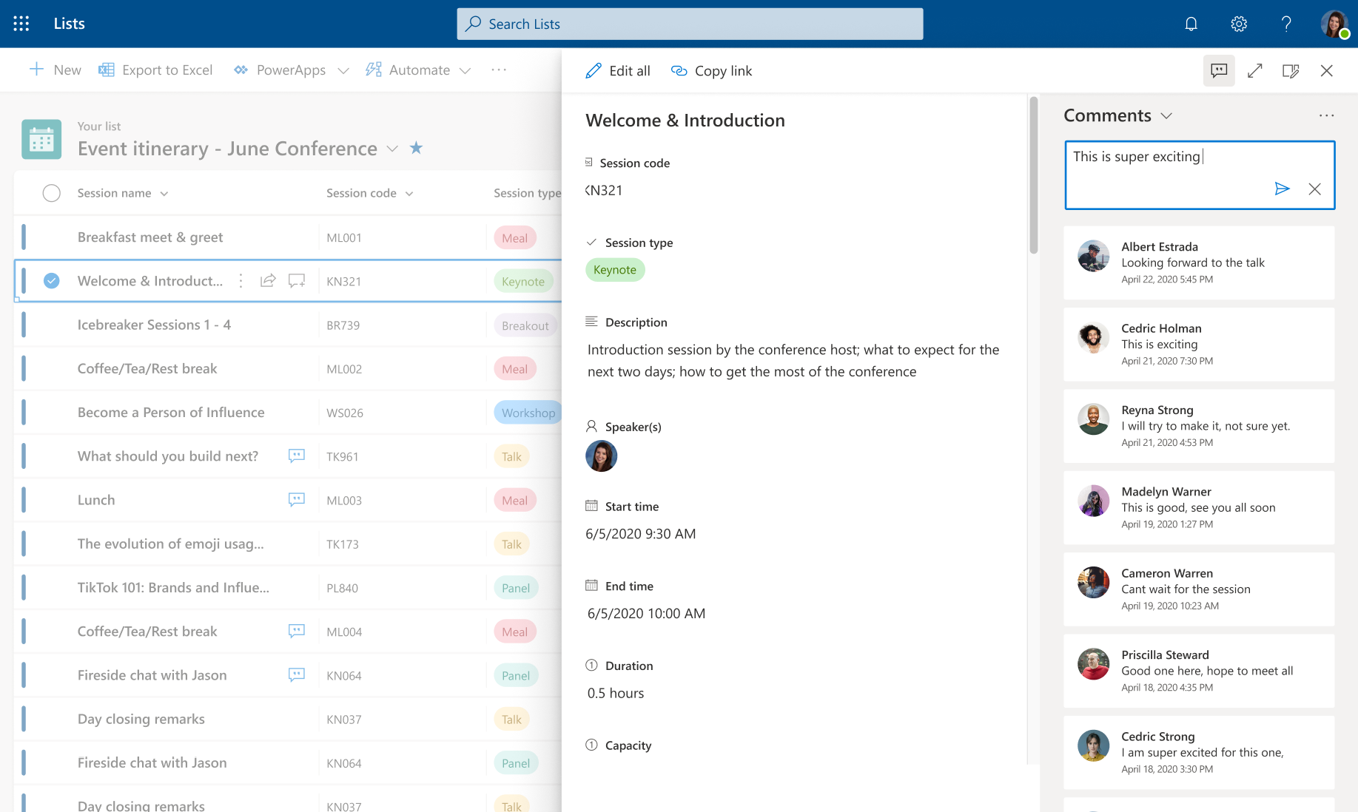
Sharing, collaboration, and commenting
What’s new
Link sharing for list items
  Company-sharable links
  Anyone links
  Set expiration date, password
Grant access to lists
Comment on list items
  Access comments via form in an expandable pane
Notes:
The best lists are like the best documents – they are the culmination of work and contributions across multiple team members.
At Build 2020, we will launch the ability to @mention colleagues inside a list, directing them to update status or fill out required information.

Slide 20
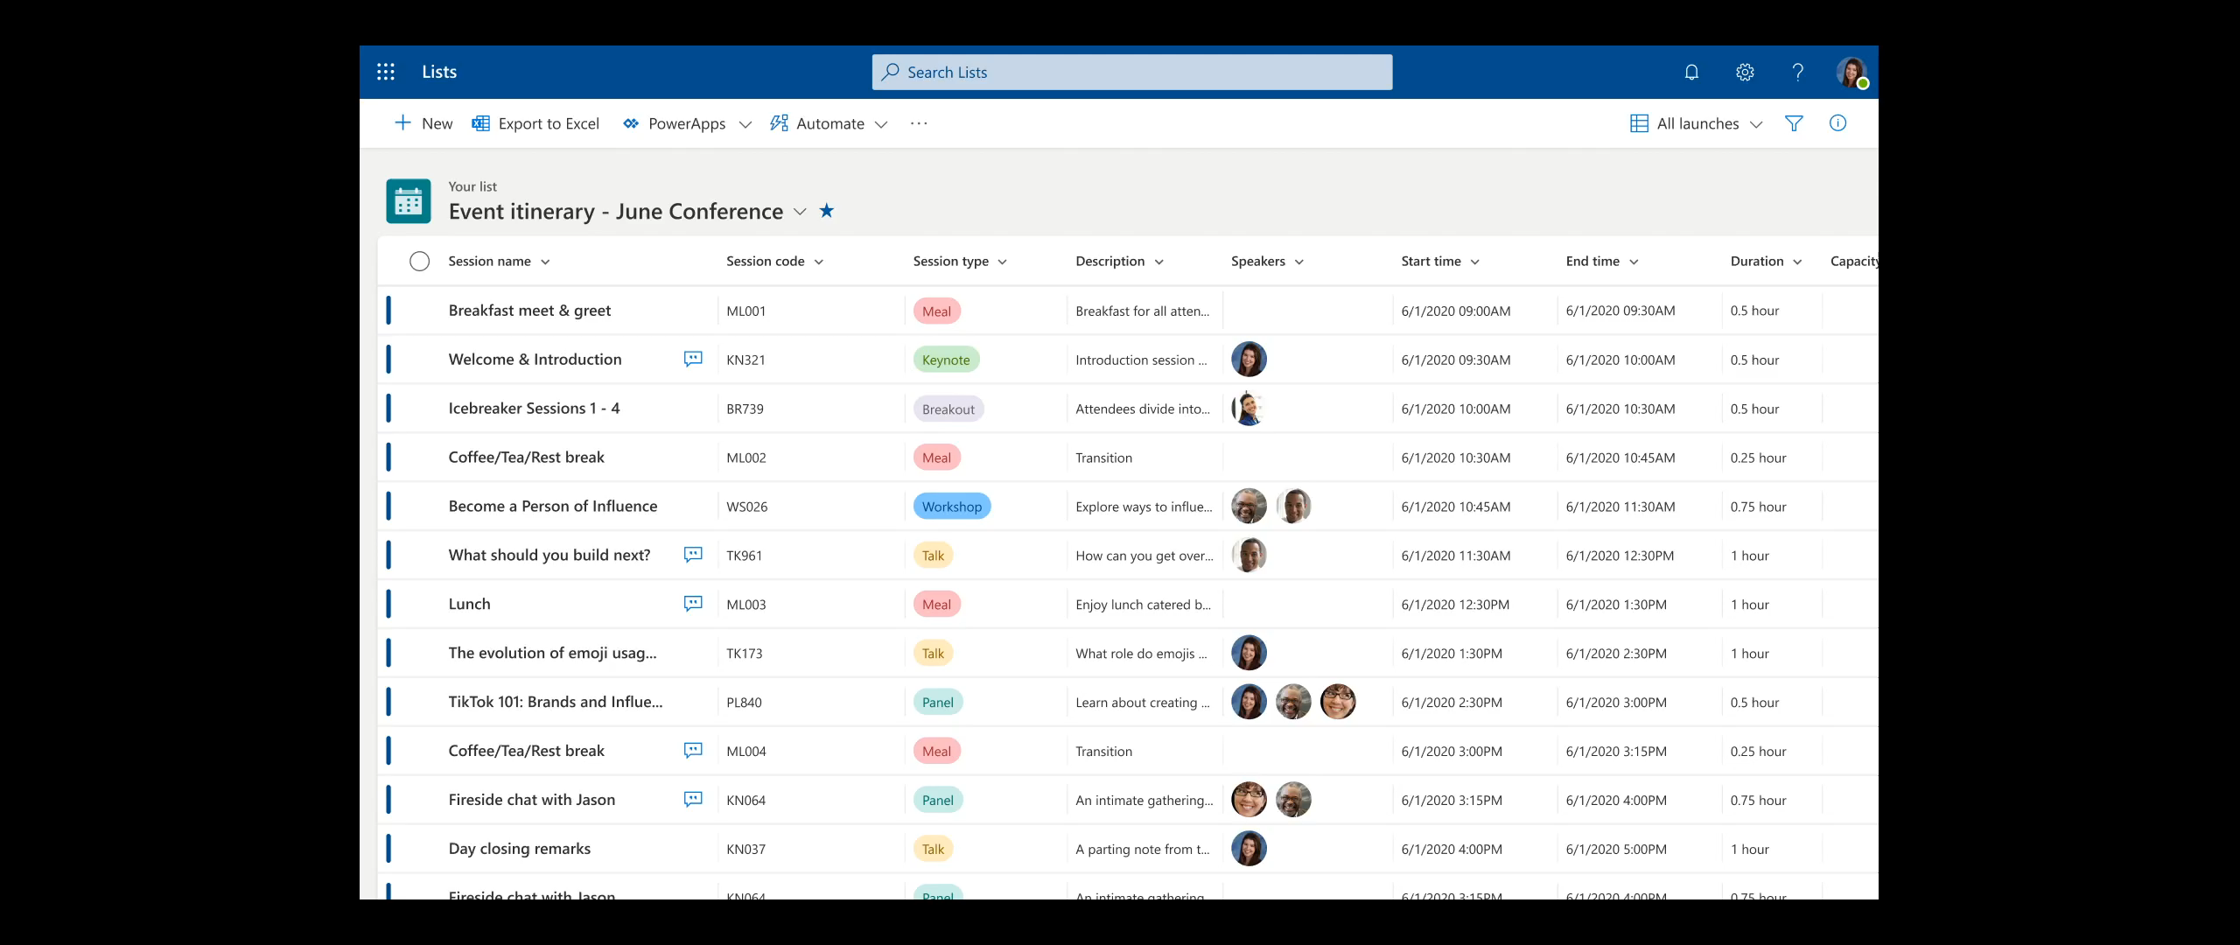
DEMO | Commenting on a list

Slide 21
Common Microsoft Lists FAQs
Microsoft Lists is an evolution of SharePoint lists (same infrastructure)
Microsoft Lists is not a task app
Personal lists are stored in a person’s My Site (like OneDrive to files)
Availability for commercial and government clouds
Rules are not based on Power Automate and integration continues
Comments are stored in a list’s schema

Slide 22
New & upcoming assets | Need to know

Slide 23
Upcoming community events
CommsVerse in UK – September 2021
TeamsFest / SharePointFest in Washington DC – September 2021
Thrive Conference in Slovenia – October 2021
European Collaboration Summit - November 2021
M365 Collaboration Conference in Las Vegas, NV – December 2021
Explore other Microsoft Events
Our next Champion Community call:
August 24th @ 8 AM & 5 PM PT

Slide 24
Microsoft 365 Champion Community News
**No community call for July**
Next community call
August 24th
Top asks:
Complete our monthly call survey: https://aka.ms/Microsoft365ChampionCallFeedback
Participate in the Driving Adoption Community:
https://aka.ms/DrivingAdoption
Invite colleagues to join the Champion Program: https://aka.ms/M365Champions

Slide 25
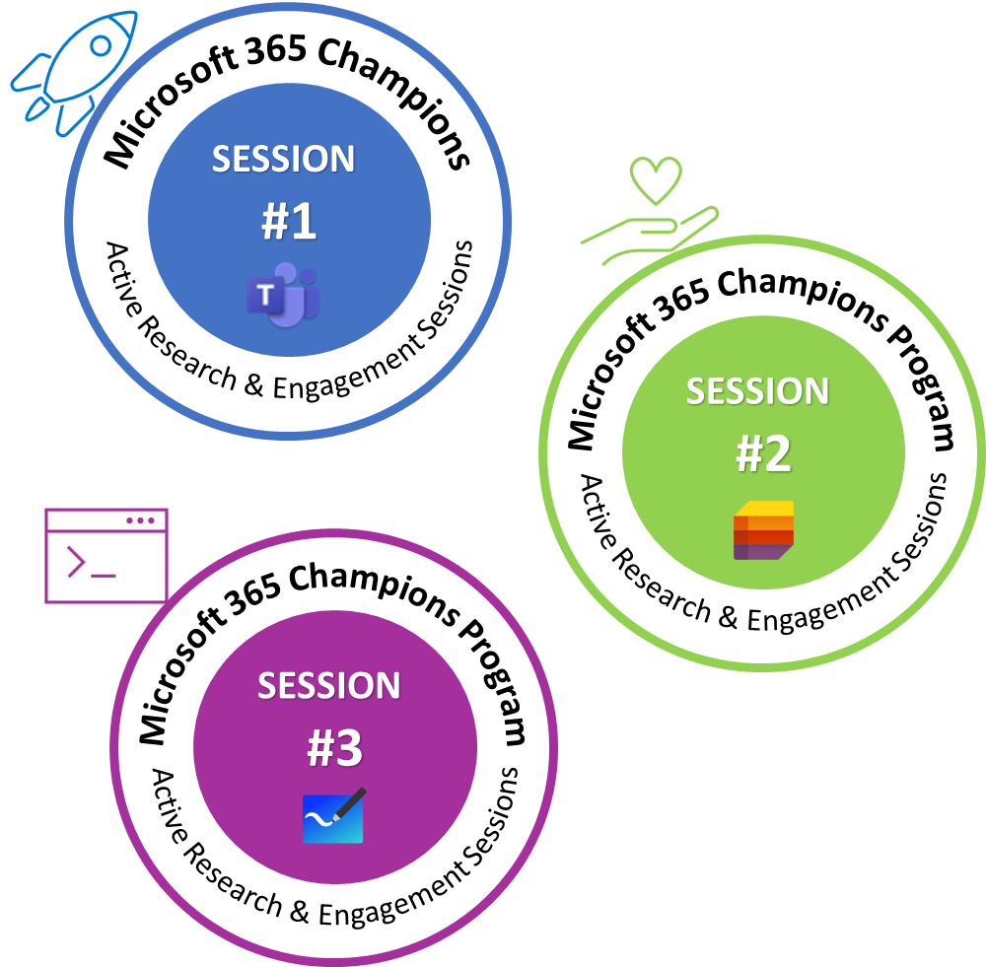


Second half program enhancements
(July – December 2021) | Based on your feedback!
CARES Program
New meeting format
(starting with our next meeting in August 2021)
Enhanced Communications

Slide 26
CARES Program
Overview
Enabling small group connections.
Designed to connect you with more Microsoft resources and engagement opportunities.
Unique badges* to represent participation throughout program.
In partnership with Teams Design Research group and their CaFE series.
Signup for sessions starting soon! Look for more information in the M365 Champions Newsletter.
*Sample badges / will be updated with feedback solution areas

Slide 27
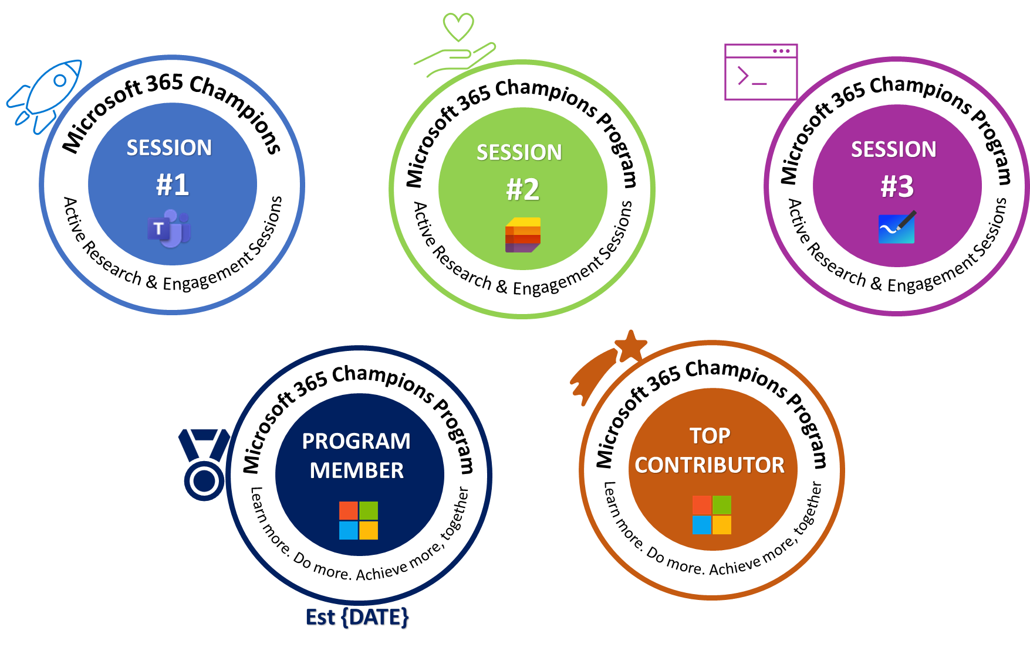
Community Digital Badges
Show off your participation and contributions to the Champion
community with badges that represent different milestones!
Notes:
Sample bad

Slide 28
New meeting format
Overview
Standard meetings + Webinars will be our new meeting format moving forward.
Same content type with added ability for open and dynamic engagements throughout the call.
Look for signups & invites via email newsletters / resources page / Driving Adoption forum.
Future of potential simulcasting to other platforms.
Resource Page: https://aka.ms/M365ChampionResources
Driving Adoption Forum: https://aka.ms/DrivingAdoption

Slide 29
Enhanced communications
Overview
Returning to delivering our newsletter to program members.
More information sharing across our community spaces (Driving Adoption).
Hear about program updates, official resources, and more.
Make sure you are a member of the program here: https://aka.ms/M365champions

Slide 30
Thanks for attending! We’d love your feedback on todays call and hear ways we can make future calls even better!
https://aka.ms/Microsoft365ChampionCallFeedback
Microsoft 365 Champion Community
Learn more. Do more. Achieve more, together.

