Slide 1
Microsoft 365 Community Call
Microsoft 365 Champion Community
February 2021 Monthly Call
Karuana Gatimu, Community Lead
Microsoft Teams Customer Advocacy Group
Notes:
Join our worldwide program at https://aka.ms/Microsoft365Champions
Materials included in this deck are free to use in your daily work.
Please reference our program as the source of this information.
For questions or comments please reach out in the Drive Adoption or Champion’s Corner forums of the Microsoft Technical Community at https://aka.ms/DriveAdoption

Slide 2
Agenda
February 2021 | Inspire & innovate, reimagine a better future
Focusing on what matters | Team Connections
Champion hub tools| Overview & guidance
Task publishing| Overview & guidance
New & upcoming assets | Need to know
Adoption Hub V2 -> launched!
Custom Background Gallery -> Call for spring content!
Upcoming events
Find resources from previous calls here:
https://aka.ms/M365ChampResources

Slide 3
Reimagine a better future
We have an enormous opportunity and responsibility to ensure the technology we create benefits everyone on the planet, as well as the planet itself.
We believe that companies that can do more, should. That’s why we focus on four key areas in which technology can and must benefit the future of humanity and our planet.
Microsoft Corporate Social Responsibility - Microsoft CSR
Notes:
As you can see, our own CEO acknowledges that human attention is a scare commodity.
We are literally inundated with messages, whether phone, text, email, or social media-based, that constantly interrupt us and our trains of thought.
Let’s dive a bit deeper here and talk about this scare resource—attention.

Slide 4
Our commitments
Support inclusive economic opportunity
Protect fundamental rights
Commit to a sustainable future
Earn trust
Microsoft Corporate Social Responsibility - Microsoft CSR

Slide 5
Introducing new community managers
Josh Leporati
Teams Customer Advocacy Group
Ryan McKinney
Customer Success Leader

Slide 6
Focusing on what matters | Team Connections

Slide 7
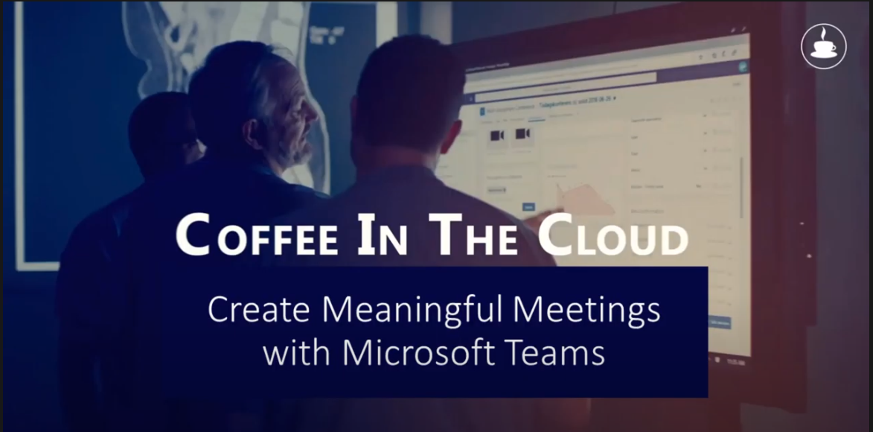
Meaningful Meetings Live your company culture Put employee well being first Use the technology #HumansFirst

Slide 8
Fostering Team Building & Employee Connections
The Digital Water Cooler
Water Cooler Channel in a Team
Virtual Team Building
Team Walk & Talk
1:1 Icebreaker Water Cooler
The Icebreaker Bot Teams App template pairs up colleagues 1:1 across the org each week, encouraging new relationships and network expansion.
#ThrowbackThursdays
Designate time for a Team meeting where everyone is encouraged to take a walk outdoors (weather permitting). Join via the Teams mobile app, turn on your camera, and have everyone take turns sharing the scenery that they are enjoying on their walk.
Everyone loves seeing and sharing old photos. In your fun/watercooler channel in Teams or Yammer community, start a thread for #ThrowbackThursday and encourage people to post some classic pictures.
Dedicated to sharing and talking about random, often non-work-related topics. Team members often use this area to share fun videos, cool virtual backgrounds, celebrating birthdays, tips on wellness, etc.
The teams you work with are the cornerstone of moving ideas and work from inspiration to action. Make sure you take the time to build and encourage connections in these groups for yourself and others!
Visit the Driving Adoption blog and forum for more ideas about fostering team building & employee connections.

Slide 9
Champion Hub Tools | Overview & Guidance

Slide 10
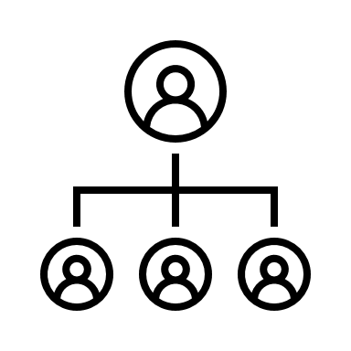
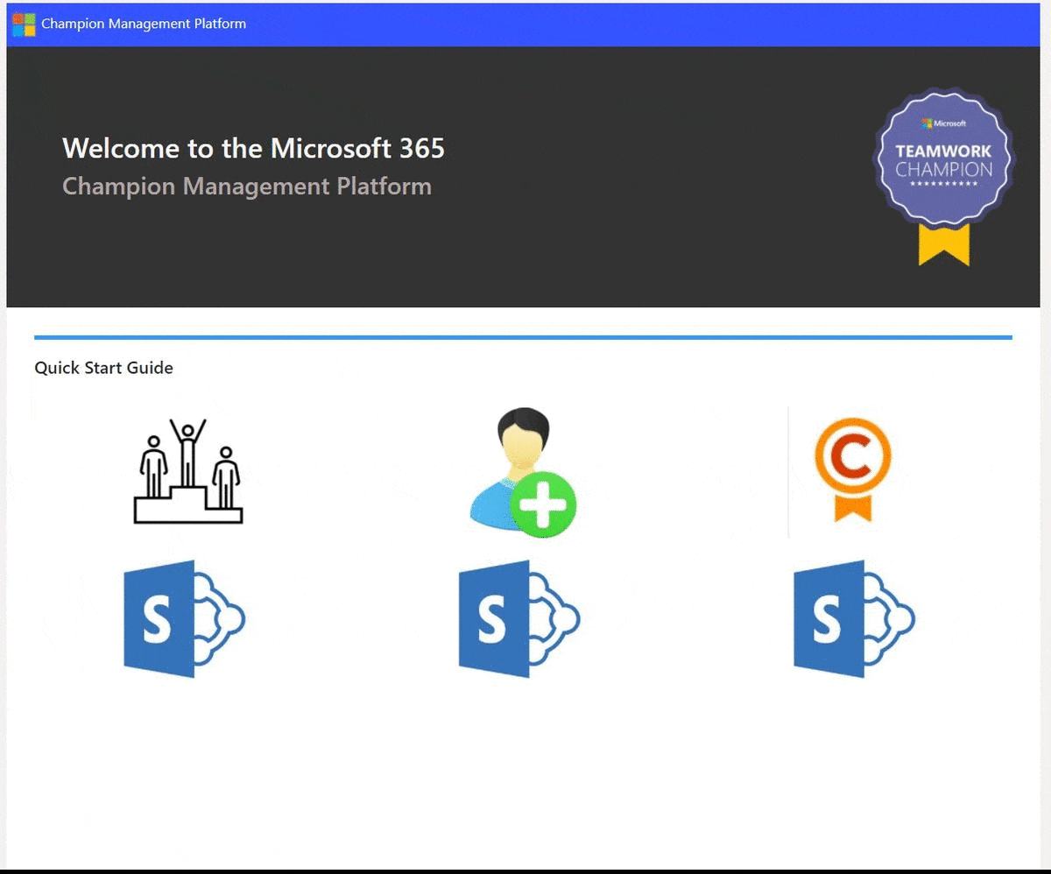
Champion Management Platform
First party toolset designed to help you manage your champions program!
Champion participation management through Lists
Leaderboard functionality to display status and track goals based on custom event types
Digital Badge tooling included
Launching at Microsoft Ignite – March 2nd | Look at our Driving Adoption Blog for release day information.
Notes:
We are readying the release of V1 which will include basic champion management through Lists, the ability to display leaderboard results and search through champions near you, as well as digital badging integration. We are excited about this V1 release and are already envisioning some exciting enhancements to V2 like bot based conversations out to your champion community for news and updates, streamlined dashboarding, etc.

Slide 11
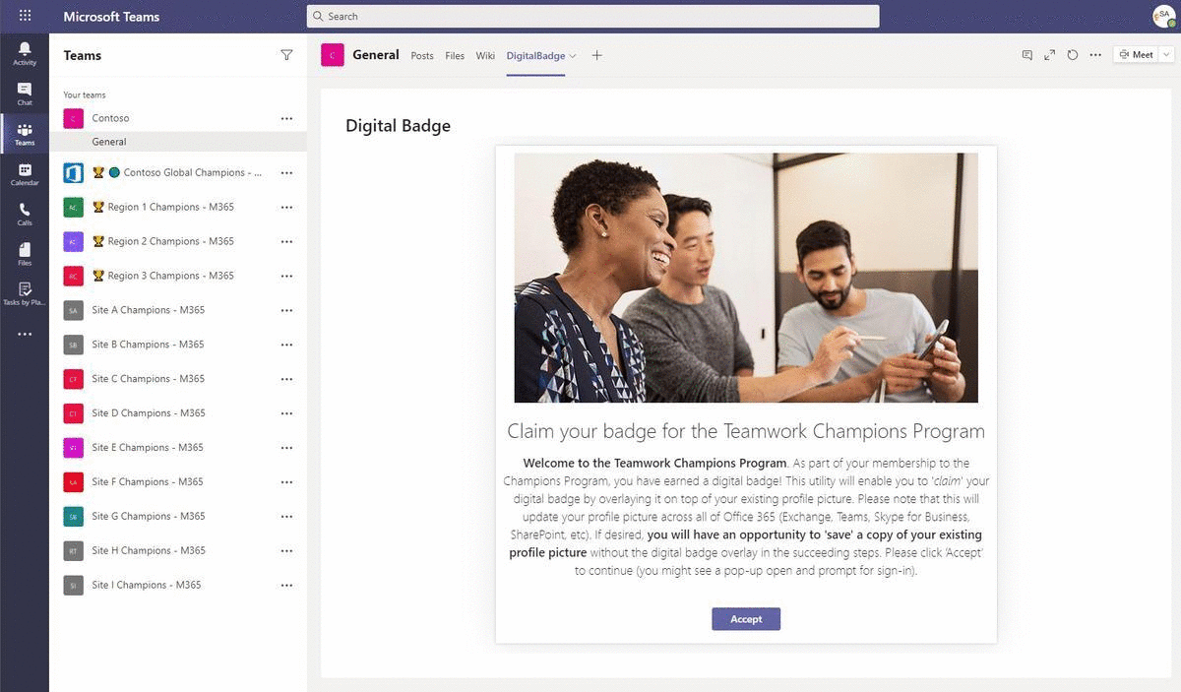
Digital badge tool
Lightweight tool to help spread awareness of your champion program
Centralized management and approval of application
Seamless usage through existing Team structures
Launching at Microsoft Ignite – March 2nd | Look at our Driving Adoption Blog for release day information.

Slide 12
Task Publishing | Overview & Guidance

Slide 13
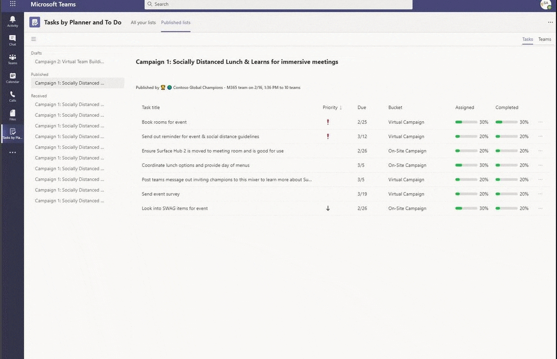
Task publishing scenarios
As a Teams user who has been enabled for task publishing by your organization, you can create a list of tasks to send to any number of teams in your org.
Each team gets its own copy of the list for assigning and completing tasks and tracking team progress. If you're a team manager, find out how to assign and track tasks in Teams.
We think there are some exciting scenarios for you to leverage with your champion programs via Task publishing.

Slide 14
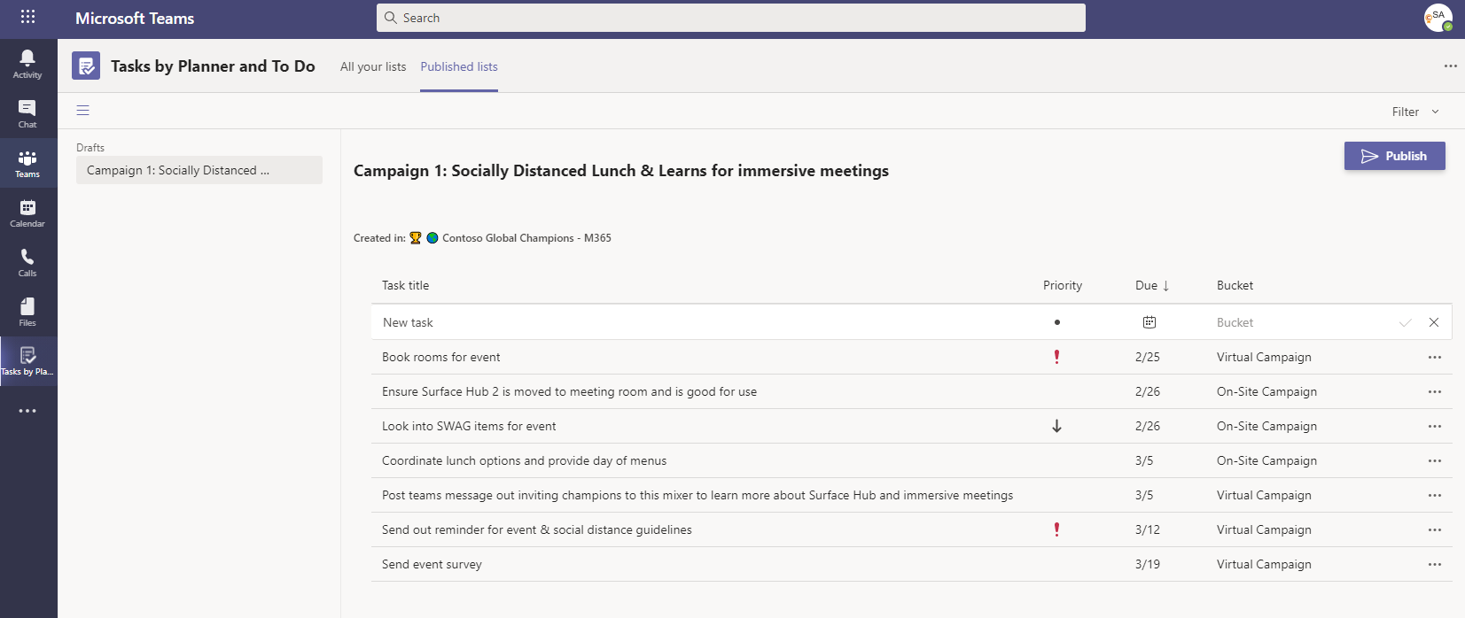
Thinking through Teams Tasks hierarchy
How you build out your organizational hierarchy will determine how you can deliver tasks to the corresponding teams.
You are in control of the hierarchy and can build it to suit your organization’s needs.
View the blog post in our Driving Adoption blog for a complete walkthrough and to engage with others in the community.

Slide 15
Getting started with Task publishing
IT Admin assistance with initial deployment
Global Admin or Teams Service Admin
Will require preview PowerShell components
Creation of initial publishing hierarchy
Development of column and bucket values
Discussion with other teams that also may want to leverage Task publishing to incorporate into hierarchy

Slide 16
Demo
Task Publishing in action

Slide 17
New & Upcoming Assets | Need to Know

Slide 18
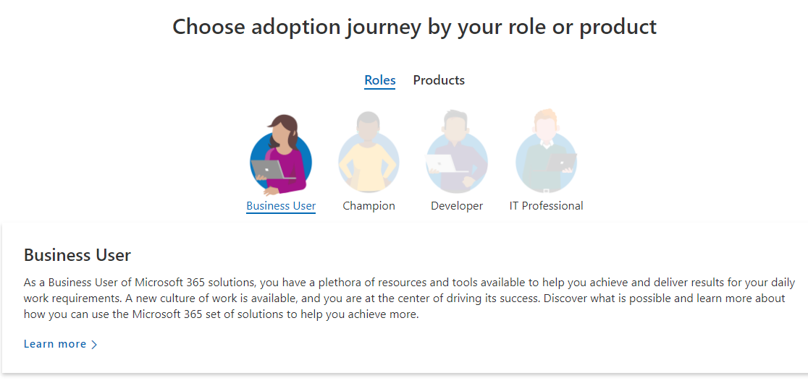
Adoption Hub V2 launch
We continue to enhance the Microsoft 365 Adoption Hub as your go-to location for business user and Champion information.
This launch includes:
Role-based guidance
Scenario-based solutions
Simplified assets by phase

Slide 19
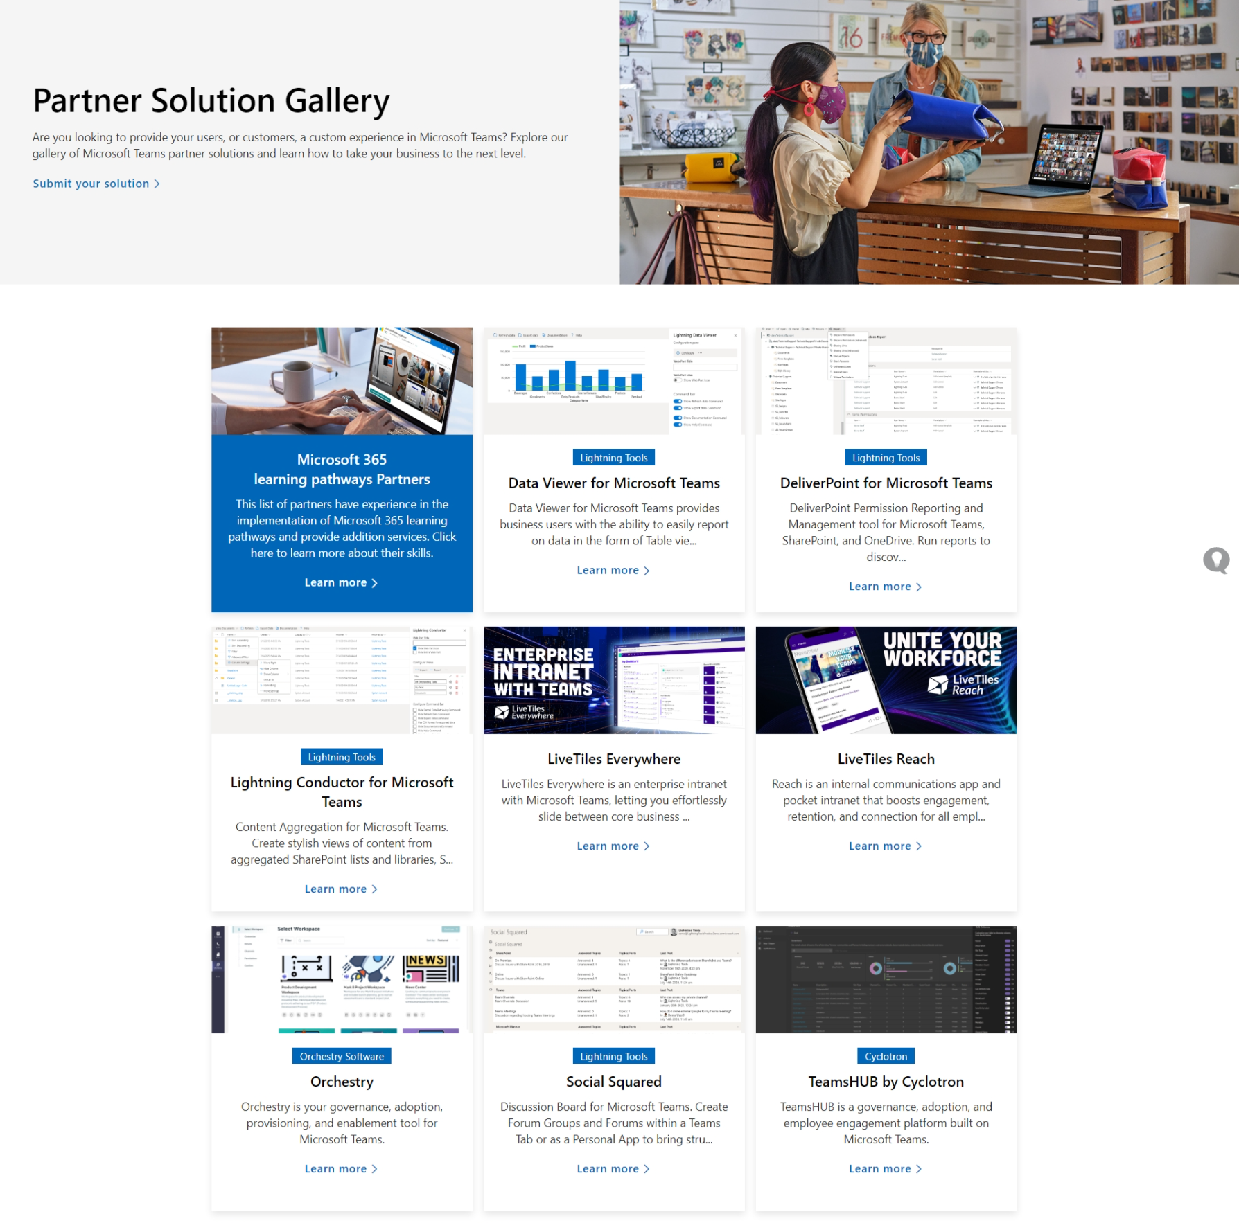
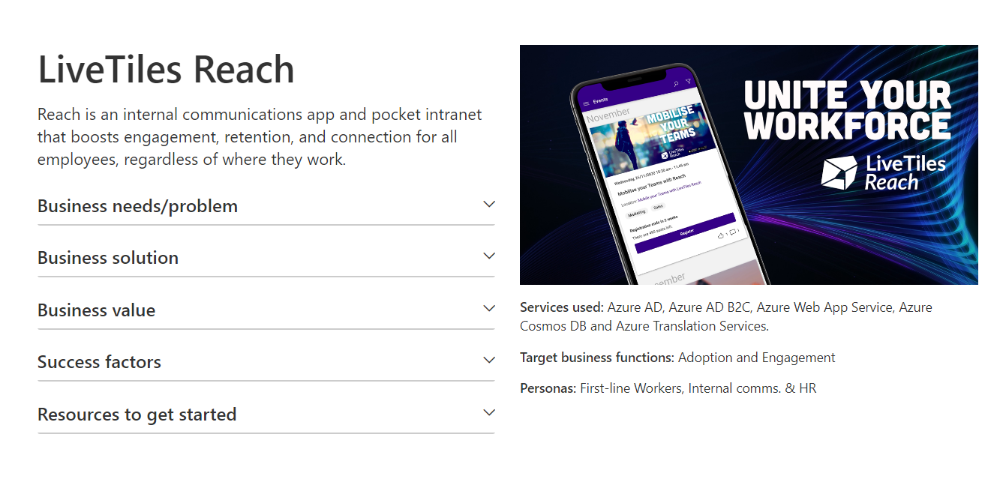
Partner Solution Gallery
Further updates by Ignite
Solutions submitted by partners; vetted by Microsoft for inclusion
To be integrated with role-based scenario pages

Slide 20
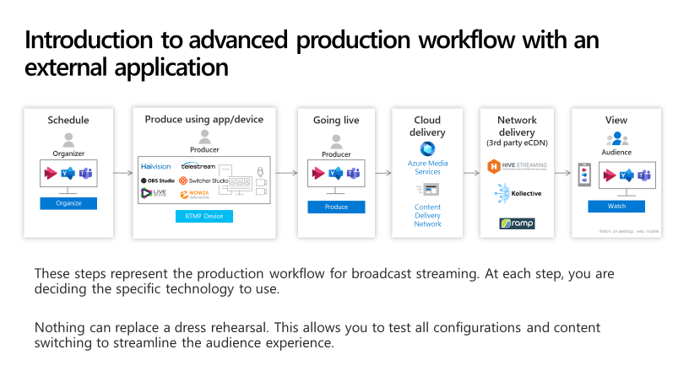
Custom Production Playbook
Initial version this month
To be updated with new features – April 2021
Digital event partners to be highlighted

Slide 21
Tutorial Message Center to Planner / Tasks in Teams Follow this tutorial to create awareness & better communication about service changes. #ChampionTools

Slide 22
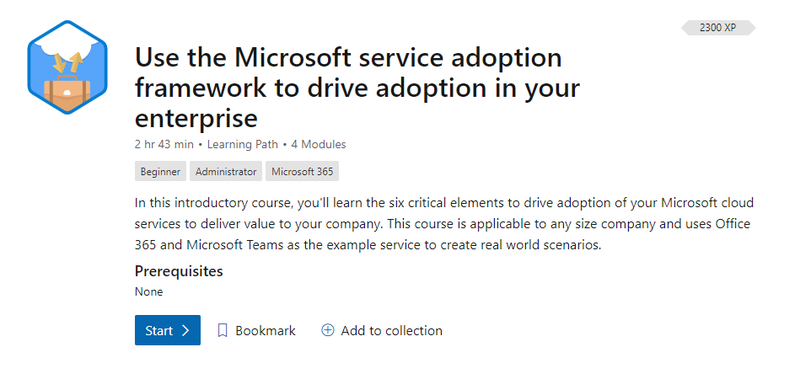
Earn your Adoption Specialist badge on Microsoft Learn New content in Q2/CY21 Existing edX course credit will transfer #ChampionTools
Adoption Course on Microsoft Learn
https://aka.ms/AdoptionCourse

Slide 23
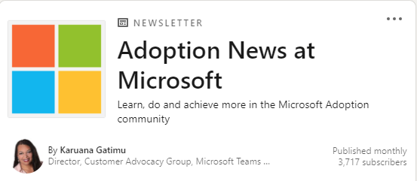
Stay up-to-date right on LinkedIn Articles about adoption assets and strategies Subscribe & share #ChampionTools
Adoption news on LinkedIn
https://aka.ms/AdoptionNews

Slide 24
Custom Background Gallery – spring content
Submit your spring content for the Custom Background Gallery!
Submit your content here
Browse the gallery
Help us expand our Microsoft Teams Custom Background Gallery by contributing!

Slide 25
Upcoming events
Microsoft Ignite (March 2-4, 2021)
Virtual Events in Microsoft Teams – Ask Microsoft Anything (March 9, 2021, 9-10 AM PT)
SharePoint Fest Virtual Workshop (March 16th, 2021, 9:30-1:30 PM PT)
Tech Community 2021 Awards (Jan 1 – March 31, 2021)
Government Collaboration Summit (April 20 – 21, 2021) **Date change**
Our next Champion community call:
March 23rd @ 8 AM & 5 PM PT

Slide 26
We’re in this together

Slide 27
Thanks for attending! We’d love your feedback on todays call and hear ways we can make future calls even better! https://aka.ms/Microsoft365ChampionCallFeedback
Microsoft 365 Champion Community
Learn more. Do more. Achieve more, together.
Notes:
Join our worldwide program at https://aka.ms/Microsoft365Champions
Materials included in this deck are free to use in your daily work.
Please reference our program as the source of this information.
For questions or comments please reach out in the Drive Adoption or Champion’s Corner forums of the Microsoft Technical Community at https://aka.ms/DriveAdoption

Slide 28
RESOURCES Microsoft 365 Adoption Hub https://adoption.microsoft.com Monthly call resources for Champions https://aka.ms/M365ChampResources COVID-19 Resources from Microsoft https://aka.ms/covid19Info

Slide 29
Microsoft resource cheat sheet
https://aka.ms/m365roadmap
https://aka.ms/techcommunity
https://docs.microsoft.com
https://developer.microsoft.com
Microsoft 365 Roadmap
All public feature delivery dates
Filter by product
Microsoft Technical Community
Product forums and blogs
Driving Adoption forum
Diversity & Inclusion forum
IT Pro & Adoption Documentation
Learn how to plan, deliver, adopt and manage Microsoft 365 products
Developer Documentation
Training, documentation, samples & communities for developers
Tools and resources
https://adoption.microsoft.com
Microsoft 365 Adoption Hub
Adoption resources for Microsoft 365 services
Microsoft 365 Champion sign up and information
Microsoft 365 learning pathways & Service Adoption Specialist course information
Visit Us

