Slide 1

We will get started shortly!
Microsoft 365 Champion Community Call
August 24, 2021
Microsoft 365 Champion Community
Learn more. Do more. Achieve more, together.

Slide 2

Microsoft 365 Champion Community
August 2021 Monthly Call

Slide 3
Agenda
August 2021
Evolving the community calls | Format, feedback, fun!
Mindful Minute | #HumansFirst
M365 CARES Program | Intro & signup for first set of small group sessions
Teams updates | Top new features releases and overviews
Other updates | Need to know
Community events & news
Open Forum | Open meeting for discussion
Find resources from previous calls here:
https://aka.ms/M365ChampionResources

Slide 4

New community call format
Welcome to our new community call format!
Leveraging standard Teams Meeting w/Managed Mode
First part of call we will go over topics
Last part of call we will open it up to connect and hear from you live
Learn more about utilizing Managed Meeting mode in Teams here.

Slide 5
Leaning into what matters
A #HumansFirst approach for prioritization
People
Lead with compassion
Listen first – gather feedback
Personas
Prioritize fatigued employees
Plans
Prioritize existing feature sets
Integrate new features by persona
Identify dominant patterns
Understand role needs
Architect for flexibility
Build in skill building time
Resource:
Returning to the Workplace: 3 Focus Areas to Smooth the Transition
Notes:
Taking a #HumansFirst approach to feature roadmaps, business scenario prioritization and feedback can allow an Adoption Specialist to navigate the difficulties of too much work, not enough leadership buy in or tech confusion with more precision. The need of any given cohort of users will provide a navigation path through these ever changing waters.
Features are not important because a tech company tells you they are. They are important when they provide value to end users in an organization in alignment with their strategic or operational goals. Living an

Slide 6
M365 CARES Program | Intro & signup for first small group sessions

Slide 7
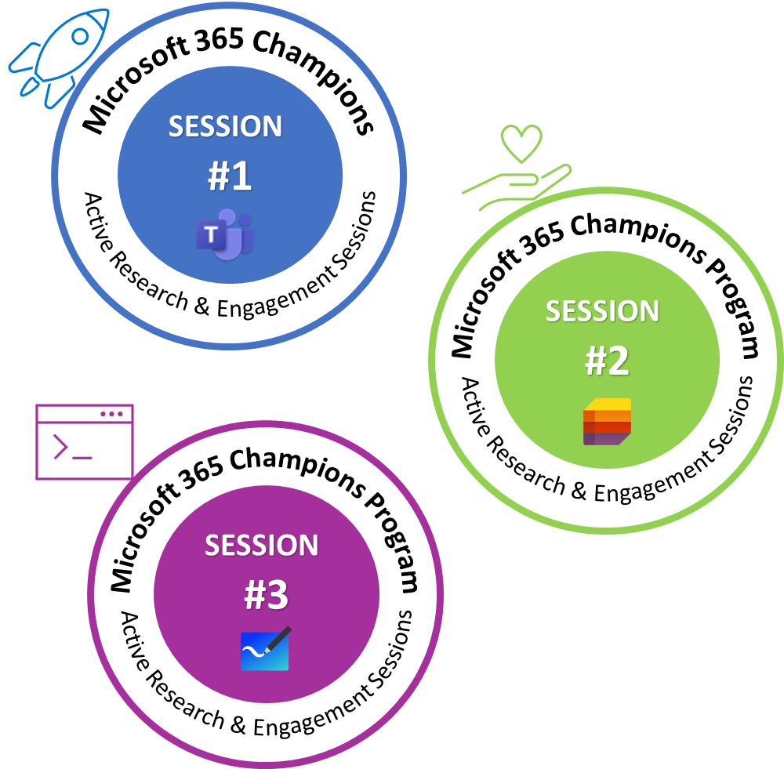
CARES Program
Champions Active Research & Engagement Sessions
Overview
Enabling small group connections.
Designed to connect you with more Microsoft resources and engagement opportunities.
Unique badges* to represent participation throughout program.
First partnership with Teams Design Research group and their CaFE / LATTE series.
*working on digital badging ability and artwork

Slide 8
CaFE + LATTE
Intro & insights
David Quiroz, Sr. Design Researcher

Slide 9

What is CaFE?
A CUSTOMER engagement activity that focuses on better understanding the end-user EXPERIENCE as well as an opportunity for us to collect FEEDBACK about design alternatives/concepts.
Notes:
CUSTOMER Engagement Activity that focused on understanding the end-user EXPERIENCE and it’s an opportunity for us to obtain FEEDBACK about design altern
atives and concepts.

Slide 10
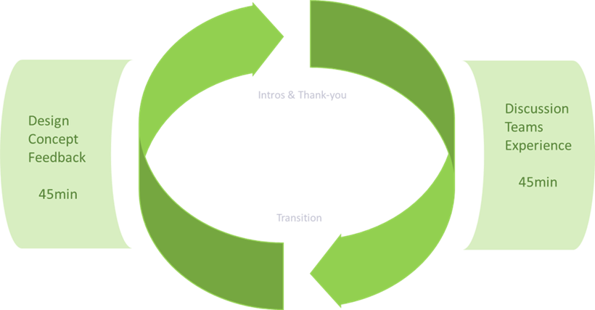
CaFE SESSIONS
Mostly SMBs but larger companies, too
3 to 5 people proficient with Teams
Broad representation of roles
Focused sessions – predetermined topic or theme
Researchers lead discussions and facilitate overall session
Designers & PMs contribute content/participate in discussions
Reports in Research/Customer Engagement channels
90-minute sessions
Notes:
General desc of CAFÉ focused sessions

Slide 11
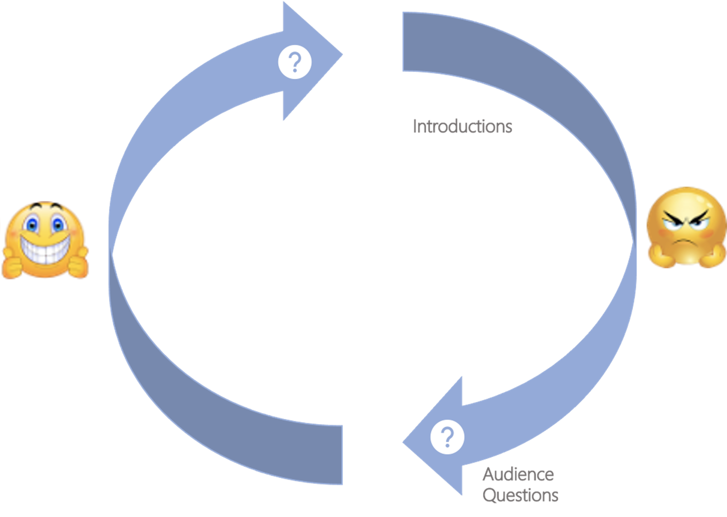
LATTE SESSIONS
Mostly SMBs but larger companies, too
3 to 5 people proficient with Teams
Broad representation of roles
Broad focus – pain points & delights
Researchers moderate overall session
Internal team members listen-in/Q&A
Reports in Research/Customer Engagement channels
60-minute sessions
Notes:
General description of LATTE format new

Slide 12
Examples of previous topics...
Experienced based topics...
What does collaboration mean to you and your org?
What's your meeting experience like now that everyone is remote?
How is your organization doing Hybrid Meetings? What needs to improve?
What is the mobile experience like when joining meetings?
Feature based topics...
What's it like to present PowerPoint content in Teams Meetings?
Integrating apps into Teams and the app store
Breakout rooms
Teams & Yammer
Notes:
General description of LATTE format new

Slide 13
Upcoming...
September
App Integrations and people experienced in going to the App Store and implementing apps into their Teams Experience
October
IT pros that are admin Teams for their orgs
Notes:
General description of LATTE format new

Slide 14
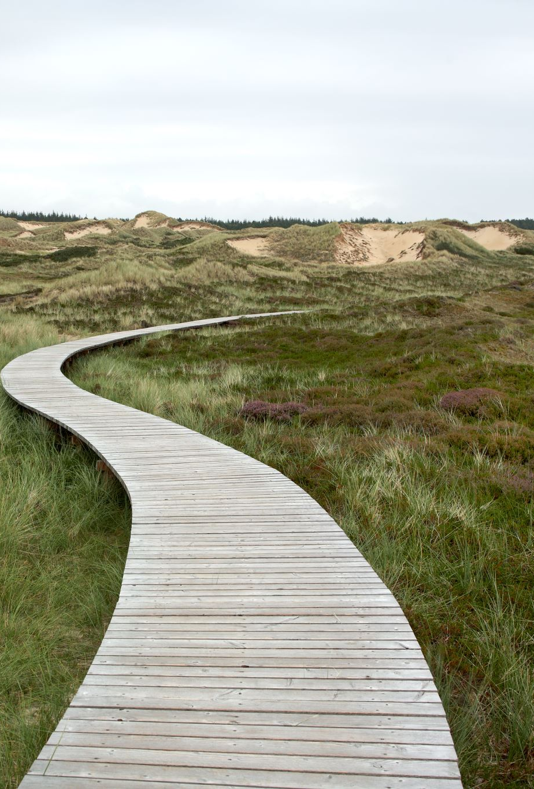
Next steps
Signup here https://aka.ms/M365CARESSignup
Once we have enough people signed up, you will receive communications to schedule the session
Join and provide feedback!

Slide 15
Teams updates | Top new feature releases and overviews

Slide 16
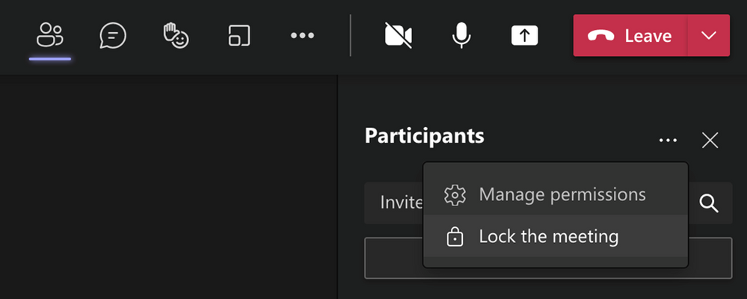
Lock a meeting from additional joins
Adoption scenarios
Manage notifications and distractions from meetings already in progress
Lock meetings taking place with sensitive content
Control meeting sprawl
Organizers can now choose to lock their meetings to prevent subsequent join attempts. Anyone attempting to join a locked meeting from any device is informed with a message that they are not able to join as the meeting is locked. This helps avoid distractions from late joiners during the meeting. You can find this feature under More actions in the Participant pane and is currently available in the desktop app only.

Slide 17
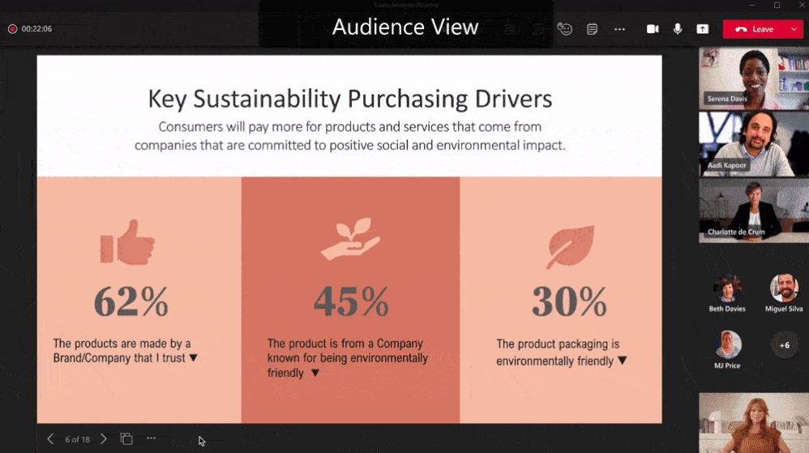
Slide translate in PowerPoint Live in Teams
Adoption scenarios
Bring more inclusion in with PPT Live + Teams scenarios
Showcase examples of PPT Live
Make your slides more inclusive with slide translate in PowerPoint Live in Teams. This private setting allows you to see a personalized view of the slide where text is translated in your chosen language. Now you can better understand the presented content privately. This feature supports 19 languages with more to come
Learn more about PowerPoint Live in Teams

Slide 18
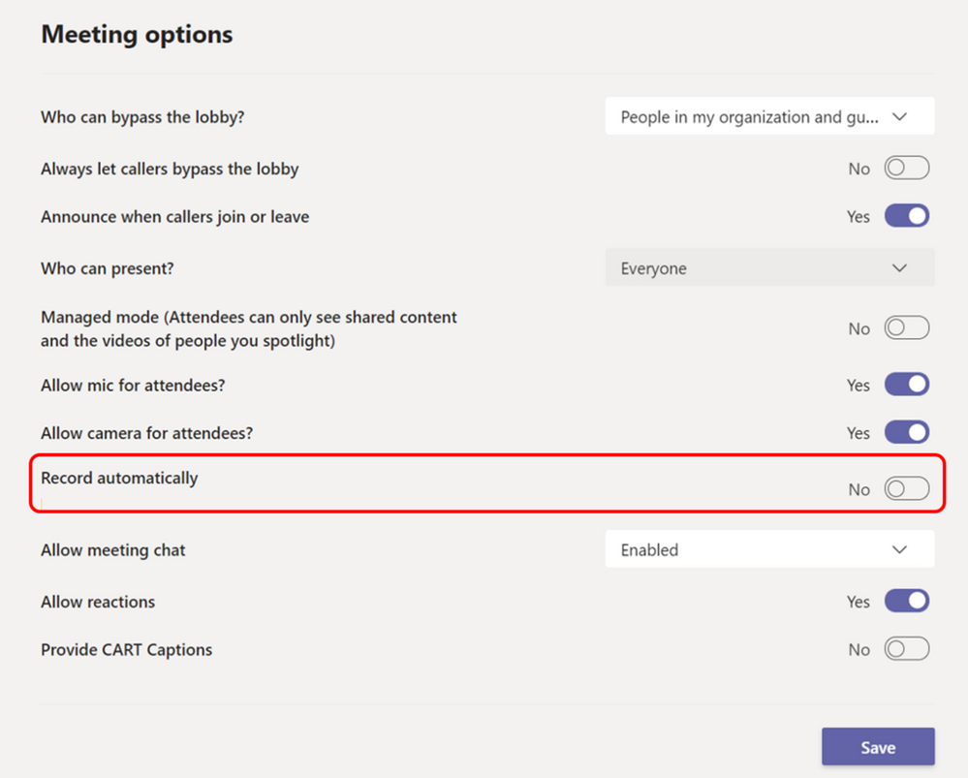
Teams Meetings Auto Recording
Adoption scenarios
Meeting organizers are now able to set a single meeting occurrence or series to auto-record by enabling the “Record automatically” setting from Meeting Options. The meeting automatically starts recording once the first participant from the same organization joins the meeting. Recording is saved to the initiator’s OneDrive (privately scheduled meetings) or SharePoint (channel meetings). This feature is available in desktop and mobile
Enable regular meetings to always record and not miss critical content
Keeps recording with the primary party / location
Establish good ROB practices

Slide 19
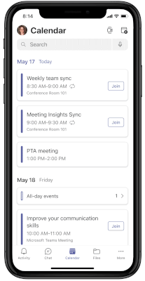
Related Content for Teams Meetings for mobile
Adoption scenarios
Popularize Teams mobile client features w/companion device strategies
Related Content makes meetings more effective by providing you with important information from your mailboxes, OneDrive for Business, and SharePoint sites. This helps you prepare before meetings by offering content you haven’t had a chance to read or may want to revisit. You can find this content on the Meeting Details page.

Slide 20
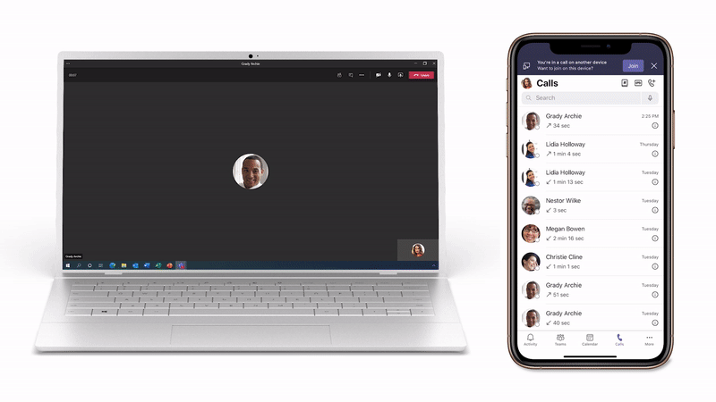
Transfer calls between desktop and mobile
Adoption scenarios
Increase awareness of dual device benefits
Teams makes it easy to place and receive calls from several different endpoints, including desktop and mobile devices, but sometimes you need to move locations or devices to finish your call. The new endpoint transfer capability allows you to seamlessly move your calls between different devices, such as from your laptop to mobile phone, without any interruption in call service or quality.

Slide 21
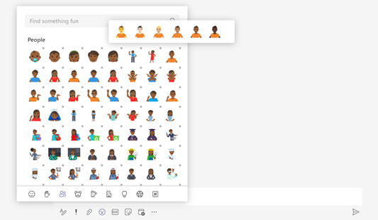
Expanded emoji picker
Adoption scenarios
Bring your whole self to the conversation! Have more fun and better express yourself with more than 800 emojis. Select a category and easily find the emoji you need and use the skin tone selector to pick an emoji that better represents you. Quickly add emojis directly when composing a chat and use the short code picker to add emojis using text.
Expand inclusion through emoji picker options / create campaigns to leverage using emojis to enhance messaging tone

Slide 22
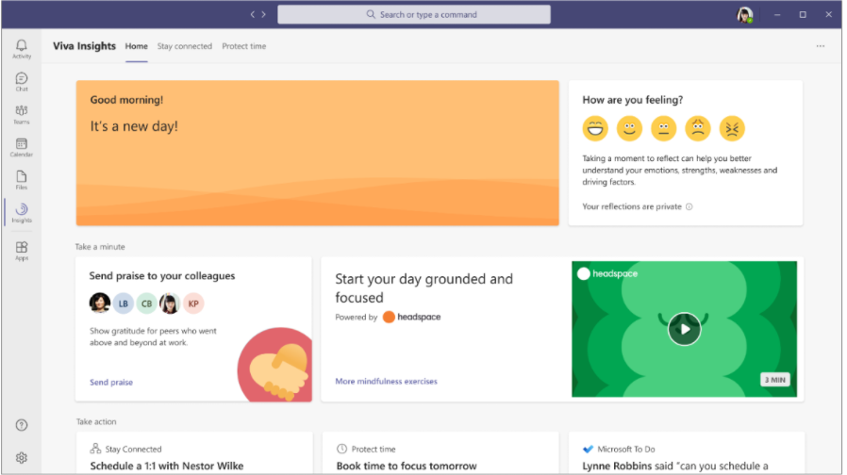
Headspace integration with Microsoft Viva Insights
Adoption scenarios
Example of a pop-out app scenario (mindfulness exercises in background)
A curated set of guided meditations and mindfulness exercises from Headspace are now available in the Viva Insights app in Teams to help you start your day grounded, relax your mind before a big presentation, or disconnect from work in the evening.

Slide 23
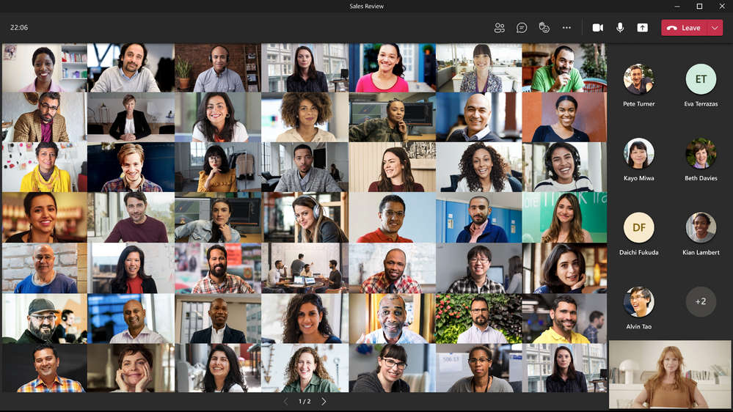
Paging in the Video Gallery
Adoption scenarios
Navigation controls < and > now appear below the Video Gallery when you are in gallery view mode and there are more videos than what can be shown at once on the meeting stage. You can use these controls to view more video participants. The maximum number of videos on the meeting stage can vary depending on your device configuration and internet bandwidth. Paging is available in Large Gallery, with Gallery (3x3) coming soon. Learn more.
Increase ability to host large scale meetings with video

Slide 24
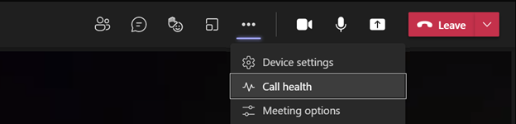
End user Real-time telemetry for meetings
Adoption scenarios
Help end users diagnose potential call health from their devices
Call health panel provides Teams end-users functionality that helps identify issues during a Teams meeting or a VOIP call. This empowers your users with diagnostics to investigate audio, video, content sharing or network related issues. The real-time metrics are updated every 15 seconds, providing the ability to trace issues as they occur. Access Call Health now under More actions. Learn more.

Slide 25
Other updates | Need to know

Slide 26
Upcoming community events
CommsVerse in UK – September 2021
TeamsFest / SharePointFest in Washington, D.C. – September 2021
Thrive Conference in Slovenia – October 2021
European Collaboration Summit – November 2021
M365 Collaboration Conference in Las Vegas, NV – December 2021
Explore other Microsoft Events
Our next Champion Community call:
September 28th @ 8 AM & 5 PM PT

Slide 27
Microsoft 365 Champion Community News
Next community call – Sept 28
Topics:
New Microsoft 365 learning pathways content & features
Top asks:
Complete our monthly call survey: https://aka.ms/Microsoft365ChampionCallFeedback
Participate in the Driving Adoption Community:
https://aka.ms/DrivingAdoption
Invite colleagues to join the Champion Program: https://aka.ms/M365Champions

Slide 28

Let’s meet!
Turn on your cameras if you are comfortable doing so
Switch to Together Mode or Large Gallery
Tell us about yourself, favorite adoption moment, funny story, etc.

Slide 29
Thanks for attending! We’d love your feedback on todays call and hear ways we can make future calls even better!
https://aka.ms/Microsoft365ChampionCallFeedback
Microsoft 365 Champion Community
Learn more. Do more. Achieve more, together.

