Slide 1

Microsoft 365 Champion Community
April 2021 Monthly Call

Slide 2
Agenda
April 2021
Inspiration | Inspire & innovate – Celebrate volunteers!
Focusing on what matters | Your success, your stories – PowerPoint Live and storytelling
Viva Overview | Discussion around the Viva Platform
The Hybrid Workplace | Resources from SharePoint templates to new end user training
New & upcoming assets | Need to know
Upcoming events
News for the community
Find resources from previous calls here:
https://aka.ms/M365ChampionResources

Slide 3

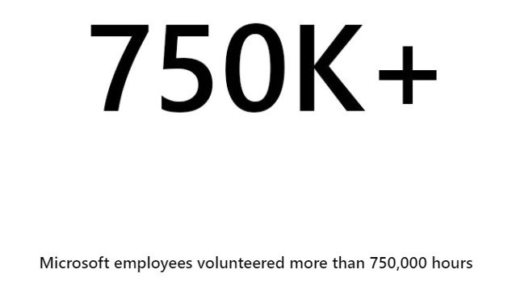
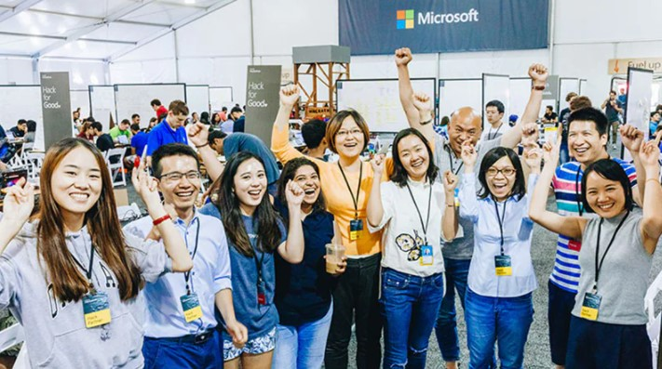
April – National Volunteer Month
Celebrate the impact volunteers have on our lives and encourage active volunteerism in your groups!
Champion communities are already doing a lot of this with their time and expertise in helping the organization grow!
Employee volunteerism is a cornerstone of the Microsoft culture. From little league to community outreach, volunteering for your passion leaves the world in a better spot.
Microsoft employees are passionate about giving time, money, and skills to address the issues facing our world. It’s part of our culture and how we live our mission.
See our employees in action

Slide 4
Focusing on what matters | Your success, your stories – PowerPoint Live and storytelling

Slide 5
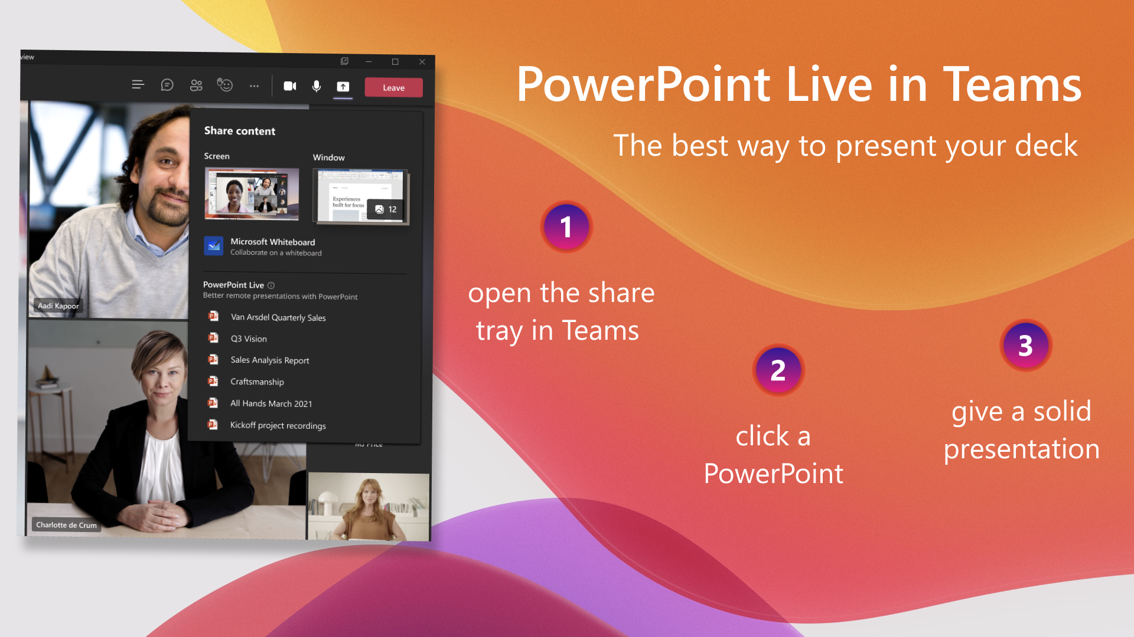
overall_1_132259420467473652 columns_1_132259420467473652
PowerPoint Live – the best way to present in a Teams meeting
PowerPoint Live was unveiled for Teams at Ignite 2021 (Mar 2-4)
Present with confidence
Presenter View gives access to notes
See your audience and chat with them seamlessly
Non-linear navigation.
Use Presenter Mode*
Interactive, Engaging and Inclusive Attendee experience
Navigate privately back and forth (if allowed enabled)
Audience can see and send reactions
Interact with content (open hyperlinks)
High Contrast mode makes content more accessible
Use screen-reader to consume content
* Some features are in the process of rolling out so may not be available in your builds.
If you are seeing the old share tray, then you can still get all the benefits; just select the file from under the “PowerPoint” section.

Slide 6

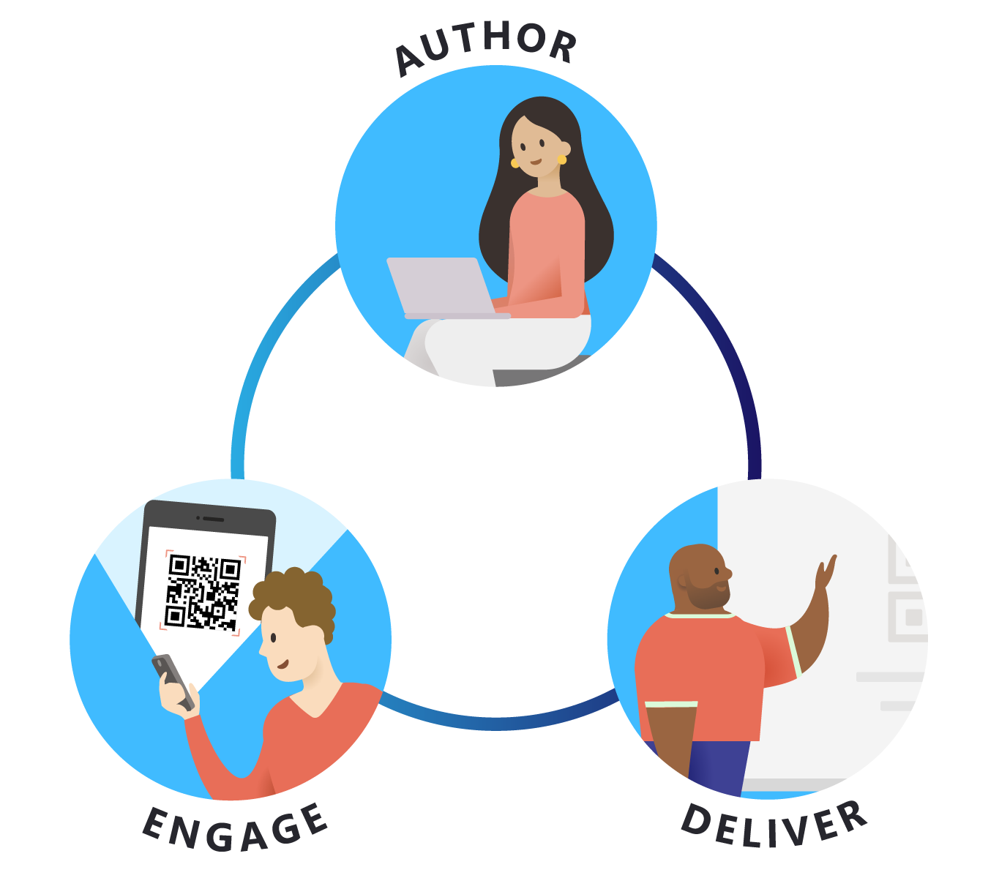


Use AI features in PowerPoint at every step: from creating the first slide to engaging your audience
overall_1_132242091259773906 columns_1_132242091259773906
Use the Design Ideas button in the ribbon to get suggestions built from the layouts in your Slide Master.
Practice your talk using the Presenter Coach feature (available only on PowerPoint on the web). Learn how to use Presenter Coach.
Engage your audience using PowerPoint Live.

Slide 7
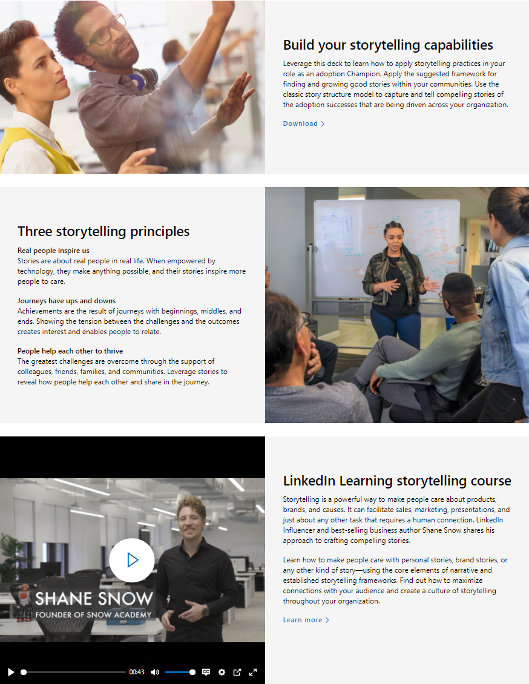
Storytelling for Microsoft 365 Adoption Champions
We have launched a new landing page for Storytelling resources: https://aka.ms/StorytellingforChampions.
Why storytelling?
  A key to adoption & change management is showcasing examples of new behavior change in action, through success stories.
A new storytelling guide includes:
  Framework for finding and growing good success stories: Empower, Capture, Amplify, Learn
  Sample structure for capturing compelling stories: Situation, Complication, Resolution, The Point
  Additional learning resources
A storytelling course from LinkedIn Learning

Slide 8
Viva Overview | Discussion around the Viva platform

Slide 9

Six key elements of a great employee experience
Wellbeing
Empowerment
Connection
Growth
Focus
Purpose
Source: Adapted from Glint's People Success Pillars
Notes:
We’ve also learned from this research, and a research project in partnership with LinkedIn and Glint, that there are these six key elements that make up a great employee experience:​
​
Wellbeing: You feel safe at work—physically, mentally and emotionally. You feel uniquely valued and are treated equitably and with dignity.​
Connection: You belong as a trusted, integral member of a diverse community. You have high-quality relationships with your colleagues, characterized by mutual respect.​
Focus: You know what success looks like and what to prioritize. You know when you’re on track and get feedback that helps you improve. ​
Empowerment: You can easily find information, people, tools, and resources you need. You are empowered to make decisions and what’s required for success.​
Growth: You get what you need to maximize your strengths, learn new skills, broaden your experience, and progress toward your goals. ​
And finally purpose: You’re part of something bigger than yourself. Your work serves others and has a meaningful impact. ​
​
But in this current environment, where people are physically apart, stressed and lacking connection, it’s harder than ever to create a great employee experience.​

Slide 10

What is an Employee Experience Platform (EXP)​
A system of experiences that help organizations create a thriving culture with engaged employees and inspiring leaders
Communications
Announcements, news & events
Growth & Development
Learning & coaching
Recruiting, on-boarding & career
Talent & performance development
Company Resources
Employee portals & apps
Workplace services (pay, benefits, IT, legal &compliance)
Wellbeing
Physical & mental Emotional & financial
Insights
Analytics, nudges & surveys
Feedback & sentiment
Employee
Communities
Diversity & Inclusion
Interest groups
Team cohesion
Knowledge
People & experts
Documents & content
Projects
Notes:
There has never been a bigger need for technology, data and insights that are designed to enable a great employee experience, regardless of your location.​
Employees want to feel more connected, more aligned to their company purpose and mission. They want to grow, make an impact, and make a difference.​
Leaders need a modern way to engage and develop their employees ​
And IT needs to be able to quickly enable this modern employee experience without having to rip and replace all their existing systems. ​
What is needed is a new approach and a new category of technology solutions we call Employee Experience platforms or EXP.​
An EXP is a digital platform that puts people at the center by bringing together systems of work with systems of support into an integrated employee experience, and it provides people with the resources and support they need to succeed and thrive, no matter their location. ​It also needs to provide an open and extensible platform that is customizable and works with your existing systems and tools.
Today, there are a lot of vendors focused on employee engagement and wellbeing. But they are mostly point solutions looking to solve one or a few of the symptoms in separate experiences.
Today’s solutions are fragmented, and they are disconnected from where people are doing their work. The services and resources employees need are often undiscovered or locked up in systems of record rather than a natural part of people’s communication and workflow.​
Our vision is an integrated employee experience that brings together all these resources into the natural flow of everyday work.​

Slide 11

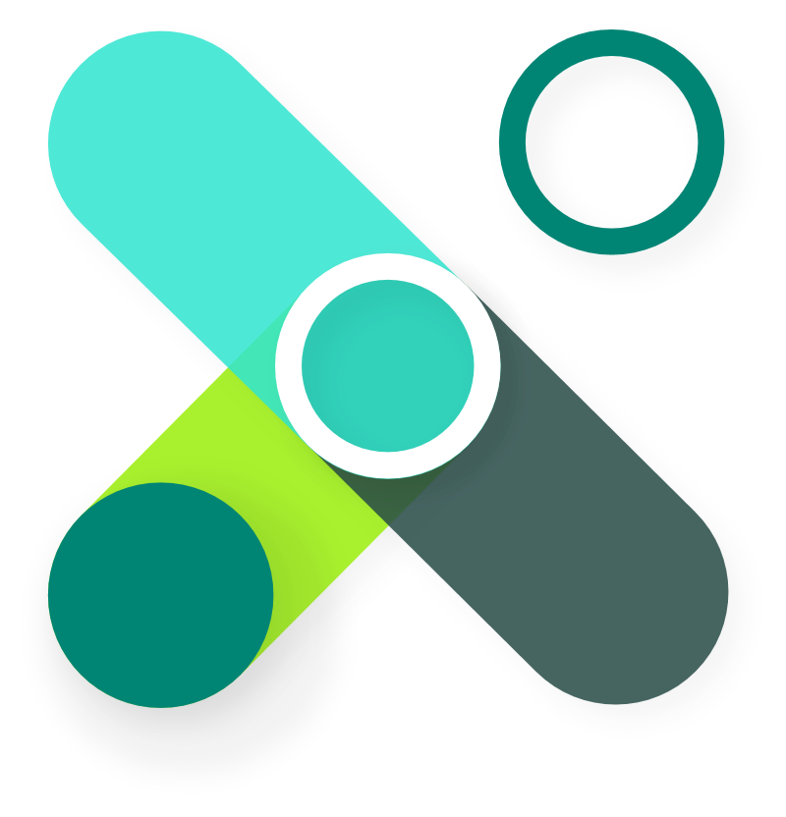

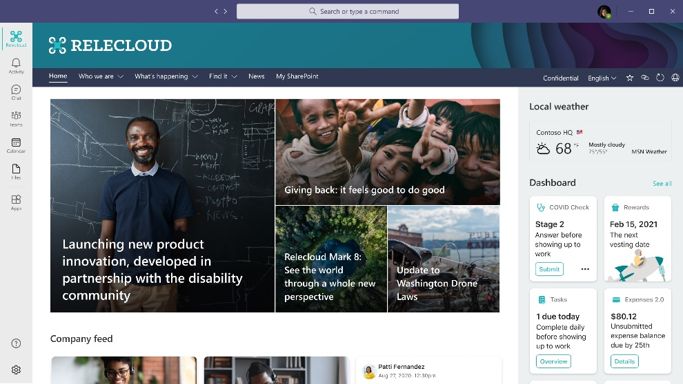
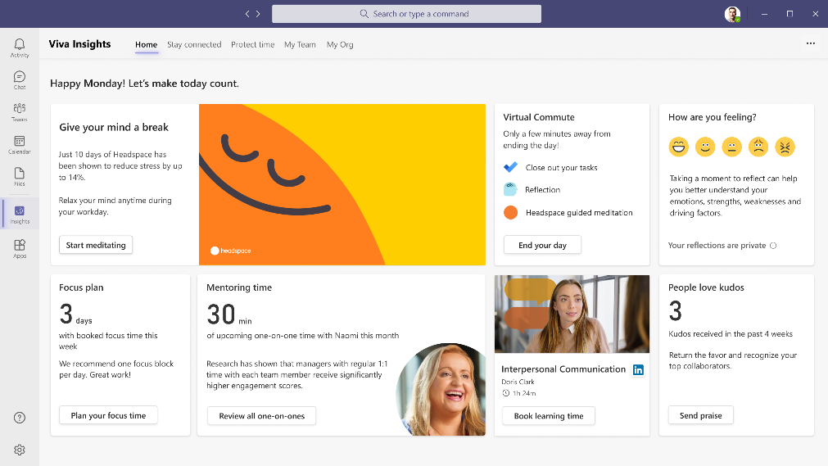
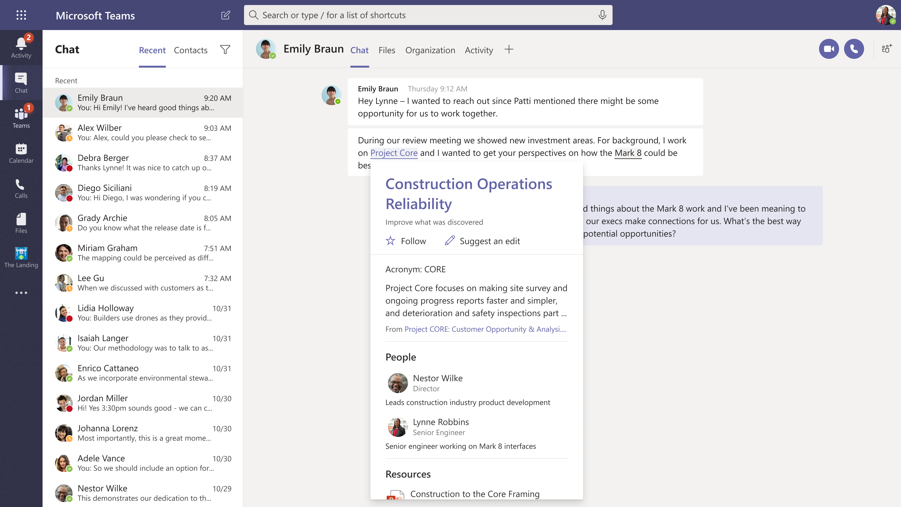
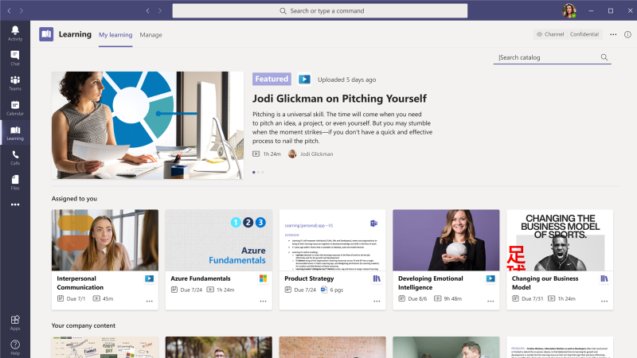


Microsoft Viva
Empower people and teams to be their best
Connections
Culture and communications
Insights
Productivity and
wellbeing
Topics
Knowledge and
expertise
Learning
Skilling and
growth
Notes:
To start with, Viva will have these 4 modules that you see here, and we’ll be adding more in the future.
Each of these builds on existing capabilities in Microsoft 365 and are integrated directly in Teams, as you can see from the UI here for each module.
I’ll provide a quick description of the modules now and then we’ll go deeper into each one in the following sections.
Connections is a company branded employee app in Teams. It is a gateway to your employee experience, with personalized news, communications, tasks, people and resources.​ It provides a single curated employee destination that can be configured for specific roles like frontline workers. So, leaders can communicate and engage their employees, and employees can get easy access to the tools and resources they need from one place.. Connections builds on existing capabilities in Microsoft 365 like SharePoint and Yammer. And it pulls your communications together into a pre-configured app in Teams, designed for both desktop and mobile workers. It also acts as a launching pad to the other 3 Viva modules
Insights brings together Workplace Analytics, MyAnalytics and Glint into a unified insights app in Teams to provide data-driven and privacy-protected insights for individuals, managers and leaders. For example, employees get personalized insights, only they can see, that help them protect their time for breaks, focused work, and learning in order to promote improved productivity and wellbeing.
Topics focuses on knowledge and expertise. Topics applies AI to identify knowledge and experts and organize them into shared topics. AI automatically creates a topic page for each topic. It’s like Wikipedia for the enterprise where AI does the first draft. And these topic pages are surfaced as Topic Cards right in the flow of work in Office and Teams.
Finally, Learning allows employees to easily discover informal and formal learning in the flow of work. It aggregates content from LinkedIn Learning, Microsoft Learn and 3rd party training content and your own organizations content – all in one place. Along with providing aggregation and recommendations, it also allows managers to assign and track training, as well as report on training within and across teams.

Slide 12
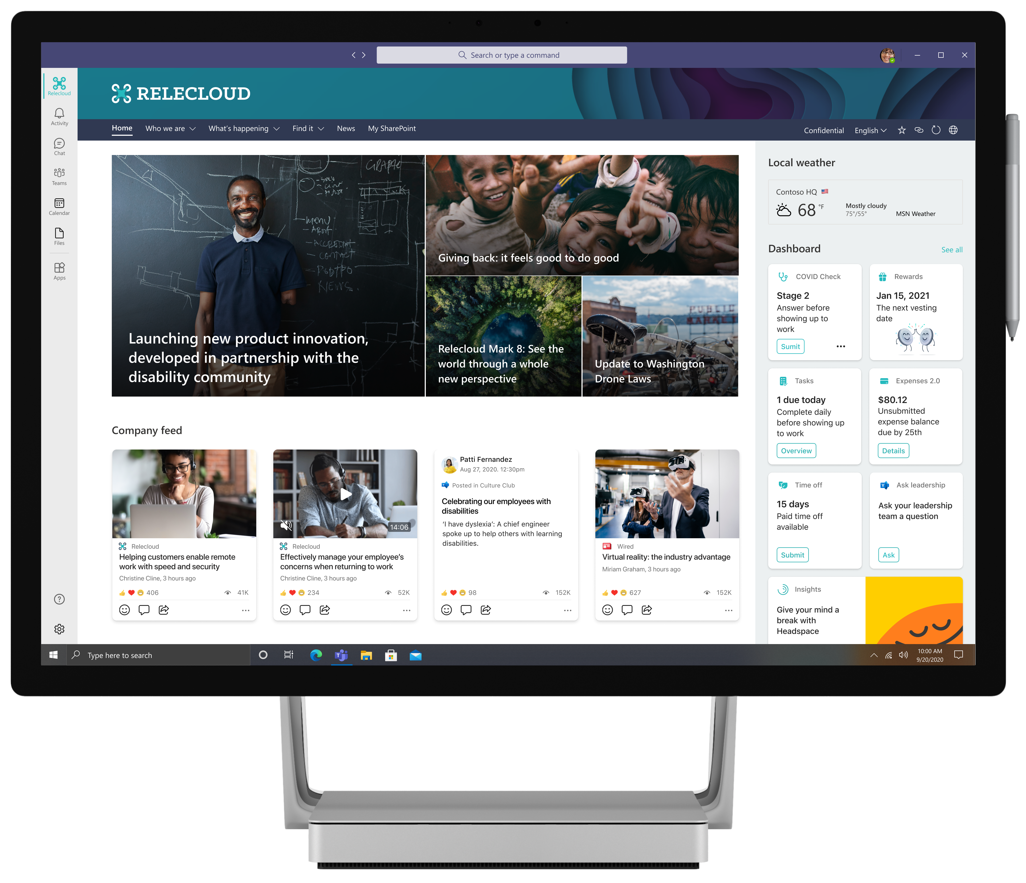
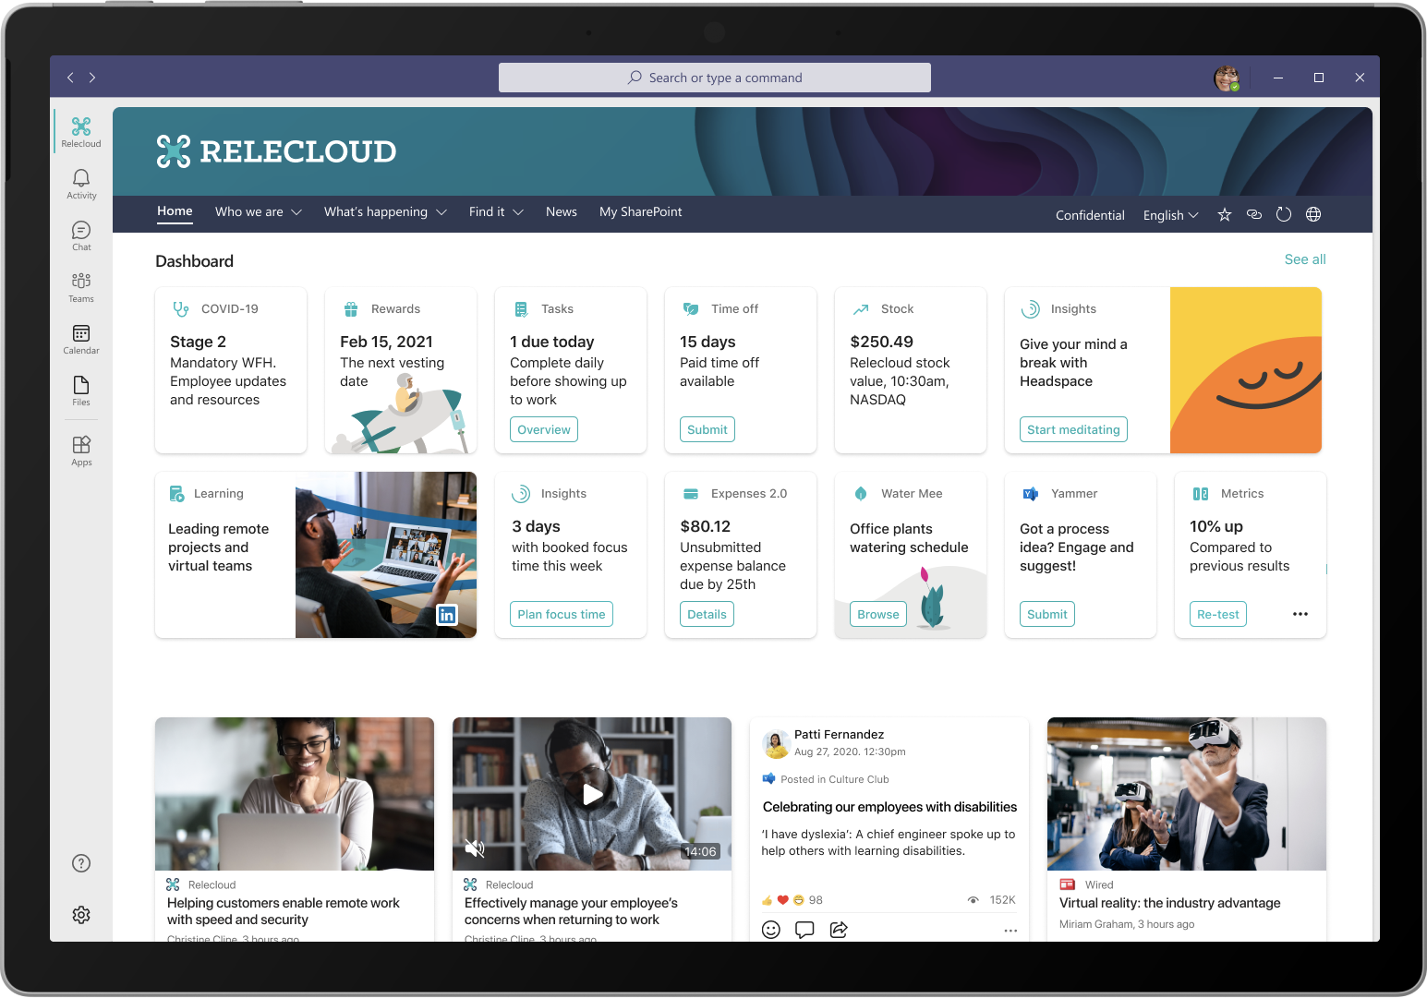
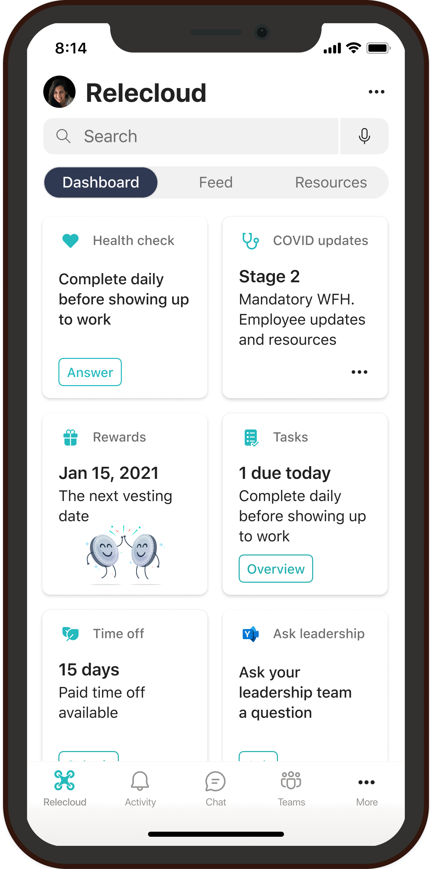
Viva Connections
Communications and culture
Keep everyone connected
Encourage meaningful connections across the organization by enabling employees to easily discover relevant communications and communities.
Make it easy for people to contribute
Foster a culture of inclusion by empowering every employee to contribute ideas and share feedback.
Unite and inspire your organization
Align the entire organization around your vision, mission, and strategic priorities.
Notes:
Viva Connections was created to keep everyone in the workforce connected to each other. It makes it easy for people to contribute and to unite your organization around the company’s vision.
Today, in Microsoft 365 we have a lot of capabilities for employee communications and engagement. We have SharePoint, Yammer, Teams and Stream. Viva Connections brings all of this together into a company branded app in Teams.
Over the last 18 months, we’ve made significant progress integrating these tools together. For example, the new Yammer communities app in Teams, with Live events, so employees can watch their company all-hands and engage in real-time Q&A across the company right from within Teams.
Connections is the next evolution of this. Our customers told us they want a pre-configured experience, that is company branded, and mobile-first, and they want it customizable for different roles.
Connections comes with a dashboard for actions and reminders. A personalized feed for company news and information. And resources where we link to the other Viva experiences like Learning and Insights.
Customers and partners can brand and customize it as their own ‘employee app’, as well as customize the dashboard and resources.
Overall, this can be a valuable channel to help people stay connected to leaders and to each other, understand company strategies and objectives, as well as ideate and collaborate on common interests and passions. The interactive aspects of the Microsoft Viva Company App contribute to a sense of belonging that helps people feel connected to others and stay engaged throughout the workday.
We think this is a really powerful concept that adds to the Frontline capabilities we already have in Teams. – and can be a unifying application, helping tie together the different services into a single experience

Slide 13
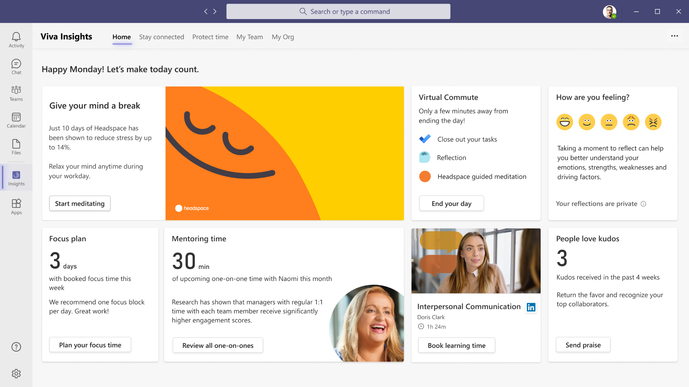

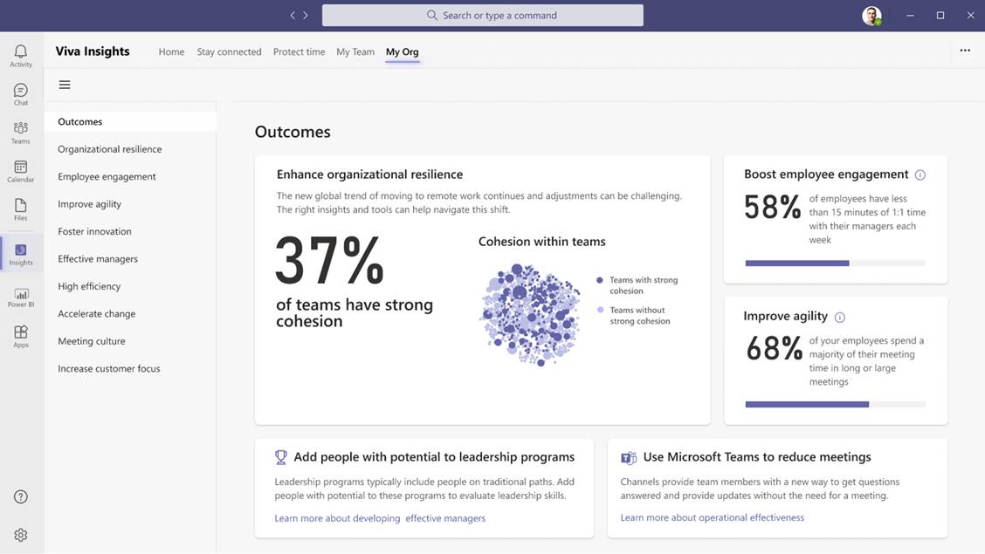
Viva Insights
Productivity and wellbeing
Deliver personalized and actionable insights
Empower individuals, teams, and orgs to achieve balance, build better work habits, and improve business outcomes with personalized insights and recommended actions.​
Quantify the impact of work on people and business
Gain data-driven, privacy-protected visibility into how work patterns affect wellbeing, productivity, and results. ​
Address complex business challenges
Use advanced tools and additional data sources to perform deeper analysis, address challenges important to your business, and respond quickly to change.​
Notes:
Viva Insights provides privacy-protected insights and actionable recommendations that help everyone in the organization work smarter and achieve balance.
Individuals receive personal insights visible only them to help identify opportunities to change how they work so they can do their best work.
Manager insights make it easy for managers to understand current team norms and take action to help their teams strike a balance between productivity and wellbeing.
Organizational insights for business leaders provide broad visibility across the org, helping them understand where a change in organizational norms could improve both the employee experience and business outcomes.
Viva Insights also offers advanced tools and capabilities for even deeper analysis to help address targeted challenges that are most important to you.

Slide 14
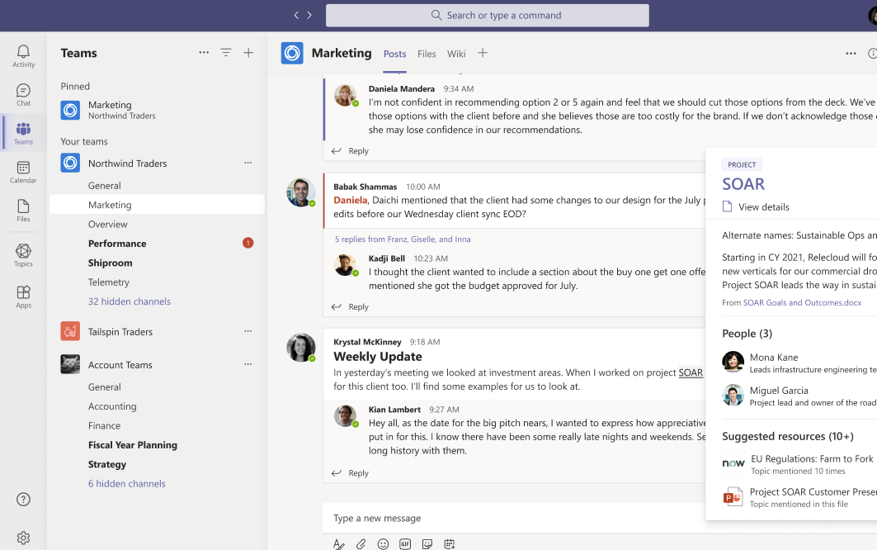
Viva Topics
Knowledge and expertise
Turn content into usable knowledge
Use AI to reason over your organization’s content and automatically identify, process, and organize it into easily accessible knowledge.
Organize knowledge into topic pages
Enable your organization’s experts to share and refine knowledge through curated topic pages, automatically generated and updated by AI.
Make knowledge easy to discover and use
Deliver relevant topic cards in the apps people use every day.
Notes:
To address these issues, we’ve created Viva Topics. Topics builds on Microsoft 365 and applies AI to identify knowledge and experts from across your organization and categorize them into shared topics. The AI not only organizes knowledge into topics, it also automatically creates topic pages for each topic. These topic pages are edited and approved by experts and then kept up to date by AI.
It’s like Wikipedia for the enterprise where AI does the first draft.
And, what’s also powerful, is that AI surfaces these topics as Topic Cards right within Teams, SharePoint and Office. So if you hover over an acronym or a project name, you get an immersive topic card that you can click on to get more details.
Because Viva Topics automatically organizes content across your teams and systems to connect topics like projects, products, processes and customers, information is ready when and where you need it. Experts at the company can also help curate the information shown in Topics by sharing knowledge through simple, highly customizable web sites called Topic Pages.
Along with content from Microsoft apps & services, Topics also surfaces information from third-party services like ServiceNow. And Graph connectors make it easy to connect to even more content employees would find helpful.
Viva provides the privacy, security and compliance you expect from Microsoft 365, so you can trust that sensitive content is protected.
According to Forrester, conservative estimates suggest that this could save employees between 1 and 3 hours each week, just by reducing search time.
[Transition to learning] In addition to finding relevant information when and where they need it, it is also important for employees to actively learn and upskill.

Slide 15

Viva Learning
Skilling and growth
Make learning a natural part of your day
Foster a culture of learning by enabling people to easily discover, share, and engage with learning integrated into Microsoft Teams.
Make your learning content available in one place
Simplify the learning experience by bringing together world class content from LinkedIn Learning, 3rd parties, Microsoft Learn, and your own content.
Drive results that matter
Empower your leaders and employees to organize, recommend, and track learning aligned with business outcomes.
Notes:
Now let's talk about 3 core pillars of Viva Learning:
Make learning natural part of your day. By this we mean we're seamlessly connecting with the Viva Learning app in Teams in the day to day of our 115 million daily active users. Users can chat about learnings and trainings, share content via chat, and pin curated resource collections to channels and tabs.
Make all your content available in one place. This is a huge pain point for customers. Bringing all learning sources into Teams allows you to avoid disruptions in your day and makes it easier than ever to learn with all your content aggregated in one place. This means no more bouncing between different solution apps, web pages, internet sites, or wherever else you go today to find your learning, it's all right within Teams. Viva Learning pulls in content from LinkedIn Learning, MSFT Learn, M365 trainings, custom built content stored on SharePoint, as well as content form third party content providers and Learning Management Systems.
Drive results that matter. We're giving managers and leaders the tools they need to facilitate a learning culture.

Slide 16
The Hybrid Workplace | Resources from SharePoint templates to new end user training

Slide 17


Rethinking the future of work, post-COVID
Over 80% of managers surveyed expect to have more flexible work from home policies post-pandemic. ^{[1]}
More than 70% of employees and managers reported a desire to continue working from home at least part-time. ^{[2]}
At Microsoft, we believe the future of work is hybrid
Sources:
Harris Poll survey commissioned by Microsoft, May 2020
Harris Poll survey commissioned by Microsoft, May 2020

Slide 18
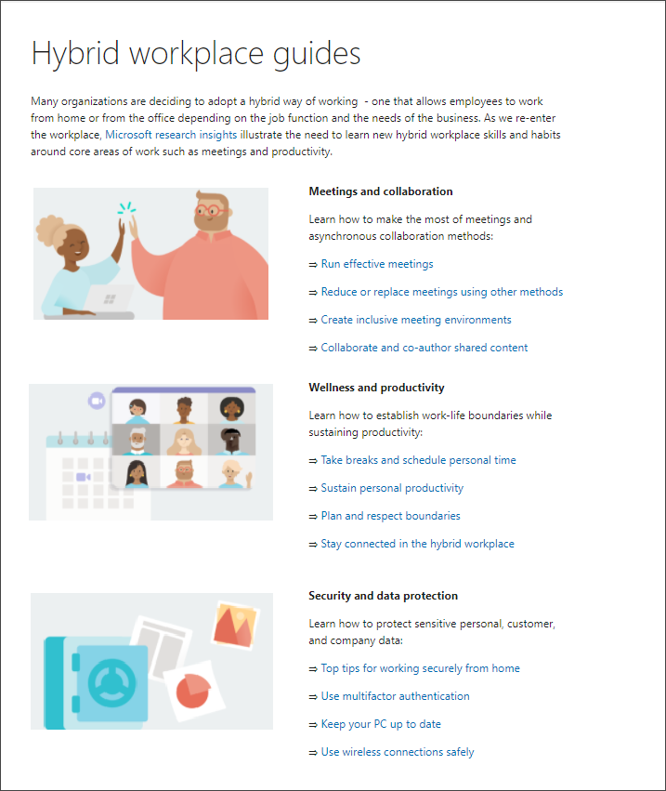
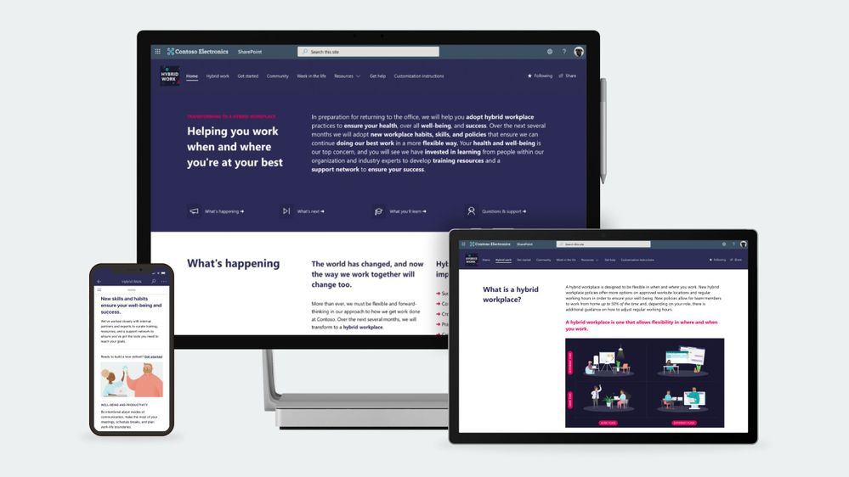
Hybrid work resources
Workplace transformation site
Hybrid workplace guides
https://aka.ms/WorkplaceTransformationSite
https://aka.ms/HybridWorkplaceGuides

Slide 19
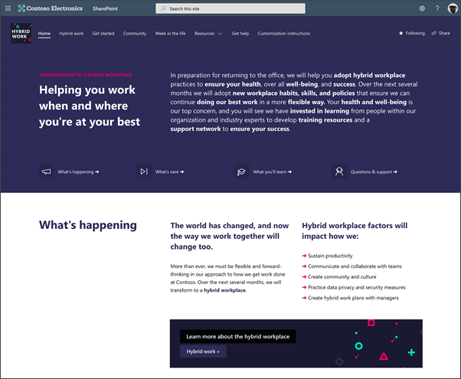
Workplace transformation site template
The Workplace transformation site template helps organizations inspire, inform and prepare their employees for a transition to a new hybrid workplace.
A fully configured and customizable hybrid work transformation site built on SharePoint communication sites: The Workplace transformation site brings together information architecture, pre-populated content, site design, and webparts to help employees transition to a new way of working. The site can be customized to add your organization’s content and to align with its look and feel.
Hybrid work checklist: Guide employees through organizational changes with a customizable activity list of tasks such as required training courses and learning events.
Inspirational help content: The Workplace transformation site includes “quick tip” guides for employees and managers, and a week-in-the-hybrid-workplace content.
Support resources: The hybrid work transformation site includes a champions program overview page, a Yammer community web part, and pre-populated FAQs to help support employees.
Mobile-ready: The Workplace transformation site can be easily accessed on mobile devices so employees can continue their hybrid work transition journey from wherever they may be working.
Add to your tenant: https://aka.ms/WorkplaceTransformationSite.

Slide 20
Workplace transformation site | Demo

Slide 21

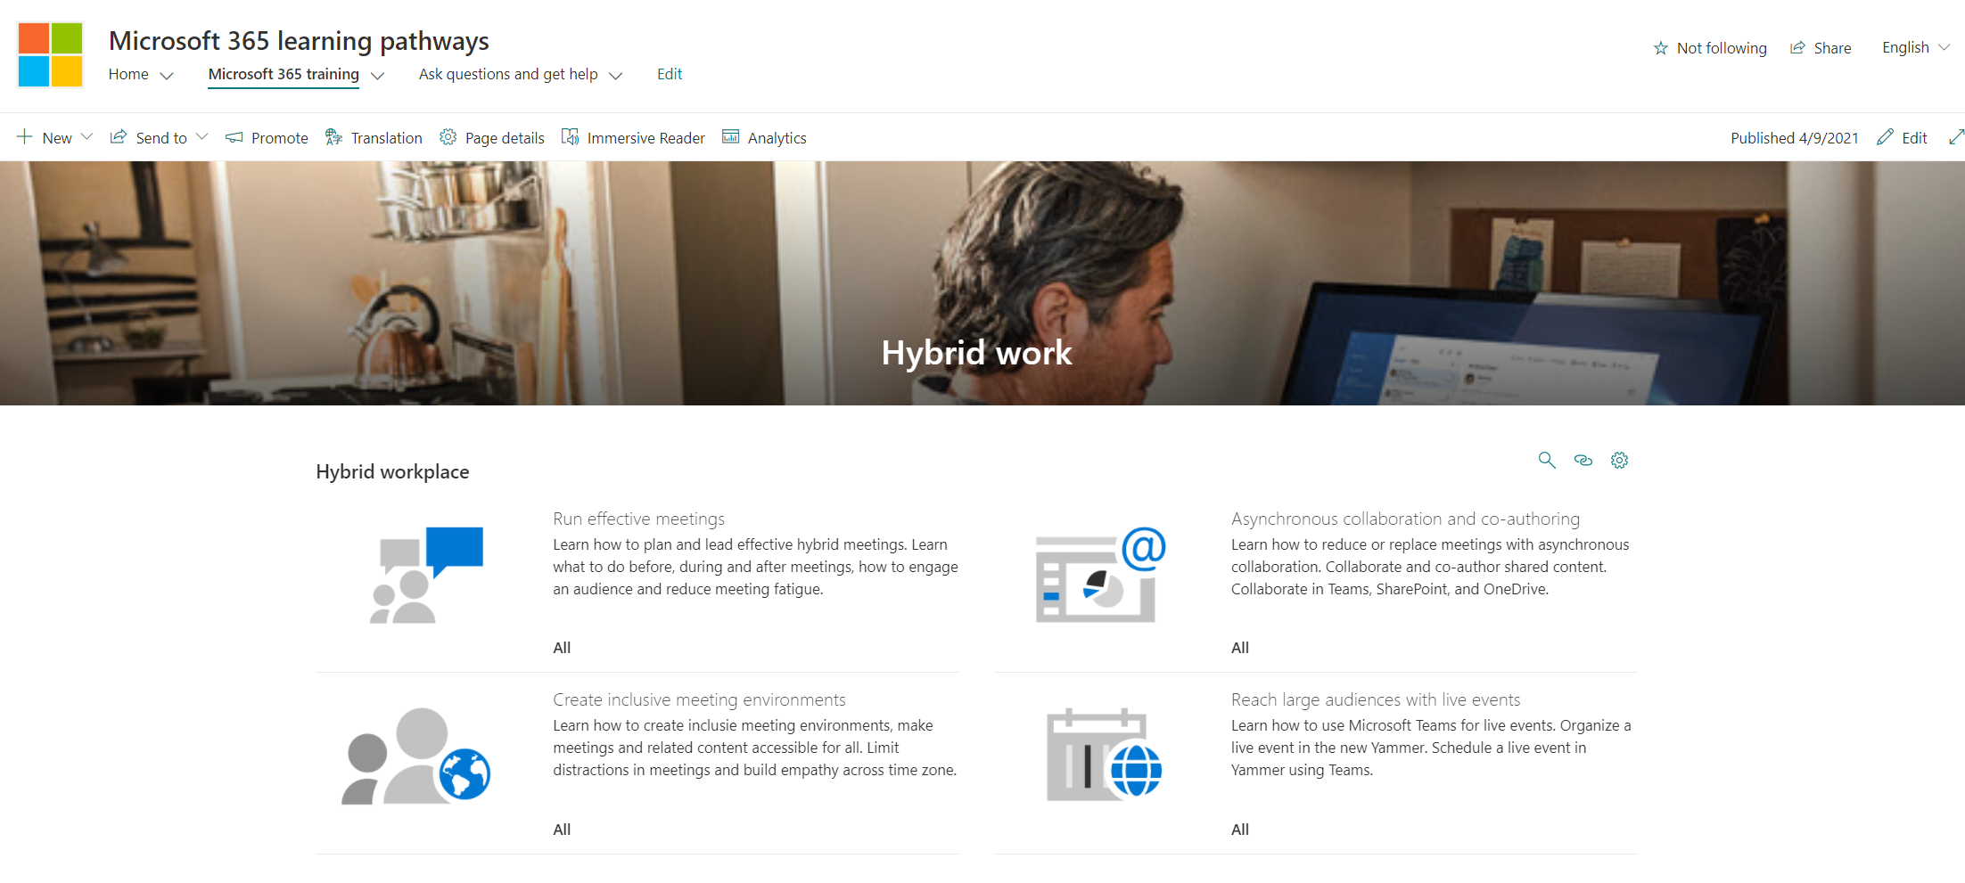
Hybrid workplace guides
Help employees develop new hybrid workplace habits and discover new tools that set them up for success with new end user training content based on Microsoft Research insights.
Embed hybrid workplace training content into your Workplace transformation site using Microsoft 365 learning pathways – a free, on-demand training solution from Microsoft.
View guides: https://aka.ms/HybridWorkplaceGuides.
Learn more about Microsoft 365 learning pathways: https://aka.ms/M365LP.

Slide 22
Hybrid work end user training (in M365 LP) | Demo

Slide 23
Next steps
1
Learn more about the Workplace transformation site template and new end user training: https://aka.ms/WorkplaceSiteBlog.
Provision the Workplace transformation site to your tenant today and customize it to help your colleagues transition to a new way of working: https://aka.ms/WorkplaceTransformationSite.
2

Slide 24
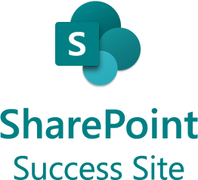
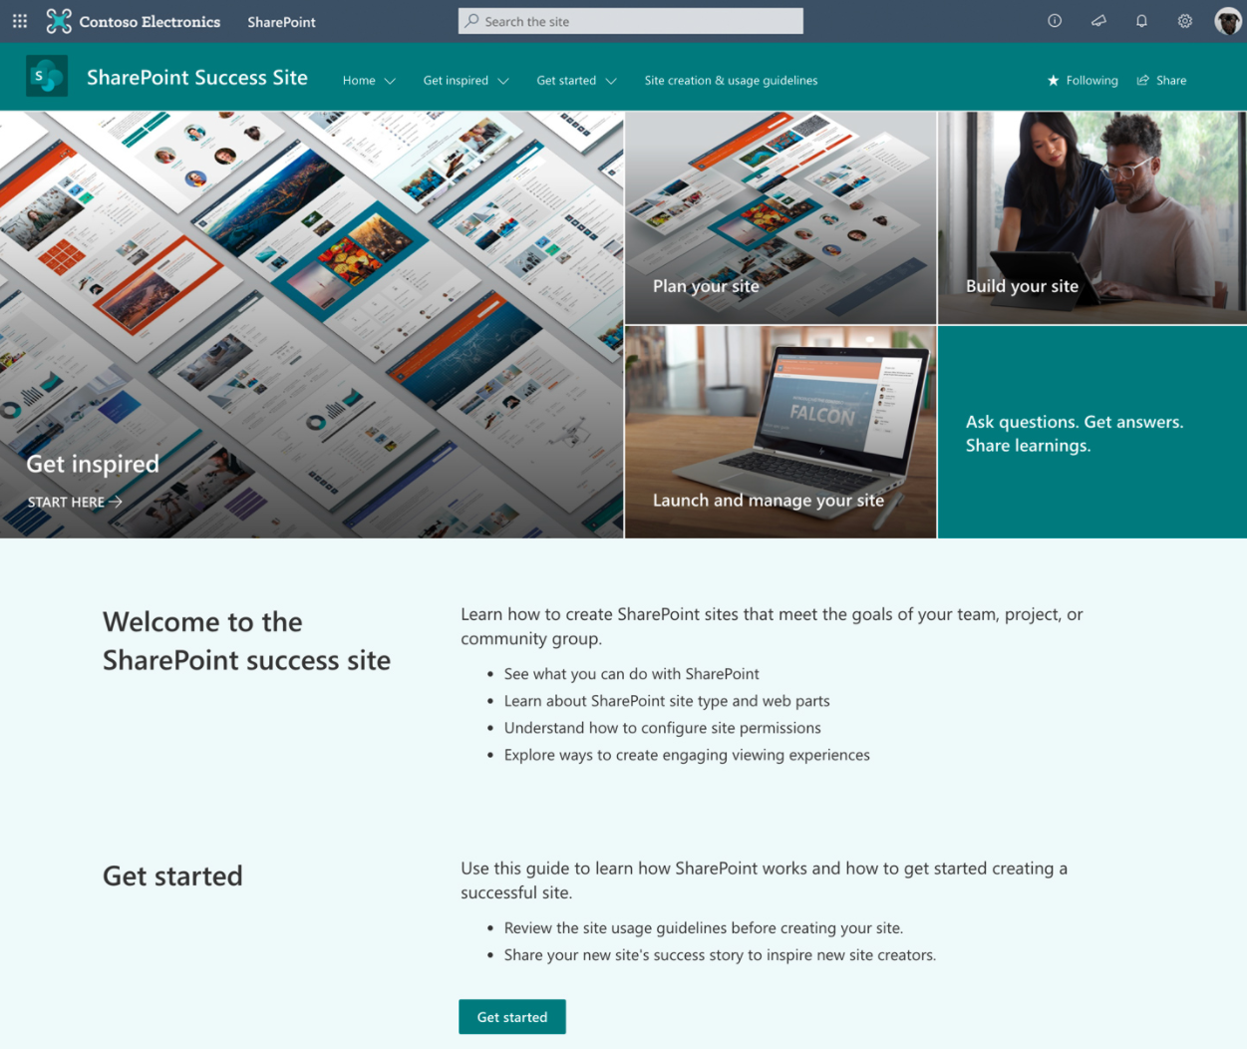
The SharePoint Success Site is a ready to implement, up-to-date and customizable SharePoint Online site that helps your organization maximize its adoption and value realization of SharePoint Online
Comprehensive site owner training content: Training on what makes a great site and how to build in SharePoint Online, in video and article format.
Usage guidelines checklist: Create appropriate SharePoint usage guidelines to ensure its proper use in your organization.
Easy to install: Deploy from https://aka.ms/SuccessSite within minutes and without any coding.
Easily customizable: Edit Microsoft curated playlists to align with how you have set up SharePoint Online in your environment.
Create your own training playlists: Add your own custom training content and playlist to feature your organization specific SharePoint Online scenarios.
Always up-to-date content: As SharePoint Online changes, the SharePoint Success site content will be updated.
https://aka.ms/SuccessSite

Slide 25
New & upcoming assets | Need to know

Slide 26
Upcoming events
Microsoft Ability Summit
  May 5-6, 2021
Explore other Microsoft Events
Our next Champion Community call:
May 25th @ 8 AM & 5 PM PT

Slide 27
Microsoft 365 Champion Community News
May call topics:
Top asks:
Hear from the Sharing is Caring Community!
  If you are looking to learn how to use the Microsoft 365 community resources or contribute back to the community and are unsure where to start, the Patterns and Practices "Sharing is Caring" team is here for you!
  Using hands-on guidance in safe space sessions, you can learn how to overcome technical and non-technical hurdles that prevent you from getting more involved in the community.
  PnP | Sharing Is Caring
Complete our monthly call survey: https://aka.ms/Microsoft365ChampionCallFeedback
Participate in the Driving Adoption Community:
https://aka.ms/DrivingAdoption
Invite colleagues to join the Champion Program: https://aka.ms/M365Champions

Slide 28
Thanks for attending! We’d love your feedback on todays call and hear ways we can make future calls even better!
https://aka.ms/Microsoft365ChampionCallFeedback
Microsoft 365 Champion Community
Learn more. Do more. Achieve more, together.

