Slide 1


Microsoft 365 Community Call
Microsoft 365 Champion Community
September 2020 Monthly Call
Karuana Gatimu
Customer Advocacy Group
Stephen Rose
Product Marketing Manager, Microsoft Teams
Notes:
Join our worldwide program at https://aka.ms/Microsoft365Champions
Materials included in this deck are free to use in your daily work.
Please reference our program as the source of this information.
For questions or comments please reach out in the Drive Adoption or Champion’s Corner forums of the Microsoft Technical Community at https://aka.ms/DriveAdoption

Slide 2

The successful adoption of Microsoft 365 represents a change in behavior.
It is more than a set of products—it is a fundamentally different way of working.
This change is about people.
And we are here to help.
Notes:
Microsoft 365 has the potential to change the trajectory of an organization in many ways, besides the technology itself:
People fundamentally change the way they work
We enable a modern workplace and the optimization of Office 365
We provide the capability to accelerate the alignment of economic and cultural business drives
We allow organizations to enter a state of dynamic stability*
*“Dynamic stability is like riding a bicycle, where you cannot stand still, but once you are moving it is actually easier. It is not our natural state. But humanity has to learn to exist in this state.¹”
1 Friedman, Thomas L. Thank you for Being Late. New York: Farrar, Straus and Giroux, 2016.
“The need to move to a highly flexible and adaptable digital approach is urgent. The applications required today are not going to last for 30 years. They are maybe only going to be used for maybe two, three years.²”
2 McKendrick, J. (2018. Jan 21) The ultimate technology success metric: owning the customer relationship. Retrieved from http://www.zdnet.com/article/business-transformation-before-technology/

Slide 3
Agenda
Inspiration
Information
Tools
Microsoft Ignite & the Virtual Hub
Virtual Event Playbook
#HumansFirst
Find resources from previous calls here:
https://adoption.microsoft.com/champion-resources/

Slide 4
Program & Resource Update

Slide 5



Evolving Adoption For Our Times
#HumansFirst Approach
Modern Collaboration Architecture (MOCA)
Microsoft 365 Adoption Framework
Prioritize employee health & wellness
Evolve the “What tool when?” conversation
Deliver on business outcomes

Slide 6
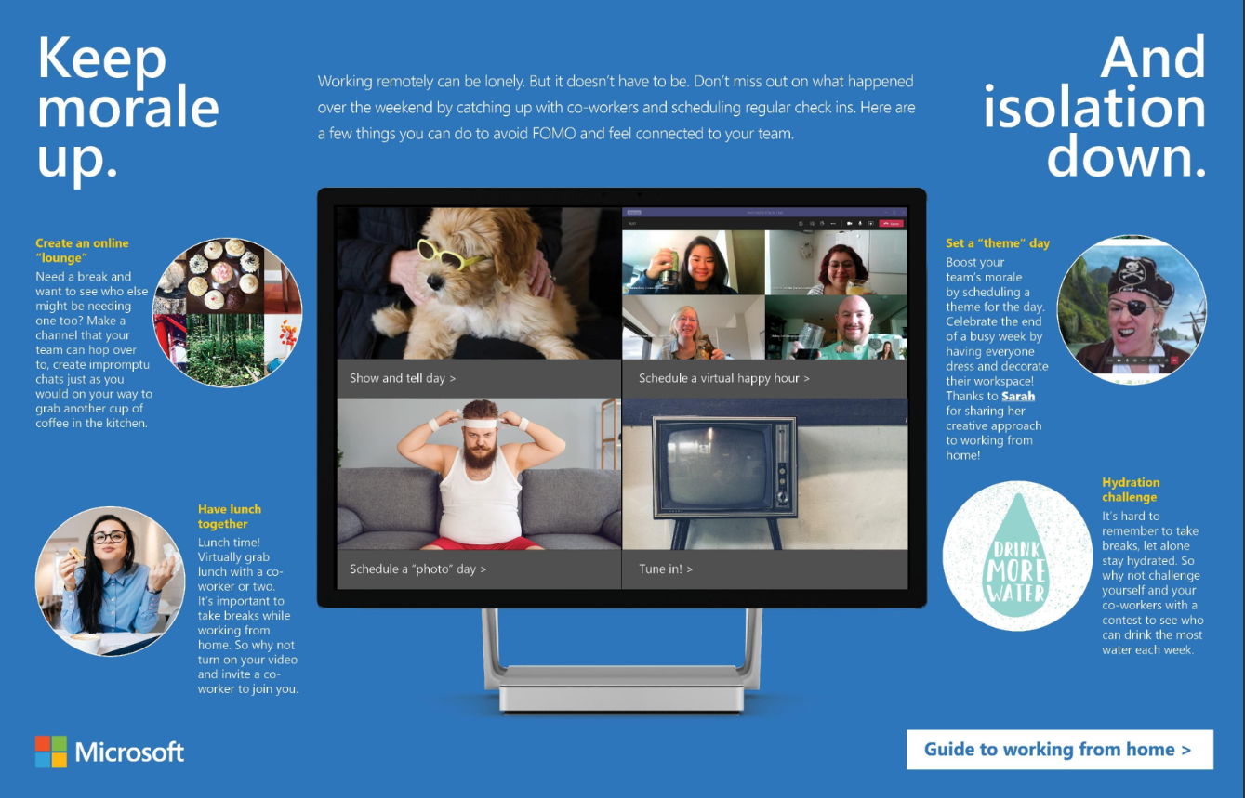
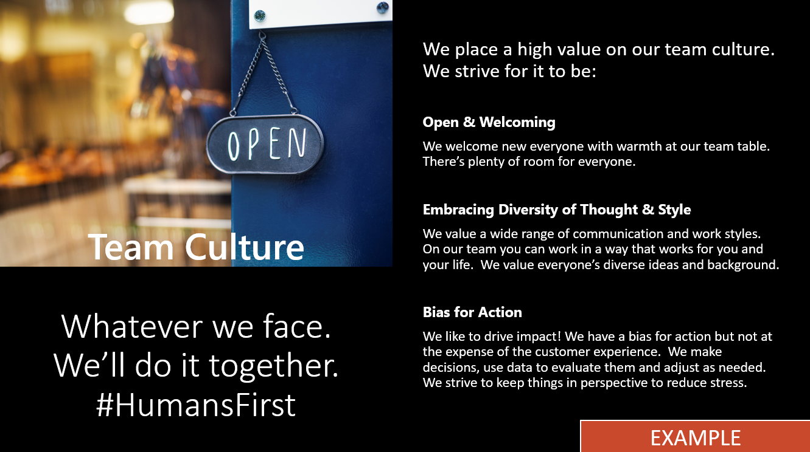
#HumansFirst
Prioritizing the health & well being of employees
Engage with co-workers & customers beyond work topics
Formalize online social engagement
Update your team mission / culture statements
Alter meeting practices to allow for mental rest & context switching

Slide 7
Charting a course…
Navigate the now
Plan what’s next
Shape the future
Remote Everything
Adapt and respond in real time
Solutions to help people stay productive and maintain business continuity
Adapt business models and product offerings
Focus on value, reduce cost
Restart customer demand
Realize new opportunities, scenarios
Focus on growth

Slide 8
We'd love to hear what you think about the champion program!
https://aka.ms/Microsoft365ChampionSurvey
Each quarter, you can tell us which of the program elements you are using and how to make them better.

Slide 9
Microsoft Ignite Briefing

Slide 10


Ignite Announcements
PowerApps Front and Center
New:
  End user experiences and ways to make meetings more personal
  First Line Worker features
  EDU features
  Admin, Governance and Security Features
  Teams Room Device management experiences
  Live Meeting Experiences
aka.ms/teamsigniteguide

Slide 11
Session types & content strategy
Digital breakouts
(30 mins)
Innovations and
new feature announcements
Level 100/200
Ask the Experts
(30 mins)
Level 200/300/400
Interstitials
(15 mins)
15-min “snackables”
Double-click from Key Segments
2 sessions per digital breakout
Pre-recorded sessions
(30-45 mins)
Immediately follow breakouts
Opportunities for interactive content
Planning to leverage CPMs/MVPs/TSPs
Evergreen skilling
In Ignite catalog
In Ignite catalog
Subset in Ignite catalog
Leads to Virtual Hub for continued skilling
Mechanics videos
In Ignite catalog
Ask the Experts; Table Topics; Community
Notes:
Selection criteria (particularly for pre-records):
Alignment with newsplate
Business priorities
Gaps with other business groups

Slide 12
The Virtual Hub
Content, Conversation & Connection
Deep dive technical training for IT Pro’s, Developers, and Champions
Coming September 22, 2020 https://aka.ms/VirtualHub
Engineering Engagement Initiative
Powered by
Product Engineering
Microsoft Marketing
Microsoft Tech Community &
Microsoft Learn

Slide 13
aka.ms/virtualhub
Your curated guide to the latest content
Ignite Videos + MSLearn + docs.com + MVP content + Mechanics and more
150+ videos for Ignite not in the catalog
Get a full learning path from start to finish across all our platforms
Early Look

Slide 14
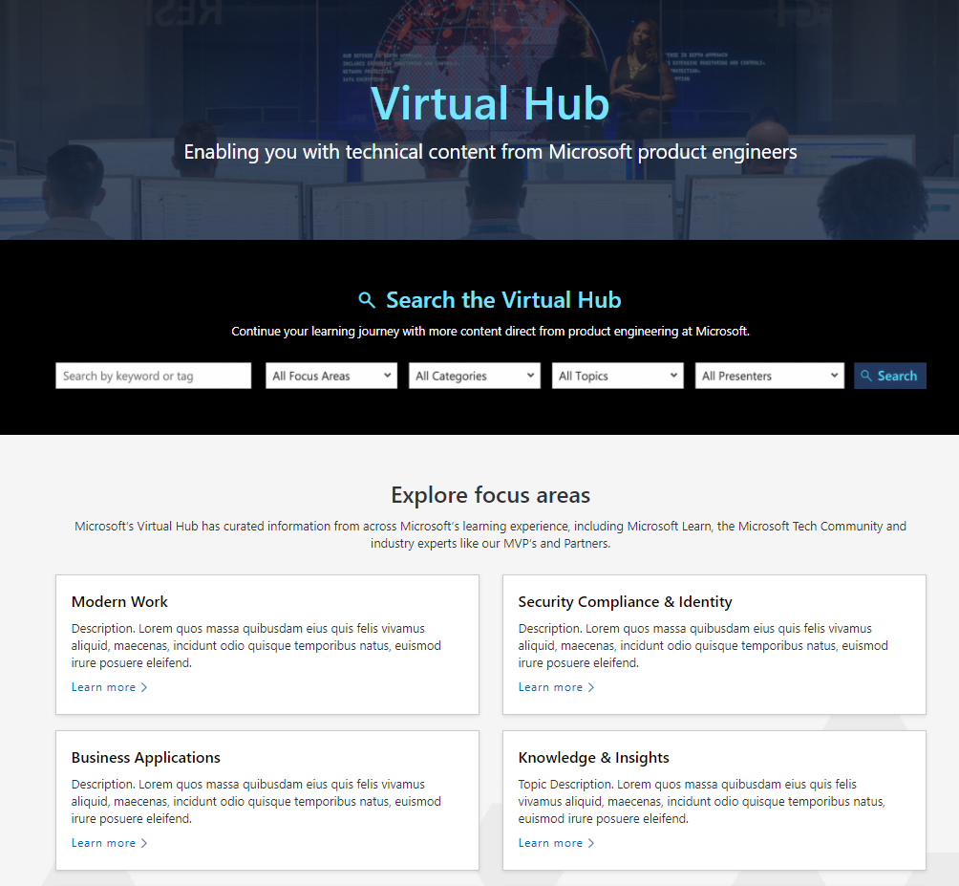
Virtual Hub Demo

Slide 15
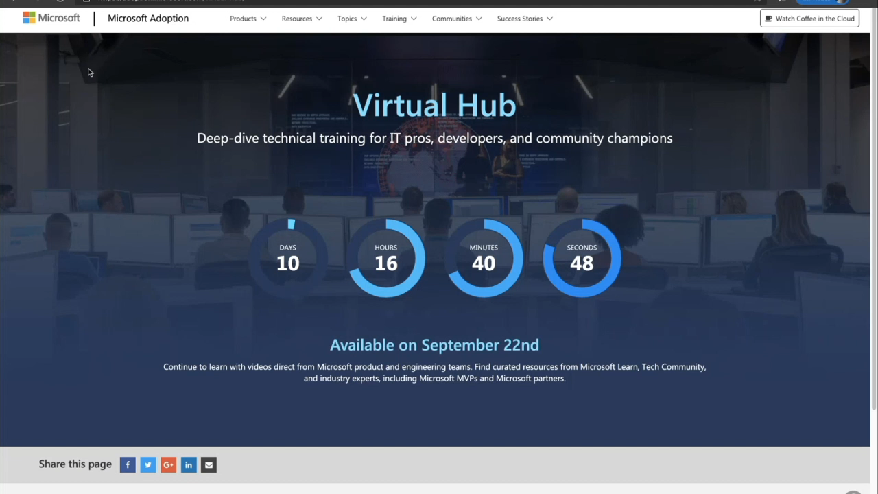
Virtual Hub Sneak Peak

Slide 16
Microsoft Teams Learning Paths and Modules on MS Learn aka.ms/TeamsonLearn
MS Learn Modules and LPs | aka.ms Links
Deploy Teams phone systems with Direct Routing (LP) | aka.ms/MSLearnDirectRouting
Manage Security, Privacy and Compliance in Microsoft Teams (LP) | aka.ms/MSLearnTeamsSecurity
Deploy Microsoft Teams meetings for your organization (LP) | aka.ms/MSLearnDeployTeamsMeetings
Plan and configure Microsoft Teams Rooms (LP) | aka.ms/MSLearnConfigureMTR
Manage team collaboration with Microsoft Teams (LP) | aka.ms/MSLearnManageTeams
Upgrade to Microsoft Teams (LP) | aka.ms/MSLearnUpgradeTeams
Manage calls in Microsoft Teams by using auto attendants and call queues(Module) | aka.ms/MSLearnTeamsPhoneSystems
Optimize your network: Configure your network for M365 and Teams connectivity (Module) | aka.ms/MSLearnNetworkM365
Navigate the Teams admin center (Module) | aka.ms/MSLearnTeamsAdminCenter
Configure enterprise grade security and compliance in Teams (Module) | aka.ms/MSLearnTeamsSecandCompliance
Onboard users to Teams (Module) | aka.ms/MSLearnTeamsOnboard
Rollout Teams using Teams advisor (Module) | aka.ms/MSLearnTeamsAdvisor

Slide 17
Microsoft Teams Interactive Guides - Links
aka.ms/TeamsLearnGuides
Interactive Guide | aka.ms link
Identity, Access management & Threat Protection for Teams | aka.ms/teamsesecurityinteractiveguide
Managing Compliance in Teams | aka.ms/complianceinteamsinteractiveguide
Using Microsoft Teams advisor: Deploying chats, teams, channels and apps | aka.ms/MicrosoftTeamsAdvisorInteractiveguide
Streamlining Teams administration with PowerShell and dynamic groups | aka.ms/StreamliningTeamsadminInteractiveGuide
Managing Teams and Guest Access in the Microsoft Teams admin center | aka.ms/TeamsandGuestAccessInteractiveGuide
Deploying Microsoft Teams Rooms | aka.ms/DeployMTRInteractiveGuide
Configure Teams Phone System: Call Queues and Auto Attendants | aka.ms/TeamsPhoneInteractiveGuide
Configure Direct Routing: connecting SBCs and voice routing | aka.ms/DirectRoutingInteractiveGuide
Configure Governance in Microsoft Teams | aka.ms/TeamsGovernanceInteractiveGuide
Configuring and deploying Teams meetings | aka.ms/TeamsMeetingsInteractiveGuide
Configure audio conferencing for Microsoft Teams | aka.ms/AudioConferencingInteractiveGuide
Configuring Microsoft Teams for Firstline workers | aka.ms/ConfigFLWInteractiveGuide

Slide 18

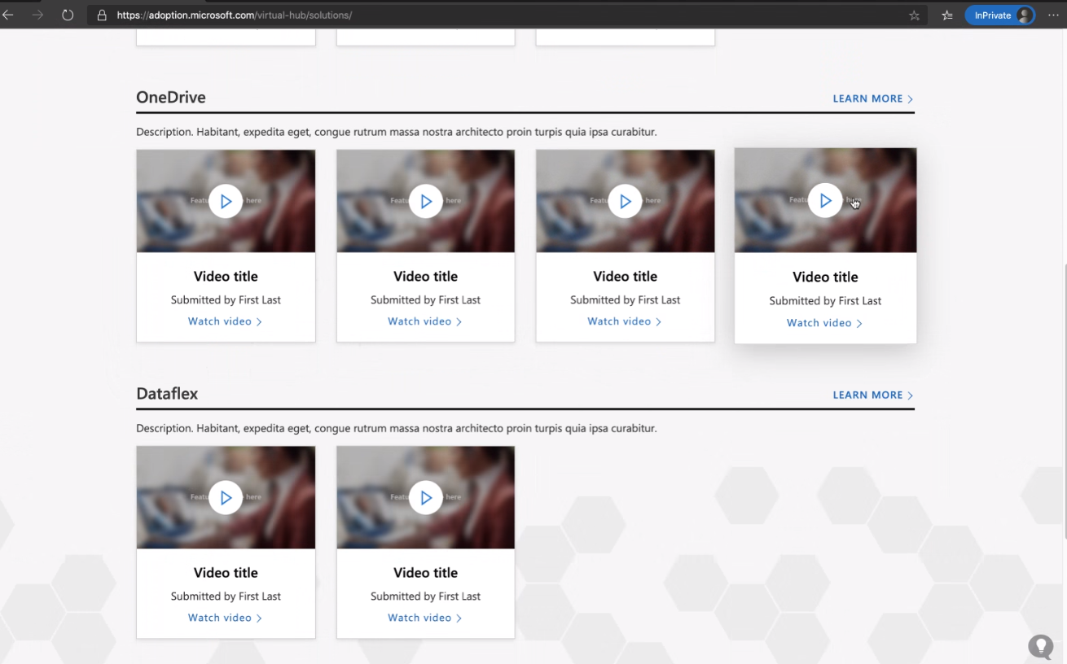
Real World Solutions and Best Practices
External content is key to help scale messaging and to provide real-world customer experiences in the voice of our community members. A call for content from MVPs, RDs, and select partners will be conducted the first week of September and will go live on the Virtual Hub October 5th.
Notes:
Contact Laurie Pottmeyer with any questions related to the external CFC; schedule on next slide.
Content Leads will approve all content. Submissions will be posted in an Excel doc for review and participate in a v-team meeting to finalize external content.
Discoverability – content will be tagged with Real World Solutions and Best Practices and searchable with key words. Additional links and slides will be available on the hub along with the recording and SMEs will be on point to answer questions related to their content in the Hub.
Phase 1 content will go live 2 weeks post –Ignite
We will have a second call for content for additional content in Phase 2 – post Airlift; content goes live in November.
Home: https://adoption.microsoft.com/virtual-hub/home
Search: https://adoption.microsoft.com/virtual-hub/home/search/
Real-World Solutions & Best Practices: https://adoption.microsoft.com/virtual-hub/solutions/
--
Focus Area: https://adoption.microsoft.com/virtual-hub/home/focus-area
Category: https://adoption.microsoft.com/virtual-hub/home/focus-area/category/
Topic: https://adoption.microsoft.com/virtual-hub/home/focus-area/category/topic/
Video: https://adoption.microsoft.com/virtual-hub/home/focus-area/category/topic/video

Slide 19
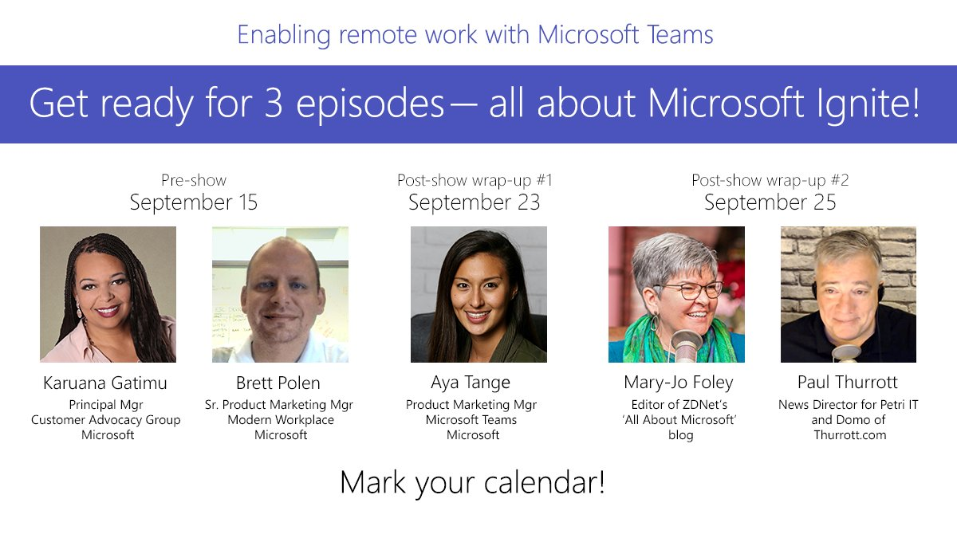
aka.ms/teams-remotework

Slide 20
Virtual Event Playbook

Slide 21
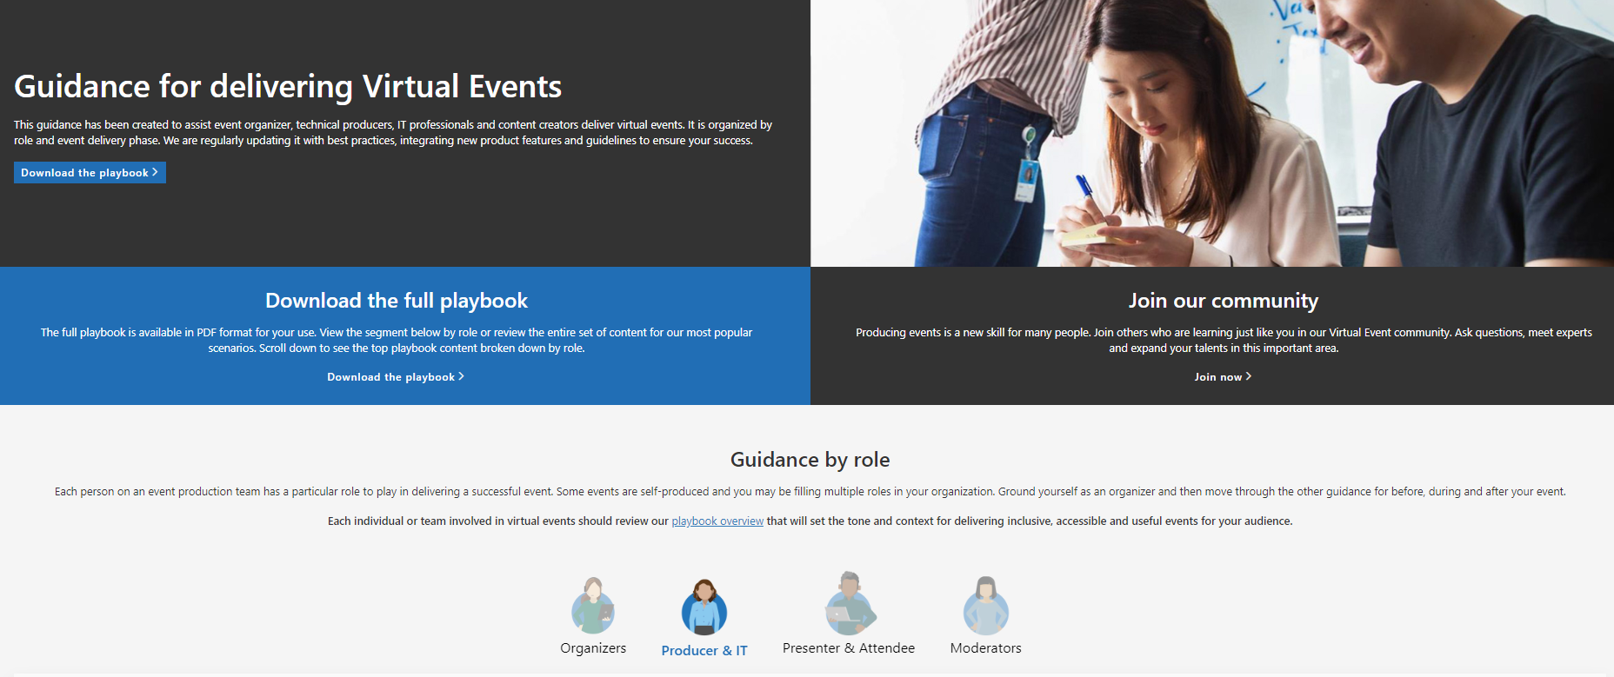
Virtual Event Playbook Launch
New! https://aka.ms/VirtualEventPlaybook

Slide 22




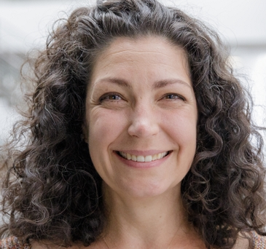



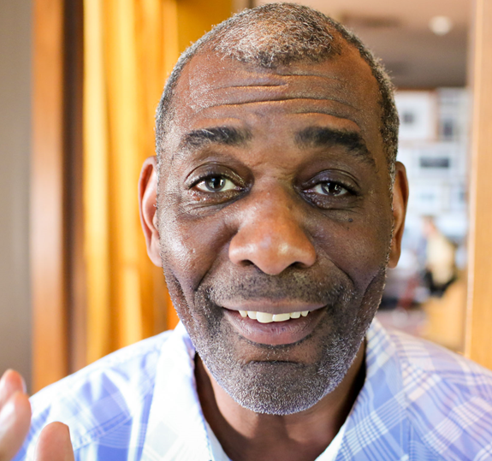

Virtual Event Playbook
Virtual Event Playbook
Accessible Inclusive Engaging
https://aka.ms/VirtualEventPlaybook
©Microsoft Corporation, 2020 v1.4
Notes:
@Microsoft Corporation, 2020
Version 1.4
August 2020
Visit https://aka.ms/VirtualEventForum for questions
Provide feedback or bugs on this document at https://aka.ms/AdoptionFeedback

Slide 23

Event Design Model
Awareness
Audience Profile
Core
Message
The one thing we can never get back is time. This is the most valuable thing an event attendee shares with you.
The most successful virtual events are a part of a long-term audience acquisition & retention strategy. Below is an example framework of an acquisition strategy.
Ensure attendee satisfaction with valuable and engaging content & on-screen talent. Clear calls to action & post-event engagement will ensure the attendees you acquire would return for further events.
Awareness – Potential attendees know about you and your event.
Education – Potential attendees gain knowledge about the purpose of your event.
Intent – Potential attendees form intent to participate in your event.
Conversion – Potential attendees convert via registration.
Engagement – Attendee participation.
Satisfaction – Attendees are satisfied with your event and would recommend it to others.
Accessibility
Satisfaction
Education
Event Model
Inclusivity
Talent &
Tools
Engagement Strategy
Audience Experience
Technology
Content
Production
Intent &
Engagement
conversion
7

Slide 24
Example: Digital events guiding principles
Event Mission: Online content and interactive experiences that foster learning, connection and inspiration
  Approach with empathy and inclusion
  Adapt to audience needs/feelings, enabling
  all to feel welcome, present and able to connect.
  Be a digital content platform
  Media and user experience optimized for digital consumption.
  Communicate core narratives
  Deliver learning content, core messaging, authentic brand experience, priority solutions and engagement opportunities.
  Earn audience attention
  Help users prioritize content via promotions, schedule reminders and participation rewards.
  Access the experts
  Reduce friction. Expand connection opportunities. Get information from the source.
  Embrace real time feedback & change
  Incorporate real time feedback for content and event experiences. Be willing to quickly change to deliver a better event.
8

Slide 25
Combination events
Large scale, multi-day events may be a combination of Teams meetings and Live Event experiences. Match the interaction and broadcast method to the audience need.
Live Events
Teams Meetings
Breakouts
Keynotes
Core conference content
Organize into subject tracks
Select experience by projected attendance
Use moderators to increase Q&A satisfaction
Interactive
All audience content
Primary conference speakers
Option for pre-recorded content
No competing content scheduled
Two-way feedback sessions
Interactive topics like feedback, ask-the-expert panels, hands-on-training
Allowing attendees to unmute or share video
Free flowing chat
Choose experience by audience size & interaction model
Tips for a successful event:
Provide navigation and awareness sign-posts on your primary attendee website or digital brochure.
Make content available for attendees as soon as possible after event. Use Stream for Microsoft 365, Microsoft Teams or other popular online video portal technology to ensure a content lifecycle.
22
Notes:
Best practice: Provide navigation and awareness sign-posts on your primary attendee website or digital brochure.
Post conference viewing
Ensure attendees have access to content after the stated schedule. Virtual events can mean less focus time for your attendees. Use Stream for Microsoft 365 users or other popular online video portal technology to ensure an appropriate lifespan for your content. Plan to make available as soon as possible for people who are participating and want to go back and review information or catch up on what they missed.

Slide 26
Selecting your event experience
I
II
III
IV
What type
of event?
What type of
attendee experience?
How many people will watch the event live?*
What level of
video production?
Single event
Open 2-way discussion
Up to 300
Simple webcam
and screen share
Event series
Managed Q&A
Up to 20,000
Multiple presenters
Part of an
engagement community
No attendee
discussion or Q&A
Up to 100,000
Custom production
Event examples:
Single event: Product launch, organizational changes, town hall
Event series: Training, office hours, employee development
Engagement community: Customer community, company partners, product support
*Are your attendees' members or guests of your Microsoft 365 tenant? Microsoft Stream does not support guest access at this time.
23
© Microsoft Corporation Microsoft 365
Notes:
*Attendee limit increases over 10,000 are temporarily available until October 1, 2020. Events above 20,000 attendees require Live Events Assistance Program Engagement
**Stream live events can be delivered outside an organization when planned though the LEAP team. It’s a case by case, temporary service to help customers communicate at scale outside their organization

Slide 27

Selecting your event experience: Teams meeting
I
II
III
IV
What type
of event?
What type of
attendee experience?
How many people will watch the event live?
What level of
video production?
Single event
Open 2-way discussion
Up to 300
Simple webcam
and screen share
Event series
Managed Q&A
Up to 20,000
Multiple presenters
Part of an
engagement community
No attendee
discussion or Q&A
Up to 100,000
Custom production
Build community and authentic connection
Provides open discussion features via audio and video for attendees
Provide meetings as a part of a team to provide continuing engagement
Support interactive chat during & multiple presenters in the meeting
Familiar content and video sharing controls
Use Yammer for your Teams produced meeting as a part of a community experience or series with continuing conversation
Recommended:
Teams meeting
24
© Microsoft Corporation Microsoft 365
Notes:
*Attendee limit increases over 10,000 are temporarily available until October 1, 2020. Events above 20,000 attendees require Live Events Assistance Program Engagement
**Stream live events can be delivered outside an organization when planned though the LEAP team. It’s a case by case, temporary service to help customers communicate at scale outside their organization

Slide 28


Selecting your event experience: Live Events
I
II
III
IV
What type
of event?
What type of
attendee experience?
How many people will watch the event live?
What level of
video production?
Single event
Open 2-way discussion
Up to 300
Simple webcam
and screen share
Event series
Managed Q&A
Up to 20,000*
Multiple presenters
Part of an
engagement community
No attendee
discussion or Q&A
Up to 100,000**
Custom production
Manage the attendee experience
Multiple Live Event options for maximum flexibility
Broad scale and highly managed content experience
Supports self-produced to custom production scenarios
Live Events can be publicized as a part of an engagement community
Recommended:
Live Events
Next Step: Follow Live Event selection decision tree
25
© Microsoft Corporation Microsoft 365
Notes:
*Attendee limit increases over 10,000 are temporarily available until October 1, 2020. Events above 20,000 attendees require Live Events Assistance Program Engagement
**Stream live events can be delivered outside an organization when planned though the LEAP team. It’s a case by case, temporary service to help customers communicate at scale outside their organization

Slide 29

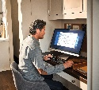







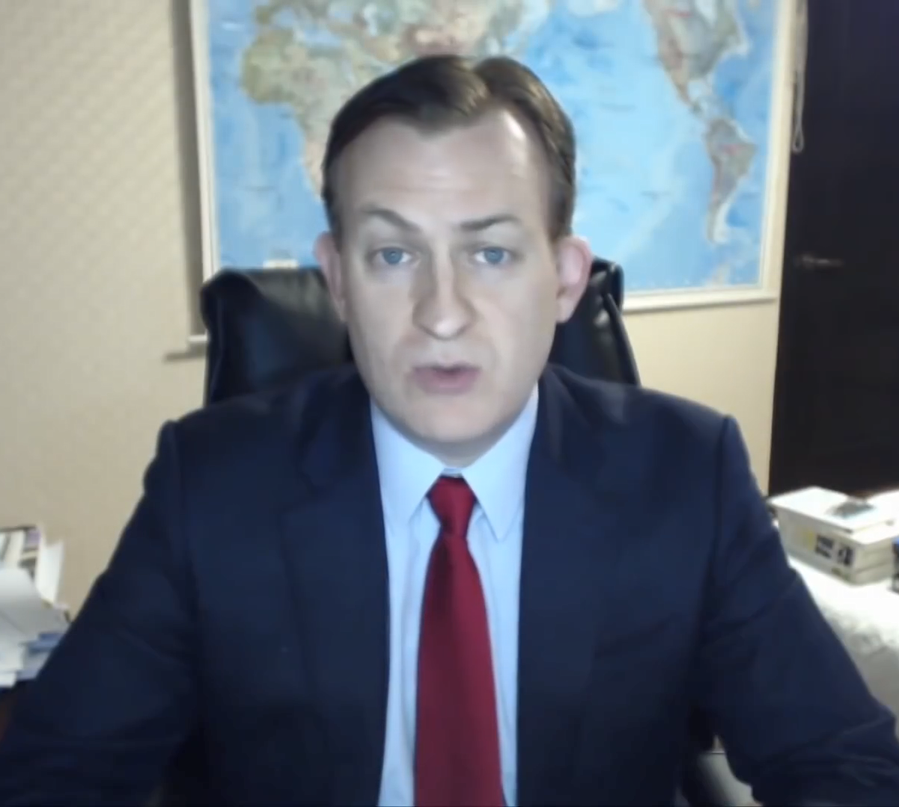






We’re in this together

Slide 30
We'd love to hear what you think about today’s call!
https://aka.ms/Microsoft365ChampionCallFeedback
At the end of each call, you can rate it and tell us how to make them even more useful in the future.

Slide 31
RESOURCES
Microsoft Adoption https://adoption.microsoft.com
Monthly Call Resources for Champions https://adoption.microsoft.com/champion-resources
COVID-19 Resources from Microsoft https://aka.ms/covid19Info

Slide 32
Resources
Microsoft Resource Cheat Sheet
https://aka.ms/m365roadmap
https://aka.ms/techcommunity
https://docs.microsoft.com
https://developer.microsoft.com
Microsoft 365 Roadmap
All public feature delivery dates
Filter by product
Microsoft Technical Community
Product forums and blogs
Driving Adoption forum
Diversity & Inclusion forum
IT Pro & Adoption Documentation
Learn how to plan, deliver, adopt and manage Microsoft 365 products
Developer Documentation
Training, documentation, samples & communities for developers
Tools and Resources
https://adoption.microsoft.com
Microsoft Adoption Hub
Adoption resources for Microsoft 365 services
Microsoft 365 Champion sign up and Information
Microsoft 365 Learning Pathways & Service Adoption Specialist course information
Visit Us

Slide 33
End Slide
Microsoft 365 Champion Community
https://adoption.microsoft.com
Notes:
Join our worldwide program at https://aka.ms/Microsoft365Champions
Materials included in this deck are free to use in your daily work.
Please reference our program as the source of this information.
For questions or comments please reach out in the Drive Adoption or Champion’s Corner forums of the Microsoft Technical Community at https://aka.ms/DriveAdoption

Slide 34
Expanding the Microsoft 365 Champion Program
Adoption Strategy & Execution
Business Process Improvement Low code / No code solutions, Power Apps & Bots
Cloud Productivity Microsoft Teams, SharePoint, Stream, Forms & Power Automate
Microsoft 365 Apps Word, PowerPoint, Excel, Outlook
Security Fundamentals Basic identity & content protection features
Clarify areas of technical acumen
Provide options for focus and career development
Provide framework for continuing education
Update essential learning areas for security
Properly reflect the industry demand

