Slide 1


Microsoft 365 Community Call
Microsoft 365 Champion Community
November 2020 Monthly Call
Karuana Gatimu
Customer Advocacy Group
Notes:
Join our worldwide program at https://aka.ms/Microsoft365Champions
Materials included in this deck are free to use in your daily work.
Please reference our program as the source of this information.
For questions or comments please reach out in the Drive Adoption or Champion’s Corner forums of the Microsoft Technical Community at https://aka.ms/DriveAdoption

Slide 2

Quote from Sayta Nadella
It is our ability to work together that makes our dreams believable and, ultimately, achievable.
We must learn to build on the ideas of others and collaborate across boundaries to bring the best of Microsoft to our customers as one—one Microsoft.
Satya Nadella, Hit Refresh
Notes:
As you can see, our own CEO acknowledges that human attention is a scare commodity.
We are literally inundated with messages, whether phone, text, email, or social media-based, that constantly interrupt us and our trains of thought.
Let’s dive a bit deeper here and talk about this scare resource—attention.

Slide 3
Charting a course…
Navigate the now
Plan what’s next
Shape the future
Remote Everything
Adapt and respond in real time
Solutions to help people stay productive and maintain business continuity
Adapt business models and product offerings
Focus on value, reduce cost
Restart customer demand
Realize new opportunities, scenarios
Focus on growth

Slide 4
Agenda
Inspiration
Information
Tools
Online Learning
Roadmap
Planning for Change
Resilience
Find resources from previous calls here:
https://adoption.microsoft.com/champion-resources/

Slide 5
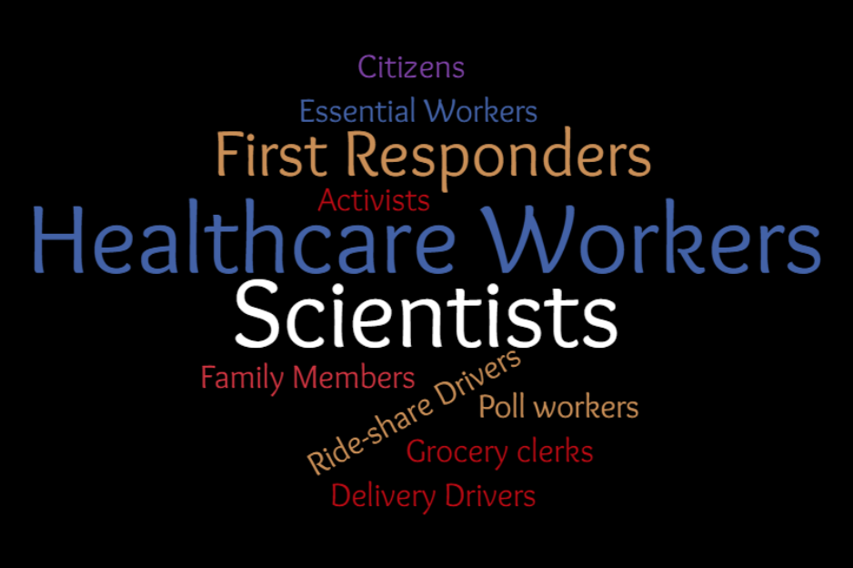
Resilience in Action
Inspiration

Slide 6
Online Learning Resources adoption.microsoft.com

Slide 7


Slide 8
What’s next at adoption.microsoft.com
December 2020
Virtual Event Custom Production Playbook
Scenario, Solution & Partner Galleries
Updated navigation & home experience
Q1/CY21
Update to Teams app template for Learning Pathways
Event management template updates (built on existing features)
Champion hub app on mobile
Final Q1 plans to lock in December

Slide 9
Planning for Change
Planner & Microsoft 365 Message Center
Content courtesy of Paolo Ciccu, Microsoft

Slide 10
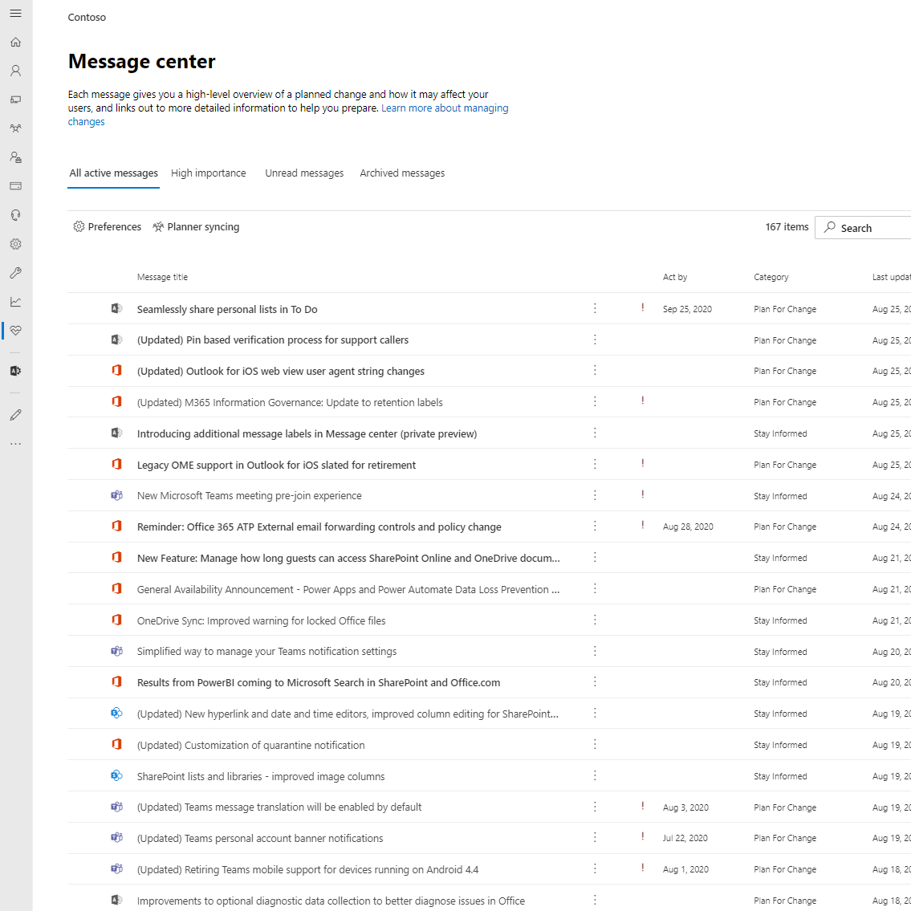
Message Center
Communicating to organizations about upcoming changes in Microsoft 365.
On average an organization can see 140 message posts per month.
Notes:
Lets start with the Message Center, this is the primary communication channel to organizations about upcoming changes in Microsoft 365. The changes we communicated can include but not limited to, new and updated features, deprications, and other items that could impact your tenant.
We know that an organization can see an average of 140 message posts per month.
For IT Admins, its important to be on top of these constant changes to their Cloud services. With ever-growing services and innovation, tracking these changes can be daunting without a good workflow management tool. Organizations spend about 4-8hrs per week in managing the content across various collaboration tools.

Slide 11
Microsoft 365 Change Management Challenges
Lack of visibility into triage accuracy and overall progress
Difficult to hold people accountable
Heavy Operational cost to track changes and required manual solutions to copy content from message center post to a workflow management solution
Collaborating with non-Admins for change management adds heavy cost to the operation
Managing “Message Center Content” rather than managing “Change”
Notes:
We are listening to your feedback and after many interviews with various organizations we have identified several key challenges to the change management process when using the message center.
It is not easy to triage the message center posts.
IN the message center there is no way to assign admins or other team members to that message so they are held accountable
So that means you would need to find a tool/solution that allows you track your changes, but having to manually copy the content from message center post to a workflow takes extra hours out of your day.
Many times the organization will have teams dedicated to change management of the services, but those teams will include non admins, so getting access to the information adds more cost to the operation
At the end of the day we found the organizations were managing Message center content rather than managing the changes themselves.

Slide 12
Change Management Best practices
Establish Change process and agree on ownership
Regular triages (at least once a week)
Ensuring right owner is assigned to the tasks and handoff to the next owner
Workflow management tool to track and avoid moving content over to different places
Planner
Azure DevOps
SharePoint
Notes:
We wanted to help customers to focuse on managing change rather than managing content so we have build Planner Syncing feature for message center

Slide 13



Message Center Planner Sync Feature
Notes:
How does it work:
There is an upcoming change for Microsoft 365 so we need to notify the organization.
We will then create a message with the relevant information and post it to the message center
Once it is in the message center, you can opt to enable the planner sync, which will automatically sync your message center posts into tasks in Planner.

Slide 14




Why Planner?
Easy to triage, assign and track tasks
Simple and intuitive to use
Included in the majority of Microsoft 365 offerings
Light weight
Notes:
When deciding on an out of the box solution we looked for a workflow management tool that provided the following:

Slide 15
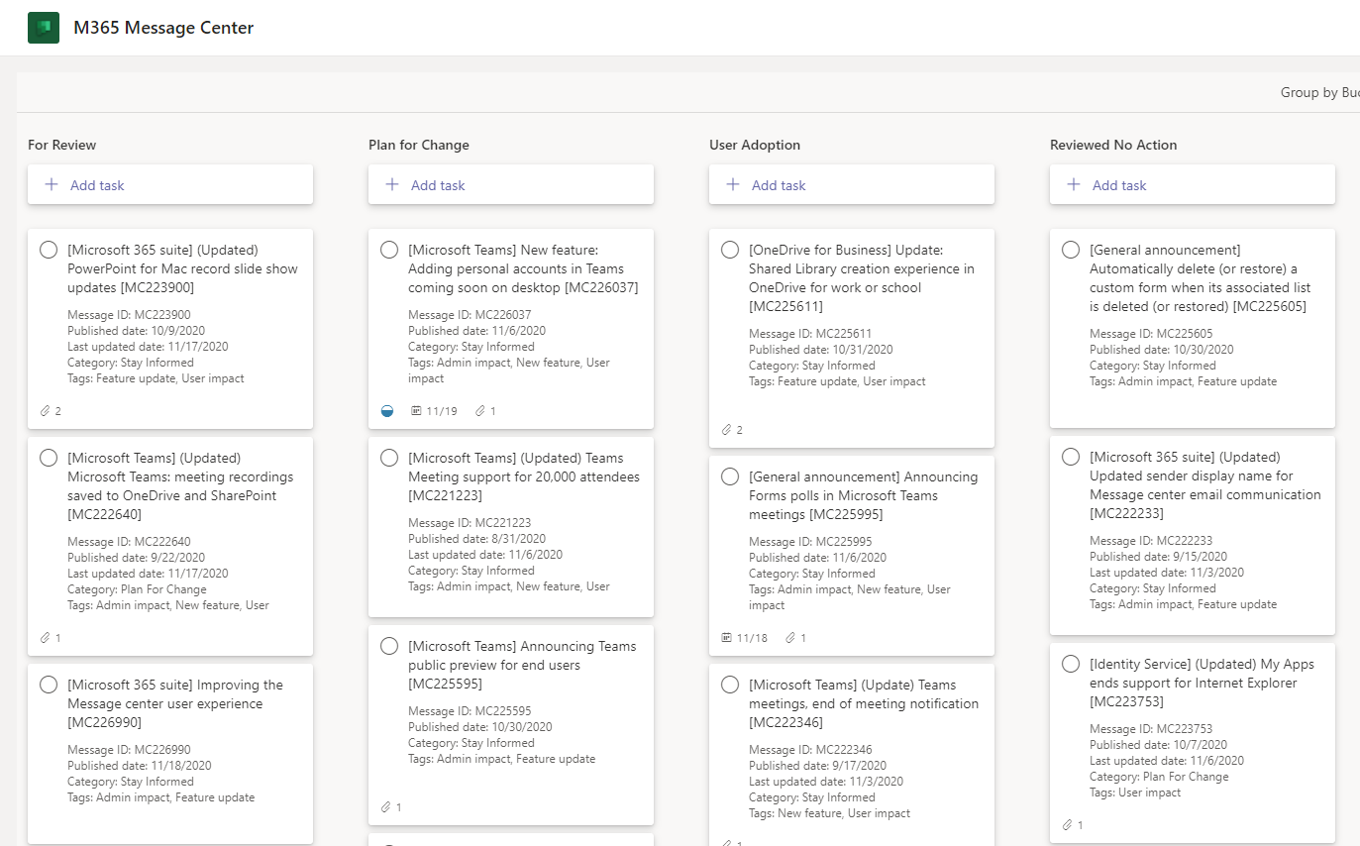
Demo

Slide 16
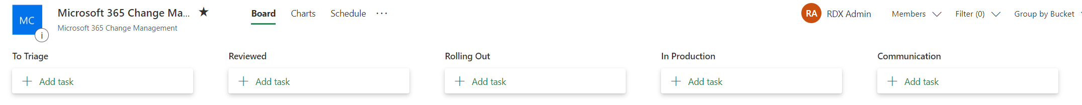
Tips and Tricks
Here are a few common ways to structure your buckets for the Planner Sync feature.
By Service/Workload
By Phases
By Workstream

Slide 17









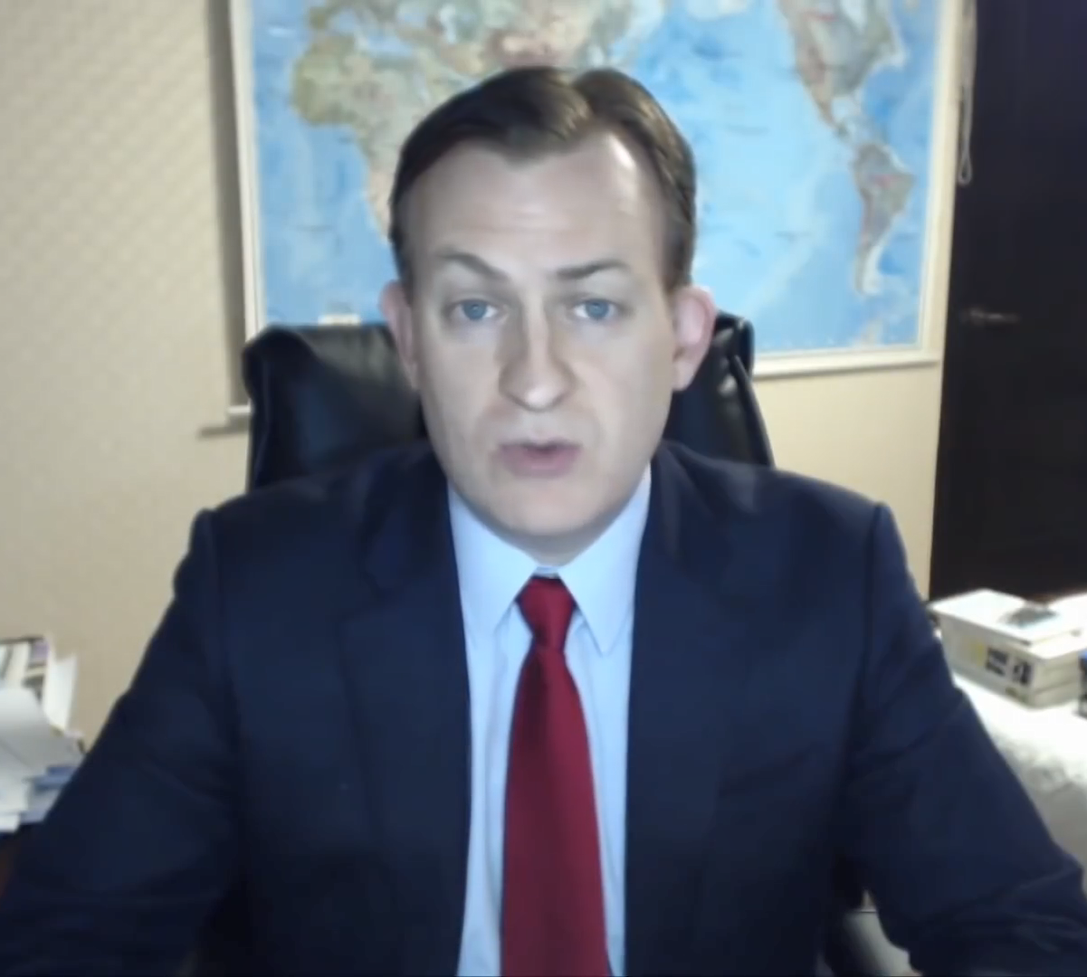






We’re in this together

Slide 18
We'd love to hear what you think about today’s call!
https://aka.ms/Microsoft365ChampionCallFeedback
At the end of each call, you can rate it and tell us how to make them even more useful in the future.

Slide 19
RESOURCES
Microsoft Adoption https://adoption.microsoft.com
Monthly Call Resources for Champions https://adoption.microsoft.com/champion-resources
COVID-19 Resources from Microsoft https://aka.ms/covid19Info

Slide 20
Resources
Microsoft Resource Cheat Sheet
https://aka.ms/m365roadmap
https://aka.ms/techcommunity
https://docs.microsoft.com
https://developer.microsoft.com
Microsoft 365 Roadmap
All public feature delivery dates
Filter by product
Microsoft Technical Community
Product forums and blogs
Driving Adoption forum
Diversity & Inclusion forum
IT Pro & Adoption Documentation
Learn how to plan, deliver, adopt and manage Microsoft 365 products
Developer Documentation
Training, documentation, samples & communities for developers
Tools and Resources
https://adoption.microsoft.com
Microsoft Adoption Hub
Adoption resources for Microsoft 365 services
Microsoft 365 Champion sign up and Information
Microsoft 365 Learning Pathways & Service Adoption Specialist course information
Visit Us

Slide 21
Microsoft 365 Community Call
Microsoft 365 Champion Community
Learn more. Do more. Achieve more, together.
Notes:
Join our worldwide program at https://aka.ms/Microsoft365Champions
Materials included in this deck are free to use in your daily work.
Please reference our program as the source of this information.
For questions or comments please reach out in the Drive Adoption or Champion’s Corner forums of the Microsoft Technical Community at https://aka.ms/DriveAdoption

Slide 22
Expanding the Microsoft 365 Champion Program
Adoption Strategy & Execution
Business Process Improvement Low code / No code solutions, Power Apps & Bots
Cloud Productivity Microsoft Teams, SharePoint, Stream, Forms & Power Automate
Microsoft 365 Apps Word, PowerPoint, Excel, Outlook
Security Fundamentals Basic identity & content protection features
Clarify areas of technical acumen
Provide options for focus and career development
Provide framework for continuing education
Update essential learning areas for security
Properly reflect the industry demand

