Slide 1
Office 365 Champion Community
May 2020 Monthly Meeting
Karuana Gatimu
Customer Advocacy Group
Notes:
Join our worldwide program at https://aka.ms/O365Champions
Materials included in this deck are free to use in your daily work.
Please reference our program as the source of this information.
For questions or comments please reach out in the Drive Adoption or Champion’s Corner forums of the Microsoft Technical Community at https://aka.ms/DriveAdoption

Slide 2
The successful adoption of Microsoft 365 represents a change in behavior. It is more than a set of products—it is a fundamentally different way of working. This change is about people. And we are here to help.
Notes:
M365 has the potential to change the trajectory of an organization in many ways, besides the technology itself:
People fundamentally change the way they work
We enable a modern workplace and the optimization of Office 365
We provide the capability to accelerate the alignment of economic and cultural business drives
We allow organizations to enter a state of dynamic stability*
*“Dynamic stability is like riding a bicycle, where you cannot stand still, but once you are moving it is actually easier. It is not our natural state. But humanity has to learn to exist in this state.¹”
1 Friedman, Thomas L. Thank you for Being Late. New York: Farrar, Straus and Giroux, 2016.
“The need to move to a highly flexible and adaptable digital approach is urgent. The applications required today are not going to last for 30 years. They are maybe only going to be used for maybe two, three years.²”
2 McKendrick, J. (2018. Jan 21) The ultimate technology success metric: owning the customer relationship. Retrieved from http://www.zdnet.com/article/business-transformation-before-technology/

Slide 3
Agenda
Inspiration
Information
Tools
Feature Updates
Apps in Teams
Determination
Find prior meeting content at https://aka.ms/O365ChampionResources

Slide 4
Self care comes first
Leading through change takes energy! Make sure you care for yourself and your family first!
Rest
Fuel
Move
Visit https://aka.ms/Covid19Info to learn about resources, offers and best practices

Slide 5
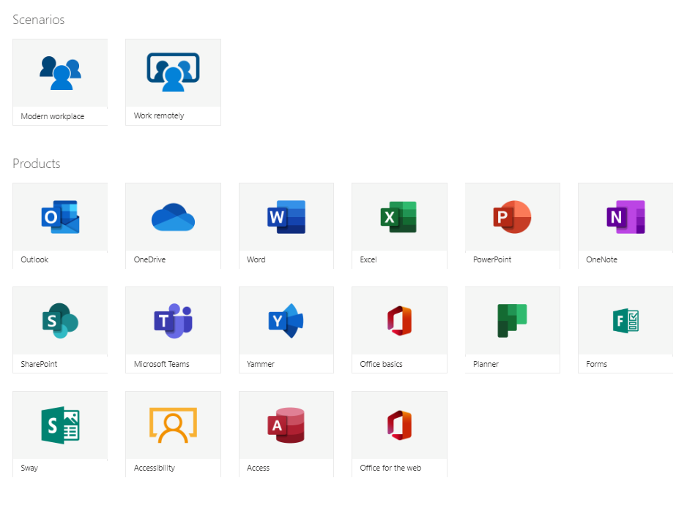
Updated: M365 Learning Pathways https://aka.ms/M365LPDocs

Slide 6
Our new reality

Slide 7
Remote everything

Slide 8
Shift to remote work
2.7 billion minutes of calling and meetings in one day on Microsoft Teams
Secure remote work
Companies deploying Windows Virtual Desktop for secure remote work has led to 3x usage growth
Evolving security landscape
Office 365 Advanced Threat Protection seeing rising COVID-19 related phishing attacks
Events become virtual
Microsoft 365 Live Events now 100k participants to meet surging demand for large scale digital events
Development is remote
Developer productivity remains consistent with pre COVID-19 code commits using Visual Studio and GitHub
More than meetings
Need for chat + meetings + collaboration driving Microsoft Teams growth – 44m daily users

Slide 9
Charting a course…
Navigate the now
Plan what’s next
Shape the future
Remote Everything
Adapt and respond in real time
Solutions to help people stay productive and maintain business continuity
Adapt business models and product offerings
Focus on value, reduce cost
Restart customer demand
Realize new opportunities, scenarios
Focus on growth

Slide 10
Remote everything
Contactless shopping
Remote selling
Curbside pickup
Virtual events
Remote learning
Telemedicine
Secure remote teamwork
Remote development

Slide 11
Scenarios
01
02
03
04
05
Enable people and teams to collaborate and be productive from anywhere
Manage and secure access to apps, data, and devices
Rapidly adapt your business processes
Sell, service, and deliver on customer expectations in a remote environment
Keep developers productive as a distributed team

Slide 12
Enable people and teams to collaborate and be productive from anywhere
01

Slide 13
How Microsoft can help you enable remote work
Empower people to stay productive
Enable people to meet and collaborate from home
Engage employees with events & communications
Make productivity applications available on any device

Slide 14
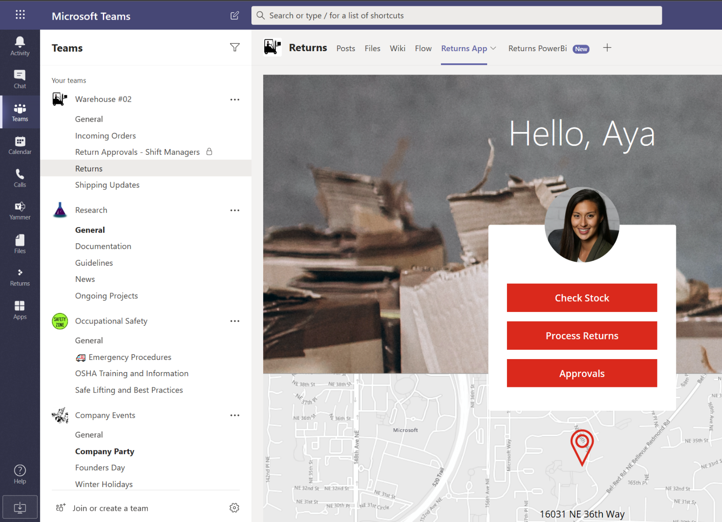
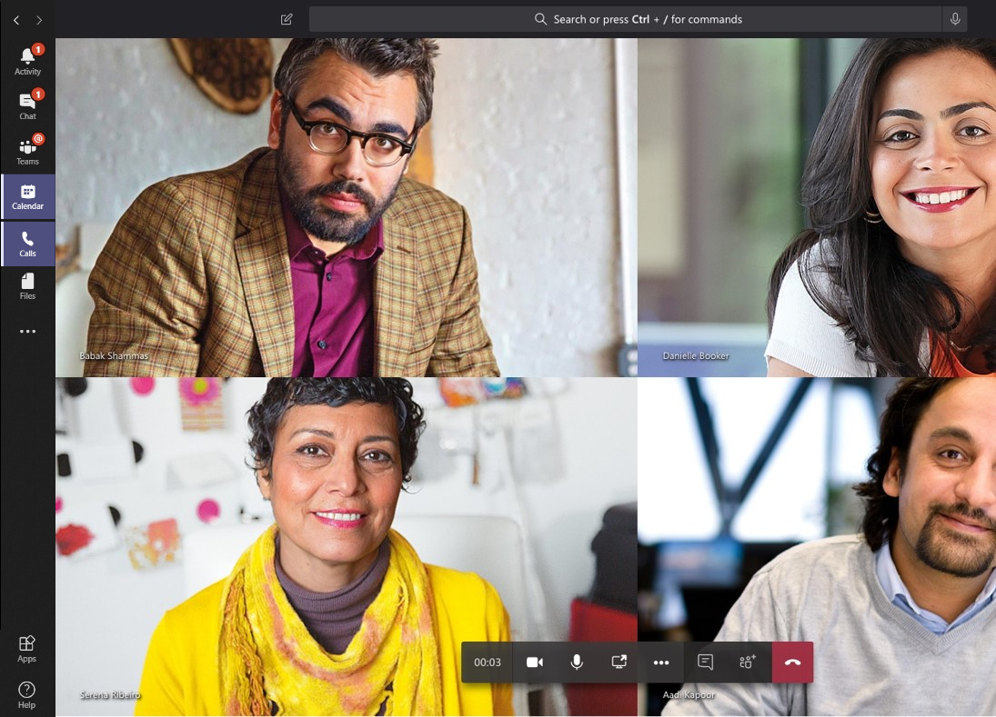
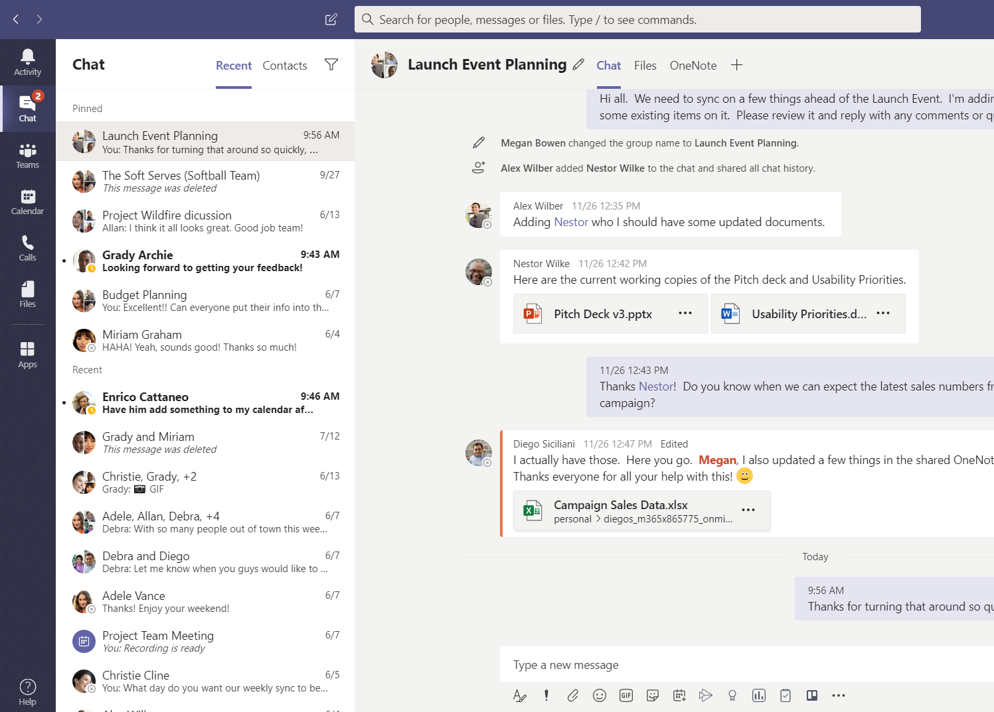
Microsoft Teams is the hub for teamwork in Microsoft 365
Meetings & calling
Chat & collaboration
Apps & workflow

Slide 15
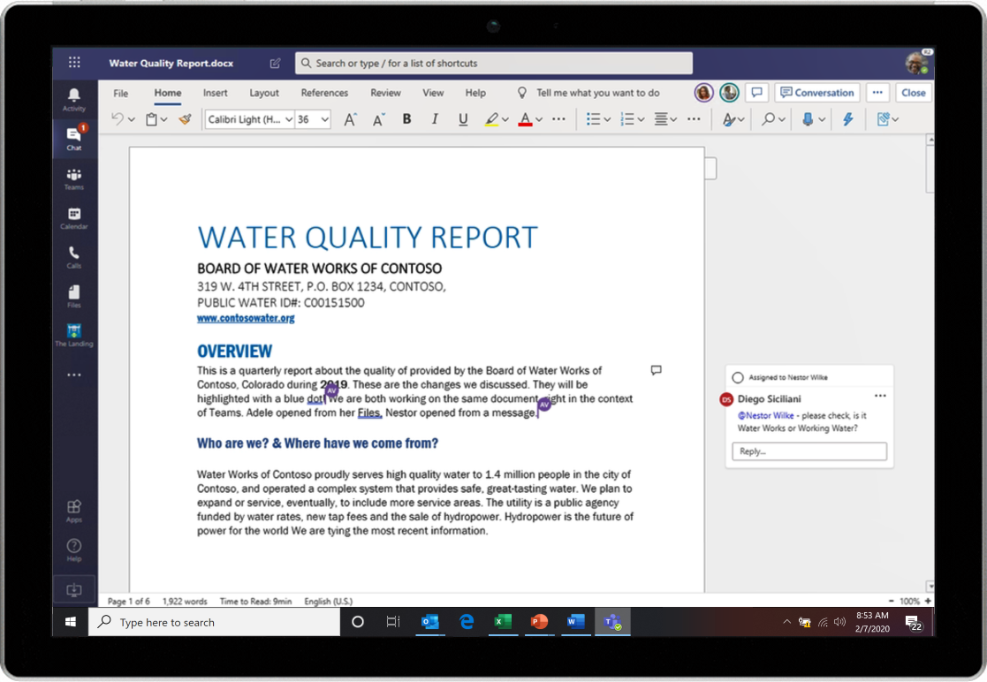
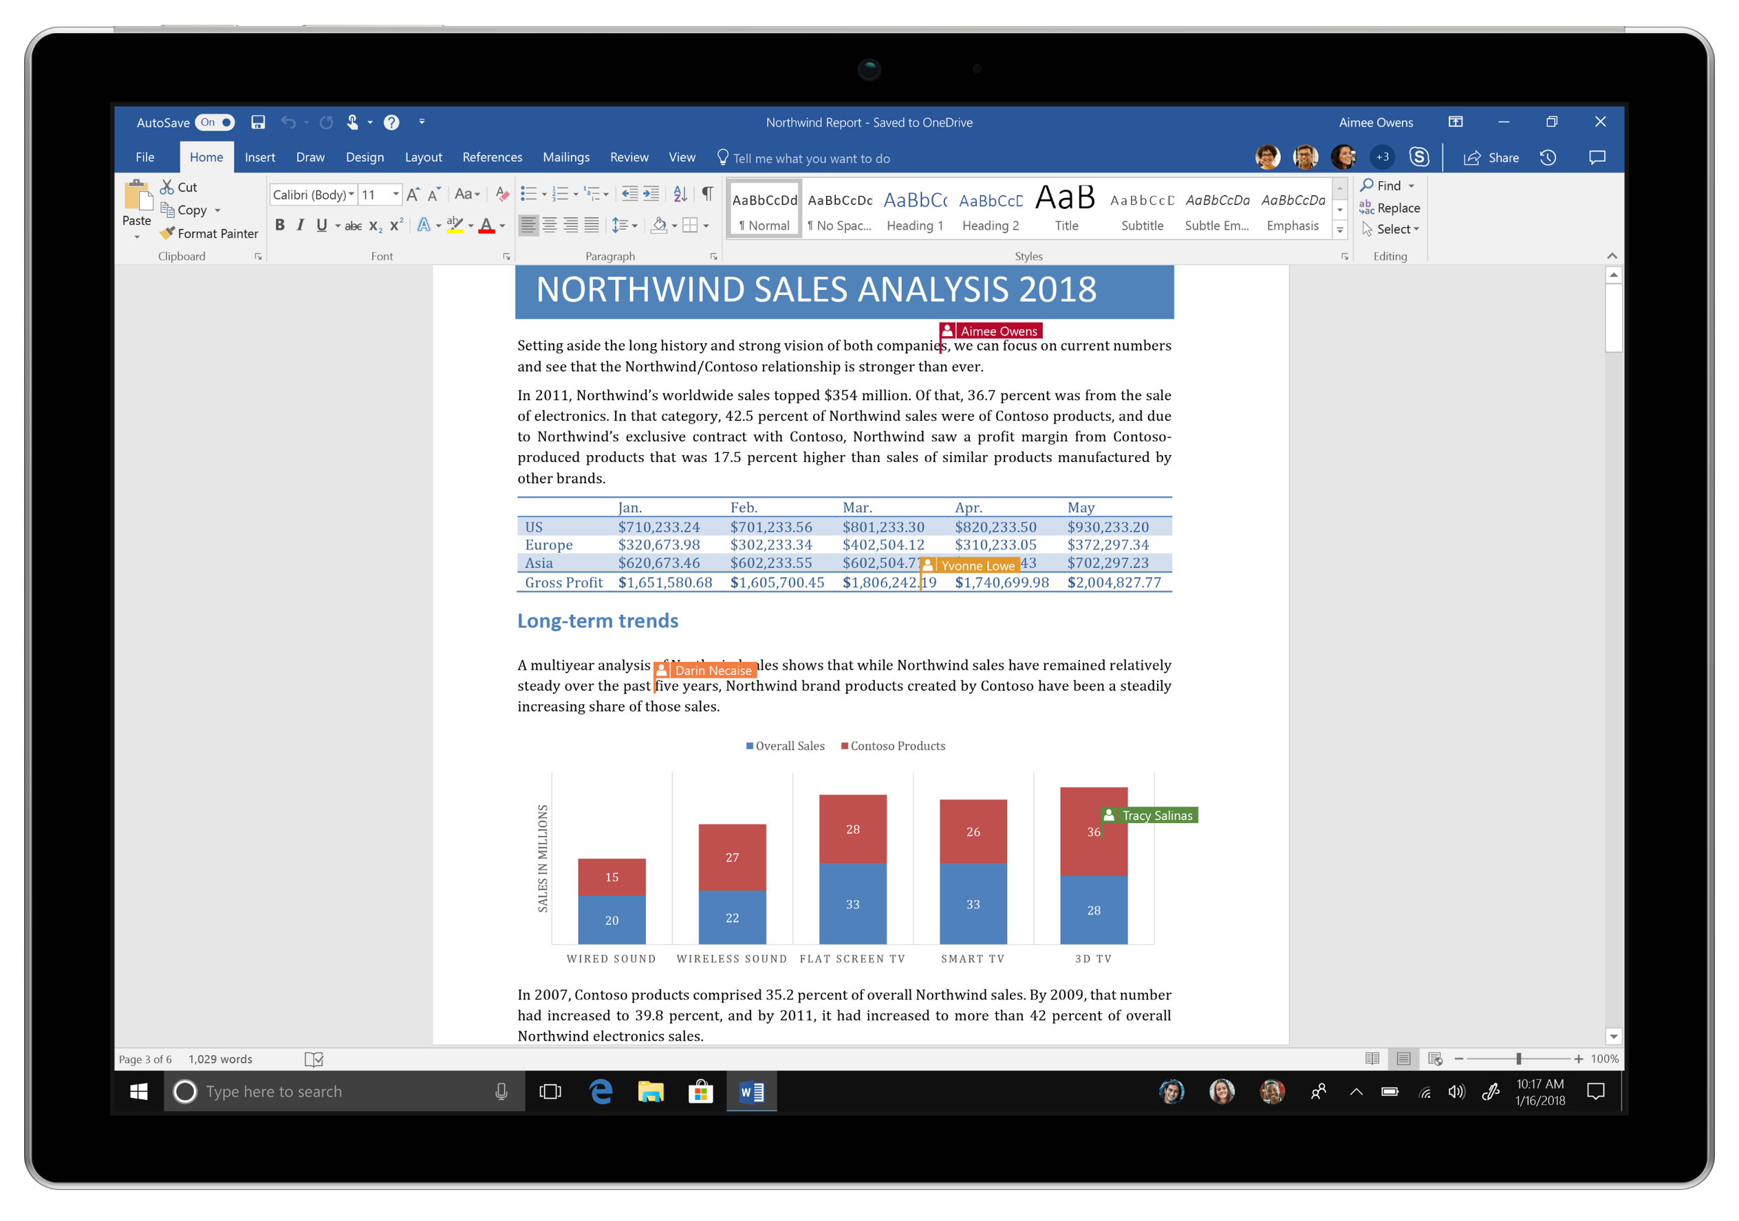
Collaborate in real-time in the desktop apps, web, or mobile
Work together in real-time, from anywhere
Stay focused on what matters
Do more through integrated experiences
Work together with trust and confidence
Find recent documents and pick up where you left off

Slide 16
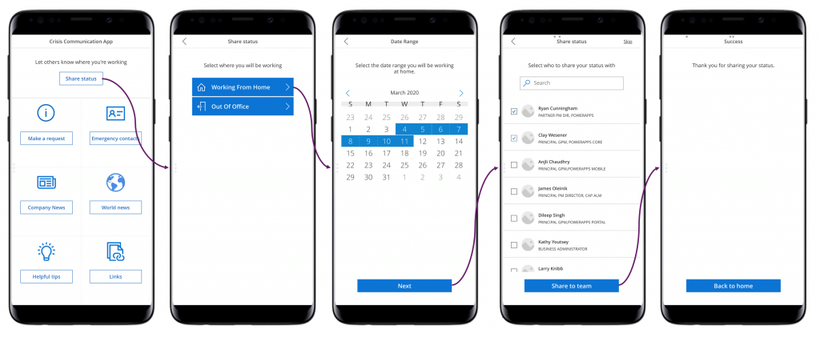
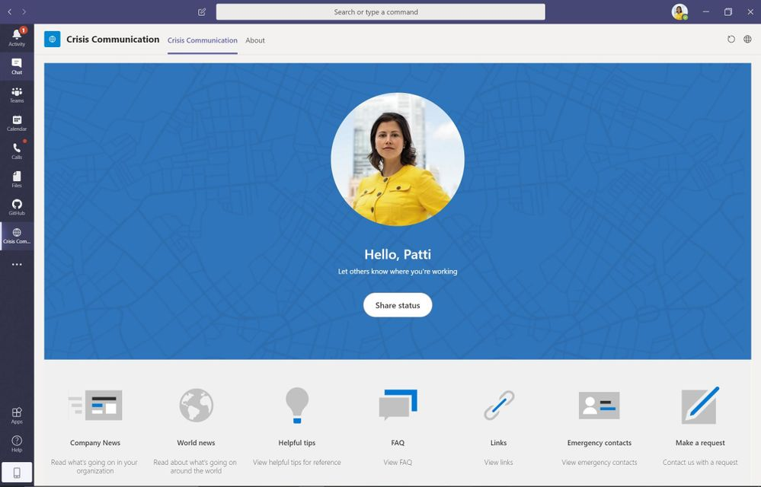
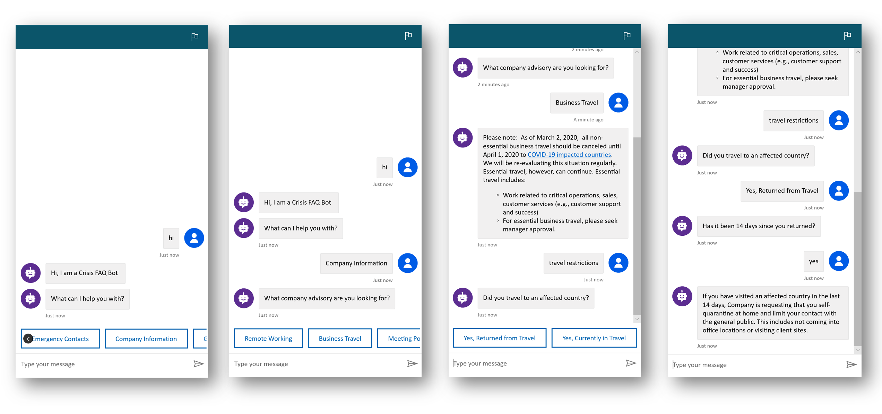
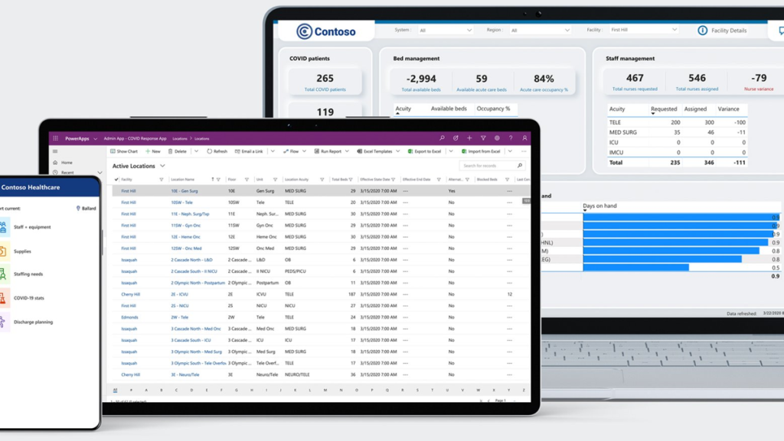
Power Apps Emergency Response Resources
Crisis Comms Blog
Power Apps + Teams Blog
Building a Crisis Bot Blog
ER Community Gallery
Learn how customers can implement a crisis communication app
Use Power Apps and Teams to share real-time information and provide a platform for employees to connect
Highlights some best practices and tips for building a crisis response bot (“Crisis FAQ bot”) for your organization
Gallery of COVID-19 related emergency solutions and best practices built by the Power Platform community
Healthcare ER Blog
Healthcare ER Demo
Healthcare ER Video
Healthcare ER Deployment
Provides a 100-level view of a customer’s business and identifies solutions from Microsoft and partners per subsidiary
View a demo of the new Power Platform Emergency Response Solution
Learn more about the Emergency Response solution for healthcare
Learn how to customize and deploy the Emergency Response solution

Slide 17
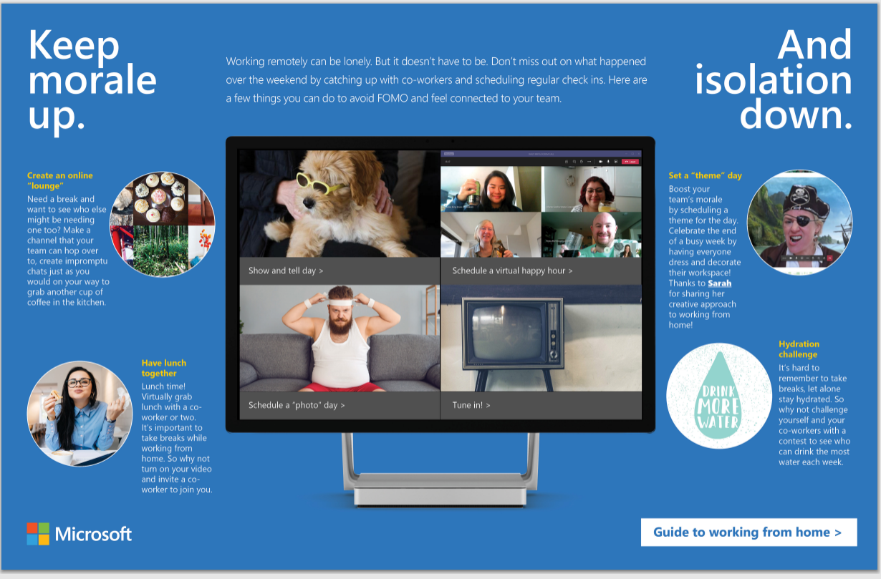
#HumansFirst: https://aka.ms/RemoteWorkFun

Slide 18
We’re in this together

Slide 19
DEMO

Slide 20
Resources Monthly Resources: https://aka.ms/O365ChampionResources Forum: https://aka.ms/DriveAdoption Covid-19 Resources from Microsoft https://aka.ms/Covid19Info

Slide 21
Microsoft Resource Cheat Sheet
https://aka.ms/M365Roadmap
https://aka.ms/TechCommunity
https://docs.microsoft.com
https://developer.microsoft.com
Microsoft 365 Roadmap
All public feature delivery dates
Filter by product
Microsoft Technical Community
Product forums and blogs
Driving Adoption forum
Diversity & Inclusion forum
IT Pro & Adoption Documentation
Learn how to plan, deliver, adopt and manage Microsoft 365 products
Developer Documentation
Training, documentation, samples & communities for developers
Tools and Resources
https://aka.ms/MicrosoftAdoption
Microsoft Adoption Hub
Adoption resources for O365 services
O365 Champion sign up and Information
M365 Learning Pathways & Service Adoption Specialist course information
Visit Us

Slide 22
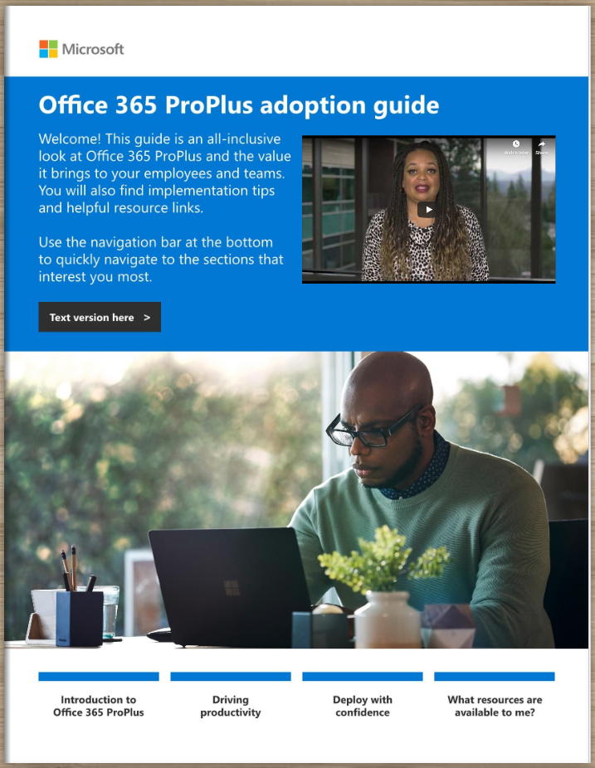
Office 365 ProPlus Adoption Guide
Champion Preview
Available at:
https://aka.ms/OPPToolkit

Slide 23
Training Tools for Microsoft Teams
Get Started with Teams
https://teams.conversationalgeek.com
Managers Guide to Microsoft Teams
https://teamsbook.info

Slide 24
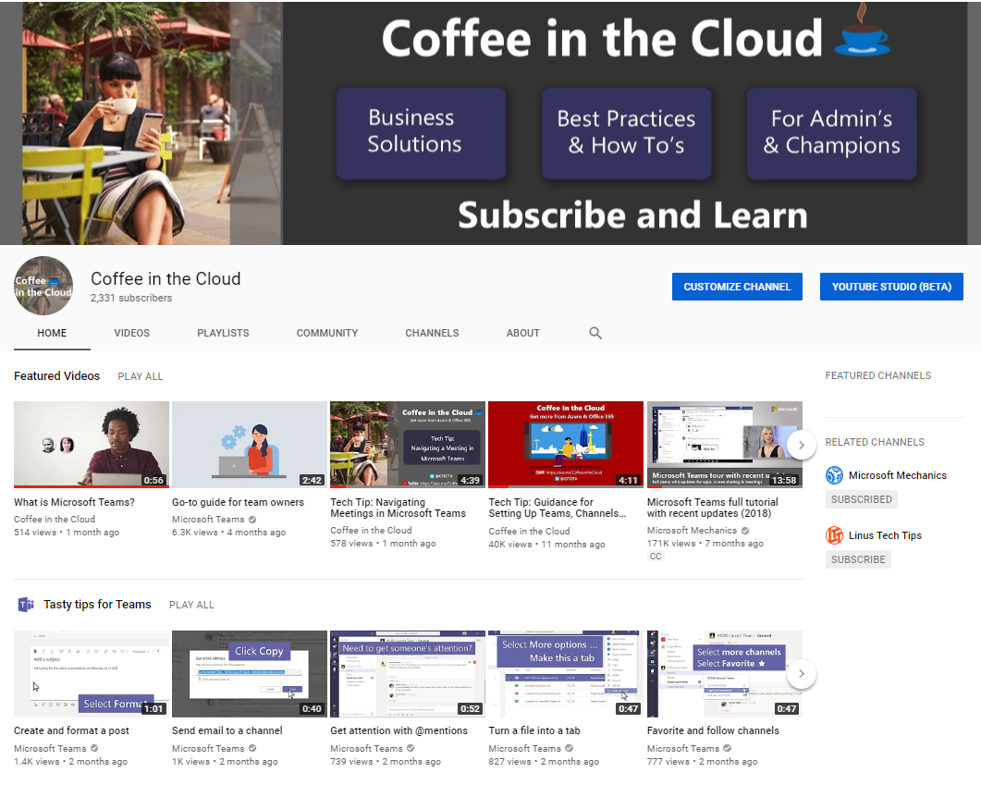
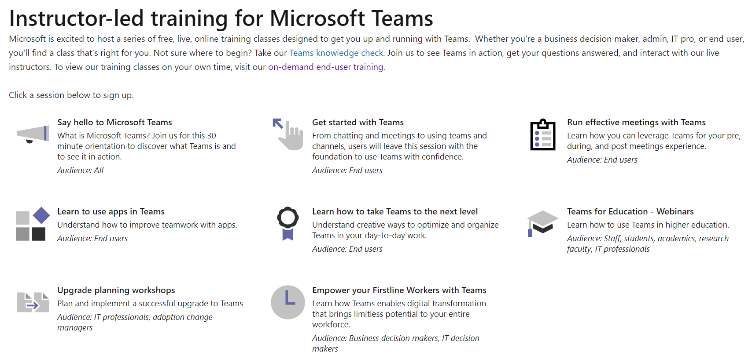
On-Line Training from Microsoft
On-demand & Instructor Led
https://aka.ms/CoffeeintheCloud
https://aka.ms/TeamsLiveTraining

Slide 25
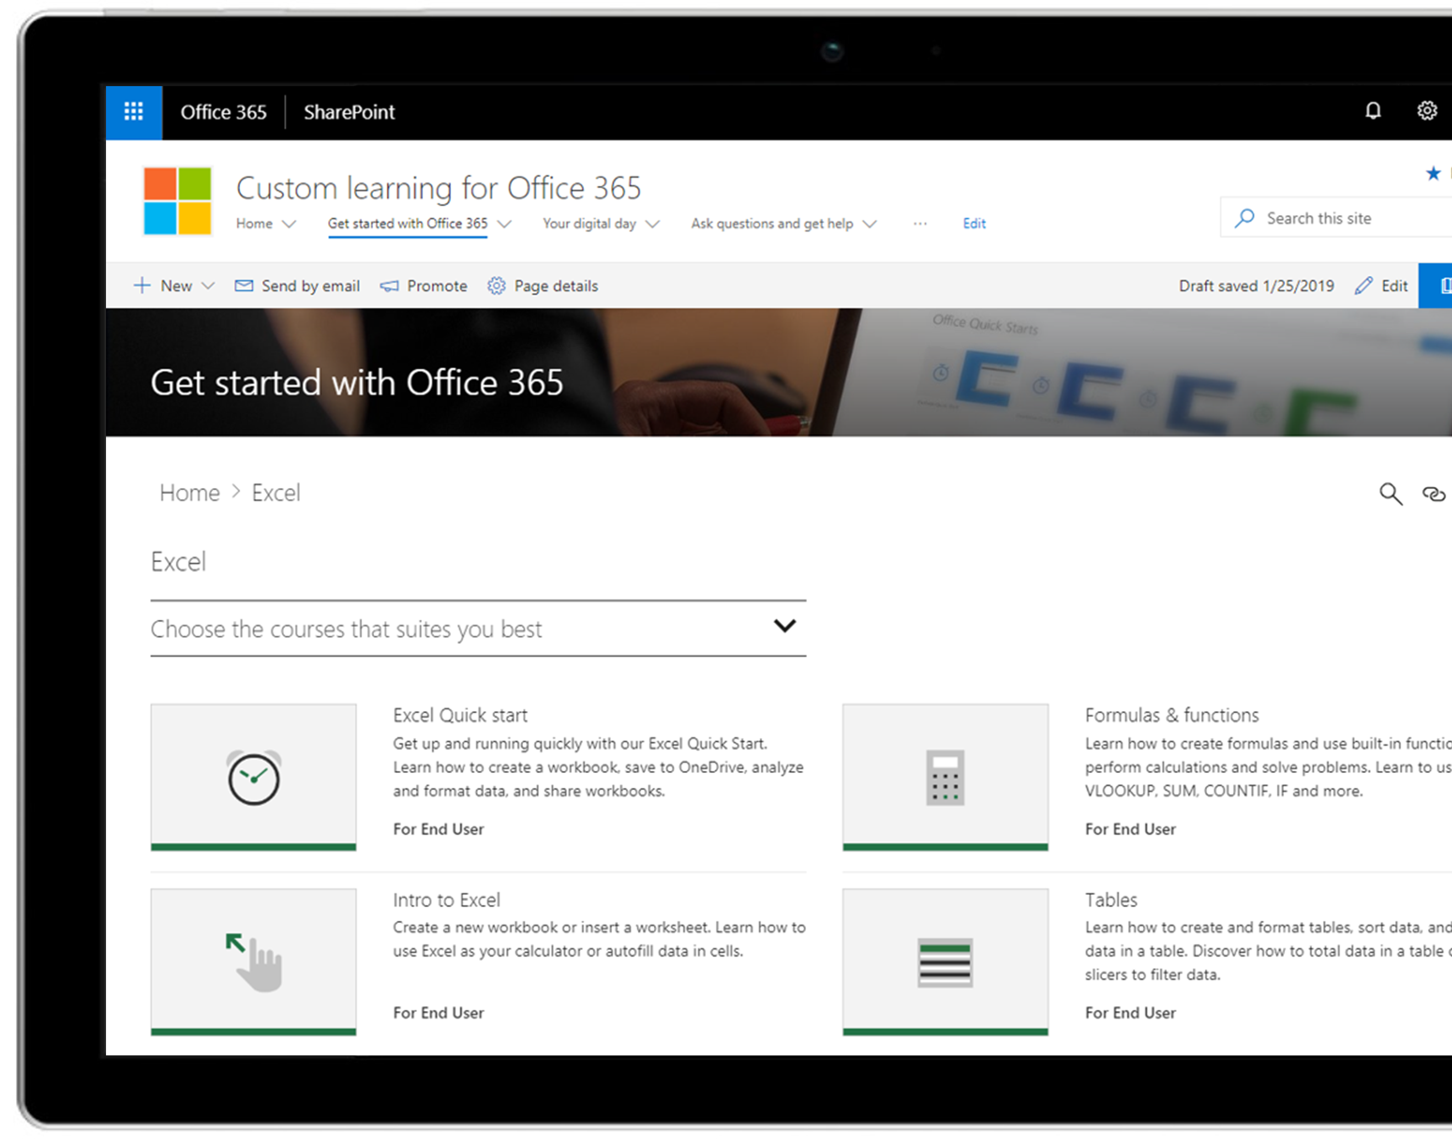
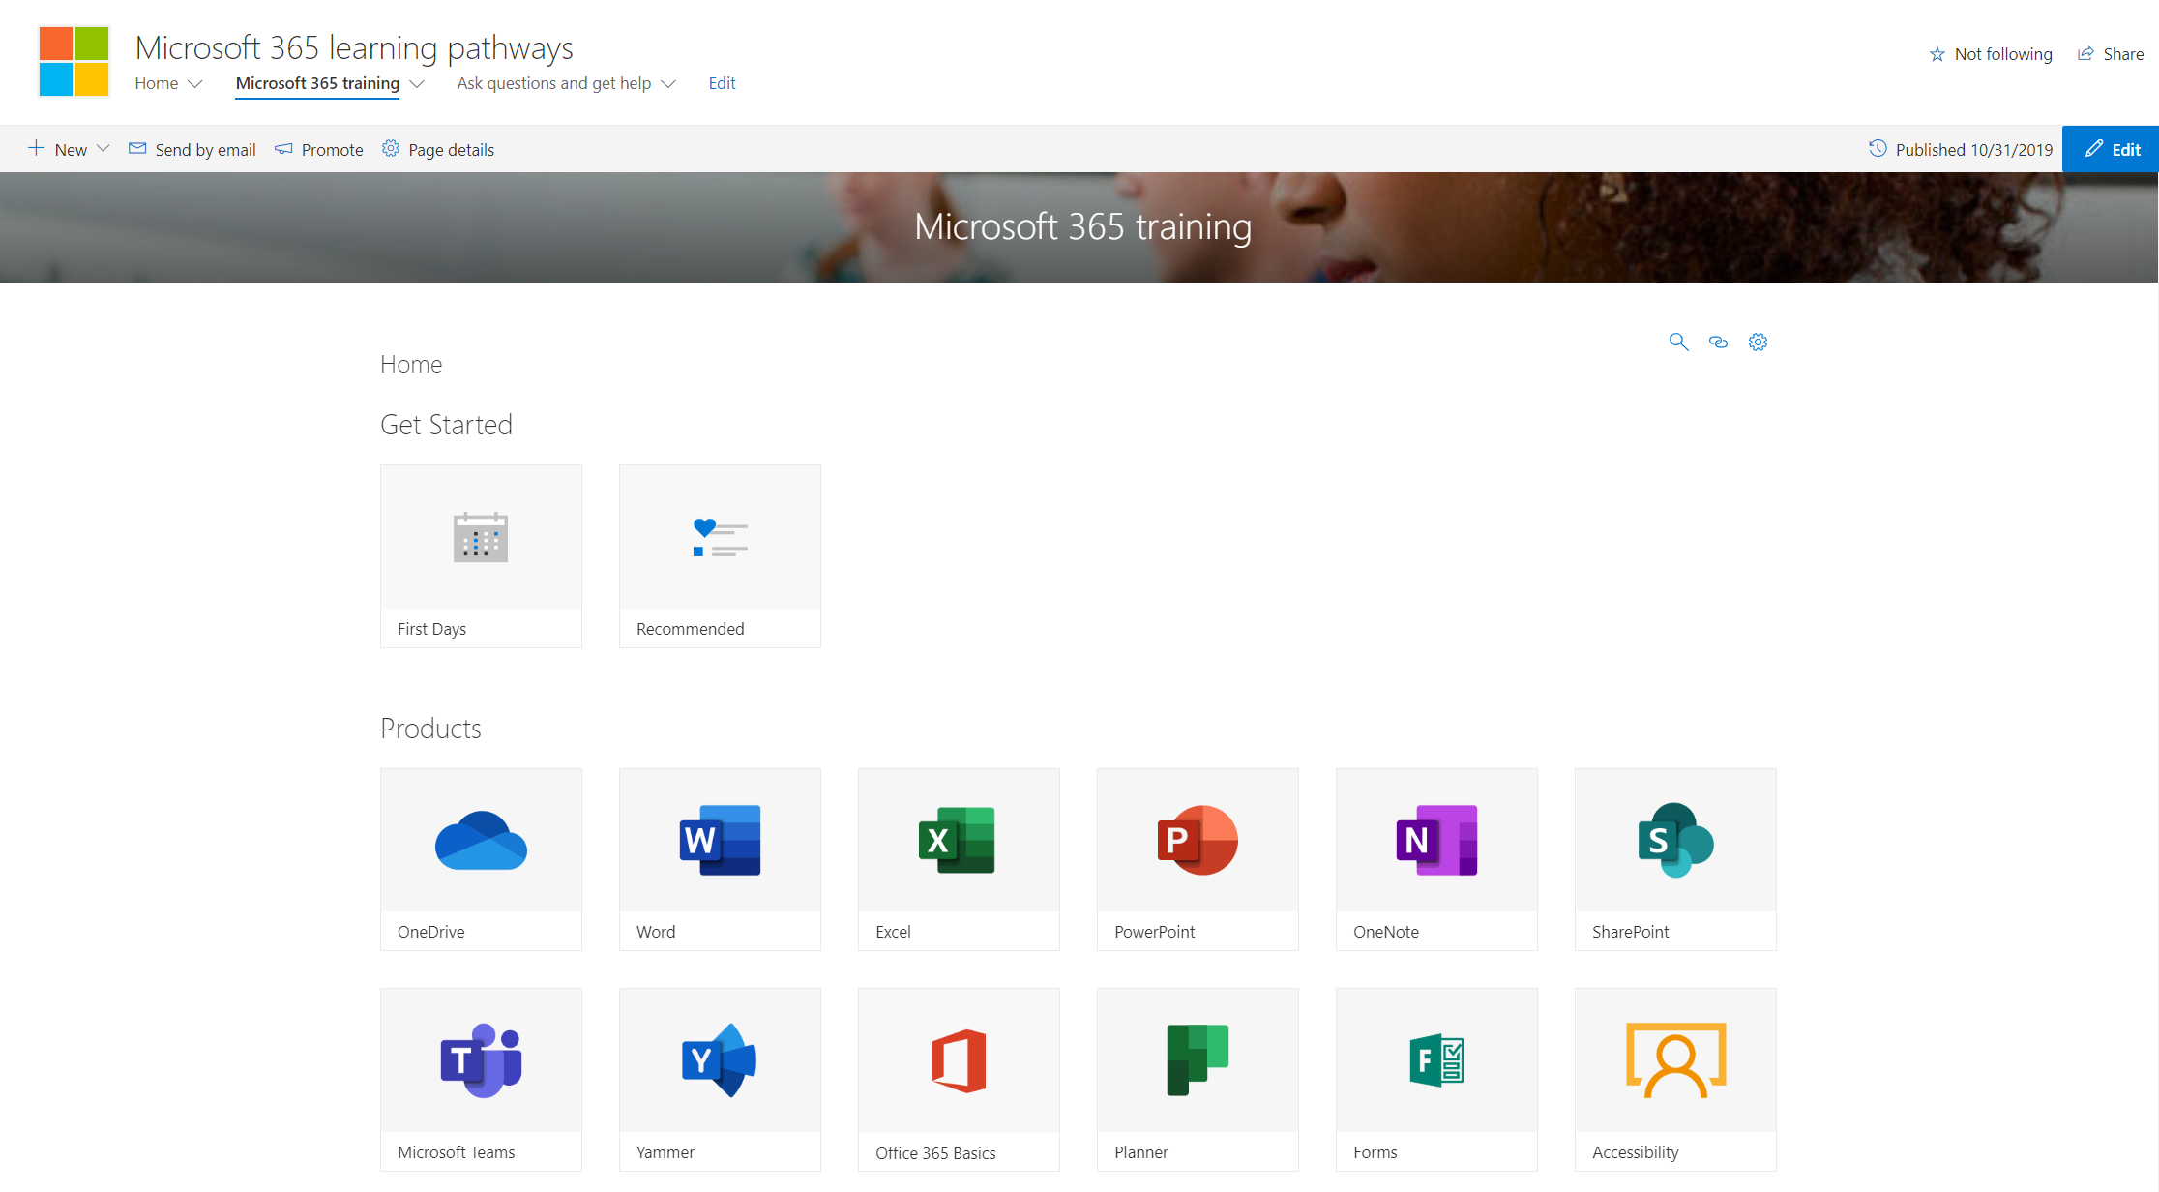
M365 Learning Pathways https://aka.ms/M365LP
Modern SharePoint Online communication site template
Connected to online catalog of Microsoft curated end-user training content
Customizable content – remove or add your own content
Easily installed via SharePoint Provisioning Service
Simple integration into Microsoft Teams
Learn More at https://aka.ms/M365LP

Slide 26
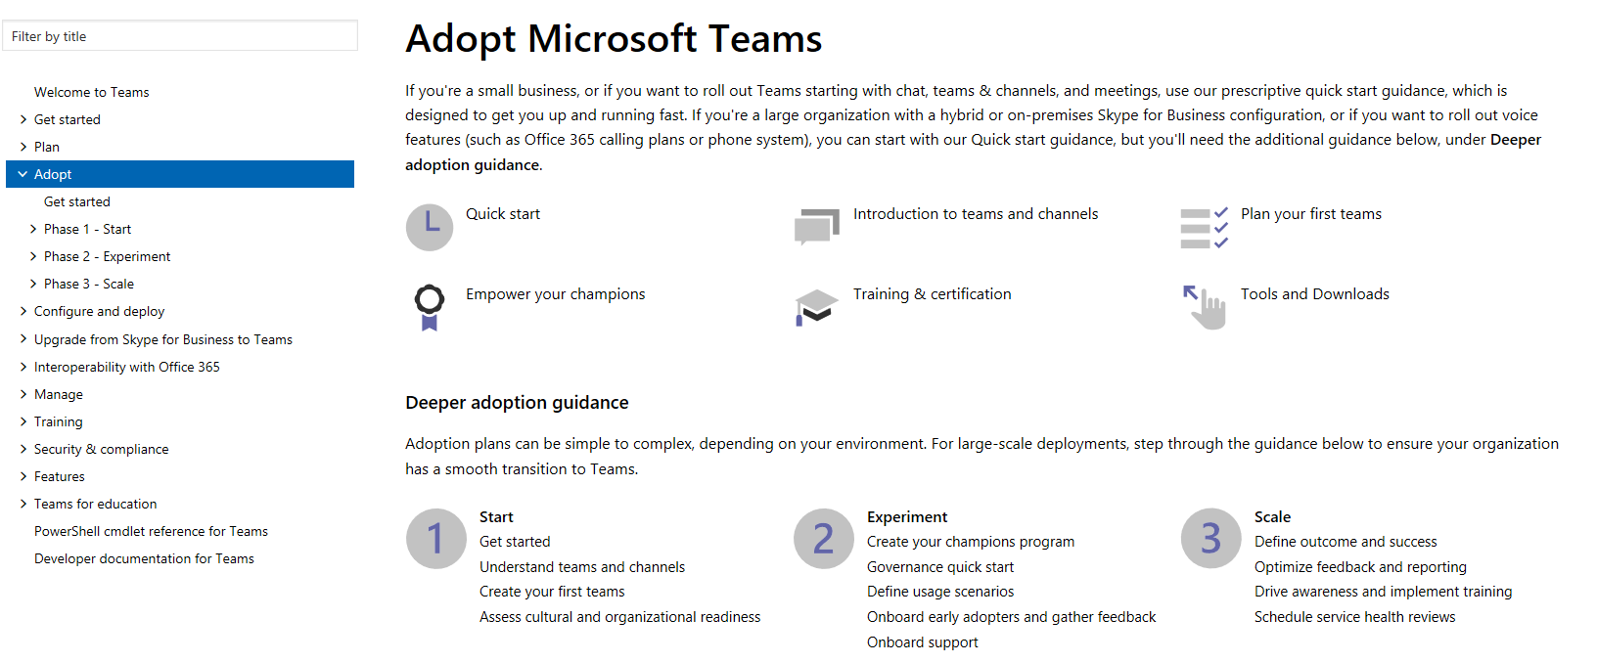
Teams Adoption Hub – https://aka.ms/TeamsAdoption

Slide 27
Coffee in the Cloud
Get more from Office 365
https://aka.ms/CoffeeintheCloud
Subscribe now to Learn About:
Business Solutions
Best Practices & How-To’s
For Admin’s and Champions
@CITCTV

Slide 28
O365 Champion Schedule & Topics January to June, 2020
22 Jan.
Getting Started with OfficePro Plus
19 Feb.
Modern Project Management using Tasks & Project
25 Mar.
Supporting Remote Workers and Virtual Events
22 Apr.
Smart Content Management with SharePoint Sites & News
13 May
SharePoint Conference Preview
(AM Only)
17 June
What’s Next in Knowledge Management
Every month we’ll share a new Champion Tip for Microsoft Teams
Stay tuned for more on our #BetterTogether webinar series on our blog at https://aka.ms/DriveAdoption

