Slide 1
Office 365 Champion Community
March 2020 Monthly Meeting
Karuana Gatimu
Customer Advocacy Group
Notes:
Join our worldwide program at https://aka.ms/O365Champions
Materials included in this deck are free to use in your daily work.
Please reference our program as the source of this information.
For questions or comments please reach out in the Drive Adoption or Champion’s Corner forums of the Microsoft Technical Community at https://aka.ms/DriveAdoption

Slide 2
The successful adoption of Microsoft 365 represents a change in behavior. It is more than a set of products—it is a fundamentally different way of working. This change is about people. And we are here to help.
Notes:
M365 has the potential to change the trajectory of an organization in many ways, besides the technology itself:
People fundamentally change the way they work
We enable a modern workplace and the optimization of Office 365
We provide the capability to accelerate the alignment of economic and cultural business drives
We allow organizations to enter a state of dynamic stability*
*“Dynamic stability is like riding a bicycle, where you cannot stand still, but once you are moving it is actually easier. It is not our natural state. But humanity has to learn to exist in this state.¹”
1 Friedman, Thomas L. Thank you for Being Late. New York: Farrar, Straus and Giroux, 2016.
“The need to move to a highly flexible and adaptable digital approach is urgent. The applications required today are not going to last for 30 years. They are maybe only going to be used for maybe two, three years.²”
2 McKendrick, J. (2018. Jan 21) The ultimate technology success metric: owning the customer relationship. Retrieved from http://www.zdnet.com/article/business-transformation-before-technology/

Slide 3
Agenda
Inspiration
Information
Tools
Remote Work & Collaboration
Hosting Virtual Events
Resilience
Find prior meeting content at https://aka.ms/O365ChampionResources

Slide 4
Self care comes first
Leading through change takes energy! Make sure you care for yourself and your family first!
Rest
Fuel
Move
Visit https://aka.ms/Covid19Info to learn about resources, offers and best practices

Slide 5
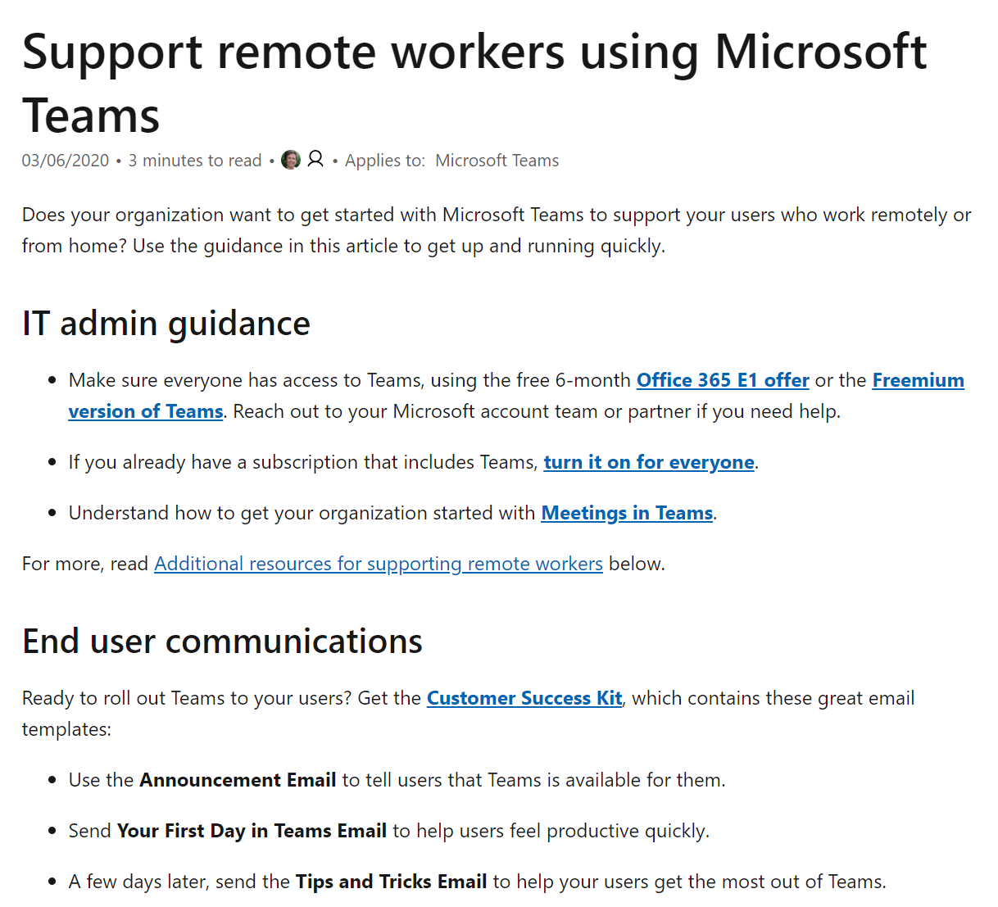
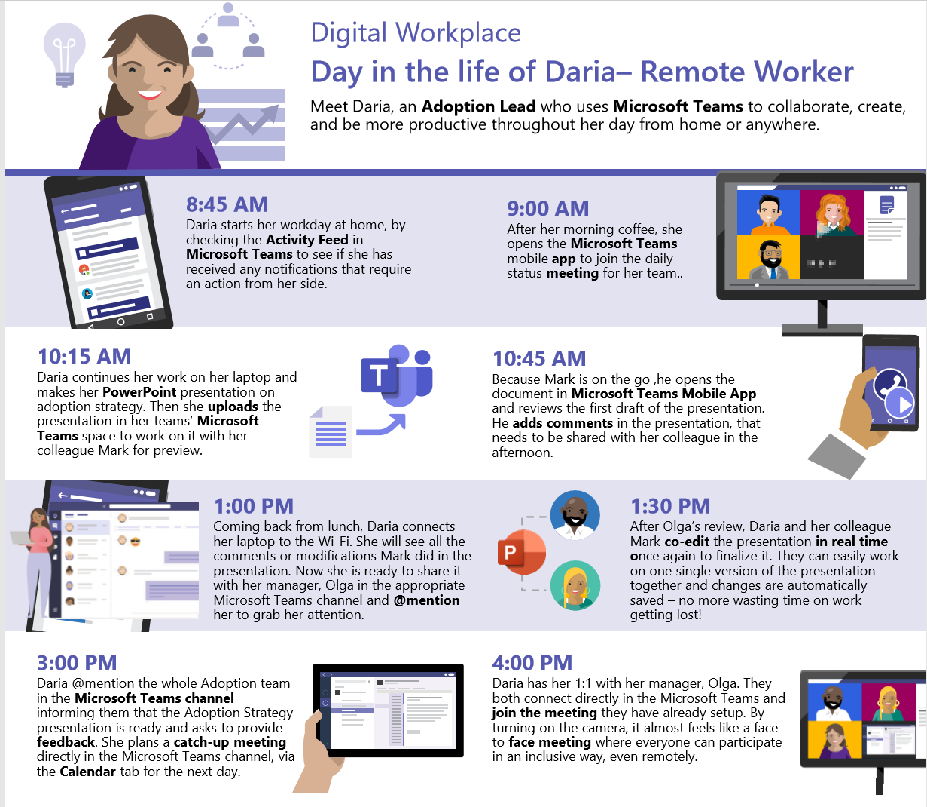
Remote Work Quick Start: https://aka.ms/TeamsforRemoteWork
IT Pro and Champion Guidance
Customer Success Kit – Resources for Champions & Users
The first 10
things to do in Teams

Slide 6
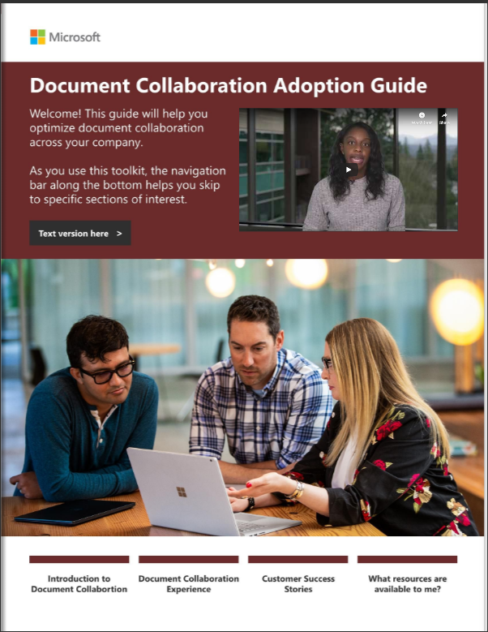
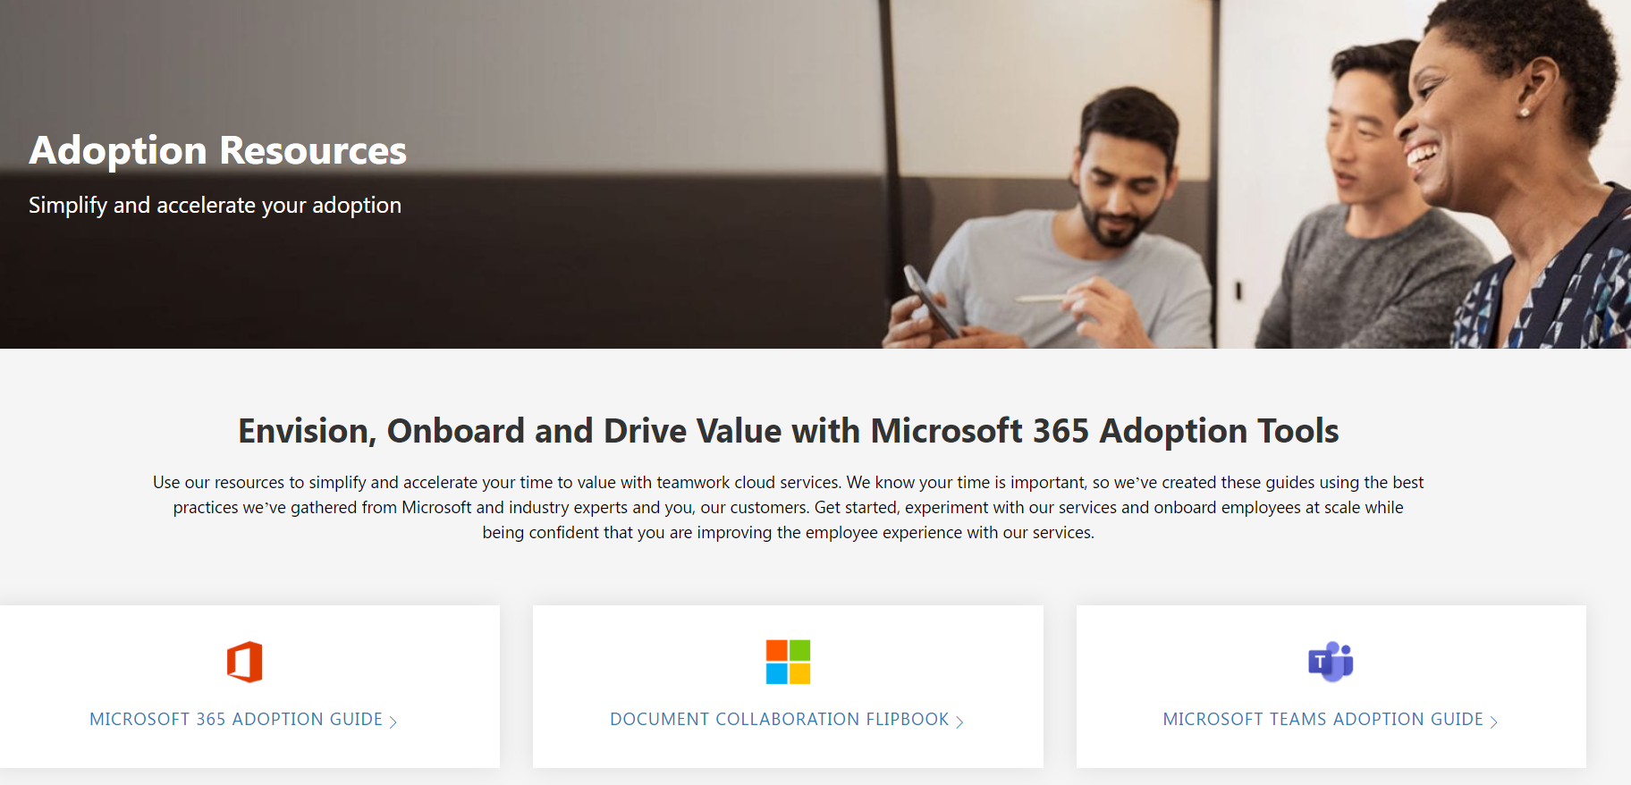
NEW: Document Collaboration Guide https://aka.ms/DocToolkit

Slide 7
Hosting Virtual Events

Slide 8
Define the roles of your support team
Essential
Recommended
Organizer
Producer
Presenter
Sponsor
Moderator
Can be the same person
Notes:
ORGANIZER The organizer acts as the host of the live event. They create the event, set attendee permissions, invite attendees, select the event team. They are responsible for sending out communications prior to the event and the recording afterwards.
PRODUCER
The producers are the people responsible for starting and stopping the live event. The producer can share video and can select layouts that will be viewed by attendees. The same person could serve as the organizer and producer.
PRESENTER A presenter is the expert and responsible for content and commentary. They can present audio, video or share their screen with the attendees. They can also serve as moderators in Yammer discussions. You can have up to 10 presenters at one time.
SPONSOR
A leader, executive, group, or organization with a special and unique interest in the education or insights of the audience. This person could also be the one presenting.
Yammer Moderator A Yammer moderator is a Yammer Champion who can help facilitate questions in Yammer and ask them during the live event. Depending on the size of your event, 1-2 people may be needed for this depending on the size and scale of the event. This person could also be the producer/organizer if needed.

Slide 9
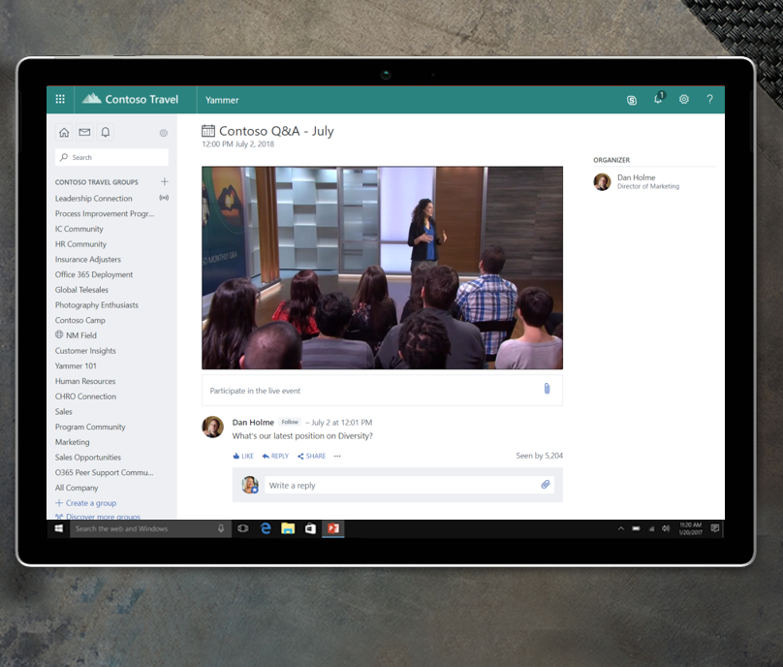
Live events in Yammer
Drive ongoing, open conversation before,
during and after the event
Connect leaders and employees in more authentic ways
Host events in communities to rally around relevant topics
Make participation easy for company wide-events

Slide 10
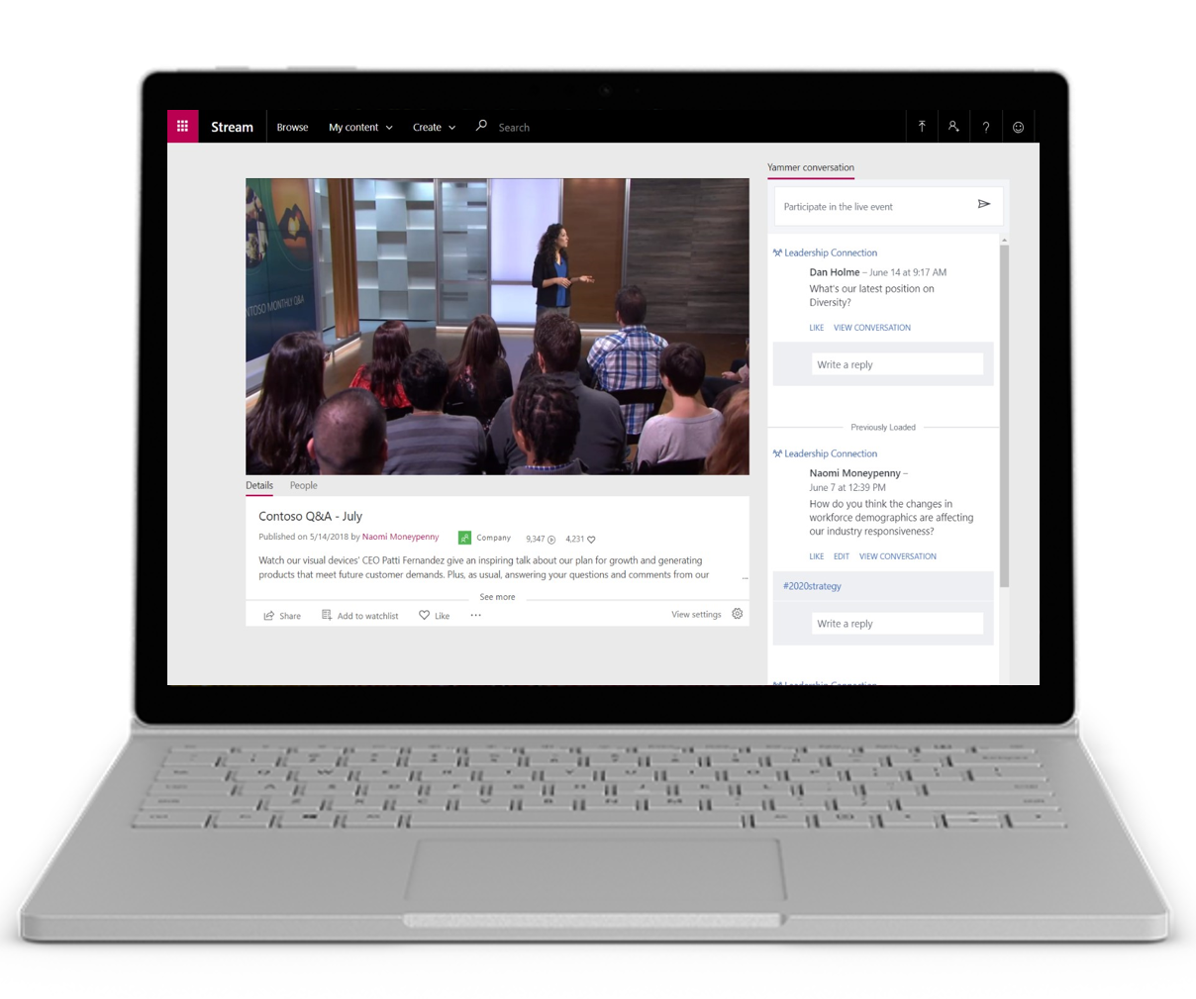
Live events in Stream
Watch events in Stream or embed in other sites (ex., SharePoint)
No conversation needed, or add in separate dialog
On-demand events leverage captions and transcripts
Manage event recordings from Teams, Stream and Yammer

Slide 11
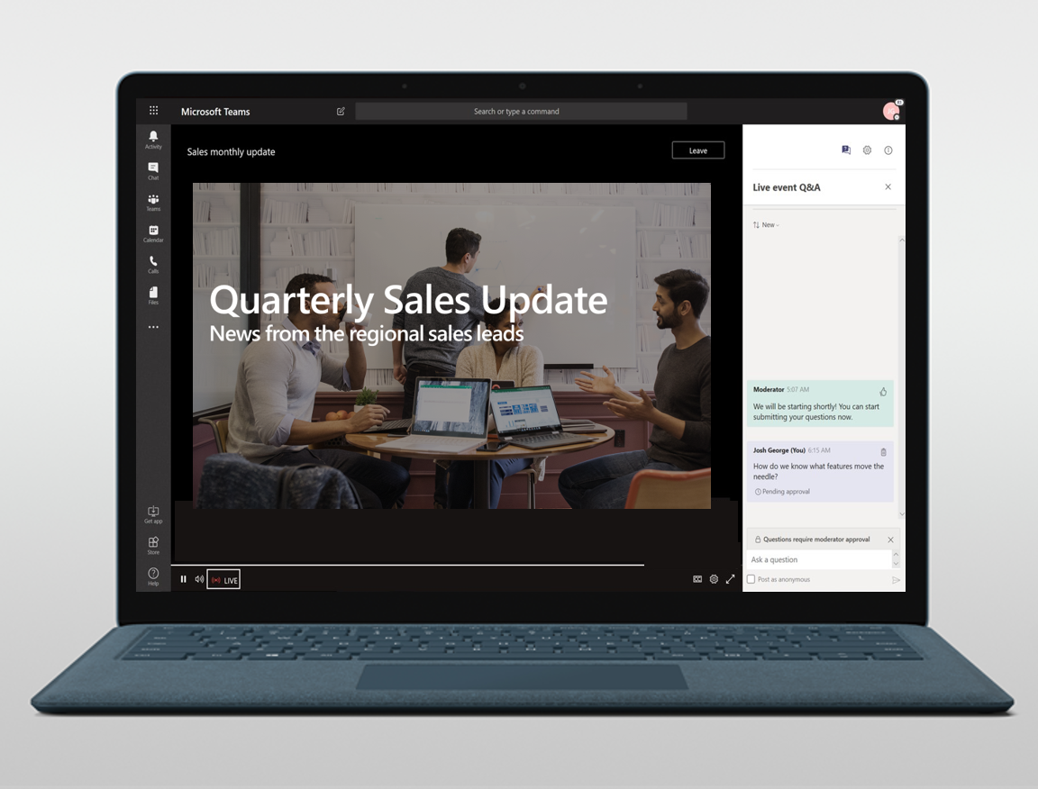
Live events in Teams
Reach internal or external participants
Use moderate Q&A to engage with attendees
Schedule and deliver events as easily as a meeting
Quickly share screens and webcams to deliver content

Slide 12
Scenarios within the Workplace
overall_1_132241972397315101 columns_1_132241972397315101
Sales Webinars
All Hands
Trainings
Leadership Review
Product Demo
Town Hall
Structure
Shiproom
Spec Review
1:1
SCRUM
Scale

Slide 13
Prepare for Your Event
Event Organizer | Technical Producer | Speaker Preparation | Attendee Experience
Design your event | Configure event experience | Prepare devices & content | Awareness & Registration
Design your event theme and duration. Select your speakers & content. Create initial messaging for promotion via email, online community or social Prepare registration experience Create Team or Channel to coordinate the event What is current attendee profile? | How long is event? How many attendees? Is this interactive? How many speakers & topics? How many locations? Any demonstrations or video from presenters? | Is your location quiet? Do you have good bandwidth? Do you have a good webcam? Do you have good audio? Is your content visually engaging? Are you playing videos with audio? | Provide visual, branded invitations through multiple sources Use short url’s to link to registration page Minimize # of fields for registration Ensure T&C & data privacy language is in place Send confirmations with more information
Make your event compelling using content, talent or location community
Small, medium or large event dictated by number of attendees & speakers

Slide 14
Producer Guidance – Meeting/Engagement Types
 | Teams Channel Meetings | Live Events in Teams | Live Events in Yammer | Combination Event
Pro’s | No requirement to manage attendees if user or tenant guest Link is shareable Can support anonymous guests Interactive chat embedded with meeting Mobile join | Up to 10,000 attendees Use standard computer & device for production or.. Can support multiple cameras / streams Mobile join Producer controlled content sharing Moderated chat Automatic recording & reporting | Same as Live Events in Teams plus: Event easily & automatically discoverable on Group page Use Yammer for conversations Same location for on demand viewing Yammer supports #hashtags in conversation; easier moderation Coming Soon: Produce in Teams | For large events Mix of scheduled, channel and Live Events Accommodates multiple experiences Best done in a dedicated Team experience Allows for meetups and ad hoc engagement
Con’s | Chat does not directly support moderation Recorded meetings can’t be accessed by tenant guests but icon can be seen Recorded meetings must be downloaded by organizer Meeting emails can cause mail flood Two step process to export meeting chat for review & repurpose No session reports | Difficult to do well alone Once started can not be stopped Chat is not interactive, requires moderation Any service interruption requires new URL No reaction emojis for engagement | Content sharing in separate document library Point in time engagement is good but post engagement requires further page/site work | Complex to manage between Live Events and Channel Meetings Must manage schedule changes in PBI or SPO schedule Need dual skills for meeting production Users get confused about experience
Each organizer must set the priority of meeting size vs engagement

Slide 15
Prepare for Your Event
Event Organizer | Technical Producer | Speaker | Attendee Experience
Design your event | Configure Event Experience | Prepare devices & content | Awareness & Registration
Design your event theme and duration. Select your speakers & content. Create initial messaging for promotion via email, online community or social Prepare registration experience Create Team or Channel to coordinate the event Recruit support staff | How long is event? How many attendees? Is this interactive? How many speakers? How many locations? Any demonstrations or video from presenters? | Is your location quiet? Do you have good bandwidth? Do you have a good webcam? Do you have good audio? Is your content visually engaging? | Distribute separate invitation to attendees Manage own registration experience or use 3rd party platform e.g. EventBuilder Prepare help forum for pre & post assistance Prepare private channels for speakers & support staff
There is no replacement for planning in creating a welcoming, well run event.

Slide 16
Produce Your Event
Event Organizer | Technical Producer & Moderators | Speaker | Attendee Experience
Design your event | Configure Event Experience | Prepare devices & content | Awareness & Registration
Hydrate Keep your sense of humor People remember how they feel more than the technology Move things along; do not dwell on mistakes Clarify policies with posts or chats in a central area Use @Mention Share video / files quickly | Doublecheck attendee list Complete a dry run with presenters Validate network connection Encourage participation; pause for people to come off mute | Show up early Save an extra copy of presentation Have local copy of videos Share application not entire screen | Remind them where support channels are Post event surveys in chat before end of presentation If audio is bad ask people to rejoin
Producers: Use your web browser to have multiple Teams instances open simultaneously

Slide 17
Resources & Tips
 | Teams Channel Meetings | Live Events in Teams | Live Events in Yammer | Combination Event
Pro’s | Coming Soon | Get Started Article Organizer & Producer Checklist Producing an Event Manage Recordings & Reports Best Practices | Setup your Live Event FAQ for Yammer Live Events Tips for Engagement Yammer supports #hashtags in conversation; easier moderation Coming Soon: Produce in Teams | For large events Mix of scheduled, channel and Live Events Accommodates multiple experiences Use channels as topic areas
Tips | Schedule meetings before adding people to a new team to avoid lots of email. Setup a group chat with you and the presenter for before, during and after Use Share to Outlook & Share to OneNote to capture chat. Can be hard to follow in large meetings. Might need to go in and “end” a meeting by removing last people and leaving meeting Use “Announcements” channel not General Build event landing pages Presenter/Attendee roles not supported | Schedule a dry run in advance Schedule the Live event a half hour earlier than the separate attendee appointment for pre-check Use a short URL service to distribute the attendee link. Have someone moderate the chat for you. Test presenter’s audio Remember to check “Share System Audio” for presenters with video clips to share | Use for event using encoders for now. Use #hashtags to mark questions for follow up Moderate the conversation; don’t ask presenters to scroll through chat during the meeting | Manage the overall schedule in a SharePoint page “Add to Calendar” does not work for guests
Stream recordings can not be viewed by Guests in your tenant

Slide 18
DEMO

Slide 19
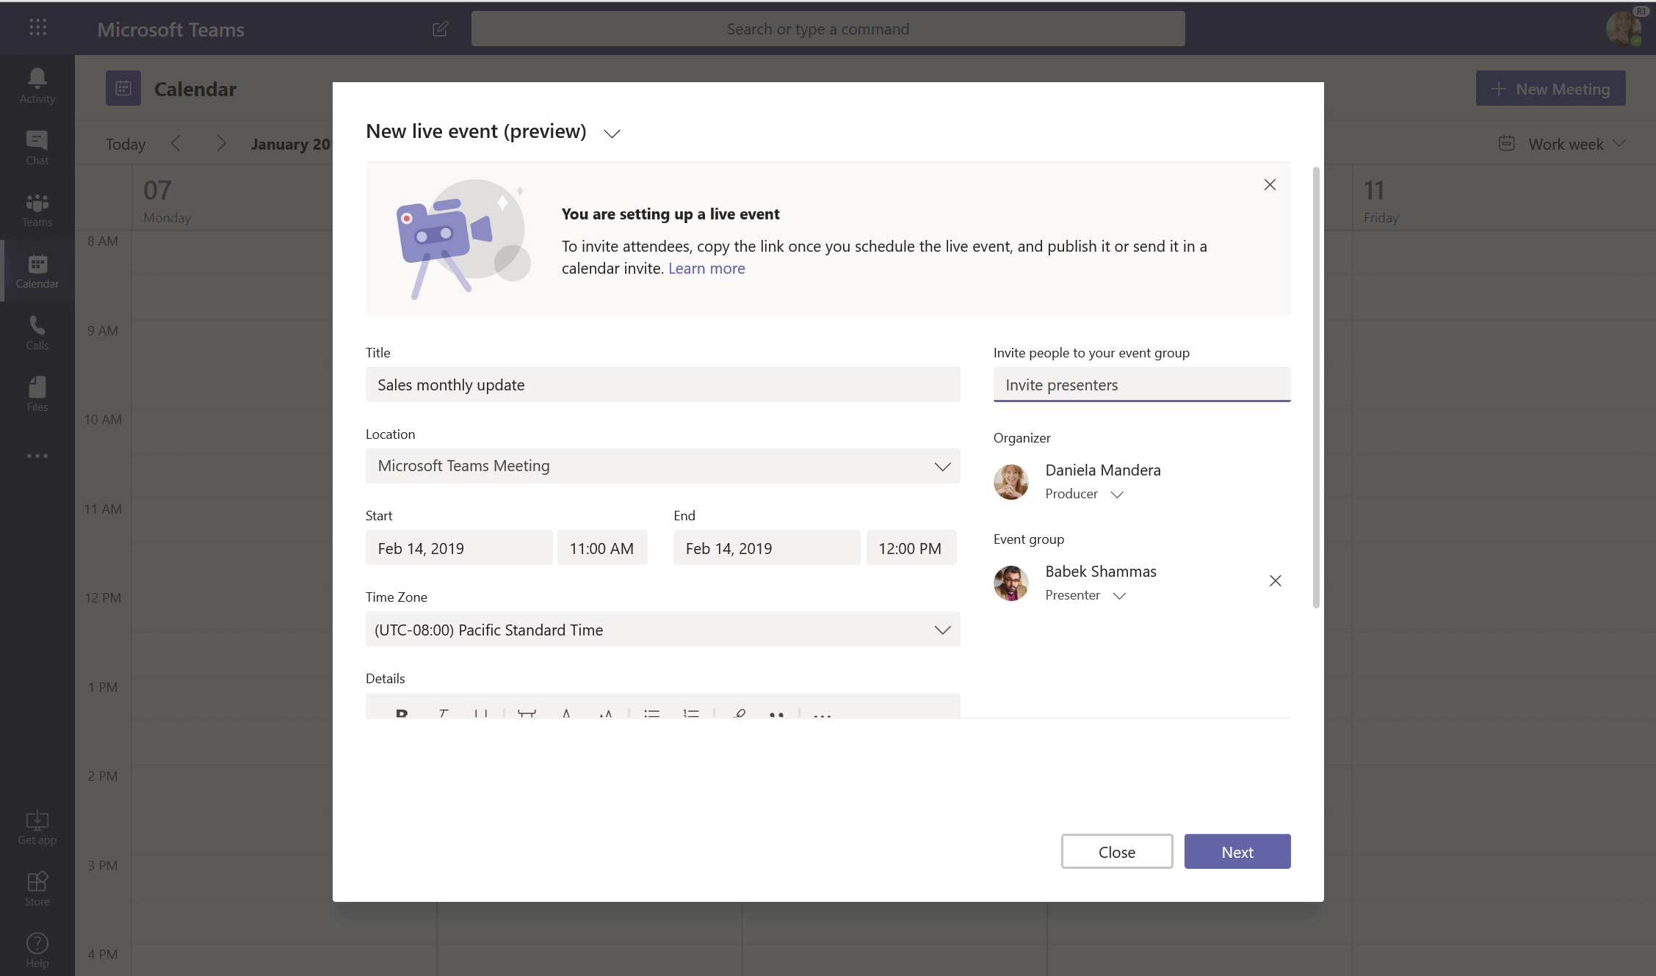
Schedule an event in Teams
Notes:
Scheduling a live event in Teams is as easy as scheduling a meeting! After adding event details and any additional presenters, I can select my audience for the event.

Slide 20
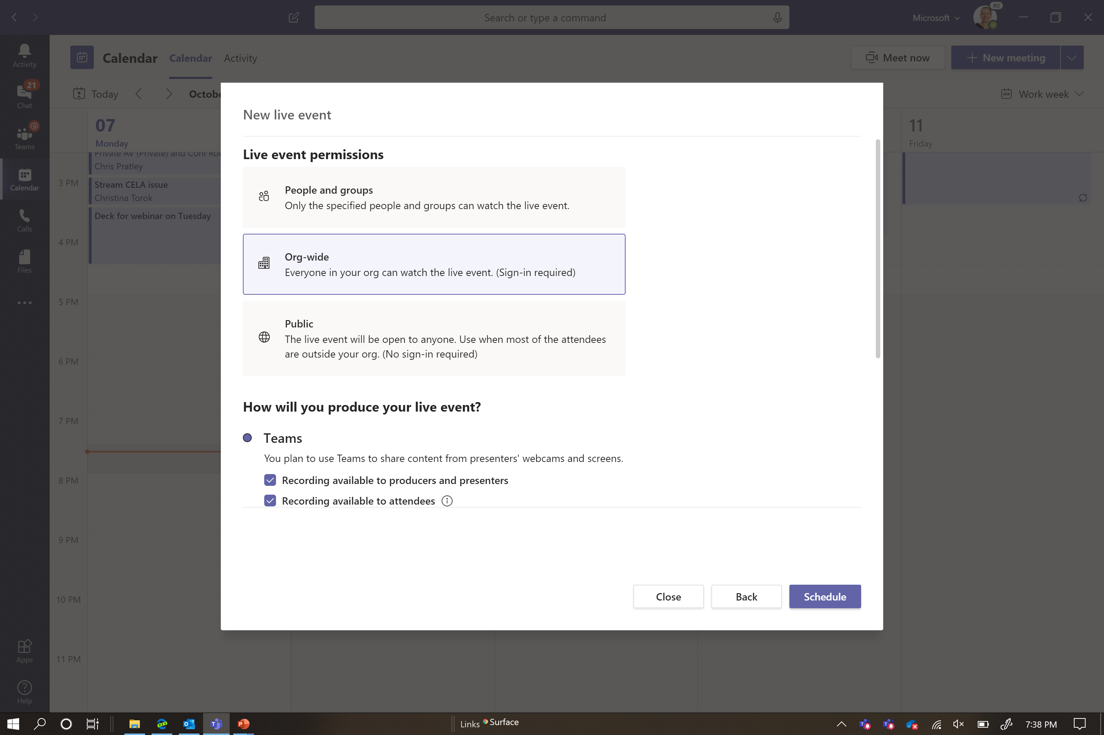
Schedule an event in Teams
Notes:
If I host the event inside my organization, I’ll select either specific people, groups of people, or the entire organization. But I do also have the option to deliver an event outside my organization, to customers or partners for example. When I’ve completed the scheduling, I’m ready to send out the calendar invite to my attendees!

Slide 21
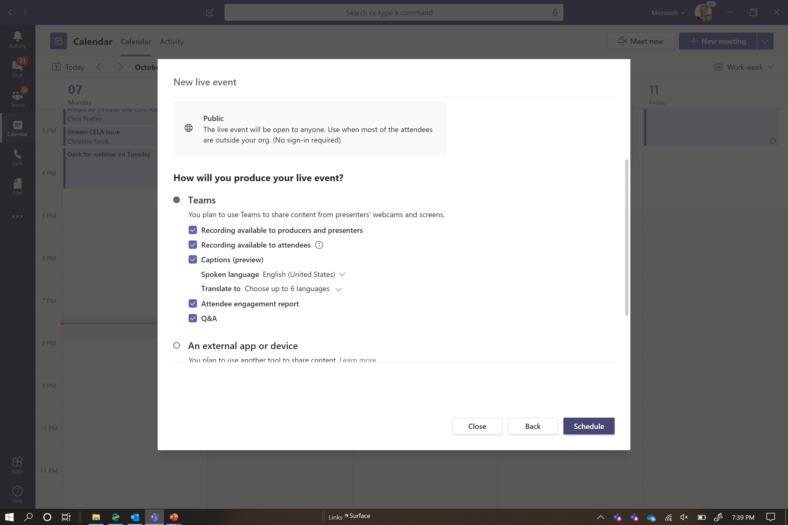
Schedule an event in Teams

Slide 22
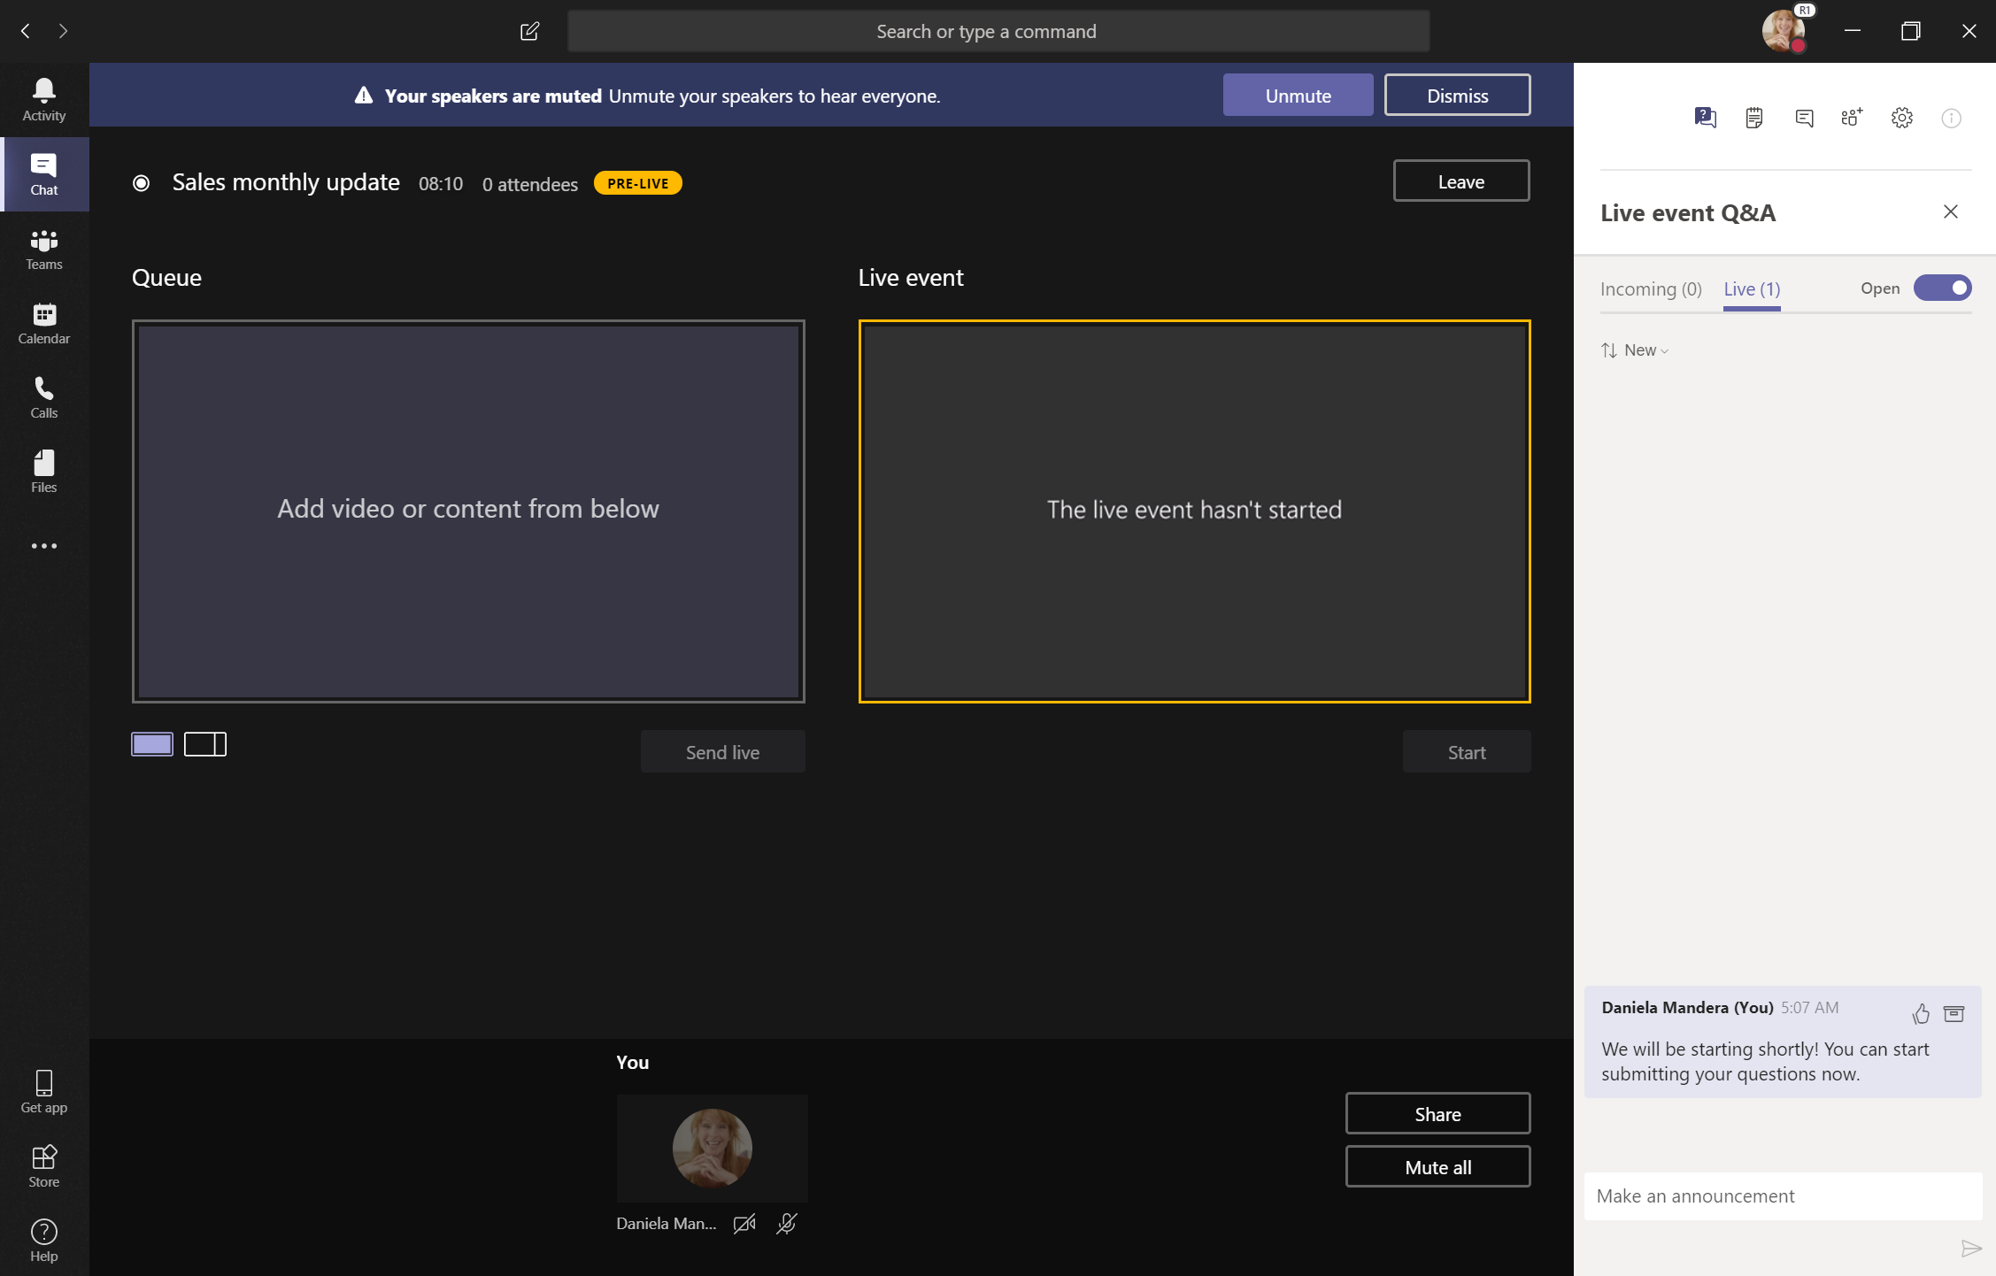
Host setup in Teams
Notes:
Let’s take a look behind the scenes, in the presenter view. Once I’ve joined, I’m now able to see the “backstage” for the event. Here we can see the Q&A with attendees, and I also can use the chat feature to backchannel with my co-presenters.

Slide 23
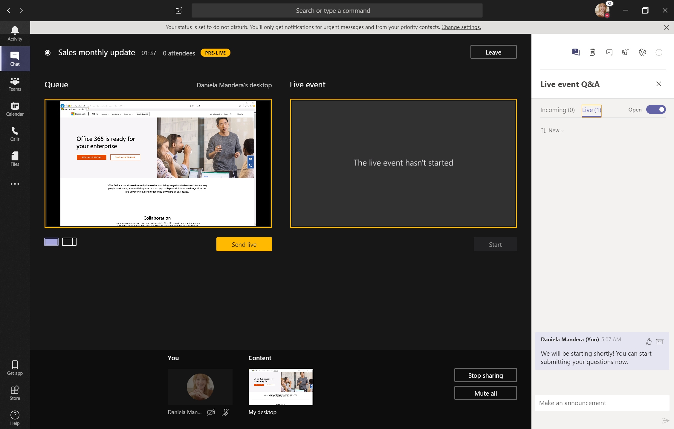
Host setup in Teams
Notes:
Now we’re ready to get the content staged – and I’m going to grab my desktop view then send it live so the other presenters can see it too.

Slide 24
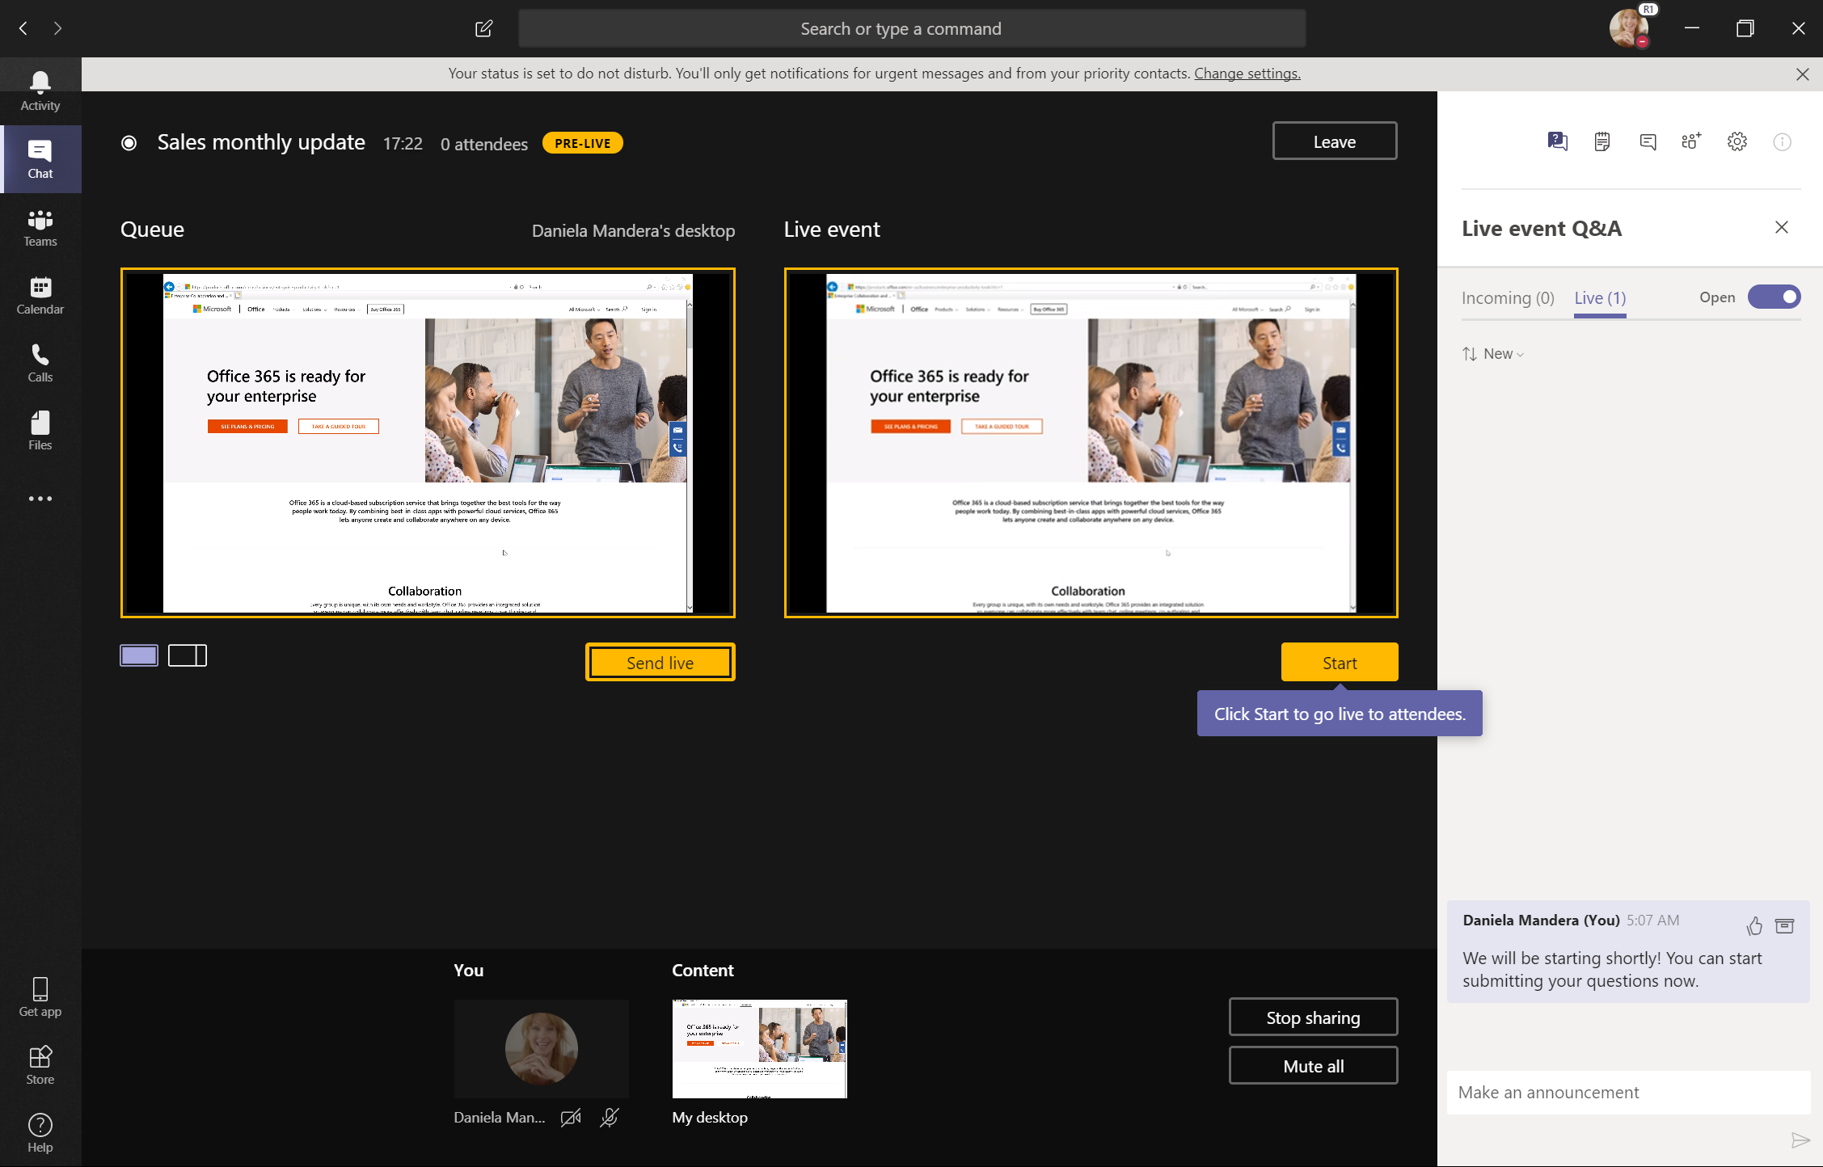
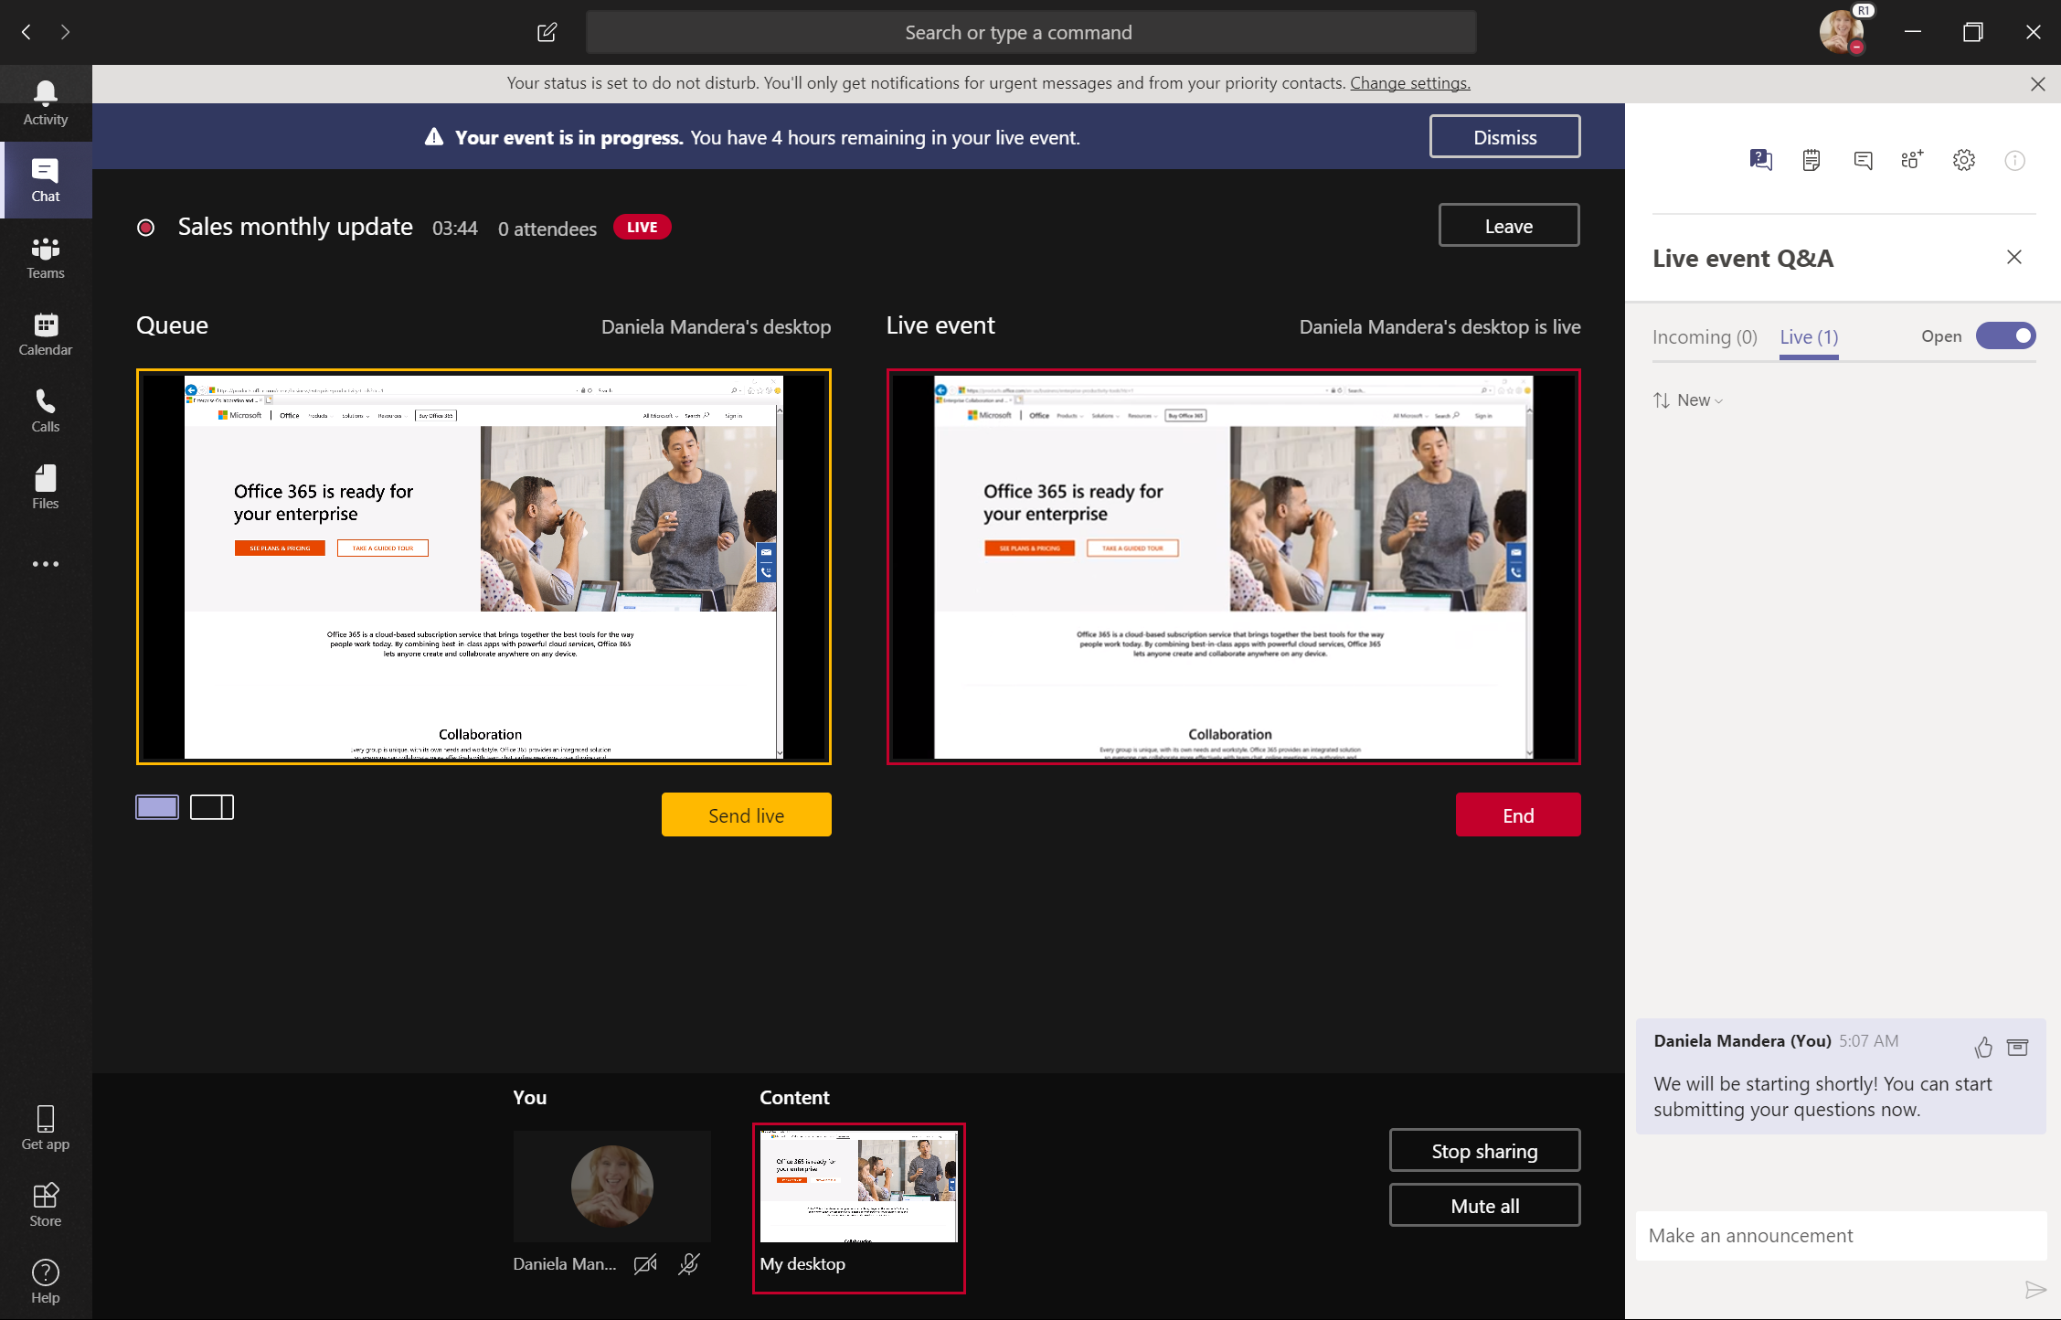
Host setup in Teams
Notes:
Once I have confirmed everything looks good and we’re ready to start the event, I just hit Start and we’re off!
Now, during the live event, other presenters can share easily take the reigns by sharing their content in two click – no one needs to coordinate presenters or hand off control. And after the event, I have access to reporting to see who attended the event, download the Q&A and the recording. And for attendees, the link to join becomes the on-demand event recording, so they can catch up easily if they missed the live broadcast.

Slide 25
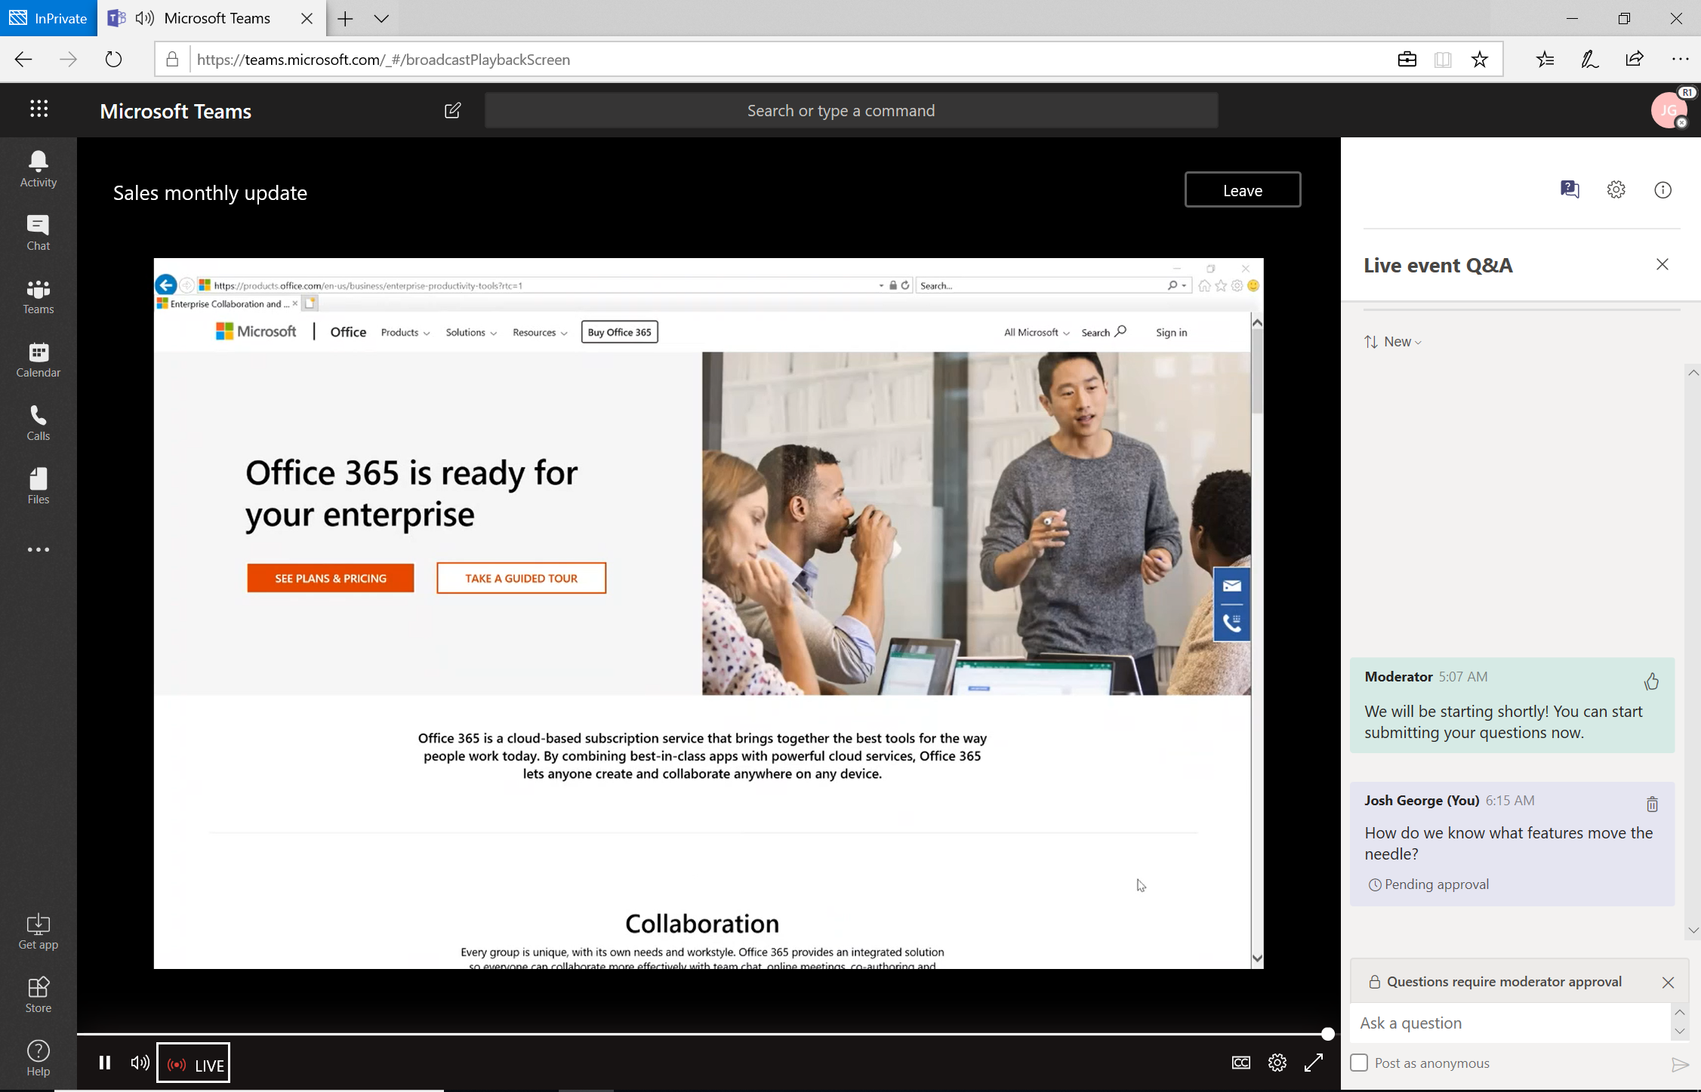
Attendee view in Teams
Off
Notes:
So let’s take a look at the attendee view…. When I join the live event as an attendee, I’m able to manage my captions, select different languages and ask presenters questions in the Q&A. Here I have the option to ask questions anonymously - if I’m feeling a bit shy - or just post one as myself. Presenters can moderate the questions that are coming into the queue, either responding privately or promoting the question to be public and then responding.

Slide 26
Resources Monthly Resources: https://aka.ms/O365ChampionResources Forum: https://aka.ms/DriveAdoption Covid-19 Resources from Microsoft https://aka.ms/Covid19Info

Slide 27
Microsoft Resource Cheat Sheet
https://aka.ms/M365Roadmap
https://aka.ms/TechCommunity
https://docs.microsoft.com
https://developer.microsoft.com
Microsoft 365 Roadmap
All public feature delivery dates
Filter by product
Microsoft Technical Community
Product forums and blogs
Driving Adoption forum
Diversity & Inclusion forum
IT Pro & Adoption Documentation
Learn how to plan, deliver, adopt and manage Microsoft 365 products
Developer Documentation
Training, documentation, samples & communities for developers
Tools and Resources
https://aka.ms/MicrosoftAdoption
Microsoft Adoption Hub
Adoption resources for O365 services
O365 Champion sign up and Information
M365 Learning Pathways & Service Adoption Specialist course information
Visit Us

Slide 28
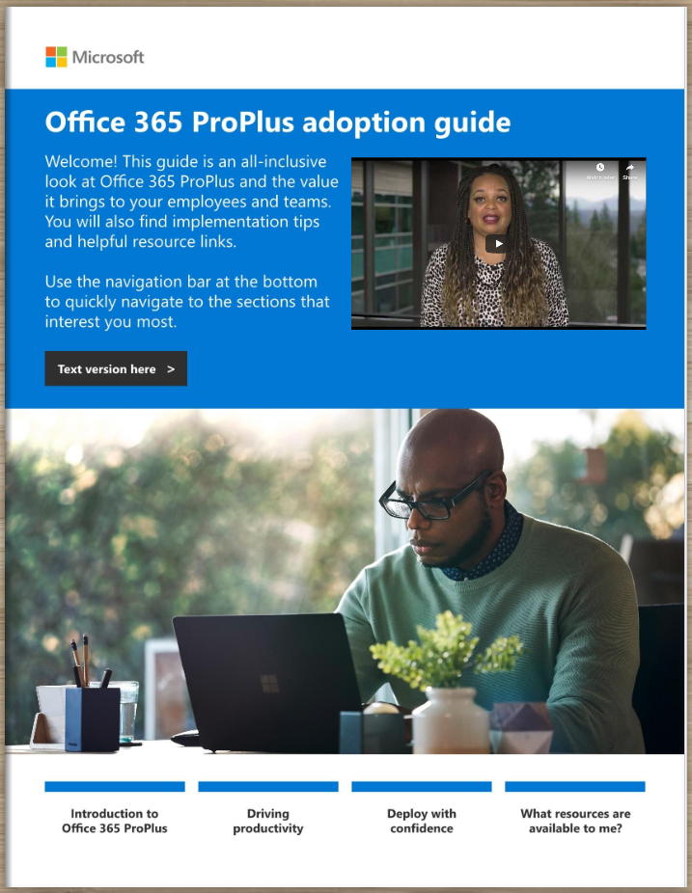
Office 365 ProPlus Adoption Guide
Champion Preview
Available at:
https://aka.ms/OPPToolkit

Slide 29
Training Tools for Microsoft Teams
Get Started with Teams
https://teams.conversationalgeek.com
Managers Guide to Microsoft Teams
https://teamsbook.info

Slide 30
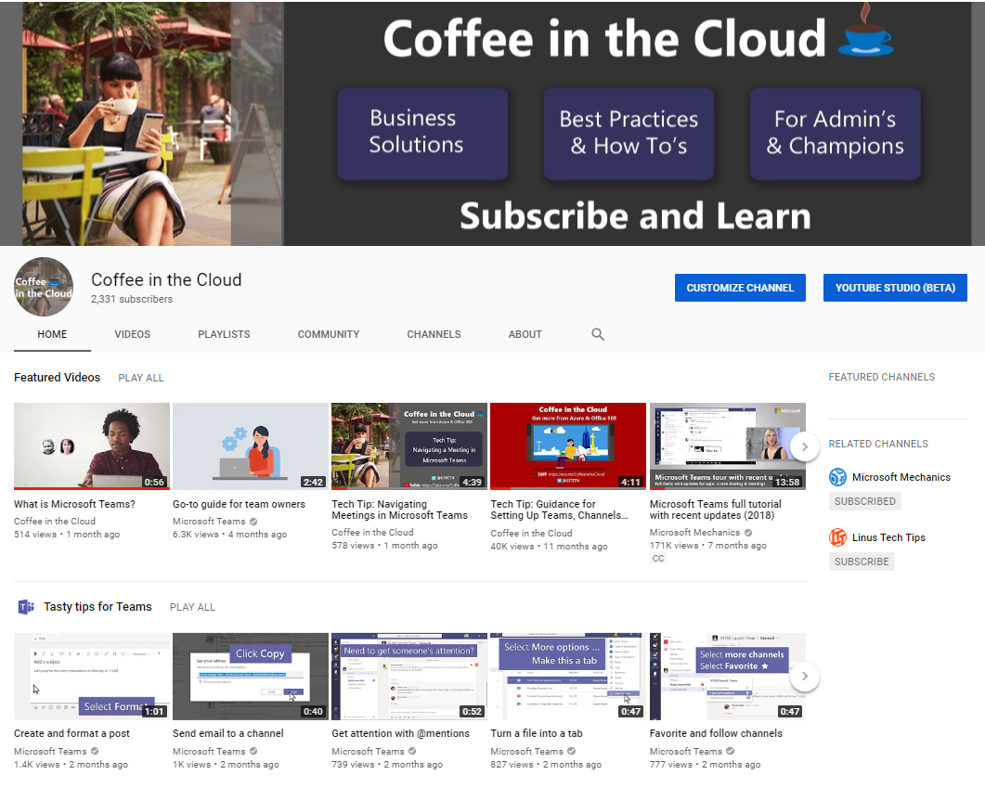
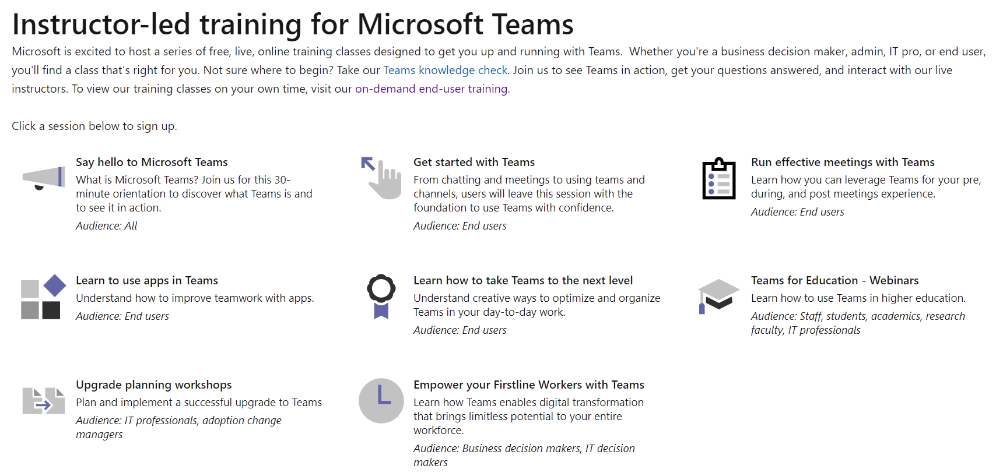
On-Line Training from Microsoft
On-demand & Instructor Led
https://aka.ms/CoffeeintheCloud
https://aka.ms/TeamsLiveTraining

Slide 31
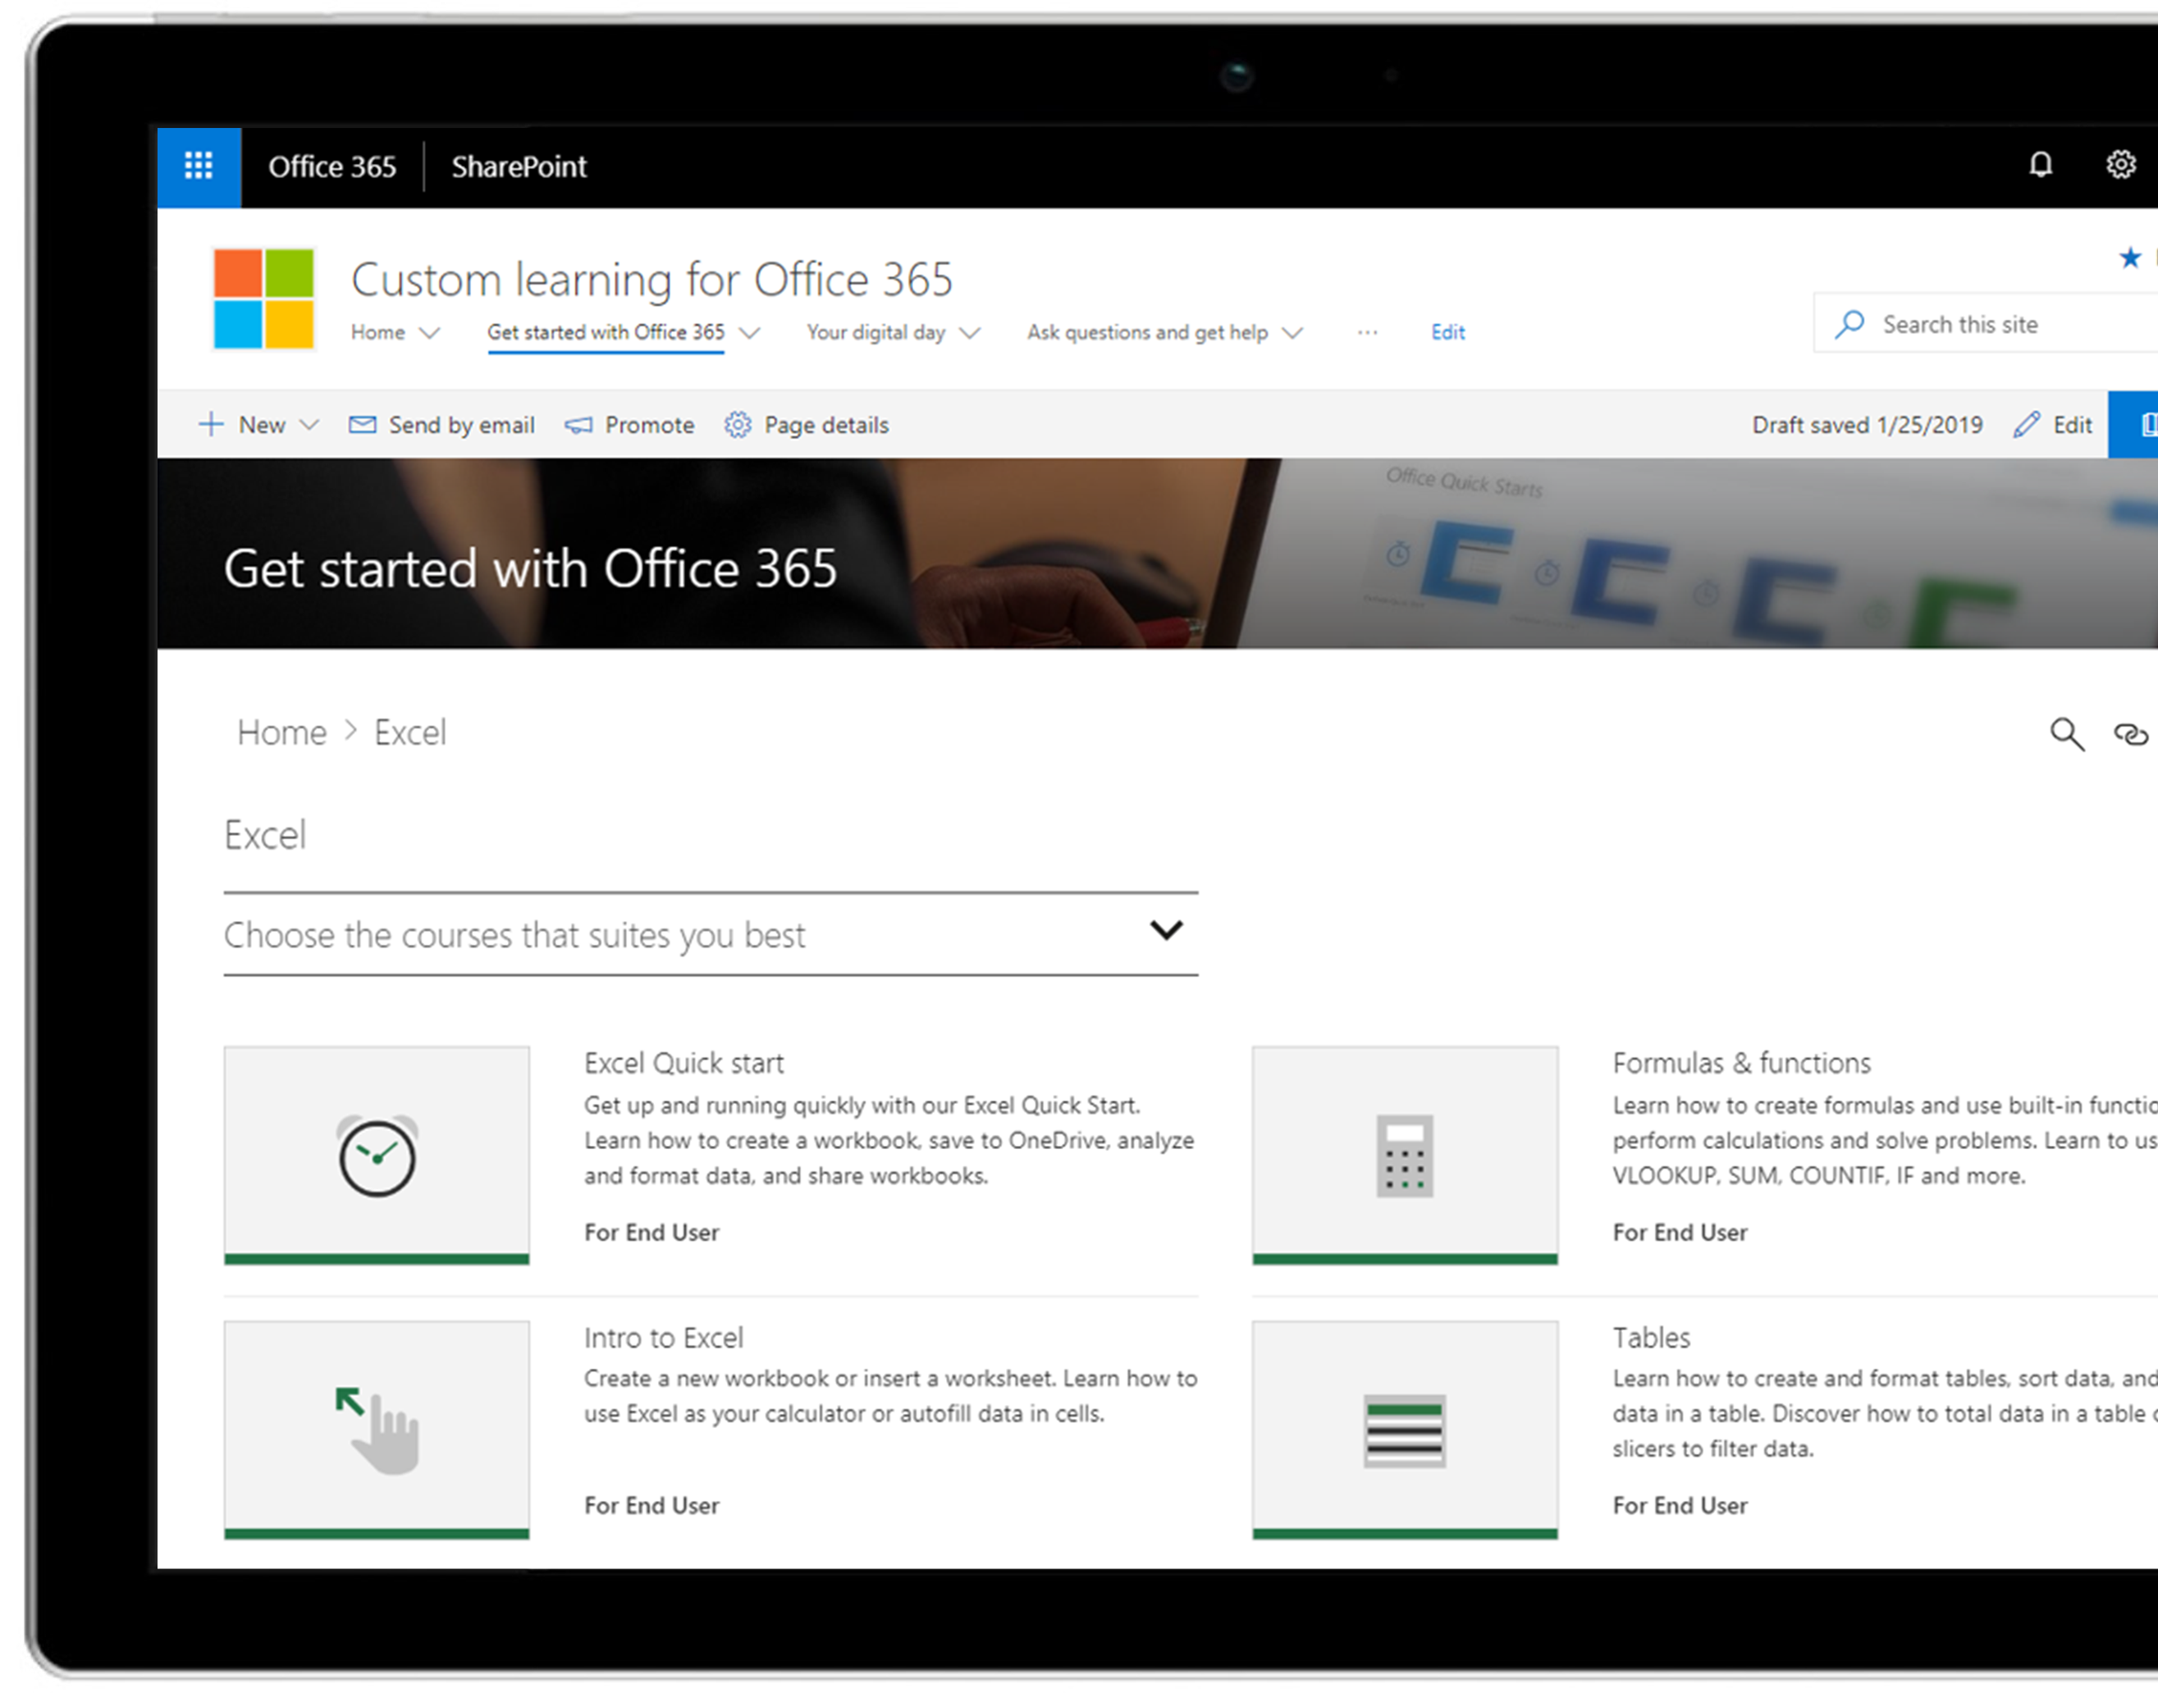
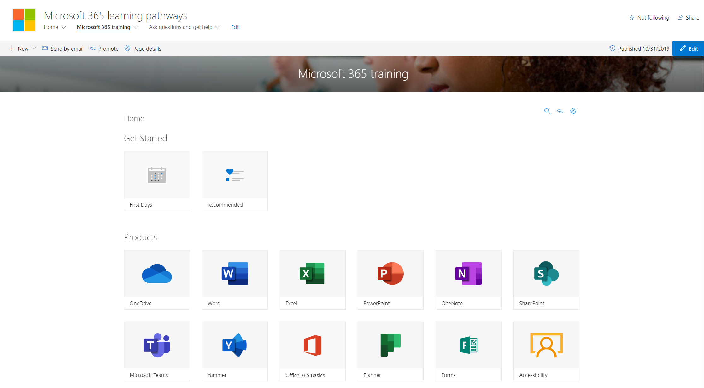
M365 Learning Pathways https://aka.ms/M365LP
Modern SharePoint Online communication site template
Connected to online catalog of Microsoft curated end-user training content
Customizable content – remove or add your own content
Easily installed via SharePoint Provisioning Service
Simple integration into Microsoft Teams
Learn More at https://aka.ms/M365LP

Slide 32
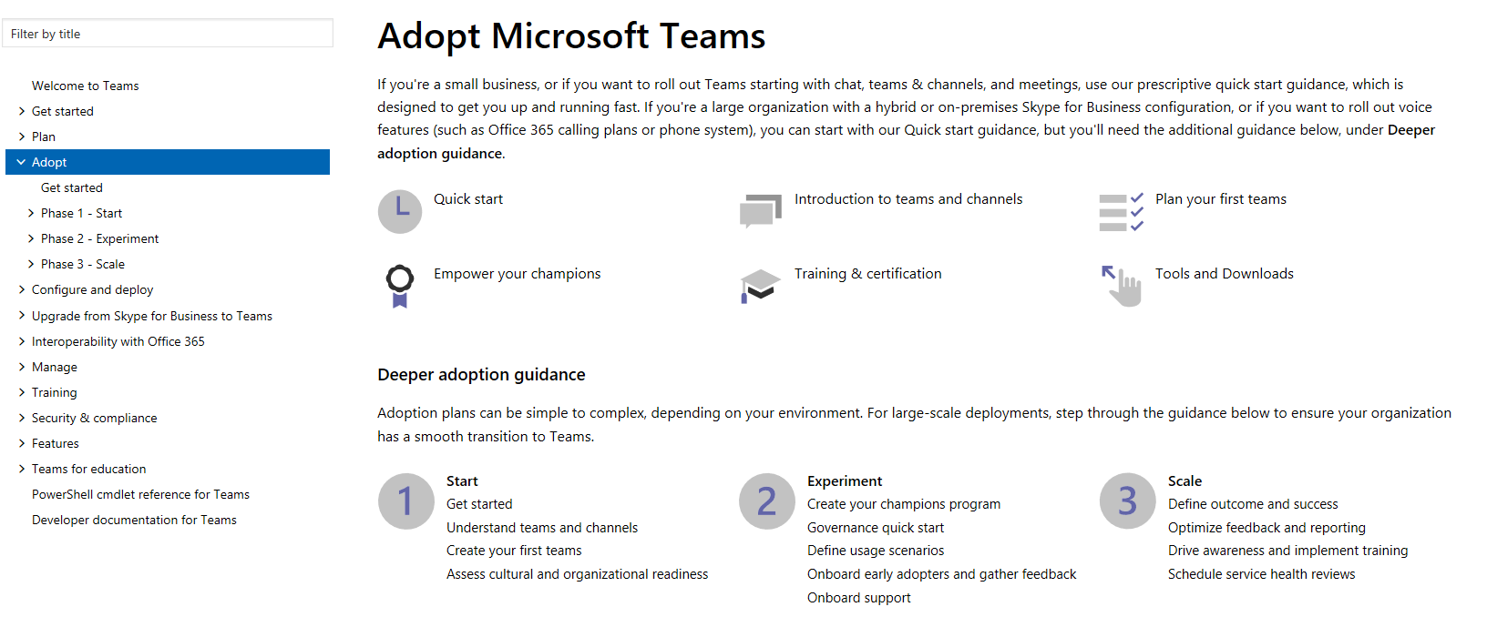
Teams Adoption Hub – https://aka.ms/TeamsAdoption

Slide 33
Coffee in the Cloud
Get more from Office 365
https://aka.ms/CoffeeintheCloud
Subscribe now to Learn About:
Business Solutions
Best Practices & How-To’s
For Admin’s and Champions
@CITCTV

Slide 34
O365 Champion Schedule & Topics January to June, 2020
22 Jan.
Getting Started with OfficePro Plus
19 Feb.
Modern Project Management using Tasks & Project
25 Mar.
Supporting Remote Workers and Virtual Events
22 Apr.
Smart Content Management with SharePoint Sites & News
13 May
SharePoint Conference Preview
(AM Only)
17 June
What’s Next in Knowledge Management
Every month we’ll share a new Champion Tip for Microsoft Teams
Stay tuned for more on our #BetterTogether webinar series on our blog at https://aka.ms/DriveAdoption

