Slide 1
Office 365 Champion Community
January 2020 Monthly Meeting
Karuana Gatimu
Customer Advocacy Group
Notes:
Join our worldwide program at https://aka.ms/O365Champions
Materials included in this deck are free to use in your daily work.
Please reference our program as the source of this information.
For questions or comments please reach out in the Drive Adoption or Champion’s Corner forums of the Microsoft Technical Community at https://aka.ms/DriveAdoption

Slide 2
The successful adoption of Microsoft 365 represents a change in behavior. It is more than a set of products—it is a fundamentally different way of working. This change is about people. And we are here to help.
Notes:
M365 has the potential to change the trajectory of an organization in many ways, besides the technology itself:
People fundamentally change the way they work
We enable a modern workplace and the optimization of Office 365
We provide the capability to accelerate the alignment of economic and cultural business drives
We allow organizations to enter a state of dynamic stability*
*“Dynamic stability is like riding a bicycle, where you cannot stand still, but once you are moving it is actually easier. It is not our natural state. But humanity has to learn to exist in this state.¹”
1 Friedman, Thomas L. Thank you for Being Late. New York: Farrar, Straus and Giroux, 2016.
“The need to move to a highly flexible and adaptable digital approach is urgent. The applications required today are not going to last for 30 years. They are maybe only going to be used for maybe two, three years.²”
2 McKendrick, J. (2018. Jan 21) The ultimate technology success metric: owning the customer relationship. Retrieved from http://www.zdnet.com/article/business-transformation-before-technology/

Slide 3
Agenda
Inspiration
Information
Tools
Events and 2020 Meeting Schedule
Getting Started with Office 365 ProPlus
A New Decade
Find prior meeting content at https://aka.ms/O365ChampionResources

Slide 4
Microsoft Resource Cheat Sheet
https://aka.ms/M365Roadmap
https://aka.ms/TechCommunity
https://docs.microsoft.com
https://developer.microsoft.com
Microsoft 365 Roadmap
All public feature delivery dates
Filter by product
Microsoft Technical Community
Product forums and blogs
Driving Adoption forum
Diversity & Inclusion forum
IT Pro & Adoption Documentation
Learn how to plan, deliver, adopt and manage Microsoft 365 products
Developer Documentation
Training, documentation, samples & communities for developers
Tools and Resources
https://aka.ms/MicrosoftAdoption
Microsoft Adoption Hub
Adoption resources for O365 services
O365 Champion sign up and Information
M365 Learning Pathways & Service Adoption Specialist course information
Visit Us

Slide 5
Training Tools for Microsoft Teams
Get Started with Teams
https://teams.conversationalgeek.com
Managers Guide to Microsoft Teams
https://teamsbook.info

Slide 6
2020: A New Decade A satisfying career is the result of reflection, planning and steady work.
What did I accomplish in the last 10 years?
What are the top 3 things I’d like to have done differently?
What are my top goals for the next 10 years?
Do I have a for-the-decade bucket list?
The impossible becomes possible with our community

Slide 7
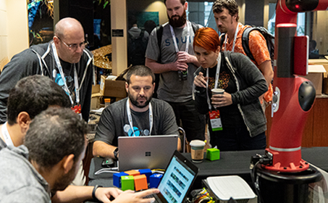
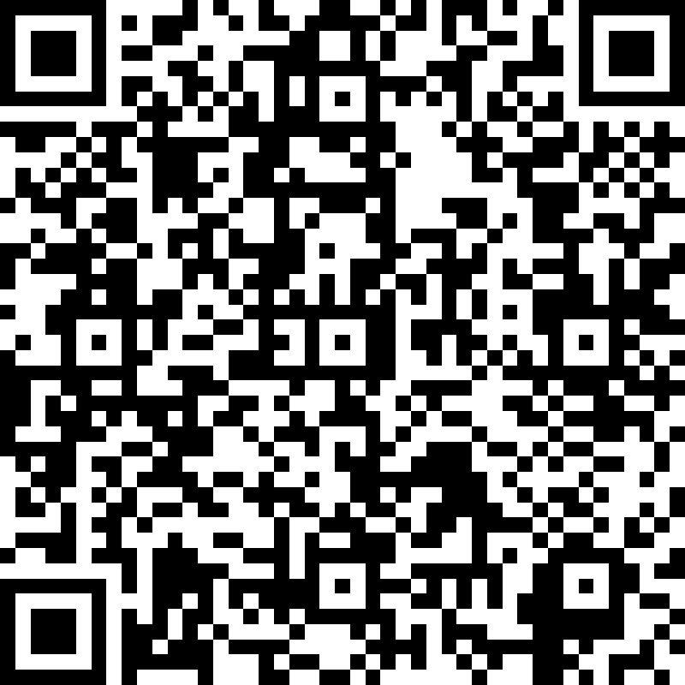
Events
O365 Champion Mixers
February 6th Ignite Tour Wa. DC
April 15th SPFestDC
May 19th SharePoint Conference
June 8th European Collab Summit
Register @ https://aka.ms/O365ChampionMixer
It’s not too late! Make your voice heard!
Complete our survey at https://aka.ms/O365ChampionSurvey

Slide 8
O365 Champion Schedule & Topics January to June, 2020
22 Jan.
Getting Started with OfficePro Plus
19 Feb.
Modern Project Management using Tasks & Project
25 Mar.
Low Code & No Code Solutions with PowerPlatform
22 Apr.
Smart Content Management with SharePoint Sites & News
13 May
SharePoint Conference Preview
(AM Only)
17 June
What’s Next in Knowledge Management
Every month we’ll share a new Champion Tip for Microsoft Teams
Stay tuned for more on our #BetterTogether webinar series on our blog at https://aka.ms/DriveAdoption

Slide 9
Getting Started with Office 365 ProPlus

Slide 10
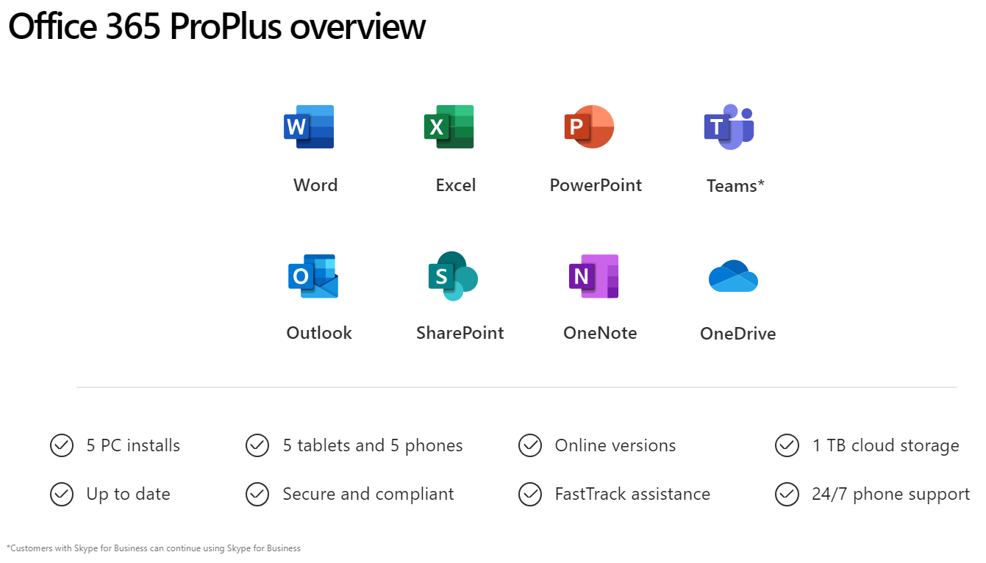

Slide 11
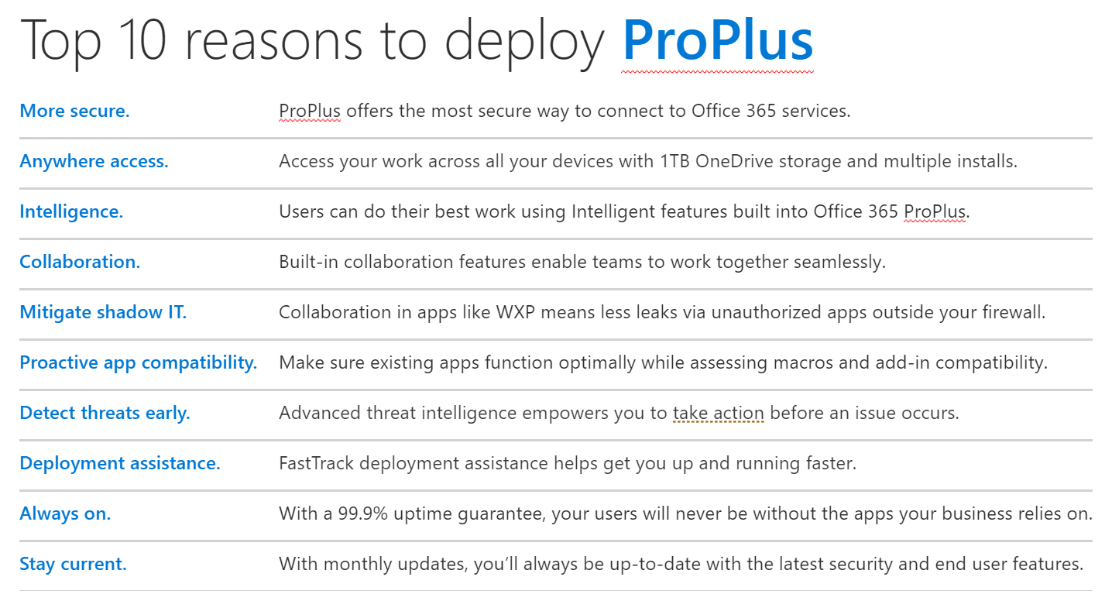

Slide 12
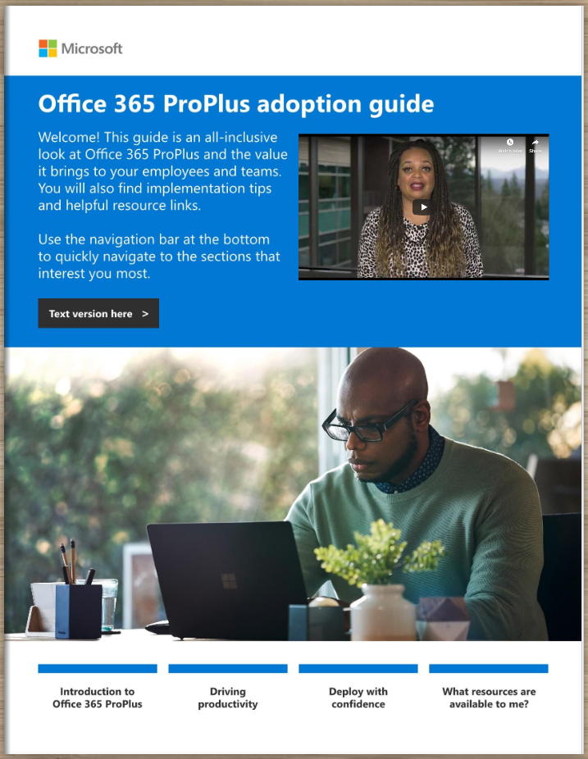
Office 365 ProPlus Adoption Guide
Champion Preview
Available at:
https://aka.ms/OPPToolkit

Slide 13
Resources Monthly Resources: https://aka.ms/O365ChampionResources Forum: https://aka.ms/DriveAdoption Ignite Overview https://aka.ms/AdoptionatIgnite

Slide 14
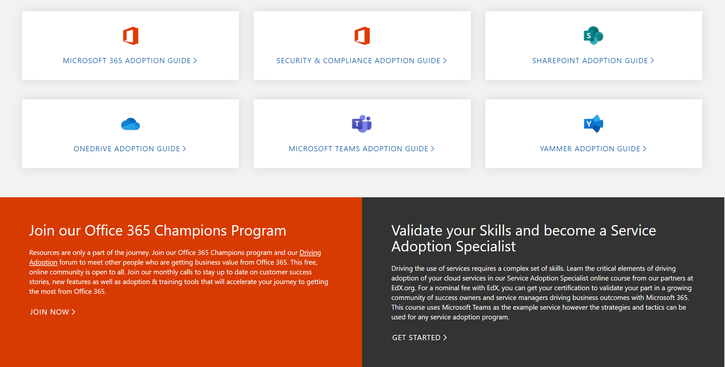
Get Started at https://aka.ms/MicrosoftAdoption
Streamline End User Training with Microsoft 365 Learning Pathways
Notes:
Accelerate your deployment and adoption of Office 365 services by visiting our unified resource page for adoption guidance on the Microsoft Technical community at https://aka.ms/MicrosoftAdoption. Review materials for Microsoft 365, our security and compliance features or key teamwork workloads like SharePoint, OneDrive, Microsoft Teams and Yammer. Find additional resources for Microsoft Teams in Government and devices for Teams within the Microsoft Teams adoption guide.
This is a step forward in our response to your feedback to make adoption materials easier to discover and use. Over the coming months we will continue to unify and standardize these materials across all our Microsoft 365 services. Share more feedback in our Driving Adoption community at https://aka.ms/DriveAdoption.

Slide 15
Training Tools for Microsoft Teams
Get Started with Teams
https://teams.conversationalgeek.com
Managers Guide to Microsoft Teams
https://teamsbook.info

Slide 16
Coffee in the Cloud
Get more from Office 365
https://aka.ms/CoffeeintheCloud
Subscribe now to Learn About:
Business Solutions
Best Practices & How-To’s
For Admin’s and Champions
@CITCTV

Slide 17
Current Survey Results
75% of respondents likely or very likely to recommend the program
Top Requested Topics
Running a Champions Program
Hub for Teamwork
Chat, Calling & Meetings
Adoption Methods
File collaboration in O365
Low Code/No-Code solutions
Intelligent Intranet
Video & Live Events
Security & Compliance
Finding Content
Areas to Improve
Advance notice of topics
Better calendar invites
Better reminders on call dates/times
More details on how-to
More in depth sessions
Preferred Call Times:
(Pacific Time)
7am
8am
9am
12 noon
84% of respondents likely or very likely to attend an in person Champions meetup
It’s not too late! Make your voice heard!
Complete our survey at https://aka.ms/O365ChampionSurvey

