Slide 1


Office 365 Champion Community
April 2020 Monthly Meeting
Karuana Gatimu
Customer Advocacy Group
Notes:
Join our worldwide program at https://aka.ms/O365Champions
Materials included in this deck are free to use in your daily work.
Please reference our program as the source of this information.
For questions or comments please reach out in the Drive Adoption or Champion’s Corner forums of the Microsoft Technical Community at https://aka.ms/DriveAdoption

Slide 2

The successful adoption of Microsoft 365 represents a change in behavior.
It is more than a set of products—it is a fundamentally different way of working.
This change is about people.
And we are here to help.
Notes:
M365 has the potential to change the trajectory of an organization in many ways, besides the technology itself:
People fundamentally change the way they work
We enable a modern workplace and the optimization of Office 365
We provide the capability to accelerate the alignment of economic and cultural business drives
We allow organizations to enter a state of dynamic stability*
*“Dynamic stability is like riding a bicycle, where you cannot stand still, but once you are moving it is actually easier. It is not our natural state. But humanity has to learn to exist in this state.¹”
1 Friedman, Thomas L. Thank you for Being Late. New York: Farrar, Straus and Giroux, 2016.
“The need to move to a highly flexible and adaptable digital approach is urgent. The applications required today are not going to last for 30 years. They are maybe only going to be used for maybe two, three years.²”
2 McKendrick, J. (2018. Jan 21) The ultimate technology success metric: owning the customer relationship. Retrieved from http://www.zdnet.com/article/business-transformation-before-technology/

Slide 3
Agenda
Inspiration
Information
Tools
Feature Updates
Forms and Flow for Feedback
Patience
Find prior meeting content at https://aka.ms/O365ChampionResources

Slide 4
Self care comes first
Leading through change takes energy! Make sure you care for yourself and your family first!
Rest
Fuel
Move
Visit https://aka.ms/Covid19Info to learn about resources, offers and best practices

Slide 5
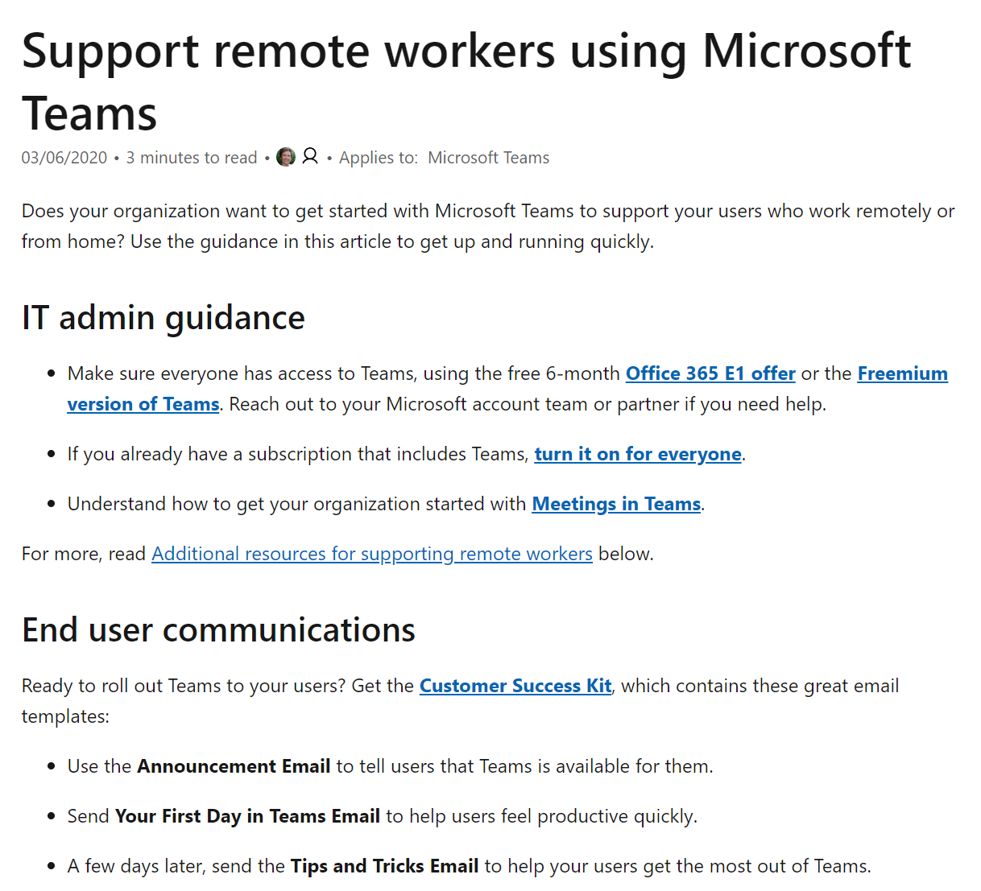
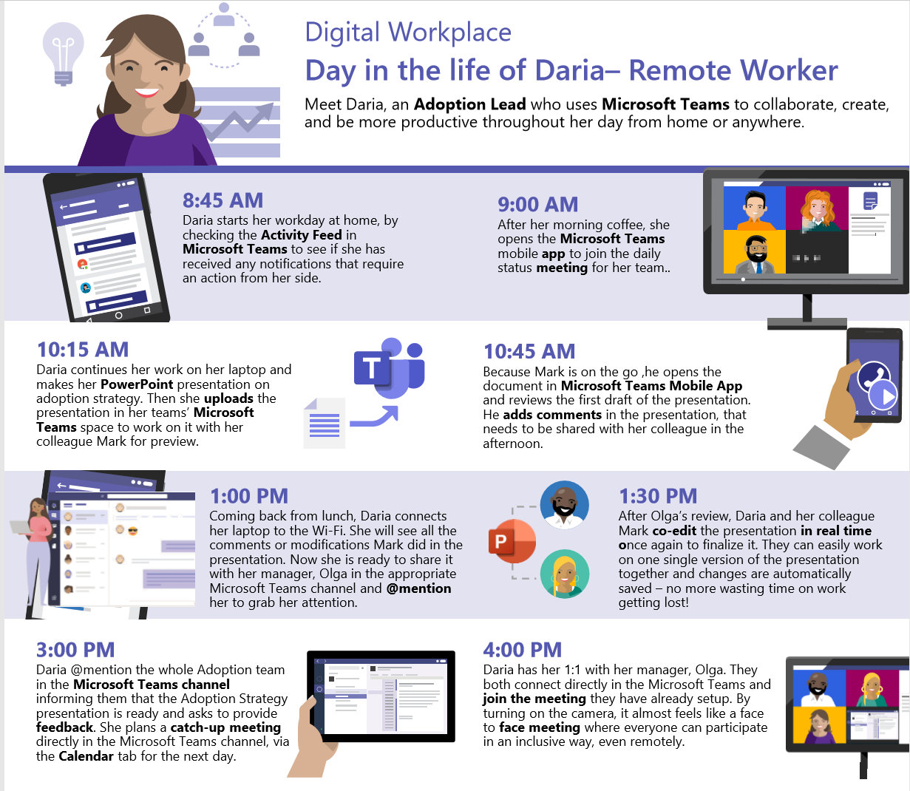


Remote Work Quick Start: https://aka.ms/TeamsforRemoteWork
IT Pro and Champion Guidance
Customer Success Kit – Resources for Champions & Users
The first 10
things to do in Teams

Slide 6
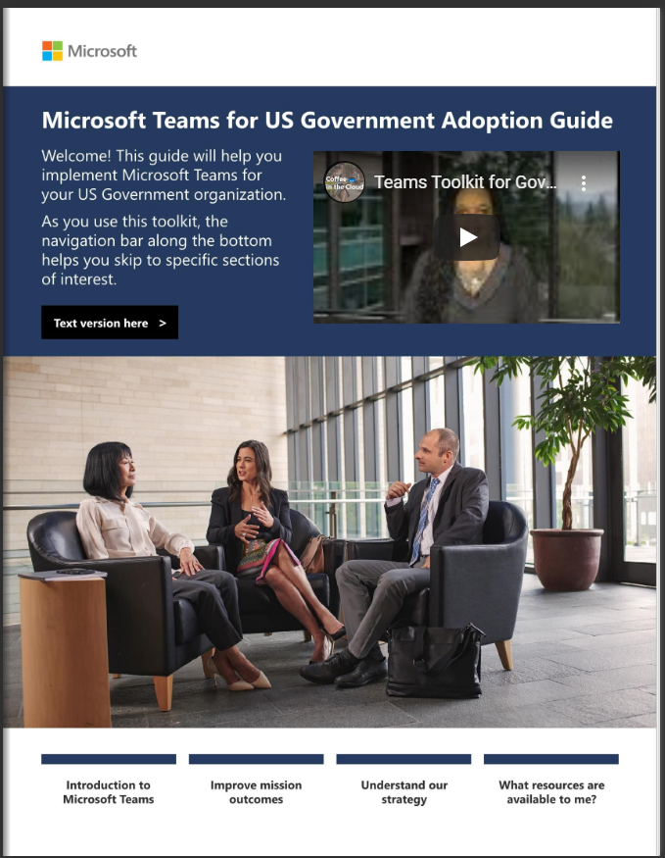
Updated:
Teams in Government https://aka.ms/TeamsinGov

Slide 7
Empower Employees to Achieve More
Work From Home Edition

Slide 8



1
Stay connected with your employees
Communicate effectively during a Crisis
Keep your diverse workforce well informed
Ensure emotional wellbeing of your employees
2
Stay productive & keep your team informed
Run daily stand ups in an easy and effective way
Leverage the power of your team and more
Don’t let WFH become Work in Isolation
3
Keep the human interactions alive
Enable employees to recognize peers
Promote and incentivize change
Be inclusive and ensure employee wellbeing
Bring people together to create communities
4
Don’t forget to have fun!
Celebrate important events and success with your team

Slide 9
Connect with your employees
Communicate effectively during a Crisis
Keep your diverse workforce well informed (2)
Ensure emotional wellbeing of your employees

Slide 10

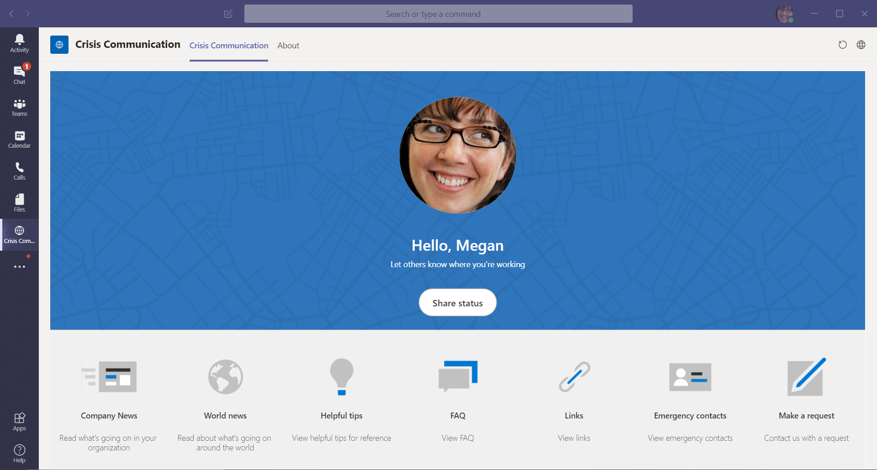

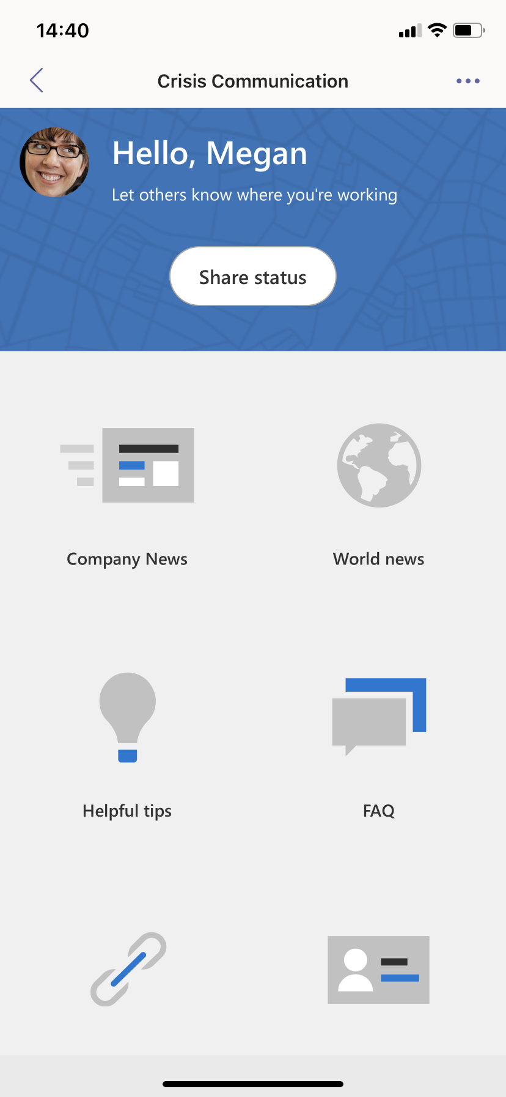
Communicate effectively during a Crisis
Stay updated on news and information from your organization
Admins can use the app to push news, updates, provide emergency contacts specific to different locations.
Employees can report WFH status and make requests thus helping central response teams track status across an organization.
Add feeds of up-to-date information from reputable sources such as WHO, CDC, or a local authority as a tab for employees to view easily
Custom extension use cases*:
Enable polling employees on their physical and mental wellbeing in the aftermath of a crisis through bot customization
Provide option for employees to proactively report changes in their health status – incl. reporting illness, potential exposure, recovered status
Integrate with Power BI to provide reports providing actionable insights – employees reached vs. seen vs. acknowledged, WFH breakup, health info that can directly help drive management decisions
Relevant App Templates
Why Now?
The overhead of organizing multiple townhall meeting (even virtual) or information trickledown is high as the crisis keeps evolving. An easy, structured, 1:many communication approach is necessary
Convey consistent updates on policy changes, updates to the entire organization.
Crisis Communication
Download
Deployment Video
*- Not available as part of existing app template. Development required

Slide 11

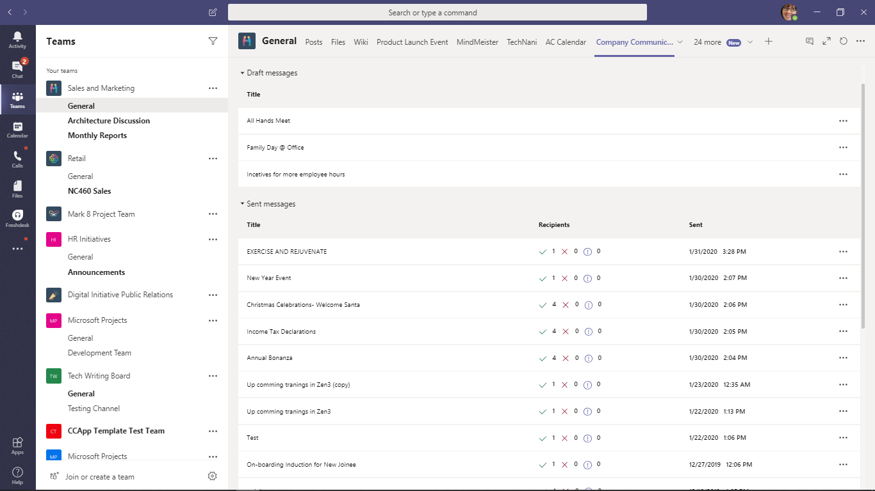
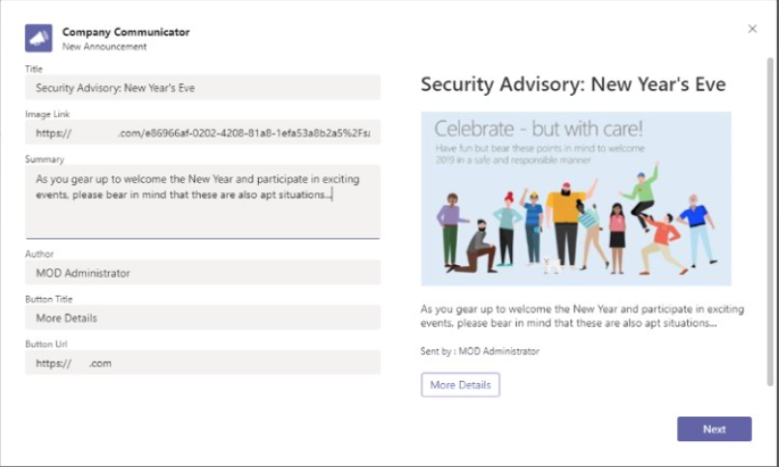
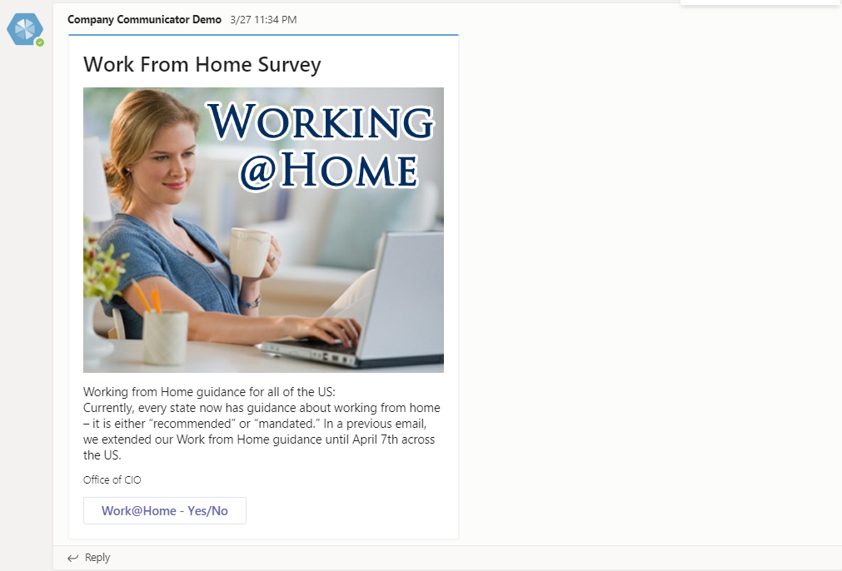
Keep your diverse workforce well informed
Deliver personalized communications to each Team, or groups of employees in Teams
Create and send messages intended for multiple teams or large number of employees over chat.
Easy interface for designated users to create, preview, collaborate and send messages in a targeted manner. (E.g. to teams based in Italy, Spain, China).
Custom extension use cases*:
Build custom targeted communication capabilities such as custom telemetry on how many users acknowledged or interacted with a message with insights directly tied to management decisions.
Extend the communicator messaging capability to broadcast info about live leadership sessions such as AMA, Fireside Chat and allow users to submit questions for the session.
Relevant App Templates
Why Now?
It is important that organizations increase communication with employees to alleviate fear of uncertainty, support employees in times of distress
Keep the dialogue flowing between the organization and employees to maintain sense of team intact
Company Communicator
Download
Deployment Video
*- Not available as part of existing app template. Development required

Slide 12
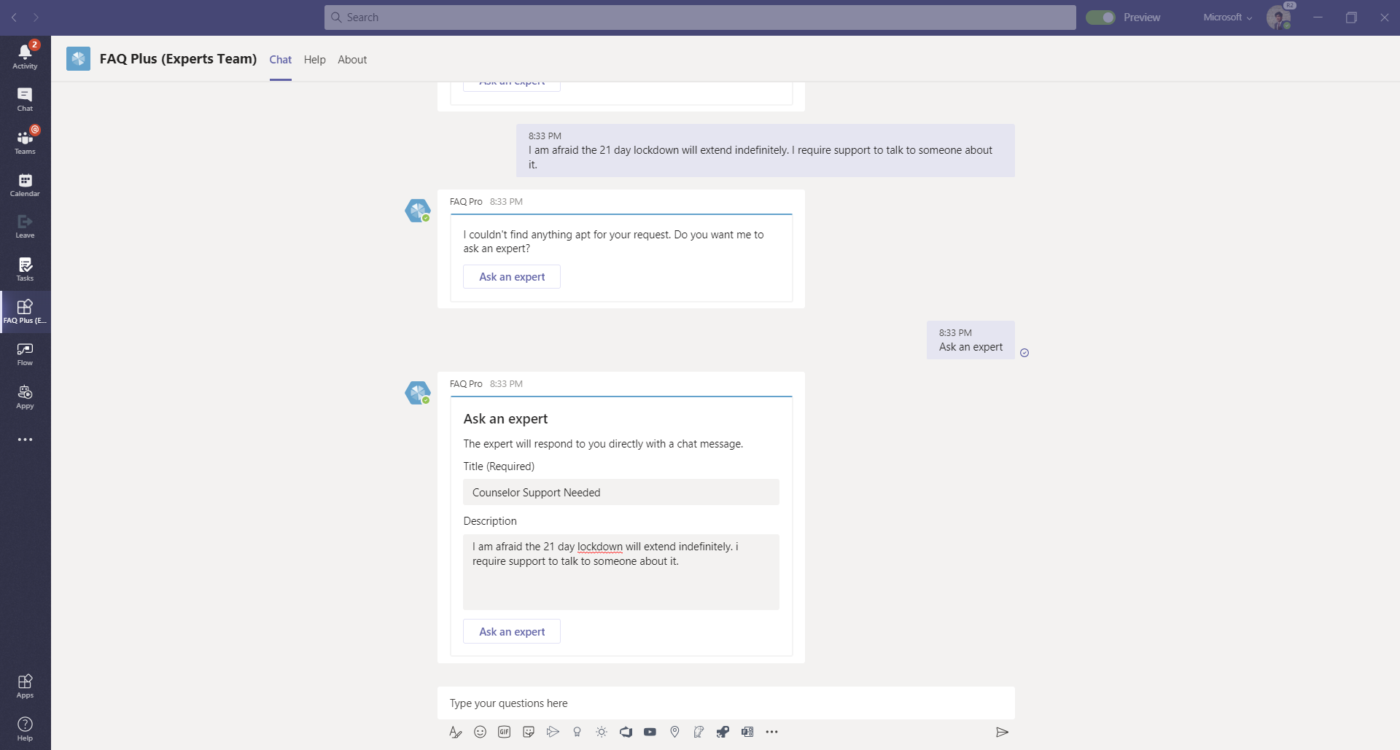
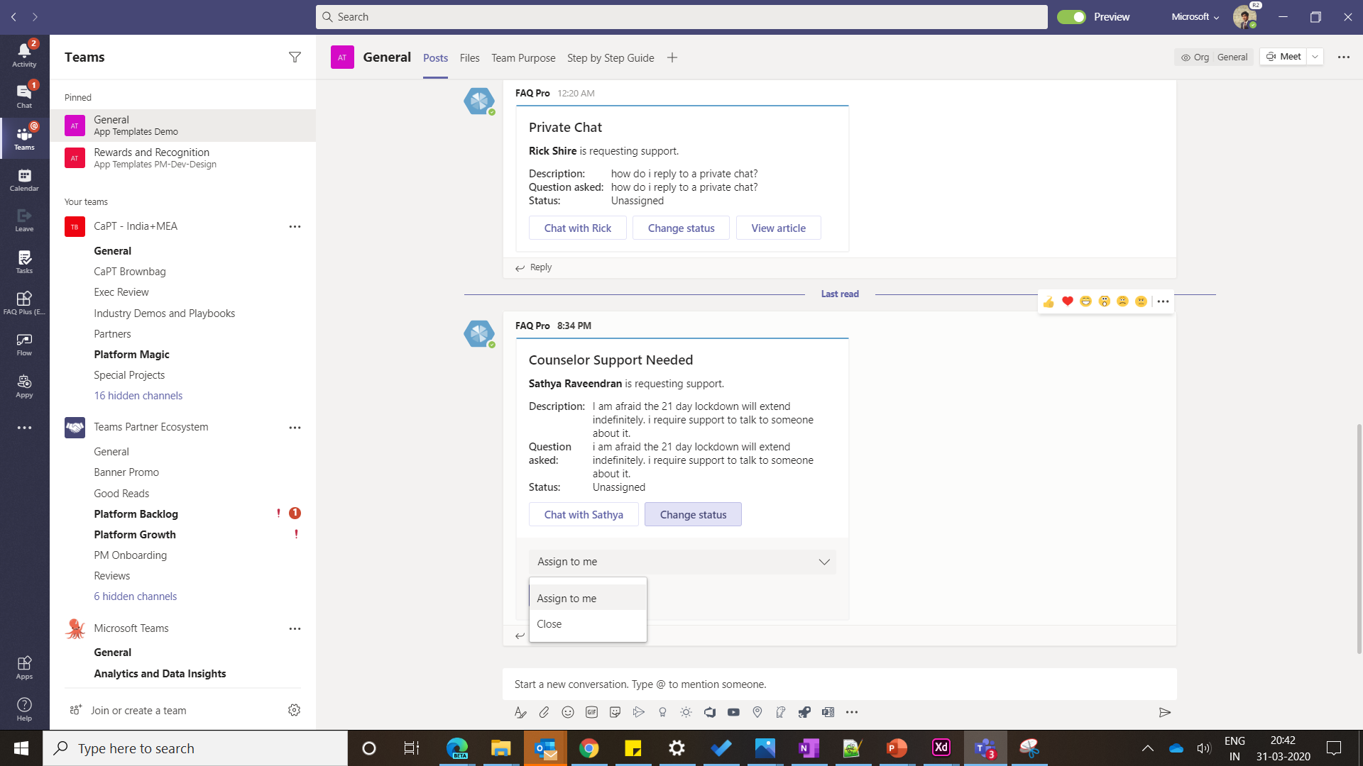
Ensure emotional wellbeing of your employees
Setup a centralized team that offers emotional counselling support to employees coping with the crisis
Create a centralized team of in-house therapists, HR personnel specialized in employee mental wellbeing
Provide counselling support to employees who need it. Establish a communication channel for employees to reach out for any sort of mental wellbeing support requests.
Systemically track and respond to requests from the entire organization
Custom extension use cases*:
With the app branded along the lines of ‘E-Wellbeing’ and not just FAQ, admin can proactively broadcast links to wellbeing articles, tips to brighten the day, tips to reduce stress
Enable Peer to Peer human connect: Enable users to register as volunteers of ‘Talk to a friend’ initiative. Through series of questions, the app could deduce mental wellbeing of employees and pair “stressed out” employees with volunteers as ‘Talk to a friend’ option
Relevant App Templates
Why Now?
Companies are increasingly offering counselling services to offer emotional support to employees. Personal support offered using this app ensures that employee needs are valued
With lack of water cooler talks, F2F contact, ongoing crisis, employees might have pent up stress with no means to vent / talk it out. Talking to peers is extremely important in dealing with stress
FAQ Plus
Download
*- Not available as part of existing app template. Development required

Slide 13
Stay productive and keep your team informed
Run daily stand ups in an easy and effective way
Leverage the power of your team and more
Don’t let WFH become work in isolation

Slide 14

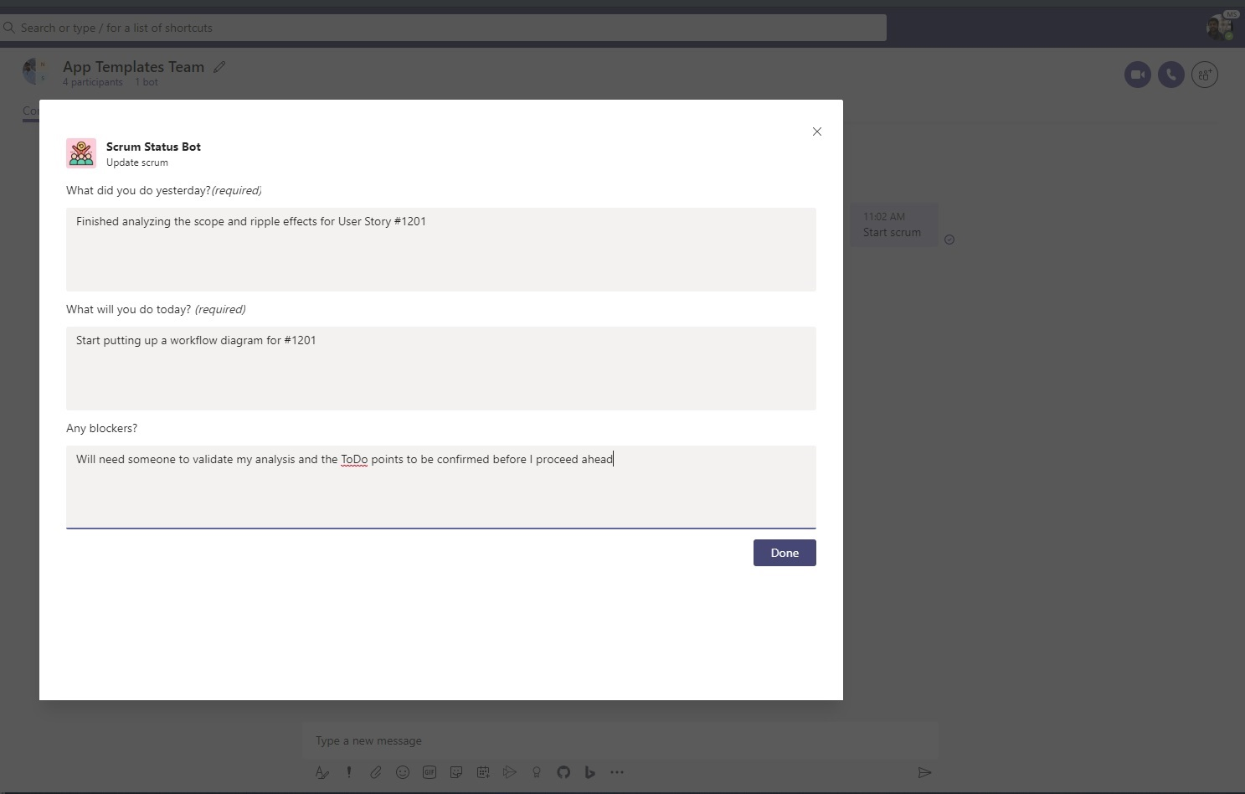
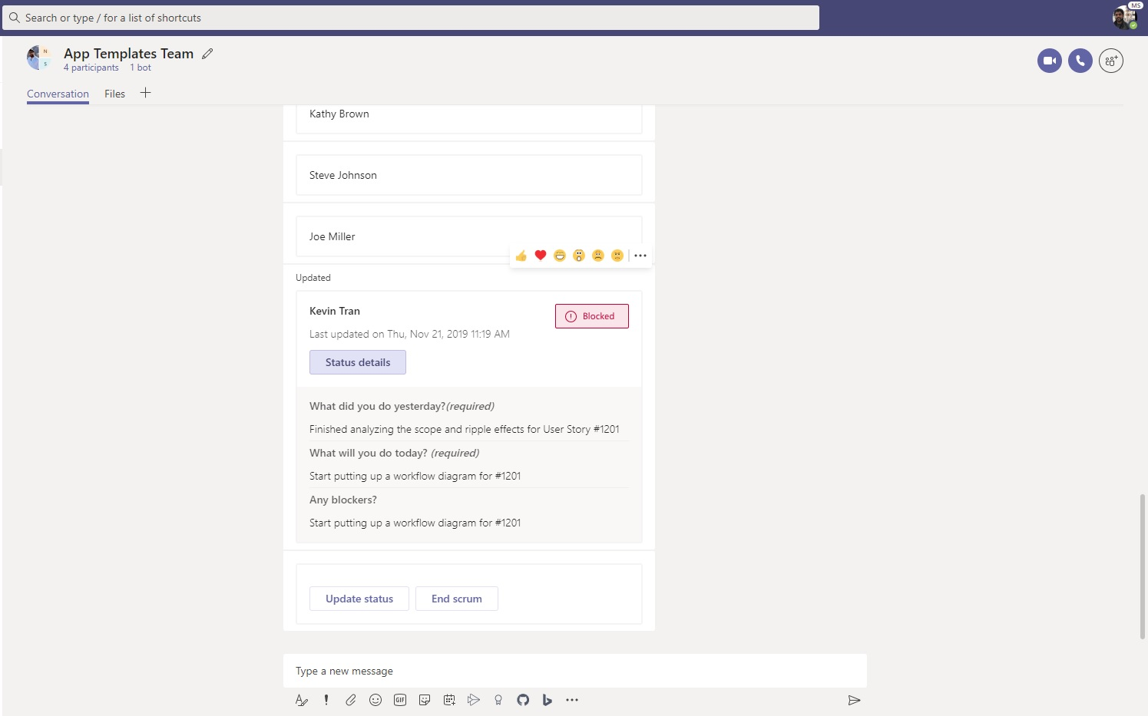
Run daily stand ups in an easy and effective way
Get your team to share their status, daily summary, team insights and participation
Automate standups and check-ins enabling team members to be more effective by sharing their status updates for all other members to see
Recognize who is blocked and help team members progress toward their objectives
Custom extension use cases*:
Integrate with planner / task cards to track progress, auto suggest planned activities for the day and upcoming activities
Provide option for manager to post tasks which are ‘Up for grabs’ that can be claimed by team member who has capacity to support
Provide option to export summary reports, progress on milestones for weekly / monthly update meetings
Relevant App Templates
Why Now?
Staying productive is difficult in a remote work setting as there are more distractions. It is important to simulate the daily work routine to the extent possible even at home
Main challenge of remote working is lack of visibility into what teammates are working on. The scrum app provides insight into everyone’s day without adding to the long list of meetings
Scrum Status
Download
*- Not available as part of existing app template. Development required

Slide 15

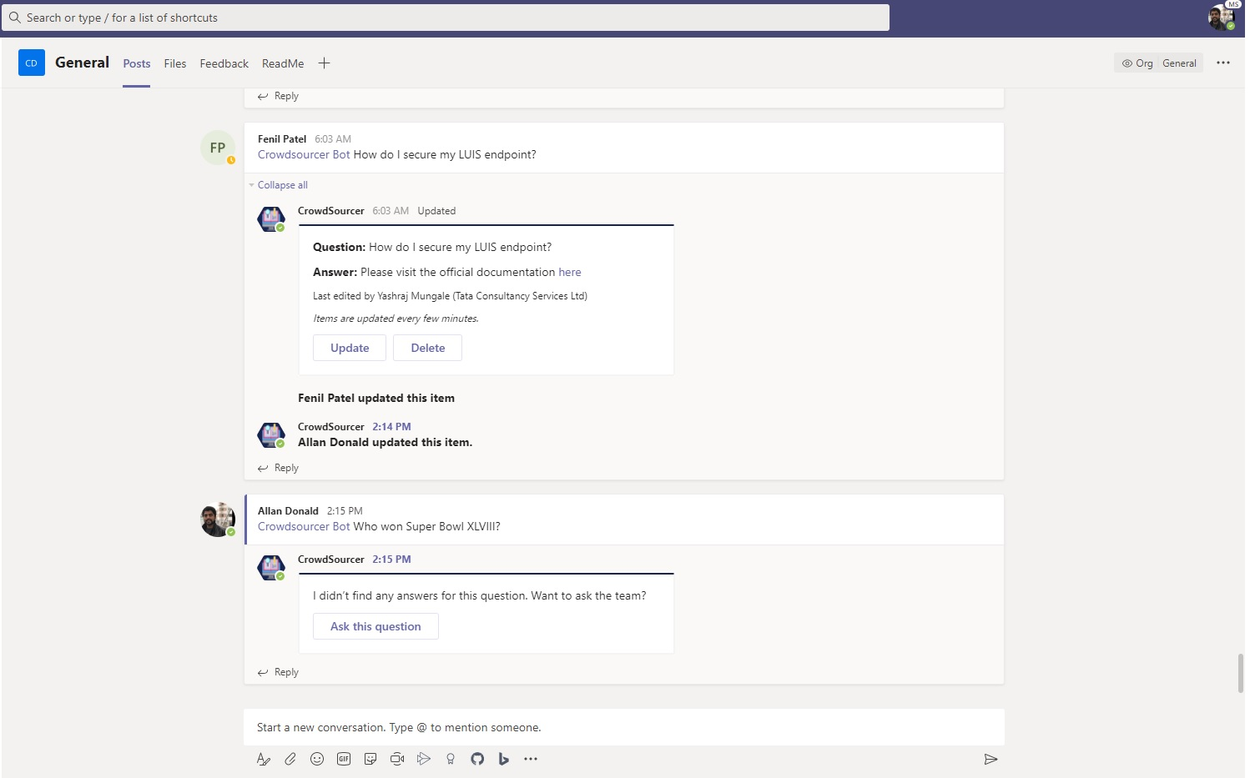
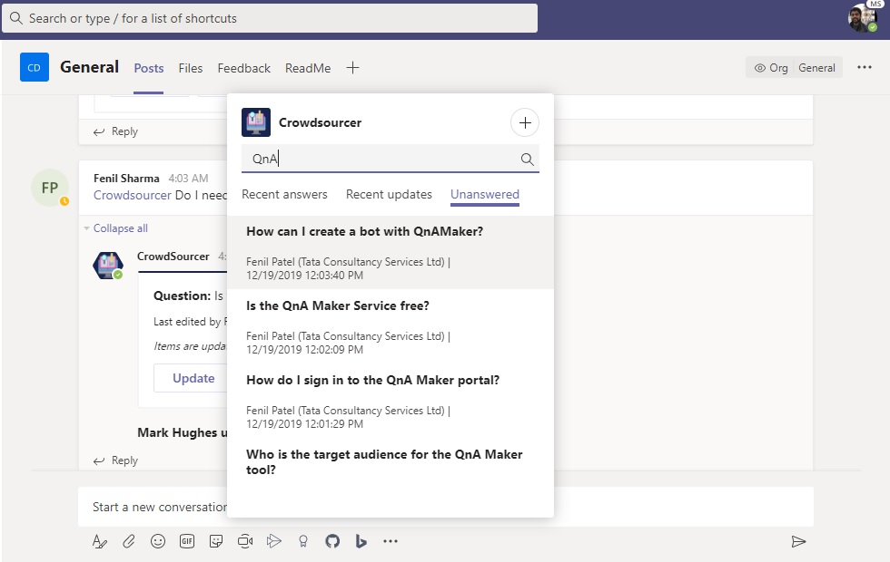
Leverage the power of your team and more
Collaborate easily to source ideas from your entire team on issues or roadblocks
Enable a group of people (team) collaborate to obtain voluntary answers to their queries
Tap into crowd intelligence and collective wisdom of the group.
Custom extension use cases*:
Enable the query poster to mark the question as solved and either select one of the solutions offered by team members as the right solution OR type in the solution that worked giving credit (tagging) users who offered useful advice
Enable users to add tags to questions. E.g. the technology, domain, topic area of the question, so that other users can find answers when they are posing similar questions
Incentives: Provide incentives for answering questions (credit points, virtual coins). Allow users to discover open questions based on said tags / topics. This encourages experts in each domain to proactively offer help and build credibility
Relevant App Templates
Why Now?
Another challenge of remote working is breaking the information walls – It is not possible to just walk over to a colleague’s desk and discuss a problem or gather the team to brainstorm a solution
Employees require tools now that put them in touch with the right people quickly. Such tools are crucial in avoiding communication delays and keeping the employees focused
Crowdsourcer
Download
*- Not available as part of existing app template. Development required

Slide 16

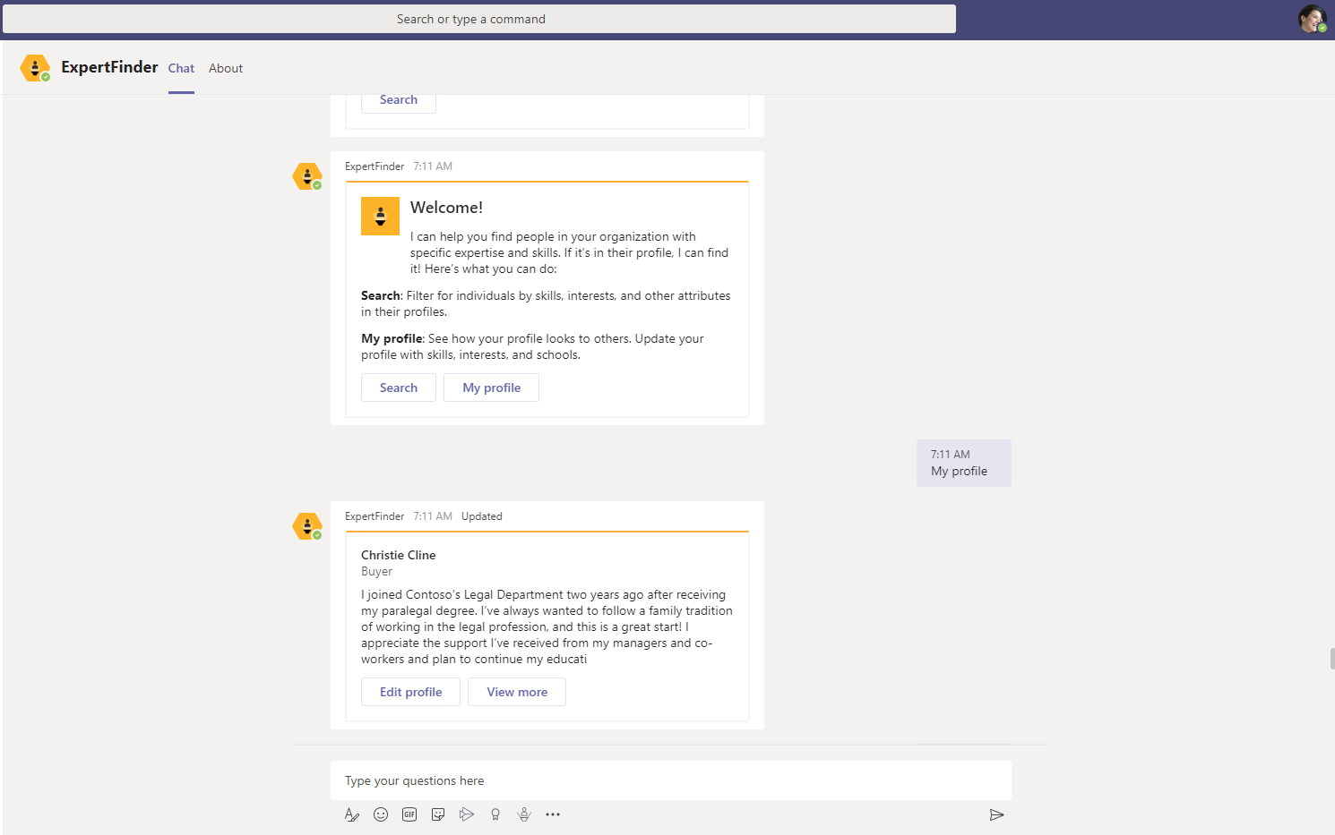
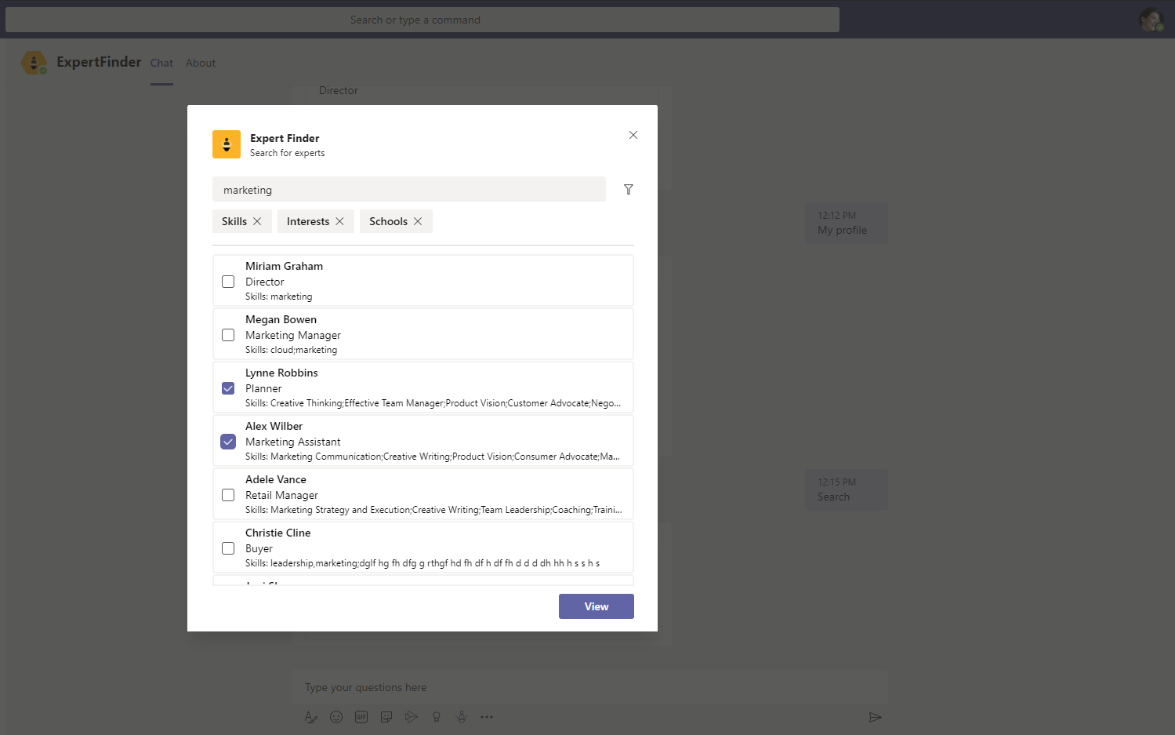
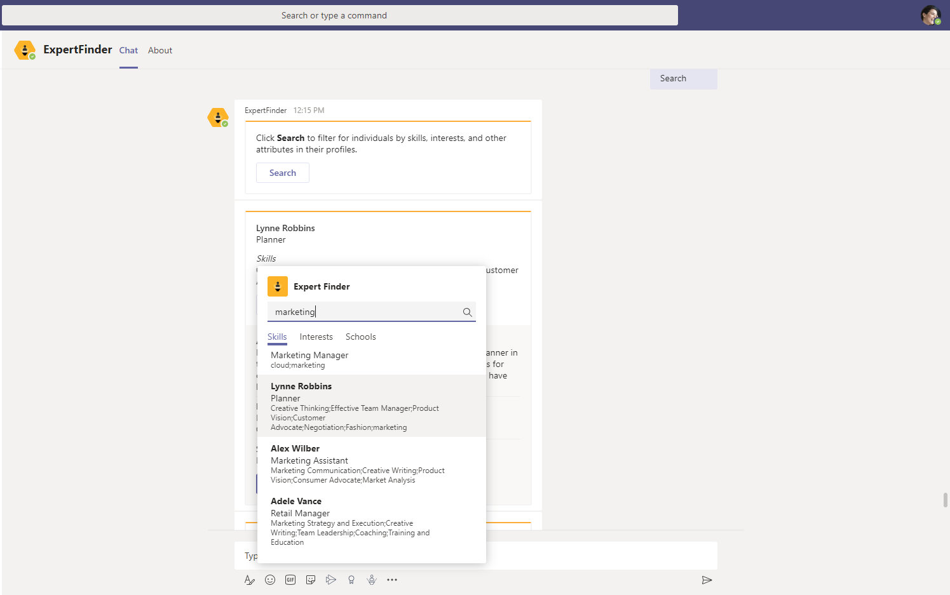
Don’t let WFH become work in isolation
Easily find subject matter experts within your organization to help on projects
Find experts within your company easily at the click of a button to collaborate and get advice on a problem you are trying to solve
Search, find and collaborate with specific organization members based on their skills, interests, and education attributes for projects
Custom extension use cases*:
Quickly spin up war rooms, focus groups with experts and team members to tackle and resolve hi-priority issues
Enable periodic polling of users encouraging them to update their skillsets based on update recency / profile completion
Allow users to chart their skill growth path, upskilling plan. Link to LMS to surface relevant sessions / webinars or workshops
Promote community building by hosting events bringing together experts within a domain
Relevant App Templates
Why Now?
Another challenge of remote working is breaking the information walls – It is not possible to just walk over to a colleague’s desk and discuss a problem or gather the team to brainstorm a solution
Employees require tools now that put them in touch with the right people quickly. Such tools are crucial in avoiding communication delays and keeping the employees focused
Expert Finder
Download
*- Not available as part of existing app template. Development required

Slide 17
Keep the human interactions alive
Enable employees to recognize peers
Promote and incentivize change
Be inclusive and ensure employee wellbeing
Bring people together to create communities

Slide 18

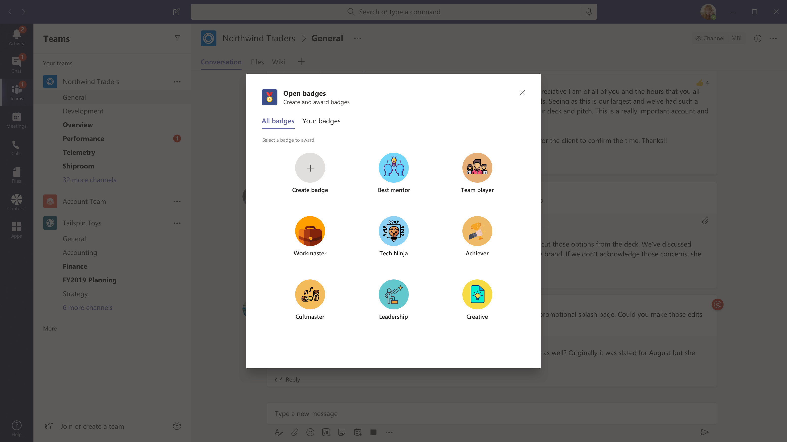
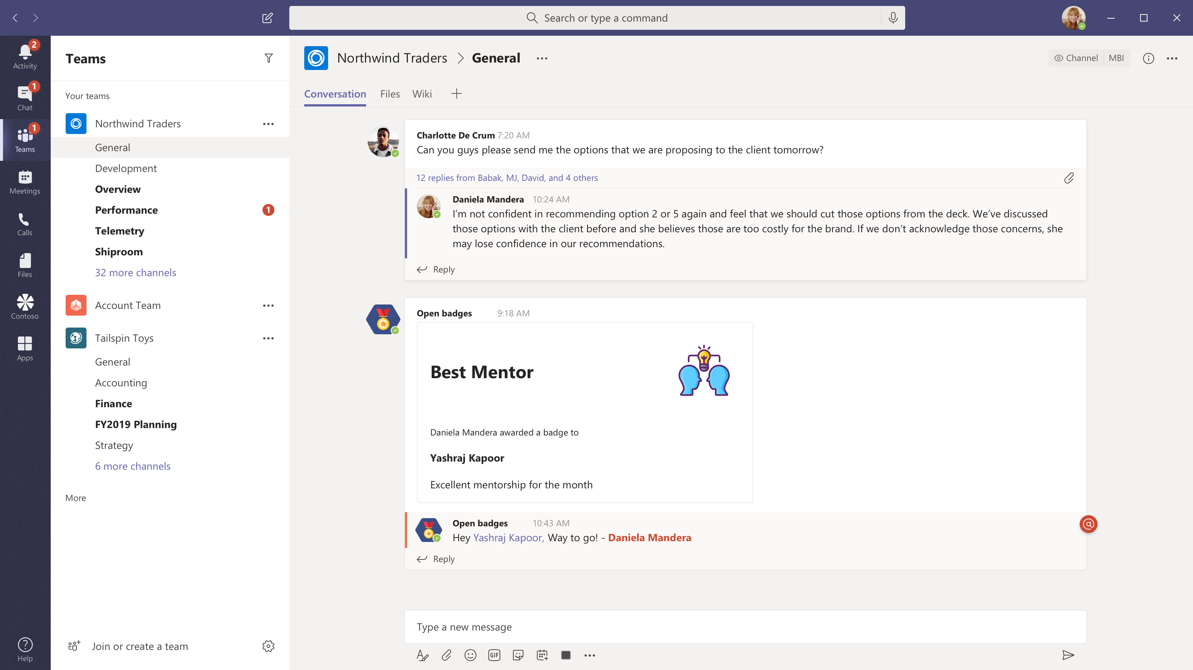
Enable employees to recognize peers
Build a culture of peer recognition & enable employees to appreciate their colleagues publicly
Enable employees to recognize peers and embrace peer relationships
Motivate and spur employee morale through digital badges within Teams
Persistent badges – awarded badges are recorded in recipient’s Badgr profile that can be shared to LinkedIn profiles
Custom extension use cases*:
Integrate the badges, rewards app with incentives app to allow monetary redemption of award badges
Promote friendly competition amidst teams with virtual revolving trophies awarded based on business criteria e.g. Efficient Team badge - most user stories implemented, Quality First badge for least bugs reported etc.
Relevant App Templates
Why Now?
It is imperative to keep the sense of team intact through collaborations outside meetings. Consciously encourage recognizing peers as it might otherwise get lost with lack of F2F interactions
Words of appreciation, recognition common in workplace, hallways can get lost in a remote work setting. It is important to consciously promote the culture to keep up employee morale
Open Badges
Download
*- Not available as part of existing app template. Development required

Slide 19

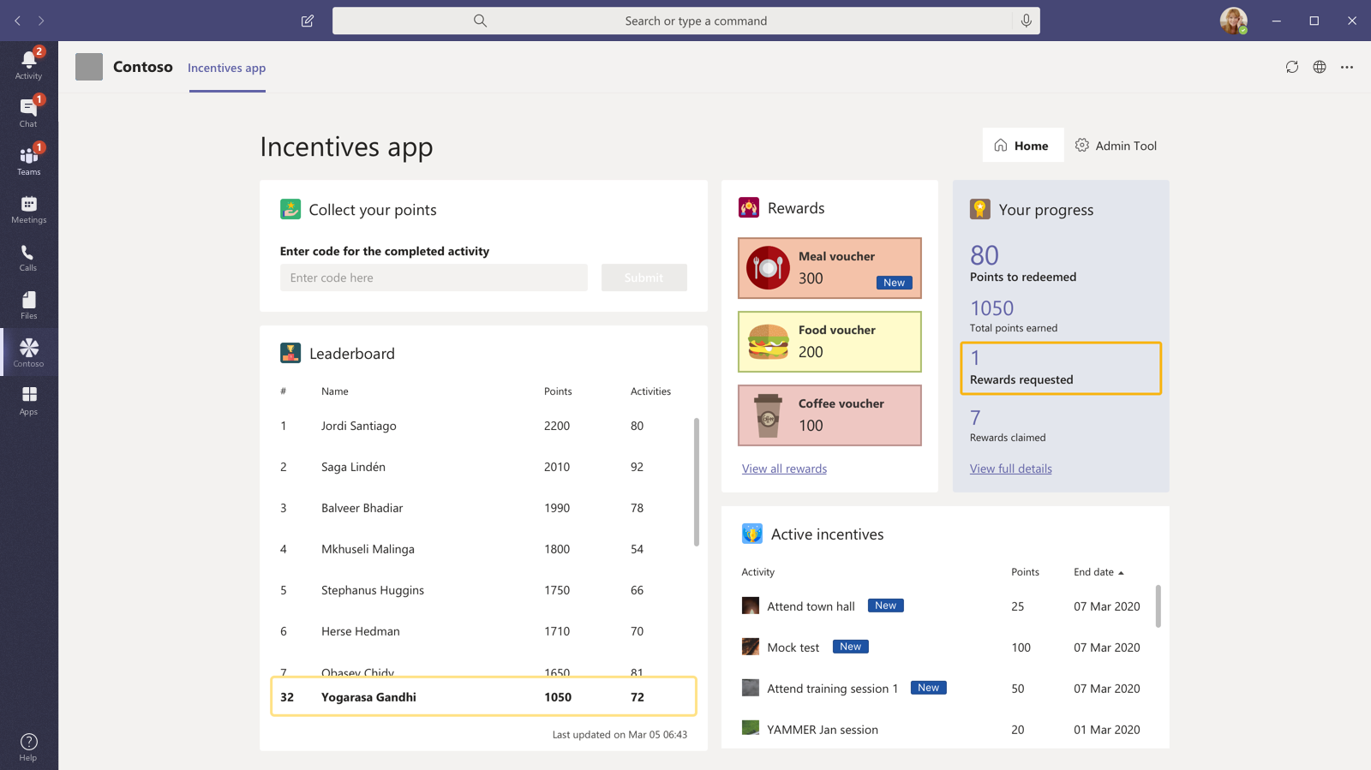
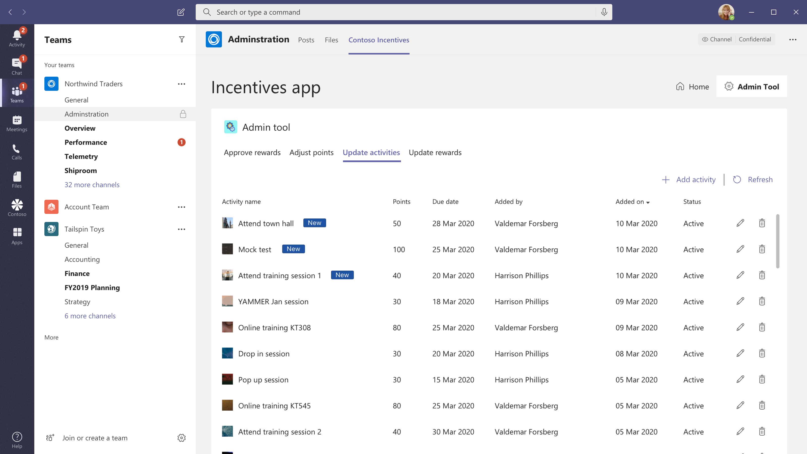
Promote and incentivize change
Incentivize employees to embrace change and try new experiences
Create activities which will award points to users on completion. The app also allows points-based redemption of rewards.
Incentivize employees to embrace the change through tracking participation in change management activities
Custom extension use cases*:
Gamify collaboration activities such as ‘helping team members solve a problem’, ‘contributing to knowledge repository’, ‘running a scrum meeting’ to encourage participation
Develop ‘Quests’ within the organization with increasing incentive points at each level. E.g. A quest lasting a week will have incentives with increasing investment at each level – participating in training session -> unblock a teammate -> deliver a training for 10 people -> Interview 3 candidates for recruiting. Users should be able to discover and signup for quests and earn points for completion
Relevant App Templates
Why Now?
Change isn’t easy and should be incentivized and gamified to get employees overcome inertia as a barrier for adoption.
Gamification can help in adoption of new experiences, allow forming of new work habits and drive engagement
Incentives
Download
*- Not available as part of existing app template. Development required

Slide 20
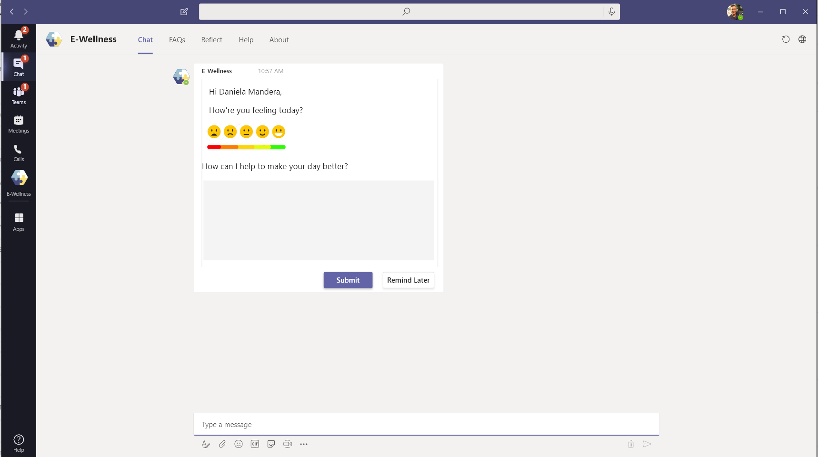
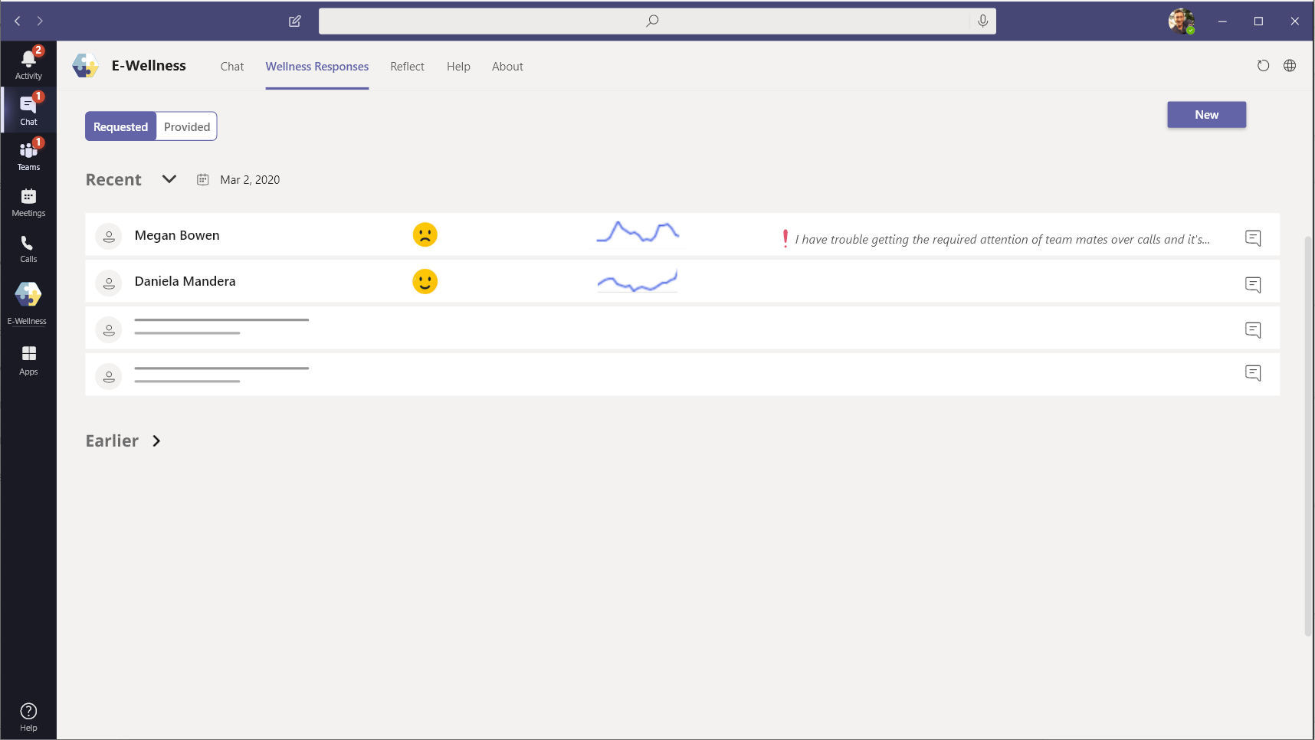
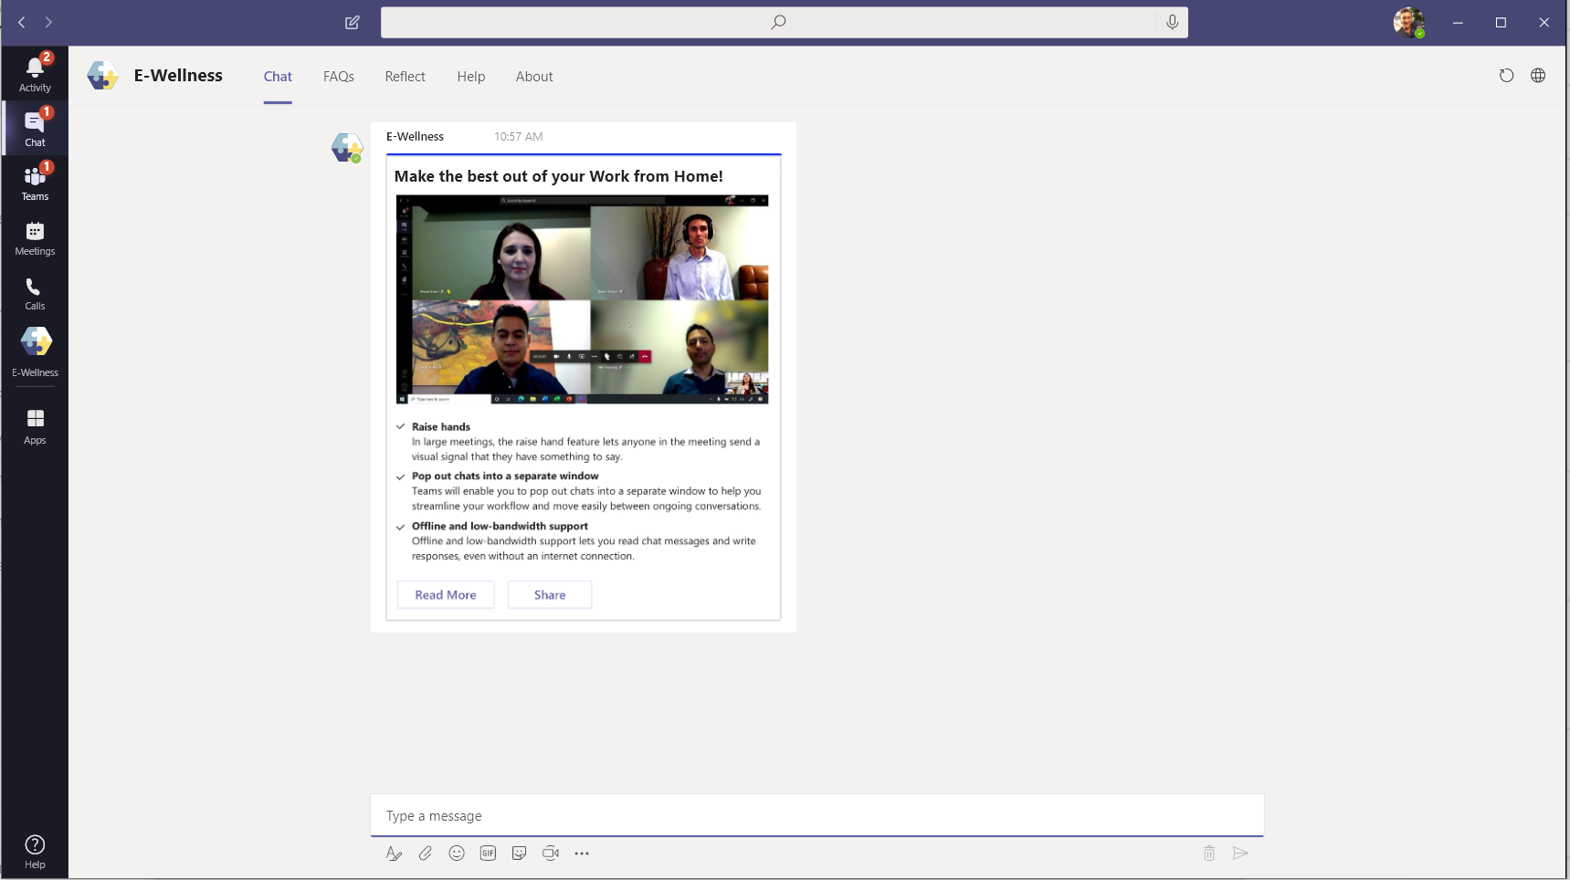
Be Inclusive & ensure employee well-being
Monitor employee morale regularly and proactively reach out to provide support
Proactively reach out to employees on a scheduled recurring basis to understand their difficulties and mood
Analyze responses at team, region level over time to recognize patterns and initiate morale building outreach if required
Share WFH tips and tricks, best practices with the Team to encourage best use of the tools available
Enable Peer to Peer human connect: Enable users to register as volunteers of ‘Talk to a friend’ initiative. Through series of questions, the app could deduce mental wellbeing of employees and pair stressed out employees with volunteers as ‘Talk to a friend’ option
Ready to build this app?
Why Now?
Companies are increasingly investing in tools that enable and monitor employee wellbeing and it becomes important now more than ever to reach out and support employees.
It is important that managers track the team’s emotional wellbeing as well at a time when the team is undergoing a paradigm shift in the way it has been operating so far.
Request Help

Slide 21
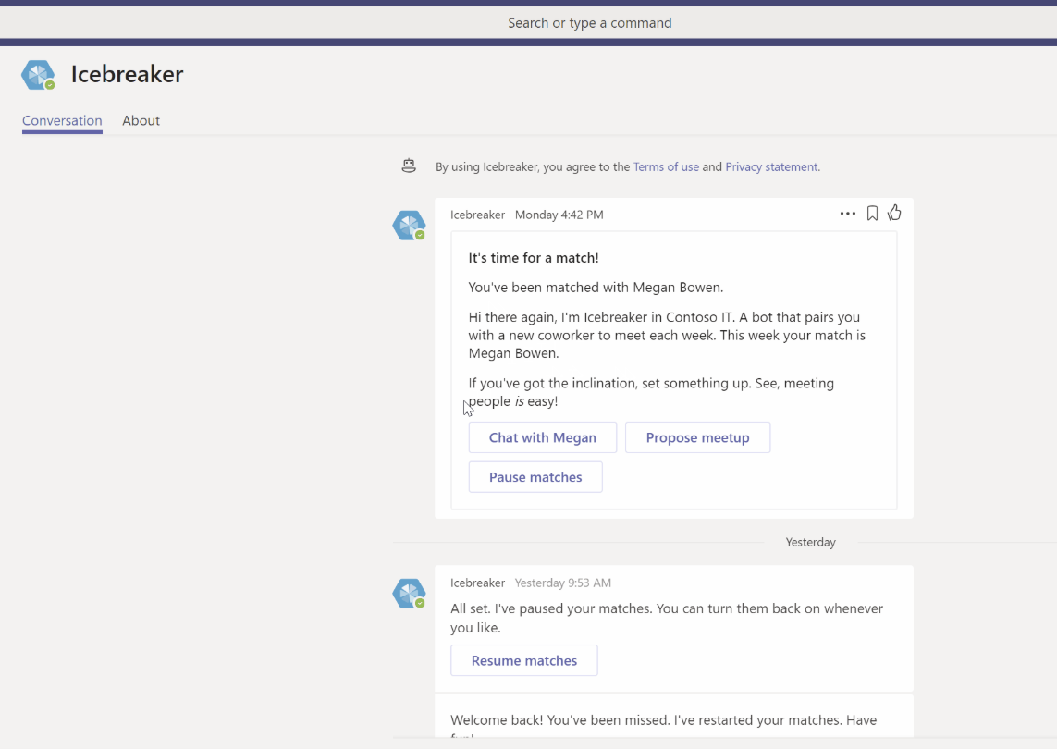
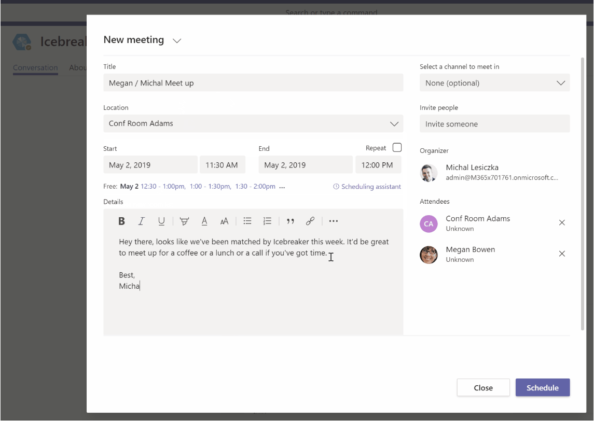
Bring people together to create communities
Encourage employees to get to know their peers and build cohesive communities to grow their professional interests
Help your team get closer by pairing two random team members up every week to meet
Strengthen personal connections and build a tightly knit community with this app
Cultivate interest-based communities within your organization
Custom extension use cases*:
Allow members to add interest areas to enable matching based on common interests. E.g. DevOps devs, Football enthusiasts
Propose common fun activities for the pair to accomplish together to introduce fun element into the process. E.g. selfie with matching T-shirts
Relevant App Templates
Why Now?
Even in physical workplace, employees are often limited in building their network with access to mostly 1st or 2nd level connections. There are fewer opportunities to build organic connections.
Icebreaker breaks these imaginary walls of socialization and is all the more important in a remote working setup where human interactions are confined to immediate team members
Icebreaker
Download
*- Not available as part of existing app template. Development required

Slide 22
Don’t forget to have fun!
Celebrate important events and success with your team

Slide 23
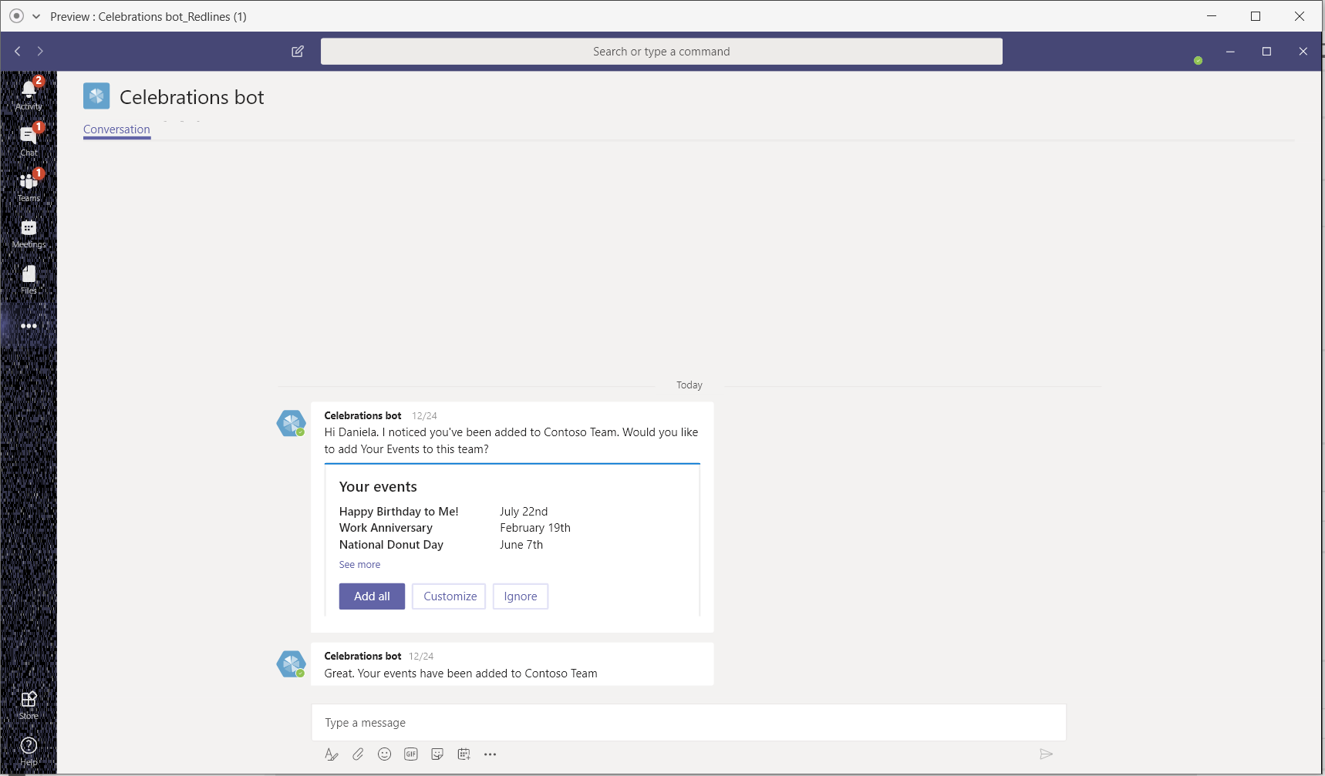
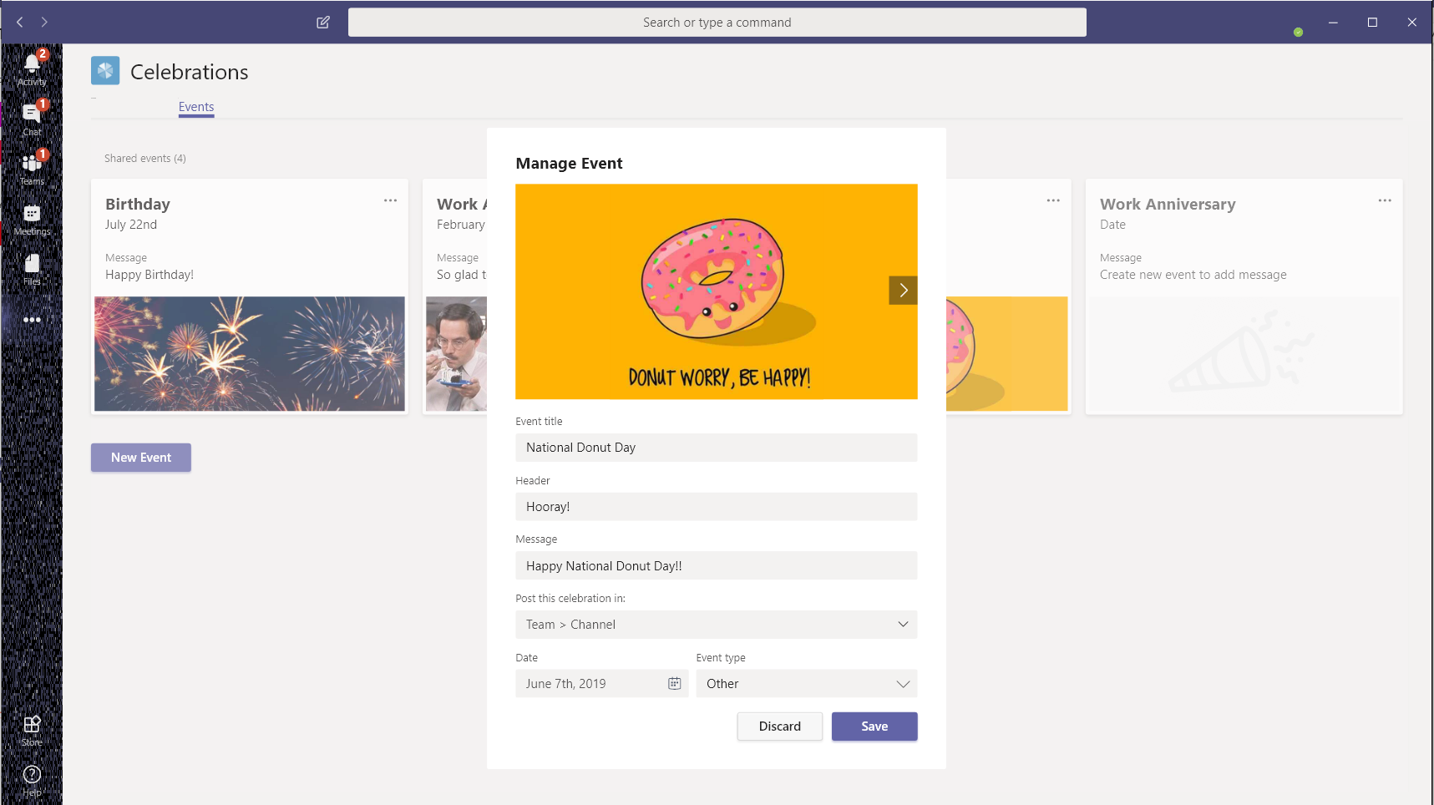
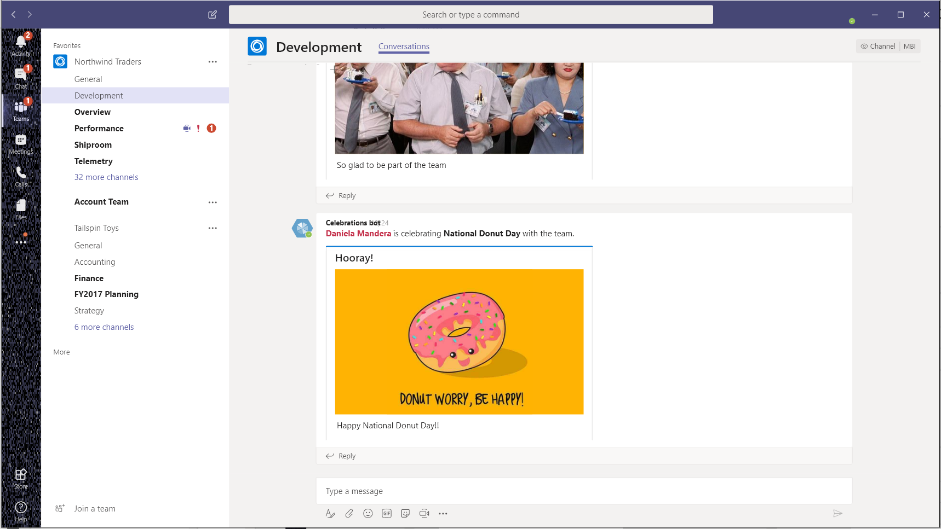
Celebrate important events and success with your team
Celebrate important events and encourage virtual socializing!
Share and celebrate important events, birthdays, anniversaries of team members all within Teams
Keep employee morale up and don’t compromise on fun event celebrations on account of remote work conditions
Custom extension use cases*:
Celebrate team success, achieving milestones and other team goals over online meetings.
  E.g. bot triggers celebration message when a milestone task is marked complete – with option to create meeting based on team members’ availability
Allow creation of group / team goals – e.g. Fitness goals with series of custom activities over a time frame. E.g. 15 minutes meditation on Monday, 20 mins Yoga on Wednesday, 30 minutes group catch-up Fridays. Bot sends reminders with option to create Team video call, encouraging Team to do meditation together.
Completion of all activities with no misses triggers celebratory msg + incentives
Relevant App Templates
Why Now?
Employees work better and support each other when there is a sense of team. Without active measures, remote working reduces team camaraderie.
Routine workplace celebrations should not be stopped due to remote work setup. Maintaining the status quo work routine includes the celebrations that used to happen at workplace too!
Celebrations
Download
*- Not available as part of existing app template. Development required

Slide 24

Start exploring
Resources
Play around with Teams App Studio, Node.js, and c#/.NET
Understand capabilities of the Teams extensible platform
Brainstorm and finalize scenarios for integrations as a Teams app (tab, bot, messaging extensions, personal apps et al)
Thank you!
Get started developing
Teams Developer Documentation
Teams Sample Code on GitHub
Leverage Teams in-house experts
Reach out to Sathya - saraveen@microsoft.com for support on building apps on Teams
Send Microsoft platform feature asks

Slide 25



DEMO

Slide 26
Resources
Monthly Resources: https://aka.ms/O365ChampionResources
Forum: https://aka.ms/DriveAdoption
Covid-19 Resources from Microsoft https://aka.ms/Covid19Info

Slide 27
Microsoft Resource Cheat Sheet
https://aka.ms/M365Roadmap
https://aka.ms/TechCommunity
https://docs.microsoft.com
https://developer.microsoft.com
Microsoft 365 Roadmap
All public feature delivery dates
Filter by product
Microsoft Technical Community
Product forums and blogs
Driving Adoption forum
Diversity & Inclusion forum
IT Pro & Adoption Documentation
Learn how to plan, deliver, adopt and manage Microsoft 365 products
Developer Documentation
Training, documentation, samples & communities for developers
Tools and Resources
https://aka.ms/MicrosoftAdoption
Microsoft Adoption Hub
Adoption resources for O365 services
O365 Champion sign up and Information
M365 Learning Pathways & Service Adoption Specialist course information
Visit Us

Slide 28
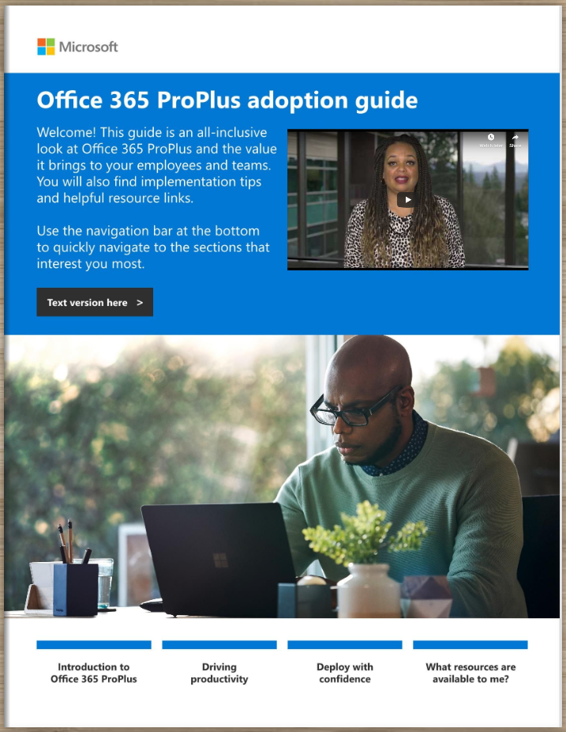
Office 365 ProPlus Adoption Guide
Champion Preview
Available at:
https://aka.ms/OPPToolkit

Slide 29


Training Tools for Microsoft Teams
Get Started with Teams
https://teams.conversationalgeek.com
Managers Guide to Microsoft Teams
https://teamsbook.info

Slide 30
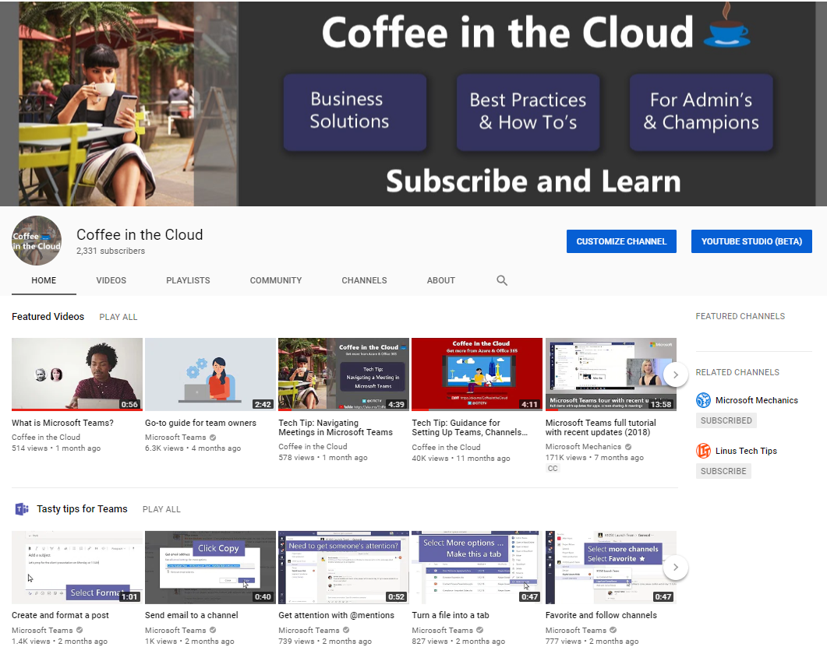
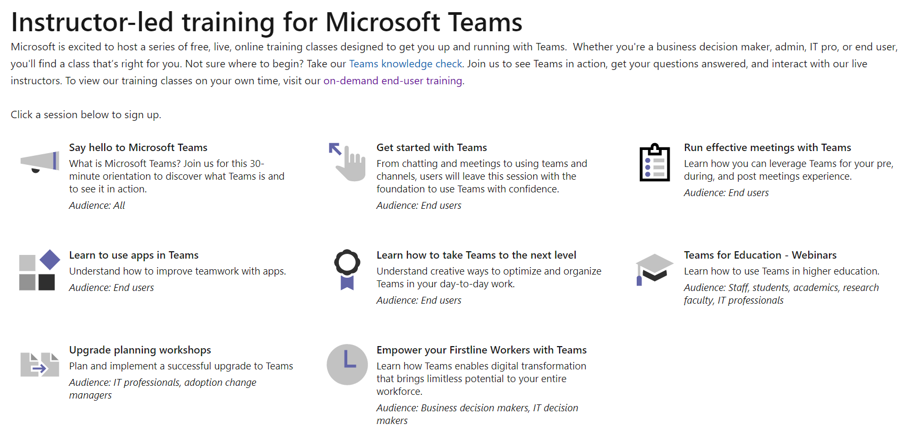
On-Line Training from Microsoft
On-demand & Instructor Led
https://aka.ms/CoffeeintheCloud
https://aka.ms/TeamsLiveTraining

Slide 31
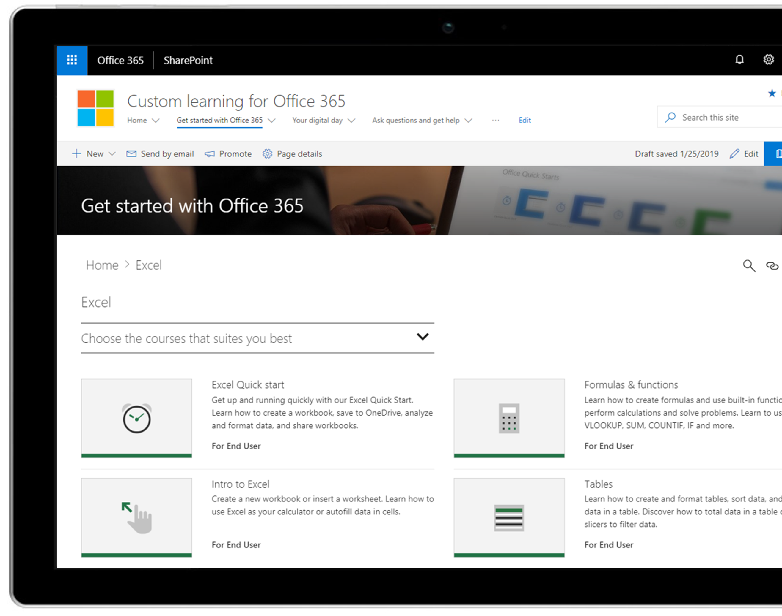
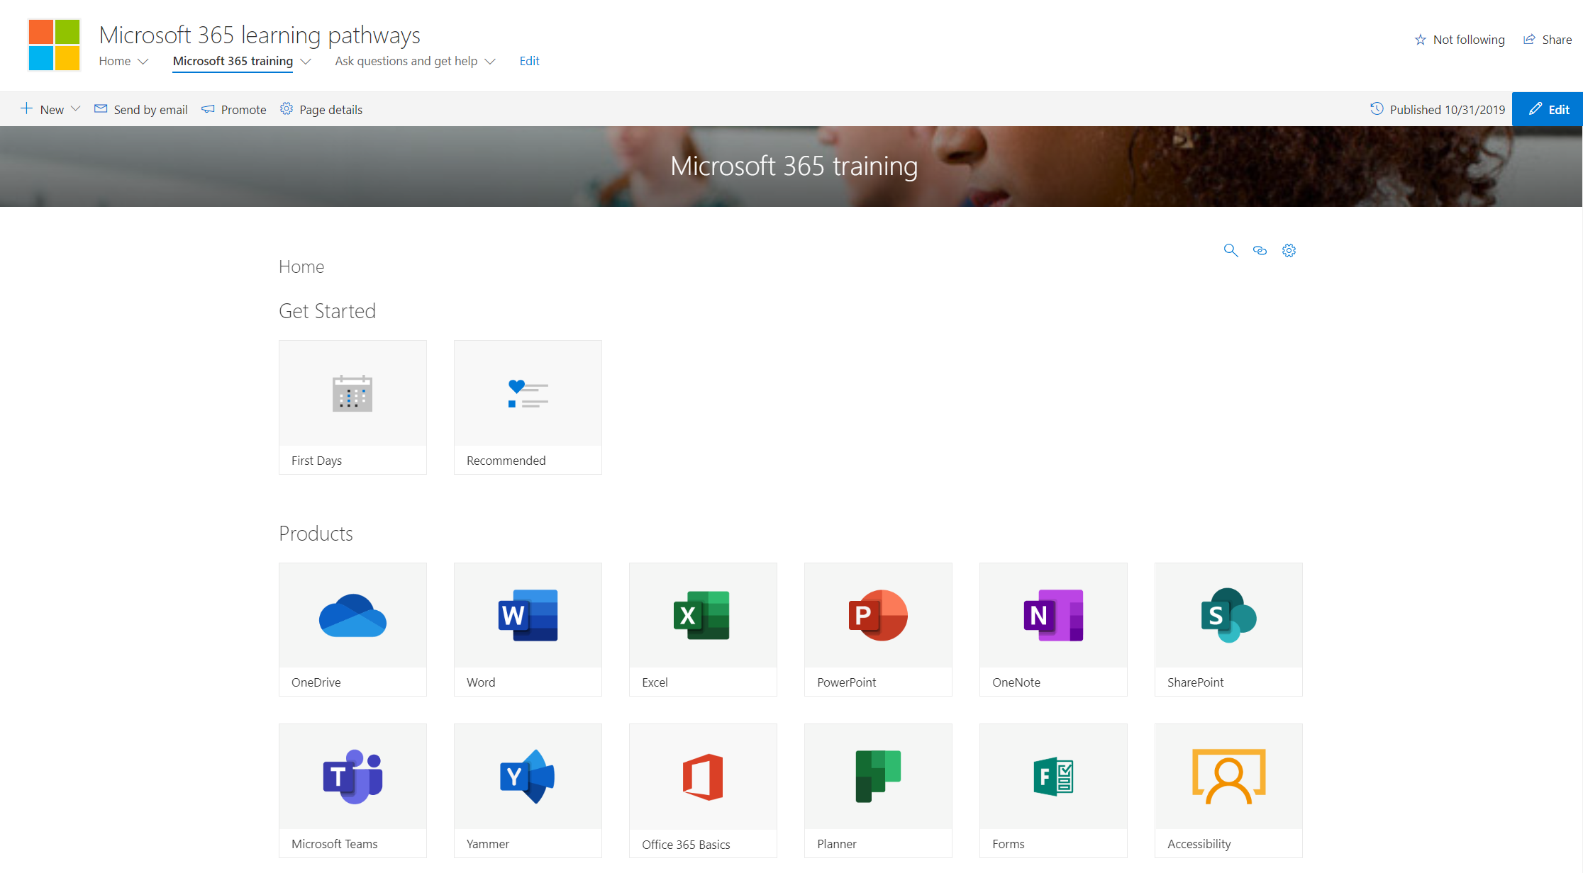
M365 Learning Pathways https://aka.ms/M365LP
Modern SharePoint Online communication site template
Connected to online catalog of Microsoft curated end-user training content
Customizable content – remove or add your own content
Easily installed via SharePoint Provisioning Service
Simple integration into Microsoft Teams
Learn More at https://aka.ms/M365LP

Slide 32
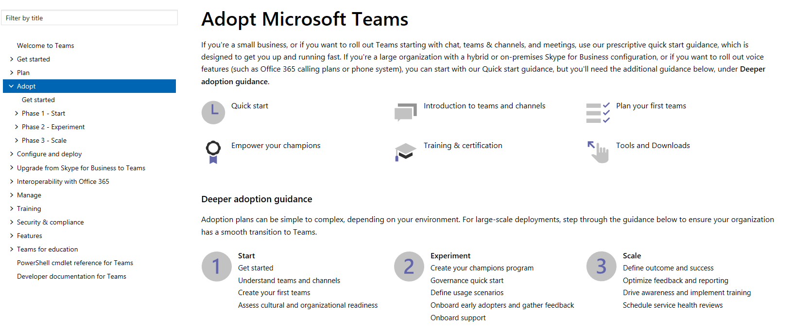
Teams Adoption Hub – https://aka.ms/TeamsAdoption

Slide 33



Coffee in the Cloud
Get more from Office 365
https://aka.ms/CoffeeintheCloud
Subscribe now to Learn About:
Business Solutions
Best Practices & How-To’s
For Admin’s and Champions
@CITCTV

Slide 34

O365 Champion Schedule & Topics
January to June, 2020
22 Jan.
Getting Started with OfficePro Plus
19 Feb.
Modern Project Management using Tasks & Project
25 Mar.
Supporting Remote Workers and Virtual Events
22 Apr.
Smart Content Management with SharePoint Sites & News
13 May
SharePoint Conference Preview
(AM Only)
17 June
What’s Next in Knowledge Management
Every month we’ll share a new Champion Tip for Microsoft Teams
Stay tuned for more on our #BetterTogether webinar series on our blog at https://aka.ms/DriveAdoption

