Slide 1
Office 365 Champion Community
September 2019 Monthly Meeting
Karuana Gatimu
Customer Advocacy Group
Notes:
Join our worldwide program at https://aka.ms/O365Champions
Materials included in this deck are free to use in your daily work.
Please reference our program as the source of this information.
For questions or comments please reach out in the Drive Adoption or Champion’s Corner forums of the Microsoft Technical Community at https://aka.ms/DriveAdoption

Slide 2
Agenda
Inspiration
Information
Tools
Amsterdam Champion Meetup
Content Planning with SPO & PowerBI
Perseverance & Pride
Find prior meeting content at https://aka.ms/O365ChampionResources

Slide 3
Microsoft Resource Cheat Sheet
https://aka.ms/M365Roadmap
https://aka.ms/TechCommunity
https://docs.microsoft.com
https://developer.microsoft.com
Microsoft 365 Roadmap
All public feature delivery dates
Filter by product
Microsoft Technical Community
Product forums and blogs
Driving Adoption forum
O365 Champion’s Corner
IT Pro & Adoption Documentation
Learn how to plan, deliver, adopt and manage Microsoft 365 products
Developer Documentation
Training, documentation, samples & communities for developers
Continue Your Education
https://aka.ms/O365Champions
Office 365 Champions Program
Free monthly calls with Microsoft experts & peers
Early access to adoption resources and tools
Open to all business users, IT Pro’s and developers who want to drive adoption of cloud solutions & services
Sign Up

Slide 4
No substitute for hard work
But have some fun too!

Slide 5
The successful adoption of Microsoft 365 represents a change in behavior. It is more than a set of products—it is a fundamentally different way of working. This change is about people. And we are here to help.
Notes:
M365 has the potential to change the trajectory of an organization in many ways, besides the technology itself:
People fundamentally change the way they work
We enable a modern workplace and the optimization of Office 365
We provide the capability to accelerate the alignment of economic and cultural business drives
We allow organizations to enter a state of dynamic stability*
*“Dynamic stability is like riding a bicycle, where you cannot stand still, but once you are moving it is actually easier. It is not our natural state. But humanity has to learn to exist in this state.¹”
1 Friedman, Thomas L. Thank you for Being Late. New York: Farrar, Straus and Giroux, 2016.
“The need to move to a highly flexible and adaptable digital approach is urgent. The applications required today are not going to last for 30 years. They are maybe only going to be used for maybe two, three years.²”
2 McKendrick, J. (2018. Jan 21) The ultimate technology success metric: owning the customer relationship. Retrieved from http://www.zdnet.com/article/business-transformation-before-technology/

Slide 6
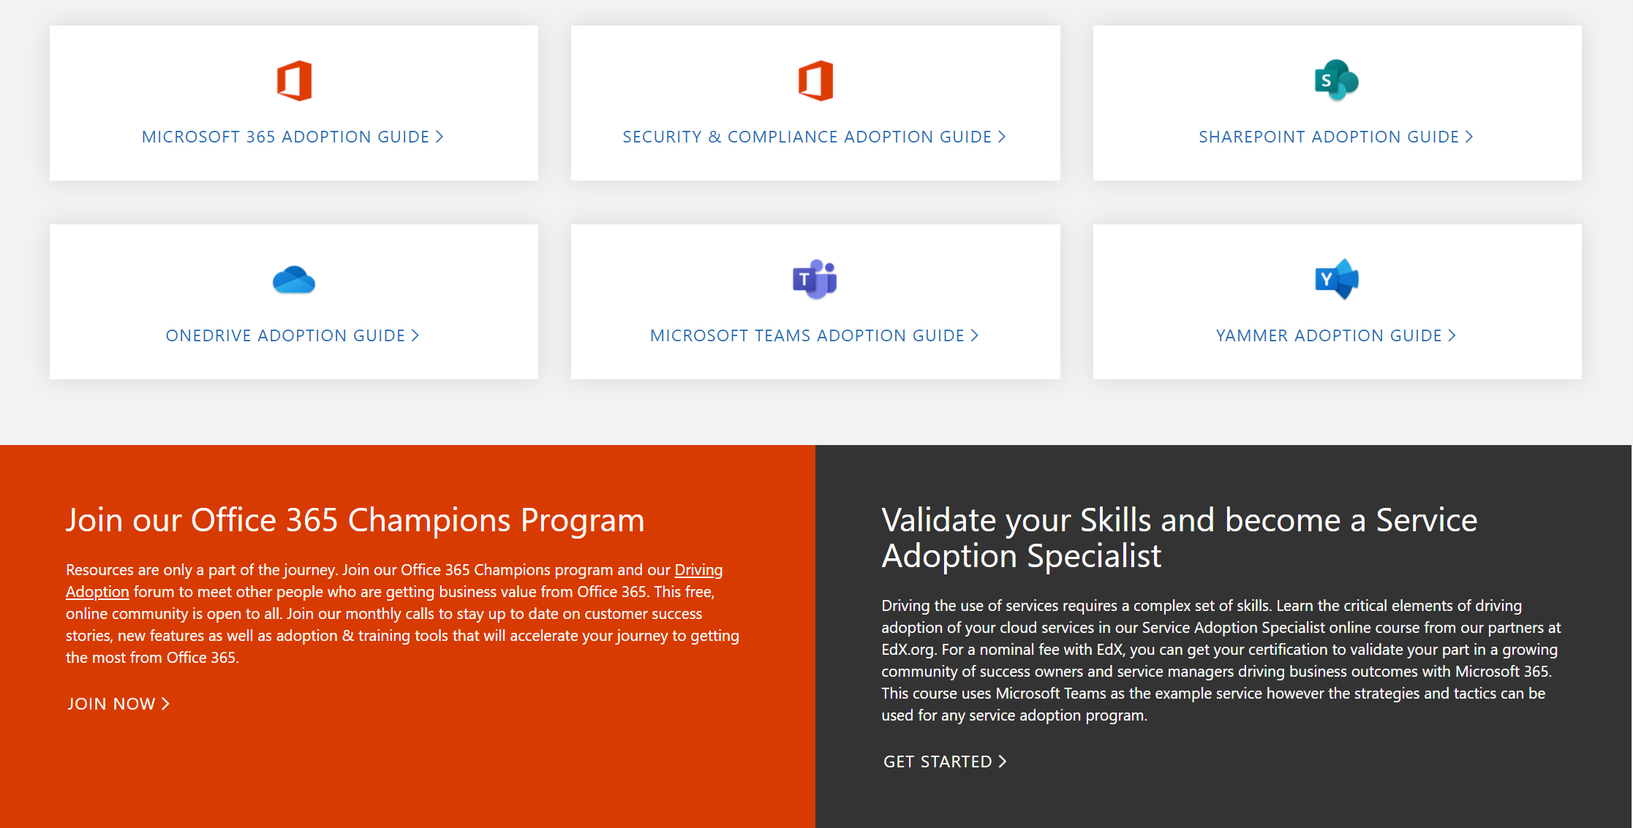
Get Started at https://aka.ms/MicrosoftAdoption
Streamline End User Training with Microsoft 365 Learning Pathways
Notes:
Accelerate your deployment and adoption of Office 365 services by visiting our unified resource page for adoption guidance on the Microsoft Technical community at https://aka.ms/MicrosoftAdoption. Review materials for Microsoft 365, our security and compliance features or key teamwork workloads like SharePoint, OneDrive, Microsoft Teams and Yammer. Find additional resources for Microsoft Teams in Government and devices for Teams within the Microsoft Teams adoption guide.
This is a step forward in our response to your feedback to make adoption materials easier to discover and use. Over the coming months we will continue to unify and standardize these materials across all our Microsoft 365 services. Share more feedback in our Driving Adoption community at https://aka.ms/DriveAdoption.

Slide 7
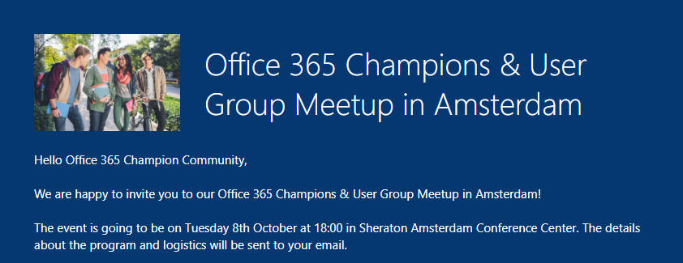
Upcoming Events
Champion Meetup
October 8th @ 6pm Sheraton Amsterdam Conference Center
Register @ https://aka.ms/O365MeetupAMS

Slide 8
Content Management with SharePoint & PowerBI Demo

Slide 9
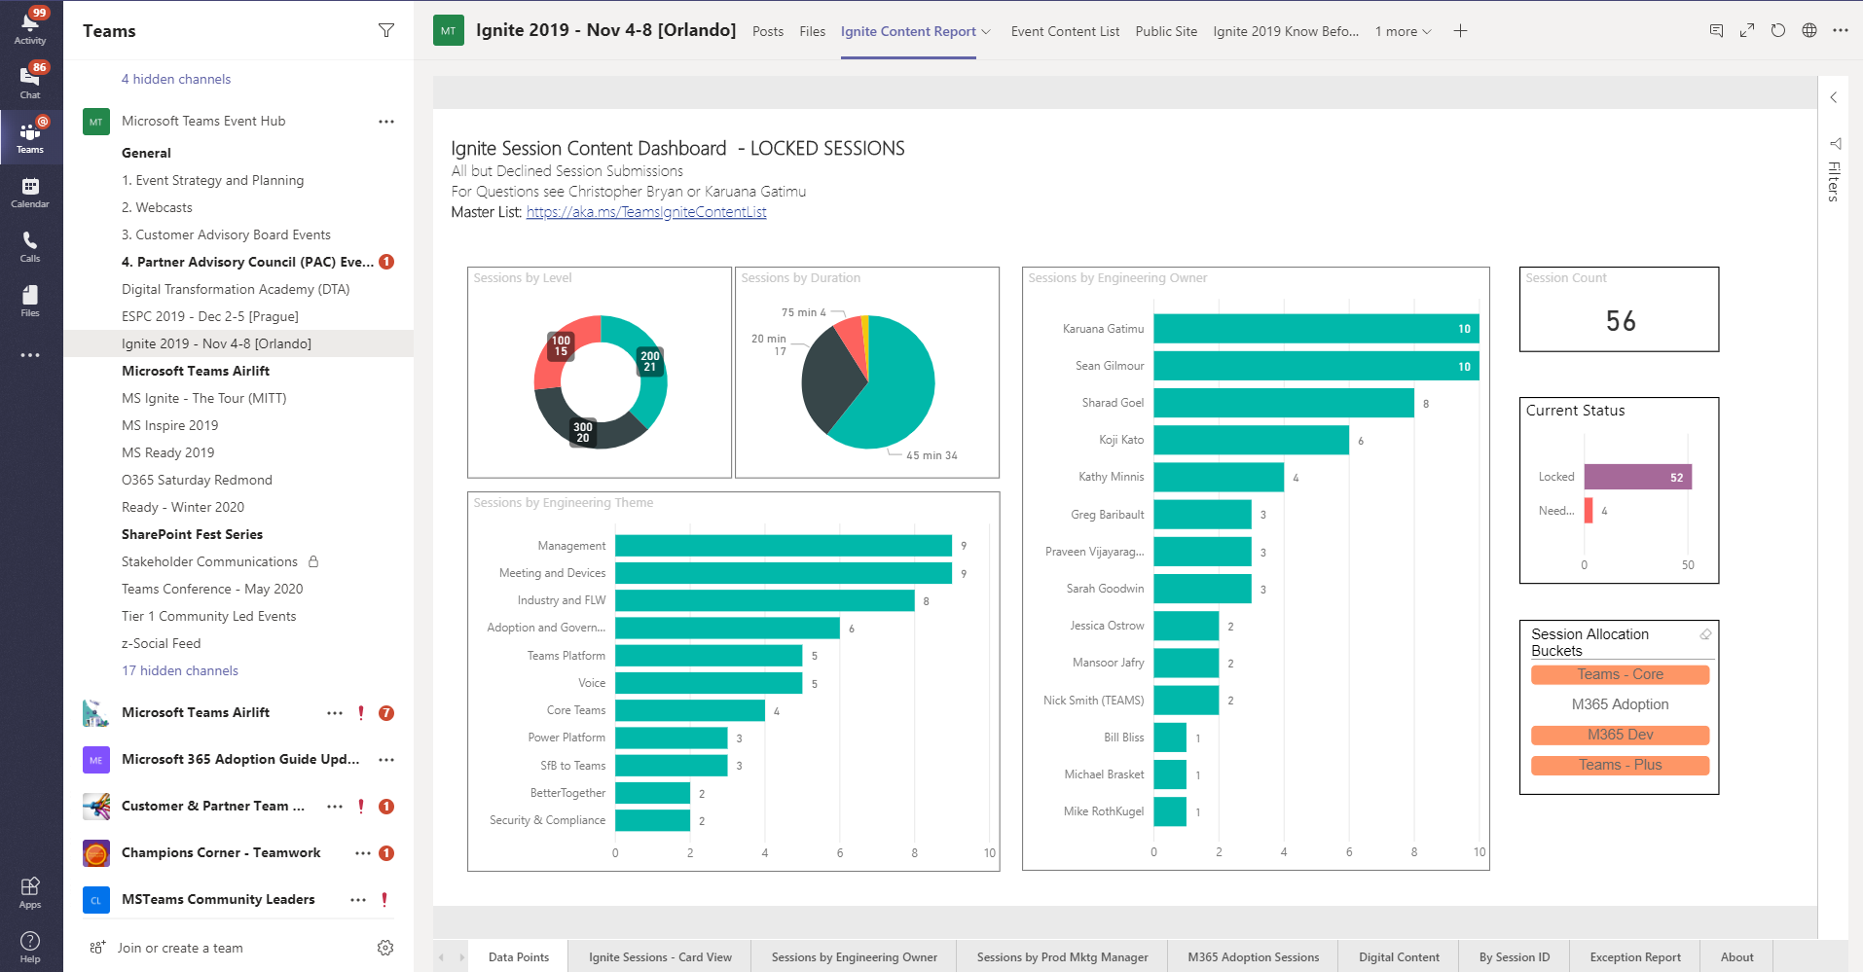
Teams, PowerBI & SharePoint = #BetterTogether

Slide 10
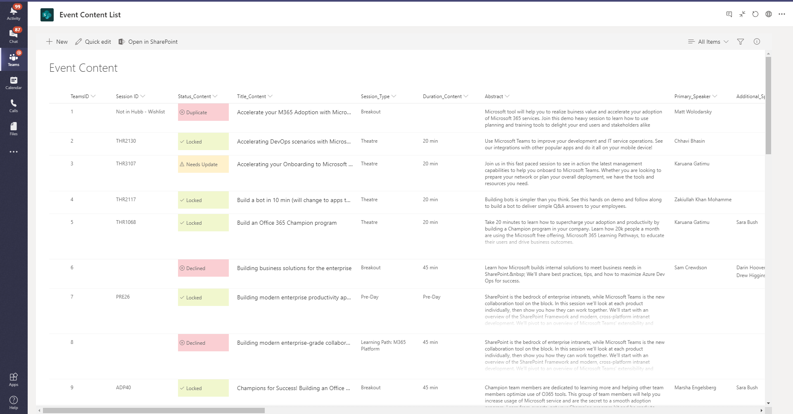
Source data = SharePoint List

Slide 11
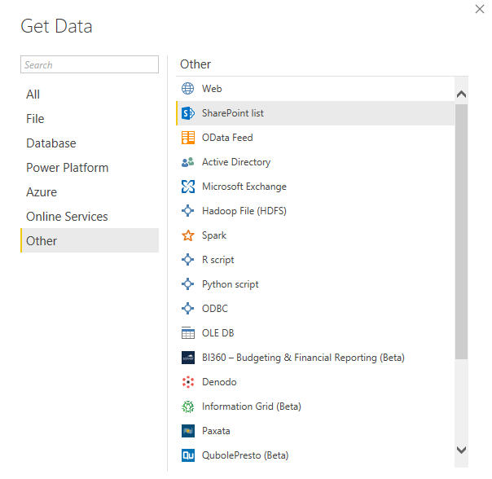
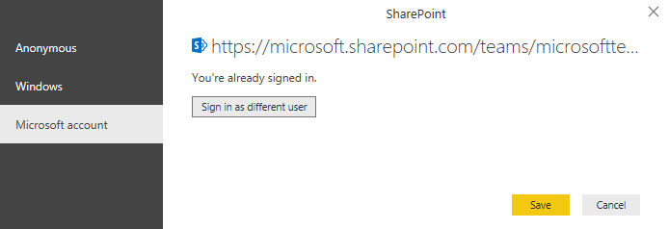
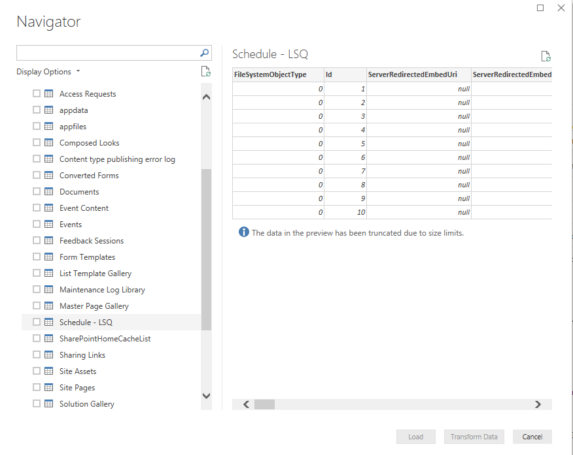

Slide 12
Resources

Slide 13
Coffee in the Cloud
Get more from Office 365
https://aka.ms/CoffeeintheCloud
Subscribe now to Learn About:
Business Solutions
Best Practices & How-To’s
For Admin’s and Champions
@CITCTV

Slide 14
Microsoft Teams Resource Cheat Sheet
https://aka.ms/M365Roadmap
https://aka.ms/TeamsCommunity
https://aka.ms/SuccessWithTeams
https://aka.ms/CoffeeintheCloud
Microsoft 365 Roadmap
All public feature delivery dates
Filter by product
Microsoft Technical Community
Product forums and blogs
Driving Adoption forum
O365 Champion’s Corner
Success with Teams Practical Guidance
Learn how to plan, deliver, adopt and manage Microsoft Teams
Skype for Business to Teams transition guidance
Coffee in the Cloud on YouTube
Short how-to videos for IT Pro’s and Champions
Long form end user & administrator training
Continue Your Education
https://aka.ms/O365Champions
Office 365 Champions Program
Free monthly calls with Microsoft experts & peers
Early access to adoption resources and tools
Open to all business users, IT Pro’s and developers who want to drive adoption of cloud solutions & services
Sign Up

Slide 15
Start building solutions
Get Started
Teams Documentation: aka.ms/TeamsDev External integrations: aka.ms/TeamsIntegrations Platform training videos: aka.ms/TeamsPlatformAcademy
Developer Support: aka.ms/TeamsDevSupport
Join the community
Teams Dev Center: aka.ms/Teams.Dev Tech Community (QnA): aka.ms/TeamsCommunity Teams dev blog: aka.ms/TeamsDevBlog
Notes:
We are happy to share these core links with you, but here are the three next steps
that are most important for you to get started and build your own integration for Microsoft Teams.

