Slide 1
Office 365 Champion Community
October 2019 Monthly Meeting
Karuana Gatimu
Customer Advocacy Group
Notes:
Join our worldwide program at https://aka.ms/O365Champions
Materials included in this deck are free to use in your daily work.
Please reference our program as the source of this information.
For questions or comments please reach out in the Drive Adoption or Champion’s Corner forums of the Microsoft Technical Community at https://aka.ms/DriveAdoption

Slide 2
Agenda
Inspiration
Information
Tools
Ignite Champion Meetup & Survey Results
Resolving Adoption Blockers
#BetterTogether
Find prior meeting content at https://aka.ms/O365ChampionResources

Slide 3
Microsoft Resource Cheat Sheet
https://aka.ms/M365Roadmap
https://aka.ms/TechCommunity
https://docs.microsoft.com
https://developer.microsoft.com
Microsoft 365 Roadmap
All public feature delivery dates
Filter by product
Microsoft Technical Community
Product forums and blogs
Driving Adoption forum
O365 Champion’s Corner
IT Pro & Adoption Documentation
Learn how to plan, deliver, adopt and manage Microsoft 365 products
Developer Documentation
Training, documentation, samples & communities for developers
Continue Your Education
https://aka.ms/O365Champions
Office 365 Champions Program
Free monthly calls with Microsoft experts & peers
Early access to adoption resources and tools
Open to all business users, IT Pro’s and developers who want to drive adoption of cloud solutions & services
Sign Up

Slide 4
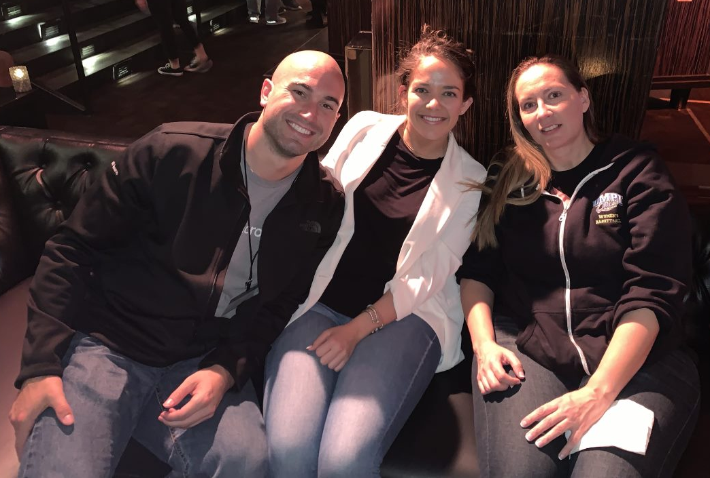
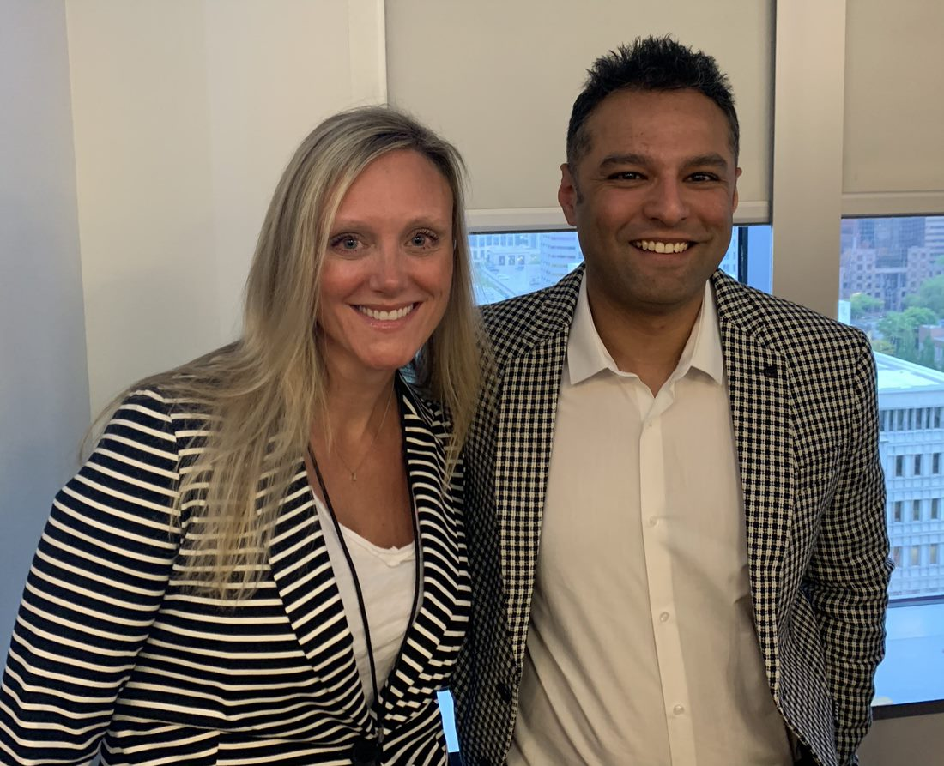
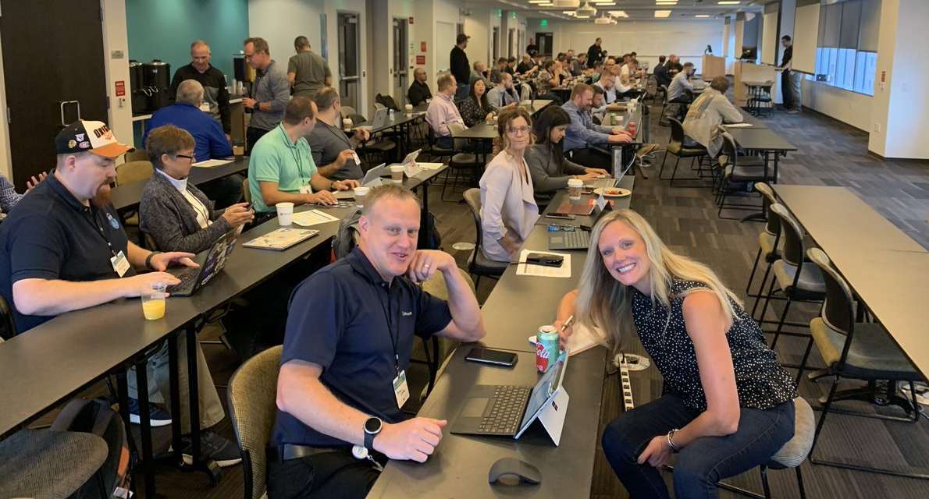
#BetterTogether
Not just about our software!

Slide 5
The successful adoption of Microsoft 365 represents a change in behavior. It is more than a set of products—it is a fundamentally different way of working. This change is about people. And we are here to help.
Notes:
M365 has the potential to change the trajectory of an organization in many ways, besides the technology itself:
People fundamentally change the way they work
We enable a modern workplace and the optimization of Office 365
We provide the capability to accelerate the alignment of economic and cultural business drives
We allow organizations to enter a state of dynamic stability*
*“Dynamic stability is like riding a bicycle, where you cannot stand still, but once you are moving it is actually easier. It is not our natural state. But humanity has to learn to exist in this state.¹”
1 Friedman, Thomas L. Thank you for Being Late. New York: Farrar, Straus and Giroux, 2016.
“The need to move to a highly flexible and adaptable digital approach is urgent. The applications required today are not going to last for 30 years. They are maybe only going to be used for maybe two, three years.²”
2 McKendrick, J. (2018. Jan 21) The ultimate technology success metric: owning the customer relationship. Retrieved from http://www.zdnet.com/article/business-transformation-before-technology/

Slide 6
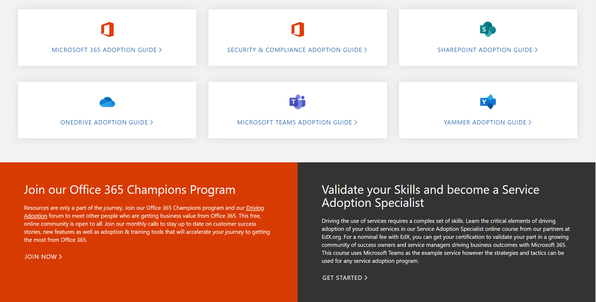
Get Started at https://aka.ms/MicrosoftAdoption
Streamline End User Training with Microsoft 365 Learning Pathways
Notes:
Accelerate your deployment and adoption of Office 365 services by visiting our unified resource page for adoption guidance on the Microsoft Technical community at https://aka.ms/MicrosoftAdoption. Review materials for Microsoft 365, our security and compliance features or key teamwork workloads like SharePoint, OneDrive, Microsoft Teams and Yammer. Find additional resources for Microsoft Teams in Government and devices for Teams within the Microsoft Teams adoption guide.
This is a step forward in our response to your feedback to make adoption materials easier to discover and use. Over the coming months we will continue to unify and standardize these materials across all our Microsoft 365 services. Share more feedback in our Driving Adoption community at https://aka.ms/DriveAdoption.

Slide 7
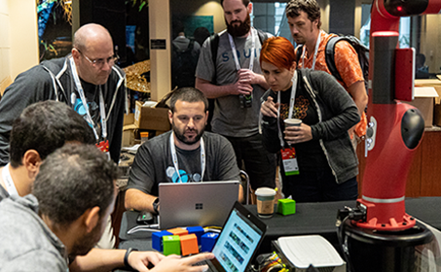
Upcoming Events
O365 Champion Meetup @ Ignite
November 6th @ 1pm Teams Booth @ Community Hall
Register @ https://aka.ms/O365MeetupAMS

Slide 8
Current Survey Results
75% of respondents likely or very likely to recommend the program
Top Requested Topics
Running a Champions Program
Hub for Teamwork
Chat, Calling & Meetings
Adoption Methods
File collaboration in O365
Low Code/No-Code solutions
Intelligent Intranet
Video & Live Events
Security & Compliance
Finding Content
Areas to Improve
Advance notice of topics
Better calendar invites
Better reminders on call dates/times
More details on how-to
More in depth sessions
Preferred Call Times:
(Pacific Time)
7am
8am
9am
12 noon
84% of respondents likely or very likely to attend an in person Champions meetup
It’s not too late! Make your voice heard!
Complete our survey at https://aka.ms/O365ChampionSurvey

Slide 9
Resolving common adoption blockers Tactics and Resources

Slide 10
Sarah - Field Sales
Issue: Poor internet connectivity; time wasted looking for documents
Fix: OneDrive & SharePoint sync capabilities allow for document access when offline. Changes sync when connectivity is restored.
Tom – Exec. Assistant
Issue: Multiple calendars to manage; difficulty finding the right data
Fix: Office 365 group calendars used for events & resources. PowerBI integration with Teams for data in context of projects and decisions.
Bob – VP, Operations
Issue: Timely awareness of customer issues for mitigation
Fix: Automated alerts from bot direct from online systems to Teams chat feed. Virtual bridge in Teams for incident management & post mortem
Wendy - CFO
Issue: Difficulty communicating with all or some employees
Fix: Live Events for broad communication. Stream for video on demand after the event. Yammer for ongoing social engagement.
Notes:
You can’t prioritize the work you do unless you discuss pain points with people around you. Visit the coffee station, lunch room or have short meetings with key employees to find out what their pain points are. This will allow you to solve important issues for people which may or may not involve new technology.

Slide 11
Resolving Common Adoption Blockers
Goal: Create a healthy adoption plan that gains momentum via fast key wins
Issue | Resolution | Supporting Tools
Governance & Security Concerns | Assemble key decision makers Step through phased governance approach Unblock workgroup collaboration | https://aka.ms/TeamworkGovernance https://aka.ms/Adoption/SandC
Lack of service strategy or desire to onboard | Complete Teamwork Assess Recruit early adopters and proof of concept project with measurable business value Gather “watercooler wisdom” – Talk to users | Teamwork Assessment workshop M365 Adoption Guide
No exec sponsor | Find one!
Little or no business engagement | Complete Teamwork Assessment Invest in onsite customer event Leverage Microsoft field events | Teamwork Assessment workshop Customer Success Kit
Lack of technical acumen | Utilize MSFT on-demand resources Conduct hand-on onboarding workshop | https://aka.ms/TeamsAcademy https://aka.ms/TeamsPlatformAcademy
Lack of business success measures | Conduct service satisfaction survey Define measures as part of project planning | M365 Adoption Guide Workbook Success Measures Module in SAS Exam
Lack of end user support | Create O365 Champions Program Onboard to MSFT WW Champions Program Use M365 Learning Pathways for on demand training | M365 Adoption Guide https://aka.ms/O365Champions https://aka.ms/M365LPDocs

Slide 12
Customer Accelerator & Readiness Roadmap
Tool | Next Release | Target Date
Microsoft Adoption Hub | Searchable assets Assets by phase Customer stories & use cases | Dec 2019
M365 Learning Pathways | Multi lingual roadmap Teams, SharePoint & Mobile content update EAP for Partner CDN Open Source webpart release | Nov 2019 Q1 / CY20
Service Adoption Specialist | Intermediate modules Success measure & use case updates | Q1 / CY20
Public Asset Library | Training & presentations assets | Q1/ CY20
Day in the Life Assets | Multi lingual release Whitelable for Partner branding Add’l Office scenarios | Dec 2019
Technical Training Updates | Teams ITPro Academy Teams Platform Academy Coffee in the Cloud Champion Channel | Quarterly Release Schedule
Get Started app w/M365LP | Open source template (Teams GitHub) | Oct 2019
Microsoft Teams Github | Templates, tools and industry scenarios | Oct 2019
Adoption Coherence | P1 Assets for #BetterTogether scenarios Search & Governance Assets Workload onboarding | Dec 2019 Q1 / CY20 Q2 / CY20

Slide 13
Resources

Slide 14
Coffee in the Cloud
Get more from Office 365
https://aka.ms/CoffeeintheCloud
Subscribe now to Learn About:
Business Solutions
Best Practices & How-To’s
For Admin’s and Champions
@CITCTV

Slide 15
Microsoft Teams Resource Cheat Sheet
https://aka.ms/M365Roadmap
https://aka.ms/TeamsCommunity
https://aka.ms/SuccessWithTeams
https://aka.ms/CoffeeintheCloud
Microsoft 365 Roadmap
All public feature delivery dates
Filter by product
Microsoft Technical Community
Product forums and blogs
Driving Adoption forum
O365 Champion’s Corner
Success with Teams Practical Guidance
Learn how to plan, deliver, adopt and manage Microsoft Teams
Skype for Business to Teams transition guidance
Coffee in the Cloud on YouTube
Short how-to videos for IT Pro’s and Champions
Long form end user & administrator training
Continue Your Education
https://aka.ms/O365Champions
Office 365 Champions Program
Free monthly calls with Microsoft experts & peers
Early access to adoption resources and tools
Open to all business users, IT Pro’s and developers who want to drive adoption of cloud solutions & services
Sign Up

Slide 16
Start building solutions
Get Started
Teams Documentation: aka.ms/TeamsDev External integrations: aka.ms/TeamsIntegrations Platform training videos: aka.ms/TeamsPlatformAcademy
Developer Support: aka.ms/TeamsDevSupport
Join the community
Teams Dev Center: aka.ms/Teams.Dev Tech Community (QnA): aka.ms/TeamsCommunity Teams dev blog: aka.ms/TeamsDevBlog
Notes:
We are happy to share these core links with you, but here are the three next steps
that are most important for you to get started and build your own integration for Microsoft Teams.

