Slide 1
Office 365 Champion Community
November 2019 Monthly Meeting
Karuana Gatimu
Customer Advocacy Group
Notes:
Join our worldwide program at https://aka.ms/O365Champions
Materials included in this deck are free to use in your daily work.
Please reference our program as the source of this information.
For questions or comments please reach out in the Drive Adoption or Champion’s Corner forums of the Microsoft Technical Community at https://aka.ms/DriveAdoption

Slide 2
The successful adoption of Microsoft 365 represents a change in behavior. It is more than a set of products—it is a fundamentally different way of working. This change is about people. And we are here to help.
Notes:
M365 has the potential to change the trajectory of an organization in many ways, besides the technology itself:
People fundamentally change the way they work
We enable a modern workplace and the optimization of Office 365
We provide the capability to accelerate the alignment of economic and cultural business drives
We allow organizations to enter a state of dynamic stability*
*“Dynamic stability is like riding a bicycle, where you cannot stand still, but once you are moving it is actually easier. It is not our natural state. But humanity has to learn to exist in this state.¹”
1 Friedman, Thomas L. Thank you for Being Late. New York: Farrar, Straus and Giroux, 2016.
“The need to move to a highly flexible and adaptable digital approach is urgent. The applications required today are not going to last for 30 years. They are maybe only going to be used for maybe two, three years.²”
2 McKendrick, J. (2018. Jan 21) The ultimate technology success metric: owning the customer relationship. Retrieved from http://www.zdnet.com/article/business-transformation-before-technology/

Slide 3
Agenda
Inspiration
Information
Tools
Champion Mixer
Productivity Score Overview
How to setup and run a Champion Program
#MSIgnite
Find prior meeting content at https://aka.ms/O365ChampionResources

Slide 4
Microsoft Resource Cheat Sheet
https://aka.ms/M365Roadmap
https://aka.ms/TechCommunity
https://docs.microsoft.com
https://developer.microsoft.com
Microsoft 365 Roadmap
All public feature delivery dates
Filter by product
Microsoft Technical Community
Product forums and blogs
Driving Adoption forum
Diversity & Inclusion forum
IT Pro & Adoption Documentation
Learn how to plan, deliver, adopt and manage Microsoft 365 products
Developer Documentation
Training, documentation, samples & communities for developers
Tools and Resources
https://aka.ms/MicrosoftAdoption
Microsoft Adoption Hub
Adoption resources for O365 services
O365 Champion sign up and Information
M365 Learning Pathways & Service Adoption Specialist course information
Visit Us

Slide 5
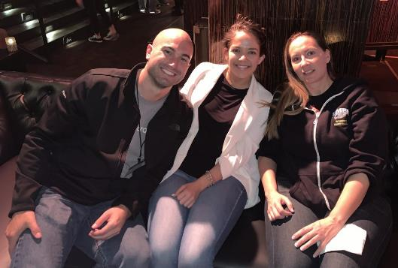
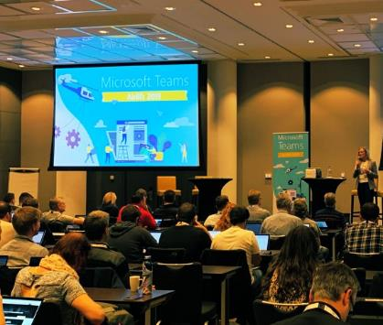
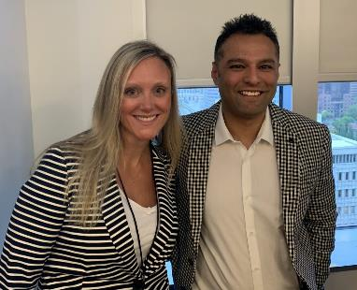
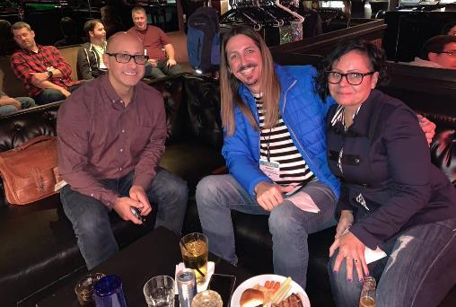
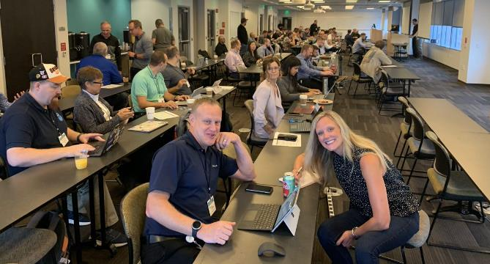
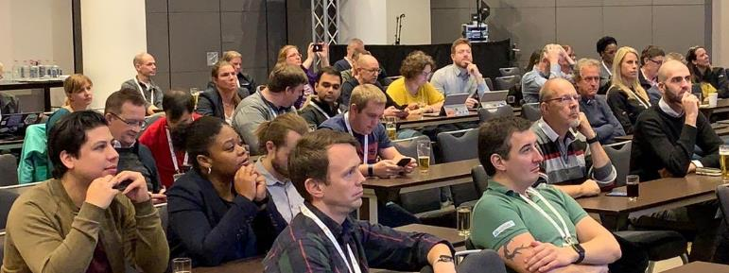
#MSSIgnite
Enthusiasm & Learning in Orlando

Slide 6
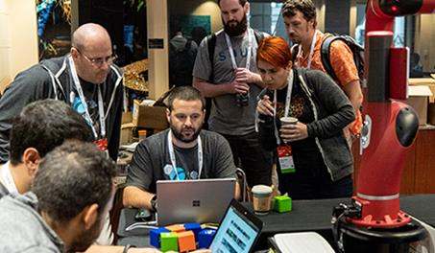
Events
O365 Champion Meetup @ ESPC
December 5th @ 6pm
Register @ https://aka.ms/O365ChampionMixer
It’s not too late! Make your voice heard!
Complete our survey at https://aka.ms/O365ChampionSurvey

Slide 7
Building a Champions Program Sara Bush

Slide 8
What can Champions do? Move mountains…
# of Teamwork Champions
% of Adoption Active Usage
Moth over Month
Month-over-month in buildings with Champions
100
74.9%
400
April
May
June
July
August
September
October
November
93.6%
450
94.9%
541
96.1%
640
98.4%
750
98.5%
906
98.8%
997
99.2%

Slide 9
The Art of Teamwork made the path clear…scale fast!
The Art of Teamwork training
Results
1-Hour webinars
L100, L200, and Persona-based courses
Multiple times weekly
Three time zones
For every 1 person trained, 6 others had increased usage
Example: Metrics for Art of Teamwork training across 6 months
No AoT | AoT | Others in AoT Org | No AoT | AoT | Others in AoT Org
89.8% | 96.9% | 93.3% | 99% | 100% | 100% | Adoption
39.7% | 37.1% | 33.3% | 93% | 97% | 96% | Chat
11.2% | 14.6% | 13.4% | 91% | 95% | 94% | Meetings
0.5% | -2% | -0.4% | -3% | -4% | -4% | Email
Art of Teamwork Get productive Level 100: Beginner
Learn how inner and outer loop conversations can help you decide which tool to use when
Art of Teamwork Design your toolkit Level 200: Intermediate
Learn how to help your workgroup decide what tool to use when
Art of Teamwork Exploring Personas—Executive Administration Level 200: Intermediate
Learn how to leverage Teams more deeply for core workstreams in the executive administration profession
“No AoT” means users who did not attend training; “AoT” are users who attended training; “Others in AoT Org” did not attend training but had same direct manager as someone who did

Slide 10
Champions lead the way
Employees in buildings with Champions…
Were the first to choose to use Teams more frequently than Skype for Business
Had the highest Teams Chat & Meeting usage in the company
Showed the earliest, most significant reduction in Email
Microsoft Upgrade Window

Slide 11
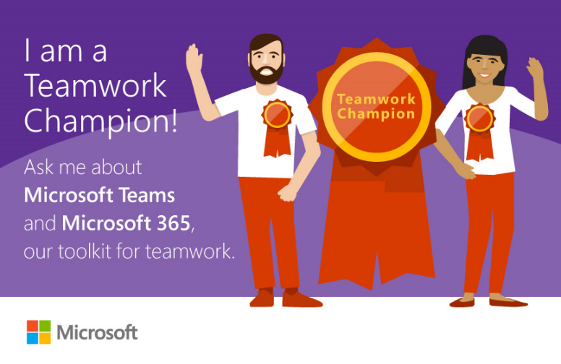
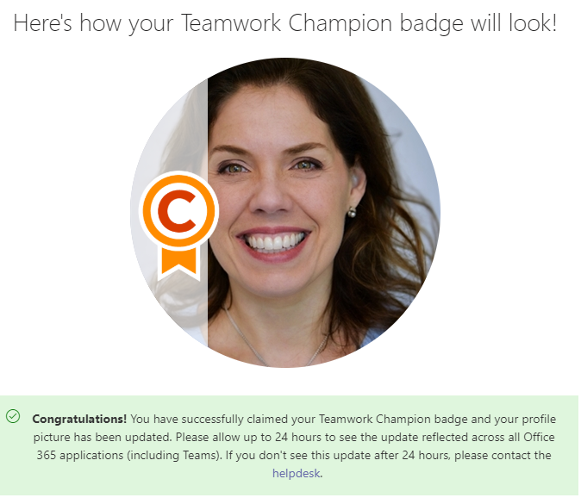
The Fundamentals
Recruit Well
Find your Evangelists
“Make it Real” – swag & letter
Train the Trainer
#1 membership enabler – other Champions
Scale Fast
Go Global
Make Champions deliverables turn-key
Make Champions local SMEs
#1 awareness enabler – Make Champions identifiable

Slide 12
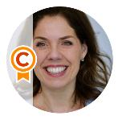
Champions Operationalized
Bring Users & Champions Together
Make Expectations Simple & Clear
Find a Champion
Champion Gives | Champion Gets
Help your organization adopt Microsoft Teams | Access to SMEs CSEO & PG
Engage in the Teams Yammer Group | Early knowledge of new features
Host Art of Teamwork training | Community Access
Participate in White Glove onboarding | Badge, Email signature, branded signage
Host office hours | Leaderboard & Prizes
Join monthly Champion events | Recognition as an expert
Looking for help? – Click here!
Become a Champion
Join the community! – Click here!

Slide 13
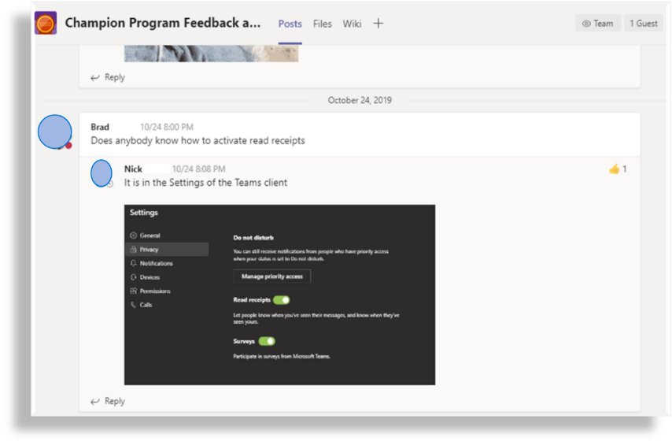
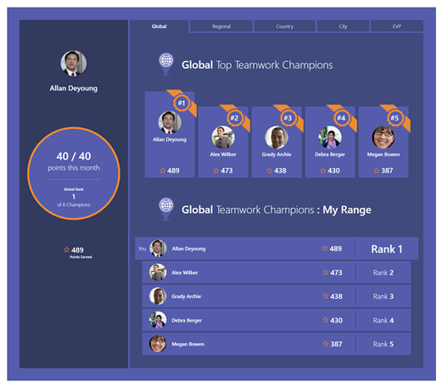
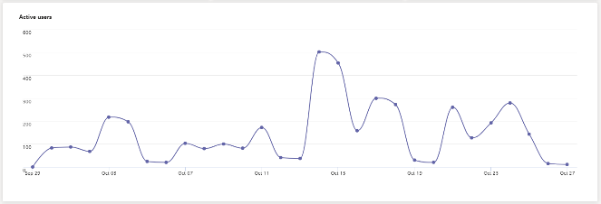
Keeping the Community relevant & engaged
“
I’ve made new virtual ‘friends’ as I find people with common questions and comments to mine
True Community: Champions helping Champions
“
“
Keep doing what you’re doing. This is a great program!”
Teamwork Champions Leaderboard
“
“
I love the Q&A that happens in the Champions Community. I’ve learned a lot in double-checking answers to questions that come up.
“
Hundreds of active users on daily basis
“
Champion Community is AWESOME! Great job bringing the community together.
“

Slide 14
What’s next for our Champions
The elements of Healthy Teamwork
Teamwork happens in Teams Channels
Communicate
The team prioritizes transparency, align on best practices and create an environment where all voices are heard
Share
The team openly shares work, provides feedback and ensures information is discoverable, accessible and secure
The team agrees on priorities, accountabilities and goals; they share a strategy for success and have a plan to get there
Collaborate

Slide 15
Productivity Score Overview A.J. Smith

Slide 16
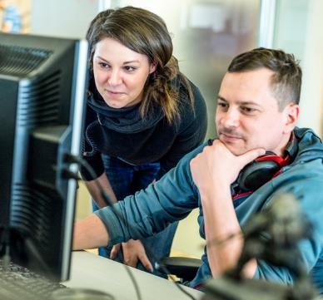

Slide 17
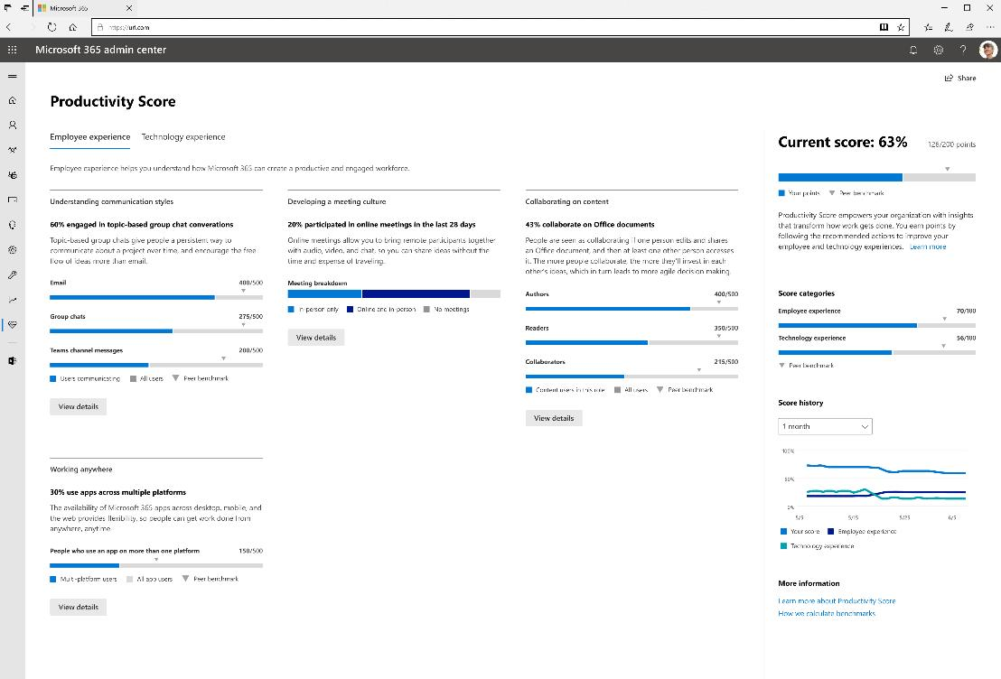
Productivity Score
Insights that transform how work gets done
Visibility
Understand how your organization works
Insights
Identify where you can enable improved experiences
Actions
Update skills and systems so everyone can do their best work

Slide 18
Demo

Slide 19
Learn more and private preview details
Learn more at: https://aka.ms/productivityscoreblog
Sign up using form at https://aka.ms/productivityscorepreview with:
Tenant id
Check the box for the employee experience preview
Provide email addresses of the people you want as contacts
Will see the experience in the Microsoft 365 Admin Center
Recommend using a “production” tenant

Slide 20
Events
O365 Champion Meetup @ ESPC
December 5th @ 6pm
Register @ https://aka.ms/O365ChampionMixer
It’s not too late! Make your voice heard!
Complete our survey at https://aka.ms/O365ChampionSurvey

Slide 21
Resources Monthly Resources: https://aka.ms/O365ChampionResources Forum: https://aka.ms/DriveAdoption Ignite Overview https://aka.ms/AdoptionatIgnite

Slide 22
Get Started at https://aka.ms/MicrosoftAdoption
Streamline End User Training with Microsoft 365 Learning Pathways
Notes:
Accelerate your deployment and adoption of Office 365 services by visiting our unified resource page for adoption guidance on the Microsoft Technical community at https://aka.ms/MicrosoftAdoption. Review materials for Microsoft 365, our security and compliance features or key teamwork workloads like SharePoint, OneDrive, Microsoft Teams and Yammer. Find additional resources for Microsoft Teams in Government and devices for Teams within the Microsoft Teams adoption guide.
This is a step forward in our response to your feedback to make adoption materials easier to discover and use. Over the coming months we will continue to unify and standardize these materials across all our Microsoft 365 services. Share more feedback in our Driving Adoption community at https://aka.ms/DriveAdoption.

Slide 23
Coffee in the Cloud
Get more from Office 365
https://aka.ms/CoffeeintheCloud
Subscribe now to Learn About:
Business Solutions
Best Practices & How-To’s
For Admin’s and Champions
@CITCTV

Slide 24
Current Survey Results
75% of respondents likely or very likely to recommend the program
Top Requested Topics
Running a Champions Program
Hub for Teamwork
Chat, Calling & Meetings
Adoption Methods
File collaboration in O365
Low Code/No-Code solutions
Intelligent Intranet
Video & Live Events
Security & Compliance
Finding Content
Areas to Improve
Advance notice of topics
Better calendar invites
Better reminders on call dates/times
More details on how-to
More in depth sessions
Preferred Call Times:
(Pacific Time)
7am
8am
9am
12 noon
84% of respondents likely or very likely to attend an in person Champions meetup
It’s not too late! Make your voice heard!
Complete our survey at https://aka.ms/O365ChampionSurvey

