Slide 1
Office 365 Champion Community
May 2019 Monthly Meeting
Karuana Gatimu
Customer Advocacy Group
Notes:
Join our program at https://aka.ms/O365Champions
Materials included in this deck are free to use in your daily work.
Please reference our program as the source of this information.
For questions or comments please reach out in the Drive Adoption or Champion’s Corner forums of the Microsoft Technical Community at https://aka.ms/DriveAdoption

Slide 2
Agenda
Inspiration
Information
Tools
Teams Platform Academy
Get in the Flow
Hard Work Matters

Slide 3
Microsoft Resource Cheat Sheet
https://aka.ms/M365Roadmap
https://aka.ms/TechCommunity
https://docs.microsoft.com
https://developer.microsoft.com
Microsoft 365 Roadmap
All public feature delivery dates
Filter by product
Microsoft Technical Community
Product forums and blogs
Driving Adoption forum
O365 Champion’s Corner
IT Pro & Adoption Documentation
Learn how to plan, deliver, adopt and manage Microsoft 365 products
Developer Documentation
Training, documentation, samples & communities for developers
Continue Your Education
https://aka.ms/O365Champions
Office 365 Champions Program
Free monthly calls with Microsoft experts & peers
Early access to adoption resources and tools
Open to all business users, IT Pro’s and developers who want to drive adoption of cloud solutions & services
Sign Up

Slide 4
The successful adoption of Microsoft 365 represents a change in behavior. It is more than a set of products—it is a fundamentally different way of working. This change is about people.
Notes:
M365 has the potential to change the trajectory of an organization in many ways, besides the technology itself:
People fundamentally change the way they work
We enable a modern workplace and the optimization of Office 365
We provide the capability to accelerate the alignment of economic and cultural business drives
We allow organizations to enter a state of dynamic stability*
*“Dynamic stability is like riding a bicycle, where you cannot stand still, but once you are moving it is actually easier. It is not our natural state. But humanity has to learn to exist in this state.¹”
1 Friedman, Thomas L. Thank you for Being Late. New York: Farrar, Straus and Giroux, 2016.
“The need to move to a highly flexible and adaptable digital approach is urgent. The applications required today are not going to last for 30 years. They are maybe only going to be used for maybe two, three years.²”
2 McKendrick, J. (2018. Jan 21) The ultimate technology success metric: owning the customer relationship. Retrieved from http://www.zdnet.com/article/business-transformation-before-technology/

Slide 5
One of the first 5 Flow MVP’s
SharePoint community leader
Speaker & Published author
Melissa Hubbard
https://melihubb.com
Tech Chat on Coffee in the Cloud

Slide 6
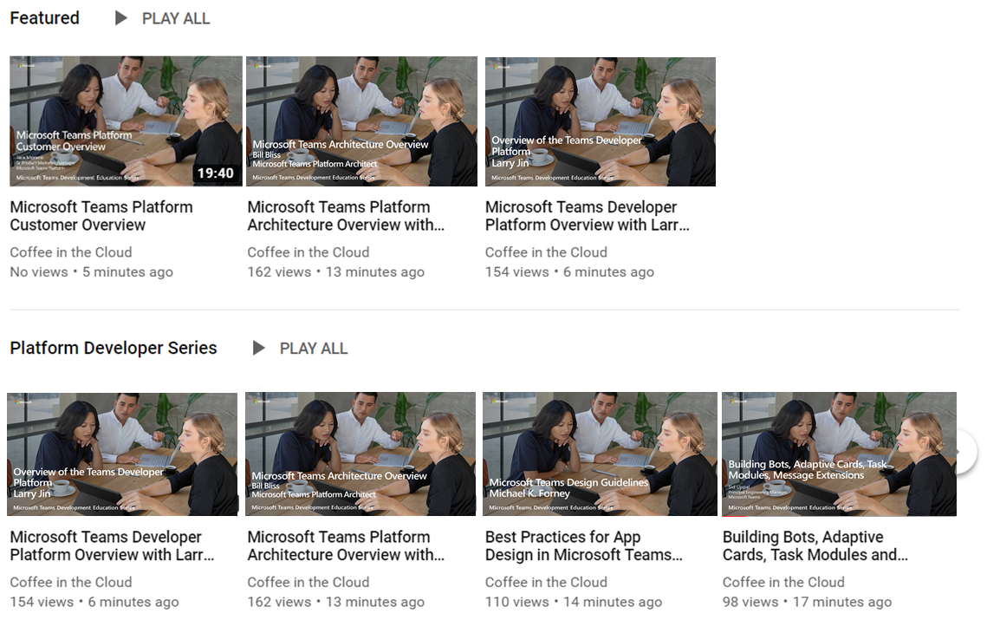
Public Launch https://aka.ms/TeamsPlatformAcademy
Dev Training for Microsoft Teams

Slide 7
Start building
Get Started
Teams Documentation: aka.ms/TeamsDev External integrations: aka.ms/TeamsIntegrations Platform training videos: aka.ms/TeamsPlatformAcademy
Developer Support: aka.ms/TeamsDevSupport
Join the community
Teams Dev Center: aka.ms/Teams.Dev Tech Community (QnA): aka.ms/TeamsCommunity Teams dev blog: aka.ms/TeamsDevBlog
Notes:
We are happy to share these core links with you, but here are the three next steps
that are most important for you to get started and build your own integration for Microsoft Teams.

Slide 8
Get in the Flow

Slide 9
Power Platform Business Automation for All
Analyze
Act
Automate
Data connectors
Power BI
Business analytics
PowerApps
Low-code/no-code application development
Microsoft Flow
Workflow automation
Standalone apps
Common Data
Service for Apps
Microsoft 365
Dynamics 365
Microsoft Azure

Slide 10
https://powerusers.microsoft.com

Slide 11
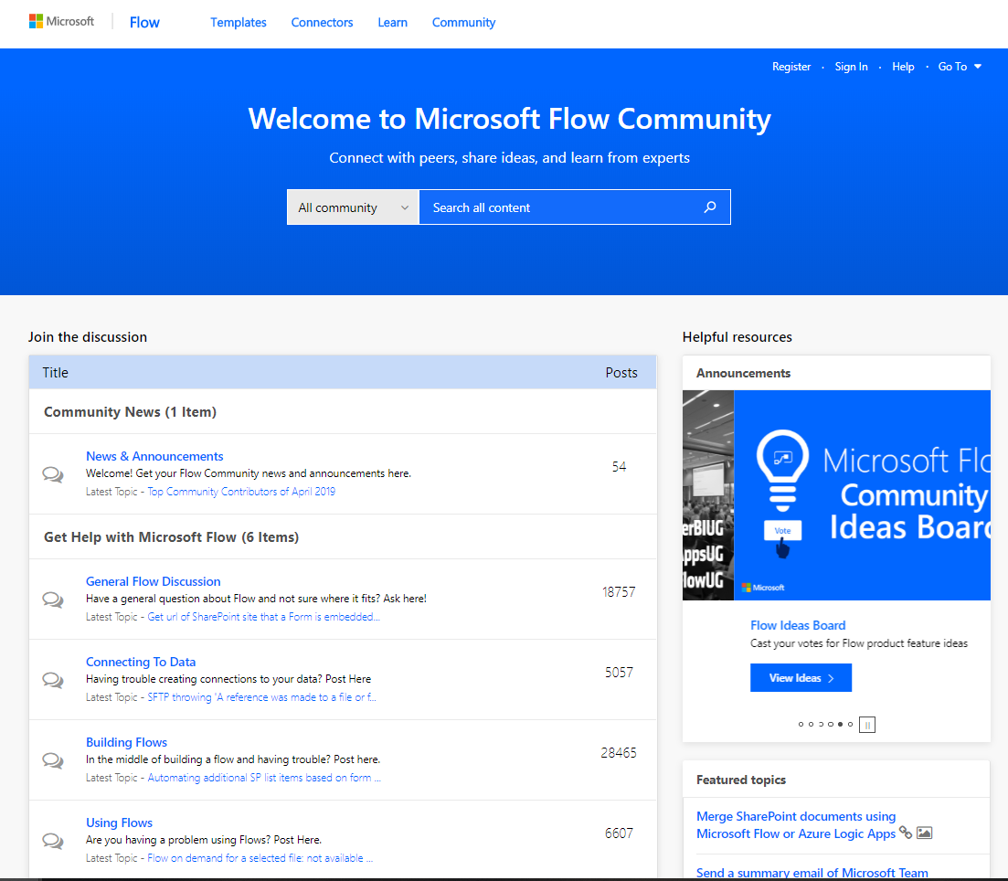
Flow Community – powerusers.microsoft.com

Slide 12
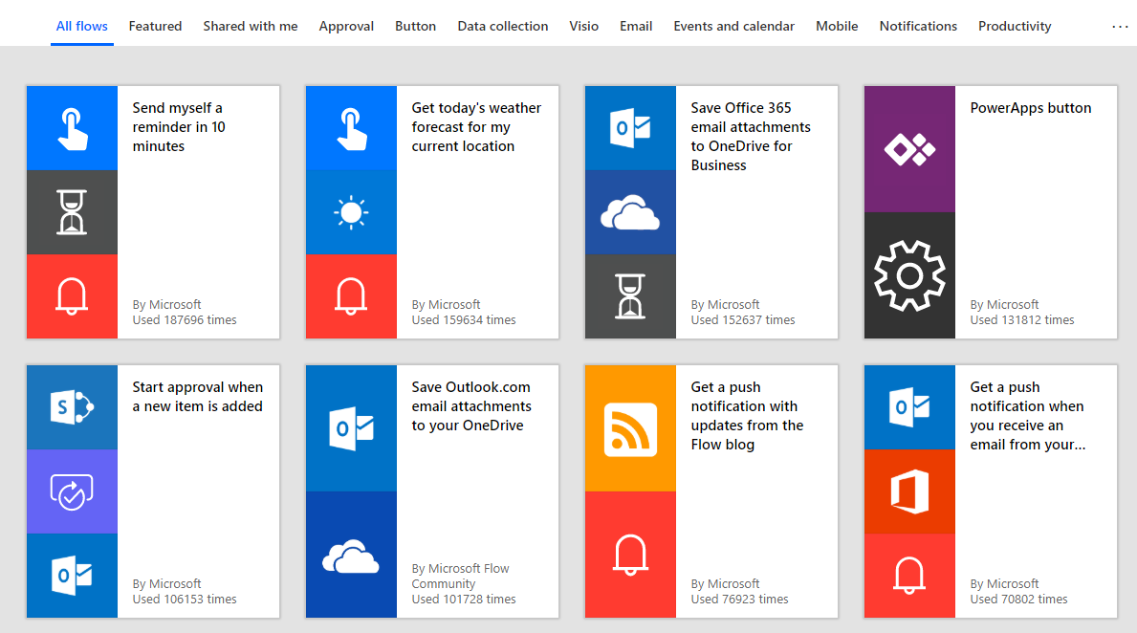
Flow Templates Accelerate Results

Slide 13
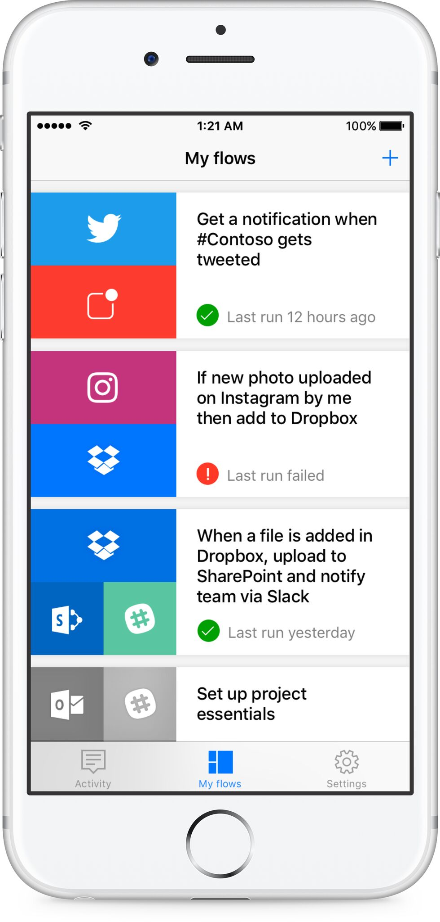
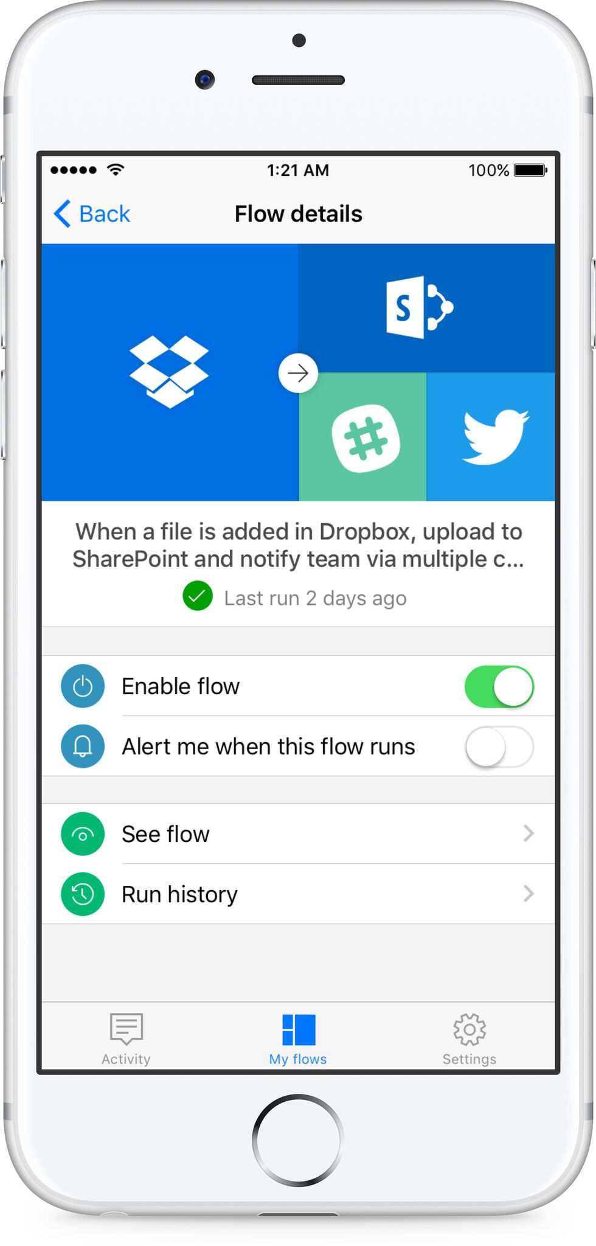
Use the Flow app to get alerts and manage your Flows

Slide 14
Modernizing Core Scenarios
Project Management
Personal Productivity
Calling & Meetings
Enable
Empower
Extend
‘Hallway conversations’ cause disconnect with group
Frustration about doc location and versioning
Confusion about accountability
Emails/attachments get lost
Calls go to voicemail
Colleagues are offline
Outdated local copies on desktop
Little/no context pre-meeting
Remote participants feel left behind
Lack of visual connection
Post-meeting momentum is lost
Access Office and 3rd party apps making true hub for teamwork
Hold all conversations in team/channel driving transparency
Pin important apps and documents to drive visibility
Streamline doc versioning
Personal apps organize notes & tasks in one place
Send online and offline messages alleviating tracking people down
Persistent conversation with file attach reducing need to search multiple places or ending up with multiple versions
Build momentum pre-meeting with conversation and content sharing
Connect with video, app sharing on any device to ensure alignment
Record for absent attendees
Capture notes and actions for easy follow-up

Slide 15
Resources

Slide 16
Coffee in the Cloud
Get more from Office 365
https://aka.ms/CoffeeintheCloud
Subscribe now to Learn About:
Business Solutions
Best Practices & How-To’s
For Admin’s and Champions
@CITCTV

Slide 17
Microsoft Teams Resource Cheat Sheet
https://aka.ms/M365Roadmap
https://aka.ms/TeamsCommunity
https://aka.ms/SuccessWithTeams
https://aka.ms/CoffeeintheCloud
Microsoft 365 Roadmap
All public feature delivery dates
Filter by product
Microsoft Technical Community
Product forums and blogs
Driving Adoption forum
O365 Champion’s Corner
Success with Teams Practical Guidance
Learn how to plan, deliver, adopt and manage Microsoft Teams
Skype for Business to Teams transition guidance
Coffee in the Cloud on YouTube
Short how-to videos for IT Pro’s and Champions
Long form end user & administrator training
Continue Your Education
https://aka.ms/O365Champions
Office 365 Champions Program
Free monthly calls with Microsoft experts & peers
Early access to adoption resources and tools
Open to all business users, IT Pro’s and developers who want to drive adoption of cloud solutions & services
Sign Up

