Slide 1
Office 365 Champion Community
March 2019 Monthly Meeting
Karuana Gatimu
Customer Advocacy Group
Notes:
Join our program at https://aka.ms/O365Champions
Materials included in this deck are free to use in your daily work.
Please reference our program as the source of this information.
For questions or comments please reach out in the Drive Adoption or Champion’s Corner forums of the Microsoft Technical Community at https://aka.ms/DriveAdoption

Slide 2
Agenda
Inspiration
Information
Tools
Microsoft 365 Adoption Workbook
Custom Learning for Office 365
The Power of Authenticity

Slide 3
Microsoft Resource Cheat Sheet
https://aka.ms/O365Roadmap
https://aka.ms/TechCommunity
https://docs.microsoft.com
https://developer.microsoft.com
Office 365 Roadmap
All public feature delivery dates
Filter by product
Microsoft Technical Community
Product forums and blogs
Driving Adoption forum
O365 Champion’s Corner
IT Pro & Adoption Documentation
Learn how to plan, deliver, adopt and manage Microsoft 365 products
Developer Documentation
Training, documentation, samples & communities for developers
Continue Your Education
https://aka.ms/O365Champions
Office 365 Champions Program
Free monthly calls with Microsoft experts & peers
Early access to adoption resources and tools
Open to all business users, IT Pro’s and developers who want to drive adoption of cloud solutions & services
Sign Up

Slide 4
The successful adoption of Microsoft 365 represents a change in behavior. It is more than a set of products—it is a fundamentally different way of working. This change is about people.
Notes:
M365 has the potential to change the trajectory of an organization in many ways, besides the technology itself:
People fundamentally change the way they work
We enable a modern workplace and the optimization of Office 365
We provide the capability to accelerate the alignment of economic and cultural business drives
We allow organizations to enter a state of dynamic stability*
*“Dynamic stability is like riding a bicycle, where you cannot stand still, but once you are moving it is actually easier. It is not our natural state. But humanity has to learn to exist in this state.¹”
1 Friedman, Thomas L. Thank you for Being Late. New York: Farrar, Straus and Giroux, 2016.
“The need to move to a highly flexible and adaptable digital approach is urgent. The applications required today are not going to last for 30 years. They are maybe only going to be used for maybe two, three years.²”
2 McKendrick, J. (2018. Jan 21) The ultimate technology success metric: owning the customer relationship. Retrieved from http://www.zdnet.com/article/business-transformation-before-technology/

Slide 5
Authenticity is the new superpower

Slide 6
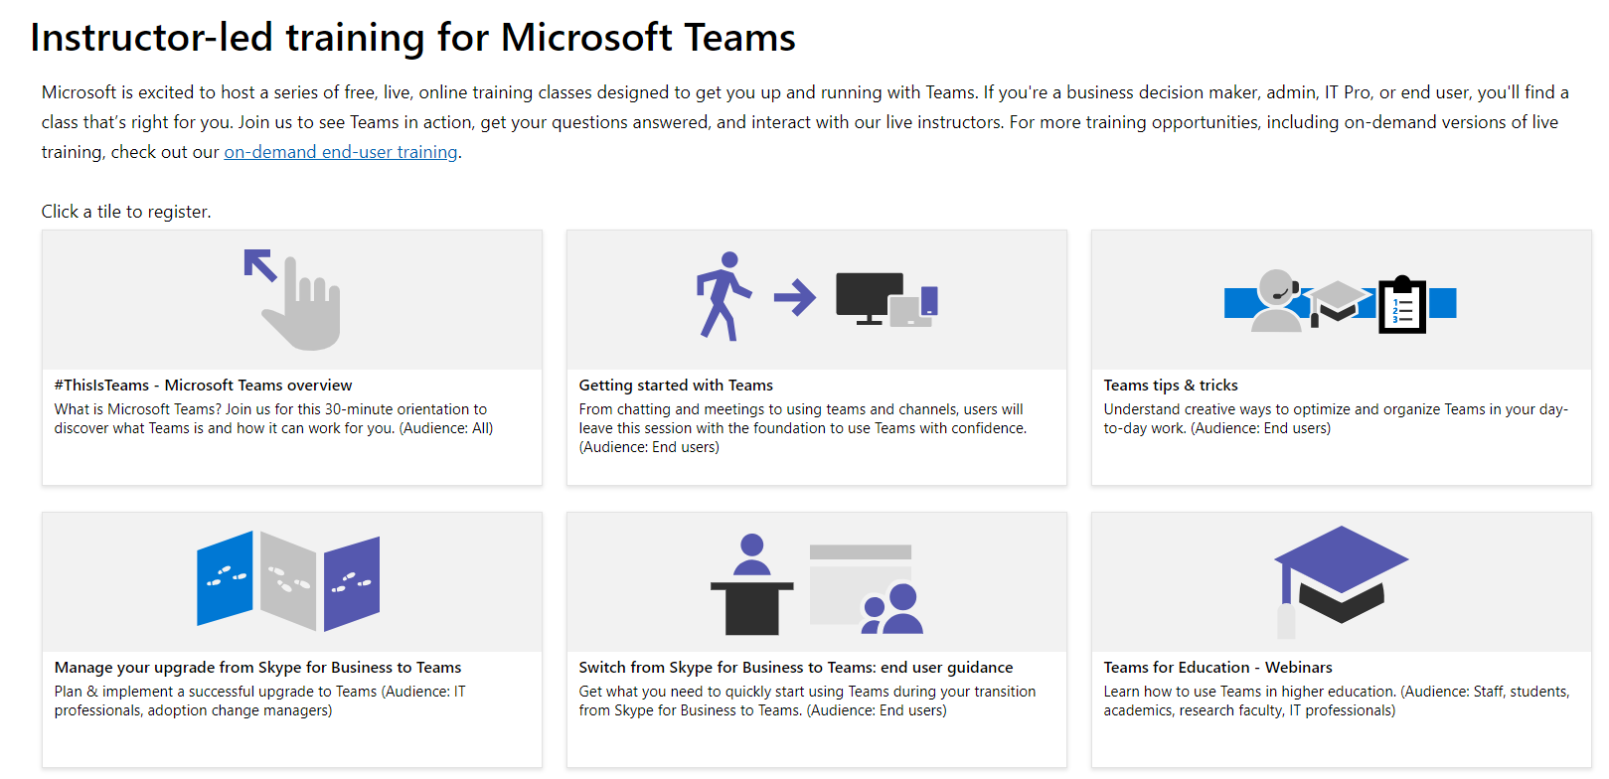
Free Training for Microsoft Teams

Slide 7
Preview Release Custom Learning for Office365
Notes:
O365 Adoption Toolkit – Adoption & Deployment Workstreams
vE10-18.1

Slide 8
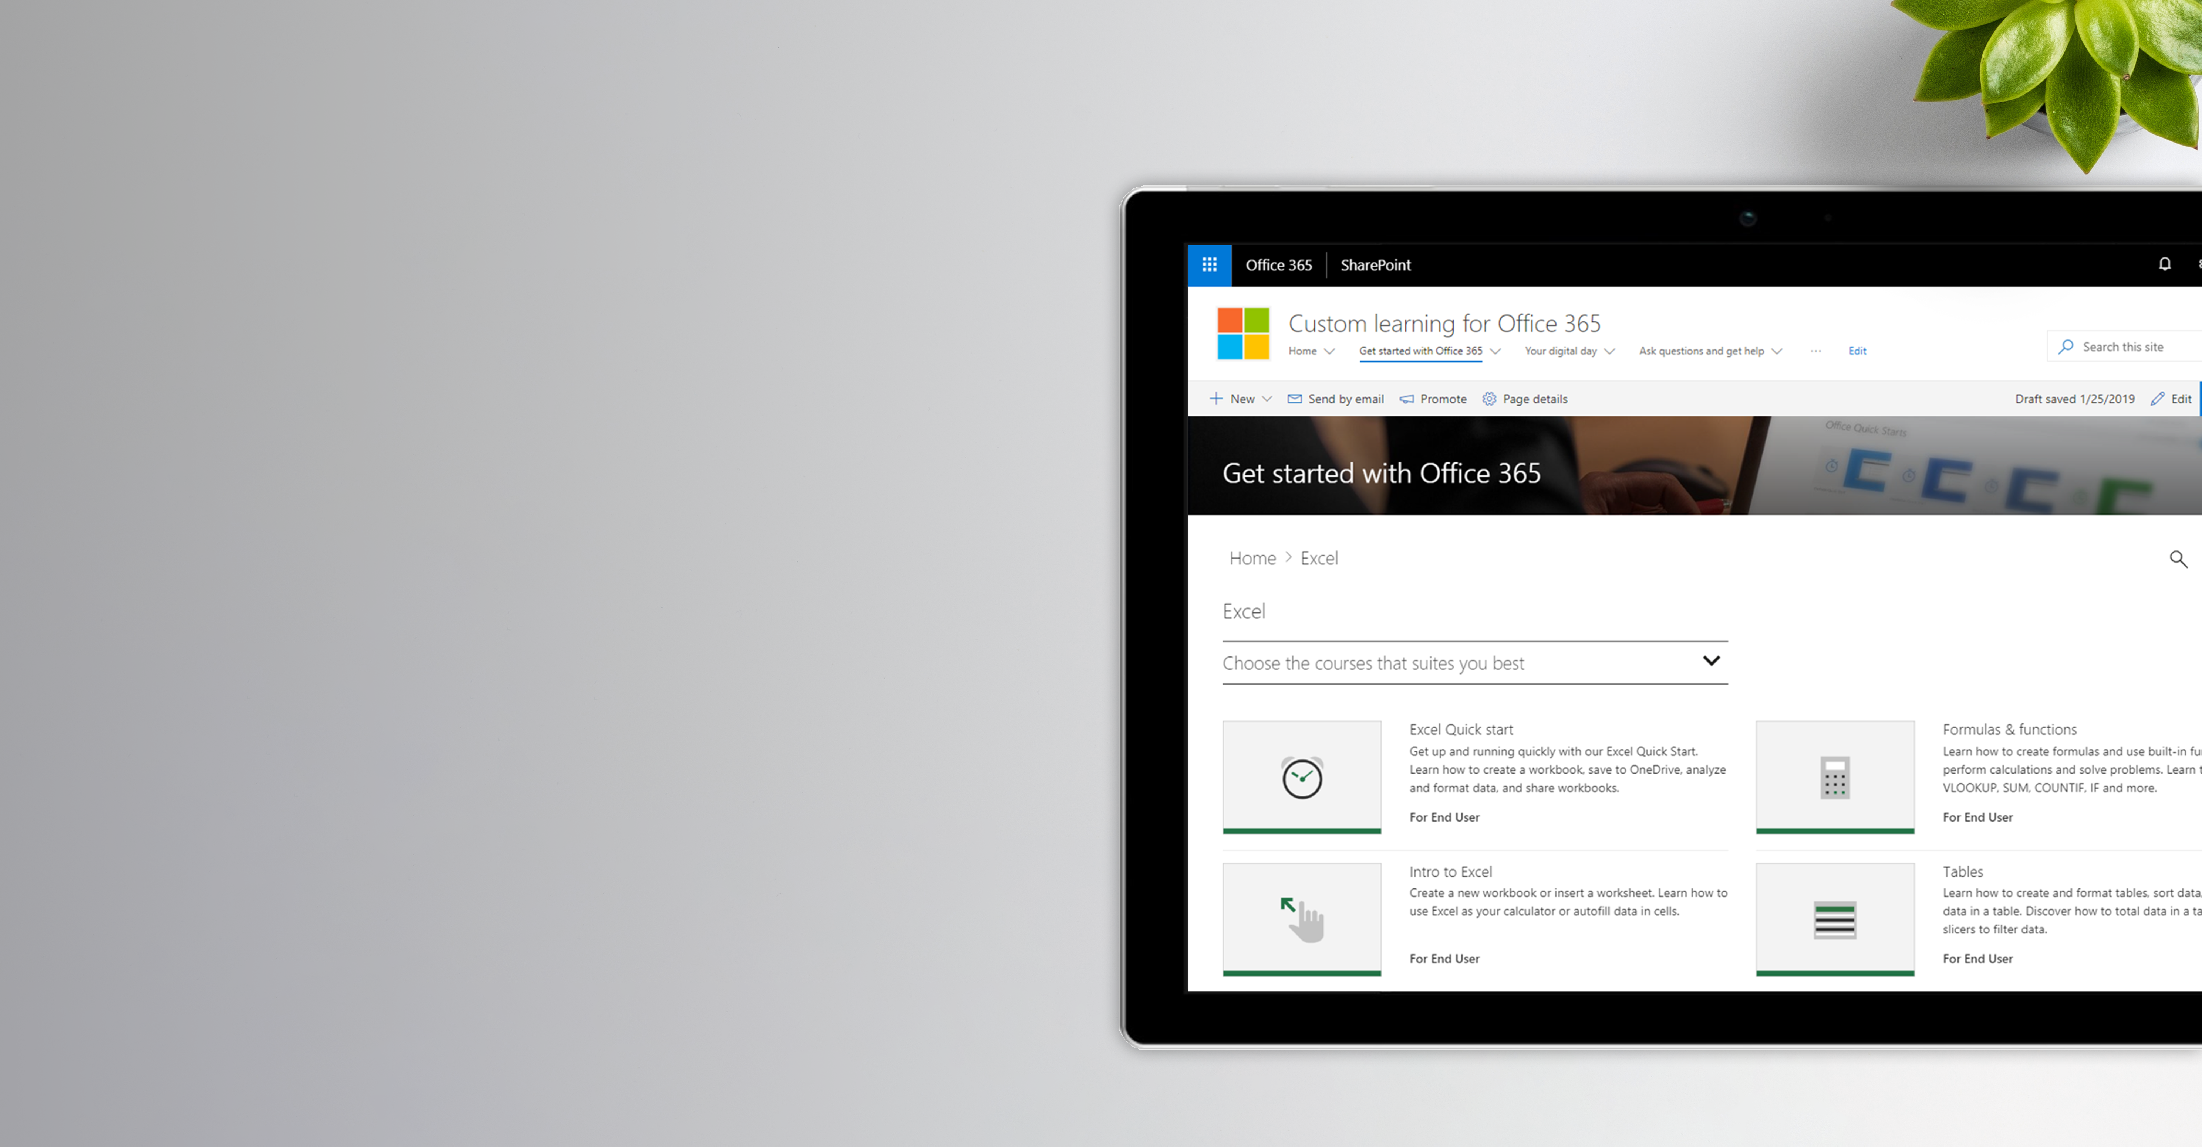
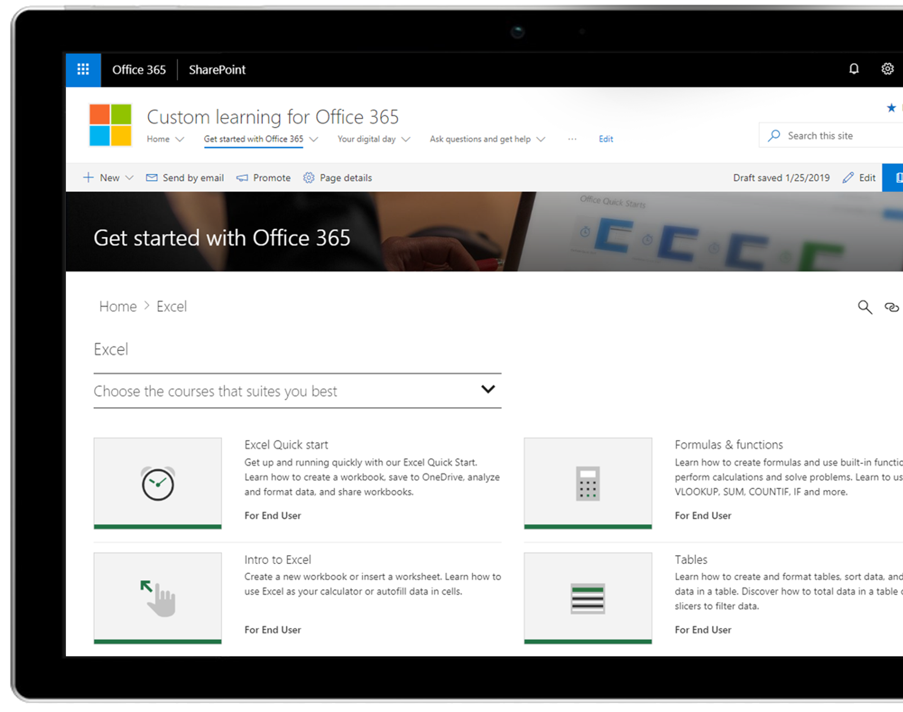
Custom Learning for Office 365 Customizable Online Learning Solution

Slide 9
SharePoint Communication site template
Custom Learning web part
Connected to online catalog of Microsoft training content

Slide 10
Why Did We Build It?
Customers want to customize content for their environment
Customers want their training content kept up-to-date
Customers want the option of an out of the box full training experience.

Slide 11
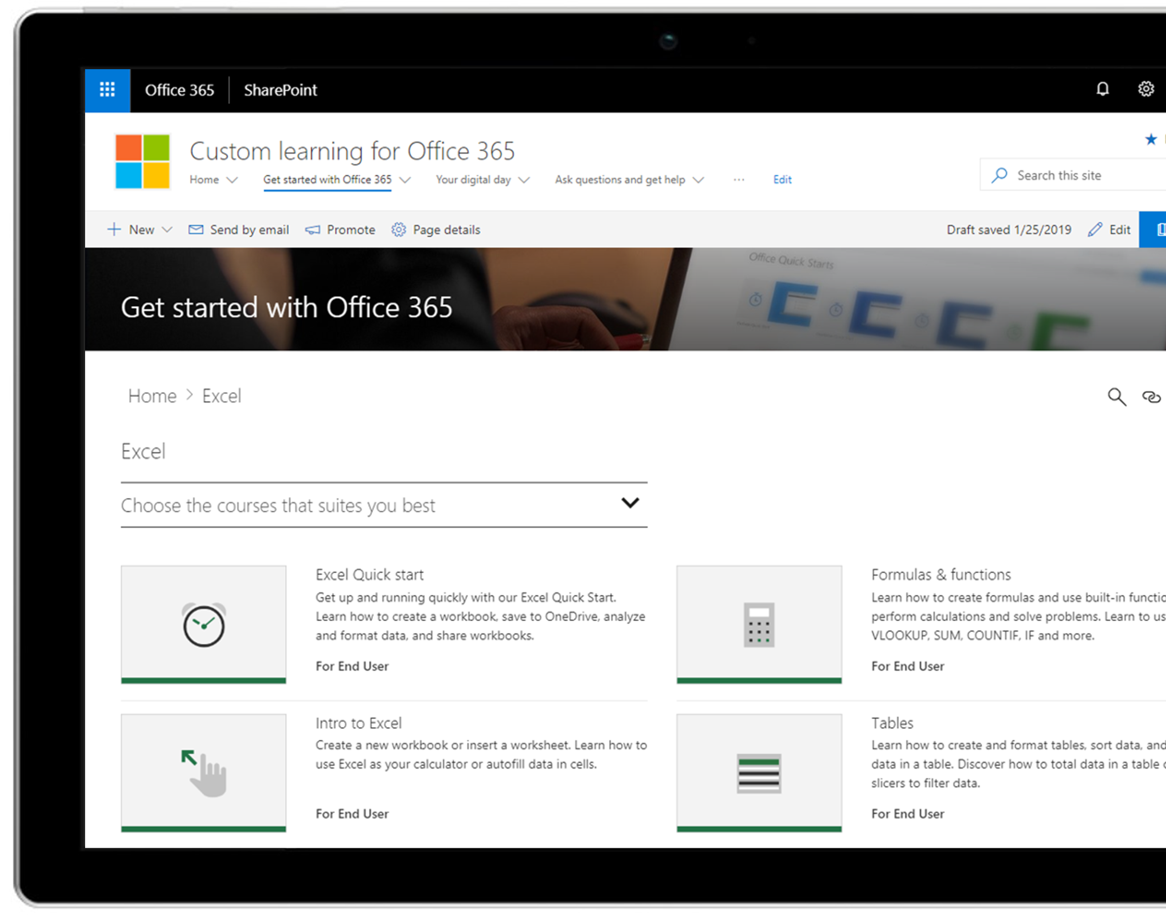
How Does It Work?
SharePoint Communication site on customer tenant
2
Support.Office.com
Content continually updated
Feed from GitHub Repository
1
Up-to-date content
Microsoft GitHub CDN
(links to SOC pages)
3
Custom Learning web part

Slide 12
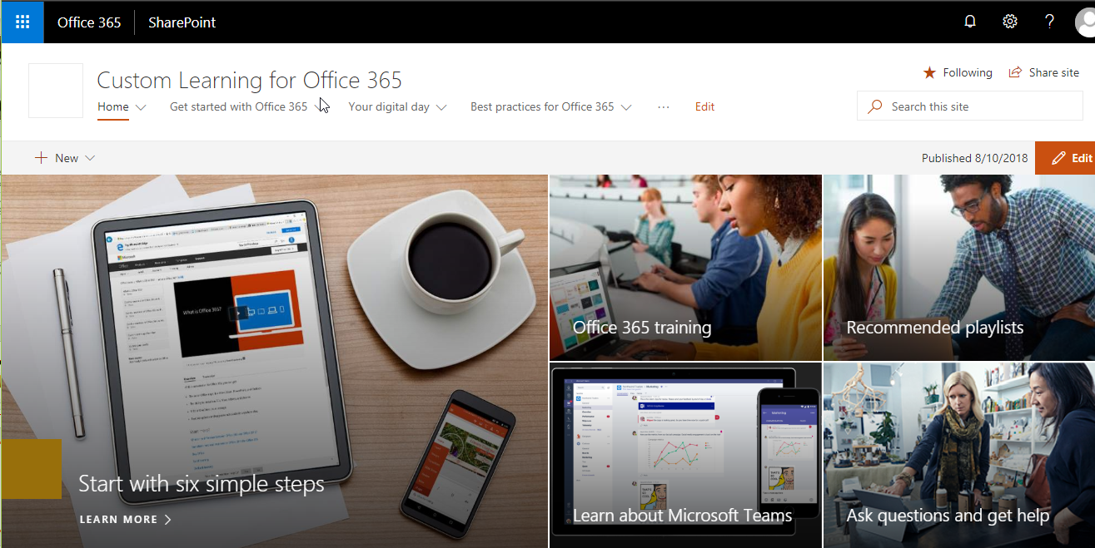
Customers get the full SharePoint modern experience
Ready to implement learning portal built on SharePoint Communication site
Looks great on the web, in the SharePoint mobile app, on PC and on Mac
Tailor the SharePoint communication site to meet your needs

Slide 13
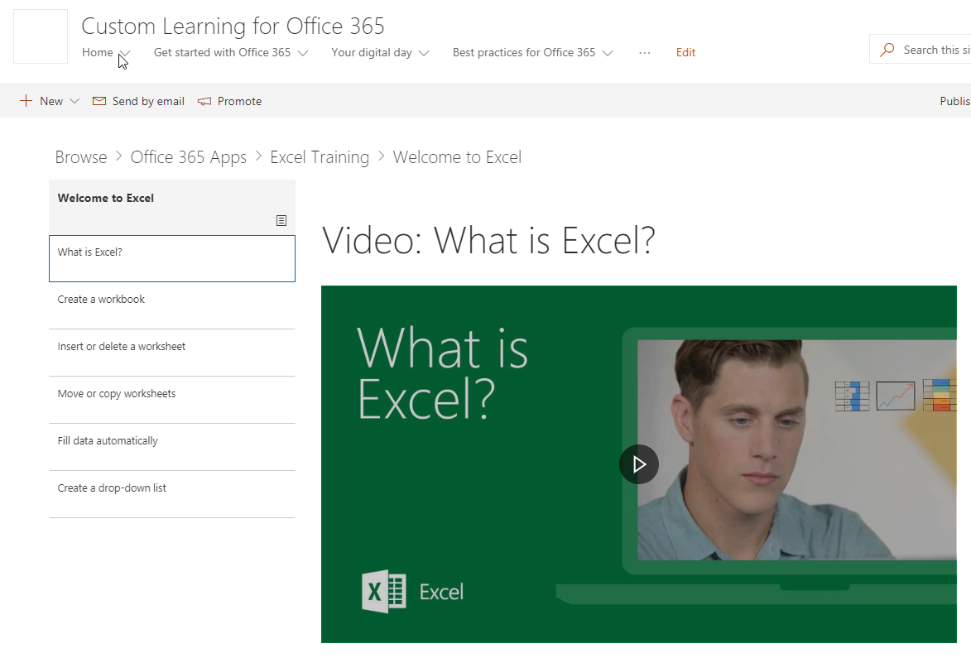
Customers get an up-to-date content feed
Customers get an up-to-date feed of content from Support.Office.Com through the Custom Learning web part

Slide 14
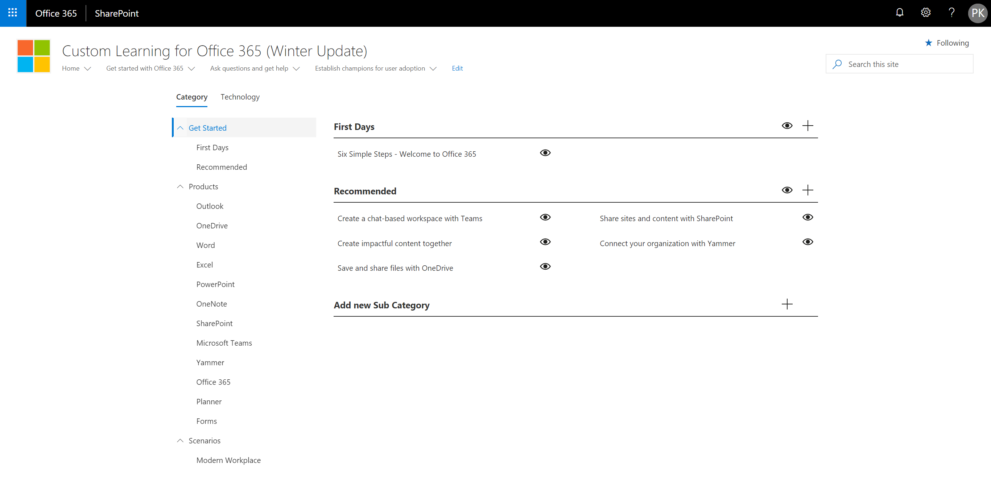
Customers can Hide/Show content
Admins can hide/show category and technology content based on their unique environment
Notes:
Update video

Slide 15
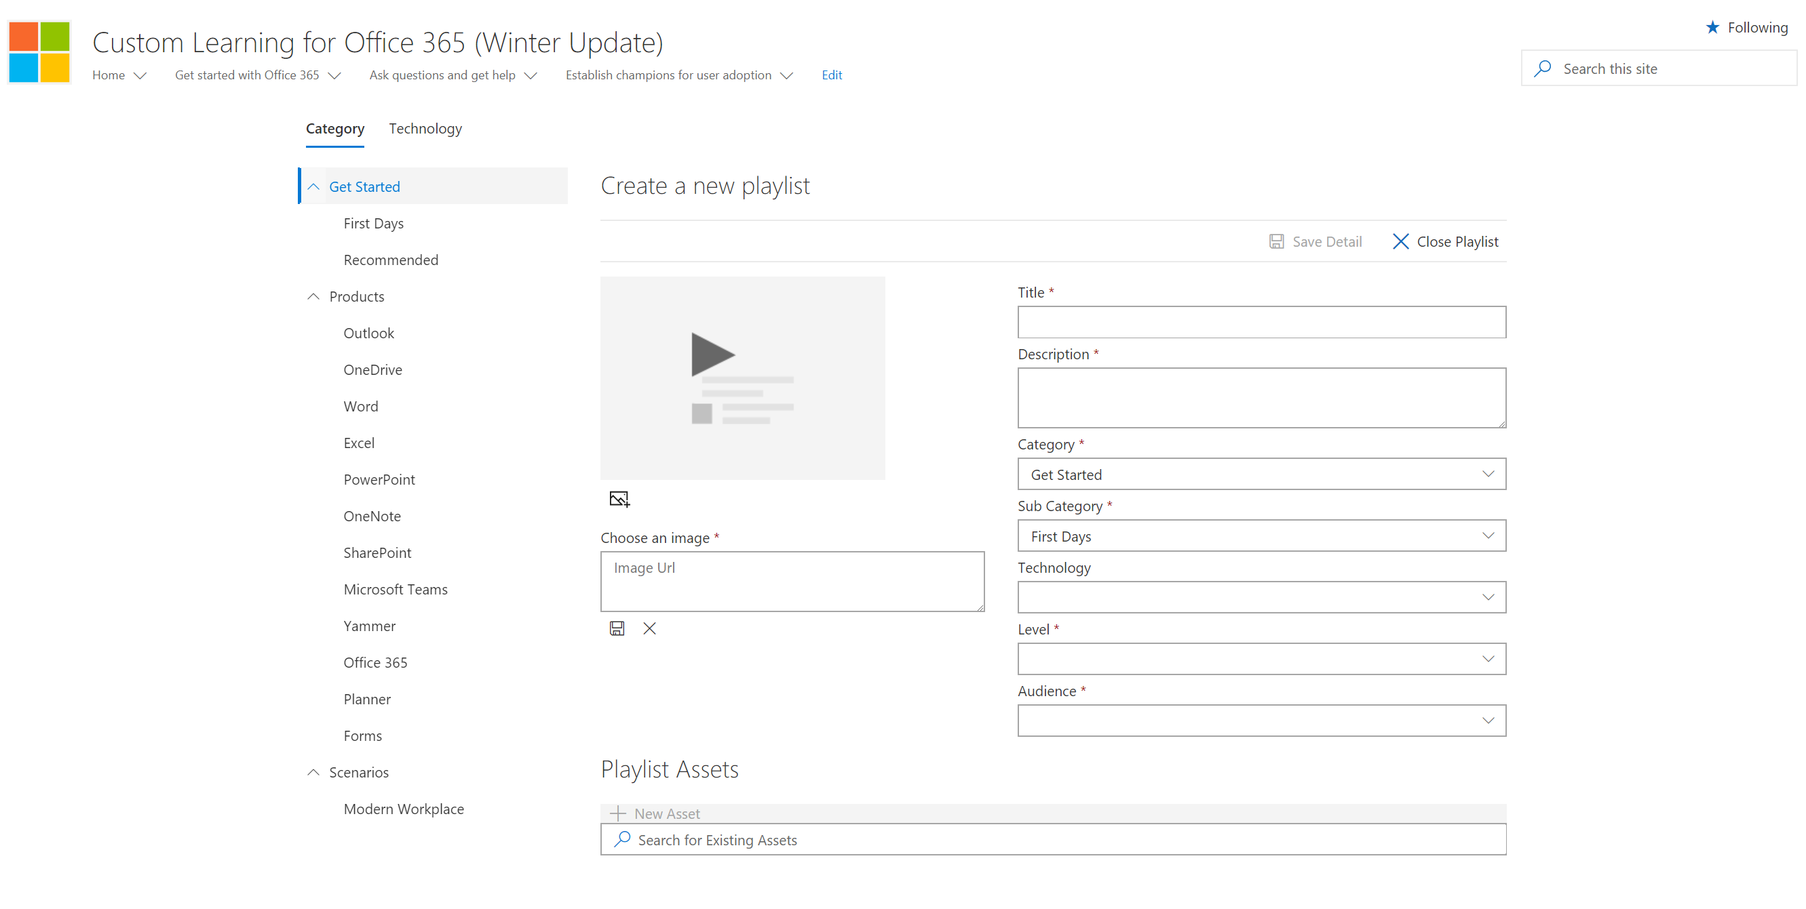
Customers can create custom playlists
Admins can create custom playlists tailored to their organizations needs
Playlist can mix Microsoft-supplied assets with customer assets, like pages with YouTube videos, forms, and .PDFs
Custom subcategories can be created
Notes:
Update video

Slide 16
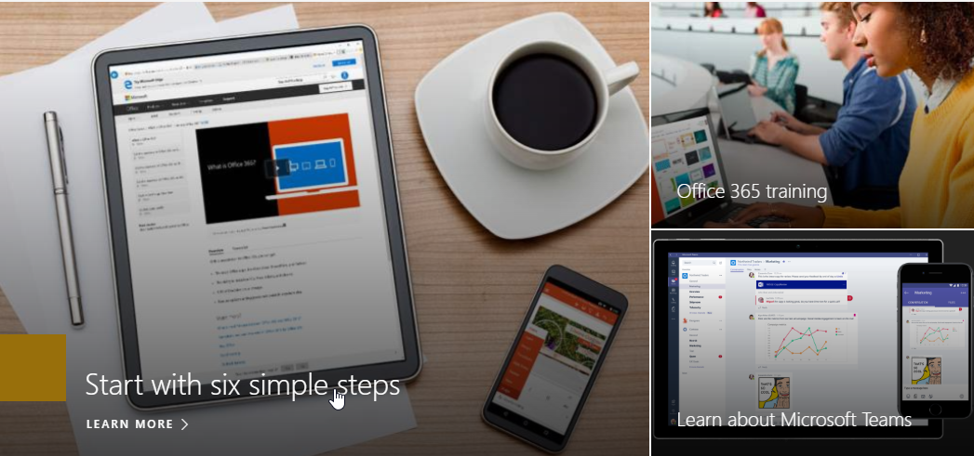
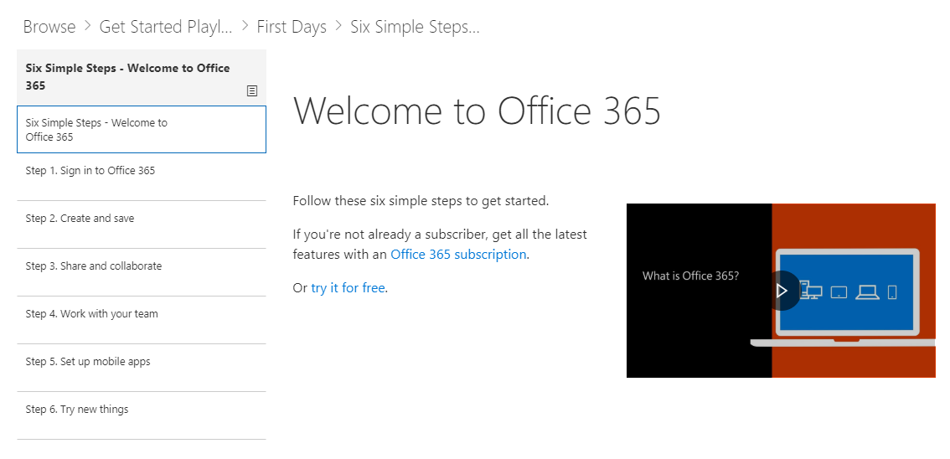
Customers can deep link into playlists
Admins can link custom playlist to from SharePoint pages to create custom learning experiences
Notes:
Update video

Slide 17
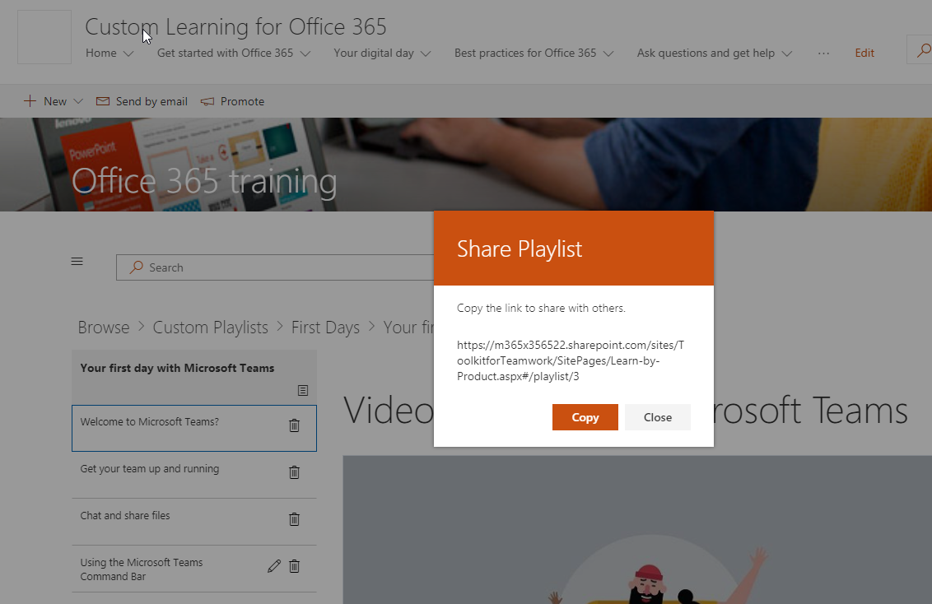
Customers can share playlists with others
Customers can share playlists with others in their organization
Notes:
Update video

Slide 18
Resources

Slide 19
Configuring O365 Classification

Slide 20
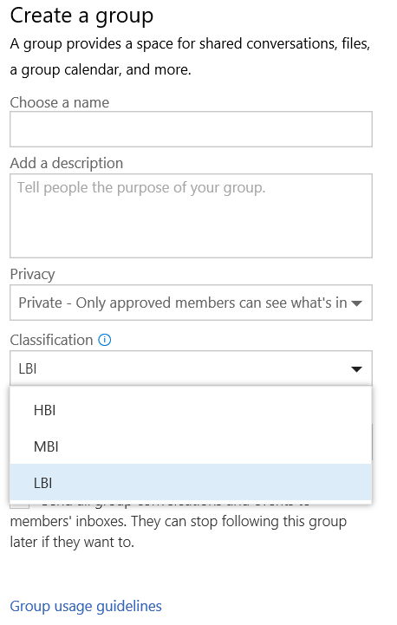
How to setup Classification
Connect-MsolService
$settings = Get-MsolAllSettings | where-object {$_.displayname -eq “Group.Unified”}
$singlesettings = Get-MsolSettings -SettingId $settings.ObjectId
$value = $singlesettings.GetSettingsValue()
$value[“ClassificationList”] = “HBI, MBI, LBI”
Set-MsolSettings -SettingId $settings.ObjectId -SettingsValue $value

Slide 21
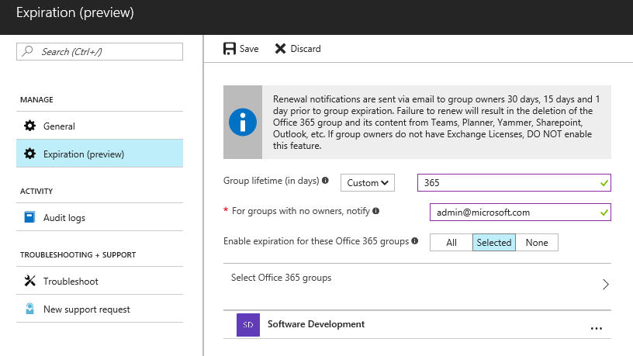
How to setup Expiration Policy
Admin
Set expiration timeline
Notification intervals are autoset
Set fallback email address for ownerless groups
Apply the policy to selective groups
Admin Tool
Azure AD powershell —Supported in V1 release
Azure AD portal —Supported in V1 release
* A maximum of 500 groups can be selected to apply the policy in the AAD portal UI. Group selection has no restriction in the AAD powershell.

Slide 22
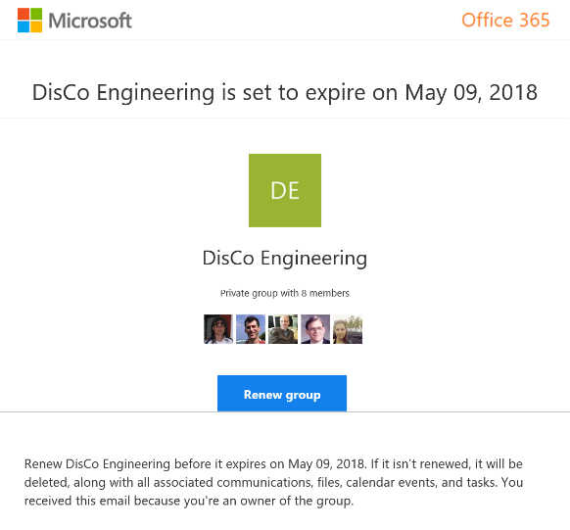
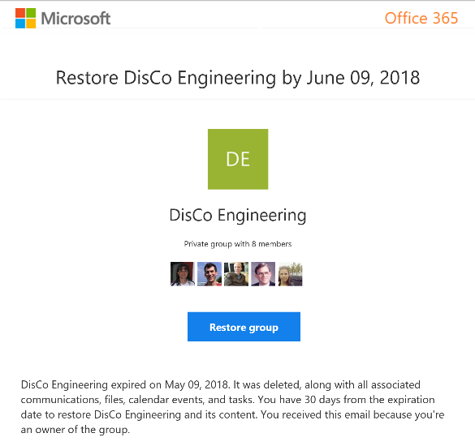
Group Owner experience of expiration policy
Renew expired groups
Restore expired groups that were soft deleted

Slide 23
Enforce policy Groups governance reduces customization
Official roadmap on fasttrack.office.com/roadmap
Policy | SharePoint custom | In product (Office 365/Azure AD) | Groups custom
Enable self-service site collection / group creation | Yes | Yes
Collect classification for all containers | Yes | Yes (Updated)
User awareness: Display classification | Yes | Yes
Enforce naming rules | N/A | Yes (New)
Usage guideline visibility | Yes | Yes
Ownership accountability: (1 Full-time, 2 people) | Yes |  | Workaround
Set public vs. private based on classification | N/A |  | Yes
External sharing limited based on classification (HBI) | Yes |  | Yes
Guest membership disallowed with classification (HBI) | N/A |  | Yes
Life cycle: 6-month expiry | Yes | Yes (New)
Membership life cycle: Enforce external renewals | Yes (policy based) | In development
Limit reach based on classification | Yes |  | Yes
Multi-geo; Provision based on user’s region |  | In development

Slide 24
Microsoft Teams Resource Cheat Sheet
https://aka.ms/O365Roadmap
https://aka.ms/TeamsCommunity
https://aka.ms/SuccessWithTeams
https://aka.ms/CoffeeintheCloud
Office 365 Roadmap
All public feature delivery dates
Filter by product
Microsoft Technical Community
Product forums and blogs
Driving Adoption forum
O365 Champion’s Corner
Success with Teams Practical Guidance
Learn how to plan, deliver, adopt and manage Microsoft Teams
Skype for Business to Teams transition guidance
Coffee in the Cloud on YouTube
Short how-to videos for IT Pro’s and Champions
Long form end user & administrator training
Continue Your Education
https://aka.ms/O365Champions
Office 365 Champions Program
Free monthly calls with Microsoft experts & peers
Early access to adoption resources and tools
Open to all business users, IT Pro’s and developers who want to drive adoption of cloud solutions & services
Sign Up

Slide 25
Coffee in the Cloud
Get more from Office 365
https://aka.ms/CoffeeintheCloud
Subscribe now to Learn About:
Business Solutions
Best Practices & How-To’s
For Admin’s and Champions
@CITCTV

