Slide 1

Office 365 Champion Community
June 2019 Monthly Meeting
Karuana Gatimu
Customer Advocacy Group
Notes:
Join our program at https://aka.ms/O365Champions
Materials included in this deck are free to use in your daily work.
Please reference our program as the source of this information.
For questions or comments please reach out in the Drive Adoption or Champion’s Corner forums of the Microsoft Technical Community at https://aka.ms/DriveAdoption

Slide 2
Agenda
Inspiration
Information
Tools
Microsoft Adoption Resources
Yammer for the Win
Community Dedication

Slide 3
Microsoft Resource Cheat Sheet
https://aka.ms/M365Roadmap
https://aka.ms/TechCommunity
https://docs.microsoft.com
https://developer.microsoft.com
Microsoft 365 Roadmap
All public feature delivery dates
Filter by product
Microsoft Technical Community
Product forums and blogs
Driving Adoption forum
O365 Champion’s Corner
IT Pro & Adoption Documentation
Learn how to plan, deliver, adopt and manage Microsoft 365 products
Developer Documentation
Training, documentation, samples & communities for developers
Continue Your Education
https://aka.ms/O365Champions
Office 365 Champions Program
Free monthly calls with Microsoft experts & peers
Early access to adoption resources and tools
Open to all business users, IT Pro’s and developers who want to drive adoption of cloud solutions & services
Sign Up

Slide 4

The successful adoption of Microsoft 365 represents a change in behavior.
It is more than a set of products—it is a fundamentally different way of working.
This change is about people.
Notes:
M365 has the potential to change the trajectory of an organization in many ways, besides the technology itself:
People fundamentally change the way they work
We enable a modern workplace and the optimization of Office 365
We provide the capability to accelerate the alignment of economic and cultural business drives
We allow organizations to enter a state of dynamic stability*
*“Dynamic stability is like riding a bicycle, where you cannot stand still, but once you are moving it is actually easier. It is not our natural state. But humanity has to learn to exist in this state.¹”
1 Friedman, Thomas L. Thank you for Being Late. New York: Farrar, Straus and Giroux, 2016.
“The need to move to a highly flexible and adaptable digital approach is urgent. The applications required today are not going to last for 30 years. They are maybe only going to be used for maybe two, three years.²”
2 McKendrick, J. (2018. Jan 21) The ultimate technology success metric: owning the customer relationship. Retrieved from http://www.zdnet.com/article/business-transformation-before-technology/

Slide 5
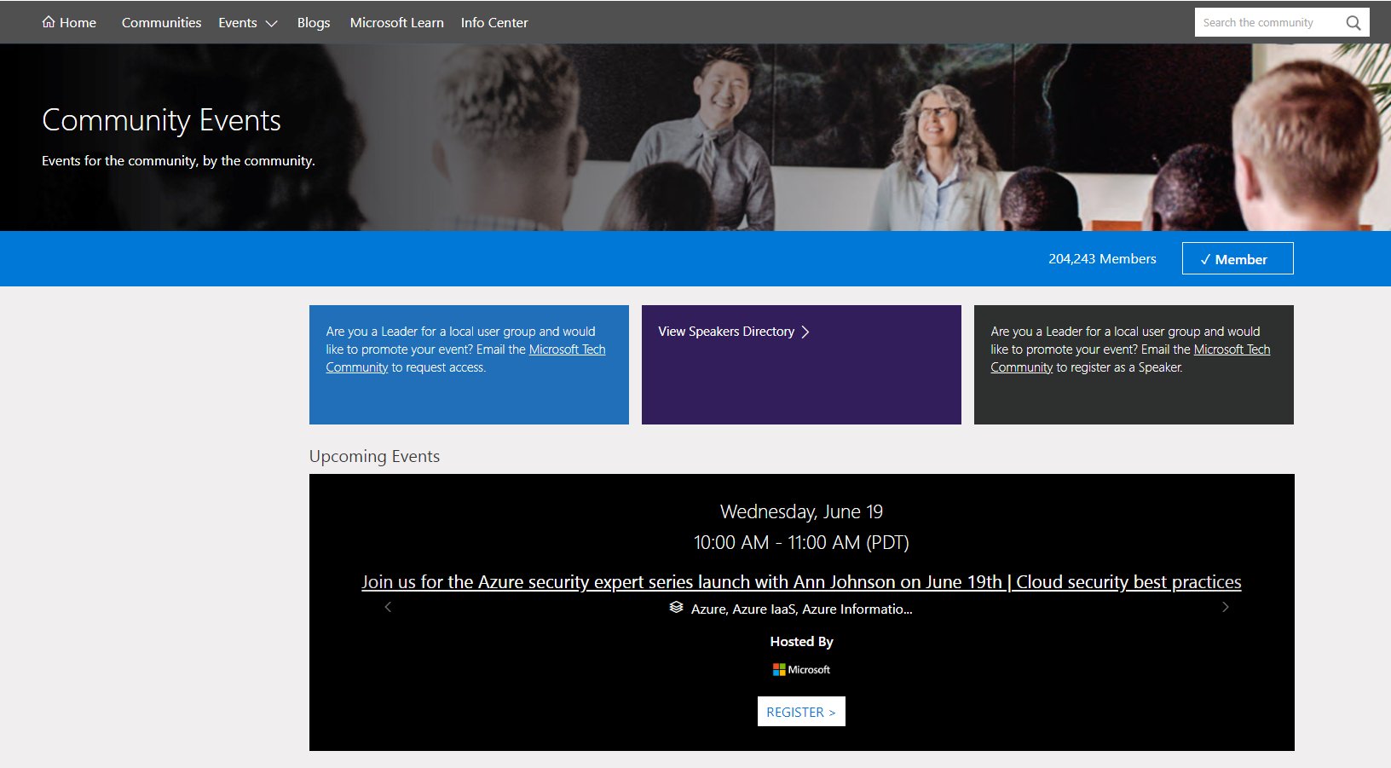
Microsoft Technical Community – Events – Community Events Page

Slide 6
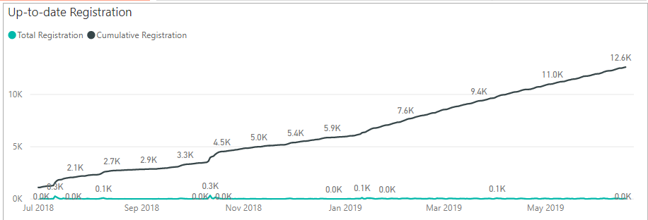
Thank you Champions Community!!

Slide 7

Celebrate!
We are 12,000 strong & growing!
Thank you for your support and enthusiasm in this community! Our growth chart is a hockeystick! Going Up Up and Up!

Slide 8
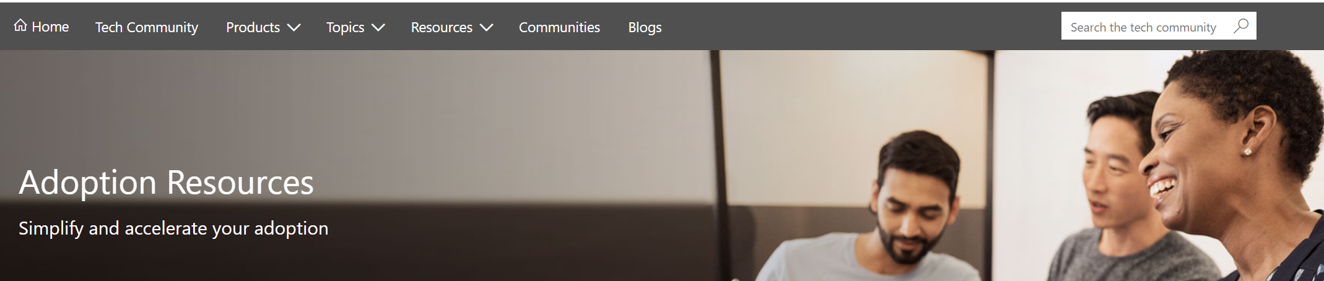
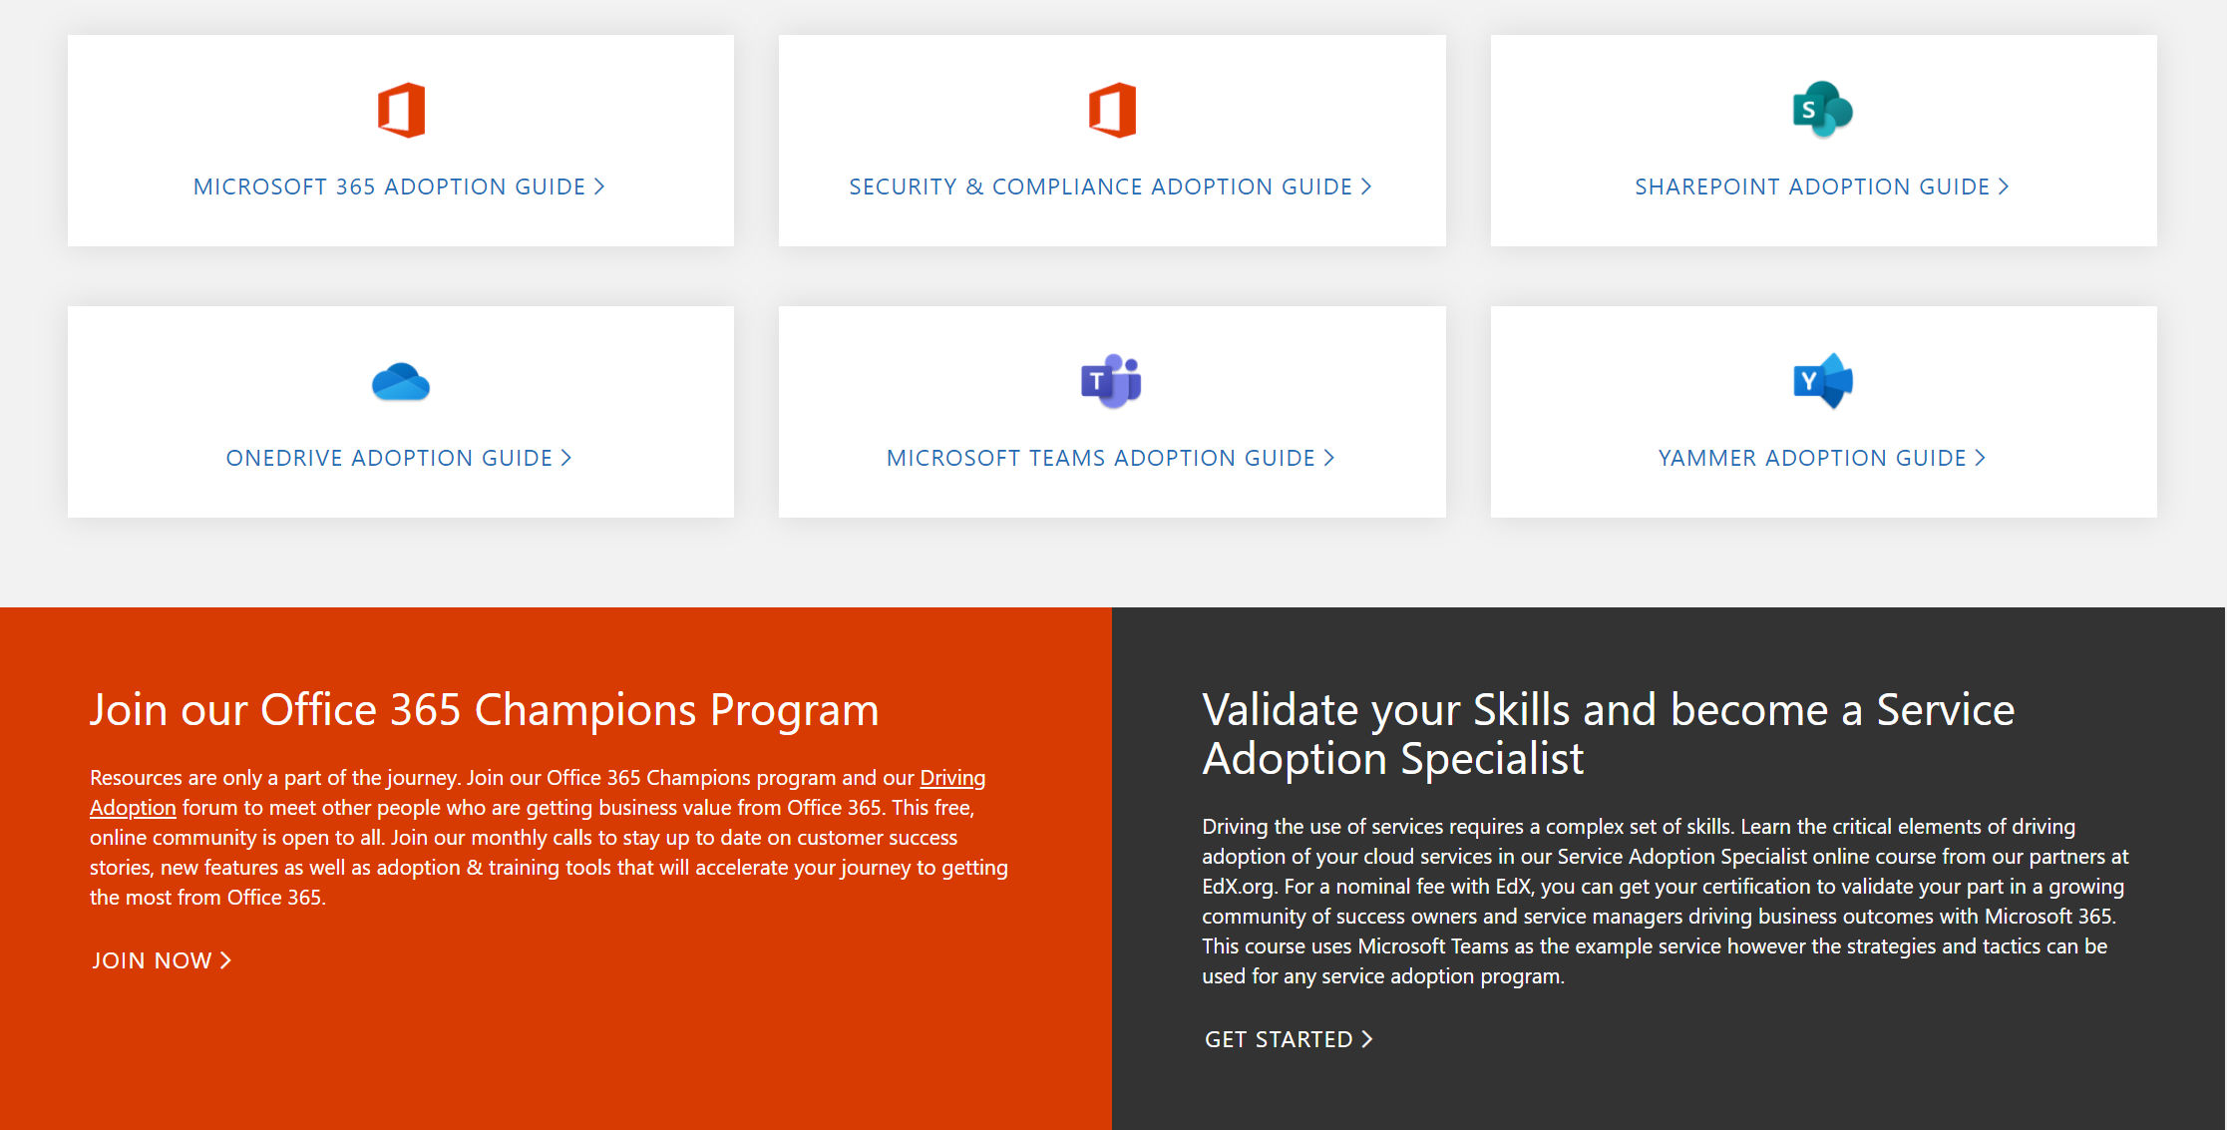
Get Started at https://aka.ms/MicrosoftAdoption
Notes:
Accelerate your deployment and adoption of Office 365 services by visiting our unified resource page for adoption guidance on the Microsoft Technical community at https://aka.ms/MicrosoftAdoption. Review materials for Microsoft 365, our security and compliance features or key teamwork workloads like SharePoint, OneDrive, Microsoft Teams and Yammer. Find additional resources for Microsoft Teams in Government and devices for Teams within the Microsoft Teams adoption guide.
This is a step forward in our response to your feedback to make adoption materials easier to discover and use. Over the coming months we will continue to unify and standardize these materials across all our Microsoft 365 services. Share more feedback in our Driving Adoption community at https://aka.ms/DriveAdoption.

Slide 9
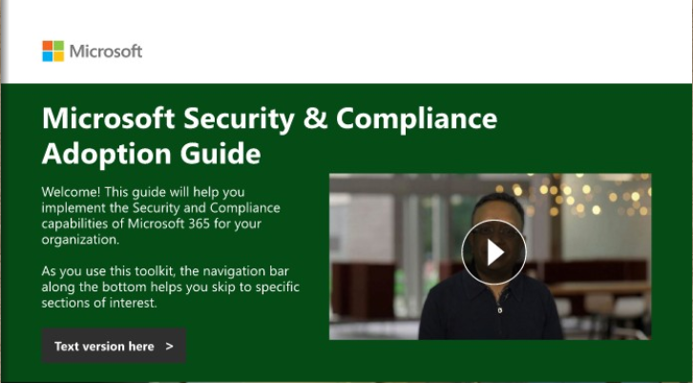


Get Started at https://aka.ms/MicrosoftAdoption

Slide 10
Yammer for the Win

Slide 11





The Power of Employee Engagement
These four key pieces influence employees to create more and stronger work, stay with their organization longer, and win the best customers for the future.*
Leadership connection
Internal communications
Build an ongoing, two-way connection between leadership and employees
Communicate at scale to keep people informed and involved
Employee Engagement
70% of employees are engaged at best performing companies *
21% more profit in business units with most engaged employees
Employee sharing & learning
Insights into your workplace
Create a culture of open sharing and learning where people exchange interests, expertise, and ideas
Understand your organization’s
own best practices
and use them
to accelerate change
* Sources Gallup: 37 Workplaces That Stand Out from the Rest

Slide 12
Teamwork in Microsoft 365
Yammer
Teams
Outlook
Inner Loop
Outer Loop
People you work with regularly
People you connect with across the org
Run effective meetings & projects
Content collaboration
Inform & engage employees
SharePoint
Video & live events
Stream
Email
Ubiquitous for targeted communications
Manage your time & communications

Slide 13

Are you driving culture change?
Is social common to your employee demographic?
Can you improve communication?
Do you have or plan to have Teams?
Are your public groups greater than 5k members?

Slide 14
Resources

Slide 15



Coffee in the Cloud
Get more from Office 365
https://aka.ms/CoffeeintheCloud
Subscribe now to Learn About:
Business Solutions
Best Practices & How-To’s
For Admin’s and Champions
@CITCTV

Slide 16
Microsoft Teams Resource Cheat Sheet
https://aka.ms/M365Roadmap
https://aka.ms/TeamsCommunity
https://aka.ms/SuccessWithTeams
https://aka.ms/CoffeeintheCloud
Microsoft 365 Roadmap
All public feature delivery dates
Filter by product
Microsoft Technical Community
Product forums and blogs
Driving Adoption forum
O365 Champion’s Corner
Success with Teams Practical Guidance
Learn how to plan, deliver, adopt and manage Microsoft Teams
Skype for Business to Teams transition guidance
Coffee in the Cloud on YouTube
Short how-to videos for IT Pro’s and Champions
Long form end user & administrator training
Continue Your Education
https://aka.ms/O365Champions
Office 365 Champions Program
Free monthly calls with Microsoft experts & peers
Early access to adoption resources and tools
Open to all business users, IT Pro’s and developers who want to drive adoption of cloud solutions & services
Sign Up

Slide 17
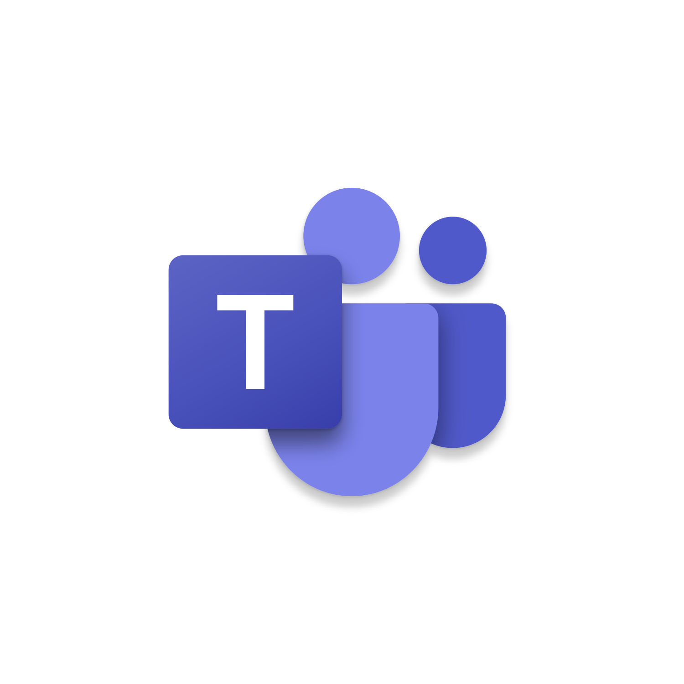
Start building solutions
Get Started
  Teams Documentation: aka.ms/TeamsDev
  External integrations: aka.ms/TeamsIntegrations
  Platform training videos: aka.ms/TeamsPlatformAcademy
  Developer Support: aka.ms/TeamsDevSupport
Join the community
  Teams Dev Center: aka.ms/Teams.Dev
  Tech Community (QnA): aka.ms/TeamsCommunity
  Teams dev blog: aka.ms/TeamsDevBlog
Notes:
We are happy to share these core links with you, but here are the three next steps
that are most important for you to get started and build your own integration for Microsoft Teams.

