Slide 1

Office 365 Champion Community
January 2019 Monthly Meeting
Karuana Gatimu
Customer Advocacy Group
Notes:
Join our program at https://aka.ms/O365Champions
Materials included in this deck are free to use in your daily work.
Please reference our program as the source of this information.
For questions or comments please reach out in the Drive Adoption or Champion’s Corner forums of the Microsoft Technical Community at https://aka.ms/DriveAdoption

Slide 2
Agenda
Inspiration
Information
Tools
User Groups & SharePoint Saturdays
Adoption Specialist
Governance
Asks
Flipbook Feedback
Super Blood Wolf Moon Lunar Eclipse

Slide 3
Microsoft Resource Cheat Sheet
https://aka.ms/O365Roadmap
https://aka.ms/TechCommunity
https://docs.microsoft.com
https://developer.microsoft.com
Office 365 Roadmap
All public feature delivery dates
Filter by product
Microsoft Technical Community
Product forums and blogs
Driving Adoption forum
O365 Champion’s Corner
IT Pro & Adoption Documentation
Learn how to plan, deliver, adopt and manage Microsoft 365 products
Developer Documentation
Training, documentation, samples & communities for developers
Continue Your Education
https://aka.ms/O365Champions
Office 365 Champions Program
Free monthly calls with Microsoft experts & peers
Early access to adoption resources and tools
Open to all business users, IT Pro’s and developers who want to drive adoption of cloud solutions & services
Sign Up

Slide 4

The successful adoption of Microsoft 365 represents a change in behavior.
It is more than a set of products—it is a fundamentally different way of working.
This change is about people.
Notes:
M365 has the potential to change the trajectory of an organization in many ways, besides the technology itself:
People fundamentally change the way they work
We enable a modern workplace and the optimization of Office 365
We provide the capability to accelerate the alignment of economic and cultural business drives
We allow organizations to enter a state of dynamic stability*
*“Dynamic stability is like riding a bicycle, where you cannot stand still, but once you are moving it is actually easier. It is not our natural state. But humanity has to learn to exist in this state.¹”
1 Friedman, Thomas L. Thank you for Being Late. New York: Farrar, Straus and Giroux, 2016.
“The need to move to a highly flexible and adaptable digital approach is urgent. The applications required today are not going to last for 30 years. They are maybe only going to be used for maybe two, three years.²”
2 McKendrick, J. (2018. Jan 21) The ultimate technology success metric: owning the customer relationship. Retrieved from http://www.zdnet.com/article/business-transformation-before-technology/

Slide 5


Rare events happen BUT they are all part of a larger cycle
Photo Credit: James Jordon
Photograph: Anadolu Agency/Getty Images

Slide 6
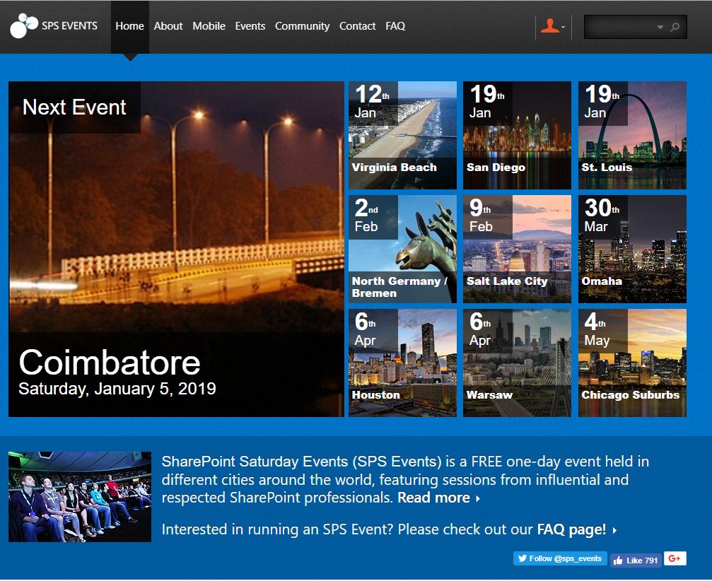
SharePoint Saturdays
SPSEvents.org

Slide 7
Now Available
Teams Toolkit Flipbook
Notes:
O365 Adoption Toolkit – Adoption & Deployment Workstreams
vE10-18.1

Slide 8
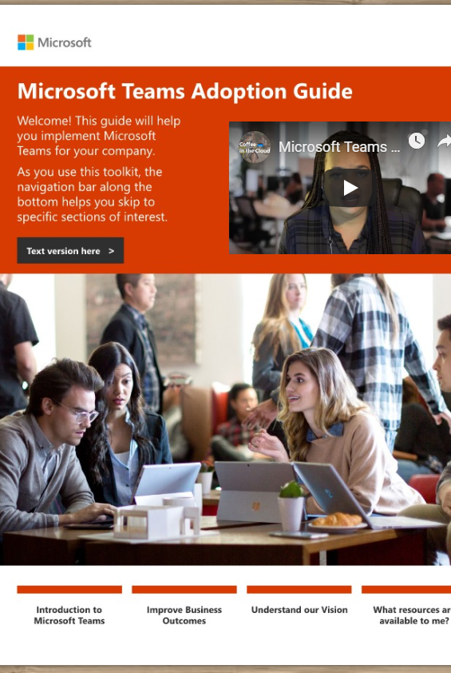
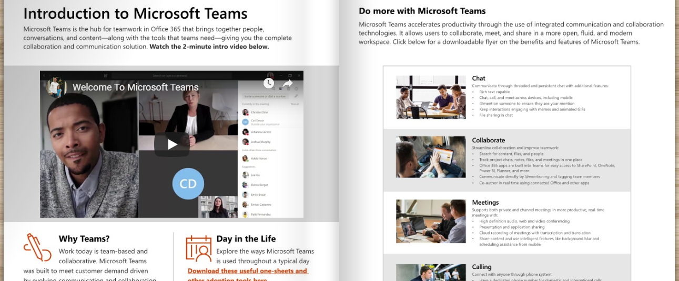
Teams Toolkit
Tell the Teams Story https://aka.ms/TeamsToolkit

Slide 9
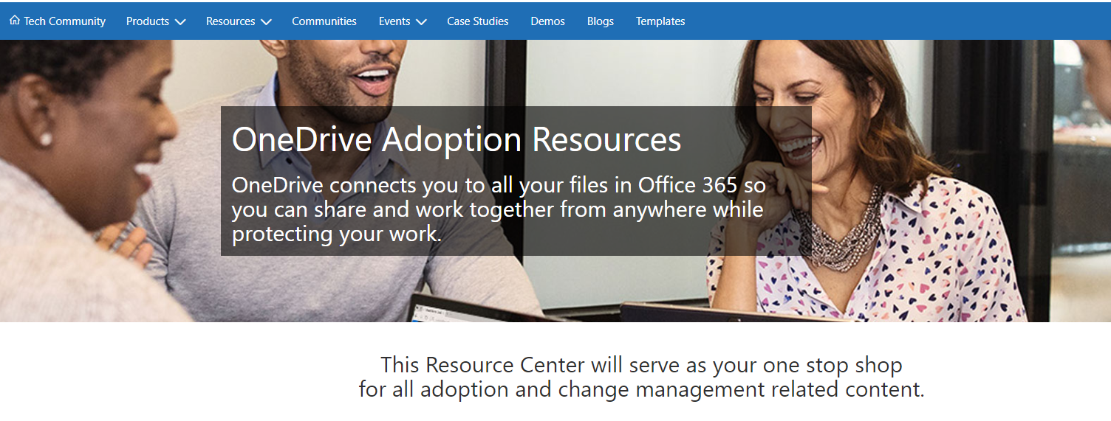
OneDrive Adoption Guidance https://aka.ms/OneDriveAdoption
Notes:
O365 Adoption Toolkit – Adoption & Deployment Workstreams
vE10-18.1

Slide 10
This Month’s Topics
Microsoft Service Adoption Specialist online course
Teamwork Governance Concepts
Notes:
O365 Adoption Toolkit – Adoption & Deployment Workstreams
vE10-18.1

Slide 11
Become a Certified Service Adoption Specialist

Slide 12
Learning Objectives
Understand the six knowledge areas required for service adoption professionals
Learn strategies and tactics for adoption implementation
Connect to a community of like-minded people to continue expanding your skills
Expand your career to include verified service adoption skills

Slide 13
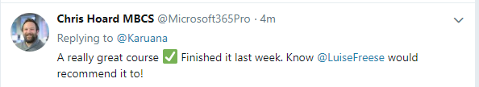
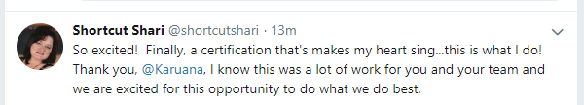
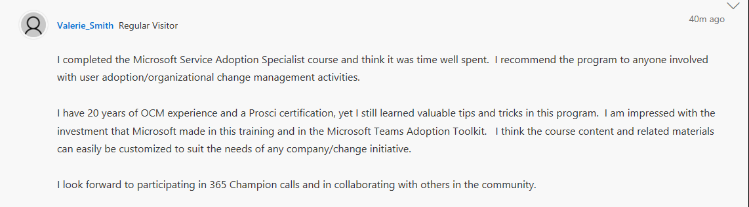
What People are Saying

Slide 14
Get Certified!
Visit https://aka.ms/AdoptionCert to get started
Pass the test and get your certification
Join the Driving Adoption community at https://aka.ms/DriveAdoption to continue your education
Share your achievement with your manager, organization and on your LinkedIn profile

Slide 15
Adoption Assets by Scenario
I want to… | Then use… | Success Looks like… | Notes
Help my customer understand why to use Teams and how to get started | https://aka.ms/TeamsToolkit | Stakeholder returns asking for help (IT, FastTrack or Partner); adoption begins to move forward
Help an ITPro understand what is required to implement Teams | https://aka.ms/SuccessWithTeams | ITPro gains information about technical requirements, begins to understand user adoption requirements. Asks for help.
Help end users use Microsoft Teams | https://TeamsLiveTraining | End users deepen their engagement with Team and increase adoption. | Instructor led courses to enable Teams beginners. Online video training also available.
Provide a consistent place where customers can learn about adoption of all teamwork workloads. Ask questions & get content | https://aka.ms/O365Champions program | Champions attend monthly calls, learning more about teamwork solutions from Microsoft. They start their own Champion program with our materials. | Customers who are currently in countries not able to join can simply visit https://aka.ms/DriveAdoption to be a part of the broader community
Give a certification path for customers, partners and employees who want to become Service Adoption Specialists | https://aka.ms/AdoptionCert | Confidence and a common language for service adoption skills, strategies and tactics. | Microsoft Service Adoption Specialist online course. Available to all on EdX.org as of Jan 1st

Slide 16
Governance

Slide 17
Roles and their needs
Business
Accomplish business goals as simply as possible – if it’s too hard, find an easier way
Limit business disruption
Security officer
Employee
Get out of my way
Make it easy for me to get my work done fast
Let me share easily, but protect my secret stuff
Prevent data leaks and breaches
Protect high value information
IT
Legal
IT admin
Comply with retention
Support eDiscovery
Manage the increasing volume of data
Keep up with changing services & threats
Make all other roles happy

Slide 18
Types of governance
Solution governance
Discovery
governance
Security
governance
Container and content governance

Slide 19

Managing identity and user experience
Device
Identity
Data
Location

Slide 20
Pillars of container and content governance
Empower
employees
Identify
valuable content
Protect
assets
Ensure
accountability
Support self-service creation
Use life-cycle management
Require classification for containers
Scan with data loss prevention (DLP)
Limit reach
Enforce policy
Use conditional access
Use Information Rights Management (IRM)
Manage group/site ownership
Review external membership
Use IT services
Notes:
David
Slide objective
Identify how we manage container and content governance.
Talking points
Container and content governance involves several important focus points to help ensure that our data is safe and secure.
Speaker notes
Container and content governance involve the most collaborative planning:
Empower employees by managing the lifecycle, so that the container or content service is resource-optimized.
Identify valuable content by managing classification of sites on-premises and in the cloud.
Protect assets by limiting access to high-value content by enforcing external membership.
Maintain accountability by ensuring that no container is without an owner.

Slide 21
Defining my Office 365 group & experiences
Determining the altitude for group membership
What are the triggers?
Factors for defining group:
Right security boundary
Appropriate classification
Topic relevant to group
Includes effective set of
members:
  Active participant
  Stakeholder
  Informed
Hub Sites
Public Communities
Company
Modern sites
Tier 1 Teams
Division
Tier 2 Teams
Targeted Communities
Department
Tier 3 Teams or SharePoint Sites
Workgroup
Many workgroups, few divisions
Notes:
Frank

Slide 22
Governance Quick Start
Who can create Teams?
Naming Conventions?
Guest Access?
Approved Apps?
Meeting Capabilities?
Data Security?
Make Phase 1 of these decisions for the Experimentation phase of your deployment.
Revisit for broad scale adoption.
https://docs.microsoft.com/en-us/MicrosoftTeams/teams-adoption-governance-quick-start

Slide 23
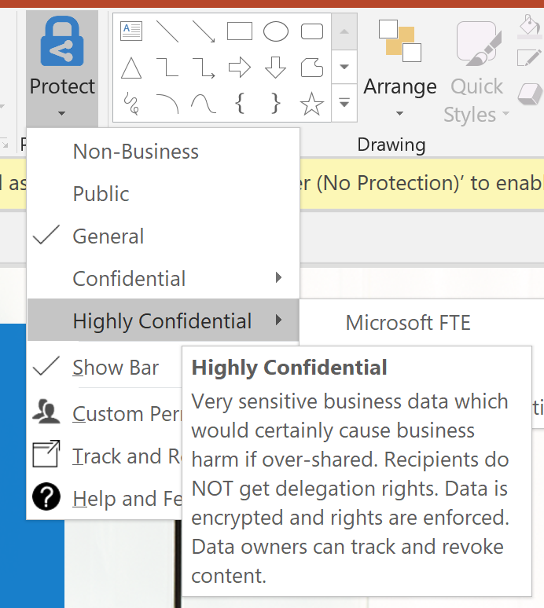
Protect content
Azure Information Protection (AIP)
End users label and classify
Apply protection to a file based on its label​
Prevent external people not in protection policy from opening a file​
Data loss protection (DLP)
Automatic detection and protection
Detect and prevent oversharing
  Block sharing based on patterns in file
  Manage DLP policies across Office 365 workloads
Protecting the group
Run jobs to change Team settings based on Team classification​
Unified labels will bring this to Office 365 groups​
Information protection life cycle
Detect
Classify
Protect
Monitor
Notes:
James
[Notes: AIP: Azure Information Protection. (UI changed) Employees label the files themselves. In addition, I want to catch patterns of content that may not have been labeled appropriately (DLP) like cc number or ss number and block it. Screenshot is AIP example. When saving to SP, you get prompted about the classification. Screenshot shows that when you save a file to SharePoint, you're prompted to classify it.]

Slide 24
Container and file classification
Example: Replace with your labels
Highly Confidential
The most critical data for Microsoft. Share it only with named recipients.
Confidential
Crucial to achieving our goals. Limited distribution—on a need-to-know basis.
General
Daily work product used and shared throughout Microsoft, like personal settings and zip codes. Share it throughout Microsoft internally.
Public
Public data is unrestricted data meant for public consumption, like publicly released source code and announced financials. Share it freely.

Slide 25
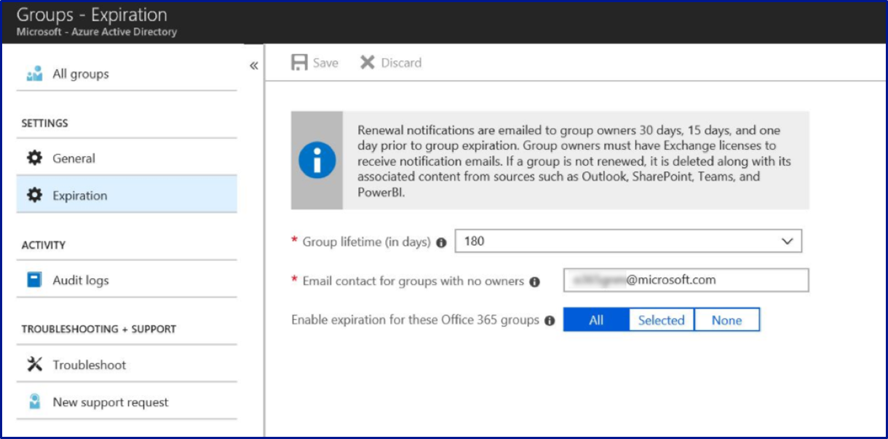
Expiration policy
Admin configuration
Set expiration timeline
Notification intervals are set automatically
Set fallback email address for ownerless groups
Apply policy to selected groups
Related resources:
Office 365 Group Expiration Policy
Configure Office 365 groups expiration
Notes:
David
Michelle – post resource to live related resources widget

Slide 26
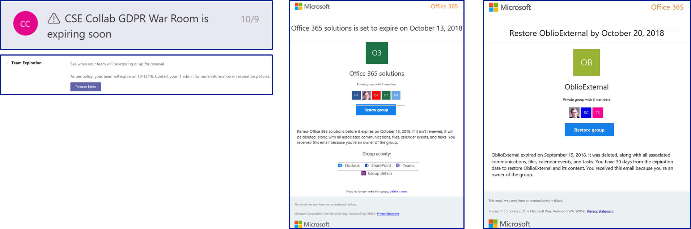
Group Owner experience of expiration policy
Group Owner
Renew expired groups
Restore expired groups that were soft deleted
Teams renewal notice
Outlook renewal notice
Outlook restore notice
Notes:
David
[Notes: This shows what happens on expiration. First box is notice. 2nd box tells you it's been done. Bottom screen shot from Teams. The group owner will get email plus notice in Teams in parallel with top left screenshot.]

Slide 27

External collaboration
Invited member
Office 365 groups
Access
Office 365 data
Group X
Policies and permissions
Group Y
SharePoint
Teams
Targeted guest
Group Z

Slide 28
Visit https://aka.ms/O365ChampionFeedback
Share your product & topics of interest
Tell us what times work for you
Open feedback section
Help us design this program!

Slide 29
Resources

Slide 30
Configuring O365 Classification

Slide 31
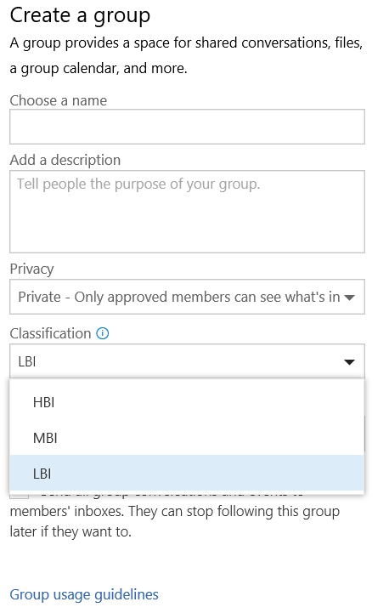
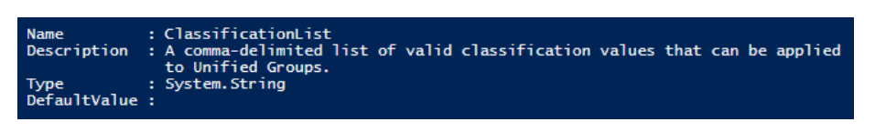
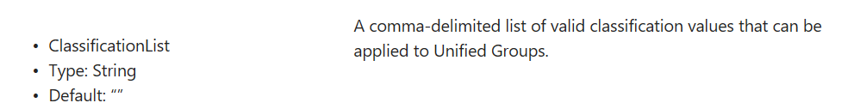
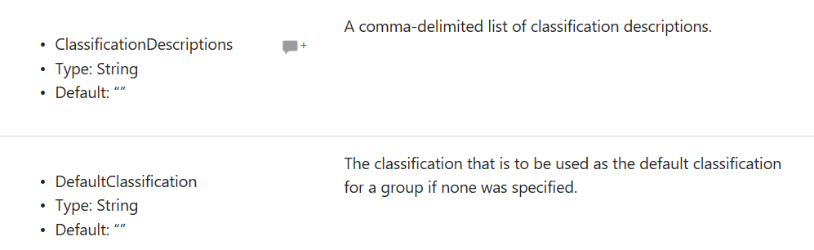
How to setup Classification
Connect-MsolService
$settings = Get-MsolAllSettings | where-object {$_.displayname -eq “Group.Unified”}
$singlesettings = Get-MsolSettings -SettingId $settings.ObjectId
$value = $singlesettings.GetSettingsValue()
$value[“ClassificationList”] = “HBI, MBI, LBI”
Set-MsolSettings -SettingId $settings.ObjectId -SettingsValue $value

Slide 32
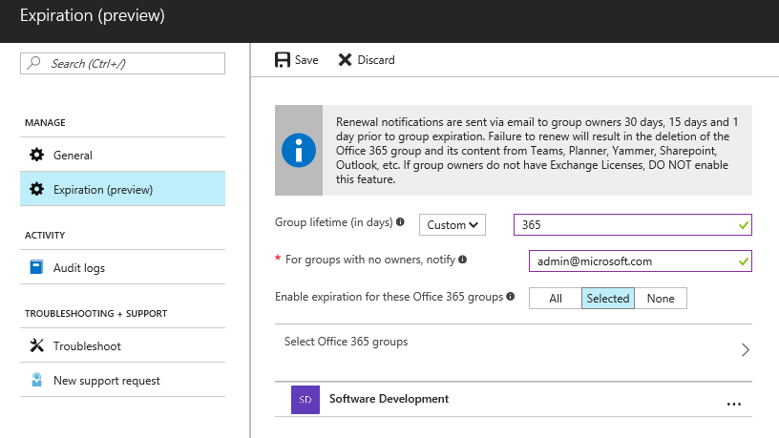
How to setup Expiration Policy
Admin
Set expiration timeline
Notification intervals are autoset
Set fallback email address for ownerless groups
Apply the policy to selective groups
Admin Tool
Azure AD powershell
—Supported in V1 release
Azure AD portal
—Supported in V1 release
* A maximum of 500 groups can be selected to apply the policy in the
AAD portal UI. Group selection has no restriction in the AAD powershell.

Slide 33
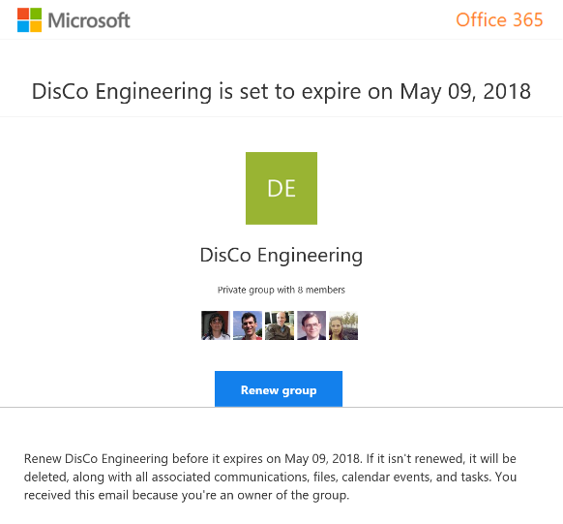
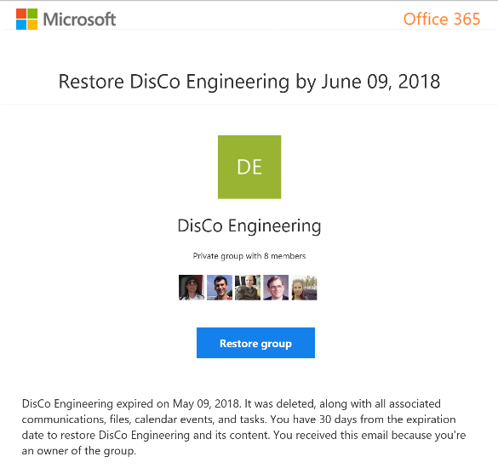

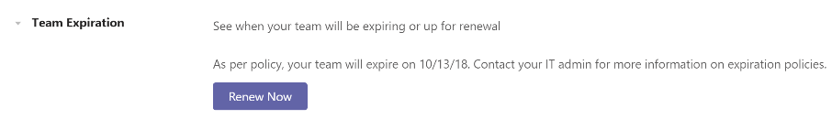
Group Owner experience of expiration policy
Renew expired groups
Restore expired groups
that were soft deleted

Slide 34
Enforce policy
Groups governance reduces customization
Official roadmap on fasttrack.office.com/roadmap
Policy | SharePoint custom | In product (Office 365/Azure AD) | Groups custom
Enable self-service site collection / group creation | Yes | Yes
Collect classification for all containers | Yes | Yes (Updated)
User awareness: Display classification | Yes | Yes
Enforce naming rules | N/A | Yes (New)
Usage guideline visibility | Yes | Yes
Ownership accountability: (1 Full-time, 2 people) | Yes |  | Workaround
Set public vs. private based on classification | N/A |  | Yes
External sharing limited based on classification (HBI) | Yes |  | Yes
Guest membership disallowed with classification (HBI) | N/A |  | Yes
Life cycle: 6-month expiry | Yes | Yes (New)
Membership life cycle: Enforce external renewals | Yes (policy based) | In development
Limit reach based on classification | Yes |  | Yes
Multi-geo; Provision based on user’s region |  | In development

Slide 35
Microsoft Teams Resource Cheat Sheet
https://aka.ms/O365Roadmap
https://aka.ms/TeamsCommunity
https://aka.ms/SuccessWithTeams
https://aka.ms/CoffeeintheCloud
Office 365 Roadmap
All public feature delivery dates
Filter by product
Microsoft Technical Community
Product forums and blogs
Driving Adoption forum
O365 Champion’s Corner
Success with Teams Practical Guidance
Learn how to plan, deliver, adopt and manage Microsoft Teams
Skype for Business to Teams transition guidance
Coffee in the Cloud on YouTube
Short how-to videos for IT Pro’s and Champions
Long form end user & administrator training
Continue Your Education
https://aka.ms/O365Champions
Office 365 Champions Program
Free monthly calls with Microsoft experts & peers
Early access to adoption resources and tools
Open to all business users, IT Pro’s and developers who want to drive adoption of cloud solutions & services
Sign Up

Slide 36



Coffee in the Cloud
Get more from Office 365
https://aka.ms/CoffeeintheCloud
Subscribe now to Learn About:
Business Solutions
Best Practices & How-To’s
For Admin’s and Champions
@CITCTV

