Slide 1
Office 365 Champion Community
February 2019 Monthly Meeting
Karuana Gatimu
Customer Advocacy Group
Notes:
Join our program at https://aka.ms/O365Champions
Materials included in this deck are free to use in your daily work.
Please reference our program as the source of this information.
For questions or comments please reach out in the Drive Adoption or Champion’s Corner forums of the Microsoft Technical Community at https://aka.ms/DriveAdoption

Slide 2
Agenda
Inspiration
Information
Tools
Instructor Led Training for Microsoft Teams
Microsoft 365 Training Guide & Workbook
Asks
Flipbook Feedback
Seattle Snowmageddon 2019

Slide 3
Microsoft Resource Cheat Sheet
https://aka.ms/O365Roadmap
https://aka.ms/TechCommunity
https://docs.microsoft.com
https://developer.microsoft.com
Office 365 Roadmap
All public feature delivery dates
Filter by product
Microsoft Technical Community
Product forums and blogs
Driving Adoption forum
O365 Champion’s Corner
IT Pro & Adoption Documentation
Learn how to plan, deliver, adopt and manage Microsoft 365 products
Developer Documentation
Training, documentation, samples & communities for developers
Continue Your Education
https://aka.ms/O365Champions
Office 365 Champions Program
Free monthly calls with Microsoft experts & peers
Early access to adoption resources and tools
Open to all business users, IT Pro’s and developers who want to drive adoption of cloud solutions & services
Sign Up

Slide 4
The successful adoption of Microsoft 365 represents a change in behavior. It is more than a set of products—it is a fundamentally different way of working. This change is about people.
Notes:
M365 has the potential to change the trajectory of an organization in many ways, besides the technology itself:
People fundamentally change the way they work
We enable a modern workplace and the optimization of Office 365
We provide the capability to accelerate the alignment of economic and cultural business drives
We allow organizations to enter a state of dynamic stability*
*“Dynamic stability is like riding a bicycle, where you cannot stand still, but once you are moving it is actually easier. It is not our natural state. But humanity has to learn to exist in this state.¹”
1 Friedman, Thomas L. Thank you for Being Late. New York: Farrar, Straus and Giroux, 2016.
“The need to move to a highly flexible and adaptable digital approach is urgent. The applications required today are not going to last for 30 years. They are maybe only going to be used for maybe two, three years.²”
2 McKendrick, J. (2018. Jan 21) The ultimate technology success metric: owning the customer relationship. Retrieved from http://www.zdnet.com/article/business-transformation-before-technology/

Slide 5
There is no exception for preparation

Slide 6
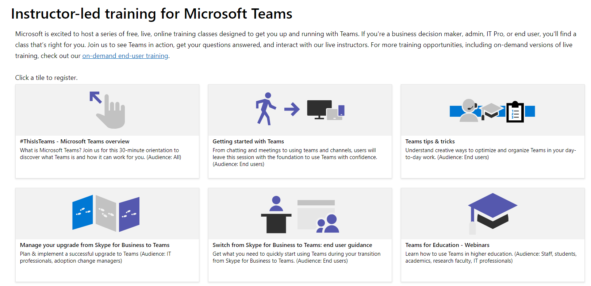
Free Training for Microsoft Teams

Slide 7
Now Available Microsoft 365 Adoption Guide & Planning Workbook
Notes:
O365 Adoption Toolkit – Adoption & Deployment Workstreams
vE10-18.1

Slide 8
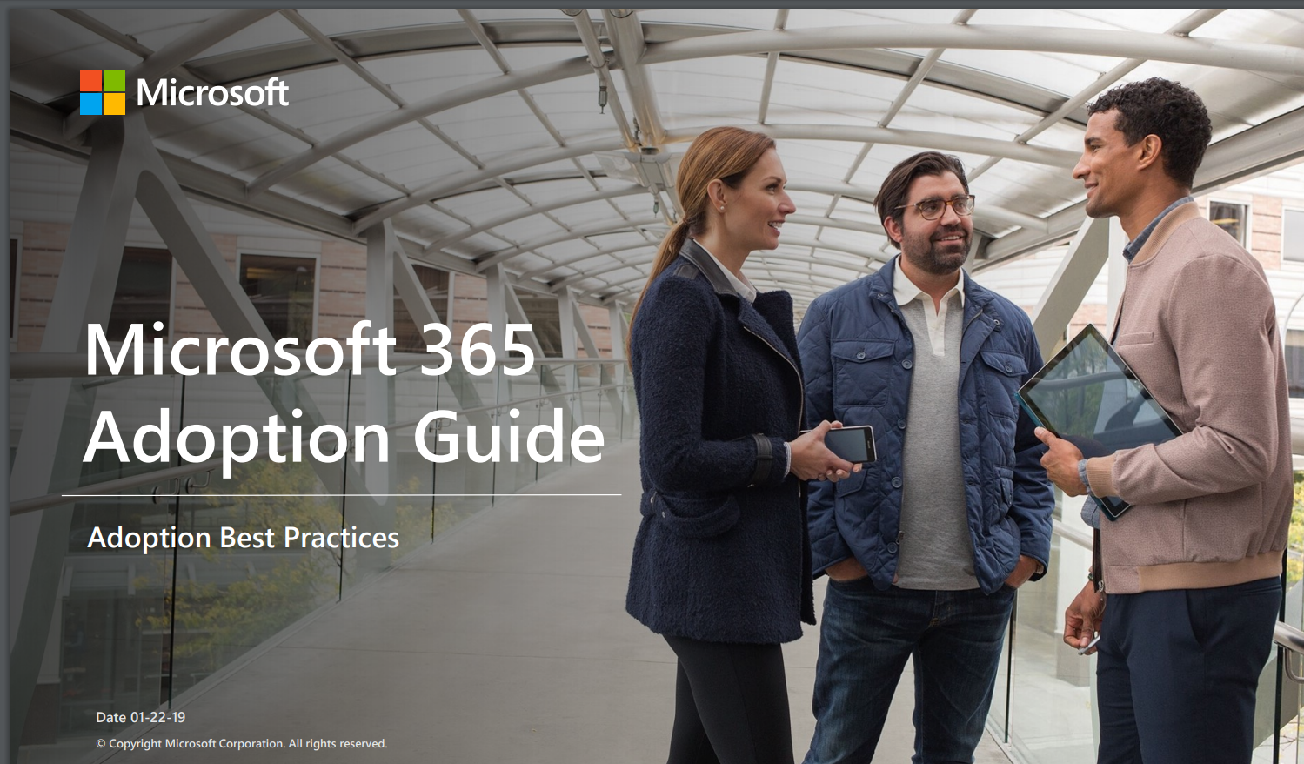
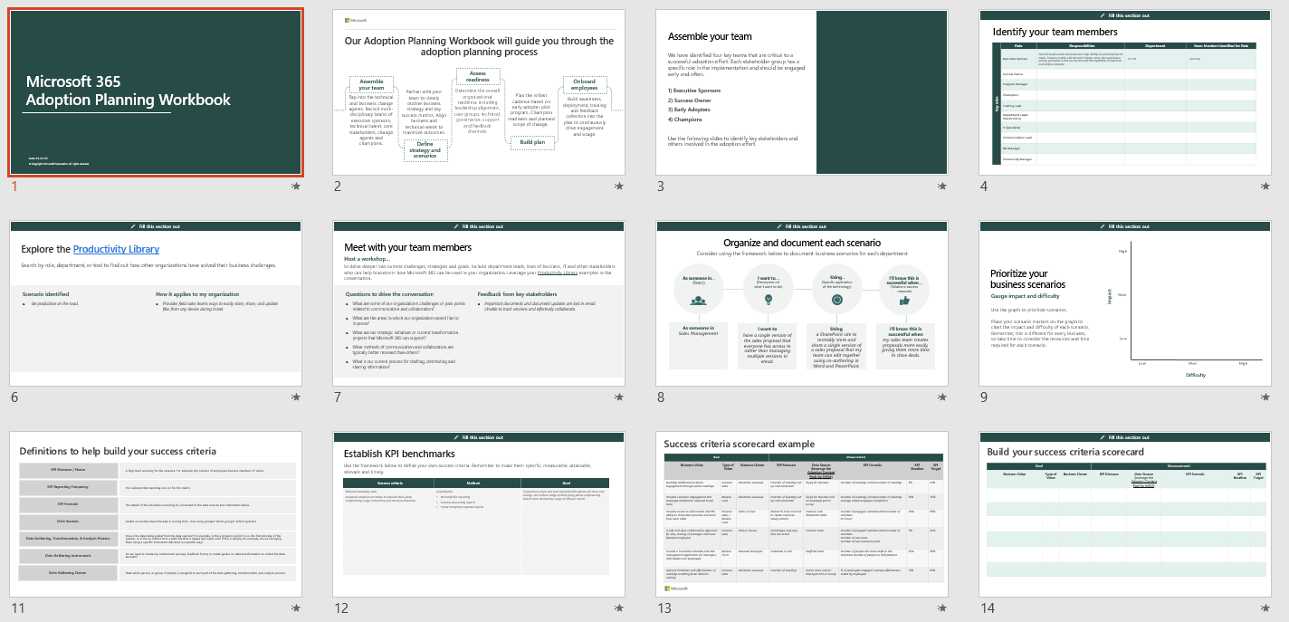
Microsoft 365 Adoption Guide: https://aka.ms/M365AG Planning Workbook: https://aka.ms/M365AGWorkbook

Slide 9
Visit https://aka.ms/O365ChampionFeedback
Share your product & topics of interest
Tell us what times work for you
Open feedback section
Help us design this program!

Slide 10
Resources

Slide 11
Configuring O365 Classification

Slide 12
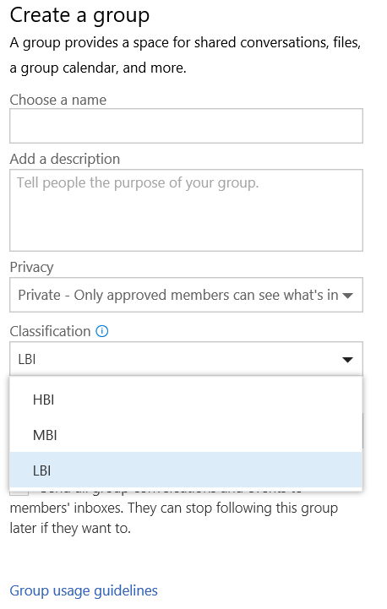
How to setup Classification
Connect-MsolService
$settings = Get-MsolAllSettings | where-object {$_.displayname -eq “Group.Unified”}
$singlesettings = Get-MsolSettings -SettingId $settings.ObjectId
$value = $singlesettings.GetSettingsValue()
$value[“ClassificationList”] = “HBI, MBI, LBI”
Set-MsolSettings -SettingId $settings.ObjectId -SettingsValue $value

Slide 13
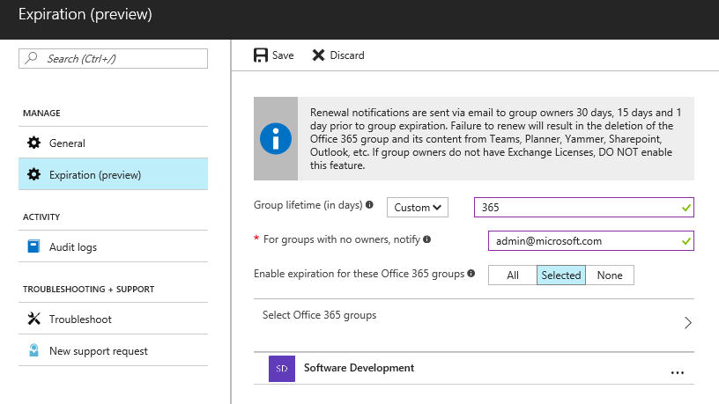
How to setup Expiration Policy
Admin
Set expiration timeline
Notification intervals are autoset
Set fallback email address for ownerless groups
Apply the policy to selective groups
Admin Tool
Azure AD powershell —Supported in V1 release
Azure AD portal —Supported in V1 release
* A maximum of 500 groups can be selected to apply the policy in the AAD portal UI. Group selection has no restriction in the AAD powershell.

Slide 14
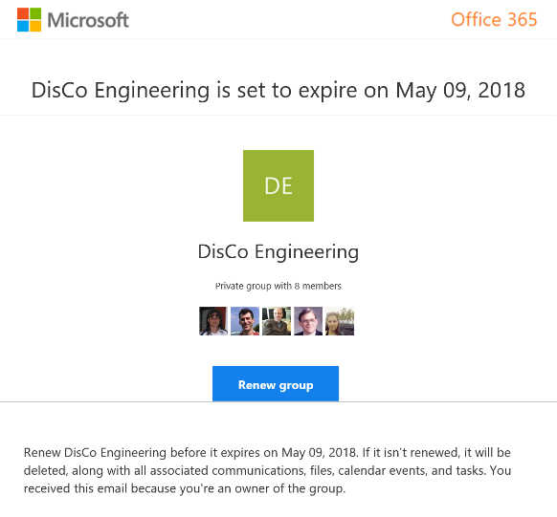
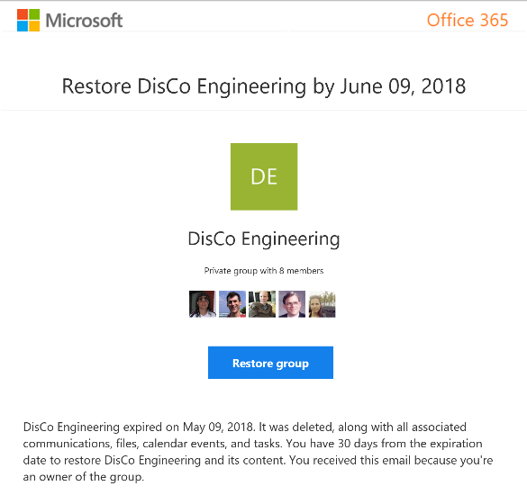
Group Owner experience of expiration policy
Renew expired groups
Restore expired groups that were soft deleted

Slide 15
Enforce policy Groups governance reduces customization
Official roadmap on fasttrack.office.com/roadmap
Policy | SharePoint custom | In product (Office 365/Azure AD) | Groups custom
Enable self-service site collection / group creation | Yes | Yes
Collect classification for all containers | Yes | Yes (Updated)
User awareness: Display classification | Yes | Yes
Enforce naming rules | N/A | Yes (New)
Usage guideline visibility | Yes | Yes
Ownership accountability: (1 Full-time, 2 people) | Yes |  | Workaround
Set public vs. private based on classification | N/A |  | Yes
External sharing limited based on classification (HBI) | Yes |  | Yes
Guest membership disallowed with classification (HBI) | N/A |  | Yes
Life cycle: 6-month expiry | Yes | Yes (New)
Membership life cycle: Enforce external renewals | Yes (policy based) | In development
Limit reach based on classification | Yes |  | Yes
Multi-geo; Provision based on user’s region |  | In development

Slide 16
Microsoft Teams Resource Cheat Sheet
https://aka.ms/O365Roadmap
https://aka.ms/TeamsCommunity
https://aka.ms/SuccessWithTeams
https://aka.ms/CoffeeintheCloud
Office 365 Roadmap
All public feature delivery dates
Filter by product
Microsoft Technical Community
Product forums and blogs
Driving Adoption forum
O365 Champion’s Corner
Success with Teams Practical Guidance
Learn how to plan, deliver, adopt and manage Microsoft Teams
Skype for Business to Teams transition guidance
Coffee in the Cloud on YouTube
Short how-to videos for IT Pro’s and Champions
Long form end user & administrator training
Continue Your Education
https://aka.ms/O365Champions
Office 365 Champions Program
Free monthly calls with Microsoft experts & peers
Early access to adoption resources and tools
Open to all business users, IT Pro’s and developers who want to drive adoption of cloud solutions & services
Sign Up

Slide 17
Coffee in the Cloud
Get more from Office 365
https://aka.ms/CoffeeintheCloud
Subscribe now to Learn About:
Business Solutions
Best Practices & How-To’s
For Admin’s and Champions
@CITCTV

