Slide 1


Office 365 Champion Community
December 2019 Monthly Meeting
Karuana Gatimu
Customer Advocacy Group
Notes:
Join our worldwide program at https://aka.ms/O365Champions
Materials included in this deck are free to use in your daily work.
Please reference our program as the source of this information.
For questions or comments please reach out in the Drive Adoption or Champion’s Corner forums of the Microsoft Technical Community at https://aka.ms/DriveAdoption

Slide 2

The successful adoption of Microsoft 365 represents a change in behavior.
It is more than a set of products—it is a fundamentally different way of working.
This change is about people.
And we are here to help.
Notes:
M365 has the potential to change the trajectory of an organization in many ways, besides the technology itself:
People fundamentally change the way they work
We enable a modern workplace and the optimization of Office 365
We provide the capability to accelerate the alignment of economic and cultural business drives
We allow organizations to enter a state of dynamic stability*
*“Dynamic stability is like riding a bicycle, where you cannot stand still, but once you are moving it is actually easier. It is not our natural state. But humanity has to learn to exist in this state.¹”
1 Friedman, Thomas L. Thank you for Being Late. New York: Farrar, Straus and Giroux, 2016.
“The need to move to a highly flexible and adaptable digital approach is urgent. The applications required today are not going to last for 30 years. They are maybe only going to be used for maybe two, three years.²”
2 McKendrick, J. (2018. Jan 21) The ultimate technology success metric: owning the customer relationship. Retrieved from http://www.zdnet.com/article/business-transformation-before-technology/

Slide 3
Agenda
Inspiration
Information
Tools
Events and 2020 Meeting Schedule
Transforming Communication with Microsoft Stream & Live Events
A New Decade
Find prior meeting content at https://aka.ms/O365ChampionResources

Slide 4
Microsoft Resource Cheat Sheet
https://aka.ms/M365Roadmap
https://aka.ms/TechCommunity
https://docs.microsoft.com
https://developer.microsoft.com
Microsoft 365 Roadmap
All public feature delivery dates
Filter by product
Microsoft Technical Community
Product forums and blogs
Driving Adoption forum
Diversity & Inclusion forum
IT Pro & Adoption Documentation
Learn how to plan, deliver, adopt and manage Microsoft 365 products
Developer Documentation
Training, documentation, samples & communities for developers
Tools and Resources
https://aka.ms/MicrosoftAdoption
Microsoft Adoption Hub
Adoption resources for O365 services
O365 Champion sign up and Information
M365 Learning Pathways & Service Adoption Specialist course information
Visit Us

Slide 5


Training Tools for Microsoft Teams
Get Started with Teams
https://teams.conversationalgeek.com
Managers Guide to Microsoft Teams
https://teamsbook.info

Slide 6
2020: A New Decade
A satisfying career is the result of reflection, planning and steady work.
What did I accomplish in the last 10 years?
What are the top 3 things I’d like to have done differently?
What are my top goals for the next 10 years?
Do I have a for-the-decade bucket list?
The impossible becomes possible with our community

Slide 7
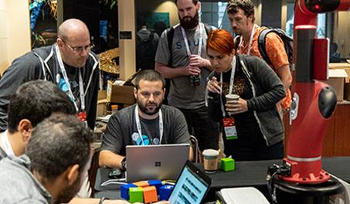
Events
O365 Champion Mixer @ MITT
February 6th – Washington DC
Register @ https://aka.ms/O365ChampionMixer
It’s not too late! Make your voice heard!
Complete our survey at https://aka.ms/O365ChampionSurvey

Slide 8

O365 Champion Schedule & Topics
January to June, 2020
15 Jan.
Getting Started with OfficePro Plus
19 Feb.
Modern Project Management using Tasks & Project
25 Mar.
Low Code & No Code Solutions with PowerPlatform
22 Apr.
Smart Content Management with SharePoint Sites & News
13 May
SharePoint Conference Preview
17 June
What’s Next in Knowledge Management
Every month we’ll share a new Champion Tip for Microsoft Teams
Stay tuned for more on our #BetterTogether webinar series on our blog at https://aka.ms/DriveAdoption

Slide 9
Preview: #BetterTogether Webinar Series
Deep Dive How To Topics - January to March 2020
29 Jan.
Implementing Teamwork Governance for Office 365
26 Feb.
Manage Projects & Events with Tasks & Teams
PowerApps for Culture Change and Process Improvement
Streamline Grant Management & Volunteer Coordination with Microsoft Teams
18 Feb.
31 Mar.
Each webinar is 90 minutes and demonstrates how to build the solutions outlined
Join our Office 365 Champion’s program for getting started topics and adoption guidance at https://aka.ms/O365Champions

Slide 10
Transforming Communication
Microsoft Stream & Live Events
(with Yammer & Teams!)

Slide 11
Types of Meetings
Product Demo
SCRUM

Trainings


Project Update
Spec Review
Sales Webinars



Town Hall

Exec Review

Shiproom


Slide 12
Purpose of Meetings
Product Demo
SCRUM

Trainings


Project Update
Spec Review
Sales Webinars



Town Hall

Exec Review

Shiproom

But…why do we even have meetings?
Why?
What?
How?

Slide 13
The Characteristics of Workplace Communication
Why?
Project Update
Exec Review
Town Hall



What?
Product Demo
Trainings
Sales Webinars



How?
SCRUM
Spec Review
Shiproom



Key Pillars


Scale
Structure
The number of people within your meeting is a key differentiating factor between the numerous scenarios
As meetings get larger, Structure is key element for success which also serves as a key differentiator of scenarios

Slide 14

Microsoft Stream & Live Events
Intelligent video for the
modern workplace

Slide 15
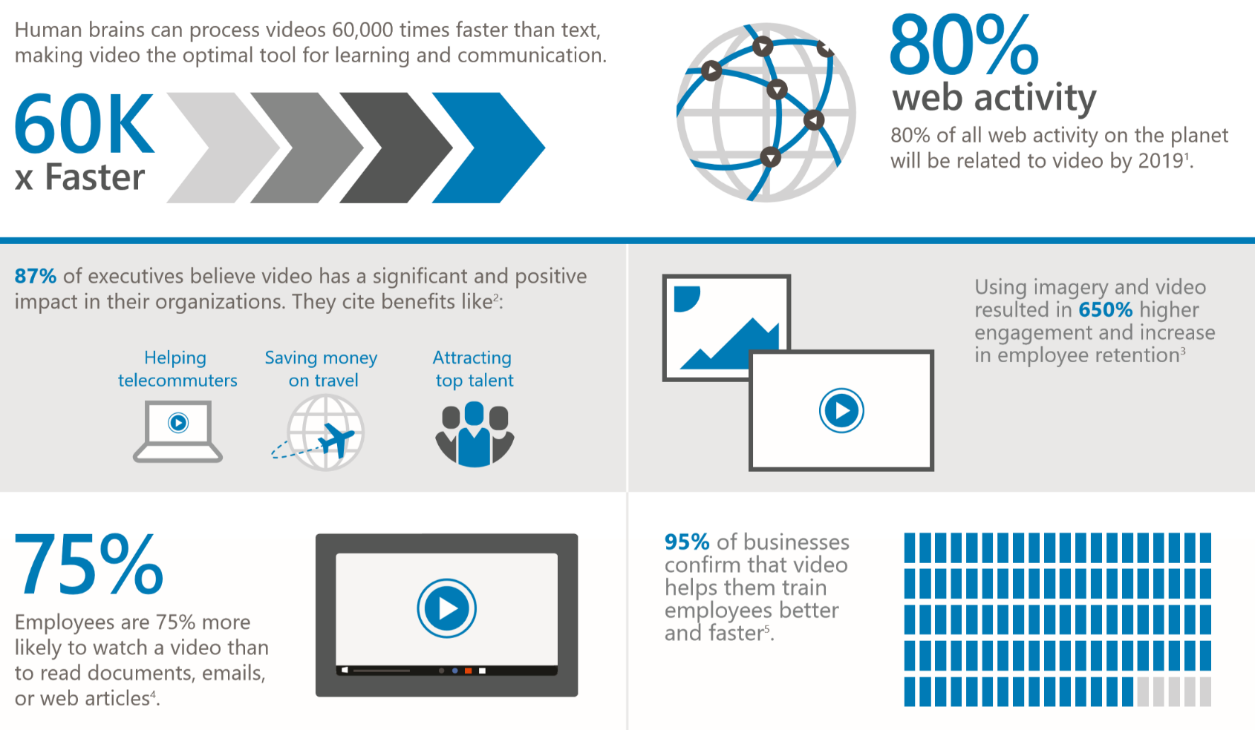
Video and interactive
content improve engagement
Notes:
Employee communications, training, consuming mass amounts of content on the go/mobile

Slide 16

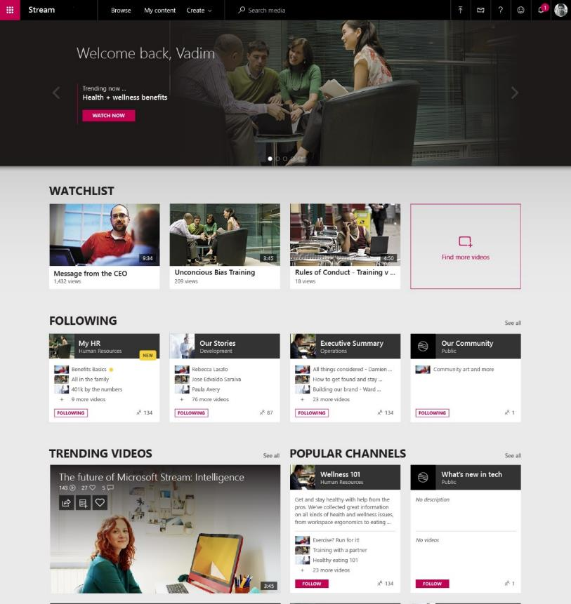
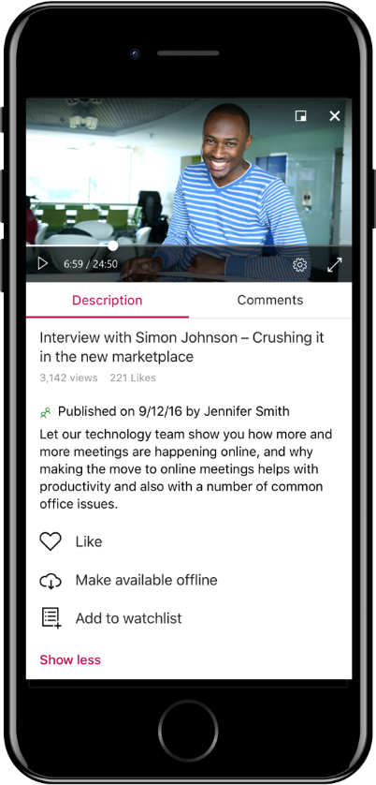
Microsoft Stream: Video that powers Microsoft 365
As a video hub
Securely manage and curate enterprise video, all in one place, with AI powered capabilities and intuitive usability
As a platform
Powering video seamlessly across Office including: Teams, Yammer, SharePoint, PowerApps & more
As a communication tool
Empower anyone to create and share on demand and live streaming content

Slide 17
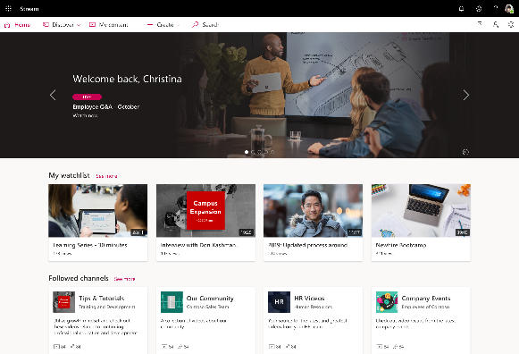
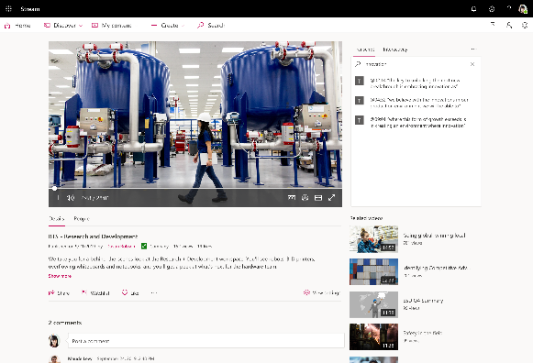
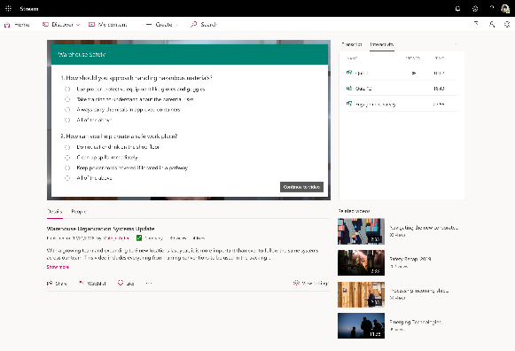
Microsoft Stream as a video hub in Microsoft 365
Curated video management
AI powered content navigation & discoverability
Video creation, editing & interactivity

Slide 18
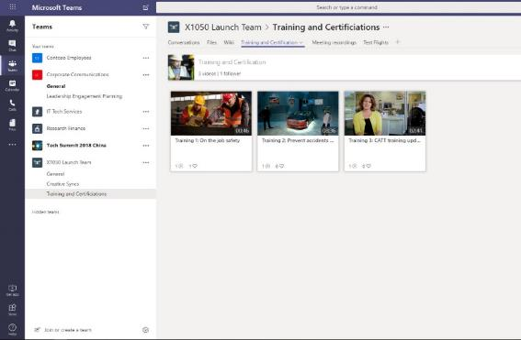
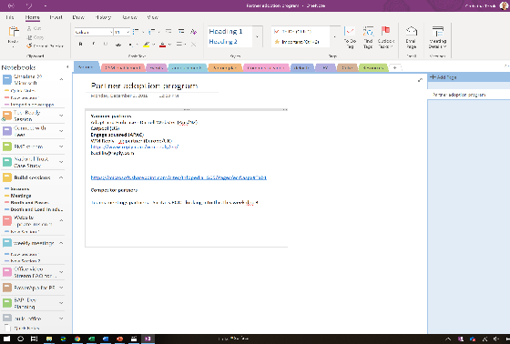
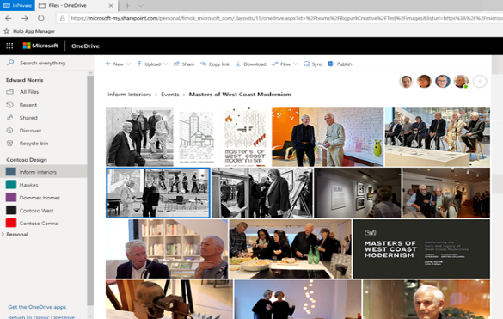


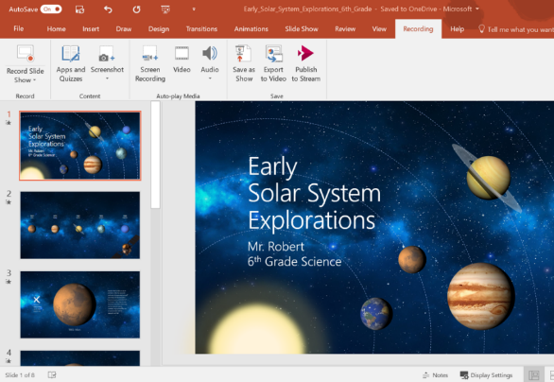
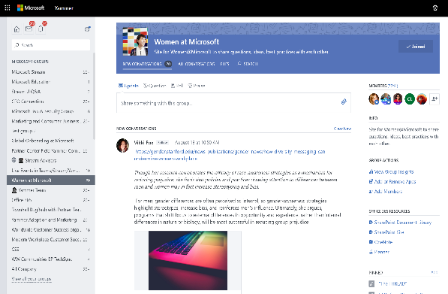
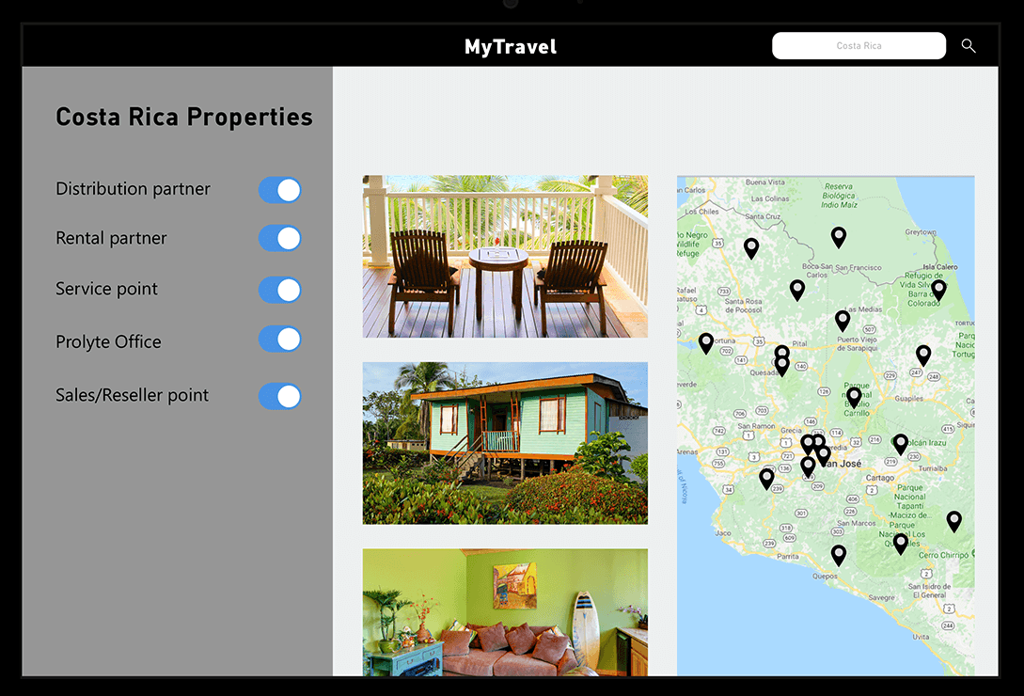

Microsoft Stream as a video platform in Microsoft 365
Teams – Team collaboration with video
OneNote - Learning with video
SharePoint – Video in context for intelligent intranets
PowerPoint – Intelligent media and video publishing
Yammer – Social video sharing
PowerApps – Custom apps enhancements with video

Slide 19
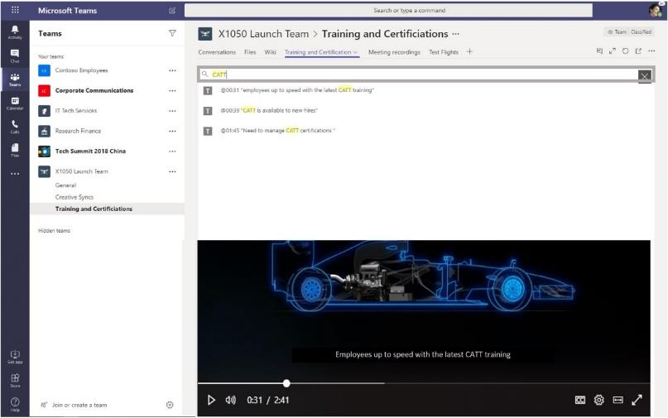
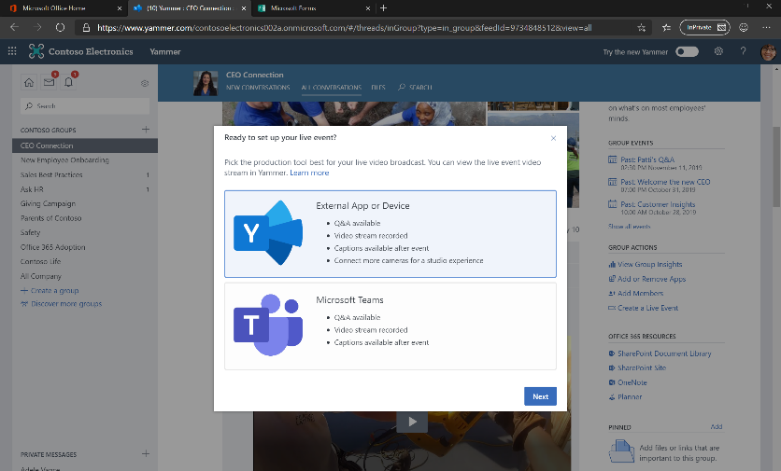
Microsoft Stream as a communication tool for Microsoft 365
Teams –Meeting recordings and live events
Microsoft 365 live events across Teams, Stream and Yammer

Slide 20
DEMO

Slide 21
Microsoft 365 live events

Slide 22






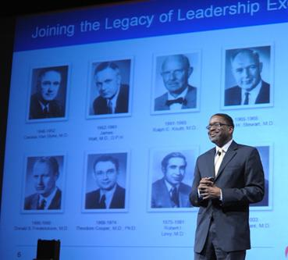






Microsoft 365 Live Events
Broadcast your screen or webcam in seconds
Easily deliver studio-grade, high profile events
Out of the box production for presenting content through your computer
Connect professional cameras, audio and more with external production
  Attendee reporting
  Moderated Q&A
  Internal/external participation
  Reach 10,000 attendees
  Seamless viewing on web and mobile
  Open dialog for attendees
  Event cloud recordings
  Searchable speech to text transcription
  Captions & subtitles
Notes:
Live Events in Microsoft 365 enables anyone to create live and on-demand events for up to 10,000 attendees.
participate in real-time from anywhere, on mobile or web in any device, or catch up later
Spectrum of events, informal webcast to professional setups with production teams
Features allow for use of events in Teams, Stream or Yammer – based on customer adoption path and event scenarios/use cases

Slide 23














Create more effective communications for employees, customers and partners
Benefits of using live events
Deliver impactful training with agility across audiences of all sizes
Drive better participation with content on mobile or web, globally and at scale
Connect leadership and employees to drive deeper engagement
Notes:
MOST COMMON ROLES
Exec comms ; Training/Learning; Employees sharing Peer to Peer expertise

Slide 24

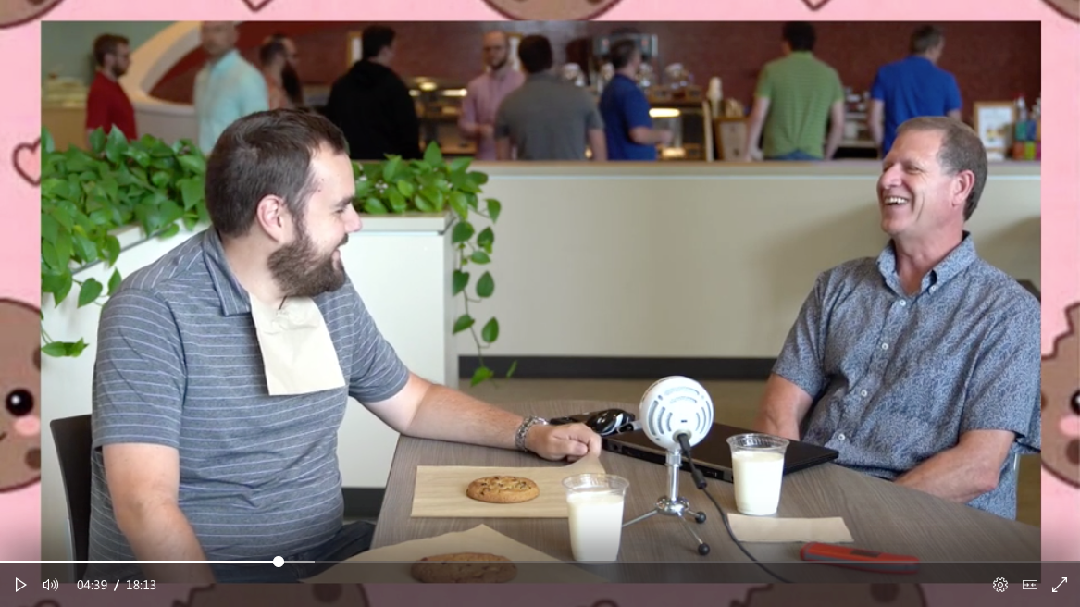
Infusing fun into the culture and making everyone feel more connected
Warm Cookie Aficionados
Notes:
Using live events to drive engagement and a connected workforce
Global company, spread out offices
Warm cookie Wednesday
Grew into a way for leaders to build better relationships with employees

Slide 25

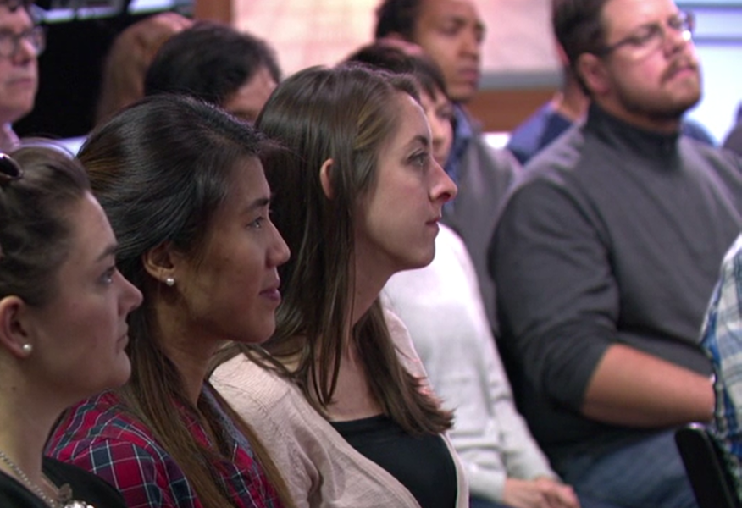



Meetings versus events – what’s the difference?
Meetings that redefine teamwork
Events that connect
audiences at scale
Many to many collaborations where everyone has equal participation
Few to many broadcasts that enable attendees to engage with interactive discussion
  Few attendees
  1:1 or group video calls
  Single meeting organizer
  Anyone can share content, audio and chat
  Many attendees
  Few to many broadcast
  Event host and designated presenters
  Presenter lead, curated attendee experience
Notes:
Meetings
give everyone a voice and screen to share.
Many to many, everyone has an equal level of participation.
Live events
one or few people the ability to broadcast to large groups, while maintaining control of the content that is shared across screens and audio.
one to many communications, host of the event is leading the interactions and content

Slide 26
Define the roles of your support team
Essential
Recommended
Organizer
Producer
Presenter
Sponsor
Moderator
Can be the same person
Notes:
ORGANIZER
The organizer acts as the host of the live event. They create the event, set attendee permissions, invite attendees, select the event team. They are responsible for sending out communications prior to the event and the recording afterwards.
PRODUCER
The producers are the people responsible for starting and stopping the live event. The producer can share video and can select layouts that will be viewed by attendees. The same person could serve as the organizer and producer.
PRESENTER
A presenter is the expert and responsible for content and commentary. They can present audio, video or share their screen with the attendees. They can also serve as moderators in Yammer discussions. You can have up to 10 presenters at one time.
SPONSOR
A leader, executive, group, or organization with a special and unique interest in the education or insights of the audience. This person could also be the one presenting.
Yammer Moderator
A Yammer moderator is a Yammer Champion who can help facilitate questions in Yammer and ask them during the live event. Depending on the size of your event, 1-2 people may be needed for this depending on the size and scale of the event. This person could also be the producer/organizer if needed.

Slide 27
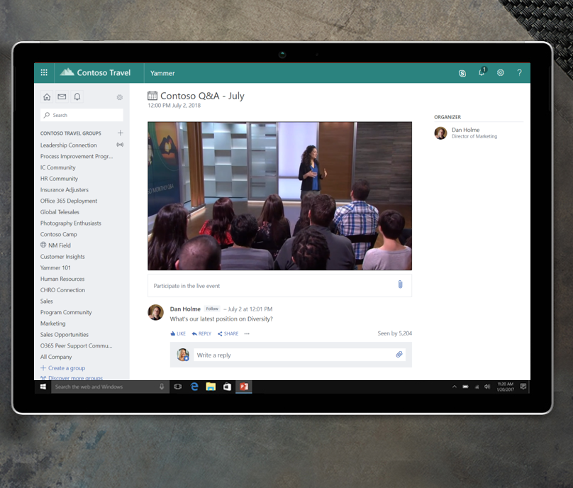
Live events in Yammer
Drive ongoing, open conversation before,
during and after the event
Connect leaders and employees in more authentic ways
Host events in communities to rally around relevant topics
Make participation easy for company wide-events

Slide 28
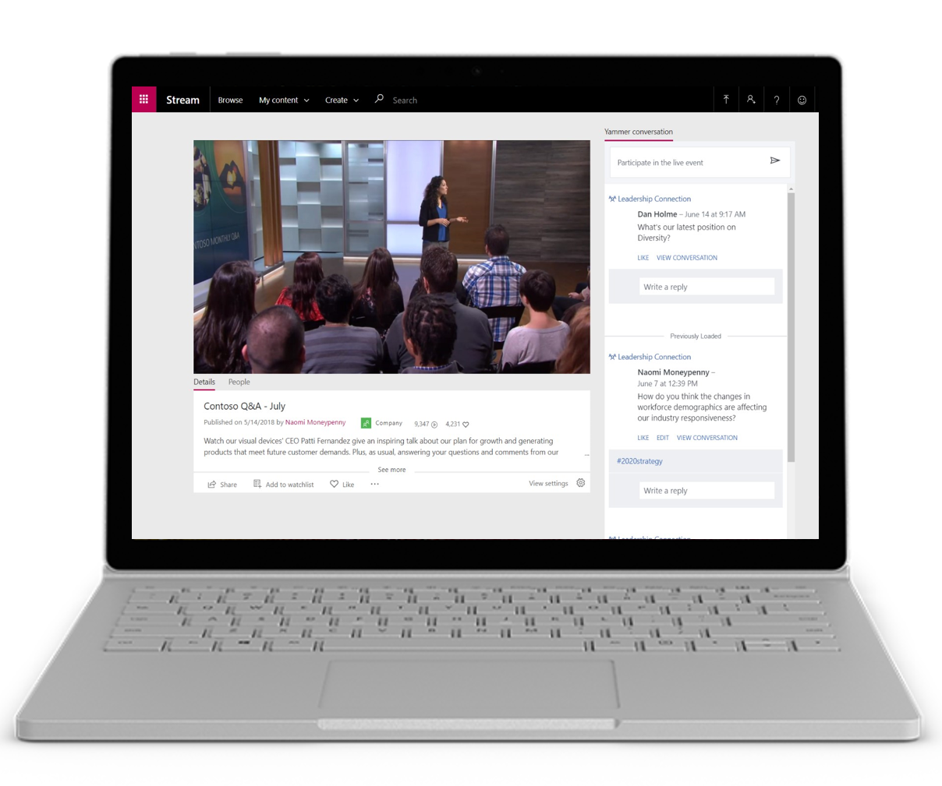
Live events in Stream
Watch events in Stream or embed in other sites (ex., SharePoint)
No conversation needed, or add in separate dialog
On-demand events leverage captions and transcripts
Manage event recordings from Teams, Stream and Yammer

Slide 29
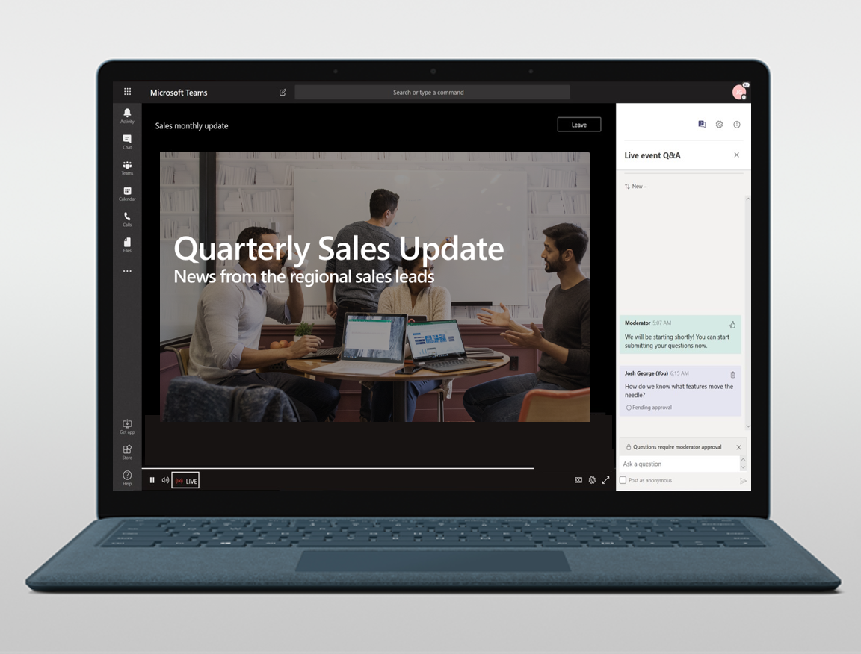
Live events in Teams
Reach internal or external participants
Use moderate Q&A to engage with attendees
Schedule and deliver events as easily as a meeting
Quickly share screens and webcams to deliver content

Slide 30






Best Practices: Scheduling & Inviting
Organize & Prepare
Invite



Ensure all policies and permissions are given

Craft your event invite so that it is easy and seamless to find the link and join

Select the correct scheduling options: engagement, recording, access

Use a short link when sharing the attendee link to your audience

Ensure all producers and presenters are invited including:
Rooms that need to have audio brought in
Q&A moderators
Anyone sharing content into the event

Do not use a Teams meeting when sharing the event - use Outlook or send via chat

Ensure your audience has a Teams enabled

Slide 31


Best Practices: Equipment & Delivery
Equipment
Network & Delivery



TEST TEST TEST TEST TEST!

Utilize an eCDN partner – Hive or Kollective - to ensure smooth delivery where needed

Refrain from using a laptop microphone, especially if presenter will be a podium

We recommend a minimum of 10Mbps bandwidth available for presenters

Ensure lighting is adequate for your viewers to see presenters.


Have one person in the event group in addition to the presenter to monitor the audio quality in the meeting.


Slide 32
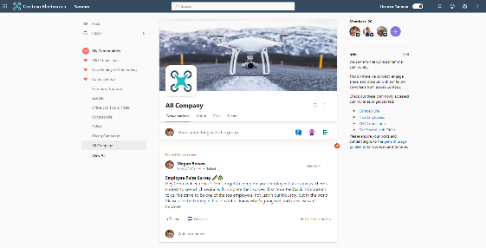
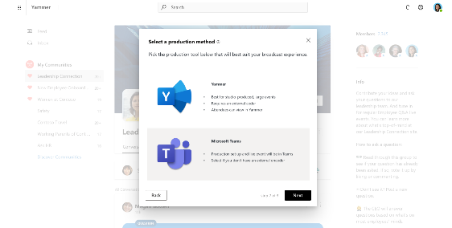
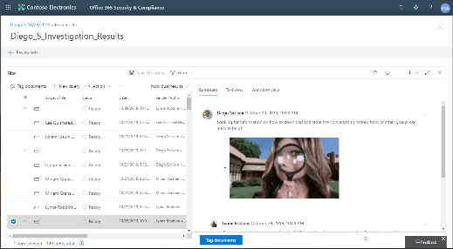
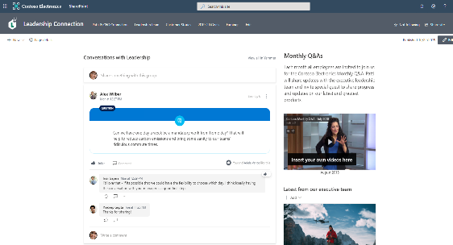
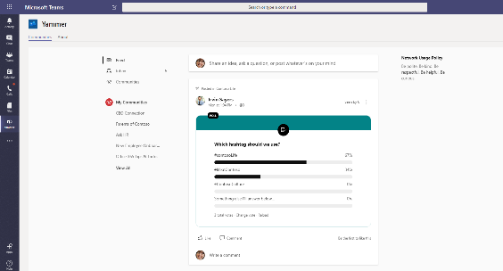
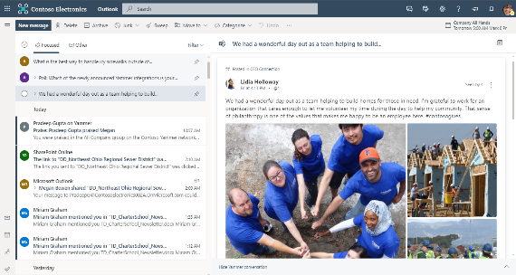
New Yammer experience
General Availability H1 2020
Live Events and Video
General Availability Q1 2020
New compliance capabilities
General Availability Q4 2019
SharePoint web part
General Availability Q1 2020
Yammer app for Teams
General Availability Q1 2020
Yammer in Outlook
General Availability Q1 2020

Slide 33

Stream Roadmap
Recently launched
In development
Future
Live events
Interactive video with polls & quizzes
Video upload from mobile app
Search driven webpart for SharePoint
Default sort order on channel
Deployed Government Community Cloud
Video creation in mobile app
Stream video playback in PowerApps
Voice enhancement
Public REST APIs
Anonymous video sharing
Guest & Federated video sharing
Live event polls
Retirement of Office 365 Video
Screen recording in browser
Retention, Legal hold, eDiscovery via SCC
Video viewership analytics
Microsoft 365 Search integration
More admin features for governance
  Reset company policy acceptance
  Persistent company policy in footer
  Search private videos as Stream admin
Office 365 Video migration
6 additional languages for transcripts
Replace videos
Trim videos
Video recycle bin
Disable speaker timeline
https://aka.ms/StreamRoadmap

Slide 34
Resources
Monthly Resources: https://aka.ms/O365ChampionResources
Forum: https://aka.ms/DriveAdoption
Ignite Overview https://aka.ms/AdoptionatIgnite

Slide 35
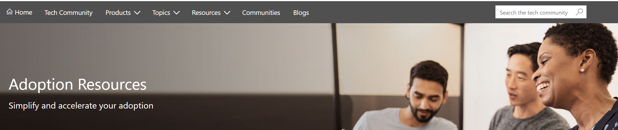
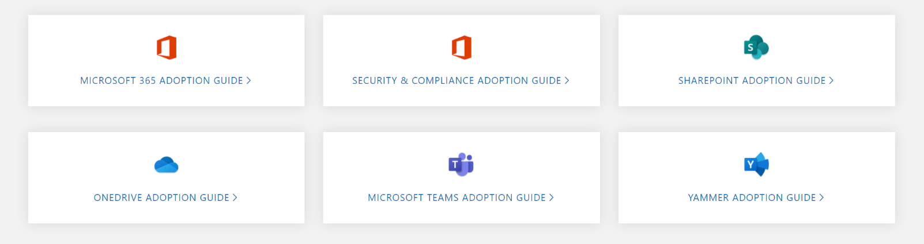
Get Started at https://aka.ms/MicrosoftAdoption
Streamline End User Training with Microsoft 365 Learning Pathways
Notes:
Accelerate your deployment and adoption of Office 365 services by visiting our unified resource page for adoption guidance on the Microsoft Technical community at https://aka.ms/MicrosoftAdoption. Review materials for Microsoft 365, our security and compliance features or key teamwork workloads like SharePoint, OneDrive, Microsoft Teams and Yammer. Find additional resources for Microsoft Teams in Government and devices for Teams within the Microsoft Teams adoption guide.
This is a step forward in our response to your feedback to make adoption materials easier to discover and use. Over the coming months we will continue to unify and standardize these materials across all our Microsoft 365 services. Share more feedback in our Driving Adoption community at https://aka.ms/DriveAdoption.

Slide 36
Training Tools for Microsoft Teams
Get Started with Teams
https://teams.conversationalgeek.com
Managers Guide to Microsoft Teams
https://teamsbook.info

Slide 37



Coffee in the Cloud
Get more from Office 365
https://aka.ms/CoffeeintheCloud
Subscribe now to Learn About:
Business Solutions
Best Practices & How-To’s
For Admin’s and Champions
@CITCTV

Slide 38
Current Survey Results
75% of respondents likely or very likely to recommend the program
Top Requested Topics
Running a Champions Program
Hub for Teamwork
Chat, Calling & Meetings
Adoption Methods
File collaboration in O365
Low Code/No-Code solutions
Intelligent Intranet
Video & Live Events
Security & Compliance
Finding Content
Areas to Improve
Advance notice of topics
Better calendar invites
Better reminders on call dates/times
More details on how-to
More in depth sessions
Preferred Call Times:
(Pacific Time)
7am
8am
9am
12 noon
84% of respondents likely or very likely to attend an in person Champions meetup
It’s not too late! Make your voice heard!
Complete our survey at https://aka.ms/O365ChampionSurvey

