Slide 1
Office 365 Champion Community
August 2019 Monthly Meeting
Karuana Gatimu
Customer Advocacy Group
Notes:
Join our worldwide program at https://aka.ms/O365Champions
Materials included in this deck are free to use in your daily work.
Please reference our program as the source of this information.
For questions or comments please reach out in the Drive Adoption or Champion’s Corner forums of the Microsoft Technical Community at https://aka.ms/DriveAdoption

Slide 2
Agenda
Inspiration
Information
Tools
Seattle Champion Meetup
Implementation Project Plan
Worldwide Local Community
Find prior meeting content at https://aka.ms/O365ChampionResources

Slide 3
Microsoft Resource Cheat Sheet
https://aka.ms/M365Roadmap
https://aka.ms/TechCommunity
https://docs.microsoft.com
https://developer.microsoft.com
Microsoft 365 Roadmap
All public feature delivery dates
Filter by product
Microsoft Technical Community
Product forums and blogs
Driving Adoption forum
O365 Champion’s Corner
IT Pro & Adoption Documentation
Learn how to plan, deliver, adopt and manage Microsoft 365 products
Developer Documentation
Training, documentation, samples & communities for developers
Continue Your Education
https://aka.ms/O365Champions
Office 365 Champions Program
Free monthly calls with Microsoft experts & peers
Early access to adoption resources and tools
Open to all business users, IT Pro’s and developers who want to drive adoption of cloud solutions & services
Sign Up

Slide 4
We are World Wide!
Updates to the sign up process are live

Slide 5
The successful adoption of Microsoft 365 represents a change in behavior. It is more than a set of products—it is a fundamentally different way of working. This change is about people. And we are here to help.
Notes:
M365 has the potential to change the trajectory of an organization in many ways, besides the technology itself:
People fundamentally change the way they work
We enable a modern workplace and the optimization of Office 365
We provide the capability to accelerate the alignment of economic and cultural business drives
We allow organizations to enter a state of dynamic stability*
*“Dynamic stability is like riding a bicycle, where you cannot stand still, but once you are moving it is actually easier. It is not our natural state. But humanity has to learn to exist in this state.¹”
1 Friedman, Thomas L. Thank you for Being Late. New York: Farrar, Straus and Giroux, 2016.
“The need to move to a highly flexible and adaptable digital approach is urgent. The applications required today are not going to last for 30 years. They are maybe only going to be used for maybe two, three years.²”
2 McKendrick, J. (2018. Jan 21) The ultimate technology success metric: owning the customer relationship. Retrieved from http://www.zdnet.com/article/business-transformation-before-technology/

Slide 6
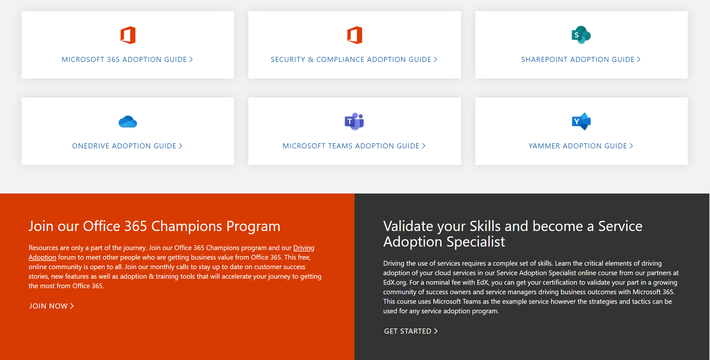
Get Started at https://aka.ms/MicrosoftAdoption
Streamline End User Training with Microsoft 365 Learning Pathways
Notes:
Accelerate your deployment and adoption of Office 365 services by visiting our unified resource page for adoption guidance on the Microsoft Technical community at https://aka.ms/MicrosoftAdoption. Review materials for Microsoft 365, our security and compliance features or key teamwork workloads like SharePoint, OneDrive, Microsoft Teams and Yammer. Find additional resources for Microsoft Teams in Government and devices for Teams within the Microsoft Teams adoption guide.
This is a step forward in our response to your feedback to make adoption materials easier to discover and use. Over the coming months we will continue to unify and standardize these materials across all our Microsoft 365 services. Share more feedback in our Driving Adoption community at https://aka.ms/DriveAdoption.

Slide 7
Upcoming Events
SharePoint Fest
Seattle, WA
August 19-23, 2019
Champion Discounts!
https://aka.ms/Events/SPFestSEA
Learn about all of Office 365 from Microsoft & Industry experts
Collab365 Summit
Virtual Online Event
September 10-12, 2019
Free Online Event
http://c365.io/collab365-sharepoint-summit
Pick and choose sessions to hear live or on demand (for a fee)

Slide 8
Office 365 User Group & Champion Meetup
O365 Seattle Meetup patrons can attend the last two SharePoint Fest conference sessions (2:40 PM & 4:20 PM) of the day for FREE, FREE, FREE! For the O365 Seattle Meetup pass, you MUST register!
Learn more at https://www.meetup.com/O365Seattle/

Slide 9
Implementation Project Plan Review

Slide 10
Skill areas required to drive adoption
Organizational Development
Business Acumen
Technical Competence
Marketing & Communications
Portfolio Management
Leadership Capability

Slide 11
Skill areas required to drive adoption
Organizational Development
Business Acumen
Technical Competence
Marketing & Communications
Portfolio Management
Leadership Capability

Slide 12
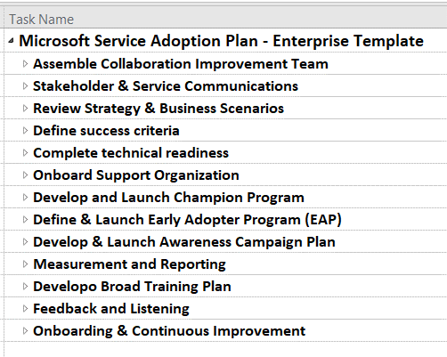
Service Adoption Project Plan
Jumpstart your implementation with this pre-defined checklist of major tasks.
Use in Microsoft Project or save to Excel or Visual Studio Team Services for easy management.
https://aka.ms/TeamsAdoption
Tools & Downloads page

Slide 13
Adoption & Deployment Work Streams
Scope and Outcomes for work streams (1 of 2)
Workstream | Outcome | Core deliverables | Scope & Notes
Service Strategy & Project Plan Stakeholder Mapping & Alignments | Phase driven deployment & adoption plan with identified owners, dates & risks/issues as needed | Collaboration Improvement Plan Sprint over sprint execution to goal Decision Log, Risks & Issues List Regular planning & alignment meetings | Core collaboration improvement team for initial phase (strategy, champion & early adopter phases) May increase team size as project expands
Program Communications & Success Stories | Stakeholders, user communities and program participants have frequent insight to progress and success examples | Project news and reporting assets
Champion Program | Increased digital literacy; reduced change fatigue; increased solution adoption; talent identification; transition support | Monthly Champion training ROB Collation of themes and issues for support, training and program leads Owner of enthusiasm | Monthly champion calls – 1 hour; Leads with others optional attendance at public O365 Champion community calls with Microsoft – 1 hour
Support Readiness | Incident support and resolution Management of issue escalation | Onboarding – 8 hours | Early training with Champions Onboarding to Feedback channels Monthly review of issues/trends within Service Health Review
Early Adopters & Feedback | Provide hands on insights of solution in target environment. Develop feedback methods that scale. Identify champion candidates & high value business process improvements | Employee engagement; interactive onboarding sessions & design/deployment & analysis of feedback channel
Governance & Security | Guide governance and policy decisions for experience. Complete required configuration. Support training & communications on same.
Notes:
O365 Adoption Toolkit – Adoption & Deployment Workstreams
v10-18.1 (Karuana Gatimu)
Activity: Now that you've reviewed the video for workstream assignments and team structures map these out for yourself for your own organization. This is an opportunity to identify talent within your organization or a gap that may need to be filled from Microsoft or another partner in our ecosystem. It is important to identify missing talent areas early in your planning process to get the correct kind of help. Download our Workstream Assignment handout to aid you in this process.
Free service adoption and deployment planning & execution assistance is available from Microsoft as a part of your Microsoft 365 subscription in a variety of formats via the FastTrack program. Your company may already be working with a technology partner who can also provide this assistance.
Here is the list of workstreams or capability areas that require a leader. The same person can do multiple workstreams depending on their existing workload. For instance, one individual can manage the Champion, Early Adopter & Feedback workstreams. If you cannot find a name of a person to put next to the workstream, identify it as a risk and discuss it with your success owner or executive sponsor during your regularly scheduled project meetings.
Example Activity for Contoso: For your Contoso project plan you begin to map out the capabilities you will need to successfully deliver a Microsoft Teams implementation. You are already working with your IT Service Manager who is reviewing SuccessWithTeams.com content to manage the technical readiness. You meet and discuss timelines and outcomes and jointly review the workstreams shown above. You both determine that you do not have the bandwidth to handle setting up the Champion & Early Adopter programs or ensure quality and support readiness. You should undertake one or all of the below actions:
1. Because you have an eligible license agreement with over 150 seats your first step is to reach out to the Microsoft FastTrack team via Fasttrack.Microsoft.com Your IT Administrator can also request help via the Get Help widget in the Office 365 Admin Center. FastTrack engineers and program managers will reach out to help you resolve your technical questions and create a success plan for Microsoft Teams.
2. To learn from other people who are also driving adoption of Microsoft Teams you can visit and ask questions in the Driving Adoption forum on the Microsoft Technical Community at https://aka.ms/DriveAdoption.
3. If you have a technology partner that is already helping you in your company you should speak with them about their Microsoft Teams experience to determine if they are qualified to assist you. Through FastTrack, community forums and your other business relationships you can find additional Microsoft Certified Partners to assist you in this work.
NOTE: If you do not have an active relationship with your IT Service Manager reach out to him/her and start a conversation about partnering on this project. Be open to their feedback and emphasize that you are focused on the end-user adoption portion of the roll out to ensure employee satisfaction with the service they are trying hard to deliver. Having this conversation over lunch never hurt building this important relationship.

Slide 14
Adoption & Deployment Work Streams
Scope and Outcomes for work streams (2 of 2)
Workstream | Outcome | Core deliverables | Scope & Notes
Technical Readiness & Alignment | Technical implementation of service ensuring quality and availability. Definition of technical projects that deliver the overall strategy & business value | Service quality, enablement and management processes and insights
Metrics & reporting | Provide on demand reporting of meaningful business and service metrics to ensure defined outcome
Business Process Mapping | Define high level scenarios for improvement based on user interviews, team focus groups and observation. | Deliver impact to difficulty ranking for ongoing prioritization of effort.
Awareness Campaign | Create awareness and enthusiasm for digital transformation and business initiatives | Key messages and creative assets used to inform users of transition and outcomes
Training Program | Increate digital literacy and operational efficiency. Reduce change fatigue. | Provide on demand and instructor led interactive onboardings to new solution
Service Health Reviews & Improvement Planning | Provide actionable insights and prioritization for improvement in the experience. | Data and analysis for monthly review on service incidents, support themes, training effectiveness, experience quality, overall adoption and user sentiment | Joint effort between IT, user adoption specialists and key experience stakeholders. Informs overall experience strategy.
Notes:
O365 Adoption Toolkit – Adoption & Deployment Workstreams
v10-18.1 (Karuana Gatimu)
These workstreams complement the Enterprise Adoption Project Plan and adoption framework best practices. The outcomes of these

Slide 15
Adoption & Deployment Tools
Best Practice: Complete worksheets and/or implement tools in support of workstream outcomes
Workstream | Core Tool(s) | Notes
Service Strategy & Project Plan Stakeholder Mapping & Alignments | Collaboration Service Team Connected Employee Strategy Doc Enterprise Project Plan Stakeholder Map | Use team template to plan and manage O365. Use PPT of Exec Summary to broadly communicate strategy. Change branded name as needed. Download tools from https://aka.ms/AdoptionTools
Program communications & success stories | Connected Employee Team & Site News Hub on SPO Site Success Stories Form, Flow and List | Configure News Hub on main Connected Employee Incorporates early adopter feedback channels
Champion Program | Teamwork Champion Team
Support Readiness | Service FAQ & Known Issues Lists
Early Adopters & Feedback | Early Adopter Program guide
Governance & Security | Service Check List
Technical Readiness & Alignment | TR Checklist from FastTrack by Service
Metrics & reporting | O365 Adoption Content Pack Outcomes matrix | Outcomes matrix capture sheet (XLS)
Business Process Mapping | Scenario Mapping slides Scenario Data Capture List (XLS) | Move to Excel sheet or Form for easy reporting
Awareness Campaign | Day One Kit Customer Success Kit
Training Program | Custom Learning for Office 365 site & webpart | Configure custom playlists for internal content and policies
Service Health Reviews (ongoing improvements) | SHR Meeting Template
Notes:
O365 Adoption Toolkit – Adoption & Deployment Workstreams
vE10-18.1 (Karuana Gatimu)
These workstreams complement the Enterprise Adoption Project Plan and adoption framework best practices. The outcomes of these workstreams can be integrated into an existing project plan. These components are essential to be covered for a full enterprise deployment. In each phase of deployment the scope of the work stream expands in both membership and complexity. Clarity around decision making, risk identification and mitigation are key to maintaining momentum throughout your improvement project.

Slide 16
Resources

Slide 17
Coffee in the Cloud
Get more from Office 365
https://aka.ms/CoffeeintheCloud
Subscribe now to Learn About:
Business Solutions
Best Practices & How-To’s
For Admin’s and Champions
@CITCTV

Slide 18
Microsoft Teams Resource Cheat Sheet
https://aka.ms/M365Roadmap
https://aka.ms/TeamsCommunity
https://aka.ms/SuccessWithTeams
https://aka.ms/CoffeeintheCloud
Microsoft 365 Roadmap
All public feature delivery dates
Filter by product
Microsoft Technical Community
Product forums and blogs
Driving Adoption forum
O365 Champion’s Corner
Success with Teams Practical Guidance
Learn how to plan, deliver, adopt and manage Microsoft Teams
Skype for Business to Teams transition guidance
Coffee in the Cloud on YouTube
Short how-to videos for IT Pro’s and Champions
Long form end user & administrator training
Continue Your Education
https://aka.ms/O365Champions
Office 365 Champions Program
Free monthly calls with Microsoft experts & peers
Early access to adoption resources and tools
Open to all business users, IT Pro’s and developers who want to drive adoption of cloud solutions & services
Sign Up

Slide 19
Start building solutions
Get Started
Teams Documentation: aka.ms/TeamsDev External integrations: aka.ms/TeamsIntegrations Platform training videos: aka.ms/TeamsPlatformAcademy
Developer Support: aka.ms/TeamsDevSupport
Join the community
Teams Dev Center: aka.ms/Teams.Dev Tech Community (QnA): aka.ms/TeamsCommunity Teams dev blog: aka.ms/TeamsDevBlog
Notes:
We are happy to share these core links with you, but here are the three next steps
that are most important for you to get started and build your own integration for Microsoft Teams.

