Slide 1
Office 365 Champion Community
April 2019 Monthly Meeting
Karuana Gatimu
Customer Advocacy Group
Notes:
Join our program at https://aka.ms/O365Champions
Materials included in this deck are free to use in your daily work.
Please reference our program as the source of this information.
For questions or comments please reach out in the Drive Adoption or Champion’s Corner forums of the Microsoft Technical Community at https://aka.ms/DriveAdoption

Slide 2
Agenda
Inspiration
Information
Tools
Microsoft Build
PowerApps Templates
Perseverance Breeds Success

Slide 3
Microsoft Resource Cheat Sheet
https://aka.ms/M365Roadmap
https://aka.ms/TechCommunity
https://docs.microsoft.com
https://developer.microsoft.com
Microsoft 365 Roadmap
All public feature delivery dates
Filter by product
Microsoft Technical Community
Product forums and blogs
Driving Adoption forum
O365 Champion’s Corner
IT Pro & Adoption Documentation
Learn how to plan, deliver, adopt and manage Microsoft 365 products
Developer Documentation
Training, documentation, samples & communities for developers
Continue Your Education
https://aka.ms/O365Champions
Office 365 Champions Program
Free monthly calls with Microsoft experts & peers
Early access to adoption resources and tools
Open to all business users, IT Pro’s and developers who want to drive adoption of cloud solutions & services
Sign Up

Slide 4
The successful adoption of Microsoft 365 represents a change in behavior. It is more than a set of products—it is a fundamentally different way of working. This change is about people.
Notes:
M365 has the potential to change the trajectory of an organization in many ways, besides the technology itself:
People fundamentally change the way they work
We enable a modern workplace and the optimization of Office 365
We provide the capability to accelerate the alignment of economic and cultural business drives
We allow organizations to enter a state of dynamic stability*
*“Dynamic stability is like riding a bicycle, where you cannot stand still, but once you are moving it is actually easier. It is not our natural state. But humanity has to learn to exist in this state.¹”
1 Friedman, Thomas L. Thank you for Being Late. New York: Farrar, Straus and Giroux, 2016.
“The need to move to a highly flexible and adaptable digital approach is urgent. The applications required today are not going to last for 30 years. They are maybe only going to be used for maybe two, three years.²”
2 McKendrick, J. (2018. Jan 21) The ultimate technology success metric: owning the customer relationship. Retrieved from http://www.zdnet.com/article/business-transformation-before-technology/

Slide 5
Perseverance Breeds Success Stay curious & expand your technical acumen
Images courtesy of the Associated Press & Getty Images
Notes:
First major win in 11 years; 15th of career
First Masters since 2005
43 years old

Slide 6
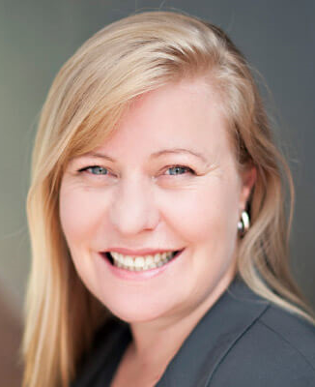
MVP Insights on Coffee in the Cloud
Tracy van der Schyff
Building Technical Acumen
Robert Bogue
Improving Communication Skills
Notes:
https://aka.ms/CoffeeintheCloud

Slide 7
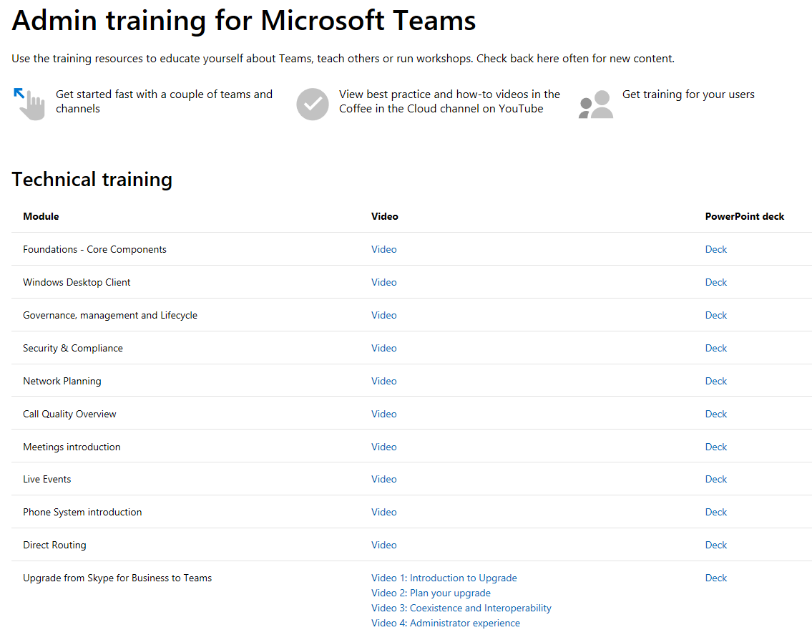
Module Update https://aka.ms/TeamsAcademy
IT Pro Training for Microsoft Teams

Slide 8
For Developers: Beginner or advanced developer education For Business: Learn platform capabilities for business transformation For the Future: Bring your aspiring developer child (age 14-21) for free build.microsoft.com
May 6-8
Seattle, WA

Slide 9
Power Platform Business Automation for All
Analyze
Act
Automate
Data connectors
Power BI
Business analytics
PowerApps
Low-code/no-code application development
Microsoft Flow
Workflow automation
Standalone apps
Common Data
Service for Apps
Microsoft 365
Dynamics 365
Microsoft Azure

Slide 10
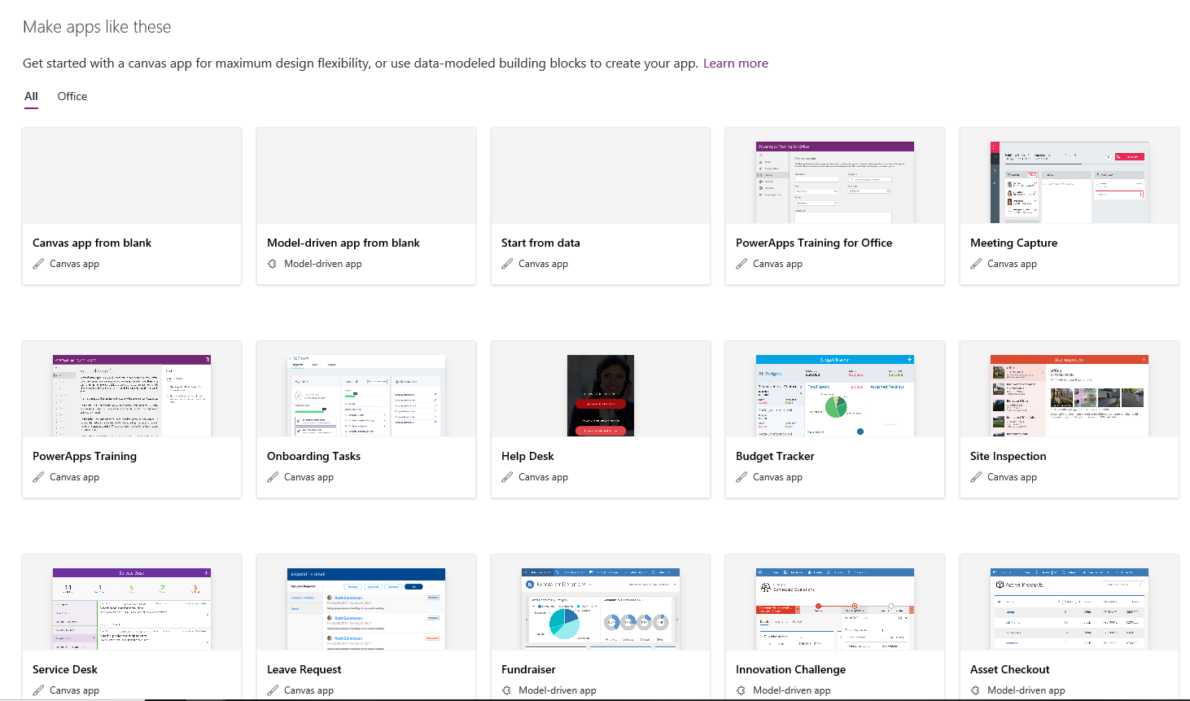
App Templates to Accelerate Results

Slide 11
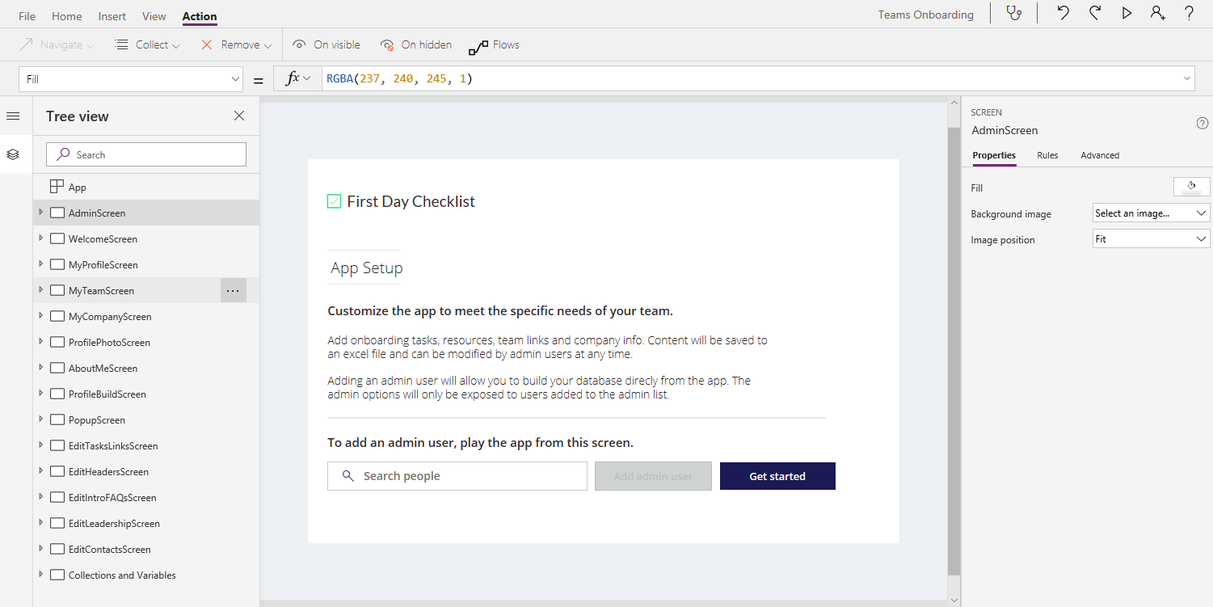
App Canvas – Edit app or Play to Preview

Slide 12
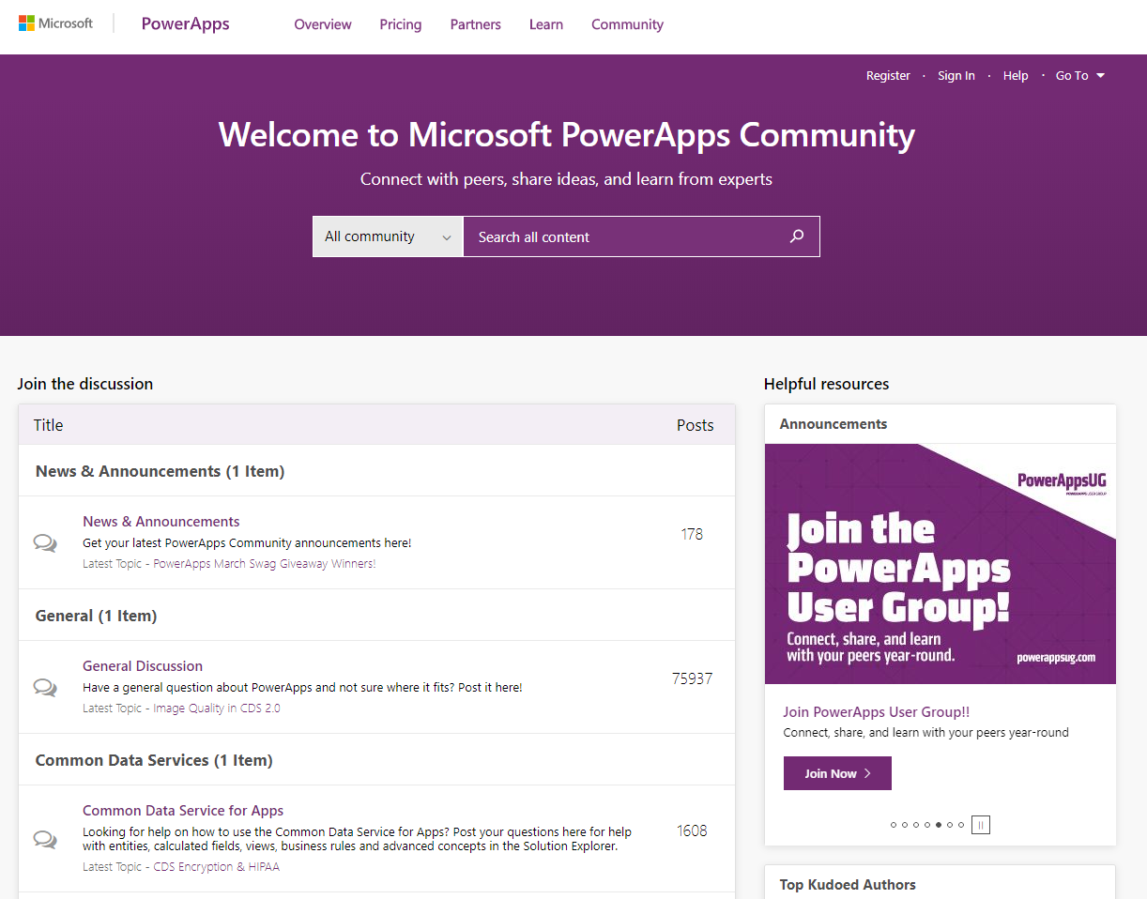
PowerApps Community – powerusers.microsoft.com

Slide 13
Modernizing Core Scenarios
Notes:
O365 Adoption Toolkit – Adoption & Deployment Workstreams
vE10-18.1

Slide 14
Modernizing Core Scenarios
Project Management
Personal Productivity
Calling & Meetings
Enable
Empower
Extend
‘Hallway conversations’ cause disconnect with group
Frustration about doc location and versioning
Confusion about accountability
Emails/attachments get lost
Calls go to voicemail
Colleagues are offline
Outdated local copies on desktop
Little/no context pre-meeting
Remote participants feel left behind
Lack of visual connection
Post-meeting momentum is lost
Access Office and 3rd party apps making true hub for teamwork
Hold all conversations in team/channel driving transparency
Pin important apps and documents to drive visibility
Streamline doc versioning
Personal apps organize notes & tasks in one place
Send online and offline messages alleviating tracking people down
Persistent conversation with file attach reducing need to search multiple places or ending up with multiple versions
Build momentum pre-meeting with conversation and content sharing
Connect with video, app sharing on any device to ensure alignment
Record for absent attendees
Capture notes and actions for easy follow-up

Slide 15
Today’s Focus
Project Management
Personal Productivity
Calling & Meetings
Enable
Empower
Extend
‘Hallway conversations’ cause disconnect with group
Frustration about doc location and versioning
Confusion about accountability
Emails/attachments get lost
Calls go to voicemail
Colleagues are offline
Tasks are in a variety of formats across projects
Little/no context pre-meeting
Remote participants feel left behind
Lack of visual connection
Post-meeting momentum is lost
Access Office and 3rd party apps making true hub for teamwork
Hold all conversations in team/channel driving transparency
Pin important apps and documents to drive visibility
Streamline doc versioning
Personal apps organize notes & tasks in one place
Send online and offline messages alleviating tracking people down
Persistent conversation with file attach reducing need to search multiple places or ending up with multiple versions
Build momentum pre-meeting with conversation and content sharing
Connect with video, app sharing on any device to ensure alignment
Record for absent attendees
Capture notes and actions for easy follow-up

Slide 16
Task Management Segments
Me
To Do
Outlook Tasks
Ours
Planner
Organization
Project
Azure DevOps
SharePoint Lists

Slide 17
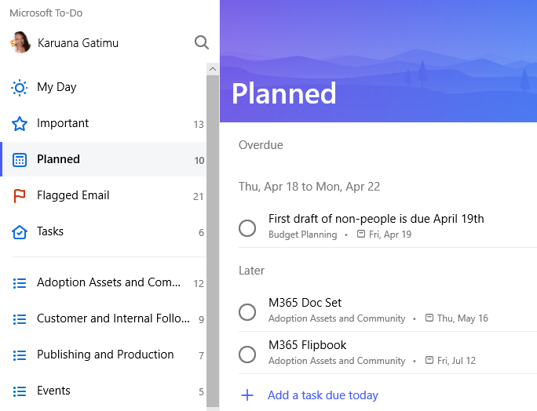
To Do
My tasks from Planner
My flagged emails

Slide 18
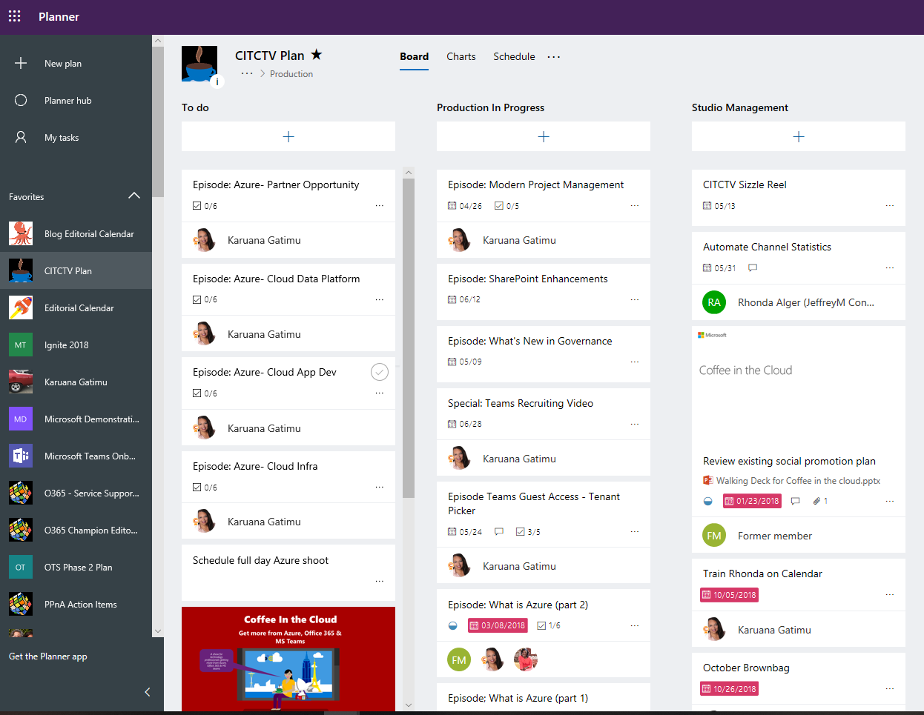
Planner Tasks

Slide 19
Resources

Slide 20
Coffee in the Cloud
Get more from Office 365
https://aka.ms/CoffeeintheCloud
Subscribe now to Learn About:
Business Solutions
Best Practices & How-To’s
For Admin’s and Champions
@CITCTV

Slide 21
Microsoft Teams Resource Cheat Sheet
https://aka.ms/M365Roadmap
https://aka.ms/TeamsCommunity
https://aka.ms/SuccessWithTeams
https://aka.ms/CoffeeintheCloud
Microsoft 365 Roadmap
All public feature delivery dates
Filter by product
Microsoft Technical Community
Product forums and blogs
Driving Adoption forum
O365 Champion’s Corner
Success with Teams Practical Guidance
Learn how to plan, deliver, adopt and manage Microsoft Teams
Skype for Business to Teams transition guidance
Coffee in the Cloud on YouTube
Short how-to videos for IT Pro’s and Champions
Long form end user & administrator training
Continue Your Education
https://aka.ms/O365Champions
Office 365 Champions Program
Free monthly calls with Microsoft experts & peers
Early access to adoption resources and tools
Open to all business users, IT Pro’s and developers who want to drive adoption of cloud solutions & services
Sign Up

Slide 22
Configuring O365 Classification

Slide 23
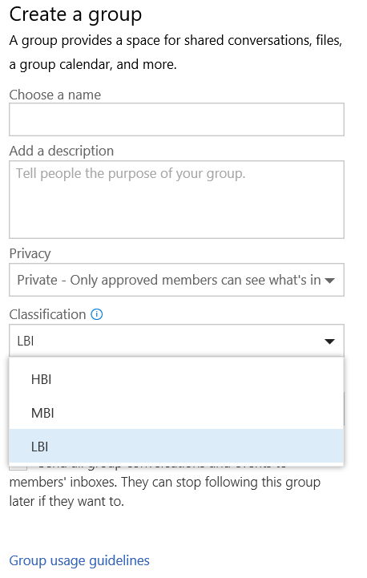
How to setup Classification
Connect-MsolService
$settings = Get-MsolAllSettings | where-object {$_.displayname -eq “Group.Unified”}
$singlesettings = Get-MsolSettings -SettingId $settings.ObjectId
$value = $singlesettings.GetSettingsValue()
$value[“ClassificationList”] = “HBI, MBI, LBI”
Set-MsolSettings -SettingId $settings.ObjectId -SettingsValue $value

Slide 24
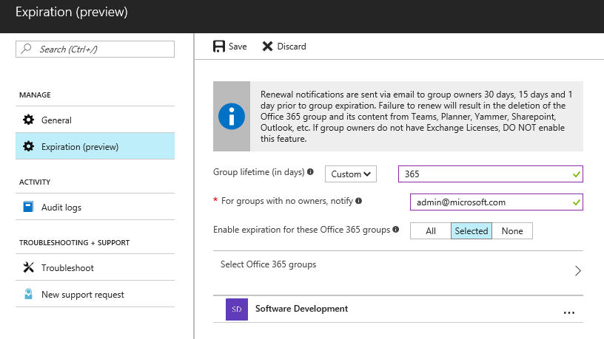
How to setup Expiration Policy
Admin
Set expiration timeline
Notification intervals are autoset
Set fallback email address for ownerless groups
Apply the policy to selective groups
Admin Tool
Azure AD powershell —Supported in V1 release
Azure AD portal —Supported in V1 release
* A maximum of 500 groups can be selected to apply the policy in the AAD portal UI. Group selection has no restriction in the AAD powershell.

Slide 25
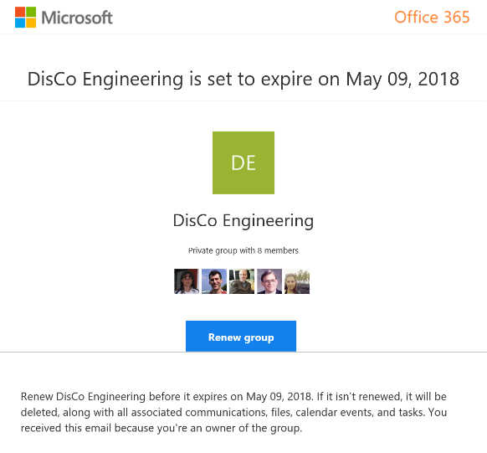
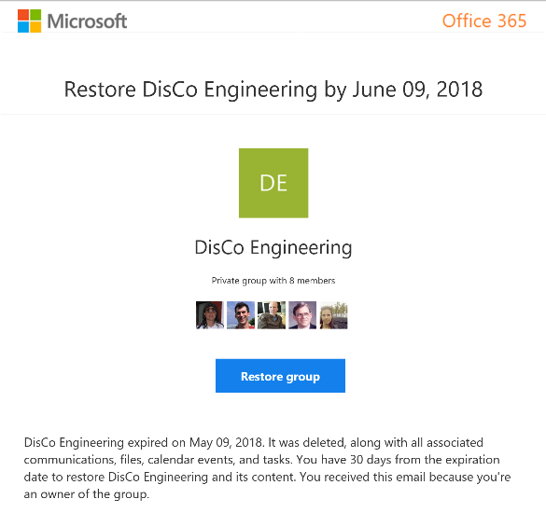
Group Owner experience of expiration policy
Renew expired groups
Restore expired groups that were soft deleted

Slide 26
Enforce policy Groups governance reduces customization
Official roadmap on fasttrack.office.com/roadmap
Policy | SharePoint custom | In product (Office 365/Azure AD) | Groups custom
Enable self-service site collection / group creation | Yes | Yes
Collect classification for all containers | Yes | Yes (Updated)
User awareness: Display classification | Yes | Yes
Enforce naming rules | N/A | Yes (New)
Usage guideline visibility | Yes | Yes
Ownership accountability: (1 Full-time, 2 people) | Yes |  | Workaround
Set public vs. private based on classification | N/A |  | Yes
External sharing limited based on classification (HBI) | Yes |  | Yes
Guest membership disallowed with classification (HBI) | N/A |  | Yes
Life cycle: 6-month expiry | Yes | Yes (New)
Membership life cycle: Enforce external renewals | Yes (policy based) | In development
Limit reach based on classification | Yes |  | Yes
Multi-geo; Provision based on user’s region |  | In development

