Slide 1
Office 365 Champion Community
October, 2018 Monthly Meeting
Program Lead: Karuana Gatimu
Customer Advocacy Team
Microsoft Teams Engineering
Notes:
Join our program at https://aka.ms/O365Champions
Materials included in this deck are free to use in your daily work.
Please reference our program as the source of this information.
For questions or comments please reach out in the Drive Adoption or Champion’s Corner forums of the Microsoft Technical Community at https://aka.ms/DriveAdoption

Slide 2
Agenda
Inspiration – Paul Allen
Information
Tools
Preview: Office 365 Adoption Framework
Planning Tools
Employee Quick Sheets
Asks
Share your adoption experience

Slide 3
“Paul Allen’s contributions to our company, our industry and to our community are indispensable. As co-founder of Microsoft, in his own quiet and persistent way, he created magical products, experiences and institutions, and in doing so, he changed the world. I have learned so much from him – his inquisitiveness, curiosity and push for high standards are something that will continue to inspire me and all of us at Microsoft. Our hearts are with Paul’s family and loved ones. Rest in peace.”
Satya Nadella
October 15, 2018

Slide 4
The successful adoption of Microsoft 365 represents a change in behavior. It is more than a set of products—it is a fundamentally different way of working. This change is about people.
Notes:
M365 has the potential to change the trajectory of an organization in many ways, besides the technology itself:
People fundamentally change the way they work
We enable a modern workplace and the optimization of Office 365
We provide the capability to accelerate the alignment of economic and cultural business drives
We allow organizations to enter a state of dynamic stability*
*“Dynamic stability is like riding a bicycle, where you cannot stand still, but once you are moving it is actually easier. It is not our natural state. But humanity has to learn to exist in this state.¹”
1 Friedman, Thomas L. Thank you for Being Late. New York: Farrar, Straus and Giroux, 2016.
“The need to move to a highly flexible and adaptable digital approach is urgent. The applications required today are not going to last for 30 years. They are maybe only going to be used for maybe two, three years.²”
2 McKendrick, J. (2018. Jan 21) The ultimate technology success metric: owning the customer relationship. Retrieved from http://www.zdnet.com/article/business-transformation-before-technology/

Slide 5
Champion Program Components
Community Learning
Business Usage Inspiration
Product & Technical Insights
Direct customer feedback
Survey & community participation
Continuing Engagement
Notes:
Participant gives and gets at a high level for the Office 365 Champion program.

Slide 6
Microsoft Resource Cheat Sheet
https://aka.ms/O365Roadmap
https://aka.ms/TechCommunity
https://docs.microsoft.com
https://developer.microsoft.com
Office 365 Roadmap
All public feature delivery dates
Filter by product
Microsoft Technical Community
Product forums and blogs
Driving Adoption forum
O365 Champion’s Corner
IT Pro & Adoption Documentation
Learn how to plan, deliver, adopt and manage Microsoft 365 products
Developer Documentation
Training, documentation, samples & communities for developers
Continue Your Education
https://aka.ms/O365Champions
Office 365 Champions Program
Free monthly calls with Microsoft experts & peers
Early access to adoption resources and tools
Open to all business users, IT Pro’s and developers who want to drive adoption of cloud solutions & services
Sign Up

Slide 7
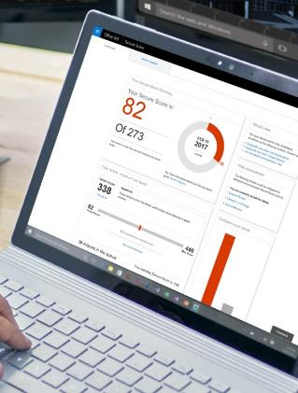
Adoption insights
Most employees are not willing to use new technology rolled out by their organization*
When CEO was either fairly or very visible, the transformation project was either very successful or extremely successful*
A well-defined set of financial and operational targets lead to an ‘extremely successful’ transformation*
Learning from co-workers is among the most effective and used methods in learning a new technology*
* Various third party and Microsoft based research
Notes:
We have spent a tremendous amount of time with our customers understanding the challenges they have in driving digital transformation and service adoption. Our enhanced framework is based on that feedback. Above are some of the insights we’ve identified.
Sources:
Creating organizational transformations, July 2008, McKinsey Quarterly, www.mckinsey.com; Copyright © 2008 McKinsey & Company. All rights reserved.
SharePoint End-User Study, Apr 2013, Microsoft Corporation
Office 365 Usage Research, May 2016, Microsoft Corporation
CIO Executive Board Business Productivity Database

Slide 8
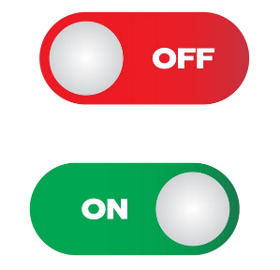
What we know for sure
People don’t automagically change
Shadow IT is more prominent than ever
Teams is more than a technical migration
People and change are not one-size-fits-all
Resistance is a normal, human behavior that takes time
80% admit to using their communication tool of choice¹
‘Deploy it and they will come’ doesn’t work
Organizations are made up of innovators, laggards and everyone in between
¹“What is Shadow IT?”, https://www.skyhighnetworks.com/cloud-security-university/what-is-shadow-it/ (accessed March 2017)

Slide 9
Skills required to drive adoption
Organizational Development
Business Acumen
Technical Competence
Marketing & Communications
Portfolio Management
Leadership Capability
These areas of expertise represent the foundation of our Microsoft Adoption Specialist certification exam which will launch in December, 2018 via EdX.org

Slide 10
Preview Office 365 Adoption Framework
Notes:
O365 Adoption Toolkit – Adoption & Deployment Workstreams
vE10-18.1

Slide 11
Your Office 365 experience Key Moments and Scenarios
During morning coffee
Check e-mail & manage your calendar via Outlook Mobile
Check chats & stay up to date on projects
Create or review documents
On your commute
Join personal meetings or chat with voice to text
Watch live video meetings
Connect to a meeting right from Outlook
Meeting at the office
Video chats and conference room meetings & meeting recordings make meetings more efficient
Notes & documents co-authored in Teams channels & SharePoint sites
Collaborating with your team
Chat, video, screen sharing, and file co- authoring in context via Teams
Track actions with Planner, Project or other tools
Save & share documents from the cloud
Connecting across the company
Use Yammer for organizational updates, knowledge sharing or providing feedback
Use hubs, communication sites & news to keep broad groups of stakeholders up to date
Notes:
Office 365 provides an integrated experience that powers a modern, connected employee experience. While not by any means exhaustive these scenarios are common across industries and company sizes. Additional services like PowerBI, Power Apps, Flow and Forms provide further tools to drive a data driven, collaborative culture.

Slide 12
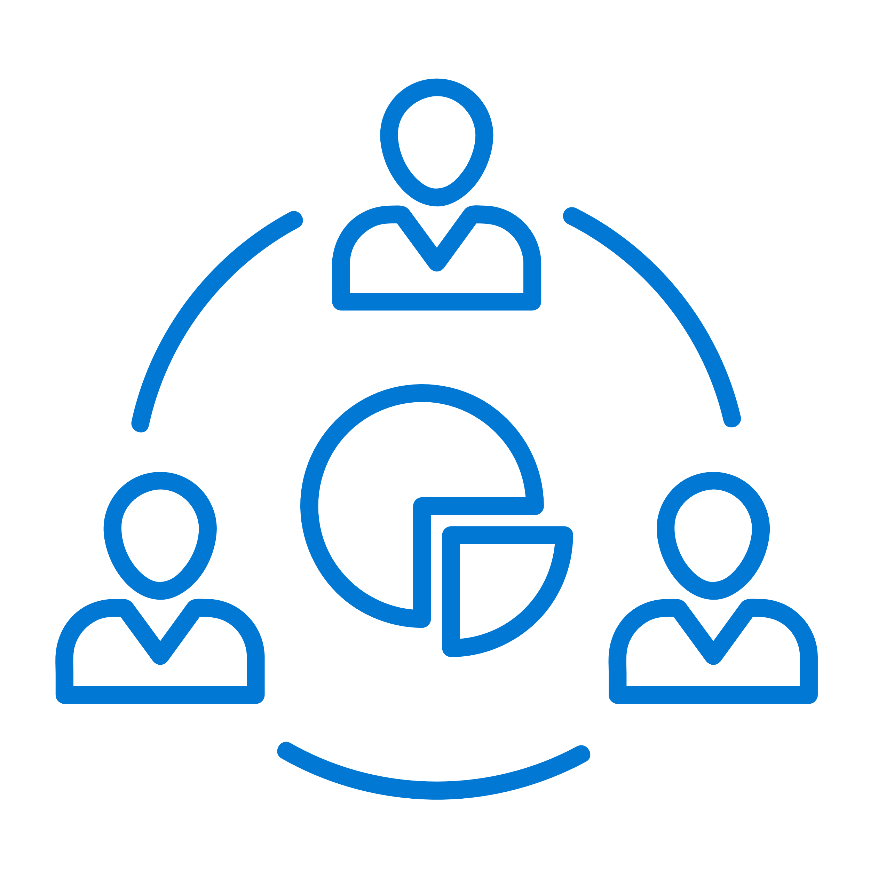
Example: Replace with your priorities
Collaboration North Star
Seamless experience for users
Connected, integrated applications streamline collaboration, sharing, discovery and simplify adoption
Our employees experience a highly productive environment where technology empowers everyone to achieve more while never getting in their way
Business agility delivered
Integration of people, content & activity enables data driven decisions, simplified processes and will accelerate decision making
Simplified IT, Security & Governance
Unified management, security and compliance ensures a security collaboration & communication experience
Tool: Collab Strategy Document
Notes:
This is an example of a high level service strategy slide intended for business exec audiences to frame the nature of the change. This slide must be followed up with a click down into specific business scenarios and capabilities that will directly impact the end user experience. A vision statement is not enough to reinvigorate trust between IT and business which has been impacted by many factors over the last decade.
While improving the end user experience is essential, addressing issues like governance and security are requirements of a fully developed deployment and adoption plan. The needs of your security team, records or risk managers must be taken into account as you plan your roll out. Without addressing the needs of this population up front you will find yourself blocked between your early adoption POC and your broad deployment phases.
Lastly, the waterfall method of delivering IT services is no longer a valid method for delivering IT services for business. Adopting an Agile methodology which breaks down work into manageable sprints with an agreed to backlog with your business stakeholder not only delivers value more quickly to your end users but can be a transformational element in the relationship between IT and business. Jointly prioritizing a backlog of capabilities will make business a part of the process rather than an observer to a seemingly slow delivery schedule.
Reference Articles:
Security & Compliance Step by Step for Office 365: https://docs.microsoft.com/en-us/office365/securitycompliance/
Security & Compliance in Microsoft Teams: https://docs.microsoft.com/en-us/MicrosoftTeams/security-compliance-overview
Governance for O365 Groups & Microsoft Teams: https://docs.microsoft.com/en-us/MicrosoftTeams/plan-teams-governance
Agile IT by Karuana Gatimu: http://solutionstrategist.com/home/agile-service-management/

Slide 13
Deliver an improved user experience and business outcomes through the service adoption framework
Assess readiness
Assemble your team
Onboard employees
Determine the overall organizational readiness including user groups, technical, governance, security, support, and feedback.
Plan the roll-out cadence based on proof of concepts (pilots), early adopter programs, champion readiness, and intentional scope of change
Tap into the technical and business change agents. Recruit multi-disciplinary teams of executive sponsors, technical talent, core stakeholders, change agents and champions
Build awareness, deployment, onboarding, and continuous measurement and feedback into the plan including success stories
Align the business and technical needs, assess organizational readiness, and assign success metrics
Build plan
Define strategy and scenarios
Notes:
Based on customer feedback we have enhanced our existing adoption framework to include key activities that drive Office 365 adoption success.

Slide 14
Adoption Framework
Project Team & Stakeholders
Strategy & Scenarios
Organization & Technical Readiness
Deployment & User Acceptance
Onboarding & Continuous Improvement
Recruit Executive Sponsors
Identify your stakeholders
Locate early adopters
Nominate Champions
Build a multi-disciplinary team including business leaders & technical talent
Define the service strategy: Align business and technical needs
Define program goals by phase
Identify & prioritize business scenarios & core capabilities
Select success measures
Assess organizational readiness
Technical readiness workstream incl. security & service governance
Support & feedback readiness
Enable metrics & reporting
Proof of concept (POC) builds
Early Adopter Programs
Champion awareness & education
Managed scope of change
Feedback informs program plan
Awareness campaign
Learning programs: instructor led to self help
Deployment & onboarding experiences
Feedback and continuing education
Outcomes – Cultural and Digital Transformation

Slide 15
Connected Employee Experience
Our employees experience a highly productive environment where technology empowers everyone to achieve more while never getting in their way
Finding
Meeting & Voice
Collaborating
Communicating
Supporting
Employee Engagement
Ability for employees to easily find the information, people and apps they need to be most effective in their job
Encompasses all elements required to ensure employees have a productive meeting, both in person and remote
Ability for people to come together to innovate across organizations, time zones, geographic locations, and work styles to accomplish a common goal
Providing employees with the tools required to have effective conversations, connect with people easily and easily send and receive information
Providing self-healing and assisted support, shifting to proactive and automated remediation
Engage Provide seamless, secure and modern employee experiences that increase
Experiences
Modern Device
Provide users with a highly productive and personalized device experience
Digital Workplace
Create an intelligent, digital workplace that delights visitors and inspires employees
Example Experiences
Notes:
Experiences that support a Connected Employee experience. An experience usually requires multiple scenarios and technical capabilities (sometimes over multiple products) to deliver. The focus on employee experiences can provide a method to prioritize the delivery of those scenarios or technical capabilities when otherwise there may be difficulty in prioritizing a portfolio of service.

Slide 16
Connected Employee Experience
Our employees experience a highly productive environment where technology empowers everyone to achieve more while never getting in their way
Finding
Meeting & Voice
Collaborating
Communicating
Supporting
Employee Engagement
Ability for employees to easily find the information, people and apps they need to be most effective in their job
Encompasses all elements required to ensure employees have a productive meeting, both in person and remote
Ability for people to come together to innovate across organizations, time zones, geographic locations, and work styles to accomplish a common goal
Providing employees with the tools required to have effective conversations, connect with people easily and easily send and receive information
Providing self-healing and assisted support, shifting to proactive and automated remediation
Engage Provide seamless, secure and modern employee experiences that increase
Project Backlog
Teams Implementation
Connected Hubs
Intranet Modernization
Product Launch Kits
Executive Engagement
Knowledge Bases
Search Improvements
Customer Care Transformation
Support Experience Update
Note: This example roadmap does not include dependencies on other service portfolios such as identity and security. Those would be noted in the individual project plans for each improvement shown here.
Example Roadmap

Slide 17
Preview Templates & Tools
Notes:
O365 Adoption Toolkit – Adoption & Deployment Workstreams
vE10-18.1

Slide 18
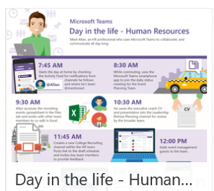
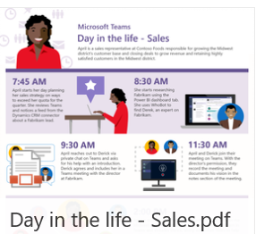
Day in the Life PDF’s for Microsoft Teams

Slide 19
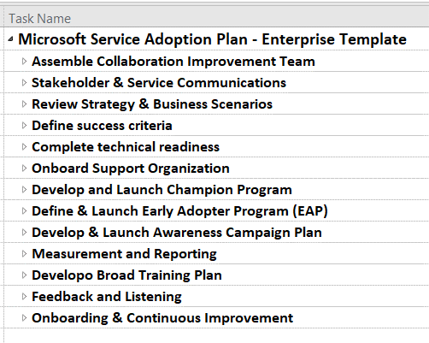
O365 Adoption Kit Content Service Adoption Project Plan
Pre-Release DRAFT view
Jumpstart your implementation with this pre-defined checklist of major tasks.
Use in Microsoft Project or save to Excel or Azure DevOps for easy management.

Slide 20
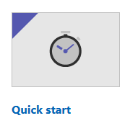
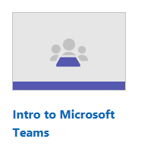
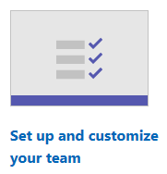
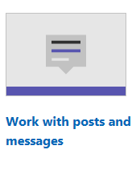
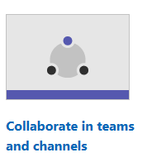
Pre-Release DRAFT view
Microsoft Teams Adoption Hub
Get Started
Deployment
Adoption
Upgrade
Features
More resources
Intro to Teams & Channels
Create your plan
Empower your Champions
Training & Certification Resources
Learn More
Learn more about driving adoption of Microsoft Teams in your company by exploring the sections below. Adoption plans can be simple to complex depending on your environment. Our quick start guidance is streamlined to take into account the most common scenarios and get you to experiencing the benefits of Microsoft Teams as quickly as possible. For large scale deployments step through the sections below and their associated tools to ensure your employees have a smooth transition to using Microsoft Teams as their hub for teamwork throughout your organization.
1
Getting Started
Planning for Initial Adoption
Your Project Team
Creating Teams and Channels
Your First Teams
2
Getting more from Teams
Creating Champions
Selecting Early Adopters
Governance Quick Start
Gathering Feedback
Defining Usage Scenarios
Onboarding Support
3
Broad Adoption Planning
Service Strategy and Stakeholders
Outcomes and Success Measures
Reporting Tools
Awareness Campaigns
Business engagement
Ongoing improvements
4
Use cases for Teams
Better together with Office 365
Training for Teams
Communicating success

Slide 21
Microsoft Teams Resource Cheat Sheet
https://aka.ms/O365Roadmap
https://aka.ms/TeamsCommunity
https://aka.ms/SuccessWithTeams
https://aka.ms/CoffeeintheCloud
Office 365 Roadmap
All public feature delivery dates
Filter by product
Microsoft Technical Community
Product forums and blogs
Driving Adoption forum
O365 Champion’s Corner
Success with Teams Practical Guidance
Learn how to plan, deliver, adopt and manage Microsoft Teams
Skype for Business to Teams transition guidance
Coffee in the Cloud on YouTube
Short how-to videos for IT Pro’s and Champions
Long form end user & administrator training
Continue Your Education
https://aka.ms/O365Champions
Office 365 Champions Program
Free monthly calls with Microsoft experts & peers
Early access to adoption resources and tools
Open to all business users, IT Pro’s and developers who want to drive adoption of cloud solutions & services
Sign Up

Slide 22
Coffee in the Cloud
Get more from Office 365
https://aka.ms/CoffeeintheCloud
Subscribe now to Learn About:
Business Solutions
Best Practices & How-To’s
For Admin’s and Champions
@CITCTV

