Slide 1

Office 365 Champion Community
December 2018 Monthly Meeting
Karuana Gatimu
Customer Advocacy Group
Notes:
Join our program at https://aka.ms/O365Champions
Materials included in this deck are free to use in your daily work.
Please reference our program as the source of this information.
For questions or comments please reach out in the Drive Adoption or Champion’s Corner forums of the Microsoft Technical Community at https://aka.ms/DriveAdoption

Slide 2
Agenda
Inspiration
Information
Tools
SharePoint Saturdays
Teams Flipbook
OneDrive Adoption
Asks
Happy Holidays!
Boyan Slat
The Ocean Cleanup

Slide 3
Microsoft Resource Cheat Sheet
https://aka.ms/O365Roadmap
https://aka.ms/TechCommunity
https://docs.microsoft.com
https://developer.microsoft.com
Office 365 Roadmap
All public feature delivery dates
Filter by product
Microsoft Technical Community
Product forums and blogs
Driving Adoption forum
O365 Champion’s Corner
IT Pro & Adoption Documentation
Learn how to plan, deliver, adopt and manage Microsoft 365 products
Developer Documentation
Training, documentation, samples & communities for developers
Continue Your Education
https://aka.ms/O365Champions
Office 365 Champions Program
Free monthly calls with Microsoft experts & peers
Early access to adoption resources and tools
Open to all business users, IT Pro’s and developers who want to drive adoption of cloud solutions & services
Sign Up

Slide 4

The successful adoption of Microsoft 365 represents a change in behavior. It is more than a set of products—it is a fundamentally different way of working. This change is about people.
Notes:
M365 has the potential to change the trajectory of an organization in many ways, besides the technology itself:
People fundamentally change the way they work
We enable a modern workplace and the optimization of Office 365
We provide the capability to accelerate the alignment of economic and cultural business drives
We allow organizations to enter a state of dynamic stability*
*“Dynamic stability is like riding a bicycle, where you cannot stand still, but once you are moving it is actually easier. It is not our natural state. But humanity has to learn to exist in this state.¹”
1 Friedman, Thomas L. Thank you for Being Late. New York: Farrar, Straus and Giroux, 2016.
“The need to move to a highly flexible and adaptable digital approach is urgent. The applications required today are not going to last for 30 years. They are maybe only going to be used for maybe two, three years.²”
2 McKendrick, J. (2018. Jan 21) The ultimate technology success metric: owning the customer relationship. Retrieved from http://www.zdnet.com/article/business-transformation-before-technology/

Slide 5




Innovation requires risk AND collaboration
Boyan Slat
CEO & Founder
https://www.theoceancleanup.com/

Slide 6
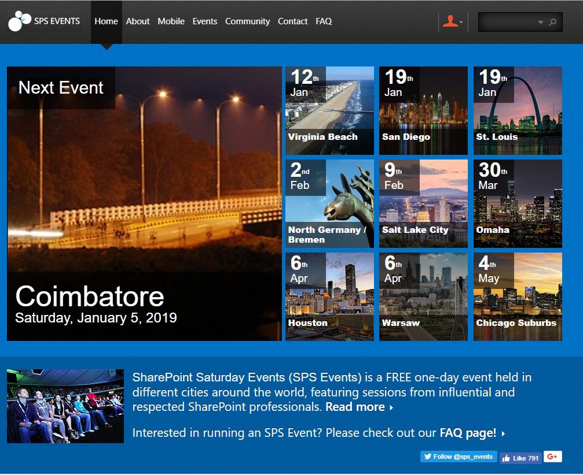
SharePoint Saturdays
SPSEvents.org

Slide 7
Now Available Teams Toolkit Flipbook
Notes:
O365 Adoption Toolkit – Adoption & Deployment Workstreams
vE10-18.1

Slide 8
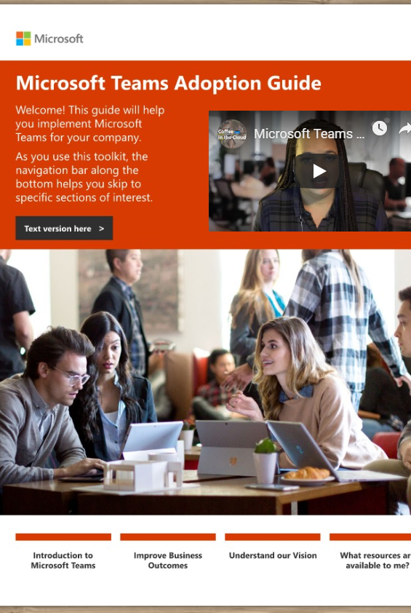
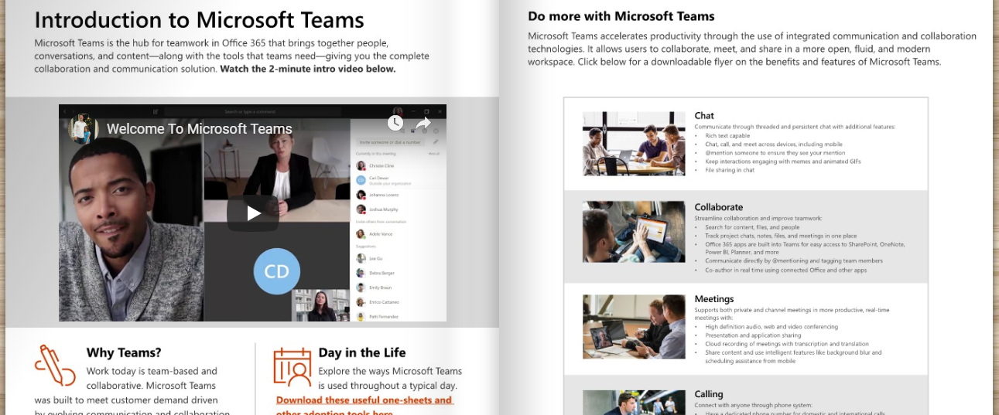
Teams Toolkit Tell the Teams Story https://aka.ms/TeamsToolkit

Slide 9
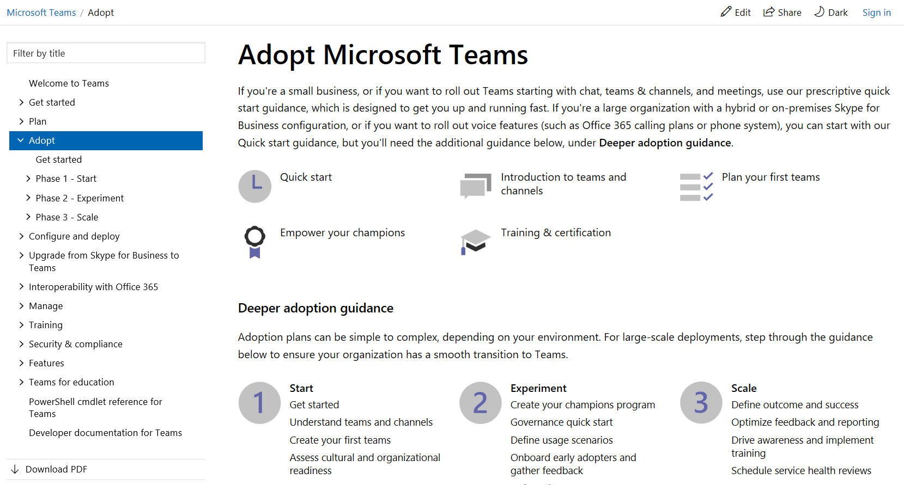

Teams Adoption Hub – Now Live @ https://aka.ms/TeamsAdoption
Tools and downloads

Slide 10
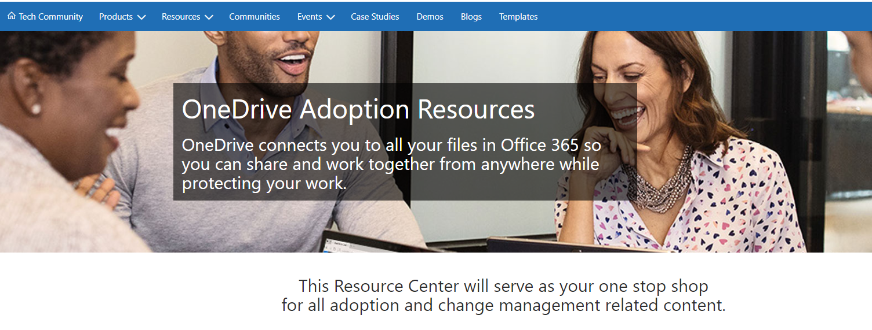
OneDrive Adoption Guidance https://aka.ms/OneDriveAdoption
Notes:
O365 Adoption Toolkit – Adoption & Deployment Workstreams
vE10-18.1

Slide 11
Preview Productivity Experience Slide
Notes:
O365 Adoption Toolkit – Adoption & Deployment Workstreams
vE10-18.1

Slide 12












Your productivity experience Create, collaborate & communicate on any device with Microsoft 365
During morning coffee
Check e-mail Manage your calendar
Check chats & stay up to date on projects
Create or review documents
On your commute
Join personal meetings or chat with voice to text
Catch up on company news
Connect to a meeting right from Outlook
Meeting at the office
Conduct private or channel meetings with teammates. Take notes, share meeting recordings and action items
Track and share meeting actions with Planner and other apps in Teams
Collaborating with your team
Chat, video, screen sharing, and file co- authoring in context via Teams
Co-author content with PowerPoint, Excel or Word
Save & share documents from the cloud
Connecting across the company
Use Yammer for organizational updates, knowledge sharing, finding answers or providing feedback
Use communication sites & news to keep broad groups of stakeholders up to date
Notes:
A day in your digital life
Get the most from Office 365 in ways that work for you. All activities shown can be accomplished from your desktop, tablet or mobile device.

Slide 13
Teamwork Business Process Improvement Categories
Gather data
Make decisions
Create content
Culture
change
Share knowledge
Forms
Surveys
Apps
BI Tools
Conversations
Workflows
LOB Apps
Office Apps
LOB Systems
Intranet
Live Events
Video Chats
Communities
Knowledge Base
Search
Bots & Apps

Slide 14
SharePoint Online Communication Sites – Best practices and use cases
The Science of Change – Understanding human responses to change
OneDrive for Business – Stop Emailing that Spreadsheet!
Modern Project Management – Tasks in Microsoft 365
Upcoming Topics

Slide 15
Visit https://aka.ms/O365ChampionFeedback
Share your product & topics of interest
Tell us what times work for you
Open feedback section
Help us design this program!

Slide 16
Resources

Slide 17
Microsoft Teams Resource Cheat Sheet
https://aka.ms/O365Roadmap
https://aka.ms/TeamsCommunity
https://aka.ms/SuccessWithTeams
https://aka.ms/CoffeeintheCloud
Office 365 Roadmap
All public feature delivery dates
Filter by product
Microsoft Technical Community
Product forums and blogs
Driving Adoption forum
O365 Champion’s Corner
Success with Teams Practical Guidance
Learn how to plan, deliver, adopt and manage Microsoft Teams
Skype for Business to Teams transition guidance
Coffee in the Cloud on YouTube
Short how-to videos for IT Pro’s and Champions
Long form end user & administrator training
Continue Your Education
https://aka.ms/O365Champions
Office 365 Champions Program
Free monthly calls with Microsoft experts & peers
Early access to adoption resources and tools
Open to all business users, IT Pro’s and developers who want to drive adoption of cloud solutions & services
Sign Up

Slide 18



Coffee in the Cloud
Get more from Office 365
https://aka.ms/CoffeeintheCloud
Subscribe now to Learn About:
Business Solutions
Best Practices & How-To’s
For Admin’s and Champions
@CITCTV

