Slide 1
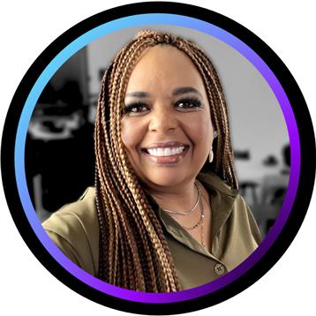
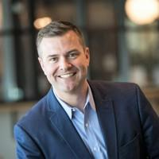
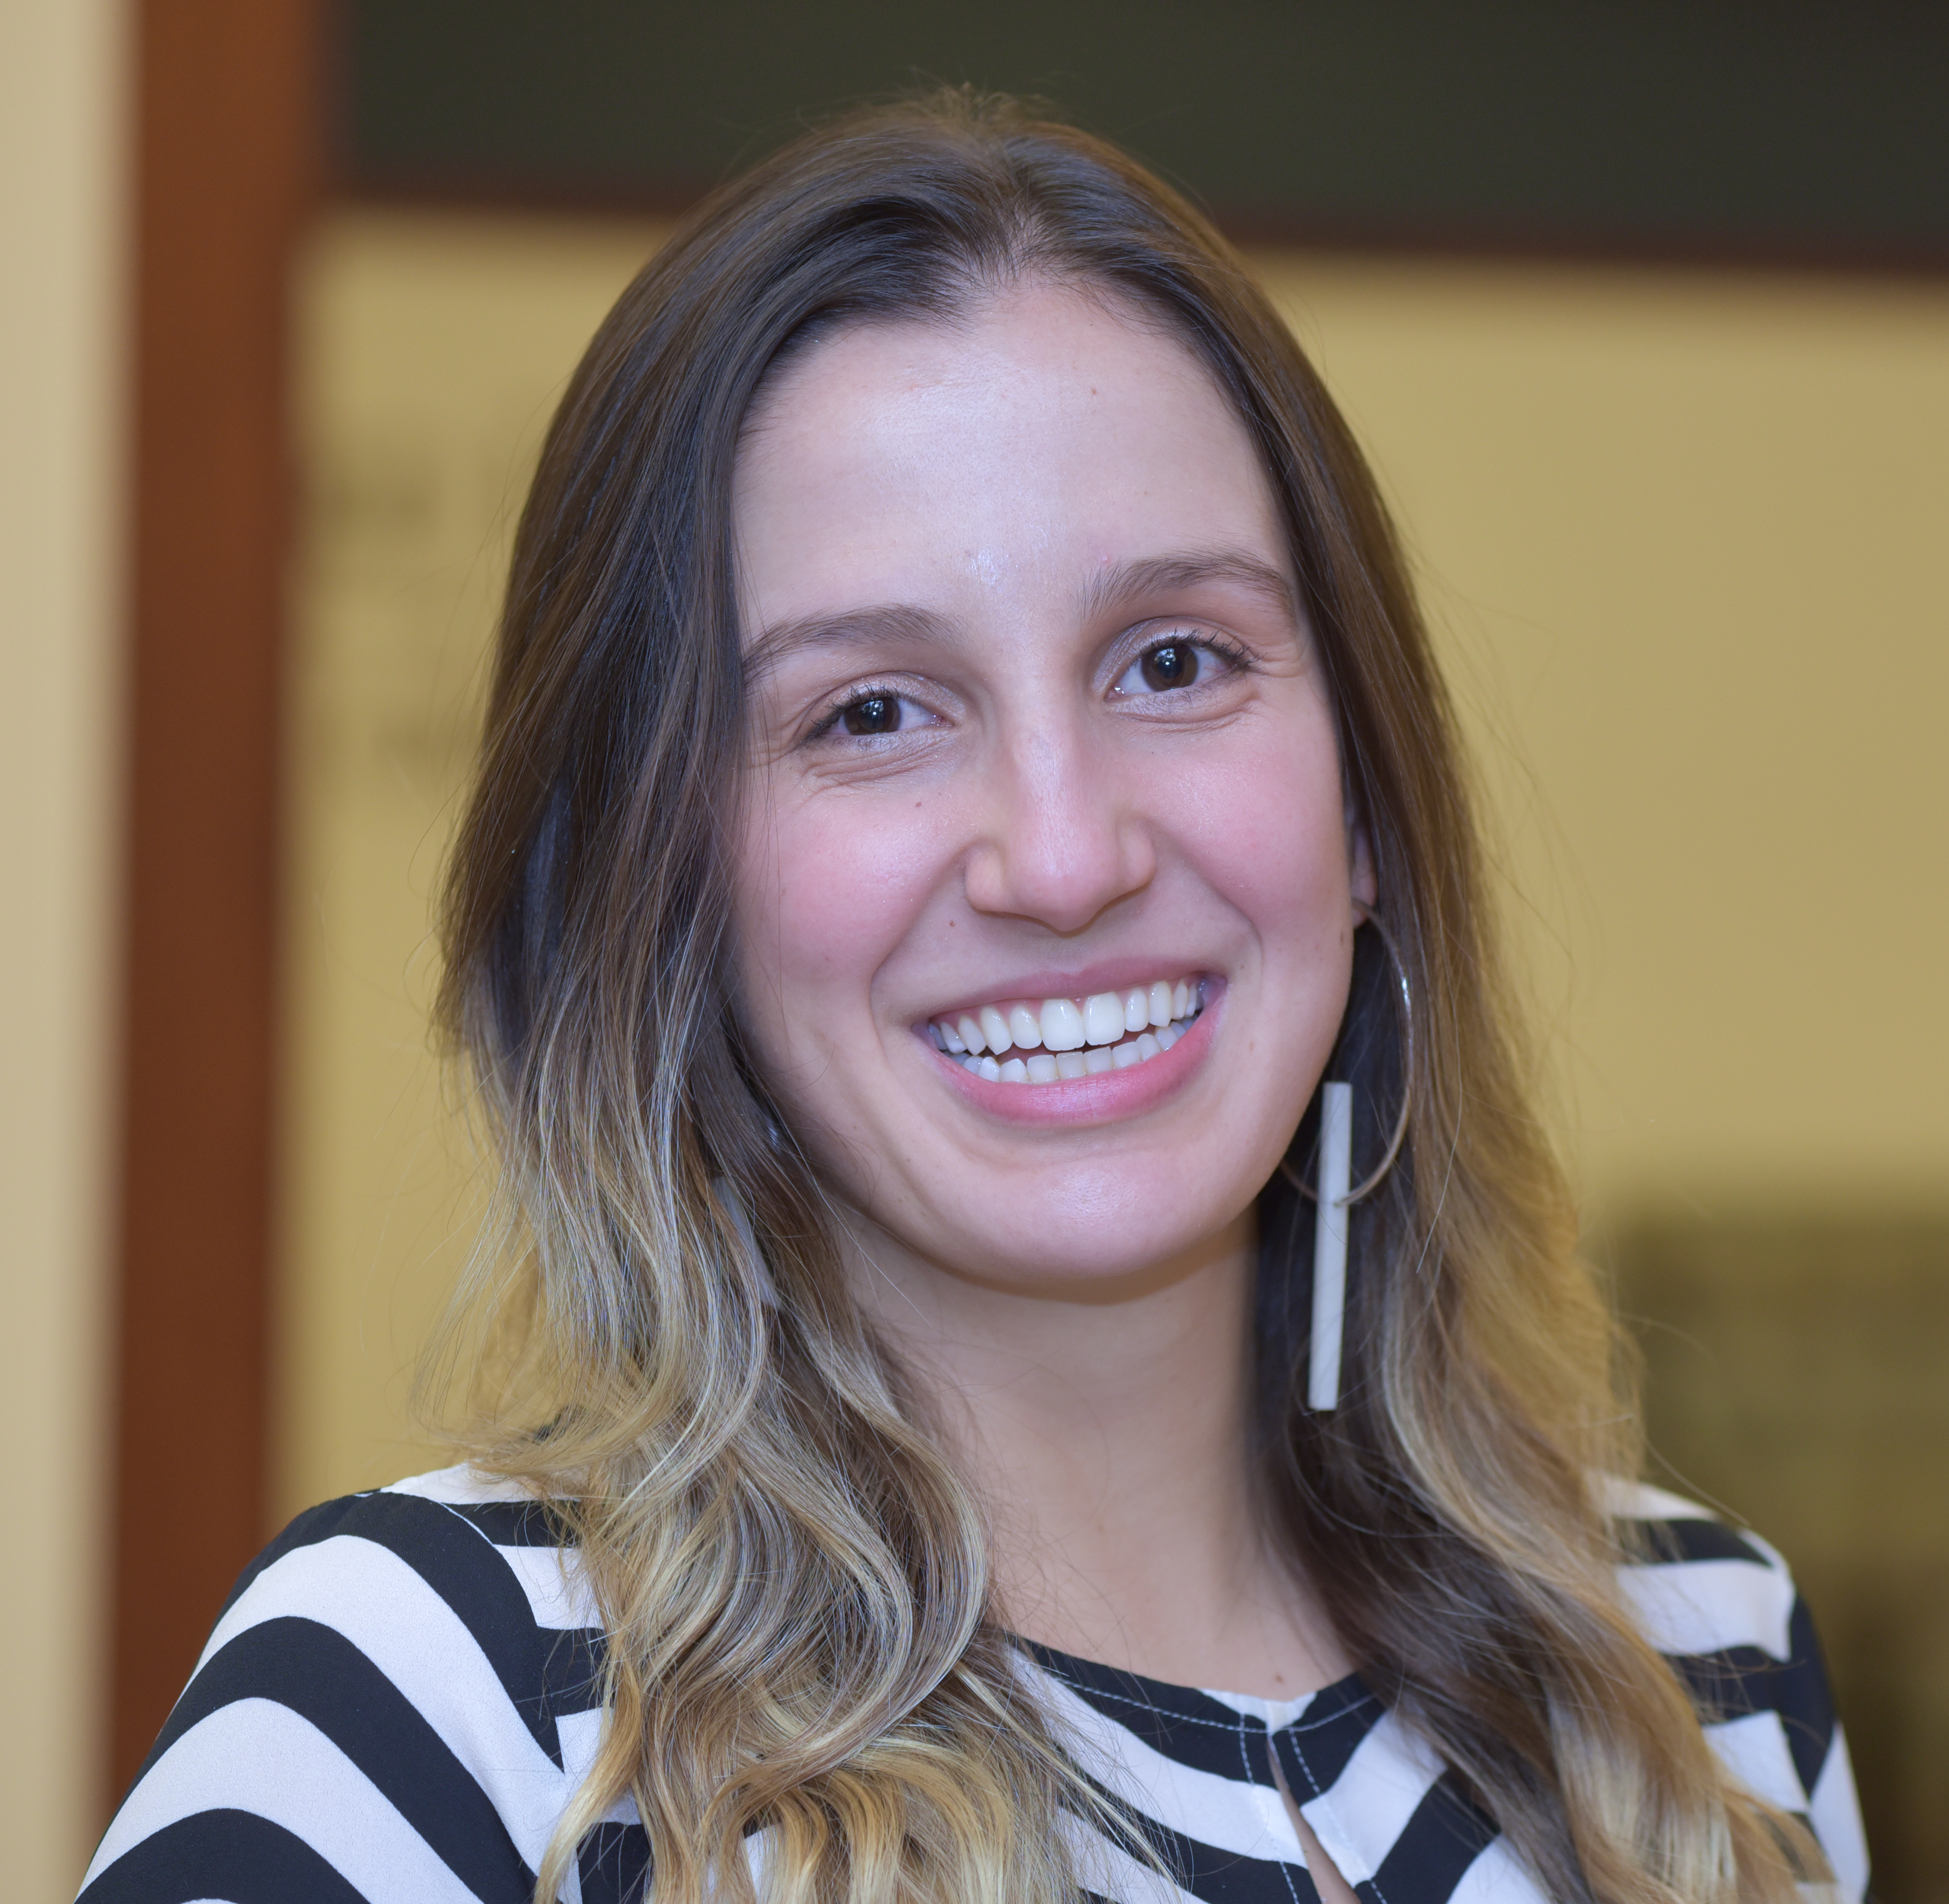
Championing continuous learning
Karuana Gatimu
Principal Manager, Customer Advocacy Group, Microsoft Teams Engineering
Steven Storey
Customer Success Director
April 2023
Mariel Vargas
Customer Success Manager

Slide 2
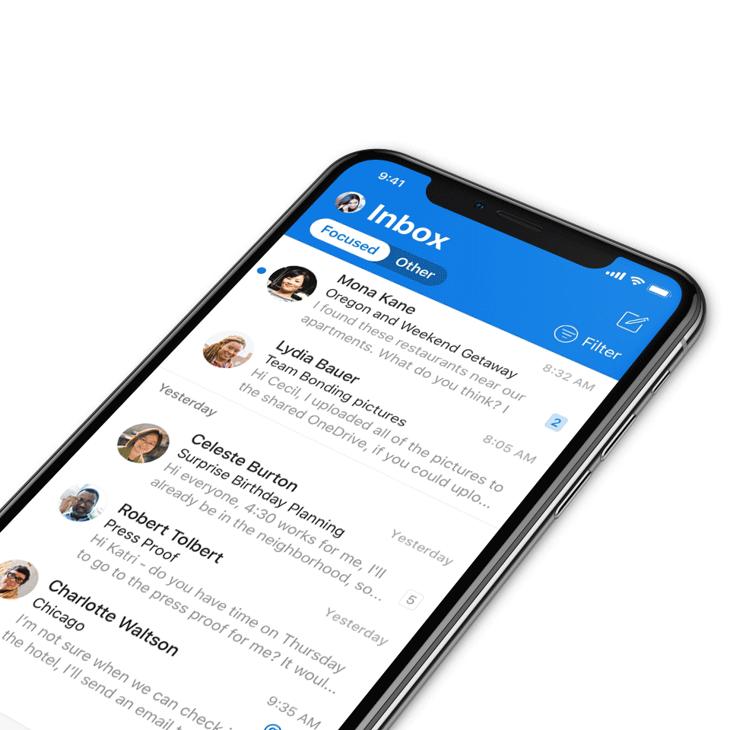
Digital Event Code of Conduct
Microsoft’s mission is to empower every person and every organization on the planet to achieve more. This includes all Microsoft events and gatherings, including on digital platforms, where we seek to create a respectful, friendly, fun and inclusive experience for all participants.​
We expect all digital event participants to uphold the principles of this Code of Conduct, which covers the main digital event and all related activities. We do not tolerate disruptive or disrespectful behavior, messages, images, or interactions by any party participant, in any form, at any aspect of the program including business and social activities, regardless of location.​
Microsoft will not tolerate harassment or discrimination based on age, ancestry, color, gender identity or expression, national origin, physical or mental disability, religion, sexual orientation, or any other characteristic protected by applicable local laws, regulations, and ordinances.​
We encourage everyone to assist in creating a welcoming and safe environment.
For more info, click here.

Slide 3
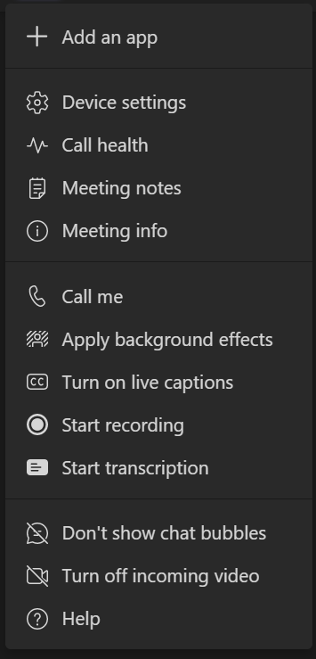

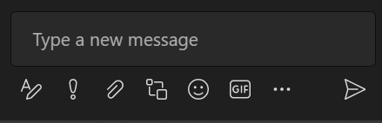
Microsoft Teams meetings
Need help? Use the chat for questions or support.
More actions
Including turn on live captions
MEETING CONTROLS
Send chat messages
Unmute or mute your microphone
Only with permission
Share your screen Only with permission
Raise your hand
CHAT OPTIONS
Type a message
Send your message
Notes:
Say: We’re using Microsoft Teams, specifically Microsoft Team’s meetings, during this virtual training.

Slide 4
What to expect today:
Get the most of this call:
Learning at Microsoft
by Karuana Gatimu
Three superpowers to accelerate your Champion Community
by Steven Storey & Mariel Vargas
Customer panel – hear from our panel of customers share their experience on how they are driving continuous learning within their organizations, the impact this has had, and lessons learned.
with Valérie Stadler from Sika & Stephanie Rook from Ferguson
What’s next
Answer our initial poll so we can better understand the audience
Engage during the call through chat or with the raise hand feature to ask questions and/or share insights with the group
Please make sure your mic is on mute when not speaking
Don’t forget to answer our feedback survey, to help us bring more relevant content and events!

Slide 5

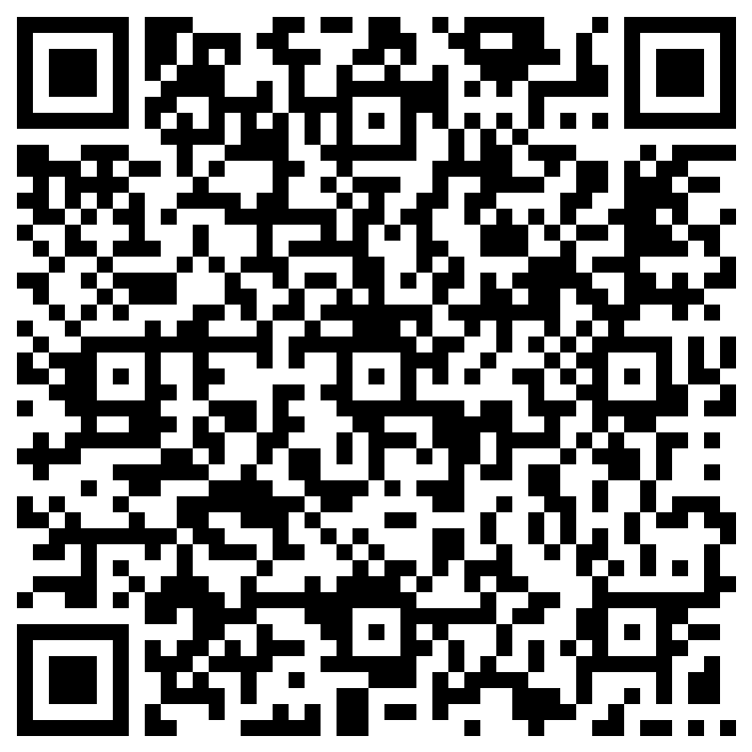
We are the Champions – quick poll
Share some insights about your experiences!
Click Here!
Scan here
Or access link in the chat!
Notes:
https://forms.microsoft.com/Pages/ResponsePage.aspx?id=v4j5cvGGr0GRqy180BHbR8wrRo4HhSNEsHewA20mdfZUM0pQOFEzRUY5WFZBODZYQjNNWU1BTlk1VC4u

Slide 6
Learning at Microsoft
Karuana Gatimu
Principal Manager,
Customer Advocacy Group,
Microsoft Teams Engineering

Slide 7

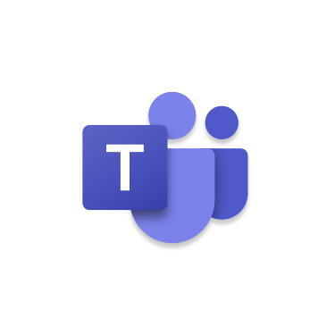

End-User Training Ecosystem
Microsoft Content Platform
Support.microsoft.com (SMC)
Docs.microsoft.com (Docs)
Microsoft Learn
Answers.microsoft.com
In app content experiences
In App Help
Support.microsoft.com (SMC) Help articles, Micro-learning, and Quick Answers
Microsoft 365 Learning Pathways
SMC, Custom & Partner content
Microsoft Community Training
SMC, Docs, MS Learn & Custom Content
Azure hosting costs required
Microsoft Viva
SMC, Learn & LinkedIn Learning – M365 Included license
Custom content support & premium content available with additional license
Content Platforms
Web & In App Content
Microsoft 365 Learning Pathways
Microsoft Community Training
Microsoft Viva Learning
Custom Content & App Templates
Partner Provided Content & Apps
= Teams integrated experience
= SharePoint Online experience
= Azure app & backend + remote/offline experience
Notes:
Q: How is Learning Pathways related to the Viva Learning app Microsoft announced in June?
A: The same end-user training content that is available in Learning Pathways will be available in the Viva Learning app, which is currently under development. Stay tuned for updates.
Q: How is Learning Pathways related to the Microsoft Skilling Initiative announced in June?
A: In the future, we plan to add the Microsoft 365 end-user content now available in Learning Pathways to the future Teams learning app which we unveiled in the June 30, 2020 blog post on Microsoft’s Global Skilling Initiative.
Q: Does Learning Pathways also include training for my Dev and IT Staff?
A: No. Learning Pathways is for training end-users in your organization on Microsoft 365 apps like Teams, SharePoint, Outlook. Dev and IT training can be found on our Virtual Hub & Microsoft Learn.
Q: OK, so what is the difference between Learning Pathways and Microsoft Learn?
A: Microsoft Learn is a free, interactive, hands-on training platform that helps people develop in-demand technical skills related to widely used Microsoft products and services including Azure, Microsoft 365, Power Platform, Dynamics 365 and more. It is publicly available on the web at: https://docs.microsoft.com/en-us/learn/.
Learning Pathways is a customizable SharePoint solution used by organizations to train their end-users on Microsoft 365 apps like Teams, Outlook, and SharePoint. It needs to be deployed and setup by IT and can then be managed by a training lead. Content is evergreen, visibility is controlled by the site owner and is evergreen being maintained by Microsoft.

Slide 8







Technical scenarios
Training Scenario
Audience
Learner identity
Learning Platform
Learning Content Source
Has M365 subscription
No Azure subscription
High bandwidth
No custom content
Azure Active Directory
Viva Learning
Connects to all
Microsoft Learn
Employees
Education
Has M365 subscription
No Azure subscription
High bandwidth
Has custom content
Azure Active Directory
Microsoft 365 Learning Pathways
Microsoft content platforms
Connects to some
Employees
Education
Flexible
Phone number
ADB2C
Custom Auth
Microsoft Community Training (MCT)
LinkedIn Learning content
No M365 subscription
Has Azure subscription
High bandwidth
Connects to some
Job Seekers (via Govt/NGO)
Custom content on SharePoint
Flexible
AAD, ADB2C
Phone number
Custom Auth
Viva for Employees + MCT for non-employees (gig workers/vendors)
Has M365 subscription
Has Azure subscription
High bandwidth
Connects depending on role
3rd party content providers (Skillsoft, Coursera, etc.)
Employees + Gig Workers
Flexible
AAD , ADB2C
Phone number
Custom Auth
Viva or M365LP and/or MCT for curriculum management, flex auth, low bandwidth
3rd party LMS/LXP
(SAP SF, Degreed, etc.)
Has M365 subscription
Has Azure subscription
High bandwidth
Connects to some
Education

Slide 9
Learning Solution Capabilities
Solution | Teams Experience | Mobile Experience | SMS Sign In / Low Bandwidth & Offline | Customer Content | Partner Content Packs | LMS Connection | Course Usage Analytics | Azure Usage
Microsoft Viva | X | X | -- | X | X | X | X | --
M365 Learning Pathways | X | X* | -- | X | X | -- | -- | --
Microsoft Community Training | X | X | X | X | X | TBA | X | X
Legacy Custom Solutions | X | Some | Some | X | X | X | Some | Some
*M365LP “Get Started” Teams App will display content from underlying installed M365LP solution. App templates are not 1st party app experiences, have no licensing fee, are supported by Microsoft and are configurable by the customer/partner.

Slide 10
Empower your Champions and employees
Learn in the flow of work
Multiple modes of training for different learning styles & scenarios
Take a crawl, walk & run approach with our tools.

Slide 11


Modern Work Superheroes
Steven Storey
Customer Success Director
Enterprise community
https://aka.ms/JoinSuperheroes
Notes:
https://aka.ms/JoinSuperheroes

Slide 12

Unleash the power of your Champion Community
Mariel Vargas
Notes:
INTRO
Hi everyone and thank you so much for being here today. This is exciting to see so many of you here!! My name is Steven Storey and for the past 5-6 years I've been helping our Enterprise Customers to maximize the value of their M365 tools. It's a great job!
You just heard from Karuana about our M365 Champions program and now I'm going to tell you about our Enterprise Superheroes Community, which was created by Customer Success Managers or CSMs for our Enterprise Customers, many of whom are here with us today. The Superheroes Community was created so that our Enterprise Customers could have a place to engage with Microsoft experts but perhaps more importantly with their customer peers. We use this community – much like a Champions Community for our Customer Champions. We provide best practices, customer examples, key roadmap updates, and customer events. The community allows us to accelerate growth and impact.
M365+Superheroes
And today, we are joining forces with our good friends running the M365 Champions programs – Karuana and her team to provide more value to all of you. Obviously Karuana, all of you, and I share a lot in common – we're all trying to help one another reach as many people as possible to help them understand best practices so the people we work with can improve productivity and wellbeing.
Superpowers
For today's session, we are really zeroing in on 3 superpowers that we want to make sure you take away, that will help you regardless of whether you haven't launched your Champions program, or if you are looking for ways to inject it with energy and inspiration. And those 3 superpowers are:
1) Sponsorship – active and visible sponsors from IT and the Business are critical for an effective Champions program and help activate members across the organization. Case in point, Karuana is one of our sponsors for the Superheroes Community and that has been instrumental to the successful growth and impact of our community. Karuana was responsible for securing one of our amazing customer panel members – Valerie, who will share the lessons learned and best practices of her Champions organization for a global enterprise with over 25,000 employees. We also have Sponsors in our Teams and Viva Product groups and other key areas within Microsoft. Broad Sponsorship is Superpower #1
2) Champions Management Platform to more effectively onboard, train, and inspire Champions. We'll hear more about Valerie's experience in a moment, but this will be exciting to many of you who are looking for help strenghening the Champions participation, recognition, and impact.
3) A digital community- creating a place for your Champions to actively engage and reach across the entire organization will accelerate the awareness and adoption of best practices.
Promote Resources
Before you leave today, we're going to provide everyone with resources and tools for all 3 superpowers!! So excited to continue the journey alongside of you.
Hand off
Now I'm going to hand it over to my colleague Mariel, who will go into a bit more detail about these superpowers. Before joining Microsoft as a CSM, and helping create incredible content for our Superheroes community, Mariel was a Microsoft customer and helped create and lead a Champions program.

Slide 13
WHY are Champions important
  Learning via coworkers is among the most effective and most used methods.
  Percent using learning method versus helpfulness
These methods are underutilized (low usage, but have high effectiveness)
Learning via coworkers is among the most effective and most used methods
My manager
IT employee
Coworker
(non-manager, non-IT)
Formal training (external)
Formal training (internal)
% who said method was “very helpful”
Community forums
User guide or manual
Microsoft’s website
Online tutorials or webinars
Myself, through
trial and error
Search engine
Self-learning is largely ineffective, but currently part of learning process for many
Learn more: https://aka.ms/BuildChampionsProgramGuide
Notes:
Sponsorship
Technology
Champions management app (Microsoft & Changing social
Amplify and community budling in Viva engage
Representation across
Recognition

Slide 14


HOW do Champions make a change
Learn more: https://aka.ms/BuildChampionsProgramGuide
Champions build a circle of influence amongst their teams.
Which helps growing adoption of the improved ways of working.
Projects involved
Colleagues on his/her team
  Champions bring the new ways of working to life across teams.
INFLUENCER:
A champion that applies the new ways of working on their day-to-day
BERGs, Volunteering and others
Notes:
A Champion is an influencer

Slide 15
Ignite your community with three Superpowers
Increase Sponsorship
  Fueling Success: see your Champions Communities thrive with sponsors across your business!
Have a management platform to communicate and engage champions
  The Champion Management Platform will help you onboard, manage, and inspire champions in your organization to accelerate results.
Create a digital community to amplify the impact and engage the entire company
  Reach your entire organization! Engage in conversations, praise colleagues, take polls.
Notes:
Sponsorship
Inspire and engage champions by having a strong network of leaders that support and
Have a formal and organized strategy to communicate and engage champions
The Champion Management Platform will help you onboard, manage, and inspire champions in your organization to accelerate results.
Have a platform to amplify the impact and engage the entire company
Have a management platform to communicate and engage champions

Slide 16

Sponsors
5 major reason why sponsors are important:
  Support, guidance and mentorship: They can offer advice, share their experience and expertise, and help you navigate challenges or obstacles that may arise within your community.
  Credibility and Influence: A sponsor's endorsement can validate your community's mission and goals, which can help you gain trust and respect from community members and stakeholders.
  Networking and Connections: By leveraging your sponsor's network, you can tap into a broader audience and increase the visibility and reach of your champions community.
  Advocacy and Promotion: They can help raise awareness about your community's goals, initiatives, and achievements, and help you gain visibility among relevant stakeholders.
  Motivation and Accountability: Having a sponsor can help you stay focused, committed, and driven in your efforts to build and manage a successful champions community.
Notes:
5 major reason why sponsors are important:
Sponsor are important for the following:

Slide 17
Champion Management Platform
Inspire the next chapter of your champion program
Four main areas to help you manage your program:
Pre-built Teams apps for common line-of-business scenarios. Templates take popular scenarios and bring them into the flow of work, inside of Microsoft Teams.
Tenant-wide: Give access to few, many or everyone.
Production ready: Download and use, today. Easily customize app templates for your organization with simple changes.
Open sourced: You can own, brand, configure and extend to your needs. Go further with your own developers or Microsoft Partners to build deeper capabilities
Program management
Leaderboard
Digital Badge
Tournament of Teams
https://aka.ms/TeamsAppTemplates

Slide 18

Amplify your success with Viva Engage
10 tips to have a successful technology community
  Define Clear Objectives
  Identify Key Champions
  Provide Resources and Support
  Foster Collaboration
  Recognize and Reward Contributions
  Leverage Leadership Support
  Monitor and Measure Success
  Promote Inclusivity and Diversity
  Adapt and Evolve
  Cultivate a Positive Community Culture
Build meaningful relationships and communities
Give employees a place to connect and express themselves.
Empower leaders to share mission, align people, and scale culture.
Encourage open sharing and contribution of knowledge, answers, and ideas.

Slide 19
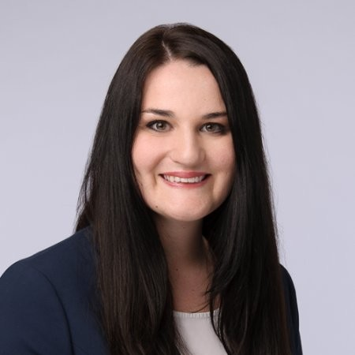
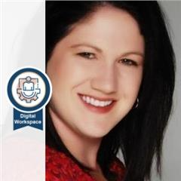


Customer panelists
Valérie Stadler
Digital Workplace Manager
Sika Services
Stephanie Rook
Senior Manager – Digital Workspace Program
Ferguson

Slide 20
Closing remarks
Karuana Gatimu
Principal Manager,
Customer Advocacy Group,
Microsoft Teams Engineering

Slide 21
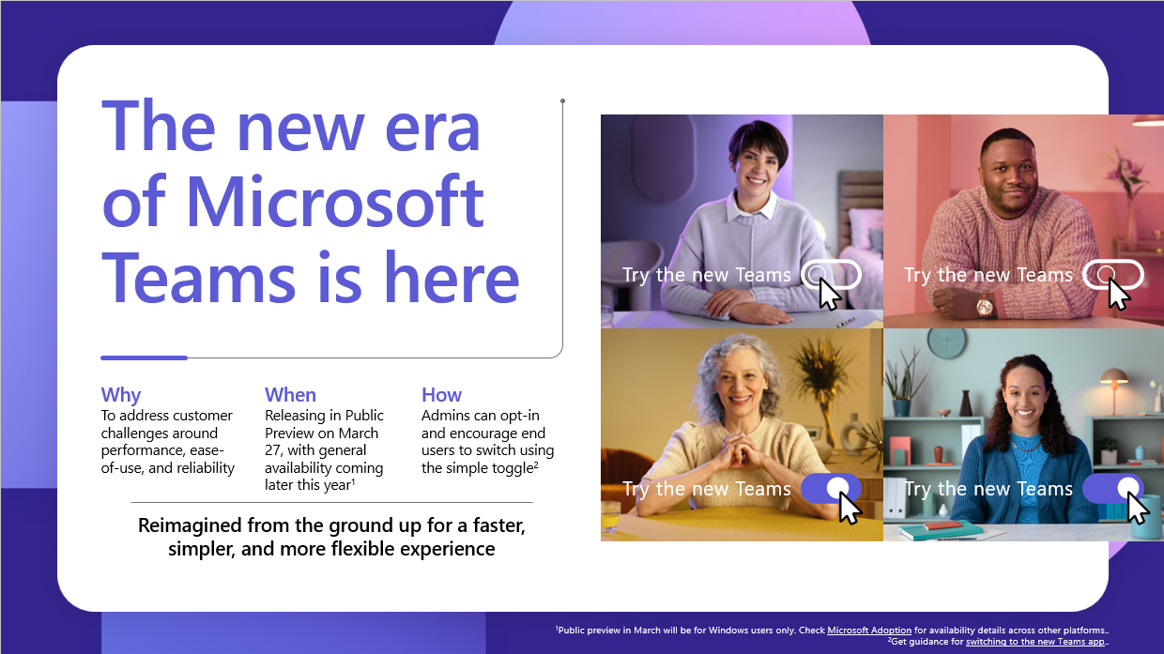
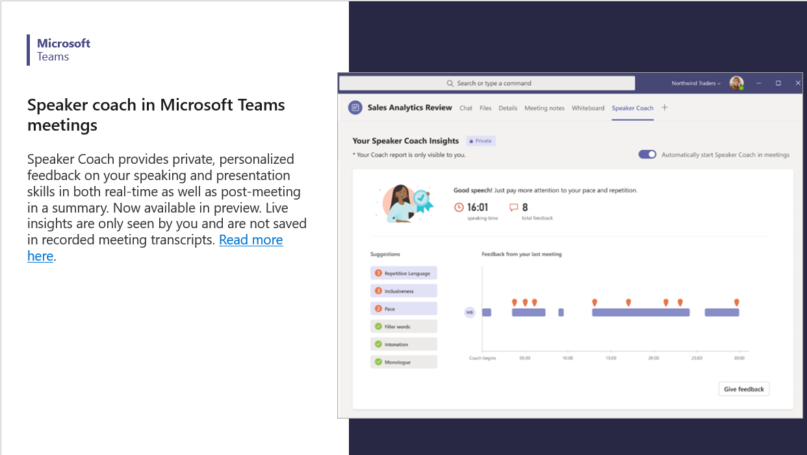
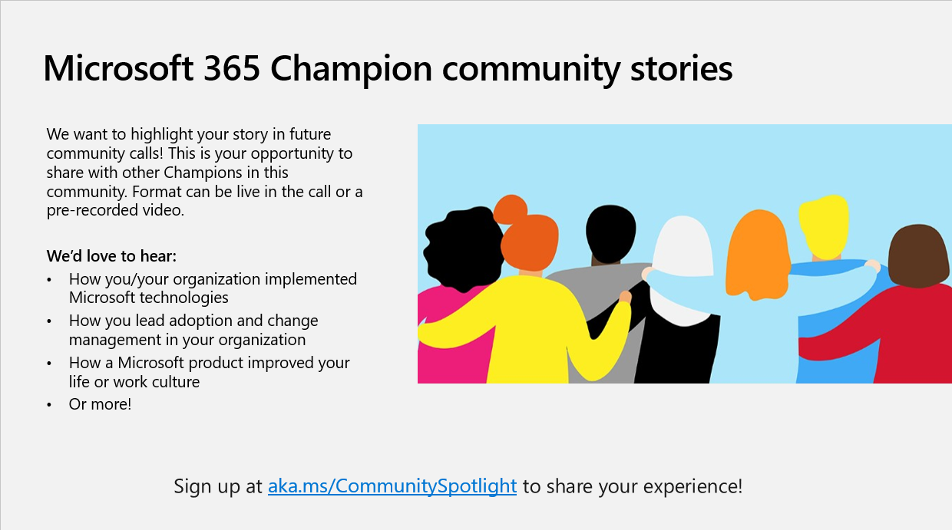
Fuel your Champion community with ours
Join the Microsoft 365 Champion Program to get access to our resources – community call recordings, PowerPoint presentations, latest feature announcements, etc. – to help you drive adoption and fuel your communities.
You can also join our Driving Adoption community to connect with other Champions, ask questions, and learn from others just like you.

Slide 22




What’s next
We’d love your feedback on today’s call and how we can make future calls better:
https://aka.ms/ChampioningContinuousLearningFeedback
Join the Microsoft 365 Champion Program to get access to additional adoption resources.
Sign up for these workshops to take your learning farther:
  Supercharging your Champion Program with the Champion Management Platform:
      May 10, 2023, 10:00 AM ET | Register now
      May 11, 2023, 3:00 PM ET | Register now
  Enabling Viva Engage to maximize the reach and impact of your Champion Program:
      May 16, 2023, 12:00 PM ET | Register now
      May 18, 2023, 6 AM ET | Register now
Additional resources for your learning journey:
    Championing Continuous Learning – today’s recording and presentation will be published by end of week
    Microsoft Adoption – adoption resources for Microsoft 365 services and more
    Modern Work Superheroes on YouTube – see real use cases and demos from real organizations

Slide 23
Thank you!

Slide 24
Appendix

Slide 25
Amplify your success with Viva Engage
Have a clear purpose and mission.
Give everyone a place to connect, ask questions and share success stories around technology and adoption
Build a strong community to support your change management campaigns
Share the outcomes and success stories from your champions community
Make sure to encourage sponsors, stakeholders and champions to constantly engage and encourage others through your community
Pro tip: Make sure to redirect technical support questions to the appropriate process to keep questions relevant to your community purpose

