Slide 1


SharePoint Envisioning and Value Realization Guide

Slide 2
Table of Contents
Explore
The art of the possible
Align
Scenario identification & prioritization
Implement
Solution design, Prototyping & Build
Engage
Launch and adoption

Slide 3
Envisioning and value realization process
Transform employee communications and digital experiences with our 4-stage approach to getting your teams connected online, now, with SharePoint and Microsoft 365
Explore
Align
Implement
Engage
Explore innovations to make it easier than ever to build solutions that connect your people to colleagues, news, knowledge, and apps.
Align with your team and stakeholders on a common vision, set of scenarios and plan.
Define and design your solution. Accelerate your time to value with out-of-the-box capabilities and scenarios.
Launch your solution with an adoption plan that will have your team ready to successfully engage.

Slide 4
Explore
The art of the possible

Slide 5





The intelligent intranet
Communicate effectively
across the organization
Connect people with relevant
information and knowledge
Engage
employees

Slide 6
Art of the Possible – Putting your Intranet to Work
Communicate effectively
across the organization
Connect people with relevant
information & knowledge
Engage
employees
Support new employee onboarding
Connect employees with company leaders
Recognize employees
Reach broad audience with intranet site
Share company news
Broadcast live events
Communicate during crisis
Train people on how to use workplace technology
Share domain expertise and knowledge in community sites
Use video to deliver training
Find company policies

Slide 7
Align
Scenario identification and prioritization

Slide 8
Business priorities
When starting any project, it’s always good to begin with the objectives – it’s the first step toward stakeholder alignment and will help drive the next steps. For each stakeholder group, enter the role (e.g., HR, Corporate Communications, etc.) and their unique priorities and challenges
 | ROLE (GROUP) | PRIORITIES | CHALLENGES
1.
2.
3.
4.
5.
6.
7.

Slide 9
Understand stakeholder priorities
Example
 | ROLE (GROUP) | PRIORITIES | CHALLENGES
1. | HR | Improve corporate and front-line employee engagement Improve new employee onboarding experience | Disparate sites used across regions Silos between teams and departments
2. | Corporate Communications | Increase awareness of authoritative news Create consistent culture experiences across different roles and locations Increase awareness of processes and procedural changes | Lack of consistent brand used across internal Intranet properties
3. | Business Units | Share what our division does with the rest of the organization. Connect front line staff with back office | Front line staff are not aware of operational changes, don’t have channels to get clarification or provide feedback
4. | Sales
5. | Marketing
Find all workshop materials at https://aka.ms/SharePoint/Resources/Adoption

Slide 10

Build interest through scenarios
Scenarios cover the ways your people will use SharePoint and Microsoft 365 to address business challenges or achieve defined business priorities

Slide 11
Create your own Scenarios
Use the stakeholder's priorities and challenges, and your understanding of the technology capabilities, to identify relevant scenarios. Consider this template for structuring your scenarios.
I want to…
[Description of what I want to do]
Using…
[Specific application of the technology]
I know this is successful when…
[Solution success measure]
As someone in…
[Team]
As someone in...
Sales Management
I want to...
train my sales reps, who are geographically dispersed, on new products we bring to market
By using...
SharePoint Communication Sites, News and Microsoft Stream to create a Sales Training Portal that alerts sales reps of new product training videos on the portal they can consume while on the road
I’ll know this is successful when...
my sales team completes the training and indicates in a survey they have improved their ability to sell the new product

Slide 12




Tips for identifying scenarios
Screen your scenarios to invest in only those that meet clear criterion
Decision Criteria:
Does it solve a real problem?
Is it obtainable?
Will it be widely used (how many people)?
How much ROI does it provide?

Slide 13
Scenario list
Enter each of the scenarios you generated with stakeholders into the business priority column that it aligns with
Business priority 1 | Business priority 2 | Business priority 3 | … | … | (Add columns as needed)
Enter solution ideas for each business priority below
Solution idea 2…
Solution idea 3…

Slide 14
Scenario list
Example
Improve Employee Engagement (HR) | Create consistent culture experiences (Corp Comms) | Connect front line staff to organization (Business Unit) | Improve product and market knowledge (Sales) | Create better ideas and innovation (Marketing) | Improve satisfaction & reduce costs (IT)
Digital workspace
Provide an employee-centric landing page experience that makes it easy for employees to be engaged and informed.
Leadership engagement
Enable employees to hear directly from organization leaders, including leader blogs, town hall meetings and strategy documents.
New hire onboarding
Provide new employees with a dedicated experience for onboarding to the organization successfully
Employee recognition
Provide enterprise-wide,
highly visible recognition to individual employees to demonstrate people are valued and celebrated for their contributions.
Company news
Site for employees to get the authoritative organization news.
Company events
Site that will be used to promote, broadcast and retrieve archived company Live Events.
Operational notifications
Provide quick updates on operational
messages relevant to frontline workers via news bulletins. Enable frontline workers to provide feedback on updates, ask questions and get the support they need to ensure guidance is clear.
Front line staff mobile app
Enable mobile workers to learn about company news, operational notifications and social updates from their personal phones from anywhere.
Sales training
Sales Training Portal that alerts sales reps of new product training videos on a portal they can consume while on the road.
Market intelligence Repository of market and competitive intelligence for salespeople to follow the latest market trends, learn about the pros and cons of competitors and gain market intelligence they can use in their customer engagements.
Idea crowdsourcing
Enable marketing team to crowdsource ideas to improve their campaigns and gain input from folks in sales and other parts of the organization.
Tech support portal
Tech support gateway for employees to learn about tech used in organization, get help on an issue, and get system and ticket status updates.
Tech support chat
Real time chat to allow IT support to help employees resolve their IT issues.

Slide 15
Scenario summary
Work with your stakeholders to create a summary of each scenario, including a description, set of objectives, metrics, sponsors and timing. Use these summaries to socialize your plans.
 | Scenario 1 | Scenario 2 | Scenario 3 | Scenario 4 | Scenario 5
Description
Objectives
Metrics/KPIs
Sponsor(s)
Timing

Slide 16
Scenario summary
Example
 | New Hire Onboarding | Company Events | Company News
Description | Help new employees onboard to Contoso successfully. Provide onboarding journey that takes new employees from day 0 to day 180 Provide a one-stop, authoritative source for new hire information Enable new hires to network with one another and more experienced employees Provide a pre-boarding experience for pre-start hires | Site that will be used to promote, broadcast and retrieve archived company Live Events. Calendar of upcoming events. During live events Yammer will be used to drive engagement and questions during the event. And Stream to be used to broadcast events. | Easy to find, one source of truth for company news. Type of news: New programs, people changes, leadership highlights, events, people on the go, policy changes
Objectives | Improve satisfaction of new employees Reduce new employee churn Get employees to experience orientation day in first 30 days | Engage audiences in diverse locations Keep employee up-to-date on important company initiatives | Increase awareness of authoritative news Drive employee engagement with company news Reduce time spent by communicators sharing news and updates in the organization
Metrics/KPIs | Retention of new employees New employee engagement and satisfaction Site stats % of employees who experience orientation day in first 30 days | Cost avoidance No. of attendees (onsite vs. virtual employees) Views by location Yammer engagement | Number of news views Social engagement – shares, likes, etc. Change in amount of time it takes to publish with current Intranet platform vs. new Intranet publishing time Change in % of news stories published in six-month timeframe
Sponsor(s) | John Smith | Steve Breeze | Meghan Bower

Slide 17
Impact vs ease of implementation
Prioritize your scenarios so you can understand where to start, get a quick win and move on to the next scenario. Determine what has the highest impact and is easiest to implement – that’s where you’ll find your highest priorities, and your starting point.
High
Med
Low
Medium priority | High priority
Low priority | Medium priority
(Copy these to map!)
Scenario name
Scenario name
Impact
Scenario name
Scenario name
Scenario name
Scenario name
Scenario name
Add your scenario’s name and add as many as needed
Hard
Somewhat
Easy
Ease of implementation

Slide 18
Impact vs ease of implementation
Example
High
Med
Low
Medium priority | High priority
Low priority | Medium priority
Digital workspace
Tech support
Leadership engagement
New hire onboarding
Company news
Idea crowd sourcing
Impact
Market intelligence
Operational notifications
Sales training
Front line staff mobile app
Hard
Somewhat
Easy
Ease of implementation

Slide 19
Roadmap
Plot each prioritized scenario on the roadmap. Highest priority scenarios should happen first, followed by medium and then low priority scenarios
Business priority 1
Business priority 2
Business priority 3
Business priority 4
Infrastructure
Adoption
(Copy these to roadmap!)
Scenario name
Scenario name
Scenario name
Scenario name
Scenario name
Scenario name
Scenario name
Add your scenario’s name and add as many as needed
0
3 months
6 months
9 months

Slide 20
Roadmap
Example
Improve employee engagement
Create consistent culture experiences
Connect front line staff to organization
Improve product and market knowledge
Create better ideas and innovation
Improve satisfaction & reduce costs
Infrastructure
New hire site
Intranet
Leadership engagement site
Company news
Company events
Operational notifications
Front line staff mobile app
Sales training
Market intelligence
Idea crowdsourcing
Tech support portal
Tech support chat
Audit on-prem sites to determine what will be migrated to cloud
Onboard departments to Intranet project
0
3 months
6 months
9 months
12 months

Slide 21
Implement
Solution design, Prototyping & Implementation

Slide 22






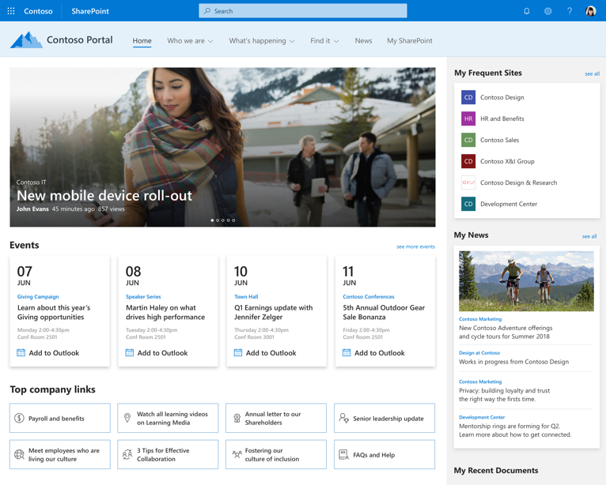
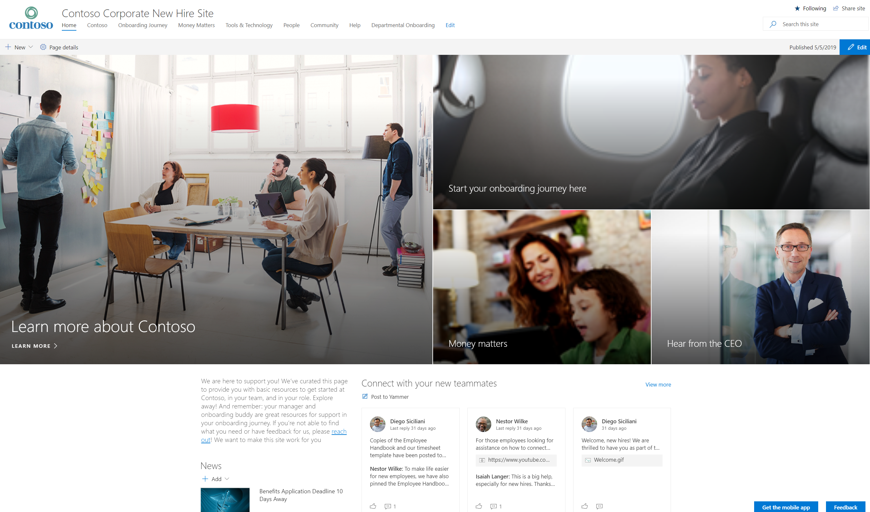
Define solutions based on prioritized business priorities and scenarios
Business Priority
Scenario
Solution
Intranet landing experience
Improve employee engagement
Digital workspace
Objectives
Metrics
Personas
Design
New hire site
New hire onboarding
Objectives
Metrics
Personas
Design

Slide 23
Solution Objectives and Measures
Example
What are the objectives of the solution? What metrics will be used to determine to what extent the solution is achieving its objectives? How will these metrics be measured?
Scenario: Digital Workspace |  | Measurement
Objective | Owner | KPI Measure | Data Source | KPI Formula | KPI Baseline | KPI Target
Increase employee engagement | HR | Change in employee engagement score | Employee engagement survey | Comparison of employee engagement survey results YoY | 70% | 80%
Increase awareness of authoritative news | Corporate Comms | Reduction in email traffic | Usage report | Difference in number of emails sent in org before and after implementation of Intranet, over 60-day period | 250K | 200K
 |  | Consumption of news | Usage report | Number of news views | N/A | 10K
Reduce time spent by communicators sharing news and updates in the organization | Corporate Comms | News publication time savings | Time study | Change in amount of time it takes to publish with current Intranet platform vs. new Intranet publishing time | 3 hours | 1 hour
 |  | Number of news stories published | Usage report | Change in % of news stories published in six-month timeframe | N/A | 100% increase
Increase awareness and understanding of company and business unit strategy | Corporate Comms, Business Unit | YoY change in employee communication score | Employee survey | Comparison of employee communication survey results YoY | 65% | 80%

Slide 24



Personas
Example
Who are the target users of the solution? What are their goals? How do they get their job done today? What systems and tools do they use today?
Users
Knowledge Worker
Frontline Worker
Remote Worker
“My goal is to find the information I need quickly and get my work done effectively”
“My goal is to stay up-to-date about what’s happening with the company and the procedures I’m responsible for when I’m onsite”
“My goal is to feel more connected to my organization and colleagues”
Enablers
Corporate Communications
Senior Leaders
“I want to cut through the noise and communicate important news and updates to the organization in a targeted and more efficient manner”
“I want the organization to understand our strategy and how their work aligns to it. I also want to hear directly from the front lines.”

Slide 25
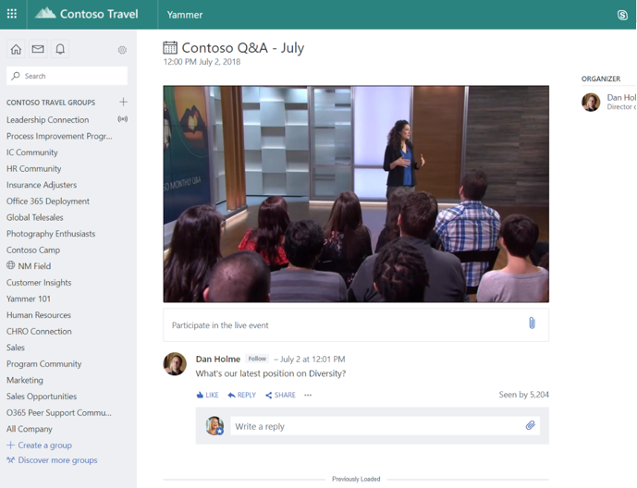
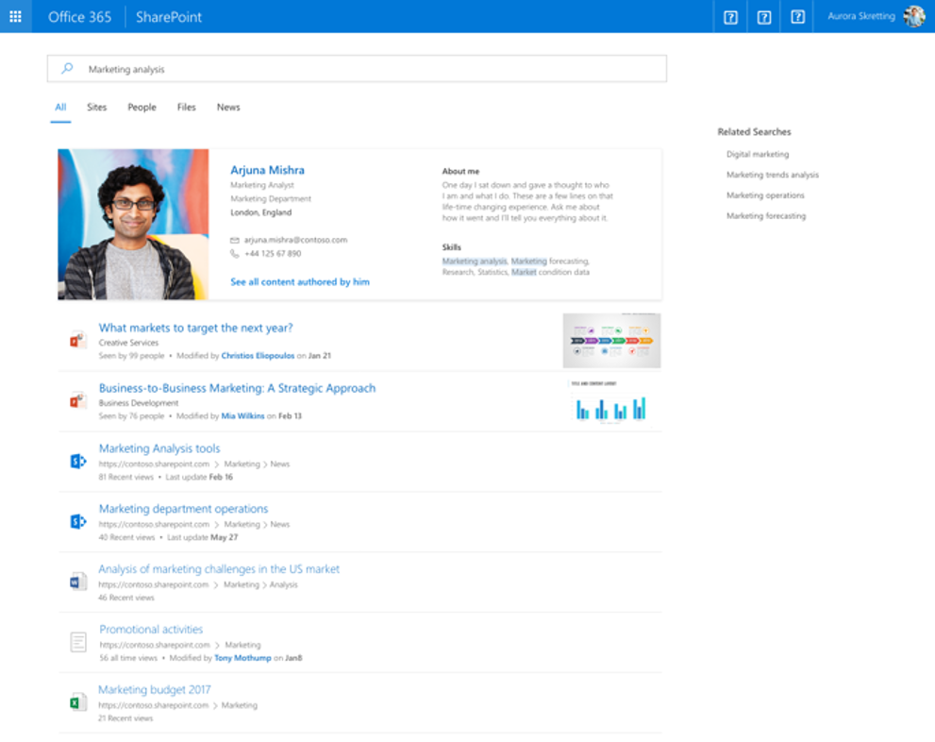
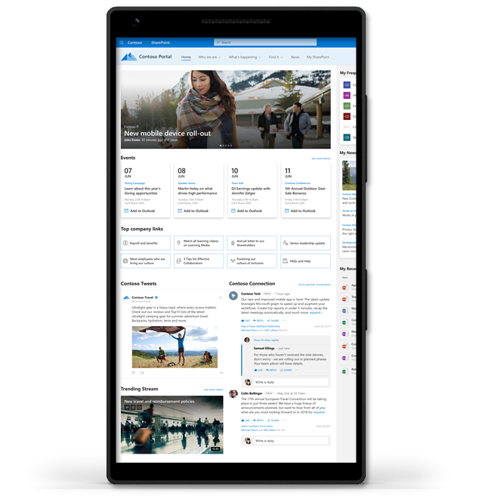
Intranet Landing Experience Design
Example
Personalized news and content
Engaging conversation and video
Intelligent search and rich navigation
Accessible and available across devices
Keep people up-to-date with corporate, departmental, business unit and regional news
Engage audience with likes, comments, and social re-sharing
Foster connections across the organization with social conversations
Create common culture experience with live company events
Find relevant content and expertise
Save time when searching with highlighted content, suggestions and answers, and refiners
Keep people in the know with important and relevant news across devices
Provide dynamic employee experience across devices
Experiences
SharePoint news web part
Audience targeting
Microsoft Stream
Yammer web part
Microsoft Search
Mega Menu
SharePoint Mobile
Components

Slide 26
Build your prototype
A prototype will help you get buy-in from stakeholders, demonstrate what’s possible and get feedback

Slide 27
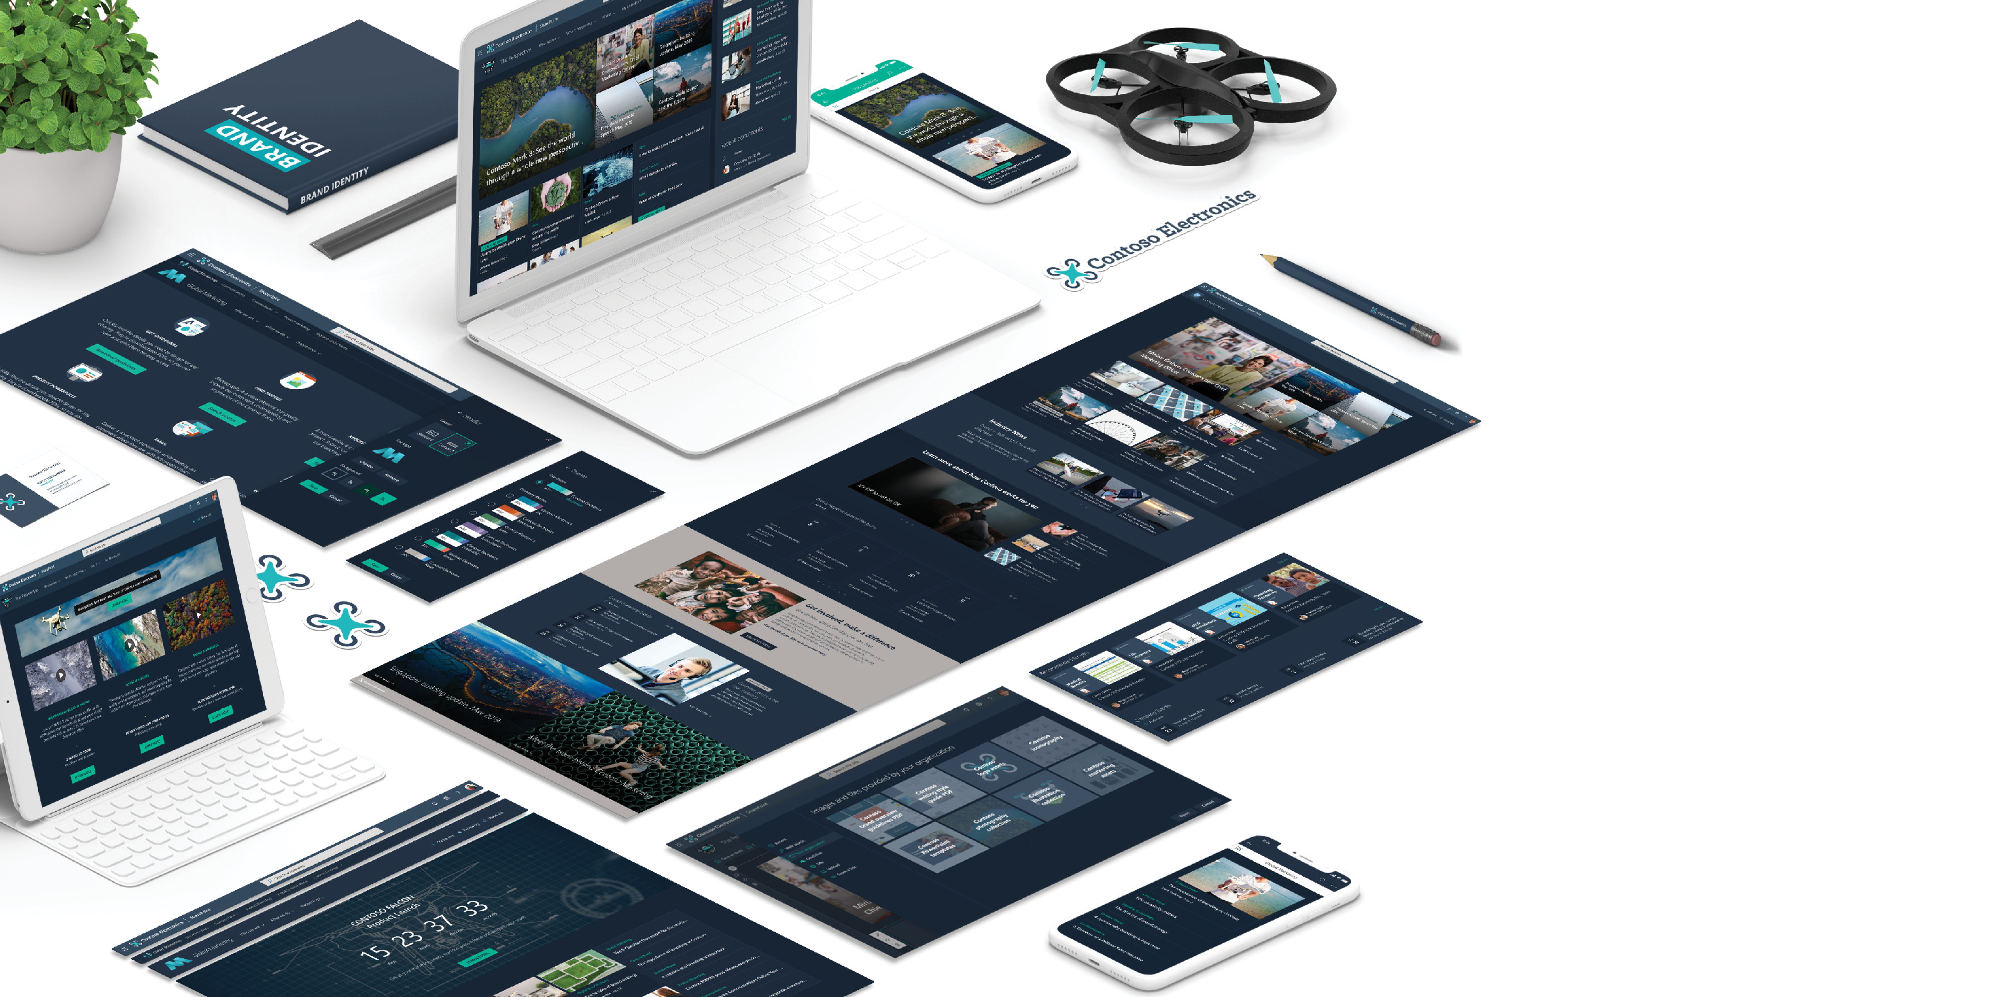

SharePoint
look book
Accelerate your prototyping
Install scenario-based, out-of-the-box SharePoint sites
lookbook.microsoft.com

Slide 28
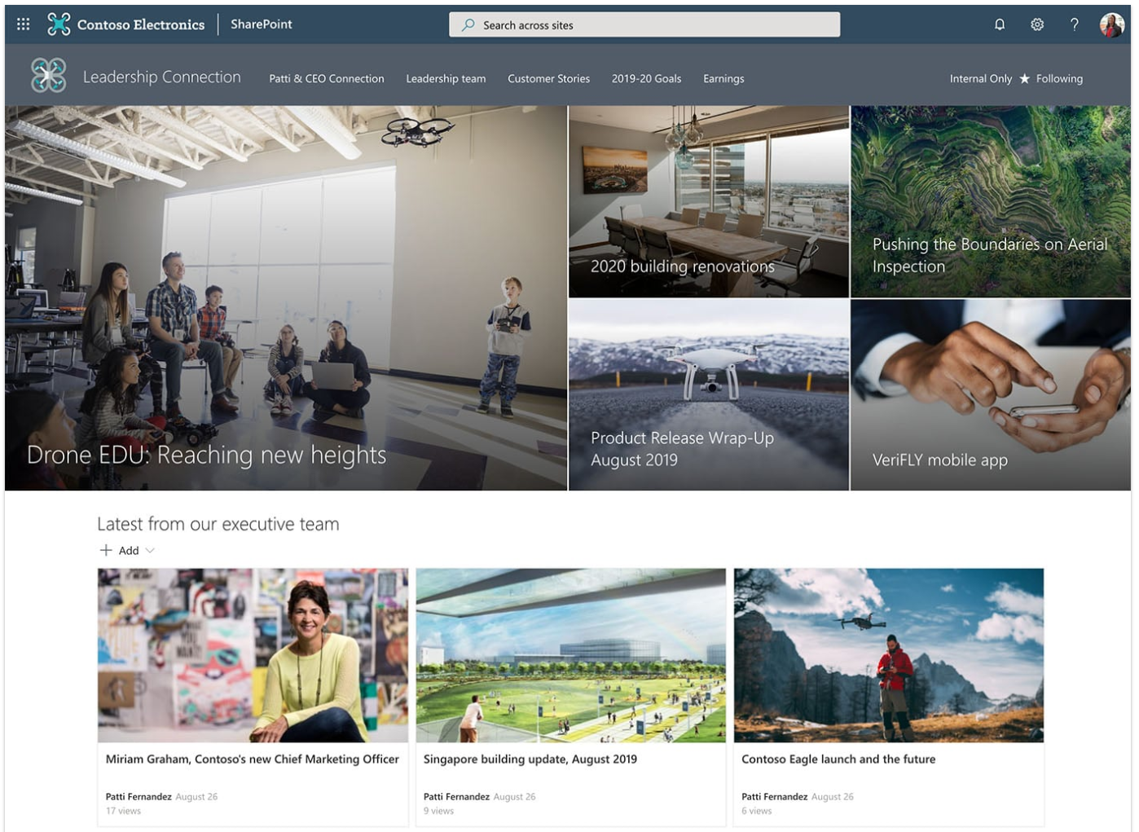
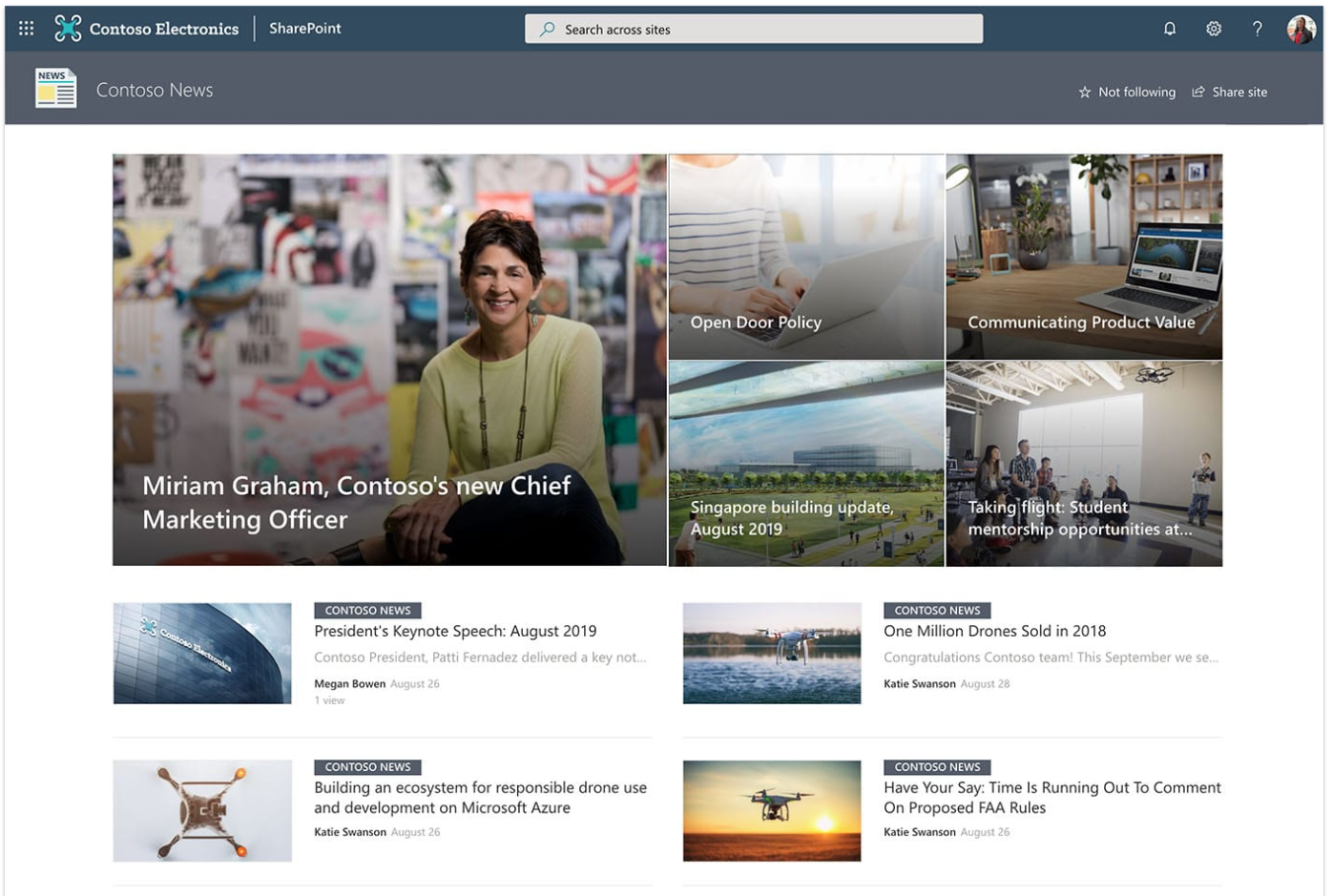
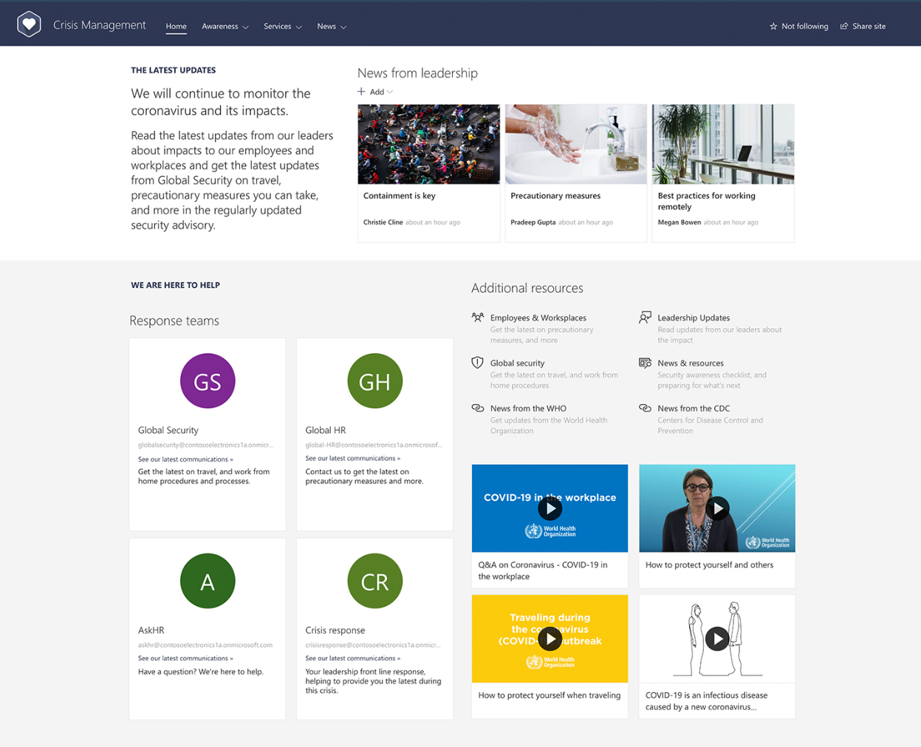

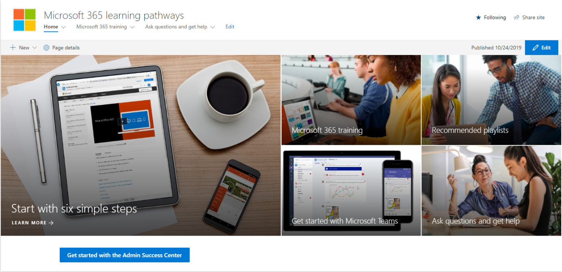
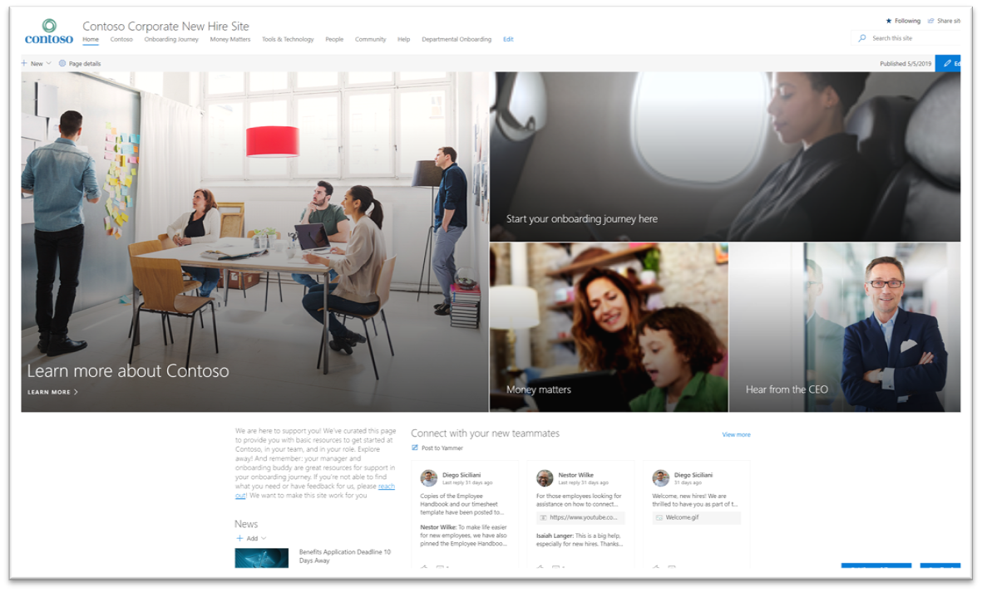
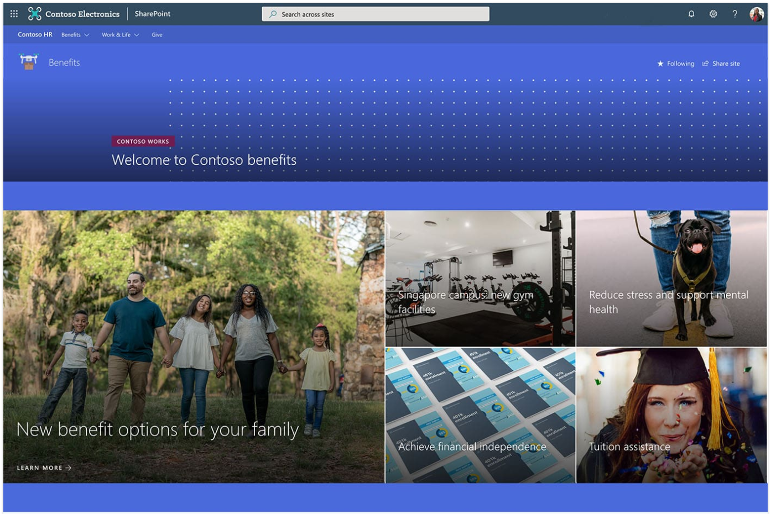
Scenarios ready to install, configure, and adopt
Leadership connection
News site
Crisis Communication
Leadership news, events, engagement
Company and organization news
Announcements, news, & resources
Corporate Communications
Corporate Communications
Corporate Communications
Microsoft 365 learning pathways
New employee onboarding
Benefits site
Microsoft 365 training
New hire site, training, onboarding journey
News, resources, actions
IT
HR
HR

Slide 29
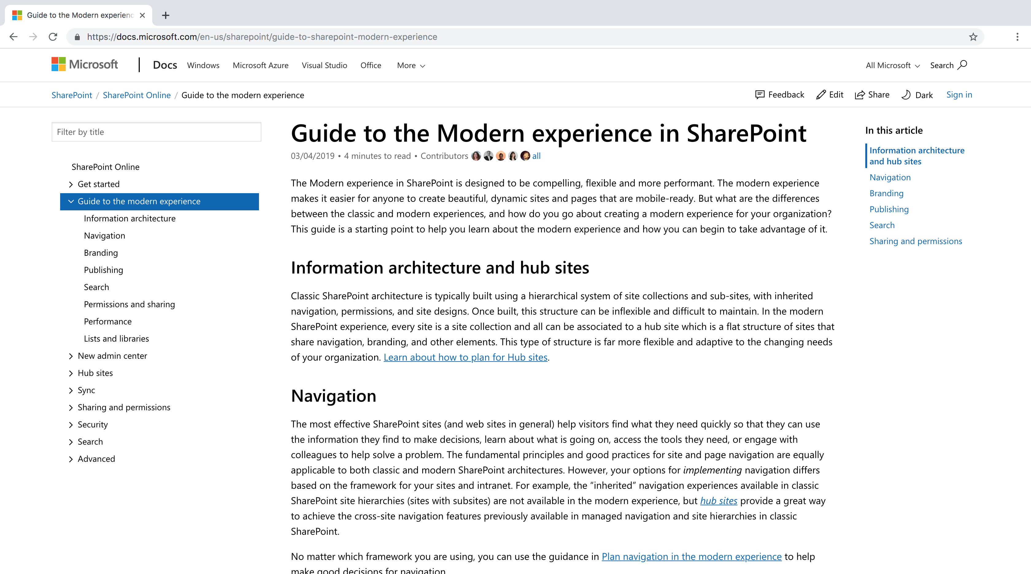
Building for SharePoint Online
Be sure to follow our modern guidelines - https://aka.ms/spmodernguide

Slide 30
Engage
Launch and adoption

Slide 31
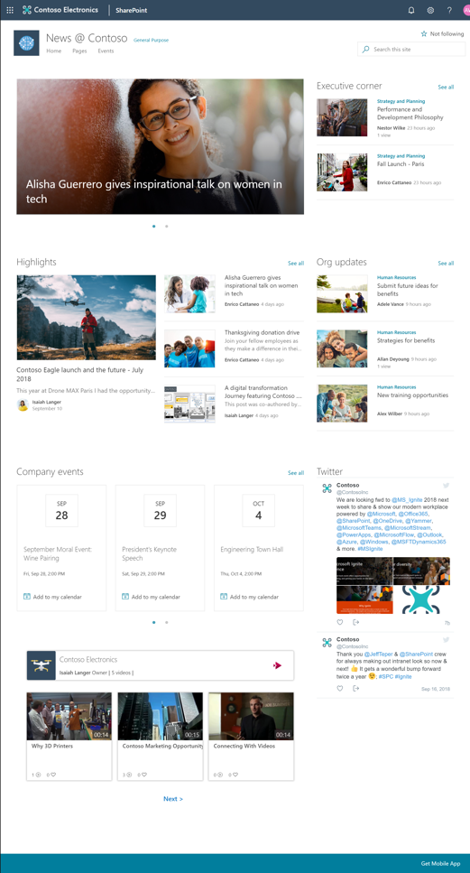
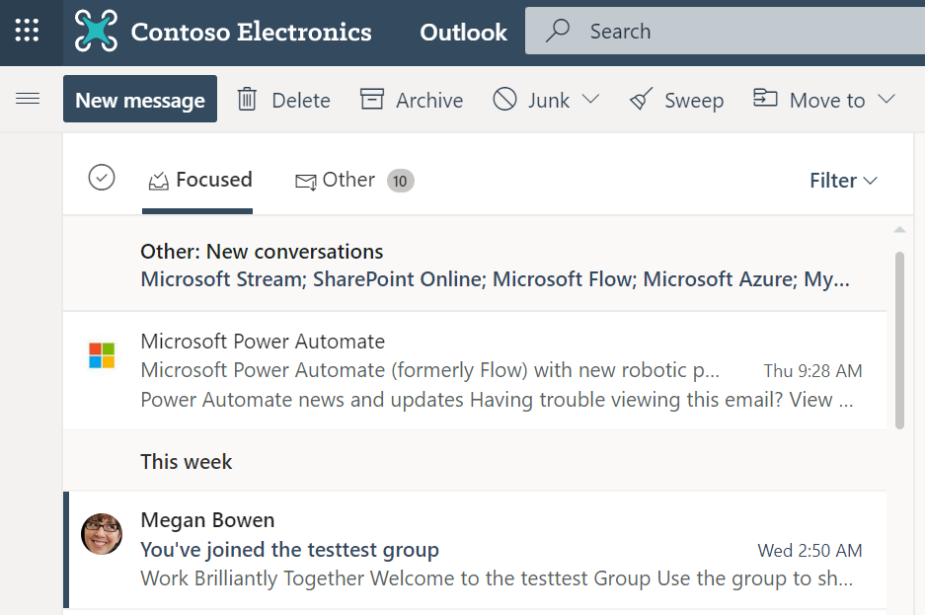
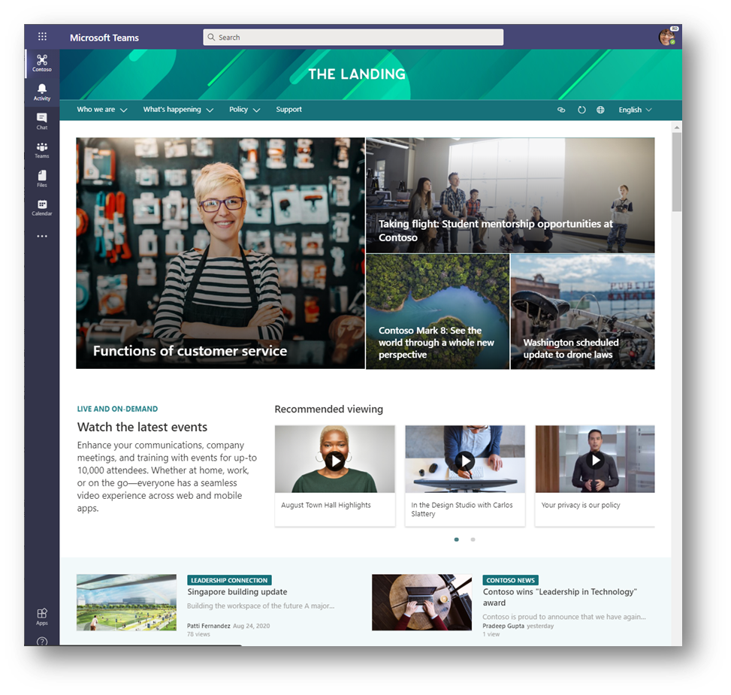
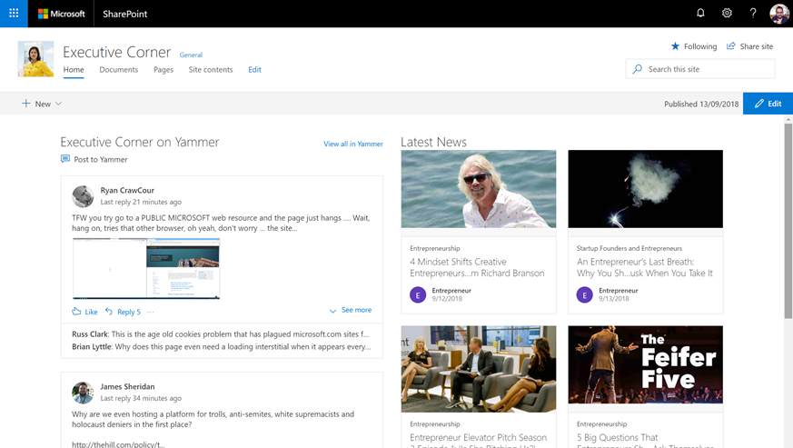
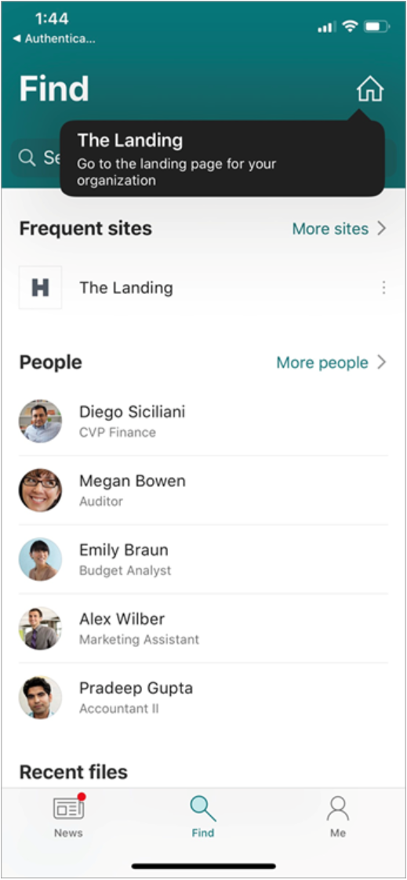
Reach and Engage your Audience
Tell your colleagues about your Intranet
Making your Intranet easy to access
Access your Intranet in Microsoft Teams
Create a conversation
SharePoint News
SharePoint Home Sites
Home Site App in Teams
NEW
Yammer web part for SharePoint

Slide 32
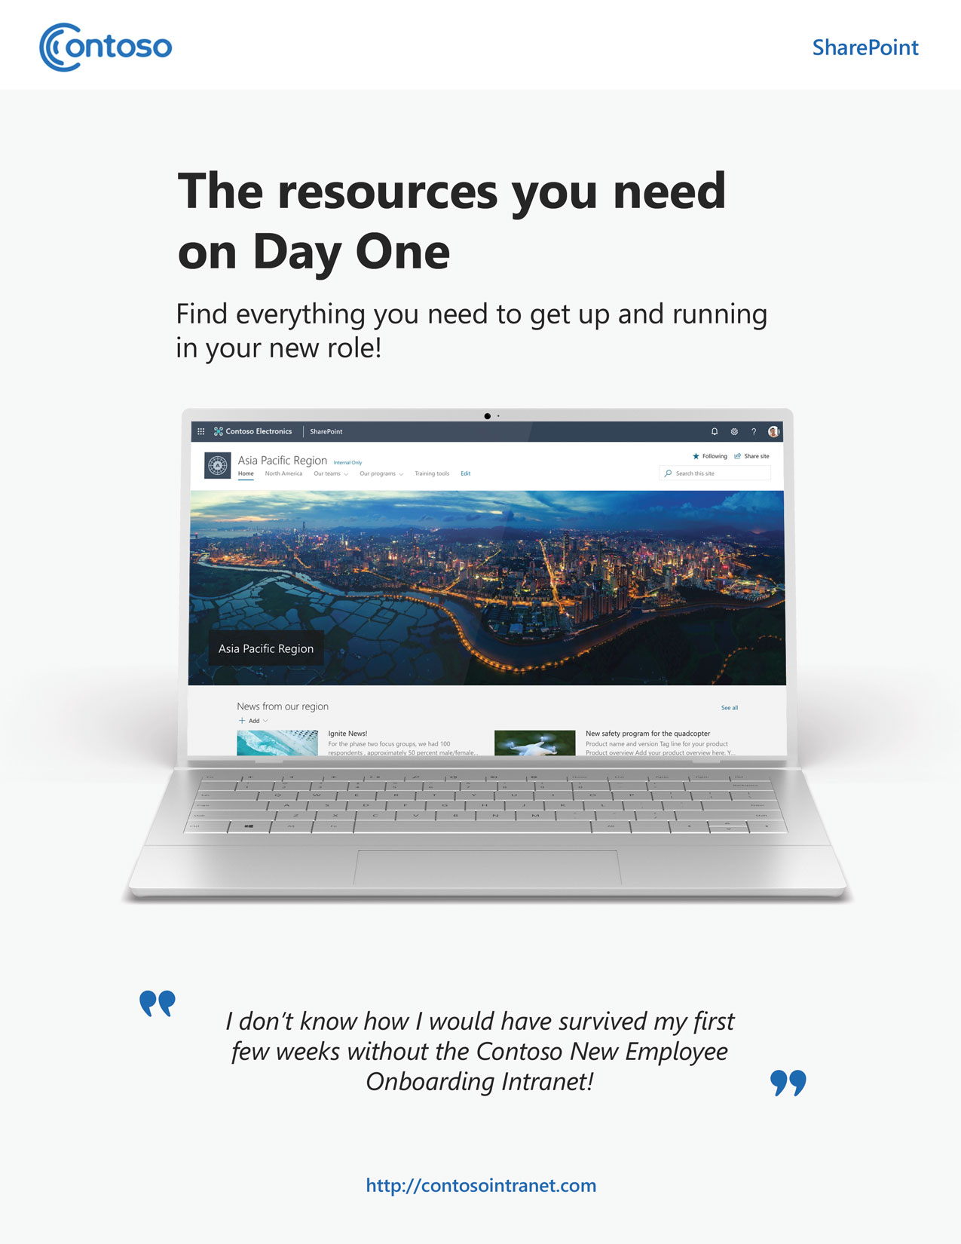
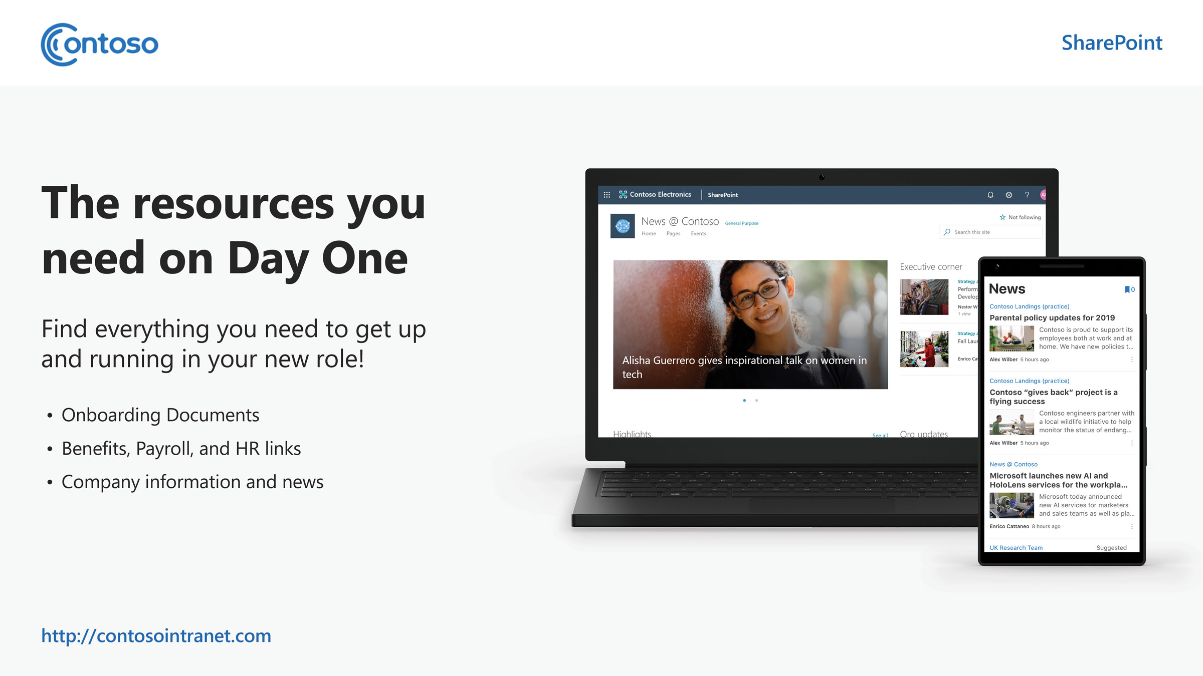
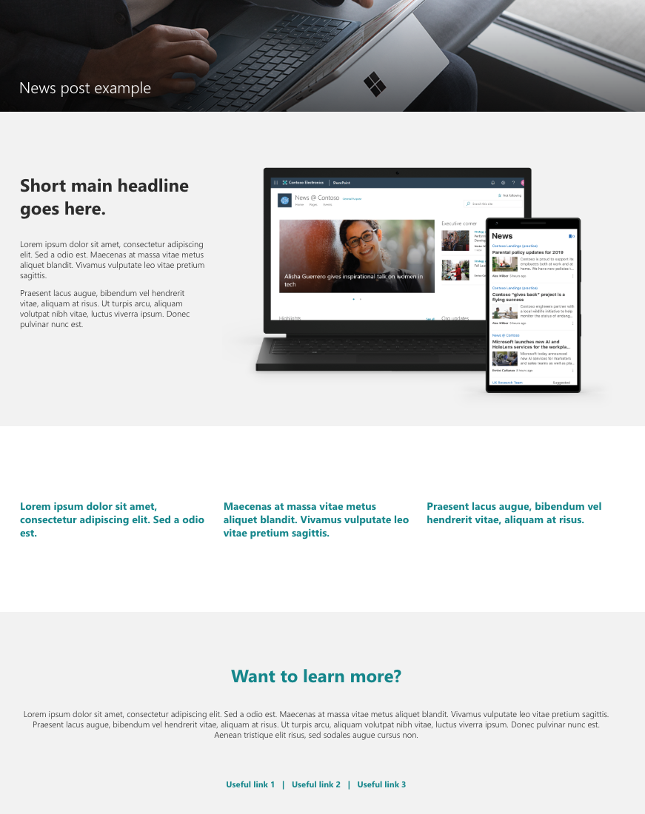
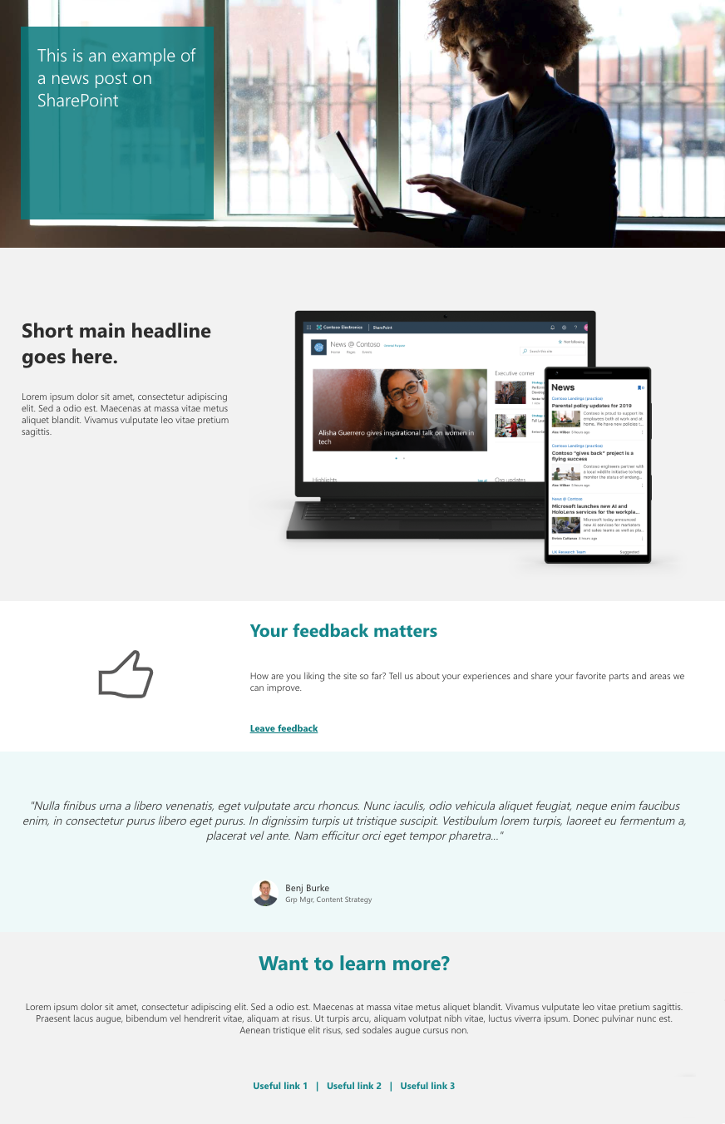
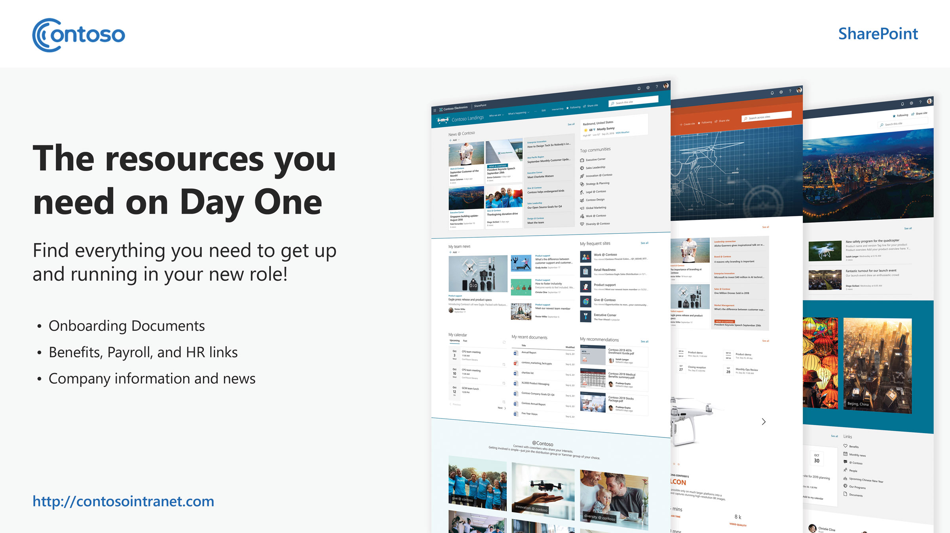
Adoption
We’ve created some assets to get you going…
https://aka.ms/SharePointAdoption
Poster templates
News posts samples

Slide 33
Adoption Plan
Identify Stakeholders to lead communications
Develop end user communication strategy and training plan
Develop adoption related assets (news post announcement, posters, training materials, etc.)
Launch
Execute end user communications strategy and training plan

Slide 34
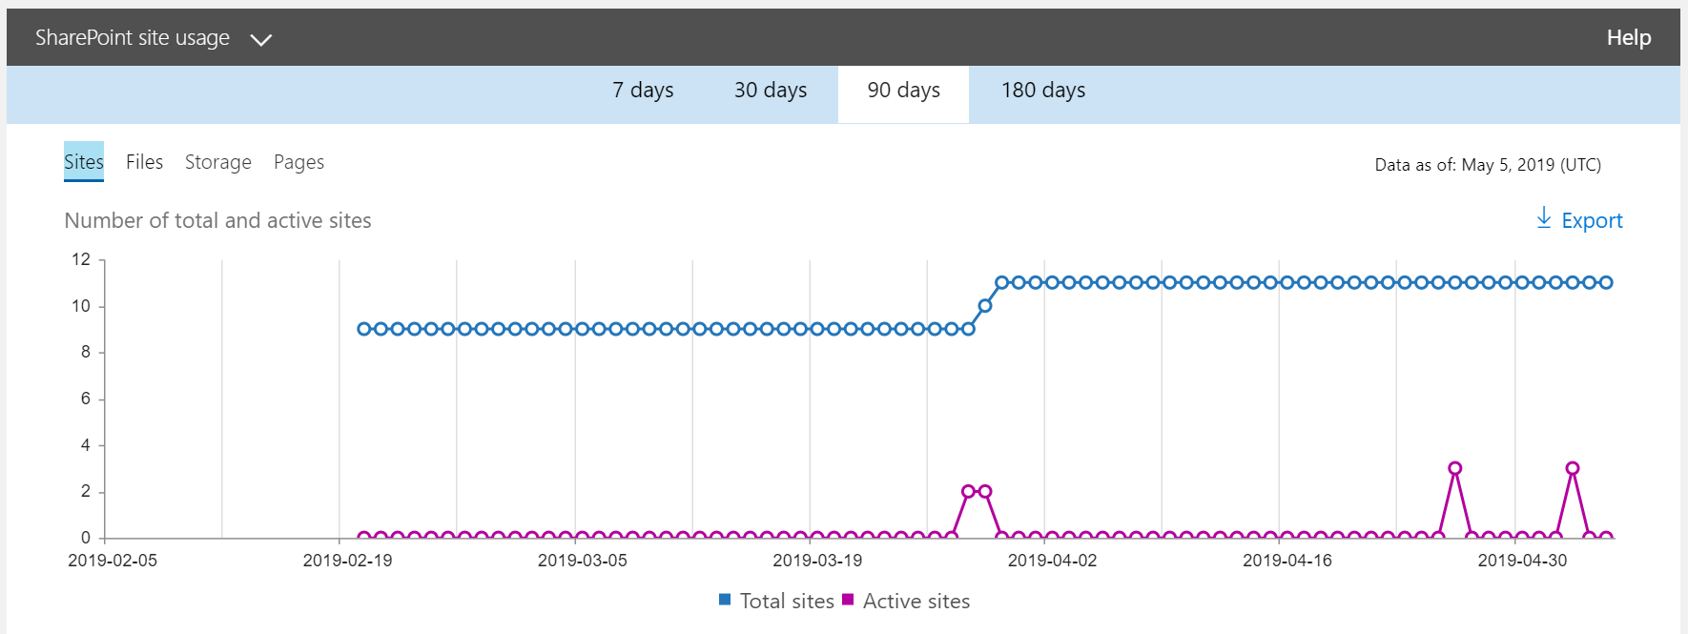
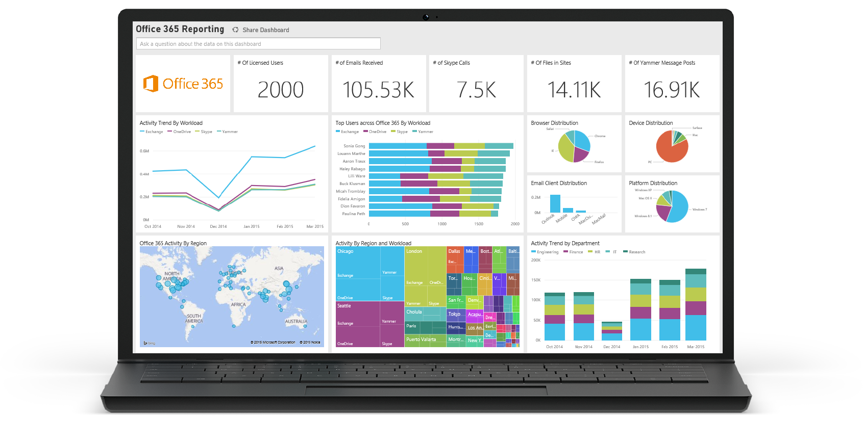
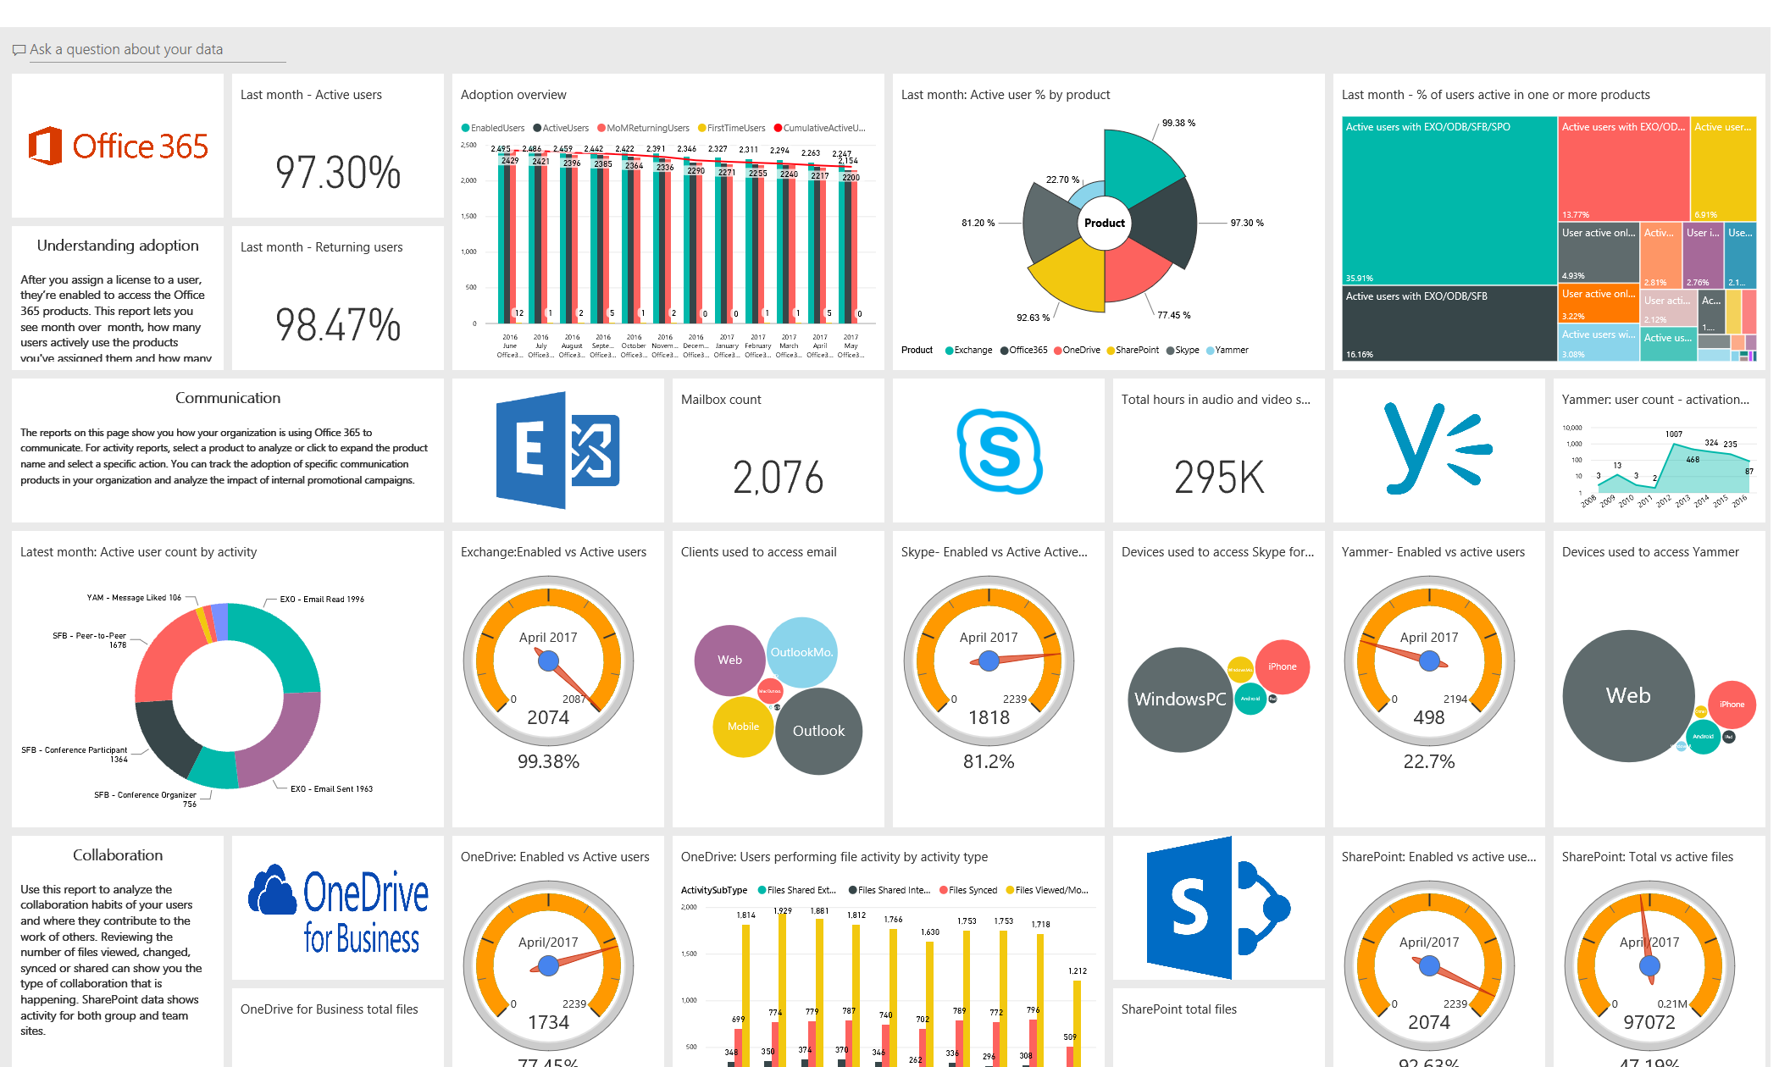
Available Usage Reporting
Admin Center
https://aka.ms/SharePointActivityReport
https://aka.ms/SPSiteUsageReport
Understand the amount of total file, page, and user SharePoint activity in your tenant
Understand the amount of activity happening against each SharePoint site and the storage utilization
Power BI
https://aka.ms/M365UsageAnalytics
Visualize and analyze Office 365 usage data, create custom reports and share the insights within your organization and gain insights into how specific regions or departments are utilizing Office 365.

