Slide 1
5 steps to get the most out of Microsoft Teams

Slide 2
In this document
Get started with Teams in 5 steps
Plan your Teams adoption in a workspace
Deliver chat and meeting capabilities
Run a project in Teams
Streamline a process
Automate repeated workflows
2. Examples of Teams workspaces by function
Marketing
Sales
Finance
Human Resources
IT professionals
Engineering
Project Management
3. Examples of Teams automated workflows
Create a hub for new hires
Resolve incidents within in a Teams workspace
Manage a contract lifecycle

Slide 3
Get started with Teams in 5 steps
3
Run a project in Teams
1
2
4
Streamline a process
Plan your Teams adoption in a workspace
Deliver chat and meeting capabilities
5
Automate repeated workflows

Slide 4
Plan your Teams adoption in a workspace
Appoint a Teams champion
Get caught using Teams!
Invite leaders and influencers to the adoption workspace to model a dynamic Teams experience.
Create a team to track adoption
Use the Teams Advisor to build this team
Add tools to track progress
Track tasks in Planner Review adoption analytics in PowerBI
Communicate in Teams
Schedule a recurring stand-up in Teams
Notes:
Nominate a usage adoption champion within your IT team
Create a team to track adoption plan and progress: (full Teams recipe)
Pin a Planner tab <and use this placemat of actions>
Pin a Power BI Dashboard of your Teams adoption progress
Pin a whiteboard for Teams brainstorming
Schedule a stand-up within Teams
Communicate with all stakeholders in Teams
Become an example of Teams usage

Slide 5
Deliver chat and meeting capabilities
Turn on Teams for everyone: https://aka.ms/enableteams
Don’t overthink it.
You don’t need to draw out migration for coworkers to fall in love with chatting, meetings and workspaces.
Separate chat and meeting deployment from longer term activities (PBX migrations, meeting rooms, etc.)
Introduce Teams as a chat and meetings tool using adoption assets: https://aka.ms/teamsadoption
Download the desktop and mobile apps
Encourage teams to create tailored workspaces with apps
Notes:
Get started by enabling Teams chat Introduce Teams as a 1:1 and group chat tool
Doesn’t require an investment in hardware, meeting rooms, etc.
(Use Teams for free..)
Ensure Teams is deployed to desktops and mobile devices (MEM)
Consider a roll-out plan for Teams HW

Slide 6
Run a project in Teams
Choose a pilot department to work with
Start with a template from the following slides
Iterate as you learn more.
Every group is different. They won’t know what they really need until they get started. Don’t be afraid to dive in and adjust along the way.
Demo Microsoft 365 apps in Teams
Try Word, Excel, Planner, and more
Help the group identify common projects, workloads, and audiences for Teams
Guide them in setting up a workspace
Evaluate the workspace after a few weeks and adjust
Replicate these successes with other teams – deploy a Teams template with these practices
Notes:
Choose a pilot team to work with
Deploy a pilot team experience and template
Use our options for:
Marketing
IT
HR
Finance
Sales
Engineering
Show useful apps <Planner>
Demo using Office 365 <show within Teams>
Audition 3rd party apps <show a few like Salesforce, DocuSign, Polly, Trello, ADP, Concur, etc. You can pick from popular apps in the Teams app store>

Slide 7
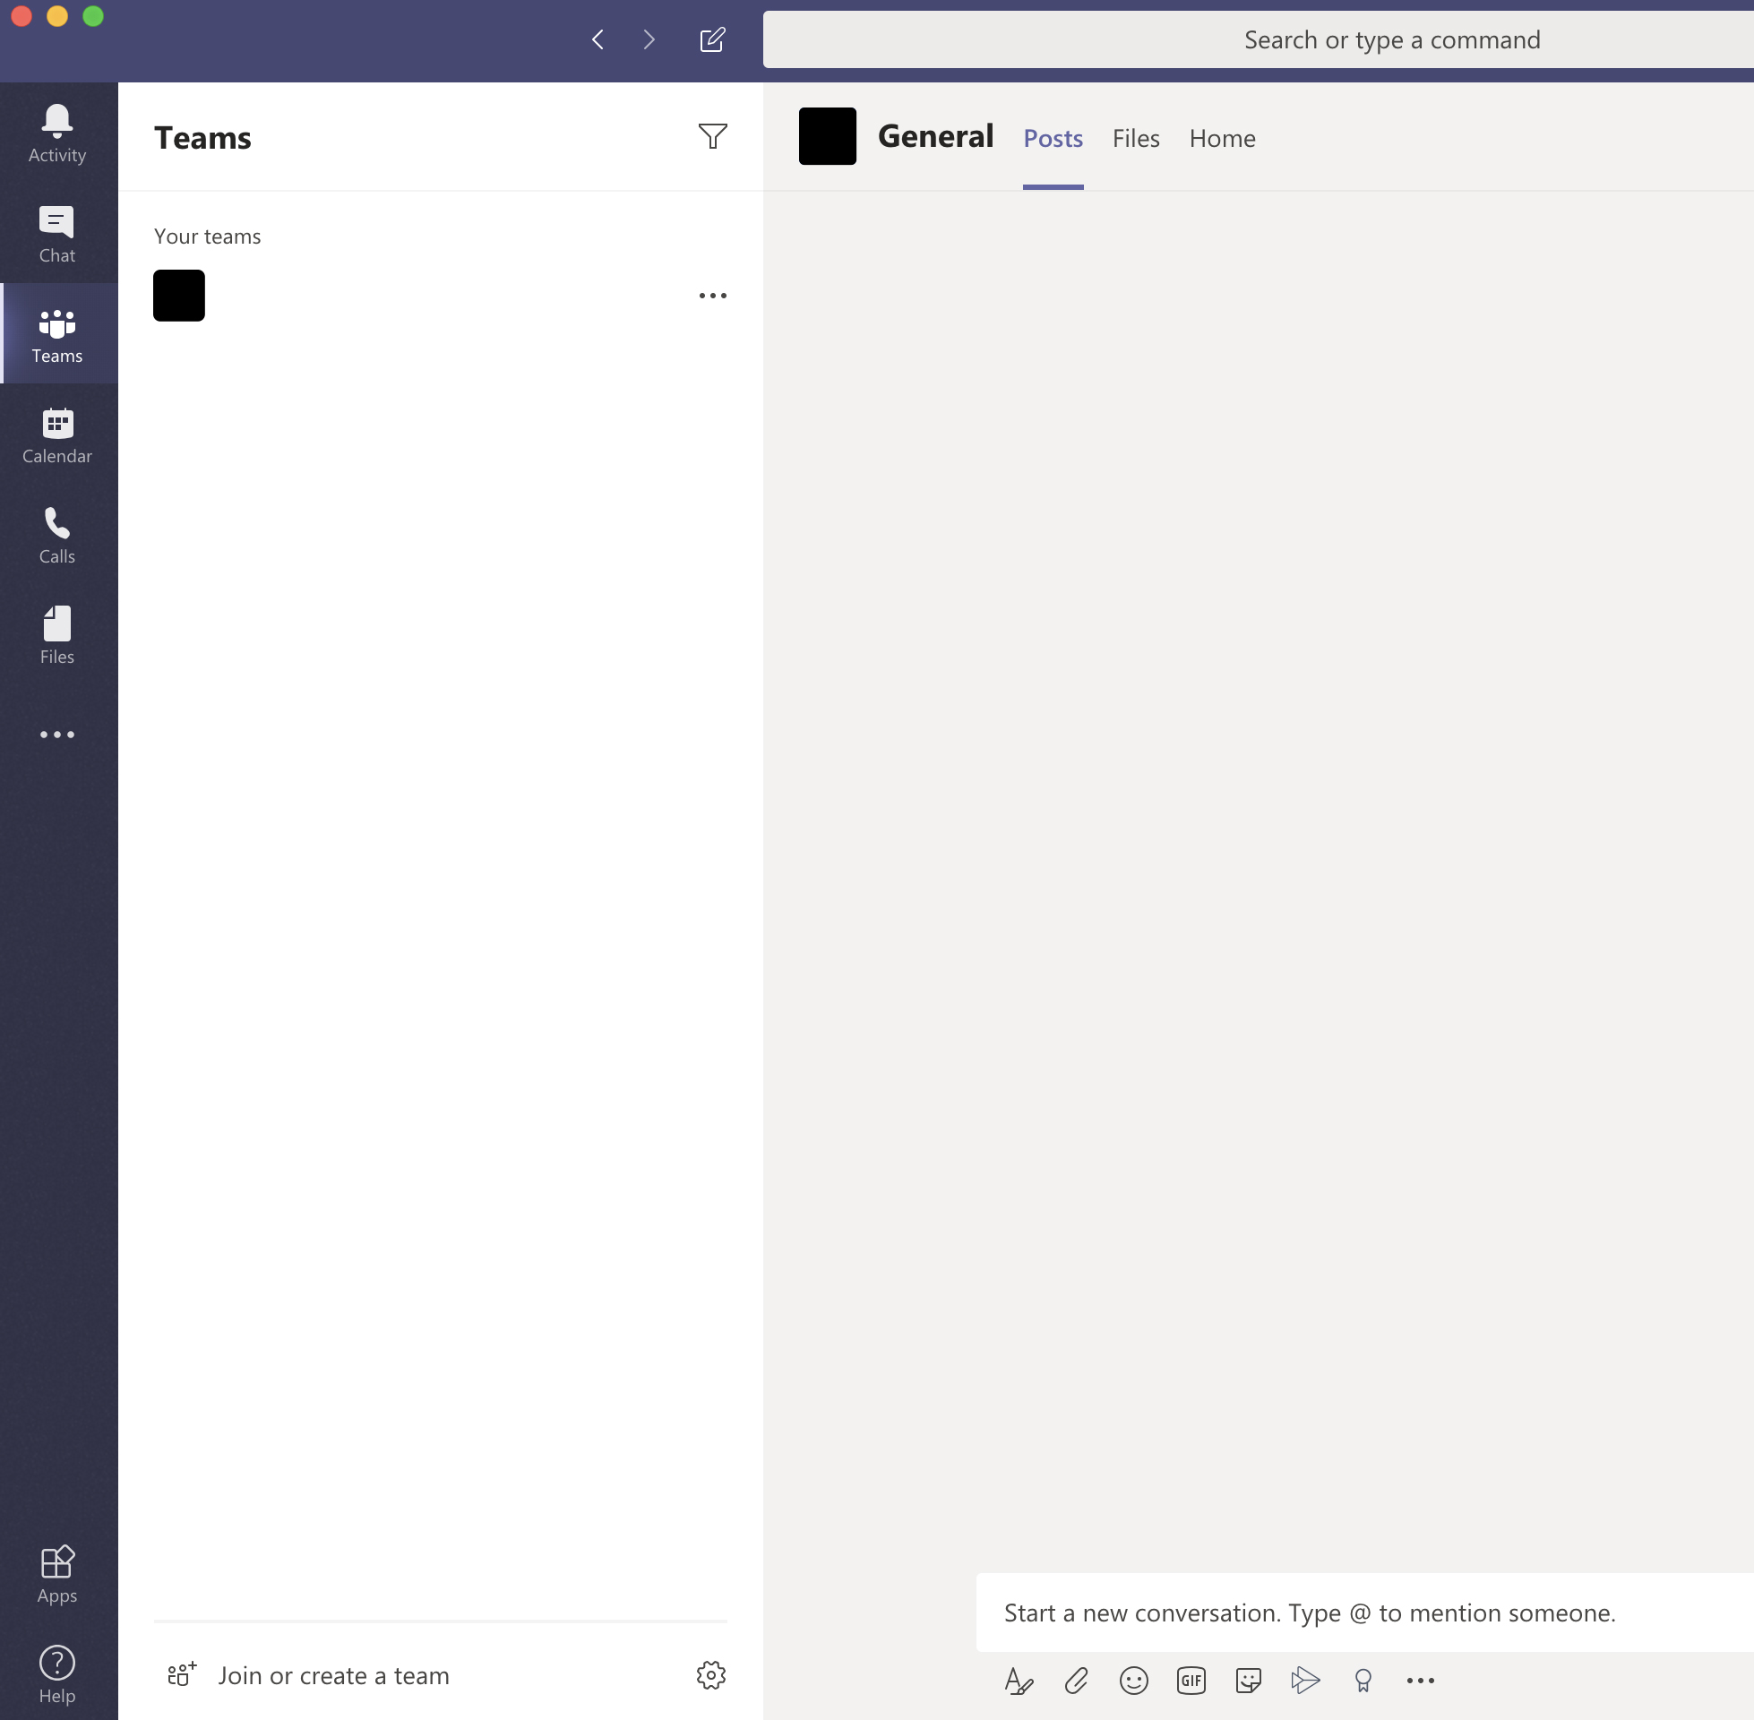
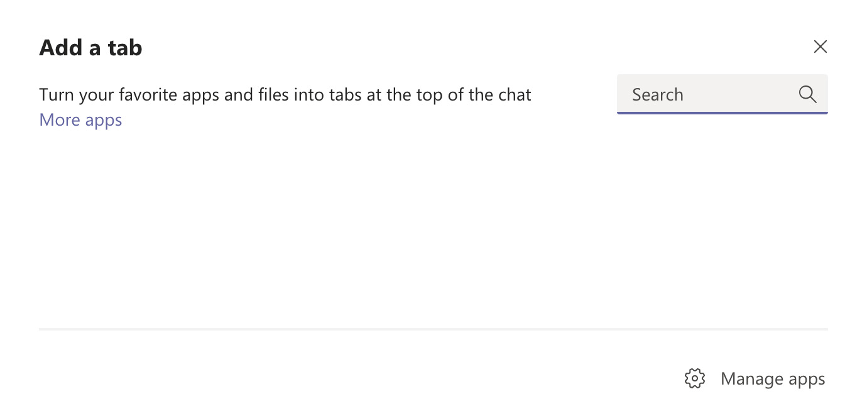
Optimize a project workspace
Adobe Creative Cloud
Marketing
Marketing
General
Go-to-market
Public relations
Budget
Manage marketing campaigns and social channels, collaborate on content creation, and plan events with a marketing team workspace.
Create a new team
Add channels
Add apps via tabs
Track marketing deliverables in Planner
Connect assets in Adobe Creative Cloud
Model budget in Excel
Measure effectiveness with SurveyMonkey
Pin marketing vision or brand guidelines with Word
Schedule and hold meetings using audio and video conferencing, chat, and file-sharing
Share plans, briefs, and design mocks in the files section
Planner
Creative Cloud
Excel
SurveyMonkey
Word
Notes:
Marketing teams need to create, collaborate and show results while working with a diverse group of people from both inside and outside the company. Why not do it all in one place? Teams provides a shared workspace for all conversations, files, and third-party services. Now it’s easier to manage marketing campaigns and social channels, collaborate on content creation, and plan events.
1. Create a new team, Marketing. Invite internal and external users from all marketing groups, including PR, Brand and Design.
2. Add channels for marketing initiatives, projects, and teams, such as Go-to-Market, Public Relations, Event Planning and Budget; as well as channels where marketers can interact and communicate with agencies, consultants, and partners using secure guest access.
3. For each channel, connect relevant third-party services, such as Bing News Alerts, Twitter Connector, Adobe Creative Cloud, HootSuite and YouTube.
4. Create and store marketing assets—such as plans, briefs, press releases and design files—in the Files section.
5. Pin the marketing plan, budget and/or campaign landing page to relevant channels for easy reference.
6. Schedule and hold meetings in Teams using audio and video conferencing features, as well as chat and file-sharing.

Slide 8
Optimize a project workspace
Power BI
Sales
Sales
General
Sales readiness
Sales planning
RFP/Proposals
Wins
Best practices
Build a proposal or collaborate on long-term projects to meet sales objectives.
Create a new team
Add channels
Add apps via tabs
Check sales metrics in Power BI
Manage RPF templates in Word
Track future fiscal plans with Trello
Connect to CRM applications like Dynamics 365
Celebrate success with Kudos
Schedule team meetings, ex. monthly business review
Share documents, ex. sales playbooks and guides in the Sales Readiness channel, RFP documents in the RFP/Proposals channel
Pin important apps and data ex. RSS feed for customer updates
Power BI
Trello
Dynamics 365
Kudos
Word
Notes:
Teams can help sales quickly build proposals with input from different stakeholders, while making it easier to manage longer term projects and programs, such as planning, training and sales readiness. Collaboration, reporting, and knowledge sharing can happen in one place, helping sales professionals everywhere work together to meet sales objectives.
1. Create a new team for your entire sales organization or a team for each sales segment. 2. Add channels, such as Sales Readiness, Sales Planning, RFPs/Proposals, Wins, and Best Practices; as well as a channel for general topics. 3. Schedule recurring team meetings, such as a monthly business review. 4. Upload team documents to relevant channels, for example sales playbooks and guides in the Sales Readiness channel, RFP documents in the RFP/Proposals channel.
5. Provide important data and customer information in one place. Pin apps used by your sales team—PowerBI, Planner, task management apps like Trello—to each channel. 6. Set up connectors, such as an RSS feed for customer updates.

Slide 9
Optimize a project workspace
Adobe Sign
Finance
Finance
General
Finance reviews
Business insights
Audit
Governance and compliance
Aggregate, report, and share data, conduct secure meetings backed by Microsoft.
Create a new team
Add channels
Add apps via tabs
Track budget spend YTD in PowerBI
Forecast future budgets with Excel
Create and review business plans in Word
Action contracts with Adobe Sign
Manage budget requests with Power Automate
Schedule team meetings, ex. monthly business review
Share documents, ex. annual financial statements and audit reports
Pin important items, ex. apps, intranet portals, and websites
Power BI
Excel
Adobe Sign
Power Automate
Word
Notes:
Finance teams need to aggregate and report on data while conducting business reviews on a regular cadence. Teams provides a hub for file and data sharing, conversations, and meetings backed by the security and compliance of Microsoft.
1. Create a new team for your entire finance organization.
2. Add channels for Finance Reviews, Business Insights, Audits, Governance and Compliance. 3. Schedule recurring team meetings, such as a monthly business review.
4. Upload team files to the channels, such as annual financial statement reviews and audit reports.
5. Pin relevant apps used by the team—Excel, Power BI, Planner—or pin critical files, intranet portals, or websites.

Slide 10
Optimize a project workspace
SurveyMonkey
Human resources
Human resources
General
Recruitment, training
Events
Reviews
Onboarding
Manage recruitment and employee onboarding activities from resume review to new hire training.
Create a new team
Add channels
Add apps via tabs
Gather employee sentiment with SurveyMonkey
Engage in companywide Q&A with Yammer
Plans shifts and work assignment with Kronos
Track new hire onboarding work with Adobe Sign
Deliver training and onramp content with Go1
Schedule meetings, interviews, candidate reviews, and host training sessions using audio/video conferencing
Share agendas, presentations, and post-training surveys using third party apps like Survey Monkey
Pin relevant apps
SurveyMonkey
Yammer
Adobe Sign
Kronos
Go1
Notes:
Teams can help HR professionals manage recruitment and employee onboarding activities, including sharing resumes and interview notes, keeping track of candidate information, communicating hiring decisions, and sharing new employee documents.
1. Create a new team for your HR department. 2. Add channels for Recruitment, Training, Events, Reviews, and Onboarding. 3. Schedule meetings, planning, interviews, candidate reviews all in Teams. 4. Upload files to Teams channels such as HR policies, candidate information, offers, training or recruitment guidance notes, HR portals, feedback forms and surveys.

Slide 11
Optimize a project workspace
InVision
IT professionals
IT
General
Service strategy
Incident management
Deployment
Readiness and adoption
Health and reporting
Plan, execute, and manage all phases of infrastructure deployments and rollouts to drive transformation and change management across your organization.
Create a new team
Add channels
Add apps via tabs
Sketch new software projects with Freehand by InVision
Follow work items with Azure DevOps
Resolve tickets in Zendesk
Follow uptime with Pingdom
Schedule and hold recurring or impromptu meetings with key stakeholders
Share important files or logs by uploading directly into a channel
Pin relevant apps
InVision
Azure DevOps
Zendesk
Pingdom
Notes:
Teams provides IT professionals with a single hub to plan, execute, and manage all phases of infrastructure deployments and rollouts—a useful tool to help drive transformation and change management across the organization.
1. Create a new team and add members from IT and other stakeholders from across the company. 2. Add channels for Service Strategy, Problem, Incident and Change, Deployment, Health and Reporting, Readiness and Adoption, Support and Management and Governance. 3. Upload important files or logs to the channels.
4. Pin relevant apps such as Word, Excel or Planner. 5. Set up connectors, such as bots for process automation. 6. Schedule and hold recurring or impromptu meetings with key stakeholders.

Slide 12
Optimize a project workspace
Zendesk
Engineering
Engineering
General
Feature releases
Testing
Feedback
Competitive information
Research
Deliver new features quickly using integrated developer tools that enable everyone to stay on track during sprints, collaborate in real-time, and fix a bug from anywhere.
Create a new team
Add channels
Add apps via tabs
Track documents and plans with integrations in Files
Follow project plans in Wrike
Resolve tickets in Zendesk
Schedule team meetings, ex. Weekly stand up
Share the latest files by uploading directly to relevant channels
Pin tabs for quick visibility to apps and services your team uses
Word
Wrike
Zendesk
Notes:
When delivering a new feature, engineers move quickly through ideation, development and deployment. Teams is integrated with developer tools that enable everyone to stay on track during sprints, collaborate in real-time, and fix a bug from anywhere.
1. Create a new team for your engineering group and add key stakeholders across the company. 2. Add channels for General, Feature Releases, Testing, Feedback, Competitive Information, Go-to-Market, Research and Product Analytics to organize and discuss these topics.
3. Upload relevant team files to the channels so everyone can easily find the latest versions.
4. Add tabs for quick visibility to apps and services your team uses, like Planner and Power BI. 5. Add tabs and connectors for developer tools like VSTS, JIRA, BitBucket, GitHub and more to view and triage issues and pull requests. 6. Schedule and hold recurring stand-up meetings with key stakeholders.

Slide 13
Optimize a project workspace
Trello
Project management
Project management
General
Planning
Budget
Analytics
Reviews and feedback
Centralize communication tools with a one hub for meetings, file sharing, and project tracking.
Create a new team
Add channels
Add apps via tabs
Track key metrics in PowerBI
Review team tasks with Trello
Request team feedback with Pulse Surveys from Polly
Pin a team charter as a Word doc
Schedule and hold recurring or impromptu meetings with key stakeholders
Share project documents to the channel, ex. budgets, schedules, information sources, and guidelines
Pin relevant apps within each channel
Power BI
Trello
Polly
Word
Notes:
Project managers are often overloaded with planning, meeting, and communication tools and services. Teams enables collaboration with a central hub to share files, manage stakeholder meetings, and track progress across multiple projects.
1. Create a team for each project, and then add stakeholders from across the company. 2. Add channels, such as Planning, Budget, Analytics, Reviews and Feedback.
3. Upload project documents to the channel, such as budgets, schedules, information sources, and guidelines.
4. Pin relevant apps used by your team within each channel, such as Planner, Trello, Smartsheet and Power BI. 5. Set up connectors, such as bots for process automation. 6. Schedule and hold recurring or impromptu meetings with key stakeholders.

Slide 14
Streamline a process
Choose a group or department that handles
1 2 3…
New-hire onboarding Incident management Contract lifecycle
Rally around a process.
A group can bring structure and order to a process by using a Teams workspace to coordinate tasks.
Demo a process template to streamline the workflow
Demo Office 365 apps in Teams
Planner Word Excel OneNote Outlook SharePoint Yammer
Help the group set up a workspace
Create a routine for process improvements
Evaluate after a few weeks and adjust workspace and process based on learnings
Notes:
We have easy recipes for processes at the core of every organization
Pick one and deploy:
New-hire Onboarding
Incident Management
Contract Lifecycle
<others>

Slide 15
Streamline a process
Process Example: A team for a Sales Cycle
Create a Customer Accounts team
1
Create a Customer Accounts team
Create a channel for RFP Proposals
2
Create a channel for RFP Proposals
Create a sales opportunity channel for every major customer
3
Create a sales opportunity channel for every major customer
Add a dashboard for your CRM system for the customer
4
Add a dashboard for your CRM system for the customer
^{Meet to close the deal}
5
^{Meet to close the deal}
Notes:
In this example, our sales team is on site with the potential customer, gathering requirements, and ultimately submitting a request. Since they are doing this in real time at a construction site, our salesperson is using a tablet. His/her organization created their own custom “Field Survey App” that helps them capture the right information. This is an example of a simply built (low code/no code) PowerApp.
Most sales organizations necessitate a CRM tool for lead generation and nurture. Our customers can connect tools like Salesforce or our very own Dynamics CRM directly into Teams so to be able to easily track, share, and follow up on opportunities.
The sales team also needs to update their bid document, and verify material prices (via this always-up-to-date SharePoint list).
They also may want to look at a this embedded PowerBI dashboard to check their progress against their sales targets.
Submitting bids for approval used to be a time consuming, complicated process- especially when you didn’t work in the same office space or location as your manager. Now our sales person can simply upload their completed bid to a folder. This act kicks off a flow – and when I switch to the manager’s view, I see that the manager has a notification that a bid needs their approval, they can access the file that was uploaded directly, AND they are taken directly to the approval tool – so this whole process is thoroughly documented.
Now that the bid is approved, we can finish up the proposal. Since this is something that I have done many times before, I can quickly search for a prior version, instead of starting my PowerPoint from scratch.
And finally, we fast forward to closing the deal with our customer. We already presented the proposal to them, and now I just want to make a phone call directly to their cell (PSTN calling) to get the verbal “Yes”.
It is also important to let the team know what has happened – so we can get started on the work, and of course, celebrate these wins together.

Slide 16
Automate repeated workflows
Work with a group with complex processes – and automate in Teams
Model processes with Power Automate Build apps with low or no code using PowerApps
Use a template to establish a process for new-hire onboarding, incident management, contract lifecycle, and sales lifecycle
Simplify repeated tasks within the process by using Power Platform to add automation (included with Microsoft 365)
Create a routine for process improvements
Evaluate after a few weeks and adjust the automation process based on learnings

Slide 17
Automate repeated workflows
Work with a group with complex processes – and automate in Teams
Model processes with Power Automate Build apps with low or no code using PowerApps
Improve processes within your pilot teams.
Automation works best on processes that have already been tested and tweaked with the group.
Use a template to establish a process for new-hire onboarding, incident management, contract lifecycle, and sales lifecycle
Simplify repeated tasks within the process by using Power Platform to add automation (included with Microsoft 365)
Create a routine for process improvements
Evaluate after a few weeks and adjust the automation process based on learnings

Slide 18
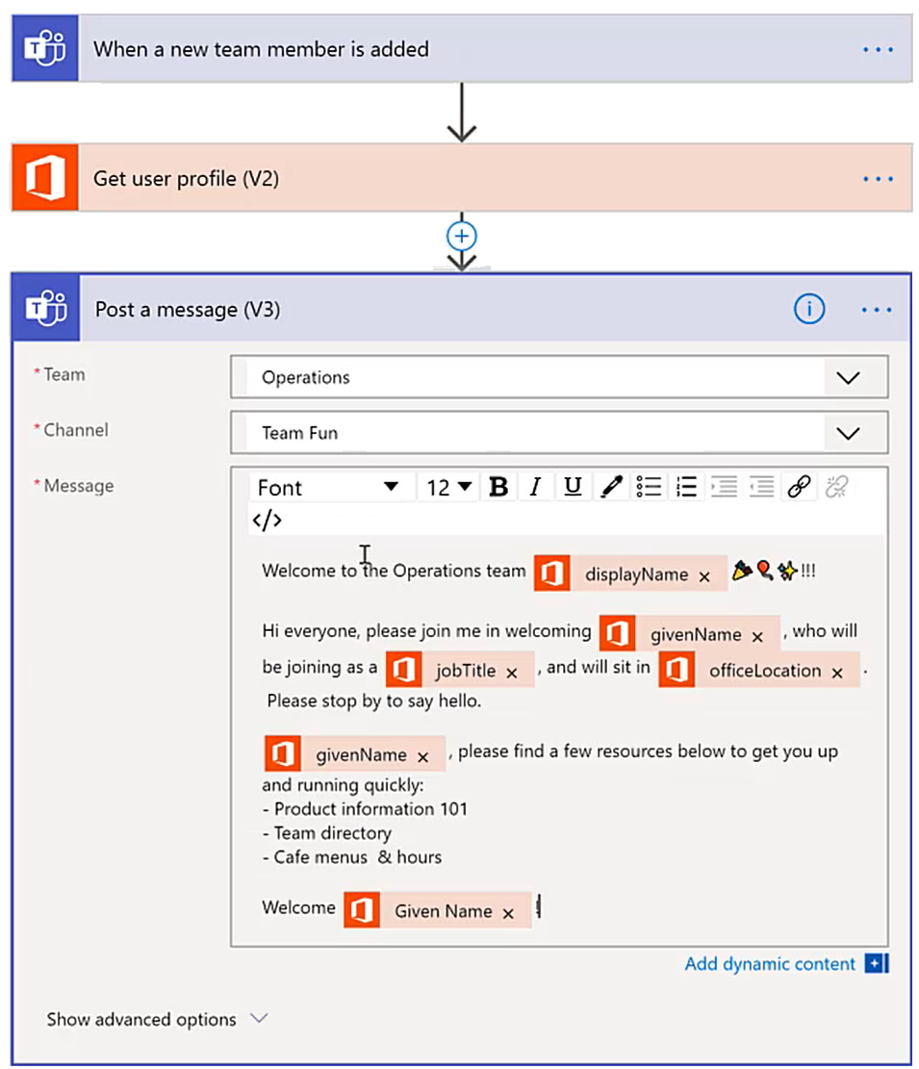
Automate repeated workflows
Create a hub for new hires in your organization
Add a rule when a new team member is added to a Teams
Automate new-hire onboarding tasks within Teams to deliver a consistent, connected experience across your organization
Retrieve information about the new user
Create a dedicated team or channel for new hires
Use Power Automate flows to:
Introduce new members to the team
Connect new members to common resources for their role
Create tasks and to-dos for new hire managers
Notify Teams about new hire opportunities
Create an Azure DevOps work item to order new hardware or set up accounts
Schedule follow-ups and new hire experience reviews
Track and route new hire onboarding forms through Adobe Sign
Send onboarding questionnaires after 1 month
Automatically post a welcome message to the channel

Slide 19
Automate repeated workflows
Create a hub for new hires in your organization
Add a rule when a new team member is added to a Teams
Automate new-hire onboarding tasks within Teams to deliver a consistent, connected experience across your organization
Retrieve information about the new user
Create a dedicated team or channel for new hires
Use Power Automate flows to:
Introduce new members to the team
Connect new members to common resources for their role
Create tasks and to-dos for new hire managers
Notify Teams about new hire opportunities
Create an Azure DevOps work item to order new hardware or set up accounts
Schedule follow-ups and new hire experience reviews
Track and route new hire onboarding forms through Adobe Sign
Send onboarding questionnaires after 1 month
Automatically post a welcome message to the channel

Slide 20
Automate repeated workflows
Create a hub for new hires in your organization
Add a rule when a new team member is added to a Teams
Automate new-hire onboarding tasks within Teams to deliver a consistent, connected experience across your organization.
Retrieve information about the new user
Create a dedicated team or channel for new hires
Use Power Automate flows to:
Introduce new members to the team
Connect new members to common resources for their role
Create tasks and to-dos for new hire managers
Notify Teams about new hire opportunities
Create an Azure DevOps work item to order new hardware or set up accounts
Schedule follow-ups and new hire experience reviews
Track and route new hire onboarding forms through Adobe Sign
Send onboarding questionnaires after 1 month
Automatically post a welcome message to the channel

Slide 21
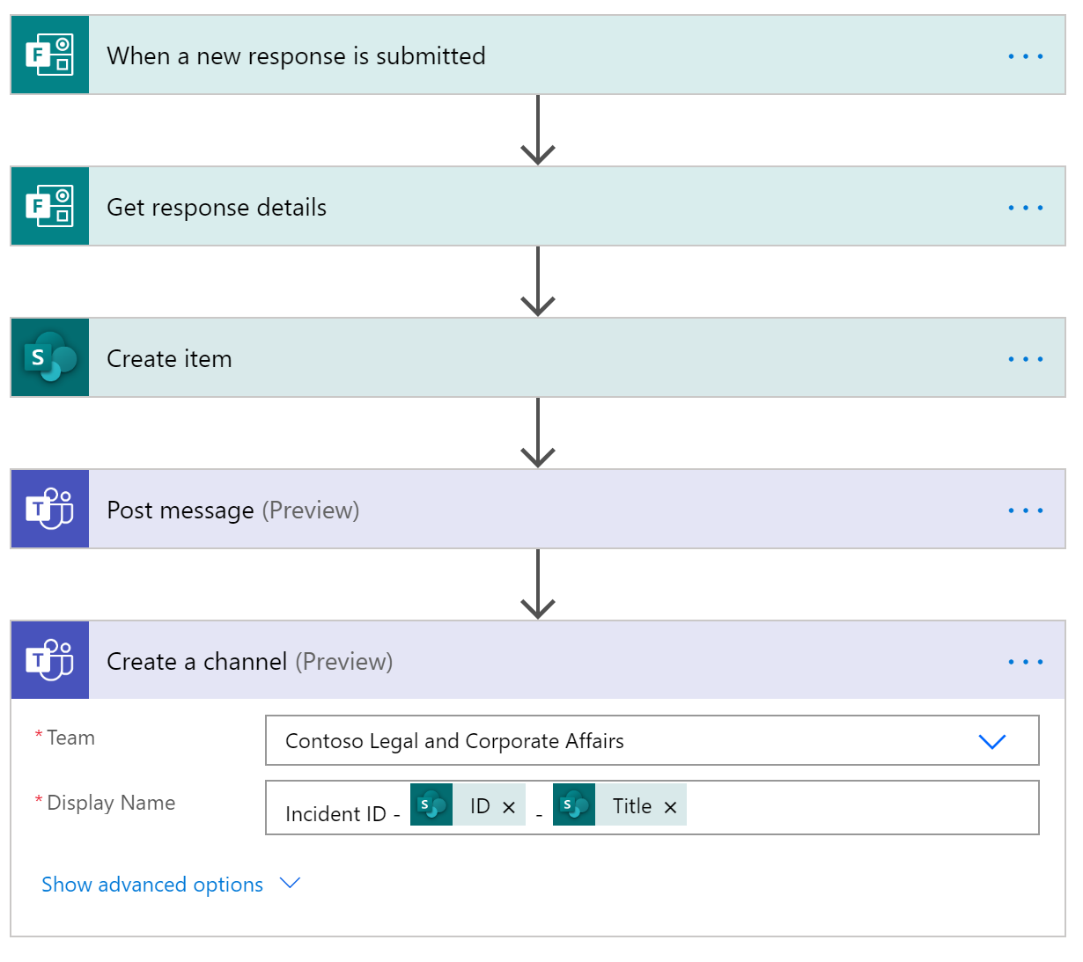
Automate repeated workflows
Resolve incidents within a Teams workspace
Create an input form for users to report the incident
Create a channel or team for managing incident lifecycle, then add automation to save time and stay focused.
Retrieve details about the incident
Use Power Automate flows to:
Create incident discussion channels in response to input forms, management alerts, data thresholds, security incidents, and more
Automatically notify incident owners if there is no action within a specified period
Create new process documents in a team for managing flow
Handle the resolution and closing of an incident
Automatically schedule follow-up postmortem briefings
Create an item in a SharePoint list for tracking
Post a message to alert the incident management team
Create a Teams channel to centrally manage communications on an incident

Slide 22
Automate repeated workflows
Resolve incidents within a Teams workspace
Create an input form for users to report the incident
Create a channel or team for managing incident lifecycle, then add automation to save time and stay focused.
Retrieve details about the incident
Use Power Automate flows to:
Create incident discussion channels in response to input forms, management alerts, data thresholds, security incidents, and more
Automatically notify incident owners if there is no action within a specified period
Create new process documents in a team for managing flow
Handle the resolution and closing of an incident
Automatically schedule follow-up postmortem briefings
Create an item in a SharePoint list for tracking
Post a message to alert the incident management team
Create a Teams channel to centrally manage communications on an incident

Slide 23
Automate repeated workflows
Resolve incidents within a Teams workspace
Create an input form for users to report the incident
Create a channel or team for managing incident lifecycle, then add automation to save time and stay focused.
Retrieve details about the incident
Use Power Automate flows to:
Create incident discussion channels in response to input forms, management alerts, data thresholds, security incidents, and more
Automatically notify incident owners if there is no action within a specified period
Create new process documents in a team for managing flow
Handle the resolution and closing of an incident
Automatically schedule follow-up postmortem briefings
Create an item in a SharePoint list for tracking
Post a message to alert the incident management team
Create a Teams channel to centrally manage communications on an incident

Slide 24
Automate repeated workflows
Resolve incidents within a Teams workspace
Create an input form for users to report the incident
Create a channel or team for managing incident lifecycle, then add automation to save time and stay focused.
Retrieve details about the incident
Use Power Automate flows to:
Create incident discussion channels in response to input forms, management alerts, data thresholds, security incidents, and more
Automatically notify incident owners if there is no action within a specified period
Create new process documents in a team for managing flow
Handle the resolution and closing of an incident
Automatically schedule follow-up postmortem briefings
Create an item in a SharePoint list for tracking
Post a message to alert the incident management team
Create a Teams channel to centrally manage communications on an incident

Slide 25
Automate repeated workflows
Resolve incidents within a Teams workspace
Create an input form for users to report the incident
Create a channel or team for managing incident lifecycle, then add automation to save time and stay focused.
Retrieve details about the incident
Use Power Automate flows to:
Create incident discussion channels in response to input forms, management alerts, data thresholds, security incidents, and more
Automatically notify incident owners if there is no action within a specified period
Create new process documents in a team for managing flow
Handle the resolution and closing of an incident
Automatically schedule follow-up postmortem briefings
Create an item in a SharePoint list for tracking
Post a message to alert the incident management team
Create a Teams channel to centrally manage communications on an incident

Slide 26
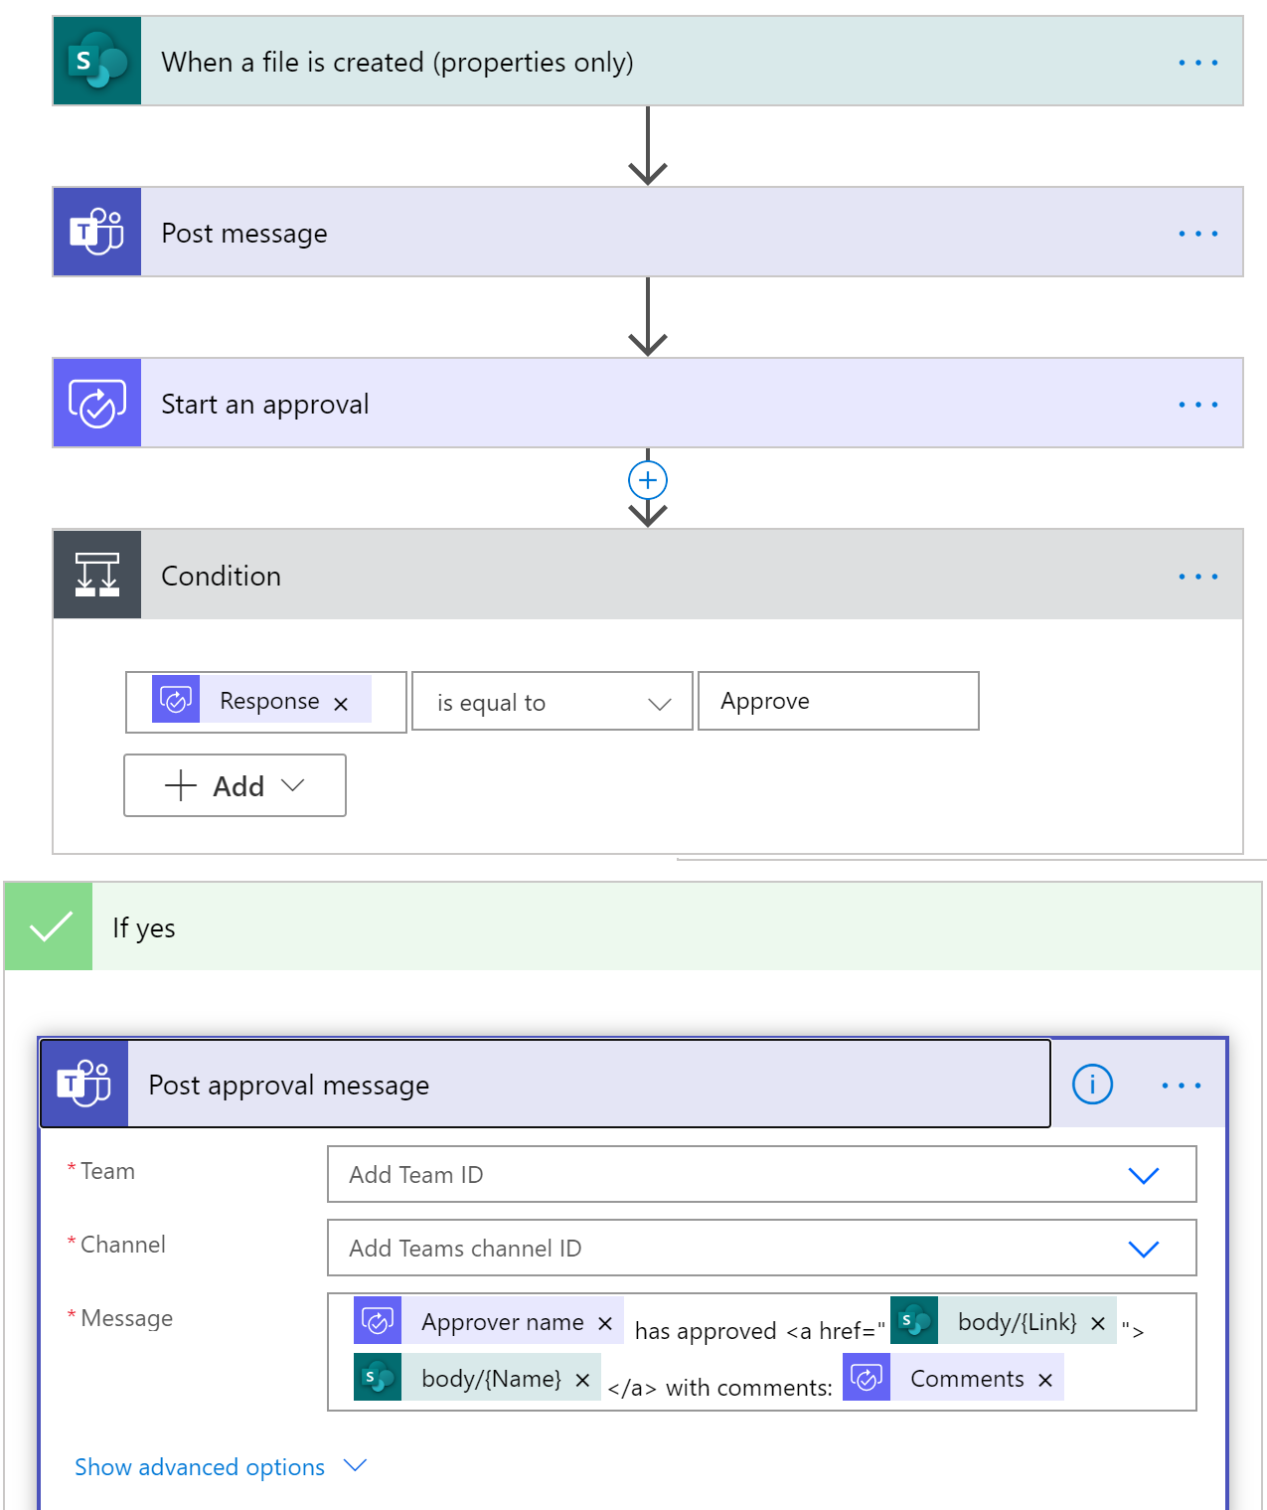
Automate repeated workflows
Manage a contract lifecycle
Use a team workspace to manage the lifecycle of critical documents in your organization, then add automation to save time and stay focused.
Update the team when new assets are added
Kick off a quick approval process
Use Power Automate flows to:
Create approvals for every stage of the document lifecycle
Move documents to different folders for different stages of the process
Send out documents for e-signatures via Adobe Sign
Use tools like OneNote for brainstorming contract details
Keep team members in the loop
Notify the team when approved

Slide 27
Automate repeated workflows
Manage a contract lifecycle
Use a team workspace to manage the lifecycle of critical documents in your organization, then add automation to save time and stay focused.
Update the team when new assets are added
Kick off a quick approval process
Use Power Automate flows to:
Create approvals for every stage of the document lifecycle
Move documents to different folders for different stages of the process
Send out documents for e-signatures via Adobe Sign
Use tools like OneNote for brainstorming contract details
Keep team members in the loop
Notify the team when approved

Slide 28
Automate repeated workflows
Manage a contract lifecycle
Use a team workspace to manage the lifecycle of critical documents in your organization, then add automation to save time and stay focused.
Update the team when new assets are added
Kick off a quick approval process
Use Power Automate flows to:
Create approvals for every stage of the document lifecycle
Move documents to different folders for different stages of the process
Send out documents for e-signatures via Adobe Sign
Use tools like OneNote for brainstorming contract details
Keep team members in the loop
Notify the team when approved

Slide 29
Automate repeated workflows
Manage a contract lifecycle
Use a team workspace to manage the lifecycle of critical documents in your organization, then add automation to save time and stay focused.
Update the team when new assets are added
Kick off a quick approval process
Use Power Automate flows to:
Create approvals for every stage of the document lifecycle
Move documents to different folders for different stages of the process
Send out documents for e-signatures via Adobe Sign
Use tools like OneNote for brainstorming contract details
Keep team members in the loop
Notify the team when approved

Slide 30
Resources
Join the Champion Community https://aka.ms/O365Champions Get started at https://aka.ms/MicrosoftAdoption
Become an adoption specialist Service Adoption Specialist
Find third party apps https://appsource.microsoft.com

