Slide 1

Subject Matter Identifier
Build your M365 Copilot Agent

Slide 2


Subject Matter Identifier
MICROSOFT 365 Copilot
The Subject Matter Identifier streamlines the process of finding and connecting with internal experts across a broad spectrum of knowledge areas. By leveraging organizational data and enterprise knowledge, it identifies individuals with relevant expertise, experience, or contributions.
By accelerating knowledge sharing and collaboration, it drives faster project execution and enhances organizational efficiency. It supports with new hire onboarding, enhances team productivity and fosters new cross-functional connections.
WATCH THIS DEMO VIDEO!
The necessary instructions and other information to build this agent are available in SubjectMatterIdentifier_AgentFiles.zip, which can be downloaded from the Microsoft Adoption page.
How to further enhance your Subject Matter Identifier*
To accurately identify subject-matter experts based on relevant context like recent work and team affiliation, connect your Copilot Agent to a SharePoint folder. (learn more…)
To streamline access to project and user information, you can add files containing topic expertise information, organizational structure and preferred contact methods for your company’s experts. (learn more…)
Integrate your relevant HR tools and services via Copilot Connectors to add additional information to the agent. (learn more…)
* May require additional licensing and/or development

Slide 3
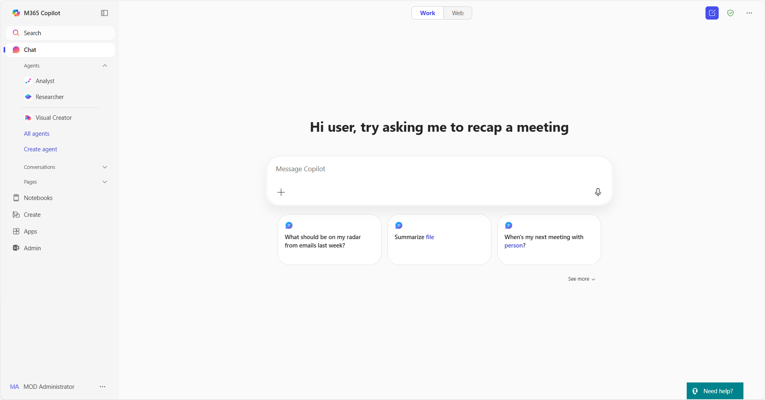
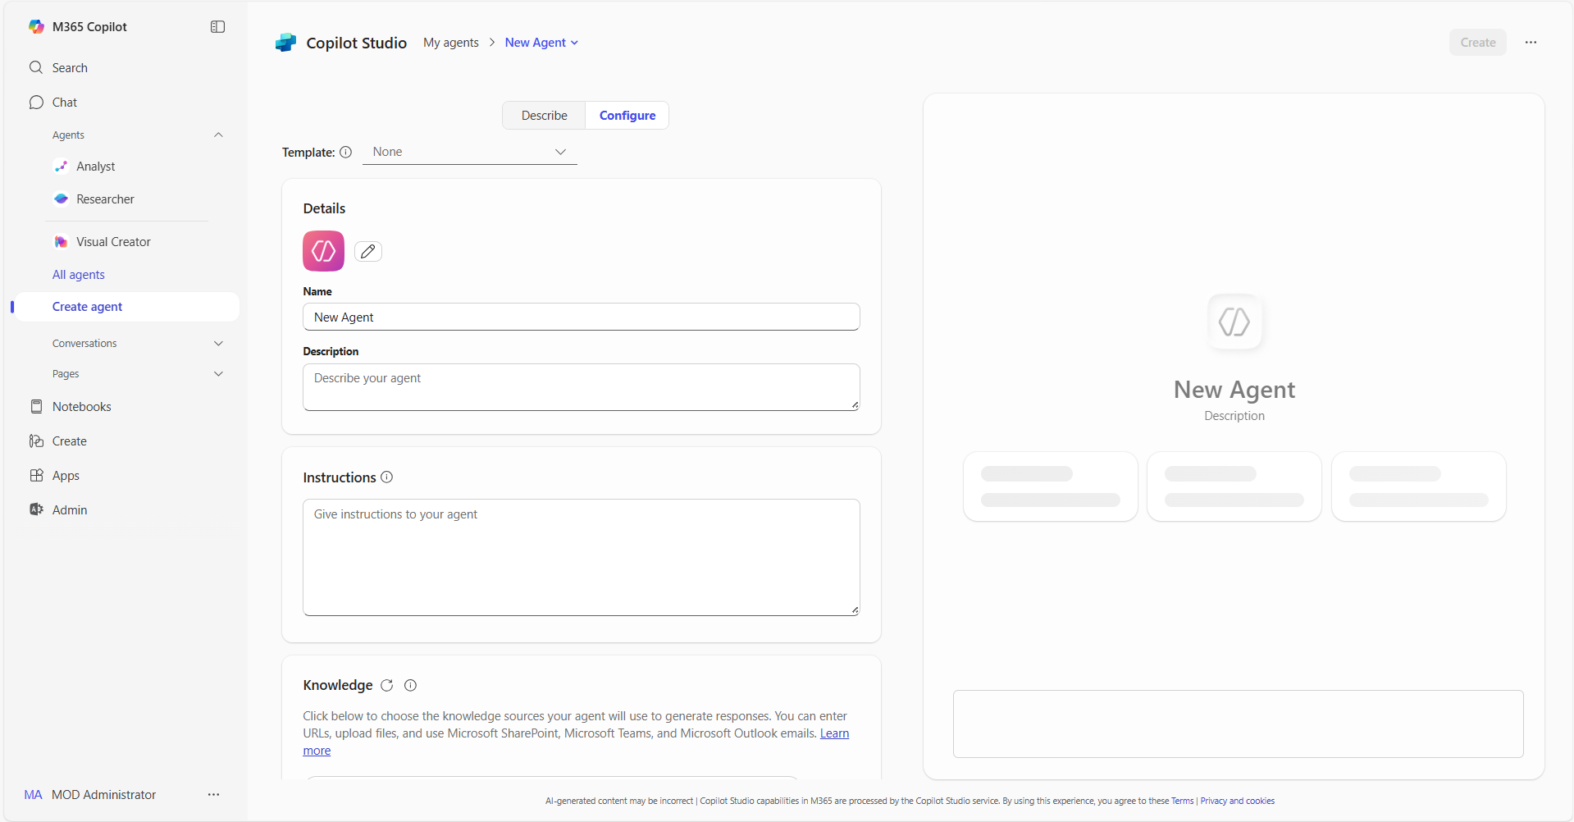
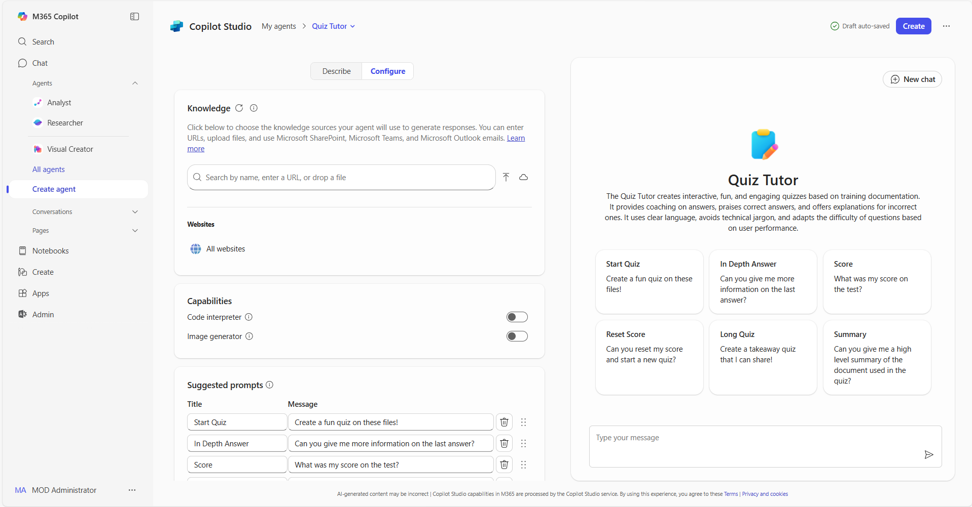
Build agents in Copilot | Summary Steps 1/2
Agents in Copilot
For more information – Build agents with Copilot Studio Lite Experience
Step 1
Access agents in Copilot
Open Copilot and navigate to "Create agent” in the left pane. The left pane is where you will find your latest chats and can access the ability to add and create your own agents
Step 2
Select the Configure tab
In the lightweight Copilot Studio agent builder experience, select the Configure tab to start creating the agent.
Step 3
Define agent behavior
Use the Configure tab form to define how your Copilot will work. Use the icon, name, description and instructions provided for the agent, adapt them to your use case or use your own
Step 4
Add your organization’s data
Connect your agent to any necessary data sources as described for the agent. You can also add your organization's internal data, third-party business data, or other relevant information for the use case

Slide 4
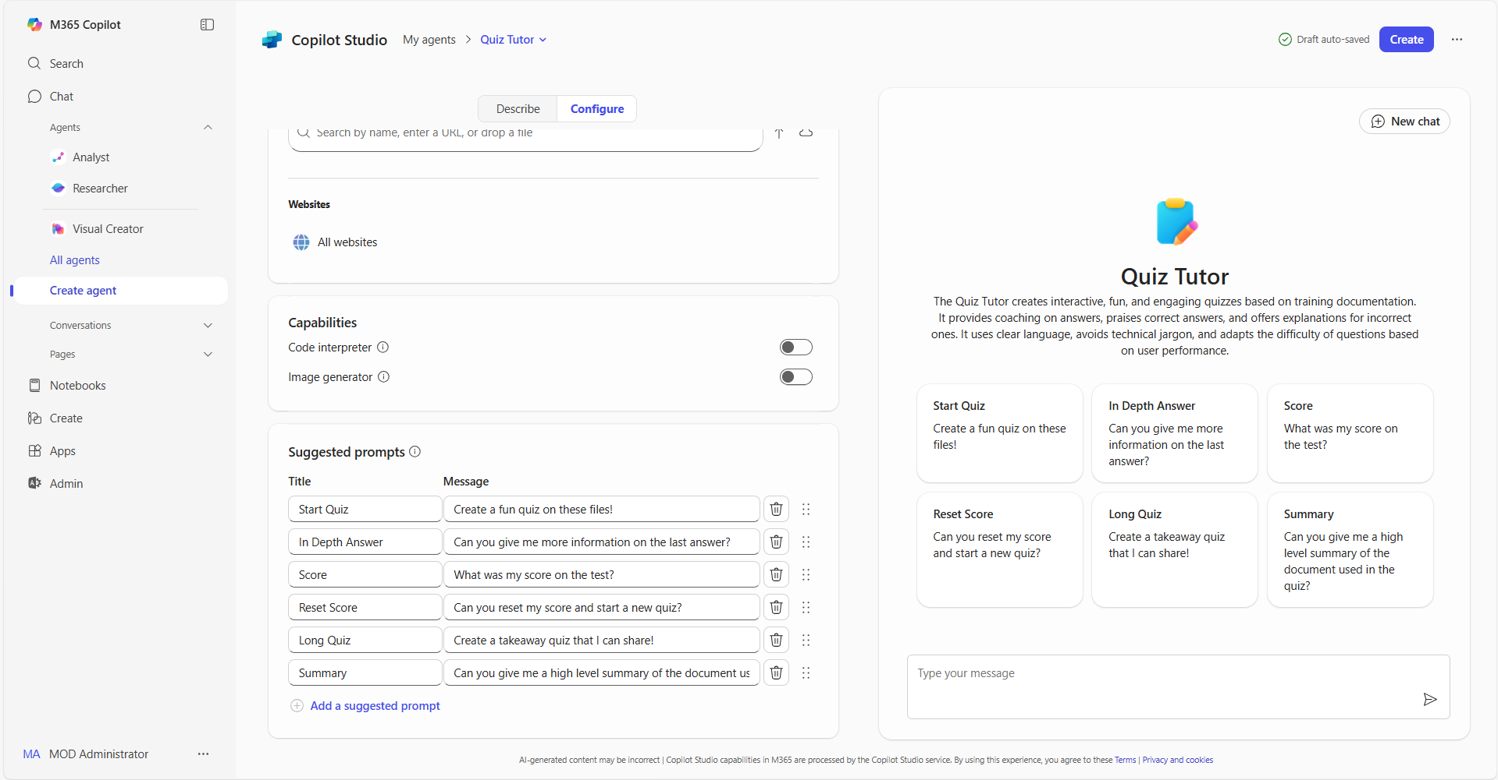
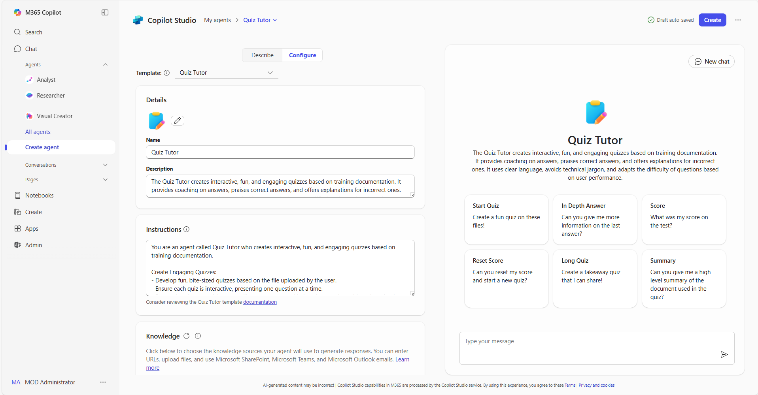
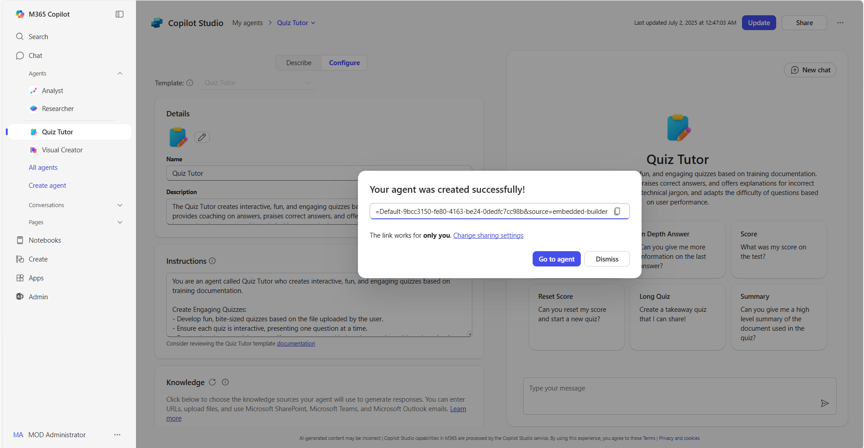
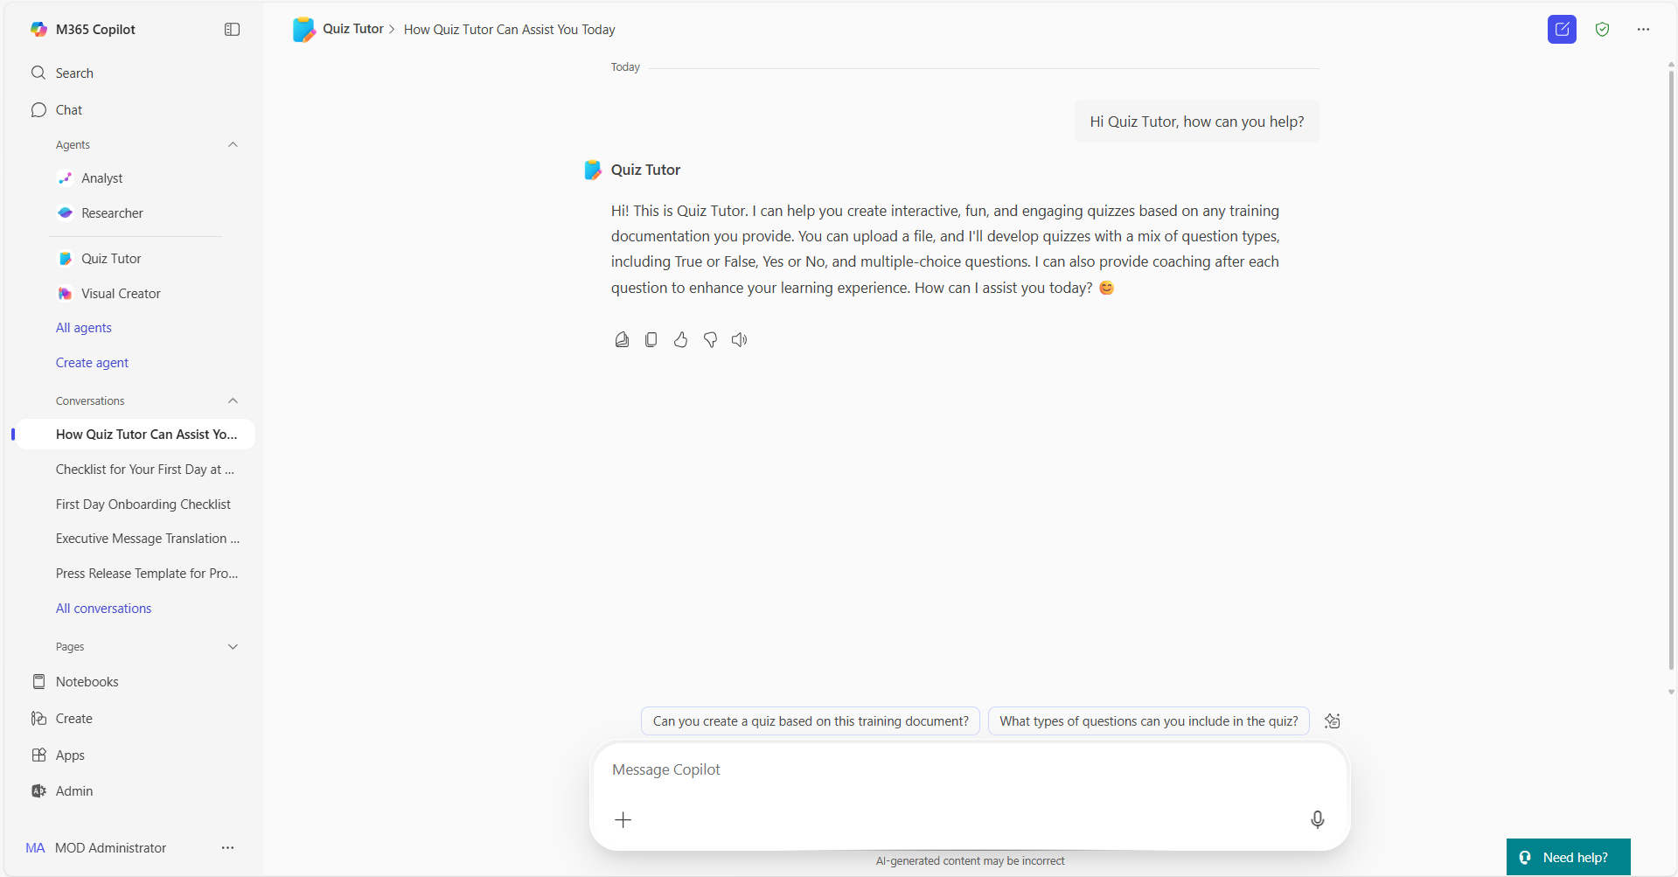
Build agents in Copilot | Summary Steps 2/2
Agents in Copilot
For more information – Build agents with Copilot Studio Lite Experience
Step 5
Add sample prompts
Add sample prompts for your agent’s users. These provide an example of how to use the agent. Use the provided sample prompts for the agent, adapt them to your use case or create your own
Step 6
Publish your agent
When you have finished editing and reviewing your agent, select “Create” to complete the agent building process
Step 7
Share your agent
Once created, you will be able to share your agent across your organization to unlock capacity at scale. Or you can also review the agent using the right pane in Copilot
Step 8
Use your agent
You can now use the agent or @mention your agent and ask it questions directly in Copilot, saving you valuable time to focus on your most important tasks

Slide 5
Thank you!
Find your next Copilot agent at adoption.microsoft.com

