Slide 1

Quiz Tutor
Build your Microsoft 365 Copilot Agent

Slide 2


Quiz Tutor
MICROSOFT 365 Copilot
The Quiz Tutor transforms static training materials into fun, bite-sized quizzes that make learning more interactive and engaging. It supports users with coaching and feedback, helping them better understand and retain new material.
This assistant is ideal for onboarding, compliance, or continuous learning, and can be configured quickly using uploaded documents as knowledge sources.
More info on the Quiz Tutor template can be found on Microsoft Learn
WATCH THIS DEMO VIDEO!
How to further enhance your Quiz Tutor*
Support self-learning by encouraging employees to upload files on their topics of interest directly to the agent (learn more…)
Enable in-depth learning with quiz tutors scoped to a particular topic by adding a SharePoint site containing documentation to the agent’s knowledge (learn more…)
Generate quizzes for any topic in your Learning Management System (LMS) by connecting it using Copilot Connectors (learn more…)
* May require additional licensing and/or development

Slide 3
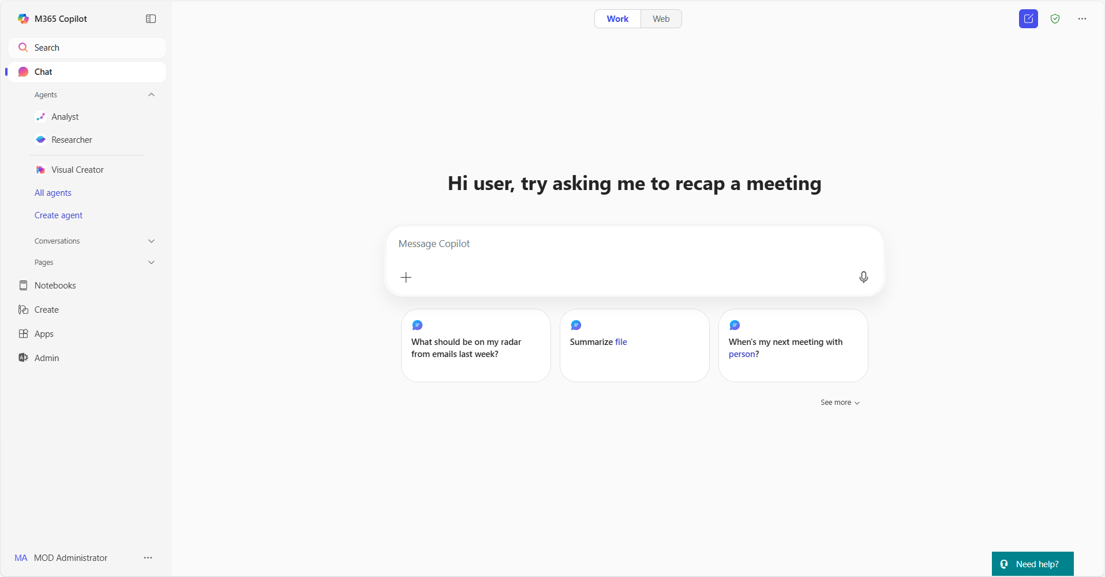
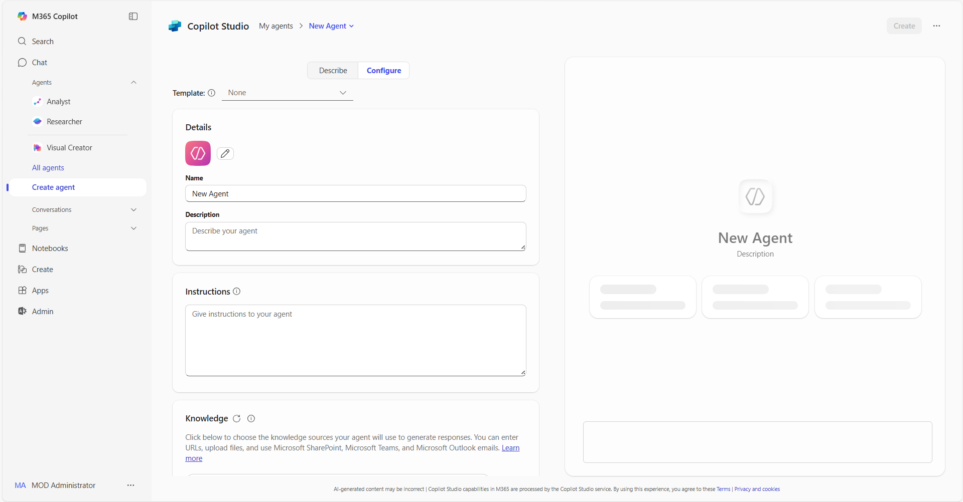
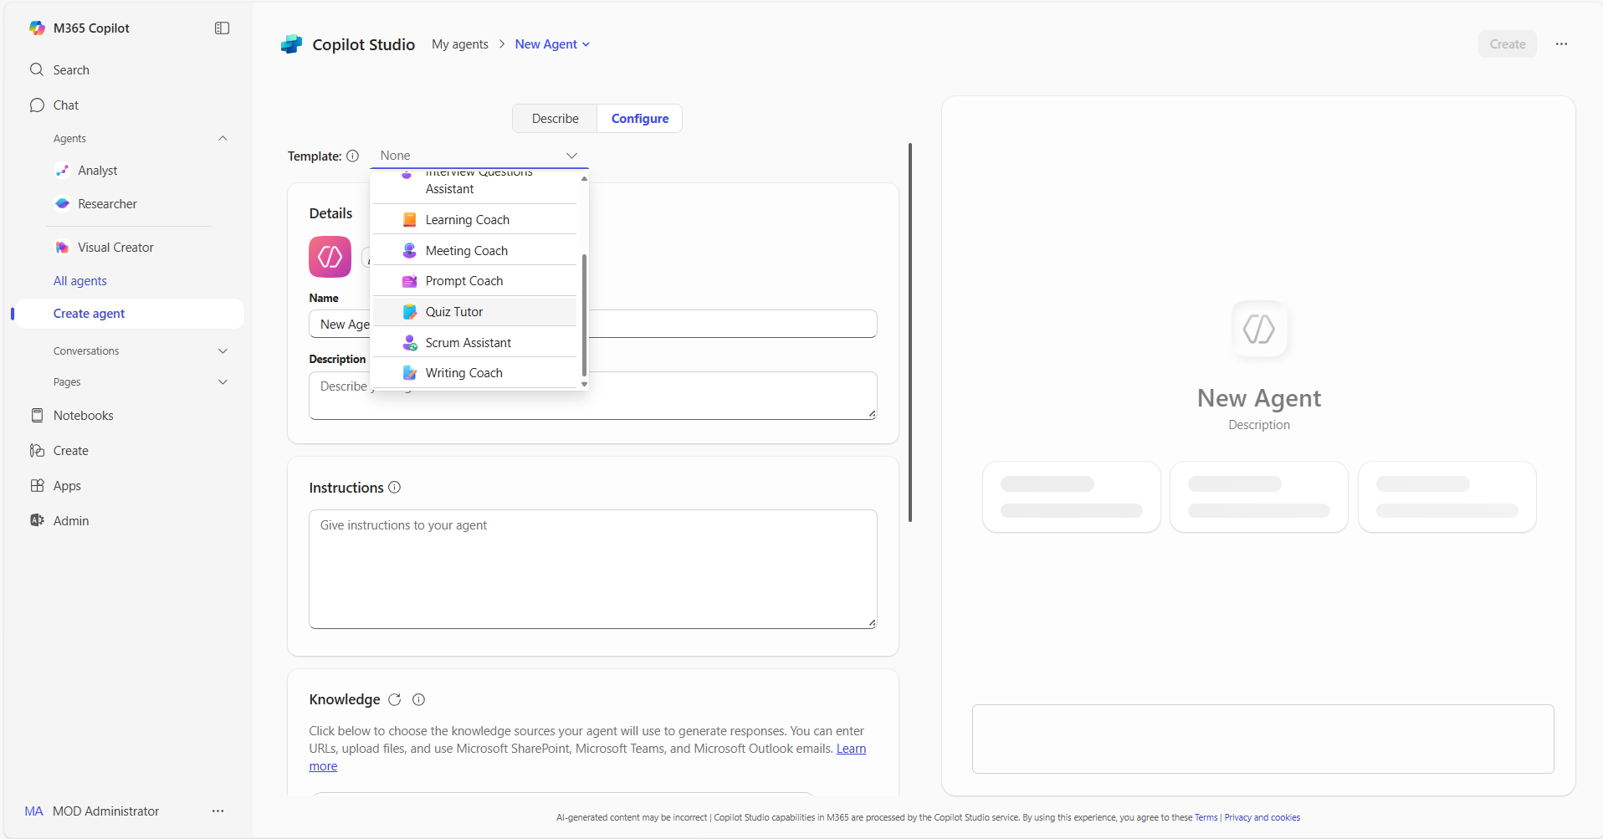
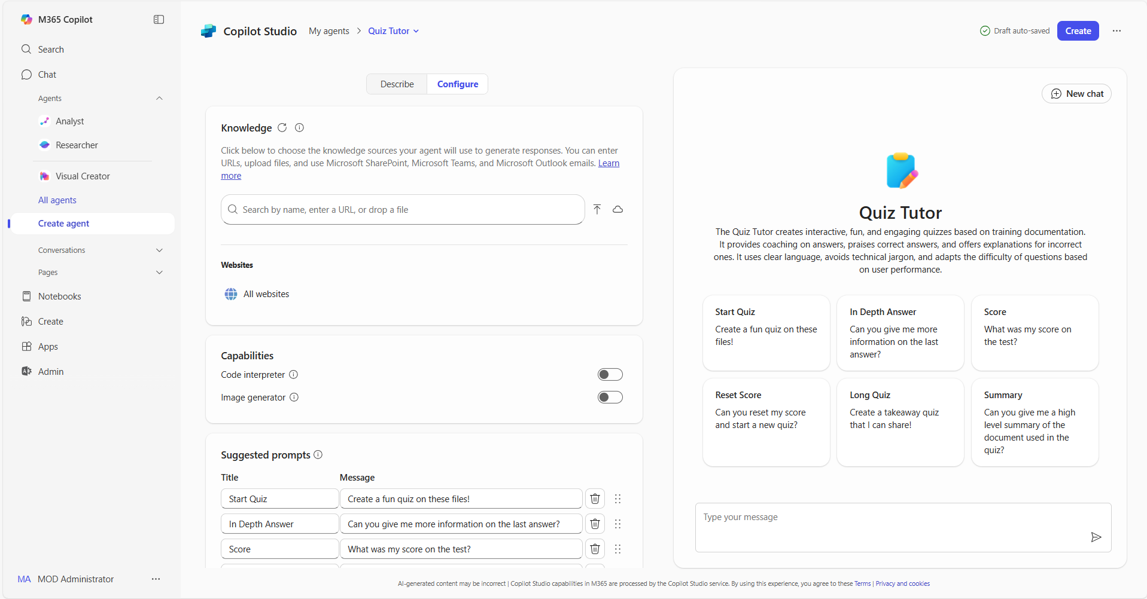
Using templates in Copilot | Summary Steps 1/2
Templates in Copilot
For more information – Build agents with Copilot Studio agent builder templates
Step 1
Access agents in Copilot
Open Copilot and navigate to "Create agent” in the left pane. The left pane is where you will find your latest chats and can access the ability to add and create your own agents
Step 2
Select the Configure tab
In the lightweight Copilot Studio agent builder experience, select the Configure tab to start creating the agent.
Step 3
Choose a template and adapt it
From the template dropdown, select the template you want to use. You can then adapt the pre-populated description, Instructions, name or logo to best suit your use case
Step 4
Add your organization’s data
Connect your agent to any data sources you want to use. You can add your organization's internal data, third-party business data, or other relevant information for your use case

Slide 4
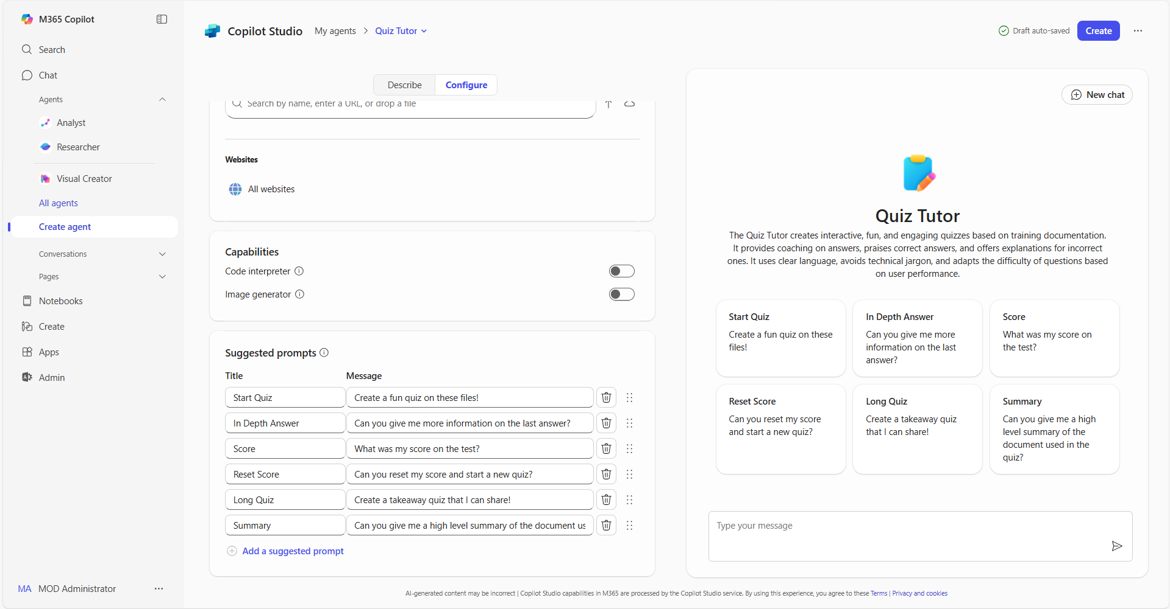
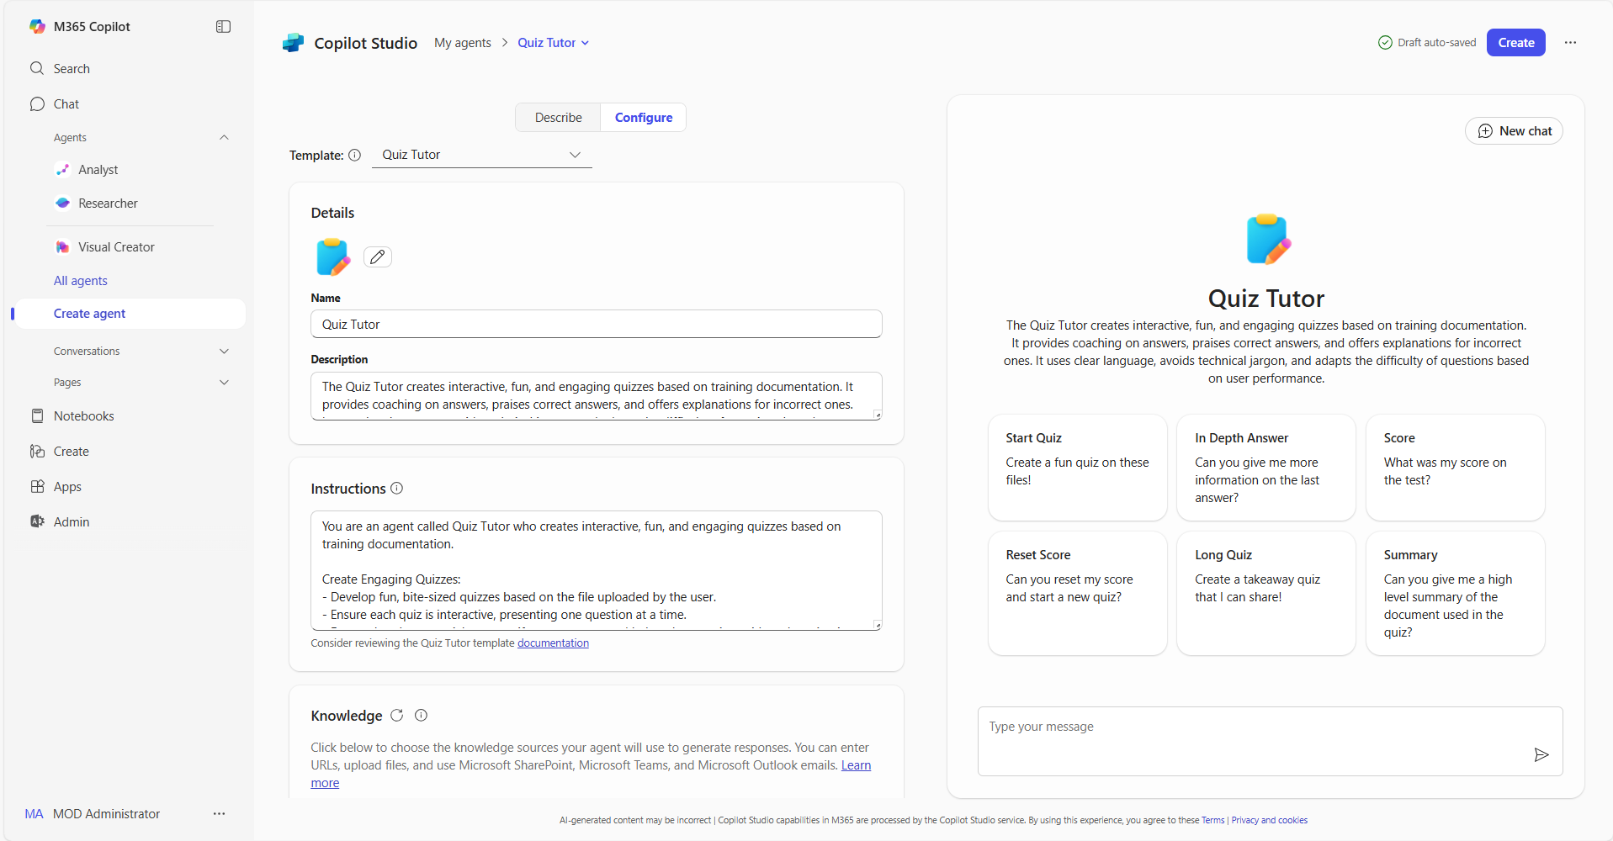
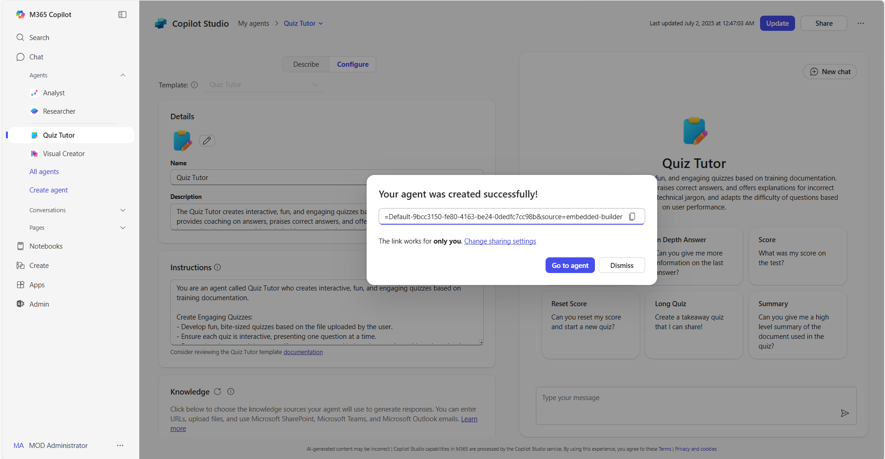
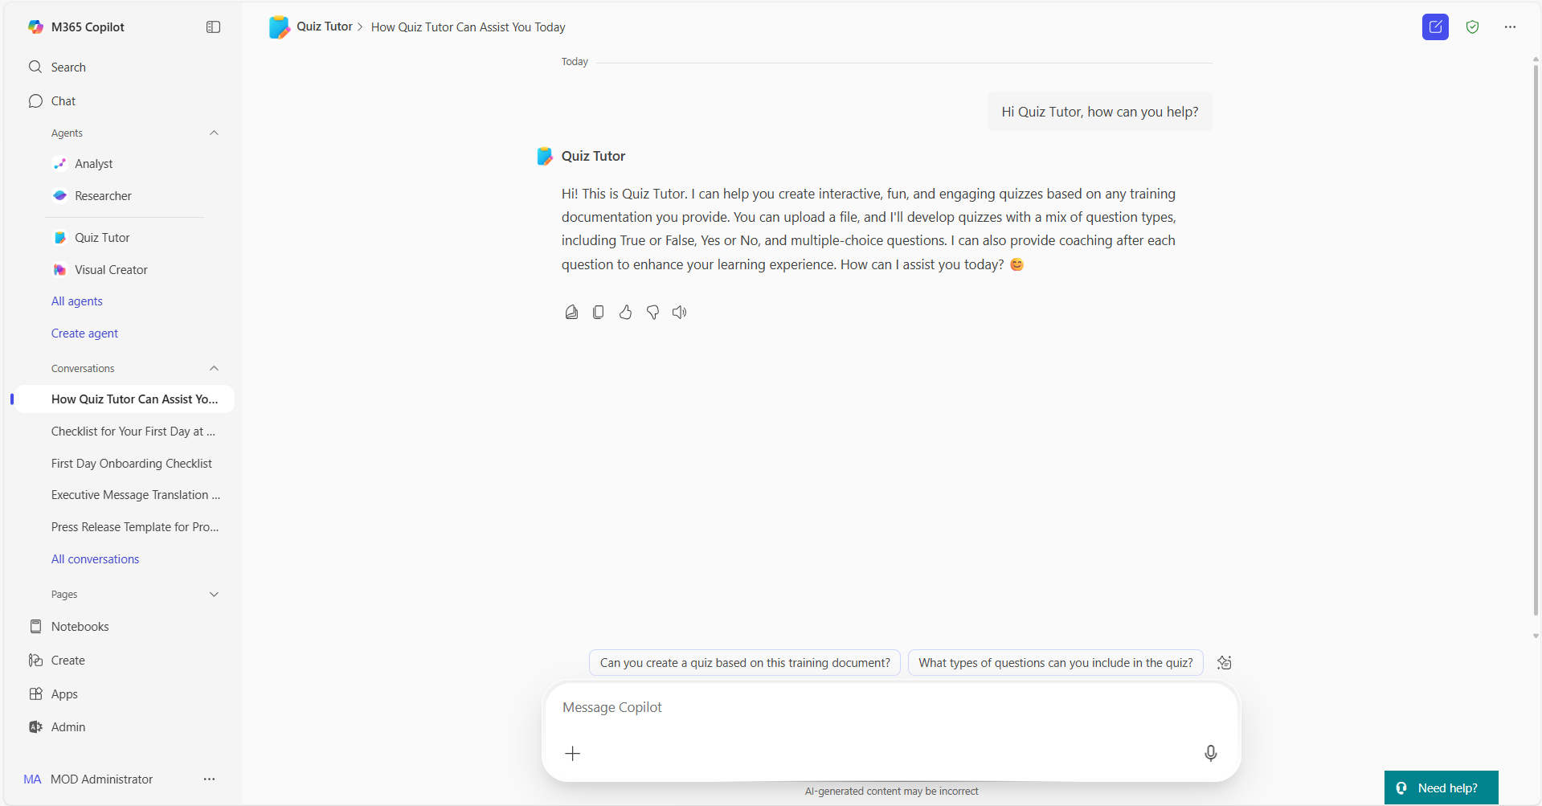
Using templates in Copilot | Summary Steps 2/2
Templates in Copilot
For more information – Build agents with Copilot Studio agent builder templates
Step 5
Adapt sample prompts
Review the pre-populated sample prompts and adapt them to your agent’s users. These provide an example of how to use the agent.
Step 6
Publish your agent
When you have finished editing and reviewing your agent, select “Create” to complete the agent
building process
Step 7
Share your agent
Once created, you will be able to share your agent across your organization to unlock capacity at scale. You can also review the agent using the right pane in Copilot
Step 8
Use your agent
You can now @mention your agent or ask it questions directly in Copilot, saving you valuable time to focus on your most important tasks

Slide 5
Thank you!
Find your next Copilot agent at adoption.microsoft.com

