Slide 1
People Skills Deployment Guide
Set up and pilot People Skills in your organization
Confidential – this document is under NDA

Slide 2
Table of Contents
Plan & Prepare for deployment
Setup Pre-requisites
Configure & Deploy People Skills
Inform users & Assess performance
Resources & Support

Slide 3
People Skills
Deployment checklist and key resources
Microsoft Resources
People Skills Adoption site
Resources to ensure you are delivering employee satisfaction and business value.
People Skills overview deck
Educate your team on key People Skills scenarios and value to employees, leaders and organization
Microsoft FastTrack
FastTrack is a Microsoft delivered benefit designed to help you deploy Microsoft 365.
People Skills setup documentation
Review setup guidelines, licensing requirements, and how to setup privacy controls
Notes:
This process flow provides a high-level roadmap for your People Skills deployment. Each section builds upon the previous one, ensuring a structured approach to implementation.

Slide 4
Plan & Prepare
Notes:
The planning phase is critical for deployment success. This section ensures you understand what People Skills can do, have the right licenses, select appropriate pilot users, and plan security controls before any technical implementation begins.

Slide 5
Key planning questions to answer
Review People Skills capabilities and answer the below questions for your organization:
Which People Skills scenarios are most critical for your organization strategy? How will you make best use of skills data?
Which interfaces will your users primarily interact with?
(For pilot deployments) Which departments or roles should be represented in your pilot?
Do I understand the strengths/limitations of People Skills and AI inference engine?
Determine which licenses you will need for your users to access desired scenarios
Resources
People Skills overview deck
People Skills adoption site
Note: For more information on AI Council and RAI, visit User Enablement Guide.
People Skills tech community blog
People Skills Licensing requirements
Notes:
Once you have completed the Optimization assessment, it is recommended to hold a meeting with the User enablement group to make sure you address any additional questions about Copilot, data security, governance and data access, or any other questions about the responsible use of AI within the business.

Slide 6
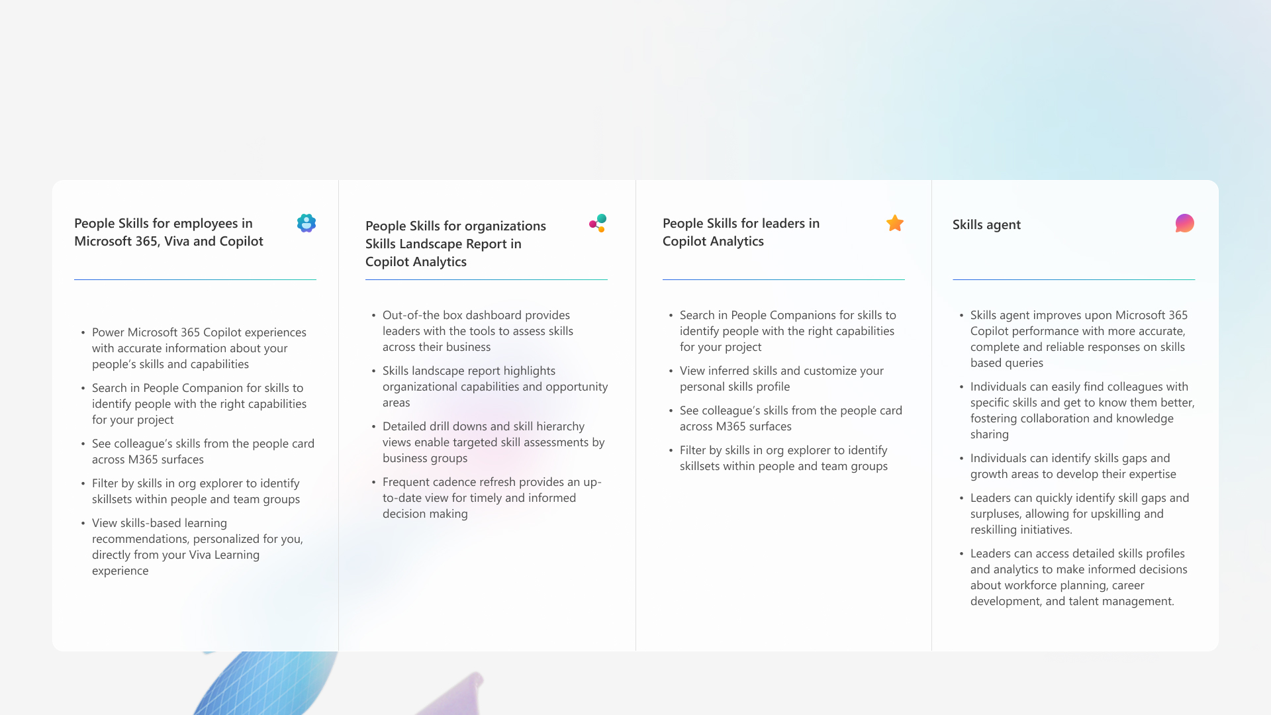
People Skills
Key Scenarios & Capabilities
Notes:
People Skills provides capabilities across multiple Microsoft 365 experiences. End-user scenarios require minimal setup and provide immediate value through enhanced profile information and search capabilities. Advanced scenarios like learning recommendations and analytics require additional configuration but offer deeper insights for workforce planning and talent development. Understanding which scenarios matter most to your organization will guide your deployment strategy and licensing decisions.

Slide 7
People Skills
Surfaces where People Skills data appears
Notes:
People Skills provides capabilities across multiple Microsoft 365 experiences. End-user scenarios require minimal setup and provide immediate value through enhanced profile information and search capabilities. Advanced scenarios like learning recommendations and analytics require additional configuration but offer deeper insights for workforce planning and talent development. Understanding which scenarios matter most to your organization will guide your deployment strategy and licensing decisions.

Slide 8
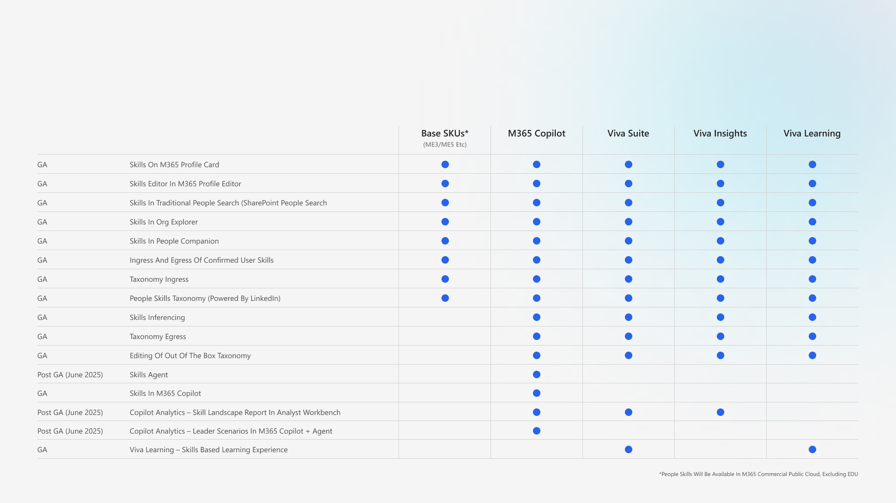
People Skills
Functionality Access by License
Review People Skills Licensing Requirements
Notes:
Licensing requirements vary significantly by scenario. End-user experiences are the most accessible, requiring only People Skills setup. Learning scenarios need Viva Learning configuration. For Copilot Analytics scenarios every user being analyzed needs premium licenses, not just the person viewing reports. Leader scenarios require premium licenses for both the leader and all team members, with minimum team sizes for meaningful insights.

Slide 9
AI Inference: Strengths & Limitations
The People Skills inference engine uses Microsoft 365 profile and activity signals from the Microsoft Graph to create personalized skill profiles for users in your organization.
We associate with a representative set of skill names based on the M365 sources available to People Skills to keep user skill profiles fresh and relevant. They aren't intended to be a comprehensive reflection of a person’s capabilities.
Please understand the following aspects to have the right expectations on what to expect from the inference model.
We currently only infer skills from Microsoft 365 sources. We don't currently use user activity in other line of business applications.
People Skills uses large language models to assign skills that most closely match the taxonomy for the user profile and activity. For example, if a user creates a document on front-end development, we might tag the user with front-end development, web development, React, or Angular based on the closest content match.
Inferences are impacted by the skill name and description uploaded by customer administrators, and by the job title of users.
Read AI transparency in People Skills to learn how to use the inferencing data.

Slide 10
Selection Guidelines
Special Considerations
Include representatives for each target scenario (For example, include org leaders to test leader functionality)
Ensure diverse department representation, avoid HR/IT over-representation
Focus on digital users with significant M365 activity, consider AI inferencing limitations for frontline/field workers
Consider local or regulatory compliance requirements
You will need a minimum 10 users in a team for leader scenarios, and we recommend 100+ users for Copilot Analytics landscape reports
Consider industry restrictions for sensitive skills (such as healthcare, legal)
For Pilots
Guidelines For Selecting Users
Once this list of users has been locked, we recommend adding all these users to a M365 group for easy access.
Notes:
Pilot user selection significantly impacts deployment success. - Ensure you have representation from the required roles to test your key scenarios
For example, For those who want to test People Skills for Leaders, ensure there are some Org. Leaders (and/or Leader Delegates) in your list. - Ensure representation from diverse skill sets in your pilot group: Avoid over representation from one department such as HR or IT. Note that People Skills works best with technical skills (for example, Software Engineering) and performance may be limited with soft and functional skills (e.g. Project management, project leadership)
- Consider which users are likely to receive the best skills suggestions: Skills AI inferencing processes skills suggestions based on M365 work activity, and therefore works best with digital users who spend a significant portion of the work time in M365. Skills AI suggestions may be limited for frontline or field workers who do not spend time on M365. Remember AI suggestions may be limited for customers in industries which have higher restrictions on sharing sensitive skills, such as Healthcare or Legal.
- We recommend a minimum of 100 users for the experience to be effective, especially if you are considering creating PowerBI reports in Copilot Analytics. This is because users begin to realize the value of finding people in their network with certain skills in larger groups; and we need a minimum of 100 users make the org level filters and distribution in the Skills Landscape report effective.

Slide 11
Setup
Pre-requisites
Notes:
The planning phase is critical for deployment success. This section ensures you understand what People Skills can do, have the right licenses, select appropriate pilot users, and plan security controls before any technical implementation begins.

Slide 12
Assign Licenses To Your Users
Assign the required licenses to users in your tenant to access your preferred People Skills experiences
For organizations planning to pilot with a small user group – ensure the right licenses are assigned to all users in your pilot user group
Proper license verification prevents deployment delays and functionality issues.
Keep In Mind
If you are intending to use Copilot Analytics, the entire group of users who will be analyzed needs to be licensed. This means:
For Copilot Analytics – Skills landscape report in Analyst workbench, the entire population of users in scope for the People Skills analysis must have a premium license assigned (M365 Copilot, Viva Insights or Viva Suite license). A minimum of 10 people is required.
For Copilot Analytics – Leader scenarios – Both the leader and his team need to have premium (either M365 Copilot or Viva Insights*) licenses. A minimum of 10 people is required.
*M365 Copilot licenses are required for access to the Skills agent. Viva Insights license can give you access to the leader experience in Viva Insights.
Resources
How to assign M365 Copilot licenses
How to assign Viva licenses

Slide 13
Common FAQ About Licensing
If we have a subset of users that will have copilot licenses, and the remaining half of the company does not have copilot - what will the difference in their experience?
If some users in your company have Copilot licenses while others do not, their experiences will differ:
For users with Advanced (Copilot or Viva) licenses: You will have access to AI-powered suggestions in the Skills editor and can choose to share your inferred skills with others (if you enable this option). When you look up someone else’s skills using Copilot, Org Explorer, or People Companion, you’ll see all users’ confirmed skills and, for those with Copilot or Viva, their inferred skills as well. You will have access to all premium Skills experiences in the apps you have setup, such as Learning recommendation in Viva Learning or leader experiences in Copilot Analytics.
For users with Foundation (M365 Commercial like ME3, ME5 licenses) and no Copilot or Viva licenses: AI suggestions in the Skills editor will not be available, but you can still manually add your own skills. When searching for others’ skills in Org Explorer or People Companion, you will see everyone’s confirmed skills and, where applicable, the inferred skills of users who have Copilot or Viva licenses.

Slide 14
Configure Pre-Requisite Experiences
People Skills is a data layer that provides skills information to other Microsoft 365 experiences, so those underlying systems must be configured first.
Note: Setting below is not essential—it depends on the People Skills scenarios you're interested in trying.
People Skills end-user experiences This includes skills in the Profile Card, managing skills via Profile Editor, People search in SharePoint, People Companion*, Org Explorer, M365 Copilot | No pre-requisite steps apart from setting up People Skills
Skills based learning experiences This includes learning recommendations in Viva Learning based on skills that you want to grow | Set up Viva Learning by following this guide Learning recommendations will be based on integrations with LMS providers. Learn about setting up integrations Once Viva Learning is setup, you must transition from interests to Skills for learning recommendations. Learn more here

Slide 15
Configure Pre-Requisite Experiences
Continued
Skills in Copilot Analytics – Skills Landscape Report | Set up Copilot Analytics Analyst workbench by following this guide Please keep in mind the following: The analyst is granted the Viva Insights analyst role and has access to the Viva Insights Advanced Insights platform. Your HR org file has been uploaded to Viva Insights and is up-to-date for the preview population. These attributes will be available as filters and visuals breakdown criteria for the report. The entire population of users in scope for the People Skills analysis must have a premium license assigned (M365 Copilot, Viva Insights or Viva Suite license). A minimum of 10 people is required, and we recommend more than 100 users for this experience to be effective.
Skills for leaders in Copilot Analytics and Skills Agent | For those testing the experience in the Skills Agent – setup the Skills Agent Assign the group manager role here Please keep in mind the following: Your HR org file has been uploaded to Viva Insights and is up-to-date for the preview population. The org. leader must be assigned the group manager role in Viva Insights Both the leader and his team need to have premium (either M365 Copilot or Viva Insights**) licenses. Each team must be a minimum of 10 people.

Slide 16
Configure & Deploy
Notes:
The planning phase is critical for deployment success. This section ensures you understand what People Skills can do, have the right licenses, select appropriate pilot users, and plan security controls before any technical implementation begins.

Slide 17
Before You Begin Setup
Admin roles required for setup
AI administrator & Knowledge Administrator
Think about which Skills library you want to enable
Quick setup with Out-of-the-box Skills Library with 16K+ skills Recommended for most customers | This option is recommended for most customers as you can quickly get started with our robust out-of-the-box library of 16k+ industry recognized skills in just a few clicks. Note: By selecting this option, you also have the ability to exclude skills from the out-of-the-box list in the Admin center
Combination of out-of-the-box People Skills Library & custom library (provided by customer) | For more mature customers who have an existing library of skills unique to their organization, we offer the option of combining your custom skills library with our out-of-box library of 16k+ skills. If this option is selected, People Skills will deduplicate and remove skills with same names to ensure there are no duplicate entries across the combined skills library
Only Custom skills library (provided by customer) | Customers who have an existing library of skills unique to their organization can choose to only proceed with their custom skills library. This option is not recommended for most customers.
People Skills will be deployed to users after setup
Users will start seeing skills after 48 hrs.
Use privacy and visibility controls to restrict access
Refer to our access controls and pilot guide
Notes:
You can always update your skills library later after the initial setup. This may include adding or removing skills from the default or custom library, or adding a custom library to the default library later after initial setup 44
Notes:
After initial setup, Skills inference will start showing to users within 48 hours but it may take up to 5 days. For each subsequent change after initial setup, such as changes to the skills library, It may take up to 3 days for changes to be reflected in users’ suggested skills
For Skills experiences for leaders (in Skills Agent or Viva Insights), or Skills landscape report in Copilot Analytics please ensure the org. data file is uploaded which tells the system about your org. hierarchies, and the required roles (such as Analyst or Group Leader) are assigned in Viva Insights. Please review the previous section (Pre-requisites) for more details.

Slide 18
Setup People Skills
Please follow the setup guide to set up People Skills.
People Skills can be found on the Copilot page in the Microsoft 365 admin center
People Skills setup documentation

Slide 19
Configure Privacy & Visibility Settings
As an admin, you can set privacy and visibility controls for users, groups, or the entire tenant to meet your organization's needs.
If you need to restrict access based on local or business regulations (for example, e.g. Works Council requirements, business requirements for sub-organizations with confidential data) we provide access controls using Feature Access Management .
Admins can setup these access controls during People Skills setup to comply with your local and business requirements
Resources
For details on the types of access controls we offer, please refer to People Skills documentation on MS learn
Detailed steps on how to set up access policies for People Skills, please refer to People Skills documentation on MS learn
For more details on what are access control policies and proper syntax for PowerShell cmdlets, please refer to Feature Access Management

Slide 20
Brief Overview of Access Controls We Offer
Admins can configure default privacy settings for skills using Feature Access Management by creating access policies that apply across the tenant or target specific users, groups, or regions. For detailed steps on setting up an access policy, refer to the People Skills settings documentation.
Skills AI Inferencing Controls
Skills Visibility Controls
Will users receive AI-based skill suggestions?
Will user’s skills be shared with others in M365?
Admins will have the option to:
Visibility controls are offered at 3 levels
Admins will have the options to:
Enable
Disable AI inferencing
Turn off inferencing
Users can opt-out
Users can opt-in
No user controls
Enable
Disable sharing
Turn off sharing*
Users can opt-out sharing
Users can opt-in to sharing
No user controls*
Skills profile (Parent)
Includes all skills in user profile, including confirmed, AI-inferred and imported skills
(Default behavior)
(Default behavior)
AI inferred skills only (Child)
Includes all skills in user profile, including confirmed, AI-inferred and imported skills
Imported skills only (Child)
Sharing is disabled if Skills profile (parent) is opted-out/disabled
*Turning off sharing completely (no user controls) is only available for the 2 child controls (AI-inferred and Imported skills) and not possible for Skills profile

Slide 21
Deploying To Users
People Skills will be deployed automatically to users after setup is complete in Admin center.
.
Keep In Mind
After initial setup, Skills inference will start showing to users within 48 hours but it may take up to 5 days. For each subsequent change after initial setup, such as changes to the skills library, It may take up to 3 days for changes to be reflected in users’ suggested skills
Skills agent must be setup separately through the Agent Store in M365 Copilot.
For Skills experiences for leaders (in Skills Agent or Viva Insights), or Skills landscape report in Copilot Analytics please ensure the org. data file is uploaded which tells the system about your org. hierarchies, and the required roles (such as Analyst or Group Leader) are assigned in Viva Insights. Please review the previous section (Pre-requisites) for more details.
You may manage your skills library at any time after initial setup. You can also change your privacy and visibility settings.

Slide 22
(Optional) How To Pilot People Skills
If you want to deploy People Skills to a smaller pilot user group and want to restrict access to People Skills experiences for the rest of users in your tenant, you can use our privacy and sharing controls to pilot People Skills in your organization.
This guide will walkthrough how to setup access policies to restrict People Skills access to your pilot group.
Before you get started:
Review privacy controls we offer (see previous section)
Pilot users have been identified and placed in M365 group
Pilot group users have been licensed: We recommend assigning premium (either M365 Copilot or Viva) licenses to users in the pilot group so they can test all People Skills experiences. The settings below assume that pilot group users have premium licenses.

Slide 23
(Optional) How To Pilot People Skills
Continued
Admins have several options to setup a set of policies that allows varying levels of control to restrict data sharing and privacy to pilot People Skills within a pilot group with confidence.
Option 1: Restrict AI inferencing suggestions for everyone outside pilot group | Option 2: Turn off AI inferencing and disable skill sharing for everyone outside pilot group* | Option 3: Custom setup Flexible setup for your organization
This is a high-level guideline on the access policies to setup.
For more details on which controls we offer for People Skills and how to set them up, please refer to People Skills documentation on MS learn
For more details on access control policies and syntax, please refer to Feature Access Management
Notes:
*Note: Admins can only soft-disable skill profile sharing, meaning you can opt-out all users of sharing their skills by default, but users are always able to add skills manually and opt-in to sharing those skills if they like.

Slide 24
(Optional) How To Pilot People Skills
Continued
 | Option 1: Restrict AI inferencing suggestions for everyone outside pilot group | Option 2: Turn off AI inferencing and disable skill sharing for everyone outside pilot group* | Option 3: Custom setup
What this means for people in pilot user group | Users in the pilot group will receive AI-powered suggestions in the Profile editor. When you look up someone else’s skills using Copilot, Org Explorer, or People Companion, you’ll see all users’ confirmed skills, and, for others in the Pilot group, their inferred skills as well. You will have access to all premium Skills experiences in the apps you have setup, such as Learning recommendation in Viva Learning or leader experiences in Copilot Analytics. | Users in the pilot group will receive AI-powered suggestions in the Profile editor. These pilot users will have access to all premium Skills experiences in the apps you have setup, such as Learning recommendation in Viva Learning or leader experiences in Copilot Analytics. When these pilot users look up someone else’s skills, they will see all skills (confirmed, AI-suggested or org-added skills) for those also in the pilot group, but they will not see any skills for those outside the pilot group. | If neither of the above options make sense for your organization, admins can flexibility to setup a set of access policies based on the controls we offer. Review the controls we offer and the enablement states to set up a set of policies that work for your organization. Admins can set up multiple policies. Incase multiple policies apply to the same user, The most restrictive policy will apply. For more details on which controls we offer for People Skills and how to set them up, please refer to People Skills documentation on MS learn For more details on access control policies, please refer to Feature Access Management
Notes:
*Note: Admins can only soft-disable skill profile sharing, meaning you can opt-out all users of sharing their skills by default, but users are always able to add skills manually and opt-in to sharing those skills if they like.

Slide 25
(Optional) How To Pilot People Skills
Continued
 | Option 1: Restrict AI inferencing suggestions for everyone outside pilot group | Option 2: Turn off AI inferencing and disable skill sharing for everyone outside pilot group*
What this means for everyone else (not in pilot) | AI suggestions in the Skills editor will not be available for these users, but they can still manually add their own skills. When searching for others’ skills in Org Explorer or People Companion, they will see everyone’s confirmed skills and, the inferred skills of users in the Pilot group. These users will not be able to opt-in to receive AI suggestions. | When users outside the pilot group look up someone else’s skills, they will see all skills (confirmed, AI-suggested or org-added skills) for those in the pilot group, but they will not see any skills for those outside the pilot group. AI skill suggestions in the M365 profile editor will not be available for these users, but they can still manually add their own skills. These users will be able to go into their personal settings and turn skill sharing on if they like.
How to setup | Create 2 access policies Disable AI inferencing for everyone in your tenant by setting a deny policy with –EVERYONE as the Access control list type Enable AI inferencing for all the users in your pilot group security group. | Create 4 access policies: Disable AI inferencing for everyone in your tenant by setting a deny policy with –EVERYONE as the Access control list type Enable AI inferencing for all the users in your pilot group security group. Soft-disable Profile Skills Visibility by creating a policy where users profile visibility is default OFF with –EVERYONE as the Access control list type Enable Profile Skills Visibility for all the users in your pilot group security group.
This is a high-level guideline on the access policies to setup.
For more details on which controls we offer for People Skills and how to set them up, please refer to People Skills documentation on MS learn
For more details on access control policies and syntax, please refer to Feature Access Management
Notes:
*Note: Admins can only soft-disable skill profile sharing, meaning you can opt-out all users of sharing their skills by default, but users are always able to add skills manually and opt-in to sharing those skills if they like.

Slide 26
Inform & Assess
Notes:
The planning phase is critical for deployment success. This section ensures you understand what People Skills can do, have the right licenses, select appropriate pilot users, and plan security controls before any technical implementation begins.

Slide 27
Inform Users
Congrats on deploying People Skills in your organization! Now we should inform our employees and users on how to best experience the product.*
Note: No automated notification is sent out to users once People Skills is deployed. Admins or IT representatives will have to send out these communications themselves.
We have provided a template to inform your users about this product and what they should test.
Use provided end-user communication templates, and adjust language as needed
Explain People Skills capabilities relevant to their scenarios
Set clear expectations for pilot participation and feedback
Provide guidance on accessing and using features
This template also contains info on how users can share feedback about the product directly with the People Skills team.
TEMPLATE LINK
WILL BE UPDATED LATER
Notes:
Effective communication is crucial for pilot success. Use the provided templates to ensure consistent messaging about People Skills capabilities and pilot expectations. Tailor your communication to highlight the scenarios most relevant to your pilot users. Encourage direct feedback through in-product mechanisms and establish clear channels for questions or issues. Consider appointing champions within each department to provide peer support and encourage adoption.

Slide 28
Tips On Collecting Meaningful Feedback
Feedback Collection Approaches:
In-product feedback mechanisms (encourage frequent use)
Targeted interviews with organizational leaders (deep insights)
Surveys for larger pilot user groups (scalable feedback)
Focus groups for specific scenarios or departments
Focus Areas by Scenario:
For organizations seeking an overview of their skill landscape for workforce planning—such as HR analysts (using Viva Insights) and org leaders consuming these reports—will likely provide the most valuable feedback.
For organizations looking to quickly capture skills data to identify skillsets for assembling project teams or gig workers, org leaders using the Skills Agent or Copilot Analytics or Viva Insights can provide the most effective feedback.
For organizations looking to improve people discovery and networking based on skills, direct feedback from your employees and end-users will be valuable
Feedback Questions to Consider:
Are skill suggestions accurate and relevant?
Does skills visibility improve people discovery?
Are the features intuitive and easy to use?
What value do you see for your specific use cases?
Notes:
Successful feedback collection requires targeting the right users for each scenario. HR analysts and organizational leaders provide the most valuable feedback for workforce planning scenarios, while end users can evaluate people discovery and networking improvements. Use interviews for deep insights from leaders and surveys for broader user input. Focus feedback collection on your original implementation goals to assess whether People Skills is delivering expected value.

Slide 29
Measuring Success Against Objectives
How to evaluate success?
Revisit original People Skills implementation goals
Analyze feedback in context of target scenarios
Identify quantitative and qualitative success indicators
Assess user adoption and engagement levels
Key Evaluation Criteria
Scenario-specific value realization (workforce planning, skills identification, networking)
User satisfaction with features and functionality
Accuracy and relevance of AI skill suggestions
Integration effectiveness with existing workflows
Decision Points for Scaling to rest of your organization
Are pilot objectives being met? What adjustments are needed for broader deployment?
Which additional user groups should be included next?
How should access policies be modified for scaling?
Notes:
Evaluate pilot success by returning to your original implementation goals. Different scenarios require different success criteria - workforce planning scenarios should show value to HR professionals and leaders, while networking scenarios should improve employee collaboration. Analyze both quantitative metrics (adoption rates, feature usage) and qualitative feedback (user satisfaction, perceived value). Use this analysis to determine whether to proceed with broader deployment and what adjustments might be needed.

Slide 30
Resources & Support
Notes:
The planning phase is critical for deployment success. This section ensures you understand what People Skills can do, have the right licenses, select appropriate pilot users, and plan security controls before any technical implementation begins.

Slide 31
Links To All People Skills Resources
People Skills admin setup documentation
People Skills end user documentation
People Skills overview deck
People Skills adoption site
Announcing People Skills general availability and new Skills agent | Microsoft Community Hub
AI transparency in People Skills - Microsoft Support
People Skills Licensing requirements

Slide 32
List of Resources For Compliance Reviews
This list is intended to accelerate customer adoption by sharing a list of all documents that may be helpful in conducting and passing customer compliance reviews
Question that may be asked during compliance reviews | Link to documentation where more information is available
How does AI inferencing work? | Please refer to People Skills documentation on MS learn
What data sources are used in AI suggestions? | Please refer to People Skills documentation on MS learn
What privacy controls are offered? | People Skills offers privacy controls for both the user to manage their own skills, and for the admin to set sharing defaults for their organization For user controls, please refer to Manage AI and sharing options - Microsoft Support For admin controls, Please refer to People Skills documentation on MS learn
Can People Skills be turned off for certain users, regions or groups? | Yes, admins can setup access control policies to disable/ turn off AI inferencing suggestions or skill sharing or users, groups or their entire tenant. For more details on which controls we offer for People Skills and how to set them up, please refer to People Skills documentation on MS learn For more details on access control policies, please refer to Feature Access Management

Slide 33
List of Resources For Compliance Reviews
Continued
Question that may be asked during compliance reviews | Link to documentation where more information is available
How does People Skills comply with Responsible AI standards? | Please refer to the following documentation: AI Transparency in People Skills Microsoft’s commitment to Responsible AI Microsoft Responsible AI standard
What are Microsoft’s Responsible AI standards? | Microsoft is committed to responsibly designing, building, and releasing AI technologies. Please see below: Microsoft’s commitment to Responsible AI Microsoft Responsible AI standard

Slide 34
List of Resources For Compliance Reviews
Continued
Question that may be asked during compliance reviews | Link to documentation where more information is available
How does Microsoft and People Skills protect data privacy and security? | As with all services within the Microsoft Cloud, Microsoft is committed to privacy and security. Microsoft has extensive expertise in protecting customer data, championing privacy, and complying with complex regulations. Your data, powering your experiences, is controlled by you. Our core privacy principle is you own your data; we will never use it for marketing or advertising purposes, so you can feel confident about where your data is stored and secured. Please refer to the Microsoft Trust Center for additional information. Within People Skills, several privacy protections are in place to safeguard user data: Users have complete control over their own skills profiles. They can choose to disable AI skill suggestions at any time. Users also decide where and if their skills are shared across Microsoft 365 through settings in the Profile Editor. Skill details are stored securely on the backend within a user’s data shared, and are only accessible to others if a user chooses to share them. Copilot Analytics reports, which include aggregated skills data, do not identify individual users or their skills. To further protect privacy, Copilot Analytics enforces minimum group sizes in aggregated data sets. Only authorized individuals, such as a user’s group manager, can access personally identifiable information.

Slide 35
List of Resources For Compliance Reviews
Continued
Question that may be asked during compliance reviews | Link to documentation where more information is available
Have the AI suggestions been tested for bias? | Yes, we conduct bias testing for AI suggestions as per our commitment to Microsoft’s Responsible AI standard. AI Transparency in People Skills Microsoft’s commitment to Responsible AI Microsoft Responsible AI standard
What are the limitations of People Skills? How can users minimize the impact of these limitations when using the system? | Please refer to AI Transparency in People Skills
What operational factors and settings allow for effective and responsible use of People Skills? | Please refer to AI Transparency in People Skills
Do users have control over skills in their profile? | Users have complete control over their own skills profiles. They can choose to disable AI skill suggestions at any time. Users also decide where and if their skills are shared across Microsoft 365 through settings in the Profile Editor. Skill details are securely stored and only visible to others if shared by the user.

Slide 36
FAQ
SETUP RELATED
If I am uploading custom skills, Is the role to skill mapping file required? | Role to skill mapping file is optional. If a role to skill mapping file is not uploaded, our inferencing system will use the descriptions of the custom skills to match them to a user's work activity, in the same way that descriptions of skills in our default skills library are used for context.
Is there a connector for 2-way sync of skills data with Workday or SAP SuccessFactors? | We currently don't have dedicated connectors for Workday or SAP SuccessFactors. You are able to import user skills from third-party applications like Workday Skills Cloud via the "skills" attribute in Org. Data upload tool (there is a .csv file upload option and an automated blob connector for import) For export, confirmed user skills are available via the Profile endpoint in MS Graph API. List skills - Microsoft Graph beta | Microsoft Learn Customers can configure their own connector to export skills from this endpoint and share them to third-party applications
How does the de-deduplication process work if we import similar custom skills (e.g. Artificial Intelligence) to those that are already in the default taxonomy? (e.g. AI) | Currently, we remove skills with the same name (i.e. exact match) if there is a duplicate across custom skills taxonomy and our default taxonomy. However, we understand context during skill AI inferencing and know which skills are like each other. We have logic that eliminates similar skills, so if customer has a custom skill called AI and we have Artificial intelligence in our taxonomy, we expect only one of these to show up in the skill AI suggestions. (Note: both skills are still in the taxonomy, so users will still be able to search for and add both skills manually)
We have 70k skills in Workday and would like to add them all as custom skills. But we are getting an error message | We have a limit of 5k custom skills, and cannot support more that that. In this case, we advise customers to reconcile which of the 70k skills are actually been assigned to users and only import those skills, as they will likely be less than 5k. Although third-party applications like Workday have 70k skills in their taxonomy, only a small percentage are typically assigned to users.

Slide 37
FAQ
Continued
SKILL AI INFERENCING
Can you import user skills from their LinkedIn Profiles? | Not at the moment
How do you validate if skills are accurate? How can we identify who is an expert in some skill vs someone who is a beginner? | We currently rely on user validation only - a user is responsible for confirming whether or not they have a skill suggestion. We currently do not offer the capability to identify skills expertise.
Are skills recommendations based on the courses taken in Viva Learning? | Not at the moment
How important is job title? What to do if the job titles of users is missing/inaccurate in AAD/Entra? | Job titles play an important role in skills inferencing because they provide context about an employee's role and responsibilities within an organization. This context helps the inferencing system accurately match and suggest relevant skills. If your organization has incomplete or missing job title data, you can use the Org. Data upload tool to upload a secondary job title which our system will use instead of the Entra job titles. (there is a .csv file upload option and an automated blob connector for import)
Some users are not getting any inferencing suggestions | First, check if the user or the admin has turned off skill inferencing suggestions in the settings (Note: admin can turn off skill suggestions for the tenant by creating an access policy using Feature Access Management) We expect skill suggestions to be limited in the following cases: We rely on M365 user activity to generate signals for AI inferencing. Performance may be limited for users who do not spend considerable time in M365 (e.g. front line, field workers) Microsoft restricts certain sensitive skills from appearing in AI suggestions to comply with responsible AI best practices. AI suggestions may be limited for customers in industries which have higher restrictions on sharing sensitive skills, such as Healthcare or Legal

Slide 38
FAQ
Continued
SKILLS USER EXPERIENCE
How are skills prioritized in the list? Which will be shown first in skill suggestions - default taxonomy skills or custom skills? | We show the skills which we have highest confidence of user engagement in. In case of duplicates (E.g. AI vs Artificial intelligence) we prioritize custom skills. Users will be able to re-order their own skills a few months post-GA.
Once we enable Skills, is there any type of notification automatically sent to users? | No. Customer administrators or representatives must inform users themselves.
If we upload user skills from a third-party via org data upload, how will they appear in the Skills editor? Will they show as confirmed skills? | Skills uploaded from third-party applications by an admin will be marked as such, and they will be shown in the editor in a different tag from AI-suggested or confirmed skills. They cannot be considered confirmed skills till the user themselves confirms them.
I want to put together a project team. How do we see person's name in the Skills Insights report? | Skills Insights report does not share user-specific or Personally identifiable information for this use-case, we recommend the customer uses Skills in Copilot for leaders. As an org. leader, you can query who in your team has some skills and you can filter the results by HR attributes such as locations or level.
If we have a subset of users that will have copilot licenses, and the remaining half of the company does not have copilot - what will be their experience? | For those with Copilot/Viva licenses: you will receive AI suggestions in the skills editor, and others will be able to see your inferred skills (if sharing setting is ON). When you query for others’ skills in Copilot/org. explorer/People Companion, you will receive a response with that user's confirmed skills (for all users including those without copilot) plus their inferred skills (only those with copilot/Viva licenses) For those without Copilot/Viva licenses: You will not receive AI suggestions in the Skills editor, but you can add your own skills manually. When you query for others’ skills in org. explorer/People Companion, you will receive a response with that user's confirmed skills (for all users including those without copilot) plus their inferred skills (only those with copilot/Viva licenses)

