Slide 1
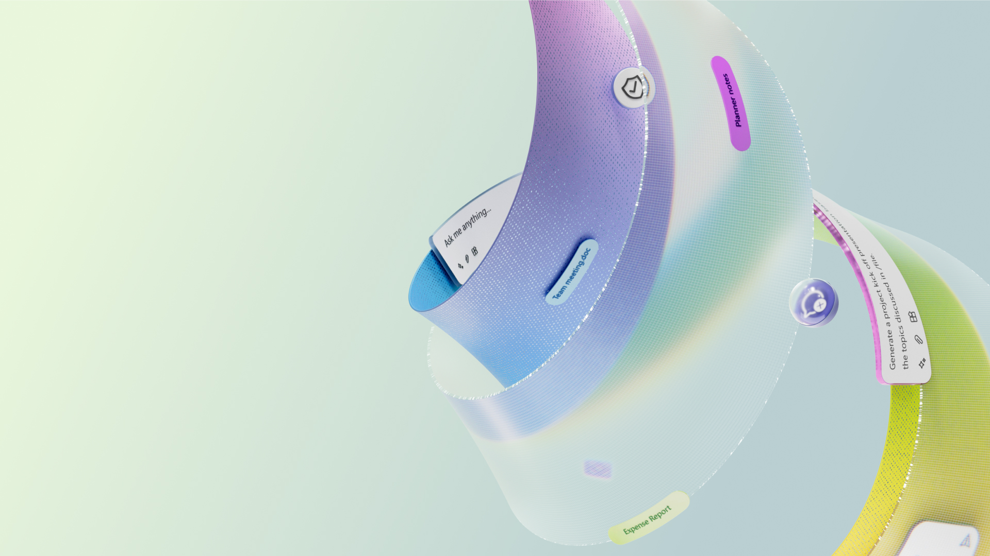

People Skills
Resources for
compliance reviews

Slide 2
List of Resources For Compliance Reviews
This list is intended to accelerate customer adoption by sharing a list of all documents that may be helpful in conducting and passing customer compliance reviews
Question that may be asked during compliance reviews | Link to documentation where more information is available
How does AI inferencing work? | Please refer to People Skills documentation on MS learn
What data sources are used in AI suggestions? | Please refer to People Skills documentation on MS learn
What privacy controls are offered? | People Skills offers privacy controls for both the user to manage their own skills, and for the admin to set sharing defaults for their organization For user controls, please refer to Manage AI and sharing options - Microsoft Support For admin controls, Please refer to https://aka.ms/peopleskills-settings
Can People Skills be turned off for certain users, regions or groups? | Yes, admins can setup access control policies to disable/ turn off AI inferencing suggestions or skill sharing or users, groups or their entire tenant. For more details on which controls we offer for People Skills and how to set them up, please refer to https://aka.ms/peopleskills-settings For more details on access control policies, please refer to Feature Access Management

Slide 3
List of Resources For Compliance Reviews
Continued
Question that may be asked during compliance reviews | Link to documentation where more information is available
How does People Skills comply with Responsible AI standards? | Please refer to the following documentation: AI Transparency in People Skills Microsoft’s commitment to Responsible AI Microsoft Responsible AI standard
What are Microsoft’s Responsible AI standards? | Microsoft is committed to responsibly designing, building, and releasing AI technologies. Please see below: Microsoft’s commitment to Responsible AI Microsoft Responsible AI standard

Slide 4
List of Resources For Compliance Reviews
Continued
Question that may be asked during compliance reviews | Link to documentation where more information is available
How does Microsoft and People Skills protect data privacy and security? | As with all services within the Microsoft Cloud, Microsoft is committed to privacy and security. Microsoft has extensive expertise in protecting customer data, championing privacy, and complying with complex regulations. Your data, powering your experiences, is controlled by you. Our core privacy principle is you own your data; we will never use it for marketing or advertising purposes, so you can feel confident about where your data is stored and secured. Please refer to the Microsoft Trust Center (HERE) for additional information. Within People Skills, several privacy protections are in place to safeguard user data: Users have complete control over their own skills profiles. They can choose to disable AI skill suggestions at any time. Users also decide where and if their skills are shared across Microsoft 365 through settings in the Profile Editor. Skill details are stored securely on the backend within a user’s data shared, and are only accessible to others if a user chooses to share them. Copilot Analytics reports, which include aggregated skills data, do not identify individual users or their skills. To further protect privacy, Copilot Analytics enforces minimum group sizes in aggregated data sets. Only authorized individuals, such as a user’s group manager, can access personally identifiable information.

Slide 5
List of Resources For Compliance Reviews
Continued
Question that may be asked during compliance reviews | Link to documentation where more information is available
Have the AI suggestions been tested for bias? | Yes, we conduct bias testing for AI suggestions as per our commitment to Microsoft’s Responsible AI standard. AI Transparency in People Skills Microsoft’s commitment to Responsible AI Microsoft Responsible AI standard
What are the limitations of People Skills? How can users minimize the impact of these limitations when using the system? | Please refer to AI Transparency in People Skills
What operational factors and settings allow for effective and responsible use of People Skills? | Please refer to AI Transparency in People Skills
Do users have control over skills in their profile? | Users have complete control over their own skills profiles. They can choose to disable AI skill suggestions at any time. Users also decide where and if their skills are shared across Microsoft 365 through settings in the Profile Editor. Skill details are securely stored and only visible to others if shared by the user.

Slide 6

Links To All People Skills Resources
People Skills admin setup documentation
People Skills end user documentation
People Skills overview deck
People Skills adoption site
Announcing People Skills general availability and new Skills agent | Microsoft Community Hub
AI transparency in People Skills - Microsoft Support

